Slide 1
Dear Resident,
TO TAKE THIS SURVEY:
1. Type this address into your web browser:
https://is.gd/ticksny or scan QR code.
2. Enter the access code found right below
your address on the other side of this postcard.
3. Start answering questions!
This is a reminder. If someone from your household has already taken the survey, please ignore! If not, read below.
The [insert EIP] and the CDC are inviting a member of your household aged 18 or older to participate in a survey about a method that could reduce ticks in areas where people live and possibly tickborne diseases, like Lyme disease. Your responses will help us learn more about ways to prevent Lyme disease and other tickborne diseases.
PLEASE NOTE:
Keep your access code on hand until you have completed the survey.
This survey expires in 4 weeks.
If you have questions, trouble accessing the survey, or would like to take the survey over the phone, please contact us using the phone number or email below.
This voluntary survey will take about 5 minutes. Your information will be kept confidential. We will mail you a $10 gift card after you complete the survey.
Thank you!
Study Coordinator/Health Dept Phone:
Email:
Website:
290569-A

Slide 2
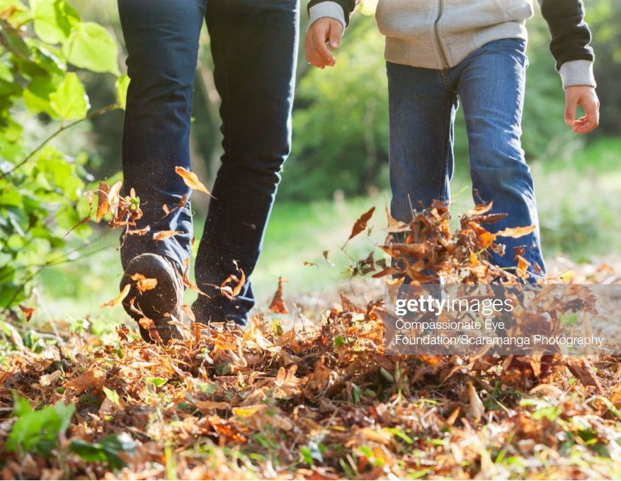
HELP US PREVENT
TICK BITES!
Address line 1
Address line 2
City, State Zip code
Participant Name Address line 1
Address line 2
City, State Zip code
TAKE A 5 MINUTE SURVEY AND GET A $10 GIFT CARD
ACCESS CODE: [INSERT ACCESS CODE]
TAKE A 5 MINUTE SURVEY
AND GET A $10 GIFT CARD

