Slide 1
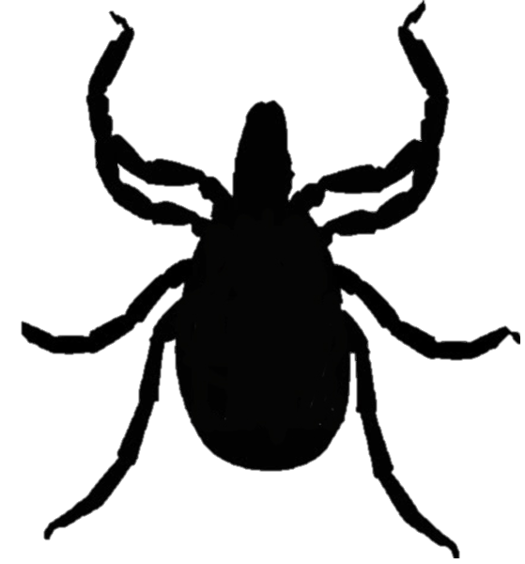
4-Poster Deer Treatment Devices to Reduce Ticks
This presentation by the U.S. Centers for Disease Control and Prevention, the New York State Department of Health, and the Yale Emerging Infections Program accompanies a survey related to the use of 4-Poster Deer Treatment Devices (or 4-poster devices) to reduce ticks in areas where people live and to possibly reduce tickborne diseases.
Notes:
Community tick control. Four poster deer treatment devices. This presentation by the U.S. Centers for Disease Control and Prevention, the New York State Department of Health, and the Yale Emerging Infections Program accompanies a survey related to the use of 4-Poster Deer Treatment Devices (or 4-poster devices) to reduce ticks in areas where people live and to possibly reduce tickborne diseases.
[click]

Slide 2
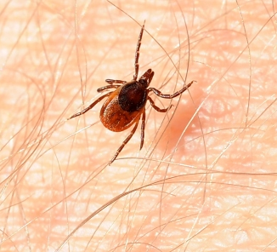
Ticks can spread several diseases, including Lyme disease
Notes:
Ticks can spread several diseases, including Lyme disease [click]

Slide 3
Deer are important for ticks to reproduce
Photo courtesy of USDA NRCS
Notes:
Deer are important for ticks to reproduce [click]

Slide 4
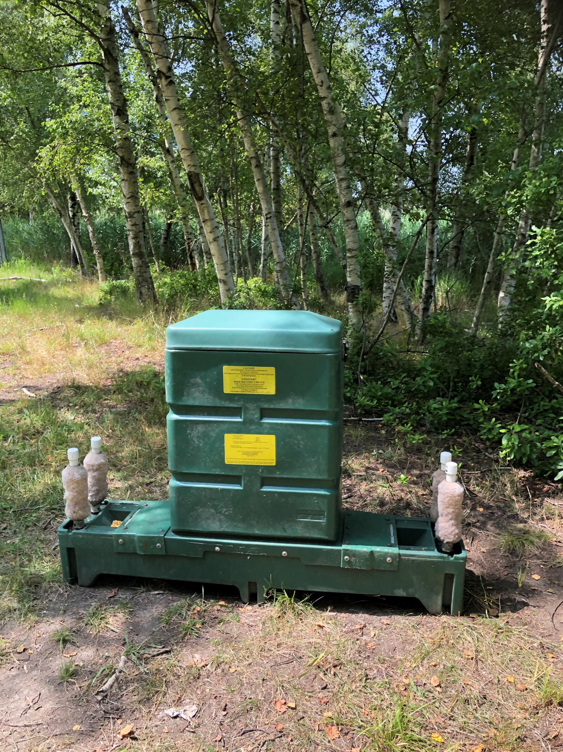
A 4-poster device treats deer with a pesticide that kills ticks
Notes:
A 4-poster device treats deer with a pesticide that kills ticks [click]

Slide 5
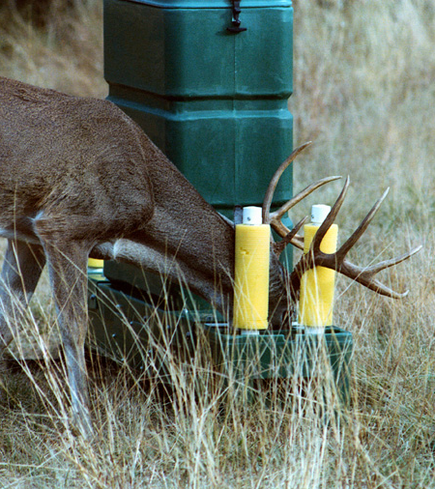
How the device works
4-poster devices have bins filled with corn
As deer eat the corn, they rub against foam rollers ("posts") coated with a pesticide called permethrin that kills ticks
To find out more about permethrin, go to: npic.orst.edu/factsheets/PermGen.html
Notes:
How the device works [click]
4-poster devices have bins filled with corn [click]
As deer eat the corn, they rub against foam rollers, or "posts“, coated with a pesticide called permethrin that kills ticks. To find out more about permethrin, please follow the link shown here. [click]

Slide 6
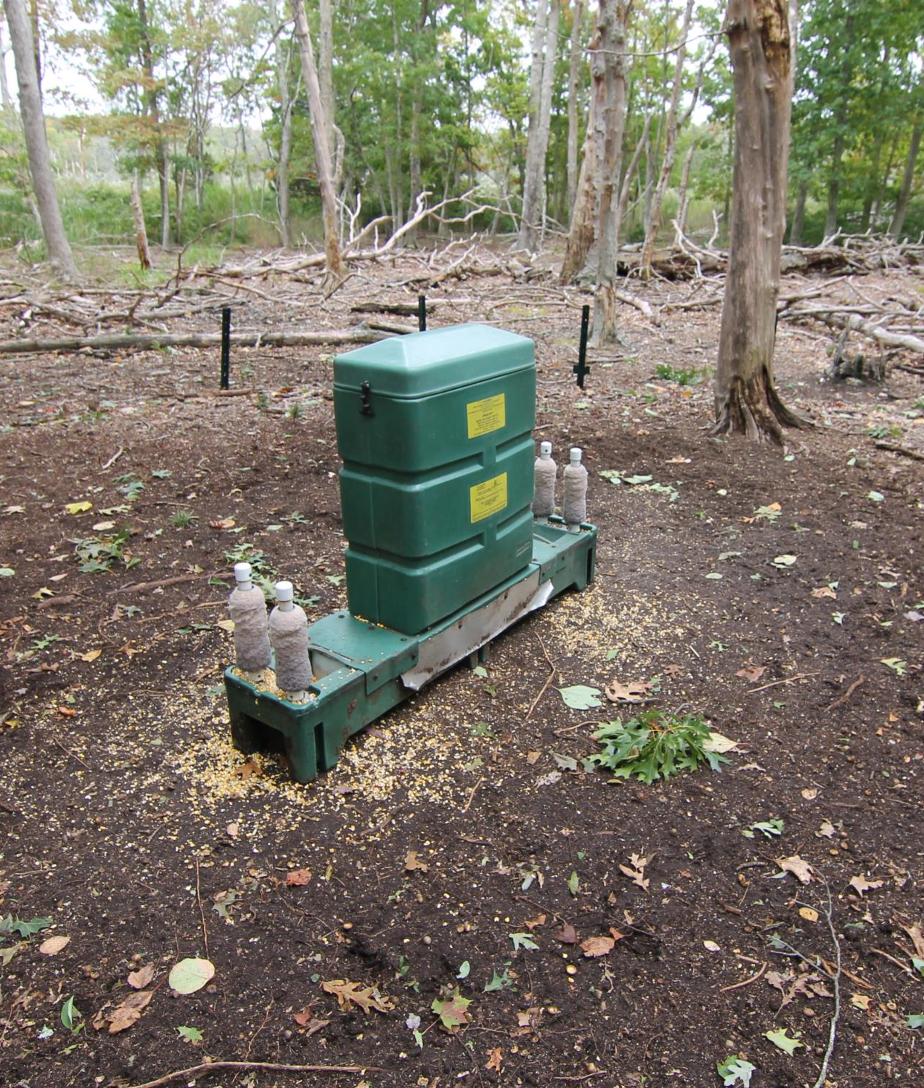
How the device works
The pesticide and the device do not harm the deer
The treatment is similar to some flea and tick treatments applied to the skin of cats and dogs
3.75 ft.
5.25 ft.
1 ft.
Notes:
[click]
The pesticide and the device do not harm the deer [click]
The treatment is similar to some flea and tick treatments applied to the skin of cats and dogs [click]

Slide 7
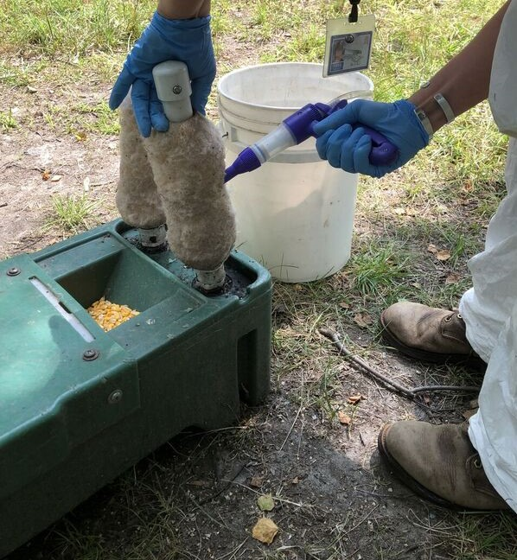
How the device works
The pesticide does not spread into the environment
Devices should not increase deer populations
Devices require weekly servicing by licensed professionals
Notes:
[click]
The pesticide does not spread into the environment, and [click]
The devices should not increase deer populations [click]
The devices also require weekly servicing by licensed professionals [click]

Slide 8
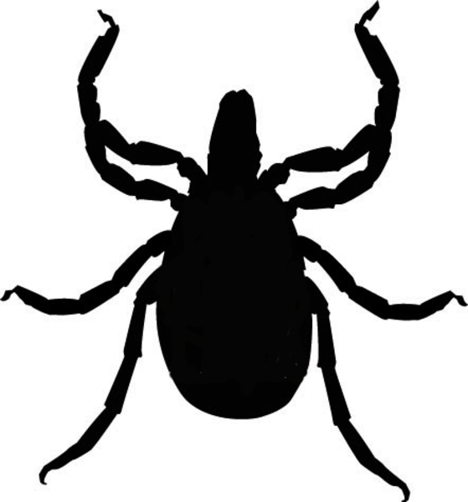
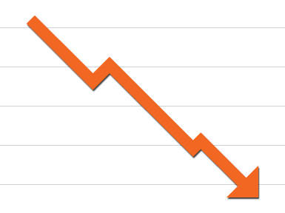
How the Device Affects Ticks
4-Poster devices are a type of long-term tick management that can be used by a community
Devices need to be in place for 2-3 years to see a decrease in ticks
2-3 Years
4-poster devices cause the number of ticks in the environment to decrease over time.
Notes:
How the device affects ticks [click]
4-Poster devices are a type of long-term tick management that can be used by a community [click]
The devices need to be in place for 2-3 years to see a decrease in ticks [click]

Slide 9
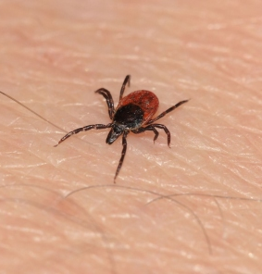
How the Device Affects Ticks
Each device will reduce ticks over roughly 50 acres
Devices may be used year round
Ticks will eventually return if the devices do not remain in service
Notes:
[click]
Each device will reduce ticks over roughly 50 acres, and [click]
may be used year round [click]
Ticks will eventually return if the devices do not remain in service [click]

Slide 10
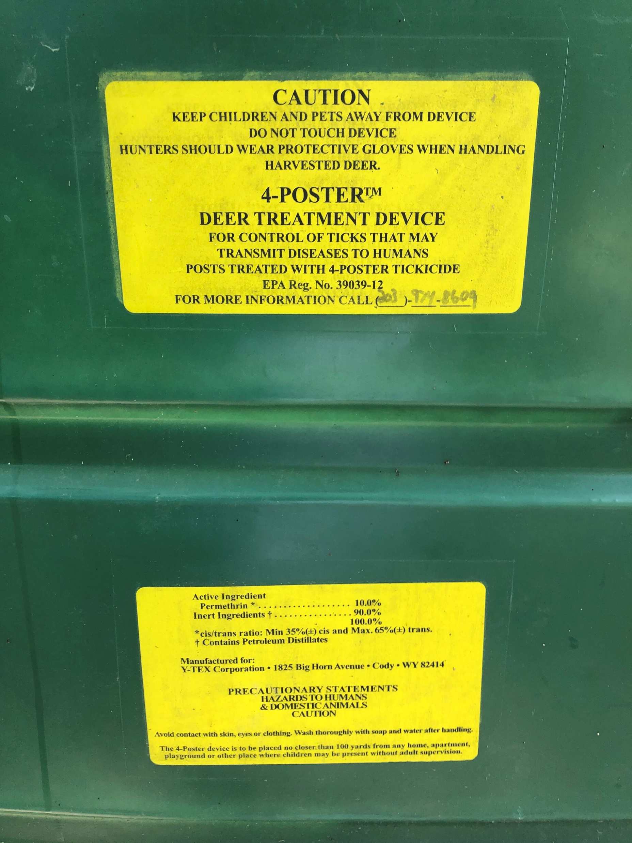
Safety and Precautions
4-poster devices are registered by the U.S. Environmental Protection Agency (EPA)
The EPA requires that pesticide warning signs be placed around each device
Notes:
Safety and Precautions [click]
4-poster devices are registered by the U.S. Environmental Protection Agency (EPA), and [click]
The EPA requires that pesticide warning signs be placed around each device [click]

Slide 11
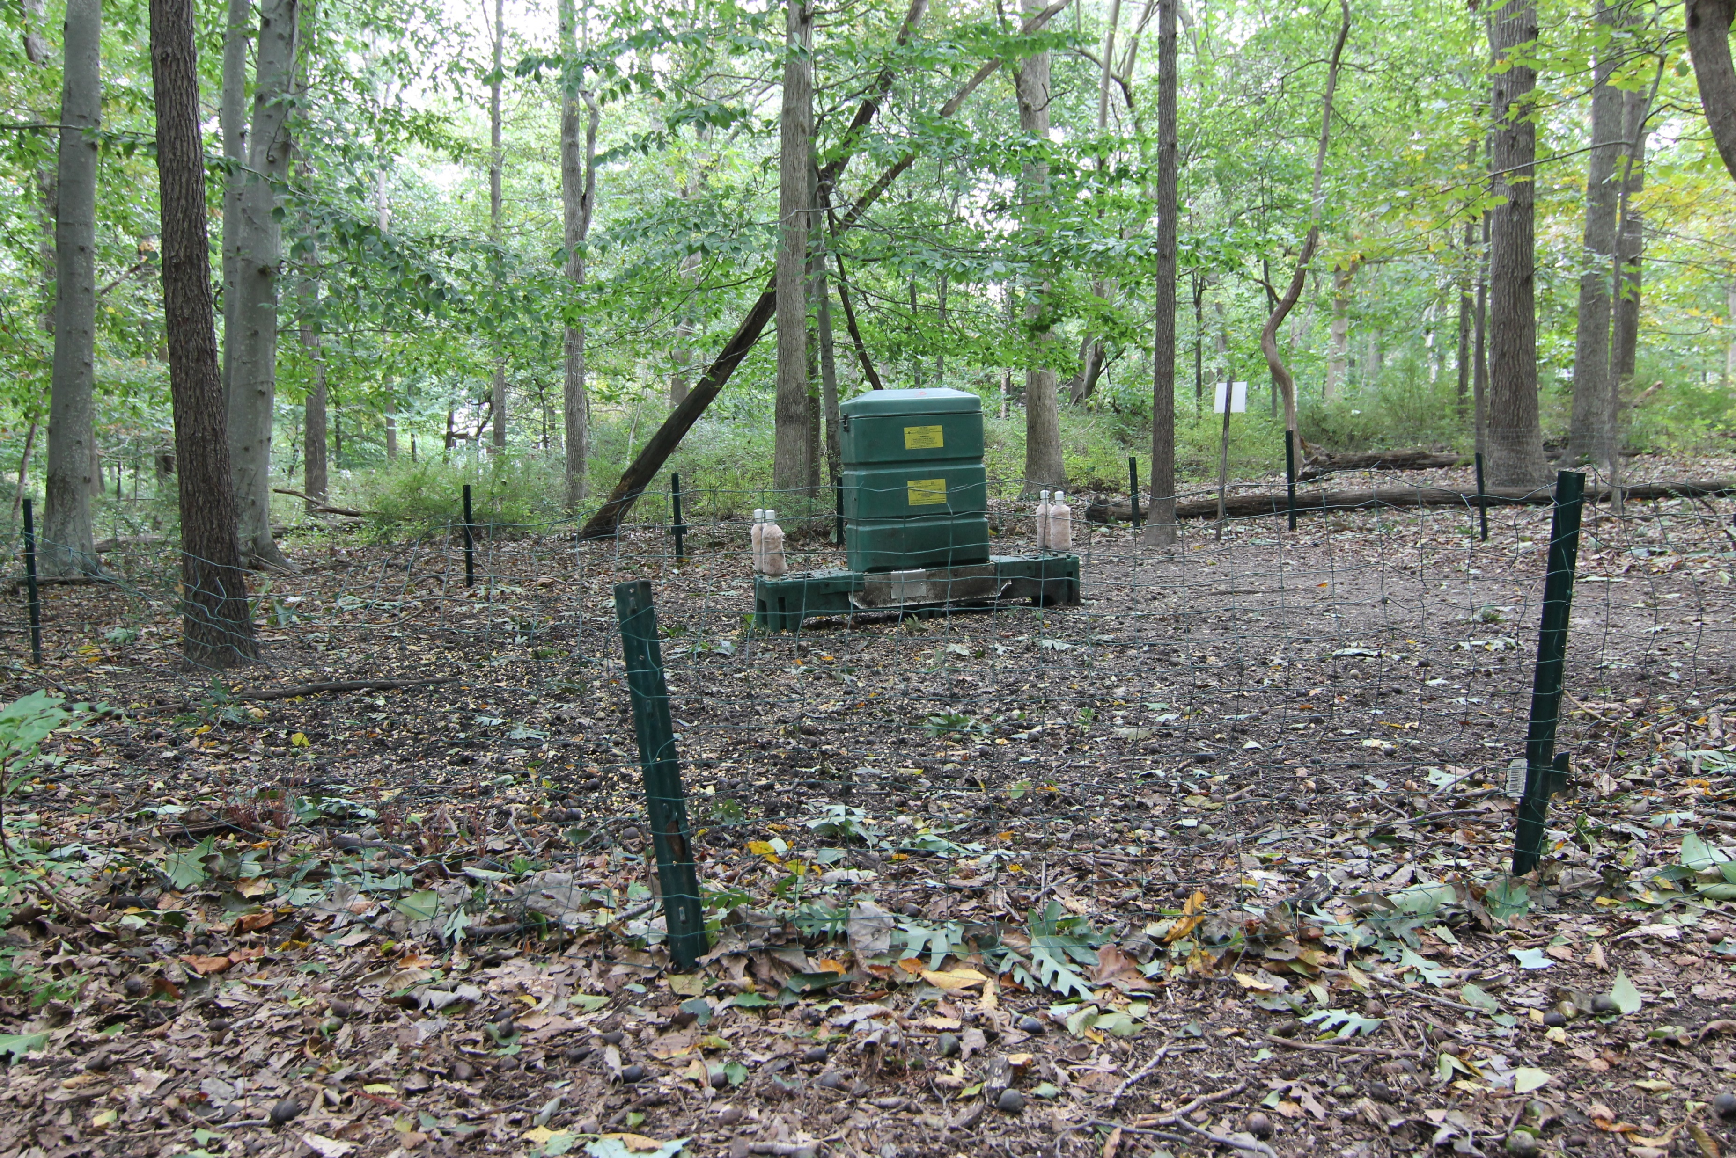
Safety and Precautions
If a device is placed within 300 feet of a home or place children may be present, a 2 ½ foot high fence must surround it
If bears are a local concern, then electric fencing may be required
Hunter-killed deer that have been treated by a 4-poster device are safe to eat
Notes:
[click]
If a device is placed within 300 feet of a home or place children may be present, a 2 ½ foot high fence must surround it [click]
If bears are a local concern, then electric fencing may be required [click]
Hunter-killed deer that have been treated by a 4-poster device are safe to eat [click]

