Slide 1
Attachment 1: Documentation of the dbGaP registration system, including changes since 2013 PRA approval

Slide 2
Study Registration Web Forms

Slide 3
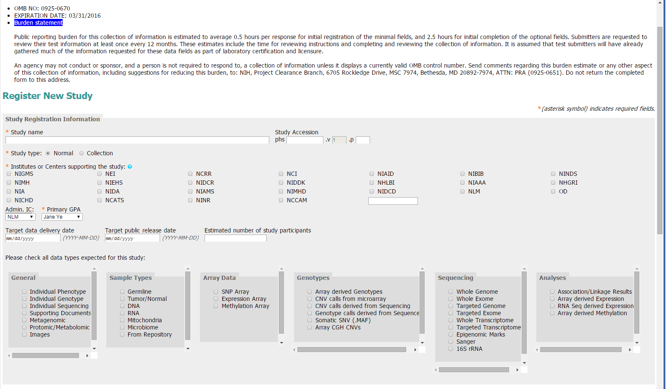
Public reporting burden for this collection of information is estimated to vary from 30 to 60 minutes per response for initial registration of the required fields. An agency may not conduct or sponsor, and a person is not required to respond to, a collection of information unless it displays a currently valid OMB control number. Send comments regarding this burden estimate or any other aspect of this collection of information, including suggestions for reducing this burden, to: NIH, Project Clearance Branch, 6705 Rockledge Drive, MSC 7974, Bethesda, MD 20892-7974, ATTN: PRA (0925-xxxx). Do not return the completed form to this address.
New categorization of data types for ease of completion and greater consistency among submissions.

Slide 4
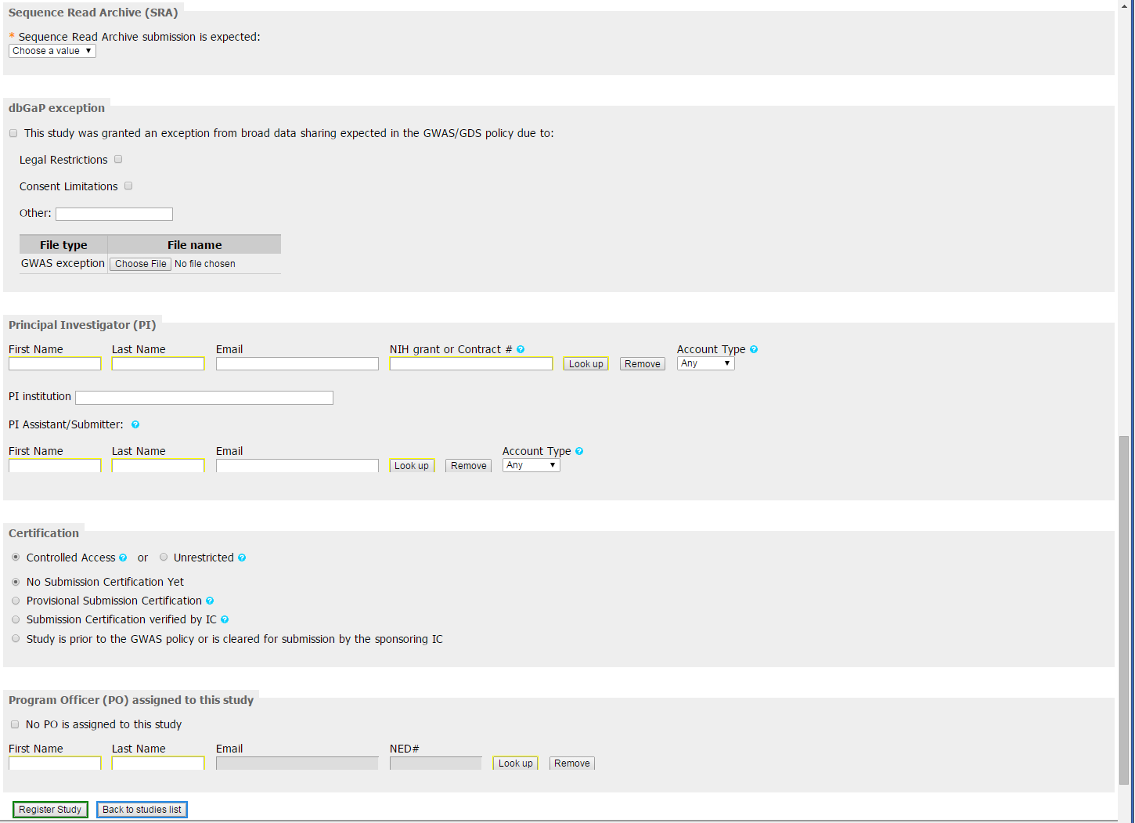
New section for inclusion of PI assistant contact information, so all correspondence do not have to go through the PI.

Slide 5
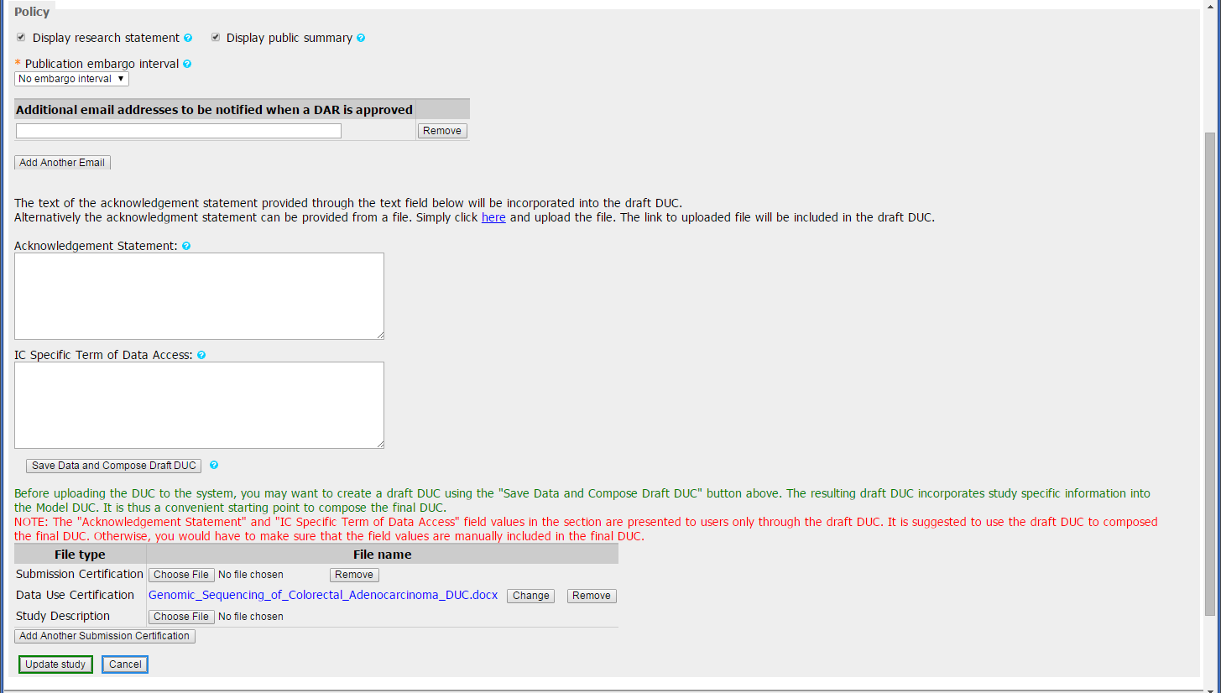
Deletion of additional questions on publication embargo because it is no longer applicable.
Added ability to auto-create the DUC from existing information in the submission package.
New fillable PDF for the submission certifications (slides 6-7).

Slide 6
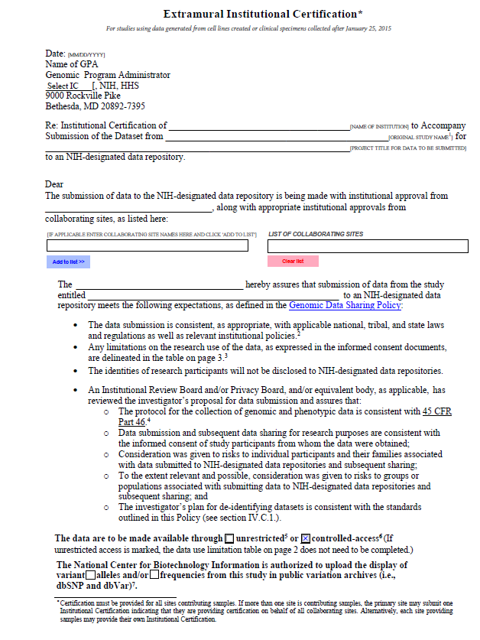
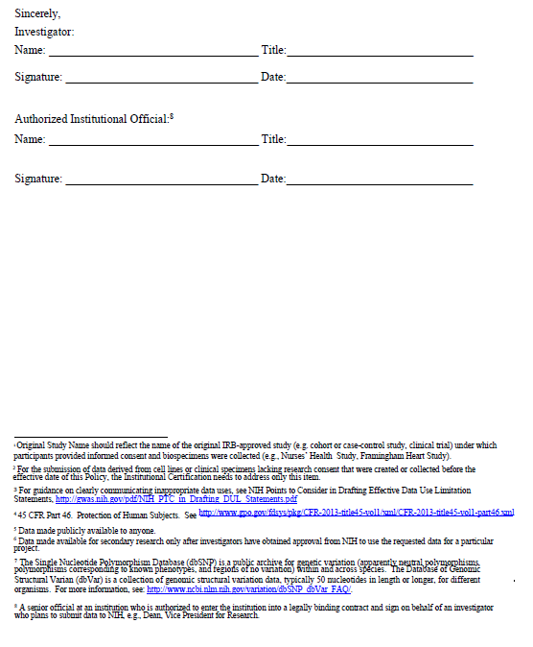
New fillable PDF for the submission certifications.

Slide 7
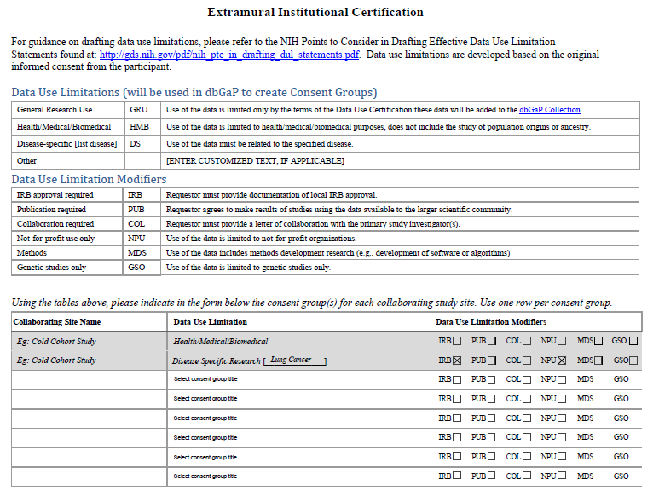
New standard data use limitations as part of the fillable PDF.

Slide 8
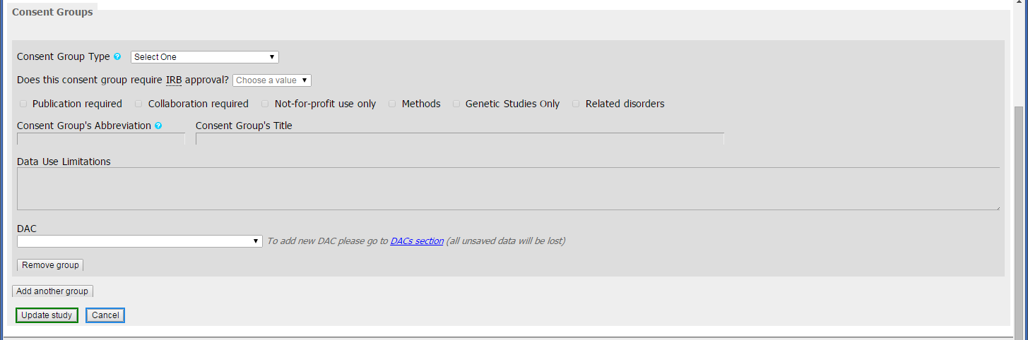
Categories for consent groups now provided in lieu of free text box for ease of completion and greater consistency among submissions.
Data Use Limitations are autopopulated based on the consent groups selected.

