Slide 1
Attachment 2: Documentation of the dbGaP access system, including changes since 2013 PRA approval

Slide 2
Screen Shots of Online Forms for
Data Access Request

Slide 3
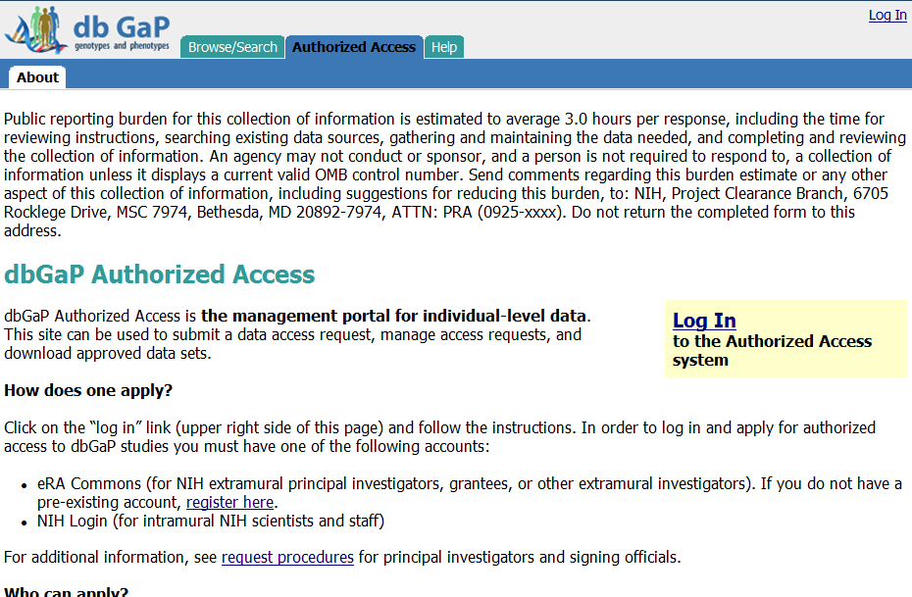
Public reporting burden for this collection of information is estimated to vary from 15 to 45 minutes per response, including the time for reviewing instructions, searching existing data sources, gathering and maintaining the data needed, and completing and reviewing the collection of information. An agency may not conduct or sponsor, and a person is not required to respond to, a collection of information unless it displays a currently valid OMB control number. Send comments regarding this burden estimate or any other aspect of this collection of information, including suggestions for reducing this burden, to: NIH, Project Clearance Branch, 6705 Rockledge Drive, MSC 7974, Bethesda, MD 20892-7974, ATTN: PRA (0925-xxxx). Do not return the completed form to this address.

Slide 4
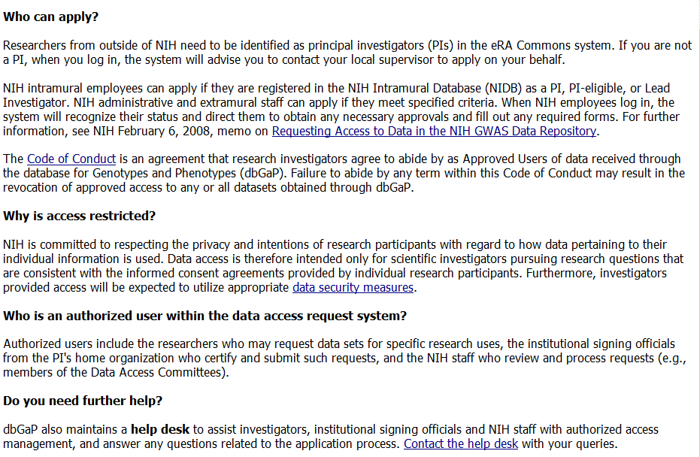

Slide 5
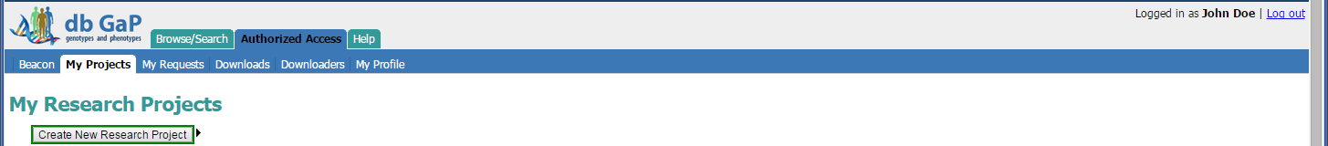

Slide 6
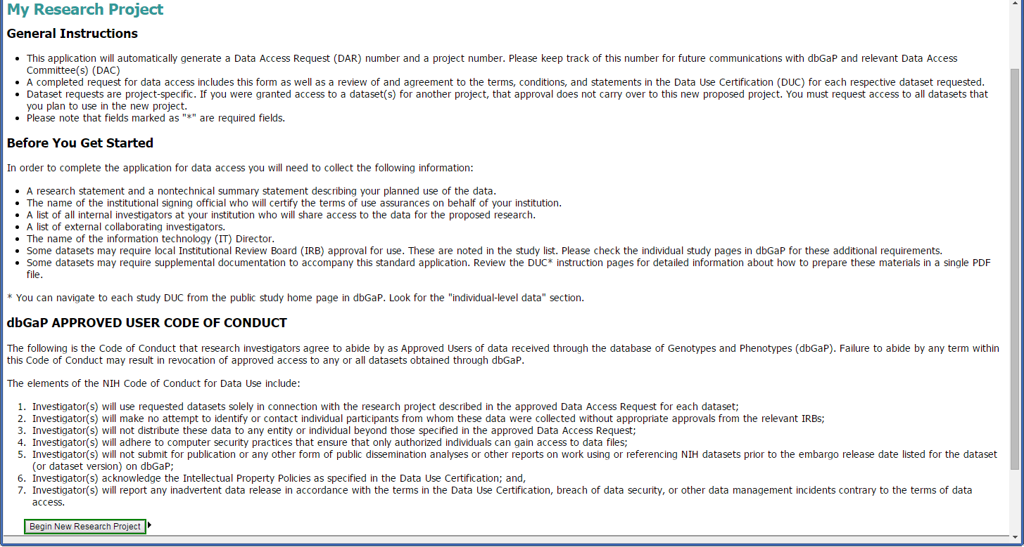

Slide 7
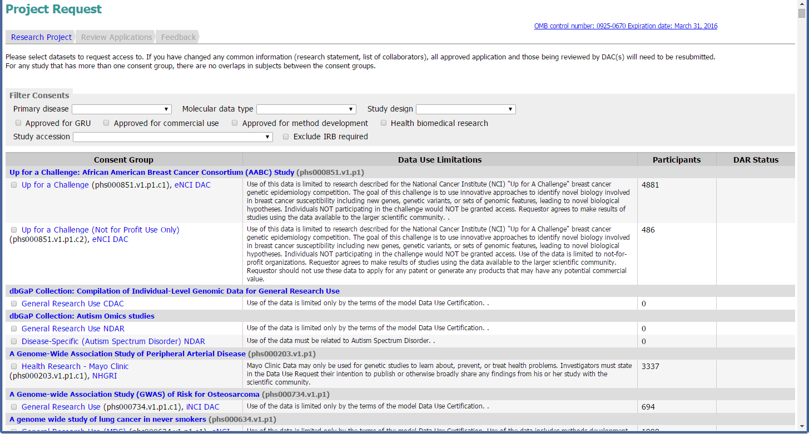
Notes:
List of studies is quite long. Filter at top allows for user to narrow list down.

Slide 8
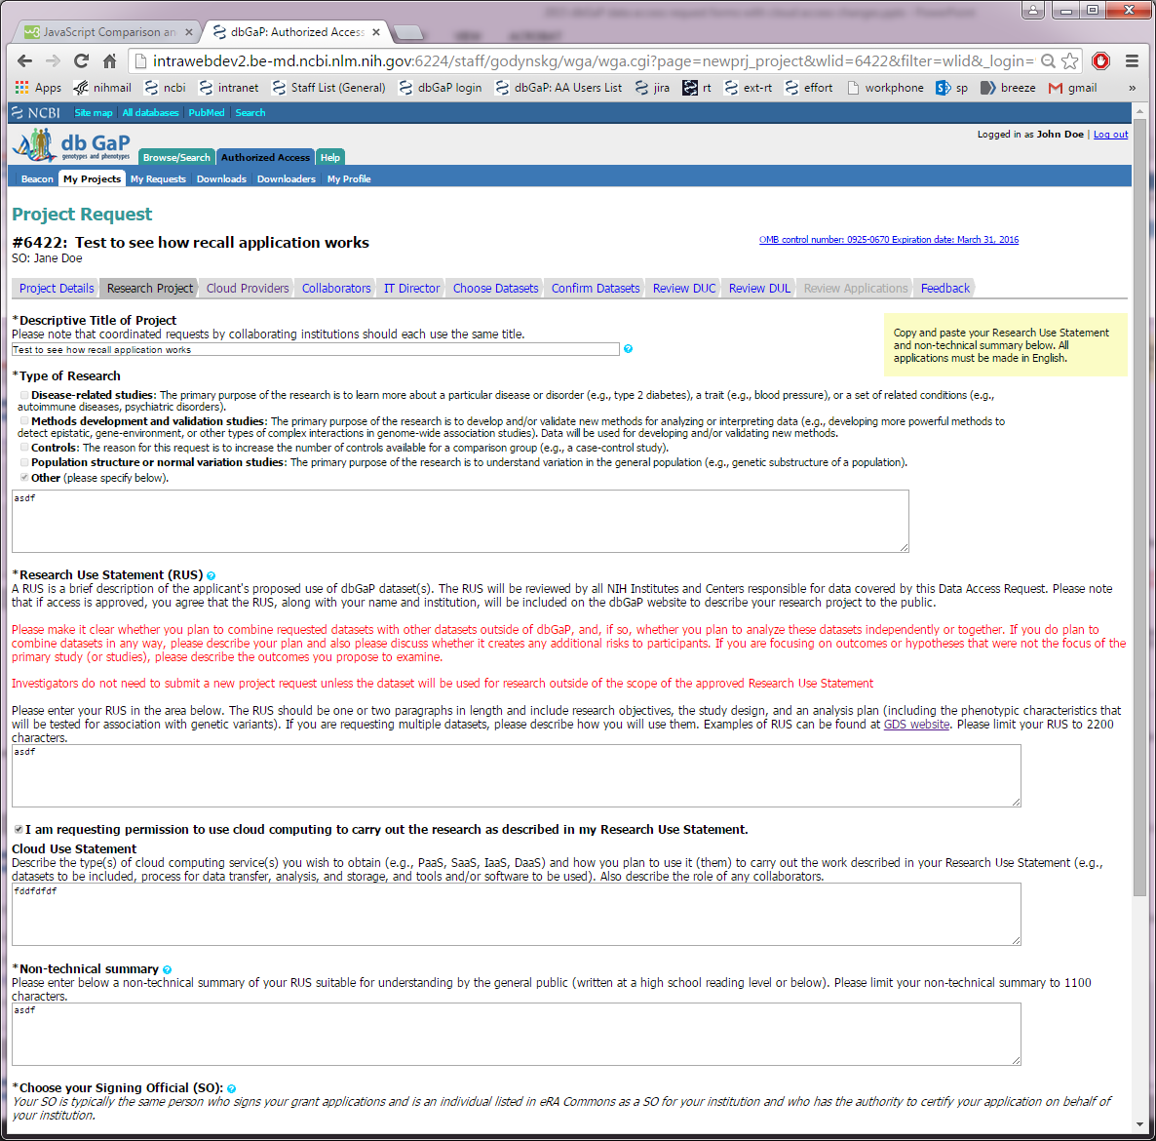
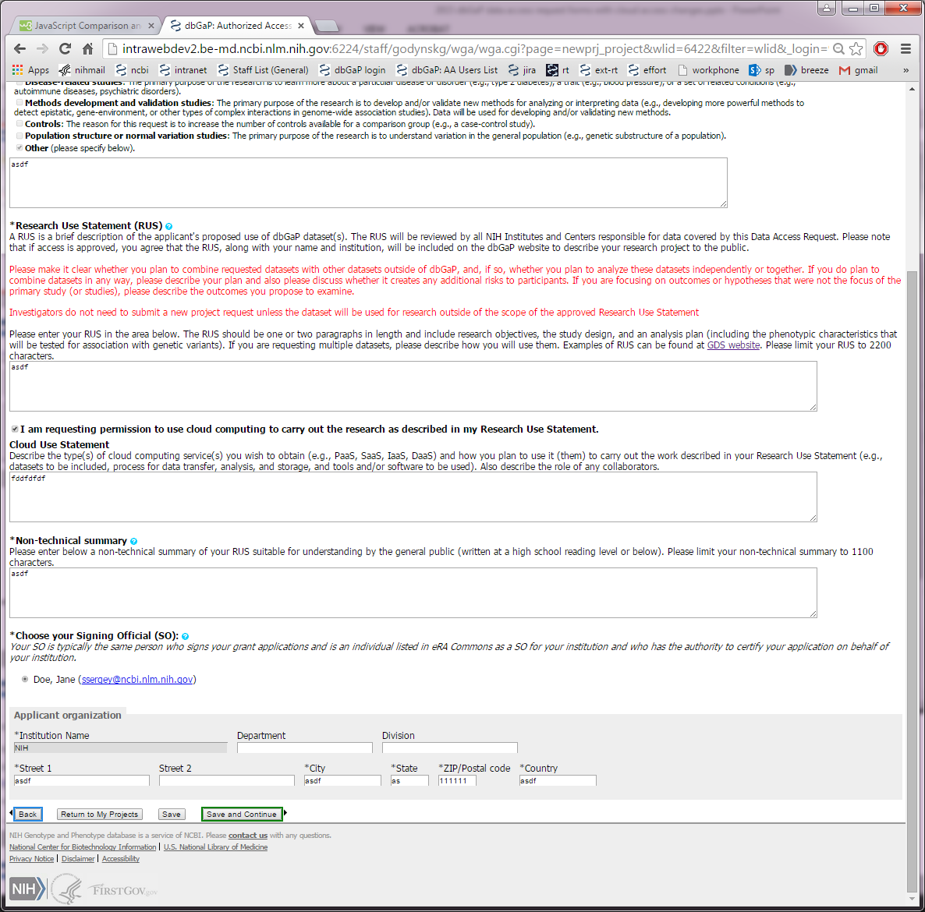
New section for details of cloud use.

Slide 9
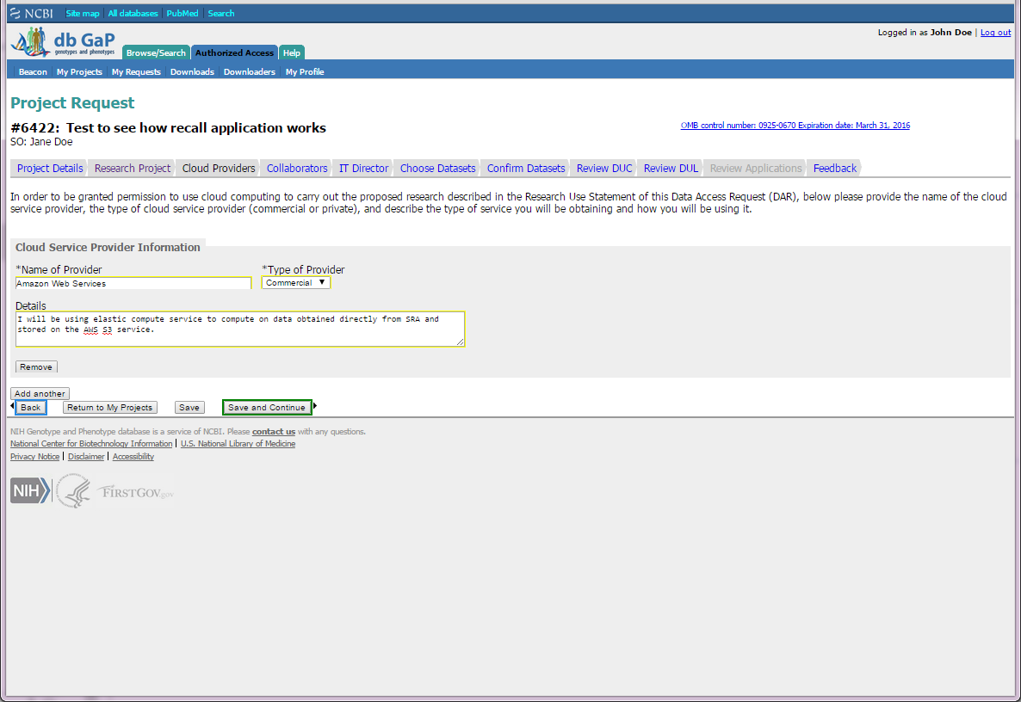
New section for details of cloud use.

Slide 10
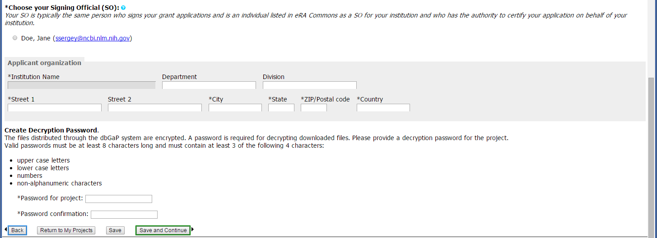
Notes:
Research Project Bottom of Page

Slide 11
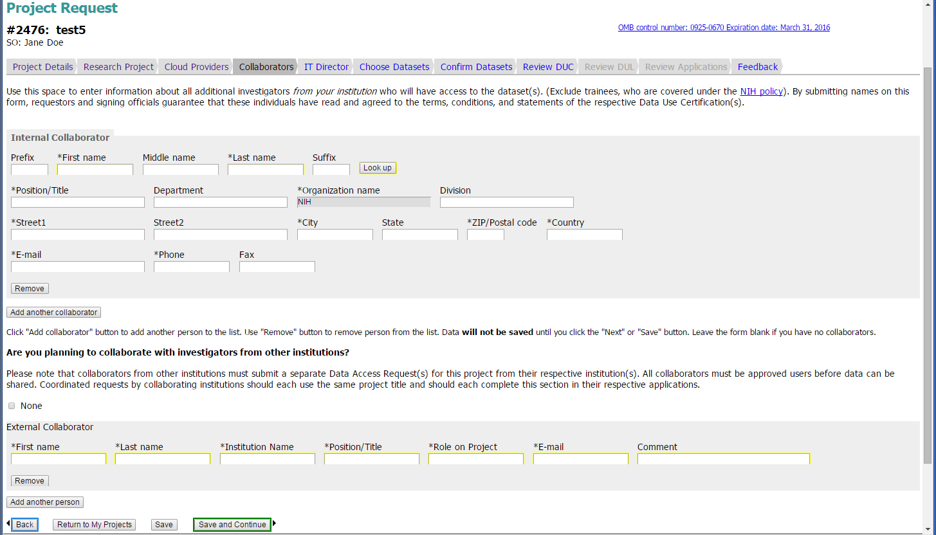

Slide 12
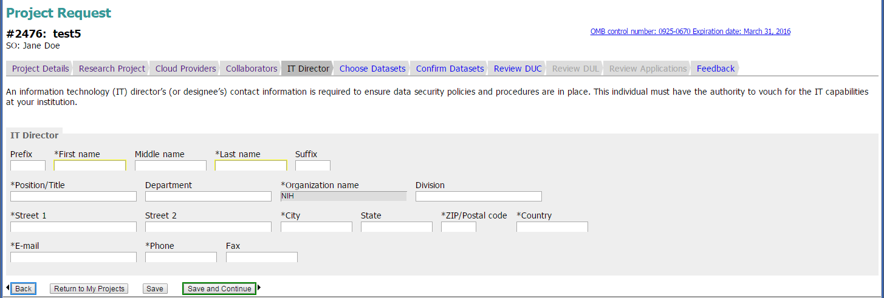

Slide 13
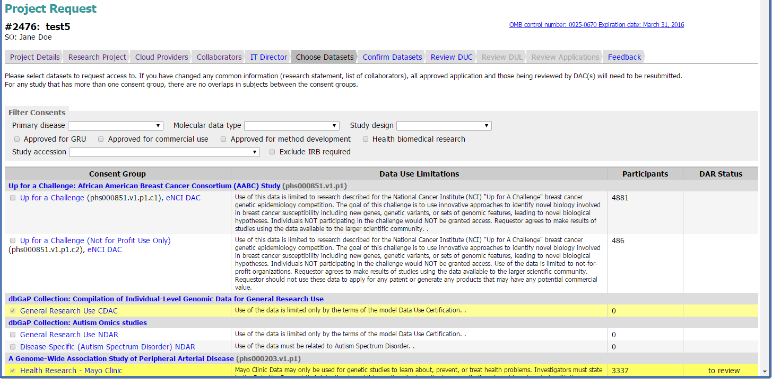
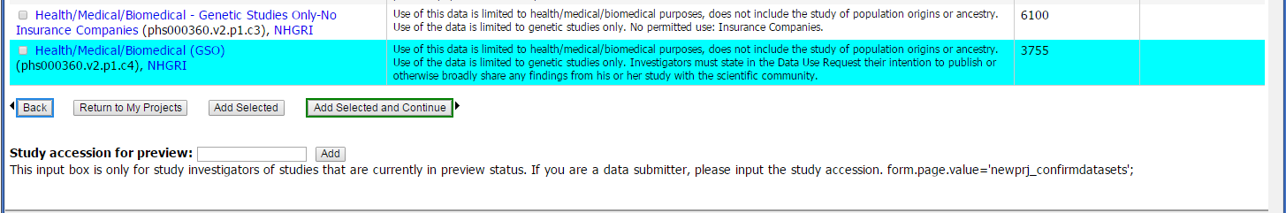

Slide 14
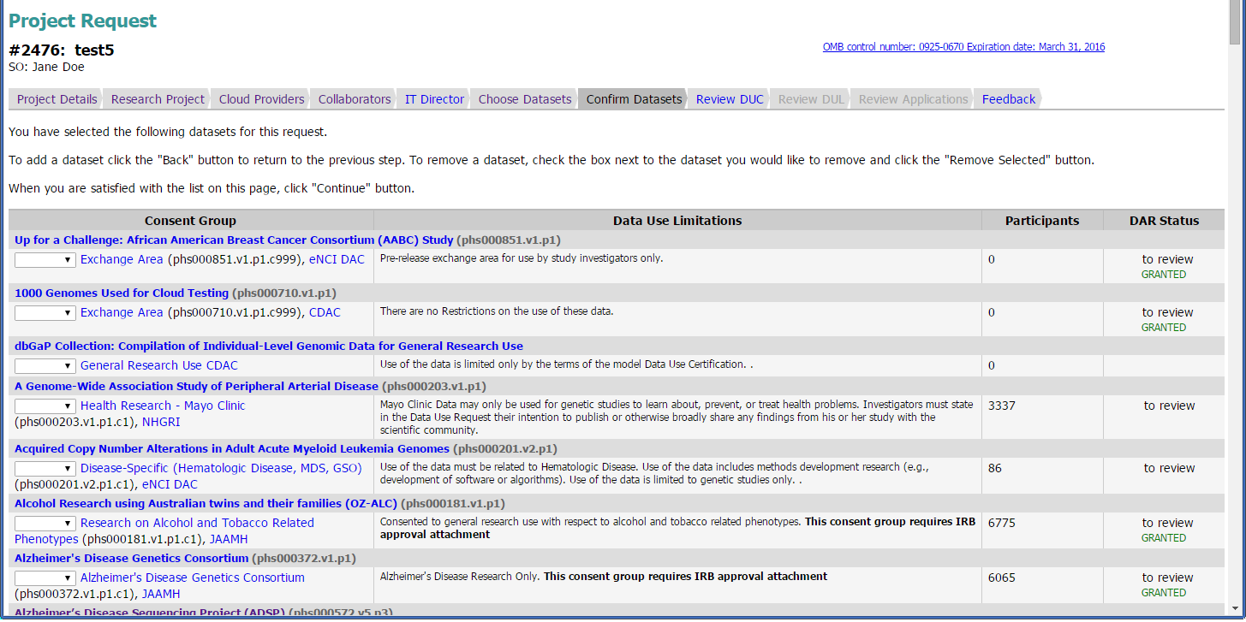

Slide 15
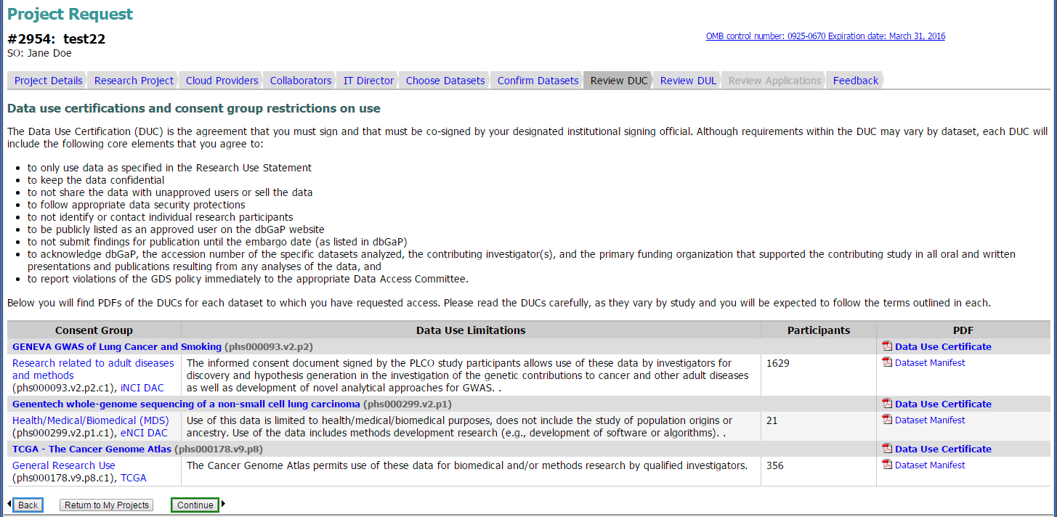

Slide 16
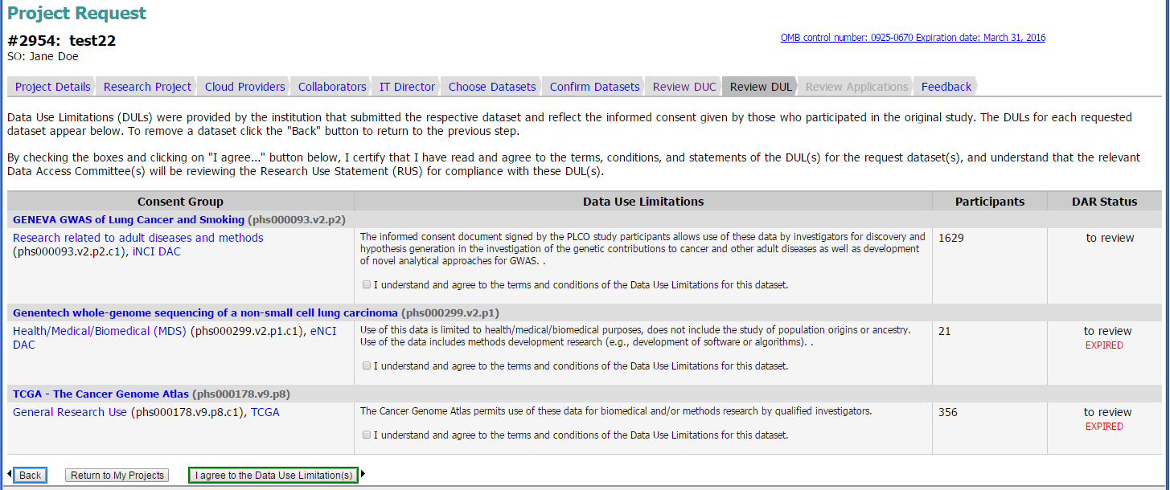

Slide 17
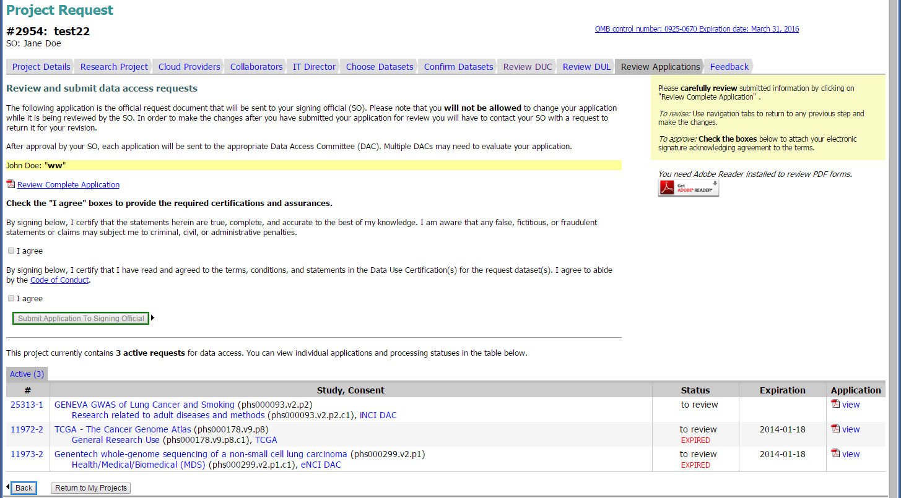

Slide 18
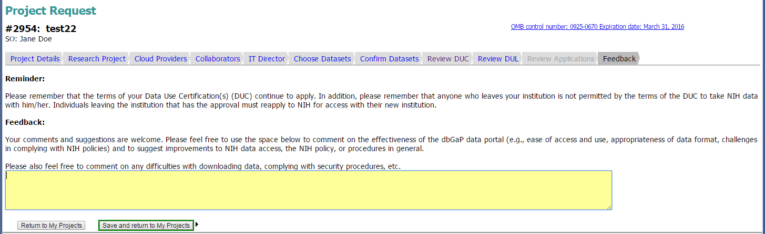

Slide 19
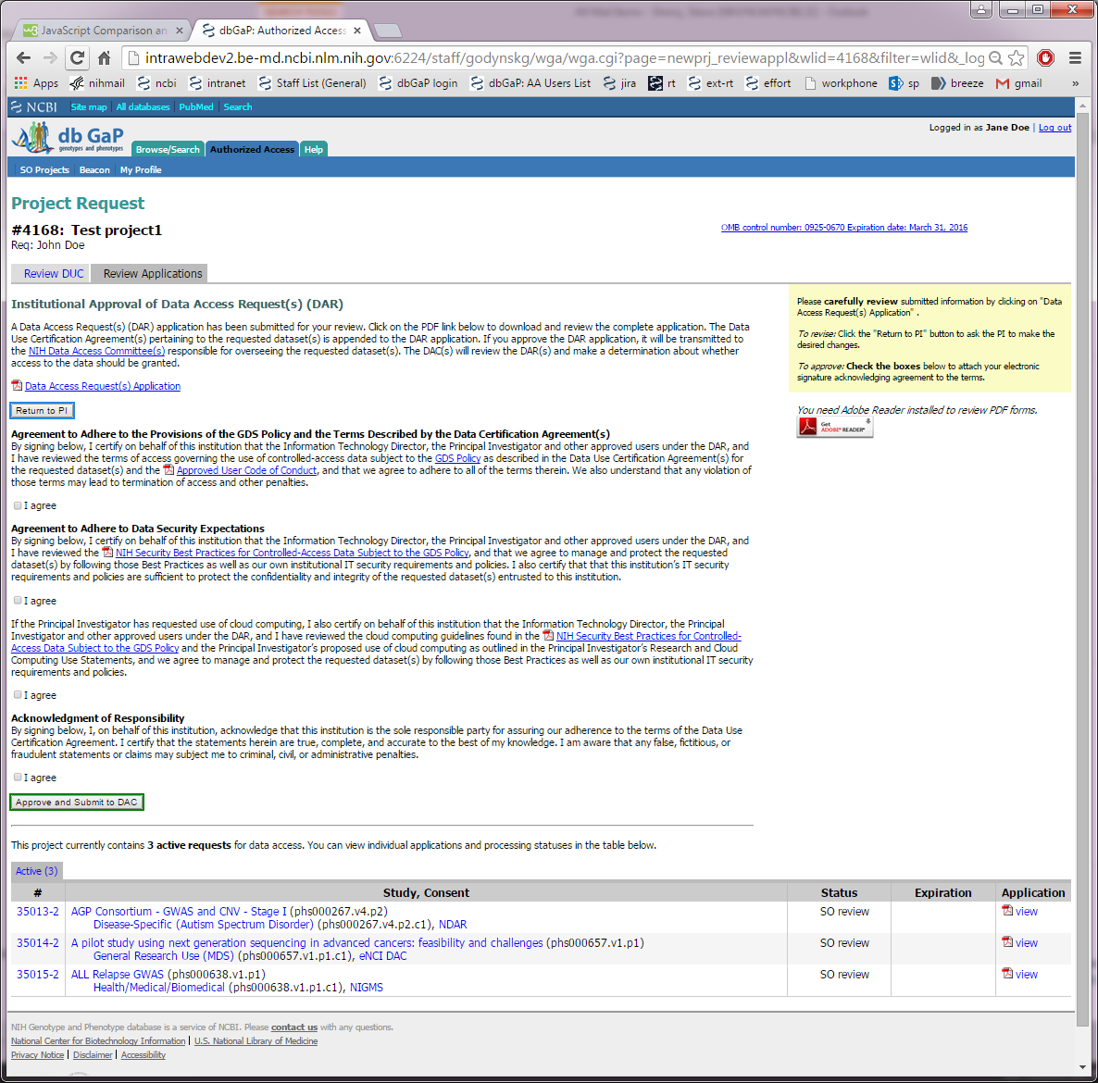
New section for details on data security expectations including cloud use.

Slide 20
dbGaP Authorized Access
Project Renewal Web Forms

Slide 21
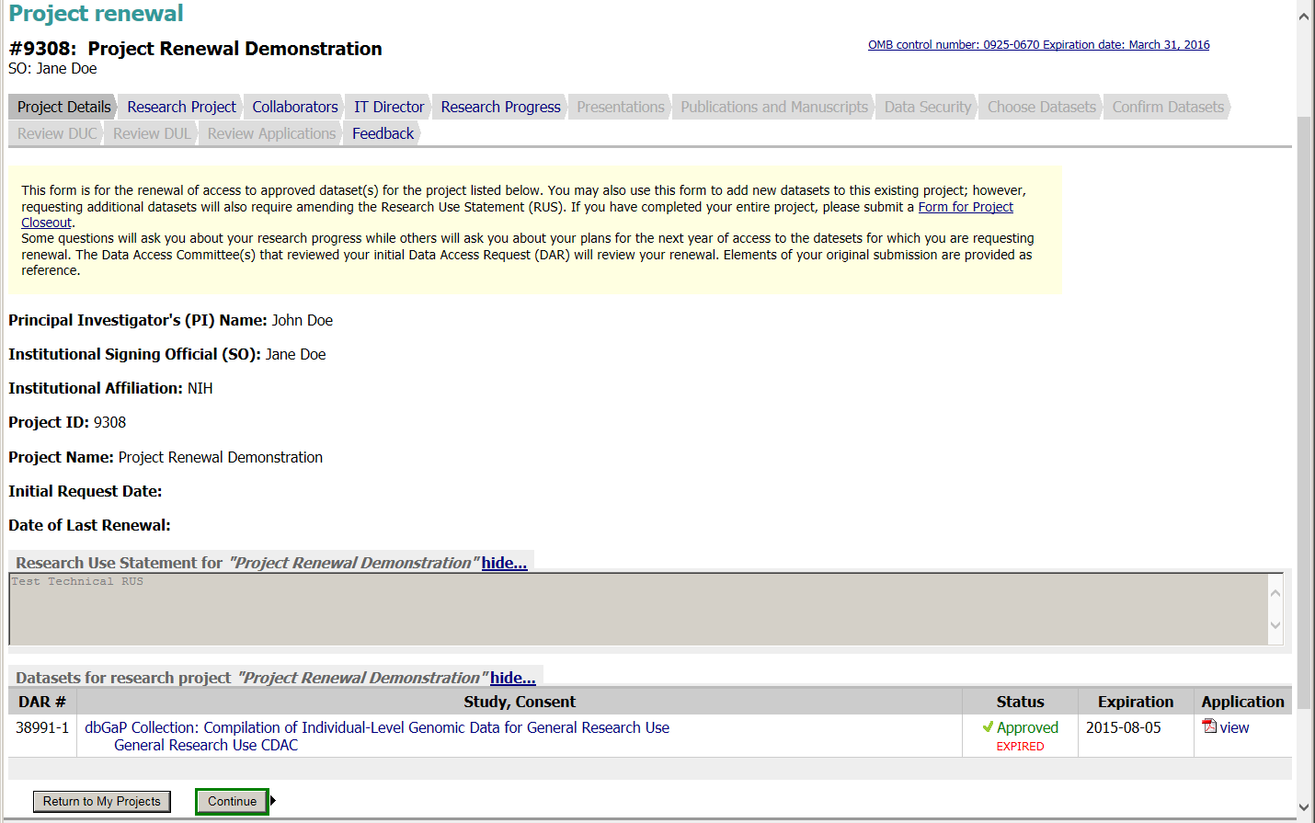

Slide 22
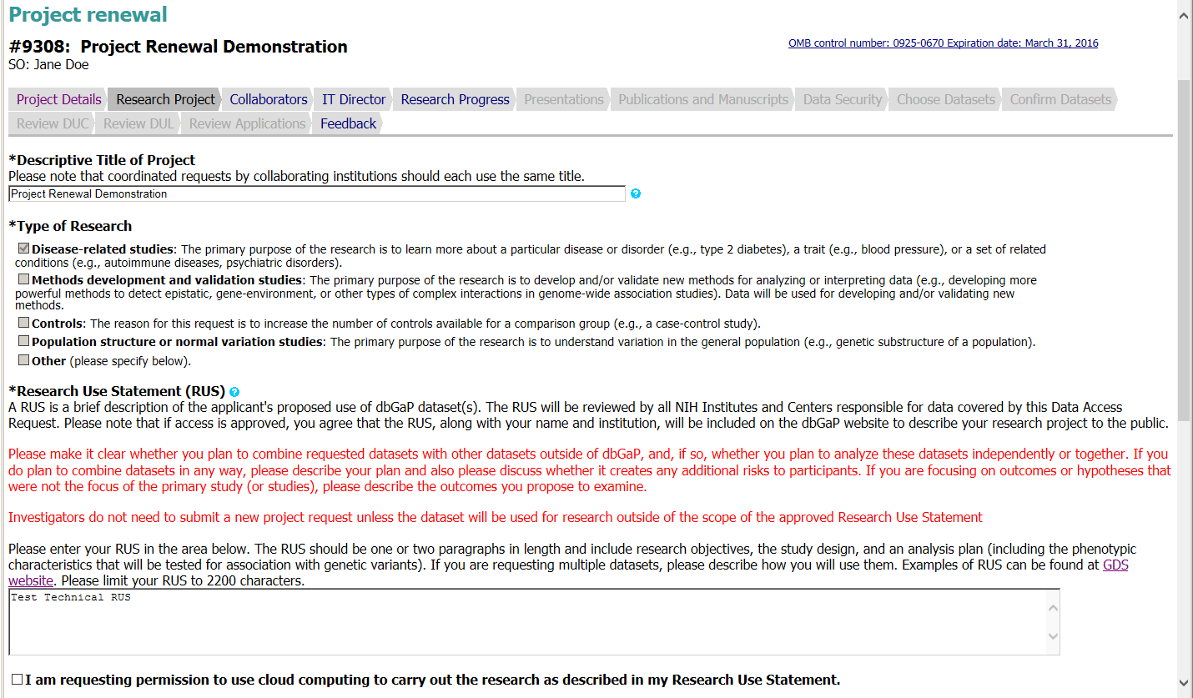
Page continues on next slide

Slide 23
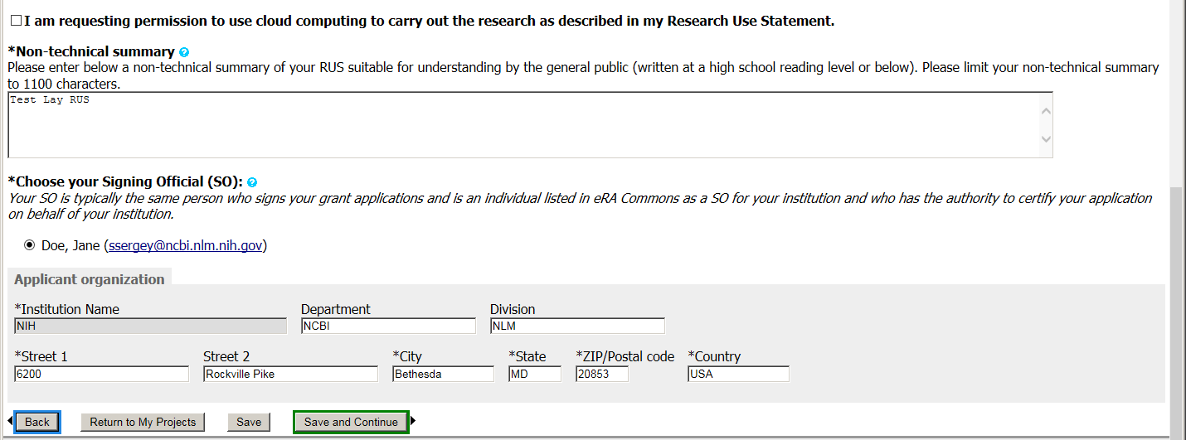
Continuation of previous slide

Slide 24
New section for details of cloud use.

Slide 25
New section for details of cloud use.

Slide 26
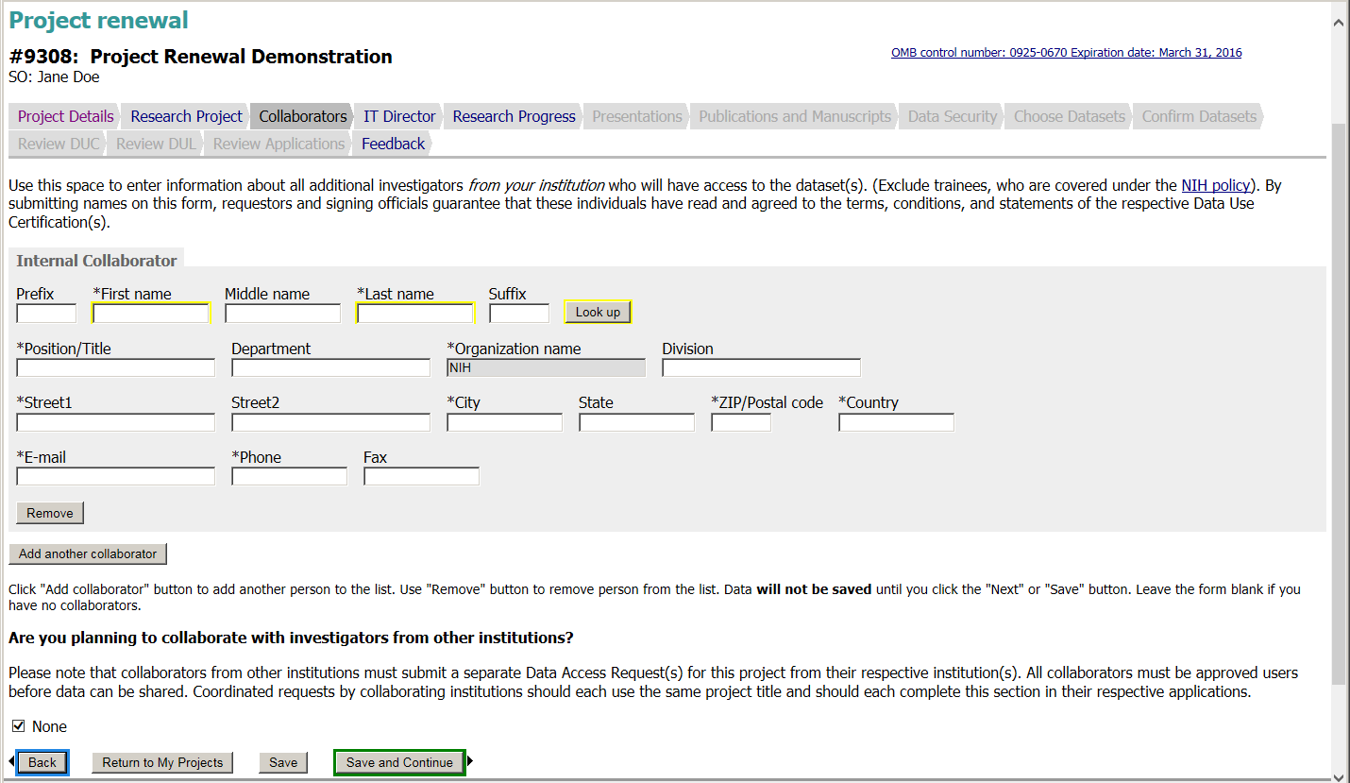

Slide 27
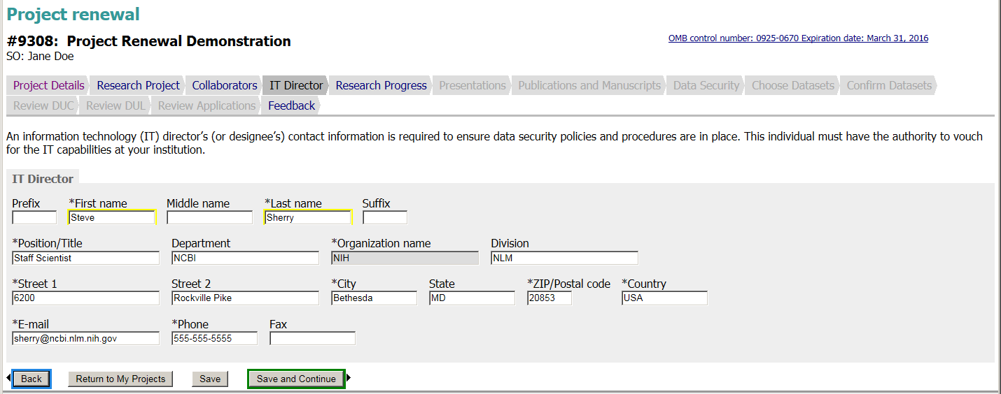

Slide 28
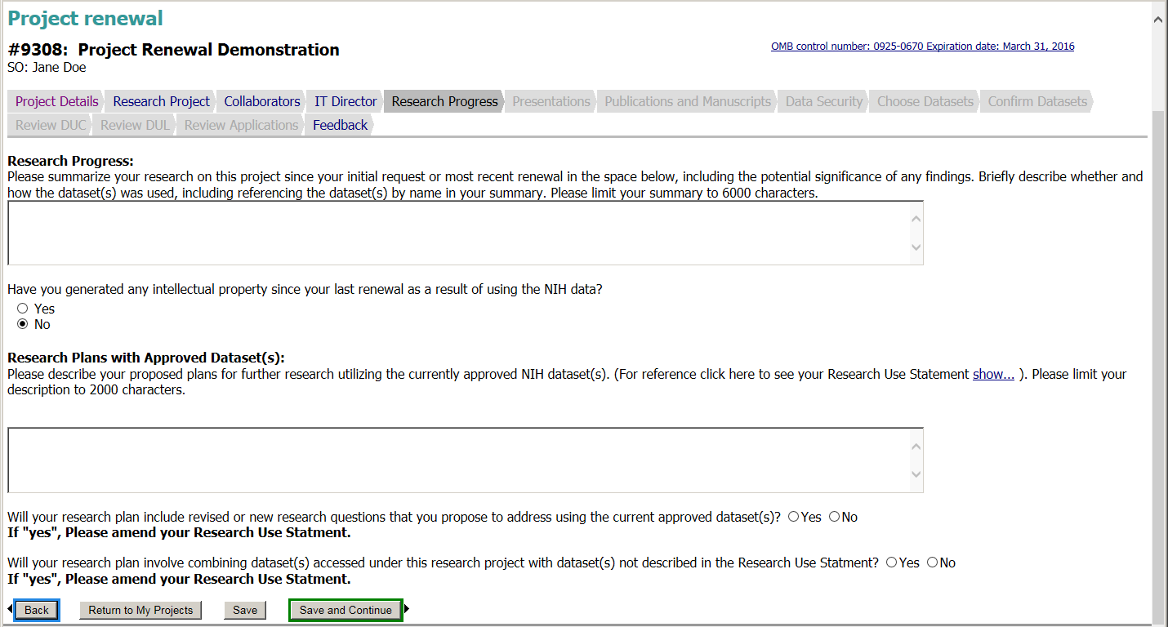

Slide 29
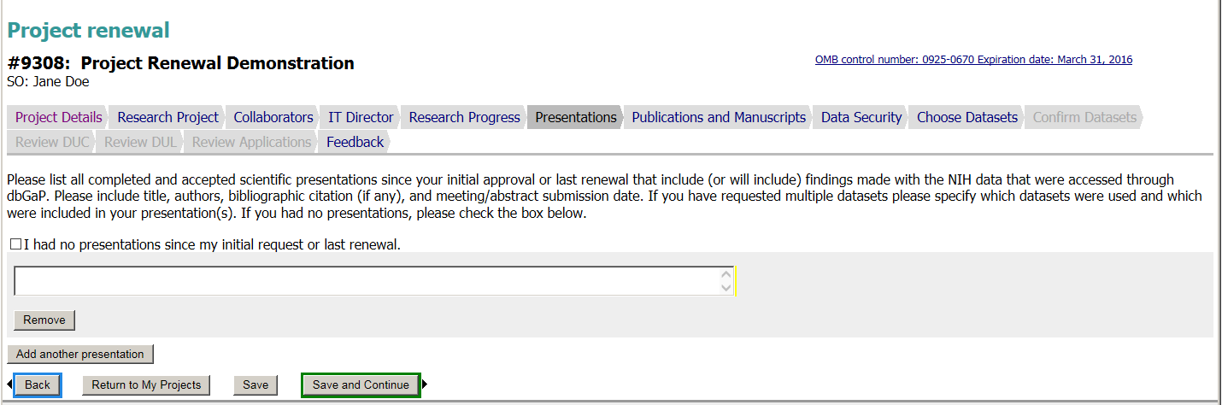

Slide 30
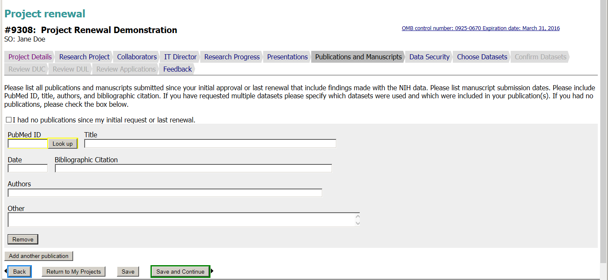

Slide 31
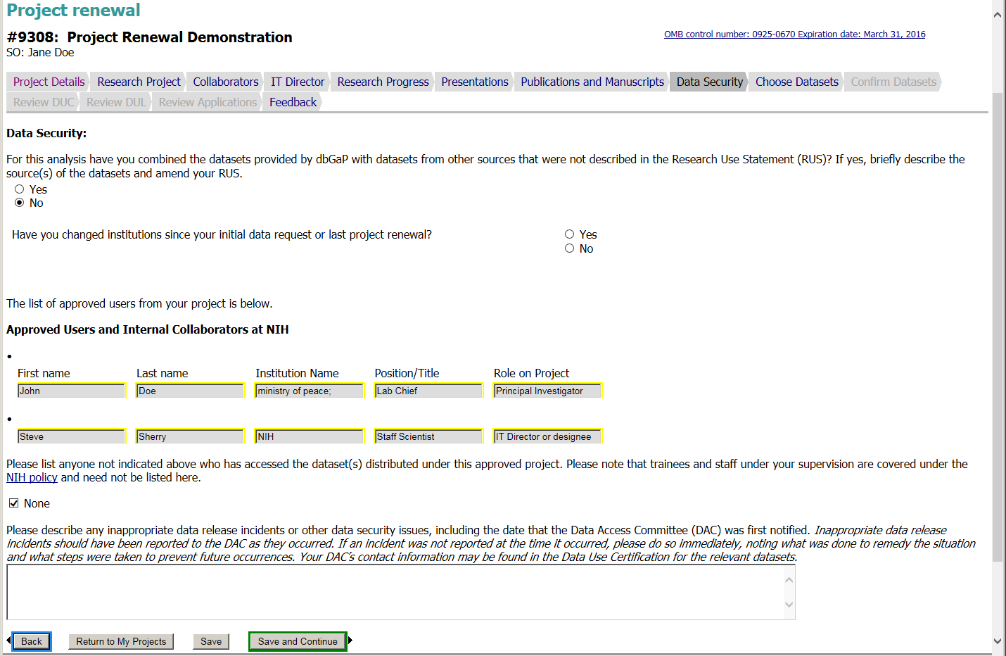

Slide 32
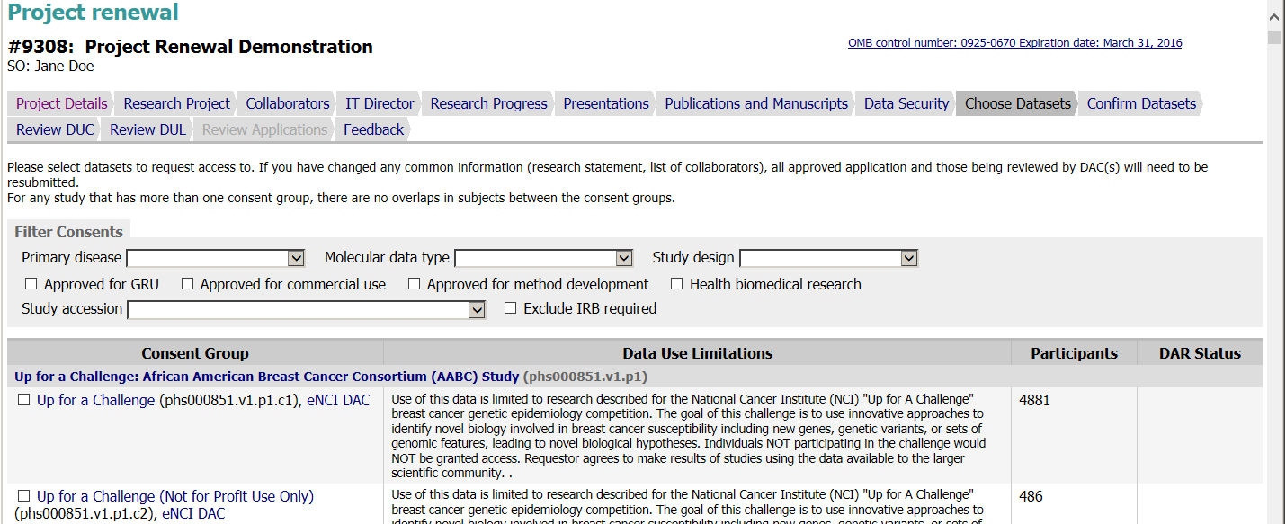
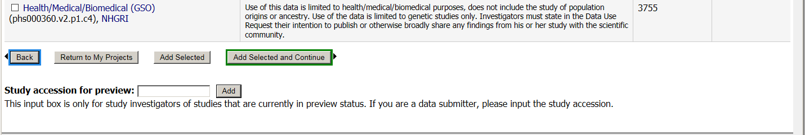
Multiple studies are not shown for brevity

Slide 33
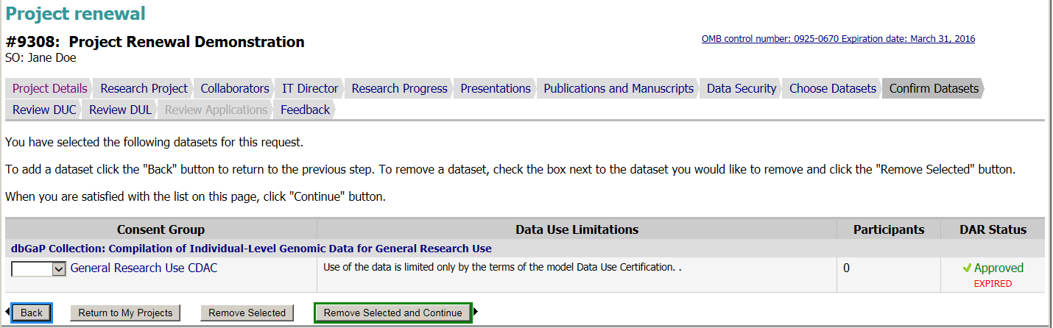

Slide 34
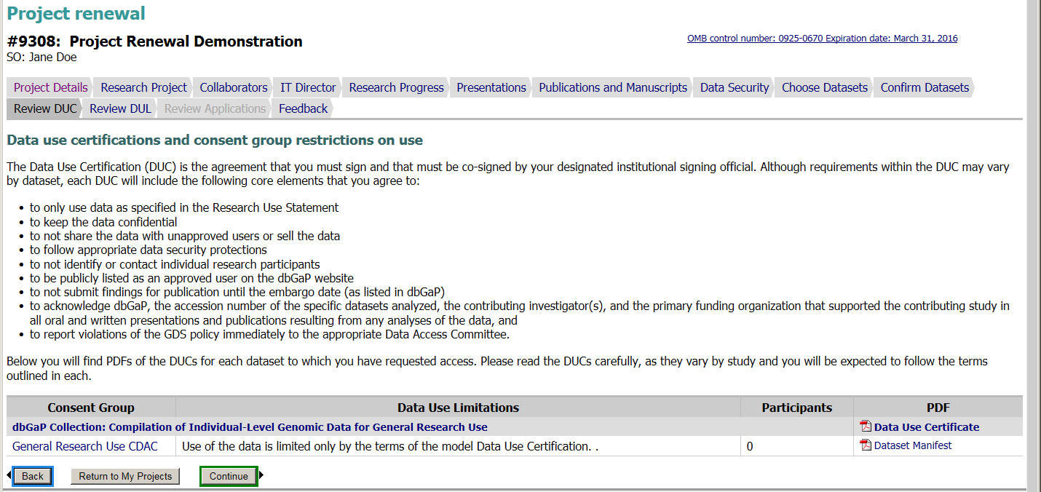

Slide 35
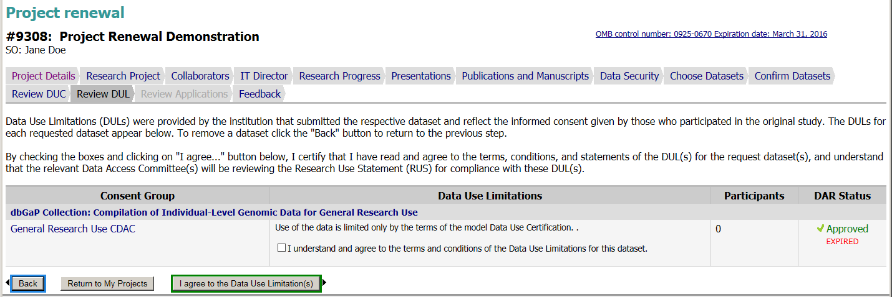

Slide 36
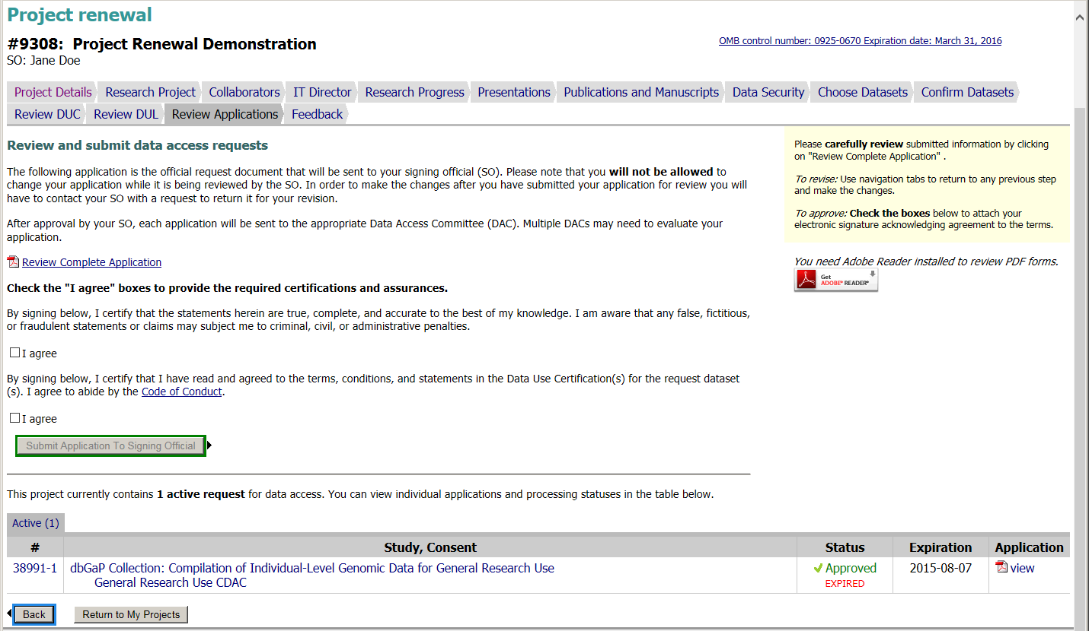

Slide 37
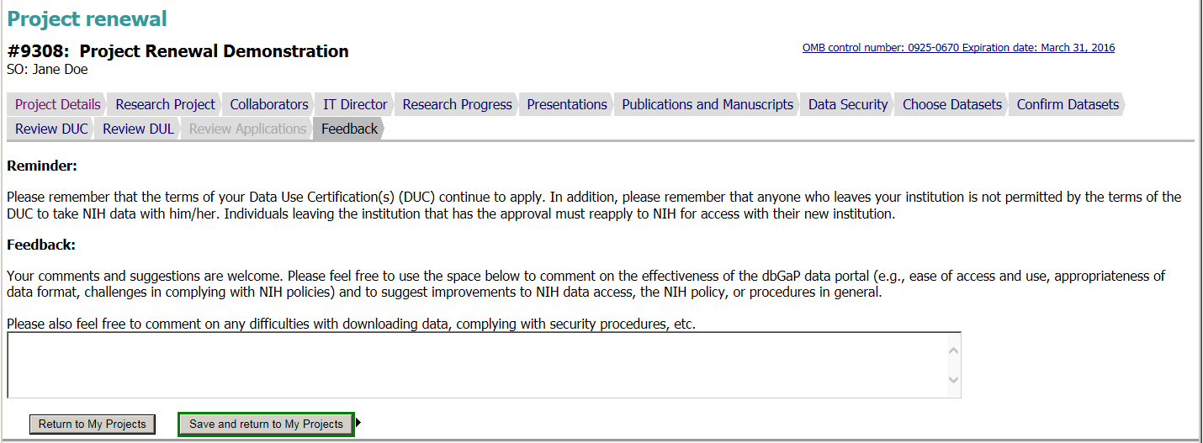

Slide 38
New section for details on data security expectations including cloud use.

Slide 39
dbGaP Authorized Access
Project Closeout Web Forms

Slide 40
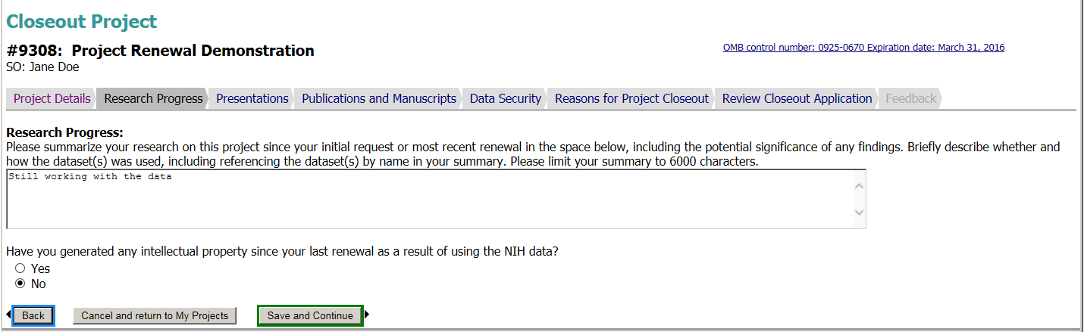

Slide 41
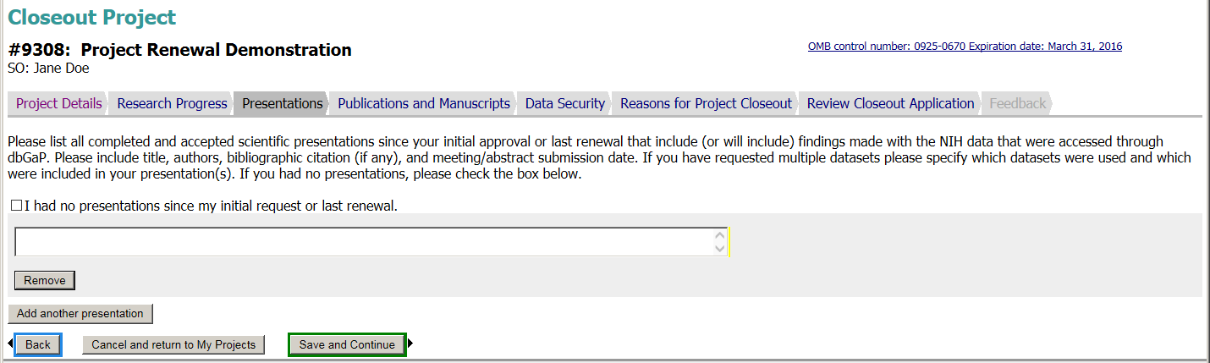

Slide 42
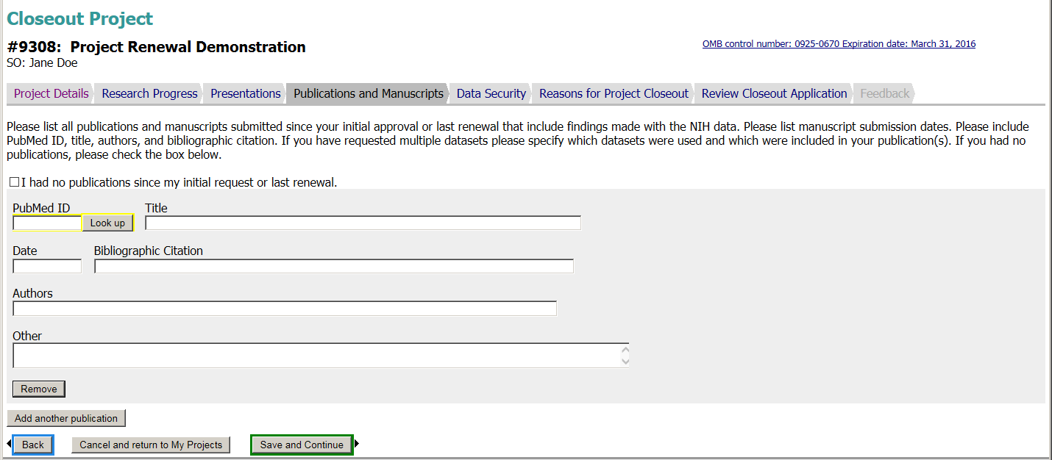

Slide 43
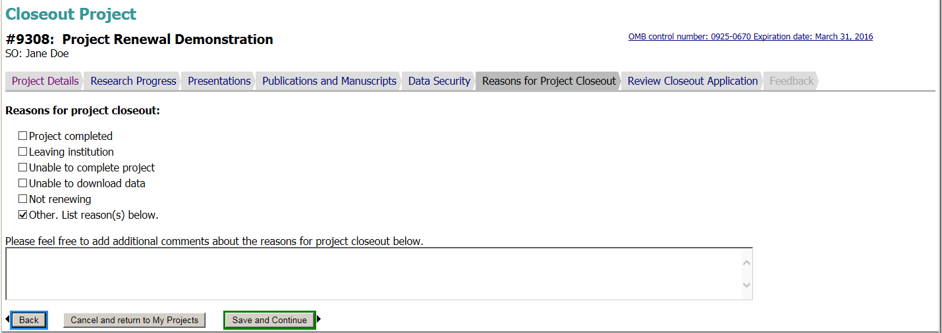

Slide 44
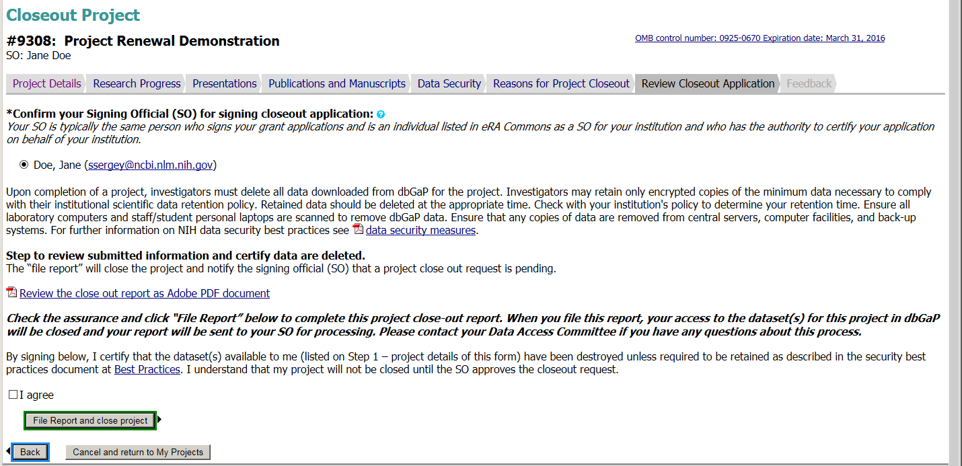

Slide 45
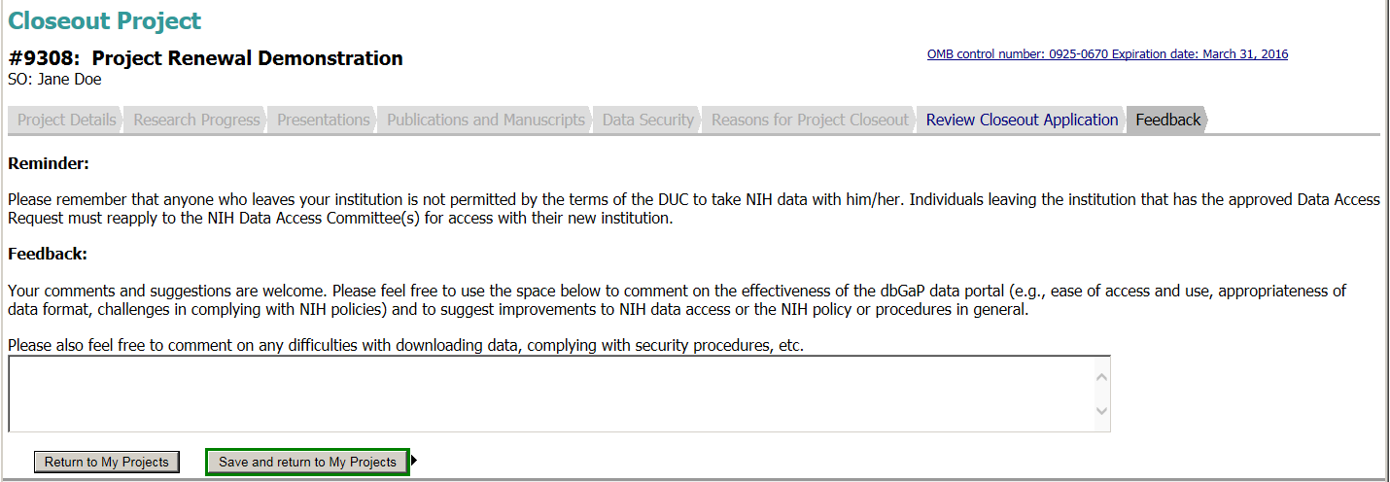

Slide 46
