Slide 1
Attachment 1: Documentation of the dbGaP registration and access system, including changes since 2015 PRA approval

Slide 2
Study Registration Web Forms

Slide 3
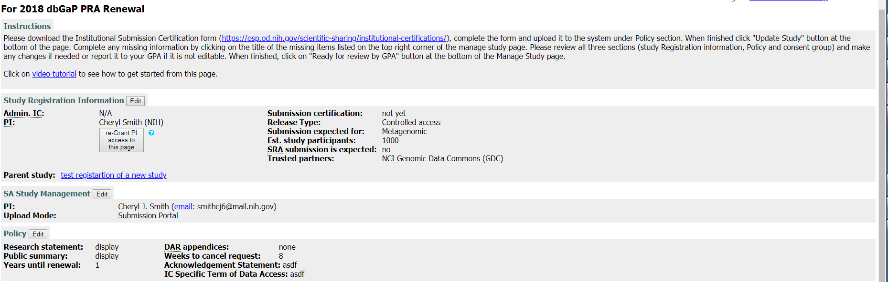
Investigator
OMB Control Number: 0925-0607
Expiration Date: July 31, 2019
Public reporting burden for this collection of information is estimated to vary from 15 to 45 minutes per response, including the time for reviewing instructions, searching existing data sources,
gathering and maintaining the data needed, and completing and reviewing the collection of information. An agency may not conduct or sponsor, and a person is not required to
respond to, a collection of information unless it displays a currently valid OMB control number. Send comments regarding this burden estimate or any other aspect of this
collection of information, including suggestions for reducing this burden, to: NIH, Project Clearance Branch, 6705 Rockledge Drive, MSC 7974, Bethesda, MD 20892-7974, ATTN: PRA (0925-
0670). Do not return the completed form to this address.

Slide 4
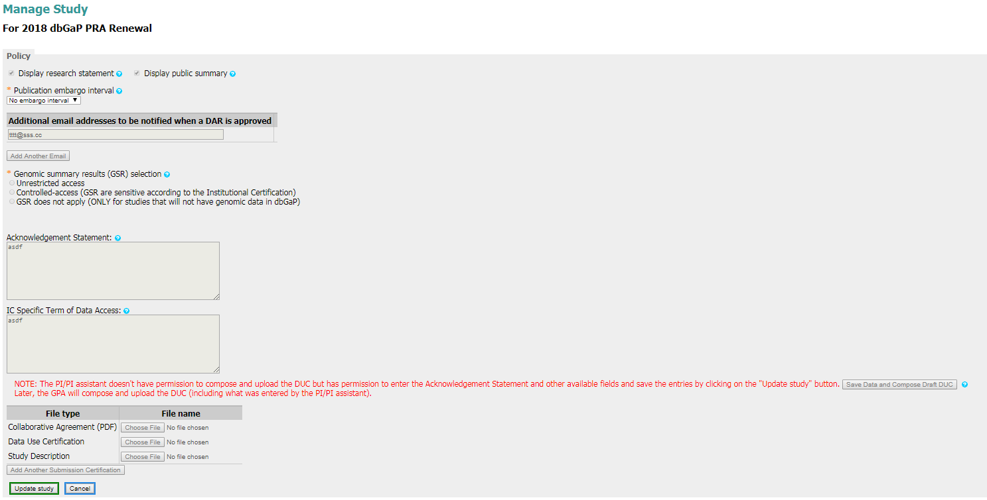
Investigator
Deletion of additional questions on publication embargo because it is no longer applicable.
Added ability for investigator to add additional investigators that are notified when a submitted dataset is uesd
Can review previously entered submission information for accuracy

Slide 5
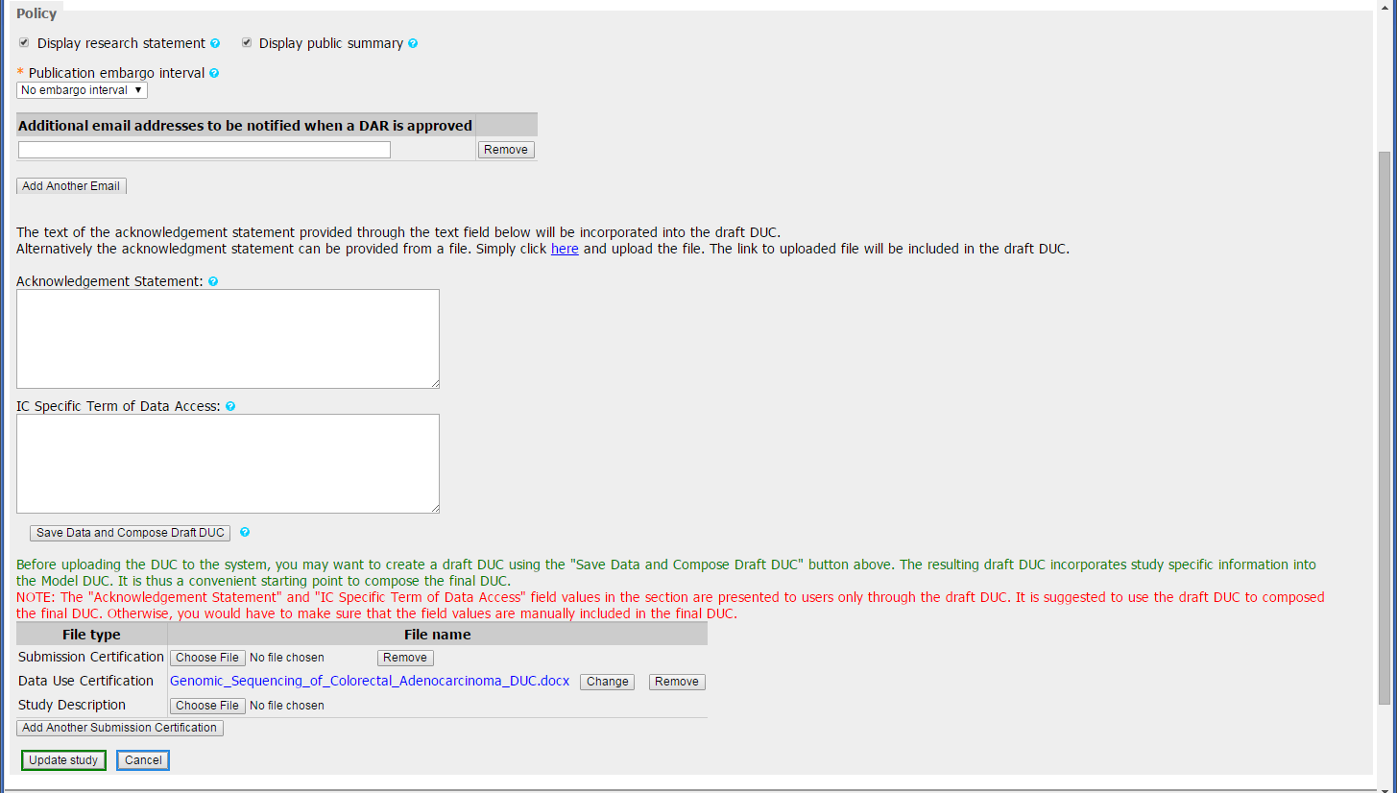
Investigator
Added ability to auto-create the DUC from existing information in the submission package.
Fillable Institutional Certiification Submission Form (PDF) has additional features (see slide 8 for specifics)

Slide 6
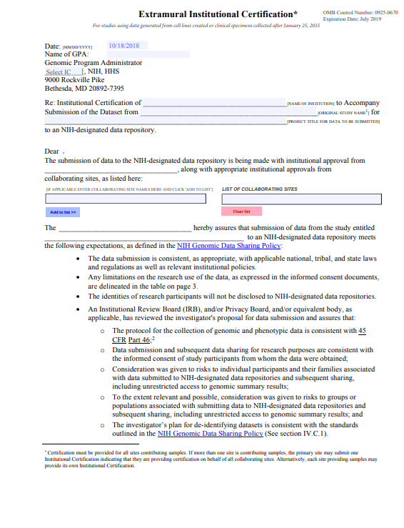
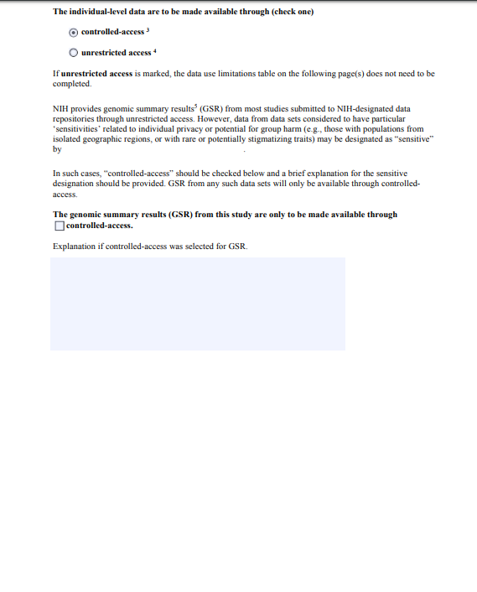
Investigator
OMB Control Number: 0925-0607
Expiration Date: July 31, 2019
Public reporting burden for this collection of information is estimated to vary from 15 to 45 minutes per response, including the time for reviewing instructions, searching existing data sources,
gathering and maintaining the data needed, and completing and reviewing the collection of information. An agency may not conduct or sponsor, and a person is not required to
respond to, a collection of information unless it displays a currently valid OMB control number. Send comments regarding this burden estimate or any other aspect of this
collection of information, including suggestions for reducing this burden, to: NIH, Project Clearance Branch, 6705 Rockledge Drive, MSC 7974, Bethesda, MD 20892-7974, ATTN: PRA (0925-
0670). Do not return the completed form to this address.

Slide 7
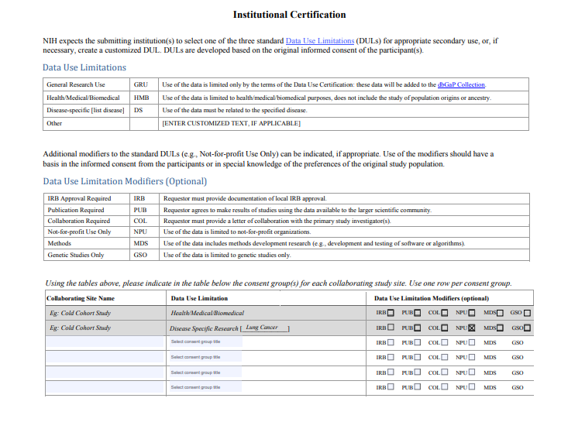
Investigator
Column “Collaborating Site” automatically adds additional rows to form when information is entered for all rows and columns.

Slide 8
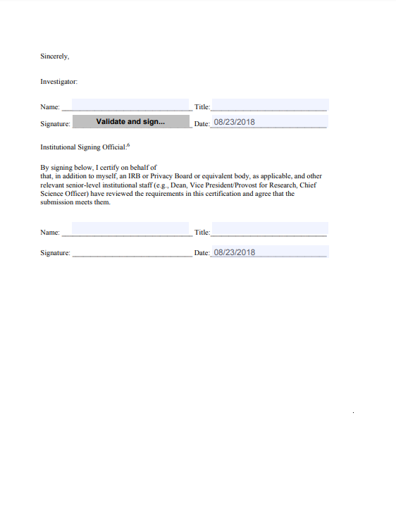
Investigator and Institutional Official
New ability for investigators and Institutional Officials to digitally sign form

