Slide 1
Attachment 2: Documentation of the dbGaP access system, including changes since 2013 PRA approval

Slide 2
Screen Shots of Online Forms for
Data Access Request

Slide 3
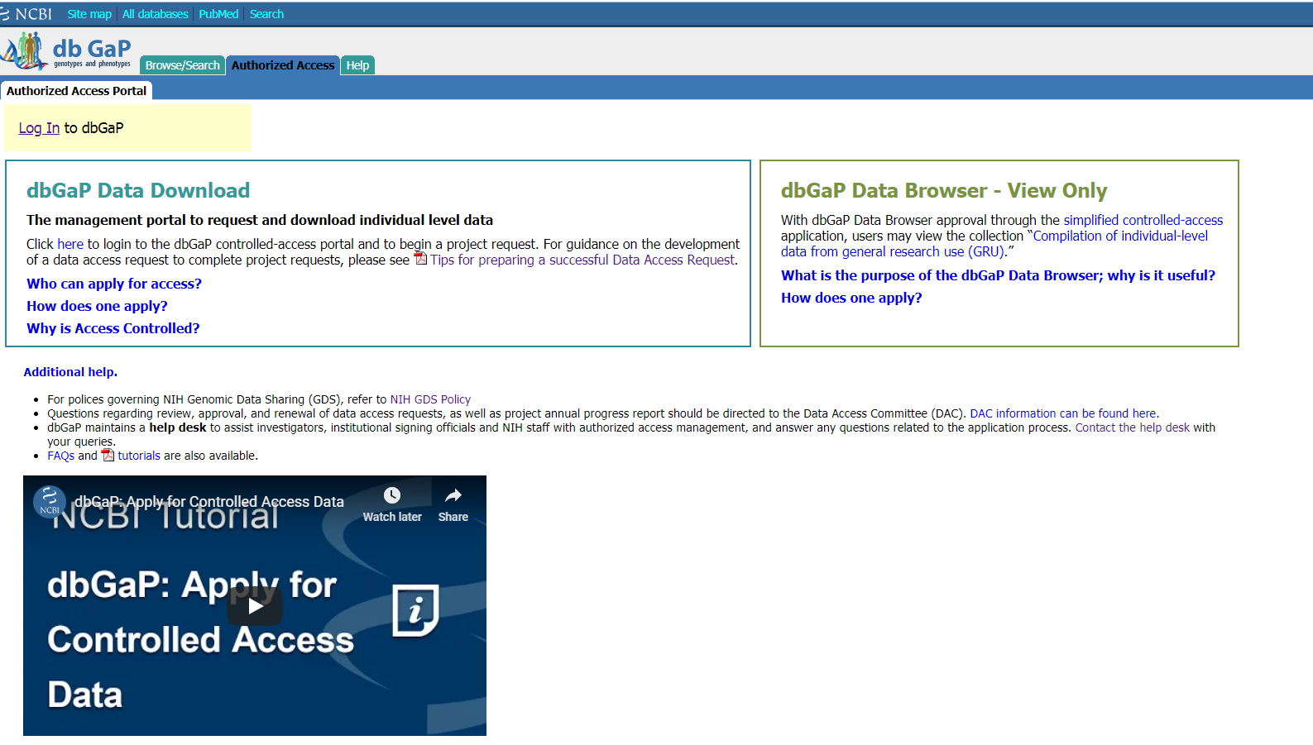
REQUESTER
Reorganized and consolidated information and made application information more apparent and prominent.

Slide 4
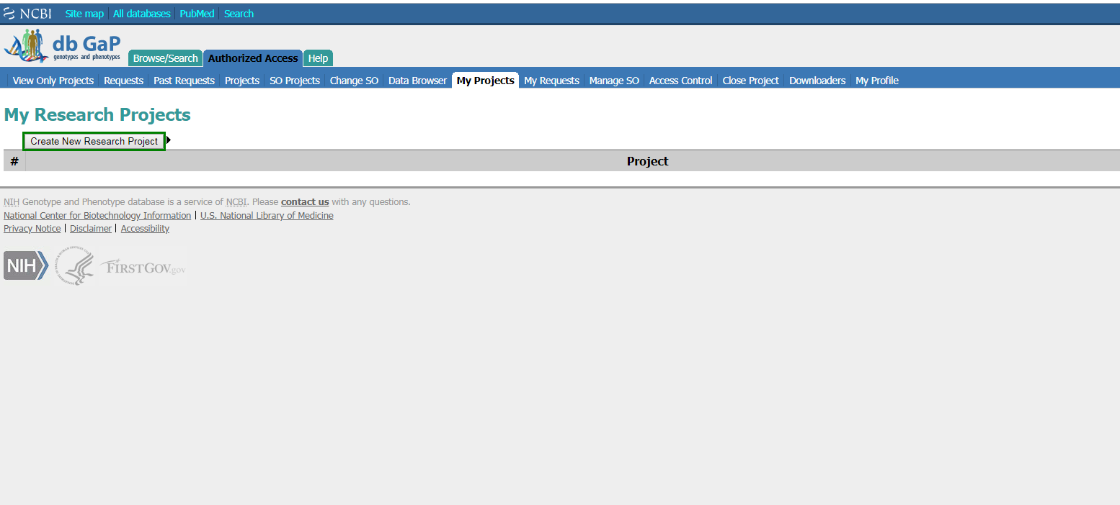
REQUESTER

Slide 5
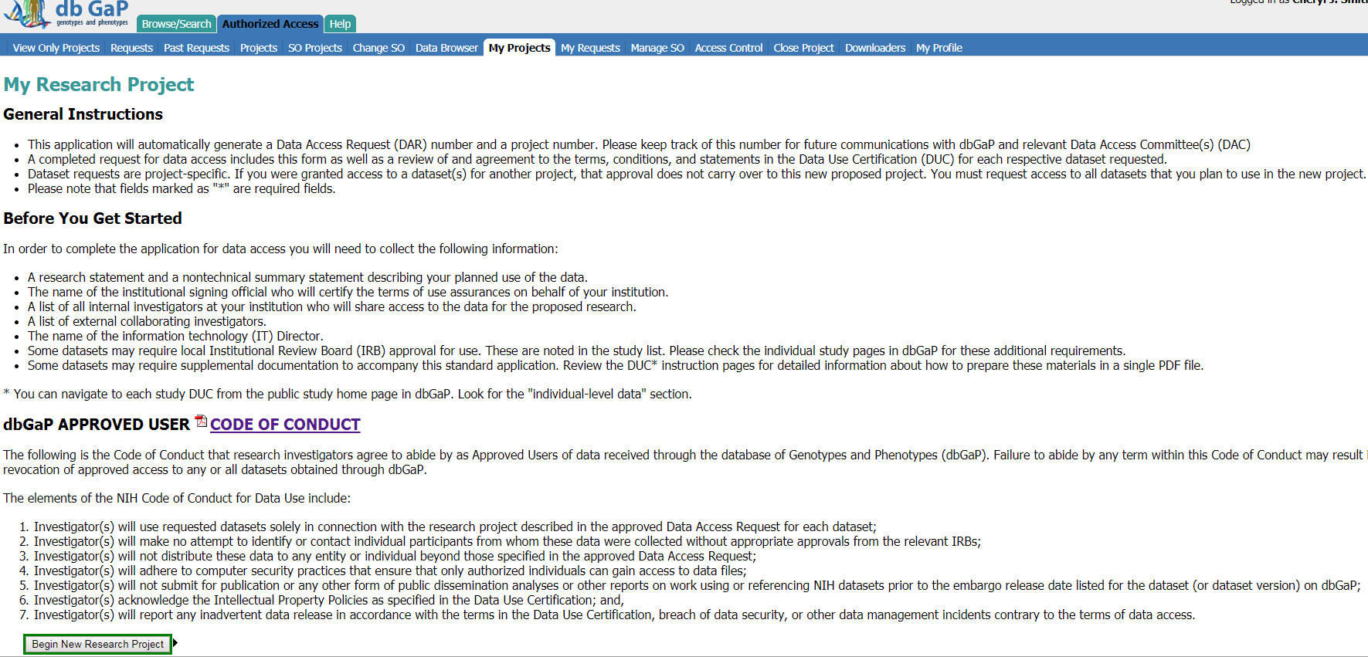
REQUESTER

Slide 6
REQUESTER
- OMB control number: 0925-0670 Expiration data: 7/31/2019

Slide 7
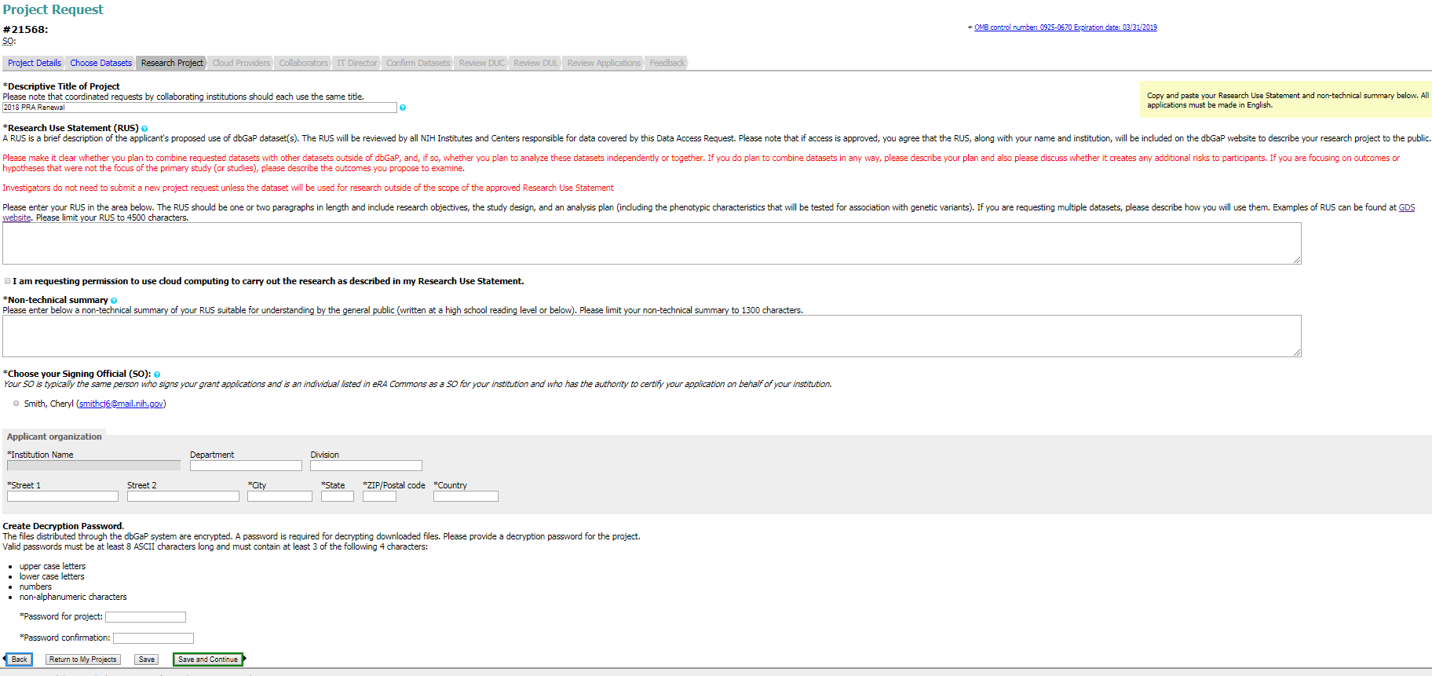
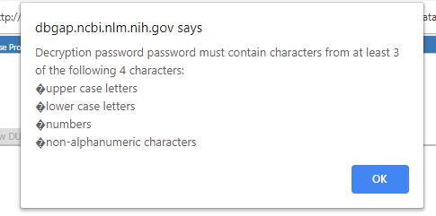
REQUESTER
+ OMB control number: 0925-0670 Expiration data: 7/31/2019
New pop-up reminders to alert requester additional information is needed

Slide 8
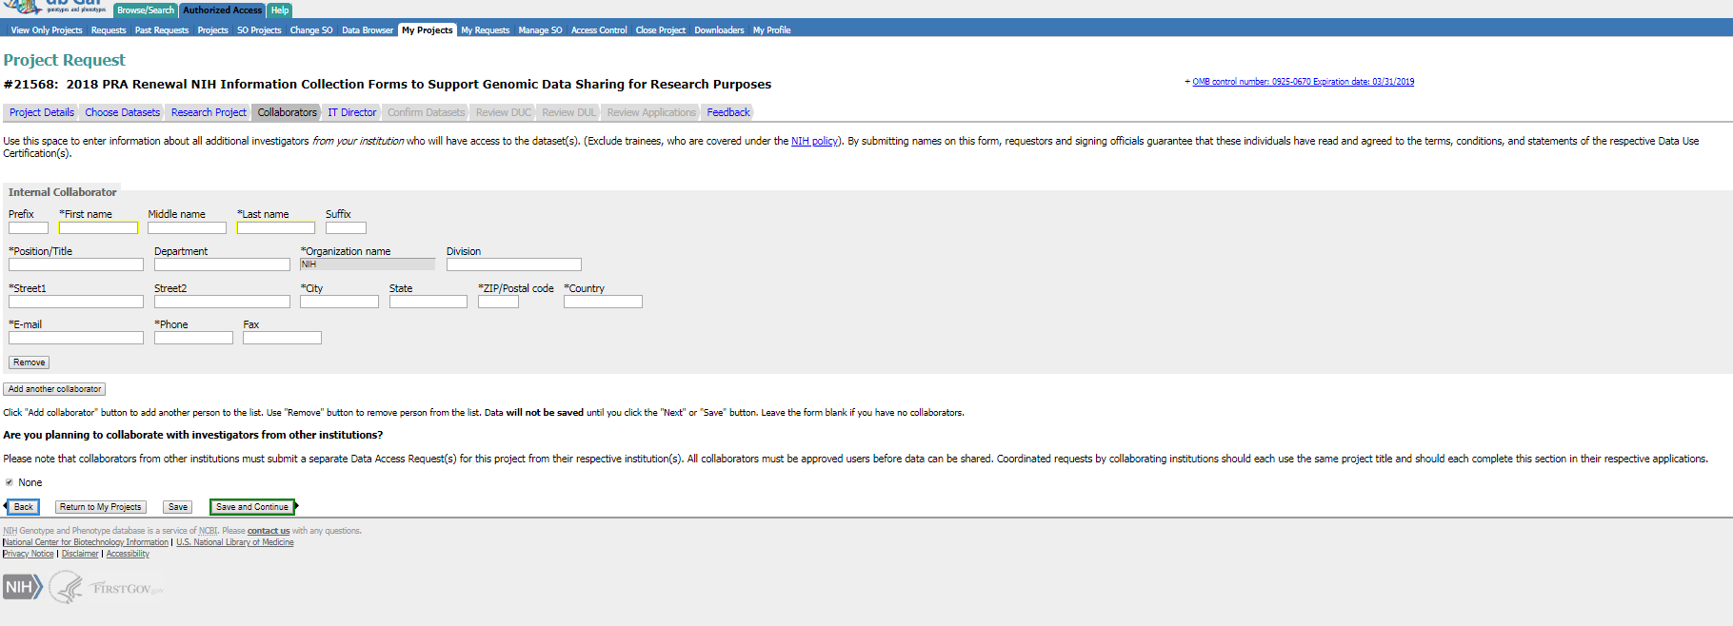
REQUESTER
- OMB control number: 0925-0670 Expiration data: 7/31/2019

Slide 9
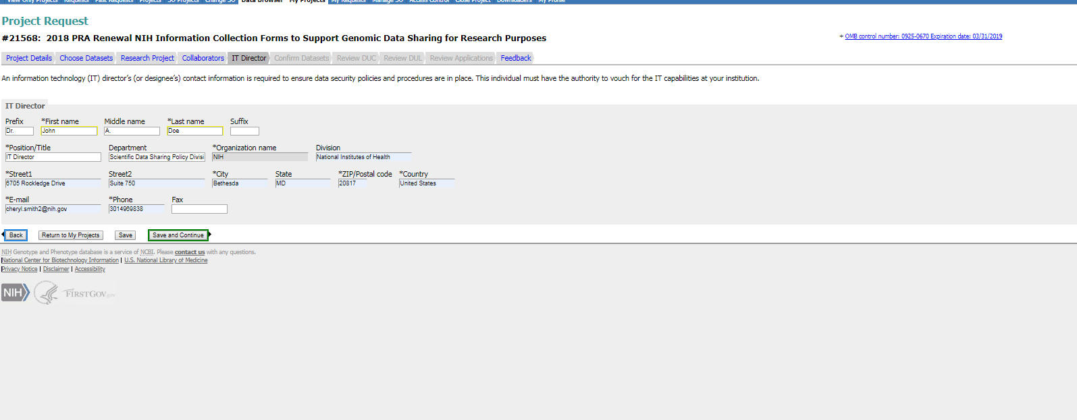
REQUESTER
- OMB control number: 0925-0670 Expiration data: 7/31/2019

Slide 10
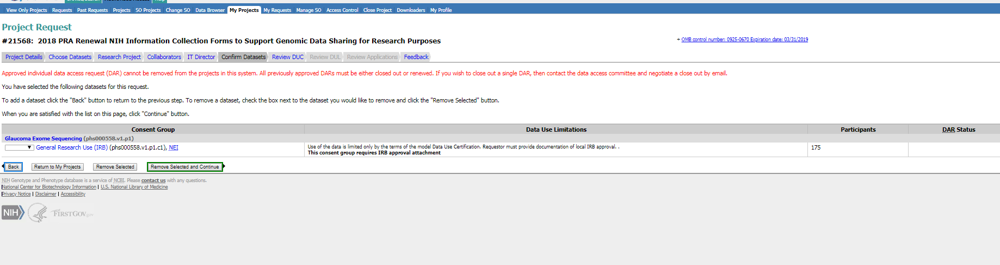
REQUESTER
- OMB control number: 0925-0670 Expiration data: 7/31/2019

Slide 11
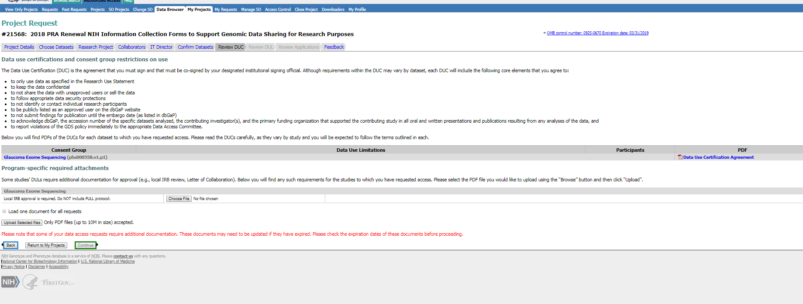
REQUESTER
- OMB control number: 0925-0670 Expiration data: 7/31/2019

Slide 12
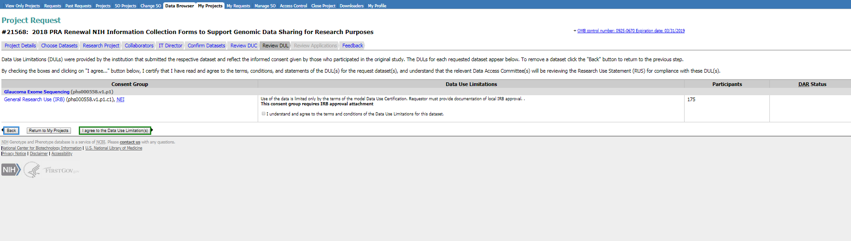
REQUESTER
- OMB control number: 0925-0670 Expiration data: 7/31/2019

Slide 13
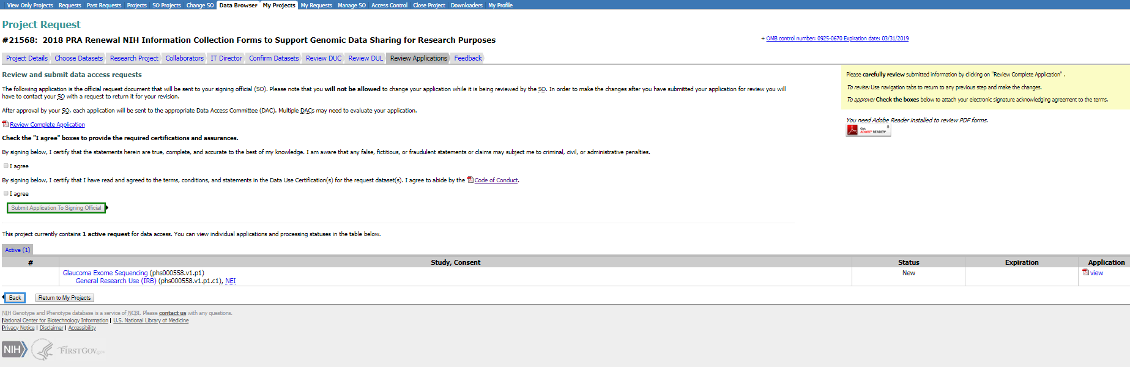
REQUESTER
- OMB control number: 0925-0670 Expiration data: 7/31/2019

Slide 14
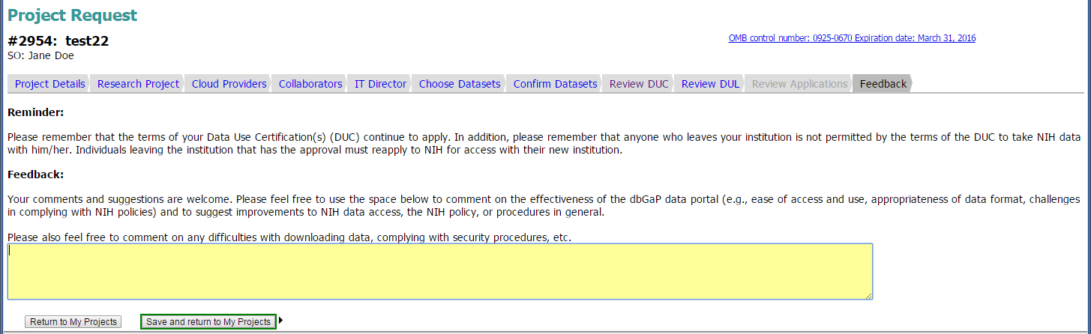
REQUESTER
- OMB control number: 0925-0670 Expiration data: 7/31/2019

Slide 15
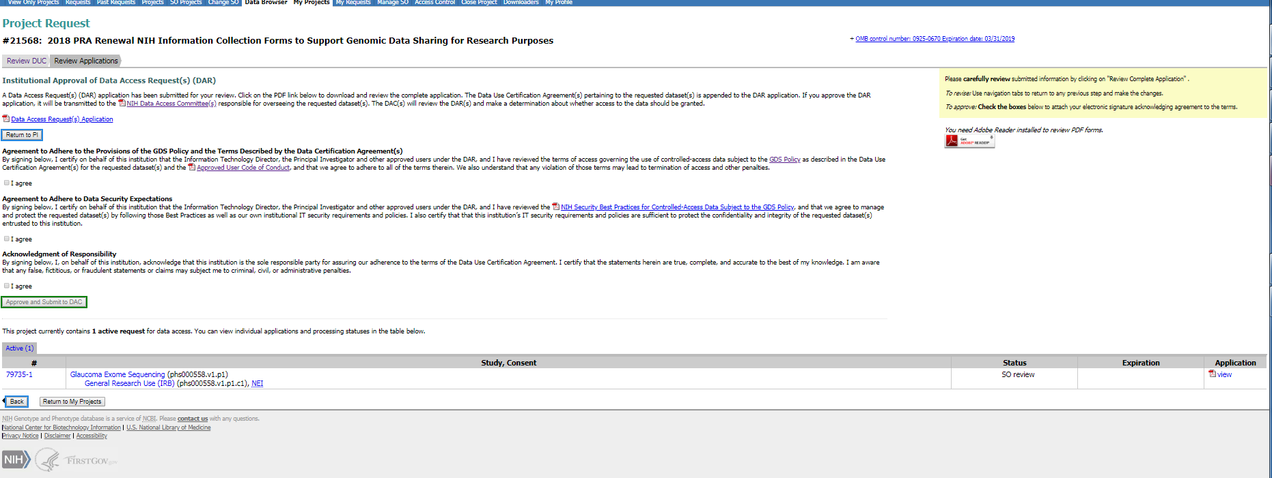
Institutional Signing Official
- OMB control number: 0925-0670 Expiration data: 7/31/2019

Slide 16
dbGaP Authorized Access
Project Renewal Web Forms

Slide 17
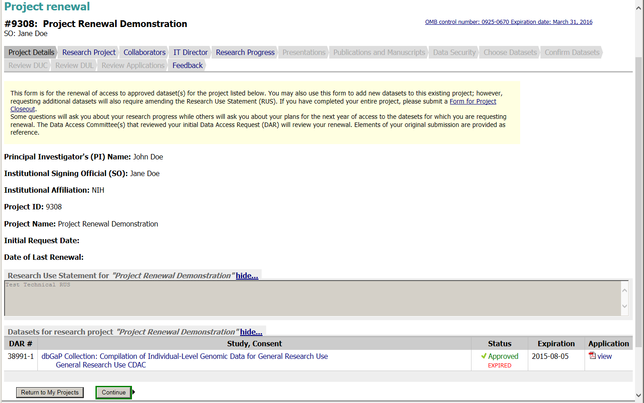
REQUESTER
- OMB control number: 0925-0670 Expiration data: 7/31/2019

Slide 18
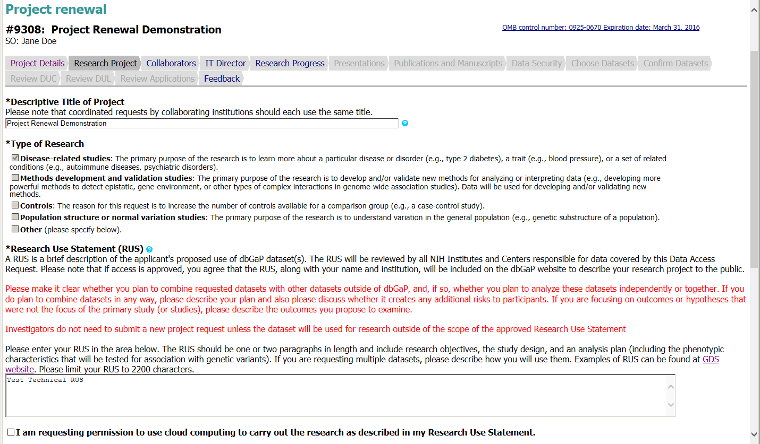
REQUESTER
- OMB control number: 0925-0670 Expiration data: 7/31/2019
Page continues on next slide

Slide 19
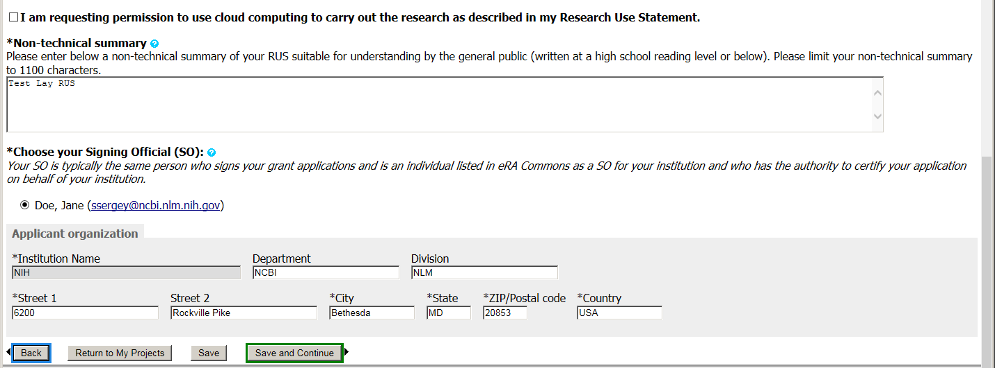
REQUESTER
Continuation of previous slide

Slide 20
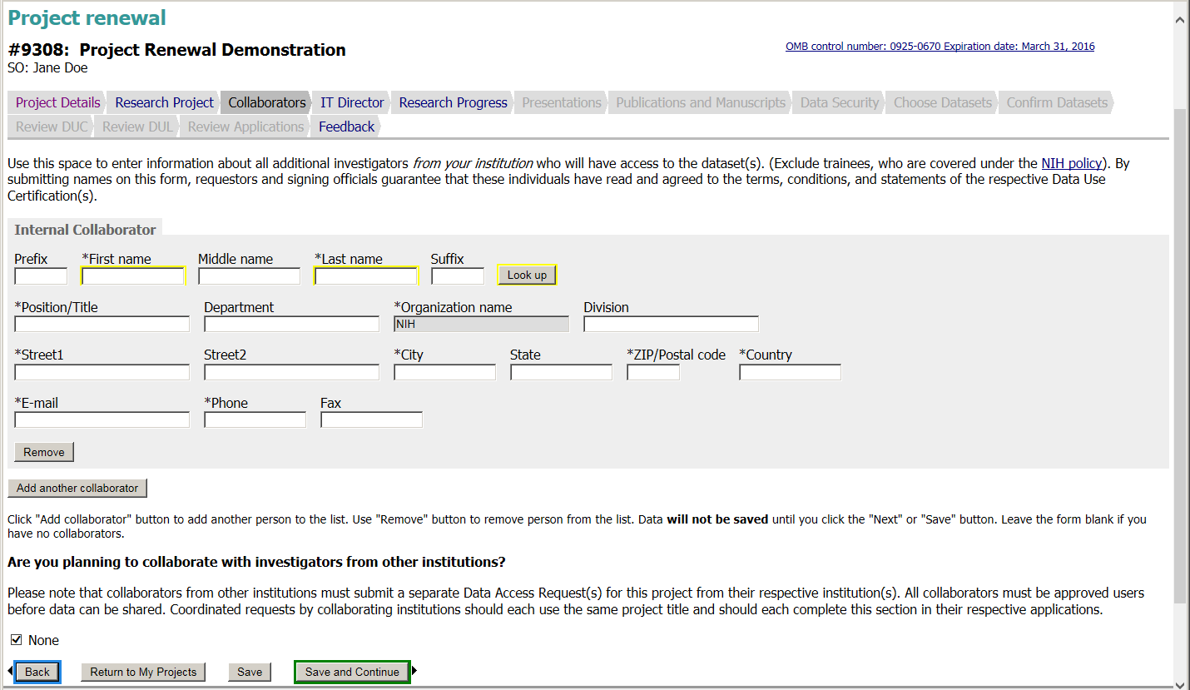
REQUESTER
- OMB control number: 0925-0670 Expiration data: 7/31/2019

Slide 21
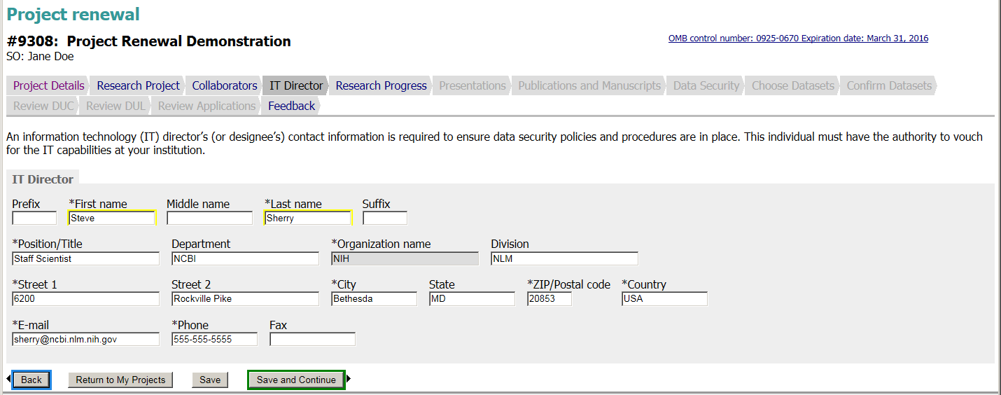
REQUESTER
- OMB control number: 0925-0670 Expiration data: 7/31/2019

Slide 22
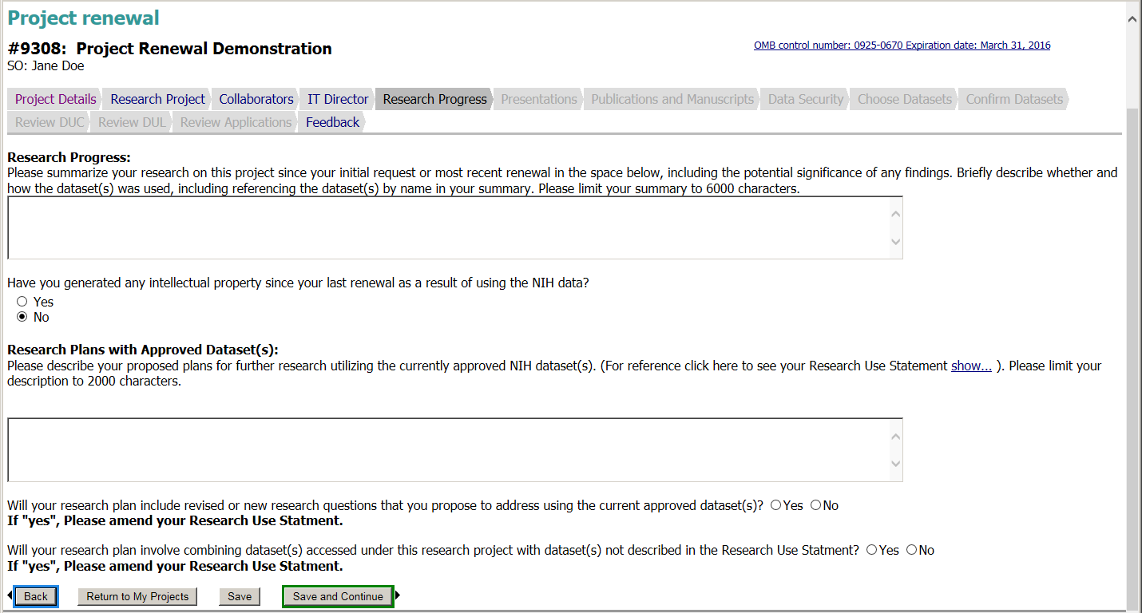
REQUESTER
- OMB control number: 0925-0670 Expiration data: 7/31/2019
Section removed to reduce redundant information entered in the “Research Progress” section and the “Research Plans with Approved Datasets” section.

Slide 23
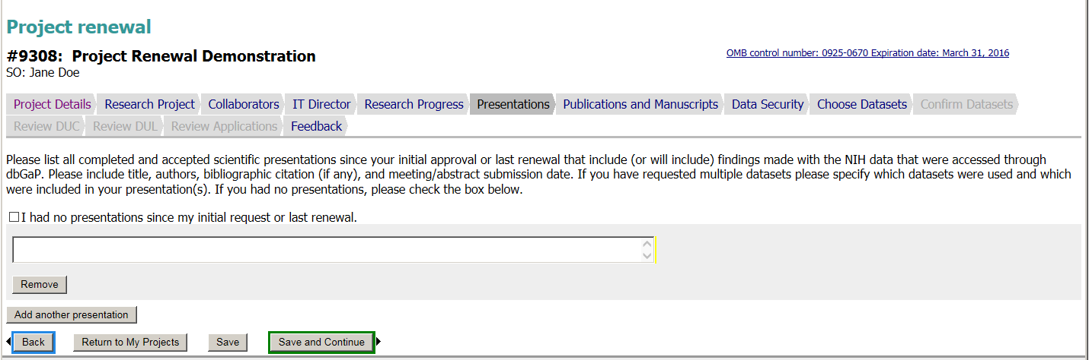
REQUESTER
- OMB control number: 0925-0670 Expiration data: 7/31/2019

Slide 24
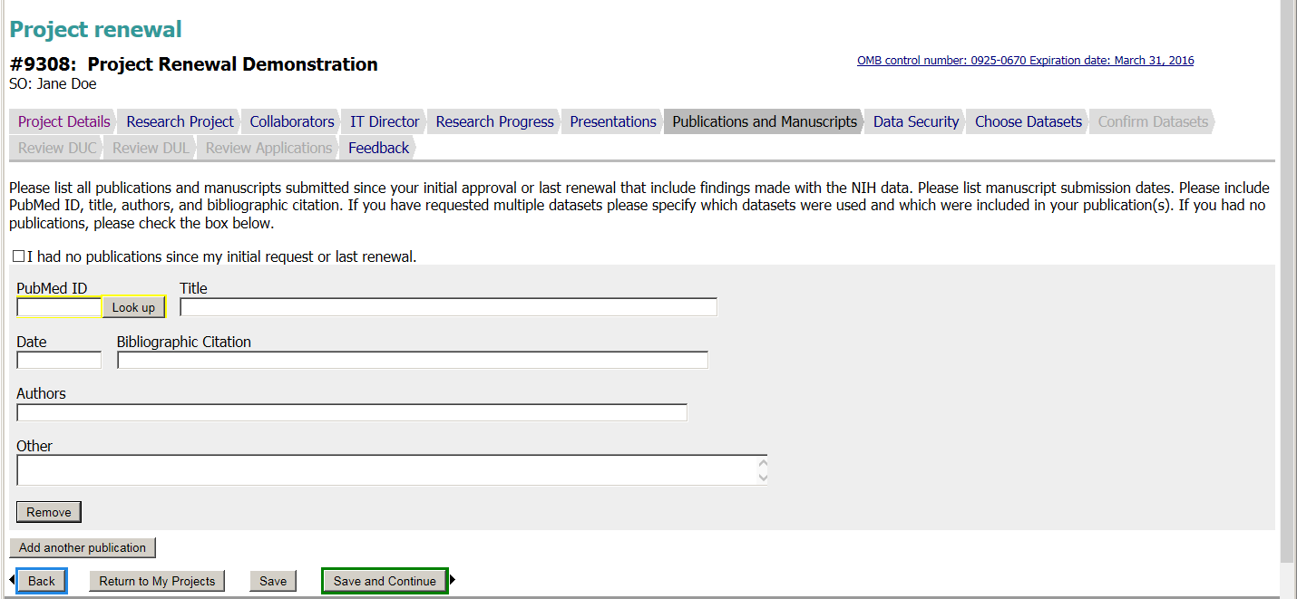
REQUESTER
- OMB control number: 0925-0670 Expiration data: 7/31/2019

Slide 25
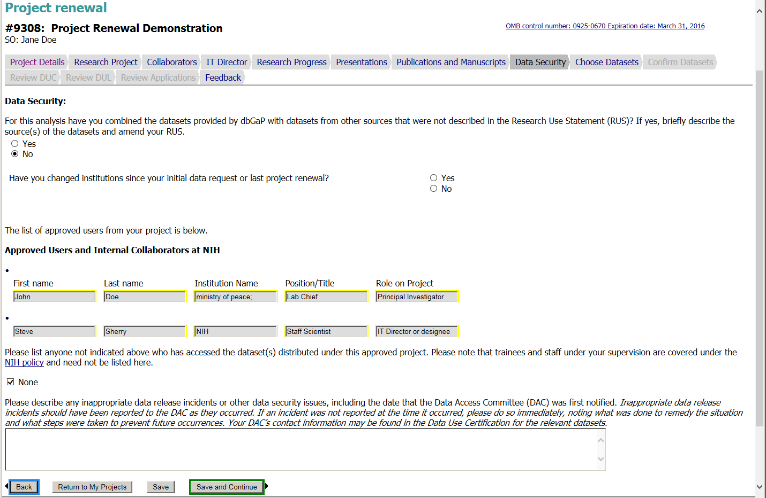
REQUESTER
- OMB control number: 0925-0670 Expiration data: 7/31/2019

Slide 26
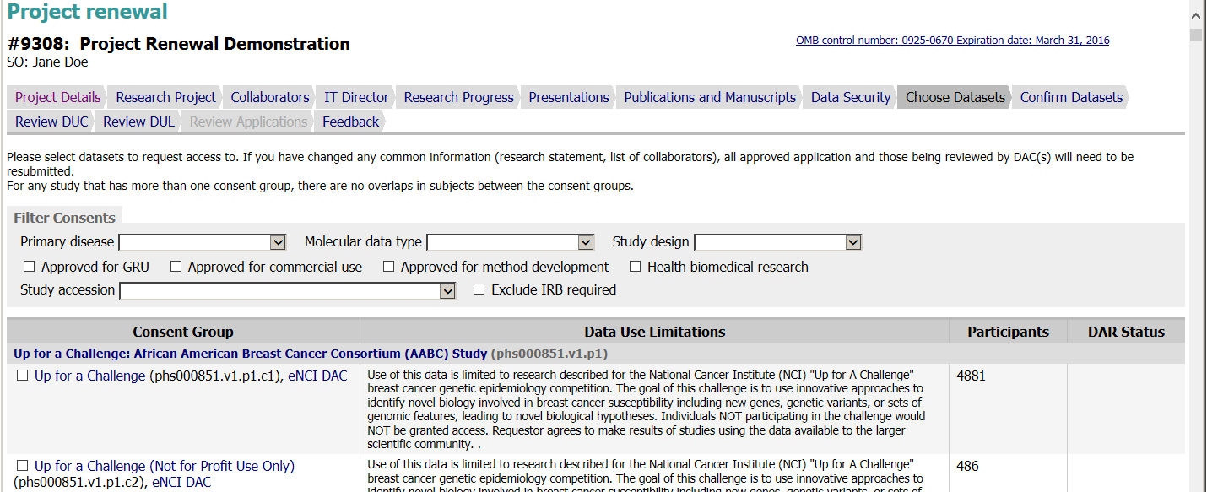
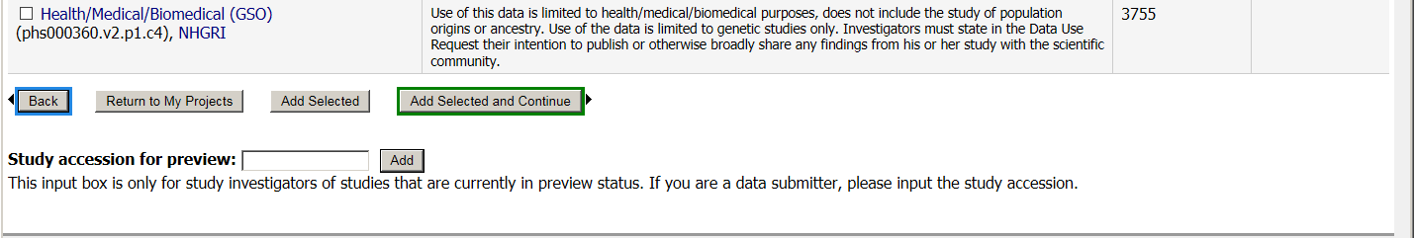
REQUESTER
- OMB control number: 0925-0670 Expiration data: 7/31/2019
Multiple studies are not shown for brevity

Slide 27
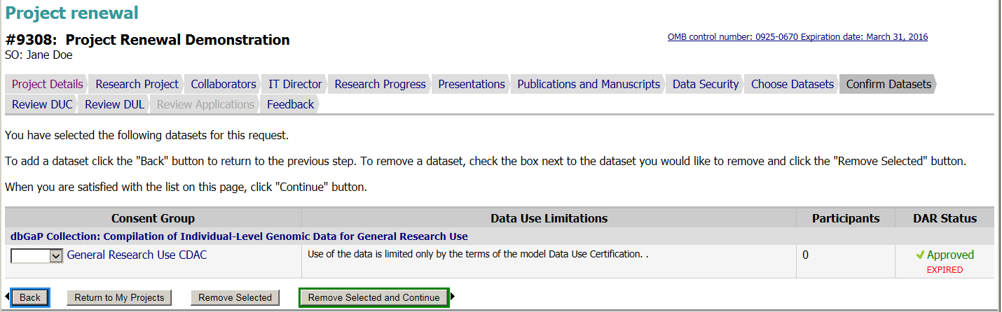
REQUESTER
- OMB control number: 0925-0670 Expiration data: 7/31/2019

Slide 28
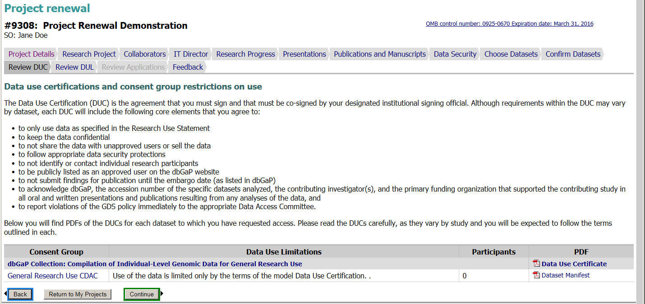
REQUESTER
- OMB control number: 0925-0670 Expiration data: 7/31/2019

Slide 29
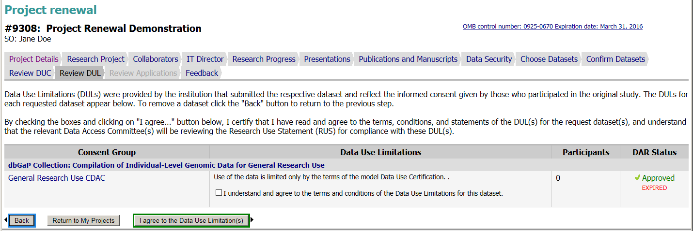
REQUESTER
- OMB control number: 0925-0670 Expiration data: 7/31/2019

Slide 30
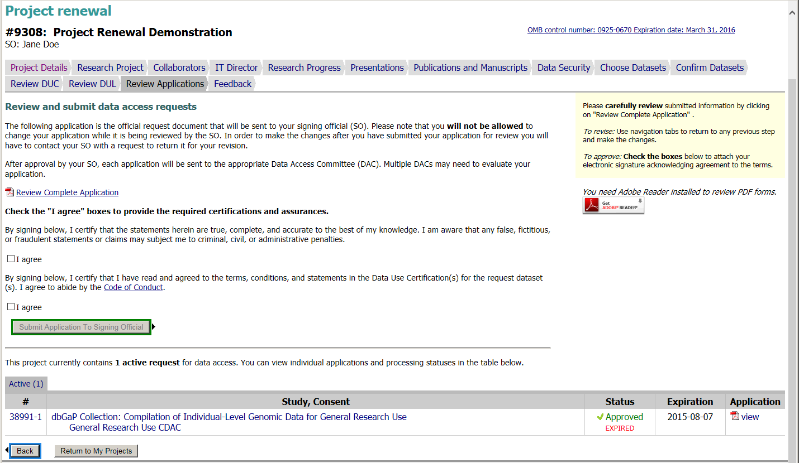
REQUESTER
- OMB control number: 0925-0670 Expiration data: 7/31/2019

Slide 31
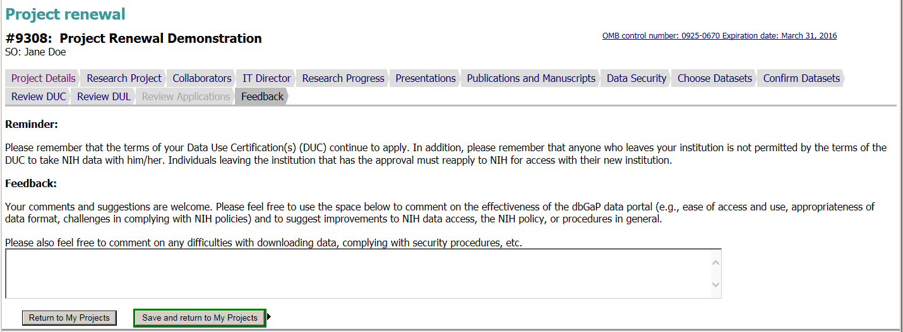
REQUESTER
- OMB control number: 0925-0670 Expiration data: 7/31/2019

Slide 32
Institutional Signing Official
- OMB control number: 0925-0670 Expiration data: 7/31/2019

Slide 33
dbGaP Authorized Access
Project Closeout Web Forms

Slide 34
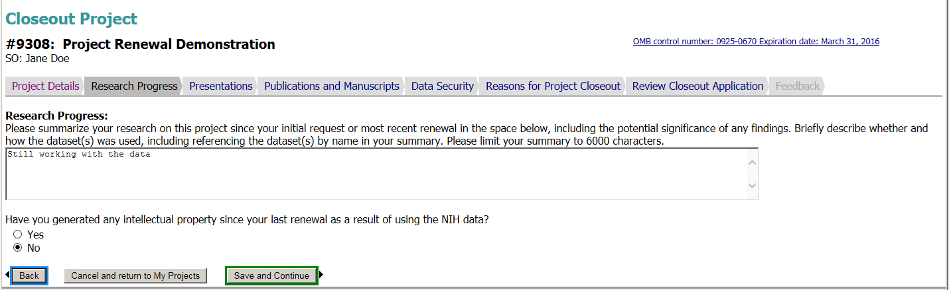
REQUESTER
- OMB control number: 0925-0670 Expiration data: 7/31/2019

Slide 35
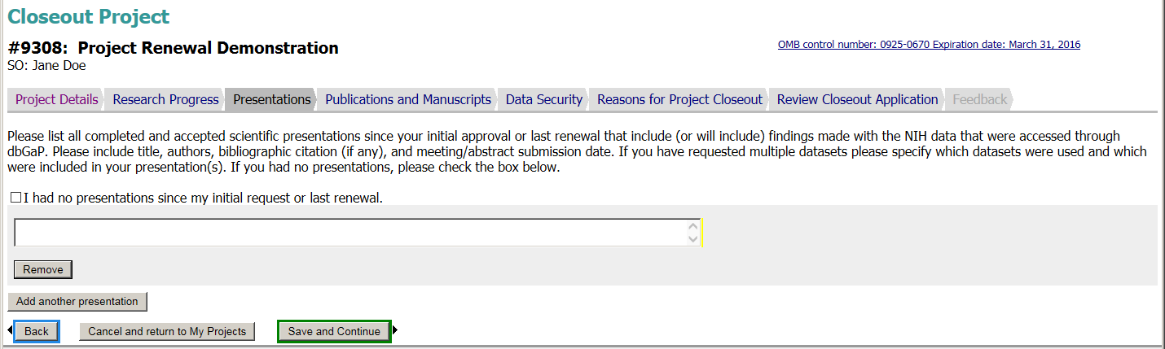
REQUESTER
- OMB control number: 0925-0670 Expiration data: 7/31/2019

Slide 36
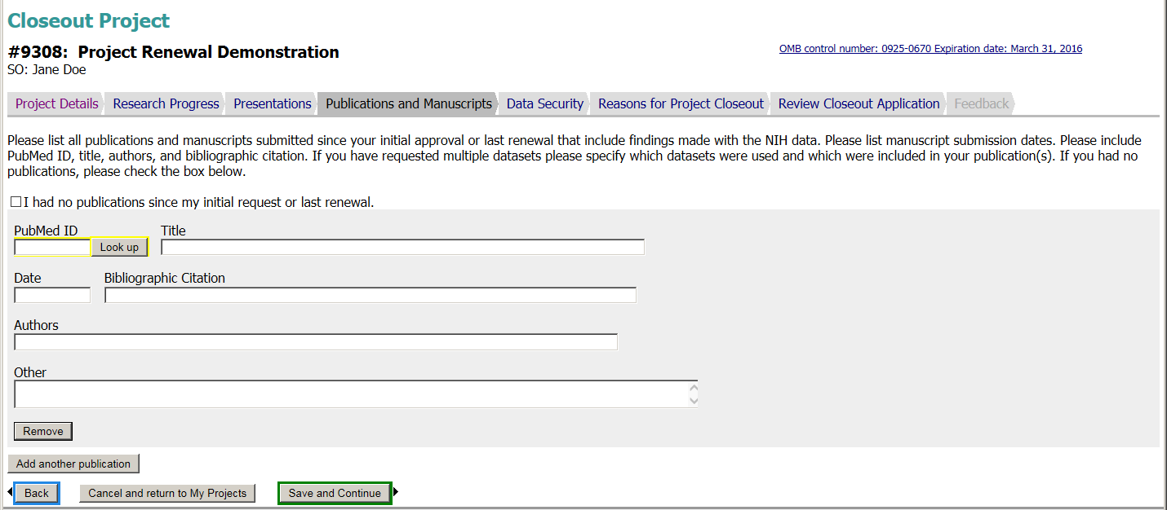
REQUESTER
- OMB control number: 0925-0670 Expiration data: 7/31/2019

Slide 37
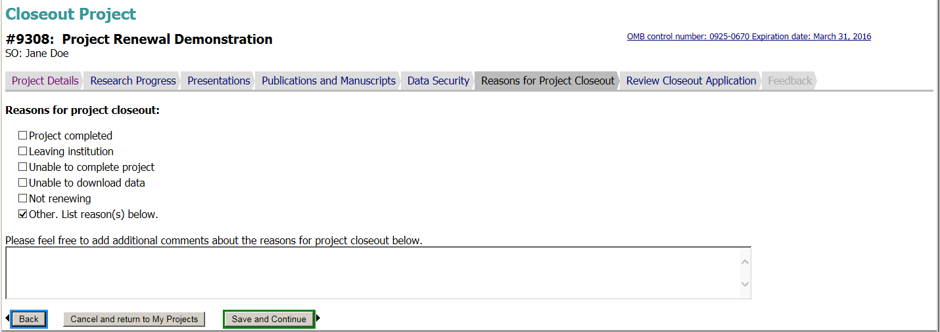
REQUESTER
- OMB control number: 0925-0670 Expiration data: 7/31/2019

Slide 38
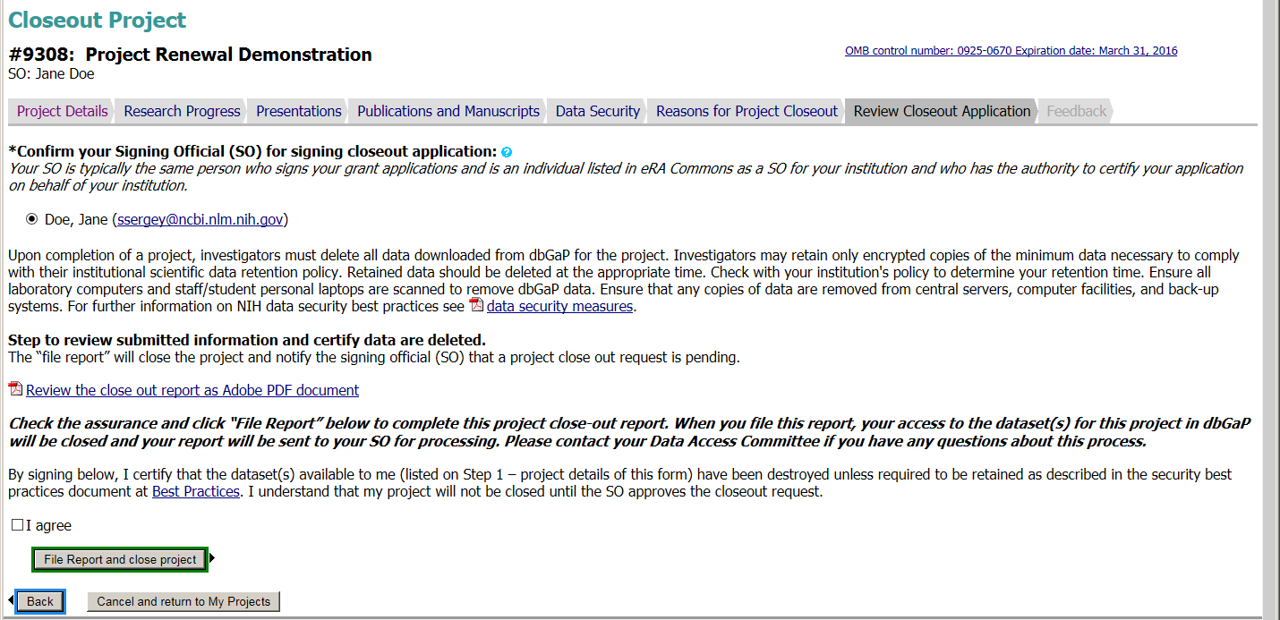
REQUESTER
- OMB control number: 0925-0670 Expiration data: 7/31/2019

Slide 39
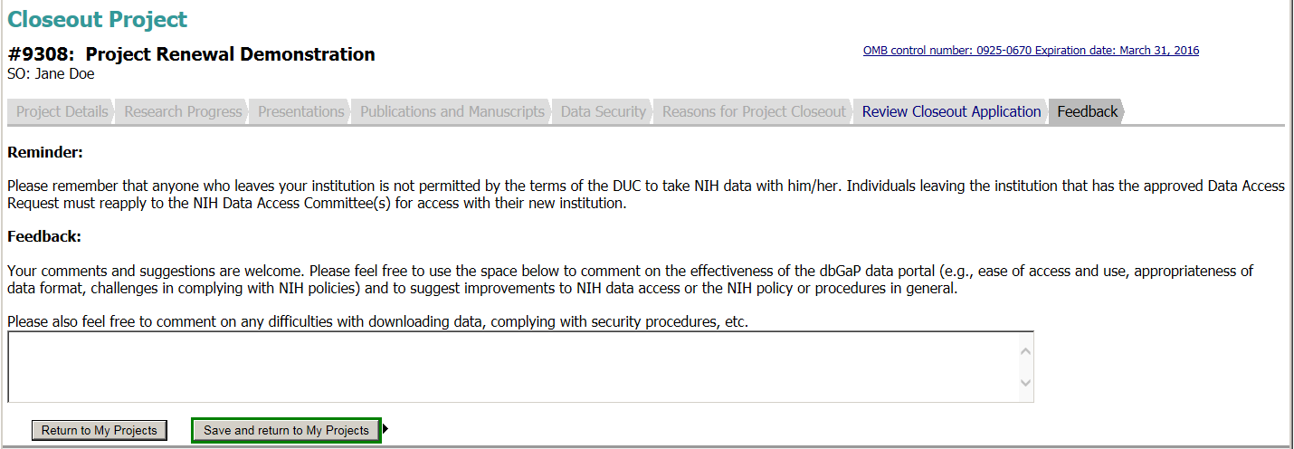
REQUESTER
- OMB control number: 0925-0670 Expiration data: 7/31/2019

Slide 40
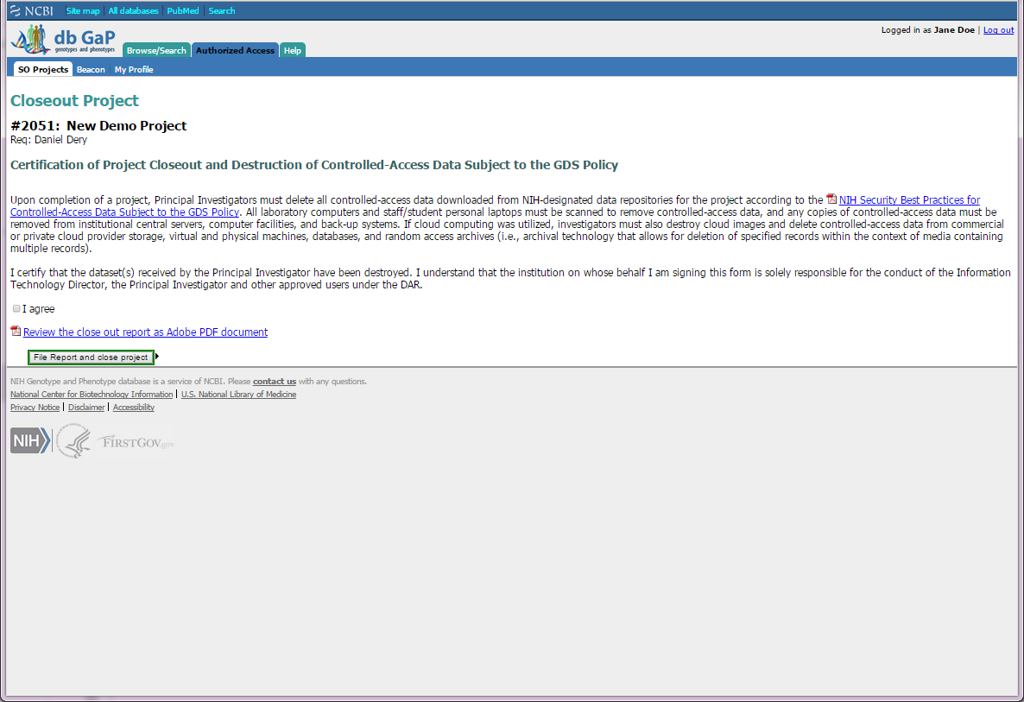
Institutional Signing Official

