Slide 1
ELECTRONIC FORMS SYSTEM (EFS)
Guide to Using EFS Preparing Form LM-20

Slide 2
ELECTRONIC FORMS SYSTEM (EFS) FORM LM-20
EFS is a web-based system for completing and filing forms required under the Labor-Management Reporting and Disclosure Act (LMRDA), including the Form LM-20 Labor Organization Officer and Employee Report.
This tutorial demonstrates basic features and functionality of the EFS Form LM-20. It does not contain instructions for what information should be provided on your report. Please consult the Form LM-20 instructions if you have questions about what information should be entered on the report.
You can download a complete set of Form LM-20 instructions from the OLMS website.

Slide 3
System Requirements and Settings
To access and use EFS, OLMS recommends that you use one of the following browsers:
Microsoft Internet Explorer – Version 11.0 or higher
Google Chrome –Version 7.0 or higher
Mozilla Firefox
Screen Resolution: For optimal viewing, set your screen resolution to 1280 x 1024 or greater. It is recommended that, at a minimum, you set your screen resolution to 1152 x 864 to avoid horizontal scrolling.

Slide 4
Accessing the System
Navigate to the OLMS Website and select OLMS LM REPORTS & CBAs, then from the drop down menu, select the “File Forms LM-2/3/4/20/21/30” link.

Slide 5
Accessing the System
From the EFS Introduction page, select on the “Access the OLMS EFS” link.

Slide 6
Accessing the System
To access the Form LM-20 in EFS, you must first register with EFS and obtain a user ID and password.
If you already have an EFS user ID and password, you do not need to register again.

Slide 7
Accessing the Form LM-20 Form
Once you have a user ID and password, select the ”EFS for LM-20, LM-21 and LM-30” link on the left side of the page.
Select the link
to access the LM-20

Slide 8
Accessing the Form LM-20
Log into EFS using your user ID and password, and select “Sign In”.

Slide 9
Select Report Type
You must choose the type of report you are filing. Select “LM-20/21”, then Next.

Slide 10
Start A New Form LM-20 Filer
If you have previously filed a Form LM-20 report, select “Locate An Existing LM-20/LM-21 Filer” Tab.

Slide 11
Registering A Form LM-20 Filer
If you have not previously filed a Form LM-20, select the “Register a New LM-20/LM-21 Filer” Tab.

Slide 12
Start a New LM-20 – Registering the Organization
Fill in the organization name and address to register the organization. Then select “Register the organization”. You will be given the File Number and Access Key number.

Slide 13
Start a New LM-20
The File Number and Access Key will be filled in. Now you can begin a new form by selecting “Start New LM-20”.
12345
123456

Slide 14
LM-20 Forms In Progress
If you have previously started a Form LM-20, select the “Forms In Progress” tab. The available file number will appear. Select the box next to the file number and the available forms will appear. Select the form and continue completing or editing the Form LM-20.

Slide 15
Form LM-20 – Submitted Forms
If you need to amend a Form LM-20 report that you previously submitted through EFS, select the “Submitted Forms” tab to view and retrieve it. You may then amend your report and submit it.
If you need to amend a Form LM-20 report that you originally submitted by mail, you may use EFS to file your amended report.
However, you will have to start a new report and re-enter information on the form, since reports that were previously filed manually may not be viewed and retrieved in EFS.

Slide 16
LM-20 Access Key – How To Share Forms
The Access Key is a private key that gives filers the ability to allow others to help prepare the Form LM-20 report. A filer can log into the EFS system using his or her own user ID and password, and can use the filer’s Access Key to view and edit reports. If forgotten, the Access Key can always be retrieved by selecting the Access Key tab.
A filer should only share this Access Key with individuals who are authorized to have access to the form. At no time should filers share their user name and password with anyone else. Every user of EFS should have his or her own user ID and password.

Slide 17
Resetting the Access Key
A filer may need to change the Access Key to prevent unauthorized access to reports. To reset the Access Key, select the “Generate New Access Key” button under the Access Key tab.

Slide 18
Navigating the Form LM-20 in EFS
Navigate forward and backward through the form by using the navigation arrows, or jump directly to a section by clicking on the page title on the left navigation pane.

Slide 19
Accessing Form LM-20 Instructions in EFS
While working on the Form LM-20 in EFS, you can select the “Form Instructions” button to view the complete Form LM-20 instructions in a new window.

Slide 20
Entering Data into the Form LM-20 in EFS
Enter data in all fields. Fields that are “grayed out” may not be edited.
It is important to save your work often by selecting the “Save” tab. The form automatically saves your work when moving between pages. If you do not save your work, you risk losing unsaved data.

Slide 21
Entering Data – Form LM-20, Item 6
For Item 6 either enter or search for the Employer with whom the agreement and arrangement was made. If searching, type part of the name of the employer and select search. Scroll through the list and if you find the Employer, select the box next to the Employer name. Select “Add Selected Employer” and all information related to the Employer will be filled in.
If the exact Employer is not listed there, select “Employer Not Found” and manually complete Item 6.

Slide 22
Entering Data – Form LM-20, Items 7 and 8
Item 7 add the date the agreement or arrangement was entered into.
Item 8 add the name of the person with whom the agreement or arrangement was made. If additional individuals need to be added, select the “Add Another Person” under Item 8.

Slide 23
Entering Data – Form LM-20, Items 9 and 10
For Item 9, check the appropriate box(es) indicating whether the object or purpose of the agreement or arrangement is to, directly or indirectly, persuade employees as to exercising their bargaining rights or to supply an employer with information related to a labor dispute. You must check either one or both of the boxes.
For Item 10, Terms and Conditions, provide a detailed explanation of the terms and conditions of the agreement or arrangement. If any agreement or arrangement is in whole or in part contained in a written contract, memorandum, letter, or other written instrument, or has been otherwise wholly or partially to writing, you must refer to that document and attach a copy to this report.

Slide 24
Entering Data – Form LM-20, Item 11
Item 11 – For each activity to be performed, provide in 11a) Nature of the Activity, in 11b) Duration of Performance, in 11c) Extent of Performance and in 11d) Name and Address of person(s) through whom the activity was performed. If there are additional persons for 11d) select the “Add Another Person” tab located beneath 11d. Also, if an additional activity for Item11 is needed, select the “Add Additional Activity” tab under the File Number.

Slide 25
Entering Data – Form LM-20, Item 12
For Item 12, identify the subject group(s) of employees and/or labor organizations that are to be persuaded or concerning whose activities information is to be supplied to the employer. For 12b, you can search by organization in the box labeled Find and add the Organization. Also, if additional labor organizations need to be added, select the “Add Another Labor Organization” tab, under 12b.

Slide 26
Printing the Form LM-20
You can print a copy of the Form LM-20 for review by selecting the Print button on the menu bar. A printable PDF copy of the report will then pop up. Note: You must have a PDF viewer like Adobe Reader installed on your machine to perform this function. (not sure if this is still correct)

Slide 27
Form LM-20 Validation
The Form Validation process ensures that the form contains all required data. You must select the “Validate” button on the menu bar to perform an error check on the entire form. The validation summary page shows the list of any errors that must be corrected before you are able to sign and submit the Form LM-20 report. You may select the error to make corrections.

Slide 28
Form LM-20 Validation
Once the form passes validation, you will receive a message indicating that All Page Validations are passed. Select “OK” to begin the signature process.

Slide 29
Signing the LM-20 Form
Once all of the validation items have been corrected, the form is ready to be signed. The signature block will turn red for signature. Select “OK” and click in the red box indicating Click Here to Sign.

Slide 30
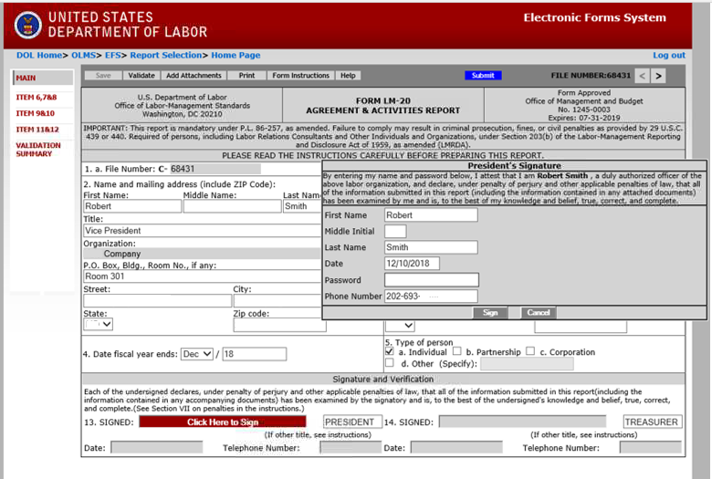
Signing the Form
When the signature box appears, you must re-enter your password to sign the form. Select sign. (If the officers title needs to be updated, select the box with President, delete the title replacing it with the correct title. Then you must save, revalidate and resign the form.)
By signing this form via password, you are legally attesting that you are the person identified by name in the signature block. It is considered forgery to digitally sign a form as someone else.

Slide 31
Signing the Form
Once the report has been signed, if any changes are made to any fields on the form, the signature will be removed and the form must be validated and signed again. You should print a copy of the form for your records. Select the “Print” tab to save the form.

Slide 32
Printing and/or Saving the Form
In order to print and/or save the form for your records, select the “Download” tab to save and/or print your form. There is NOT an option to print once the form has been submitted. After you have saved and/or printed your form, select the “Submit” tab.

Slide 33
Submitting the Form
Once the signatures have been applied, select the “Submit” button from the top menu bar. Once the form has been processed (this may take a few minutes), a confirmation message will be displayed.

Slide 34
Confirmation page
You can print this message for your records by using the print option on your browser.

Slide 35
Getting Help
If you experience difficulty using EFS, please contact OLMS Form Technical Support toll-free at:
1-866-401-1109
This PowerPoint presentation and other information regarding EFS can be found on the OLMS EFS Help page
If you have additional questions or comments, please contact OLMS E-Mail
OLMS at olms-public@dol.gov or contact your local OLMS District Office.

