Slide 1
TSA Reimbursable Screening Services Program (RSSP) Application
OMB Control number 1652-NEW
Screenshots

Slide 2
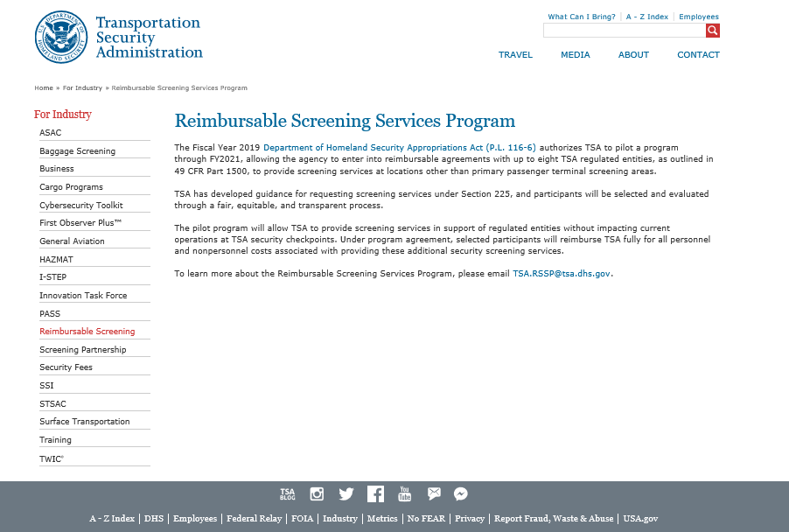

Slide 3
Paperwork Reduction Act Statement:
Transportation Security Administration (TSA) is collecting this information from public and private entities interested in participating in the Reimbursable Screening Services Program. TSA estimates that the average burden for this collection is 8 hours per request. This is a voluntary collection of information. Send comments regarding this burden estimate or any other aspect of this collection to: TSA-11, Attention: PRA 1652-NEW TSA Reimbursable Services Program Request, 601 South 12th Street, Arlington, VA 20598. An agency may not conduct or sponsor, and persons are not required to respond to, a collection of information unless it displays a currently valid OMB control number. The OMB control number assigned to this collection is 1652-xxxx, which expires xx/xx/xxxx.

