Slide 1
MySECO Spouse Registration Process
Screen Captures

Slide 3
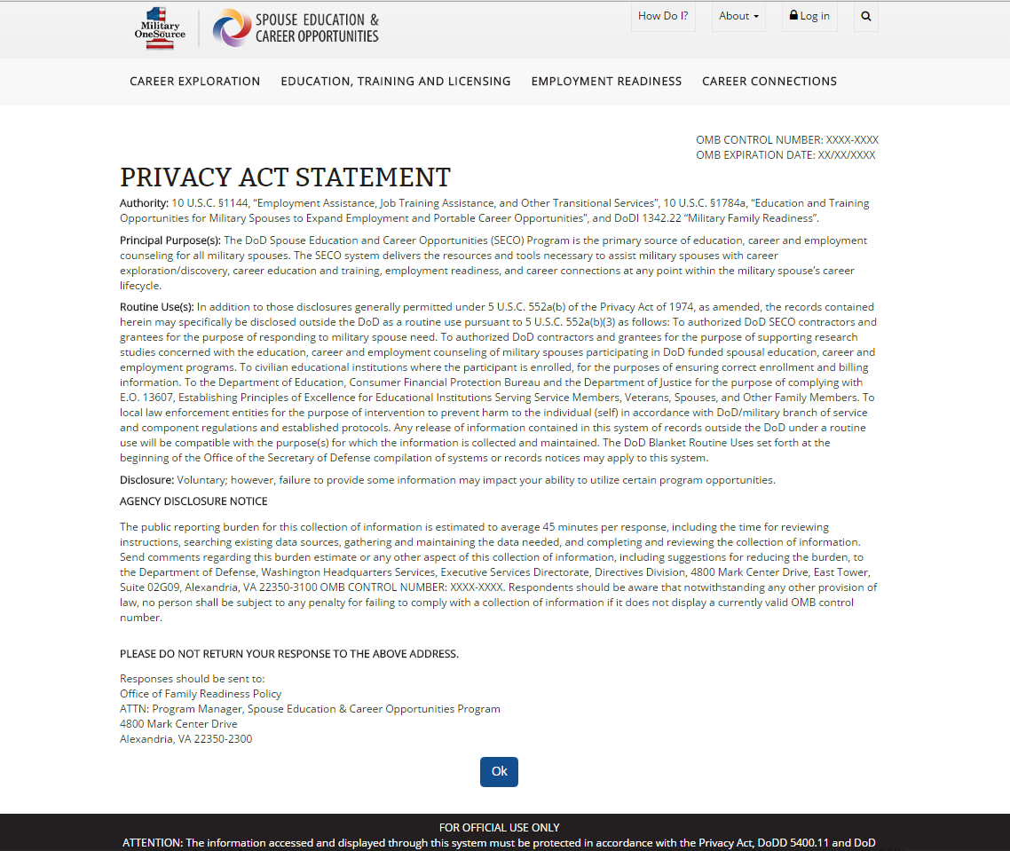

Slide 4
DS Logon

Slide 5
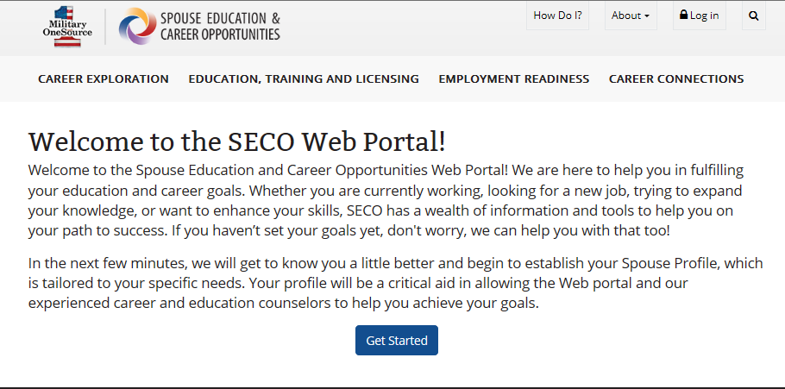
Spouse Registration Welcome Page

Slide 6
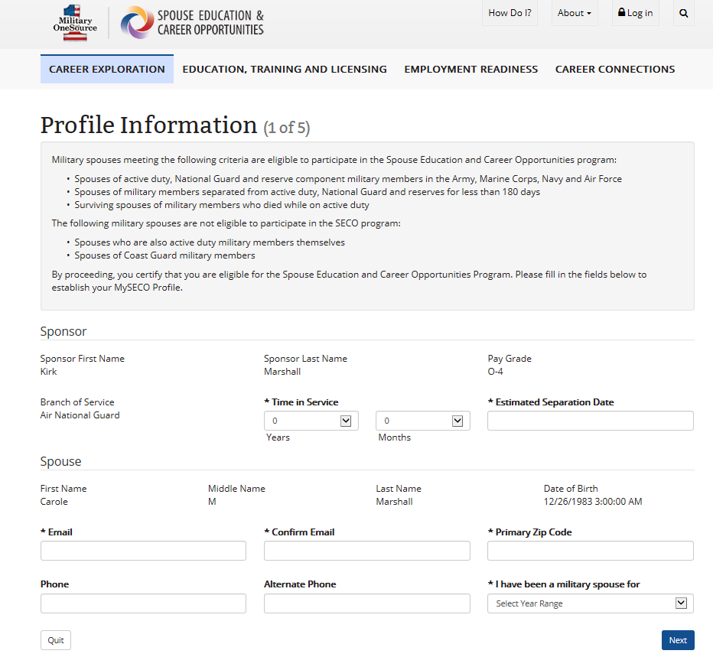
Spouse Registration Profile Information Page Step 1 of 5

Slide 7
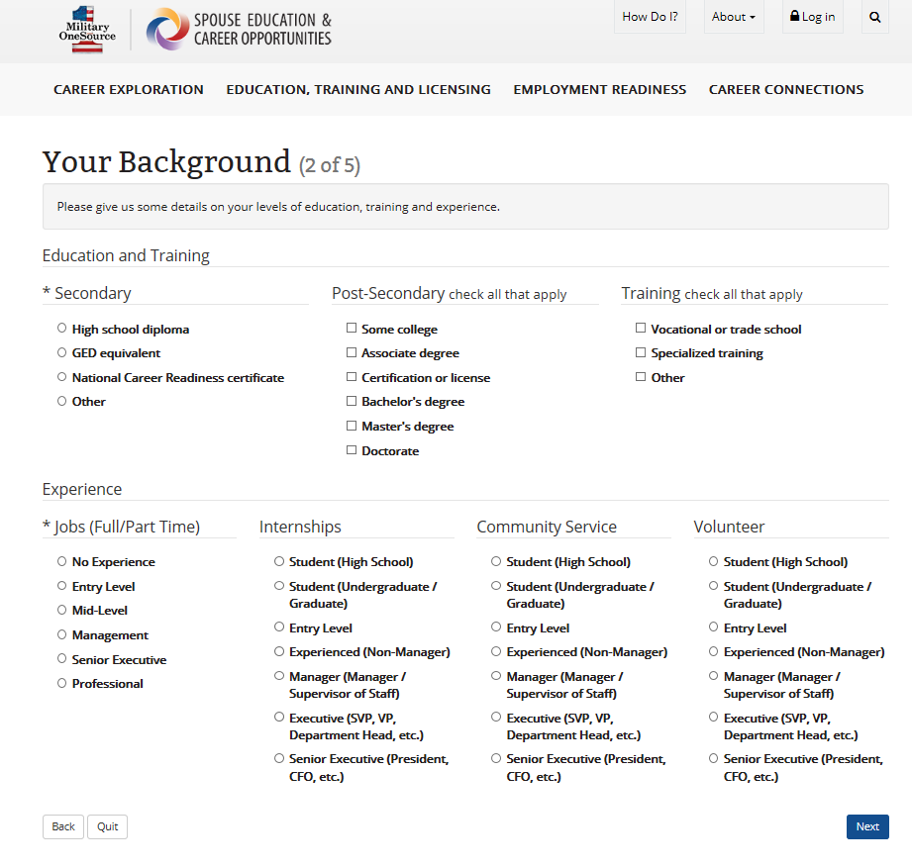
Spouse Registration Your Background Page Step 2 of 5

Slide 8
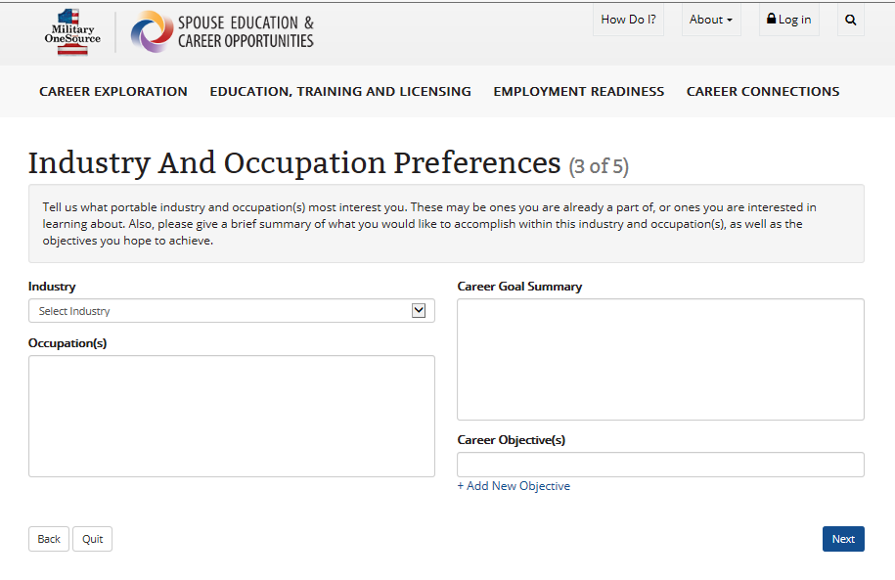
Spouse Registration Industry and Occupation Preferences Page Step 3 of 5

Slide 9
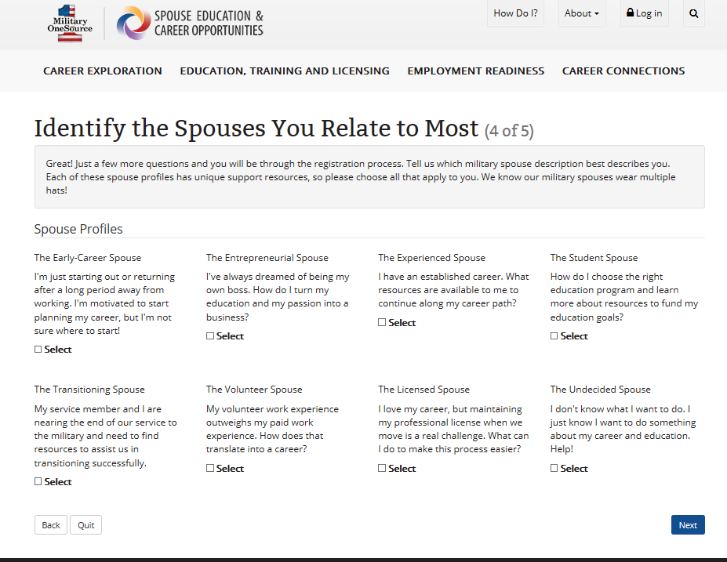
Spouse Registration Identify the Spouses You Relate to Most Page Step 4 of 5

Slide 10
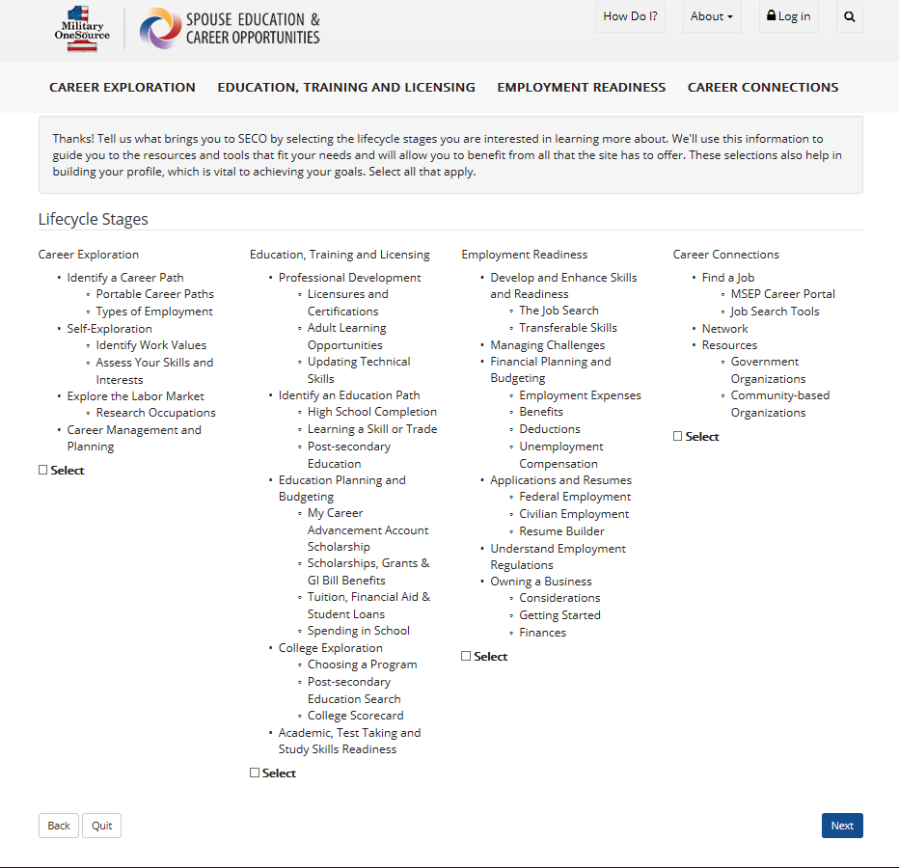
Spouse Registration Lifecycle Stages Page Step 5 of 5

Slide 11
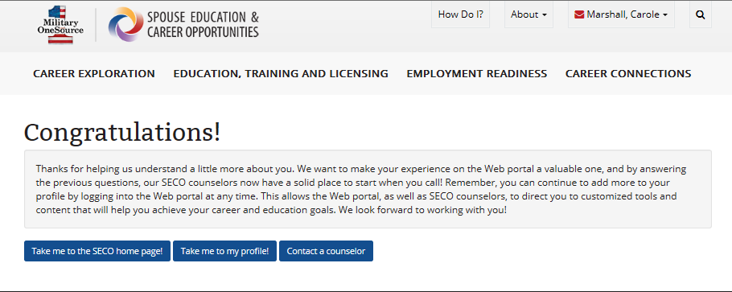
Spouse Registration Congratulations Page End of Registration

Slide 12
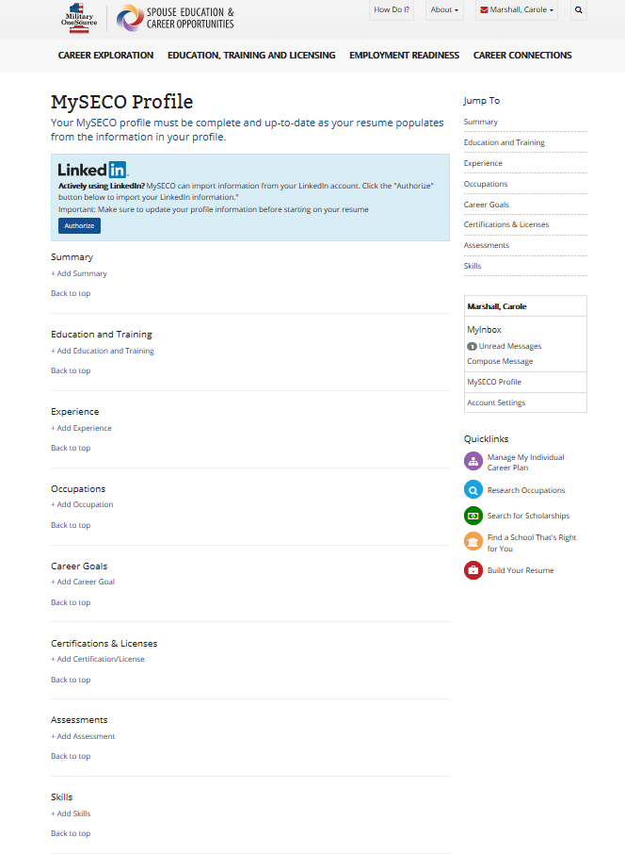
Spouse Registration MySECO Profile Page of Registered New User

Slide 13
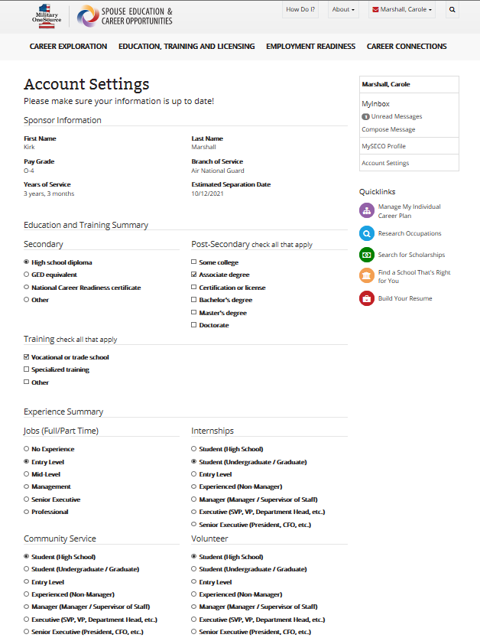
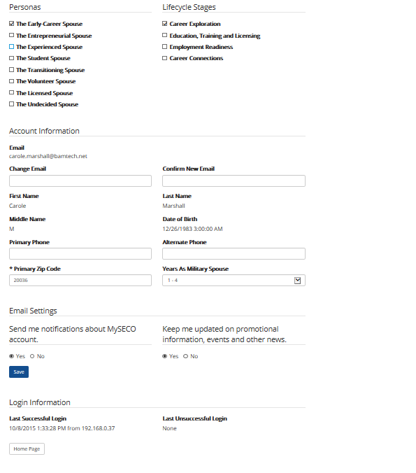
Spouse Account Settings Registered New User

