Slide 1
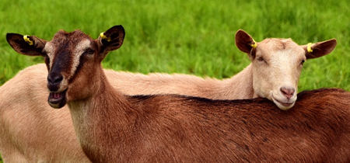
National Animal Health Monitoring System (NAHMS) 2019 Goat Study Timeline
July - August 2019
September - December 2019
December 2019 - onwards
NASS¹ Visit
Veterinary Services (VS) Visit
Reports
General Goat Management Questionnaire
Consent Form²
Producer Agreement³
VS Questionnaire
Agritourism Questionnaire (if applicable)
Biologic Testing:
Internal Parasite Test: Pre- and post-deworming fecal egg counts and egg count reduction tests will give you information about dewormer resistance on your operation. Do not deworm 60 days prior to VS Visit.
Scrapie Genetic Test: DNA based blood test to identify genetic resistance/susceptibility to scrapie.
Enteric Microbe Test: Detection of E. coli, Salmonella, Campylobacter, Giardia, and Cryptosporidium in your goats.
Mycoplasma ovipneumoniae (M. ovi) Test: Nasal swab to test for the bacterium M. ovi.
Producer Reports: Operation specific biologic results mailed to the producers approximately 3 months post-collection
Data Analysis
Descriptive Reports
¹National Agricultural Statistics
Service (NASS)
²Producer consent for contact from
Veterinary Services (VS)
³Producer agrees to participate in
questionnaires and biologic testing
To learn more and access reports, visit www.aphis.usda.gov/nahms or scan the QR code above.

Slide 2
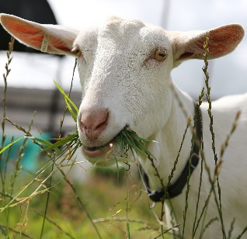
NAHMS 2019 Goat Study
Free Biological Testing
Total Savings of up to $2,467
Internal Parasite Test*
You Save: $532
Scrapie Genetic Test*
You Save: $450
Enteric Microbe Test*
You Save: $1,485
Test includes:
Pre- and post-deworming fecal egg counts and egg count reduction tests will give you information about dewormer resistance on your operation. Do not deworm 60 days prior to VS Visit.
Test includes:
DNA based blood test to identify genetic resistance/susceptibility to scrapie.
Test includes:
Detection of E. coli, Salmonella, Campylobacter, Giardia, and Cryptosporidium in your goats.
* Biological testing costs includes: Diagnostic testing and an interpretive report of results
* Values based on estimated national average cost at diagnostic laboratories for the sampling of 15 goats
* Results are confidential

