Slide 1
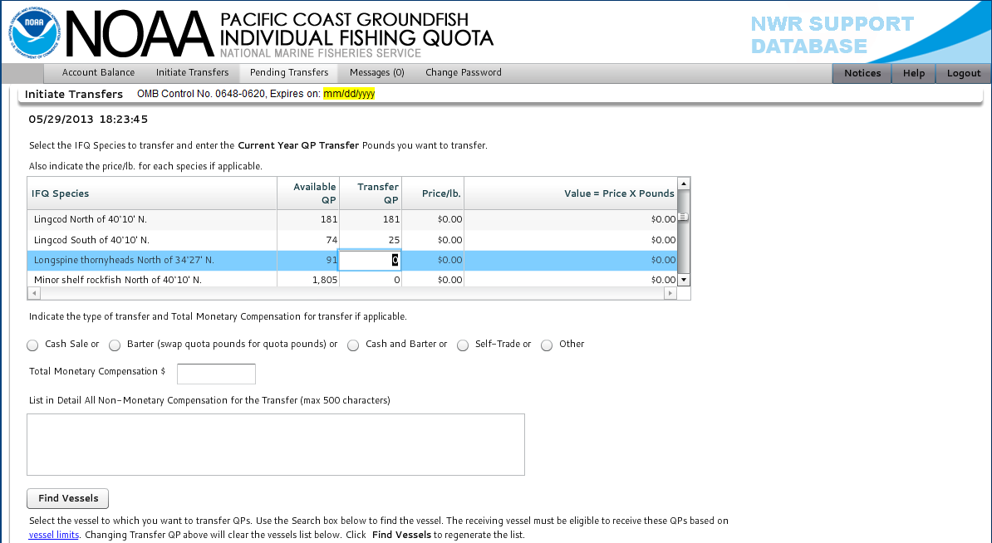
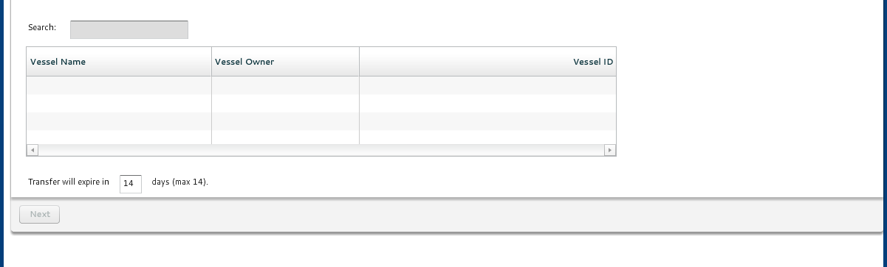
11/30/2014

Slide 2
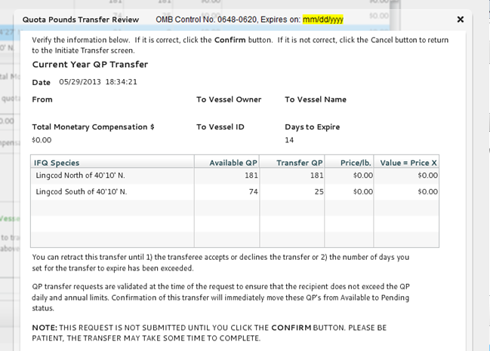

11/30/2014
WARNING STATEMENT: A false statement on this form is punishable by permit sanctions (revocation, suspension, or modification) under 15 CFR Part 904, a civil penalty up to $100,000 under 16 USC 1858, and/or criminal penalties including, but not limited to, fines or imprisonment or both under 18 USC 1001.
PRIVACY ACT STATEMENT: Some of the information collection described above is confidential under section 402(b) of the Magnuson-Stevens Act and under NOAA Administrative Order 216-100, Protection of Confidential Fisheries Statistics. QP transfer amount and price are not released to the public. The information collected is part of a Privacy Act System of Records, COMMERCE/NOAA #19, Permits and Registrations for United States Federally Regulated Fisheries. A notice was published in the Federal Register on April 17, 2008 (73 FR 20914) and became effective on June 11, 2008 (73 FR 33065).
PRA STATEMENT: Public reporting burden for this collection of information is estimated to average 8 minutes per response (with initiation and acceptance of transfer), including the time for reviewing the instructions, searching existing data sources, gathering and maintaining the data needed, and completing and reviewing the collection of information. Send comments regarding this burden estimate or any other suggestions for reducing this burden to NOAA/National Marine Fisheries Service, Northwest Region, Attn: Assistant Regional Administrator, Sustainable Fisheries Division, 7600 Sand Point Way NE, Seattle, WA 98115. Notwithstanding any other provisions of the law, no person is required to respond to, nor shall any person be subjected to a penalty for failure to comply with, a collection of information subject to the requirements of the Paperwork Reduction Act, unless that collection of information displays a currently valid OMB Control Number.

Slide 3
