Slide 1

American Indian and Alaska Native Head Start Family and Child Experiences Survey
[TRIBE]
[TRIBE ENTITY] Meeting
[DATE]
[PRESENTER]
[PRESENTER TITLE]

Slide 2
Overview
Why is there a need for data on the children and families served by Region XI Head Start?
What are the benefits of participation?
What will a study of Region XI Head Start look like?
Why is the participation of [TRIBE] Head Start Program important?
What will the study look like to the children, families, and Head Start staff in your community?
How will the data be used?
Answer any questions you may have about the study and how it will be conducted in your program and community
Paperwork Reduction Act Statement: The referenced collection of information is voluntary. An agency may not conduct or sponsor, and a person is not required to respond to, a collection of information unless it displays a currently valid OMB control number. The OMB control number for the described collection is 0970-0151 and it expires XX/XX/XXXX.

Slide 3
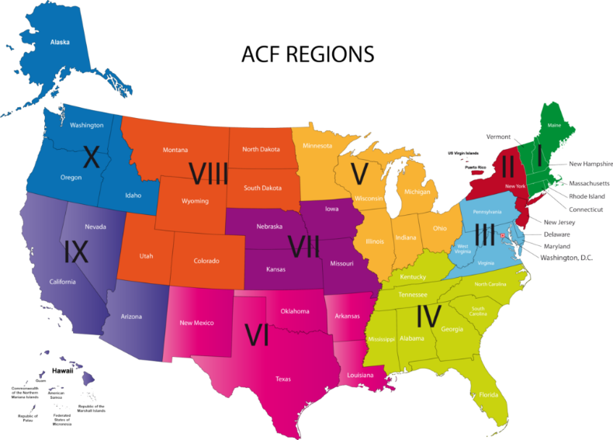
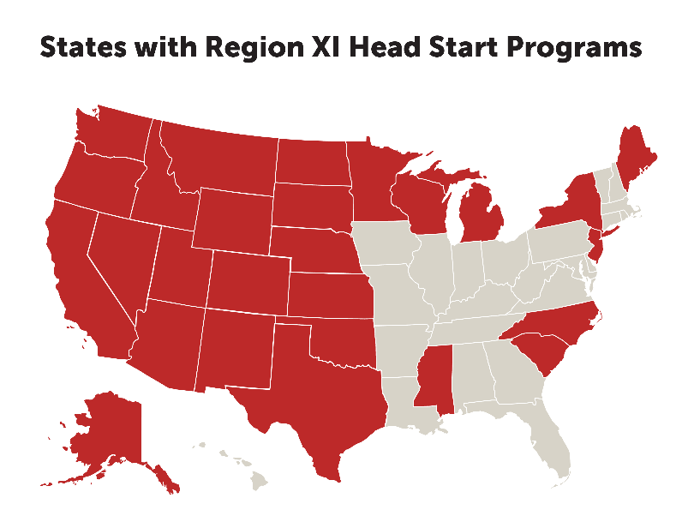
What data is available on Head Start?
Available data has depended on the Head Start region
Regions I-X are geographically defined
Region XI is defined by the population it serves

Slide 4
Head Start Family and Child Experiences Survey (FACES)
Since 1997, FACES has collected data from nationally representative samples of Head Start programs, centers, classrooms, children, and their families
Rich source of national-level descriptive data on
Children’s school readiness outcomes (health and physical development, cognitive and social emotional development)
Families of the children who are served by Head Start, and the programs that serve them
Information to help improve services (identifying needs and areas where improvement in services and outcomes are needed)
Information for examining changes over time (HS population, services, quality, outcomes)

Slide 5
National data on children and families served by tribal Head Start programs are limited
FACES collects data on Head Start programs in Regions I-X
Region XI programs or tribal Head Start programs have not been included in FACES
Descriptions of the national Head Start program and of the children and families it serves do not include tribal programs, children and families
Limited information about the more than 21,000 children served by tribal Head Start programs, their families, and the programs that serve them
In 2015-2016 AI/AN FACES 2015 was launched, and was the first nationally representative study of Region XI tribal Head Start children, families, and programs.
AI/AN FACES 2019 is the next round of the study

Slide 6
Why is it important that AI/AN Head Start programs be included in FACES?
What Region XI stakeholders have said…
Tribal Head Start programs have been “invisible” when it comes to national studies on Head Start; children and families in Region XI are not a part of the picture of Head Start that is painted using FACES data
Region XI is lacking nationally-representative data to inform decisions by congress, Office of Head Start, and tribal programs themselves
Participating in FACES will give Region XI the same kinds of rich descriptive information available to Regions I-X
These data will be an additional important source of information about the tribal programs – their successes, their needs, and their challenges

Slide 7
What will a study of Region XI Head Start look like?

Slide 8
AI/AN FACES Workgroup Study design guided by tribal voices
AI/AN FACES Workgroup
Region XI
Head Start Directors
Tribal Early Childhood Researchers
Federal ACF Staff
Study Team Researchers

Slide 9
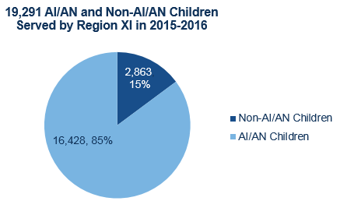
AI/AN FACES 2019 will be representative of all children served by Region XI
Source: 2015-2016 Head Start Program Information Report

Slide 10
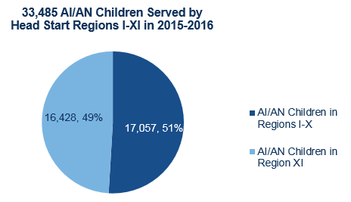
AI/AN children served in Regions I-X will not be in AI/AN FACES 2019
Source: 2015-2016 Head Start Program Information Report

Slide 11
22 Region XI Head Start programs will be randomly selected
22
Programs
37 Centers
800 (80 * 10)
Children and Parents
80 Classrooms/Lead Teachers
Protocols for tribal review will be followed in each community
Data will be collected from children, parents, teachers/classrooms, and program and center directors

Slide 12
What will we learn from this study?
The focus of AI/AN FACES 2019 is description of children and families, and their experiences
These data will help us to learn more about:
Children’s cognitive and social-emotional growth in tribal Head Start programs from the beginning to the end of the program year
The kinds of things that are related to Region XI children’s growth, including what’s going on in Head Start and what’s going on at home
The needs of children and families in Region XI
How children and families in Region XI are similar to or different from children and families in Regions I-X; their unique needs and strengths

Slide 13
Data will come from multiple sources
Direct assessments of children’s school readiness skills
Language
Literacy
Math
Executive function – Inhibitory control and working memory
Teacher reports
Social skills
Problem behaviors
Approaches to learning

Slide 14
Data will come from multiple sources (continued)
Parent Survey
Head Start Staff Surveys
Classroom teachers
Program directors
Center directors
Classroom Observations

Slide 15
How can the data be used?
To support findings about children in Region XI
Region XI as a whole
Can argue for resources to address identified needs
Can argue for changes to policy and practice to better meet the needs
Individual programs in Region XI
Individual programs will not see their data but…
Programs can use study findings to think about how their program might be similar to or different from all of Region XI
Use data on Region XI as a whole and their individual tribal data to support the need for additional resources and services
Notes:
The study will support estimates of children. For example, that means we can report the percentage of children’s teachers who have a Bachelor’s degree. We cannot report the percentage of teachers who have a Bachelor’s degree.

Slide 16
Program Participation Considerations
Participation is voluntary
Participation of each selected program helps to make sure that the picture that emerges reflects the depth and breadth of experiences and activities in Region XI programs
Being a part of something that is important to tribal programs in Region XI and to research on Native children’s early development in general
Additional considerations
Data will not be representative at the program or tribal community level
Findings will be reported only for Region XI as a whole, not by tribal community

Slide 17
What information from the study will be shared in reports?
Initially, all analyses of the AI/AN FACES data will be conducted by professional researchers at Mathematica
The AI/AN FACES Workgroup will play a key role by
Helping to set the analysis and reporting priorities
Identify the research questions and topics that are of most interest to Region XI and tribal communities
Identify the types of reporting formats what would be most accessible to tribal governments, parents, and Head Start staff
Reviewing all reports and presentations prepared by the study team
Provide feedback on how the findings are presented and whether the conclusions are well supported by the data
Offer suggestions for how the findings are interpreted and their implications for Region XI programs, children, and families

Slide 18
Who will have access to the data and where will it be stored?
AI/AN FACES data will be available to qualified researchers working in institutions of higher education or research organizations.
AI/AN FACES data and documentation will be housed at the Child Care & Early Education Research Connections Data Archive (www.researchconnections.org)

Slide 19
Who will have access to the data and how can we be sure that it is used accurately and responsibly?
Individuals requesting access to the data must:
submit a plan for how they will analyze the data and who they will engage in the interpretation of the findings from the analysis, to be reviewed by a committee with tribal representation,
show evidence demonstrating that they or a member of their research team has prior experience conducting research with tribal programs and communities,
show evidence that their plan was reviewed by an Institutional Review Board (IRB),
review and acknowledge best practices for uses of the AI/AN FACES data on tribal programs and peoples, and
sign a confidentiality pledge agreeing to protect the privacy of the study participants.

Slide 20
Who will have access to the data and how can we be sure that it is used accurately and responsibly?
Researchers requesting access to the data must agree to:
Submit drafts of manuscripts and presentations for review by the committee prior to publication or presentation
Strongly consider the feedback and recommendations provided by the committee when finalizing publications and presentations
Research Connections sharing the names of the institutions and research organizations that have been granted access to the data with brief descriptions of the research
Report all findings for Region XI programs as a whole

Slide 21
How will identifying and sensitive information be protected?
Preparation of the data file entails removing any tribal identities and the names or other direct identifiers of any participating programs, staff, children, or parents
In addition, researchers will have agreed to present findings only for Region XI as a whole

Slide 22
AI/AN FACES 2019 Timeline
Fall 2018
Region XI Program Recruitment
Fall 2019 Child and Family Data Collection
Summer 2020
Analysis and Reporting begin
2021 Restricted use data available for qualified researchers
Spring 2019 Region XI Program Recruitment
Spring 2020 Child, Family, Teacher, Classroom, and Program Data Collection

Slide 23
What will the study look like in your community?
[TRIBE] Head Start sample
2 Centers chosen at random
4 Classrooms/Teachers (2 per center) chosen at random
On average, 52 children and their parents (13 per classroom; 26 per center) chosen at random
The study team will visit your program 3 times
Early fall 2019 to select the sample of classrooms and children, distribute parent consent forms, and speak with parents (2-3 days)
Fall 2019 to administer the school readiness assessments (3-4 days)
Spring 2020 to administer the school readiness assessments and conduct classroom observations (3-4 days)

Slide 24
What will the study look like in your community?
Your children’s parents will be asked to complete a 30-minute survey in fall 2019 and spring 2020
Head Start teachers in your program will be asked to complete a Teacher Child Report for each study child in their classroom in fall 2019 and spring 2020 (each takes about 10 minutes)
Teachers will also be asked to complete a 30-minute survey in spring 2020
Each sampled classroom in your program will be observed for 4 hours in spring 2020
Your program and center directors will each be asked to complete a 30-minute survey in spring 2020

Slide 25
Data Collection Staff
We will use an experienced staff
All staff will sign confidentiality agreements and will have completed criminal background checks as a condition of employment
Staff will be trained by members of the Mathematica study team and members of the AI/AN FACES Workgroup
Training will include lessons on working with tribal communities, families and children
To underscore these lessons, some trainings will occur in tribal communities

Slide 26
Sharing findings with tribal programs and communities
A copy of each publication, report, and presentation that is prepared by the study team will be provided to [TRIBE]
Publications, reports and presentations prepared by others will be archived at Research Connections and available to [TRIBE]
The study team, the AI/AN FACES Workgroup, and officials from the Administration for Children and Families will work together to identify the best ways to share findings with tribal Head Start staff, parents, and tribal leaders
Notes:
We would also be interested in hearing about what you think are the best ways to share findings.

Slide 27
QUESTIONS??

