Slide 1

Electronic Visa Update System (EVUS)
U.S. Customs and Border Protection
November 2019

Slide 2
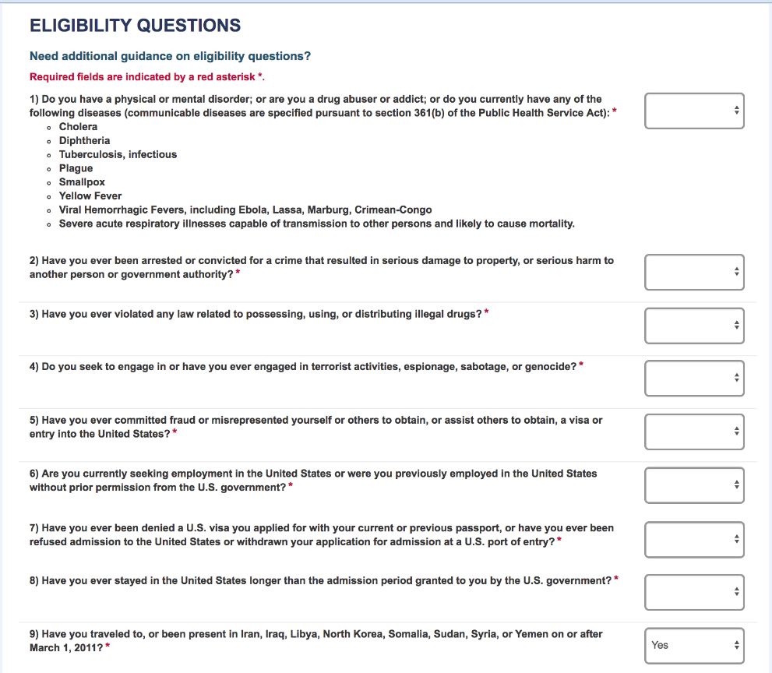
Eligibility Question 9 w/North Korea
On the fourth screen the applicant will be asked a series of eligibility questions. This page includes a drop down menu where the applicant can selection Yes or No to each question.
Notes:
Add North Korea added to question 9. The question will be Have you traveled to, or been present in Iraq, Syria, Libya, Somalia, Yemen, or North Korea on or after March 1, 2011?

Slide 3
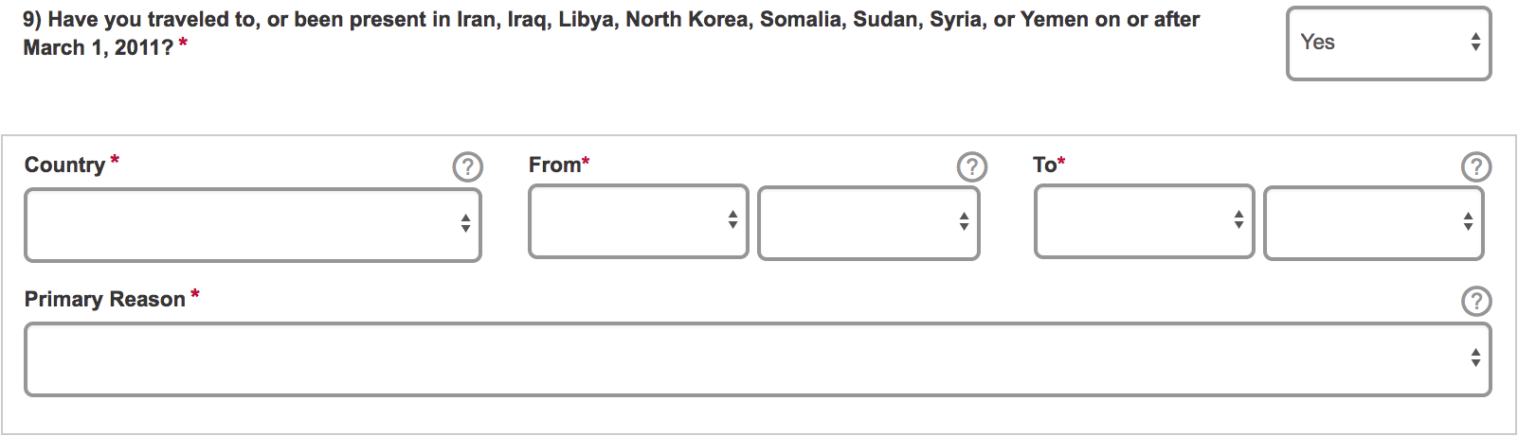
Eligibility Question 9 w/North Korea
Eligibility question that asks if the applicant has traveled to Iran, Iraq, Libya, North Korea, Somalia, Sudan, Syria and Yemen has been added. If they answer “Yes” to this question they will be asked to select from the above options the primary reason for their trip. If they select certain options they will be asked to fill out an additional questionnaire. These additional fields can be seen on the next few slides. Per this change if an applicant selects North Korea as well they will also be asked to fill out the questionnaire.

Slide 4
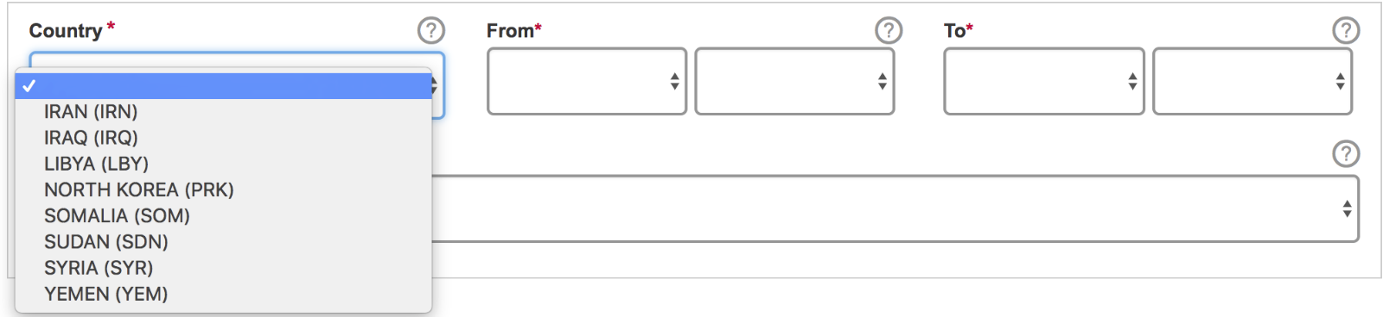
Eligibility Question 9 w/North Korea
Notes:
Add North Korea added to the question and the Country drop down.

Slide 5
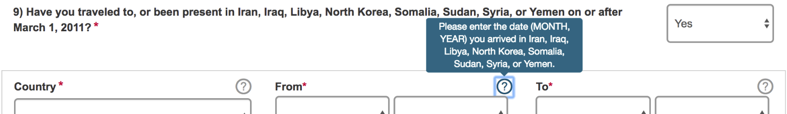
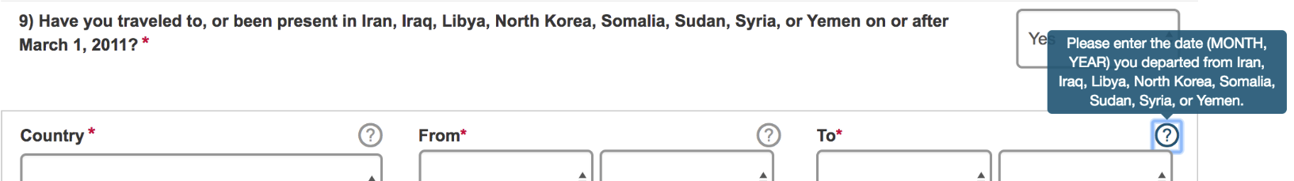
Help Text including North Korea
Notes:
Add North Korea to the tooltips.

Slide 6
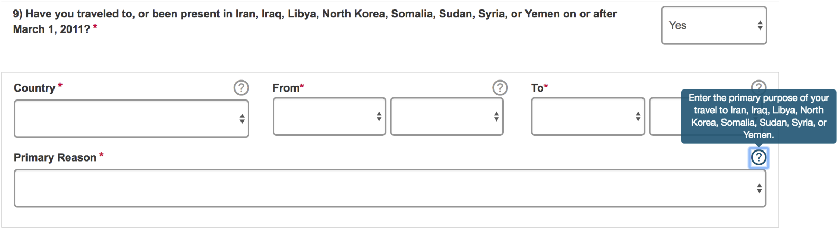
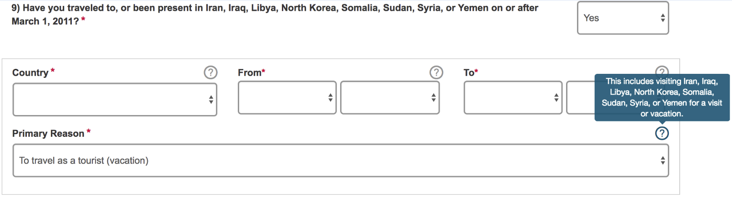
Help Text including North Korea
Notes:
Add North Korea to the tooltips.

Slide 7
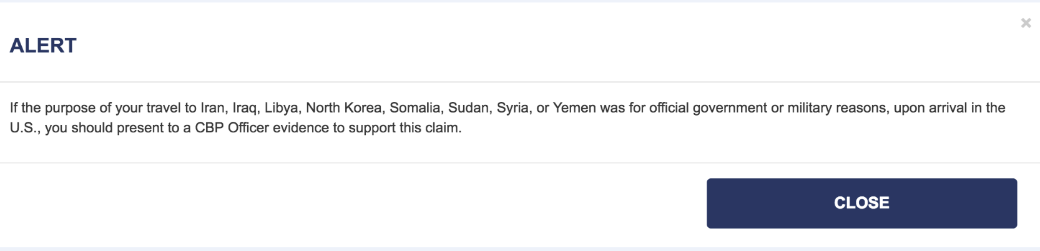
Alerts w/North Korea
After selecting one of the following Primary Reasons, the Alert popup message is displayed.
Primary Reason:
To carry out official duties as a full-time employee of the government of a Visa Waiver Program country.
To perform military service in the armed forces of a Visa Waiver Program country.
Notes:
Add North Korea to pop-up Alerts

Slide 8
Additional Eligibility Questions
Regardless of the Primary Reason selected, sub questions are not displayed in EVUS.
Notes:
Add North Korea added to the question and Country drop down. Have you traveled to or been present in Iraq, Syria, Iran, Sudan, or North Korea on or after March 1, 2011? Add North Korea to sub question under organization information.

Slide 9


