Slide 1
Attachment 20-B FPRS Screen Shots
FNS-153

Slide 2
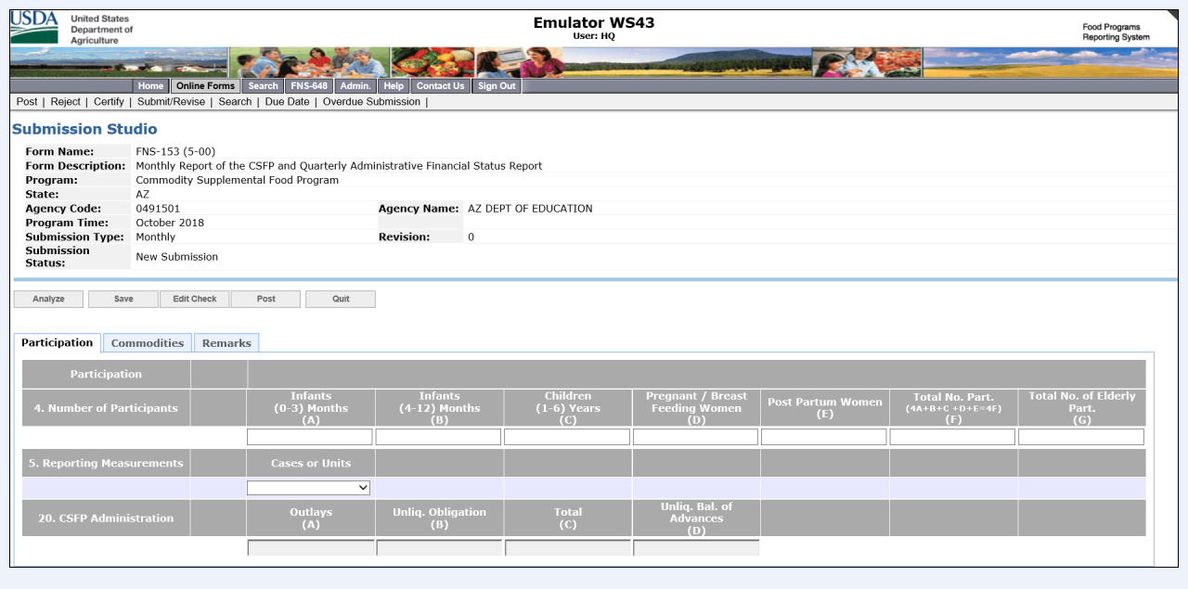
Attachment 20- FNS-153 FPRS Screen Shots

Slide 3
Attachment 20- FNS-153 FPRS Screen Shots

