Slide 1
Attachment 20-D FNS-44 FPRS Screen Shots

Slide 2
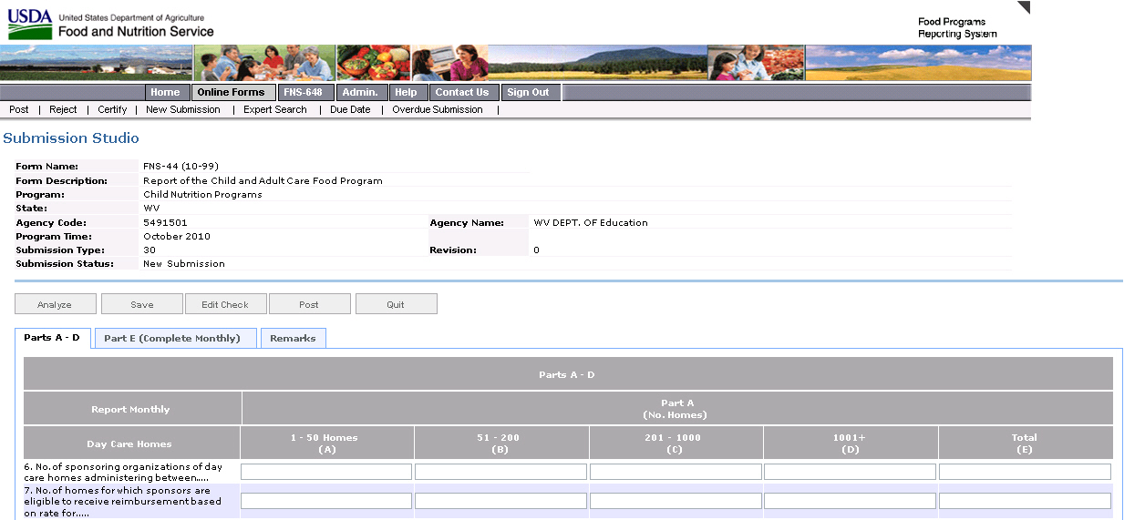
Attachment 20- FNS-44 FPRS Screen Shot

Slide 3
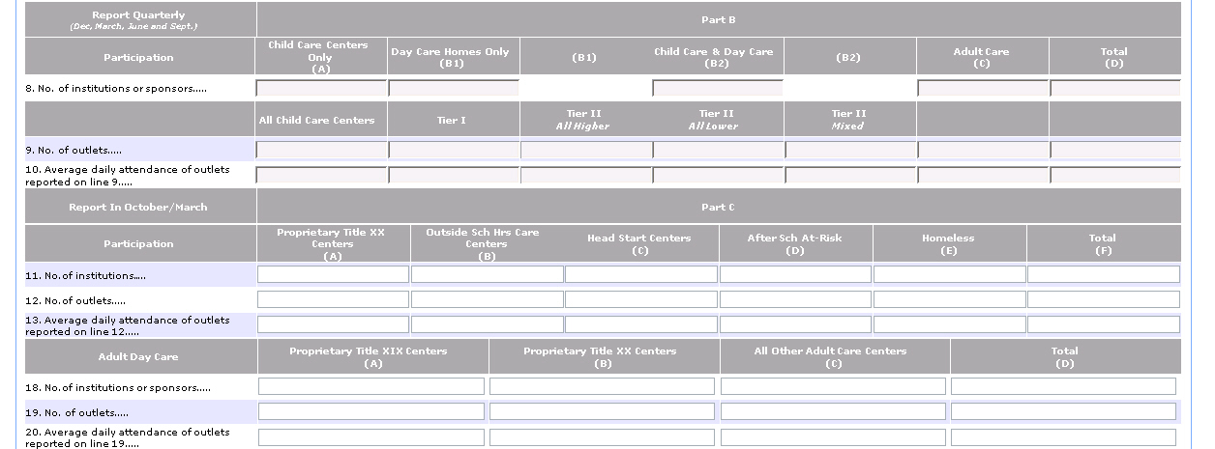
Attachment 20- FNS-44 FPRS Screen Shot

Slide 4
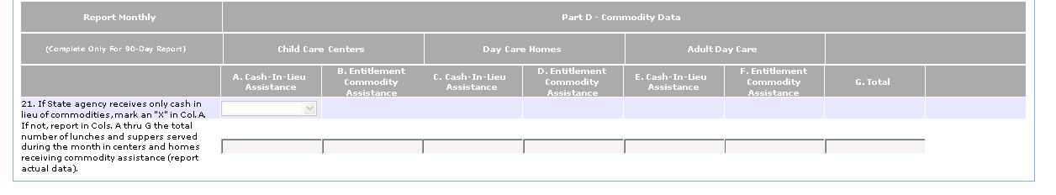
Attachment 20- FNS-44 FPRS Screen Shot

Slide 5
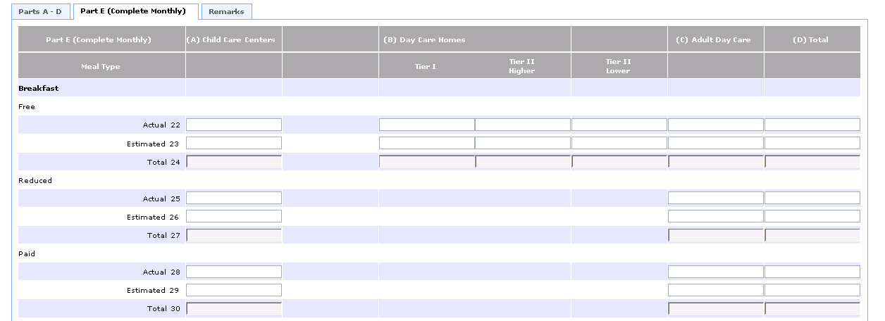
Attachment 20- FNS-44 FPRS Screen Shot

Slide 6
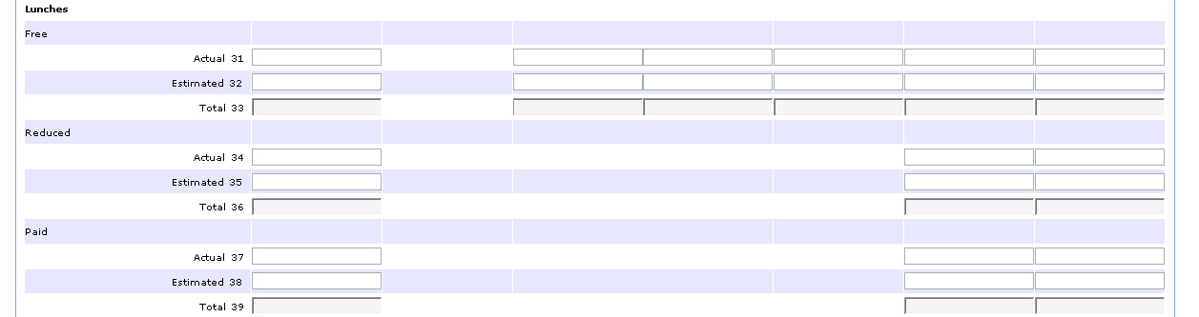
Attachment 20- FNS-44 FPRS Screen Shot

Slide 7
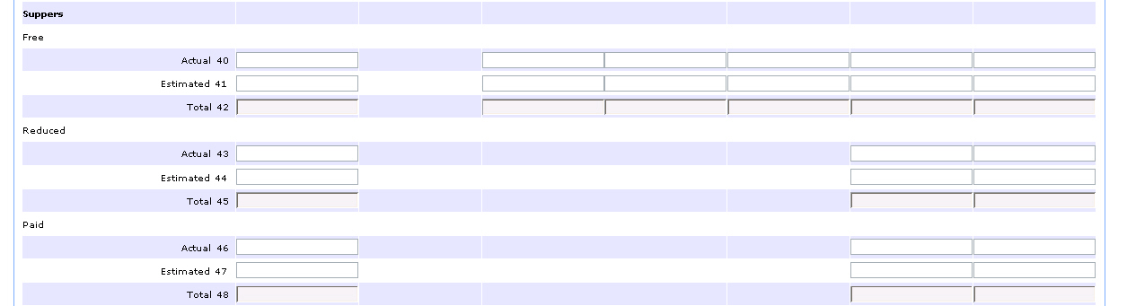
Attachment 20- FNS-44 FPRS Screen Shot

Slide 8
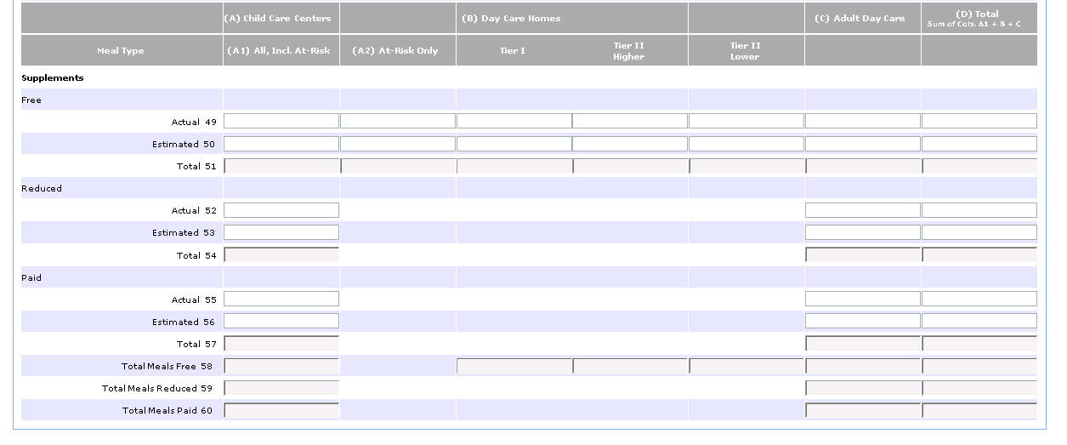
Attachment 20- FNS-44 FPRS Screen Shot

