Slide 1
Drug Approval Pathways
Standard Approval
Accelerated Approval
Drug/medication is developed.
Drug goes through a clinical trial.
The clinical trial shows the drug has clinical benefits.
The clinical trial shows that the benefits of the drug outweigh the risks.
FDA grants standard approval and the drug is made available for public use.
Drug/medication is developed.
Drug goes through a clinical trial.
Surrogate endpoints suggest it may be effective.
FDA grants accelerated approval and the drug is made available for public use.
Confirmatory study is required to show that there are clinical benefits, and that the benefits continue to outweigh the risks of the drug.

Slide 2


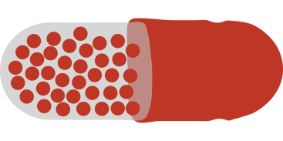
Standard Approval
Up to 7 years
New drug is developed
Clinical trial
Clinical benefit
FDA Standard Approval

Slide 3


Accelerated Approval
FDA Standard Approval
New drug is developed
Clinical trial
Sign of possible clinical benefit
FDA Accelerated Approval
Confirmatory study required
OR
Approval withdrawn

Slide 4
Definitions
Clinical trial: A scientific way to measure the benefits and risks of a new drug.
Surrogate endpoint: A measure of a drug's effect that may or may not be associated with clinical benefit (e.g., a tumor gets smaller or blood tests get better).
Clinical benefit: A drug is shown to help people live longer and/or to improve their symptoms.

Slide 5
Label Term Definitions
Response rate: The proportion of people for whom the tumor shrinks.
Duration of response: How long the benefit of the drug lasts over time (e.g., how long the drug is able to shrink or stop the tumor from growing).

