Slide 1

I-130, Application To Petition For Alien Relative
United States Citizenship and Immigration Services
myUSICS Team
August 2019
Screenshots
Notes:
Petition for Alien Relative

Slide 2
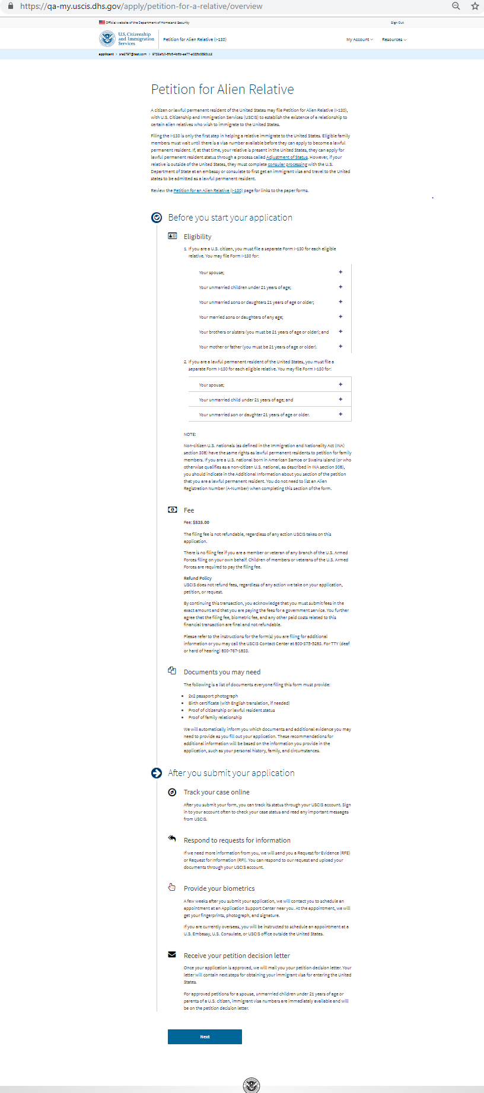
I-130: Application Overview

Slide 3
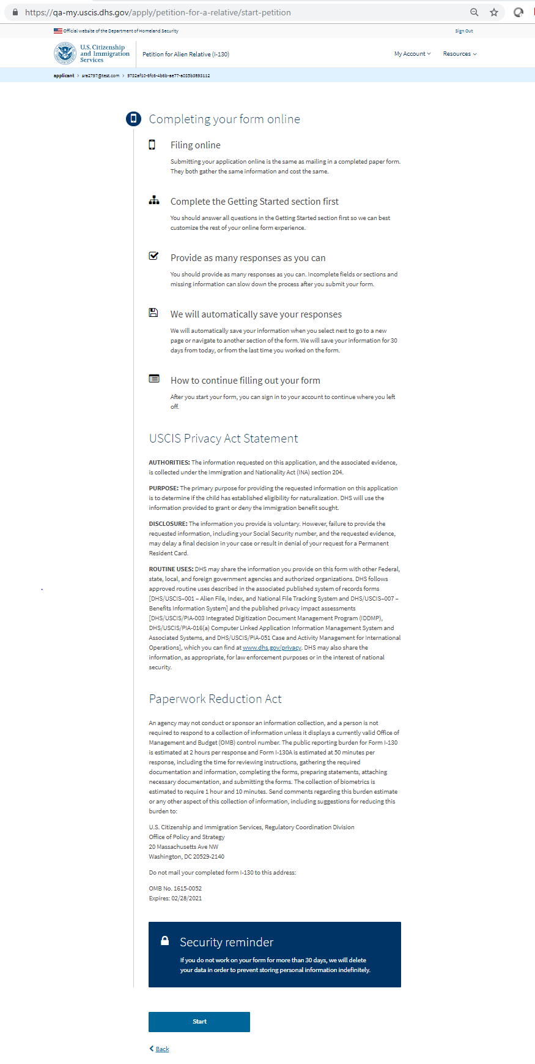
I-130: Start Application

Slide 4
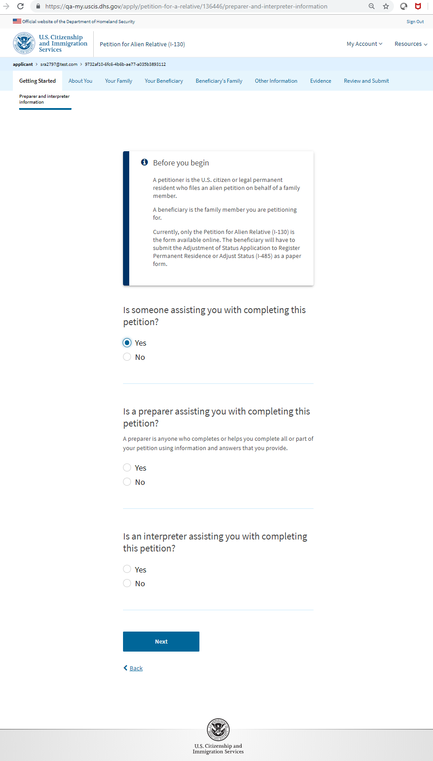
I-130: Getting Started – Preparer and interpreter information

Slide 5
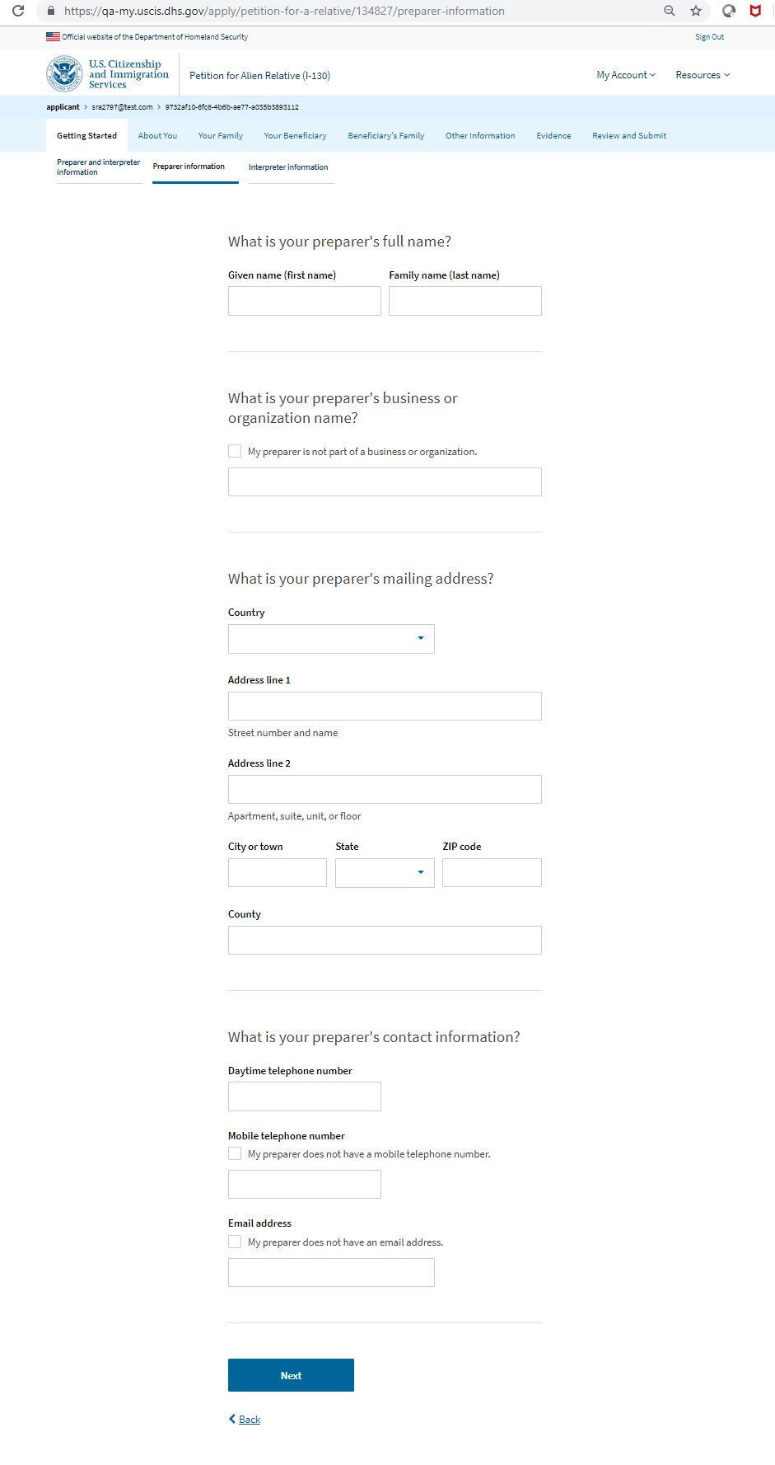
I-130: Getting Started – Preparer information

Slide 6
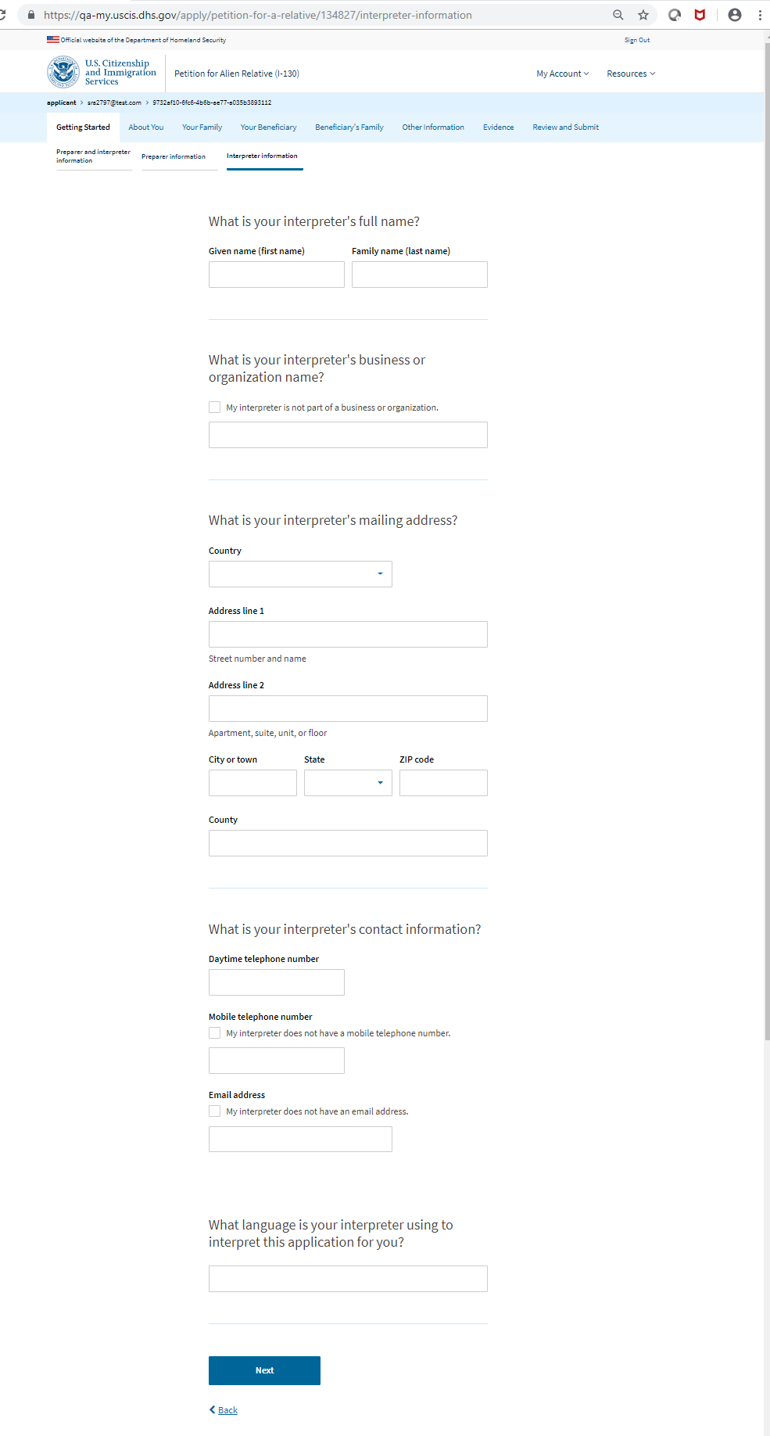
I-130: Getting Started – Interpreter information

Slide 7
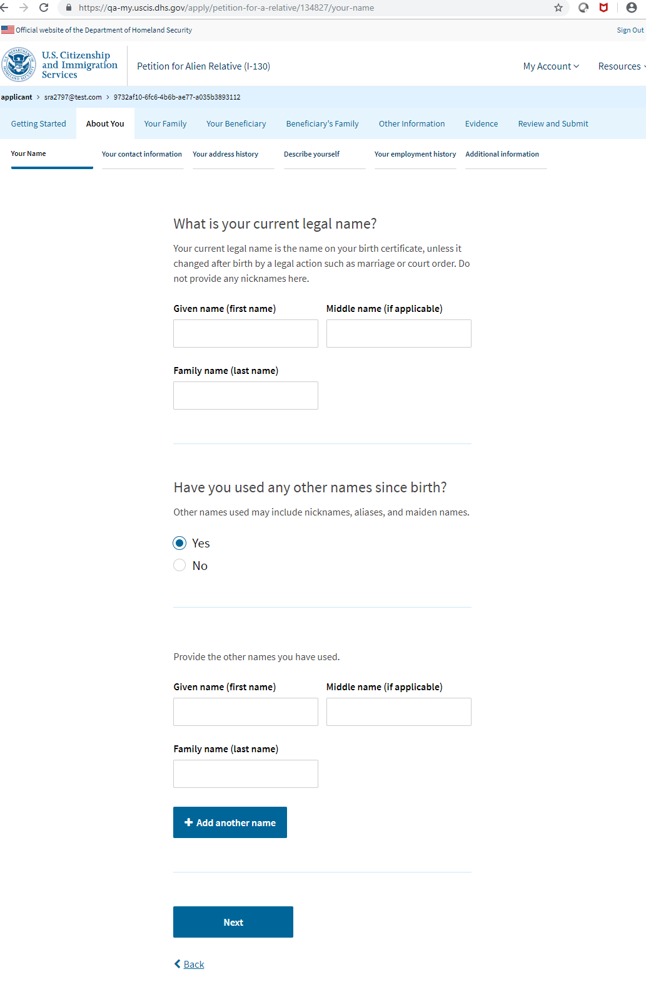
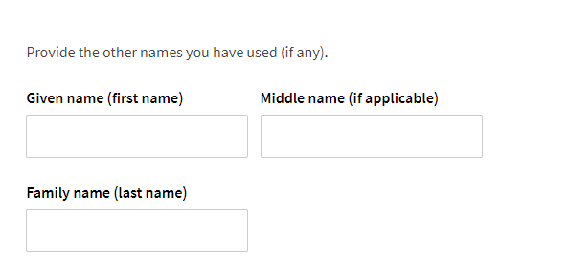
I-130: About You – Your name

Slide 8
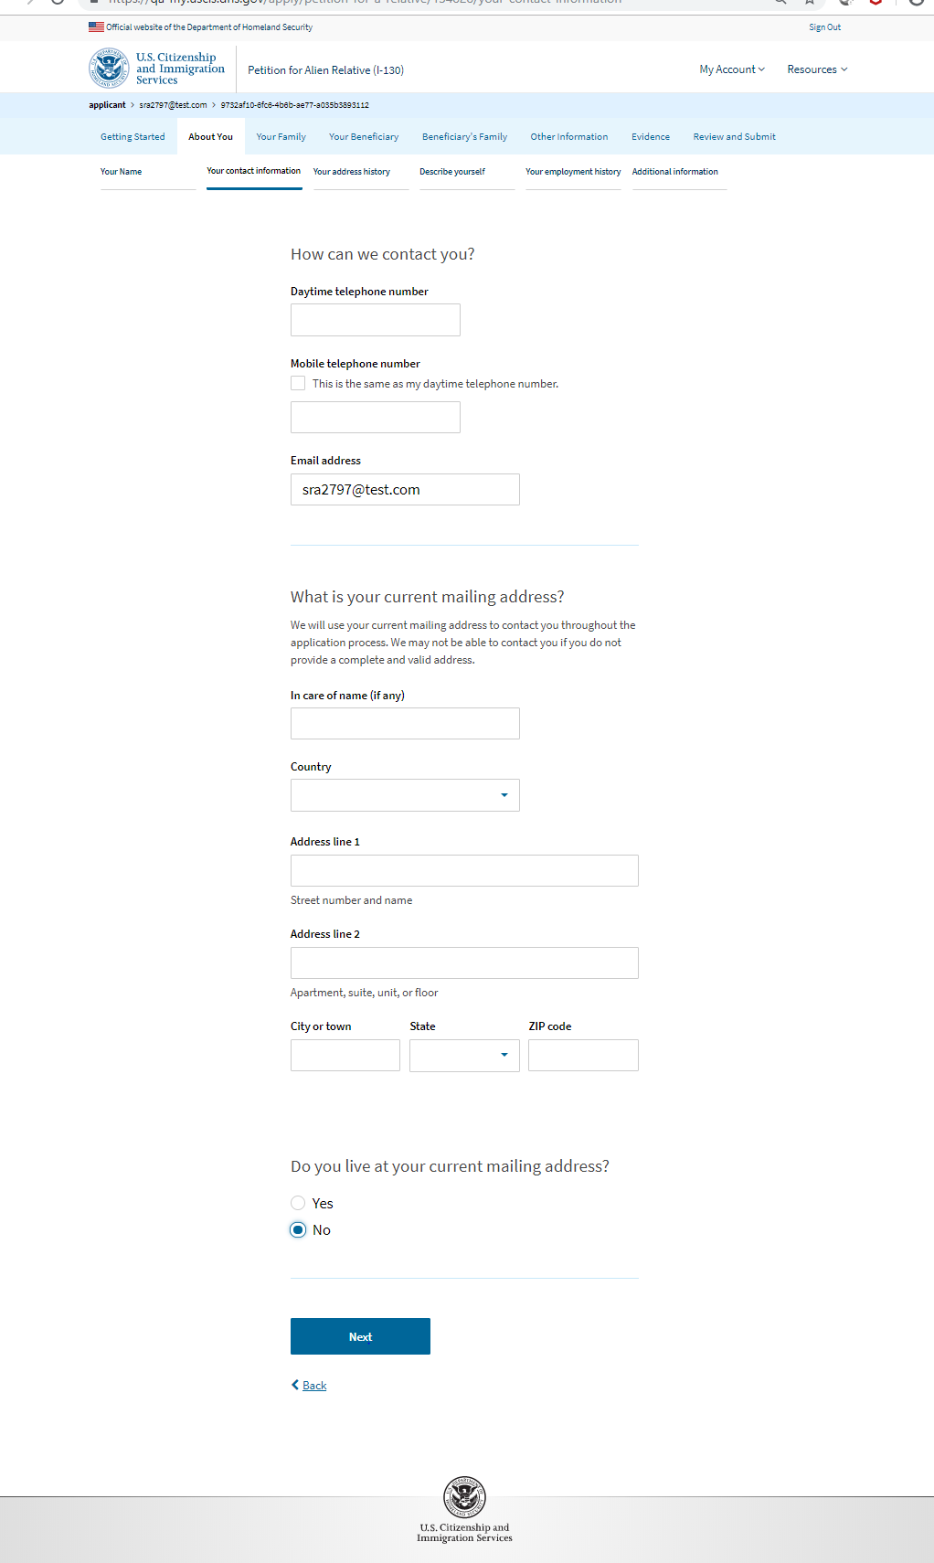
I-130: About You – Your contact information

Slide 9
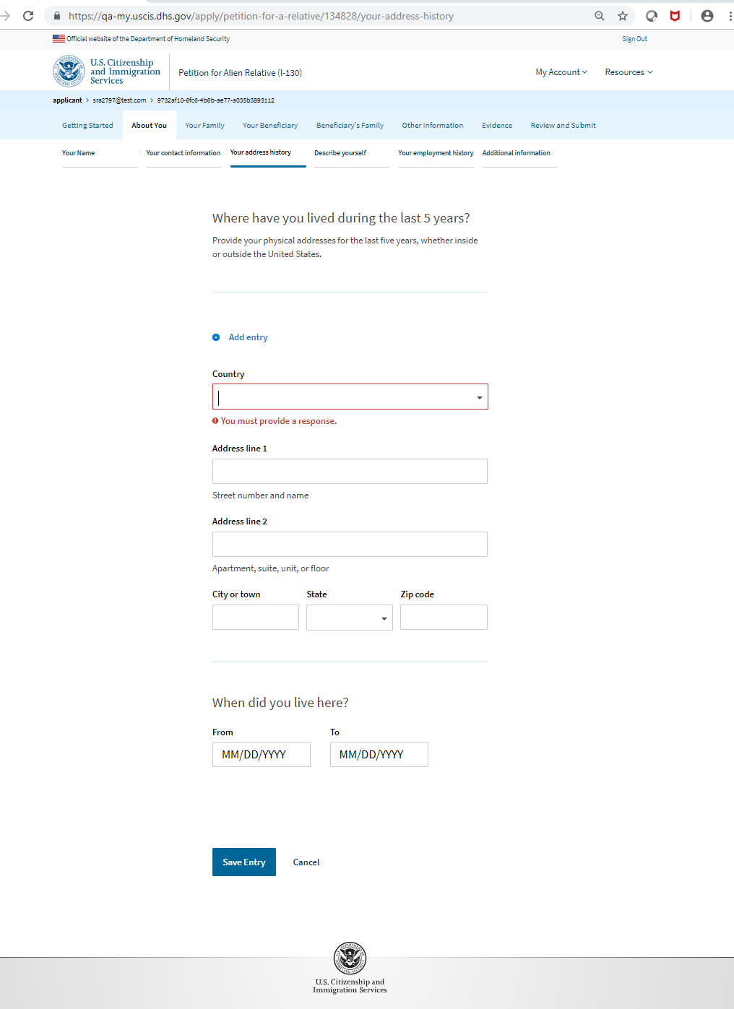
I-130: About You – Address History

Slide 10
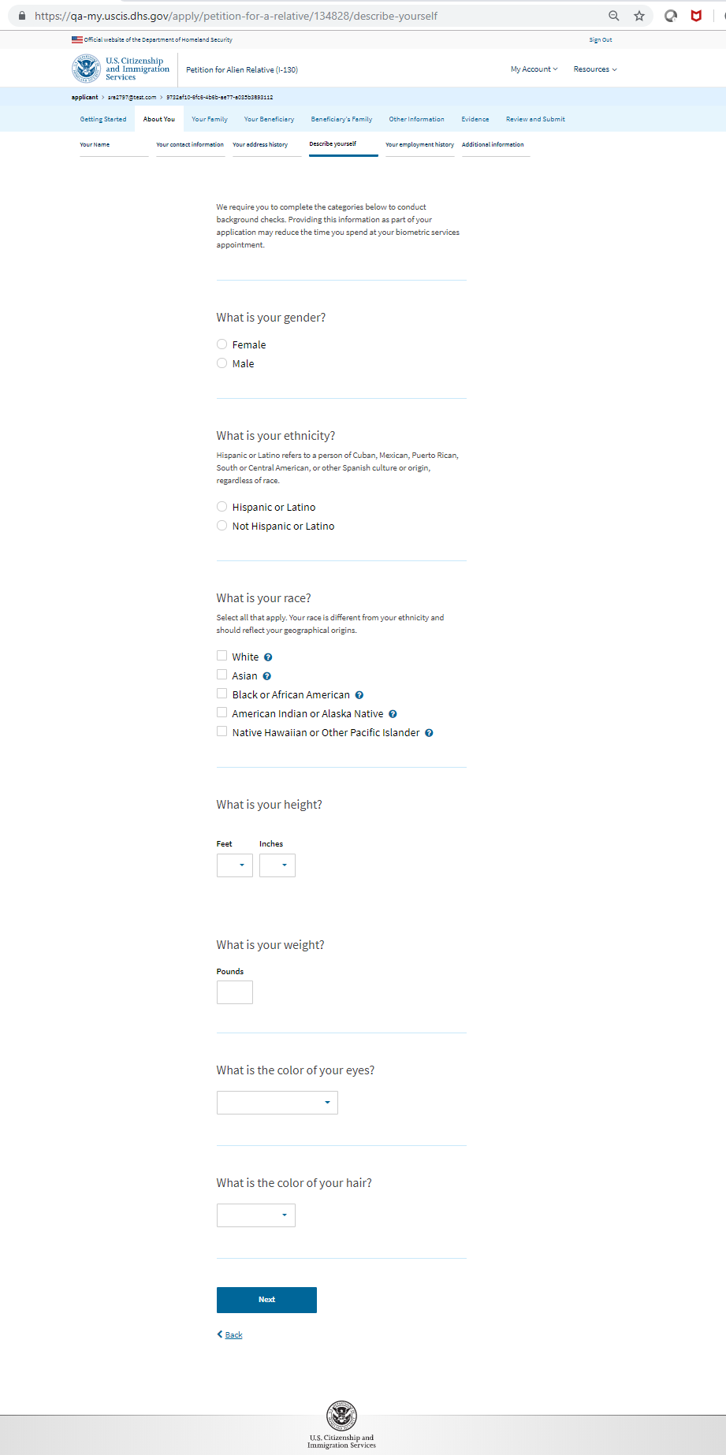
I-130: About You – Describe Yourself

Slide 11
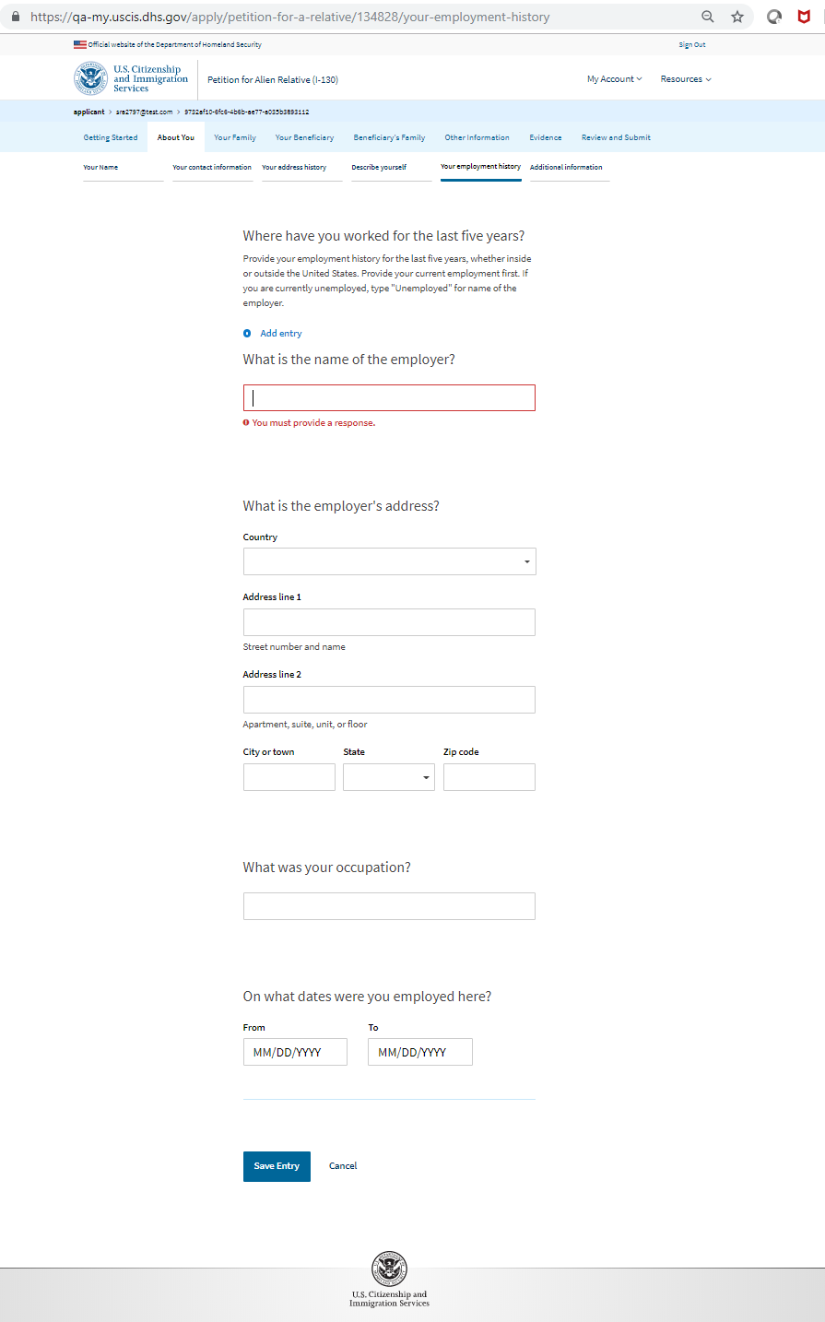
I-130: About You – Your Employment History

Slide 12
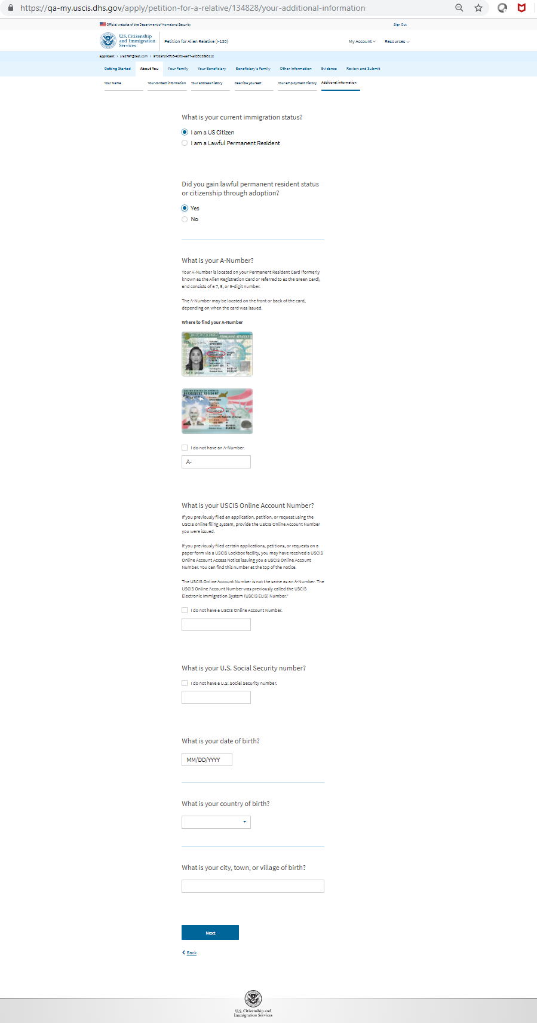
I-130: About You – Additional Information

Slide 13
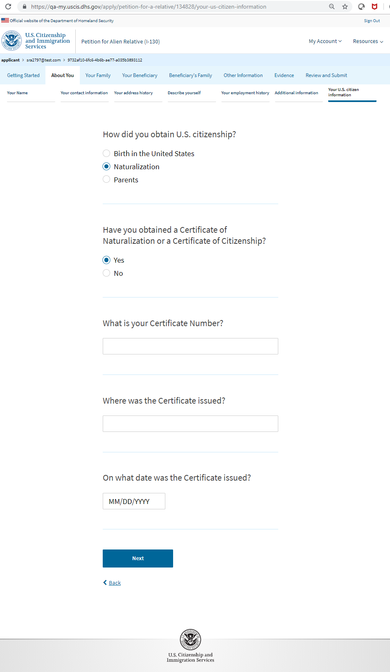
I-130: About You – Your U.S. Citizen Information

Slide 14
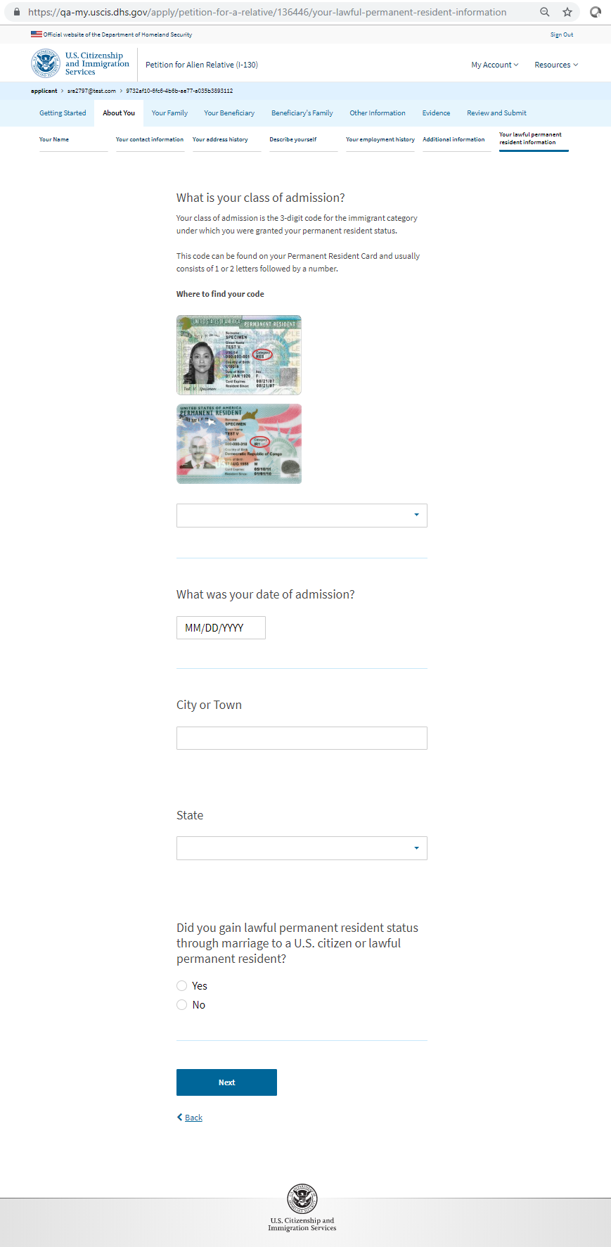
I-130: About You – Your lawful permanent resident information

Slide 15
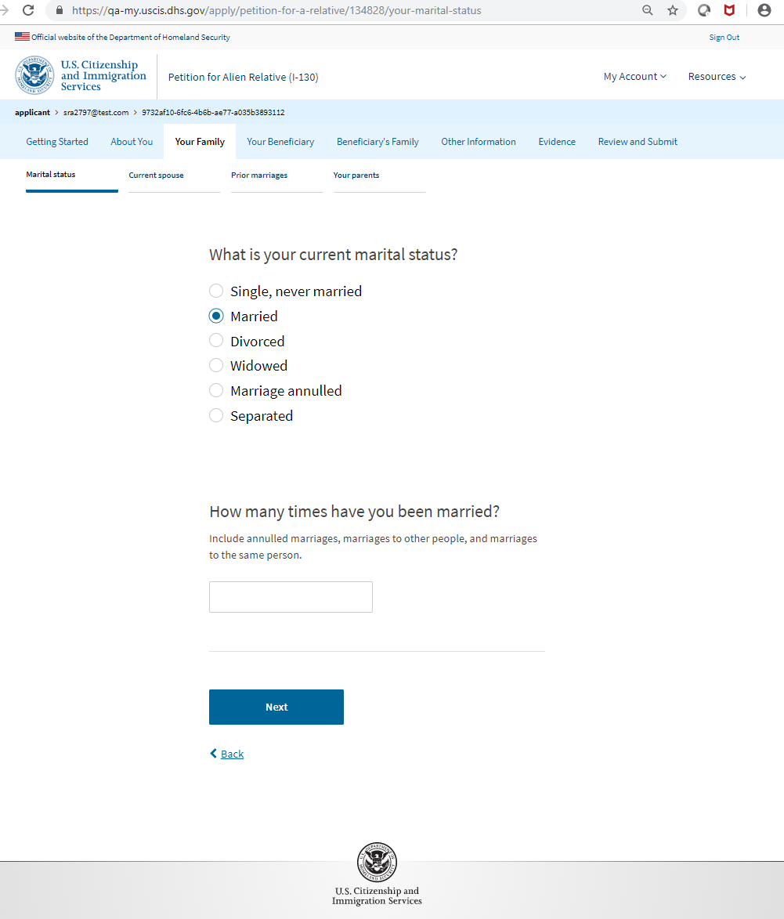
I-130: Your Family – Marital Status

Slide 16
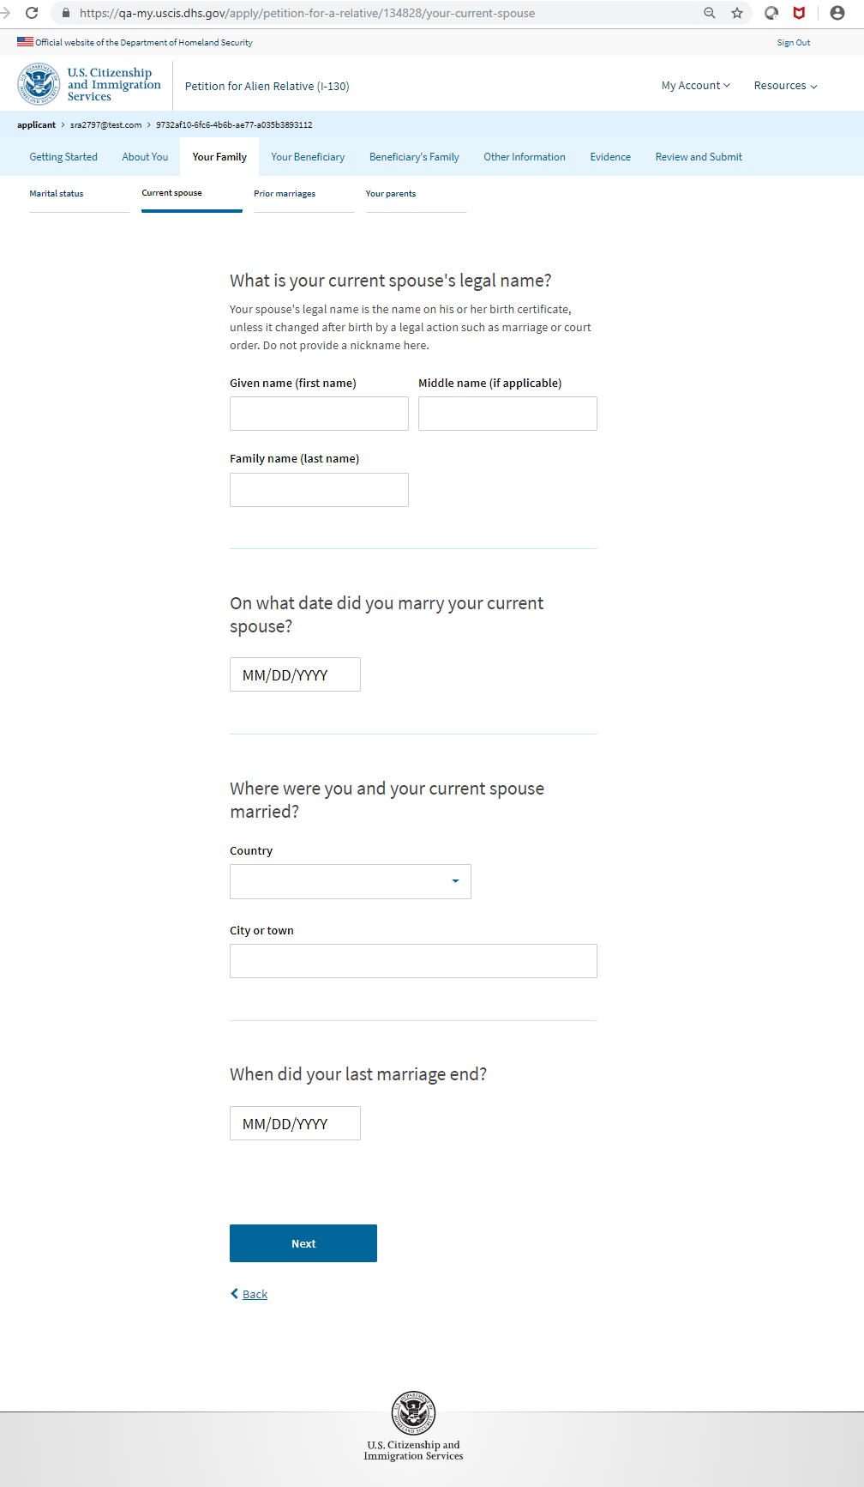
I-130: Your Family – Current Spouses

Slide 17
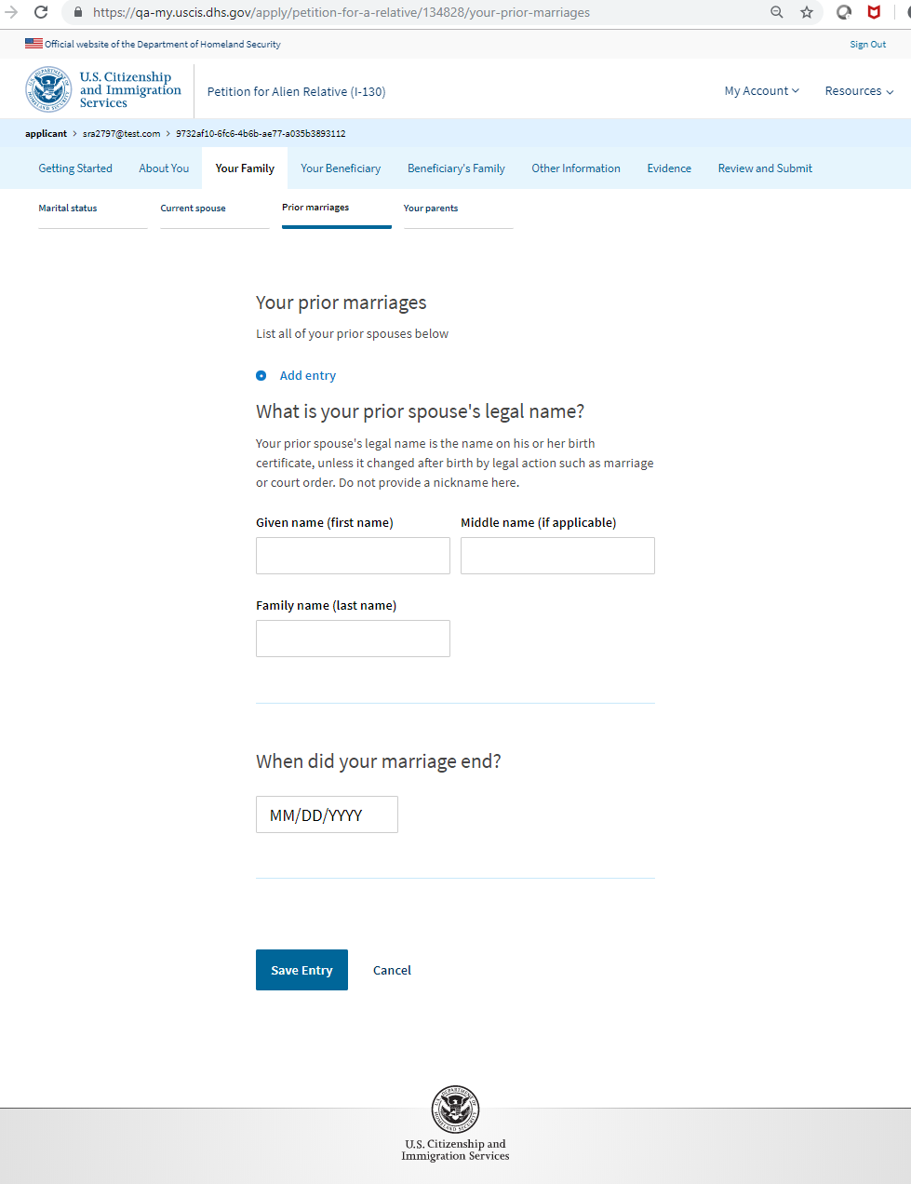
I-130: Your Family – Prior Marriages

Slide 18
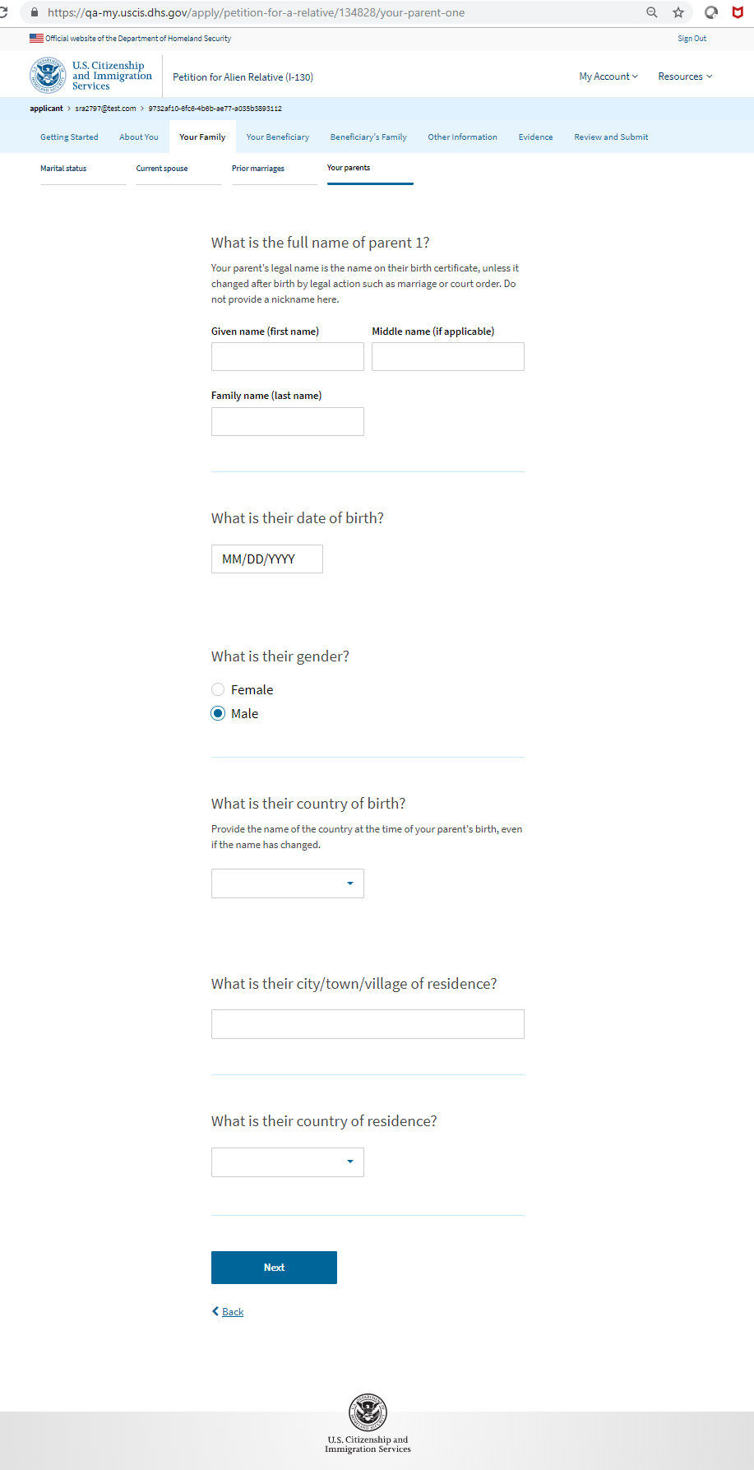
I-130: Your Family – Your Parents (Parent 1)

Slide 19
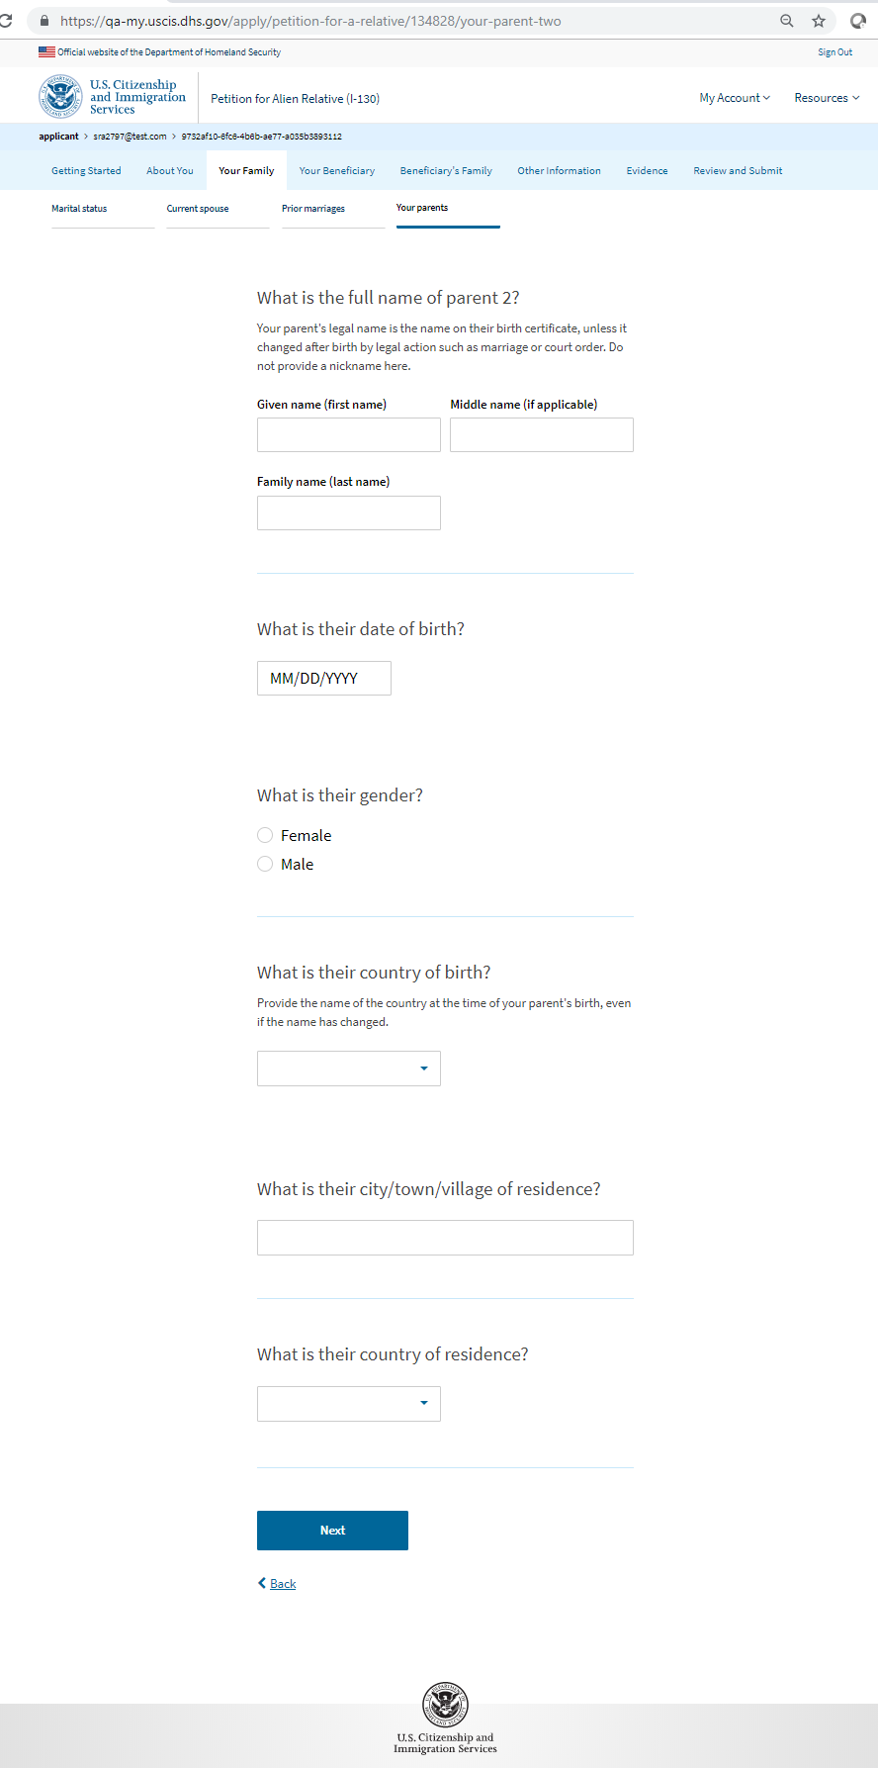
I-130: Your Family – Your Parents (Parent 2)

Slide 20
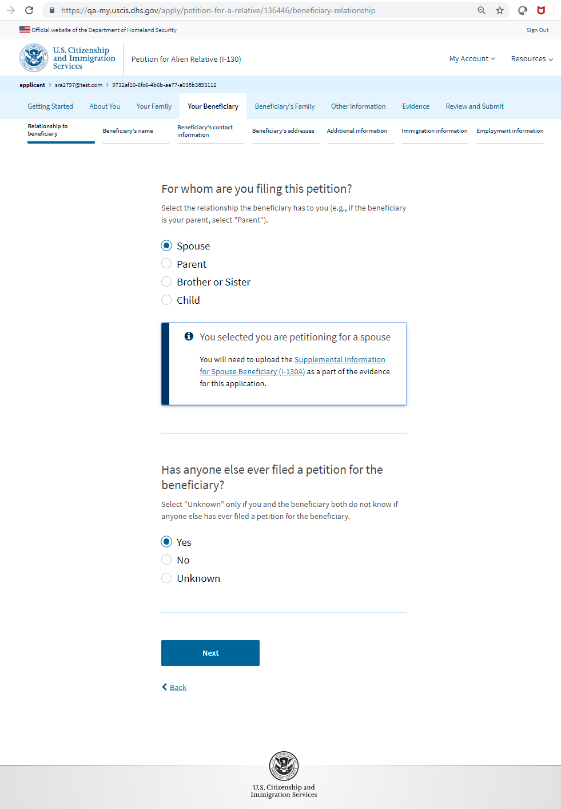
I-130: Your Beneficiary– Relationship to Beneficiary (Spouse)

Slide 21
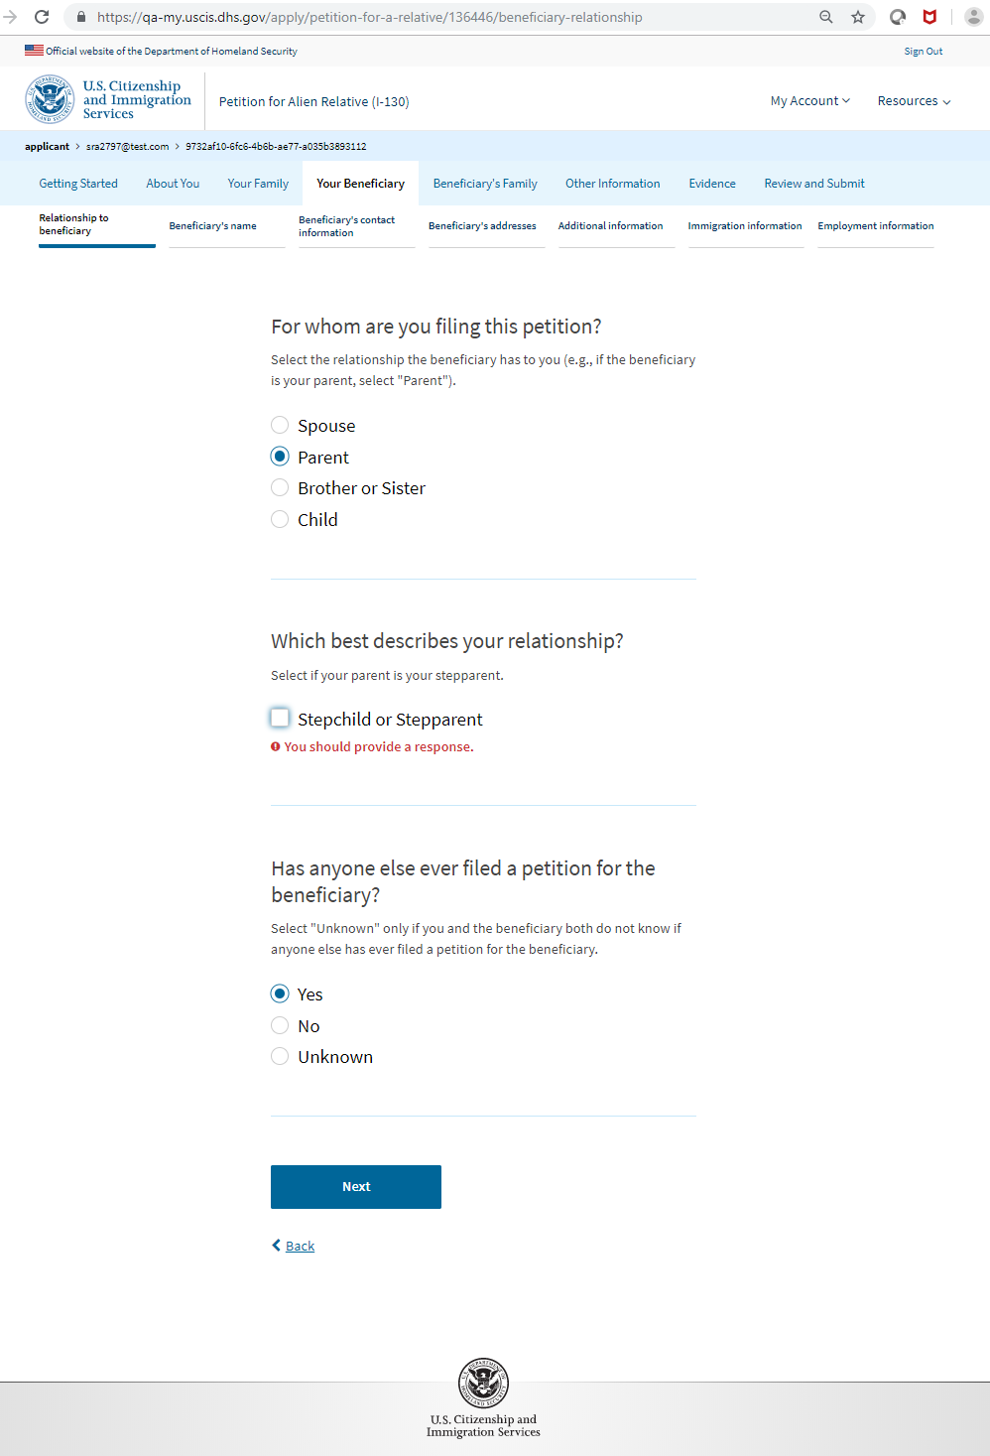
I-130: Your Beneficiary– Relationship to Beneficiary (Parent)

Slide 22
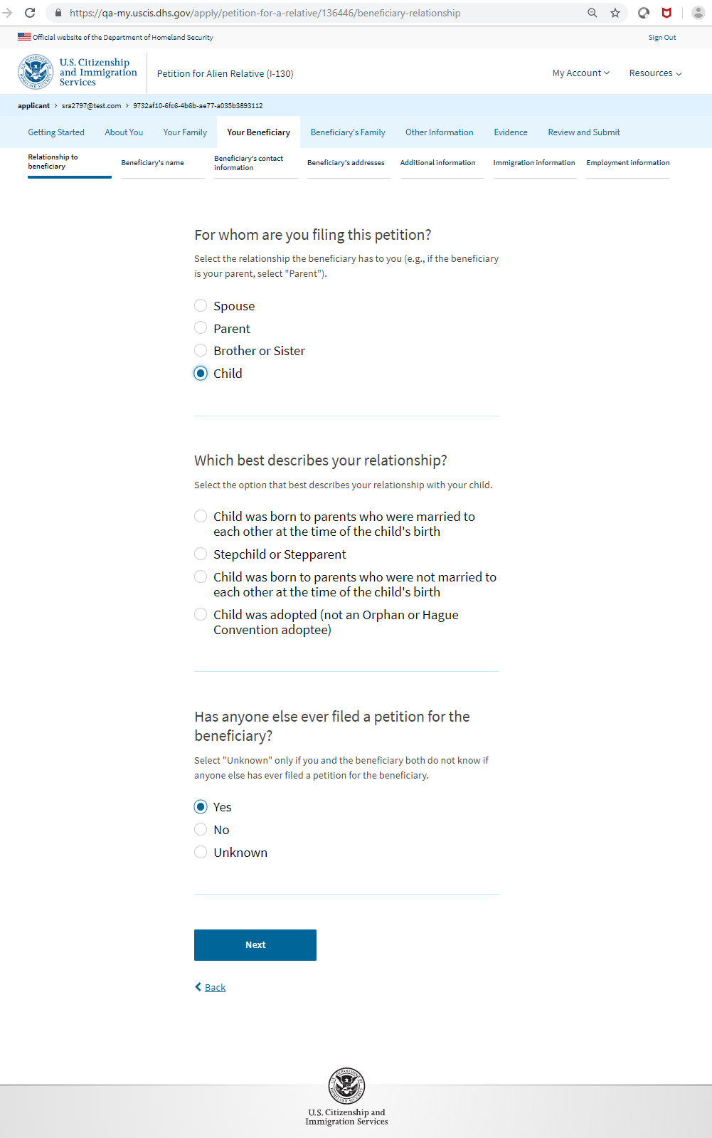
I-130: Your Beneficiary– Relationship to Beneficiary (Child)

Slide 23
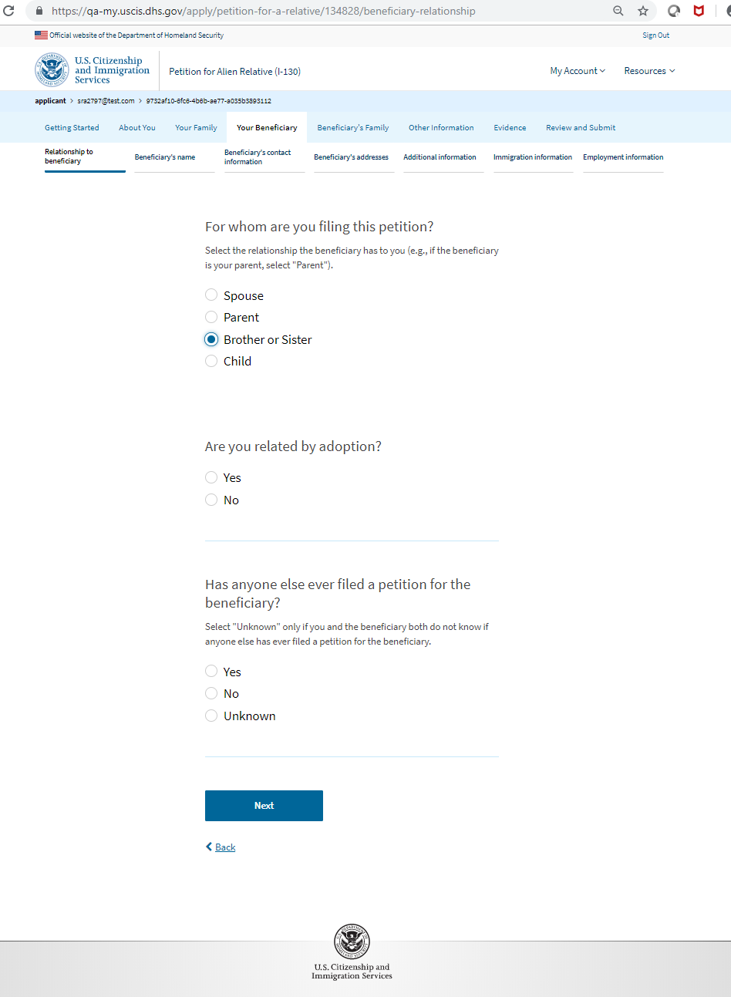
I-130: Your Beneficiary– Relationship to Beneficiary (Brother or Sister)

Slide 24
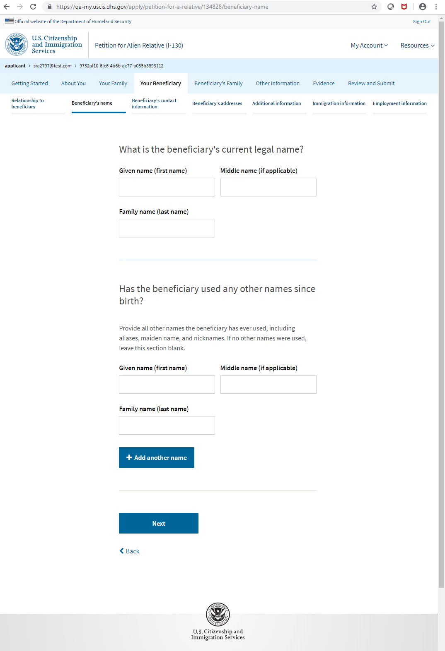
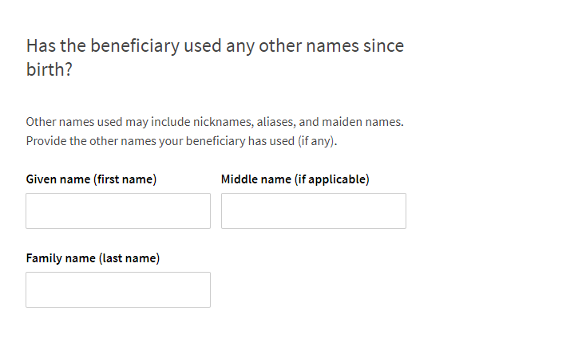
I-130: Your Beneficiary – Beneficiary’s Name

Slide 25
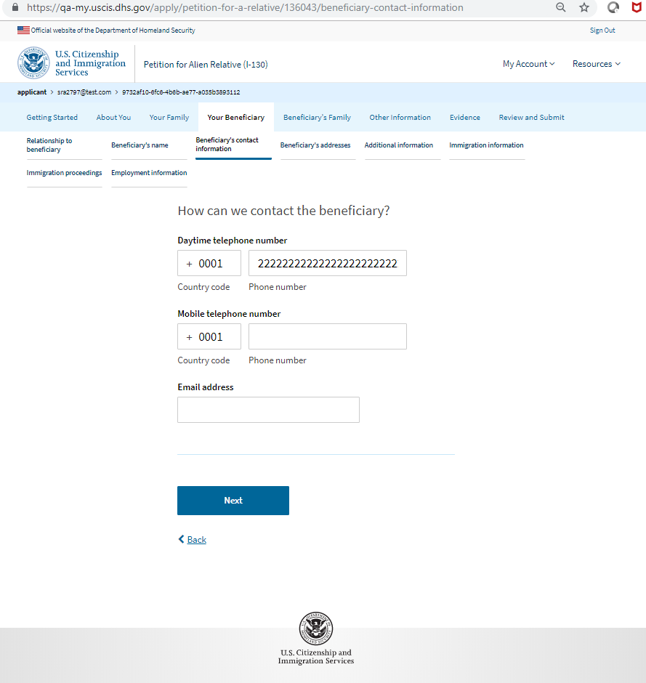
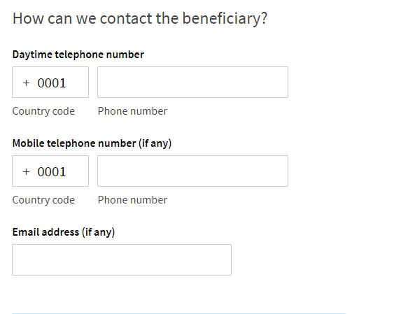
I-130: Your Beneficiary–Beneficiary’s Contact Information

Slide 26
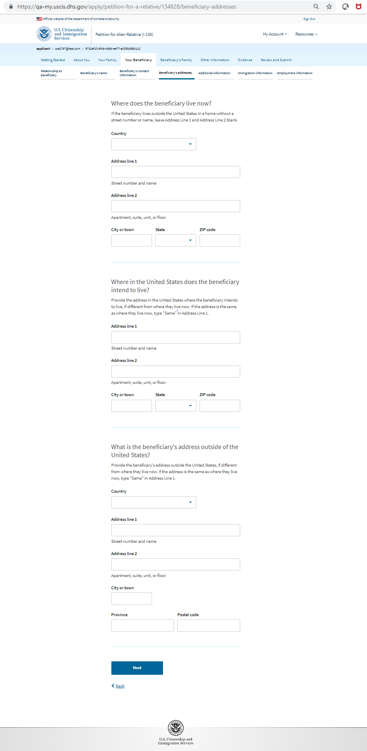
I-130: Your Beneficiary–Beneficiary’s Addresses

Slide 27
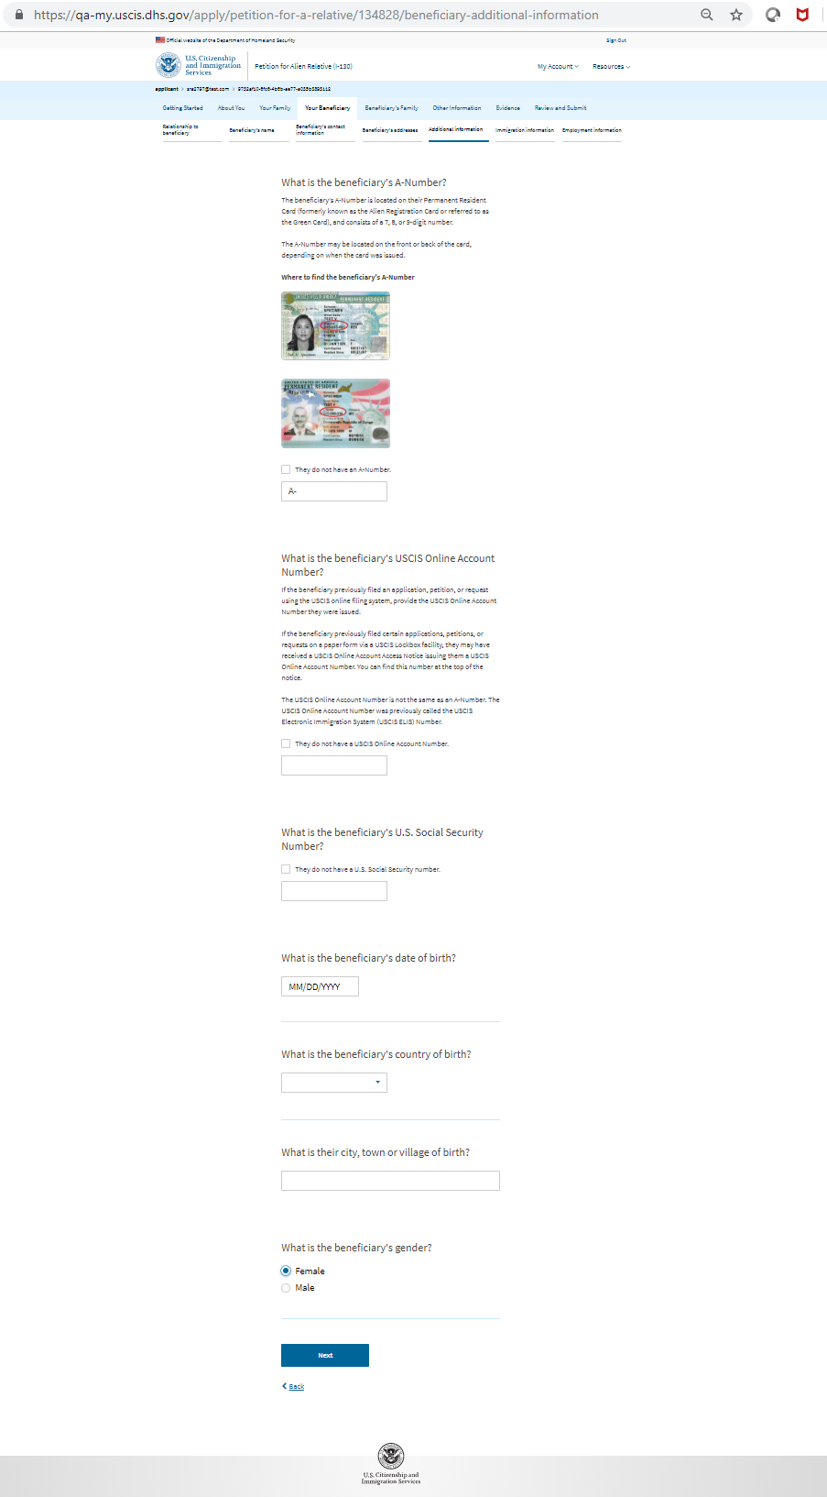
I-130: Your Beneficiary – Additional Information

Slide 28
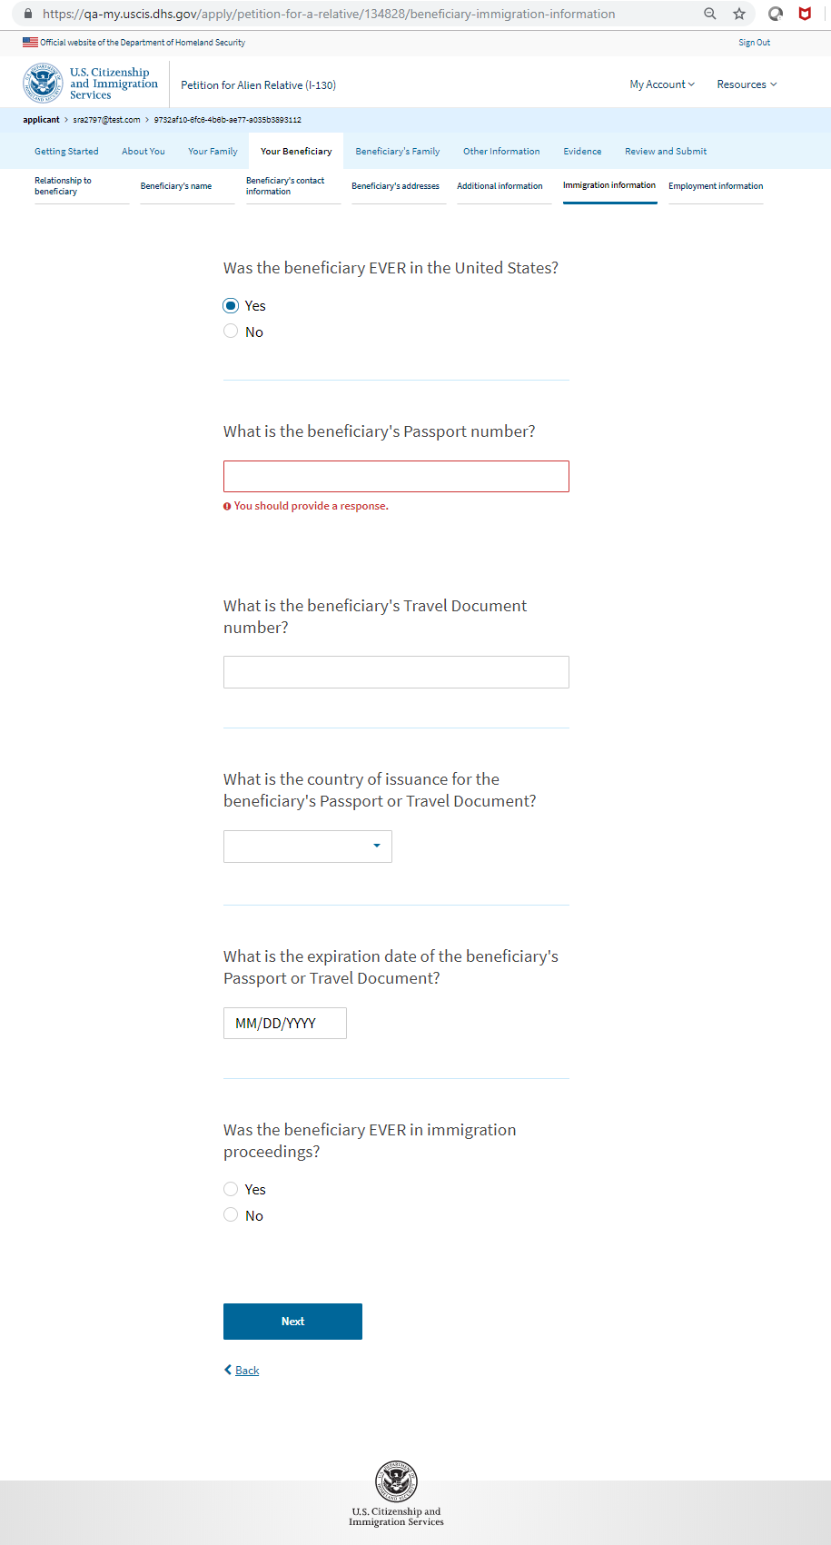
I-130: Your Beneficiary – Immigration Information

Slide 29
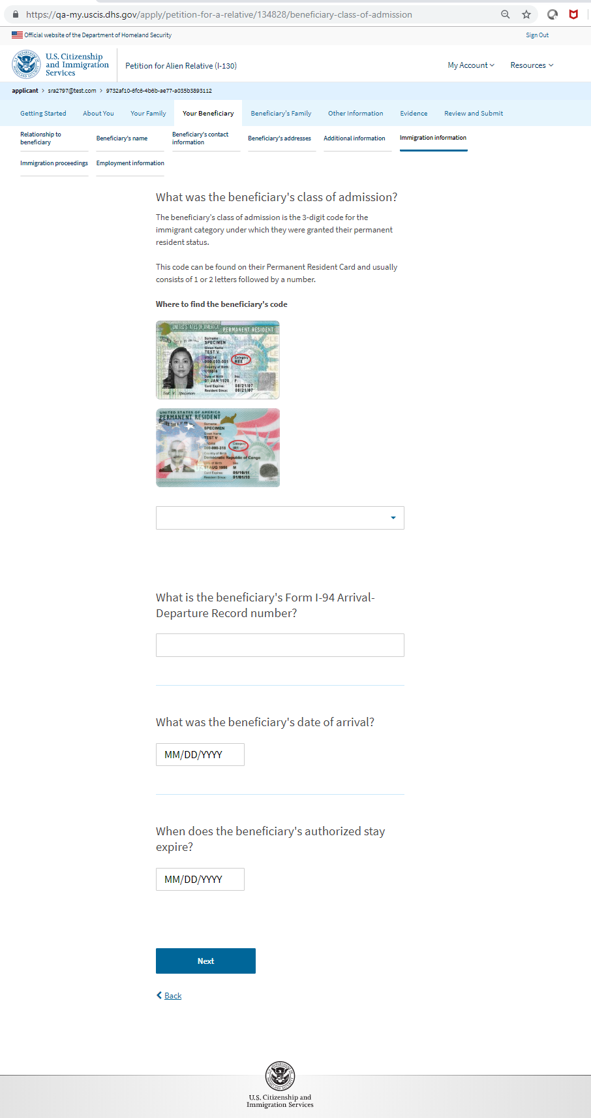
I-130: Your Beneficiary – Immigration Information (Class of Admission)

Slide 30
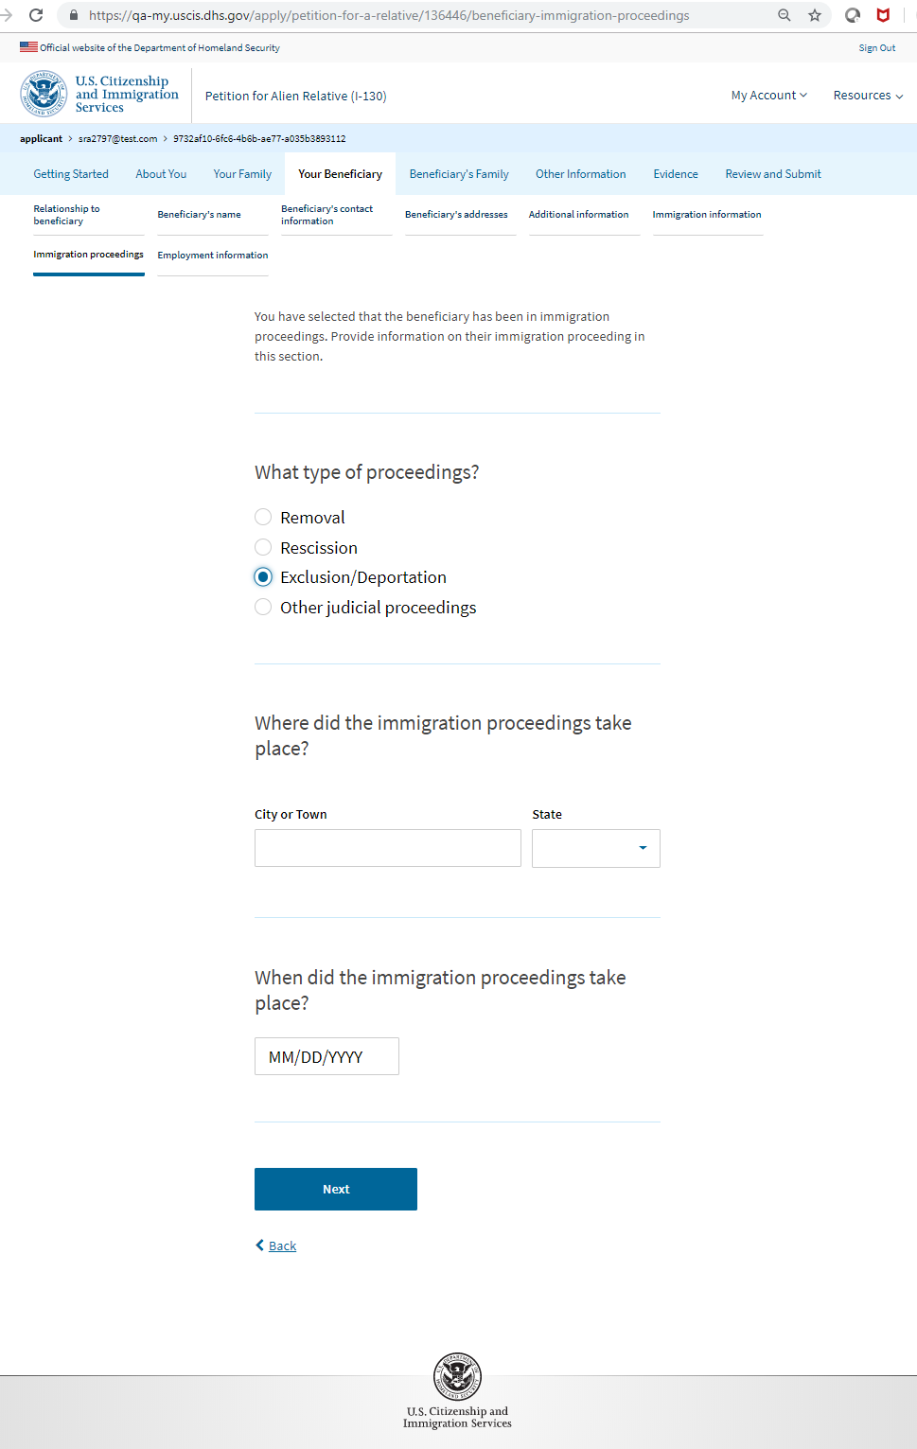
I-130: Your Beneficiary – Immigration Proceedings

Slide 31
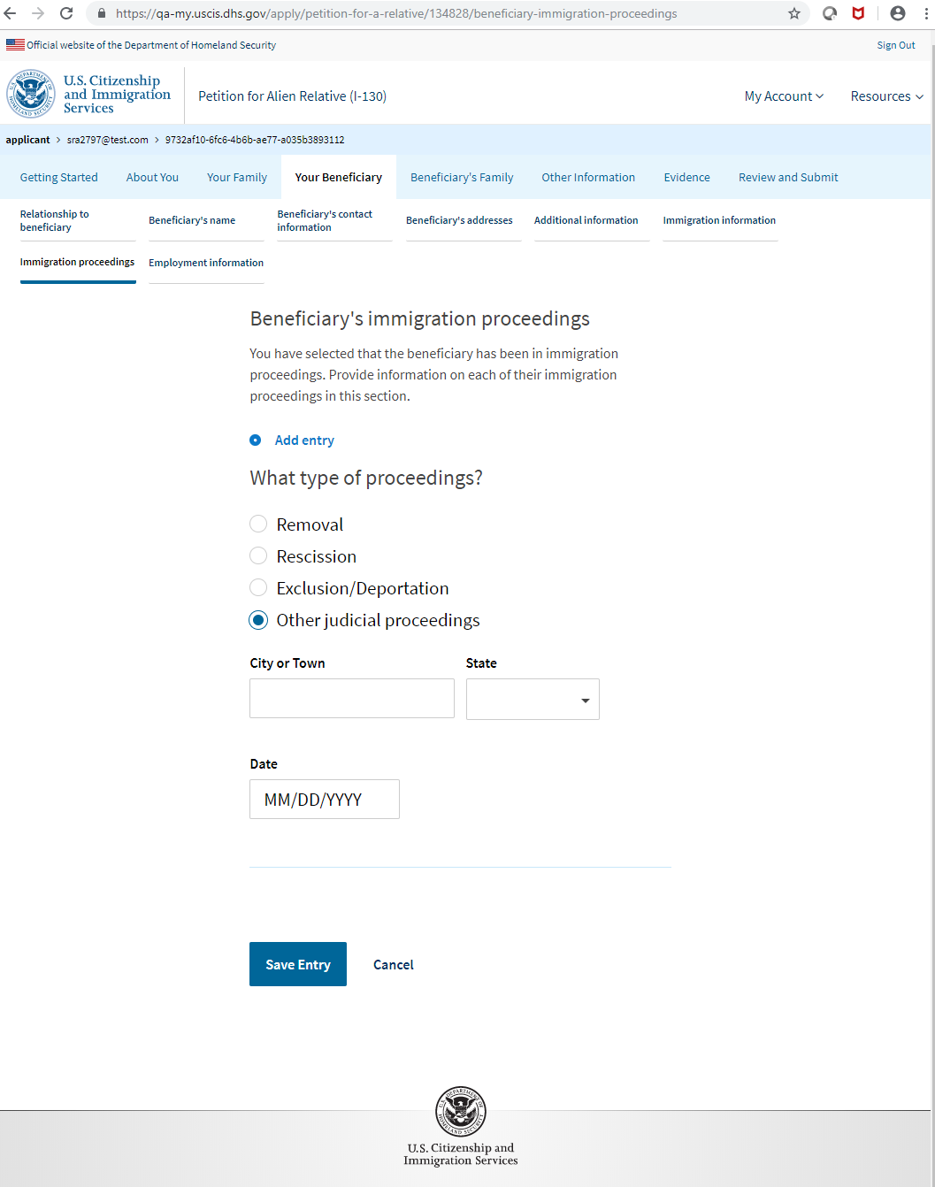
I-130: Your Beneficiary – Immigration Proceedings

Slide 32
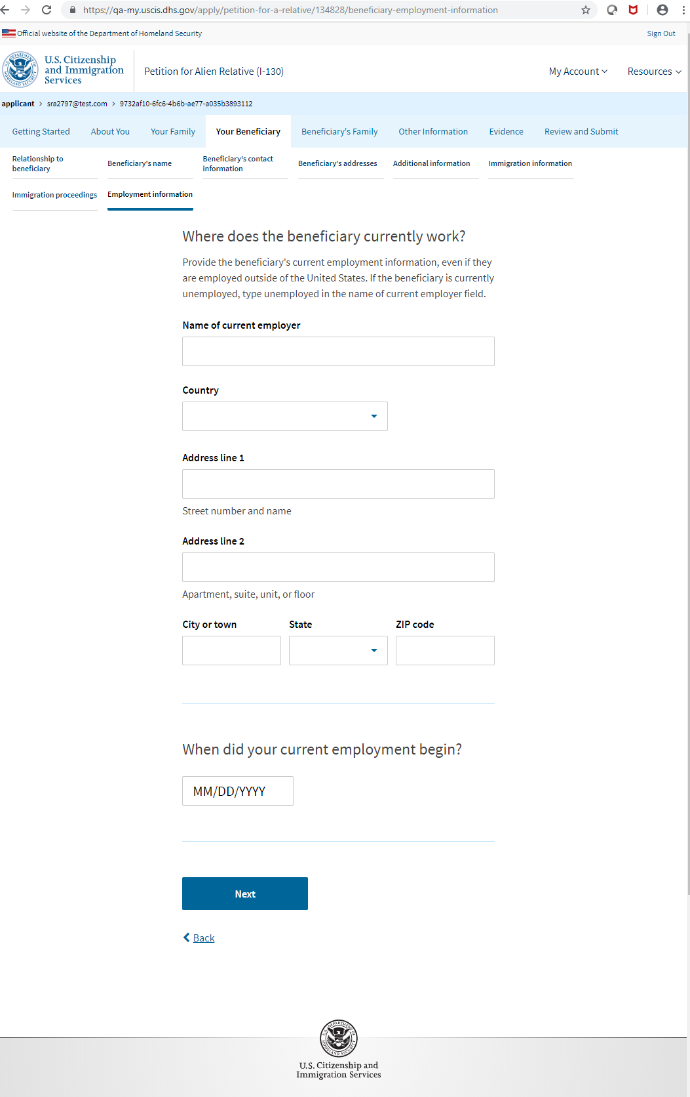
I-130: Your Beneficiary – Employment Information

Slide 33
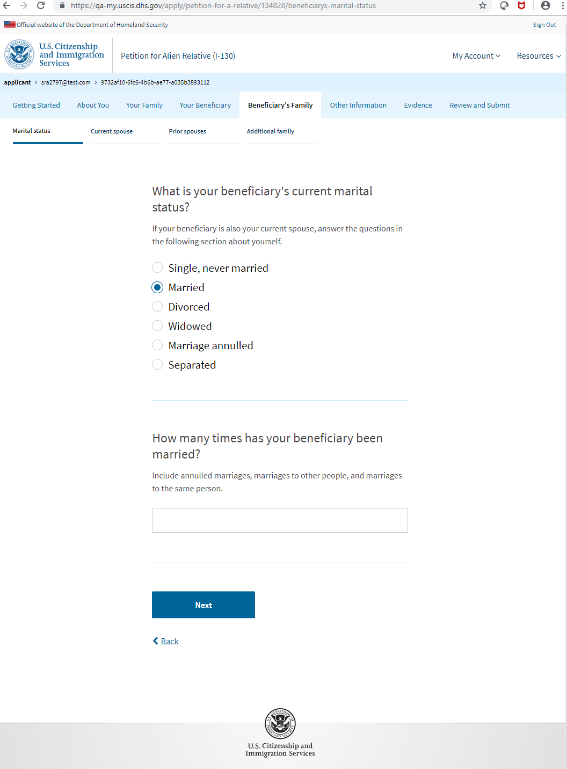
I-130: Beneficiary’s Family– Marital Status

Slide 34
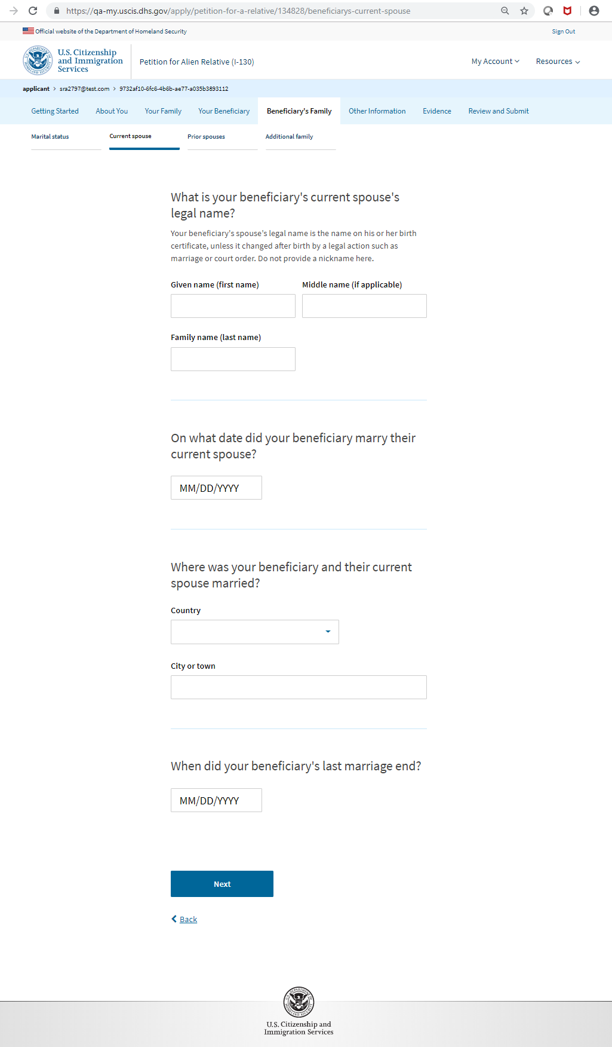
I-130: Beneficiary’s Family – Current Spouse

Slide 35
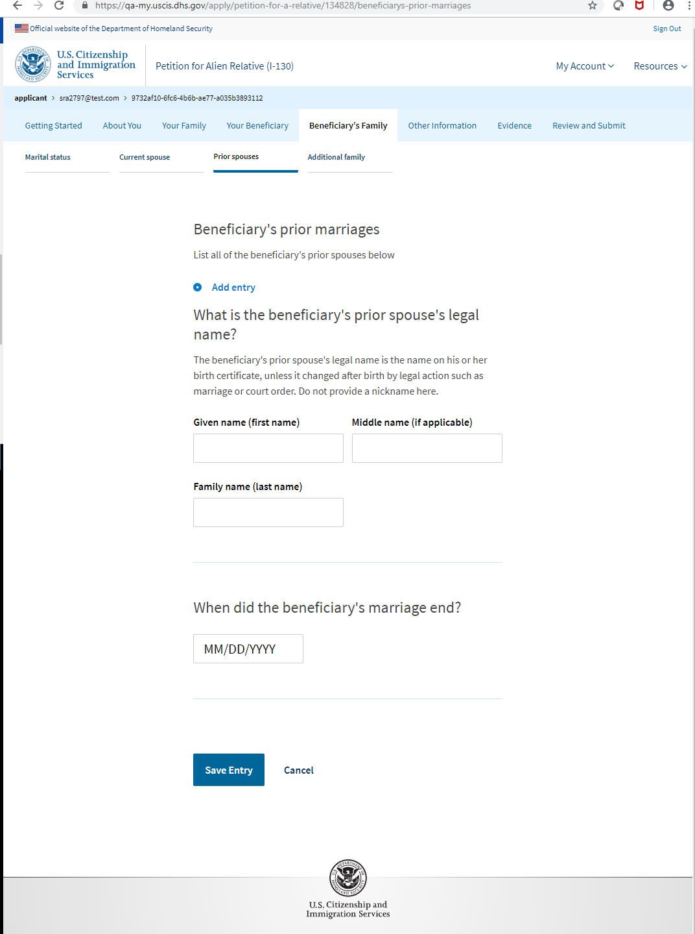
I-130: Beneficiary’s Family – Prior Spouses

Slide 36
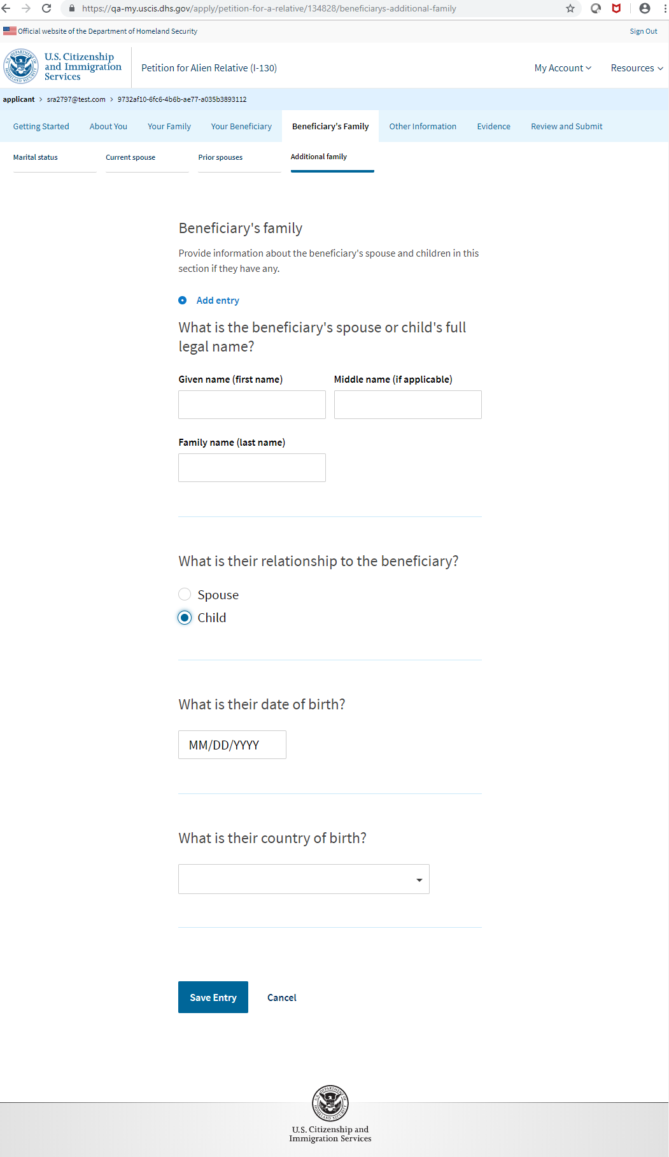
I-130: Beneficiary’s Family – Additional Family

Slide 37
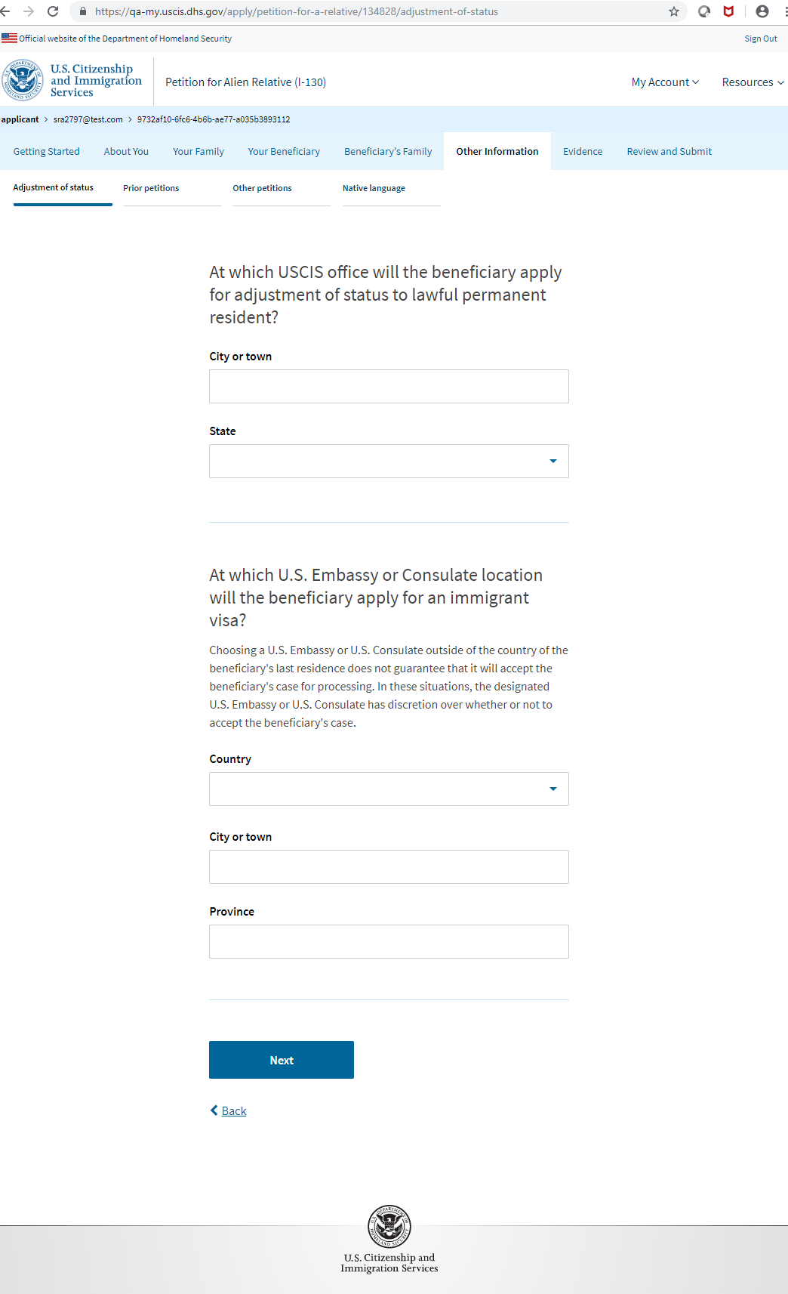
I-130: Other Information – Adjustment of Status

Slide 38
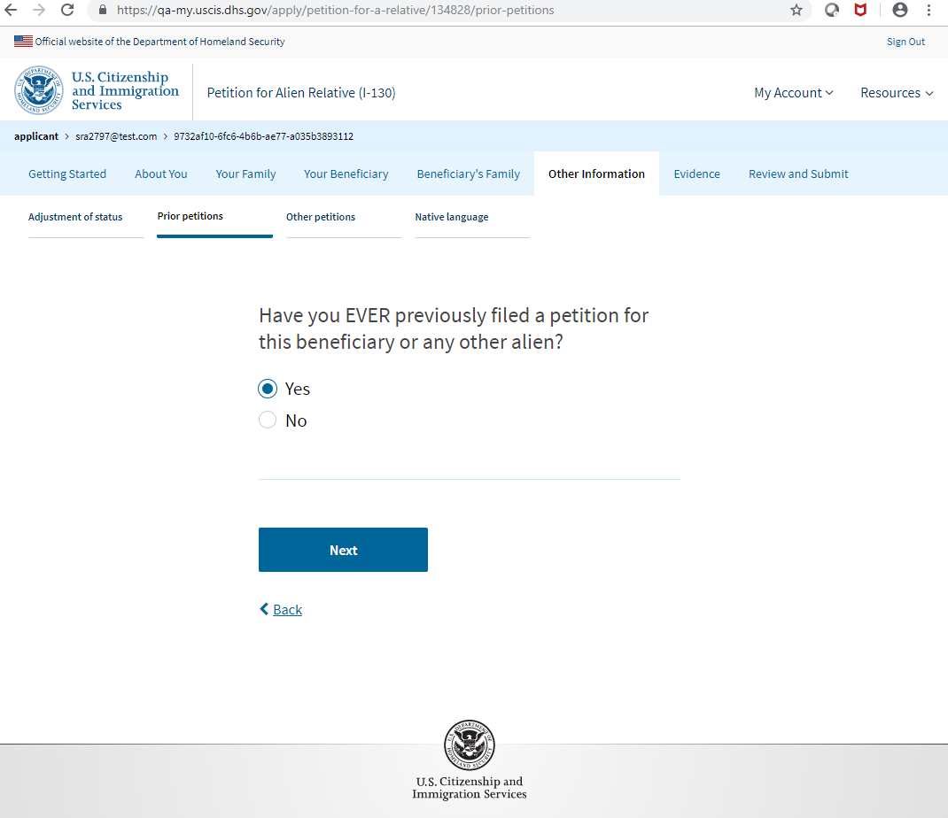
I-130: Other Information – Prior Petitions

Slide 39
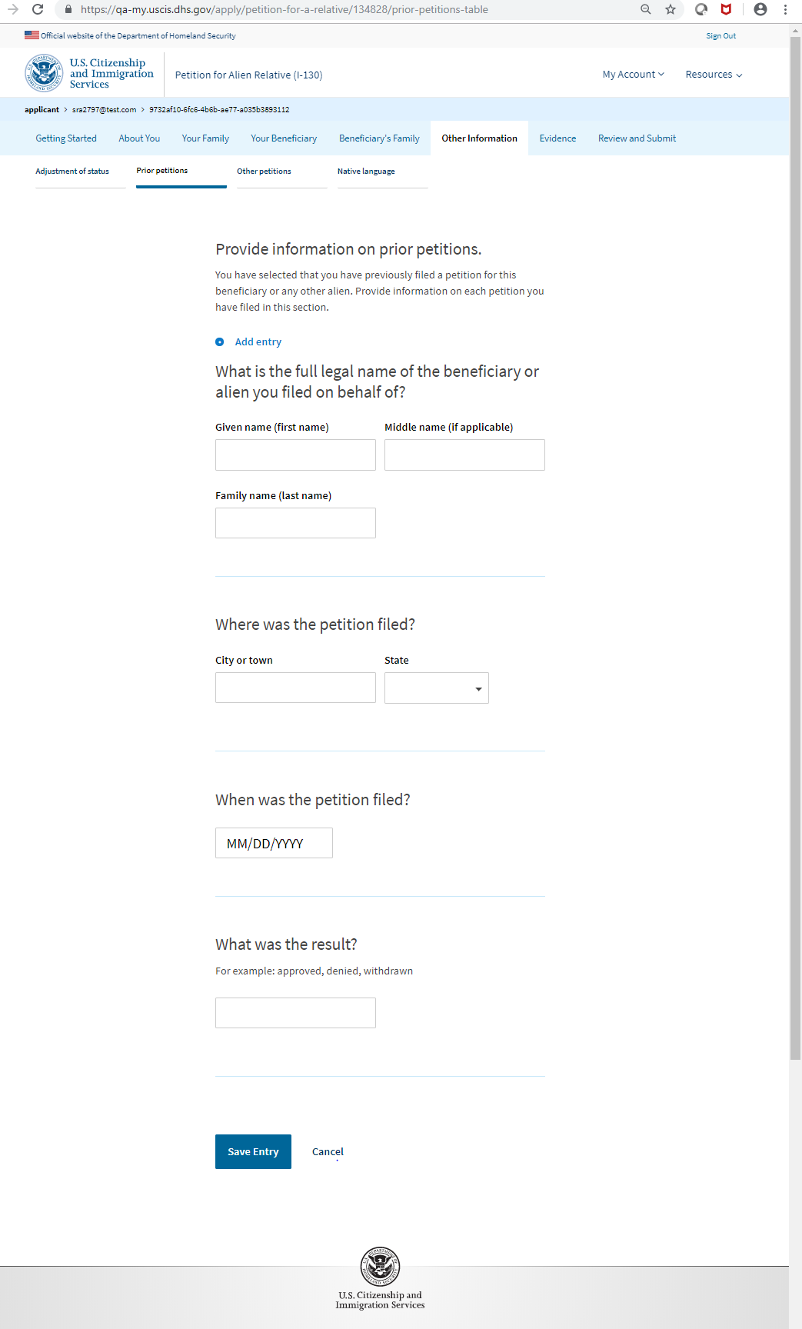
I-130: Other Information – Other Petitions

Slide 40
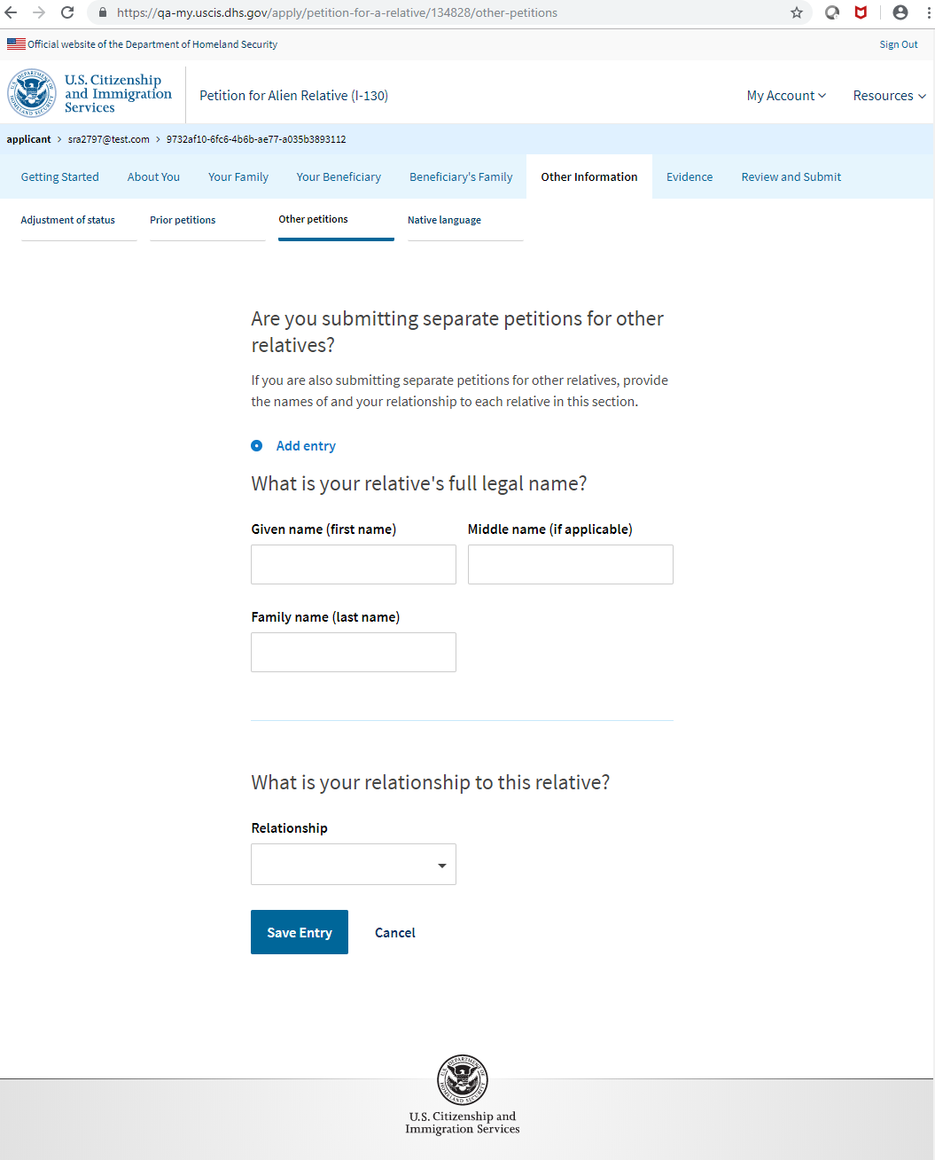
I-130: Other Information – Prior Petitions (Information)

Slide 41
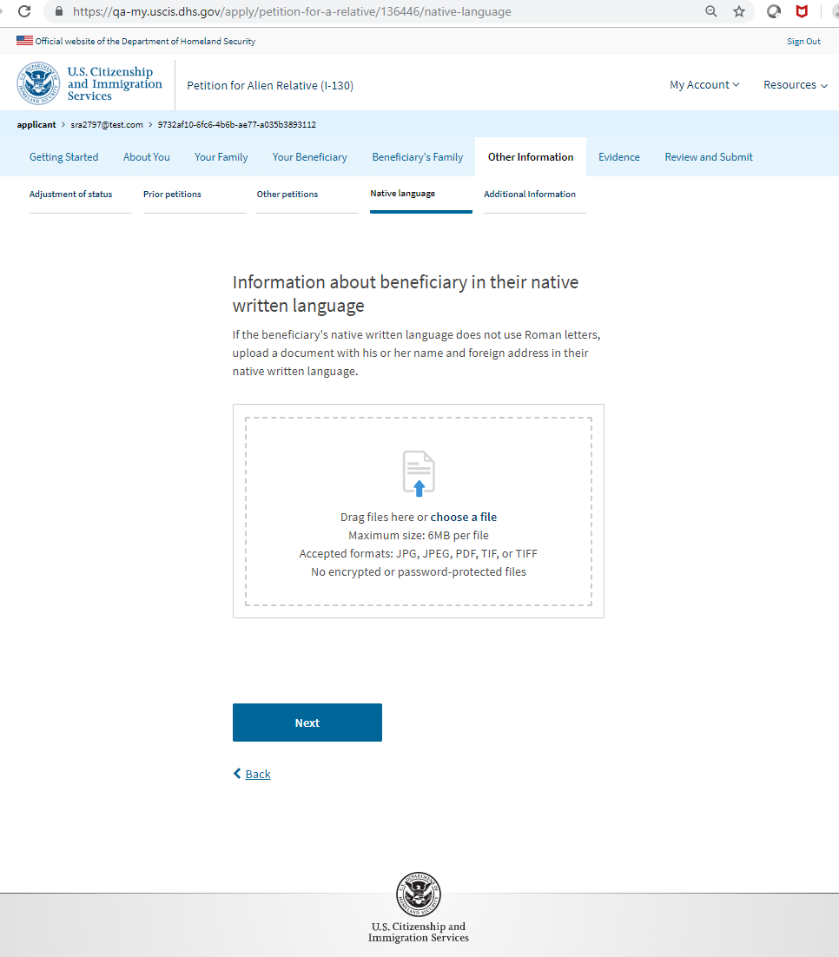
I-130: Other Information – Native Language

Slide 42
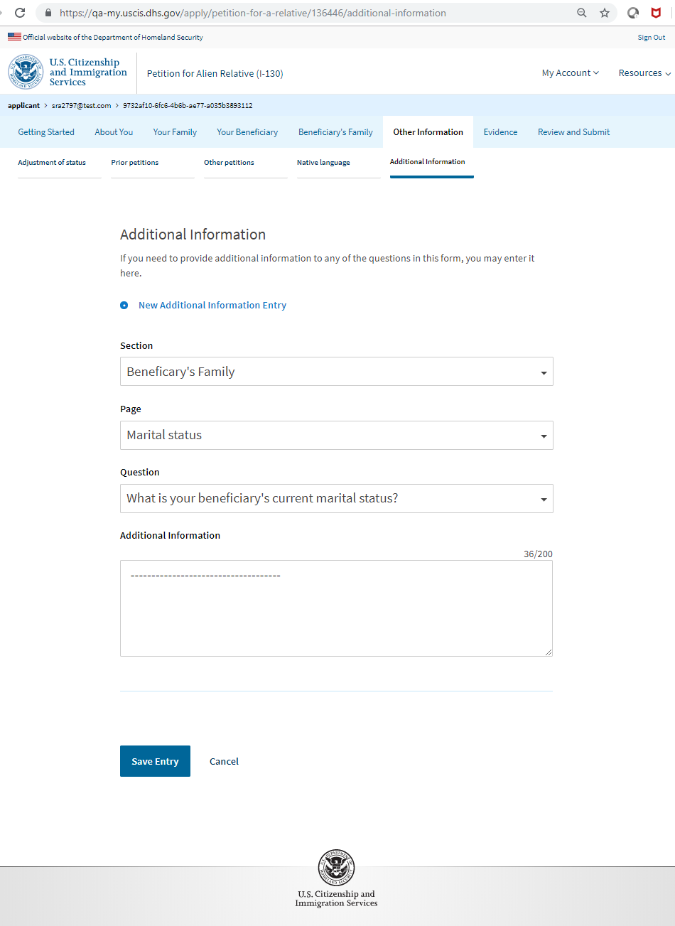
I-130: Other Information – Additional Information

Slide 43
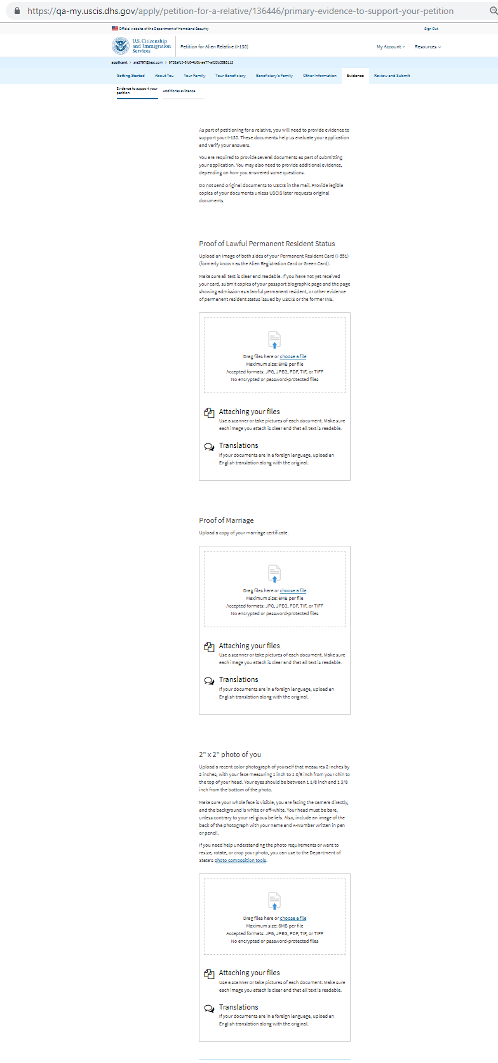
I-130: Evidence – Evidence to support your petition

Slide 44
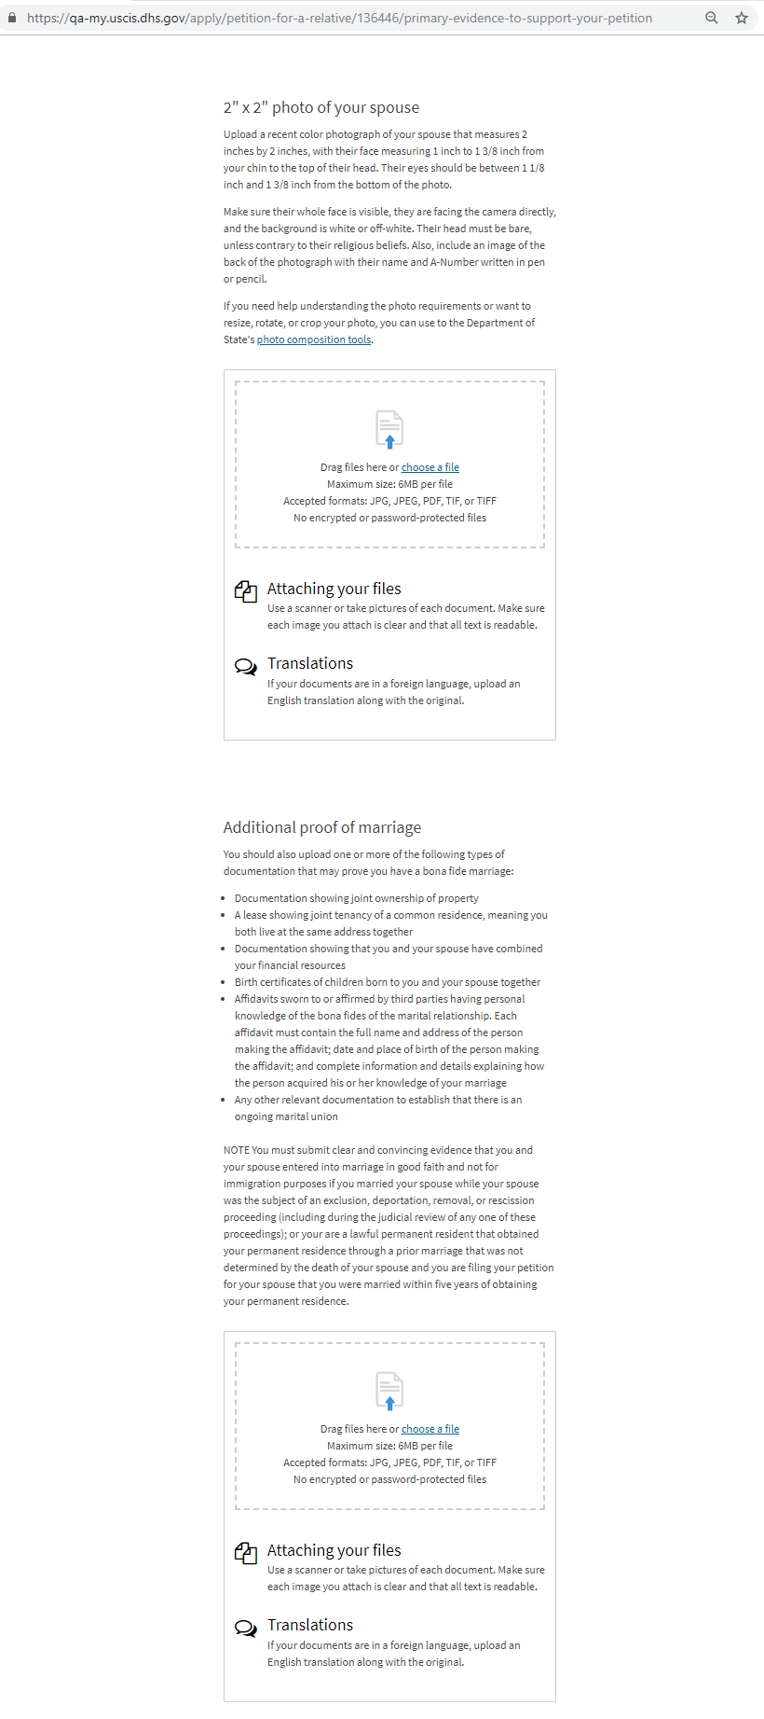
I-130: Evidence – Evidence to support your petition (continued)

Slide 45
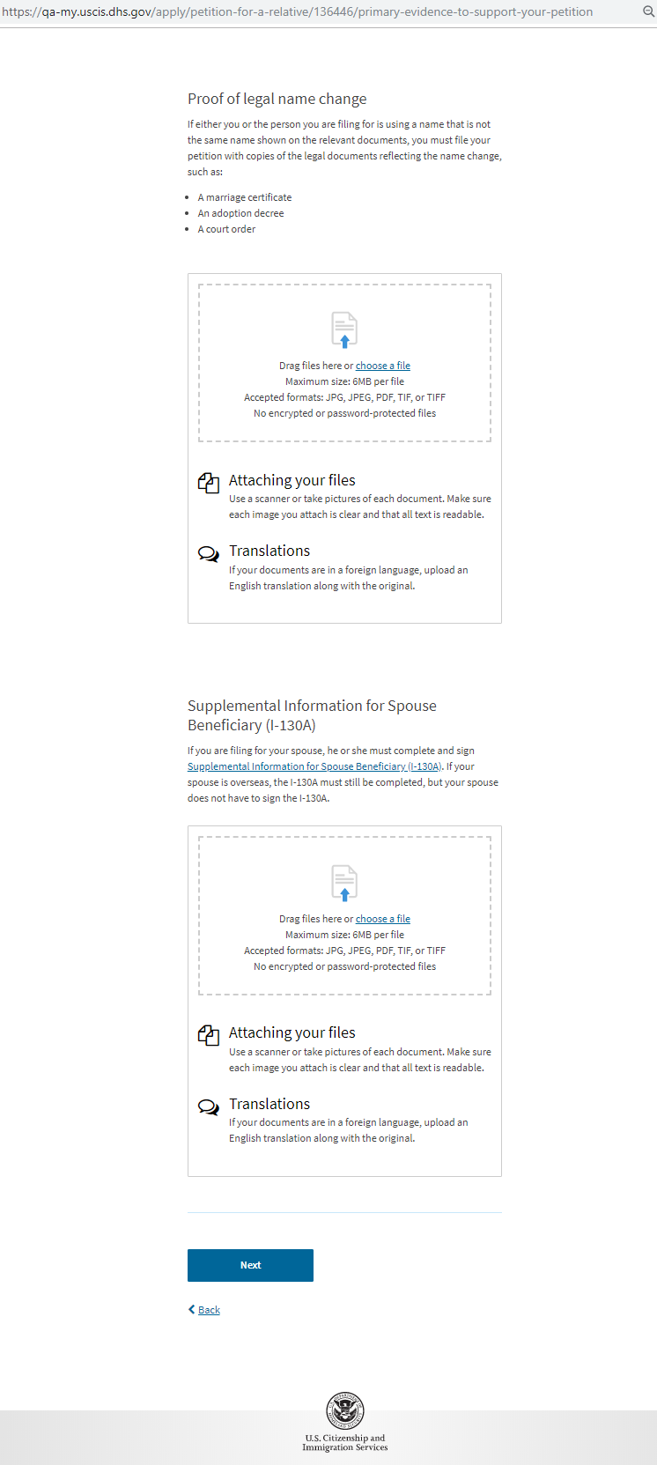
I-130: Evidence – Evidence to support your petition (continued)

Slide 46
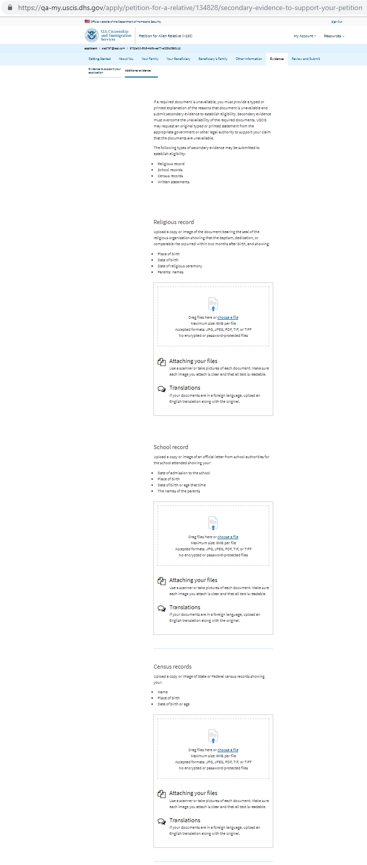
I-130: Evidence – Additional evidence

Slide 47
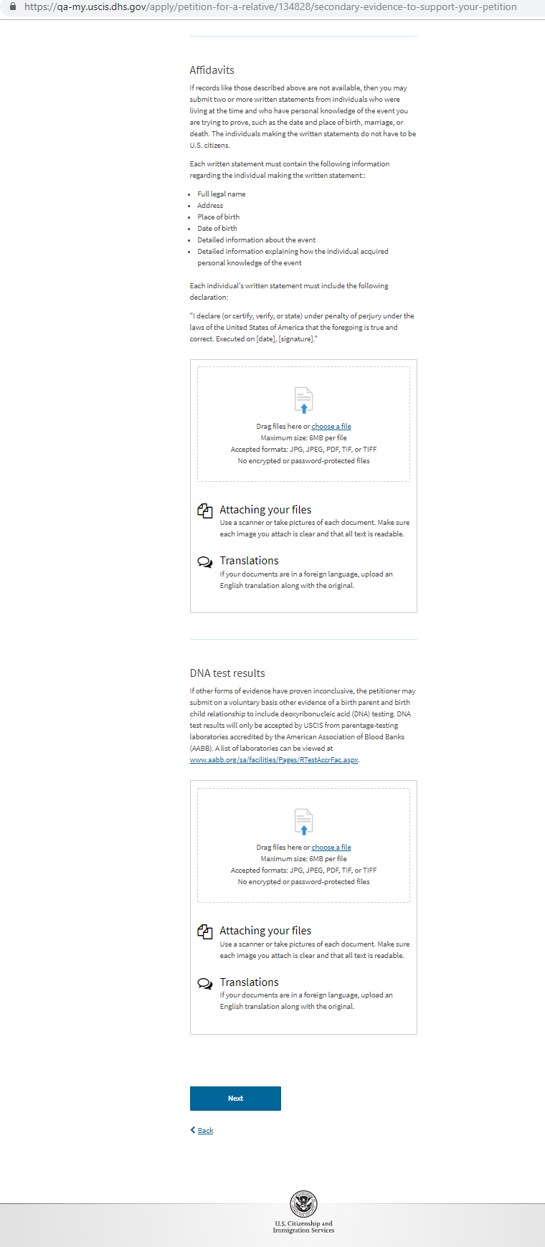
I-130: Evidence – Additional evidence (continued)

Slide 48
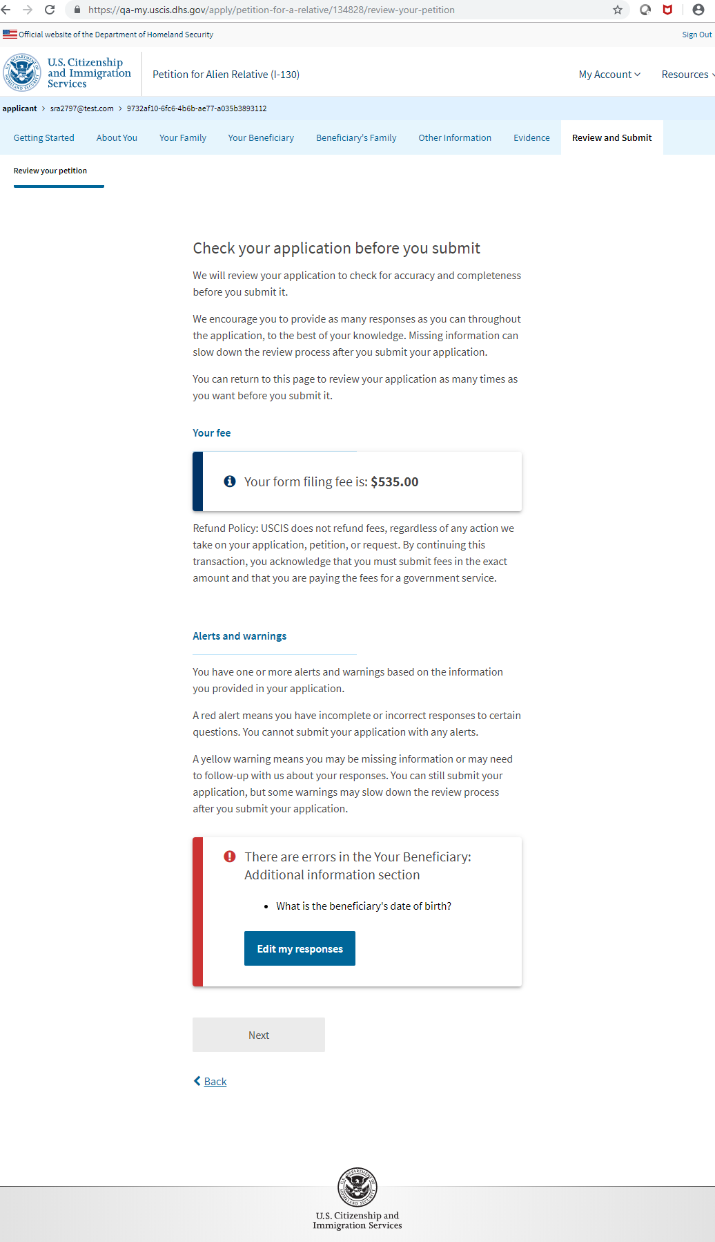
I-130: Review and Submit – Review Your Petition (with a Hard Stop)

Slide 49

I-130: Review and Submit – Review Your Petition

Slide 50

I-130: Review and Submit –Your Petition Summary

Slide 51

I-130: Review and Submit –Your Petition Summary (continued)

Slide 52

I-130: Review and Submit –Your Petition Summary (continued)

Slide 53

I-130: Review and Submit –Your Petition Summary (continued)

Slide 54

I-130: Review and Submit – Preparer Statement (If Exist)

Slide 55

I-130: Review and Submit – Preparer Signature Upload (If Exist)

Slide 56

I-130: Review and Submit – Interpreter Certification (If Exist)

Slide 57

I-130: Review and Submit – Interpreter Signature Upload (If Exist)

Slide 58

I-130: Review and Submit – Your Signature Note: with Interpreter and Preparer

Slide 59

I-130: Review and Submit – Your Signature Note: without Interpreter and Preparer

Slide 60

I-130: Review and Submit – Your Signature

Slide 61

I-130: Review and Submit – Pay and Submit

Slide 62
Pay.gov screens

Slide 63

I-130: Confirmation– Payment unsuccessful

Slide 64

I-130: Confirmation– Payment successful

