Slide 1

N-600: Application for Certificate of Citizenship
United States Citizenship and Immigration Services
myUSICS Team

Slide 2
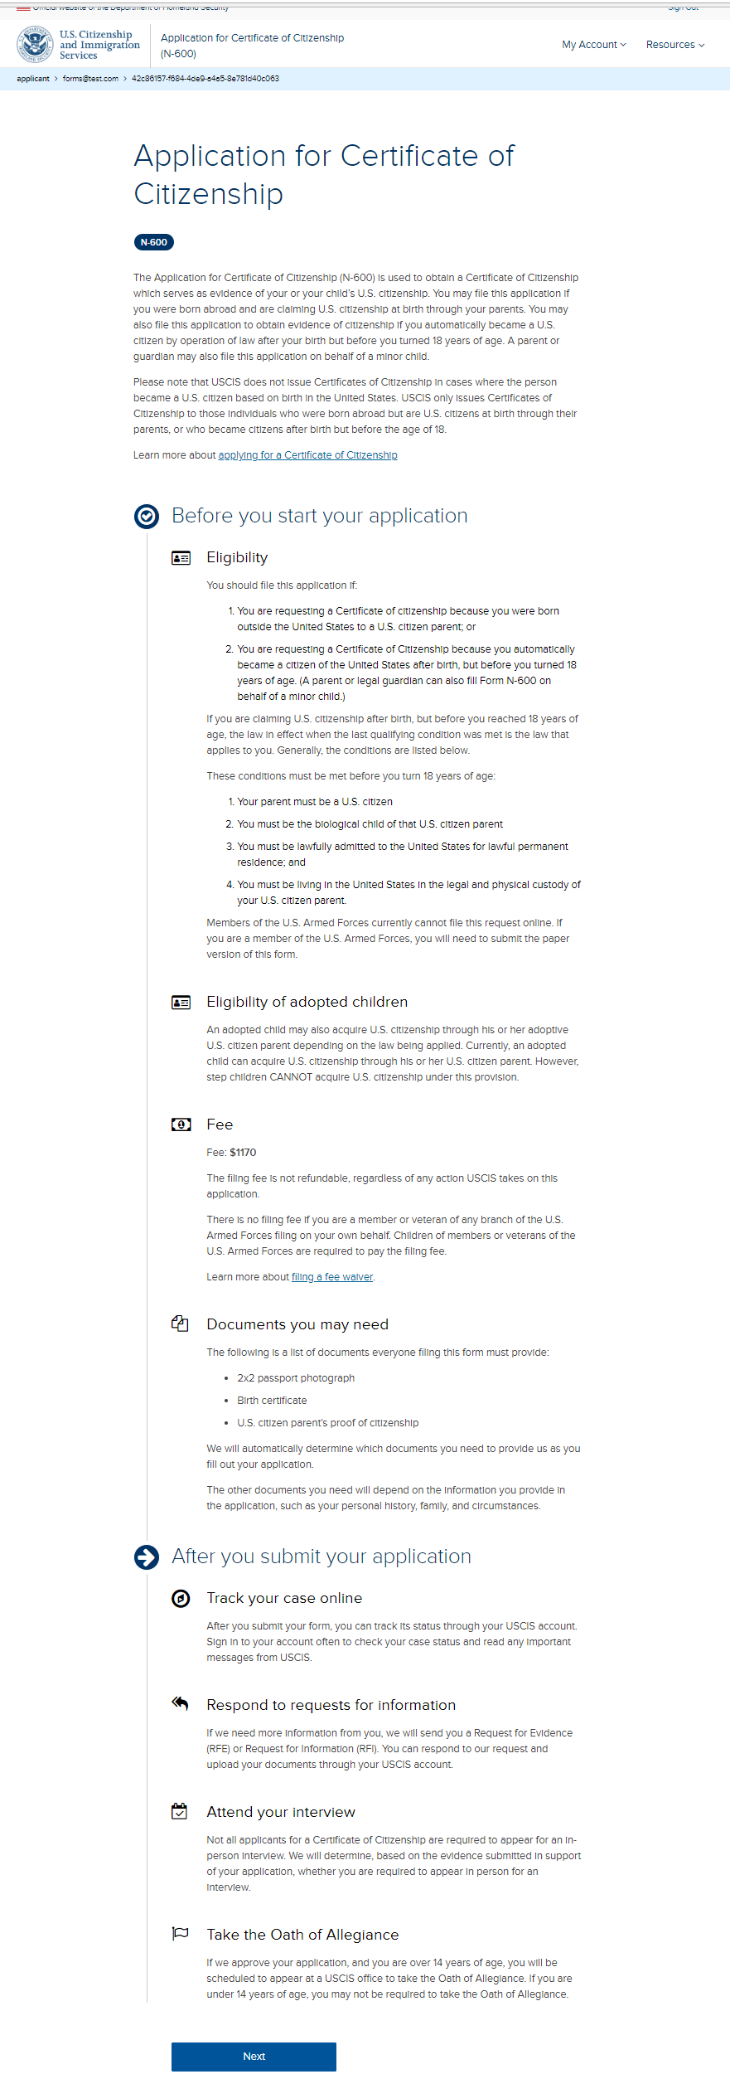
N-600: Application Overview

Slide 3
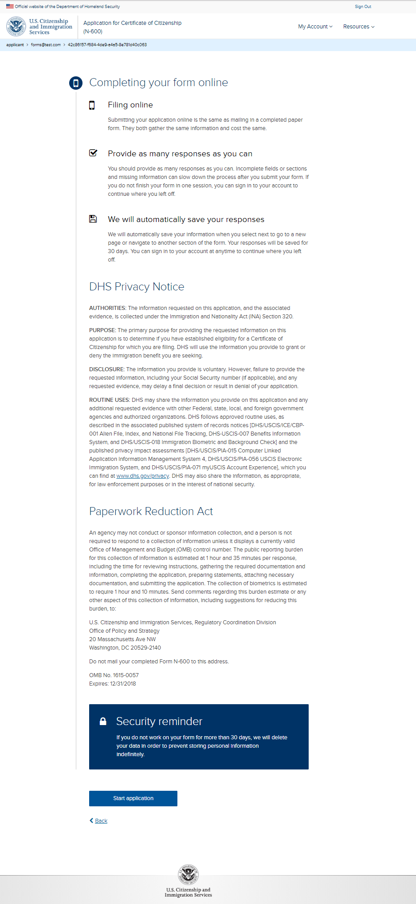
N-600: Application Overview page 2

Slide 4
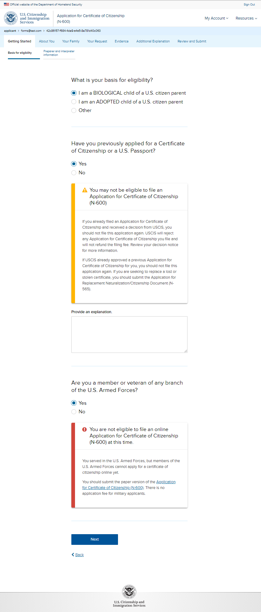
N-600: Getting Started – Basis for eligibility

Slide 5
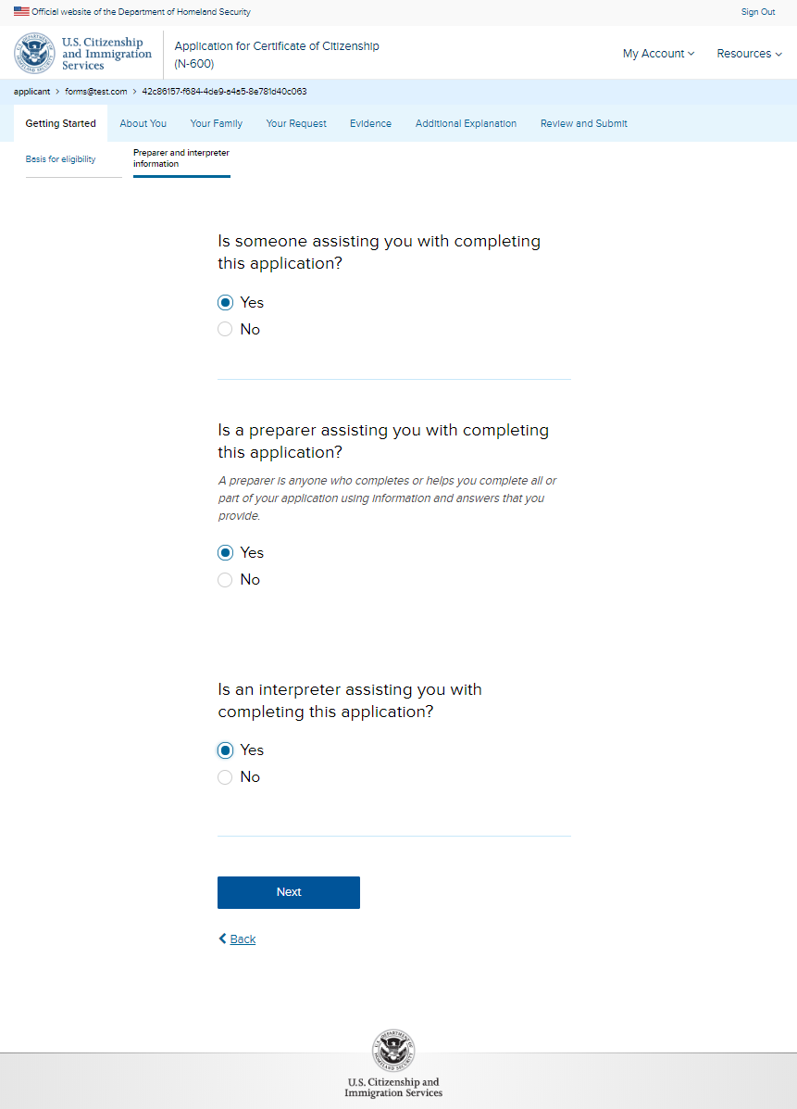
N-600: Getting Started – Preparer and interpreter information

Slide 6
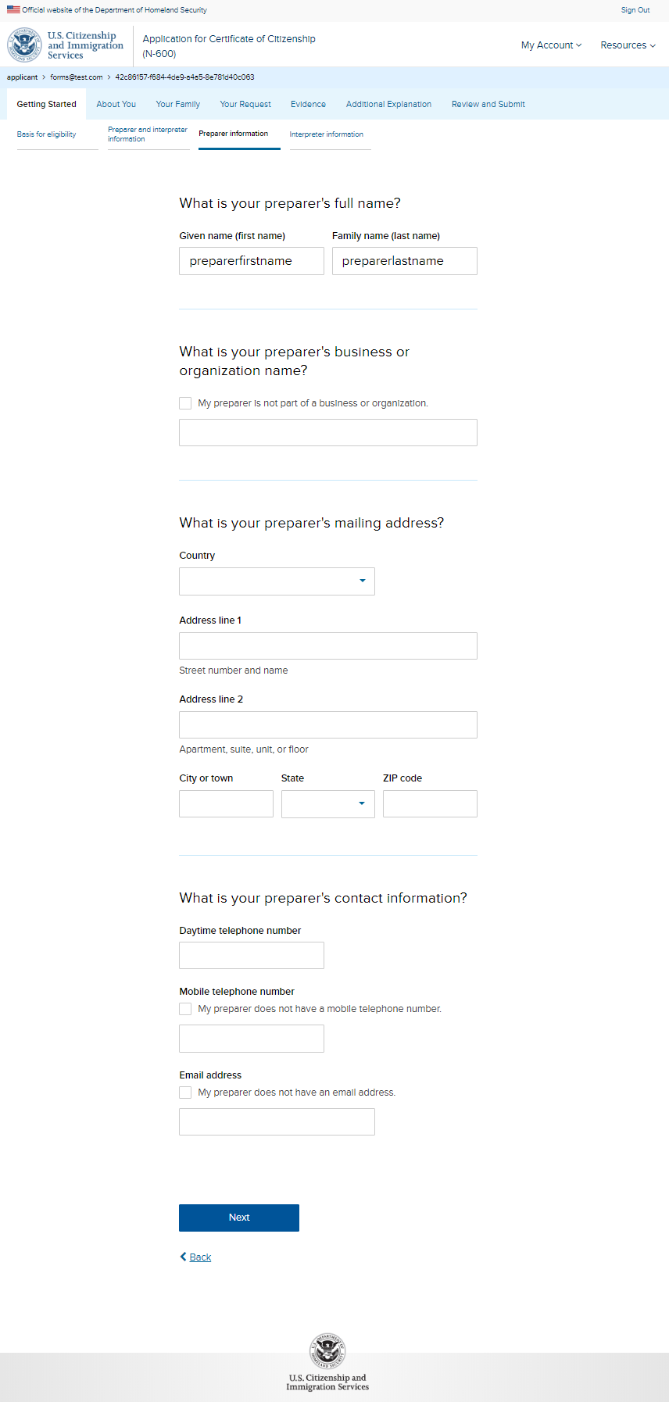
N-600: Getting Started – Preparer information (conditional)

Slide 7
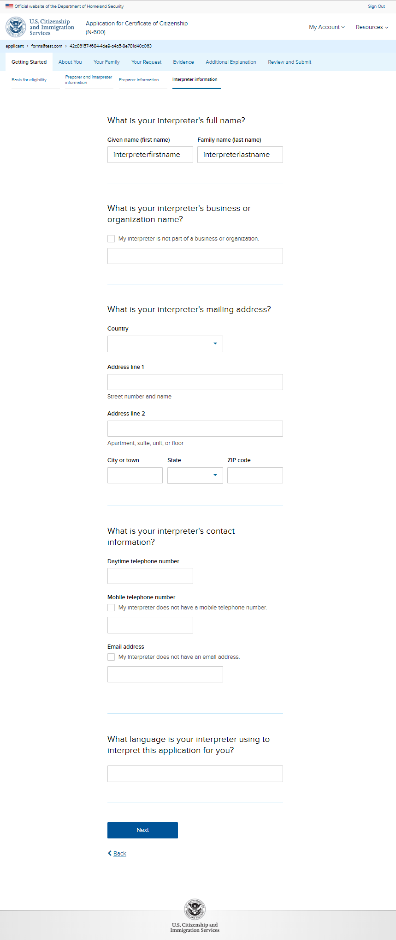
N-600: Getting Started – Interpreter information (conditional)

Slide 8
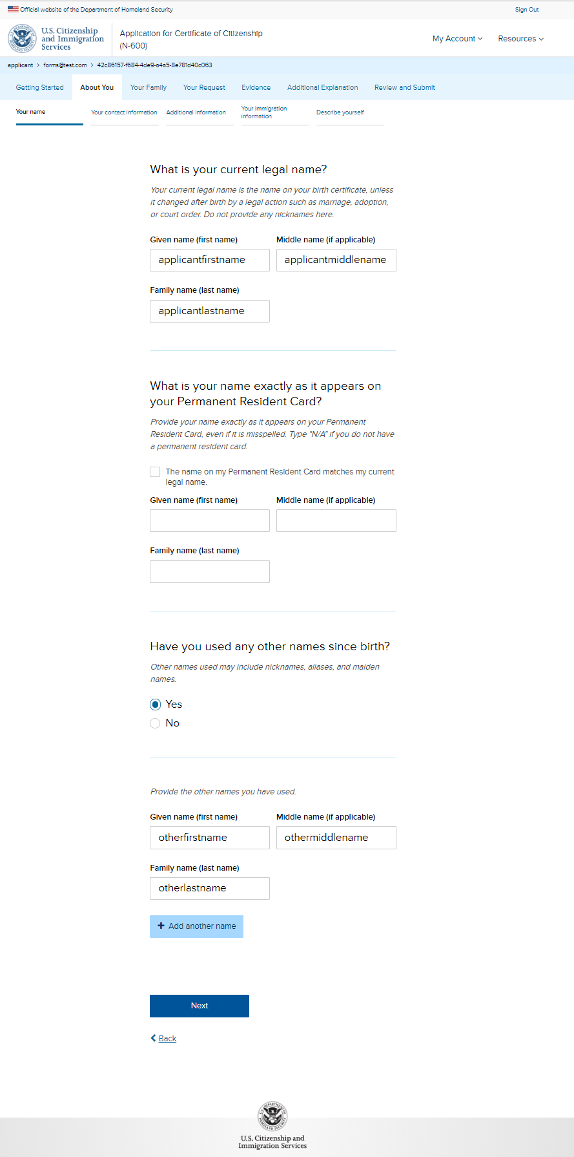
N-600: About you – Your name

Slide 9
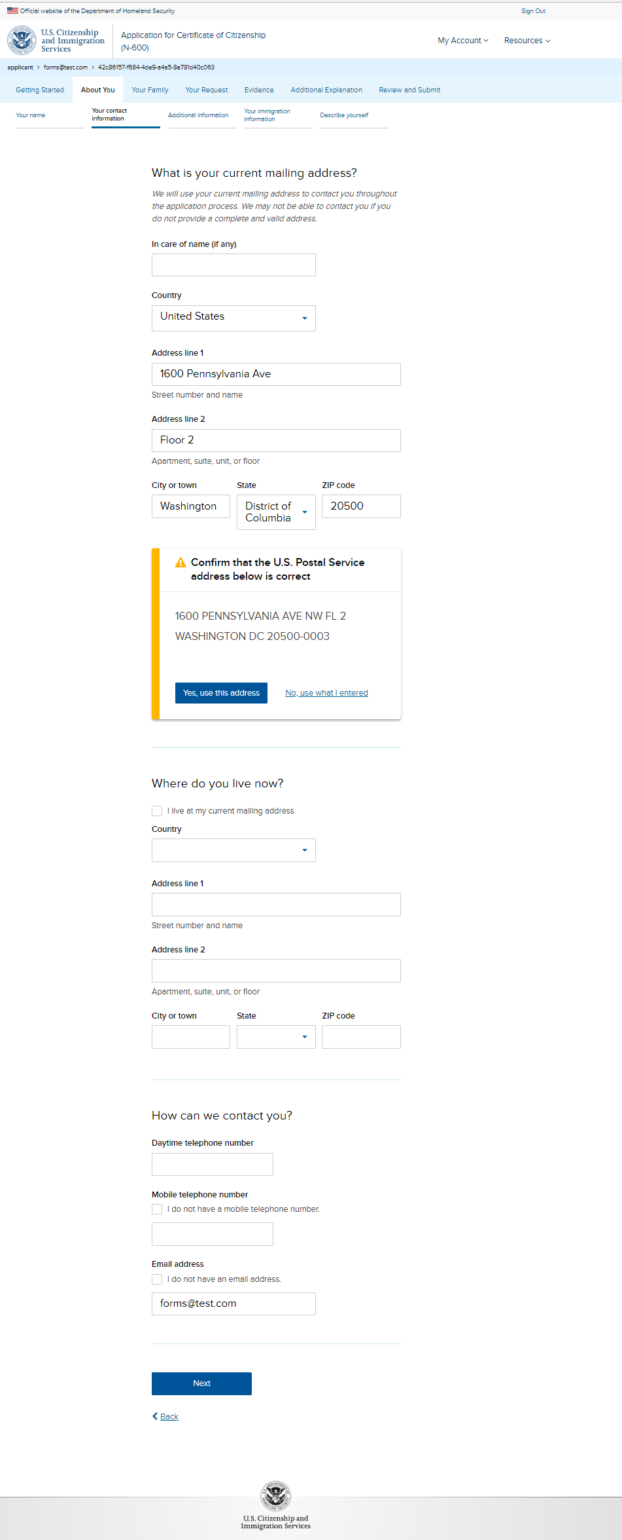
N-600: About you – Your contact information

Slide 10
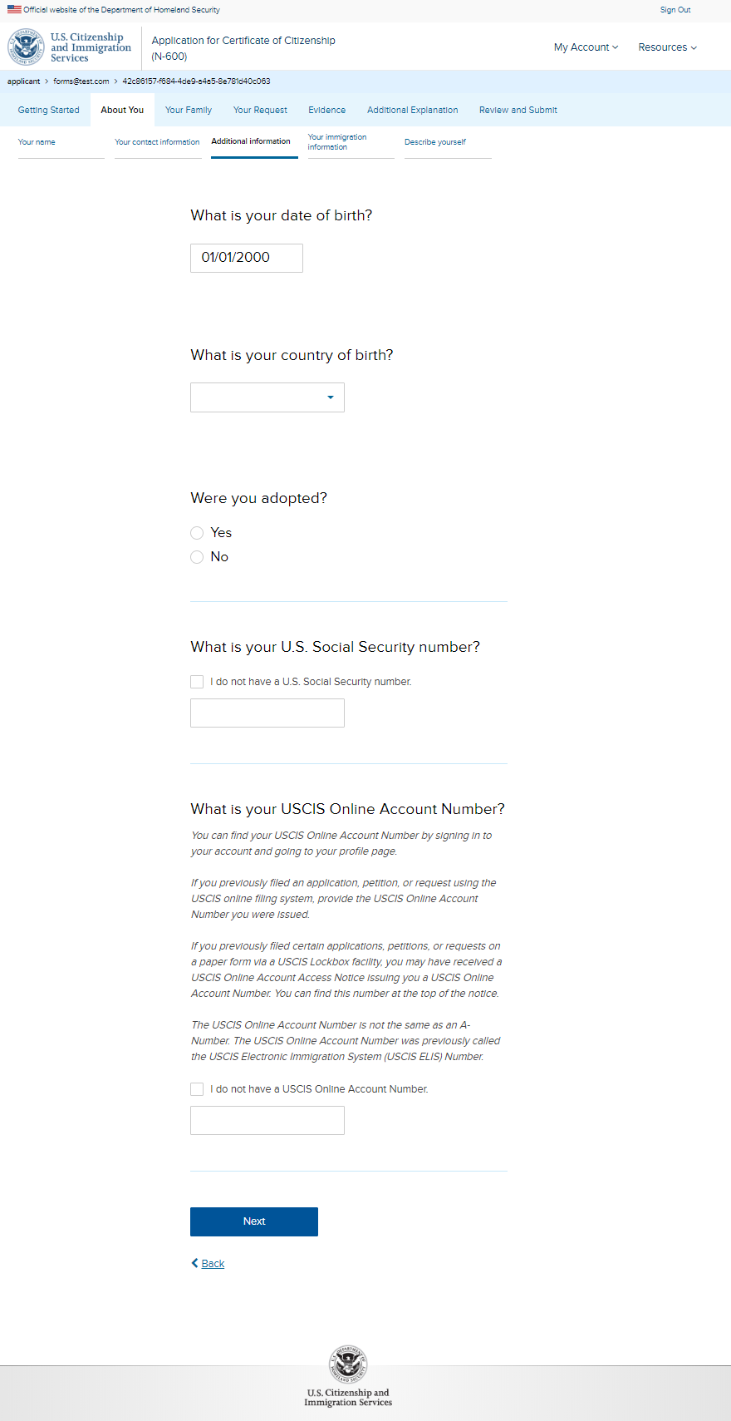
N-600: About you – Additional information

Slide 11
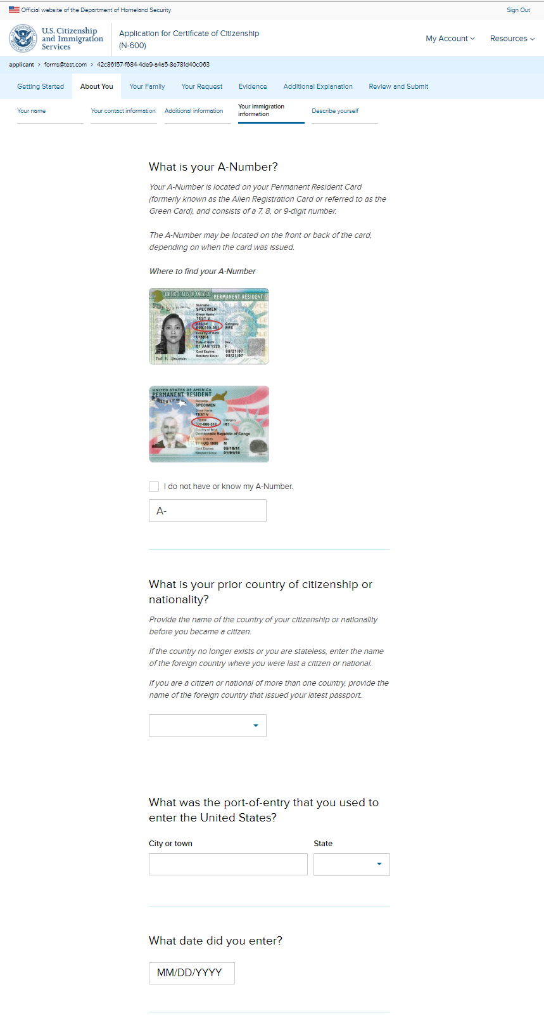
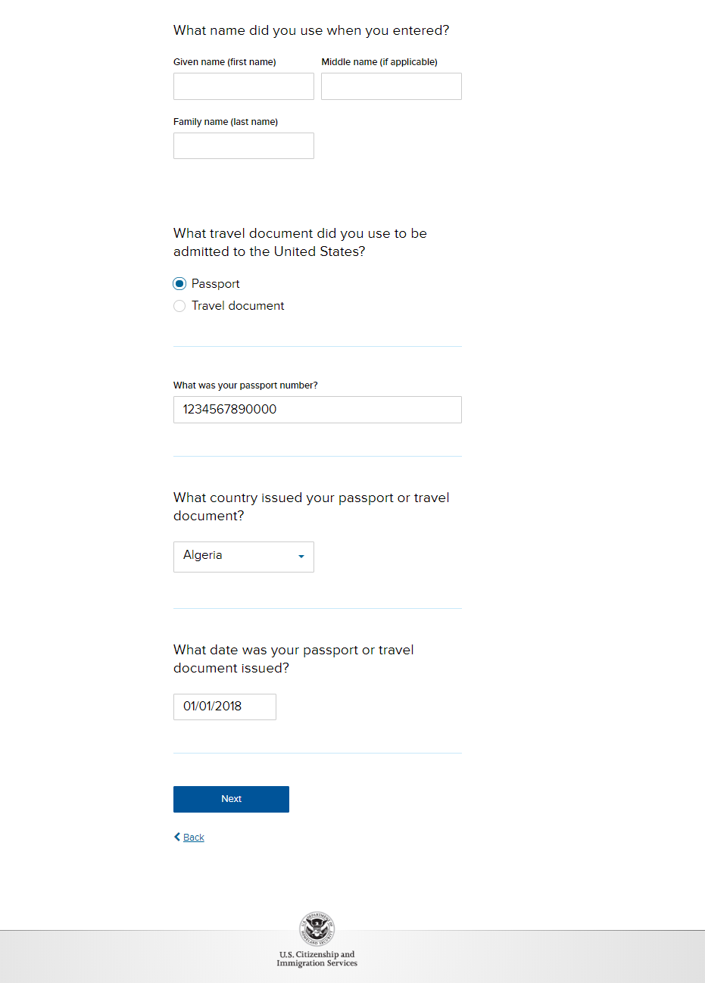
N-600: About you – Your immigration information

Slide 12
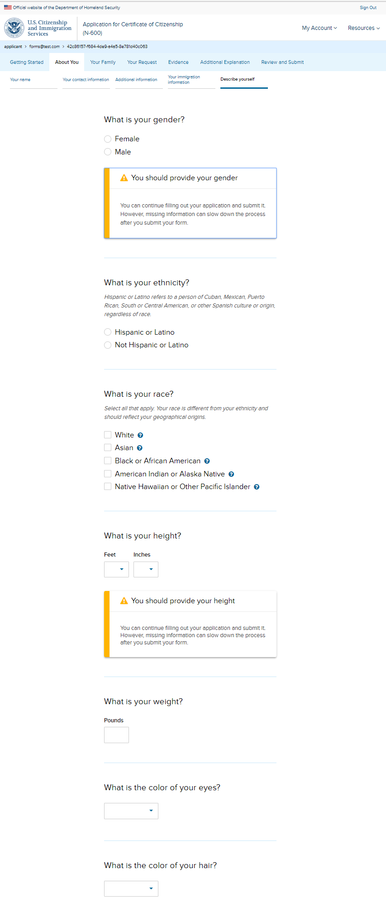
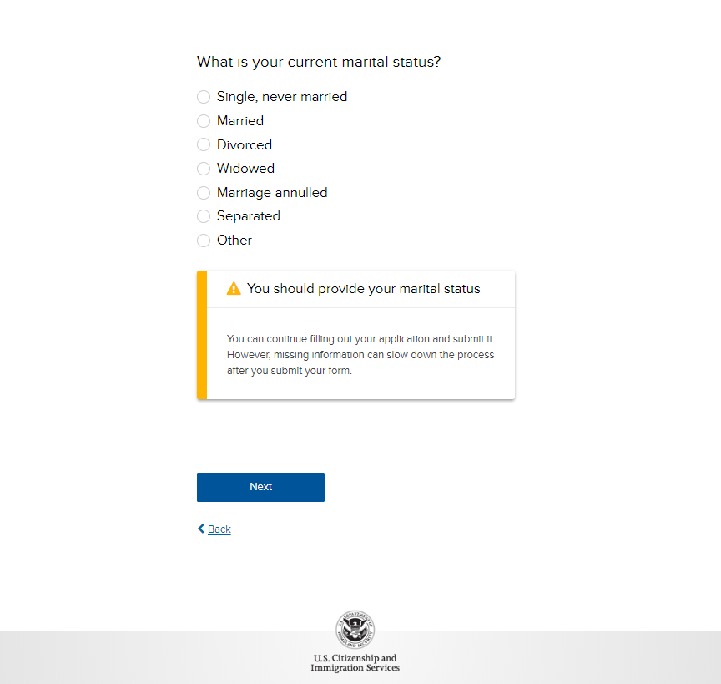
N-600: About You – Describe yourself

Slide 13
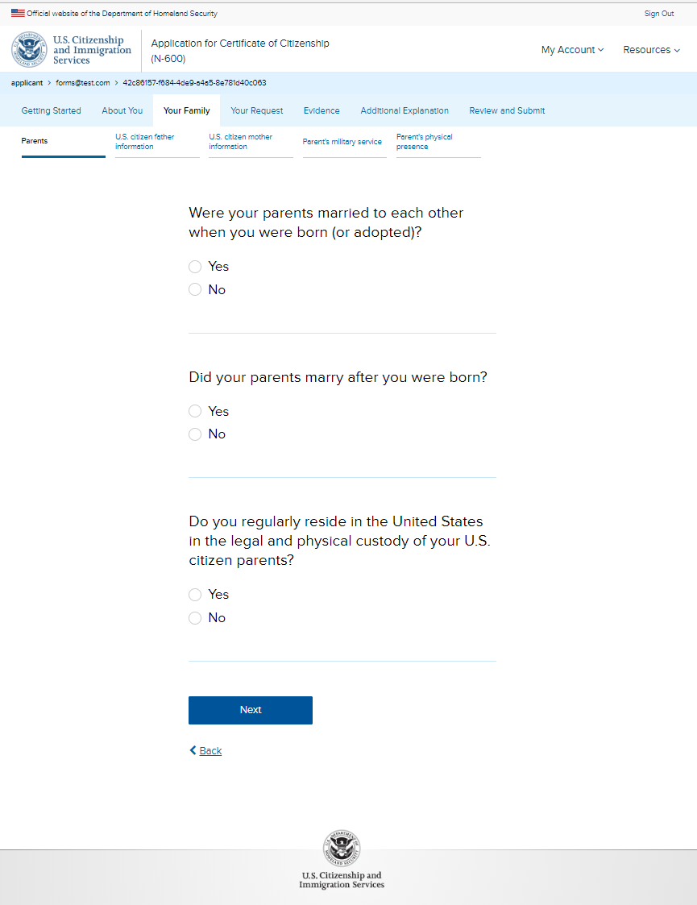
N-600: Your Family - Parents

Slide 14
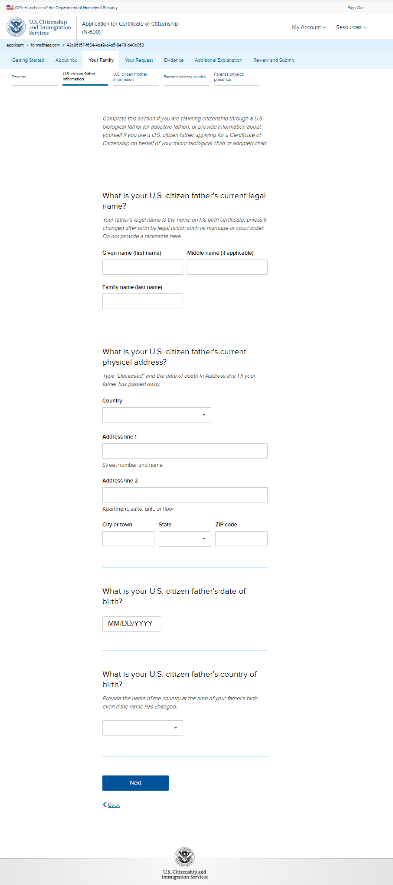
N-600: Your Family – U.S. citizen father information

Slide 15
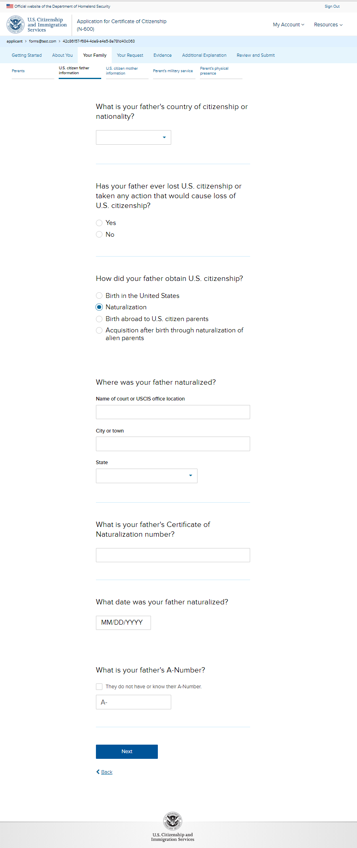
N-600: Your Family – U.S. citizen father information page 2

Slide 16
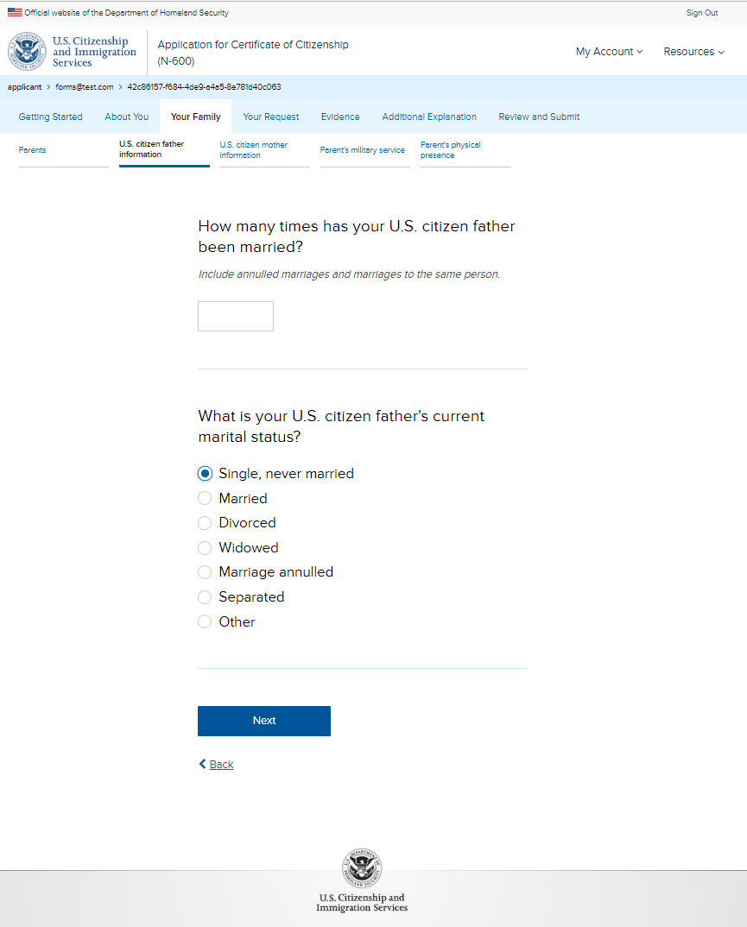
N-600: Your Family – U.S. citizen father information page 3

Slide 17
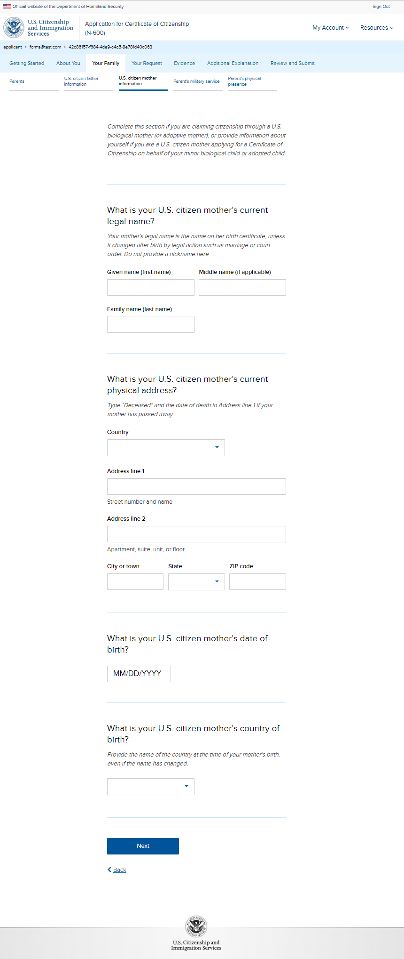
N-600: Your Family – U.S. citizen mother information

Slide 18
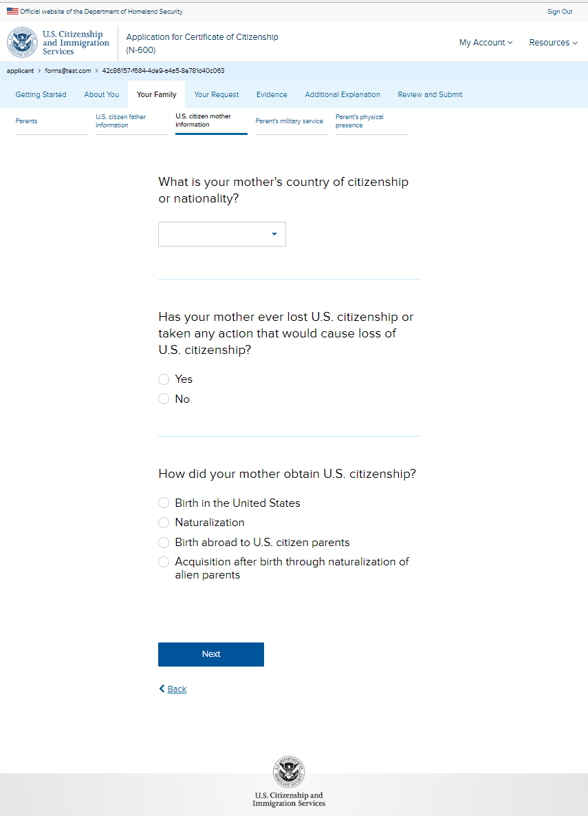
N-600: Your Family – U.S. citizen mother information page 2

Slide 19
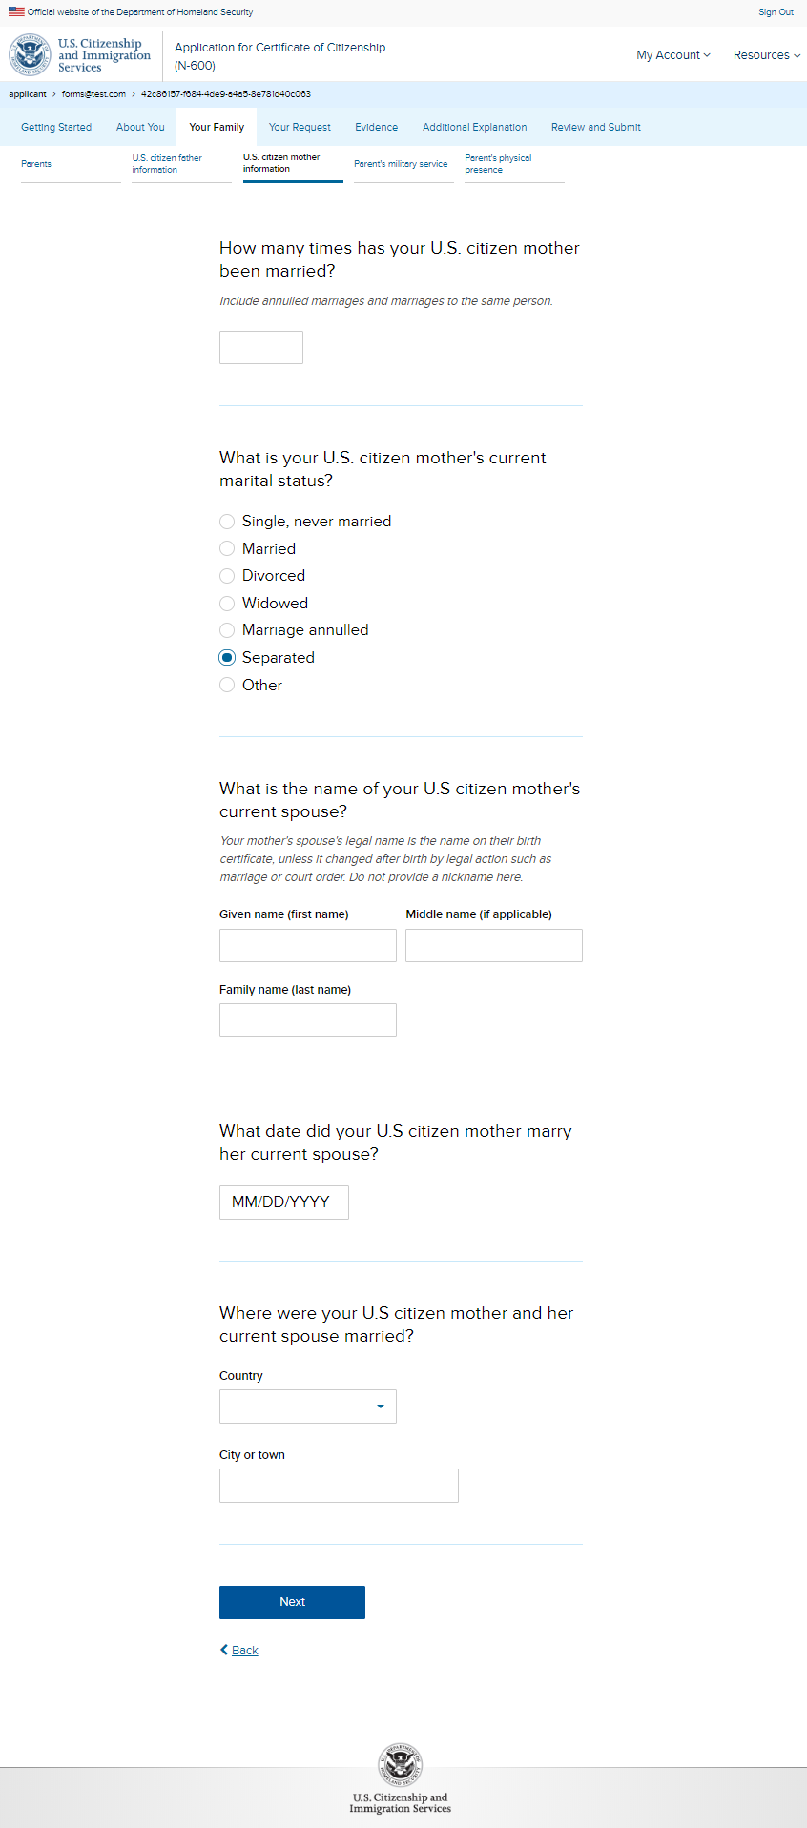
N-600: Your Family – U.S. citizen mother information page 3

Slide 20
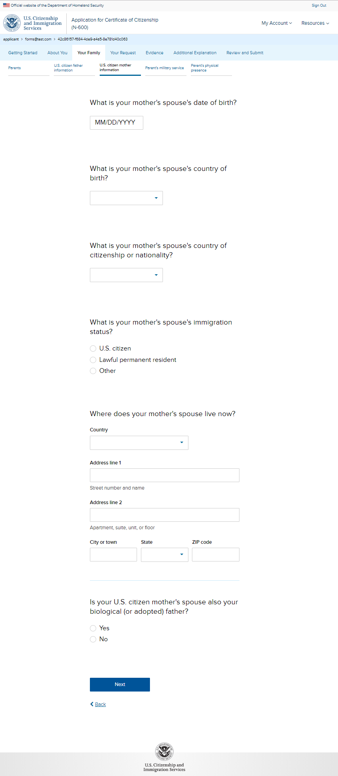
N-600: Your Family – U.S. citizen mother information page 4

Slide 21
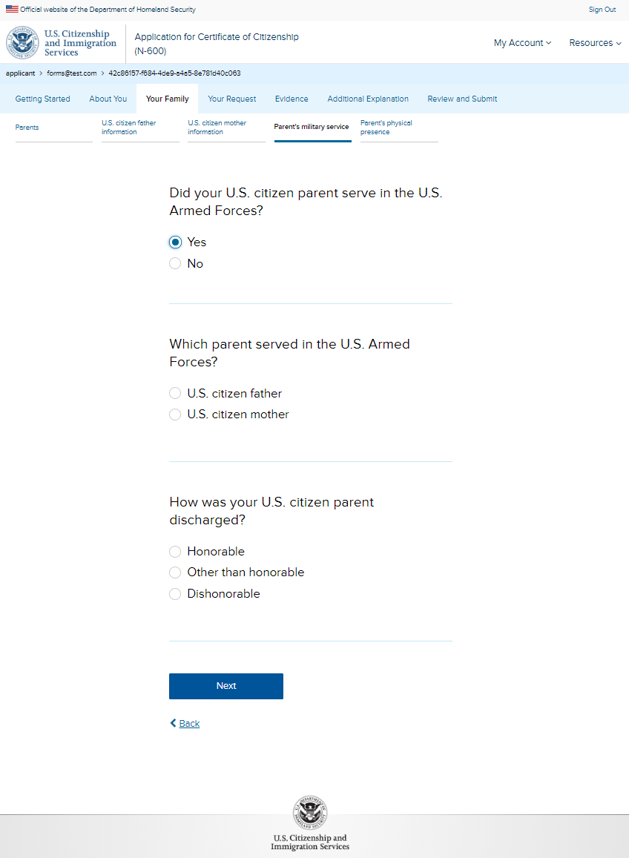
N-600: Your Family – Parent’s military service

Slide 22
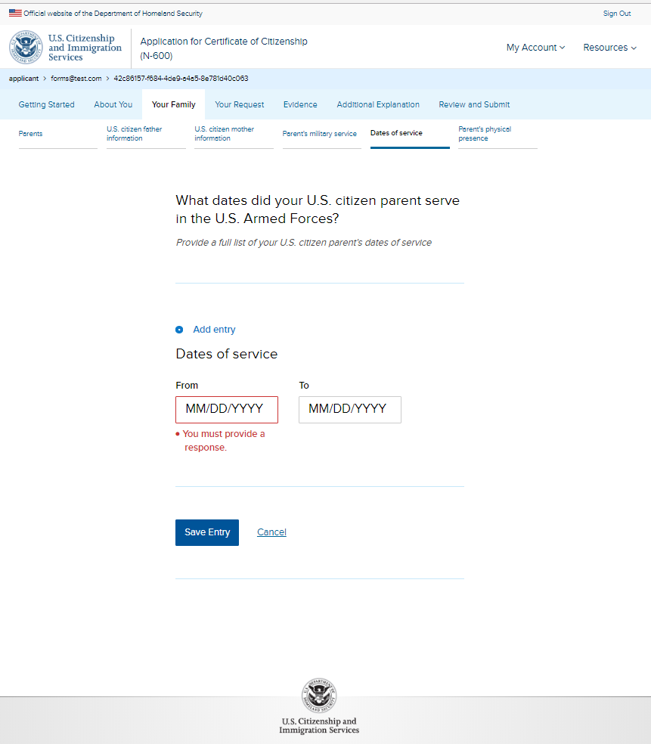
N-600: Your Family – Dates of service page 1 (conditional)

Slide 23
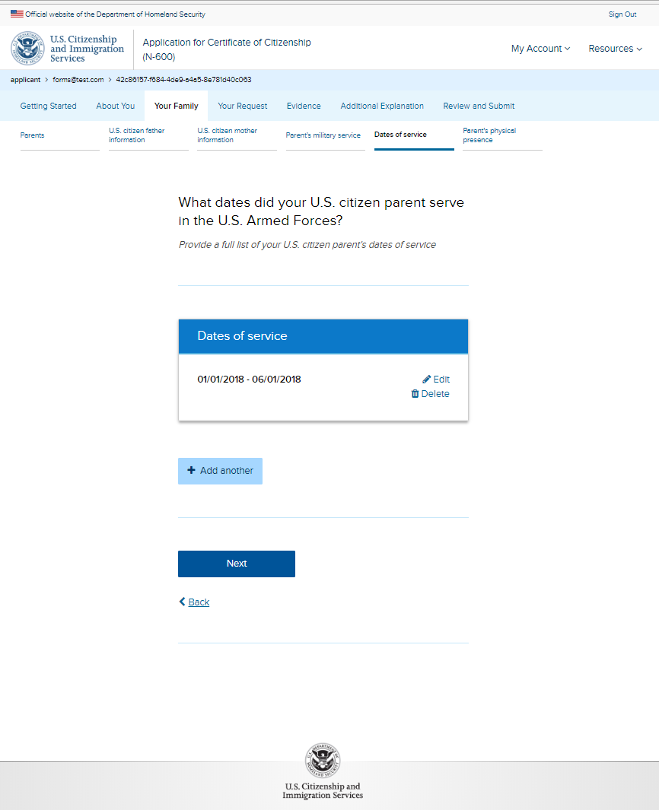
N-600: Your Family – Dates of service page 2 (conditional)

Slide 24
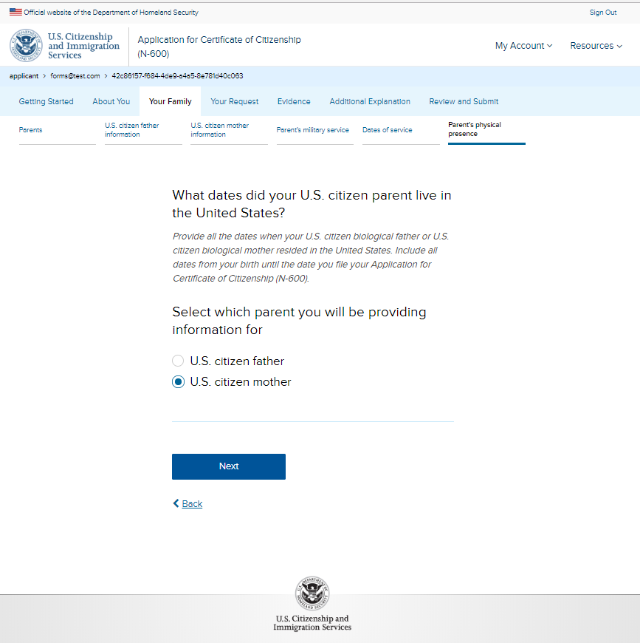
N-600: Your Family – Parent’s physical presence page 1

Slide 25
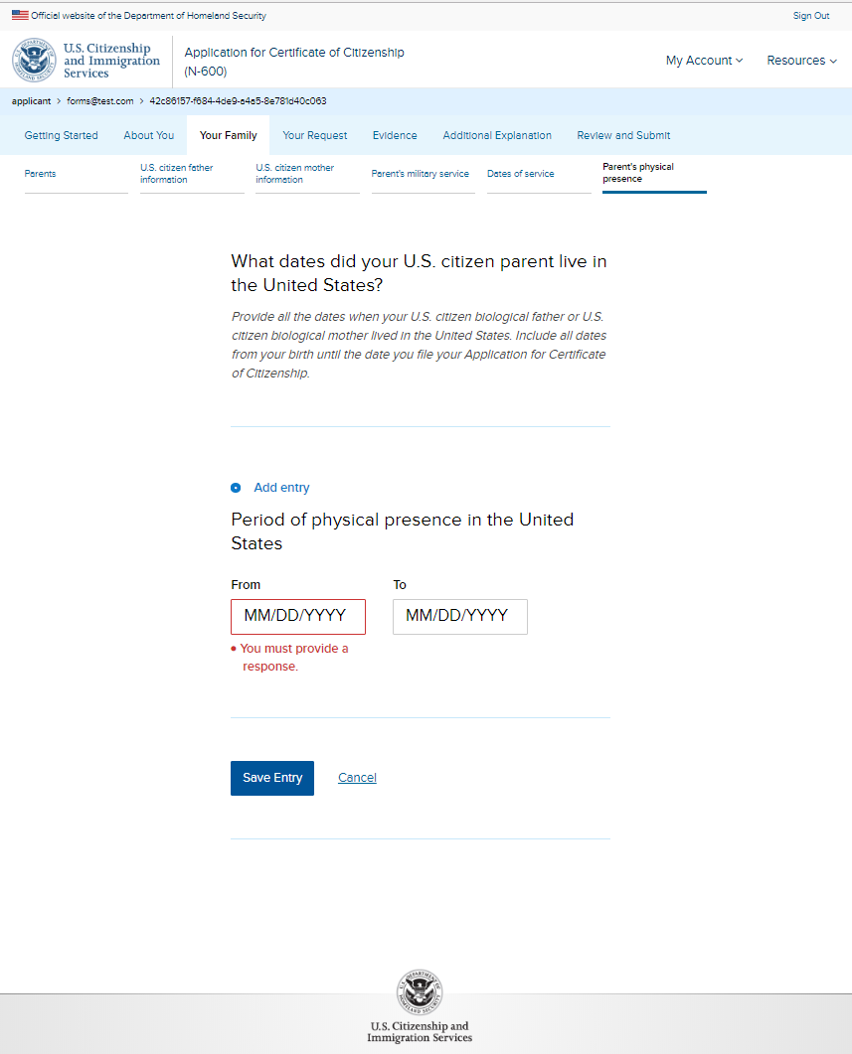
N-600: Your Family – Parent’s physical presence page 2

Slide 26
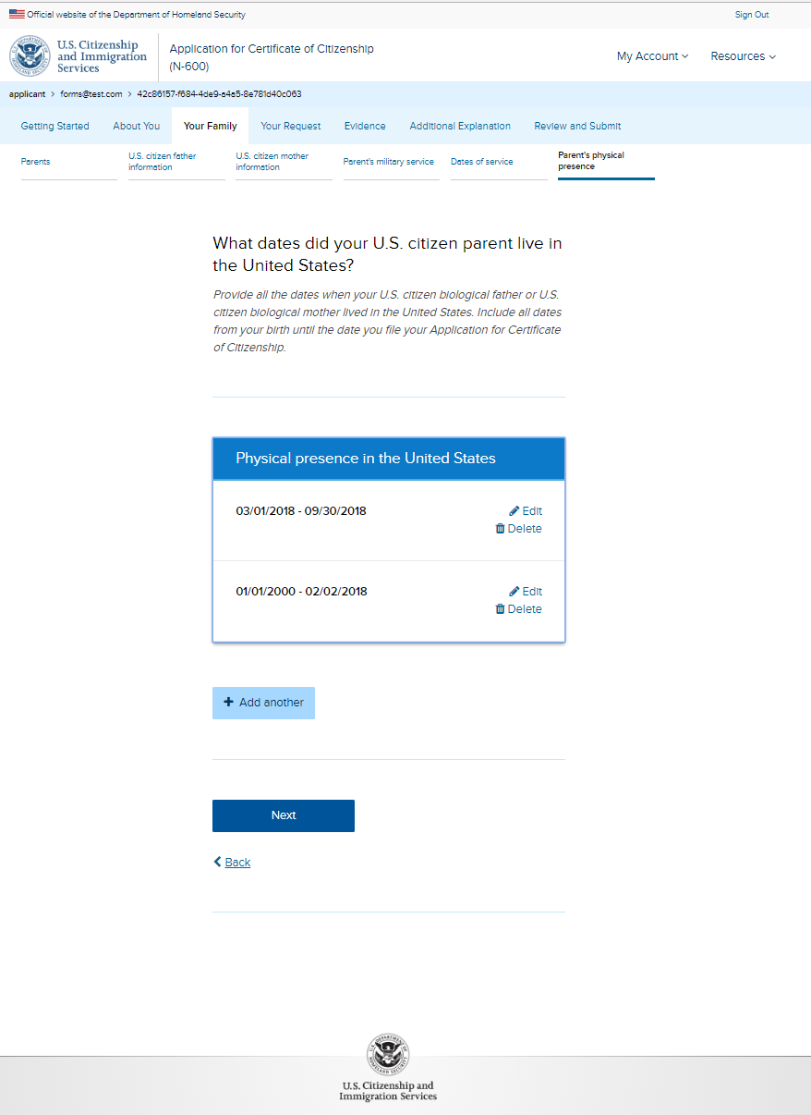
N-600: Your Family – Parent’s physical presence page 3

Slide 27
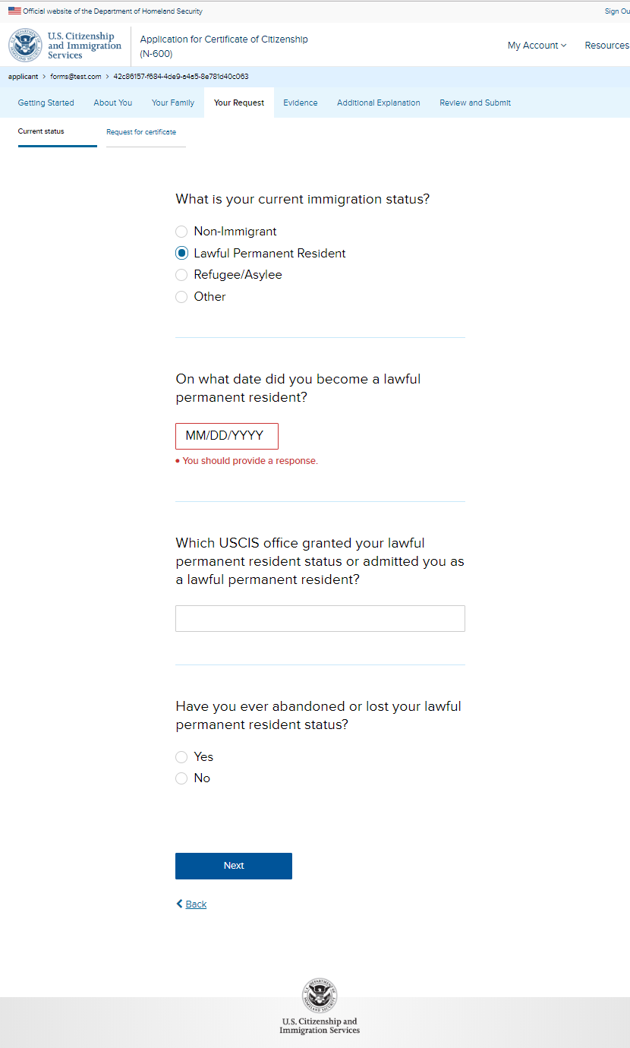
N-600: Your Request – Current status

Slide 28
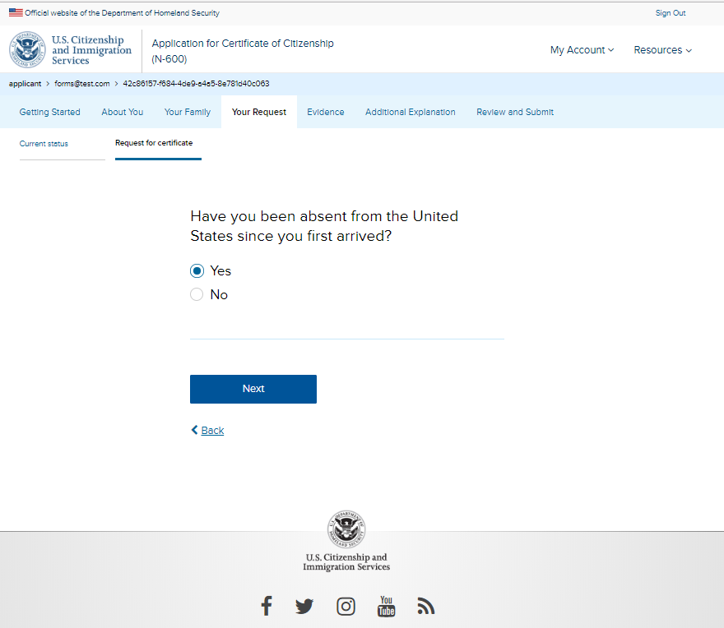
N-600: Your Request – Request for certificate

Slide 29
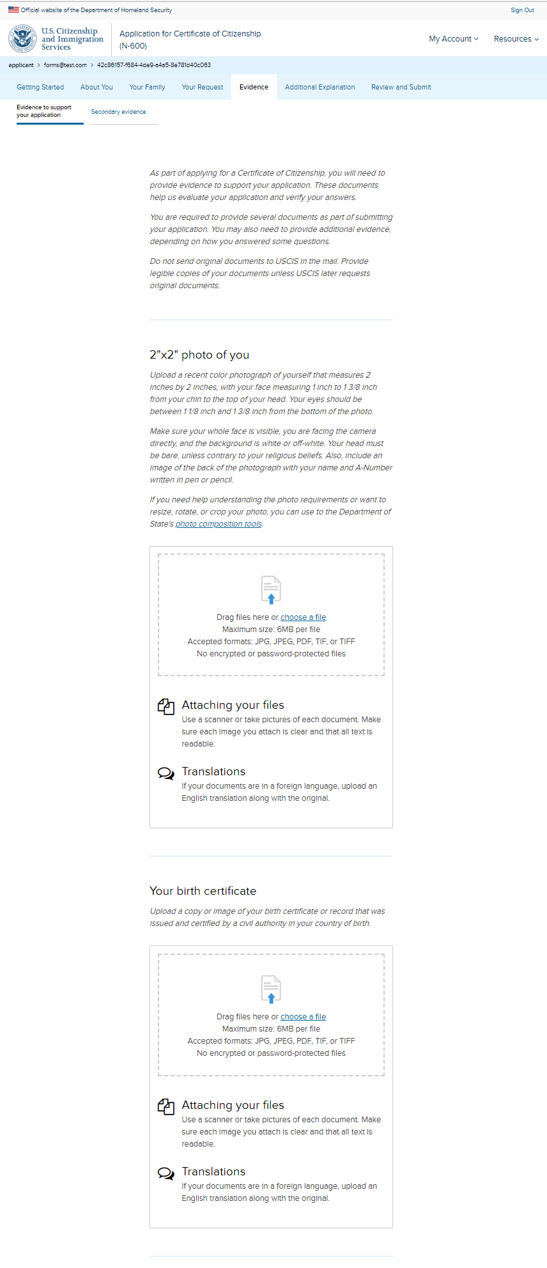
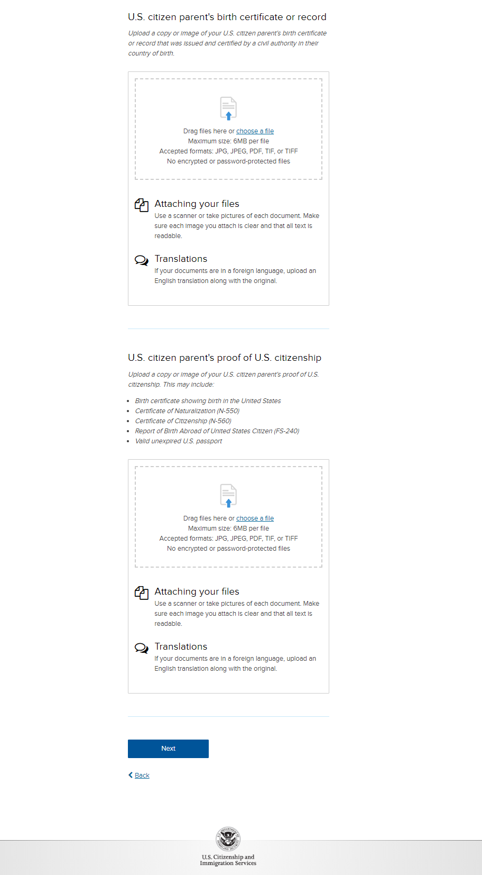
N-600: Evidence – Evidence to support your application

Slide 30
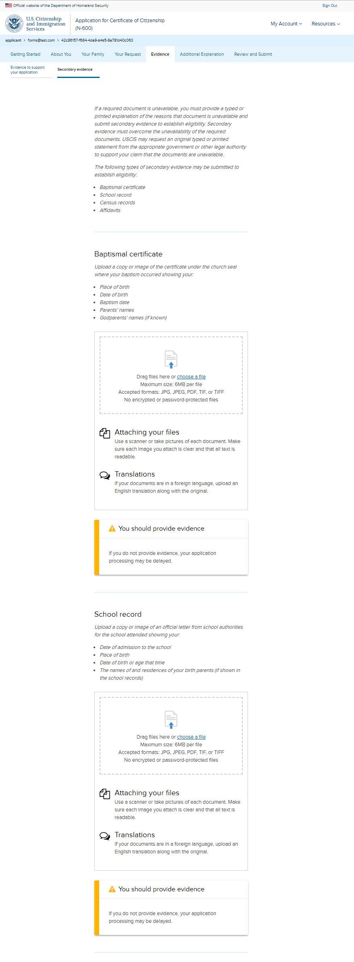
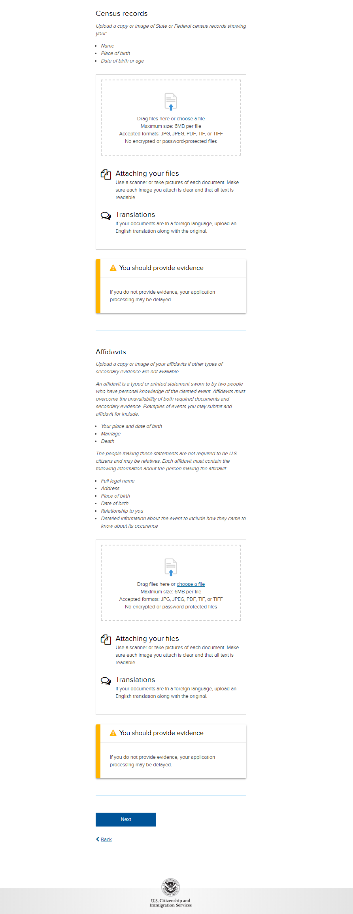
N-600: Evidence – Secondary evidence

Slide 31
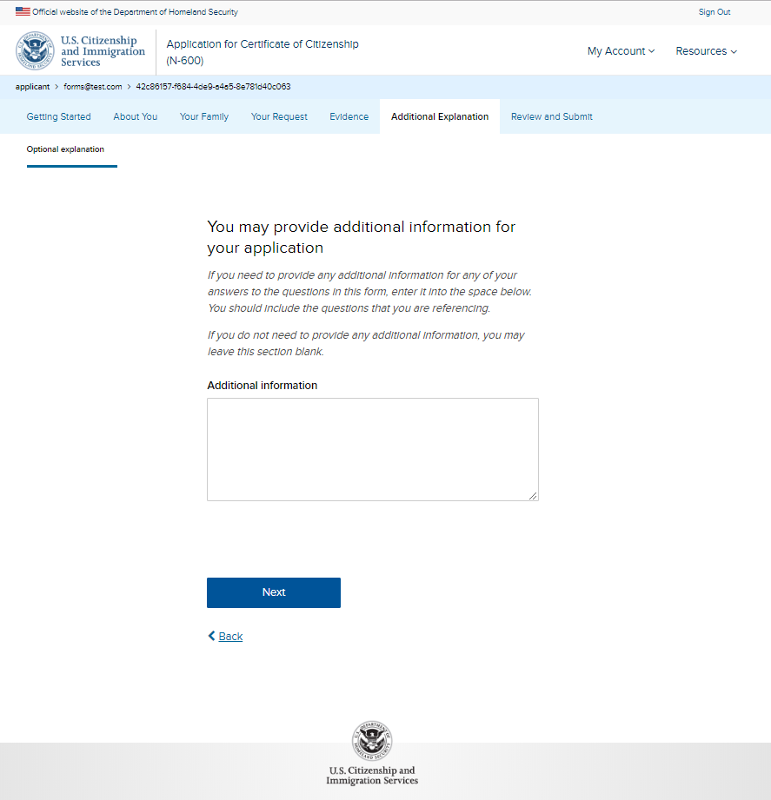
N-600: Additional Explanation – Optional explanation

Slide 32
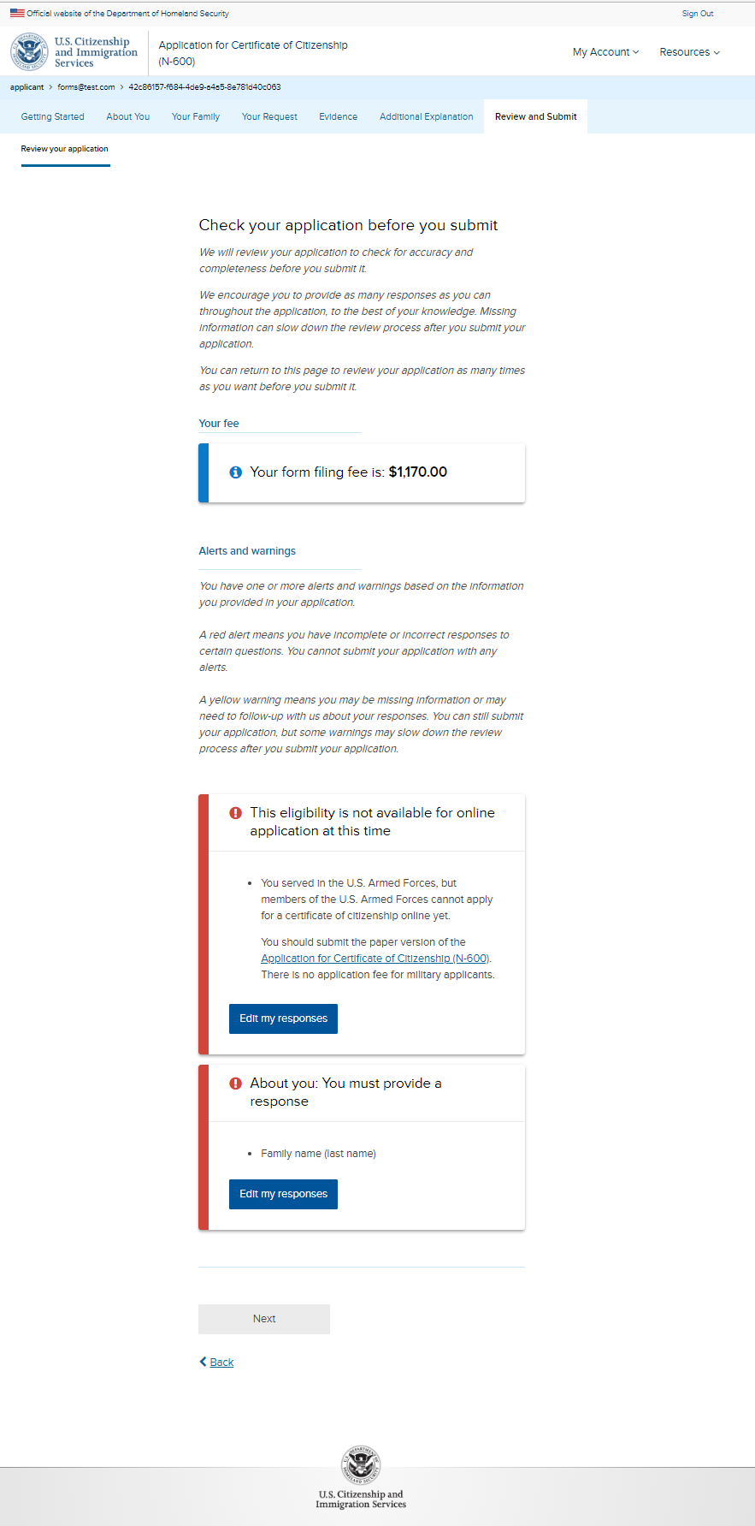
N-600: Review and Submit – Review your application (with hard stop errors)

Slide 33
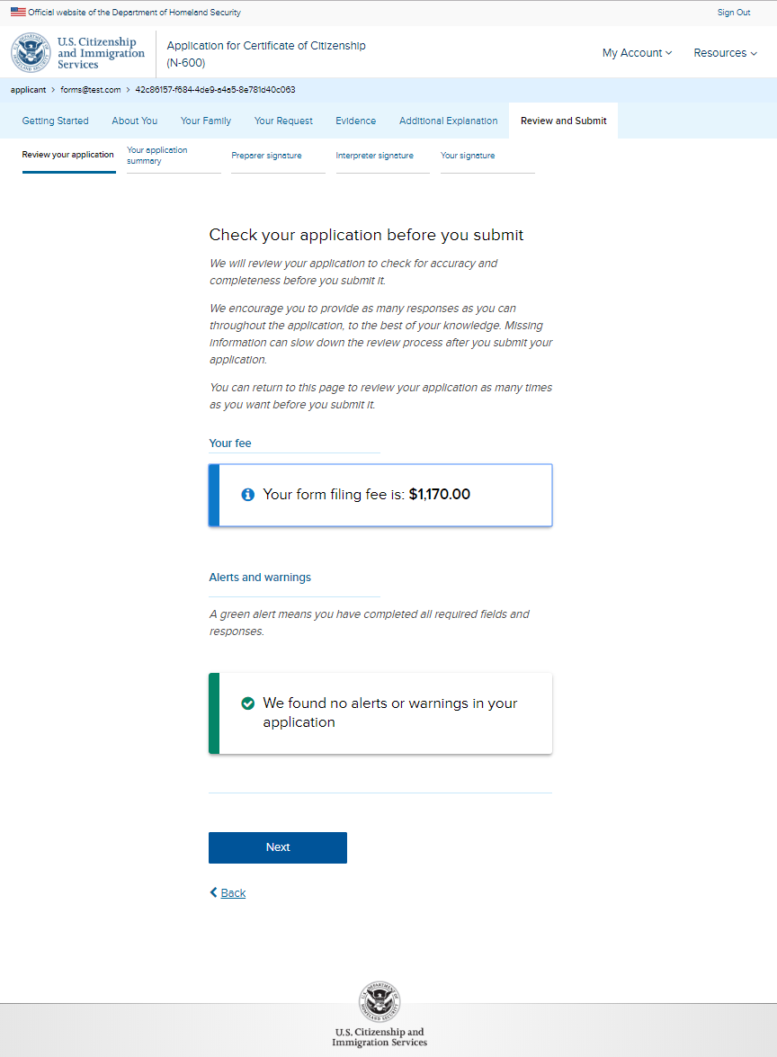
N-600: Review and Submit – Review your application (without hard stop errors)

Slide 34
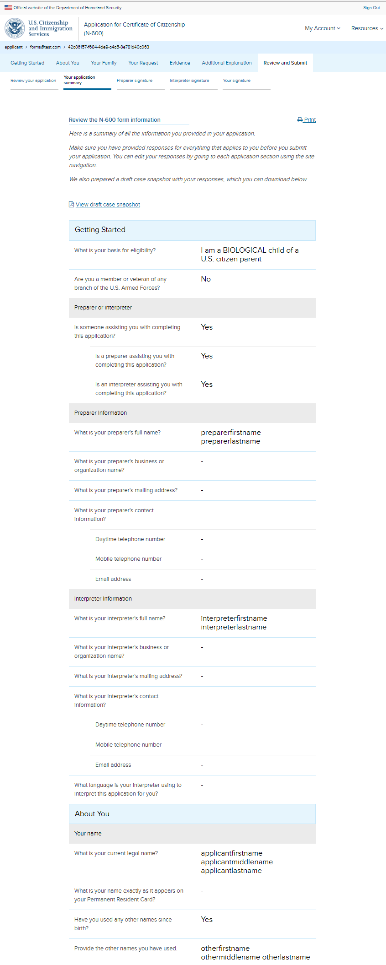
N-600: Review and Submit – Your application summary (will show all users’ answers )

Slide 35
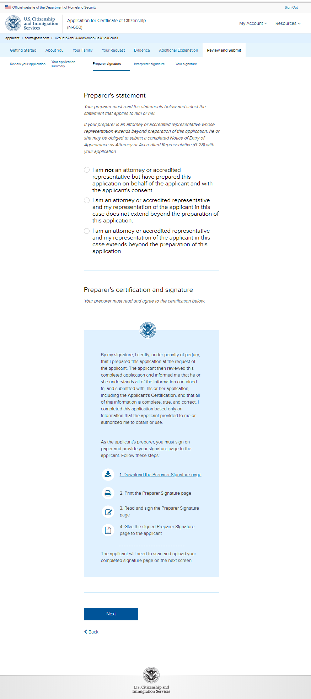
N-600: Review and Submit – Preparer signature page 1 (conditional)

Slide 36
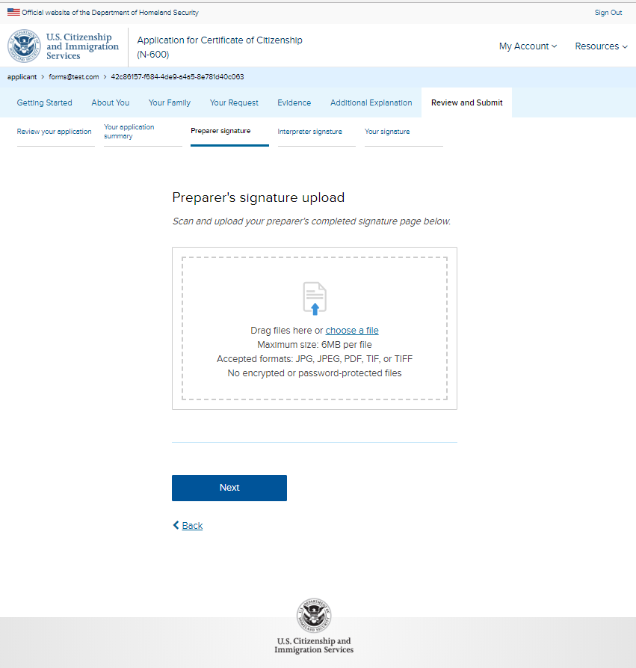
N-600: Review and Submit – Preparer signature page 2 (conditional)

Slide 37
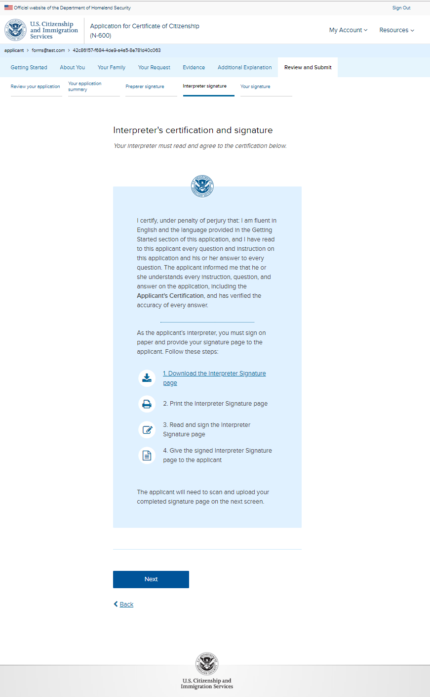
N-600: Review and Submit – Interpreter signature page 1 (conditional)

Slide 38
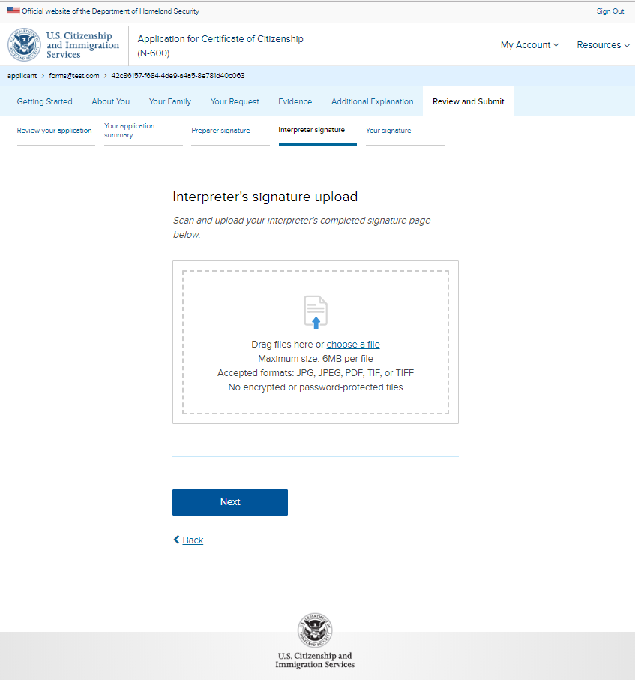
N-600: Review and Submit – Interpreter signature page 2 (conditional)

Slide 39
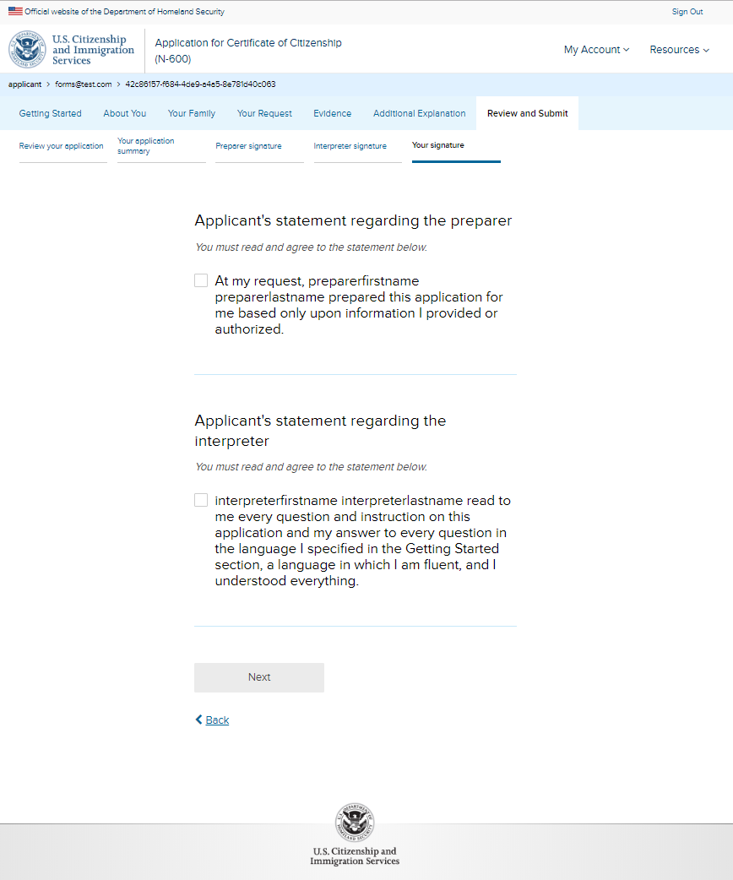
N-600: Review and Submit – Your signature (conditional copy with preparer and interpreter)

Slide 40
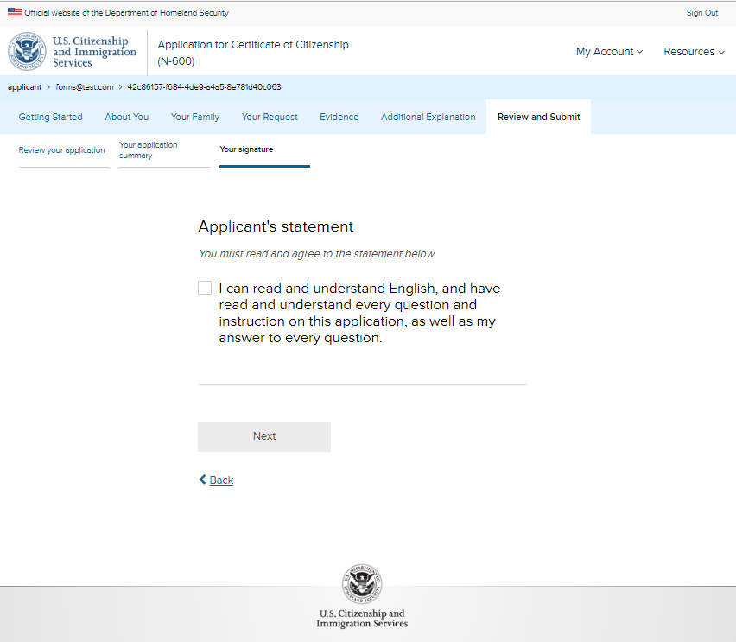
N-600: Review and Submit – Your signature 1 (without preparer or interpreter)

Slide 41
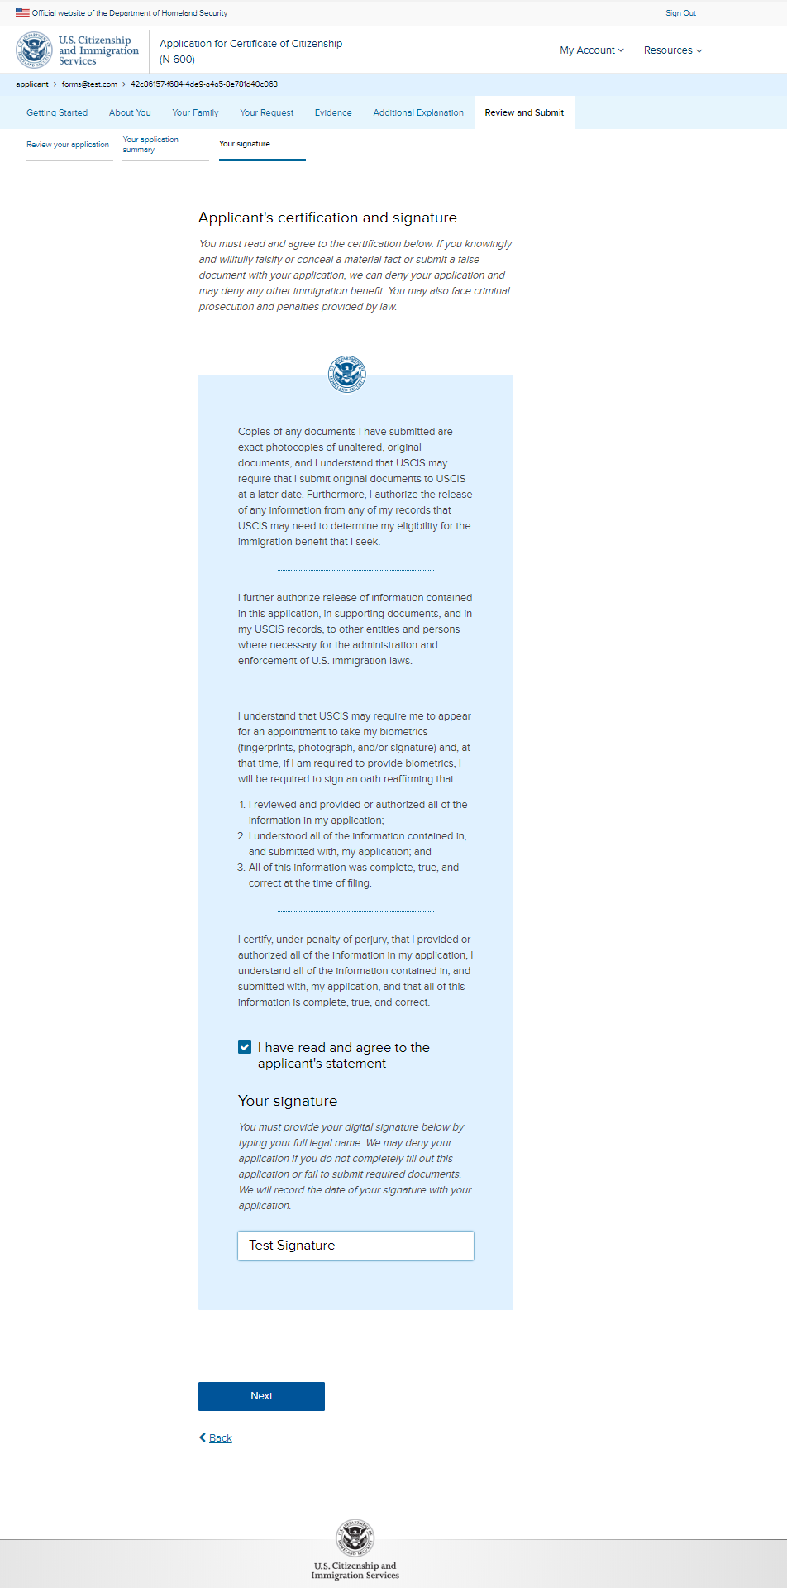
N-600: Review and Submit – Your signature 2

Slide 42
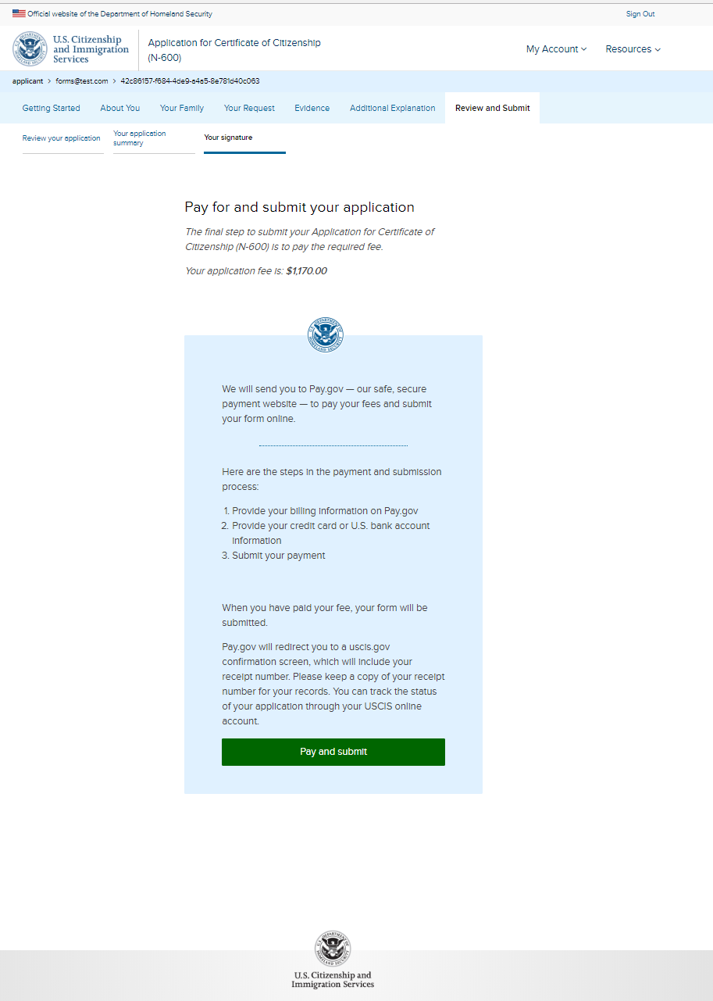
N-600: Review and Submit – Your signature 3

