Slide 1

How to Complete a Provider Enrollment Application
GROUP PROVIDER(S)

Slide 2

How to Complete a Provider Enrollment Application
The Purpose of the Enrollment Application
How to Complete an Application for a Group
What Types of Credentials are Required
How to submit your Provider Enrollment Application

Slide 3

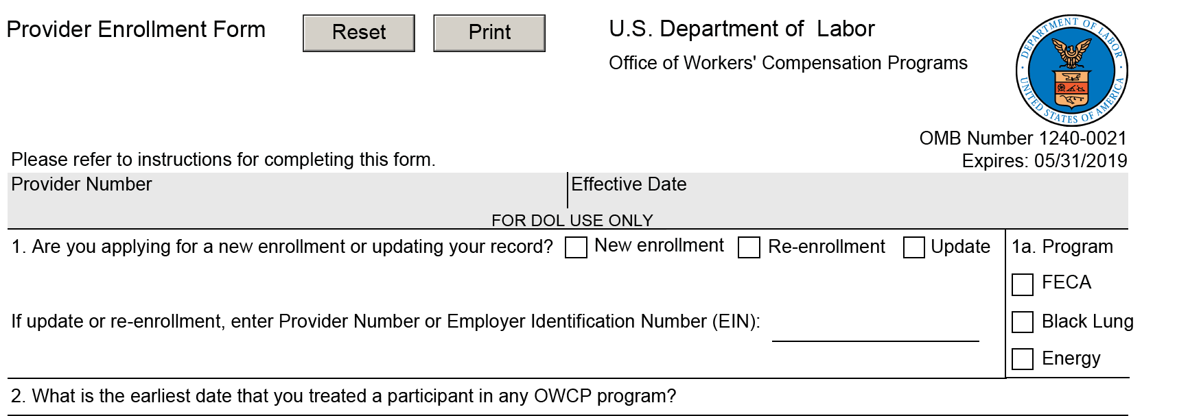
Completing an Enrollment Application Provider Enrollment Form - U.S. Department of Labor
All practice types (Individual/Facility/Group), must complete this section of the application.
Block 1: Indicate whether this form is being used for a new enrollment, or to update an *
existing enrollment record.
Note: If the form is being submitted to update your record, enter your Provider Number or Employer Identification Number.
Block 1a: Check the program in which you want to enroll as a provider. *
Note: If the provider wants to enroll in additional programs, a separate application is required for each program
* If data is missing from these fields, the application will be Returned to the Provider (RTP)

Slide 4
Completing an Enrollment Application
999909999
Ex. 2/22/2015
Block 2: Indicate earliest date you treated any OWCP participant.

Slide 5
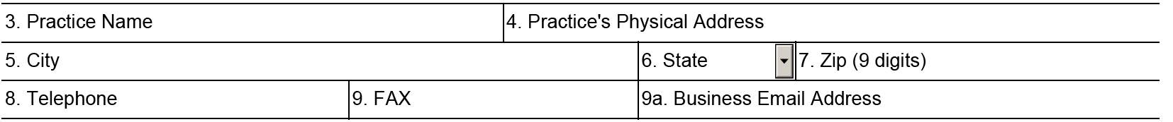
Completing an Enrollment Application Provider Enrollment Form - U.S. Department of Labor
Practice Information (Section 3)
All practice types (Individual/Facility/Group), must complete this section of the application.
Provider Company Inc.
4090 Corporate Street
Corporate Town
FL
51551-5555
999-999-9999
999-999-9999
Corporate@Corp.Com
Box 3: The provider should type/print their practice name
Box 4: The provider should type/print their practice physical address (P.O. Box is not acceptable - RTP)
Box 5: The provider should type/print their practice city
Box 6: The provider should type/print their practice state
Box 7: The provider should type/print their zip code (all 9-digits)
Box 8: The provider should type/print their practice phone number
(Note: if the provider submits a cell phone # for the practice, the provider must submit a copy
of their cell phone bill. The address on the bill MUST match the address in box 4)
Box 9 & 9a: The provider should include fax number and business email address if available (not required)
* If data is missing from any of these fields, the application will be Returned to the Provider (RTP)

Slide 6
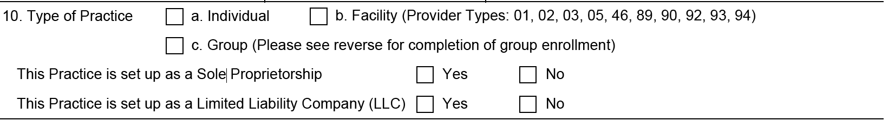


Completing an Enrollment Application Provider Enrollment Form - U.S. Department of Labor Providers MUST Select a Type of Practice

Slide 7
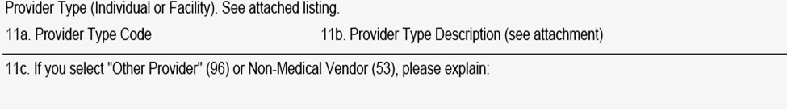
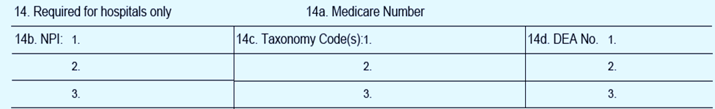
Completing an Enrollment Application Provider Enrollment Form - U.S. Department of Labor If the provider checked “c” for group they must complete box 12
Block 11a through Block 11c: Is NOT required for a Group Provider
Block 12: The provider should check the box and type or print their SSN or EIN as appropriate. *
Note: If the provider is a sole proprietor they should use their SSN #
If the provider is an LLC, INC., etc., they should use their EIN #
Block 13a through Block 13c is NOT required for a Group Provider
Block 14a through Block 14d is NOT required for a Group Provider
* If data is missing from these fields, the application will be Returned to the Provider (RTP)

Slide 8
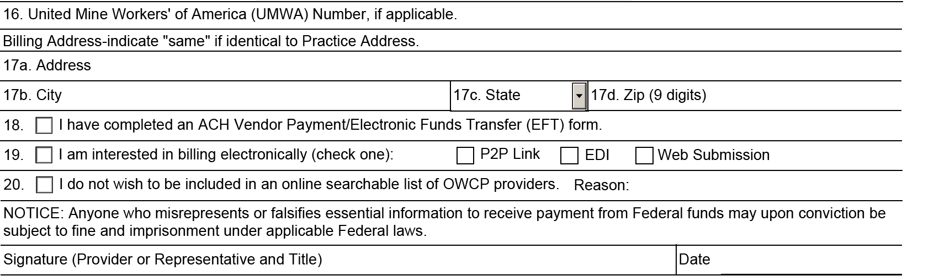
Completing an Enrollment Application Provider Enrollment Form - U.S. Department of Labor
If the provider checked “c” for group provider, they must complete boxes 17a through 20. *The provider MUST sign and date the enrollment application or it will be returned to provider and will NOT be processed
Coral Jakes, MD
1/24/2016
Box 16: This box is only for Black Lung providers who have a UMWA Health & retirement Fund member #
Box 17a: The provider should type/print address where they want the Remittance Advice to be sent
Box 17b: The provider should type/print billing city if this is different from block # 5
Box 17c: The provider should type/print billing state if this is different from block # 6
Box 17d: The provider should type/print billing zip code (all nine digits), if this is different from block # 7
Box 18: The provider should check this box to indicate they have completed an ACH Vendor Payment
Box 19: If the provider is interested in electronic billing they should check the box and indicate one of the 3 methods
Box 20: If the provider does not wish to be included in an online searchable list of OWCP providers, they must check
this box and indicate the reason
Signature/date: The provider MUST sign and date the enrollment application *

Slide 9
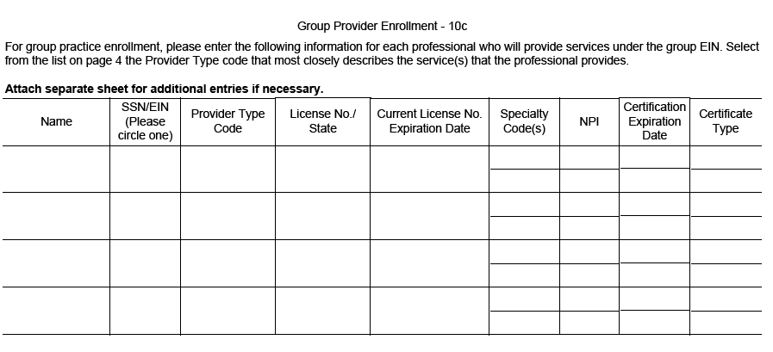
Completing an Enrollment Application Provider Enrollment Form - U.S. Department of Labor
Group Provider Enrollment – 10c
For group practice enrollment, please enter the following information for each professional who will provide services under the group EIN. Select the Provider Type code (from the list attached to the application) that most closely describes the service(s) that the provides.
*If data is missing from these fields, the application will be Return to Providers (RTP)

Slide 10
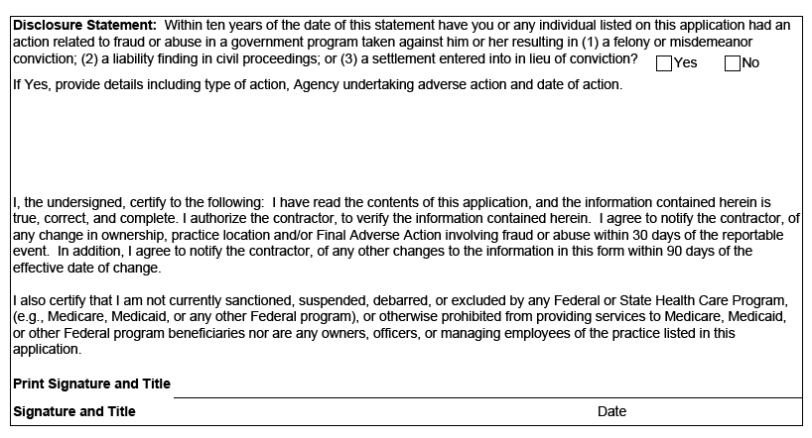
Completing an Enrollment Application Provider Enrollment Form - U.S. Department of Labor Disclosure Statement - New Addition to the Provider Enrollment Application
Provider must check either Yes or No
Any provider that indicates “Yes” on the disclosure statement will not be initially enrolled. The provider application will be forwarded to DOL for review and final decision
Provider must print name and title
Provider must sign and date
* If data is missing from these fields, the application will be Returned to the Provider (RTP)

Slide 11

Submitting an Enrollment Application Provider Enrollment Form - U.S. Department of Labor
Once the enrollment application is completed, the provider will mail the application to the appropriate program shown below. The completed enrollment form must be accompanied by a completed ACH Vendor Payment Information Form or it will be returned to the provider.
For Federal Employees’ Compensation Act (FECA) Program | For Black Lung Program | For Energy Program
OWCP/FECA P.O. Box 8300 London, KY 40742-8300 | DCMWC/Black Lung P.O. Box 8302 London, KY 40742-8302 | DEEOIC P.O. Box 8304 London, KY 40742-8304
If you have any questions regarding the completion of the form, please call Toll Free: 1-844-493-1966 | If you have any questions regarding the completion of the form, please call Toll Free: 1-800-638-7202 | If you have any questions regarding the completion of the form, please call Toll Free: 1-866-272-2682

Slide 12


How to Complete a Group Provider Enrollment Application _Training Complete
Exit

