Slide 1
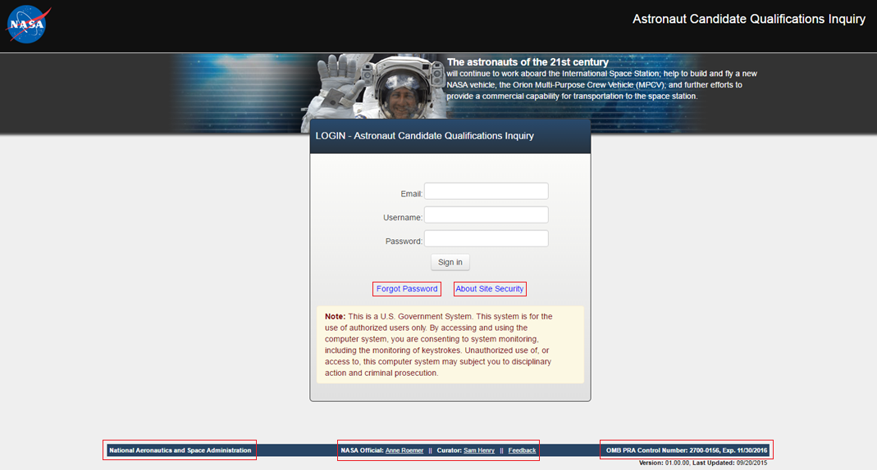
ASCAN Candidate Qualifications Inquiry
Login Page Functions
Display Password Reset Modal
Display Site Security Information Modal
Web Link to NASA Homepage
Email Links to Site POCs
Web Link to Display PRA

Slide 2
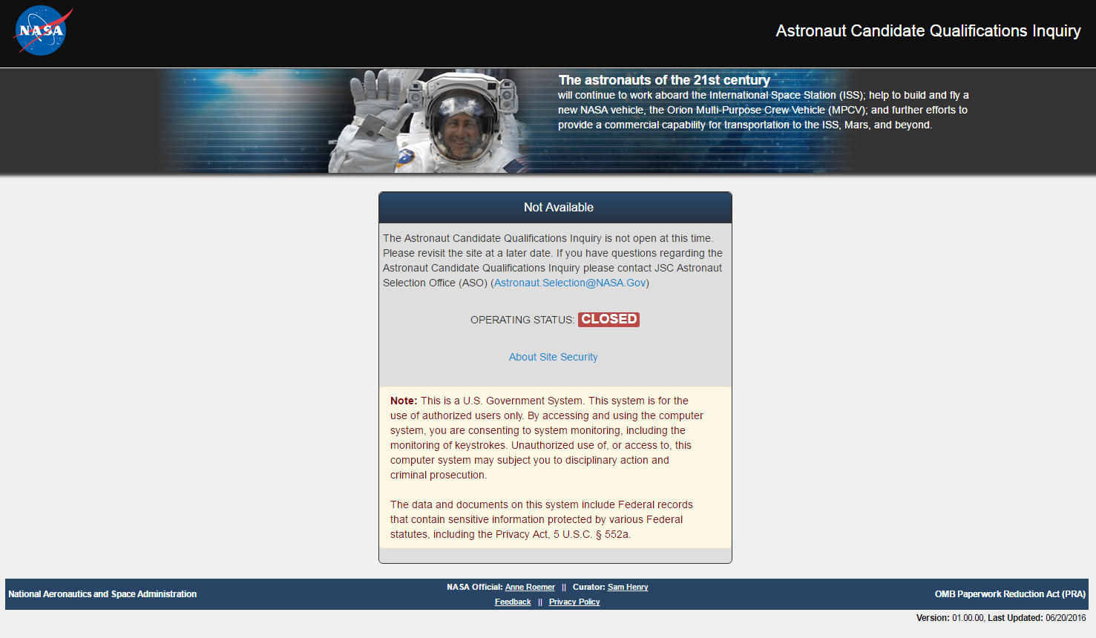
ASCAN Candidate Qualifications Inquiry
Selection CLOSED

Slide 3
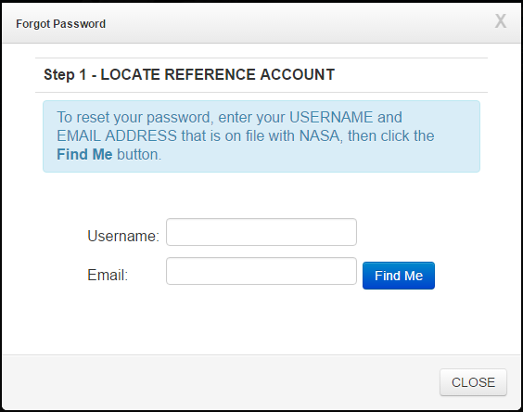
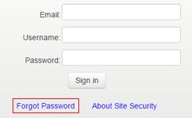
ASCAN Candidate Qualifications Inquiry
Password Reset (Step 1)

Slide 4
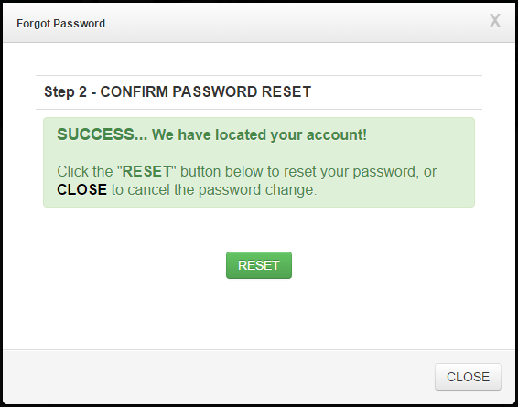
ASCAN Candidate Qualifications Inquiry
Password Reset (Step 2)

Slide 5
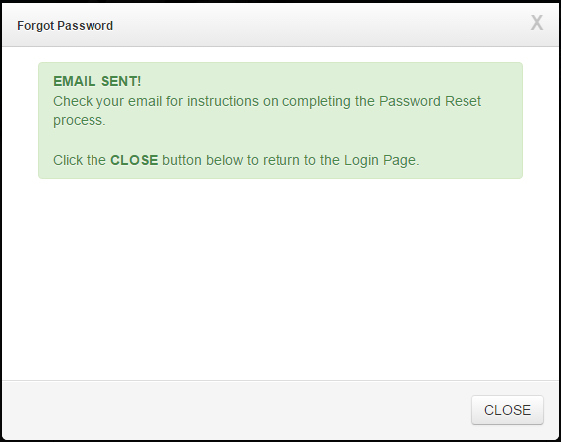
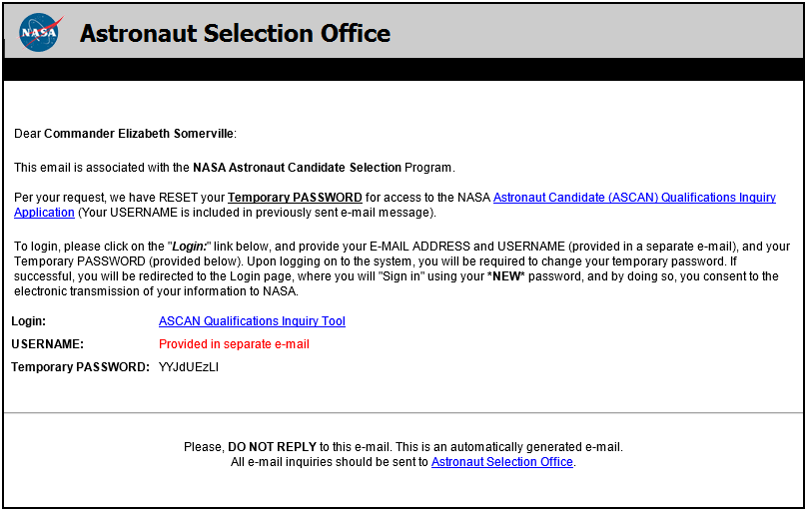
ASCAN Candidate Qualifications Inquiry
Password Reset (Step 3)

Slide 6
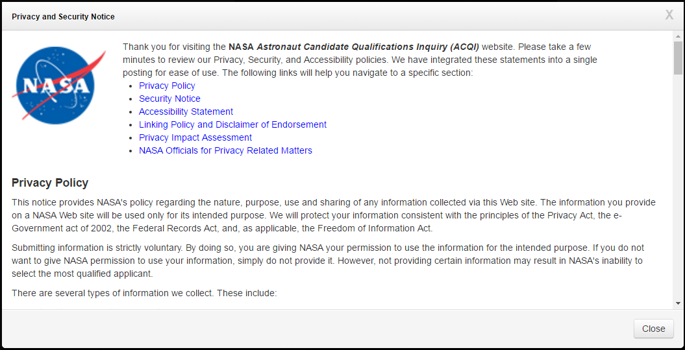
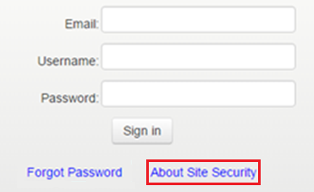
ASCAN Candidate Qualifications Inquiry
Site Security Information Modal *
* See accompanying attachment (2700-0156.Privacy and Security Notice_COMPLETE.pdf) for complete notice content.

Slide 7
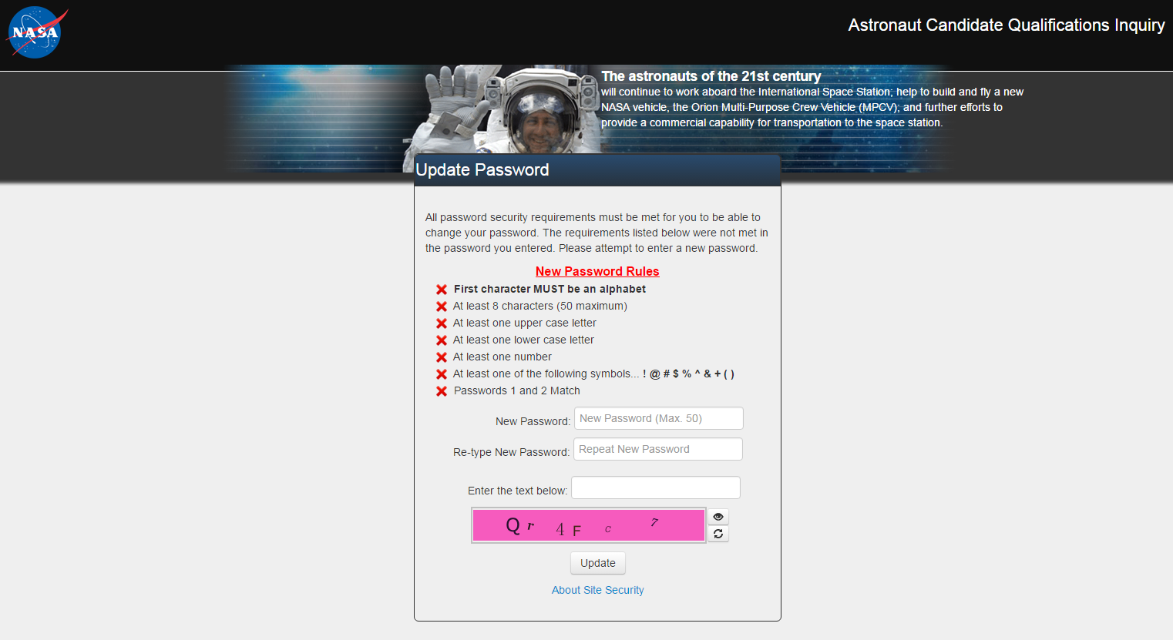
ASCAN Candidate Qualifications Inquiry
Initial Login & After Password Change

Slide 8
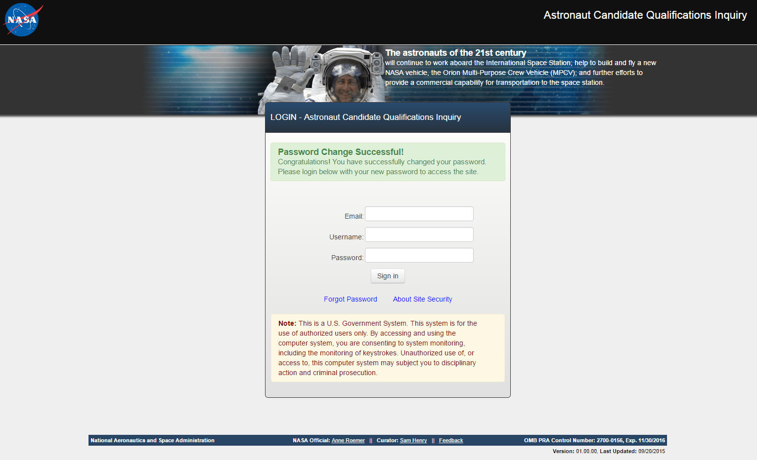
ASCAN Candidate Qualifications Inquiry
Initial Login & After Password Change

Slide 9
ASCAN Candidate Qualifications Inquiry
Login

Slide 10
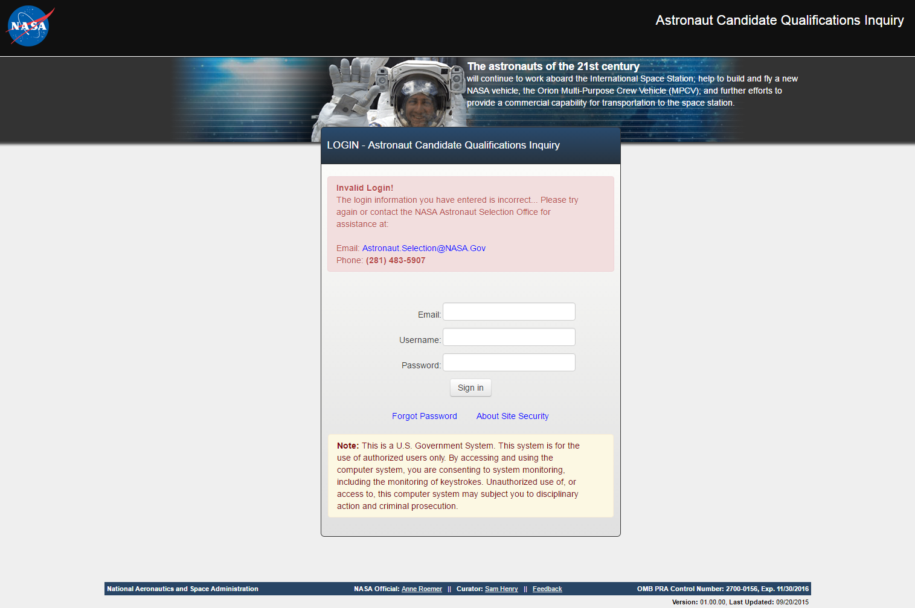
ASCAN Candidate Qualifications Inquiry
Invalid Login Credentials

Slide 11
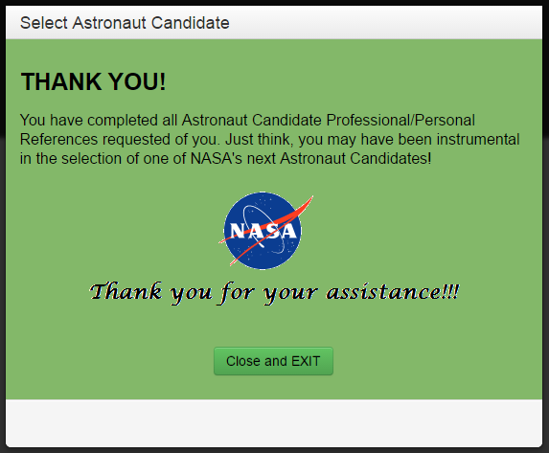
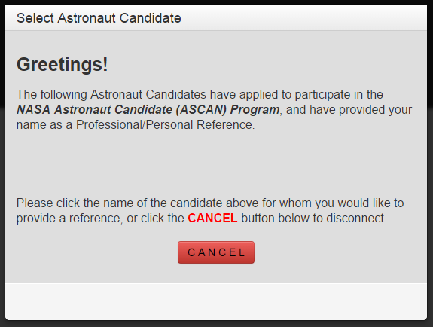
ASCAN Candidate Qualifications Inquiry
Applicant Selection Modal
Respondents are presented with this modal listing the (URL-linked) name(s) of the candidates for whom references are requested.
This modal is presented to respondents after completing all requested candidate references.

Slide 12
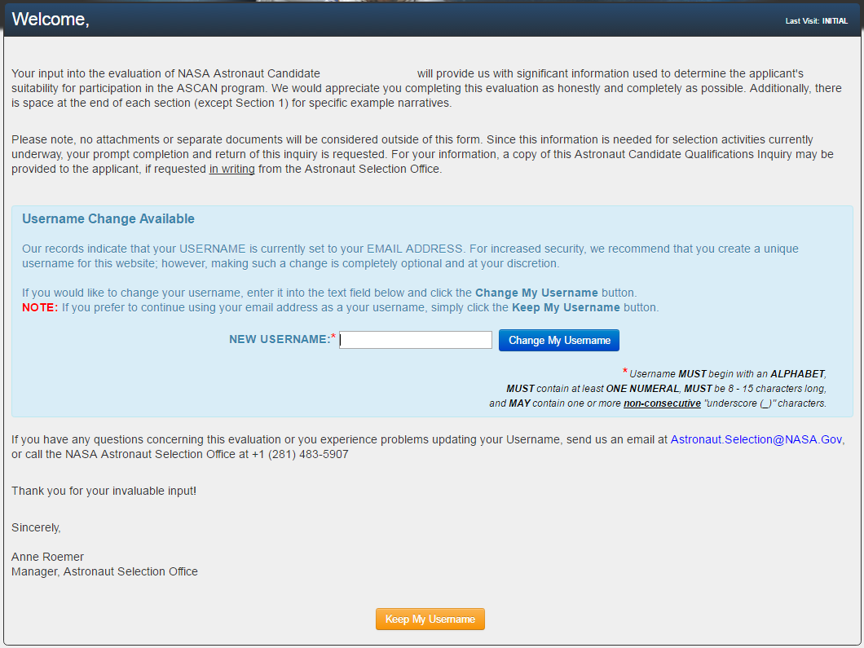
ASCAN Candidate Qualifications Inquiry
Optional Username Change (After Applicant Selection)
[ Reference Name Here ]
[Candidate Name]

Slide 13
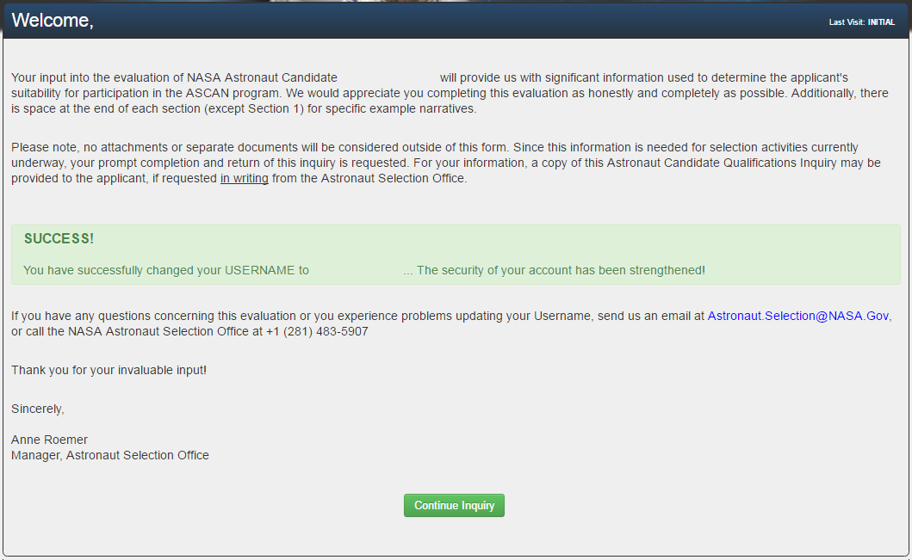
ASCAN Candidate Qualifications Inquiry
Username Change Accepted
[ Reference Name Here ]
[Candidate Name]
[New Username]

Slide 14
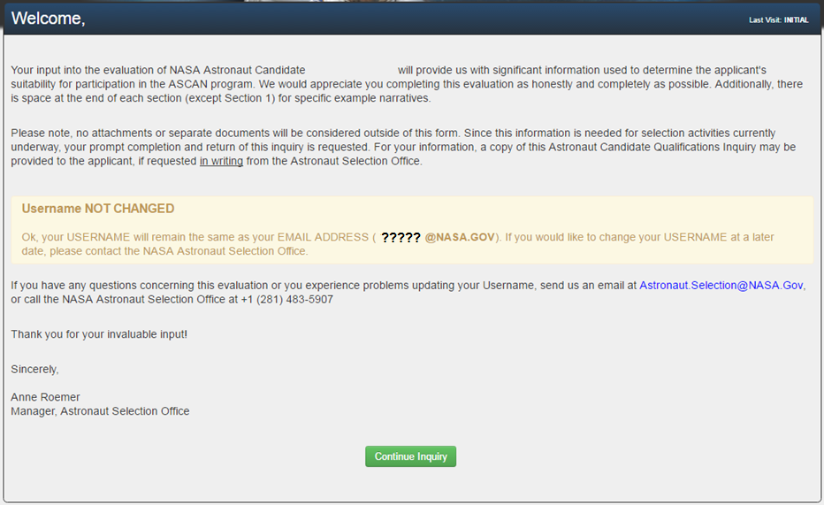
ASCAN Candidate Qualifications Inquiry
Username Change Refused
[ Reference Name Here ]
[Candidate Name]

Slide 15
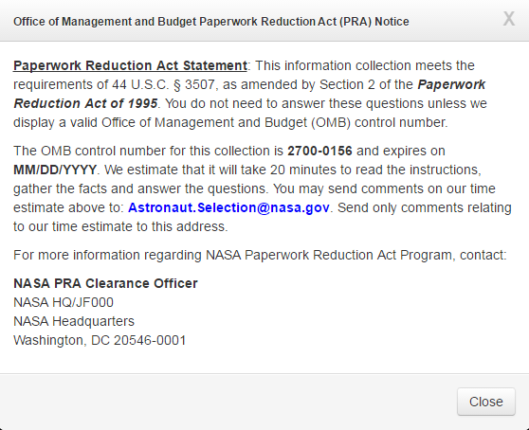
ASCAN Candidate Qualifications Inquiry
PRA Notification Modal
This modal is a pop-up that is displayed the first time the respondents log in to the application.
Following the initial connection and access to the application, the modal can be manually recalled by clicking the PRA link located on the bottom-right corner of the footer.
The footer is displayed on every page of the collection instrument.

Slide 16
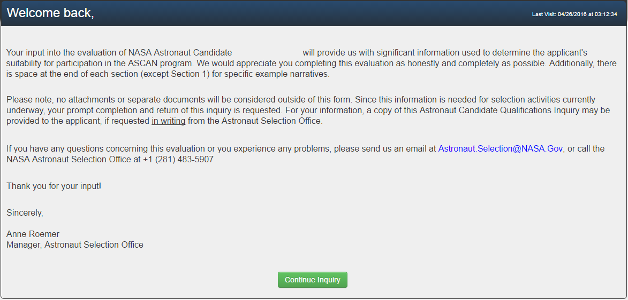
ASCAN Candidate Qualifications Inquiry
Welcome Page
[ REFERENCE NAME ]
[Candidate Name]

Slide 17
ASCAN Candidate Qualifications Inquiry
Navigation / Progress Bar
The Progress Bar Indicators display progress of Step completion. Indicators can be click to navigate to that Step.
[ Candidate Name Here ]
[ Reference Name Here ]
An alert is displayed when Step 6 is completed and any other step remains un-started/incomplete.

Slide 18
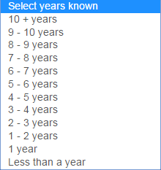
ASCAN Candidate Qualifications Inquiry
Step 1

Slide 19
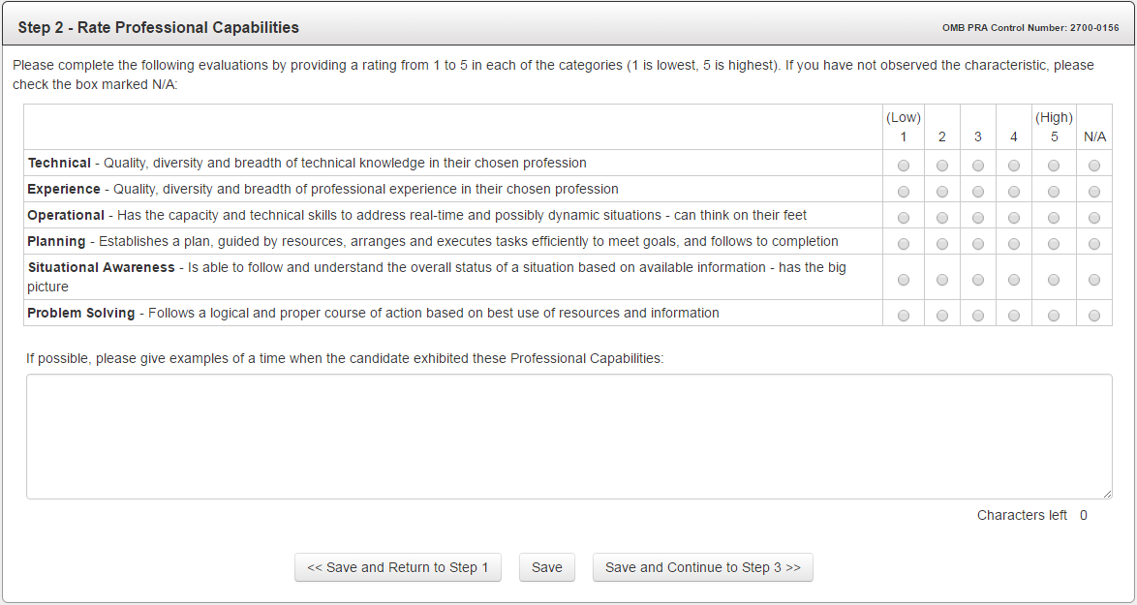
ASCAN Candidate Qualifications Inquiry
Step 2

Slide 20
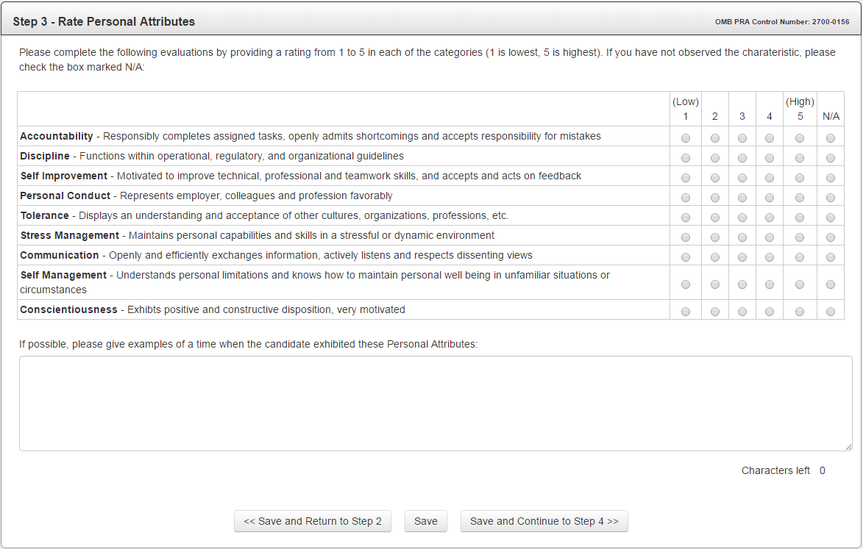
ASCAN Candidate Qualifications Inquiry
Step 3

Slide 21
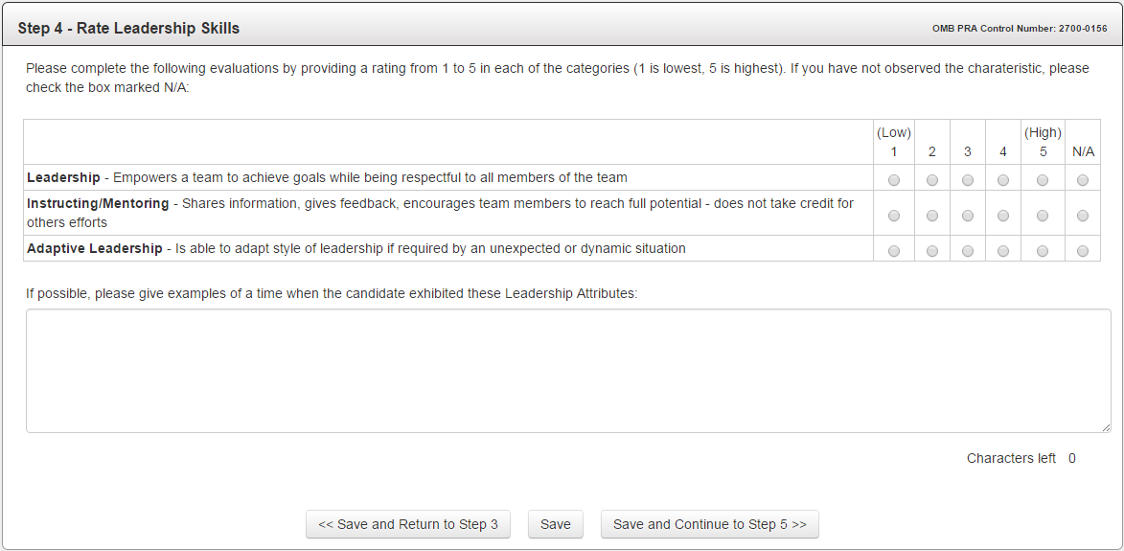
ASCAN Candidate Qualifications Inquiry
Step 4

Slide 22
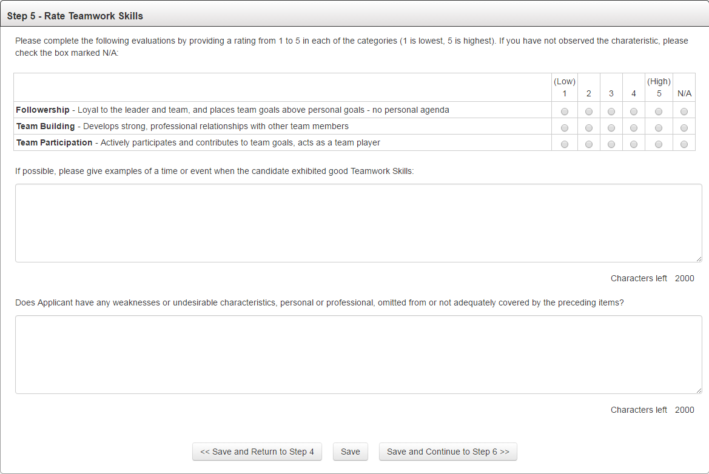
ASCAN Candidate Qualifications Inquiry
Step 5

Slide 23
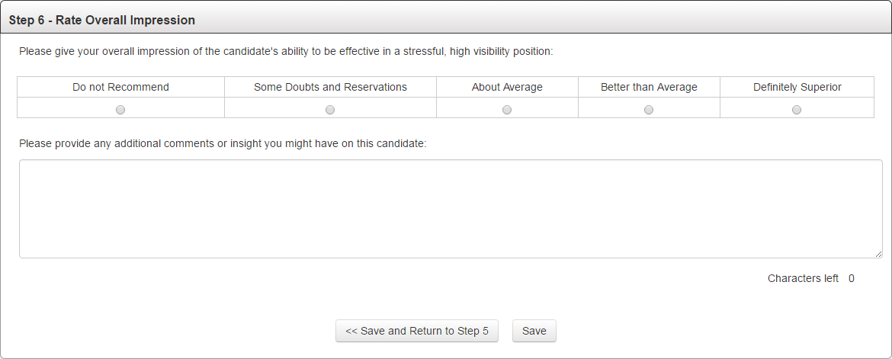
ASCAN Candidate Qualifications Inquiry
Step 6

Slide 24
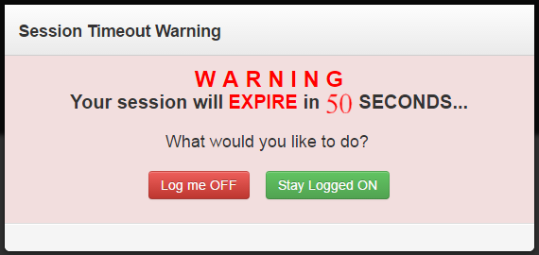
ASCAN Candidate Qualifications Inquiry
Timeout Warning
Inactivity timeout and logoff occurs after fifteen (15) minutes. Respondents receive a Session Timeout Warning after 14 minutes of inactivity, and are subsequently disconnected after sixty additional (60) seconds.

Slide 25
ASCAN Candidate Qualifications Inquiry
Closing Salutation (Additional Input Requested)
[Candidate Names Listed Here]

Slide 26
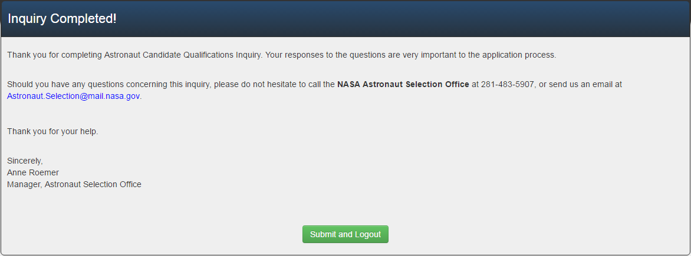
ASCAN Candidate Qualifications Inquiry
Closing Salutation (FINAL)

