Slide 1
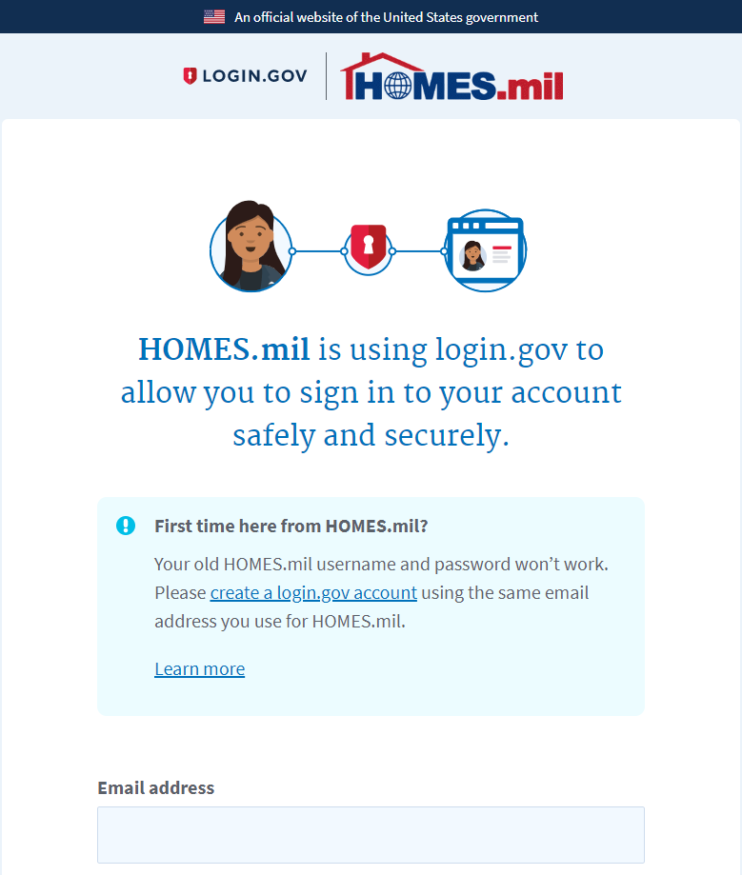
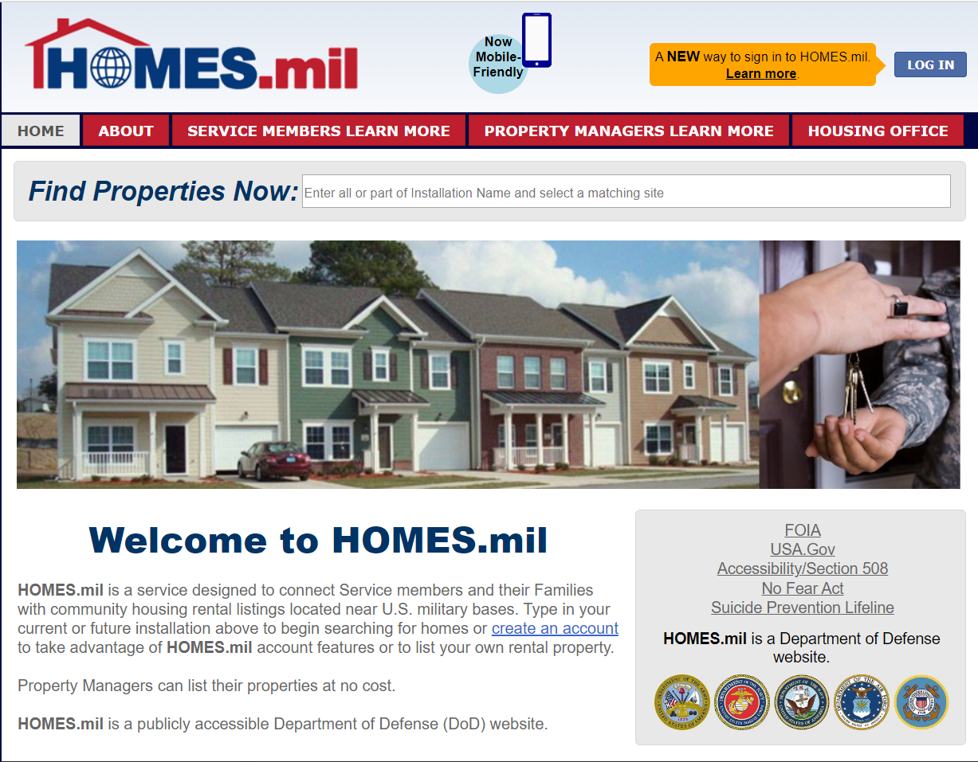
Log In to HOMES.mil
Select LOG IN to be directed to LOGIN.GOV landing page

Slide 2
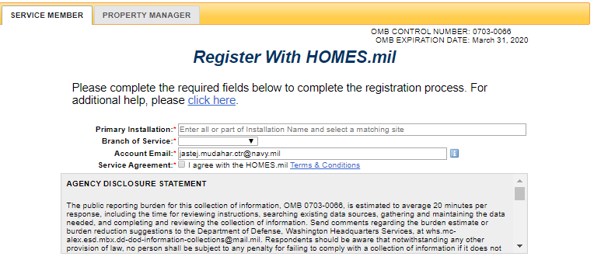
Service Member Landing Page
OMB Control Number, OMB Expiration Date Agency Disclosure Statement and Privacy Statement are located on this page. Full Disclosure Statement is on slide 6 and PAS on slide 8

Slide 3
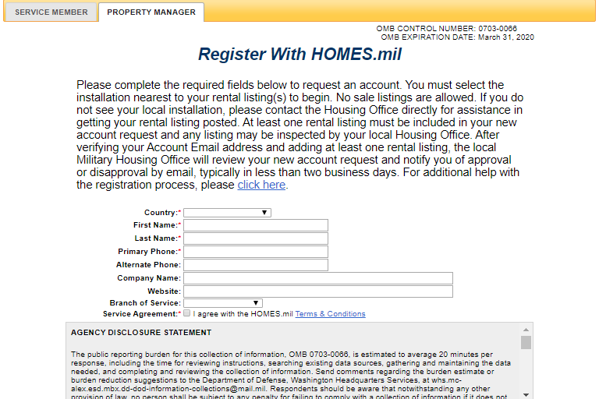
Property Manager Landing Page/Register Page
OMB Control Number, OMB Expiration Date Agency Disclosure Statement and Privacy Statement are located on this page. Full Disclosure Statement is on slide 6 and PAS on slide 8

Slide 4
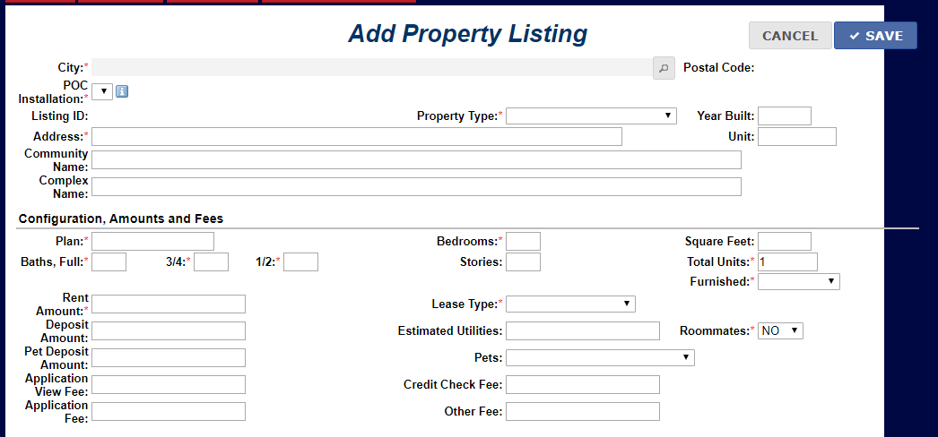
Add Property Listing Page

Slide 5
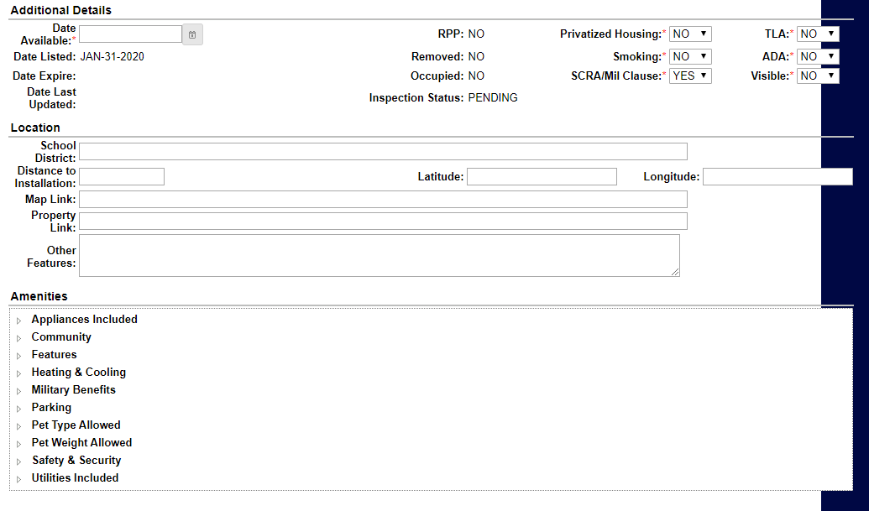
Add Property Listing Page Cont.

Slide 6
Agency Disclosure Statement
OMB Control Number and OMB Expiration Date are located on top of page as noted on slide 2 and 3
Copy and Paste of Statement:
AGENCY DISCLOSURE STATEMENT
The public reporting burden for this collection of information, OMB 0703-0066, is estimated to average 20 minutes per response, including the time for reviewing instructions, searching existing data sources, gathering and maintaining the data needed, and completing and reviewing the collection of information. Send comments regarding the burden estimate or burden reduction suggestions to the Department of Defense, Washington Headquarters Services, at whs.mc-alex.esd.mbx.dd-dod-information-collections@mail.mil. Respondents should be aware that notwithstanding any other provision of law, no person shall be subject to any penalty for failing to comply with a collection of information if it does not display a currently valid OMB control number.

Slide 7
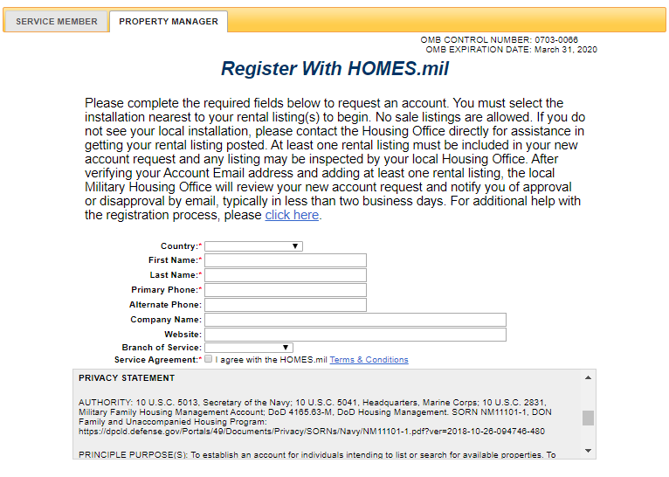
Privacy Statement

Slide 8
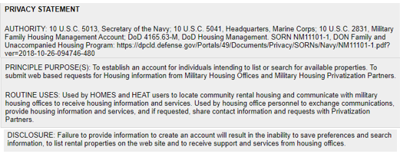
Full Privacy Statement
Copy and Paste of PAS:
PRIVACY STATEMENT
AUTHORITY: 10 U.S.C. 5013, Secretary of the Navy; 10 U.S.C. 5041, Headquarters, Marine Corps; 10 U.S.C. 2831, Military Family Housing Management Account; DoD 4165.63-M, DoD Housing Management. SORN NM11101-1, DON Family and Unaccompanied Housing Program: https://dpcld.defense.gov/Portals/49/Documents/Privacy/SORNs/Navy/NM11101-1.pdf?ver=2018-10-26-094746-480
PRINCIPLE PURPOSE(S): To establish an account for individuals intending to list or search for available properties. To submit web based requests for Housing information from Military Housing Offices and Military Housing Privatization Partners.
ROUTINE USES: Used by HOMES and HEAT users to locate community rental housing and communicate with military housing offices to receive housing information and services. Used by housing office personnel to exchange communications, provide housing information and services, and if requested, share contact information and requests with Privatization Partners.
DISCLOSURE: Failure to provide information to create an account will result in the inability to save preferences and search information, to list rental properties on the web site and to receive support and services from housing offices.

