Slide 1
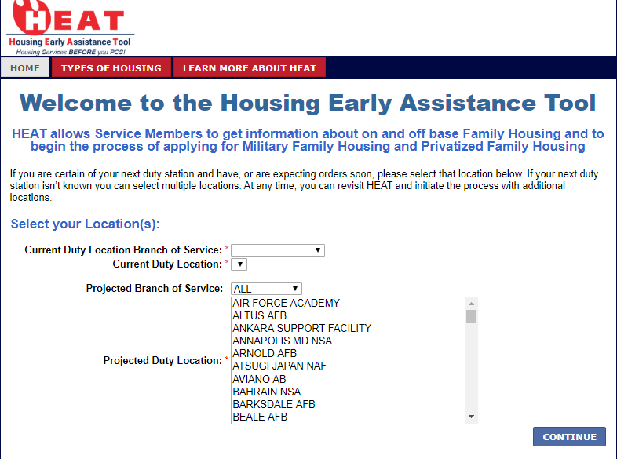
HEAT Storyboard
Fill in all information and select CONTINUE
wS9c5n

Slide 2
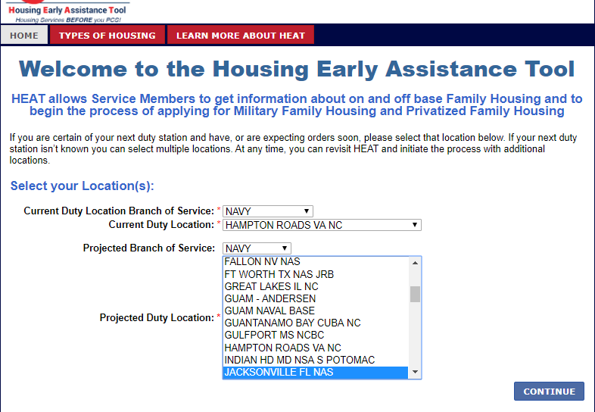
HEAT Storyboard
Fill in all information and select CONTINUE

Slide 3
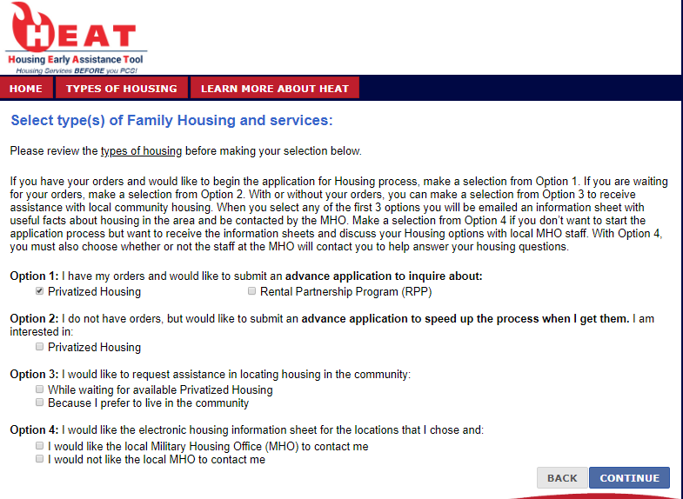
HEAT Storyboard
Select an Option and then select CONTINUE

Slide 4
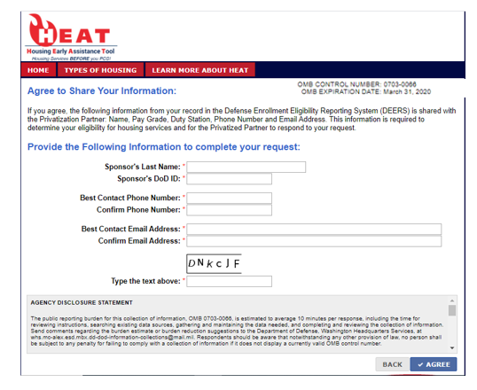
HEAT Storyboard
Fill out all information and select Agree. This is a successful event. The ADN and PAS are located on this screen. Additional screenshots below for these two.

Slide 5
Agency Disclosure Statement
The public reporting burden for this collection of information, OMB 0703-0066, is estimated to average 10 minutes per response, including the time for reviewing instructions, searching existing data sources, gathering and maintaining the data needed, and completing and reviewing the collection of information. Send comments regarding the burden estimate or burden reduction suggestions to the Department of Defense, Washington Headquarters Services, at whs.mc-alex.esd.mbx.dd-dod-information-collections@mail.mil. Respondents should be aware that notwithstanding any other provision of law, no person shall be subject to any penalty for failing to comply with a collection of information if it does not display a currently valid OMB control number.

Slide 6
Privacy Act Statement
PRIVACY STATEMENT
AUTHORITY: 10 U.S.C. 5013, Secretary of the Navy; 10 U.S.C. 5041, Headquarters, Marine Corps; 10 U.S.C. 2831, Military Family Housing Management Account; DoD 4165.63-M, DoD Housing Management. SORN NM11101-1, DON Family and Unaccompanied Housing Program: https://dpcld.defense.gov/Portals/49/Documents/Privacy/SORNs/Navy/NM11101-1.pdf?ver=2018-10-26-094746-480
PRINCIPLE PURPOSE(S): To establish an account for individuals intending to list or search for available properties. To submit web based requests for Housing information from Military Housing Offices and Military Housing Privatization Partners.
ROUTINE USES: Used by HOMES and HEAT users to locate community rental housing and communicate with military housing offices to receive housing information and services. Used by housing office personnel to exchange communications, provide housing information and services, and if requested, share contact information and requests with Privatization Partners.
DISCLOSURE: Failure to provide information to create an account will result in the inability to save preferences and search information, to list rental properties on the web site and to receive support and services from housing offices.

