Slide 1
Enroll Company
Steps:
Access E-Verify Enrollment Website
Read and Agree to Terms to Access the E-Verify Website
Review Enrollment Checklist and Collect Needed Information (offline)
Determine Access Method (choose company type)
Select Organization Designation and Applicable Federal Contractor Category
Select Option for reverification
Sign Memorandum of Understanding (MOU)
Enter Company Information
Register Users
Review and Certify Information
Print MOU

Slide 2
Privacy Statement

Slide 3
Paperwork Reduction Act Help

Slide 4
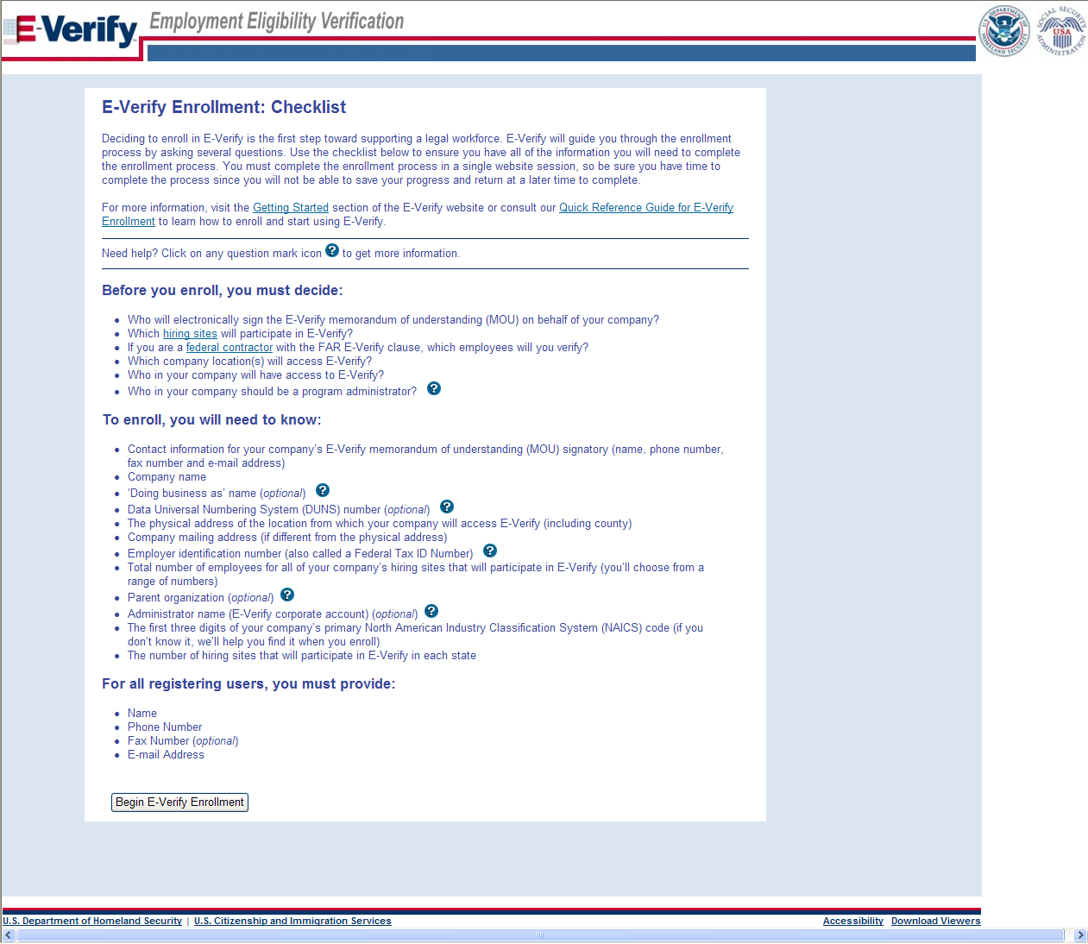
Review Enrollment Checklist
∙If you will create reverification cases for employees without existing cases in E-Verify

Slide 5
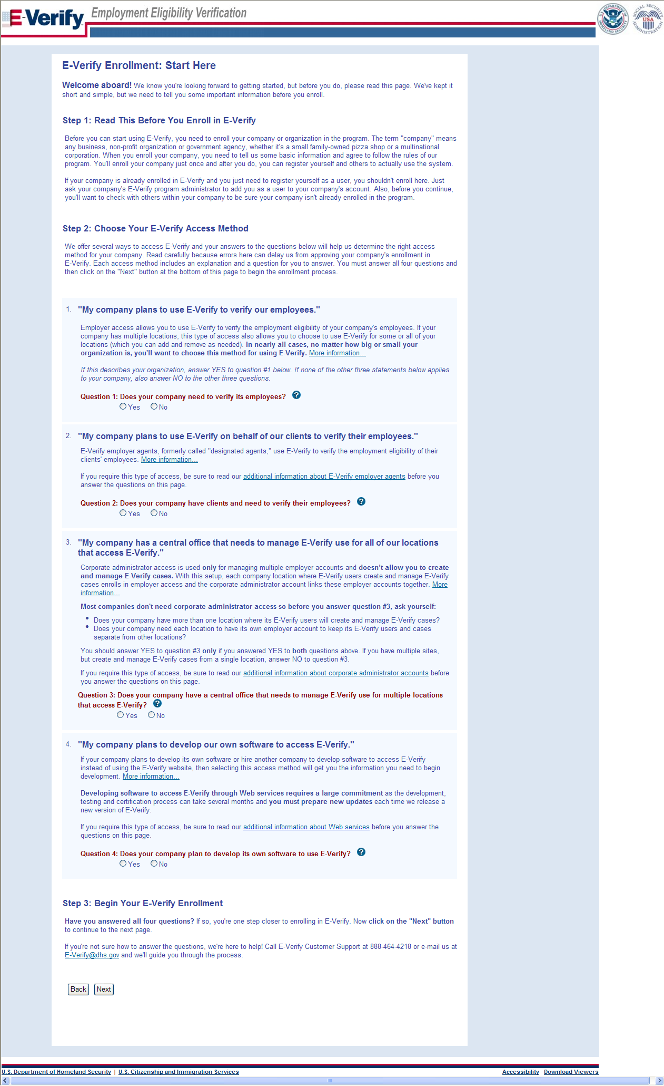
Determine Access Method

Slide 6
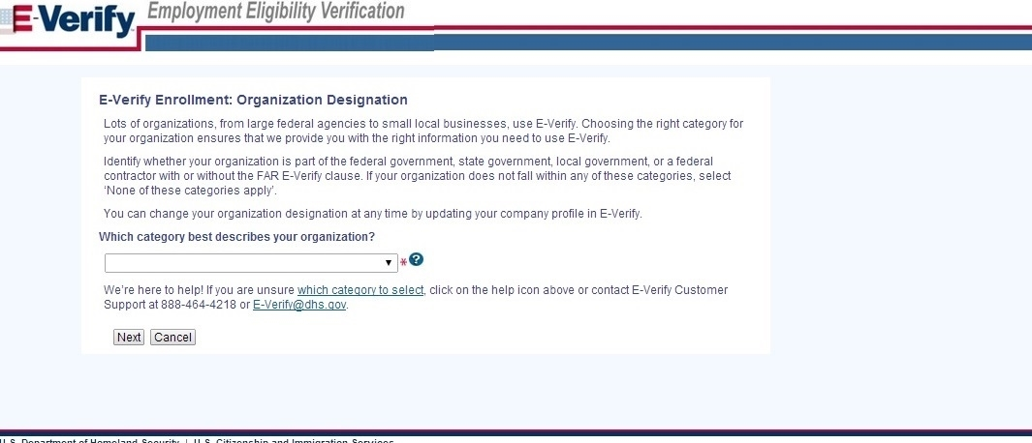
Select Organization Designation

Slide 7
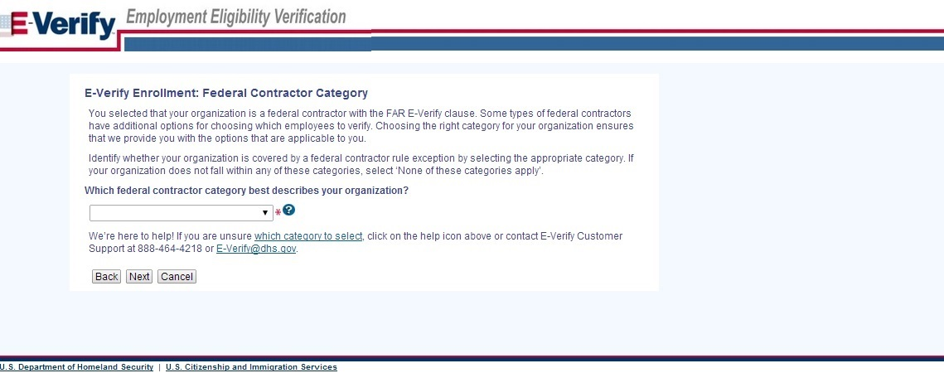
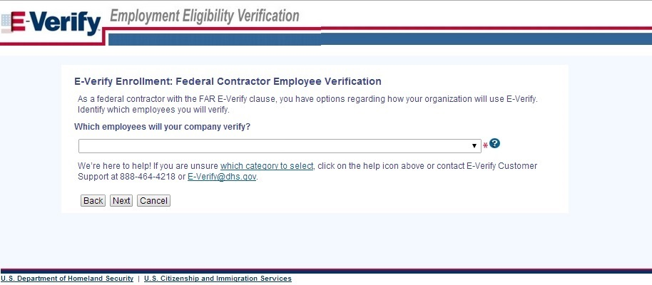
Select Federal Contractor Category

Slide 8
Sign Memorandum of Understanding (MOU)

Slide 9
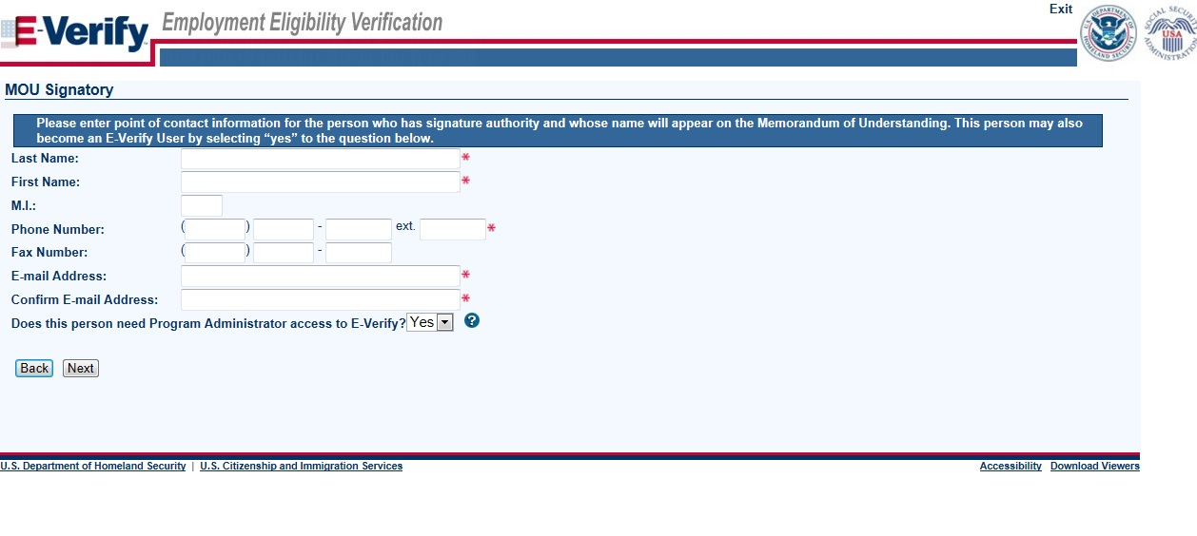
Enter Company Information – MOU Signatory

Slide 10
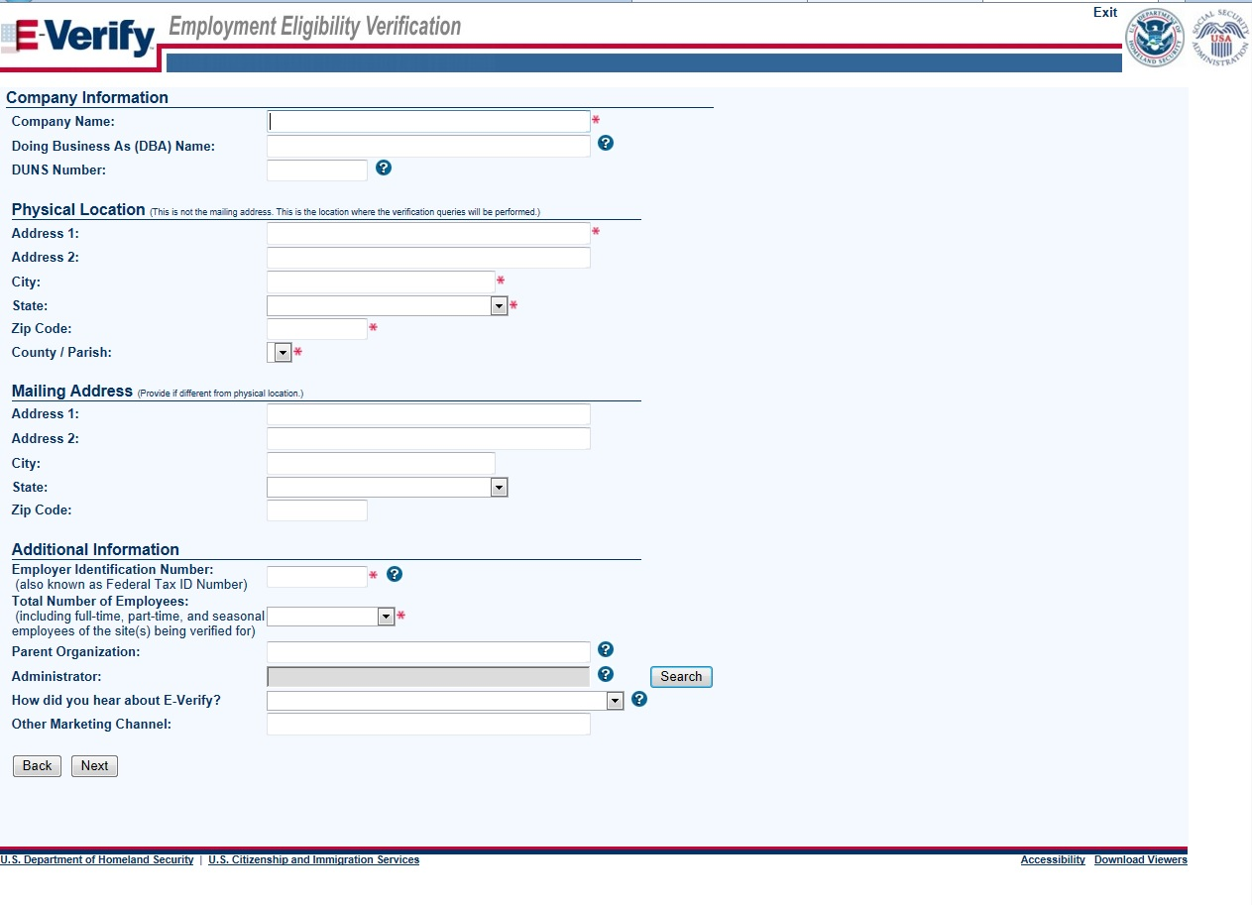
Enter Company Information

Slide 11
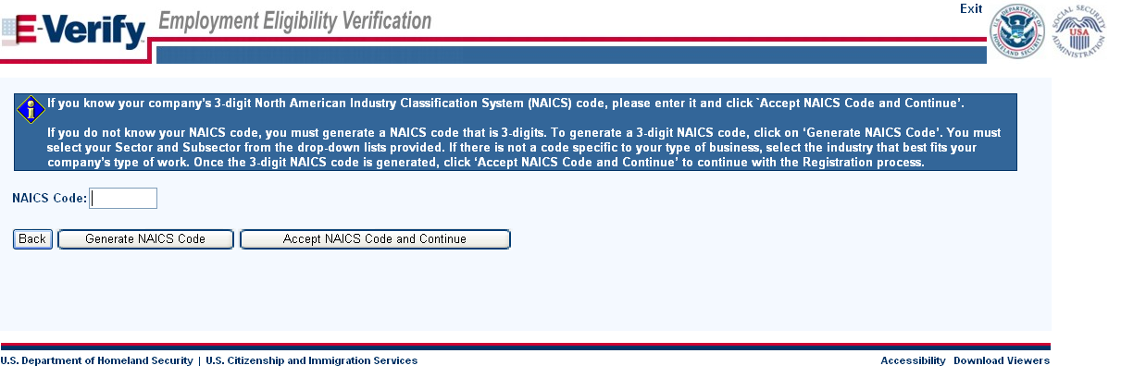
Enter NAICS Code

Slide 12
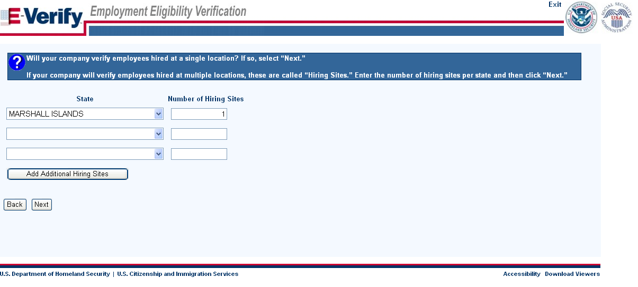
Enter Hiring Site Information
VIRGINIA

Slide 13
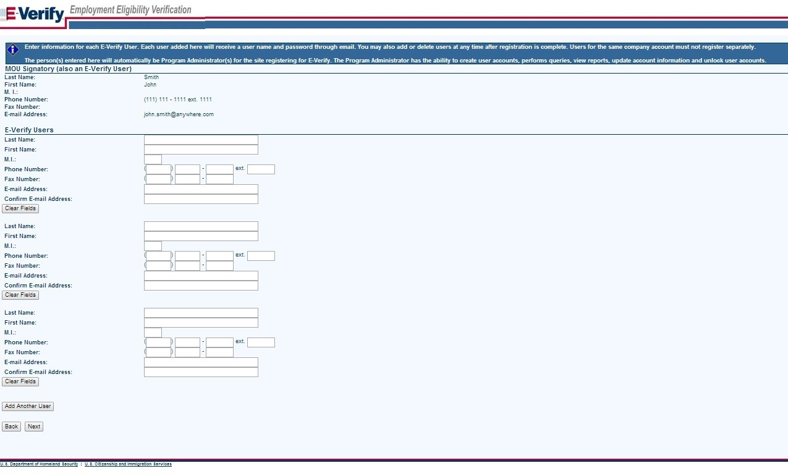
Register E-Verify Users

Slide 14
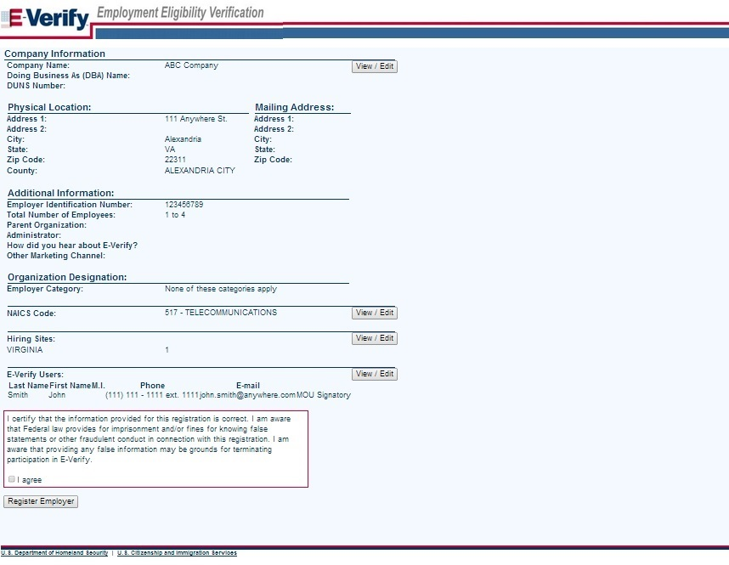
Review and Certify Information

Slide 15
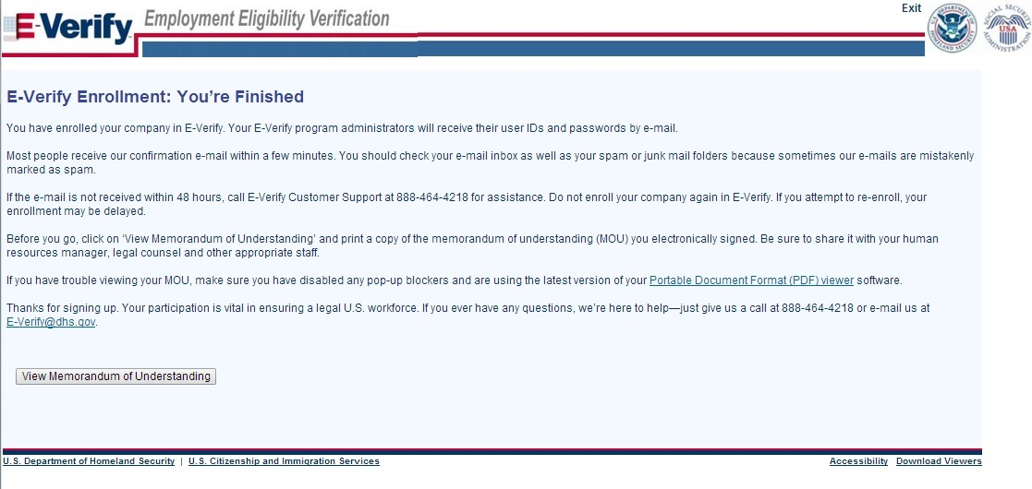
Print MOU

Slide 16
Complete Tutorial
Steps:
Log into E-Verify
Receive Required Tutorial Notification
Complete Tutorial
Pass Knowledge Test

Slide 17
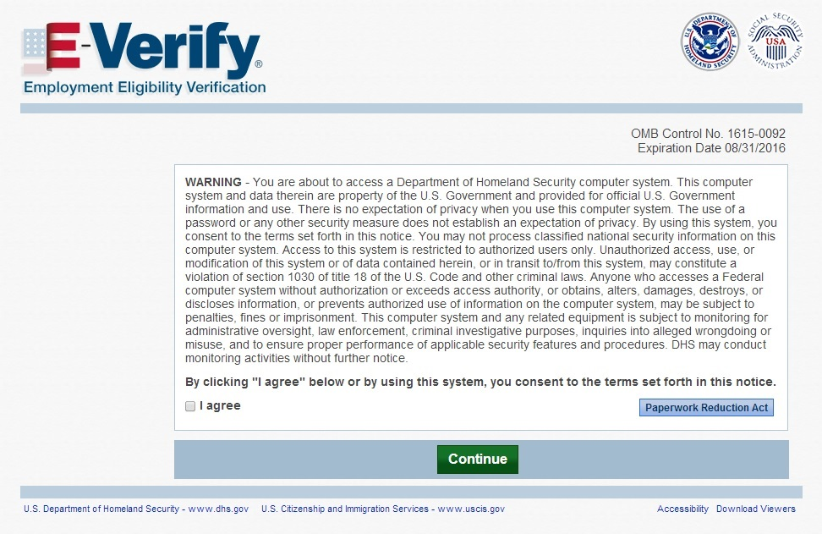
Access E-Verify Website

Slide 18
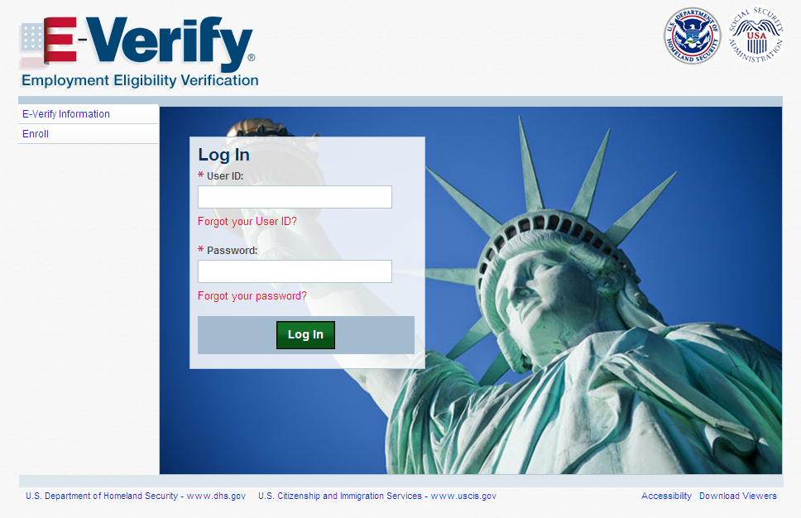
E-Verify Log-in Screen

Slide 19
Tutorial Required

Slide 20
Tutorial Completion Screen

Slide 21
Knowledge Test Completed

Slide 22
Create Case
Steps:
Log into E-Verify
Select Create New Case
Select and Enter Form I-9 Information
Submit Case to E-Verify
Review Case Results

Slide 23
Access E-Verify Website

Slide 24
E-Verify Log-in Screen

Slide 25
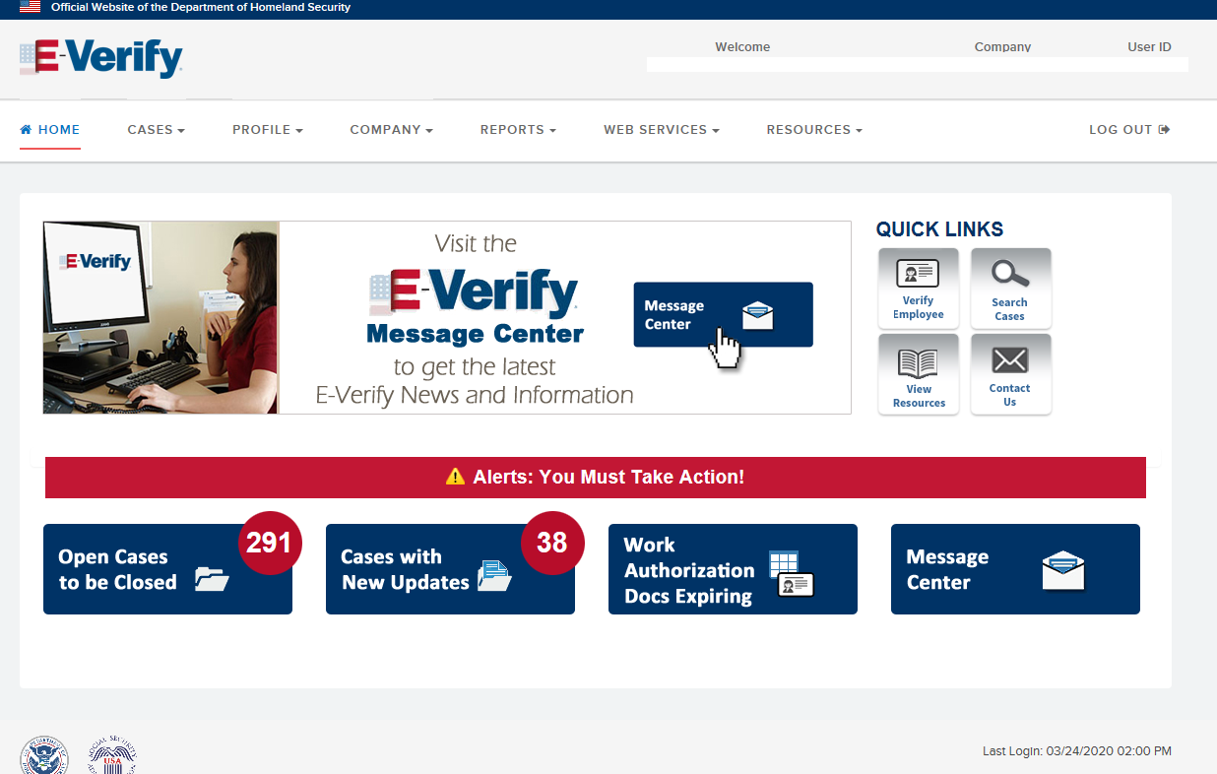
E-Verify Home Page

Slide 26
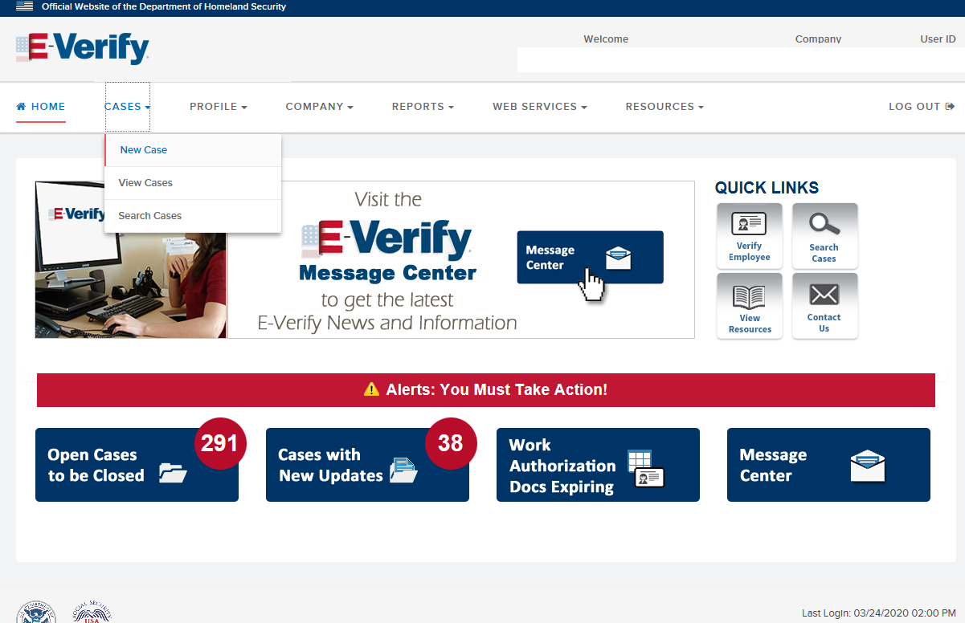
Create New Case

Slide 27
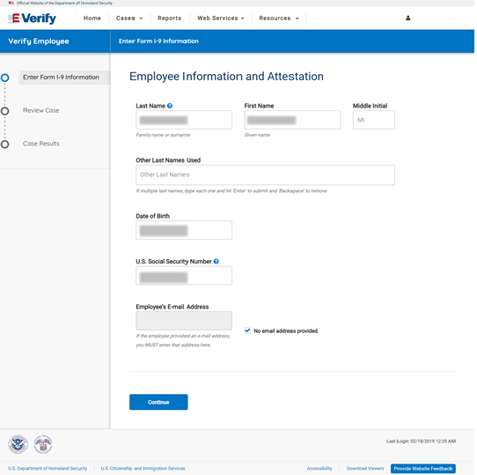
Form I-9 Section 1 Entry Page

Slide 28
Attestation Page

Slide 29
Form I-9 Section 2 Entry Page

Slide 30
Additional Case Details Entry Page

Slide 31
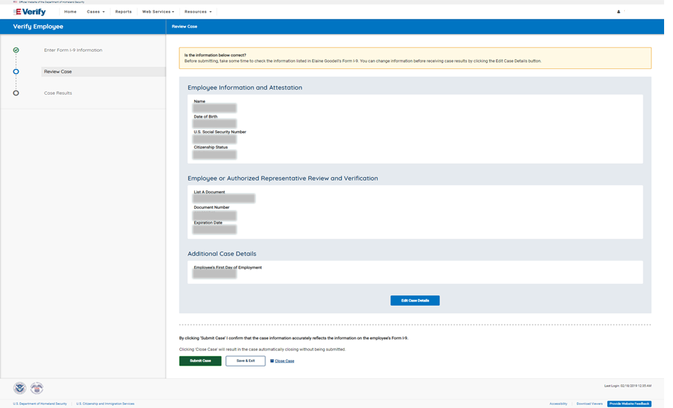
Verify Data

Slide 32
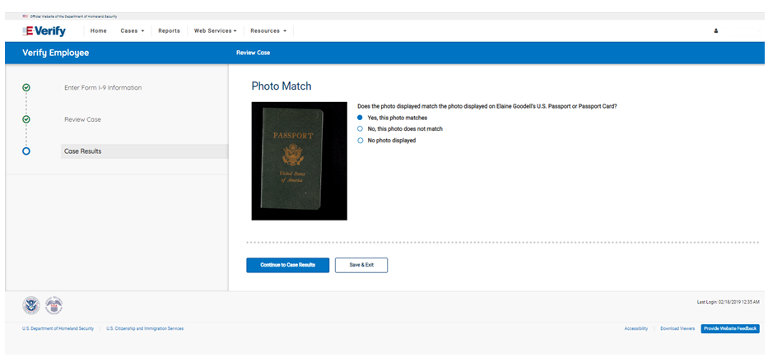
Photo Matching

Slide 33
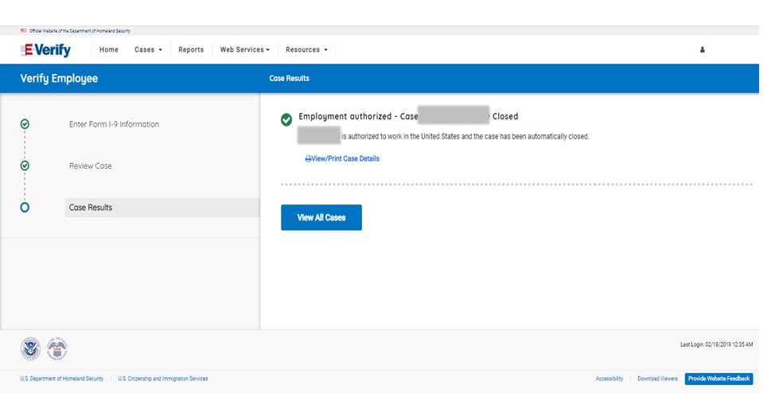
Case Results

Slide 34
Final Nonconfirmation Result

Slide 35
Tentative Nonconfirmation Process
Steps
Review Case
Tentative Nonconfirmation (Social Security Administration and Department of Homeland Security)
Further Action Notice
Referral Date Confirmation Notice
Review Case Results

Slide 36
Review Case

Slide 37
Tentative Nonconfirmation

Slide 38
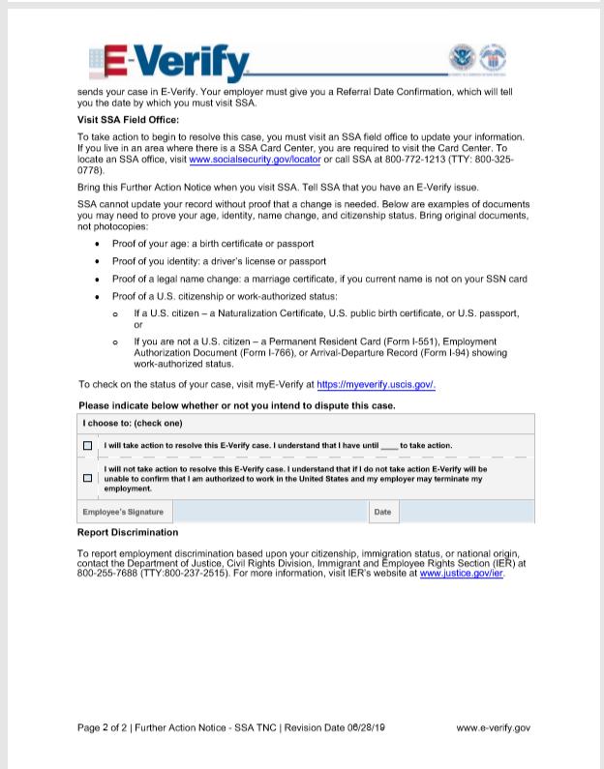
Social Security Administration Further Action Notice

Slide 39
Referral Date Confirmation

Slide 40
Social Security Administration Referral Date Confirmation Notice

Slide 41
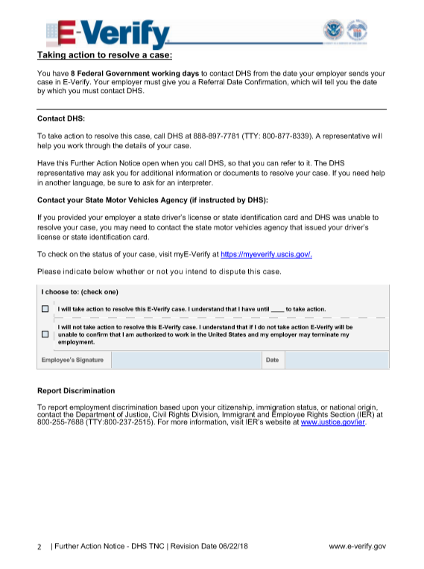
Department of Homeland Security Further Action Notice

Slide 42
Referral Date Confirmation

Slide 43
Department of Homeland Security Referral Date Confirmation Notice

Slide 44
Case Results

Slide 45
Final Nonconfirmation Result

