Slide 1
SAC Visitor Request Form
&
Foreign National Vetting Request
Screenshots

Slide 2
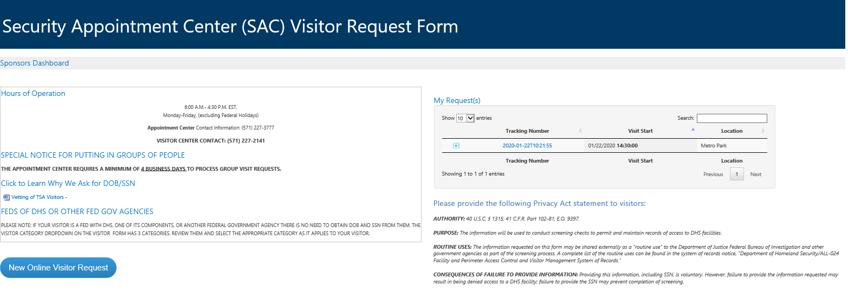
Host - SAC Visitor Request Form

Slide 3
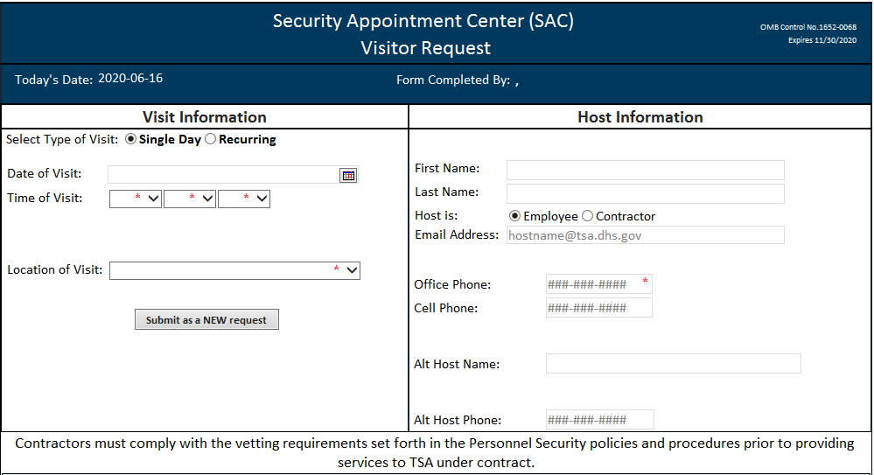
Visit and Host Information

Slide 4
Date of Birth (required) & Social Security # (voluntary)

Slide 5
Foreign National Information

Slide 6
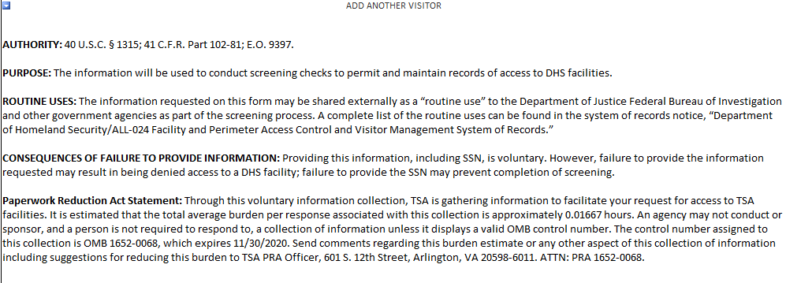
AUTHORITY, PURPOSE, ROUTINE USES, CONSEQUENCES OF FAILURE TO PROVIDE, PRA STATEMENT

Slide 7
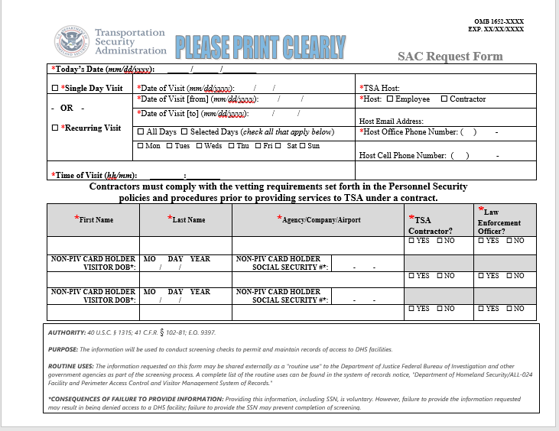
SAC Request Form (Paper)

