Slide 1
009-0-1T (English)
Change Request 5.26.2020

Slide 2
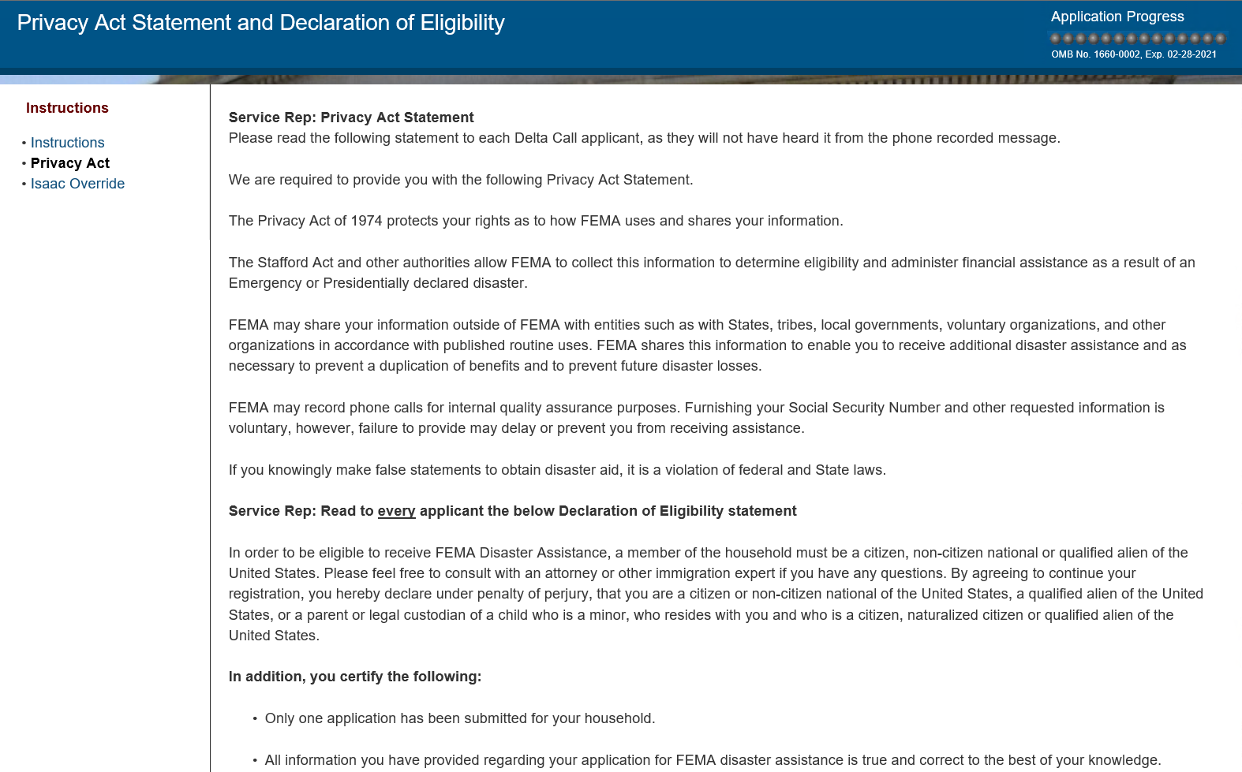
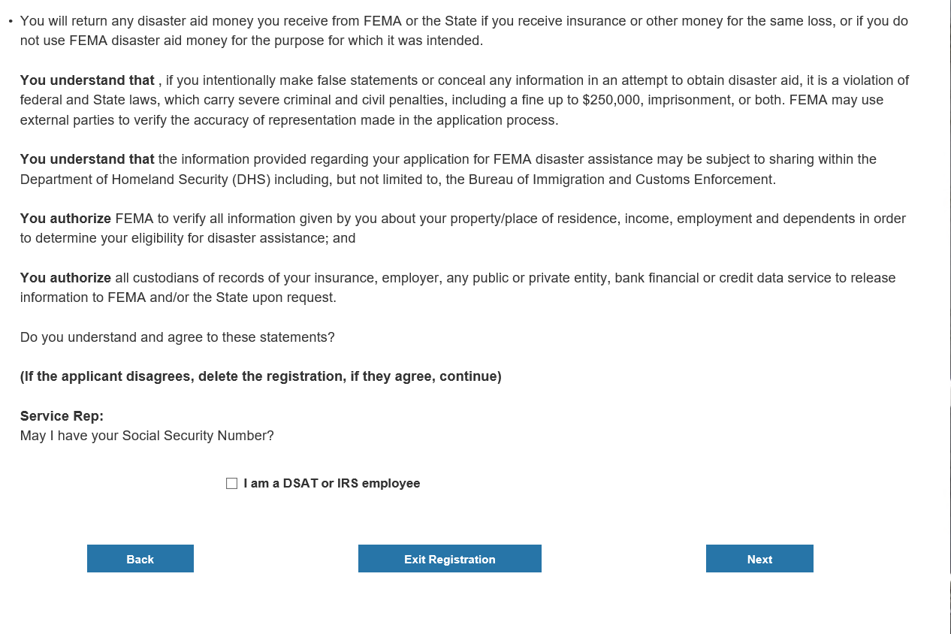
Service Rep: Please read the following statement to each Delta Call applicant, as they will not have heard it from the phone recorded message. FEMA is required to provide you with the following statement: The Privacy Act of 1974 protects your rights as to how FEMA uses and shares your information with entities such as other Federal agencies, including Department of Homeland Security, States, tribal or local governments, voluntary organizations, and other organizations providing disaster assistance in accordance with the law. FEMA may share your information with these partners to make sure you receive all disaster assistance available to you, prevent duplicating benefits, or to prevent future disaster losses. The Stafford Act, Privacy Act and other laws allow FEMA to collect information to determine eligibility and provide assistance as a result of a Presidentially declared disaster.
FEMA may record phone calls for internal quality assurance purposes. Providing your Social Security Number and other requested information is voluntary, however, refusing to provide this information may delay or prevent you from receiving assistance.
To be eligible for FEMA Assistance, you must hereby declare under penalty of perjury, that you are a citizen, non-citizen national, a qualified alien of the United States, or a parent or legal custodian of a minor child, who lives with you and who is a citizen, non-citizen national or qualified alien of the United States.
You must understand that if you intentionally lie or hide any information in an attempt to obtain disaster assistance, it is a violation of federal and State laws, which carry severe fines and or imprisonment.
You must understand that if you received FEMA Assistance and have insurance that covers the same loss or receive other assistance for the same loss, you may be required to return some or all of the FEMA Assistance provided to you.
You must authorize FEMA to verify all information given by you about your primary residence, income, identity, and dependents in order to determine your eligibility for disaster assistance. You must authorize FEMA and/or the State to request your personal information from entities such as your insurance company, or financial institution.
To continue your registration, you must acknowledge you understand and that you agree with the information I have just read to you. Do you understand and agree to these statements? (If the applicant disagrees, delete the registration, if they agree, continue) Service Rep: May I have your Social Security Number?

Slide 3
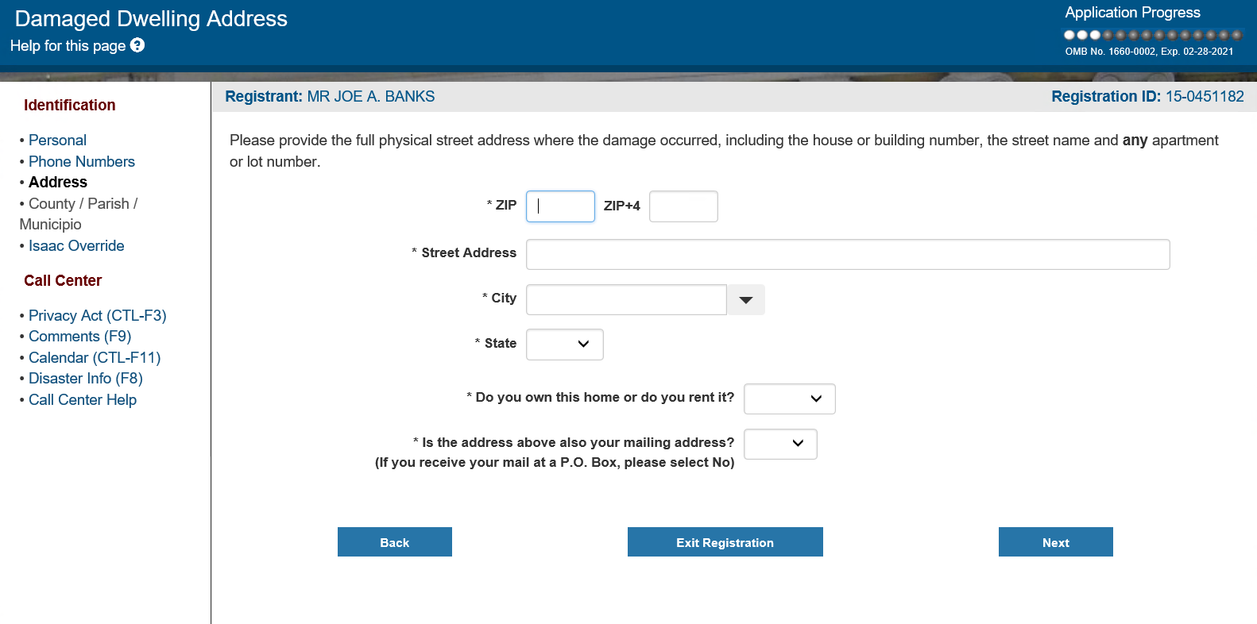

Slide 4
Damaged Dwelling Address – Help Text
The damaged dwelling address is used by the inspection teams to locate your property. Please follow these tips when entering your damaged dwelling address.
Tips for Damaged Dwelling Address - 50 United States
Enter the service address (home address) exactly as it appears on a utility bill.
If you don't have access to a utility bill: Enter the Street Address, City, State and Zip Code without any abbreviations (use 23 Back Mountain St instead of 23 Bk Mtn St).
Do not enter a P.O. Box or General Delivery address for the damaged dwelling address. You can use Rural Route, Rural Road, Farm Road, FM, etc. but not a PO Box address.
Do not enter a "#" symbol.
The input field takes up to 60 characters. If you have to abbreviate words due to the character limit, use the following:
APT for Apartment
BLDG for Building
STE for Suite
RR for Rural Route
Tips for Damaged Dwelling Address - Puerto Rico (PR)
Enter the service address exactly as it appears on a utility bill.
If you don't have access to a utility bill, or live in a rural area, enter the address in the following format: Carr, KM (kilometro), HM (hectometro), Barrio, and Sector.
Tips for Damaged Dwelling Address - United States Virgin Islands (VI)
Enter the service address exactly as it appears on a utility bill.
If you don't have access to a utility bill: Do not abbreviate the street name.
Do not use lot numbers.
Tips for Damaged Dwelling Address - Commonwealth of Northern Mariana Islands (CNMI)
If you do not have a house number, place a description of the home in the Street Address field. Example: "Red house on Papago Drive" or "4th house on the left Koa Lane."
Enter the name of your village in the City field.
If your island name is not listed, enter the island name in the County/Parish field.
If this is a vehicle only application or a medical/dental/funeral only application, enter only the name of the street on which the damaged occurred.
Current Mailing Address If the current Mailing Address is not the same as the damaged dwelling address enter the address where you are currently receiving mail:
The mailing address does not have to be where you are living.
You may enter a P.O. Box or General Delivery address for the mailing address field.
If possible, enter an address where you will receive mail for a minimum of 60-days.
Own or Rent Damaged Dwelling From the drop down list select Owner or Renter to indicate your residency status. To be considered the legal OWNER of the home, you must:
have the deed; or
maintain the home, pay no rent, and pay taxes (if applicable); or
have lifetime occupancy rights while not holding the legal title to the home
Select RENT if you do not meet any of the above criteria, even if you pay no rent.
Current Mailing Address Same as Damaged Dwelling Address Check this box to identify damaged dwelling address and current mailing address are the same.
Only one special character (#, -, /) is permitted
Do not enter extra spaces.

Slide 5
