Slide 1
N-565: Application Overview – Page 1

Slide 2
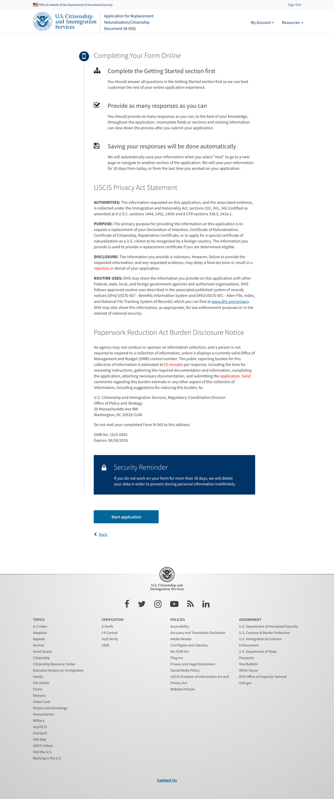
N-565: Application Overview – Page 2

Slide 3
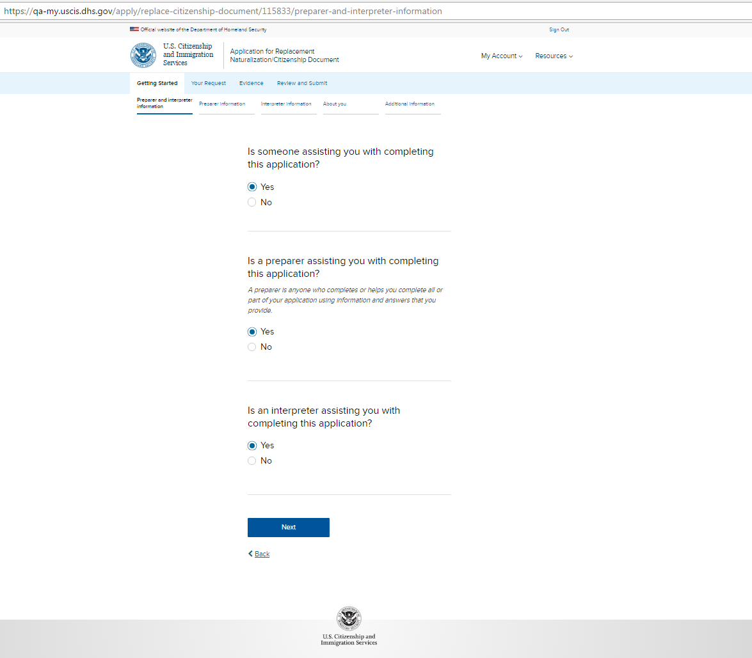
N-565: Getting Started - Preparer and interpreter information

Slide 4
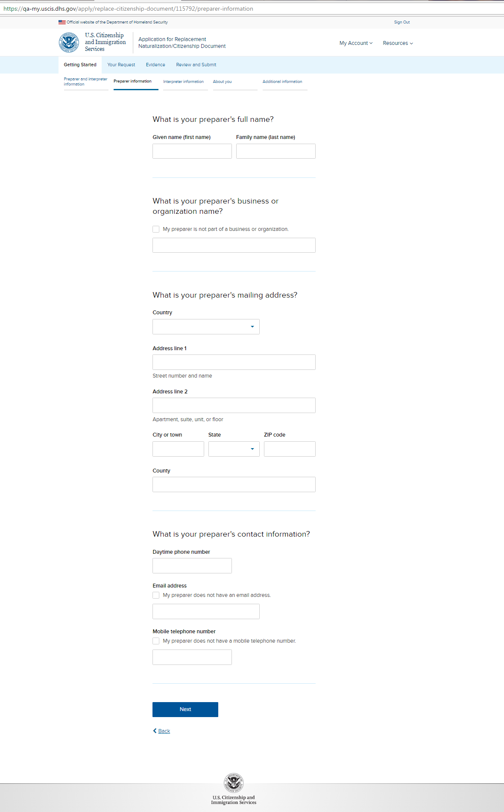
N-565: Getting Started - Preparer information (conditional)

Slide 5
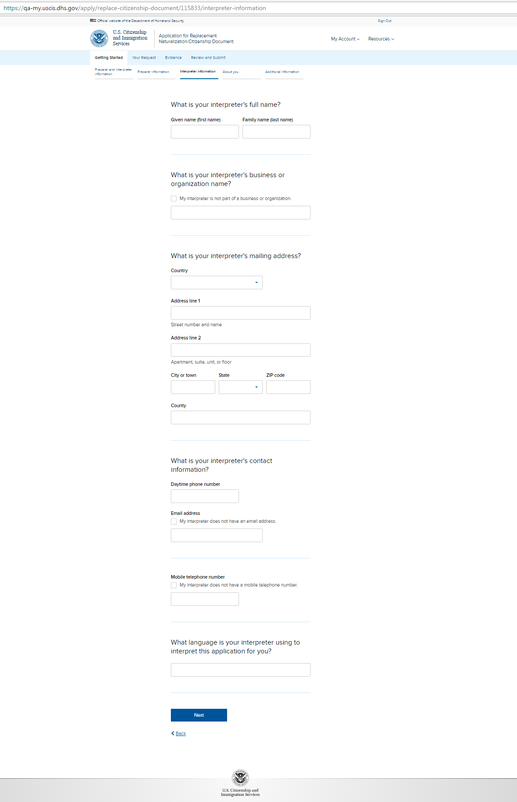
N-565: Getting Started - Interpreter information (conditional)

Slide 6
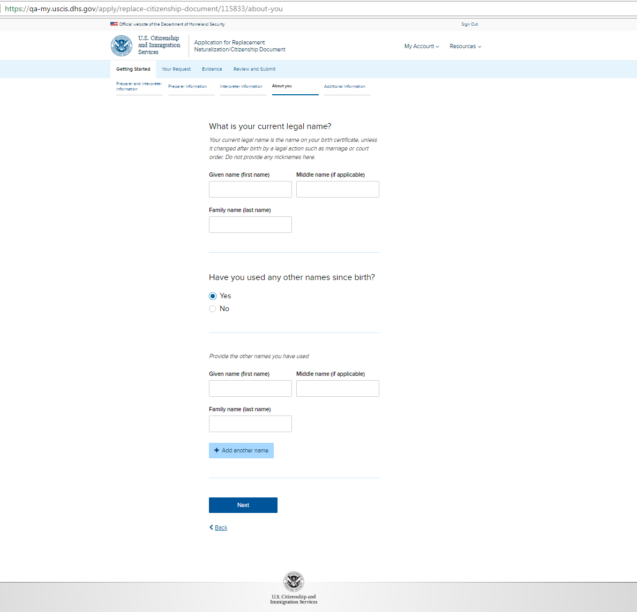
N-565: Getting Started - About you – page 1

Slide 7
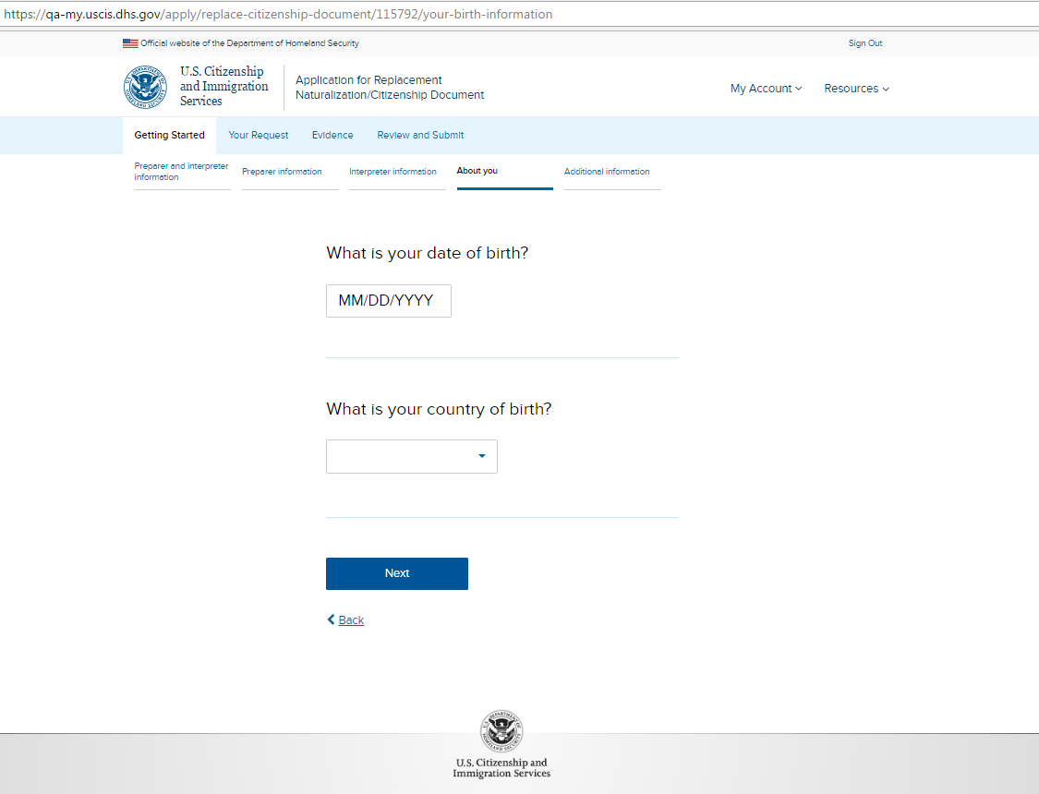
N-565: Getting Started - About you – page 2

Slide 8
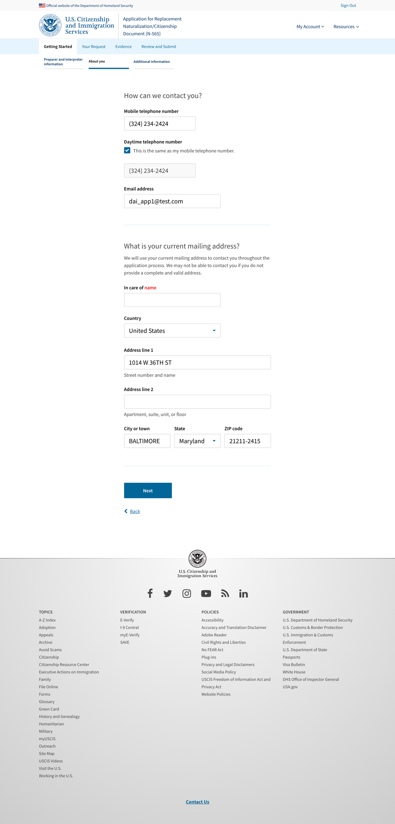
N-565: Getting Started - About you – page 3 (with USPS Validation)

Slide 9
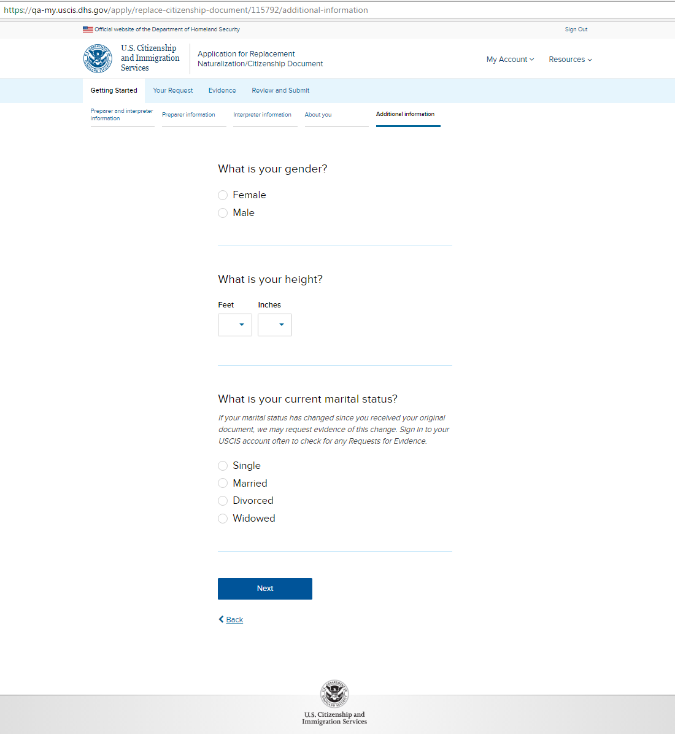
N-565: Getting Started - Additional information – page 1

Slide 10
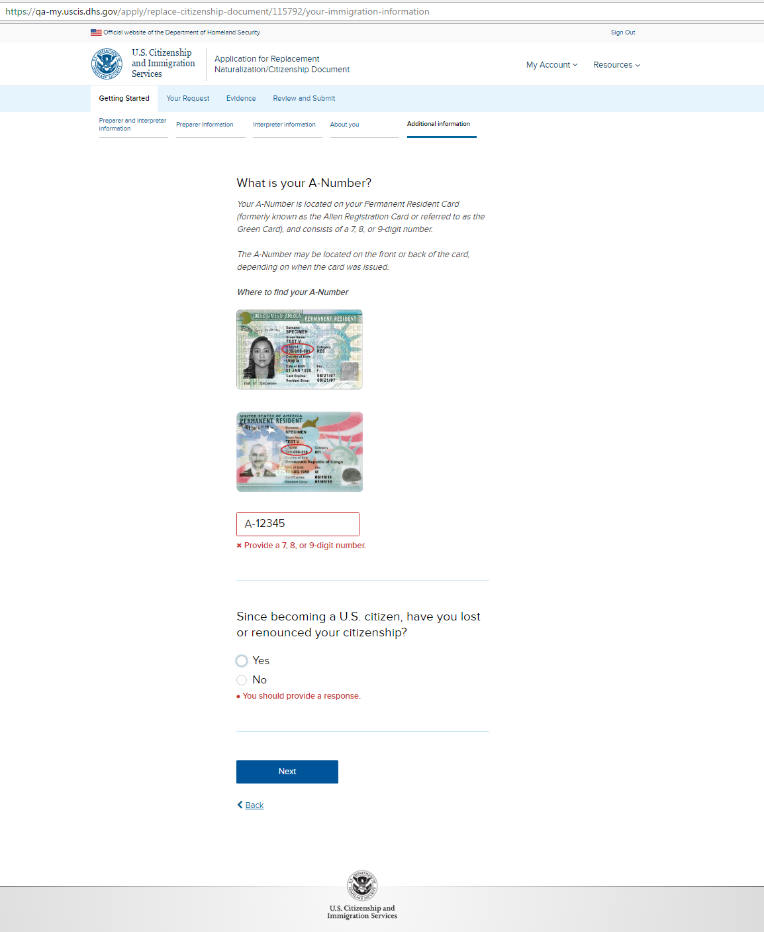
N-565: Getting Started - Additional information – page 2

Slide 11
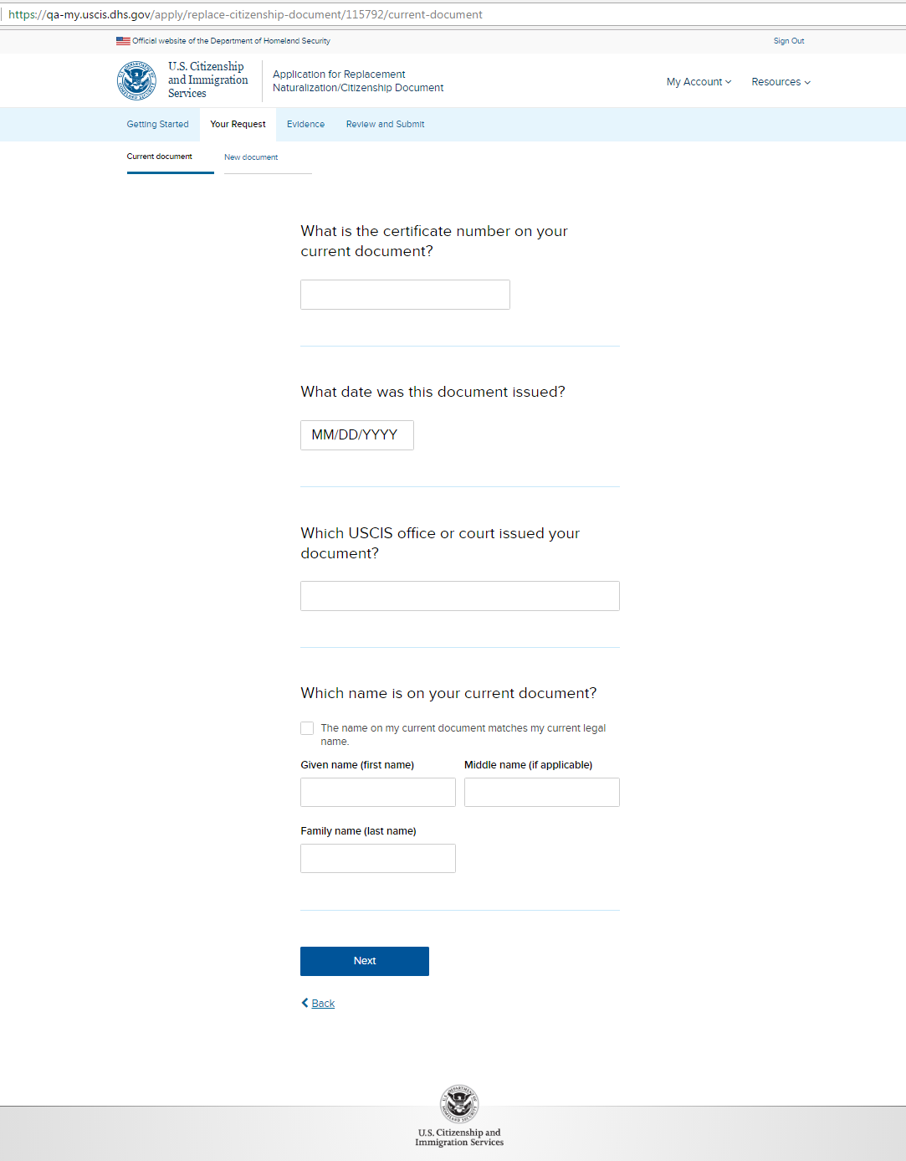
N-565: Your Request - Current document

Slide 12
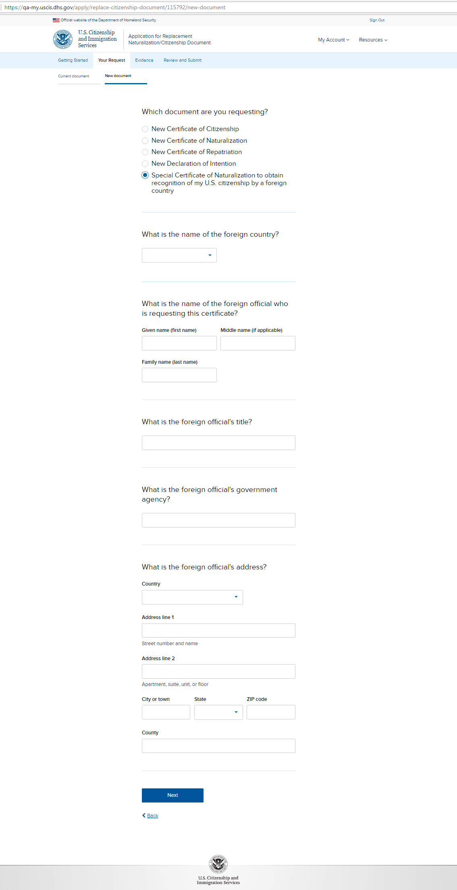
N-565: Your Request - New document – page 1

Slide 13
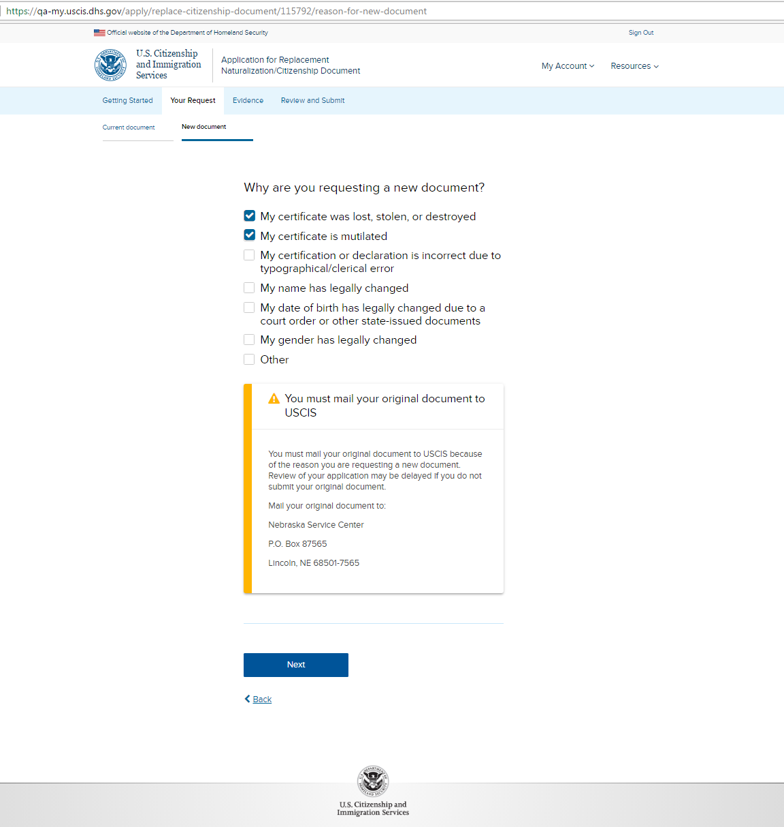
N-565: Your Request - New document – page 2 (with yellow alert)

Slide 14
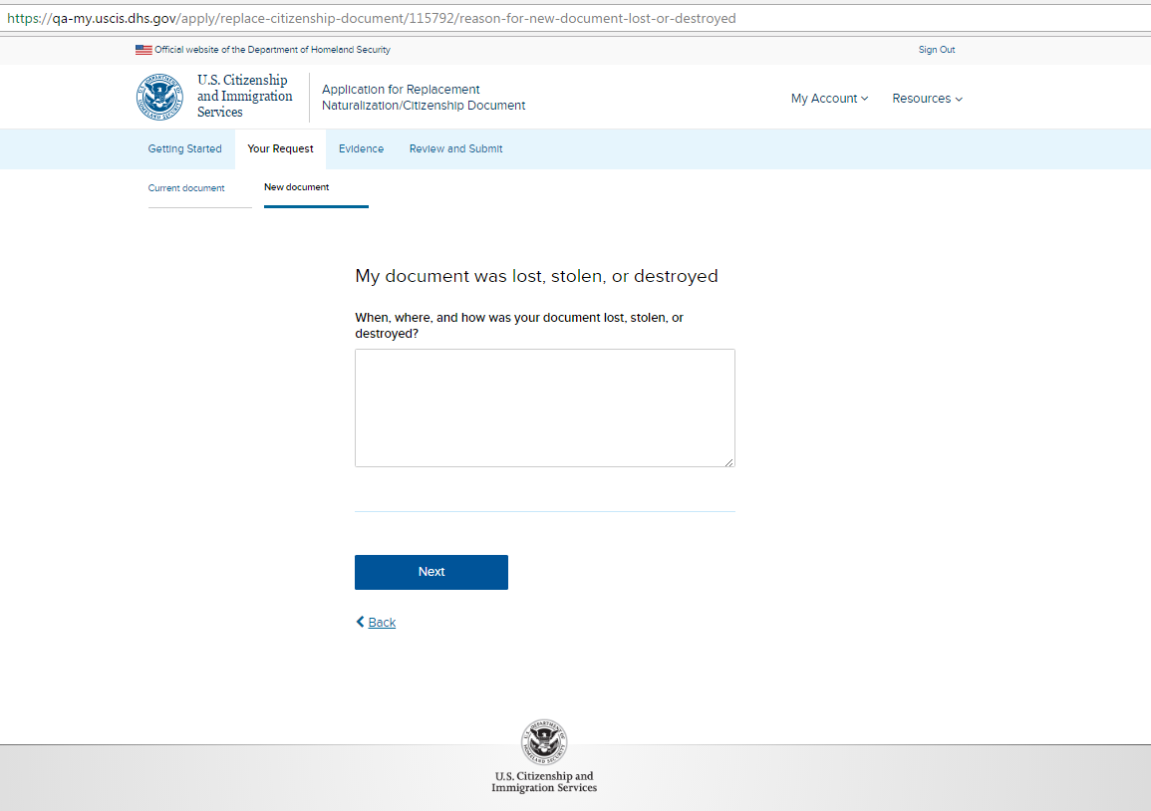
N-565: Your Request - New document – page 3a (conditional)

Slide 15
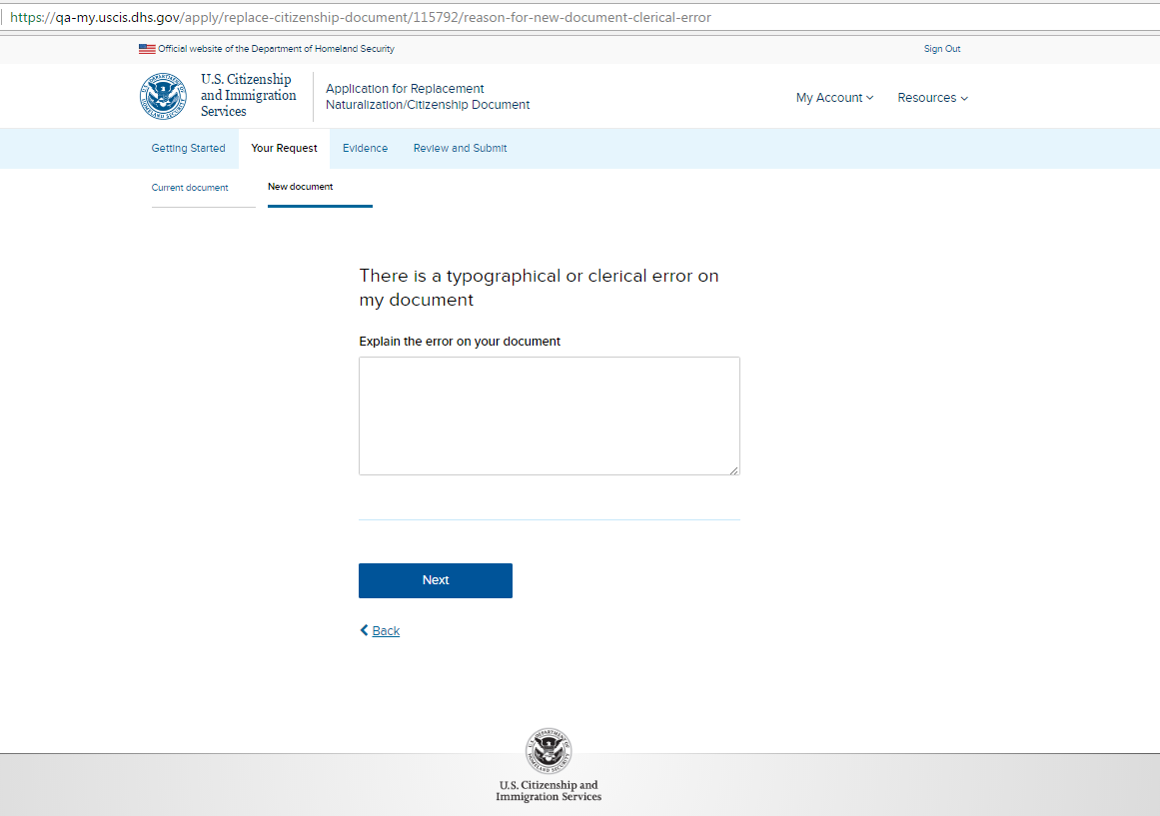
N-565: Your Request - New document – page 3b (conditional)

Slide 16
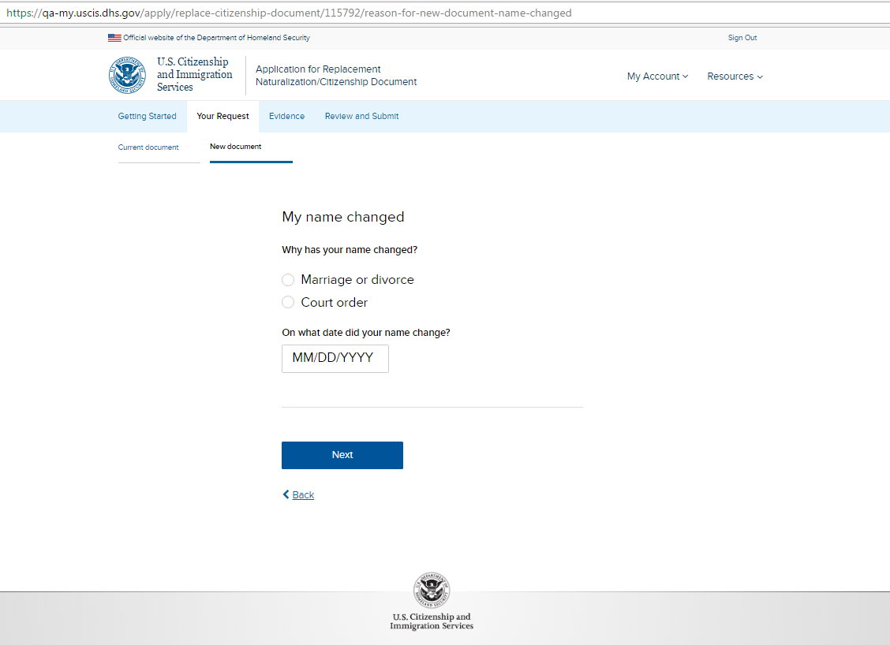
N-565: Your Request - New document – page 3c (conditional)

Slide 17
N-565: Your Request - New document – page 3d (conditional)

Slide 18
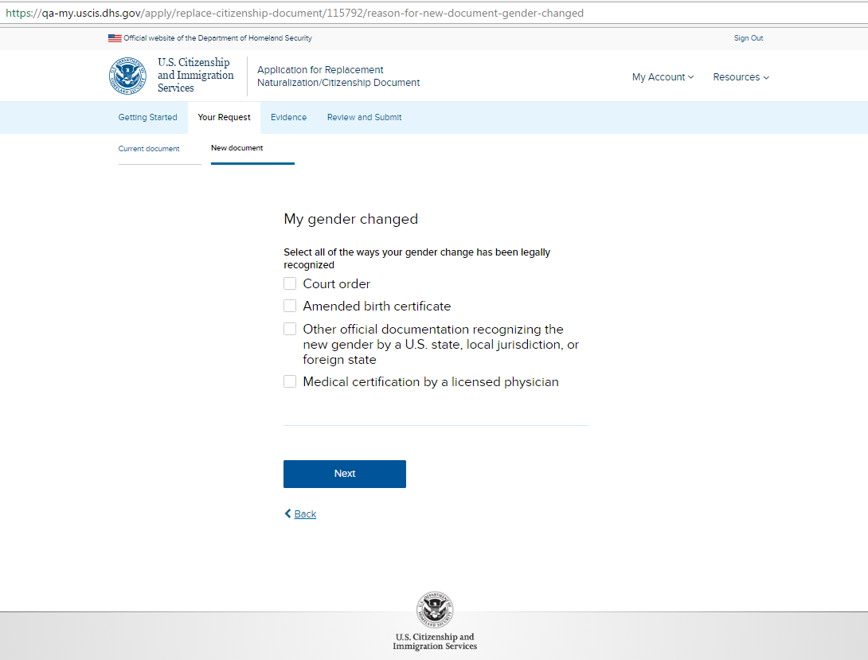
N-565: Your Request - New document – page 3e (conditional)

Slide 19
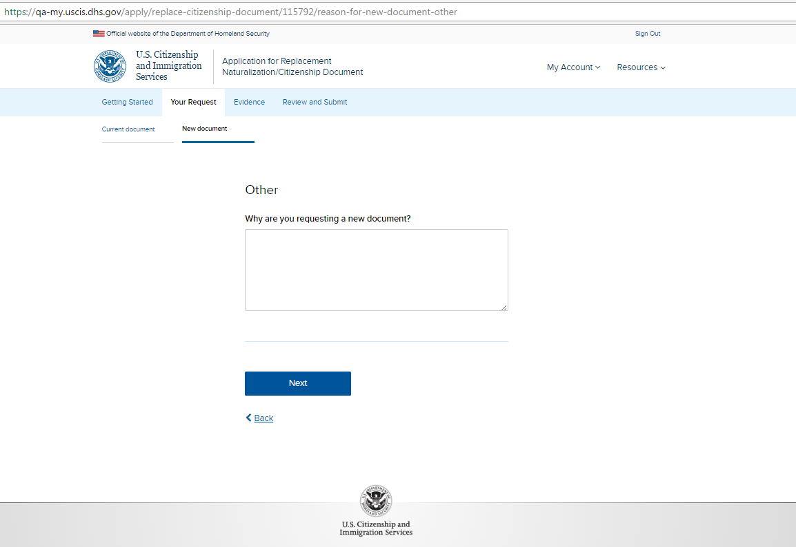
N-565: Your Request - New document – page 3f (conditional)

Slide 20
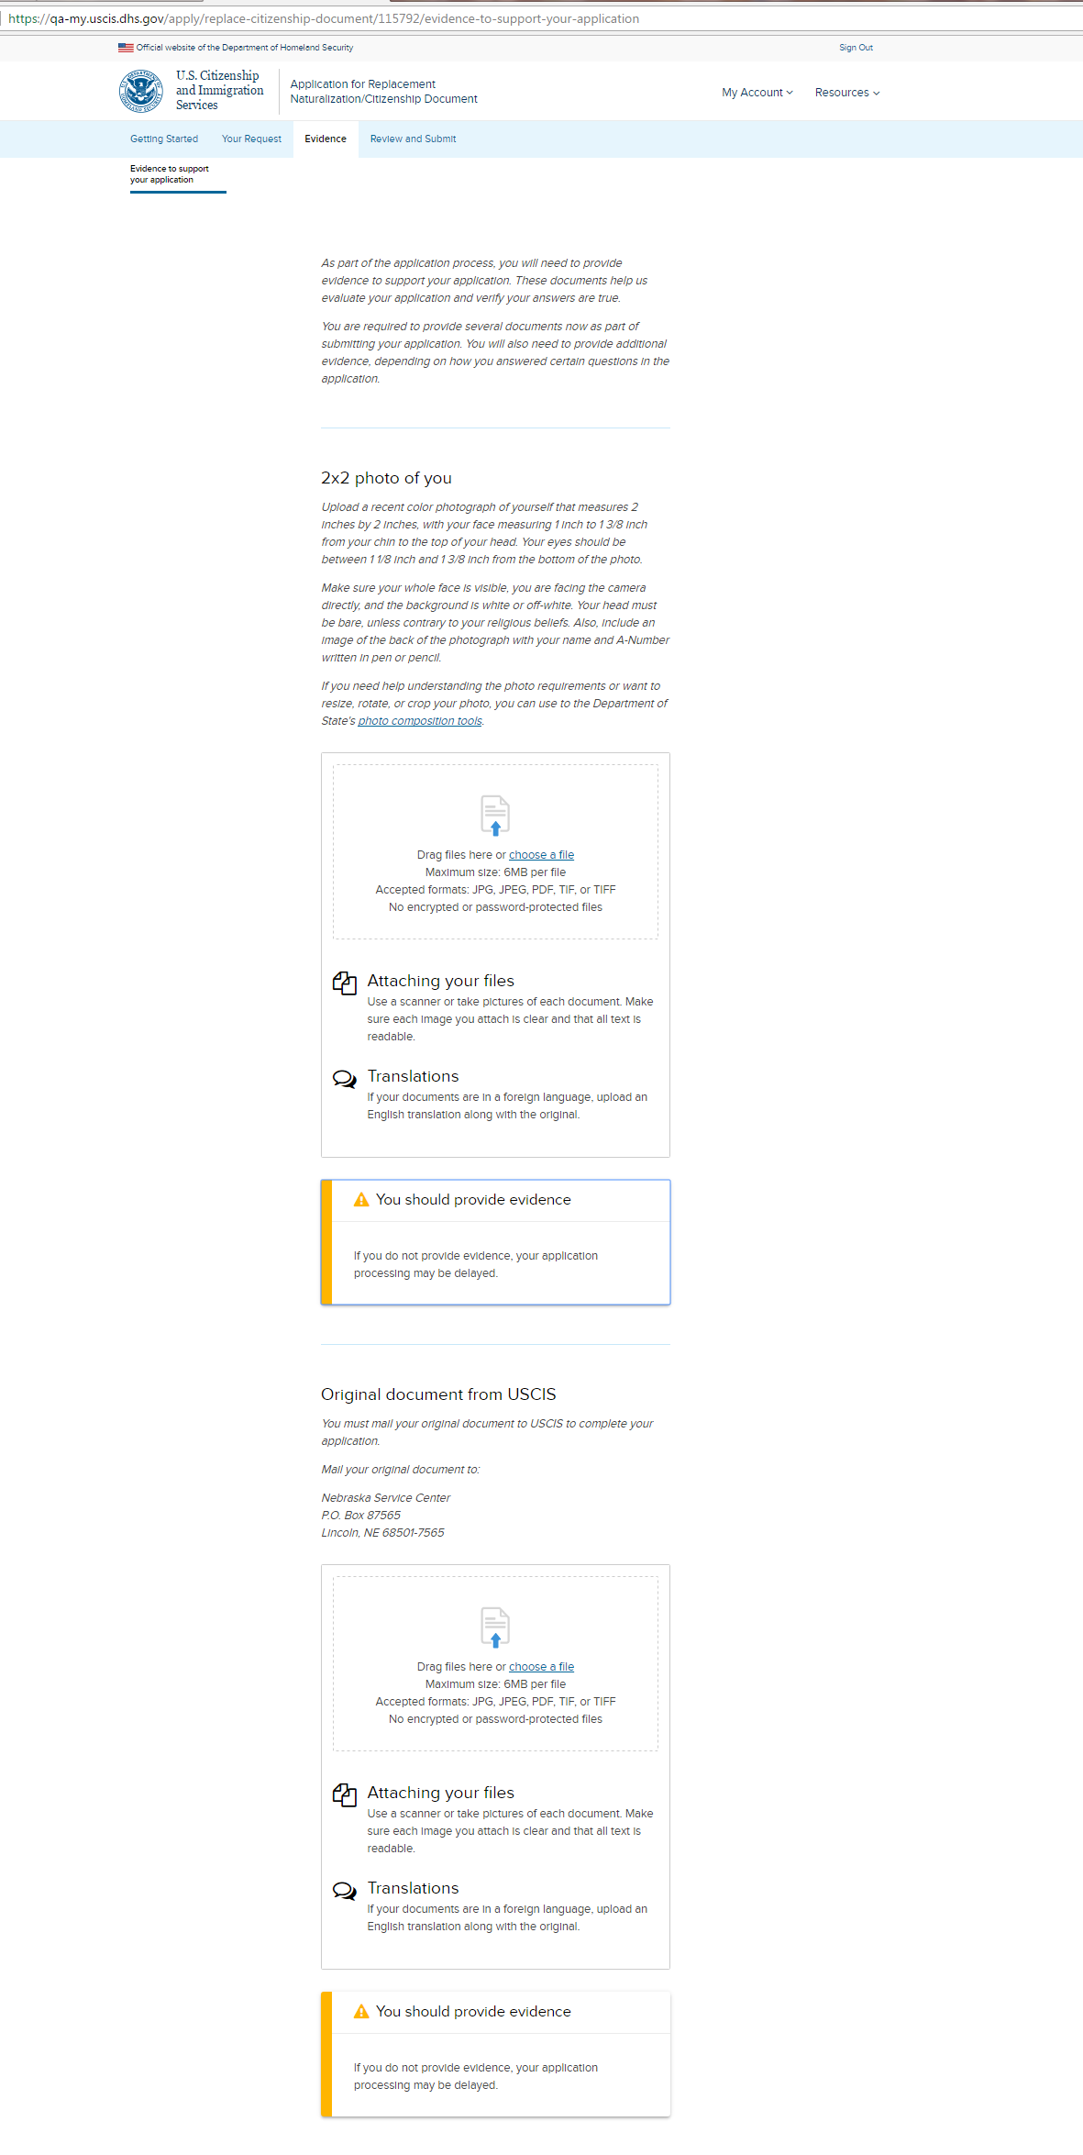
N-565: Evidence – Evidence to support your application

Slide 21
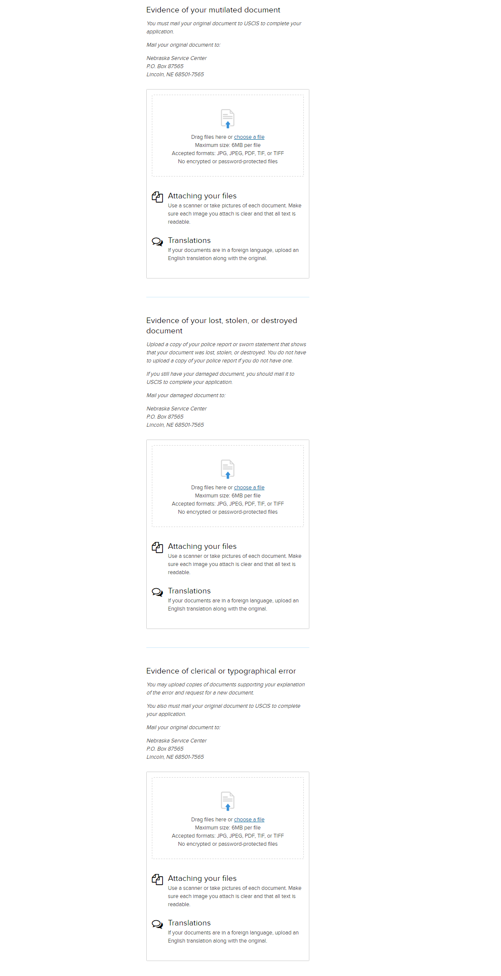
N-565: Evidence – Evidence to support your application (continued)

Slide 22
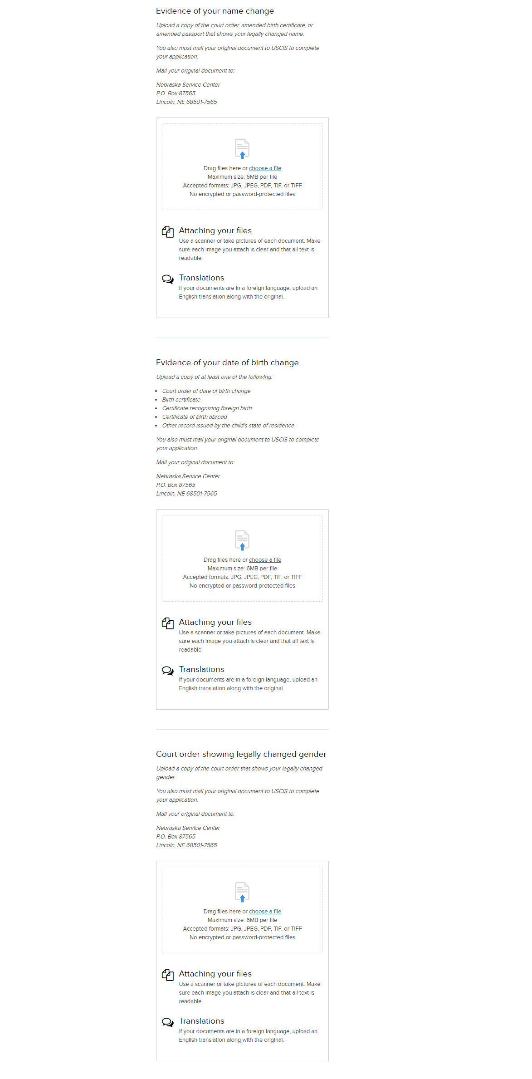
N-565: Evidence – Evidence to support your application (continued)

Slide 23
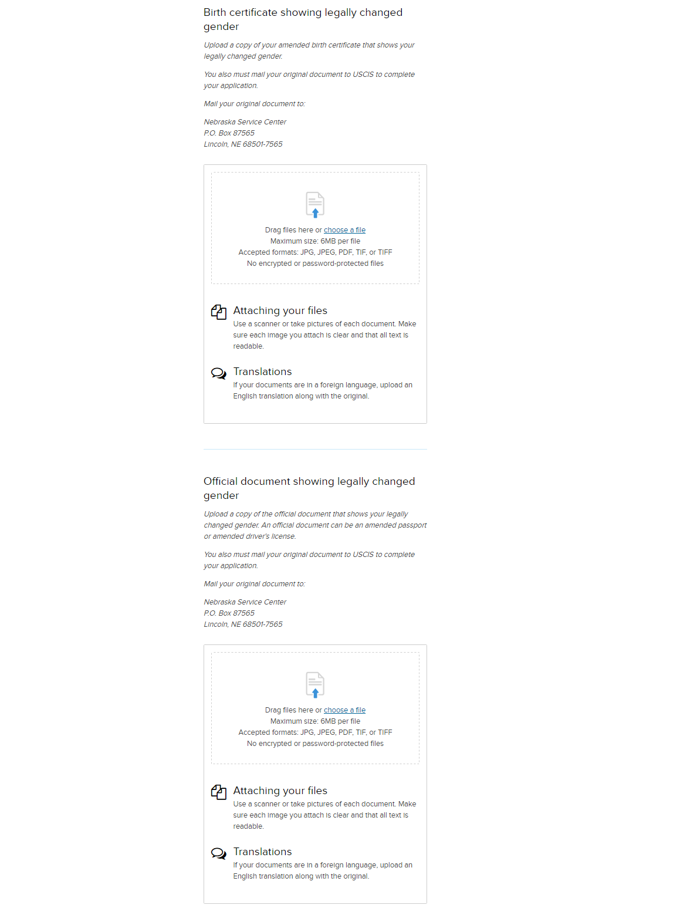
N-565: Evidence – Evidence to support your application (continued)

Slide 24
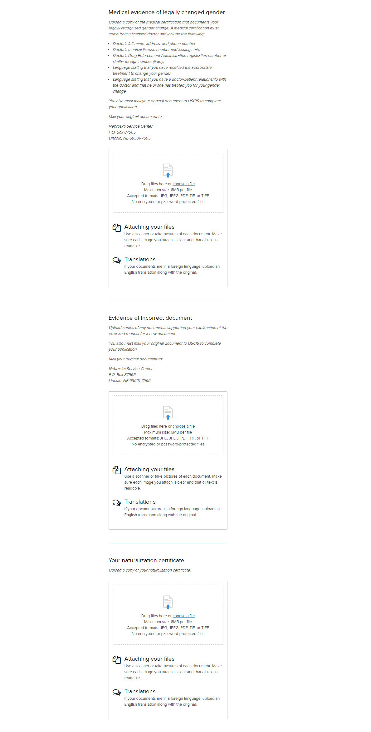
N-565: Evidence – Evidence to support your application (continued)

Slide 25
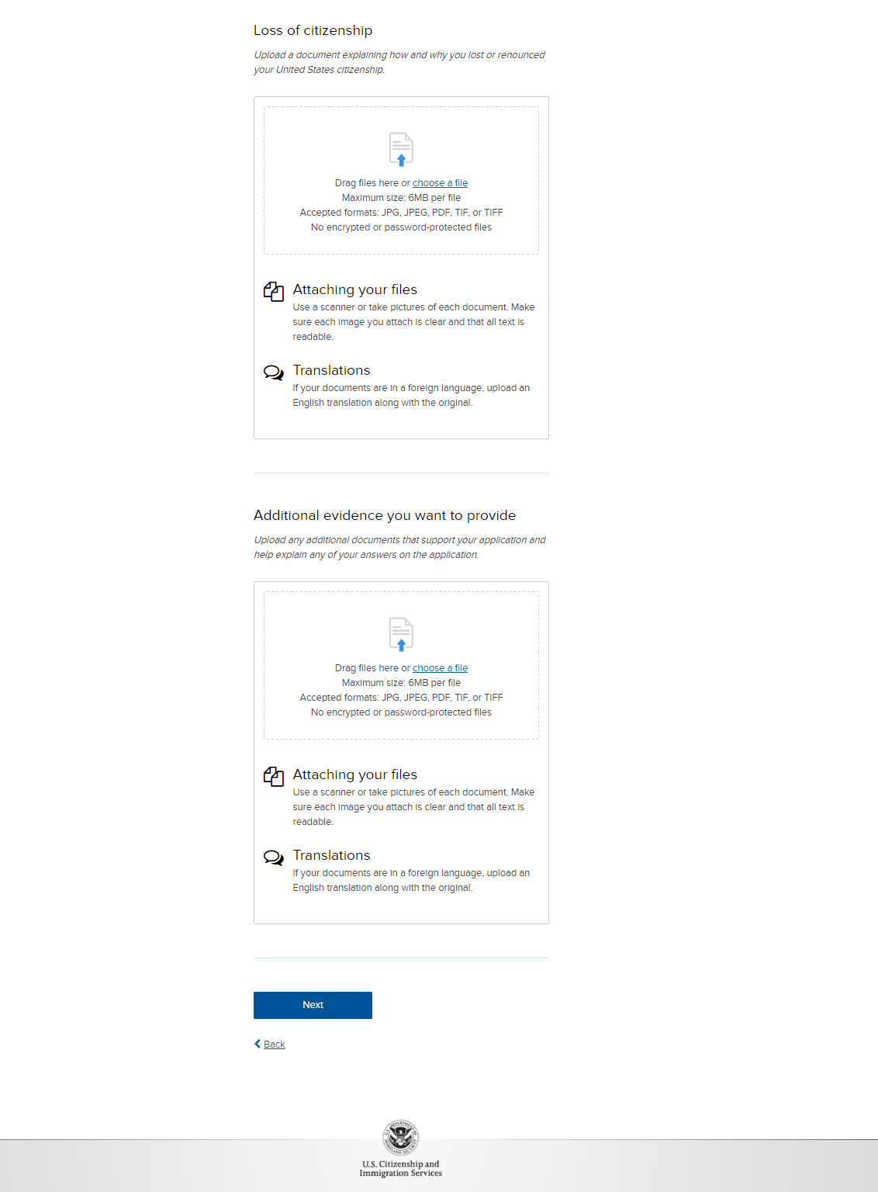
N-565: Evidence – Evidence to support your application (continued)

Slide 26
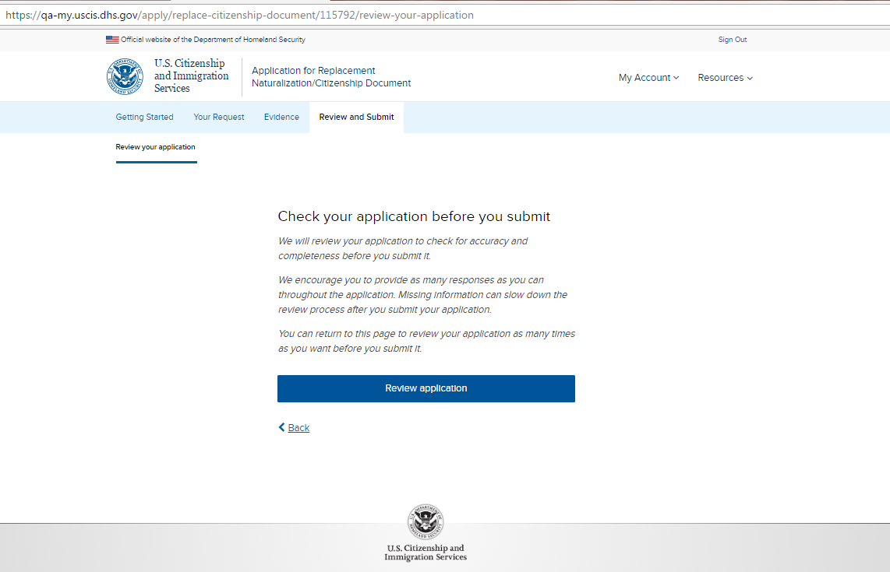
N-565: Review and Submit – Review you application - page 1

Slide 27
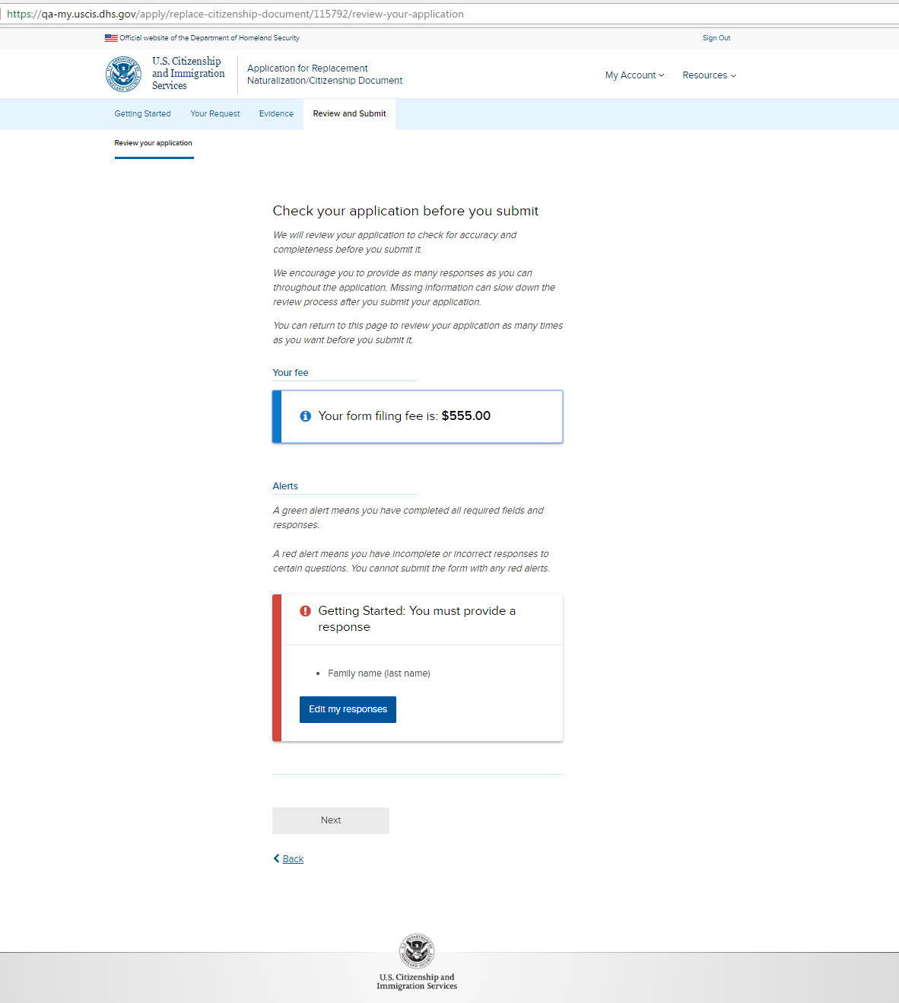
N-565: Review and Submit – Review you application - page 2 (with a hard stop)

Slide 28
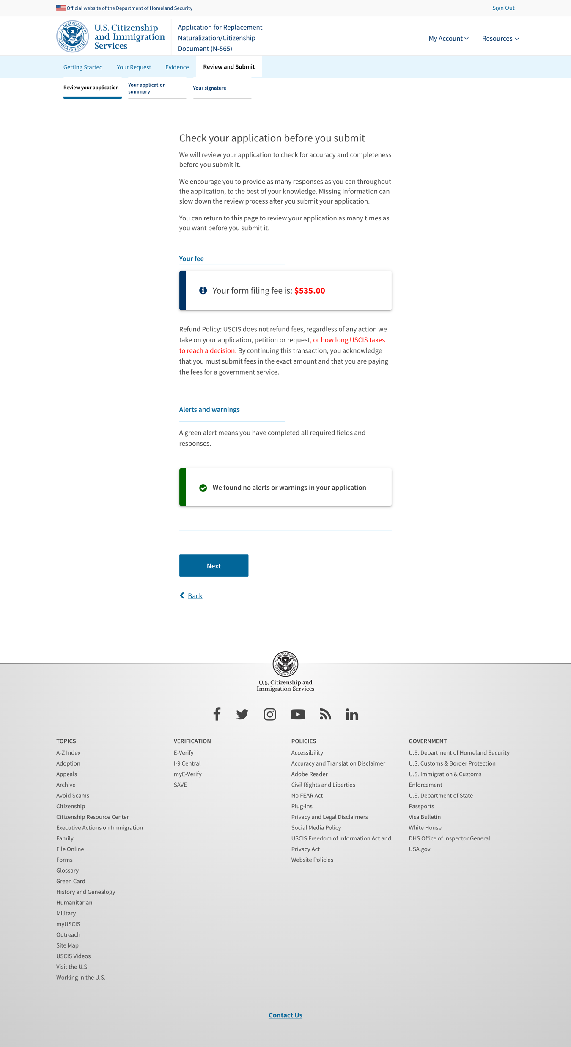
N-565: Review and Submit – Review you application - page 2 (without a hard stop)

Slide 29
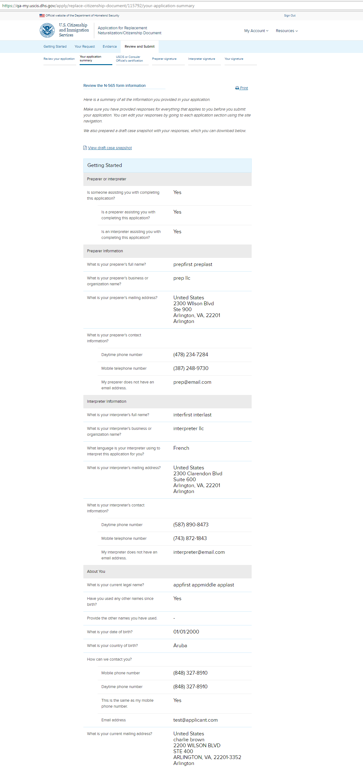
N-565: Review and Submit – Your application summary

Slide 30
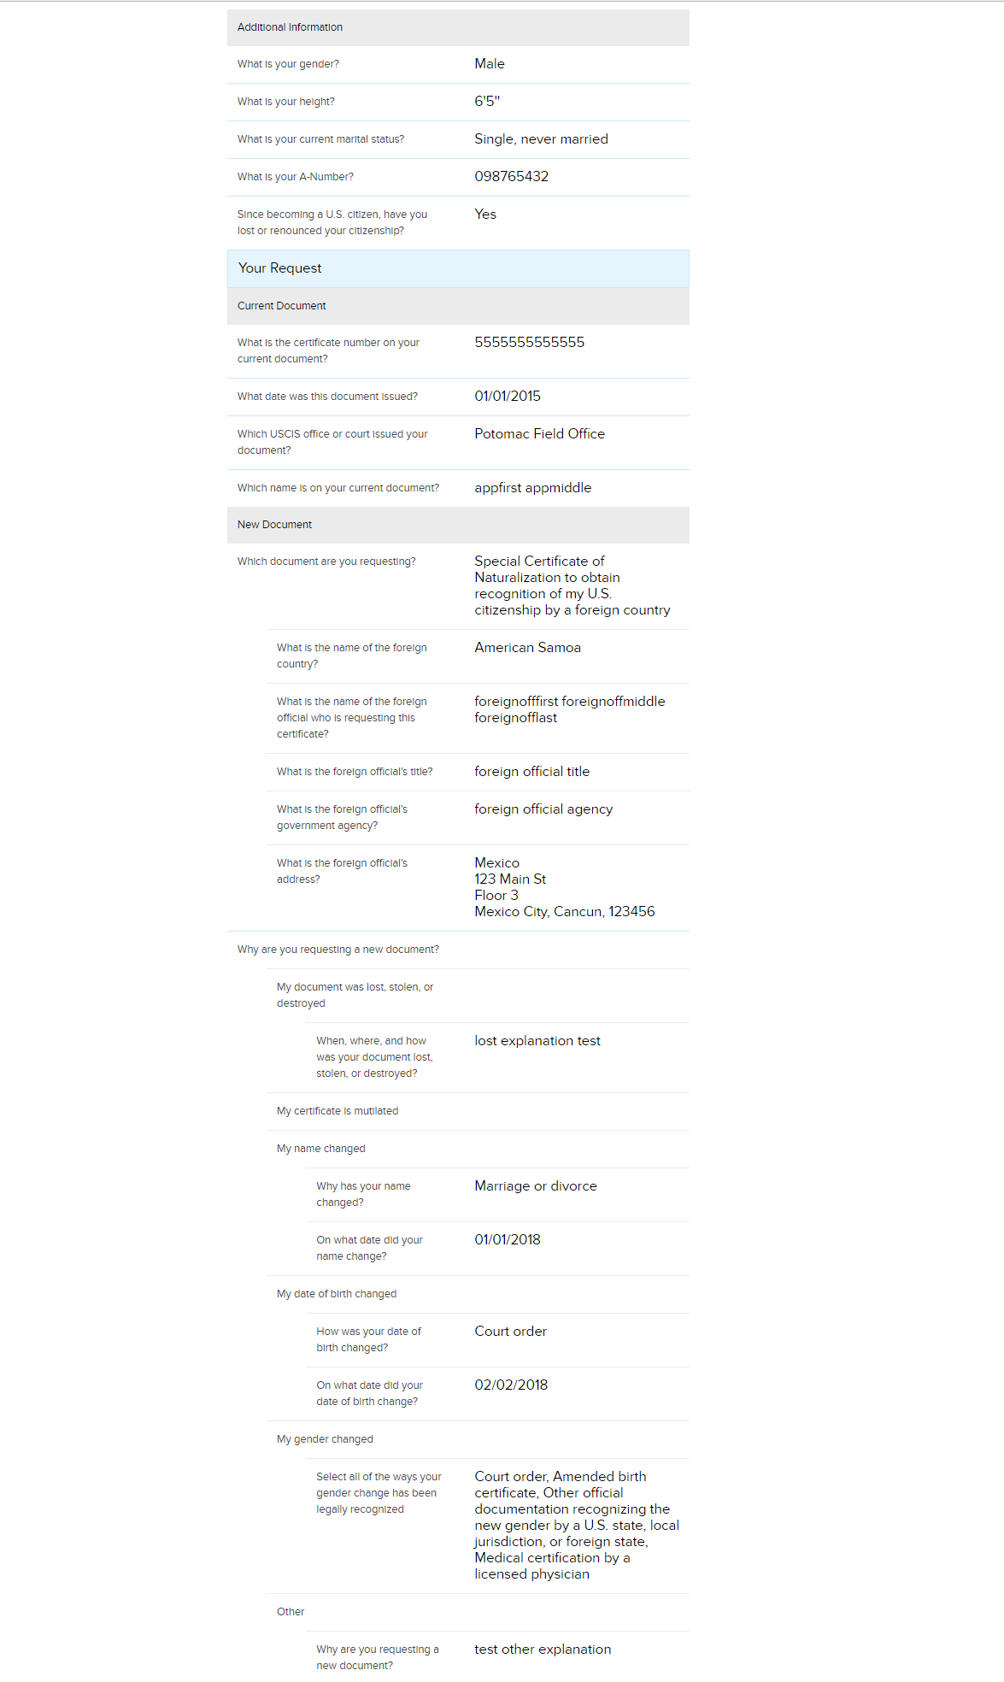
N-565: Review and Submit – Your application summary (continued)

Slide 31
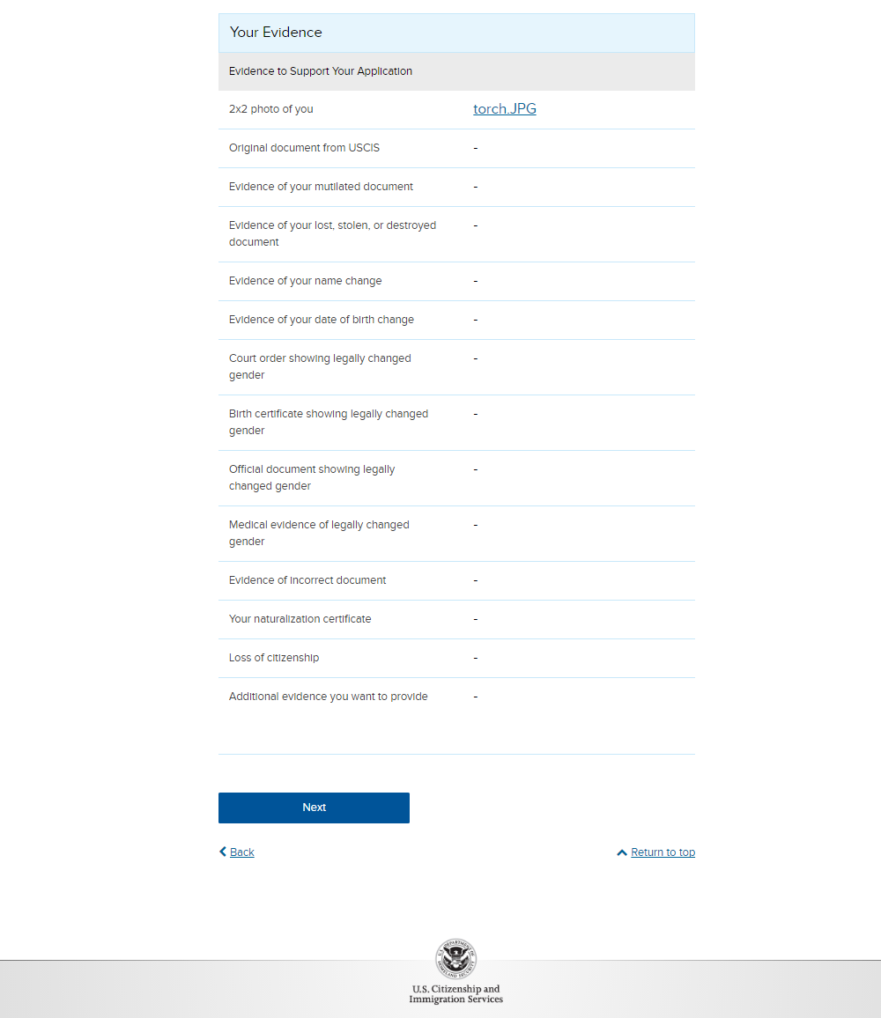
N-565: Review and Submit – Your application summary (continued)

Slide 32
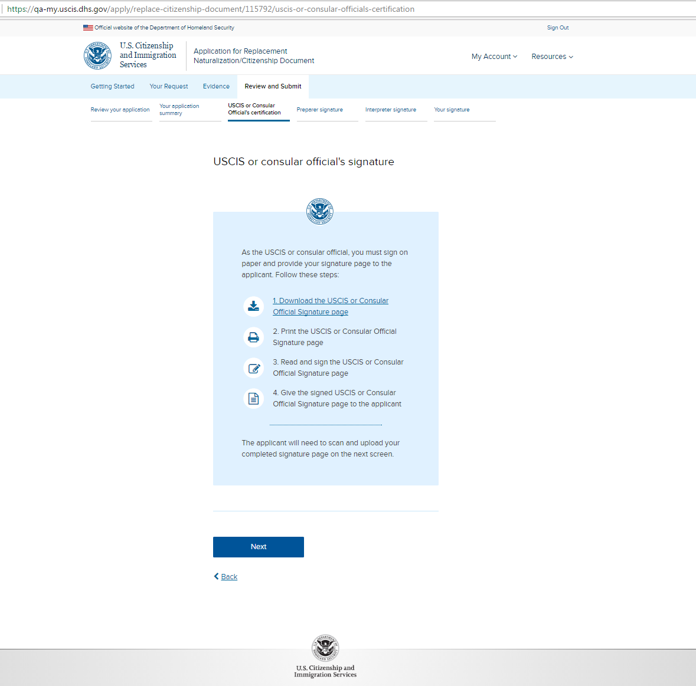
N-565: Review and Submit – USCIS or Consular Official’s certification

Slide 33
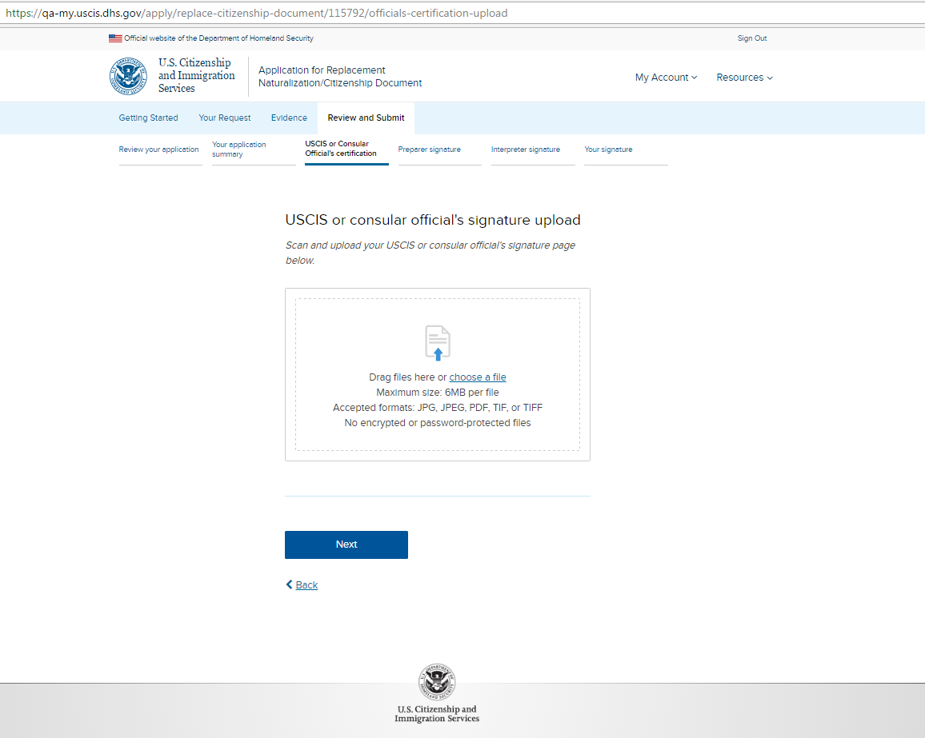
N-565: Review and Submit – USCIS or Consular Official’s certification upload

Slide 34
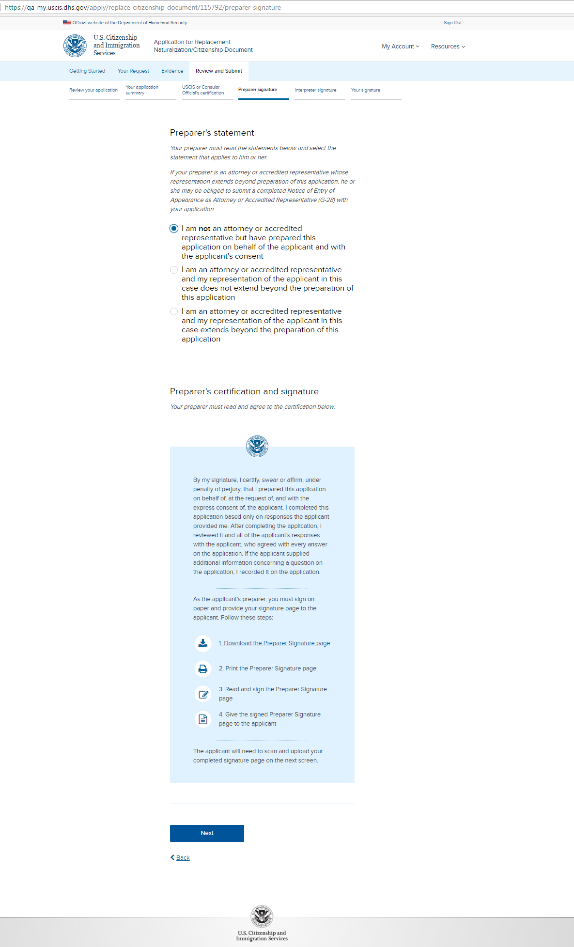
N-565: Review and Submit – Preparer signature (conditional)

Slide 35
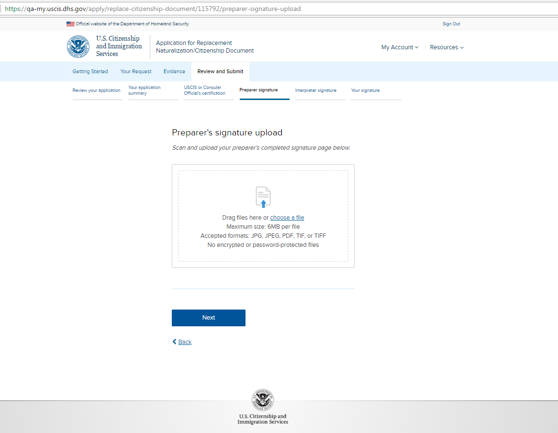
N-565: Review and Submit – Preparer signature upload

Slide 36
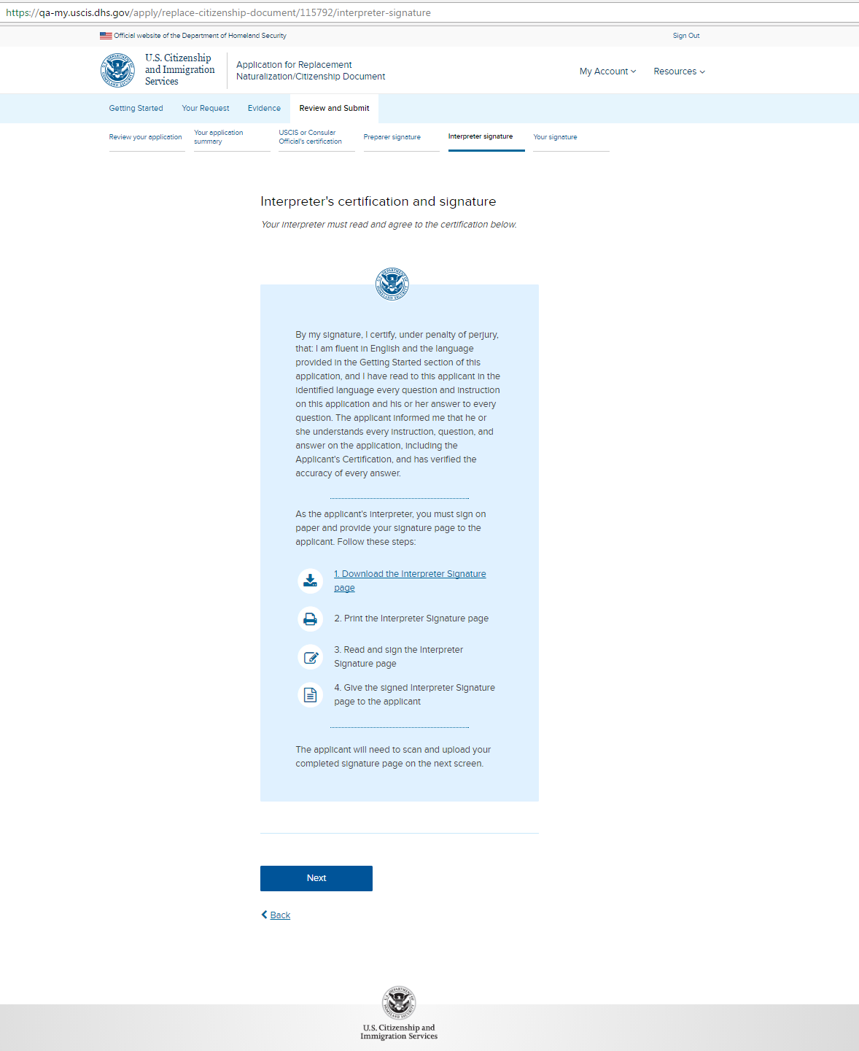
N-565: Review and Submit – Interpreter signature (conditional)

Slide 37
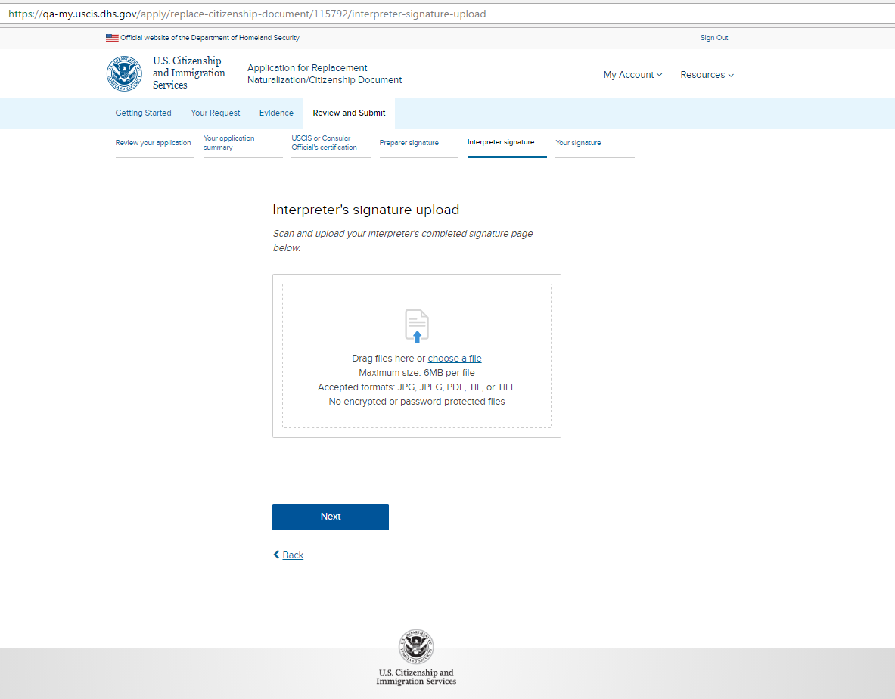
N-565: Review and Submit – Interpreter signature upload

Slide 38
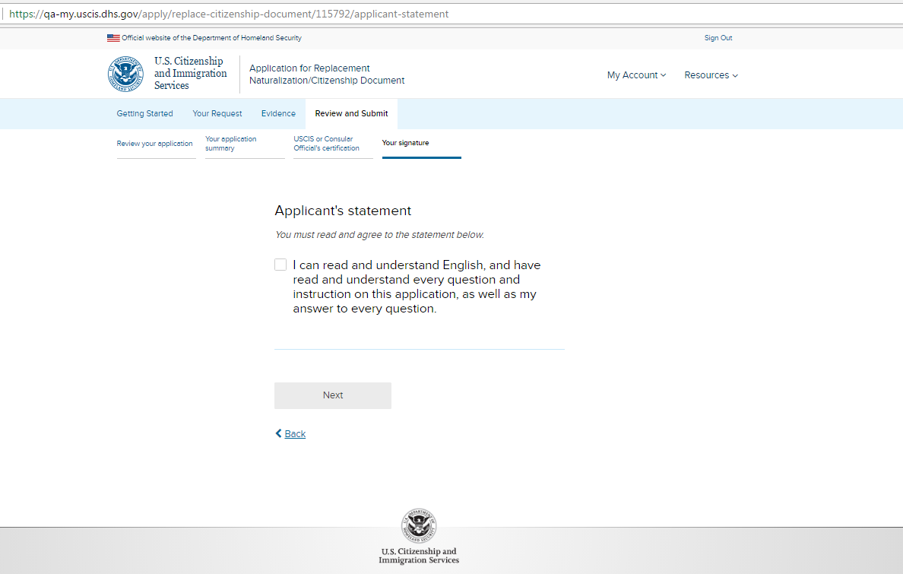
N-565: Review and Submit – Your signature – page 1a (without preparer or interpreter)

Slide 39
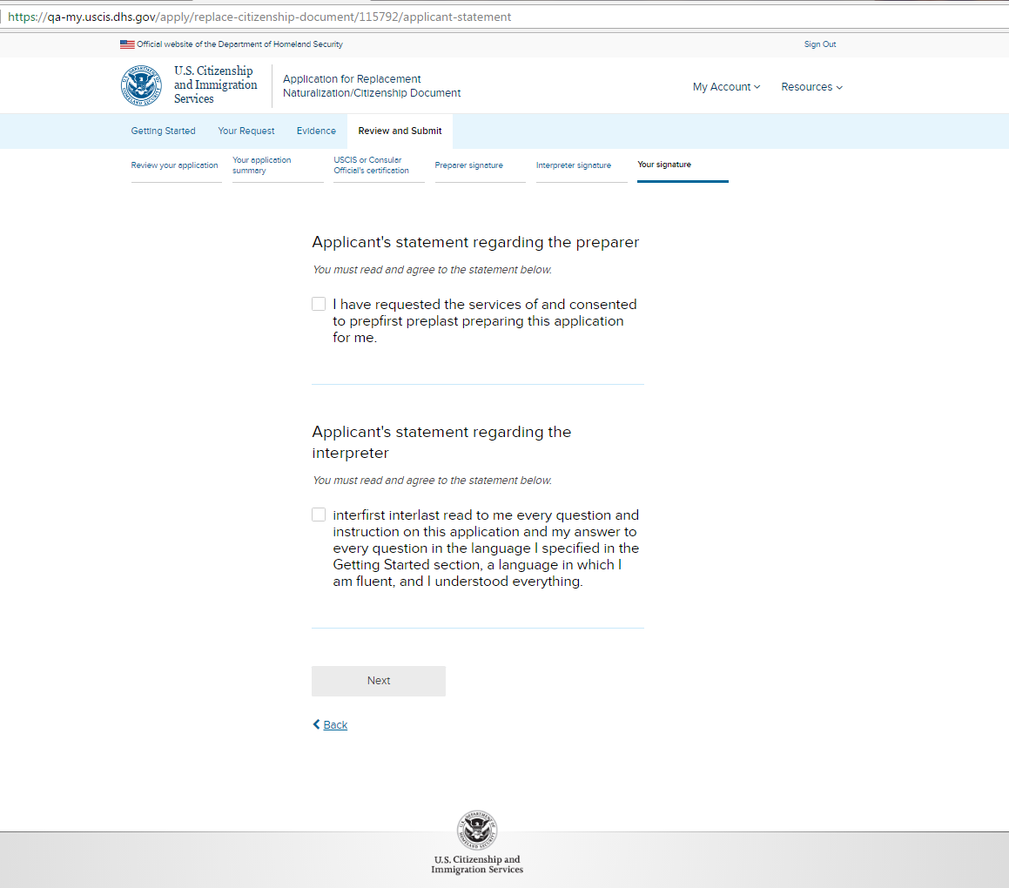
N-565: Review and Submit – Your signature – page 1b (conditional with preparer/interpreter)

Slide 40
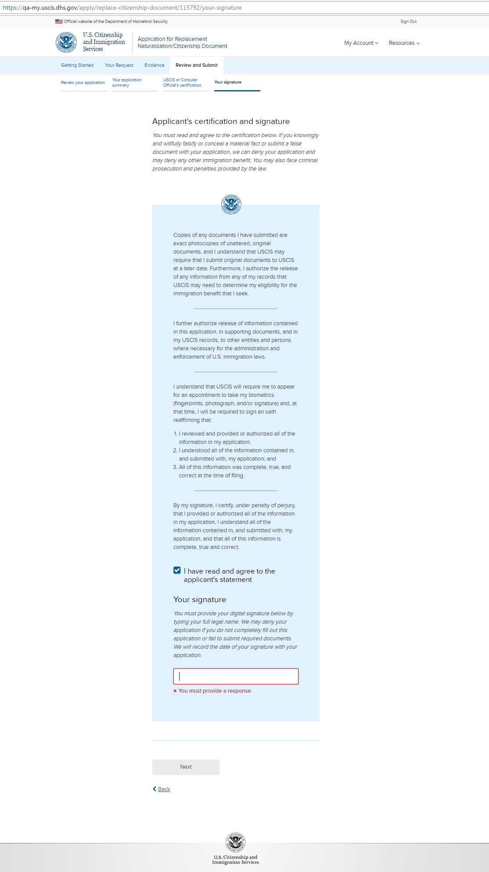
N-565: Review and Submit – Your signature - page 2

Slide 41
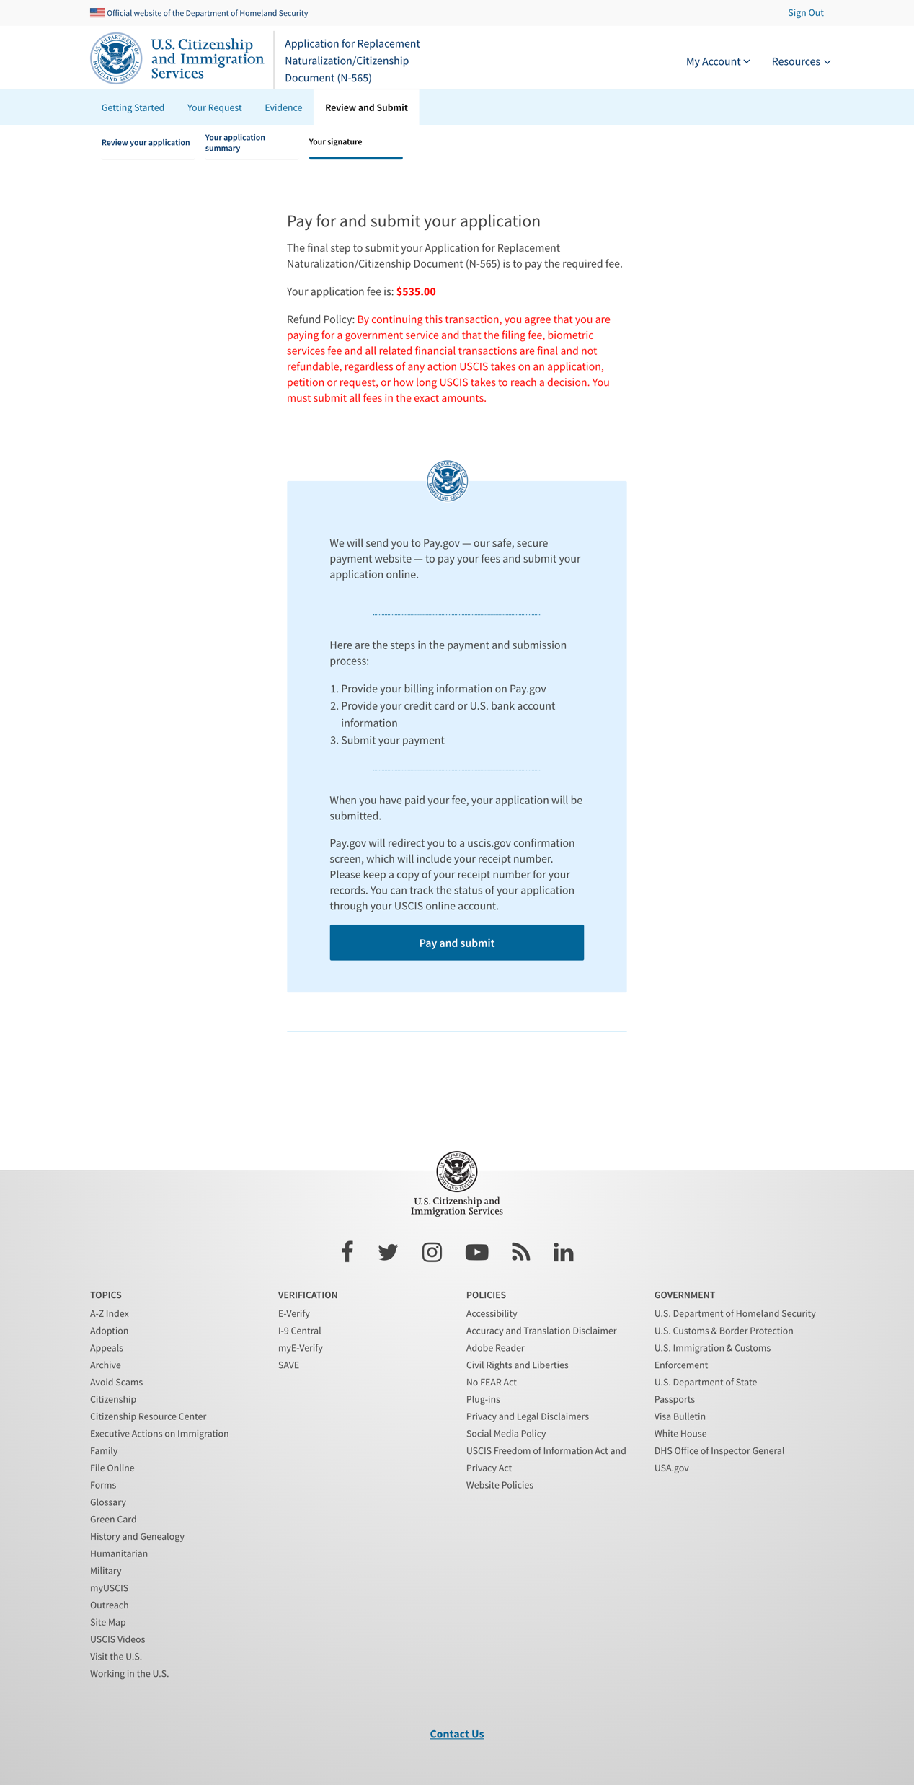
N-565: Review and Submit – Your signature – page 3

Slide 42
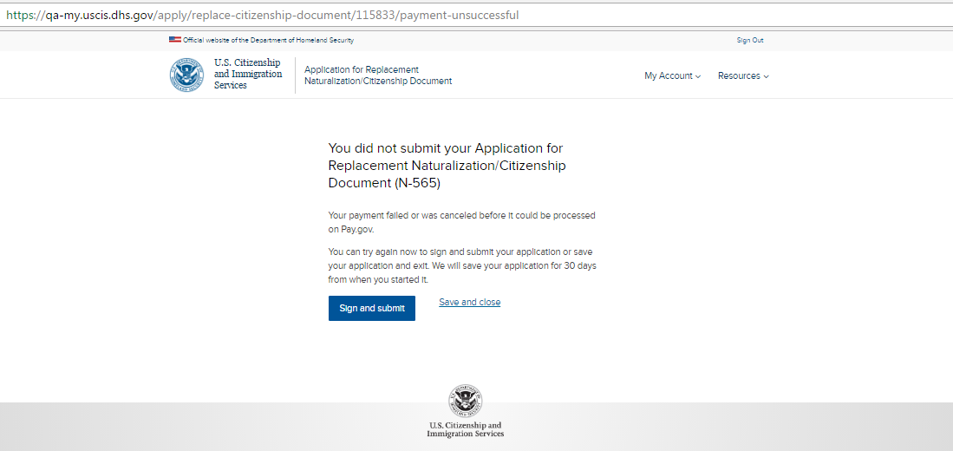
N-565: Review and Submit – unsuccessful payment

Slide 43
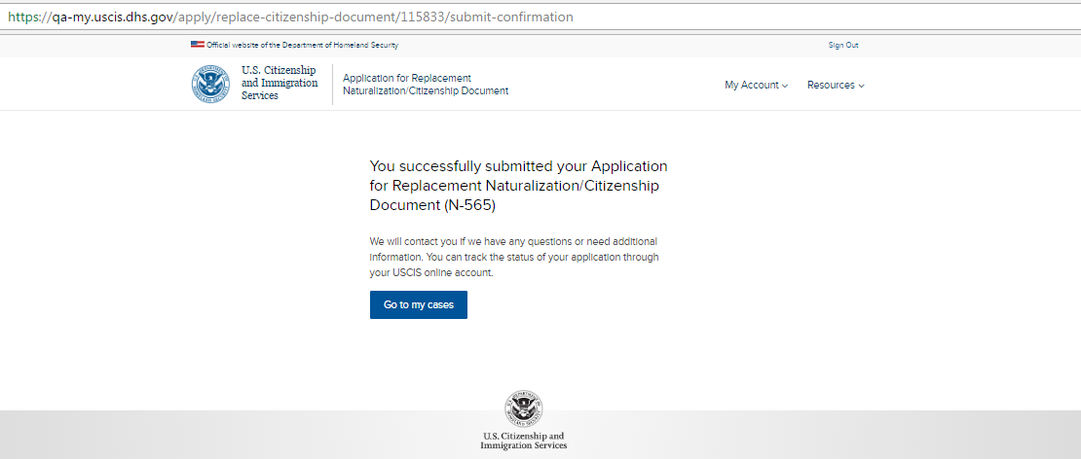
N-565: Review and Submit – successful payment

