Slide 1

N-600K: Application for Citizenship and Issuance of Certificate Under Section 332
United States Citizenship and Immigration Services
myUSICS Team

Slide 2
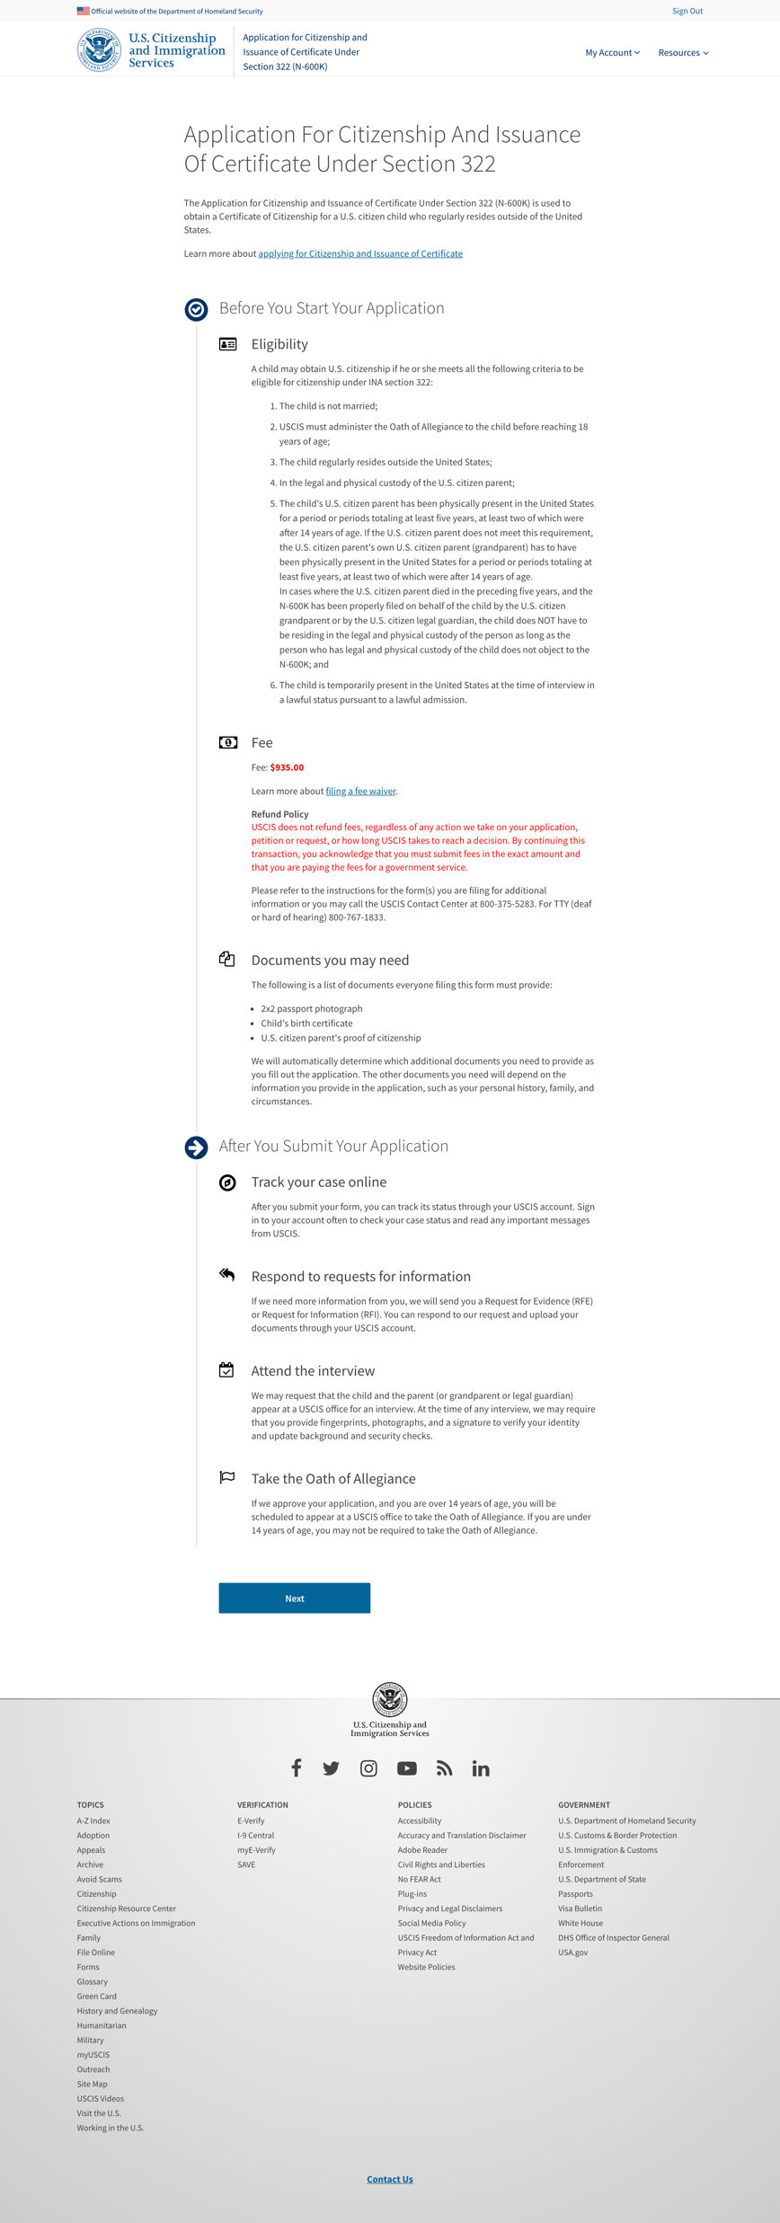
Overview

Slide 3
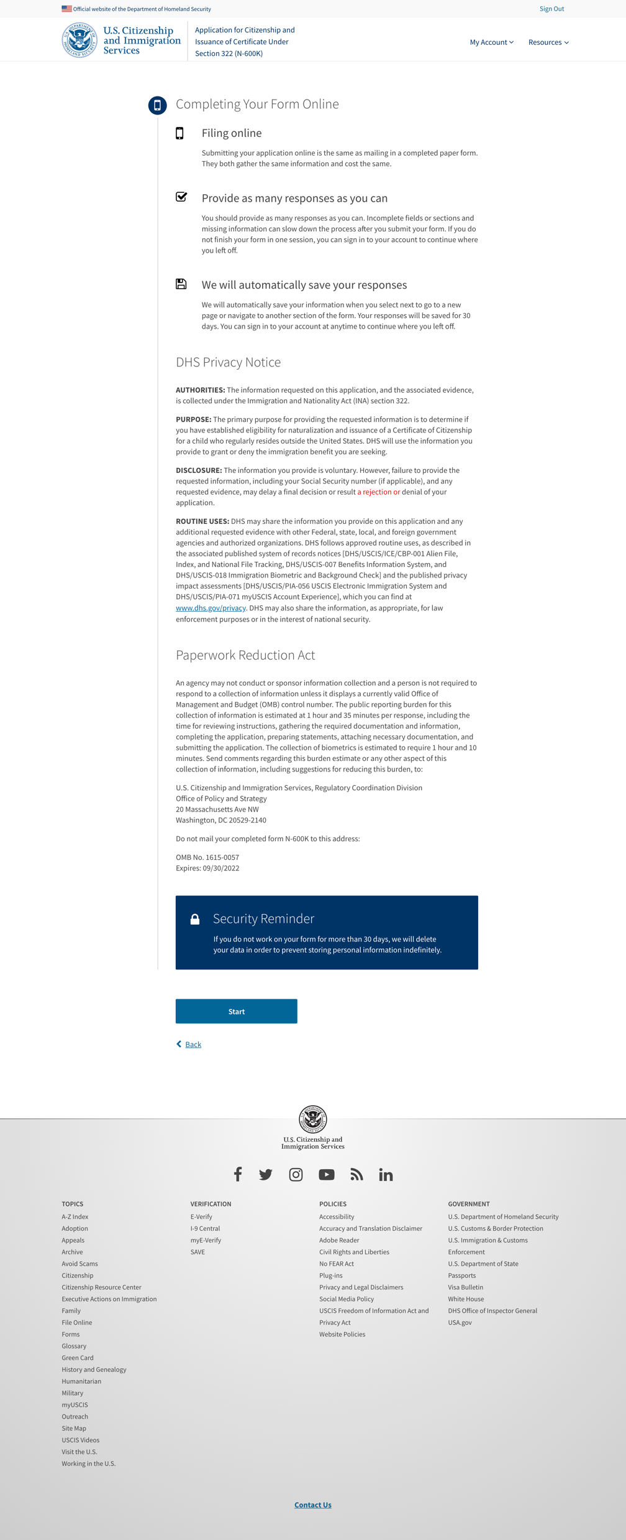
Start Application

Slide 4
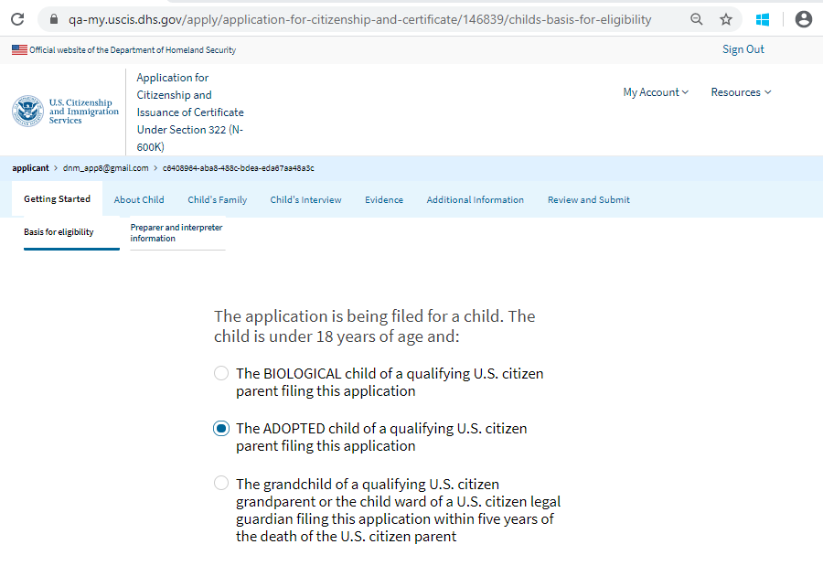
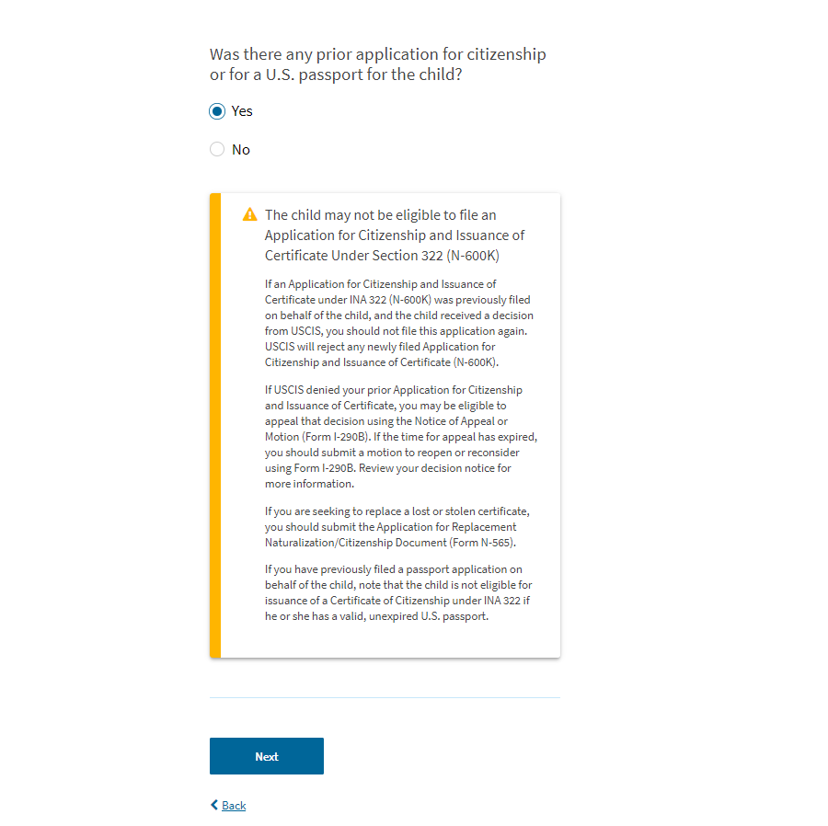
Basis for Eligibility

Slide 5
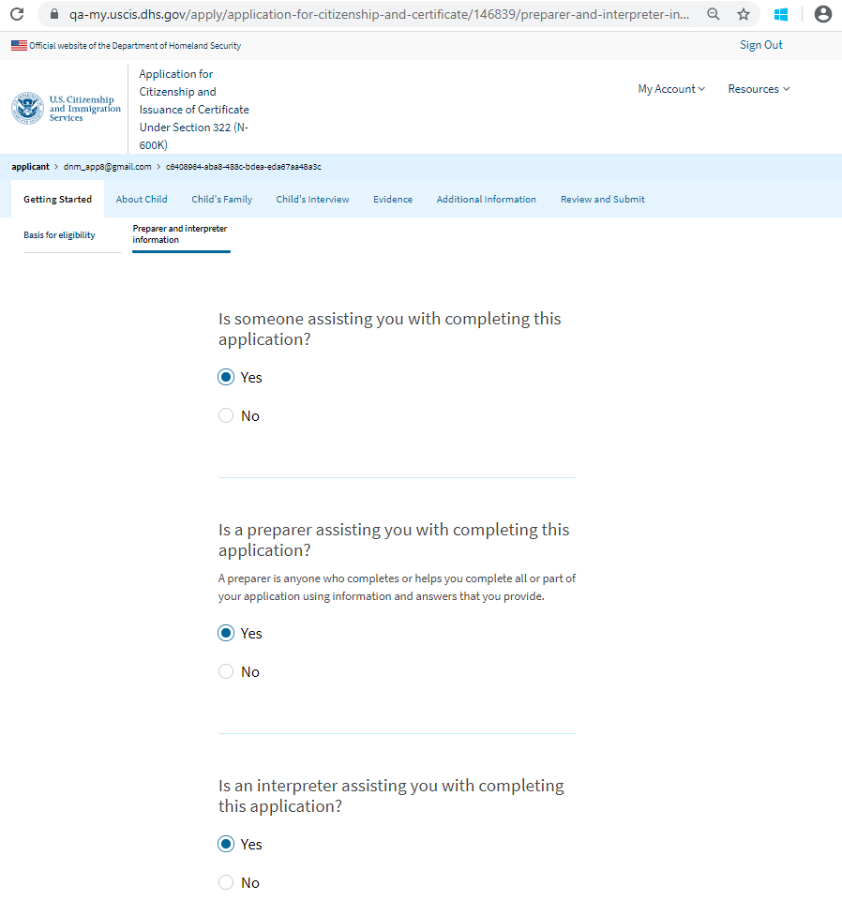

Preparer and Interpreter Questions

Slide 6
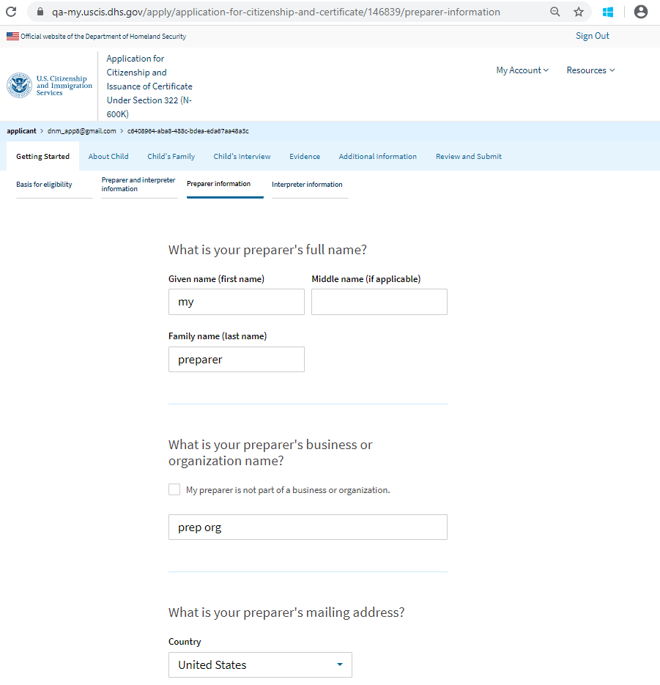
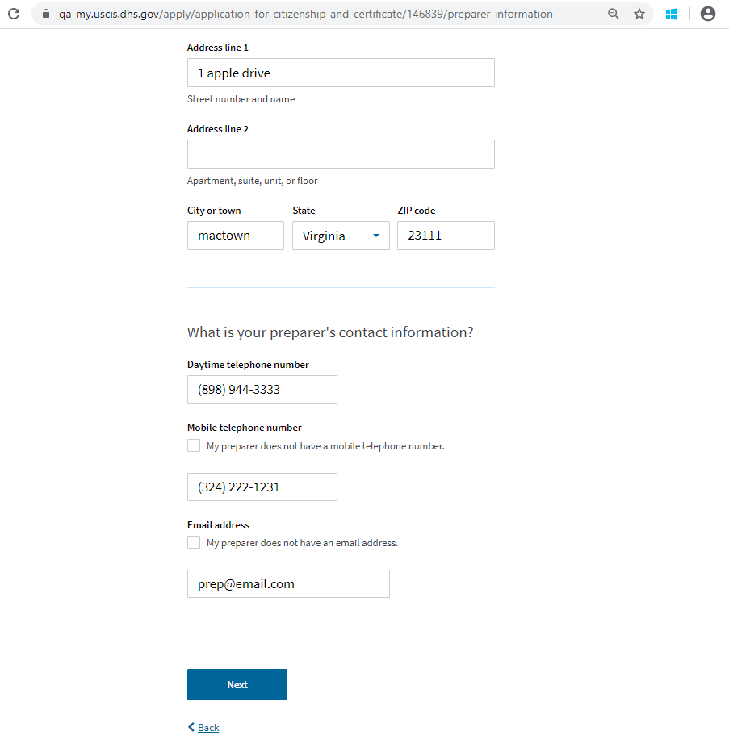
Preparer Information

Slide 7
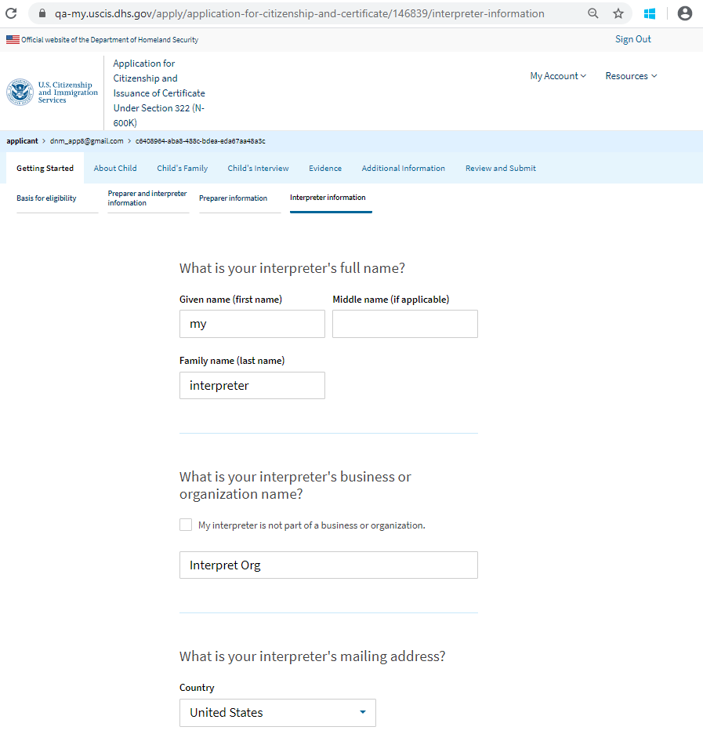
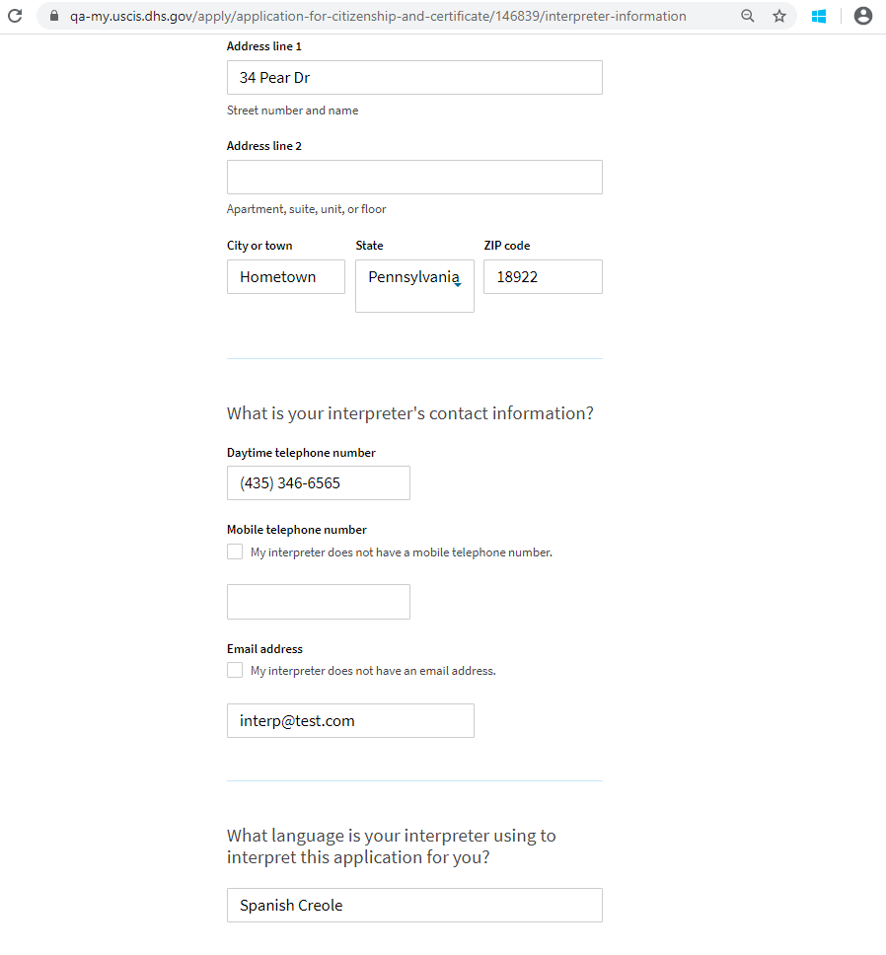
Interpreter Information

Slide 8
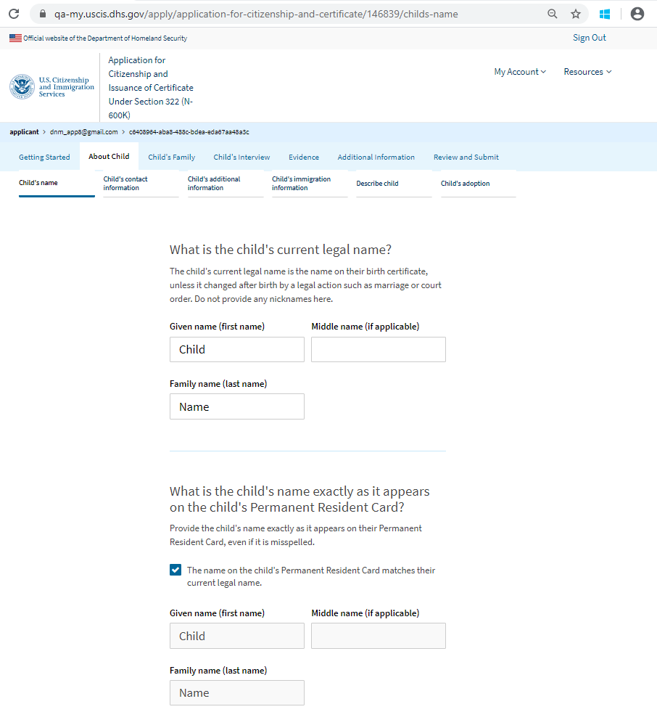
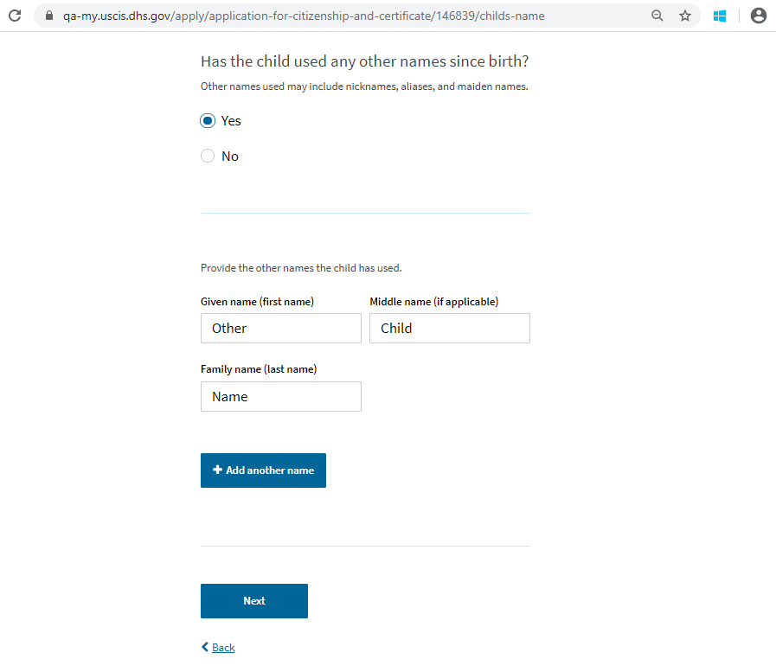
Child’s Name

Slide 9
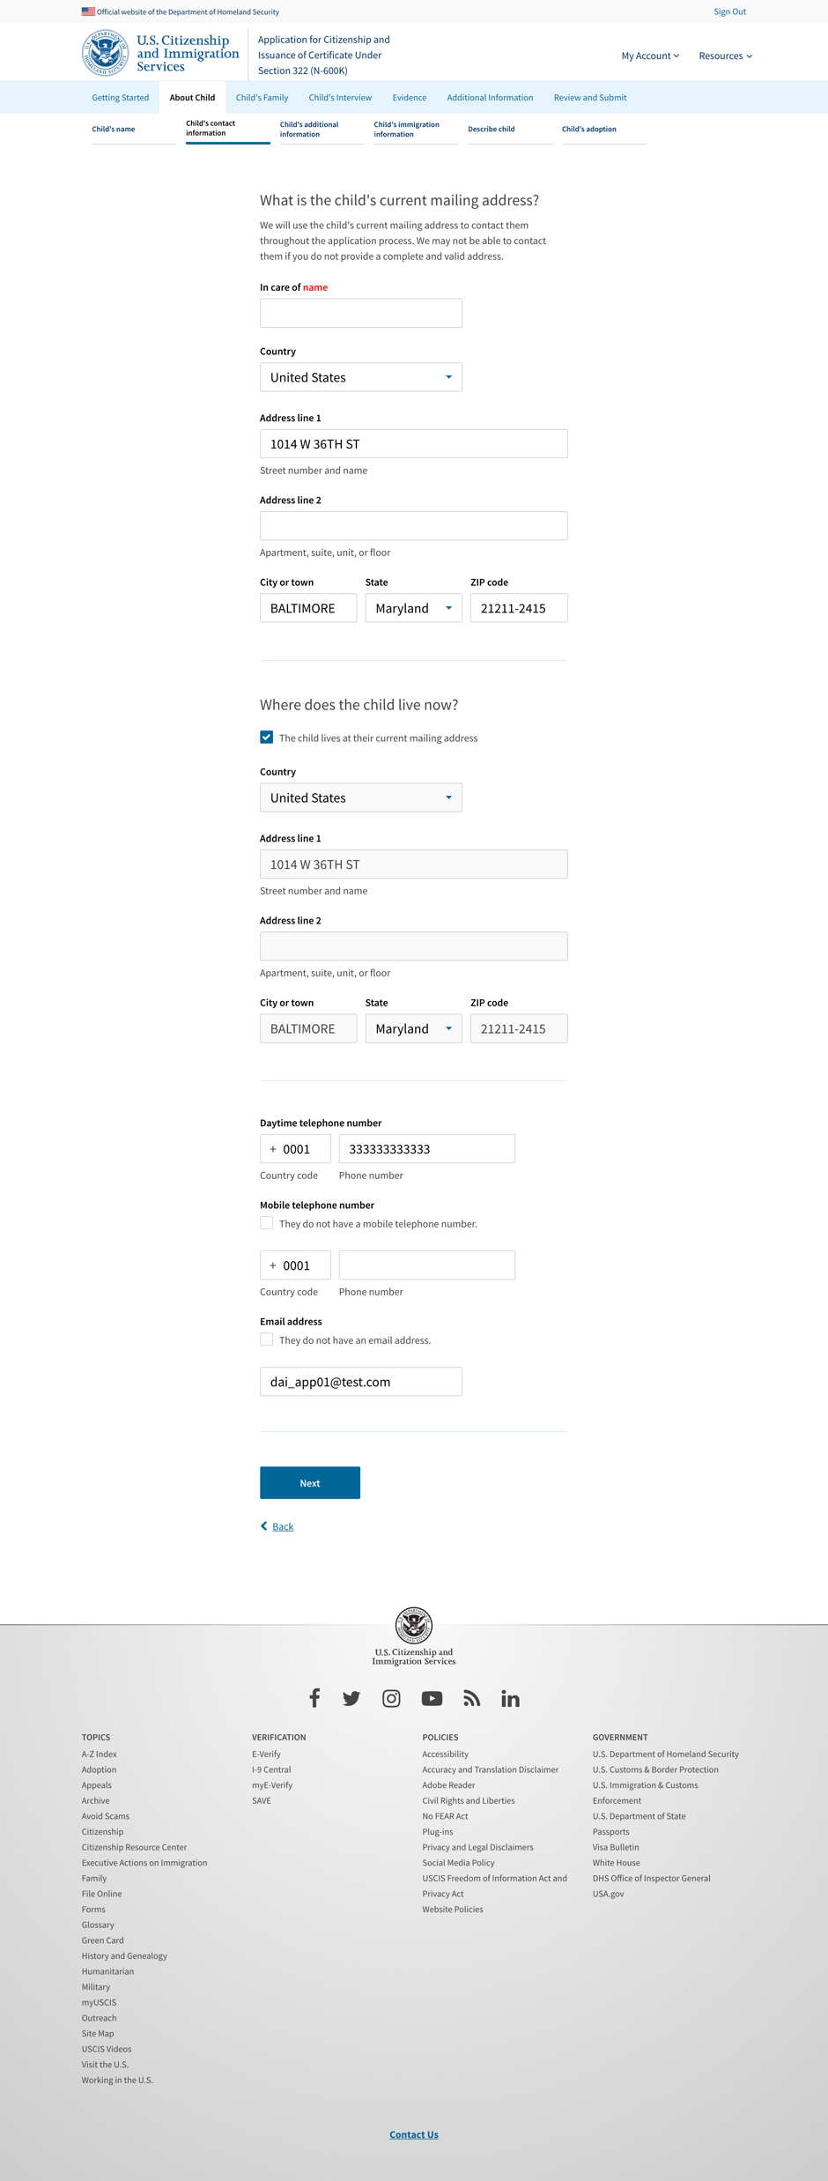
Child’s Contact Information

Slide 10
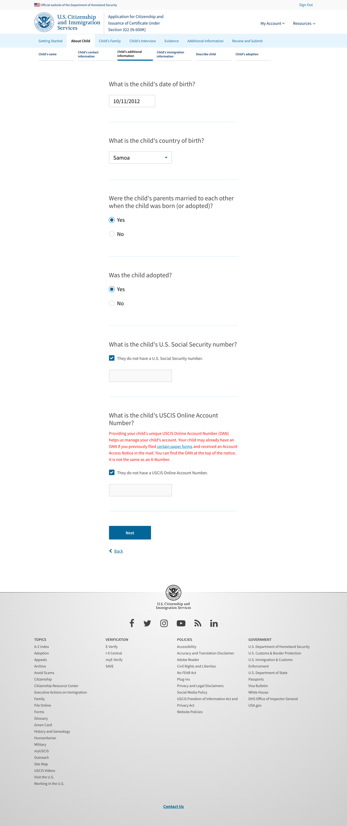
Child’s Additional Information

Slide 11
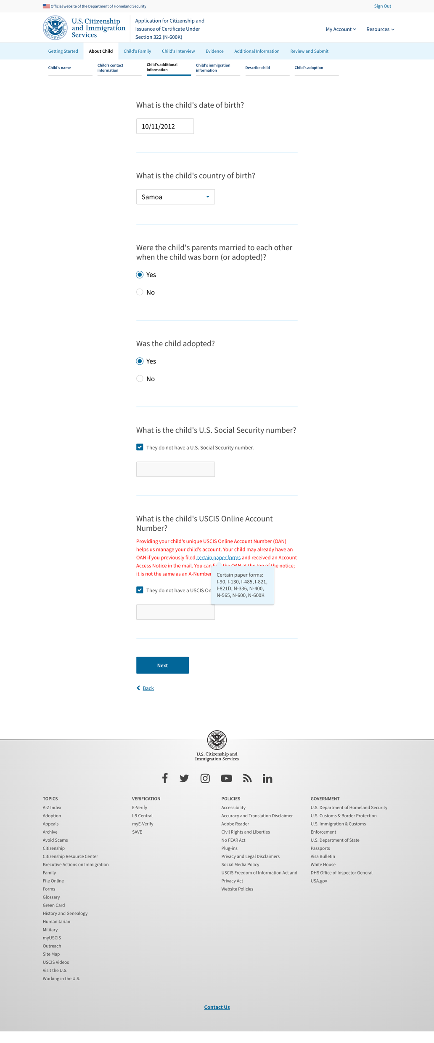
Child’s Additional Information – hint text

Slide 12
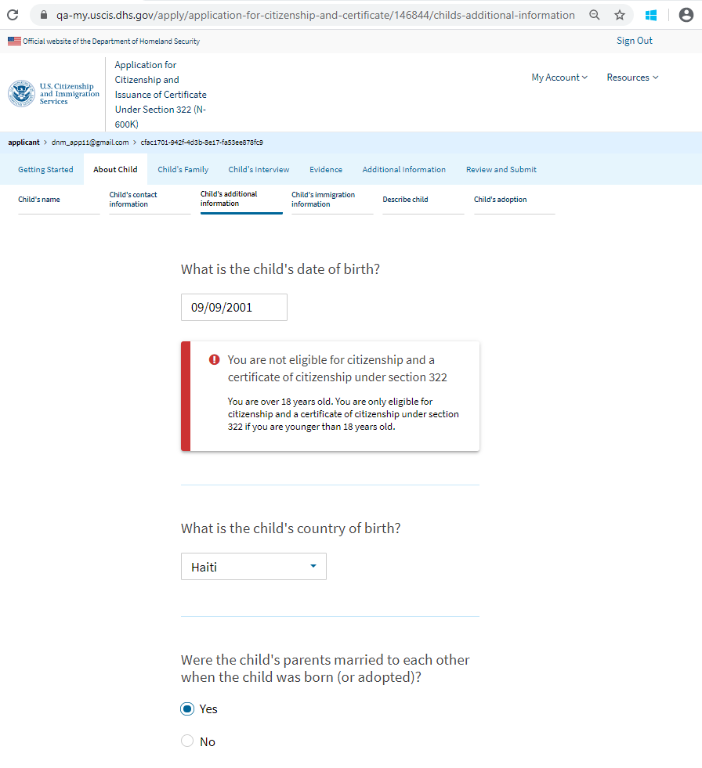
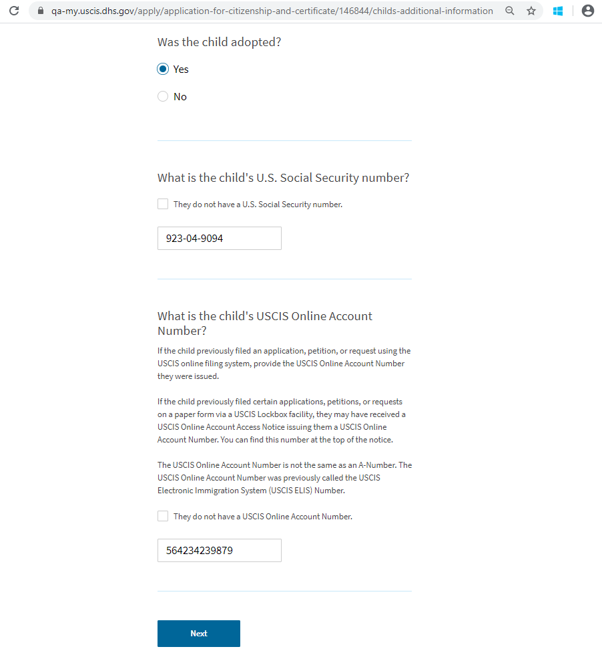
Child’s Additional Information – If overage

Slide 13
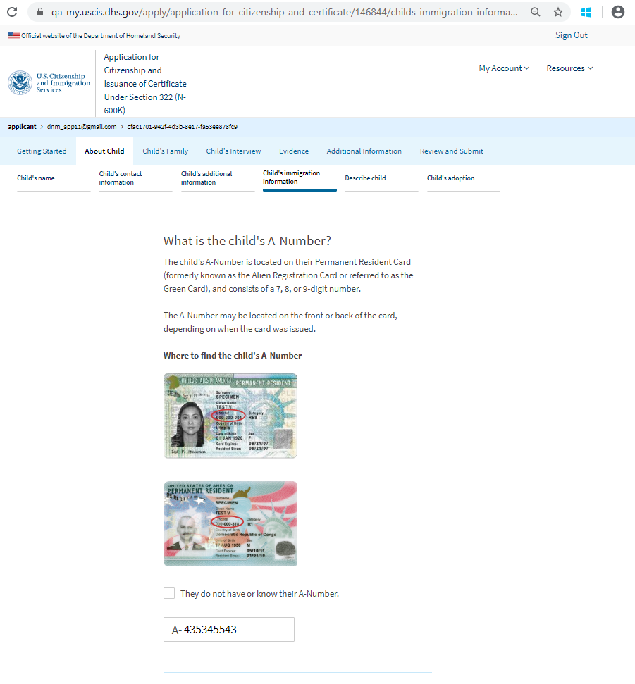
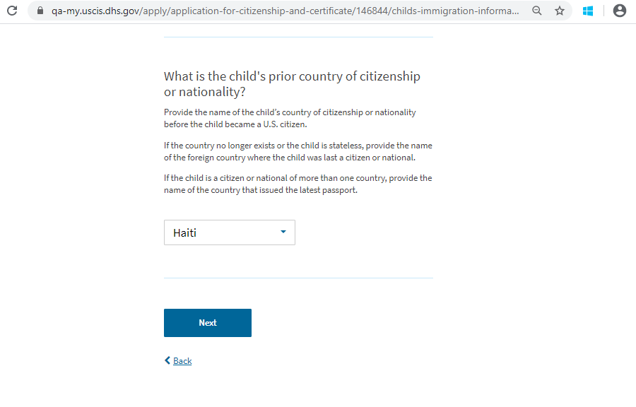
Child’s Immigration Information

Slide 14
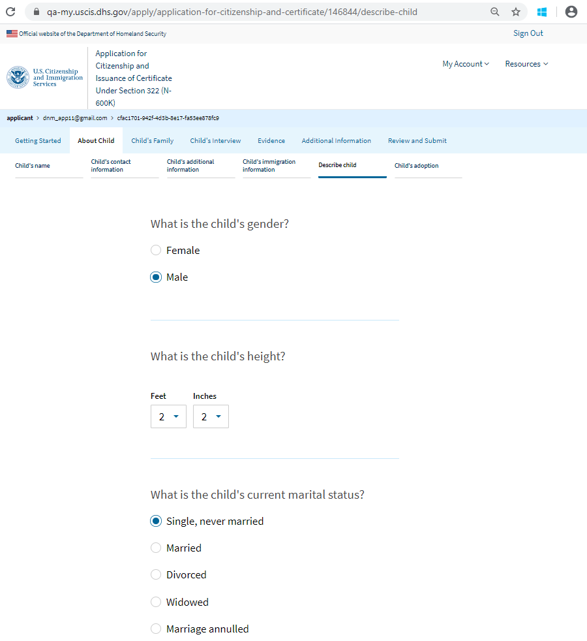
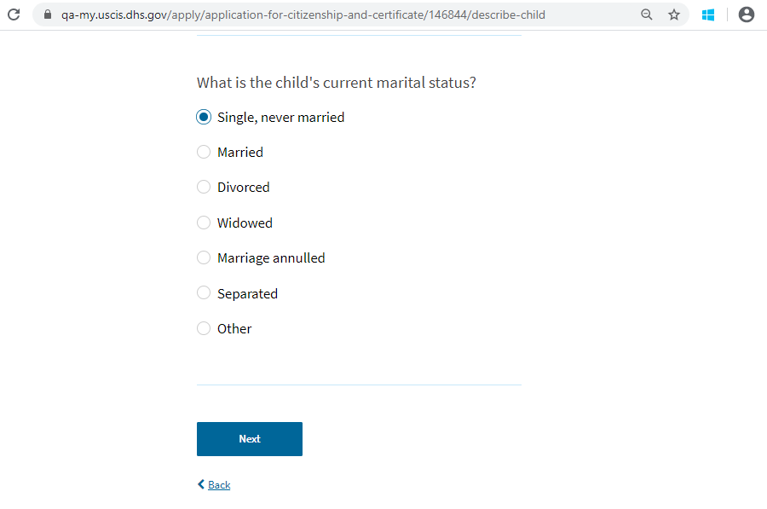
Describe Child

Slide 15
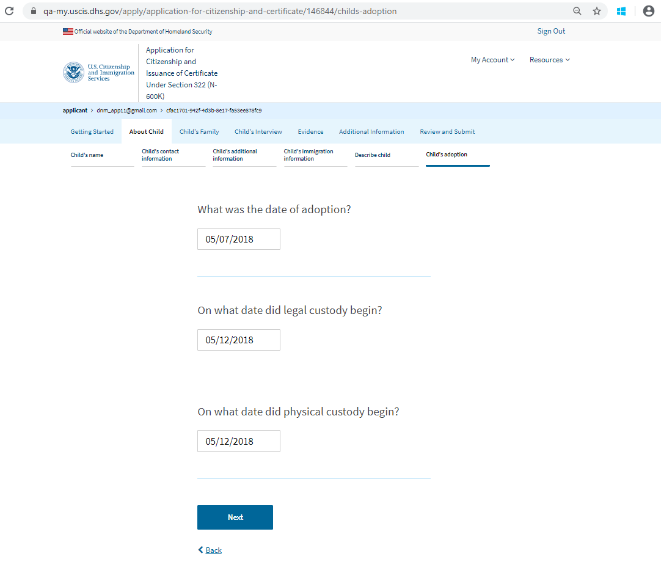
Children’s Adoption

Slide 16
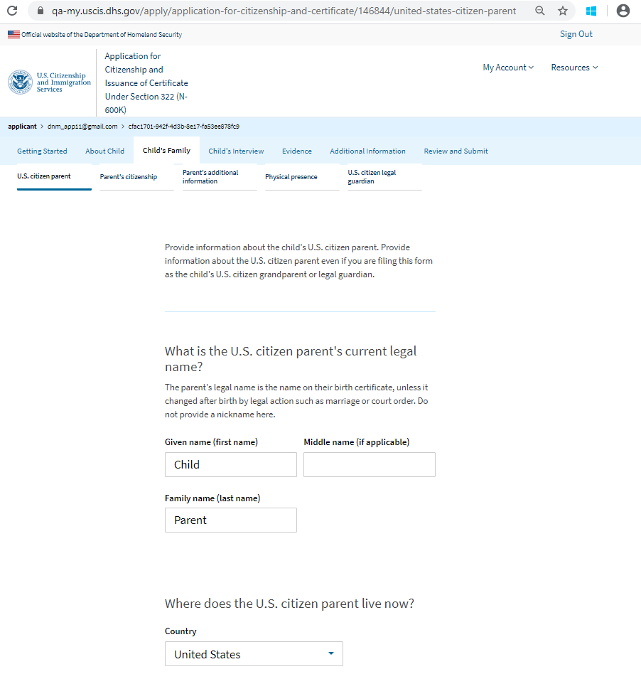
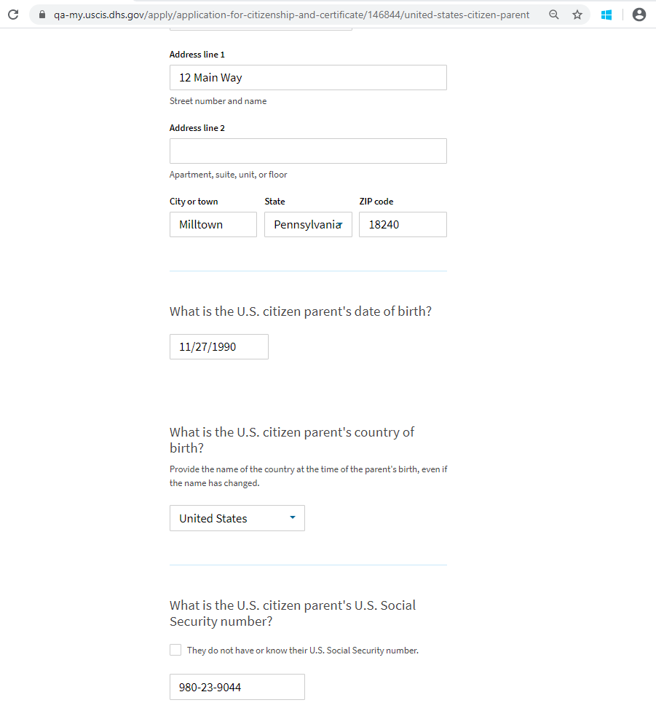
U.S. Citizen Parent – Page 1

Slide 17
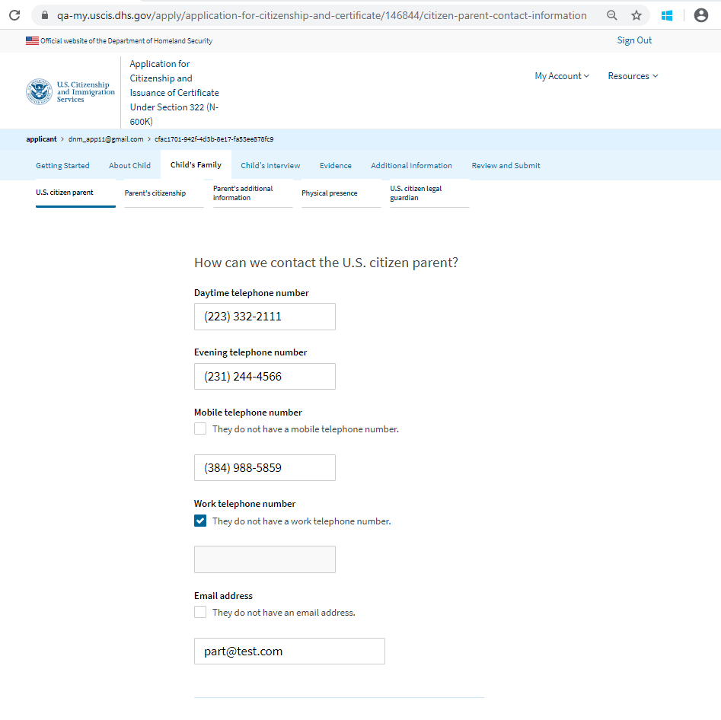
U.S. Citizen Parent – Page 2

Slide 18
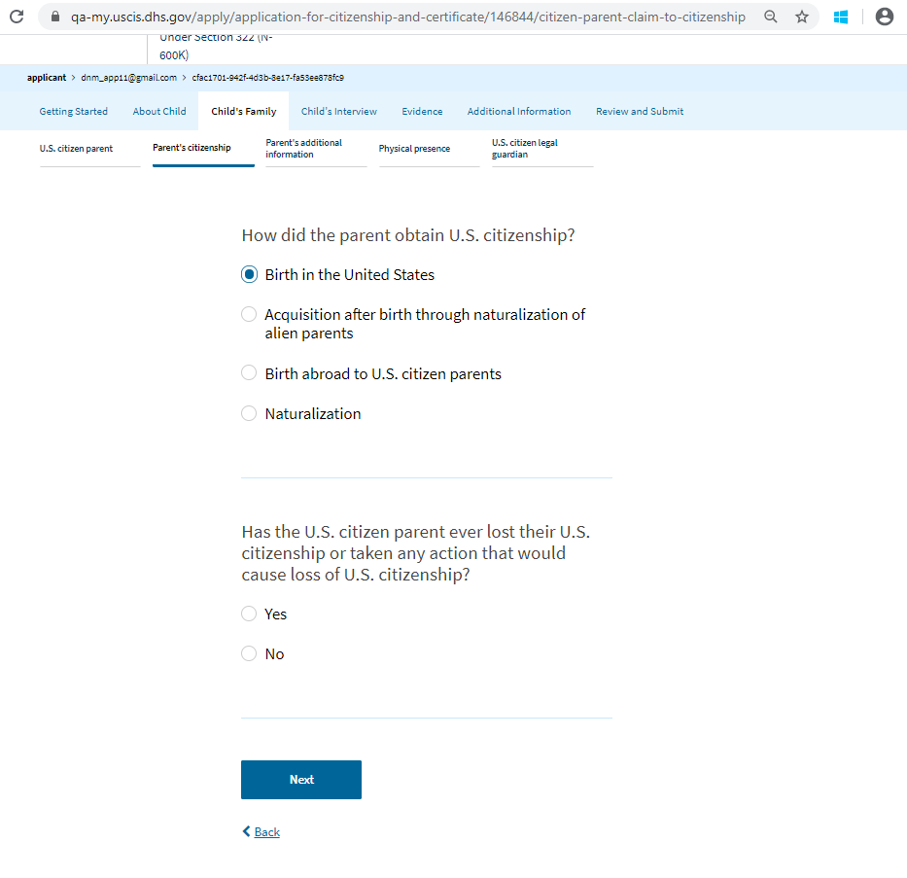
Parent’s Citizenship – By birth in the U.S. or acq. from naturalization of parents

Slide 19
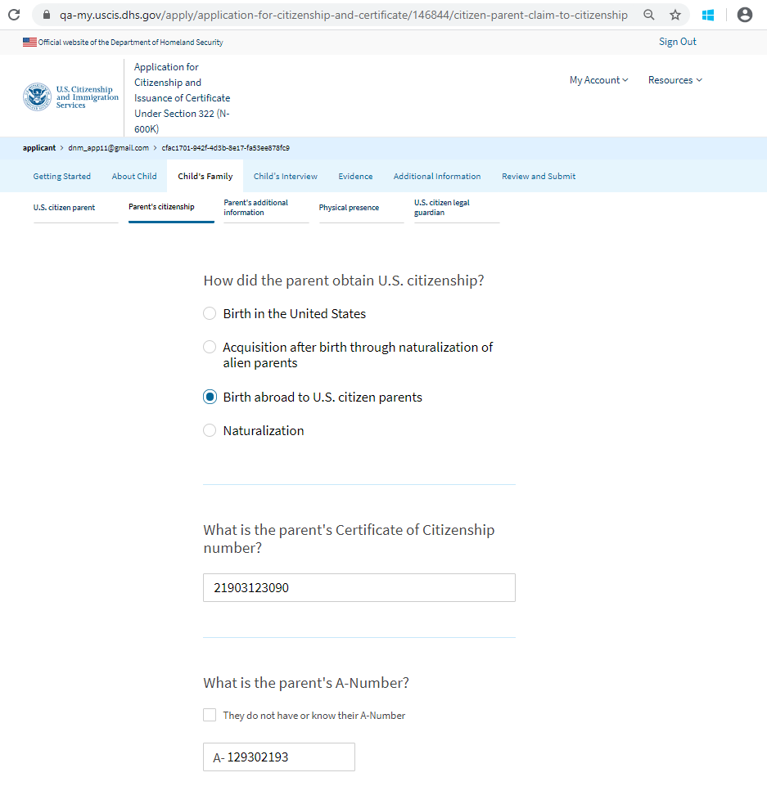
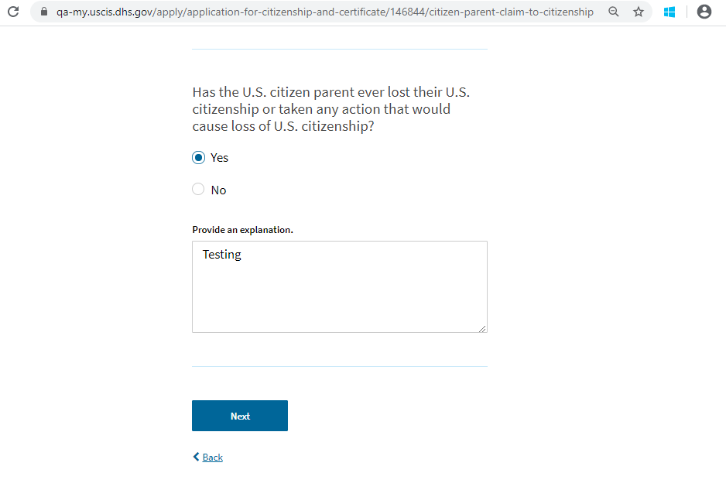
Parent’s Citizenship – By birth abroad to U.S. citizen parents

Slide 20
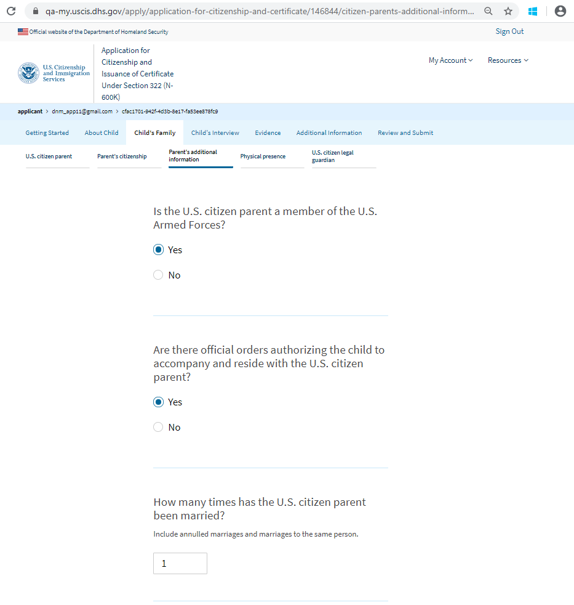
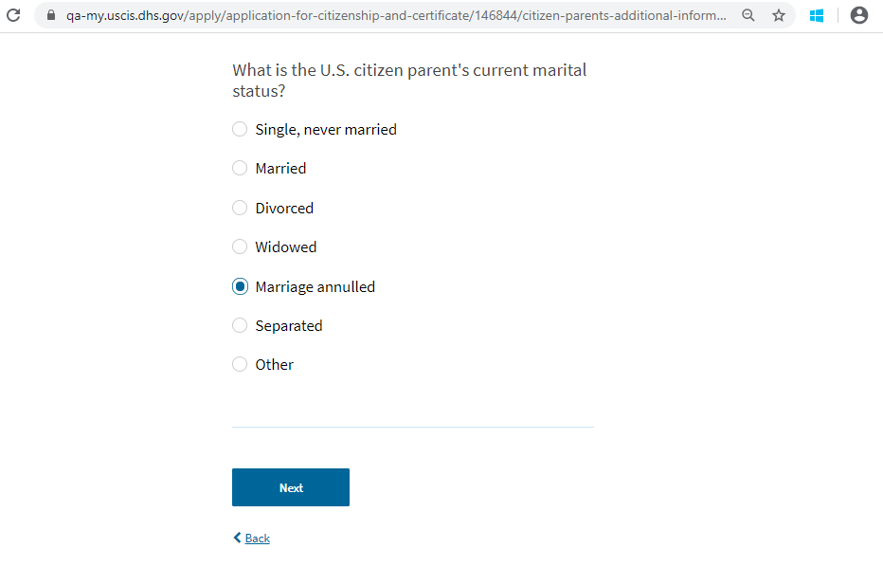
Parent’s Additional Info – If single, divorced, widowed, or marriage annulled selected

Slide 21
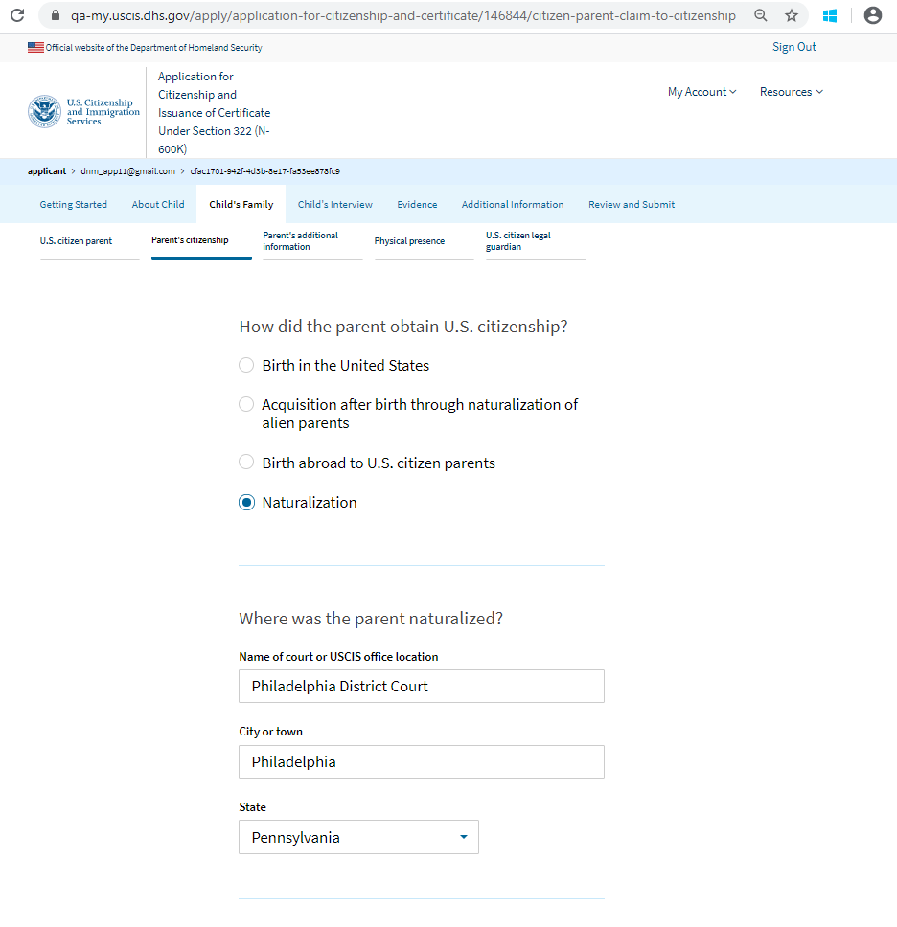
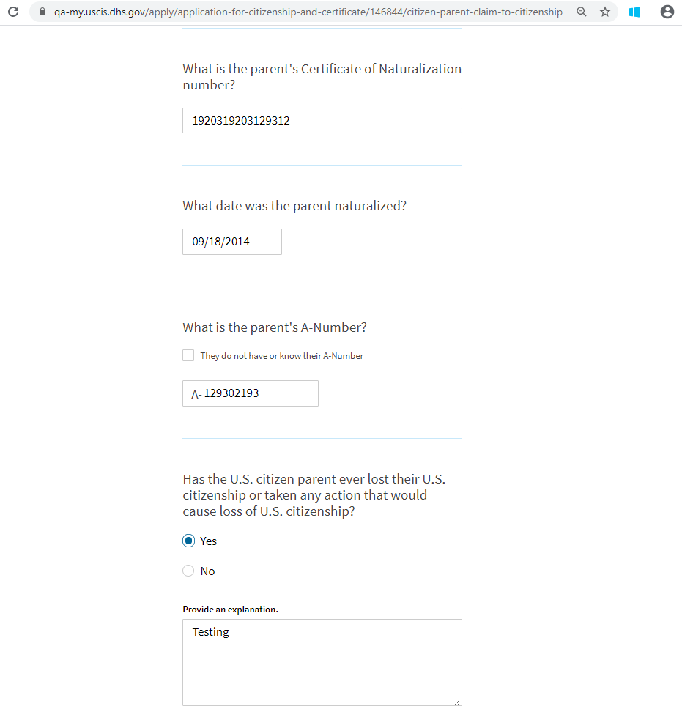
Parent’s Citizenship – By naturalization

Slide 22
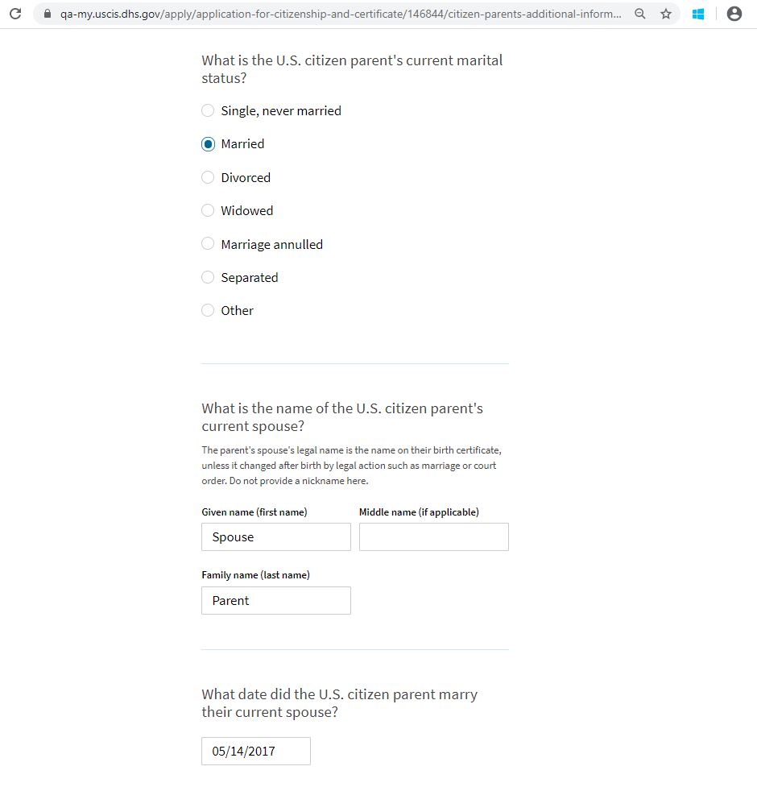
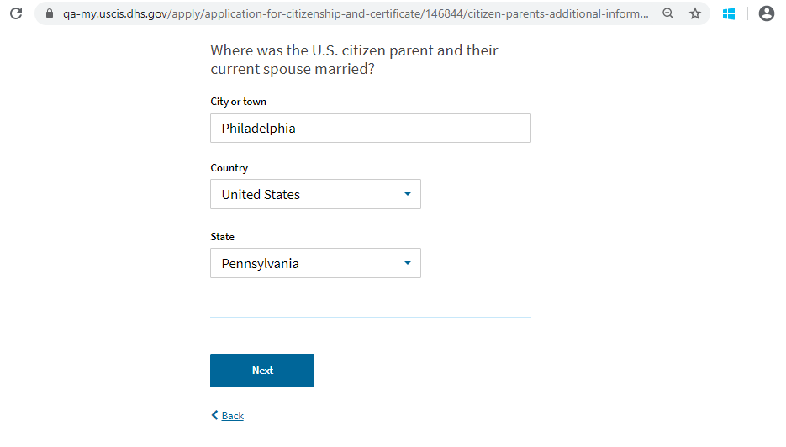
Parent’s Additional Info – If married or separated is selected

Slide 23
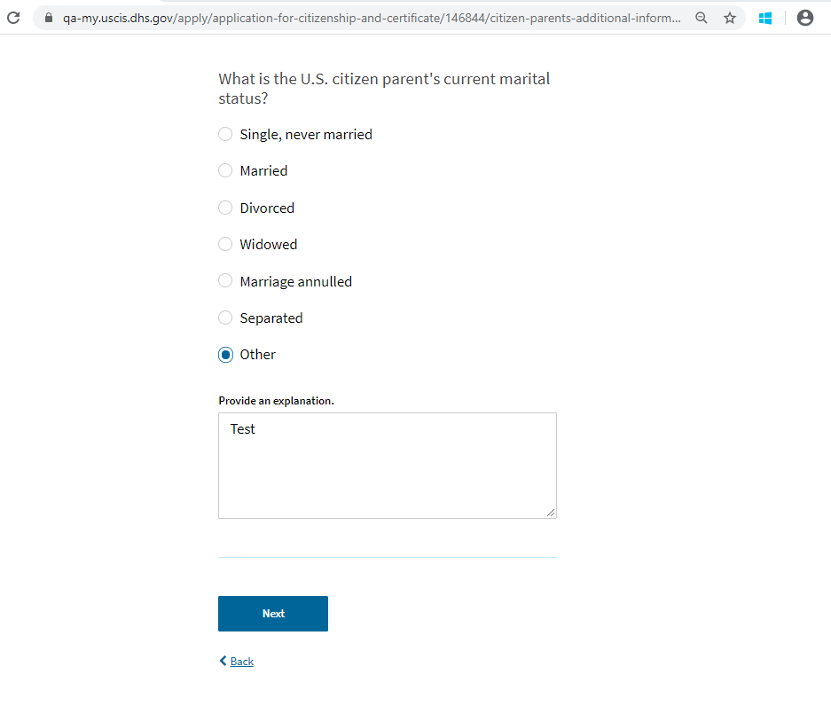
Parent’s Additional Info – If other selected

Slide 24
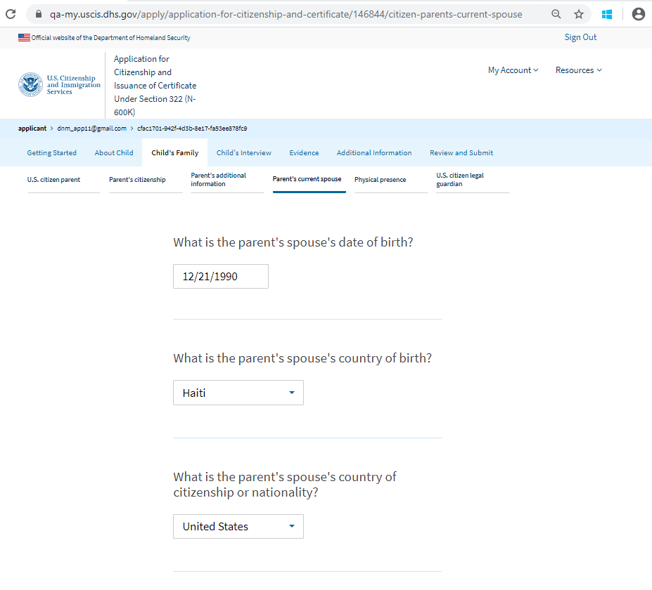
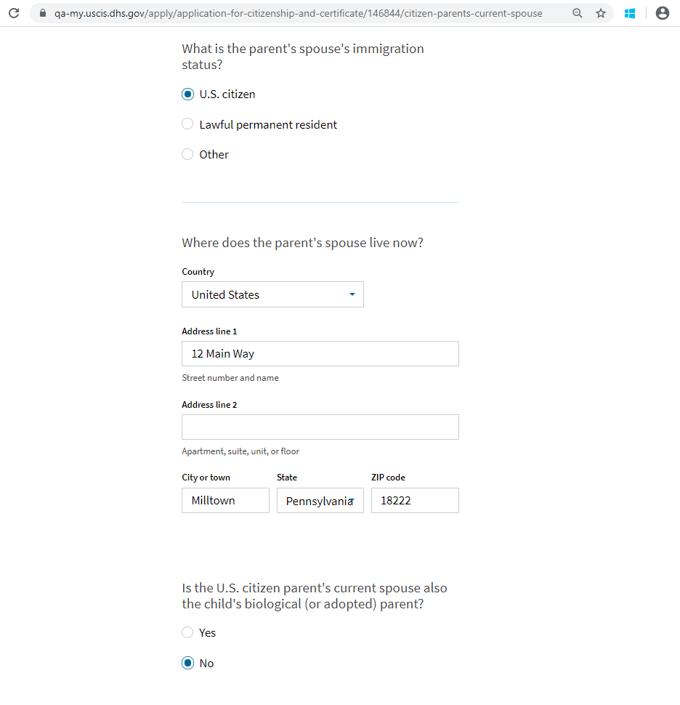
Parent’s Current Spouse – Displays only if previously selected married or separated

Slide 25
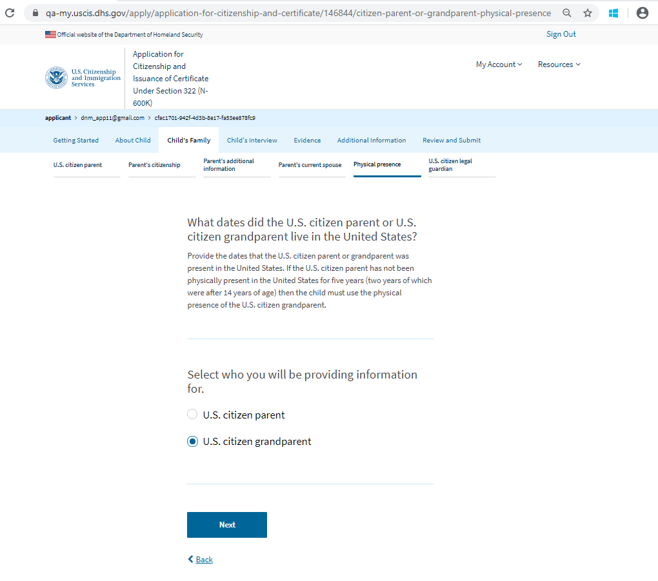
Physical Presence - Page 1

Slide 26
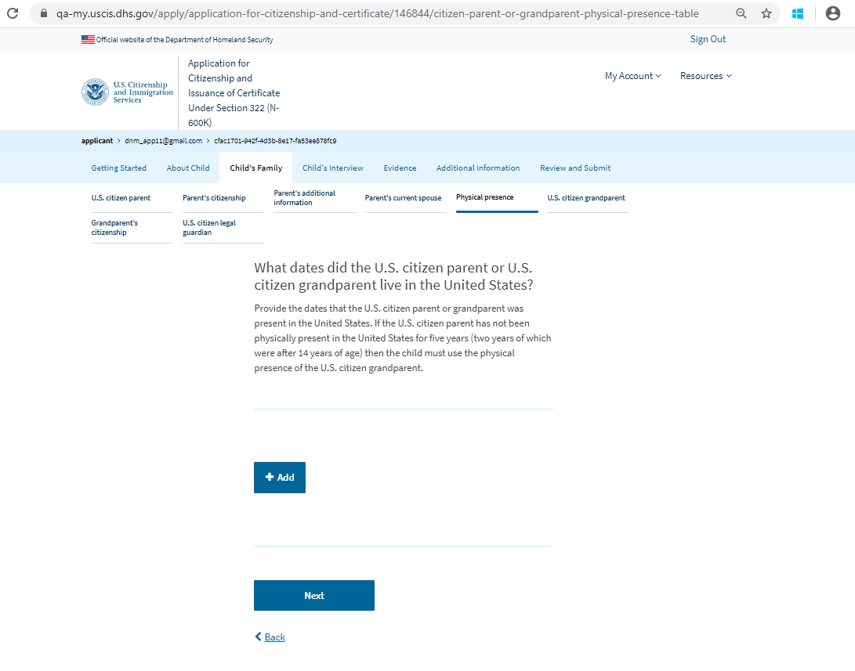
Physical Presence - Page 2

Slide 27
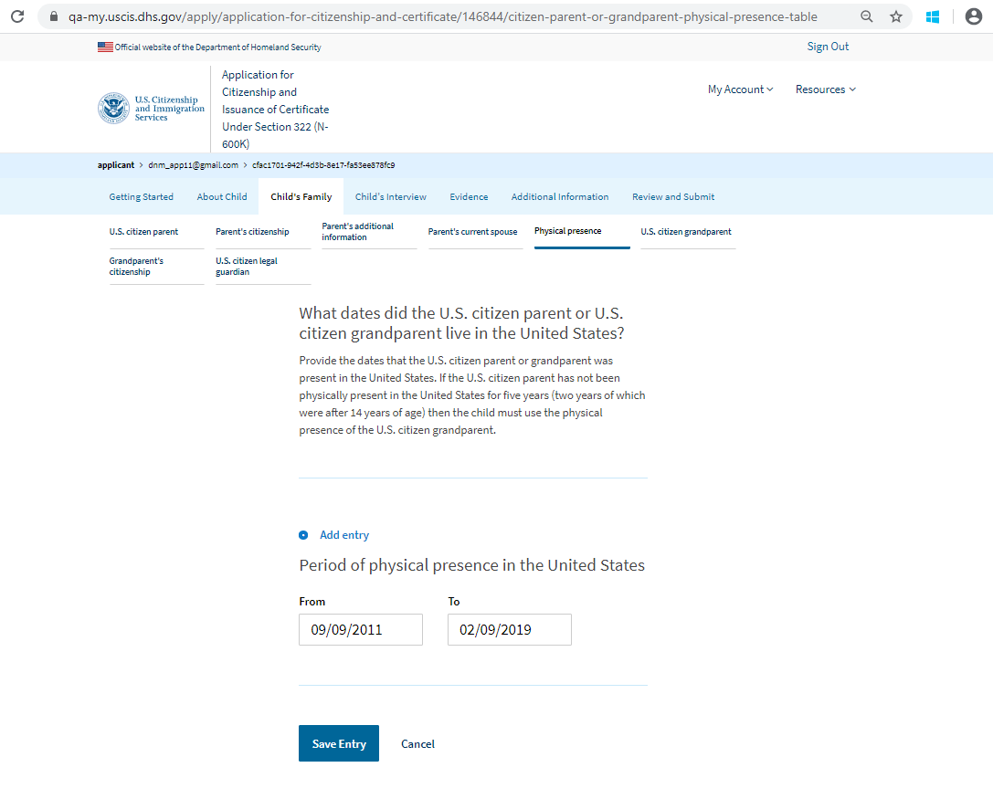
Physical Presence - Page 2 adding entry

Slide 28
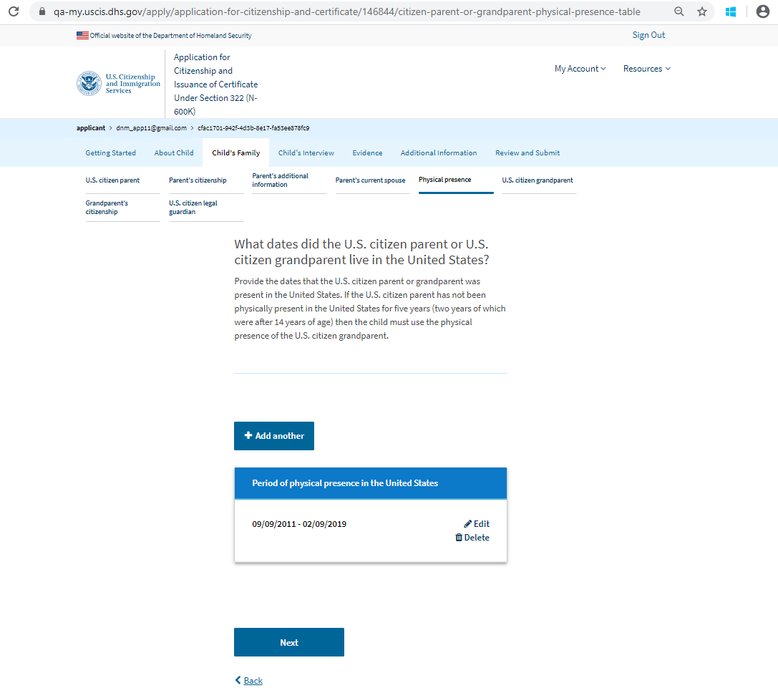
Physical Presence - Page 2 saved entry

Slide 29
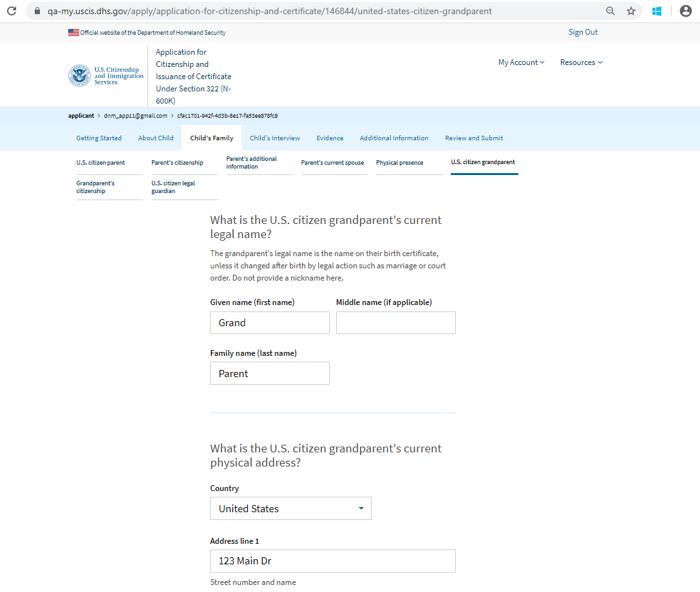
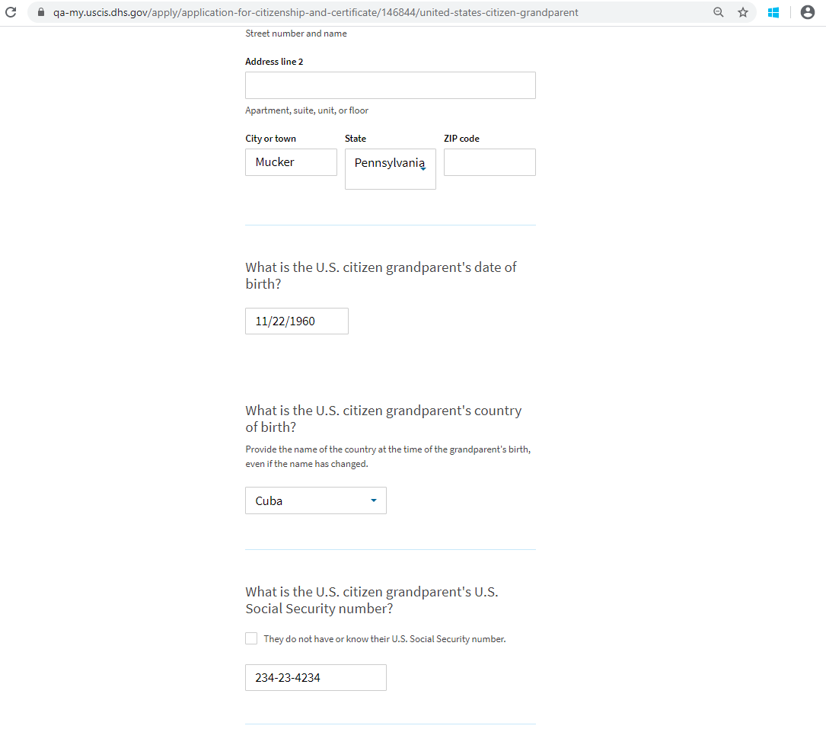
U.S. Citizen Grandparent – Page 1 only displays if selected on Physical Presence page

Slide 30
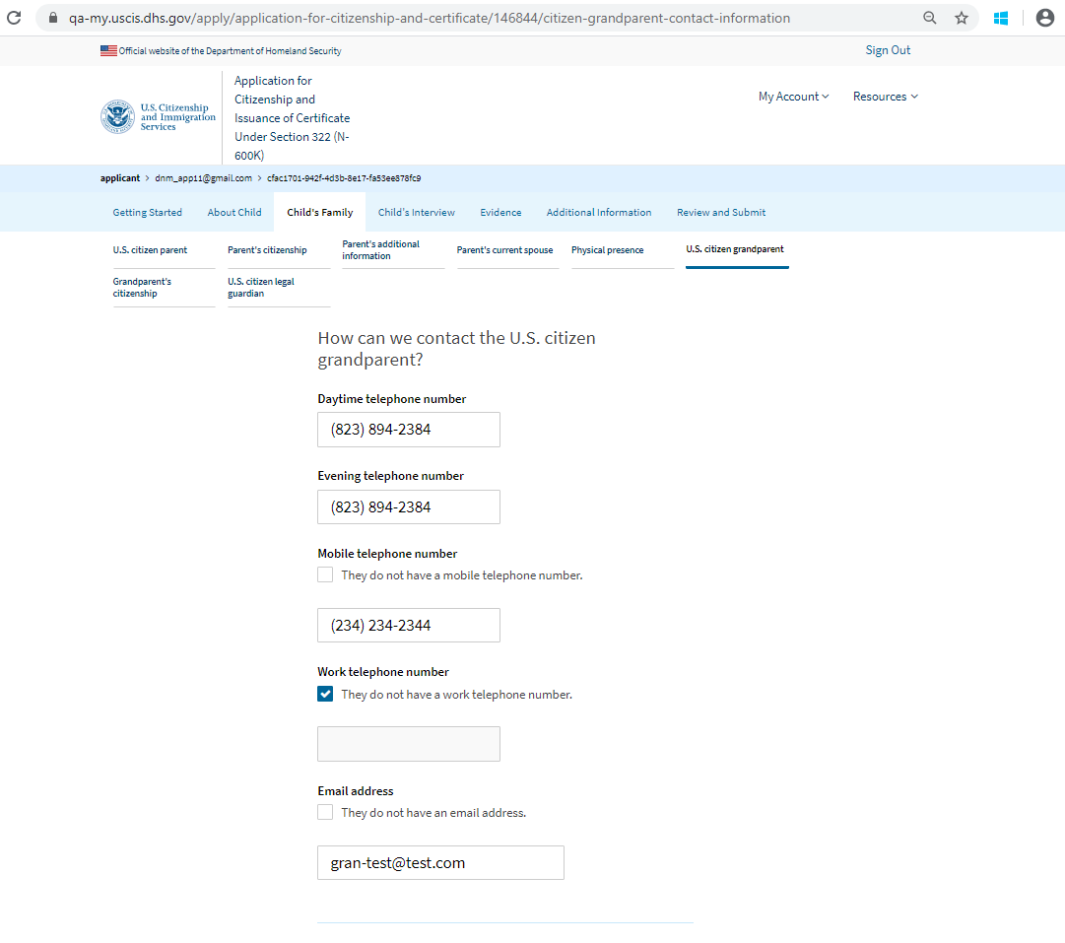
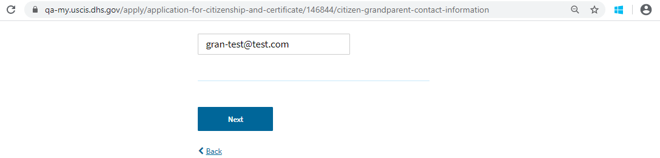
U.S. Citizen Grandparent – Page 2 only displays if selected on Physical Presence page

Slide 31
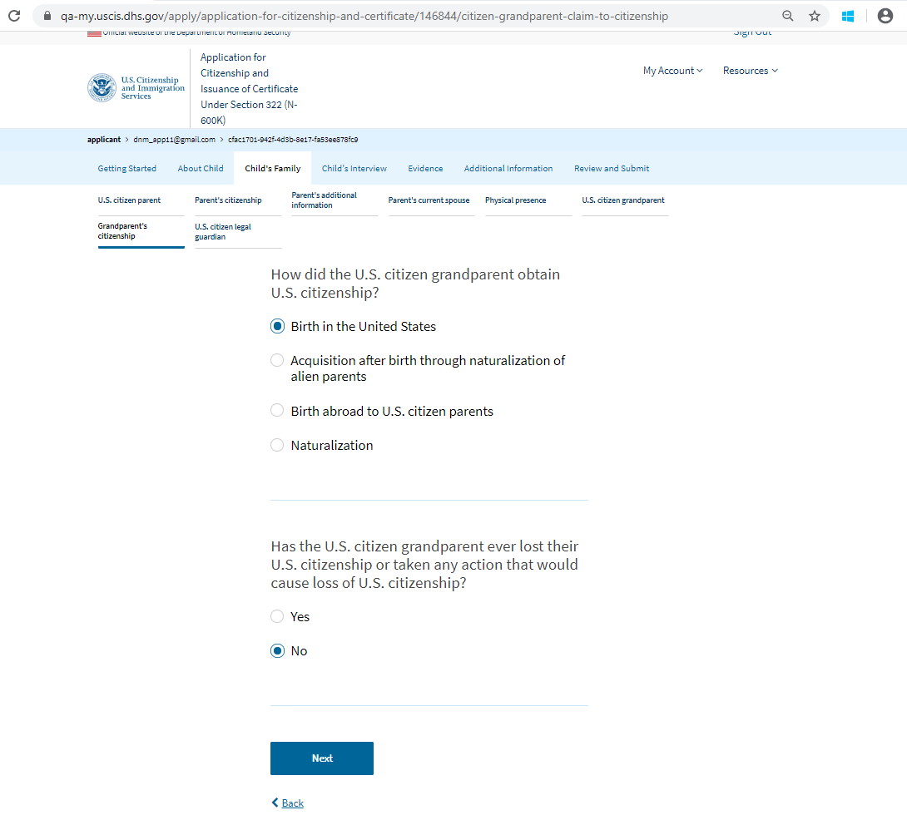
Grandparent Citizenship – By birth in the U.S. or acq. from naturalization of parents

Slide 32
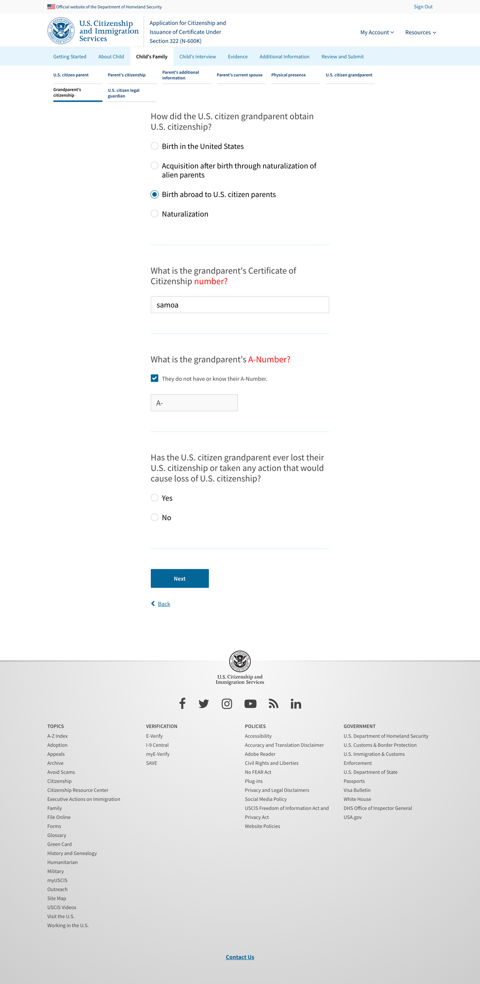
Grandparent Citizenship – By birth abroad to U.S. citizen parents

Slide 33
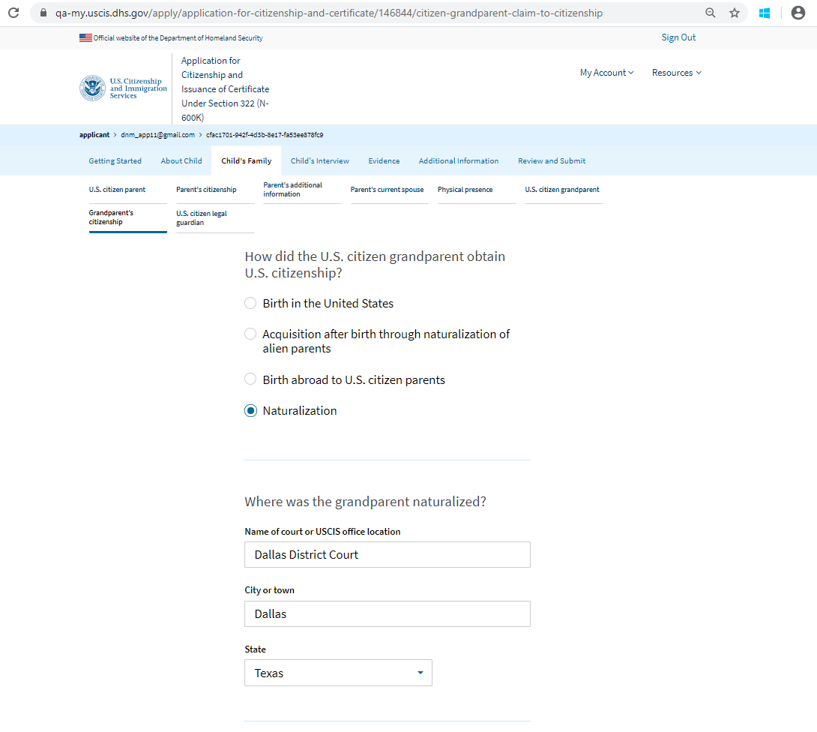
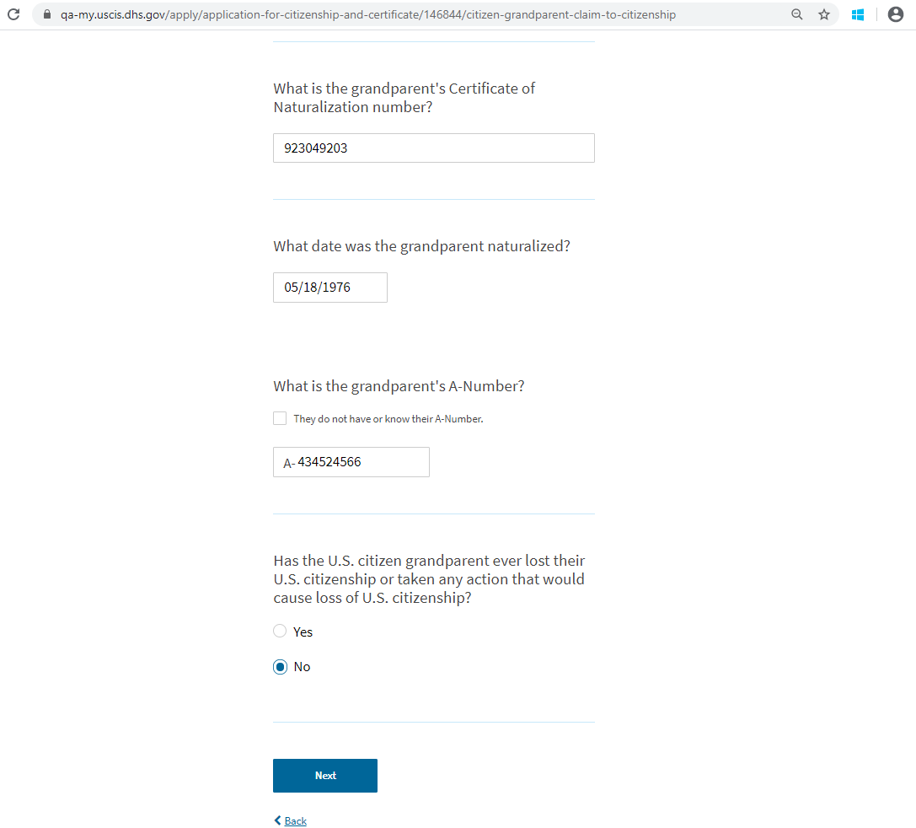
Grandparent Citizenship – By naturalization

Slide 34
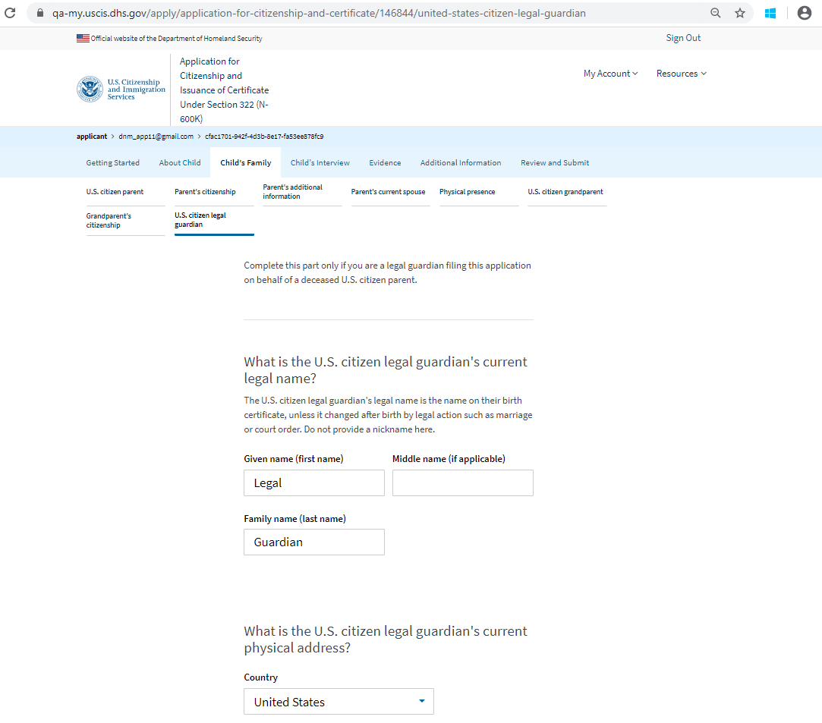
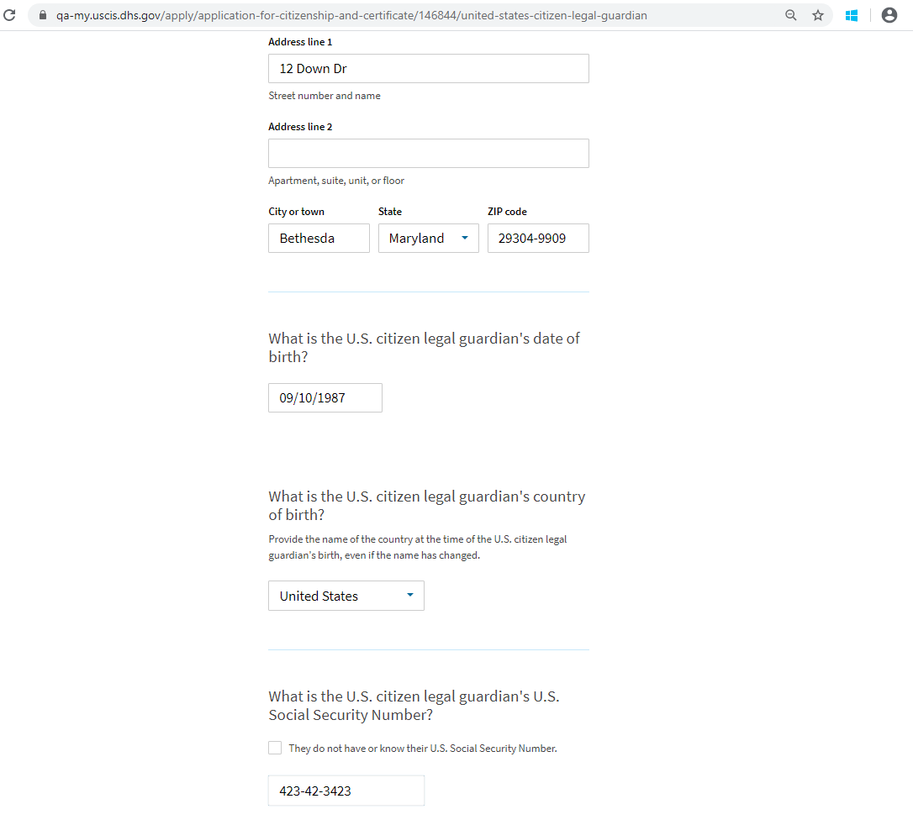

U.S. Citizen Legal Guardian – Page 1

Slide 35

U.S. Citizen Legal Guardian – Page 2

Slide 36

U.S Citizen Legal Guardian – By birth in the U.S. or acq. from naturalization of parents

Slide 37

U.S. Citizen Legal Guardian – By birth abroad to U.S. citizen parents

Slide 38


U.S. Citizen Legal Guardian – By naturalization

Slide 39


U.S. Citizen Legal Guardian – Guardianship Information

Slide 40


Child’s Interview

Slide 41








Evidence to Support Your Application

Slide 42






Secondary Evidence

Slide 43

Additional Information

Slide 44

Review

Slide 45












Summary

Slide 46


Preparer Signature – Preparer Statement

Slide 47

Preparer Signature – Preparer Signature Upload

Slide 48


Interpreter Signature – Interpreter Statement

Slide 49

Interpreter Signature – Interpreter Signature Upload

Slide 50

Your Signature – Confirmation Statement

Slide 51


Your Signature – Signature

Slide 52
Your Signature – Signature

Slide 53

Your Signature – Pay and Submit

Slide 54

Pay.gov – Select payment method

Slide 55

Pay.gov – Enter payment details

Slide 56

Submission Confirmation

Slide 57

Case card on account page

