Slide 1
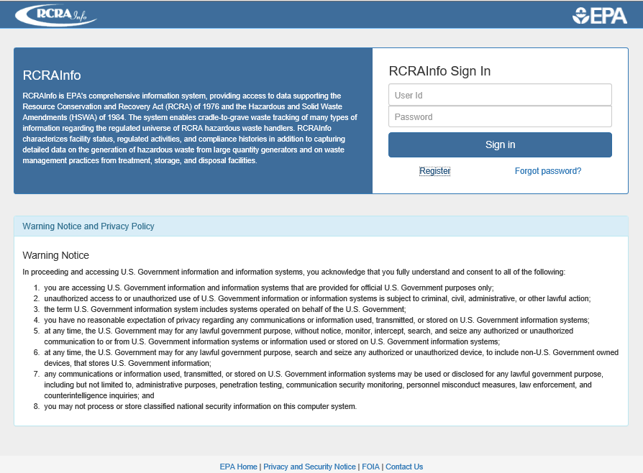
Notes:
e-Manifest user must enter his/her user id and password to access the e-Manifest system.

Slide 2
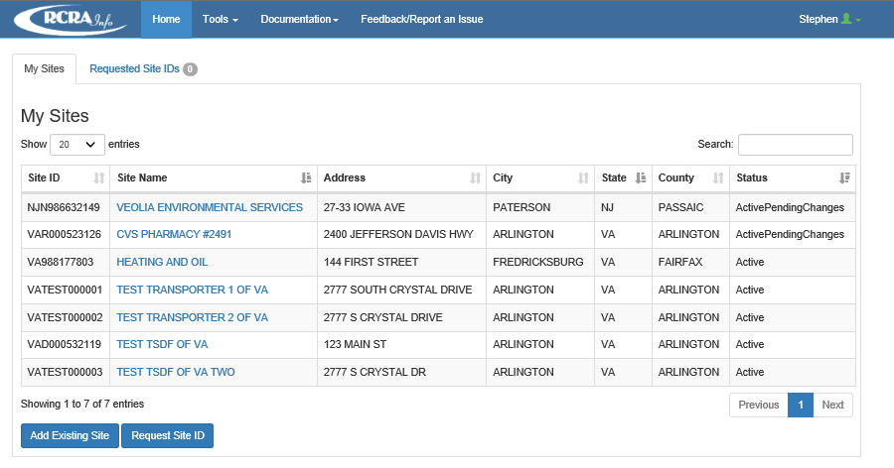
Notes:
The account user must click on a Site Name to see manifests in the Dashboard for the chosen Site ID and Site Name. If an EPA or state ID is not shown for an existing site, the account user must click the "Add Existing ID" button to add an existing site location. If the site does not exist in the system, the account user must click the "Request Site ID" button to obtain a Site ID using the Site Id form (EPA Form 8700-12), (See Supporting Statement for EPA Information Collection Request Number 0976.18).
FORM CROSSWALK: The information on this slide is used to populate fields 1, 3, and 5 on the 8700-22, and fields 21 and 24 on 8700-22a.

Slide 3
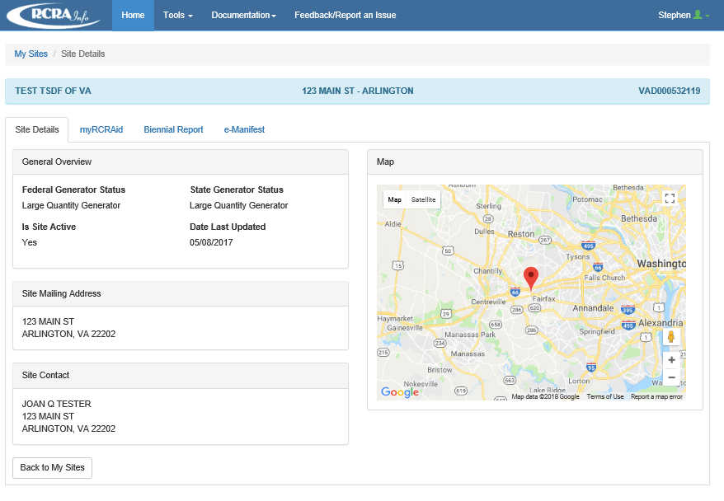
Notes:
The account user must select the e-Manifest link to access the system.
FORM CROSSWALK: The information on this slide is used to populate fields 1, 3, and 5 on the 8700-22, and fields 21 and 24 on 8700-22a.

Slide 4
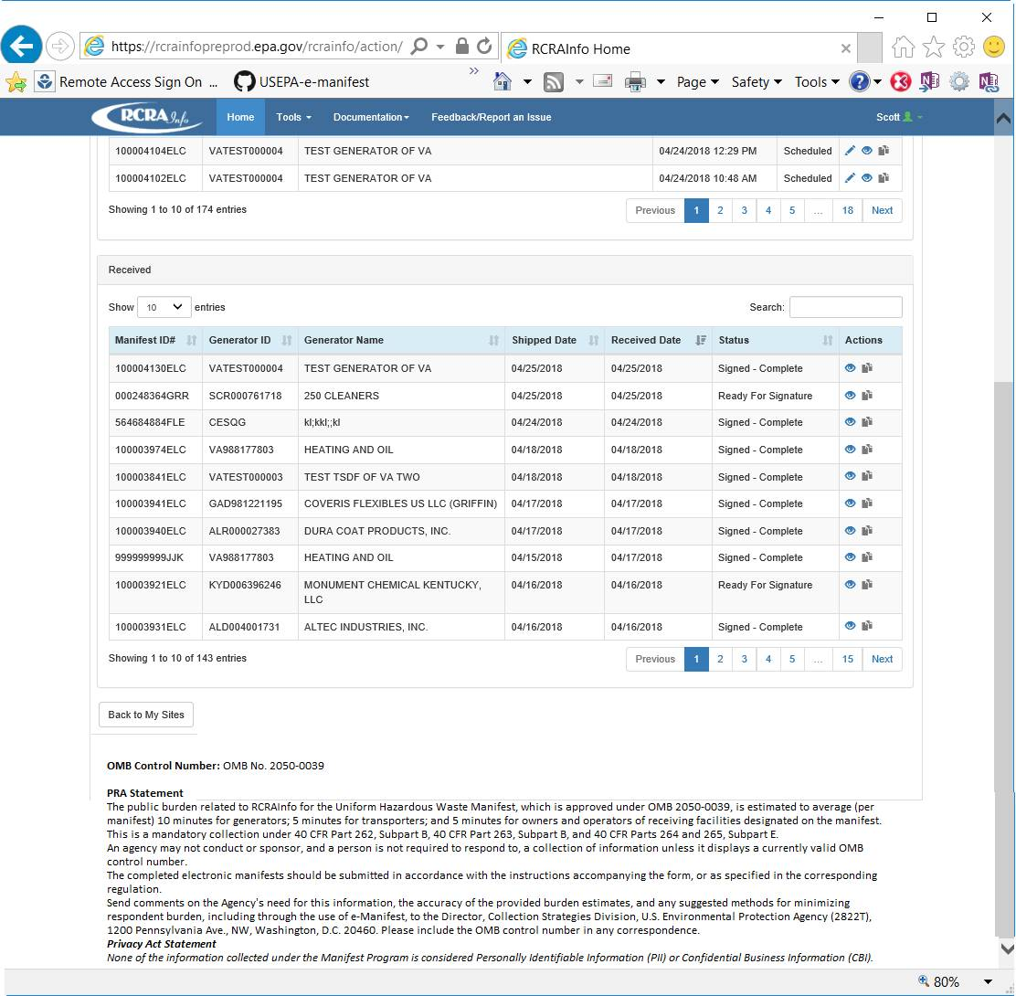
Notes:
OMB Control Number and PRA Statement are displayed on the first page in the e-Manifest web application. This is the e-Manifest dashboard, which all users are routed to upon logging into the system.

Slide 5
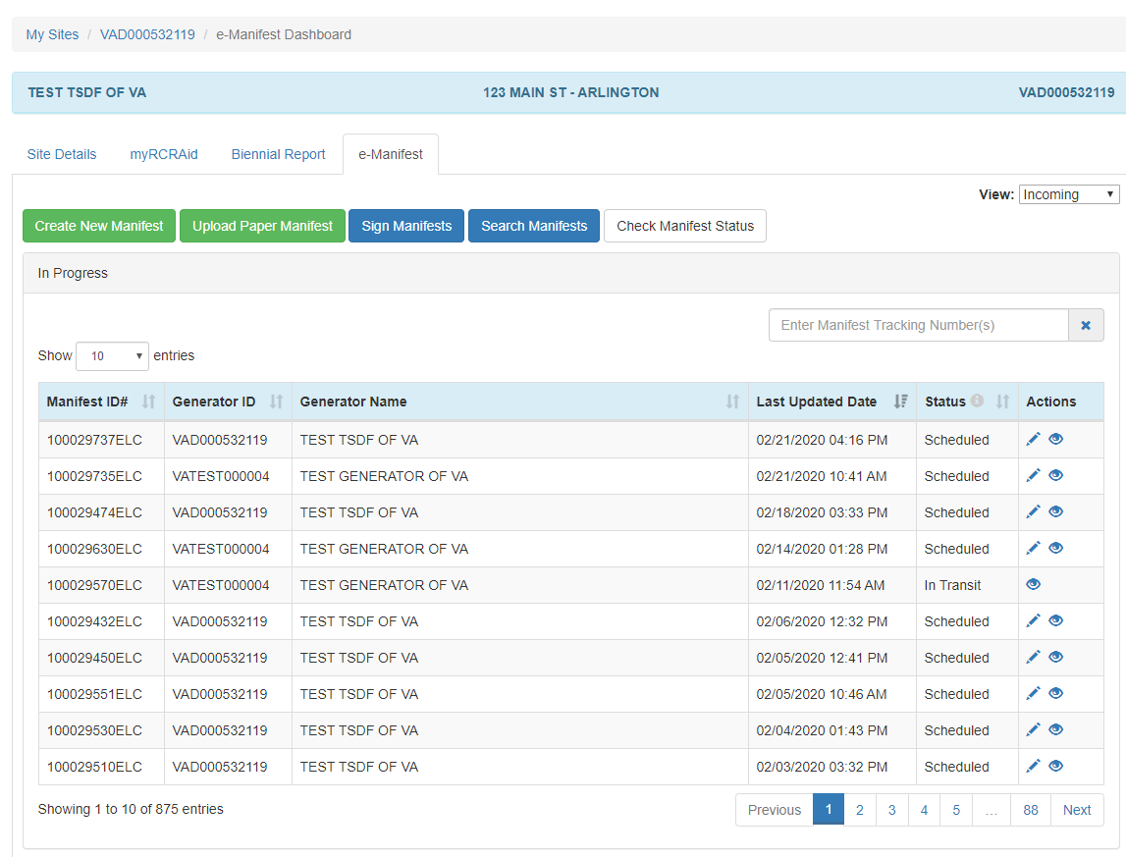
Notes:
The public reporting and recordkeeping burden per response for collection of information is estimated to average 60
minutes per paper manifest and 10 minutes per electronic manifest for generators; 20 minutes per paper manifest
and 5 minutes per electronic manifest for transporters; and 30 minutes per paper manifest and 5 minutes per
electronic manifest for owners and operators of receiving facilities designated on the manifest. Send comments on
the Agency's need for this information, the accuracy of the provided burden estimates, and any suggested methods
for minimizing respondent burden, including through the use of e-Manifest, to the Director, Collection Strategies
Division, U.S. Environmental Protection Agency (2822T), 1200 Pennsylvania Ave., NW, Washington, D.C. 20460.
Include the OMB control number in any correspondence. Do not send the completed form to this address.
e-Manifest Dashboard – When an account user clicks on the "e-Manifest" tab from the Site Dashboard, manifests associated with the account user's site will be displayed. Manifests with a status of "Draft," "Pending," "Scheduled," and "In Transit" will be displayed in the "In Progress" table. Manifests with a status of "Received," "Ready For Signature," or "Signed" will be displayed in the "Received" table. The actions that can be taken on a manifest at any given time are dependent on the entity acting upon the manifest (generator, transporter, receiving facility, broker), the permissions of the user (viewer, preparer, certifier, site manager), and the current status of the manifest (draft, pending, scheduled, in transit, received, ready for signature, signed).
Only users who have Preparer, Certifier, or Site Manager permissions for the site can create a new manifest by clicking the "Create New Manifest" button at the bottom of the "In Progress" table

Slide 6
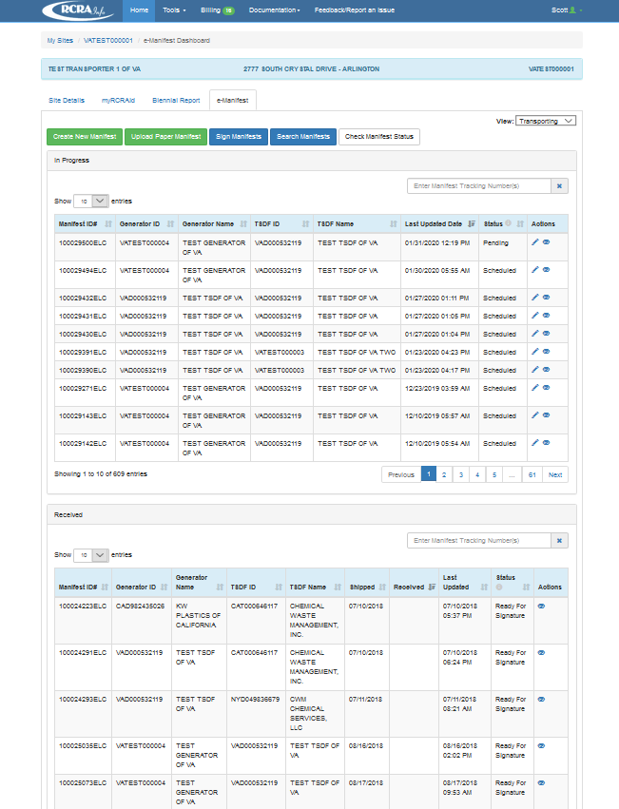
Transporter
Notes:
If the site selected is identified as a transporter within the RCRAInfo Industry Application, the e-Manifest Dashboard will show manifests where this site is listed as the transporter in the "In Progress" and "Received" tables.Use the Next and Previous buttons to see them.

Slide 7
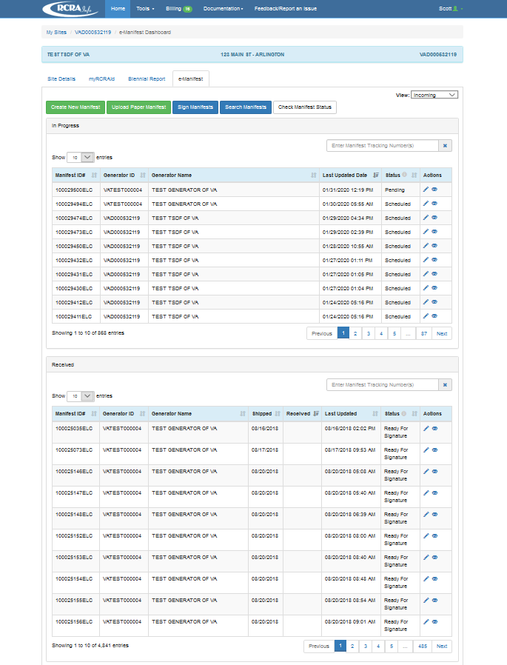
TSDF
Notes:
If the site selected is identified as a receiving facility within the RCRAInfo Industry Application, the e-Manifest Dashboard will show manifests where this site is listed as the receiving facility in the "In Progress" and "Received" tables. However, the user may show the manifests where this. Use the Next and Previous buttons to see them

Slide 8
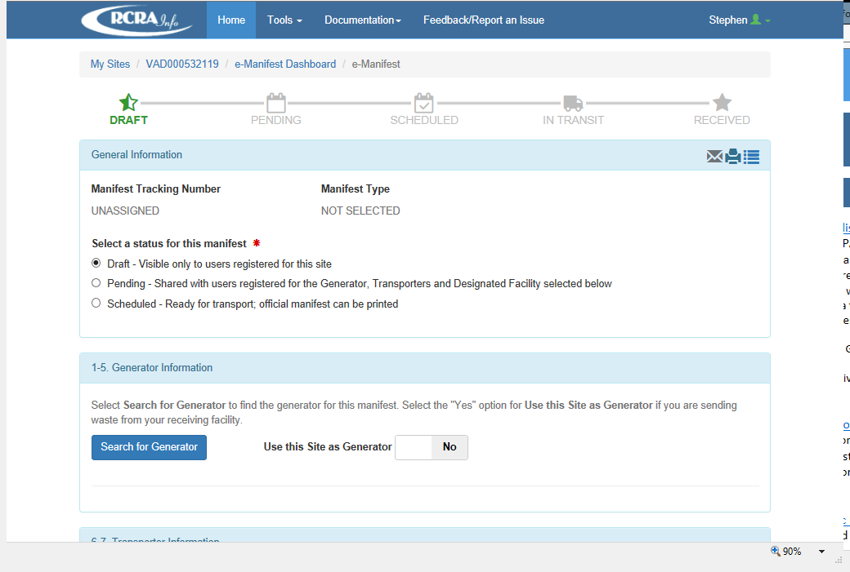
Notes:
When the "Create New Manifest" button is clicked, the manifest, by default, is given a status of "Draft." The "Draft" status indicates that the manifest is in a draft state and is only visible to the site that is creating the manifest.
Per Section 4B of the Supporting Statement and the reverse side of copy 5 (Generator's Initial Copy), i.e., the generator "Instructions for Completing a Hazardous waste Manifest form," the account user must record the generator's company information in Items 1 thru 5 of the e-manifest. The system populates Item 1 (Generator ID number) of the e-Manifest with the previously selected site ID. If the account user is a receiving facilty and is preparing a manifest for the generator, the facility should click the "Search for Generator" button to begin completion of those sections.

Slide 9
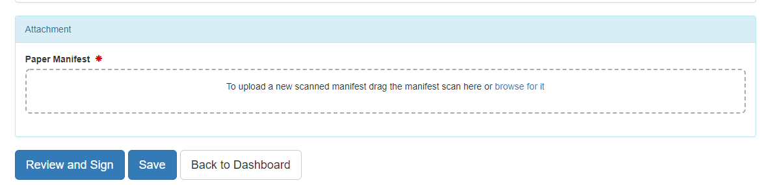
Notes:
The "Back to Dashboard " button returns you to the e-Manifest Dashboard. Before leaving the page, you will warned that any data that you entered or changed is unsaved and will be lost. Click "Continue" to return to the e-Manifest Dashboard and lose any unsaved data, or click "Cancel" to return to the Create New Manifest screen. Click the "Save" button at the bottom of the page. If the required information associated with the current status of the manifest has not been provided, an error message will be displayed for each piece of information that is missing. You must provide this information before the manifest can be saved.
If the manifest status is set to "Scheduled", a pop-up window will be displayed prompting you to specify the type of manifest you are creating (electronic, hybrid, on behalf of, or paper). Note: In order to create an electronic manifest, all sites on the manifest must have at least one user who can electronically sign the manifest for their site. Click the "Save" button to save all of the data associated with the manifest and return to the manifest screen. Click the "Save and Close" button to save all of the data associated with the manifest and return to the e-Manifest Dashboard Would this be the “save and return” button?
No, see bottom right of slide 34 (of current version).

Slide 10
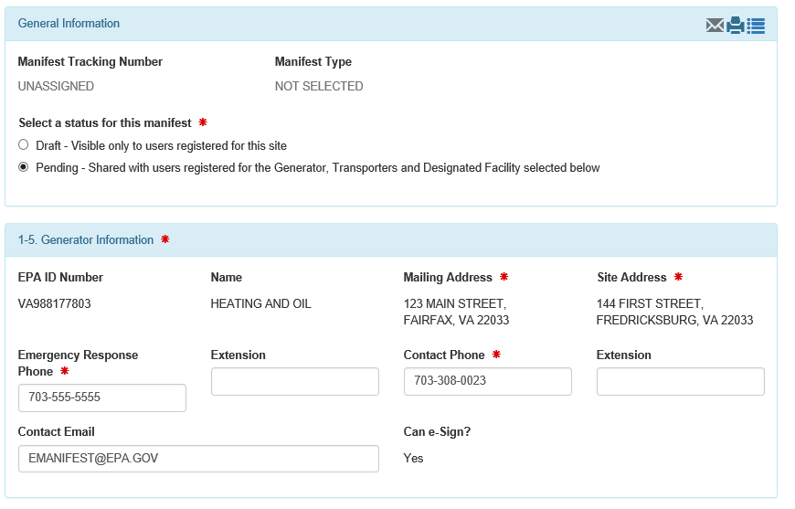
Notes:
If the site ID is associated with a generator, their information will automatically populate items 1-5 on the manifest via RCRAinfo Site ID information
FORM CROSSWALK: The information on this slide is used to populate fields 1, 3, and 5 on the 8700-22, and fields 21 and 24 on 8700-22a.

Slide 11
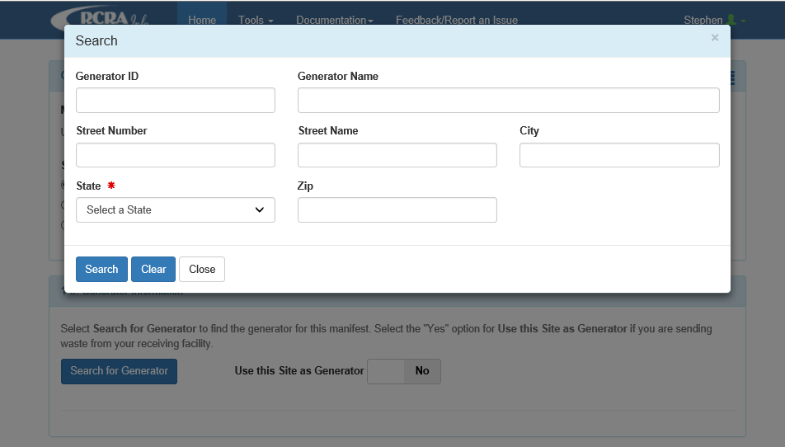
Notes:
If the receiving facility prepares the manifest for the generator (or some other entity prepares the manifest on behalf of the generator) the facility can obtain generator information by entering the generator name, selecting the generator state, and clicking on the search button.
FORM CROSSWALK: The information on this slide is used to populate fields 1, 3, and 5 on the 8700-22, and fields 21 and 24 on 8700-22a.

Slide 12
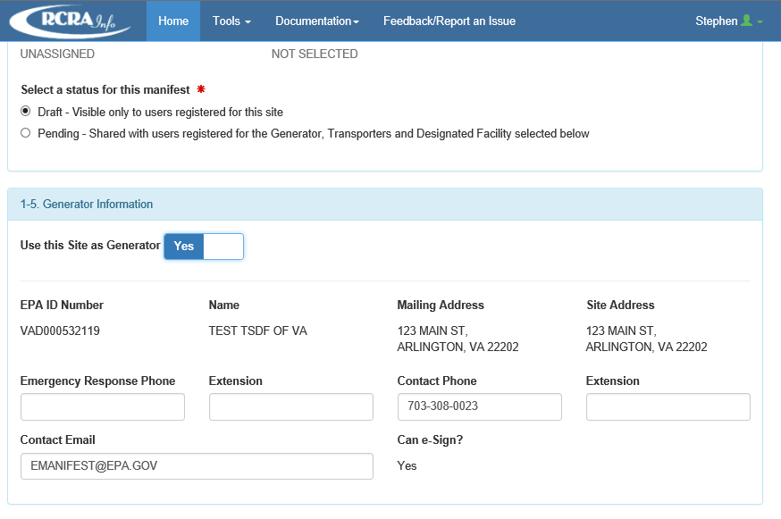
Notes:
The system search feature generates the generator's mailing address, site address, phone number, and email address based on the information provided by the receiving facility. The receiving facility must provide the Emergency Response Number Information per item 3 of the e-manifest instructions. The system will indicate whether the account user has permission to electronically sign the manifest. The account user should click the "Yes" button to confirm the displayed generator information is correct.
FORM CROSSWALK: The information on this slide is used to populate fields 1, 3, and 5 on the 8700-22, and fields 21 and 24 on 8700-22a.

Slide 13
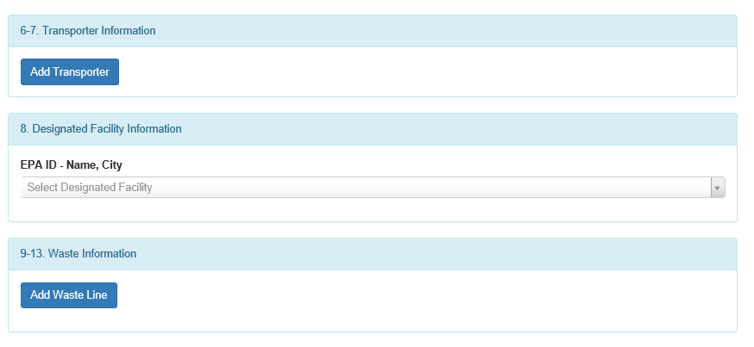
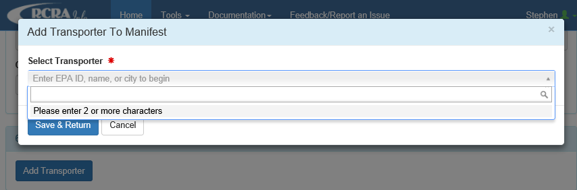
Notes:
Per Section 4B of the Supporting Statement and the reverse side of copy 5, i.e., the generator "Instructions for Completing a Hazardous waste Manifest form" for items 6 and 7 of the e-manifest, the account user must click the "Add transporter" button to enter the company name of the first transporter who will transport the waste and if necessary the company name of the second transporter. The account user must provide the EPA ID, or city to display a list of transporter options.
FORM CROSSWALK: The information on this slide is used to populate fields 6 and 7 on the 8700-22, and fields 25 and 26 on 8700-22a.

Slide 14
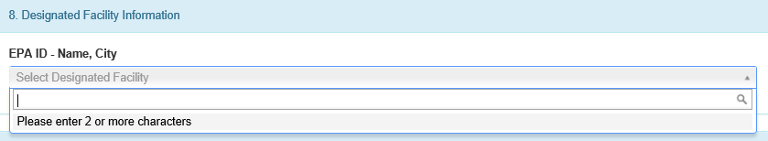
Notes:
Per Section 4B of the Supporting Statement and the reverse side of copy 5 (Generator's Initial Copy), i.e., the generator "Instructions for Completing a Hazardous Waste Manifest form" for item 8 of the e-manifest, the account user must enter the company name and site address of the facility designated to receive the waste. The account user must also provide the EPA or State ID number of the designated facility
FORM CROSSWALK: The information on this slide is used to populate field 8 on the 8700-22

Slide 15
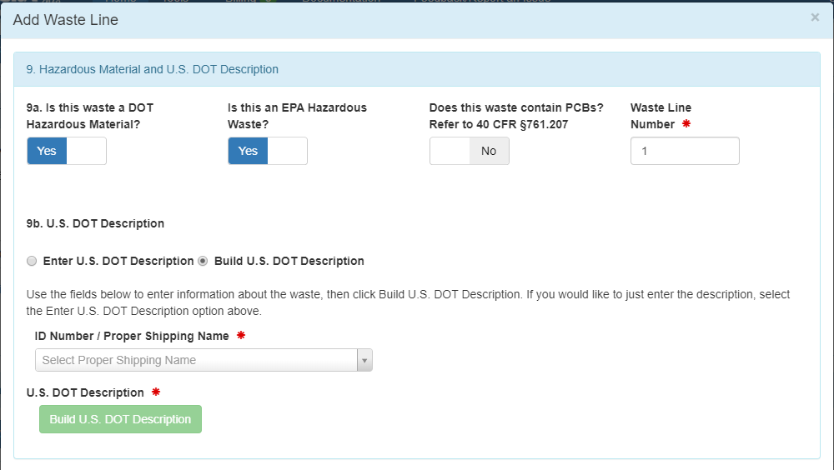
Notes:
The account user must click on the "Add Waste Line" button to open a new "Add Waste Line" screen to enter data for each waste stream associated with the shipment. Per section 4B of the Supporting Statement and the reverse side of copy 5 (Generator's Initial Copy), i.e., the generator "Instructions for Completing a Hazardous waste Manifest form" for items 9a and 9b of the e-manifest, the account user must identify whether the waste is a hazardous material and provide the USDOT description of the waste. The system defaults to "Yes" for whether the waste is a hazardous material and "No" to whether the waste contains PCBs.
FORM CROSSWALK: The information on this slide is used to populate fields 9a and 9b on the 8700-22, and fields 27a and 27b on 8700-22a.

Slide 16
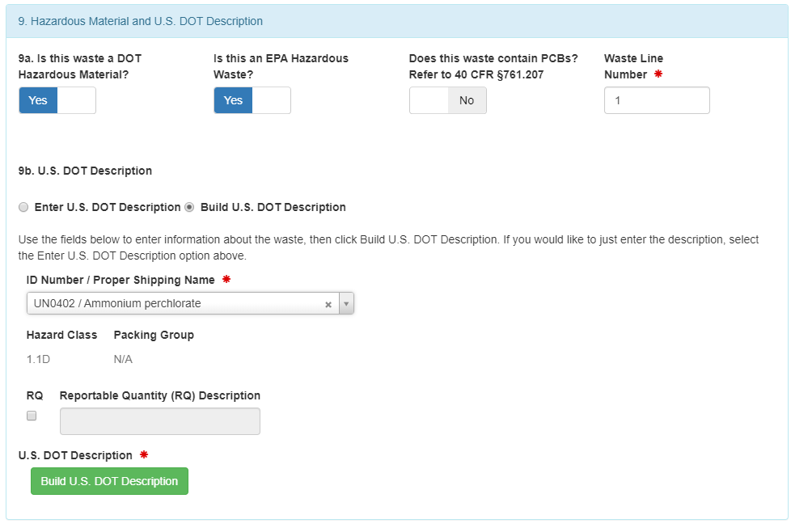
Notes:
Per Section 4B of the Supporting Statement and the reverse side of copy 5 (Generator's Initial Copy), i.e., the generator "Instructions for Completing a Hazardous waste Manifest form" for item 9b of the e-manifest, the account user must also enter the hazard class or division packing group. The system will generate this information based on the ID and shipping name provided from the previous screen as well as the emergency response guidebook information. The account user must select the "Add to Printed DOT Information" button so that the information is printed on the paper manifest form which is printed and placed on the truck per U.S. DOT's Hazmat rules.
FORM CROSSWALK: The information on this slide is used to populate fields 9a and 9b on the 8700-22, and fields 27a and 27b on 8700-22a.

Slide 17
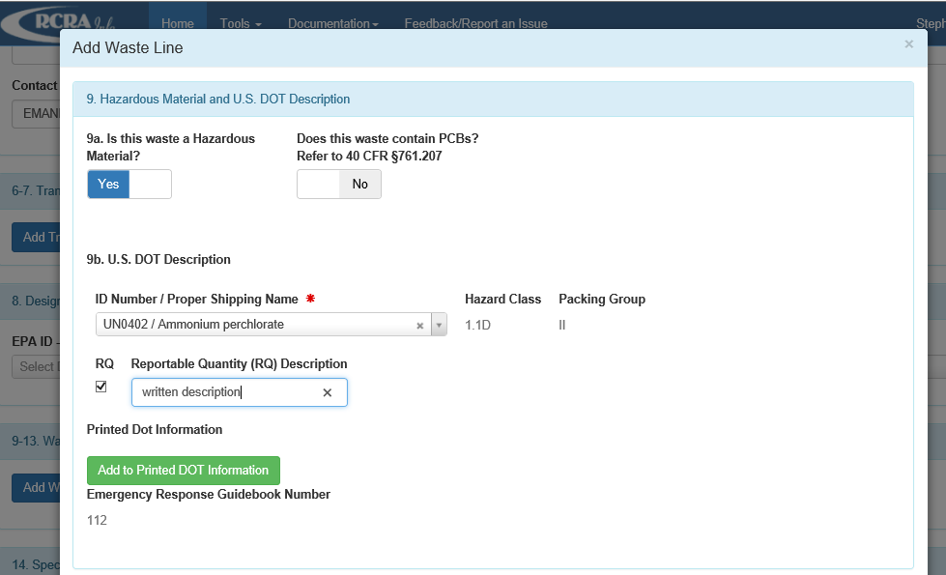
Notes:
If applicable, the account user must check the RQ box and enter the technical name(s) and reportable quantities references. The account user must select the "Add to Printed DOT Information" button so that the RQ information is printed on the paper manifest form which is printed and placed on the truck per U.S. DOT's Hazmat rules.
FORM CROSSWALK: The information on this slide is used to populate fields 9a and 9b on the 8700-22, and fields 27a and 27b on 8700-22a.

Slide 18
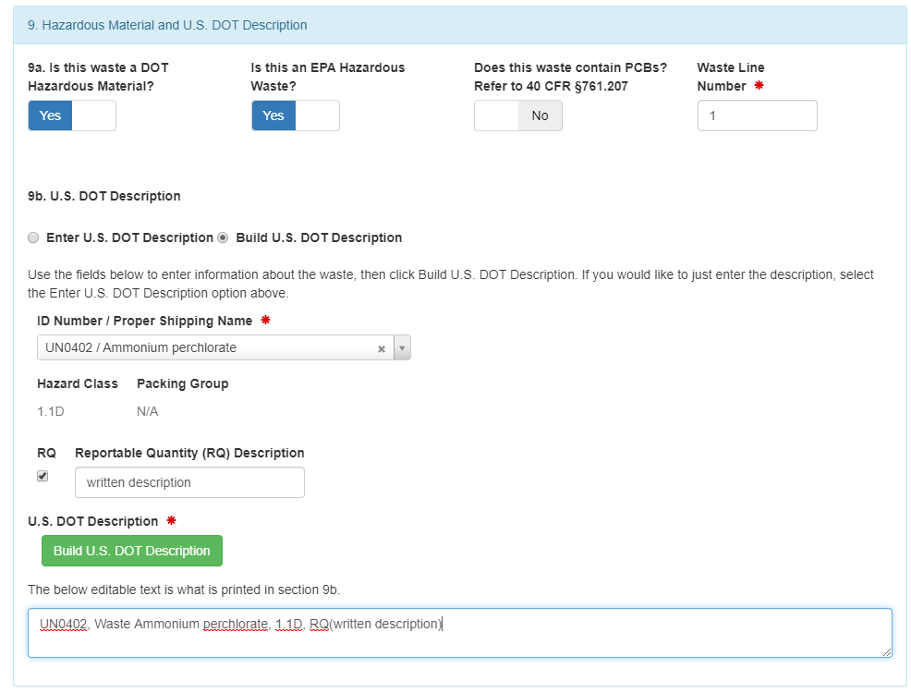
Notes:
The system will generate and indicate the U.S DOT information that will be printed on the paper manifest.
FORM CROSSWALK: The information on this slide is used to populate fields 9a and 9b on the 8700-22, and fields 27a and 27b on 8700-22a.

Slide 19
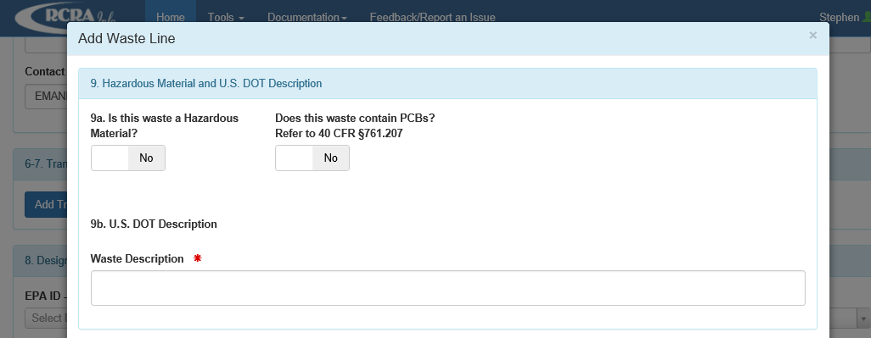
Notes:
If the waste is a state-regulated hazardous waste or is not regulated under federal or state law, the account user must switch the default selection of "Yes" to "No" and characterize the waste in the "Waste Description" box.
FORM CROSSWALK: The information on this slide is used to populate fields 9a and 9b on the 8700-22, and fields 27a and 27b on 8700-22a.

Slide 20
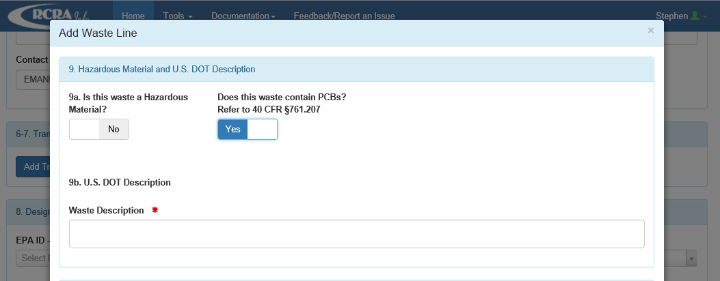
Notes:
If the waste stream is a PCB waste, then the account user must switch the default selection of "No" to "Yes" and characterize the waste in the "Waste Description" box.
FORM CROSSWALK: The information on this slide is used to populate fields 9a and 9b on the 8700-22, and fields 27a and 27b on 8700-22a.

Slide 21
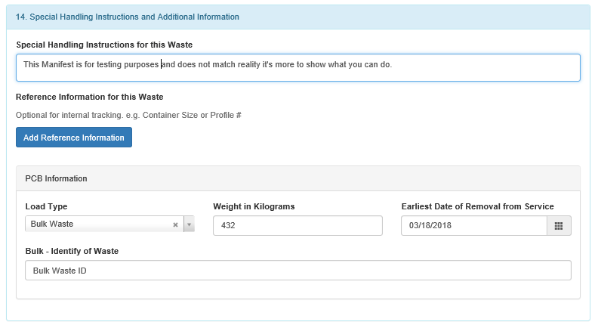
Notes:
If a waste is identified as PCB waste, the system screen displays "Item 14" of the e-manifest on the screen. The account user should provide additional information about PCB waste here.
FORM CROSSWALK: The information on this slide is used to populate fields 14 on the 8700-22, and fields 32 on 8700-22a.

Slide 22
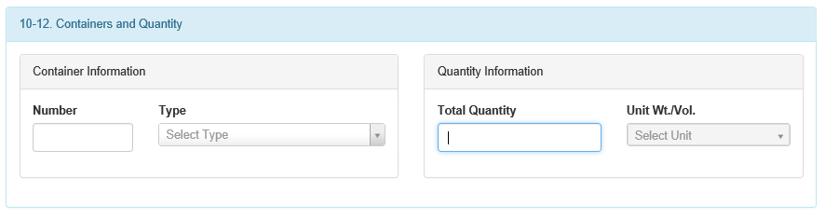
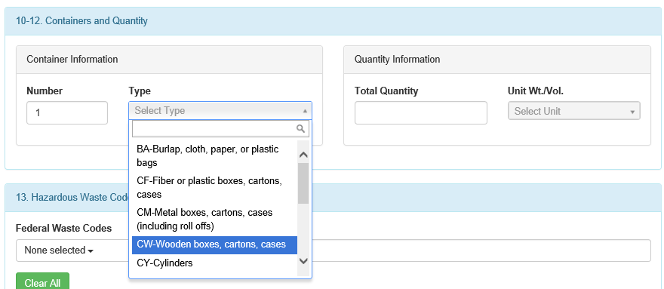
Notes:
Per Section 4B of the Supporting Statement and the reverse side of copy 5 (Generator's Initial Copy), i.e., the generator "Instructions for Completing a Hazardous waste Manifest form" for item 10 of the e-manifest, the account user must enter the container number and type in Item 10 of the e-manifest. The account user can select the container type from the drop-down list shown on the screen shot.
FORM CROSSWALK: The information on this slide is used to populate fields 10, 11, 12 and 13 on the 8700-22, and fields 28, 29, 30, and 31 on 8700-22a.

Slide 23
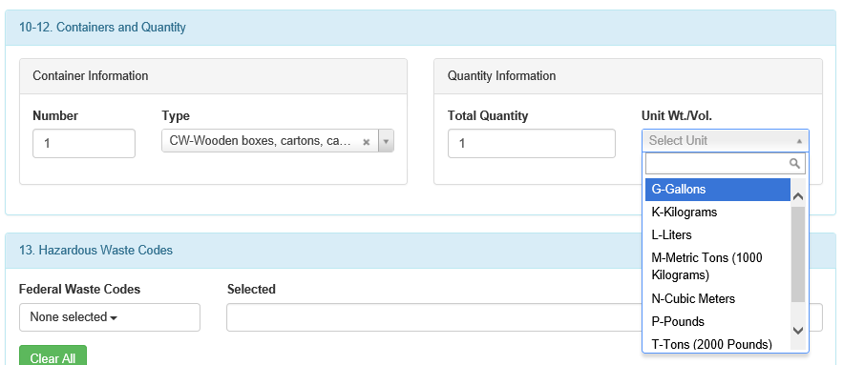
Notes:
Per Section 4B of the Supporting Statement and the reverse side of copy 5 (Generator's Initial Copy), i.e., the generator "Instructions for Completing a Hazardous waste Manifest form" for items 11 and 12 of the e-manifest, the account user must enter the total quantity of waste and the units of measure in Items 11 and 12, respectively, of the e-manifest.
FORM CROSSWALK: The information on this slide is used to populate fields 10, 11, 12 and 13 on the 8700-22, and fields 28, 29, 30, and 31 on 8700-22a.

Slide 24
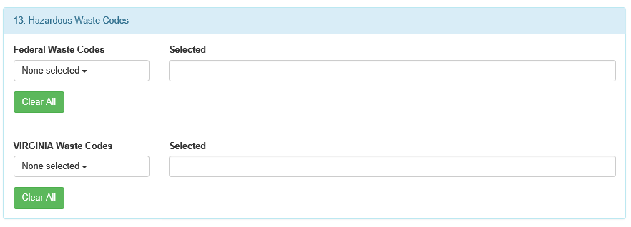
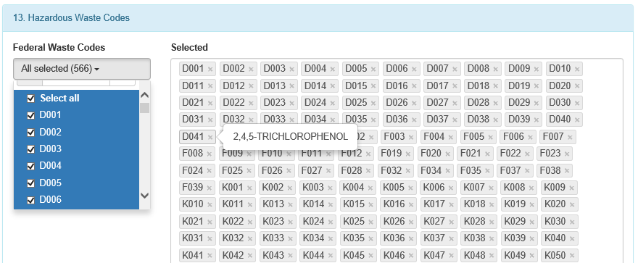
Notes:
Per Section 4B of the Supporting Statement and the reverse side of copy 5 (Generator's Initial Copy), i.e., the generator "Instructions for Completing a Hazardous waste Manifest form" for item 13 of the e-manifest, the account user must enter up to six federal and state waste codes to describe the waste stream identified in Item 13 of the e-manfest. The account user can select the federal waste codes from the drop-down list shown on the screen shot. The selected waste codes should be codes that are most representative of the properties of the waste.
FORM CROSSWALK: The information on this slide is used to populate fields 10, 11, 12 and 13 on the 8700-22, and fields 28, 29, 30, and 31 on 8700-22a.

Slide 25
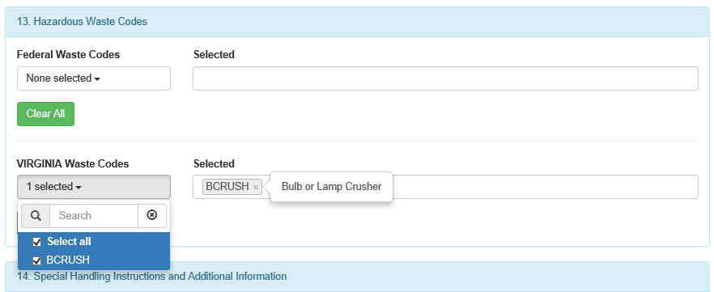
Notes:
State waste code availability is determined by the generation and destination states. the information is pulled from e-Manifest database. State waste codes that are not redundant with federal codes must be entered. The account user can select the state waste codes from the drop-down list shown in the screenshot.
FORM CROSSWALK: The information on this slide is used to populate fields 10, 11, 12 and 13 on the 8700-22, and fields 28, 29, 30, and 31 on 8700-22a.

Slide 26
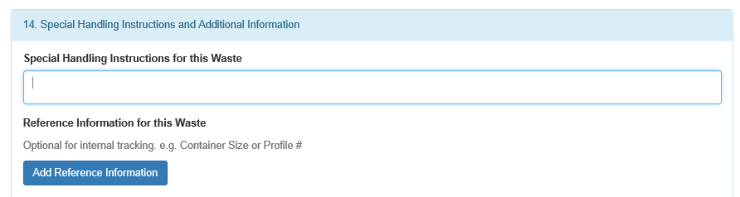
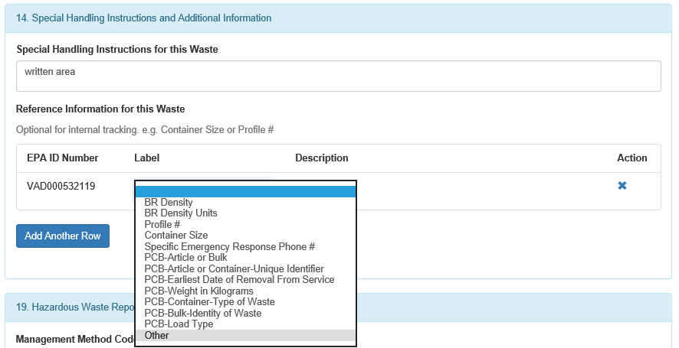
Notes:
Per Section 4B of the Supporting Statement and the reverse side of copy 5 (Generator's Initial Copy), i.e., the generator "Instructions for Completing a Hazardous waste Manifest form" for item 14 of the e-manifest, the account user may enter any special handling or shipment-specific information necessary for the proper management or tracking of the materials. The account user may also enter additional descriptive information about their shipped materials, such as chemical names constituent percentages, physical state, or specific gravity of wastes identified with volume units in Item 12. The information may be captured in the system by entering information in the Special Handling Instructions for this Waste text box and/or providing reference information by clicking the "Add Reference Information" button. The Reference Information is helpful if a user has information that he/she wants to retrieve at a later date, such as container size, waste profile numbers, or any type of internal tracking that is deemed necessary and/or appropriate.
FORM CROSSWALK: The information on this slide is used to populate field 14 on the 8700-22, and fields 32 on 8700-22a.

Slide 27
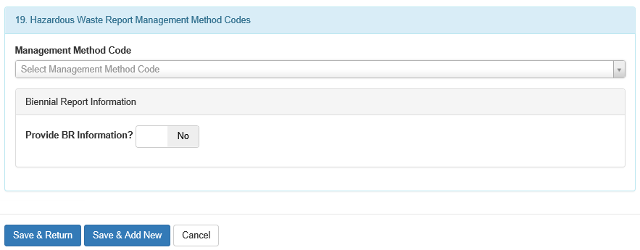
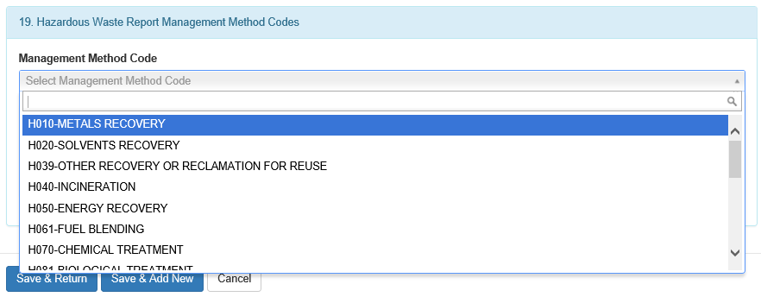
Notes:
If a generator prepares the manifest, he or she must change the status of the manifest from "Draft to "Pending" to make the manifest visible to all parties specified on the manifest (e.g., receiving facility). A Manifest Tracking Number is assigned to the manifest when the status of the manifest is set to "Pending.“
Per Section 4B of the Supporting Statement and the reverse side of copy 3 (Designated Facility Copy), i.e., the receiving facility "Instructions for Completing a Hazardous waste Manifest form" for item 19 of the e-manifest, the account user must enter the most appropriate Hazardous Report Management Method Codes for each waste listed in Item 9. These codes must be entered by the receiving facility designated in Item 8 of the e-manifest. The receiving facility account user can select the management method codes codes from the drop-down list shown on the screen shot.
FORM CROSSWALK: The information on this slide is used to populate fields 19 on the 8700-22, and fields 36 on 8700-22a.

Slide 28
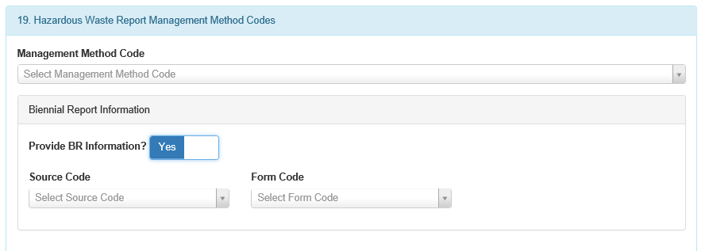
Notes:
Voluntary field for collecting BR data. e-manifest act mandates that at some point we integrate manifest and BR.
Within the Hazardous Waste Report Management Method Codes section, the designated facilty may provide Biennial Report Information for each waste stream. However, the Biennial Report information is entirely voluntary so the receiving facility is not required under this information collection to enter the source code and form code data. However, the e-Manifest Act mandates that EPA at some point integrate e-Manifest system with the Biennial Report. Thus, collection of source code and form code information will eventually become mandatory for manifest recordkeeping and reporting purposes, but only after EPA adds these elements to the paper manifest form, adjusts this Supporting Statement (EPA Information Collection Request Number 0801.22) accordingly, and provides notice and comment to affected parties regarding the recorkeeping and reporting burden associated with the additions. In the meantime, if the designated facility voluntarily provides the data, the information will enable completion of the required Biennial Report submission for Large Quantity Generators and TSD Facilities easier as this information is required for Biennial Report submissions (See Section 4(b) of the Supporting Statement for EPA Information Collection Request Number 0976.18). Note: If the designated facility elects to provide the Biennial Report information, all of the fields associated with the Biennial Report become required.
FORM CROSSWALK: The information on this slide is used to populate fields 19 on the 8700-22, and fields 36 on 8700-22a.

Slide 29
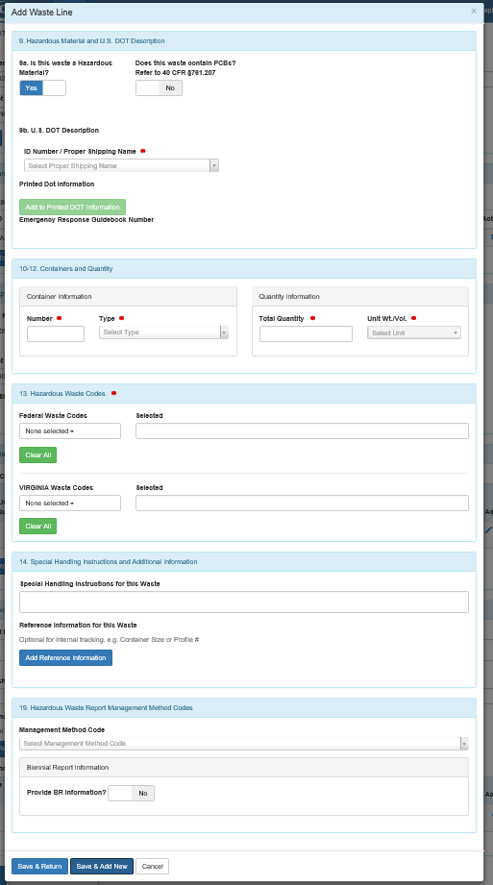
Notes:
The account user must click the "Save & Add New" button to save the selected code in e-manifest and return to the previous screen to add more codes for each waste stream listed in Item 9. If all codes have been entered, the account user should click the "Save & Return" button.
FORM CROSSWALK: The information on this slide is used to populate fields 19 on the 8700-22, and fields 36 on 8700-22a.

Slide 30
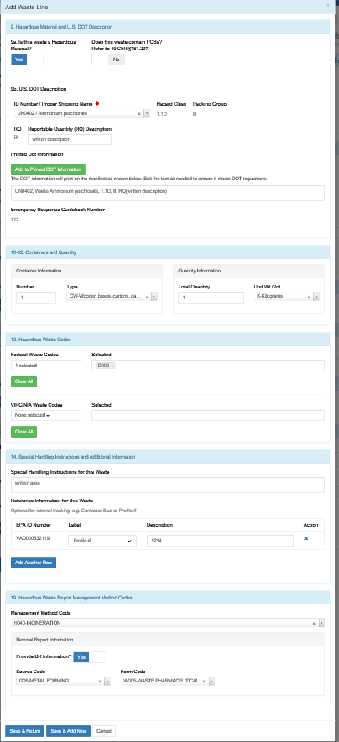
Notes:
If all codes have been entered for each waste stream identified and listed in Item 9 of the e-manifest, the account user must click the "Save & Return" button to save the last selected waste code and complete the e-manifest.
FORM CROSSWALK: The information on this slide is used to populate fields 19 on the 8700-22, and fields 36 on 8700-22a.

Slide 31
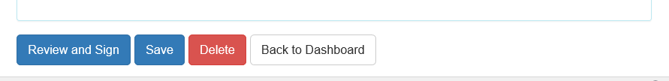
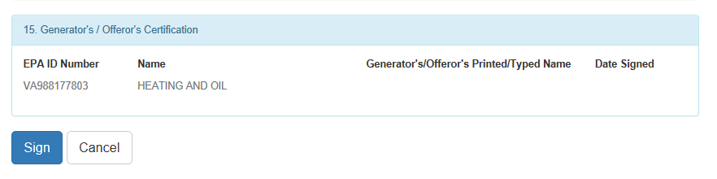
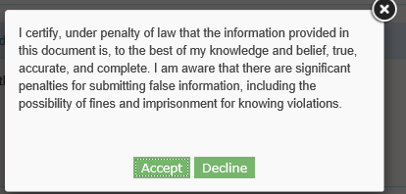
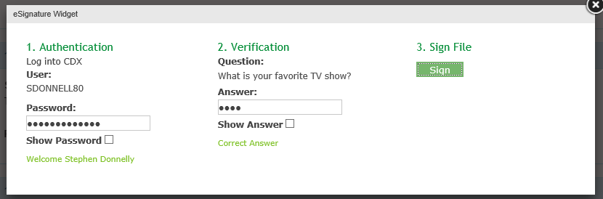
Notes:
Per Section 4B of the Supporting Statement and the reverse side of copy 5 (Generator's Initial Copy), i.e., the generator "Instructions for Completing a Hazardous waste Manifest form" for item 15 of the e-manifest, the account user must sign the generator/offeror statement on the e-Manifest. Note: The account user must have a permission level of "Site Managaer" or "Certifier" to sign the e-manifest.
Once the e-manifest contains all of the information needed for signature, the receiving facility may place the manifest into the "Scheduled" status indicating that the waste is ready for pickup at the generator site by the specified transporter. The account user must click the "Review and Sign" button to initiate the signature process. The generator or offeror will be taken to the "Review" page where he/she can review the manifest. Once the generator/offeror has reviewed the manifest, he/she must click the "Sign" button at the bottom of the page. The account user must certify that the information provided is accurate and complete to the best of his/her knowledge by clicking the "Accept" button. Next, the user will be prompted to provide his/her password and click "Login." One of the five security questions that the account user selected during the user registration process will be displayed. The user must enter the correct answer in the box and click "Answer.“
FORM CROSSWALK: The information on this slide is used to populate field 15 on the 8700-22.

Slide 32
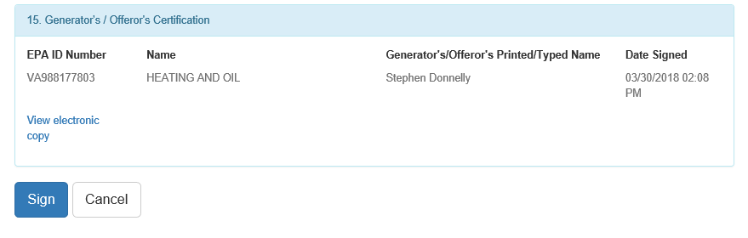
Notes:
Once the e-manifest system verifies the answer, the account user must click the "Sign" button to complete the signature process. If applicable, the status of the e-Manifest will be changed to the appropriate status and the system will return the user to the e-Manifest Dashboard. For example, if the first transporter signs a manifest then the manifest will be changed from "Scheduled" to "In-Transit.“
FORM CROSSWALK: The information on this slide is used to populate field 15 on form 8700-22.

Slide 33
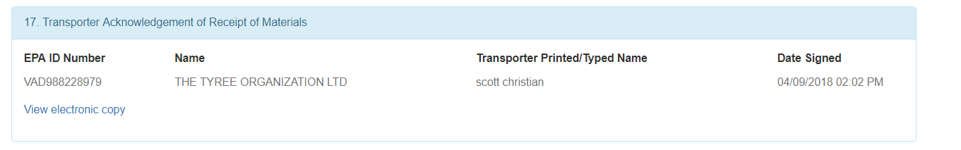
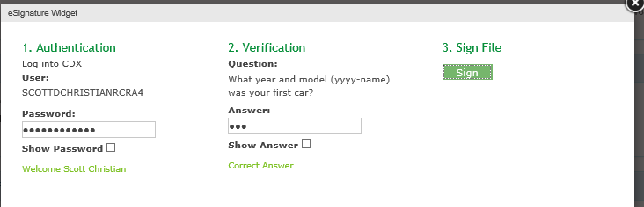
Notes:
Per Section 4B of the Supporting Statement and the reverse side of copy 4 (Transporter Copy), i.e., the transporter "Instructions for Completing a Hazardous waste Manifest form," the account user must sign and date Item 17 of the e-manifest to acknowledge acceptance/receipt of the generator's hazardous waste shipment. Note: The account user must have a permission level of "Site Managaer" or "Certifier" to sign the e-manifest.
If more than one transporter is identified on the manifest, the status of the manifest changes from "Scheduled" to "In Transit" once the initial transporter electronically signs the e-Manifest. The transporter's signature indicates that the waste has been picked up at the generator's site by the specified transporter and now is en route to the receiving facility.
FORM CROSSWALK: The information on this slide is used to populate field 17 on the 8700-22, and fields 33 and 34 on form 8700-22a.

Slide 34
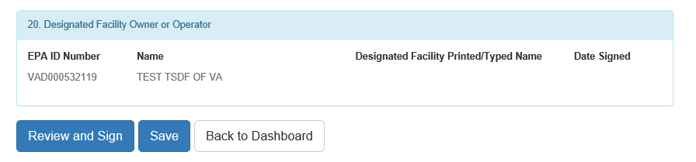
Notes:
Per Section 4B of the Supporting Statement and the reverse side of copy 3 (Designated Facility's Copy), i.e., the receiving facility "Instructions for Completing a Hazardous waste Manifest form," the account user must sign and date Item 20 of the e-Manifest. Note: The account user must have a permission level of "Site Manager" or "Certifier" to sign the e-manifest.
In the case of electronic, hybrid, and on-behalf-of manifests, the status of the manifest is set to "Ready For Signature" when the last transporter signs the manifest acknowledging receipt of the waste shipment from the generator or another transporter. Once the transporter arrives to the receiving facility, the facility must immediately sign the manifest acknowledging receipt of the shipment from the transporter. The manifest is placed into the "Signed" status once the receiving facility completes the initial signing ceremony and enters the Received Date. This ceremony is initiated by clicking the "Sign e-Manifests" button at the bottom of the e-Manifest Dashboard or the "Sign" button on the "Review and Sign" screen. Note: The manifest is not complete at this time and may be missing information such as Management Method Codes and Discrepancy information. Once the manifest is signed and it passes all validations needed, the status will be set to "Sign-Completed.“
FORM CROSSWALK: The information on this slide is used to populate field 30 on form 8700-22.

Slide 35
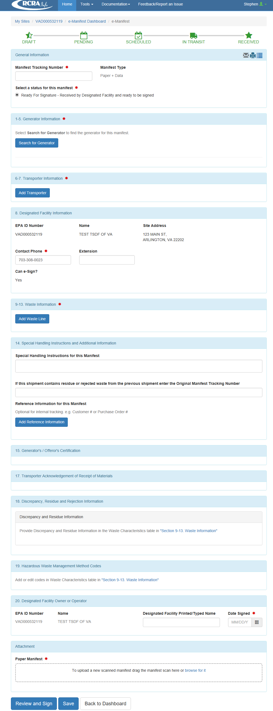
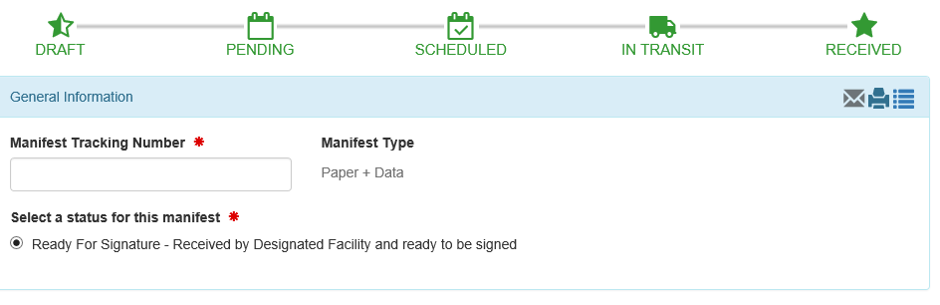
Notes:
Receiving facility adds information from paper manifest.
For mailed paper manifests, the "Ready For Signature" status is set when the designated facility uploads the paper manifest in the e-manifest system. The account user must enter the Manifest Tracking Number of the paper manifest in the space shown on the screen and select the "Ready For Signature" status.
FORM CROSSWALK: The information on this slide is used to populate field 4 on form 8700-22, and field 22 on form 8700-22a.

Slide 36
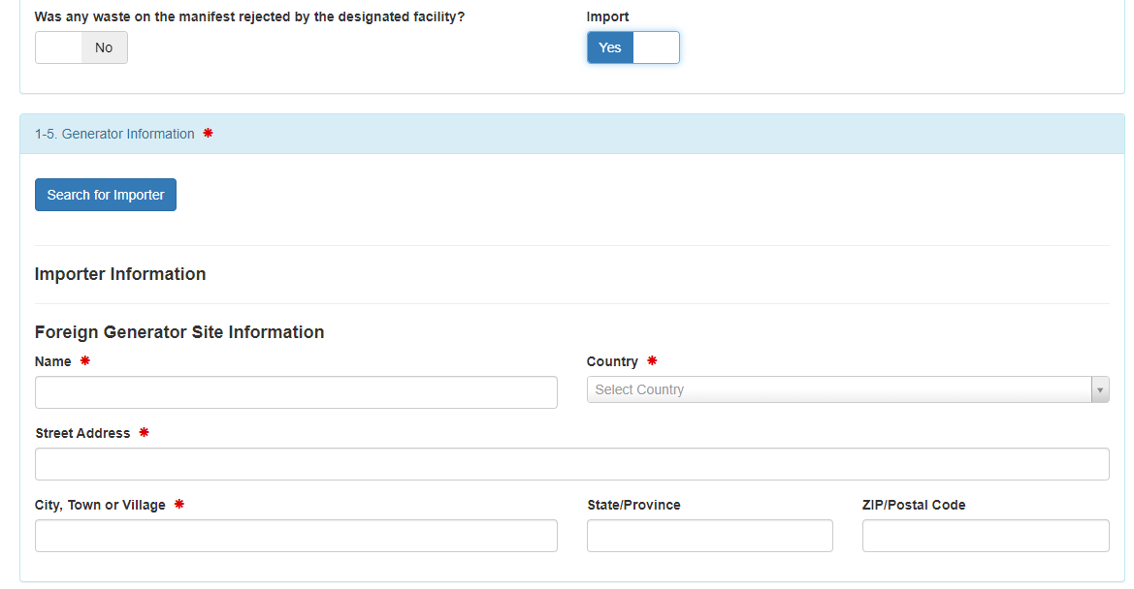
Notes:
Data fields for import shipments. Exports are not included in the initial release of eManifest.
Per Section 4B of the Supporting Statement and the reverse side of copy 5 (Generator's Initial Copy), i.e., the generator "Instructions for Completing a Hazardous waste Manifest form" for item 16 of the e-Manifest, the account user must ­in place of the generator’s name, and address, enter the name and address of the foreign generator.
FORM CROSSWALK: The information on this slide is used to populate field 16 on form 8700-22.

Slide 37
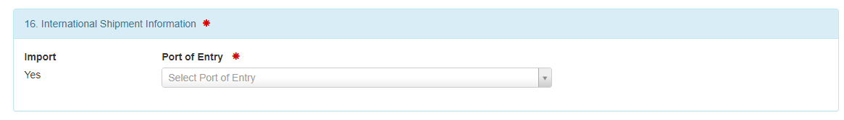
Notes:
Data fields for import shipments. Exports are not included in the initial release of eManifest.
The account user must select the port of entry by typing two or more characters into the drop-down list and selecting the appropriate port
FORM CROSSWALK: The information on this slide is used to populate field 16 on form 8700-22.

Slide 38
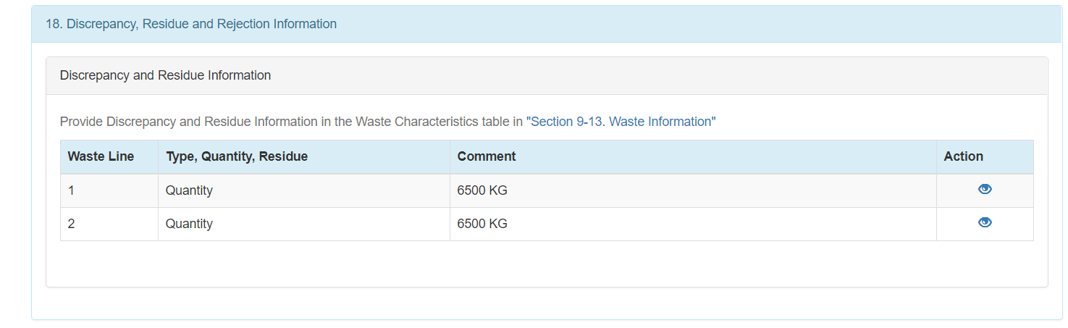
Notes:
Note: Documentation of discrepancies generally occur after the delivering transporter has left the receiving facility. Per Section 4B of the Supporting Statement and the reverse side of copy 3 (Designated Facility's Copy), i.e., the receiving facility "Instructions for Completing a Hazardous waste Manifest form" for Item 18 of the e-manifest, the account user must note in this space any discrepancies between the waste
described on the manifest and the waste actually received at the facility.
FORM CROSSWALK: The information on this slide is used to populate field 18a on form 8700-22, and field 35 on form 8700-22a.

Slide 39
Notes:
Receiving facility adds information from paper manifest.
For mailed paper manifests, the "Ready For Signature" status is set when the designated facility uploads the paper manifest in the e-manifest system. The account user must enter the Manifest Tracking Number of the paper manifest in the space shown on the screen and select the "Ready For Signature" status.
FORM CROSSWALK: The information on this slide is used to populate field 4 on form 8700-22, and field 22 on form 8700-22a.

Slide 40
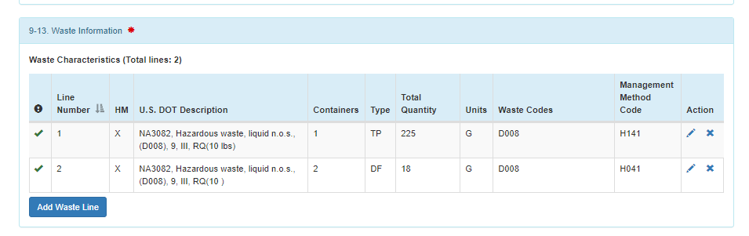
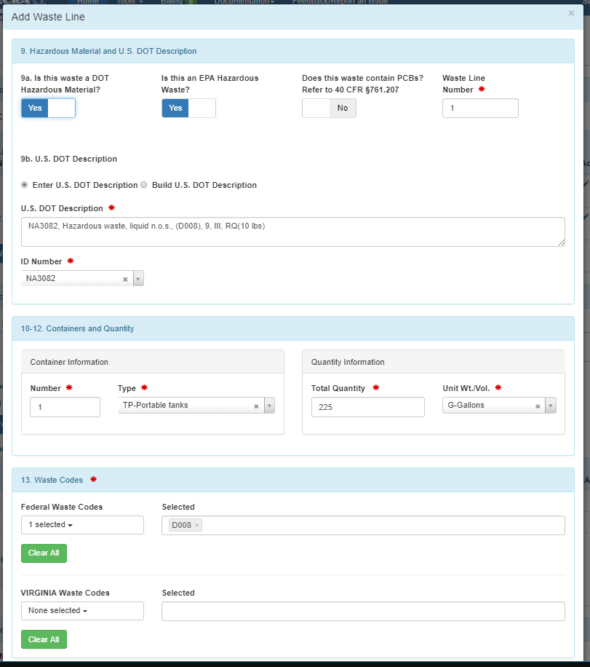



Notes:
Click on the "pencil" icon next to the waste line or lines affected by the discrepancy in Section 9-13 of the manifest. A pop-up window containing the information for that waste line will be displayed. Make the corrections to the waste line as appropriate. In Section 18, indicate the type of discrepancy you encountered by setting the Yes/No slider boxes for Quantity and Type to the appropriate values. A value of Yes for Quantity indicates that a quantity discrepancy for this waste was discovered. A value of Yes for Type indicates that a waste type discrepancy for this waste was discovered. You must also provide comments describing the discrepancy encountered. Click the "Save & Return" button to save the revisions made to the waste line and the discrepancy information entered, then click "Save" (if you are a Preparer) or "Review and Sign" (if you are a Certifier or Site Manager) to save the revisions to the manifest.

Slide 41

Notes:
Discrepancy Reporting
FORM CROSSWALK: The information on this slide is used to populate field 18a on form 8700-22, and field 35 on form 8700-22a.

Slide 42

Notes:
Discrepancy Reporting
FORM CROSSWALK: The information on this slide is used to populate field 18a on form 8700-22, and field 35 on form 8700-22a.

Slide 43


Notes:
Discrepancies – this is for electronic/hybrid manifests only (manifest which have ELC suffix). To report a discrepancy for an electronic or hybrid manifest, click the "eye" icon next to the manifest of interest within the Received Section of the e-Manifest Dashboard. Next, scroll to the bottom of the page and click "Make Changes"

Slide 44

Notes:
A designated facility may reject waste shipment either in full or in part that they cannot accept. For rejected loads and residues (40 CFR 264.72(d), (e), and (f), or 40 CFR 265.72(d), (e), or (f)), the shipment must be sent to an alternate facility or returned to the generator. The account user must enter the manifest tracking number and identify whether the shipment is a full or partial rejection.
CROSSWALK: The information on this slide is used to populate field 18 on form 8700-22. FORM CROSSWALK: The information on this slide is used to populate field 18 on form 8700-22.

Slide 45



Notes:
For rejected loads and residues (40 CFR 264.72(d), (e), and (f), or 40 CFR 265.72(d), (e), or (f)), check the appropriate box if the shipment is a rejected load (i.e., rejected by the designated and/or alternate facility and is being sent to an alternate facility or returned to the generator) or a regulated residue that cannot be removed from a container. Full rejections occurring after the transporter has left the facility and partial rejections (or residues) that are being reshipped to an alternate facility or generator, must be reshipped under a new manifest. The account user must provide the manifest tracking number of the new manifest, and the waste shipment information must be entered in the general information fields of the manifest. Additionally, the MTN of the original manifest must be entered in the Special Handling and Additional Information field.
CROSSWALK: The information on this slide is used to populate field 18 on form 8700-22. FORM CROSSWALK: The information on this slide is used to populate field 18 on form 8700-22.

Slide 46

Notes:
Discrepancy Reporting
FORM CROSSWALK: The information on this slide is used to populate field 18a, 18b, and 18c on form 8700-22, and field 35 on form 8700-22a.

Slide 47






Notes:
Manifest users can correct errors to manifests after the have been submitted to the system. If errors are discovered on a manifest after the manifest has a Status of "Signed-Completed", the manifest may be corrected. Any party to the manifest (i.e., the generator, transporter(s), receiving facility, or alternate receiving facility) may initiate the corrections process by clicking the "eye" icon next to the manifest to correct on the e-Manifest Dashboard from either the "Received" section or the "Paper Manifests (Image-Only)" section then clicking the "Make Correction" button next to the Status or at the bottom of the page.
ELECTRONIC / HYBRID
Electronic and hybrid manifests allow the user to make corrections to the following data:
Section 8 Designated Facility Information (Contact Phone and Extension only)
Sections 9-13 Waste Information
Section 14 Special Handling Instructions and Additional Information
Section 16 International Shipment Information (Port of Entry and State Only)
Section 18 Discrepancy, Residue and Rejection Information (Note: if the waste was rejected, you cannot change the alternate receiving facility where the waste was subsequently shipped)
PAPER + DATA
Paper + Data manifests allow the user to make corrections to the following data:
Section 1-5 Generator Information
Section 6-7 Transporter Information
Section 8 Designated Facility Information (Contact Phone and Extension only)
Sections 9-13 Waste Information
Section 14 Special Handling Instructions and Additional Information
Section 15 Generator's / Offeror's Certification
Section 16 International Shipment Information
Section 17 Transporter Acknowledgement of Receipt of Materials
Section 18 Discrepancy, Residue and Rejection Information (Note: if the waste was rejected, you cannot change the alternate receiving facility where the waste was subsequently shipped)
Reload Paper Manifest Attachment
PAPER ONLY
The Paper Only manifests only allows the user to reload the paper manifest attachment. No other data may be revised or corrected.
SAVE / REVERT CORRECTIONS
Click the "Save" button at the bottom of the page to save your corrections. At a later date, your corrections will need to be electronically signed (see below) or reverted to the most recently signed manifest. To revert the manifest back to the most recently signed manifest, click the "Revert" button. The corrections that you saved will be discarded and the manifest data displayed will reflect the data from the most recently signed manifest. The manifest will remain in the "Under Correction" status until your corrections are electronically signed or reverted.
RE-SIGNING THE MANIFEST
Once a correction is initiated, one party (i.e., the generator, transporter, receiving facility, or alternate receiving facility) must re-sign the manifest to certify the corrections. Once the manifest has been re-signed, the manifest status is set to "Corrected". To make additional corrections, the corrections process must be re-initiated by clicking the "Make Correction" button. To discard the corrections, click the "Revert" button (see above). Note: You cannot revert to a previous manifest once the corrections to the manifest have been re-signed. However, the application maintains all versions of the manifest and may be referenced as needed.
MANIFEST VERSIONS
Every time a correction is initiated a new version of the manifest is created. To see previous versions of the manifest, from the correction page, click the "paper" icon in the top right-hand corner of the General Information section, then click the "eye" icon next to the version of interest. Note: You can only make corrections to the current version of the manifest.

