Slide 1



School Food Purchase Data Submission
OMB Control No: 0584-0471
Expiration Date: XX/XX/20XX
Appendix B9. Purchase Data Webinar
School Food Purchase Study IV
School Year 2021-22

Slide 2




Study Overview Webinar
Note that this webinar is being recorded and will be posted on the study website.

Slide 3

Purpose of Today’s Webinar
Provide details on food purchase data needed for the study
Provide a checklist to help you ensure all required data elements are included
Tell you how to submit the data
Answer questions
Provide you with resources if you need support, including one-on-one technical assistance

Slide 4
Agenda
Welcome and Introductions
Why repeat the study?
Quarterly Food Purchase Data Collection in SFPS IV
  Food purchase data elements
  Options for submitting food purchase data

Slide 5

Why repeat the School Food Purchase Study?
The study provides information on SFA food purchase behavior and the cost of food
USDA uses the study results when considering future program changes, including the type and/or form of available USDA Foods
There have been significant changes to school food service since the last study (HHFKA)
  The study will help identify mechanisms for SFAs to purchase more efficiently

Slide 6
Food Purchase Data Collection in SFPS IV
    SFAs will provide details of all food purchases/acquisitions made from all sources in one specified quarter of the school year
            Commercially purchased foods
            Direct delivered USDA Foods
            Processed end products containing USDA foods as ingredients
            Foods provided in reimbursable meals and a la carte
      USDA will provide information on DoD Fresh deliveries to SFAs

Slide 7
Food Purchase Data Submission
  Include purchases from all sources (e.g. distributors, vendors, food buying cooperatives, FSMCs, USDA Foods, etc.).
  Include all foods received by the SFA or the school in the specified quarter, regardless of when the order was placed.
  Exclude DoD Fresh deliveries and foods purchased for other programs (e.g. CACFP, adult meals, catering).
  Submit SFA level summary data.
  Submit velocity reports or vendor summaries in editable formats such as EXCEL.

Slide 8
Food Purchase Data Checklist
Reporting Period
Inclusions
Exclusions
Data Elements
Data aggregation status for each file:
  SFA or school level data?
  Quarterly or daily, weekly, monthly data?

Slide 9
Food Purchase Data Checklist:
Reporting Period
Include all deliveries made to the SFA between <DATE RANGE> regardless of when the order was placed.

Slide 10
Food Purchase Data Checklist:
Food Purchase Inclusions and Exclusions
Include quarterly food purchases (deliveries):
For NSLP, SBP, and a la carte
From commercial vendors, FSMCs, distributors, and USDA Foods direct deliveries
  Make sure the source is identifiable
Exclude quarterly food purchases (deliveries):
For other programs such as CACFP, adult meals, catering, etc.
From DoD Fresh suppliers (this information will be provided by USDA)

Slide 11
Food Purchase Data Checklist:
Data Elements
  Include:
  Product name and description
    Canned tomato, pizza, hamburger patty, etc.
  Product code
    Vendor or manufacturer assigned codes that describe the product
  Quantity purchased
    Unit size and number of units purchased
    6/10 lb bags of carrots; 3 /5 lb cases of potato tater tots; 400 hamburger buns
  USDA Foods codes and value pass through methods for processed end products containing USDA Foods as ingredients
    Value pass through methods include indirect discount or net off invoice, rebate or refund, fee for service.
  Total or unit cost per food product

Slide 12
Food Purchase Data Checklist:
Data Aggregation Status For All Files
Is the data contained in the file:
    Aggregated at the SFA level
    Individual school level
Is the data contained in the file:
  Rolled up at the quarterly level
  Provided on a daily, weekly, or monthly level (i.e., as it was delivered)

Slide 13
Food Purchase Data:
Sample Velocity Report
Product | DID | Brand | Pack Size | Unit | MID | # Cases Sold | Total price ($)
CHIP 40% REDUCED FAT (1138200) | 1138200 | CAPCOD | 104/.5 Z | CS | 112155 | 263.00
CHIC TENDER WG FC CN (3599500) | 3599500 | RICHCH | 1/320PC | CS | CRC54453 | 135.00
PIZZA CHS LUNCH RND 5" WG (4197300) | 4197300 | THEMAX | 60/5.05 | CS | 77387-12514 | 128.00
CHIPS TOSTITOS ROUNDS WG (2043700) | 2043700 | FRITO | 8/16 OZ | CS | 28400-62399 | 113.00
FRIES SEASONED SPIRLS OU (3207500) | 3207500 | MCCAIN | 6/4 LB | CS | MCL03622 | 103.00
BEEF FINE GRIND 81/19 (9866100) | 9866100 | PACKER | 1/10LB | LB | 42499 | 102.00
YOGURT STRAW/BANANA DANIM (3054100) | 3054100 | DANNON | 48/4 OZ | CS | 2732 | 83.00
WRAP WHOLE WHEAT 10" WG (3776700) | 3776700 | SOLIS | 12/12 CT | CS | 61644-10206 | 70.00
SYRUP PANCAKE CUP P/C (2156000) | 2156000 | AMERIC | 100/1.5Z | CS | 78000841 | 67.00
CHIPS BAKED LAYS SS FG (1177000) | 1177000 | FRITOL | 60/.875Z | CS | 33625 | 58.00
ROLL HOTDOG NE TOP SLICE (4068400) | 4068400 | HOMSTD | 9/12 CT | CS | 41 | 50.00
JUICE APPLE CUP 100% (3252600) | 3252600 | ARDMOR | 96/4 OZ | CS | 41381 | 49.00
SNACK BAR RICE KRISPY WG (1014100) | 1014100 | KELLOG | 80/1.41Z | CS | 38000-11052 | 48.00
GATORADE COOL BLUE (0604000) | 604000 | QUAKER | 24/20 OZ | CS | 32481 | 44.00
MEATBALLS BEEF .5OZ CN (3760500) | 3760500 | ADVANC | 320/.5 | CS | 17-505-0 | 44.00
SNACK PIRATE BTY WHT CHDR (1171900) | 1171900 | PIRATE | 24/.75Z | CS | 62407 | 40.00
BAGEL WHITE WHEAT WG IW (4095500) | 4095500 | LENDER | 1/72 2OZ | CS | 76800-00075 | 40.00
Verify that the velocity report includes either unit price or total price ($) per product.

Slide 14
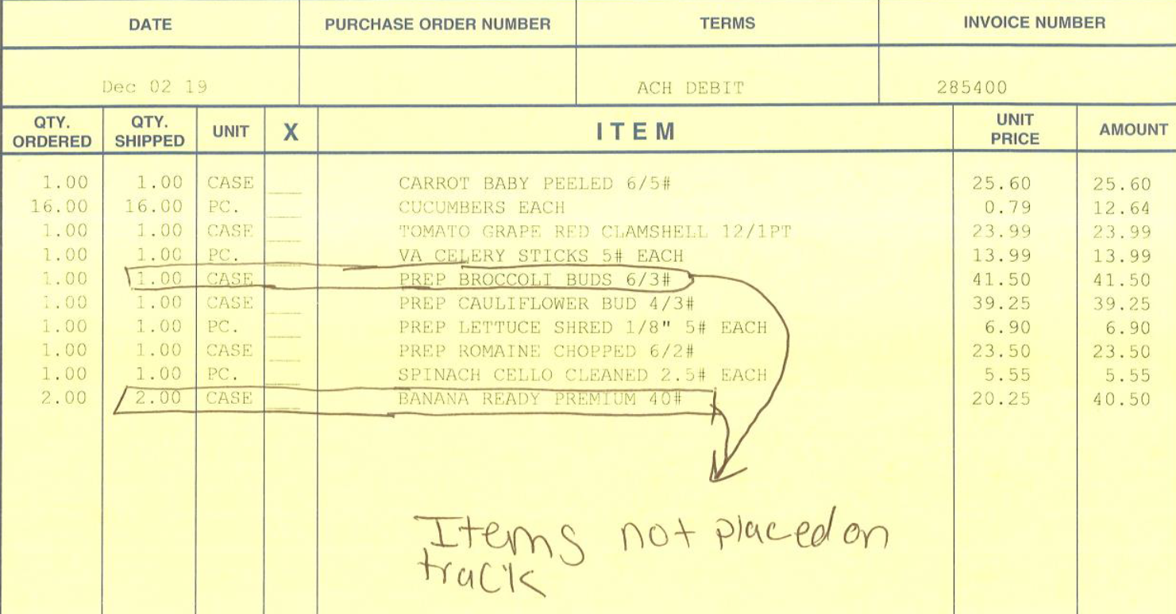
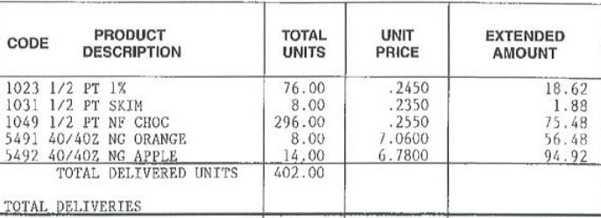
Food Purchase Data:
Sample School Level Dairy and Produce Invoice
If needed, include multiple invoices for school deliveries spanning the entire quarter.

Slide 15
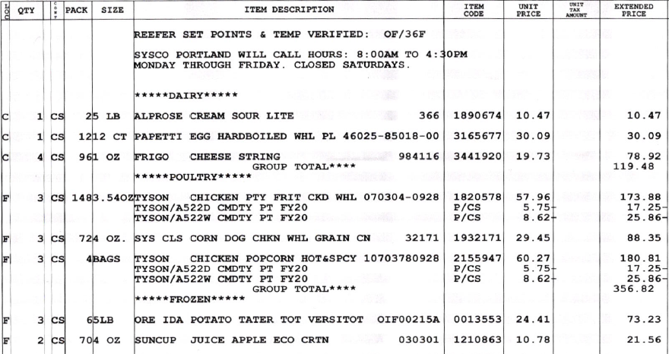
Food Purchase Data:
Sample Distributor Invoice
      The invoice includes USDA Foods codes for processed end products containing USDA foods as ingredients.
      The invoice also depicts the value pass through method (Net Off Invoice -- NOI)

Slide 16
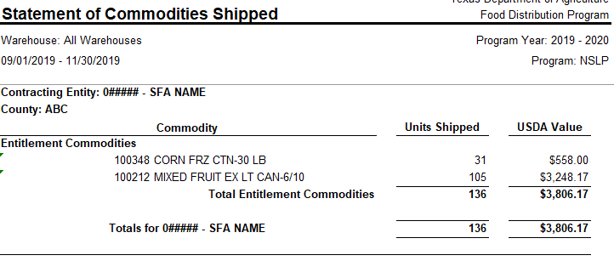
Food Purchase Data:
Sample Direct Delivered USDA Foods

Slide 17
Upload the Quarterly Food Purchase Data to the Secure Study Website
  Assemble the food purchase data for the entire quarter before starting the upload process.
  Use the unique PIN provided to you to access the purchase data submission area on the study website.
  Upload all food purchase data in one seating.
  View your submissions at any point to check for completeness and upload missing invoices or remove duplicates, as necessary.
  Contact your study liaison if you have questions.

Slide 18
After you Submit your Data…
  We will consolidate the list of food purchases for your SFA and send it to you within 45 days of receiving your submission.
  You will review the list of all foods to:
    Confirm that the list is complete and accurate
    Update any missing information
    Fill in the amount (%) of each product used in a la carte vs. meals vs. other programs – can be an estimate

Slide 19
Complete the Quarterly Program Data Form
Number of serving days and meals served/claimed by type (free, reduced price, paid)
Total revenue from the sale of nonprogram foods and beverages (i.e., a la carte, competitive foods)
Top 10 selling nonprogram foods
Other food program sales (if applicable)
Total food expenditures for food and beverages

Slide 20
Timeline
  The email request to submit the quarterly food purchase data will include a due date.
    Approximately 4 weeks from the date the email is sent
    This lag is to allow you sufficient time to consolidate and review documents from all sources

Slide 21
Study Website: www.purchasestudy.com
Welcome to the School Food Purchase Study Portal USDA’s Food and Nutrition Service (FNS) has contracted with Westat and its Partner, Agralytica to conduct the fourth School Food Purchase Study. Westat is an employee owned company, headquartered in Rockville, Maryland. Westat is committed to providing technical assistance to SFAs taking part in this study.
Data Collection Study Overview Data Collection Plans | Resources and Upcoming events | Restricted Access study participants Use your unique PIN to review task status or submit data

Slide 22
Technical Assistance Center
Email: PurchaseStudy@Westat.com
Technical Assistance Center hotline: 800-###-#### from 9 – 4 pm
Website: www.PurchaseStudy.com

Slide 23
School Food Purchase Study IV
QUESTIONS?
Notes:
This slide will need Sujata and Melissa to fill in

