Slide 1
Welcome to the ATSDR (or insert name of state or local agency)
SMS Text Survey!
Get out your cell phones and get ready…
Attachment H. SMS Text Survey

Slide 2
Thank you for your interest in the SMS Text Survey.
This brief 3-minute survey is voluntary.
We will not keep your cell phone number.
Your answers will be anonymous.
Here is some more information about this survey and how you can consent to take part.

Slide 3
The ATSDR Program Evaluation Team (or insert name of state and local agency) is conducting this Text Survey to gather feedback on how effective and timely ATSDR (or insert name of state or local agency) is in informing communities. The information will be used to help public health staff improve what they do in a way that’s best for community members.

Slide 4
We have approval to
conduct this survey.
Form Approved | OMB No. 0923-0055 | Exp. Date 06/30/2020
ATSDR estimates the average public reporting burden for this collection of information is
3 minutes per survey, including the time for reviewing instructions, searching existing data/information sources, gathering and maintaining the data/information needed, and completing and reviewing the collection of information. An agency may not conduct or sponsor, and a person is not required to respond to a collection of information unless it displays a currently valid OMB control number. Send comments regarding this burden estimate or any other aspect of this collection of information, including suggestions for reducing this burden to CDC/ATSDR Information Collection Review Office, 1600 Clifton Road NE, MS D-74, Atlanta, Georgia 30333; ATTN: PRA (0923-0055).

Slide 5

We want you to know what
you can agree to do.
CONSENT: Taking part in this survey is completely voluntary. You may skip any question or stop at any time. Your responses will be kept private to the extent allowed by law. Digital data will be stored in secure computer files. We will not release information that may identify you in any ATSDR (or insert name of state or local agency) reports. Please be sure to get all of your questions about the survey answered by ATSDR (or insert name of state or local agency) before you begin. By choosing the cell phone survey, you agree to accept all text message charges, if applicable. By proceeding, you indicate that you are 18 years of age or older, and CONSENT to participate in this survey.

Slide 6
Text 1, 2, 3, or 4
Question 1 -
Has ATSDR (or insert name of state or local agency) helped you to better understand
the environmental risk(s) at this site?
    1 – Yes
    2 – No
    3 – Some, but not all
    4 – Don’t know

Slide 7
Text 1, 2, or 3
Question 2 -
Since ATSDR (or insert name of state or local agency) came into your community, do you NOW know more about what you and your family should do to avoid contact with the environmental risk(s) at the site?
    1 – Yes
    2 – No
    3 – Don’t know

Slide 8
Text 1, 2, 3, or 4
Question 3-
Have you taken (or will you take) any actions to avoid contact with environmental risks at the site based upon ATSDR’s (or insert name of state or local agency) recommendations?
1. Yes
2. No
3. Some
4. Don’t know

Slide 9
Text 1, 2, or 3
Question 4-
Have you experienced any positive outcomes from the work of ATSDR (or insert name of state or local agency) at this site?
1. Yes
2. No
3. Don’t know

Slide 10
Sample Responses for
SMS Text Survey

Slide 11
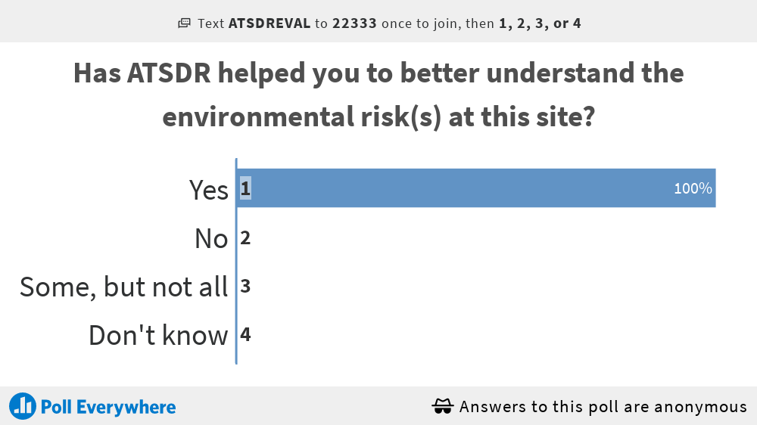

Slide 12
