Slide 1
The following 6 slides contain screen shots illustrating the fields an Officer has available to populate for any given incident within the Incident Creation module of RMS.
  Note – the vast majority of fields are not required and Officers record data relevant to each incident per training
The landing page for creating an incident is the Header tab, which is one of 6 tabs available in the user interface.
  Users can click along the tabs to access the fields relevant to the incident being handled.

Slide 2
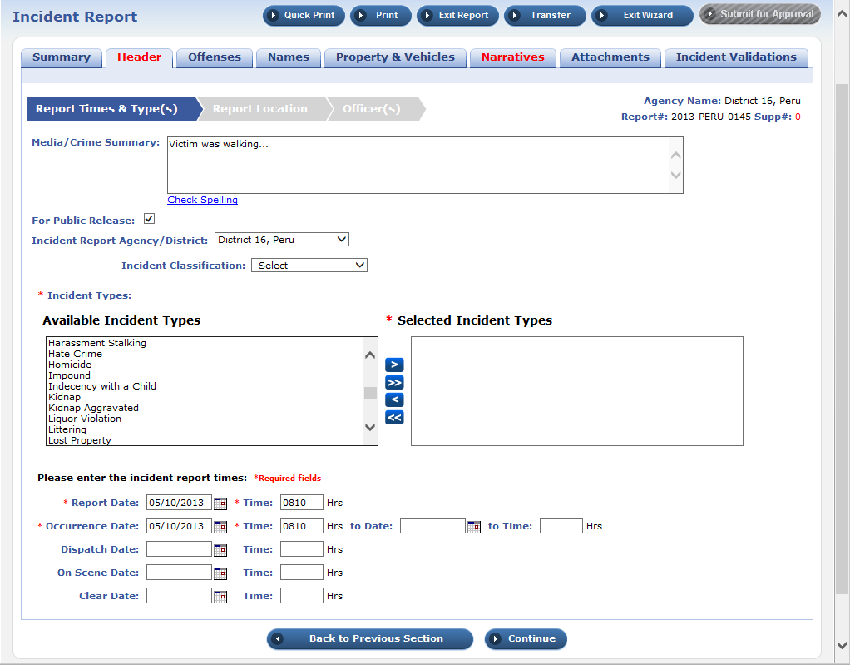
Incident – Header
1 of 6
The incident type selected will dictate which fields become mandatory within each incident report (e.g., a traffic stop will require vehicle information to include license, color, make, etc)

Slide 3
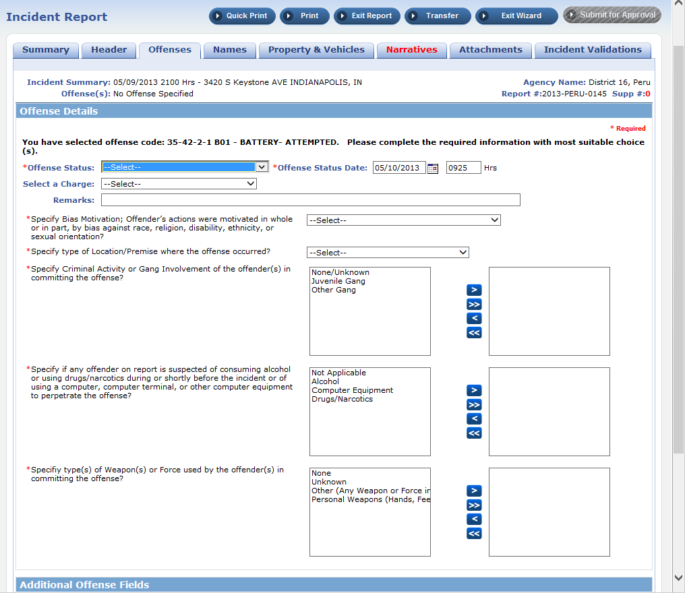
Incident - Offenses
2 of 6
Incident types are listed by common name and federal ID # to standardize data entry.

Slide 4
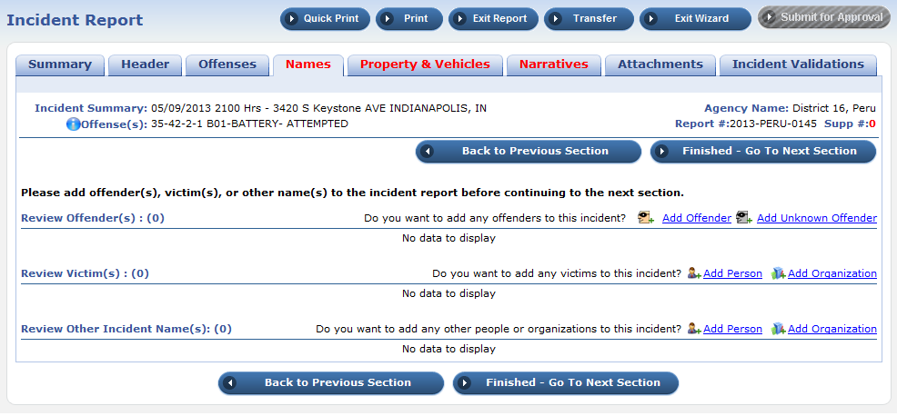
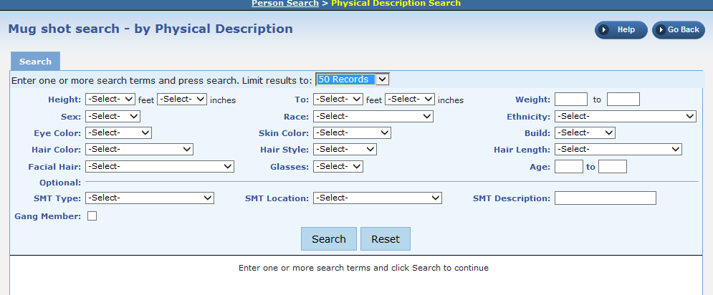
Incident - Names
3 of 6
Fields available for Search or Add “Mug Shot by Physical Description”
Offender, victim, and witness personal data is entered here. In the absence of photographs, the Officer can record a physical description of either person if necessary

Slide 5
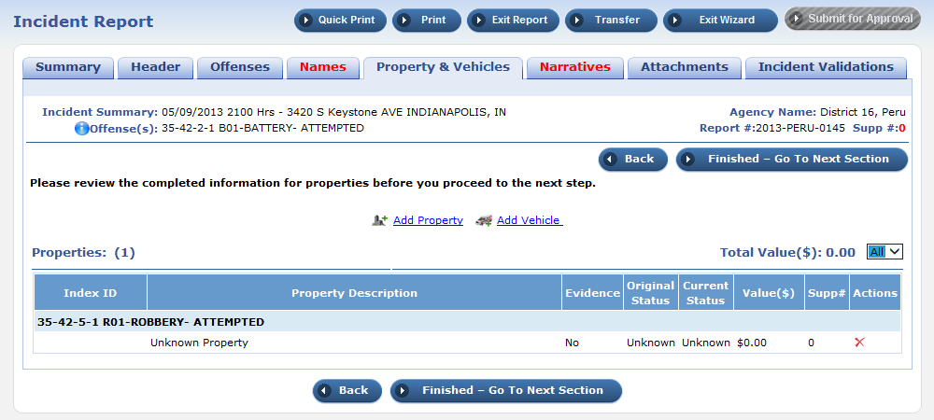
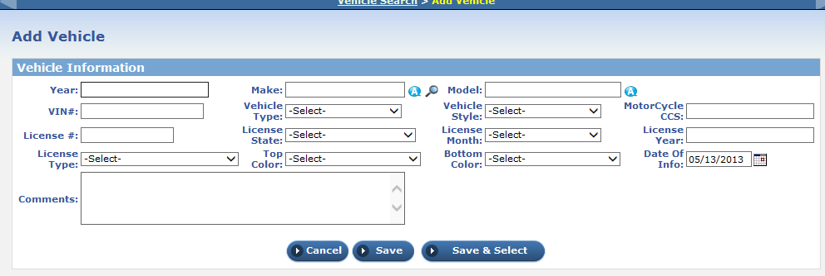
Incident – Property/vehicles
4 of 6
These fields are filled in only if a vehicle or property is involved. Otherwise, left blank.

Slide 6
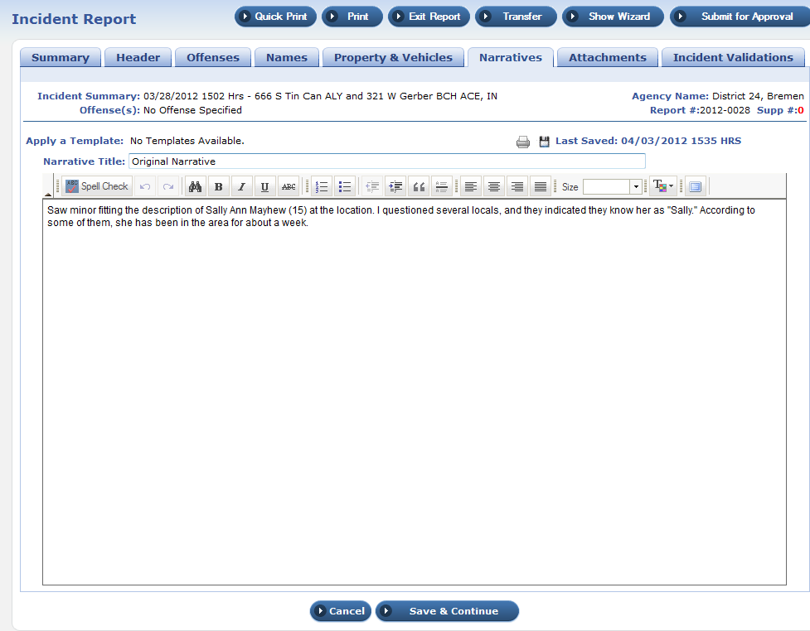
Incident - Narrative
5 of 6
The bulk of the incident report is contained within the Narrative. This is a free text box wherein the Officer describes the incident from beginning to end, using any information he deems appropriate and necessary.

Slide 7
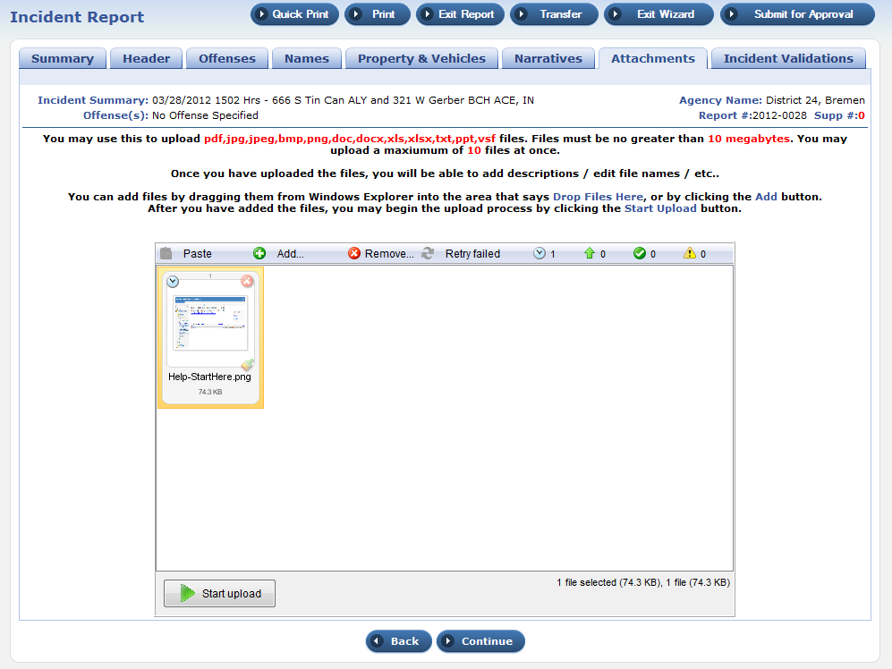
Incident - Attachments
6 of 6
Attachments include scanned documents, photographs, video clips, or other media collected during an incident that is relevant to the incident description or later prosecution.

Slide 8
The following 4 slides contain screen shots illustrating the fields an Officer has available to populate with the citations, warrants, towing, or evidence modules.
  Note – the vast majority of fields are not required and Officers record data relevant to each incident per training

Slide 9
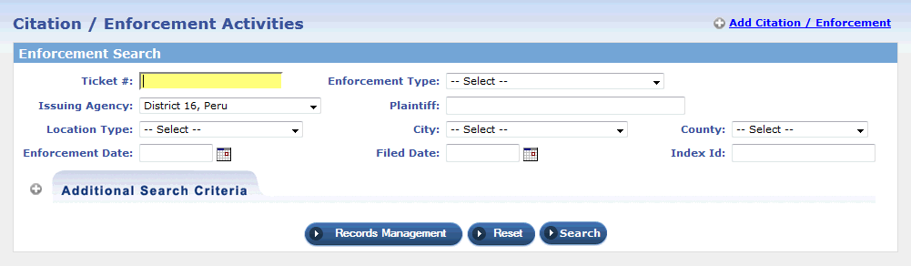
Add citation
The citation module is used to create a centralized area of collected data for citation/ enforcement activities against individuals, and/or vehicles. The Court Liaison division within PPD would use this to compile case documents quickly. This module can also be used to search for a previous incident using a known incident number.

Slide 10
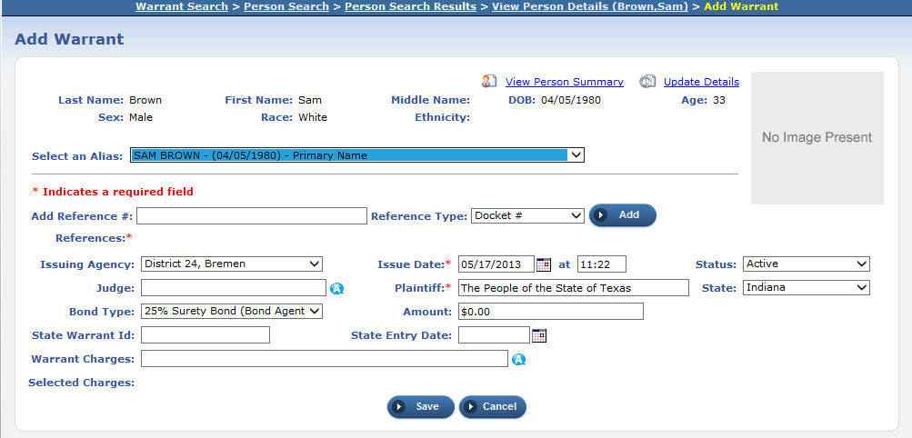
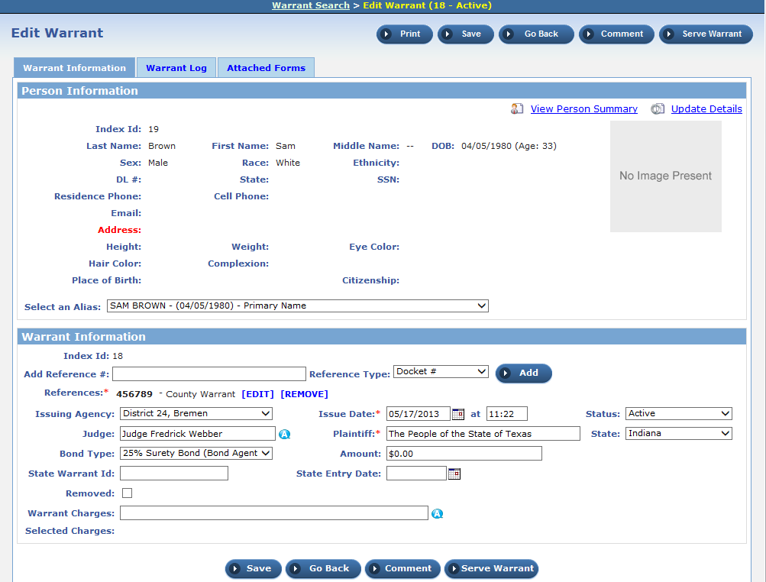
Add/edit warrant
The warrant module is used to record issuances of a warrants by other Agencies. Though not often used, this module is available to support force protection efforts.

Slide 11
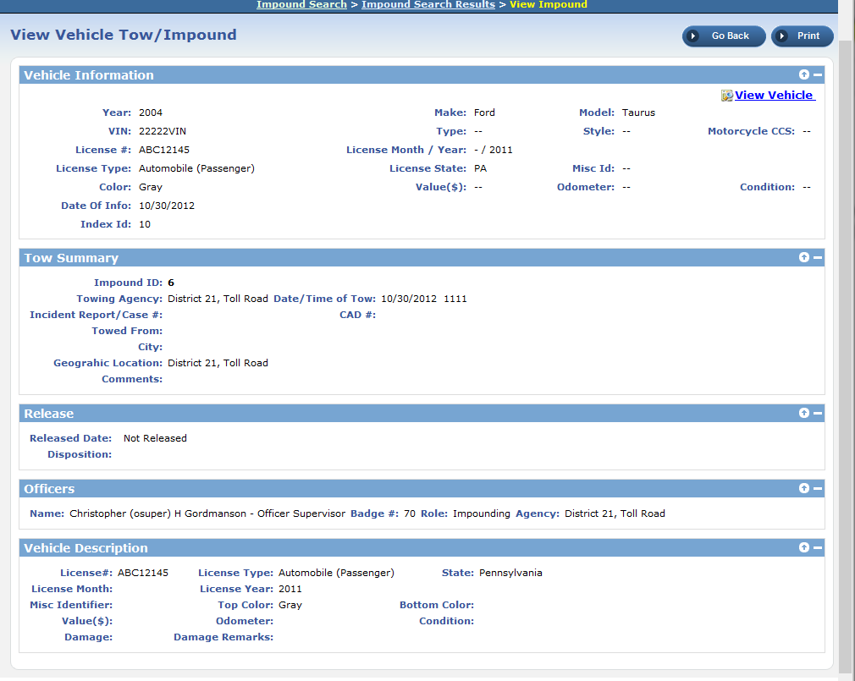
Add/edit vehicle for towing/impound
This module will be used exclusively by the Traffic division of PPD for logging parking violations and requests for tow.

Slide 12
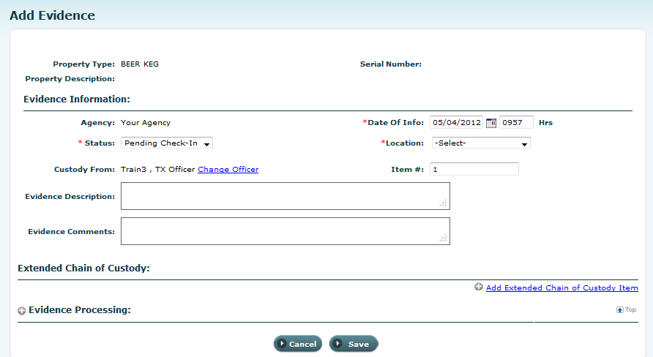
Evidence add/edit
This module will be used exclusively by the Evidence division of PPD for logging items collected during incidents. These items may or may not be associated with PII; however, when the owner claims an item s/he is listed as part of the chain of custody.

