Slide 1
Emergency Capital Investment Program (ECIP) Loan Form
System Screenshots
March 4, 2020

Slide 2
Overview: ECIP Loan Landing Page
Provide low- and moderate-income community financial institutions the opportunity to apply for capital investment from the government.

Slide 3
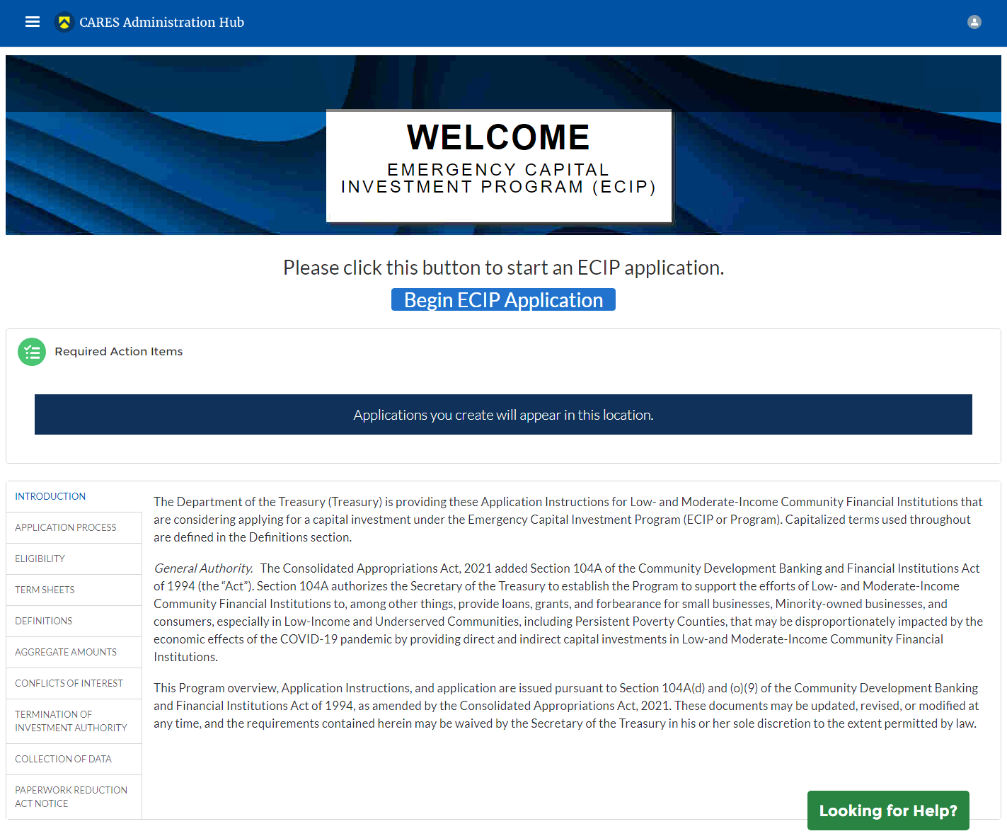
Step 1: Applicant logs in to Homepage
Applicants assigned this form will see the below layout.

Slide 4
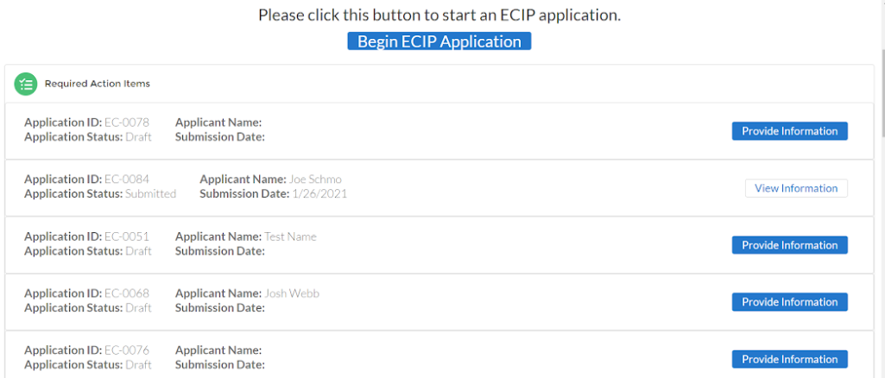
Step 1: Applicant logs in to Homepage
Applicants who have made an application already will have “Required Action Items” populated with a previously made application.

Slide 5
Step 2: Review Form Instructions
Introduction

Slide 6
Step 2: Review Form Instructions
Application Process

Slide 7
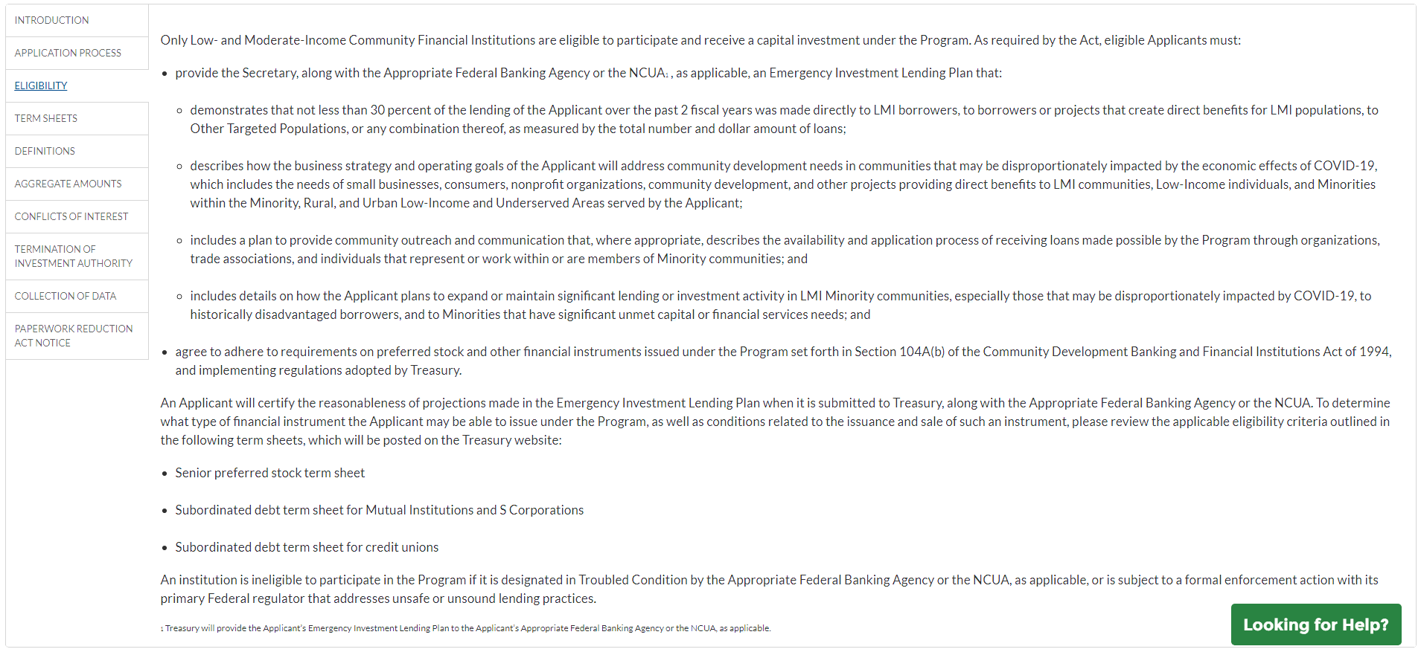
Step 2: Review Form Instructions
Eligibility

Slide 8
Step 2: Review Form Instructions
Term Sheets (on landing page)

Slide 9
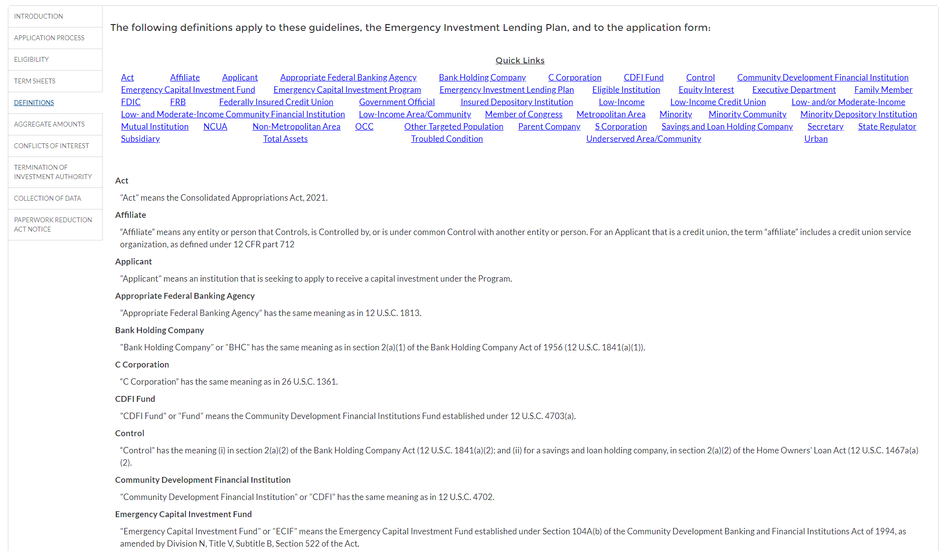
Step 2: Review Form Instructions
Definitions (on landing page)

Slide 10
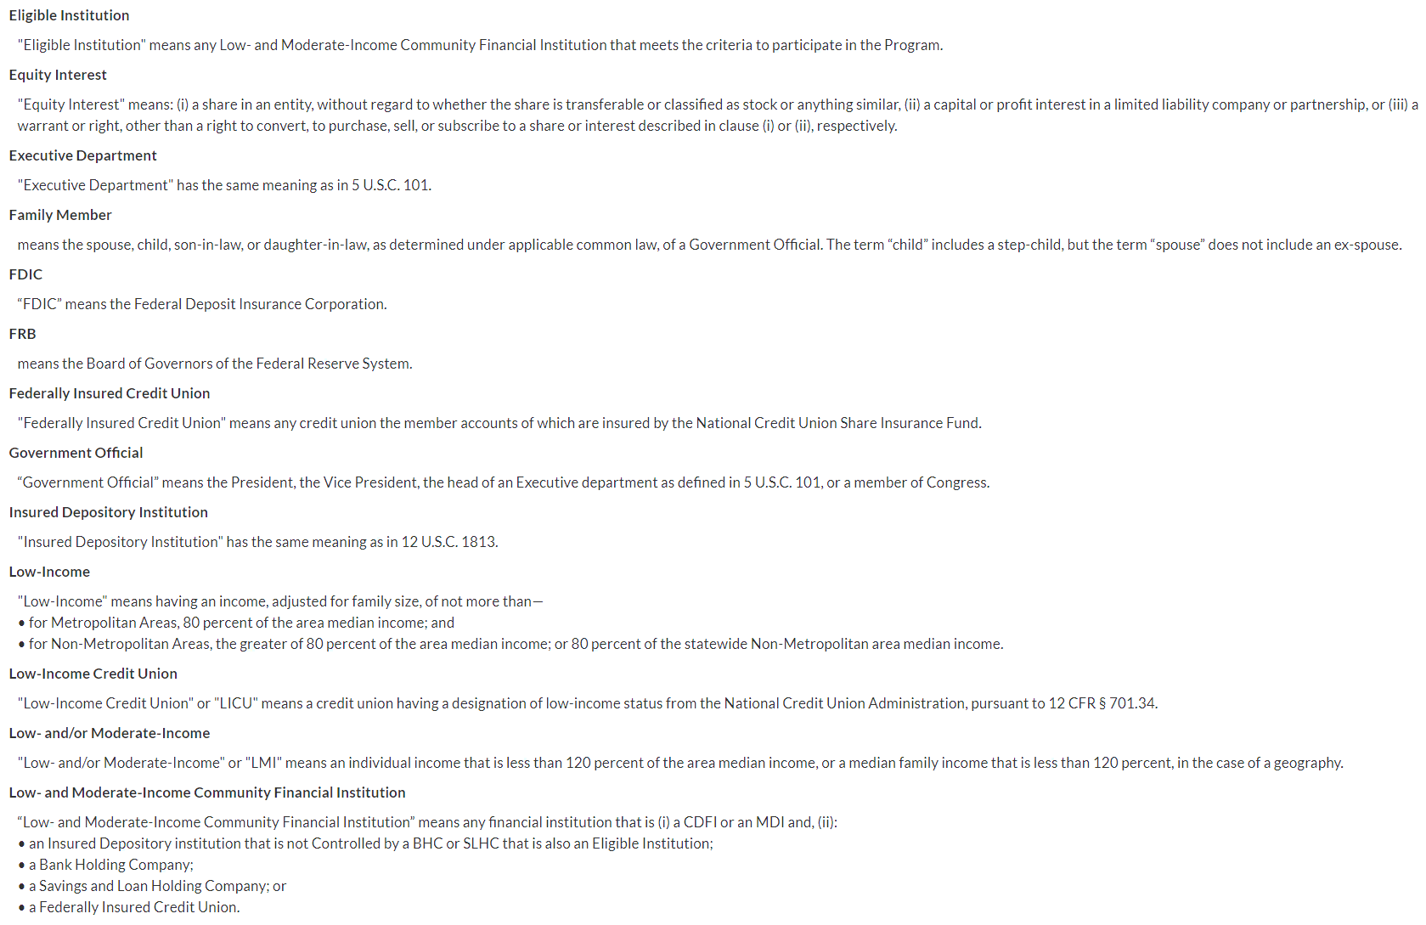
Step 2: Review Form Instructions
Definitions (on landing page) - continued

Slide 11
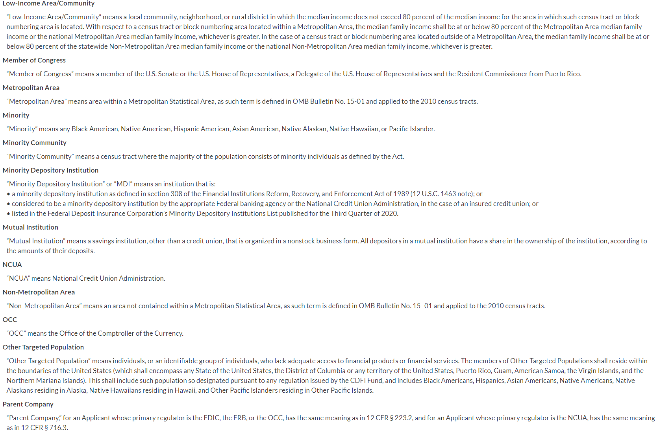
Step 2: Review Form Instructions
Definitions (on landing page) - continued

Slide 12
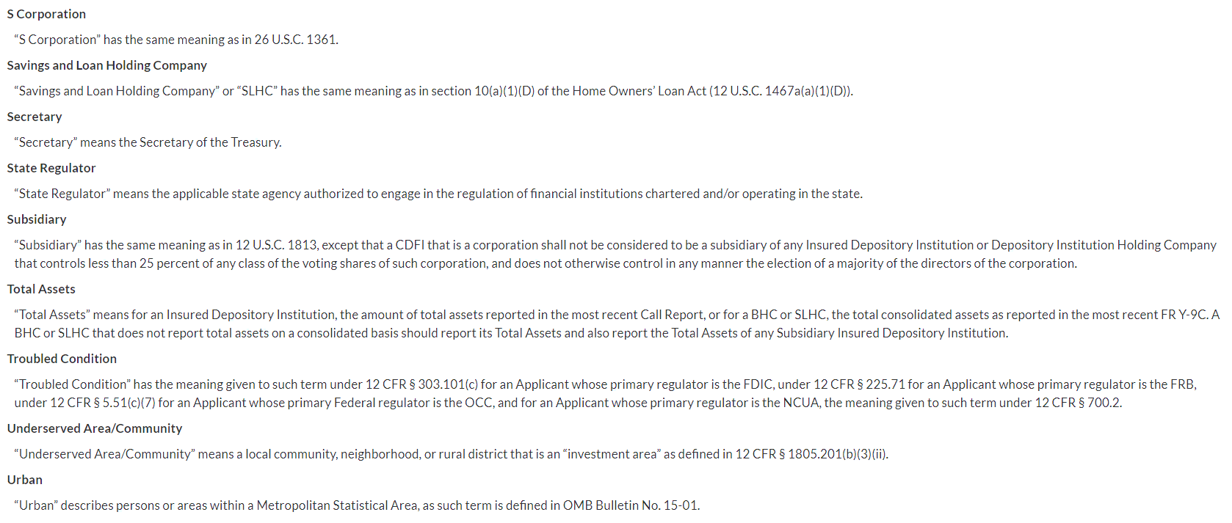
Step 2: Review Form Instructions
Definitions (on landing page) - continued

Slide 13
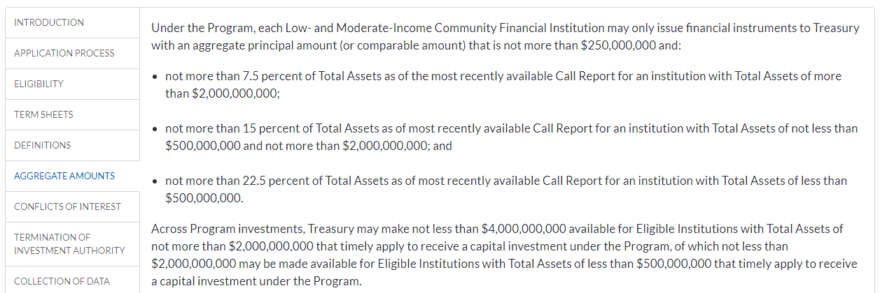
Step 2: Review Form Instructions
Aggregate Amounts

Slide 14
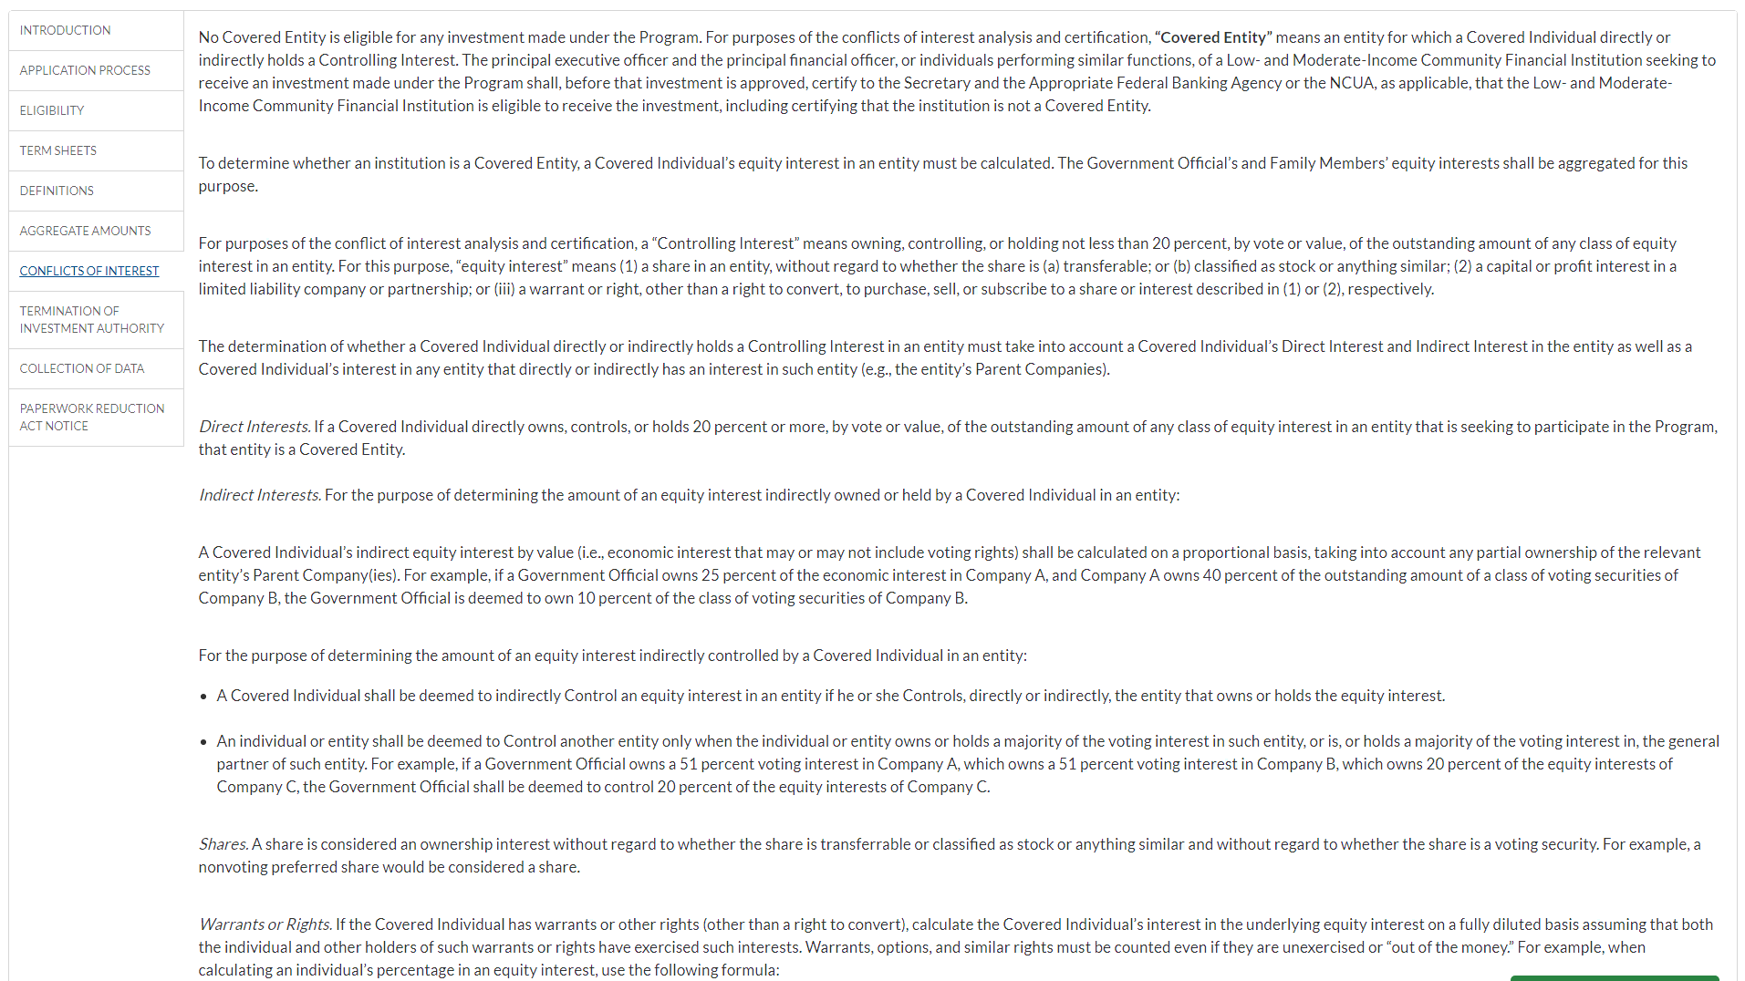
Step 2: Review Form Instructions
Conflicts of Interest

Slide 15
Step 2: Review Form Instructions
Conflicts of Interest - continued

Slide 16
Step 2: Review Form Instructions
Termination of Investment Authority

Slide 17
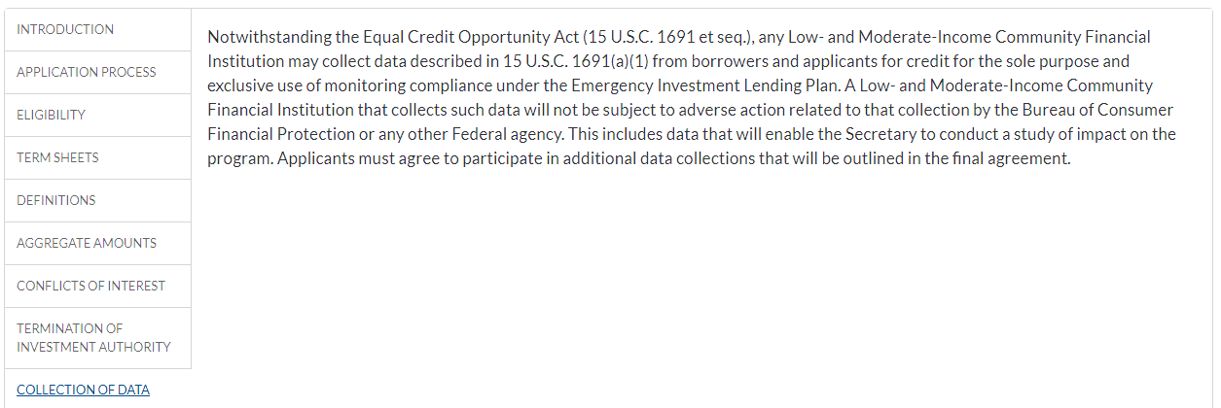
Step 2: Review Form Instructions
Collection of Data

Slide 18
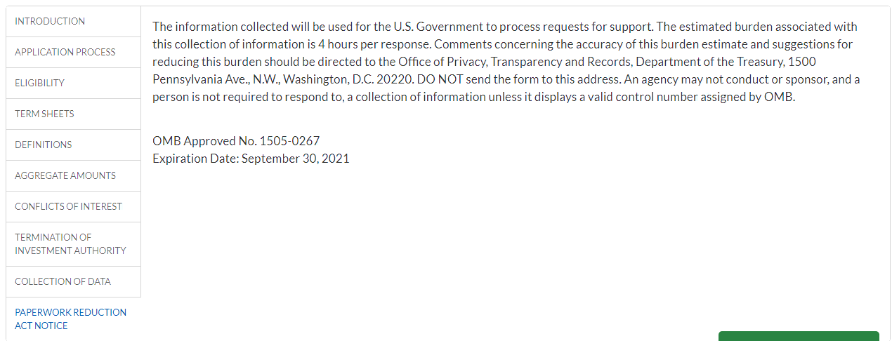
Step 2: Review Form Instructions
Paperwork Reduction Act Notice

Slide 19
Step 3: Create the Form
Click the button at the top of the ECIP Landing page to begin the application

Slide 20
Step 3: Create the Form
Record is created that can be navigate back to.

Slide 21
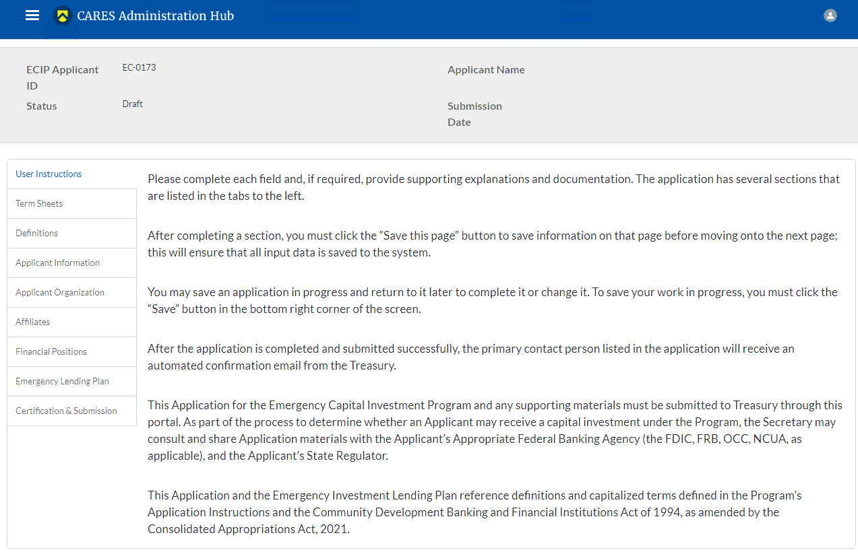
Step 4: Review Form Instructions
User Instructions

Slide 22
Step 4: Review Form Instructions
Term Sheets (within the form)

Slide 23
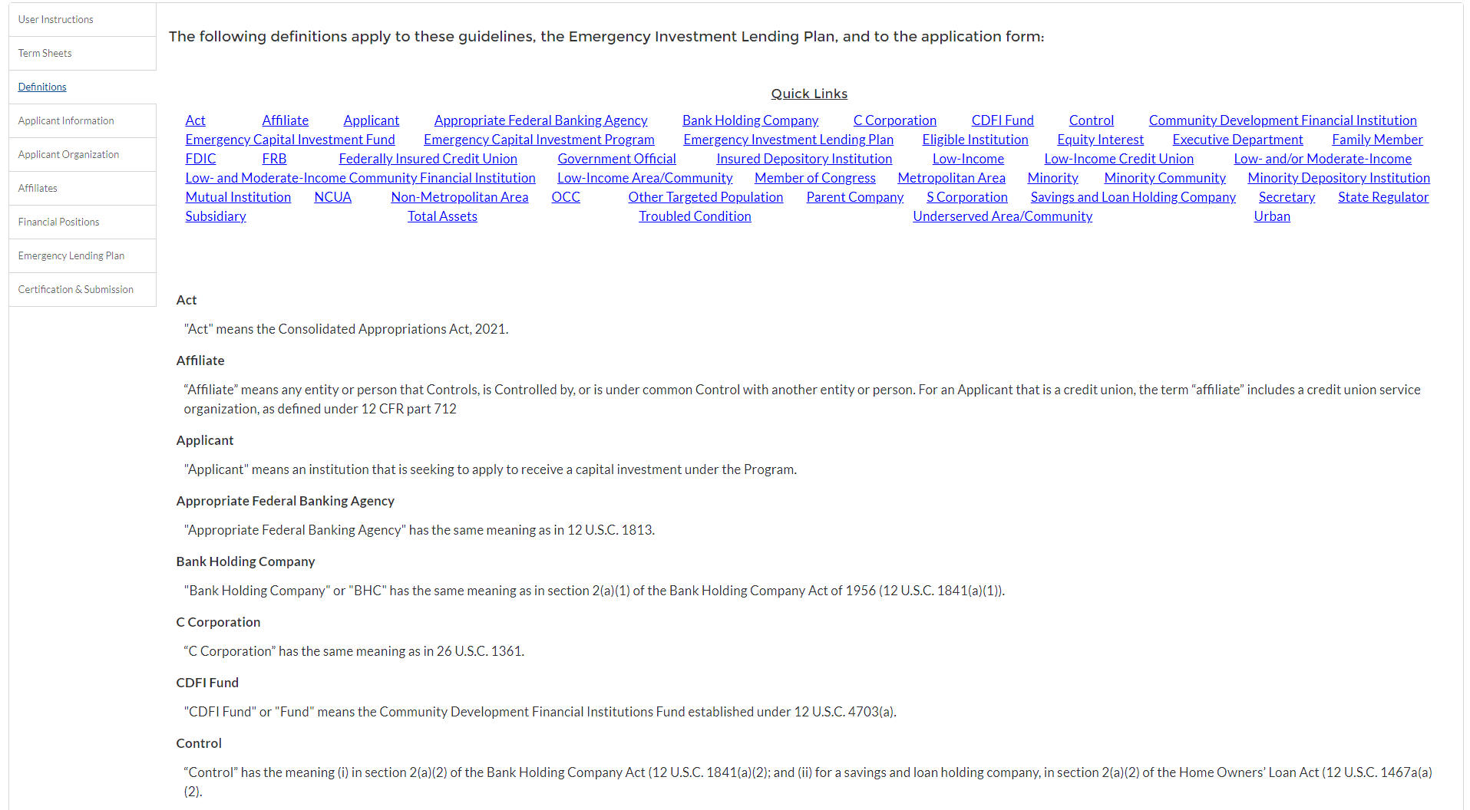
Step 4: Review Form Instructions
Definitions (within the form)

Slide 24
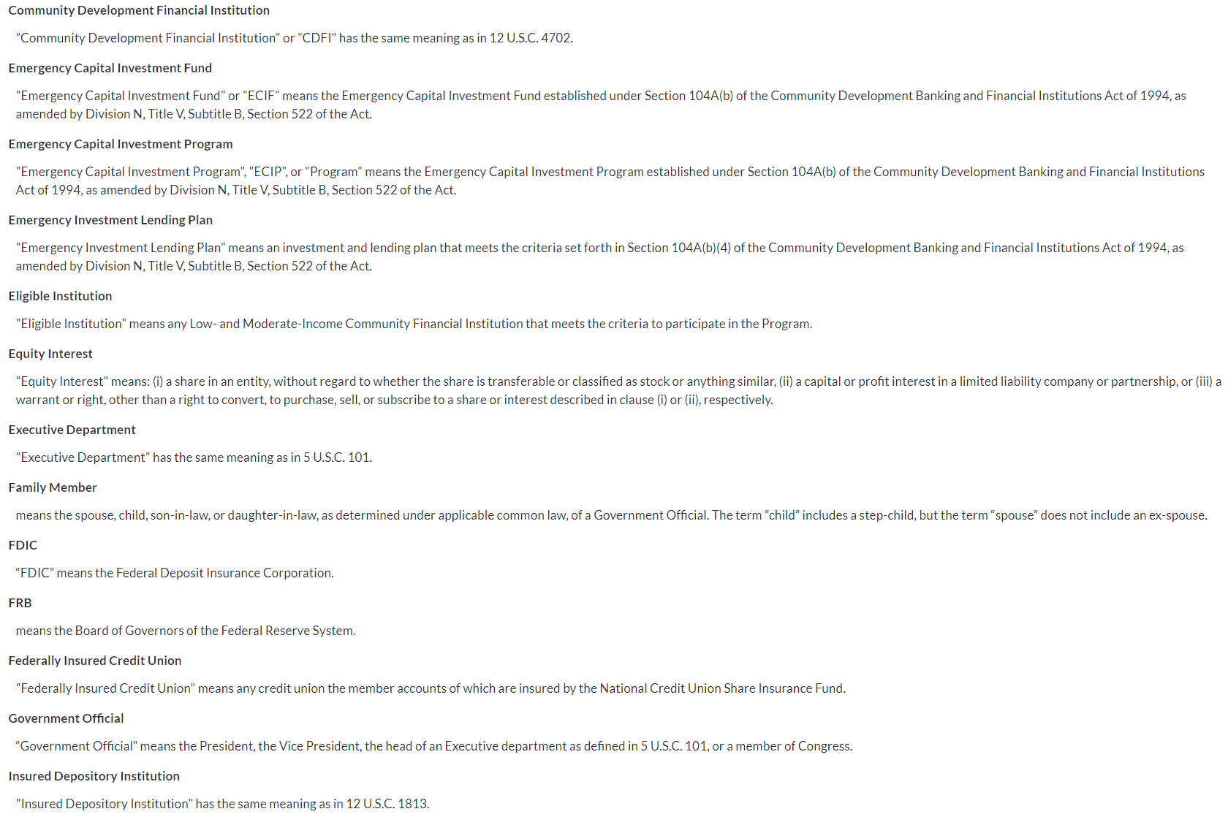
Step 4: Review Form Instructions
Definitions (within the form) - continued

Slide 25
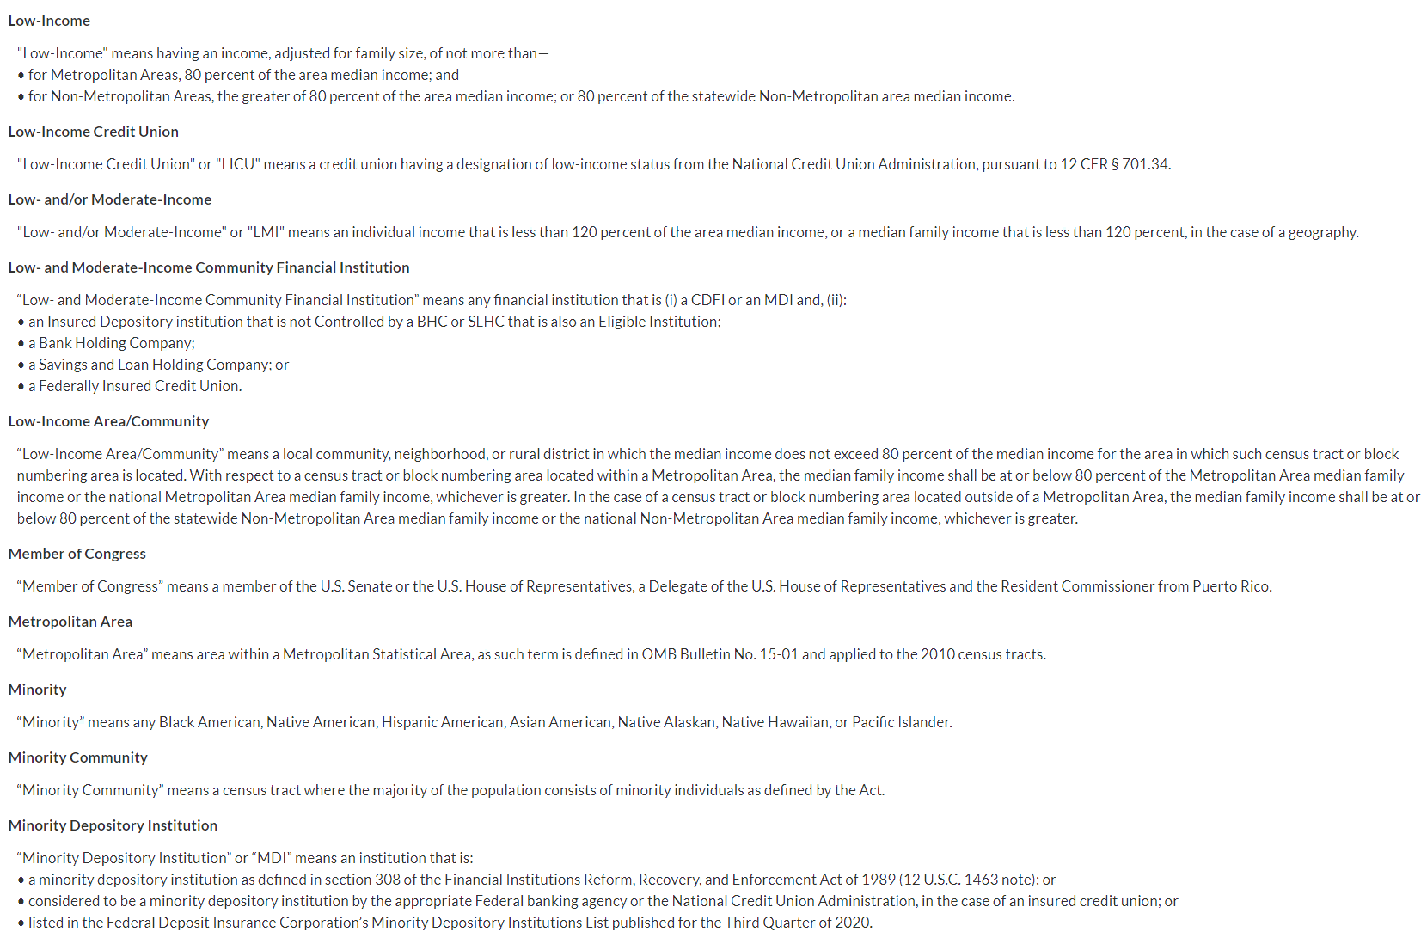
Step 4: Review Form Instructions
Definitions (within the form) - continued

Slide 26
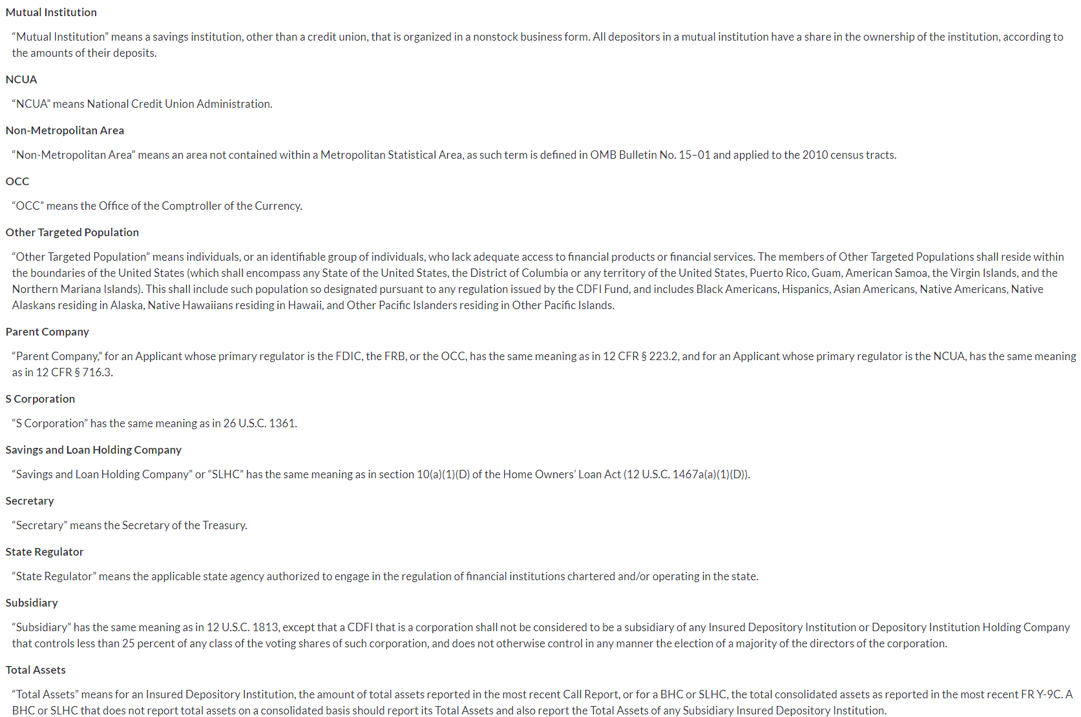
Step 4: Review Form Instructions
Definitions (within the form) - continued

Slide 27
Step 4: Review Form Instructions
Definitions (within the form) - continued

Slide 28
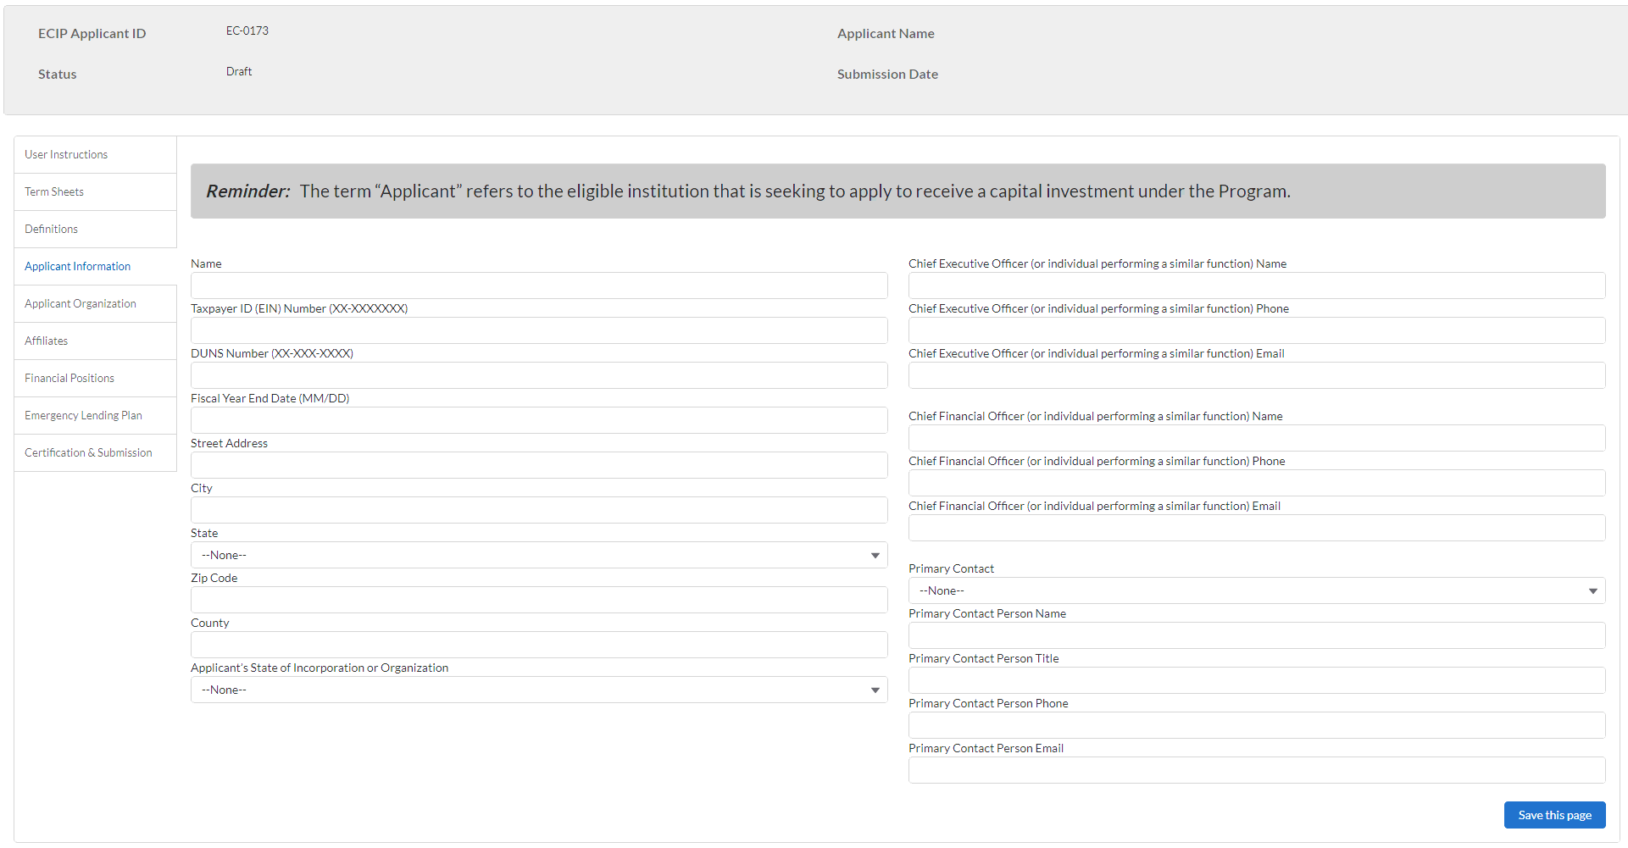
Step 5: Populate the Form
Applicant Information

Slide 29
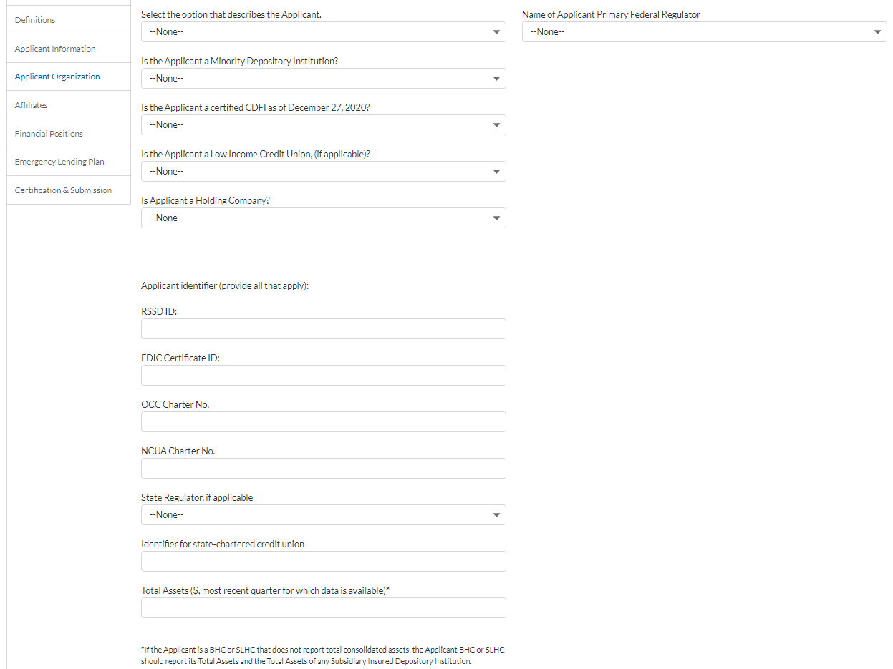
Step 5: Populate the Form
Applicant Organization

Slide 30
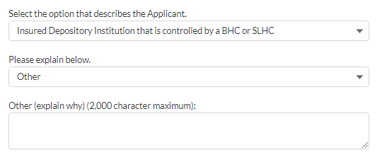
Step 5: Populate the Form
Applicant Organization – conditional If “Select the option that describes the Applicant” is “Insured Depository Institution that is controlled by a BHC or SLHC AND “Please explain below” is “Other” THEN “Other (explain why) (2,000 character maximum)” will be visible

Slide 31
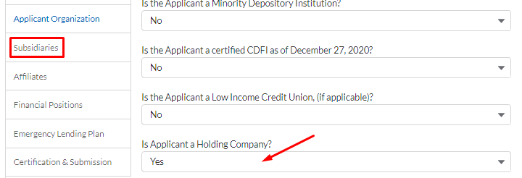
Step 5: Populate the Form
Applicant Organization – conditional If “Is Applicant a Holding Company?” is “Yes”, upon saving the form page, a Subsidiaries tab will appear.

Slide 32
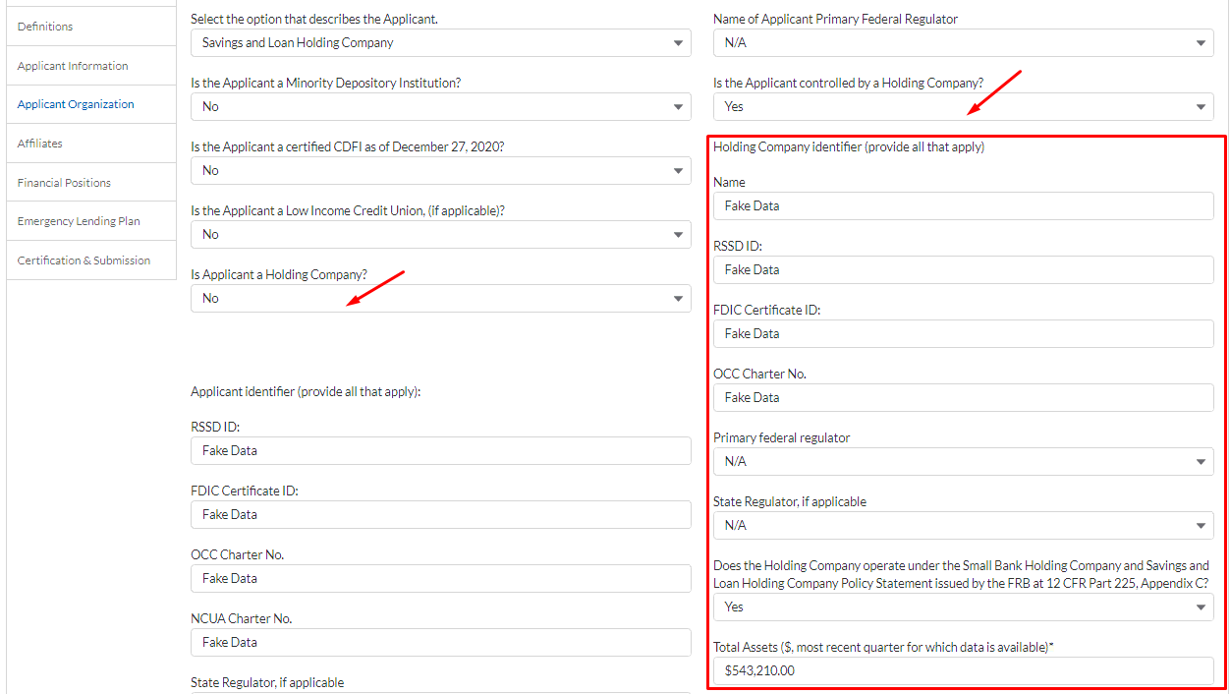
Step 5: Populate the Form
Applicant Organization – conditional If “Is Applicant a Holding Company?” is “No” then “Is the Applicant controlled by a holding Company” will appear. If “Is Applicant a Holding Company?” is “No” and “Is the Applicant controlled by a holding Company” is “Yes” then the Holding Company section will appear.

Slide 33
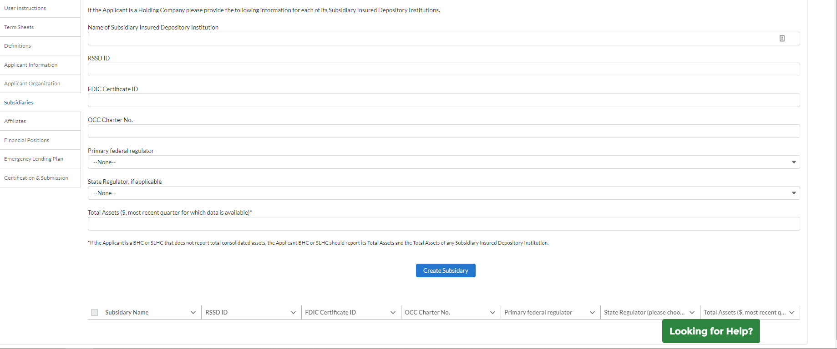
Step 5: Populate the Form
Subsidiaries (If “Is Applicant a Holding Company?” is “Yes”, upon saving the form page, a Subsidiaries tab will appear.)

Slide 34
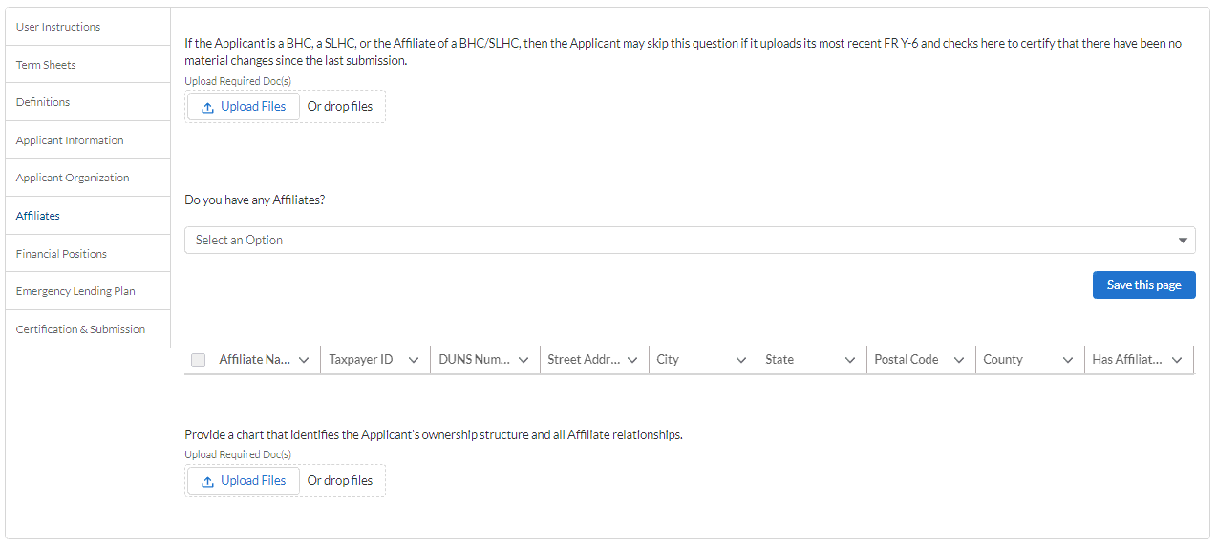
Step 5: Populate the Form
Affiliates

Slide 35
Step 5: Populate the Form
Affiliates – conditional If a document is uploaded to the “If the Applicant is a BHC, a SLHC, or the Affiliate of a BHC/SLHC, then the Applicant may skip this question if it uploads its most recent FR Y-6 and checks here to certify that there have been no material changes since the last submission.”, then “Has The Applicant had any material changes since the last submission” field will appear

Slide 36
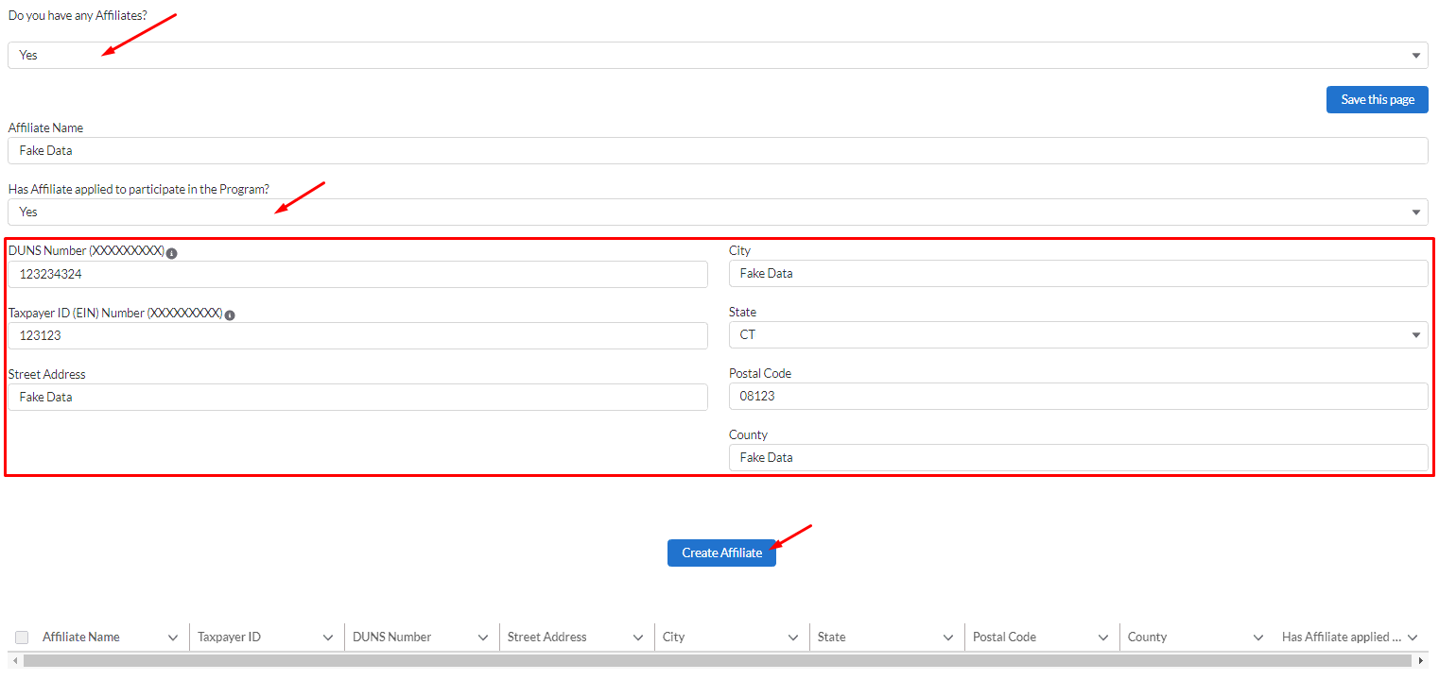
Step 5: Populate the Form
Affiliates – conditional If “Do you have any affiliates?” is “Yes” then “Affiliate Name” and “Has Affiliate applied to participate in the program?” appear. If “Has Affiliate applied to participate in the program?” is “Yes” then everything in the box appears.

Slide 37
Step 5: Populate the Form
Affiliates – conditional Upon clicking the create affiliate button, the table will populate. Additional affiliates can be created as necessary.

Slide 38
Step 5: Populate the Form
Financial Positions

Slide 39
Step 5: Populate the Form
Financial Positions – conditional If “Is the Applicant able to issue preferred stock to Treasury in connection with its participation in the Program?” is “Yes” AND “Is the Applicant (or its Parent Company) a publicly traded company?” is “No” then no additional fields appear.

Slide 40
Step 5: Populate the Form
Financial Positions – conditional If “Is the Applicant able to issue preferred stock to Treasury in connection with its participation in the Program?” is “Yes” AND “Is the Applicant (or its Parent Company) a publicly traded company?” is “Yes” THEN “If yes, provide ticker symbol of listed common shares.” field appears

Slide 41
Step 5: Populate the Form
Financial Positions – conditional If “Is the Applicant able to issue preferred stock to Treasury in connection with its participation in the Program?” is “No” AND “If No, provide the reason” is “No” THEN “If other reason, provide explanation.” appears.

Slide 42
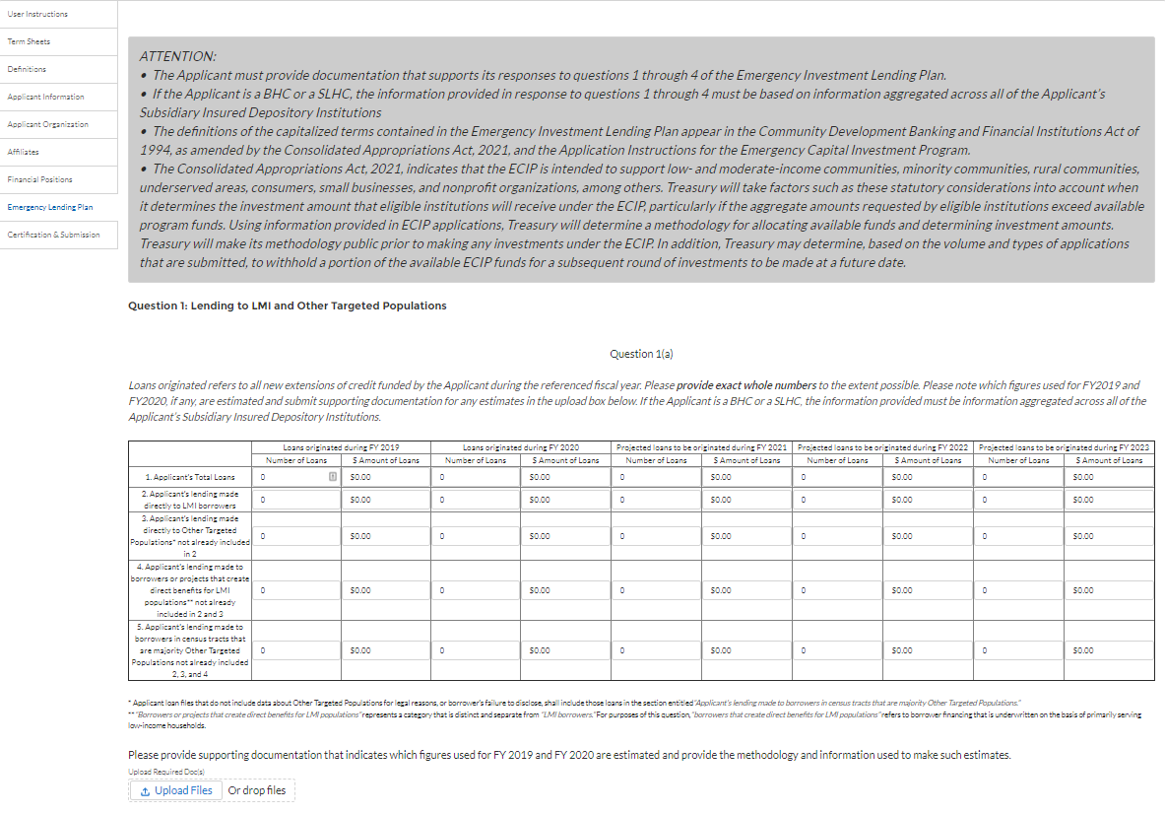
Step 5: Populate the Form
Emergency Lending Plan

Slide 43
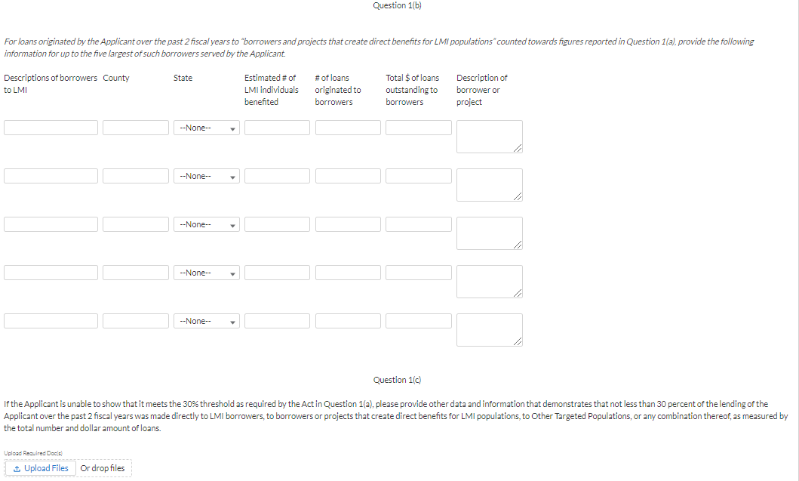
Step 5: Populate the Form
Emergency Lending Plan - continued

Slide 44
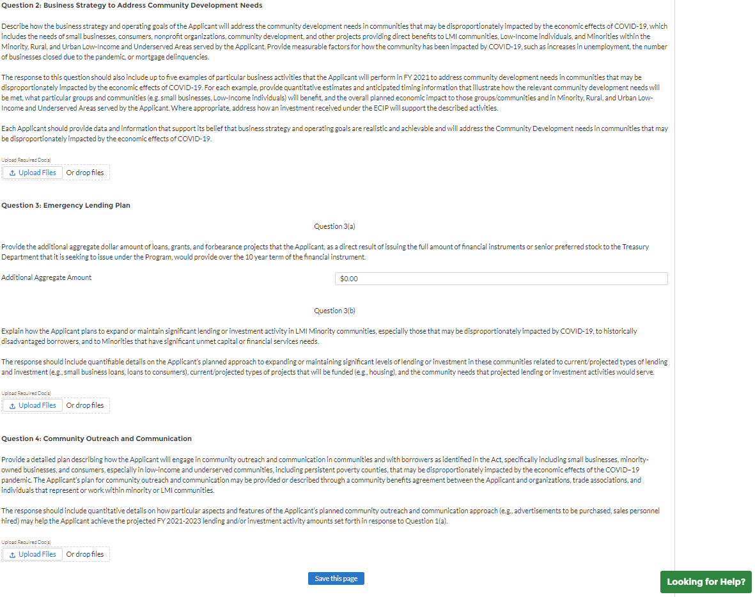
Step 5: Populate the Form
Emergency Lending Plan - continued

Slide 45
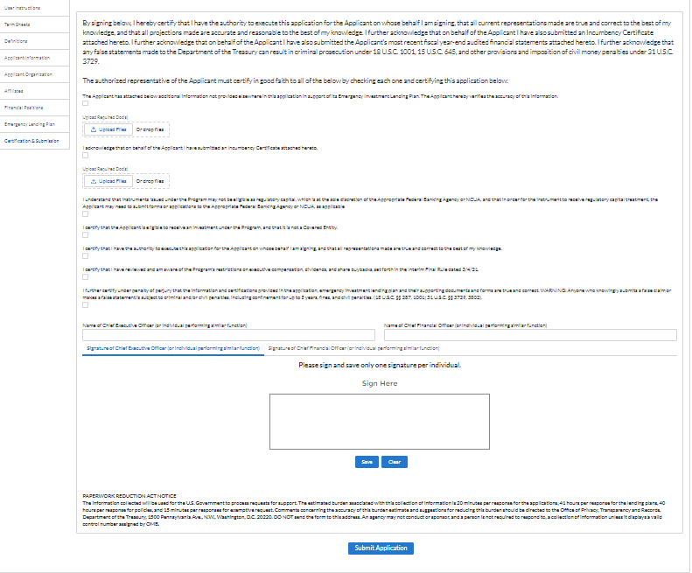
Step 6: Certify the Application
Certification - CEO Signature

Slide 46
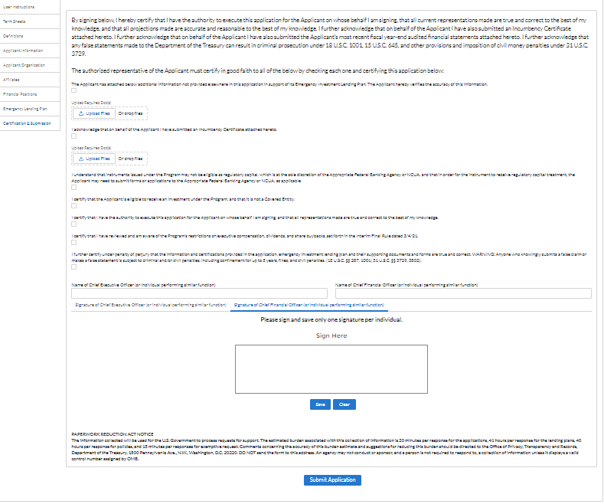
Step 6: Certify the Application
Certification - CFO Signature

Slide 47
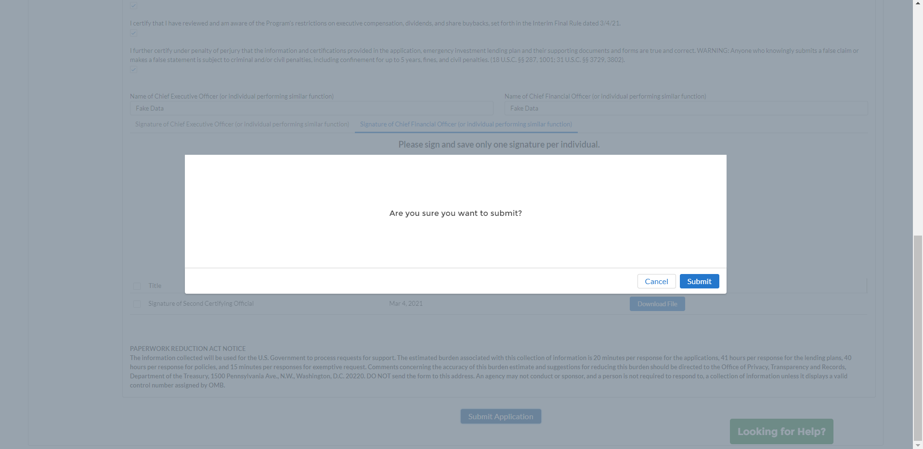
Step 7: Submission Confirmed
Submission Confirmed by System

Slide 48
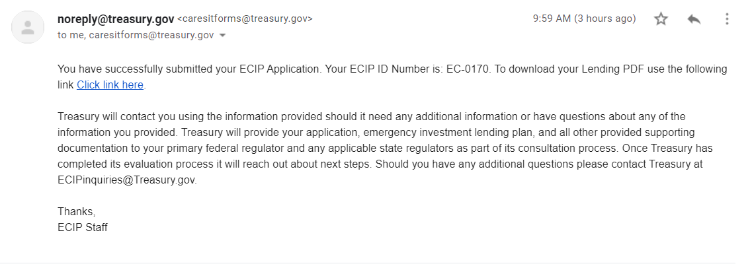
Step 7: Submission Confirmed
Submission Confirmed by Email

Slide 49
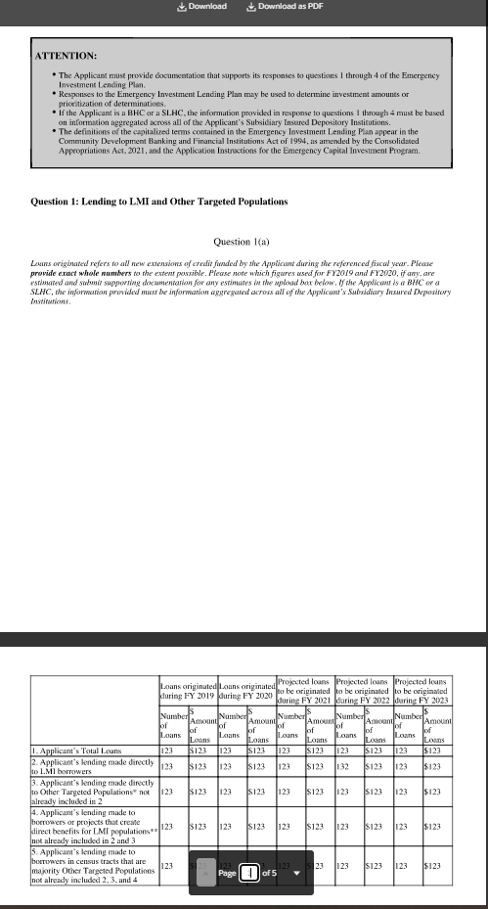
Step 7: Submission Confirmed
Submission Confirmed by Email – PDF – data conditional to what you input in Emergency Lending Plan tab

Slide 50
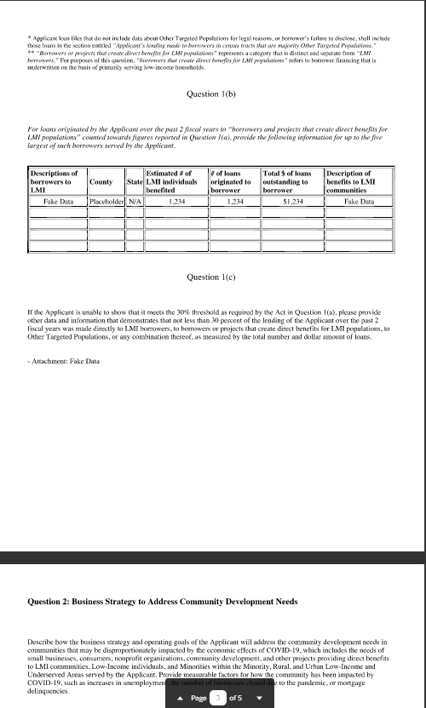
Step 7: Submission Confirmed
Submission Confirmed by Email – PDF – continued

Slide 51
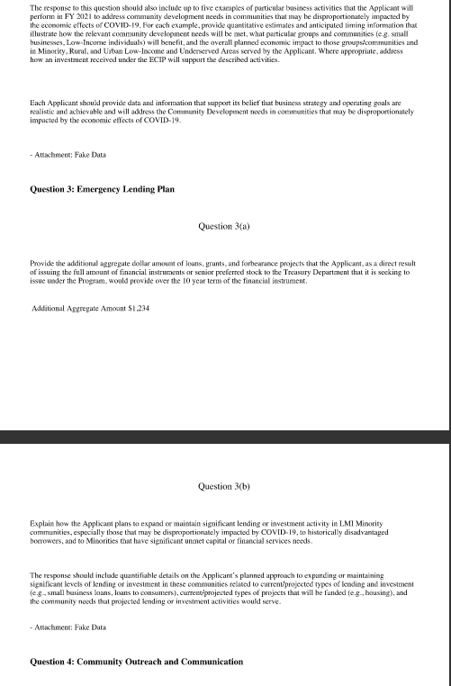
Step 7: Submission Confirmed
Submission Confirmed by Email – PDF – continued

Slide 52
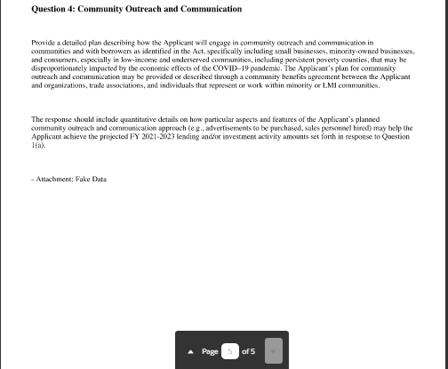
Step 7: Submission Confirmed
Submission Confirmed by Email – PDF – continued

