Slide 1
The FEMA Operations Center Presents:
ENS!
Point of Contact (POC) training course

Slide 2
PRIVACY ACT STATEMENT
Authority: The Homeland Security Act of 2002, Pub. L. No. 109-295, §§ 501-521; the Robert T. Stafford Disaster Relief and Emergency Assistance Act as amended, 42 U.S.C. §§ 5121-5207; National Security Presidential Directive (NSPD)-51/Homeland Security Presidential Directive (HSPD)-20; Federal Continuity Directive (FCD)-1; and FEMA Directive 262-3 authorize the collection of this information.
Purpose: FEMA is collecting this information to ensure that the Emergency Notification System (ENS) has the most current personal contact information for emergency responders in the event of a man-made disaster, a natural disaster, or planned exercise.
Routine Uses: FEMA will use this information to send notifications, alerts, and/or activations and to relay critical updates and guidance to DHS personnel, other federal departments, and other agencies or non-governmental organizations in response to an emergency scenario or exercise.
Disclosure: Furnishing this information is voluntary; however, failure to provide accurate information may delay or prevent the individual from receiving notifications in the event of an emergency.

Slide 3
For POCs within ENS, we must provide you with the following, and in turn, you must provide to all of your users:
VERBAL PRIVACY NOTICE (EN SYSTEM)
“The information that you give the Department of Homeland Security, Federal Emergency Management Agency, is collected under the Homeland Security Act of 2002, the Robert T. Stafford Disaster Relief and Emergency Assistance Act, and other authorities. It will be used to send notifications, alerts, and/or activations and to relay critical updates and guidance to DHS personnel, other federal departments, and other agencies or non-governmental organizations in response to an emergency scenario or exercise. DHS/FEMA may share this information outside the agency upon written request, by agreement, or as required by law. Furnishing the requested information is voluntary, but failure to provide accurate information may delay or prevent the individual from receiving notifications in the event of an emergency.”

Slide 4
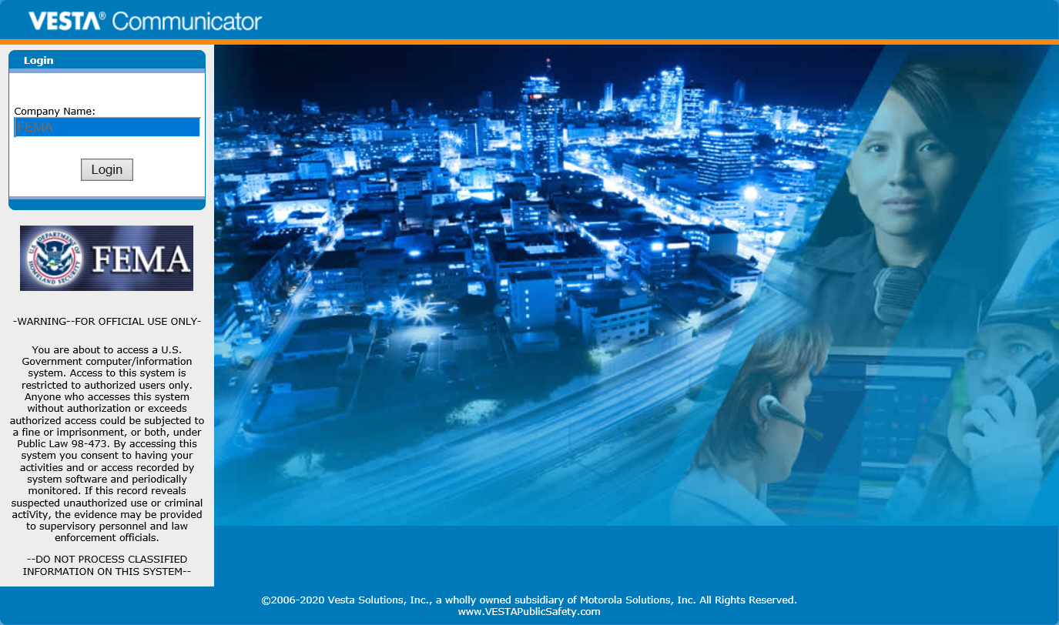
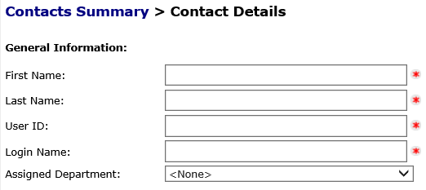
Intro to the Training
The format of this training will contain various animations, photos, and self assessment questions, such as the following. It’s important to view this training in the slideshow view.
True or False: A Roster User is able to edit their own information in ENS.
Questions will appear in green. You can answer these by clicking the available responses.
True
False
Notes:
It is true that once a Roster User has their login credentials they can edit their information in ENS. The exception to this is their login name and user ID. Those will have to be changed by an administrator.

Slide 5
Topics and Expectations
These are the topics that will be covered:
ENS capabilities
The POC Role and Responsibilities
The Contacts tab
The Groups tab
Additional information and resources
When this course is finished you should have good working knowledge of ENS and the role of a point of contact in the system.
Please click to continue to the next slide, or click a link above to skip to a specific section.

Slide 6
ENS Capabilities
ENS has the capability of notifying people, and allowing them to qualify, via:
Voice: Work, home, cell
Email
SMS
Automated Reports can be sent to contacts at intervals or at the completion of a scenario.
ENS has three sites, each of which functions the same. Your involvement with those will be focused entirely on the primary, ENS1, but you should be aware of ENS2 and ENS3.
On Wednesday and Thursday we run a testing period on ENS2 and ENS3 (8am to 3pm Eastern).
NOTE: Changes to data should not be made on ENS2 and ENS3 as they will be overwritten after the testing period is complete.

Slide 7
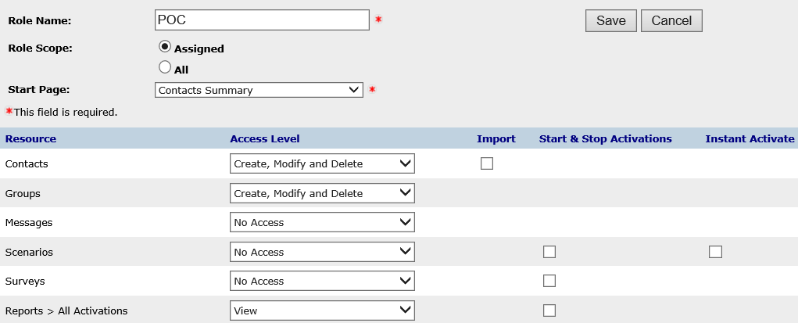
POC Role and Responsibilities
The role you will have in ENS is POC. A POC is able to work in the following tabs:
Contacts
Groups
These are where you will be working primarily as a POC, and what we will be covering in this material.

Slide 8
POC Responsibilities
The primary responsibility of a POC is to manage their contacts and groups. To do this you must interact with your contacts at least quarterly and ensure that group membership is up to date.
This involves:
Adding new contacts that need to be notified by ENS.
Removing contacts when they depart FEMA. If they change sections within FEMA, contact the ENS-Admin team for assistance.
Maintaining updated contact rosters and group membership.
Assist contacts with any data changes they may need.
Keep data up to date and cleaned. Ensure your contact and group membership is accurate and up to date to help improve notification effectiveness.
Other areas of ENS are open for you view, such as the messages and scenario tab, but you should not create or edit anything in these sections.

Slide 9
Question
On what days of the week should you not log into ENS 1 between 8:00 AM and 3:00 PM Eastern time?
Monday & Tuesday
Tuesday & Wednesday
Wednesday & Thursday
Thursday & Friday
Notes:
That is correct. On Wednesday and Thursday between 8:00 am and 3:00 pm Eastern time we have testing periods on ENS 2 and ENS 3. During that time ENS 1 may be down for maintenance so it’s important to remain off of ENS 1 during that time. Also remember that changes should not be made to contacts or groups on ENS 2 or ENS 3 as they will be over written after the testing period.

Slide 10
Login Page
This is the login page for ENS. It is the same for all three servers, so before logging in it is important to note the URL.
Logging into either ENS2 or 3 during unauthorized times will break Datasync.
Remember that all data changes should only be made on ENS1.

Slide 11
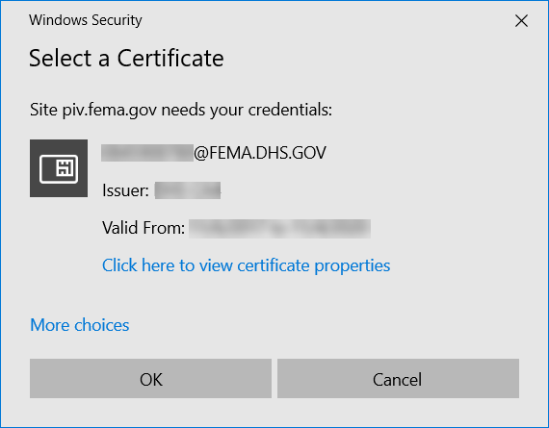
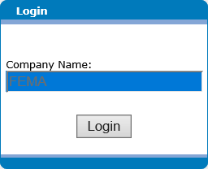
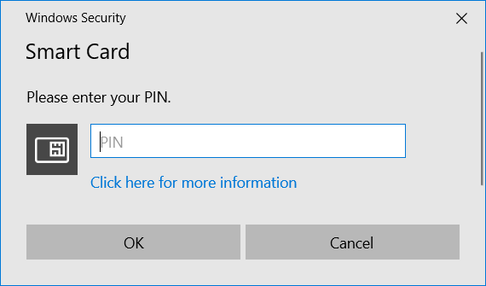
To login with PIV credentials you will need to do the following:
Insert your PIV badge and give it a few seconds
Click on the login button and follow the pop-up prompts (selecting your certificate and entering your PIN)
If you have issues logging in with your PIV badge please contact the ENS-Admin Team.

Slide 12
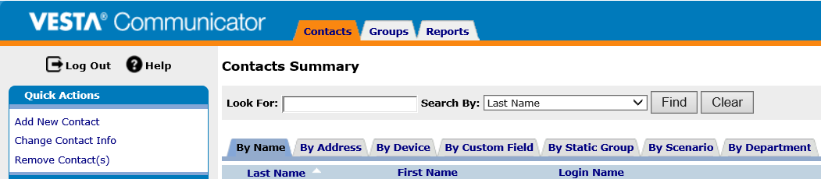

Contacts Tab
The contacts tab is where you can find all the contacts that you will be managing in ENS. This is also where you can go to add or remove contacts from the system.
At the top of each tab you’ll find a search, or “Look For”, area which will allow you to find specific entries in the system.
Each sub-tab gives different options on how to search for a contact. These are the available options for the “By Name” Sub-tab.

Slide 13
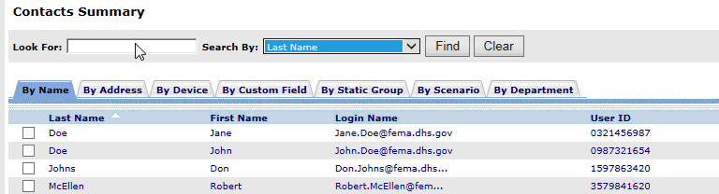
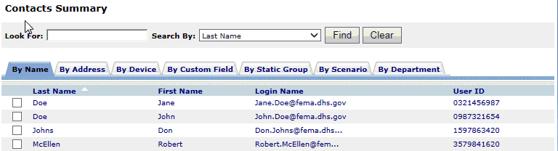
Other search methods are available in ENS, such as:
Each category has their own unique set of search criteria.
You can also search using wild cards. By adding a % at the beginning and end of your search value ENS will provide a list of contacts similar to what you’ve searched for. These wild cards can be used throughout the search functions in ENS.

Slide 14
Question
When performing a search in ENS, what is used for a wild card value?
*
@
&
%
Notes:
That is correct. Use the % at the beginning and end of your search and the system will search for anything similar to the value. For instance if you’re searching for contacts with phone numbers in the 540 area code, you can search with %(540% . This feature can be used in all search areas.

Slide 15
Who needs to be added?
An important part of being a POC is adding new contacts into the system. The first question though is do they have a need to be notified by the system?
ENS is established to notify emergency groups such as:
COOP
ERG
IMAT
ETC...
It is up to the POC’s discretion on whether a contact needs to be in the system or not.

Slide 16
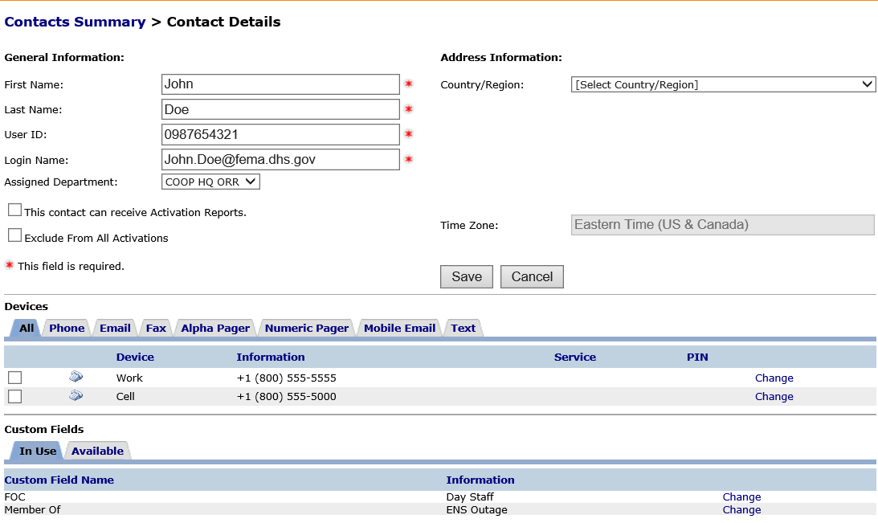
Contact information
This is the basic layout for contact information. The top section is the users general information.
The middle section is where the contact devices are maintained. These are the devices ENS can use to notify a contact.
The bottom section will be discussed in the groups section.

Slide 17
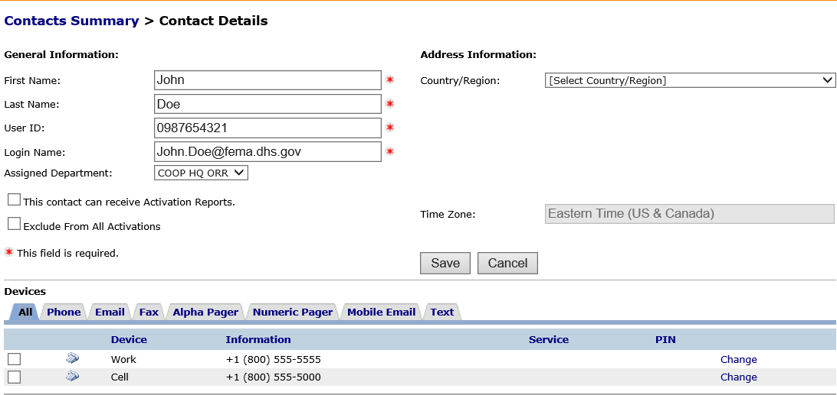
Contacts have a set of basic information that must be in ENS.
First Name
Last Name
User ID
Login Name
User IDs are typically a contact’s phone number (Home, Cell, or Work in that order)
The Login Name should be the same as the individual’s FEMA Email address. If they don’t have a FEMA Email address their ENS login name should be a user’s work email address.
Devices are entered into the system below the contact’s general information. These are used by ENS during a scenario. Typical devices include:
Phones (Work, Cell, Home)
Email
SMS\Text

Slide 18
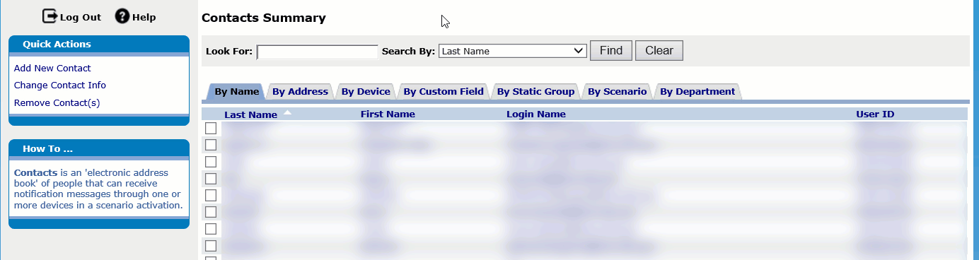
Adding a new contact
Watch the animation below for how to add a new contact into ENS.
Note the 4 items that are entered into the system (First Name, Last name, User ID, and Login name). These are required fields for adding a new contact.
The Assigned Department is where the individual will be placed in ENS, and who will manage their contact.
The “This contact can receive Activation Reports” check box will allow the contact to be on a list of those that can receive automatic scenario reports.
Address information is optional information you can add for the contact, but we do not require it.

Slide 19
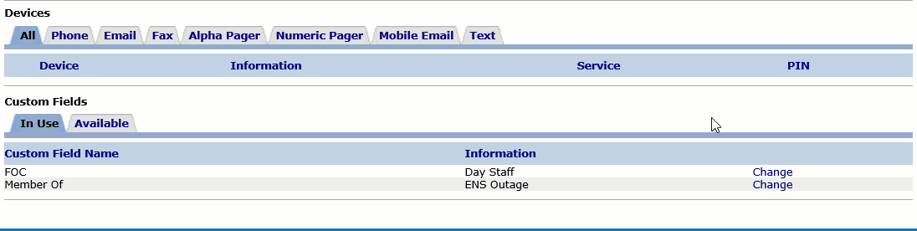
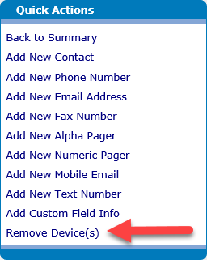
From the Devices section of the Contact Information page you will see tabs for each of the devices ENS can contact. By clicking on the tab it will bring up a section to add new device information. See the animation below.
You can also change information on devices if needed. There is also a Move up and Move down button to prioritize similar device types (specifying one email, text, or phone device over another).
To remove a device click the check box next to the device and click on the Remove device link on the quick actions menu. It will appear with an “Are you sure?” pop-up, where you can click yes to remove the device.

Slide 20
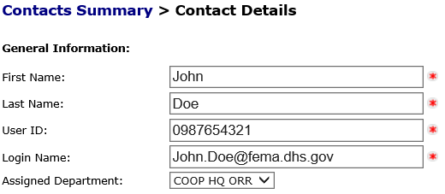
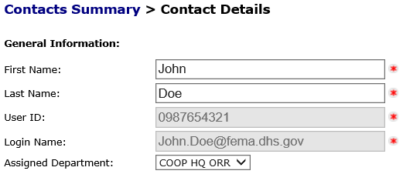
Once a contact has been added in to the system, with an email in their devices, it may take up to 24 hours for them to become a Roster User. These are contacts that are able to change their own contact information in ENS.
When the system automatically makes a contact into a roster user the system will email them. The system will automatically create a password for them, and use the login name you gave them, but those will not be necessary for a PIV Login.
Once they become a Roster User you will no longer be able to change their User ID or Login Name. These will need to be changed by an Administrator.
Before becoming a roster user
After becoming a roster user

Slide 21
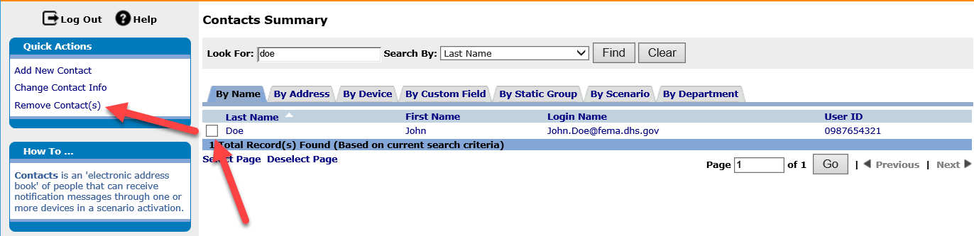
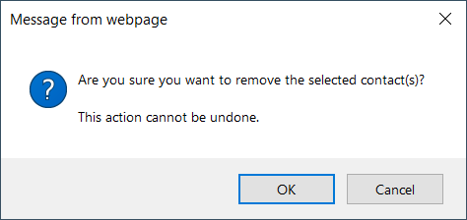
Removing a contact
Removing contacts is another important part of being a POC. Old data, such as bad phone numbers or contacts that don’t need to be notified can cause errors and miscommunication.
This will provide a pop-up window, asking if you’re sure.
Once a contact is removed from the system they can no longer be contacted by ENS. If a contact only leaves your section to another area in FEMA, do not remove them from the system. Contact an ENS Administrator to have their information moved to another POC.

Slide 22
Question
Which of the following is not a required field when adding a new contact into ENS?
Email Address
Work Phone number
Last name
User ID
Notes:
That is correct. A Work phone number is not needed to enter in a new contact in ENS. It is however useful to have this as the contact will need to be reached for notification.

Slide 23
Groups tab
Groups are utilized by ENS to include different contacts in a scenario. The only way a person can be contacted by ENS is by being a member of a group.
There are 2 basic types of groups we will be discussing: Static and Dynamic. Below is some basic information on each type.
Static groups:
Typically used for on the fly activations
Allows for calling in order of importance, it can call a supervisor before the rest of the contacts
Very intuitive and easy to add users
Dynamic groups:
Great for grouping users with a common value, such as location, shift, or function
Able to add users quickly during an import of new contacts
Removal of contacts from the group requires a change to their contact information

Slide 24
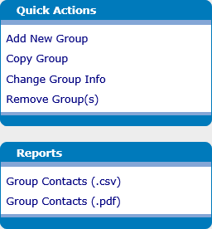
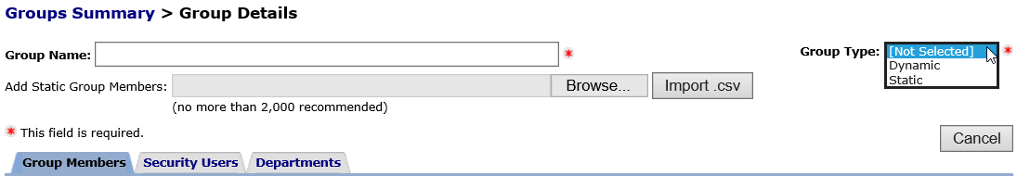
The quick actions on the left hand side of the groups tab, is where you can select the different options available to you when working with groups.
Below that is the reports you can generate from a selected group. They can be generated as either a pdf file or a csv file.
When you click on the Add new group option from the quick actions you will be brought to the following screen, where you add a name to the group and select the type. When naming your groups in ENS, be sure to identify who the group belongs to and who it contains. There are many groups in ENS, and we don’t want to mistakenly send a notification out to the wrong contacts.
We will start by working with a Static group, showing you how to create one, add and remove contacts, and some information on moving group members.

Slide 25
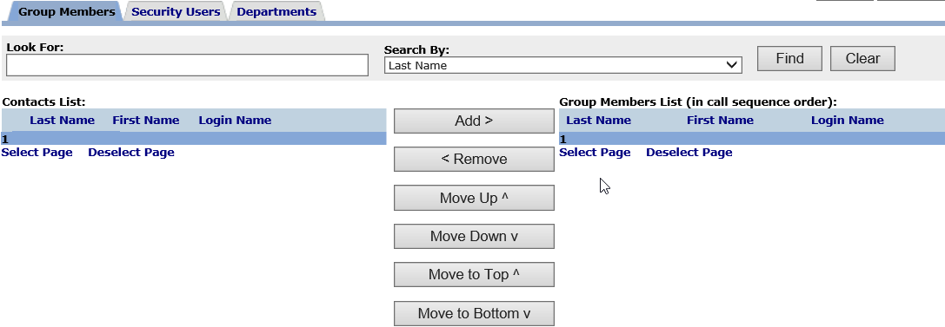
Static Groups
Static groups are the more basic of groups available in ENS. They allow for quick adding and removing of contacts.
Once we have selected a static group type from the previous menu it will become populated with more information, such as the list of available contacts that can be added to the group, a search function, and a list of the group members. Below is a view of what a static group looks like.

Slide 26
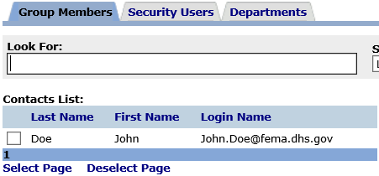

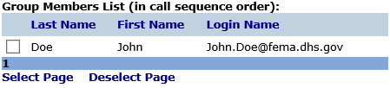
The left section of the static group is the contacts list. This is where you search through the list of available contacts and select which ones you would like to add. From the Look For box there is a variety of methods you can search for a contact, but most of the time we search by last name.
Once a contact is found, click the check box next to their name, and then click the add button to have them moved to the group members list on the right hand side.
Now that this user is on the group members list they are a member of that group, and can be contacted if this group is added to a scenario. It’s as simple as that!
To remove a user you have to select one from the group members list and click remove. Once they are removed from the group members list, they will not be a part of that group.

Slide 27
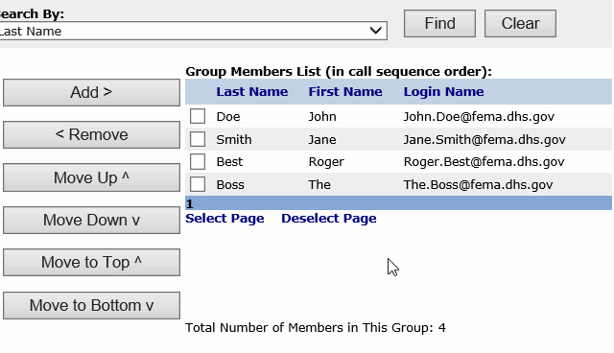
Another feature to static groups is the ability to move users around in the call order. As you can see to the right you can move a contact up, down, and to the top and bottom of the list.
With static groups we are able to set the call order so that the people that need to know first can be contacted first.
Lastly when developing a group, be it static or dynamic, it is important to provide it with a name. We recommend that group names should be identifiable as there are so many to work with in the system. Group names should consist of a location, section within FEMA, function within FEMA, and/or other identifiable information. This will help keep each group unique and identifiable.
That is how you would create, add and remove users, and order them in a calling sequence.

Slide 28
Question
True or False
A Static group is best used as a permanent group with a large group membership.
True
False
Notes:
That is correct. A Static group is best used as an on the fly group with only a few members. Large Static groups can become very hard to manage as there is no way to search for specific group members, and there is also no automatic organization to the group.

Slide 29
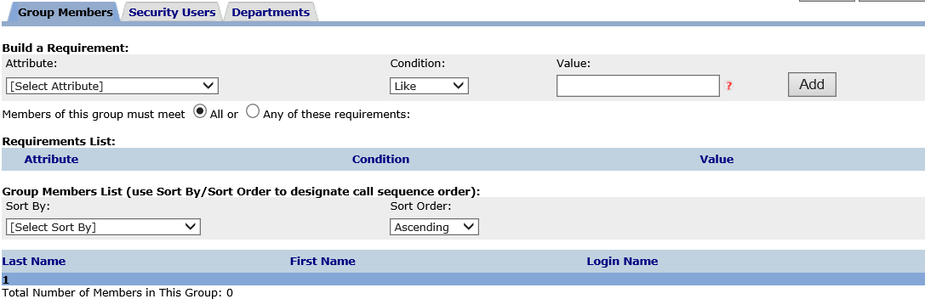
Dynamic Groups
Dynamic groups are the other available group type, and widely used within ENS. The function of a dynamic group is to group contacts based on a common value. This is done through the use of custom fields, or a contact’s information, which you may have seen while working with the contact tab.
Once you select the group type for dynamic, when creating a new group, you will see this populate the screen:

Slide 30
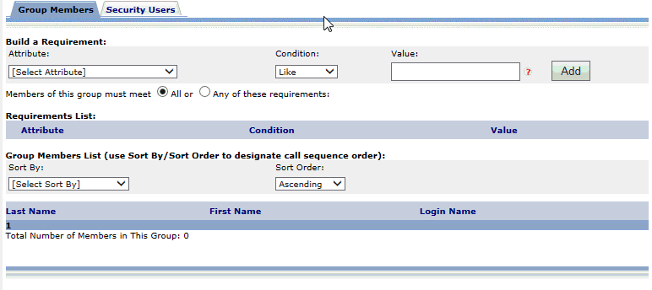
This is how you build requirements for Dynamic groups:
When working with a dynamic group you must select an attribute:
As well as a condition that must be met.
And a value which is common with the contacts you are trying to add.
Then by clicking Add the following will appear under Requirement list:
Any contacts with this value in that specific attribute will be added to the group and appear as:
Notes:
Animate this process with a Gif.

Slide 31

As part of the dynamic group and generating requirements you have a few options to work with, such as the condition for the requirement, and the “All or Any of these requirements” options.
Just below the “Build a requirement” section there is the option you see above. This allows you to apply multiple requirements for a single dynamic group, and make it so that the contacts must meet all, or any, of the requirements you create for the group. This comes in handy when you’re trying to zero in on a specific set of contacts for the group.
The other option you have to work with is the condition for a requirement.
The like and not like conditions are there to include individuals that have similar information to that of the requirement. For instance, in the last slide we used the value test group in the Member of attribute/custom field. With that we have a like condition, which means that any contact with test group, or more than that, will be included in the group. So a new contact with test group alpha in their Member of attribute/custom field will be in the group. It is important to make sure the value in your requirement is unique and identifiable, as you may draw in unwanted contacts.
“Not like” looks for every contact without the value in the requirement, which can produce a rather large group.

Slide 32

When working with the like and not like conditions you may find the wildcard symbol after the value that was entered. The wildcard, when used in a dynamic group requirement, allows the system to search through all values found in that specific attribute/custom field. For instance, above you can see test group%. With that value set test group must be the first value found in that contacts attribute/custom field, but if we change that to %test group% in the requirement they can have that value anywhere in an attribute/custom field. With the wild card value beginning and ending the value on a requirement you can have multiple values within the member of attribute/custom field. For example:
This contact would be included in the group because they have the value test group somewhere in the member of attribute/custom field.
Equal and not equal are similar to like and not like, except the value in the attribute/custom field must be exactly that and nothing else. So using the example from before of test group, if there is only test, or other information in there, they will not be a part of the group.
Not equal follows the same lines as not like, it will include everyone without the specific value in the requirement.
The other options are basic arithmetic values ( <, <=, >, >= ). These work well if you’re looking for a range of individuals based on area or zip codes.

Slide 33

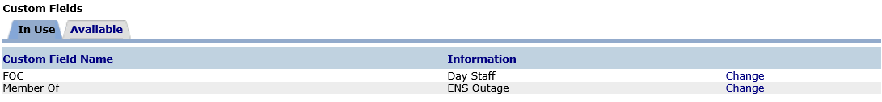
You can also sort the dynamic group which will allow for a different calling order.
The selection for Sort by is that of your available custom fields, and you can sort this list in Ascending or Descending order.
Custom fields are set up to go along with dynamic groups. A user can have information entered into this area that will assign them to a group. A certain value in a specific custom field name will make that user a member of a group, grouping based on a common set of values.
In the example above we could create a dynamic group that looks for users with a value of “ENS Outage” in the Member of attribute, and it will grab every contact with that value in that specific attribute, making them a member of that dynamic group.

Slide 34
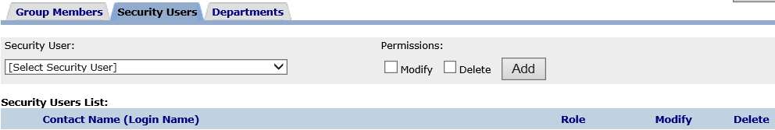
Group Security users
The role of a security user is different from one type of group to the next, but the layout of the security user tab is the same for both:
By selecting a user from the drop down list you can give them either modify or delete rights to this group. Modify rights allow a user to change any of the information on the group, and Delete will allow them to remove the group.
Modify rights in a static group will allow you to add and remove members to the group, where as in Dynamic groups you can only change the requirements for a group, which can change the group members.
Be sure to add any users to the Security Users section that will need to view, modify, or delete the group. This could be any other ENS POCs in your section.

Slide 35
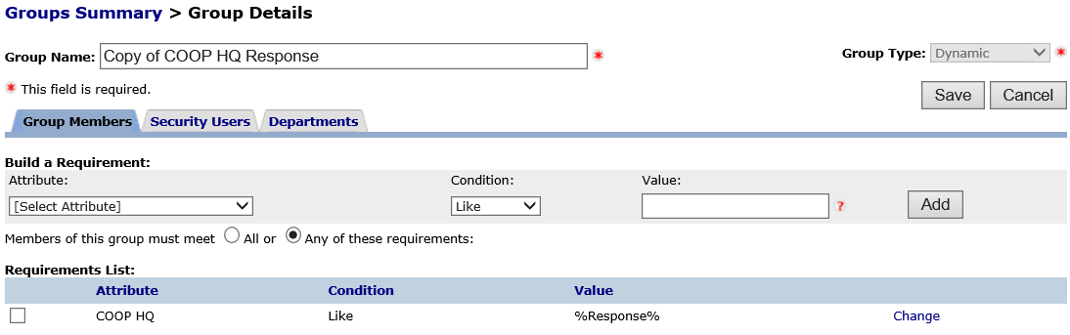
Copying Groups
One of the items you may have noticed from the Quick Actions section is the ability to copy groups.
To copy a group, select a group you already have established in ENS, and click Copy Group.
This will make an exact duplicate of the group you selected, with “Copy of” at the beginning of the name. This means that it will copy over the contacts or requirements (depending on the group type), the security users, as well as the departments. This can be extremely useful when generating a new group.

Slide 36
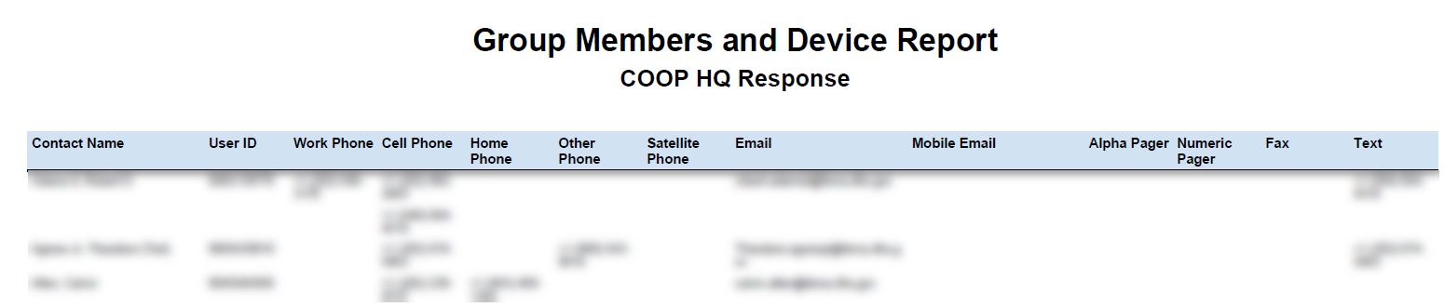
Group Reports
One last tool you have in the groups tab is group reports. From the groups tab, select a group and click the type of report you would like to view.
One last tool you have in the groups tab is group reports. From the groups tab, select a group and click the type of report you would like to view. The report should open in a few moments, but if it doesn’t you will get a pop-up, and you can find it on the reports tab, under completed reports.
Group reports will provide information on who is in the group and any contact devices for that individual. It is very important that you do not disseminate this information to others. There is Personally Identifiable Information on the reports, and we ask that you do not share it with others.

Slide 37
Question
When building a dynamic group based on location, which attribute could you use?
Member of
1 Position
Zip/Postal code
Assigned Department

Slide 38
In Summary
Throughout the slide show we’ve covered a lot of material.
ENS capabilities
  ENS can send out mass notification for emergency situations via email, voice, and text.
The POC role and responsibilities
  A POC manages contacts and groups in ENS, and maintaining roster lists for emergency notification.
  They are the first line of communication between the contacts and the ENS-Admin team.
The Contacts Tab
  Searching for contacts, adding and removing contacts, and editing contact information.
The Groups Tab
  How to add new groups and manage group membership for both static and dynamic groups.
  How to generate group reports to check on group membership.

Slide 39
Additional Resources
You can find additional resources on ENS at our collaboration site:
Please be sure to review the ENS standards and best practices document, as well as the other documentation we’ve provided there.
ENS Collaboration site
Some additional resources are the ENS request for activation form, which can be found via the collaboration site or the link below:
The ENS request for activation form is for the POC to fill out in the event they wish the FEMA Operations Center, Region, or MOC to activate a scenario for their group. Instructions are found in Tool Tips on the form.
ENS Request for Activation

Slide 40
Also as a POC it is important to keep an updated POC listing. Check and update your contact information on the ENS Collaboration site using the link below. If you are not on the list add a new entry or provide your information to the ENS Admin team.
ENS POC Roster
If you have any questions or concerns on ENS please contact the ENS-Admin Team.

Slide 41
Questions?
Contact the ENS Admin team at ENS-Admin@fema.dhs.gov with any questions you may have.

Slide 42
Incorrect
I’m sorry that answer is incorrect. Please return and try again.
Click here to return to the course.

Slide 43
Correct
It is true that once a Roster User has their login credentials they can edit their information in ENS. The exception to this is their login name and user ID. Those will have to be changed by an administrator.
Click here to return to the course.
Notes:
True or False: A Roster User is able to edit their own information in ENS.

Slide 44
Correct
That is correct. On Wednesday and Thursday between 8:00 am and 3:00 pm Eastern time we have testing periods on ENS 2 and ENS 3. During that time ENS 1 may be down for maintenance so it’s important to remain off of ENS 1 during that time. Also remember that changes should not be made to contacts or groups on ENS 2 or ENS 3 as they will be over written after the testing period.
Click here to return to the course.
Notes:
On what days of the week should you not log into ENS 1 between 8:00 AM and 3:00 PM Eastern time?

Slide 45
Correct
That is correct. Use the % at the beginning and end of your search and the system will search for anything similar to the value. For instance if you’re searching for contacts with phone numbers in the 540 area code, you can search with %(540% . This feature can be used in all search areas.
Click here to return to the course.
Notes:
When performing a search in ENS, what is used for a wild card value?

Slide 46
Correct
That is correct. A Work phone number is not needed to enter in a new contact in ENS. It is however useful to have this as the contact will need to be reached for notification.
Click here to return to the course.
Notes:
Which of the following is not a required field when adding a new contact into ENS?

Slide 47
Correct
That is correct. A Static group is best used as an on the fly group with only a few members. Large Static groups can become very hard to manage as there is no way to search for specific group members, and there is also no automatic organization to the group.
Click here to return to the course.
Notes:
A Static group is best used as permanent groups with large group membership.

Slide 48
Correct
That is correct. When establishing a dynamic group it’s best to use location based attributes, such as the Zip/Postal code.
Click here to return to the course.
Notes:
When building a dynamic group based on location, which attribute could you use?

