Slide 1
Registration Intake Internet
5/25/2018

Slide 2
WEB Version of RI

Slide 4
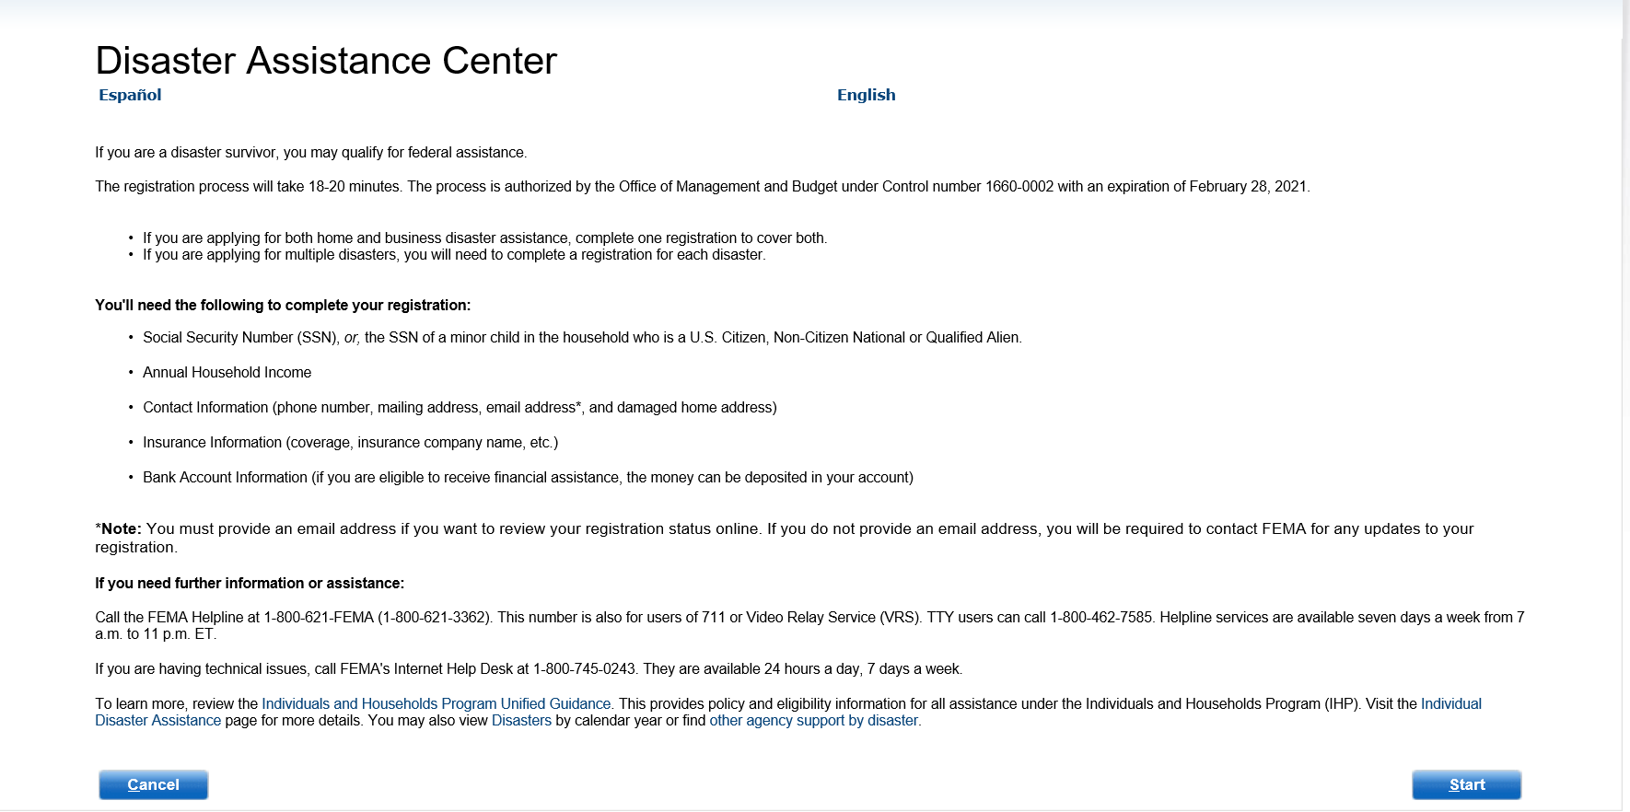
Disaster Assistance Center

Slide 5
Registration Instructions

Slide 6
Privacy Act Statement and Declaration of Eligibility

Slide 7
Personal Information

Slide 8
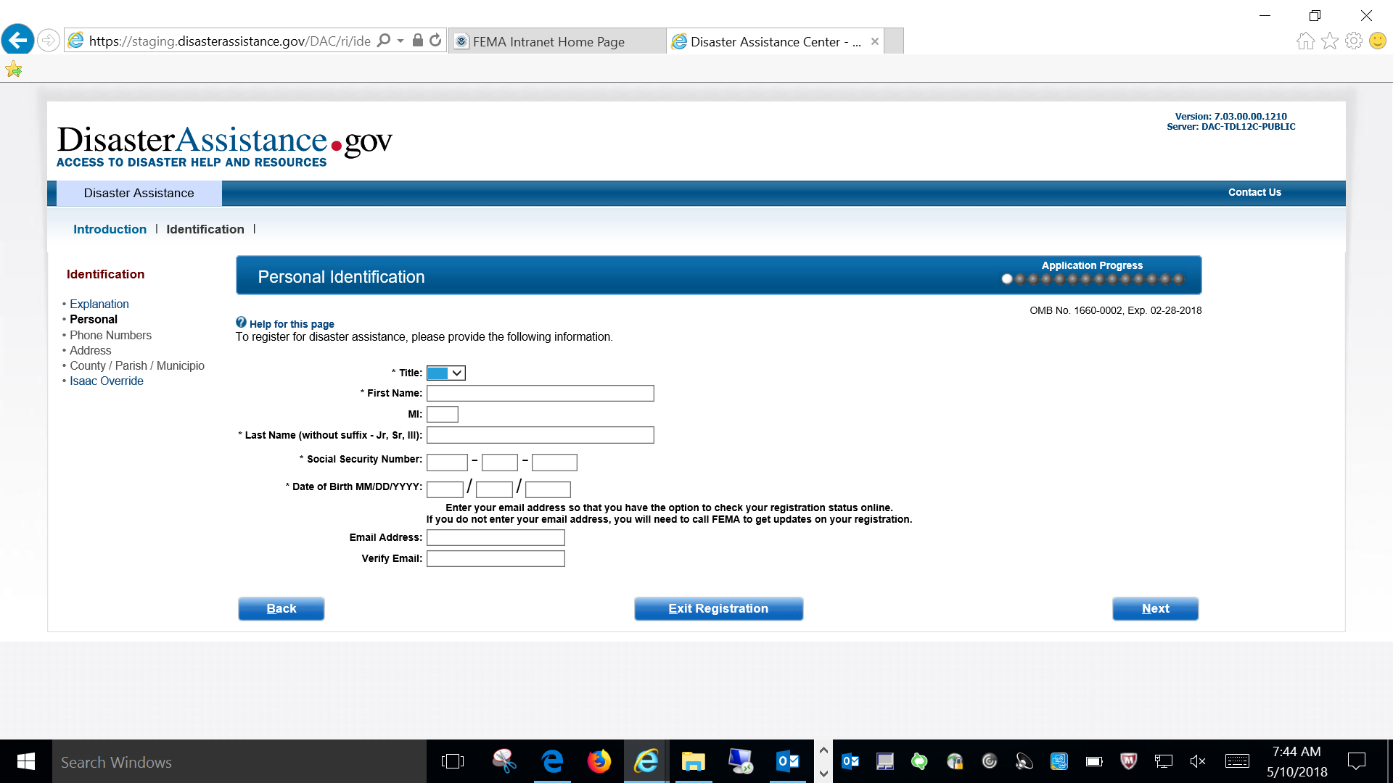
Personal Information

Slide 9
Contact Phone Numbers

Slide 10
Damage Dwelling Address

Slide 11
County/Parish/Municipio

Slide 12
Disaster and Damages

Slide 13
Disaster Selection

Slide 14
Damage Type

Slide 15
Damage Type “Other”

Slide 16
Disaster Losses and Needs

Slide 17
Disaster Related Losses

Slide 18
Damaged Dwelling

Slide 19
New Screen

Slide 20
Home Insurance

Slide 21
Home Insurance (If did not note insurance for home then must select Under Penalty of perjury prior to moving on)

Slide 22
Disaster Related Expenses

Slide 23
Other Insurance

Slide 24
Disaster Related Vehicle Damage

Slide 25
Vehicles

Slide 26
Update Vehicle

Slide 27
Emergency Needs

Slide 28
Special Needs General Categories

Slide 29
Special Needs Specific Categories

Slide 30
Occupants Information

Slide 31
Occupants

Slide 32
Update Occupant

Slide 33
Update Occupant note drop down when selecting co-applicant

Slide 34
Financial Information

Slide 35
Business Damages

Slide 36
Financial Information when selecting yes to self employed

Slide 37
Financial Information when selecting no to self employed

Slide 38
Electronic Funds Transfer

Slide 39
Income Verification

Slide 40
Letter and Documents

Slide 41
Correspondence Preferences

Slide 42
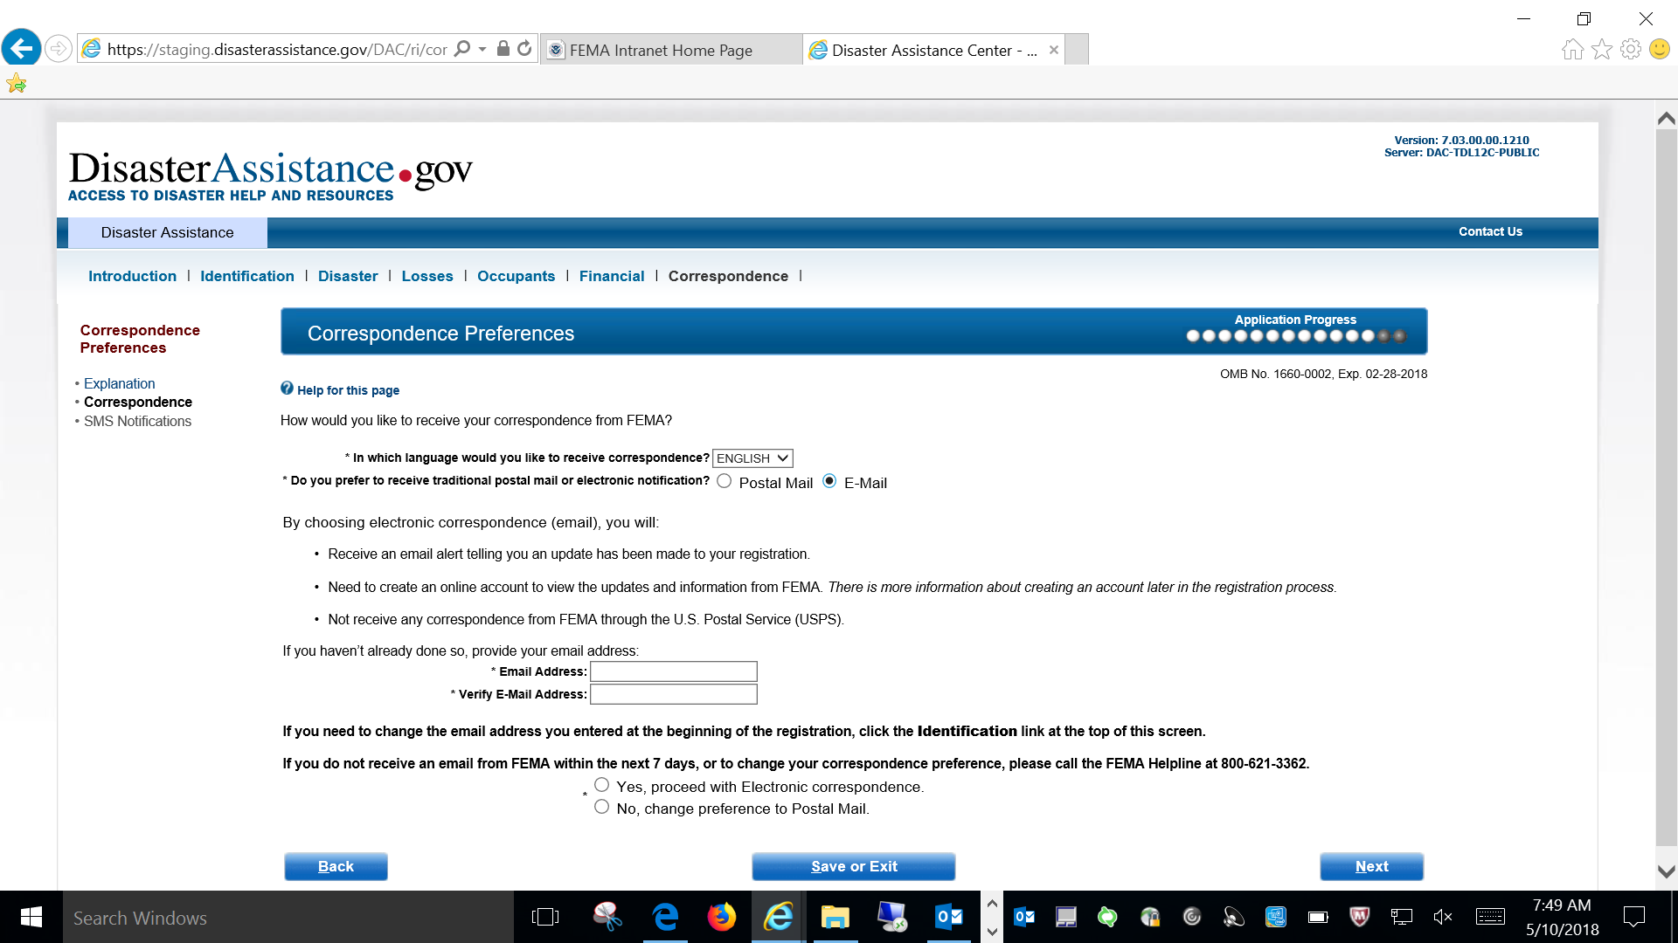
Correspondence Preferences when selecting E-mail has a way of receiving correspondence

Slide 43
SMS Correspondence Summary

Slide 44
SMS Correspondence Summary when selecting yes to SMS

Slide 45
SMS Correspondence Summary when selecting yes the Phone number auto fills

Slide 46
Review Registration

Slide 47
Conclusion

Slide 48
Next Steps

Slide 49
Public Record Questions

Slide 50
User ID and Password

Slide 51
Account Created

Slide 52
What to Expect

Slide 53
Assistance Activities

Slide 54
Referrals

Slide 55
DisasterAssistance.gov Survey Invitation

