Slide 1
Transportation Worker Identification Credential
Information Collection/Paperwork Reduction Act Enrollment Workflow

Slide 2
Contents
Introduction: TSA TWIC® Workflow Trees & Disclosure Statements
Part 1: Pre-Enrollment Workflow
Part 2: Standard Enrollment Workflow
Part 3: Online Renewal Workflow
Part 4: Post-Enrollment Survey

Slide 3
Introduction
TWIC® Workflow Trees

Slide 4
Workflows: Pre-Enrollment, Standard Enrollment & Renewal
Pre-Enrollment (Optional)
Standard Enrollment
Online
Renewal
Biographic Information
Biographic Information
Biographic Information
Notices
Notices
Citizenship
Citizenship
Citizenship
Documents
Attributes
Attributes
Attributes
Address Information
Employment Information
Employment Information
Employment Information
Biometrics
Acknowledgements
Acknowledgements
Acknowledgements
Card Issuance
Documents
Card Issuance
Fee Payment
Fee Payment
Appointment
Submission/
Confirmation
Confirmation
Submission/
Confirmation
Survey
Survey
All applicants may pre-enroll online or via call center representative and provide required enrollment information and schedule appointment for biometric collection.
All Items except Biometrics, Card Issuance, Fee Payment and the Post Enrollment Survey may be done in a pre-enrollment option online.
Eligible applicants may renew online unless they have had a change in biographic information or have been informed they must submit additional biometrics or documentation.

Slide 5
Introduction
TWIC® Disclosures

Slide 6
Disclosure: Privacy Act Statement
PRIVACY ACT STATEMENT
Authority: 6 U.S.C. § 1140, 46 U.S.C. § 70105; 49 U.S.C. §§ 106, 114, 5103a, 40103(b)(3), 40113, 44903, 44935-44936, 44939, and 46105; the Implementing Recommendations of the 9/11 Commission Act of 2007, § 1520 (121 Stat. 444, Public Law 110-52, August 3, 2007); and Executive Order 9397, as amended.
Purpose: The Department of Homeland Security (DHS) will use your information to conduct a security threat assessment. Biometrics collected from applicants to the TSA PreCheck™ Application Program may also be used to conduct screening at airport checkpoints. Your fingerprints and associated information will be provided to the Federal Bureau of Investigation (FBI) for the purpose of comparing your fingerprints to other fingerprints in the FBI’s Next Generation Identification (NGI) system or its successor systems including civil, criminal, and latent fingerprint repositories. The FBI may retain your fingerprints and associated information in NGI after the completion of this application and, while retained, your fingerprints may continue to be compared against other fingerprints submitted to or retained by NGI. DHS will also transmit your fingerprints for enrollment into Automated Biometrics Identification System (IDENT). If you provide your Social Security Number (SSN), DHS may provide your name and SSN to the Social Security Administration (SSA) to compare that information against SSA records to ensure the validity of the information.
Routine Uses: This system may disclose information in accordance with the Privacy Act, 5 U.S.C. 552a(b), including as a routine use pursuant to 5 U.S.C. 552a(b)(3) with third parties during the course of a security threat assessment, employment investigation, or adjudication of a waiver or appeal request to the extent necessary to obtain information pertinent to the assessment, investigation, or adjudication of your application under the TSA system of records notice (SORN) DHS/TSA 002, Transportation Security Threat Assessment System, or DHS/TSA 021, TSA PreCheck Application Program for applicants to that program. Disqualifying criminal offenses uncovered during your application limit your ability to access TSA PreCheck expedited screening. For as long as your fingerprints and associated information are retained in NGI, your information may be disclosed pursuant to your consent or without your consent as permitted by the Privacy Act of 1974 and all applicable Routine Uses as may be published at any time in the Federal Register, including the Routine Uses for the NGI system and the FBI’s Blanket Routine Uses.
Disclosure: Furnishing this information (including your SSN) is voluntary; however, if you do not provide your SSN or any other information requested, DHS may be unable to complete your application for a security threat assessment.

Slide 7
Disclosure: Paperwork Reduction Act Statement
PAPERWORK REDUCTION ACT STATEMENT
Statement of Public Burden: TSA is collecting this information to determine your eligibility for a TWIC®. This is a voluntary collection of information but failure to provide the information may result in an inability to approve your eligibility for a TWIC®. TSA estimates that the total average burden per response associated with this collection is estimated as follows:
online pre-enrollment is 1.08 hours
in-person enrollment is 0.92 hours
online renewals is 10 minutes
in-person renewals is 55 minutes
customer satisfaction survey is 2.5 minutes
appeals and waivers is 6 hours
An agency may not conduct or sponsor, and a person is not required to respond to a collection of information unless it displays a valid OMB control number. The control number assigned to this collection is OMB 1652-0047, which expires 04/30/2021. Send comments regarding this burden estimate or collection to: TSA-11, Attention: PRA 1652-0047, 6595 Springfield Center Drive, Springfield, VA 20598.

Slide 8
Part 1
TWIC® Online Pre-Enrollment Workflow (Optional)

Slide 9
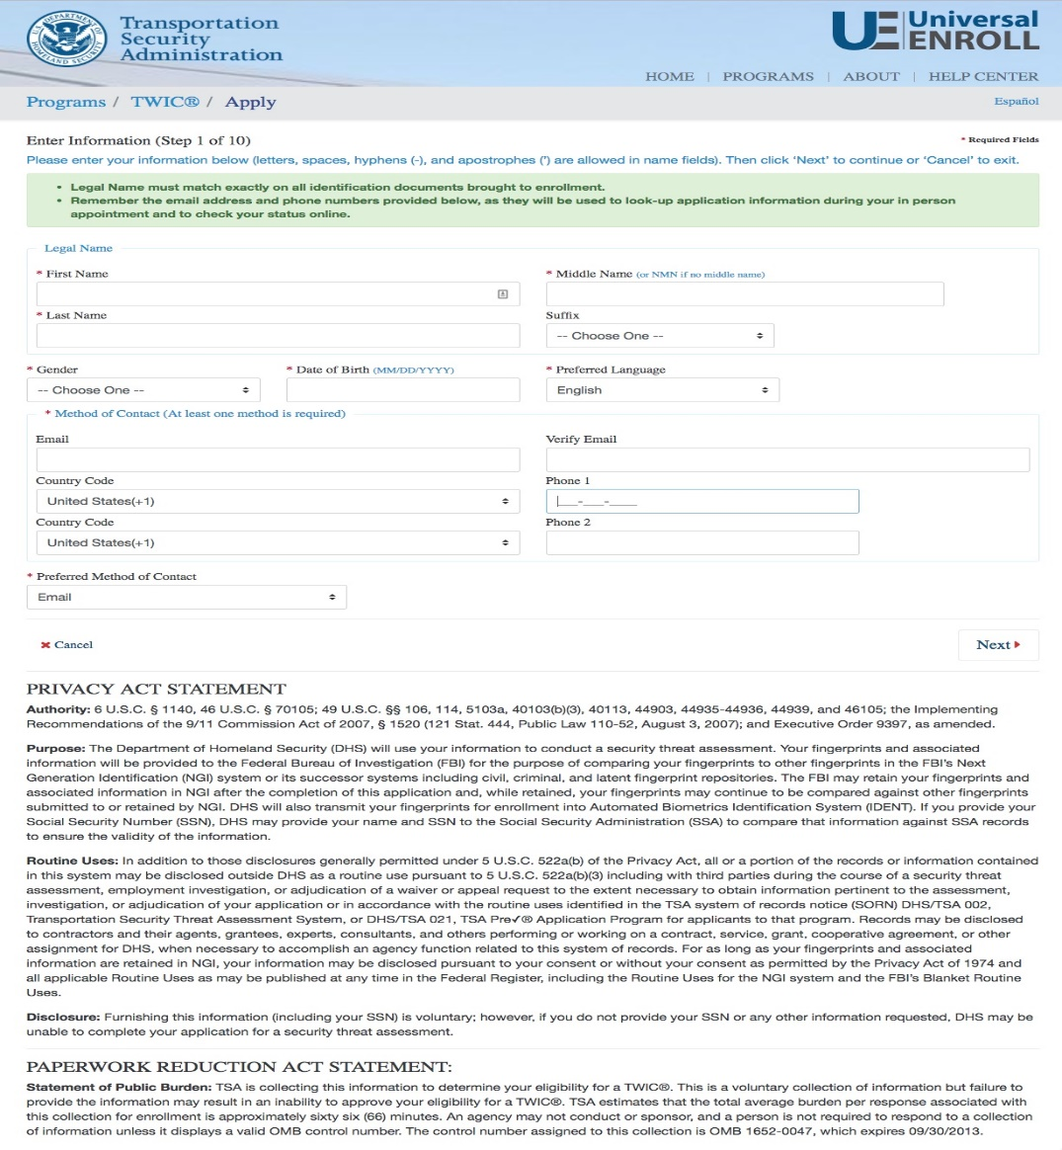
TWIC® Pre-Enrollment
START
Biographic Information
Citizenship
Attributes
Address Information
Employment Information
Acknowledgements
Documents
Appointment
Confirmation
FINISH

Slide 10
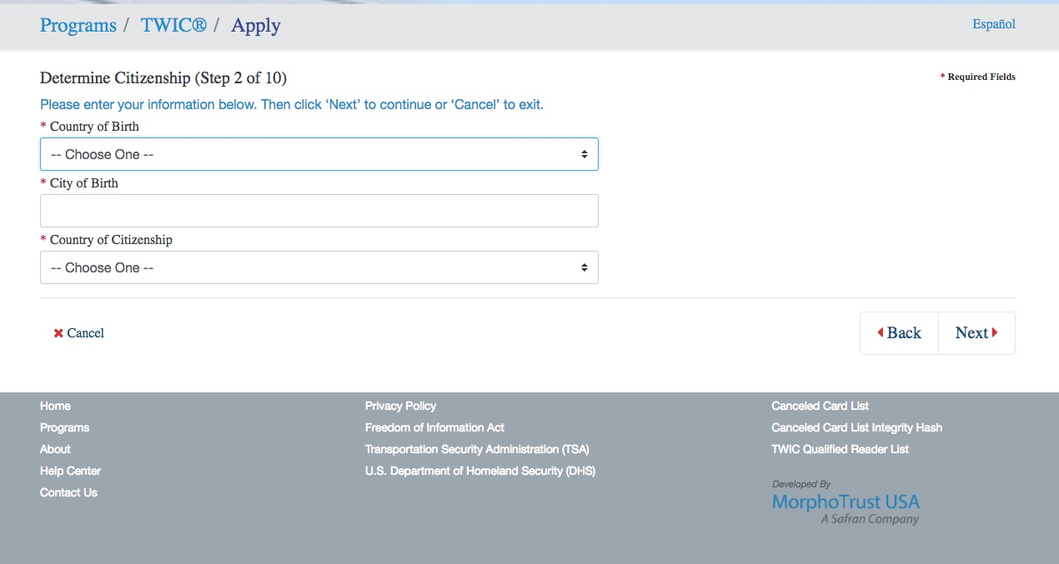
TWIC® Pre-Enrollment
START
Biographic Information
Citizenship
Attributes
Address Information
Employment Information
Acknowledgements
Documents
Appointment
Confirmation
FINISH

Slide 11
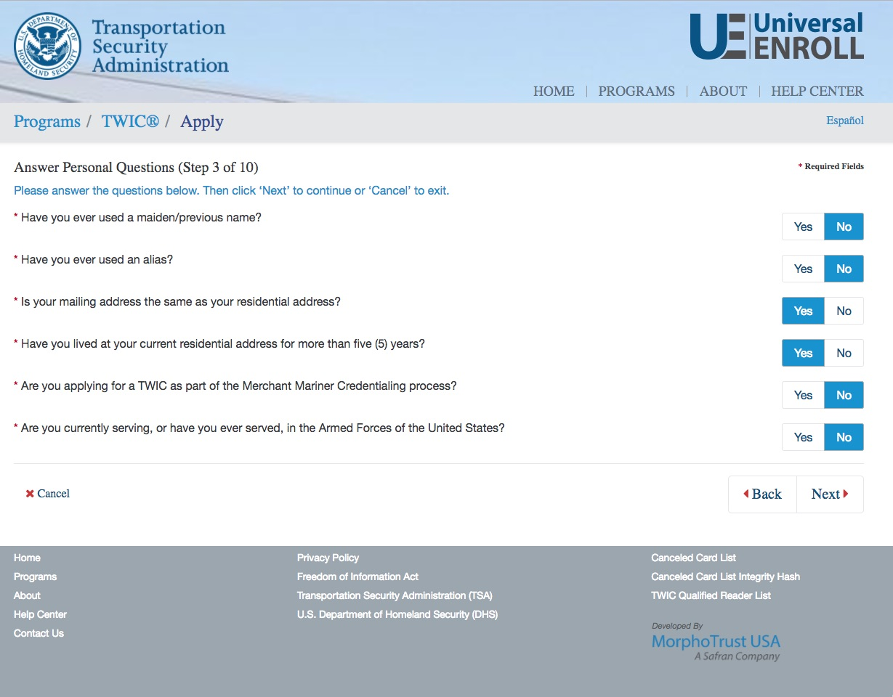
TWIC® Pre-Enrollment
START
Biographic Information
Citizenship
Attributes
Address Information
Employment Information
Acknowledgements
Documents
Appointment
Confirmation
FINISH

Slide 12
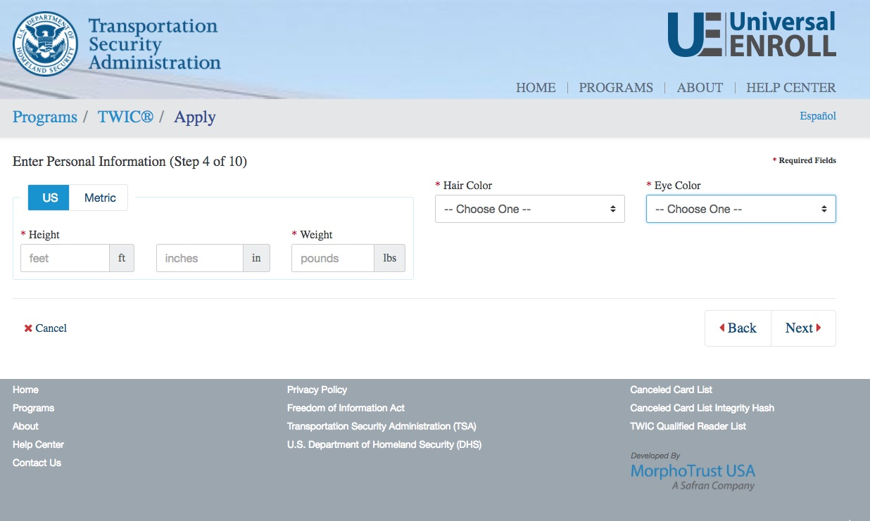
TWIC® Pre-Enrollment
START
Biographic Information
Citizenship
Attributes
Address Information
Employment Information
Acknowledgements
Documents
Appointment
Confirmation
FINISH

Slide 13
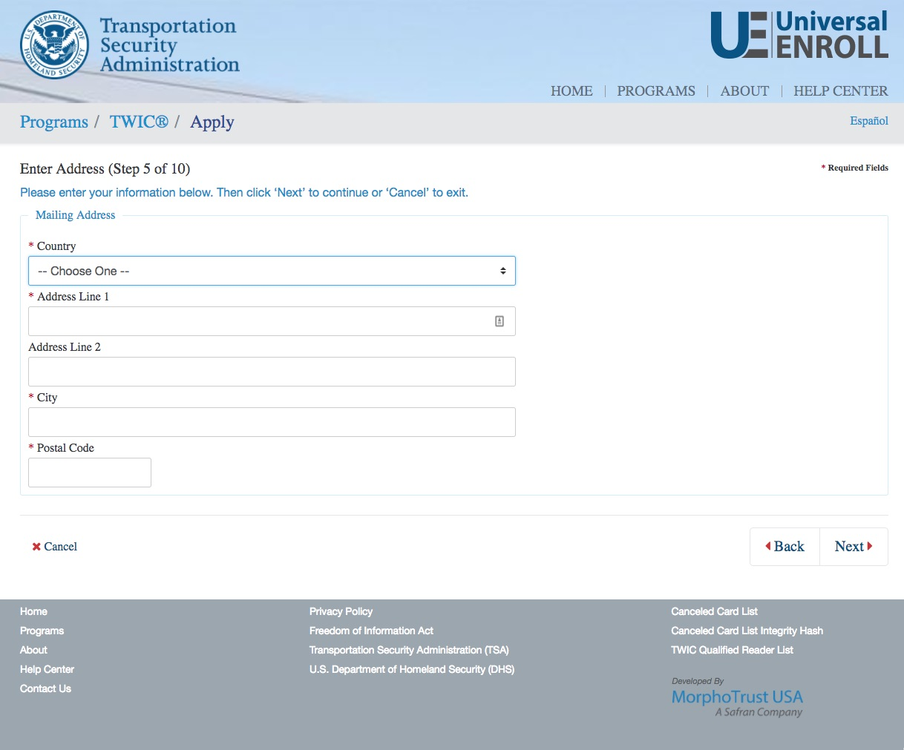
TWIC® Pre-Enrollment
START
Biographic Information
Citizenship
Attributes
Address Information
Employment Information
Acknowledgements
Documents
Appointment
Confirmation
FINISH

Slide 14
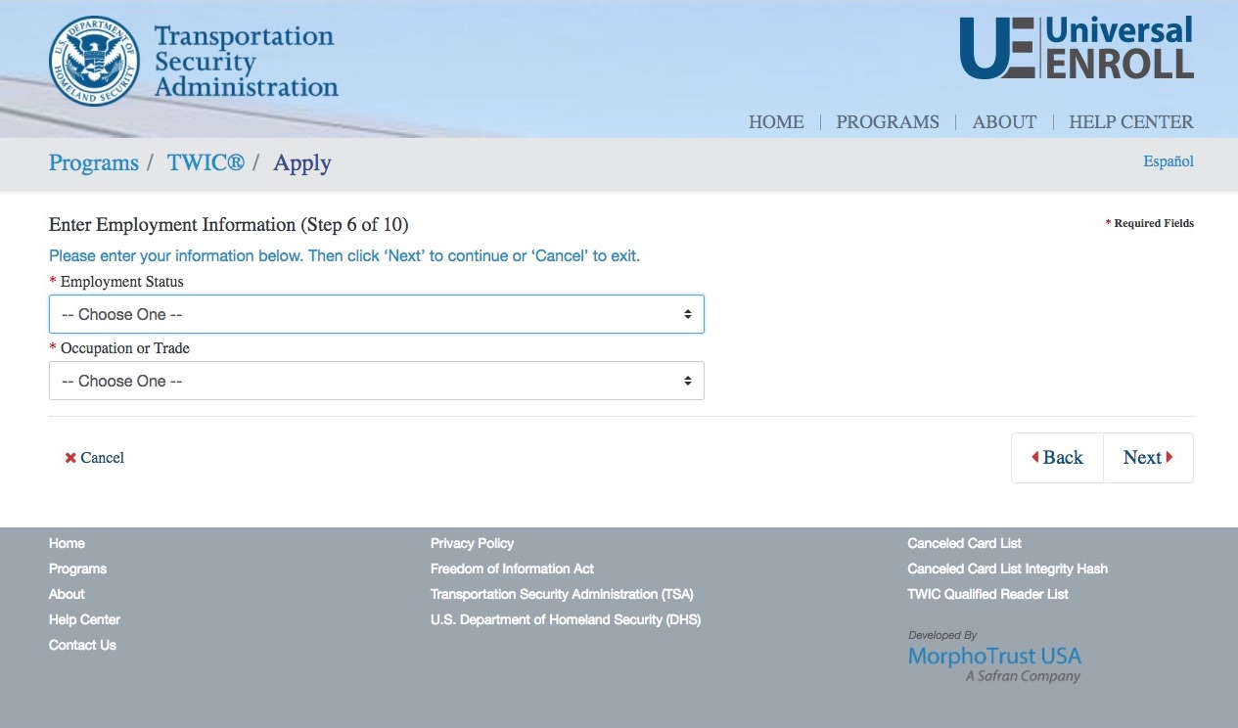
TWIC® Pre-Enrollment
START
Biographic Information
Citizenship
Attributes
Address Information
Employment Information
Acknowledgements
Documents
Appointment
Confirmation
FINISH

Slide 15
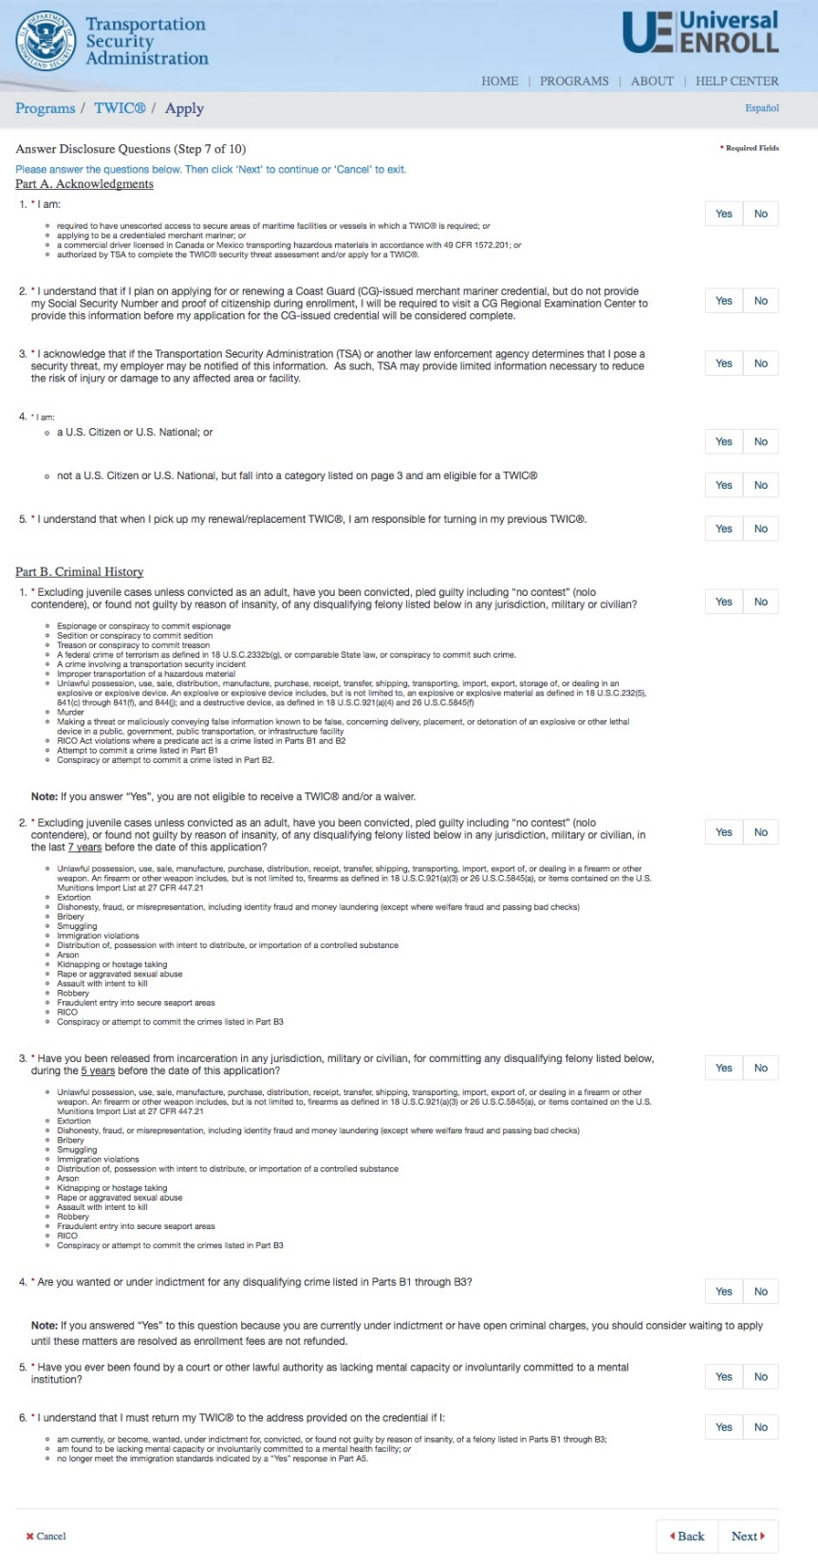
TWIC® Pre-Enrollment
START
Biographic Information
Citizenship
Attributes
Address Information
Employment Information
Acknowledgements
Documents
Appointment
Confirmation
FINISH

Slide 16
TWIC® Pre-Enrollment
START
Biographic Information
Citizenship
Attributes
Address Information
Employment Information
Acknowledgements
Documents
Appointment
Confirmation
FINISH

Slide 17
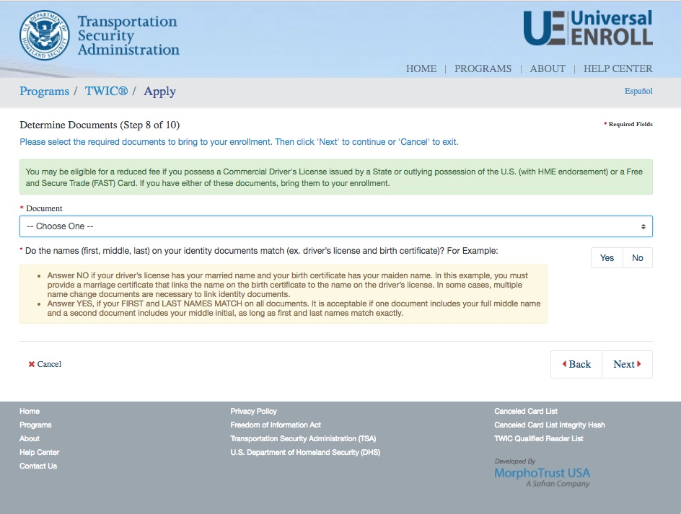
TWIC® Pre-Enrollment
START
Biographic Information
Citizenship
Attributes
Address Information
Employment Information
Acknowledgements
Documents
Appointment
Confirmation
FINISH

Slide 18
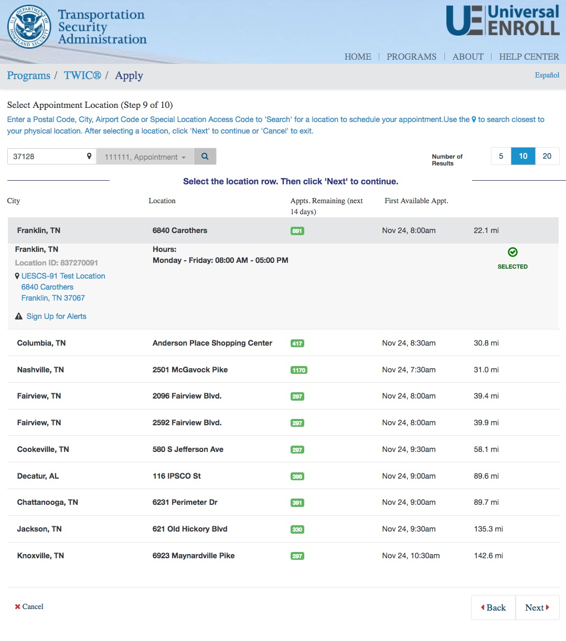
TWIC® Pre-Enrollment
START
Biographic Information
Citizenship
Attributes
Address Information
Employment Information
Acknowledgements
Documents
Appointment
Confirmation
FINISH

Slide 19
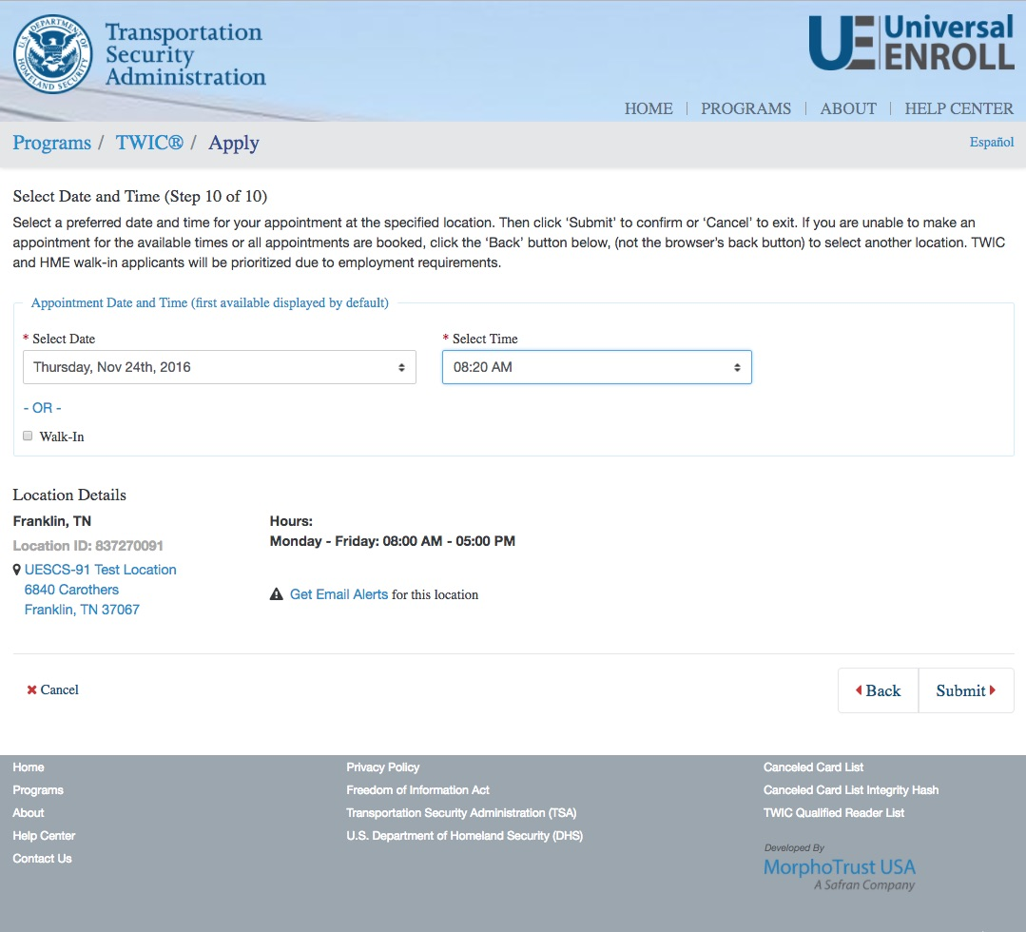
TWIC® Pre-Enrollment
START
Biographic Information
Citizenship
Attributes
Address Information
Employment Information
Acknowledgements
Documents
Appointment
Confirmation
FINISH

Slide 20
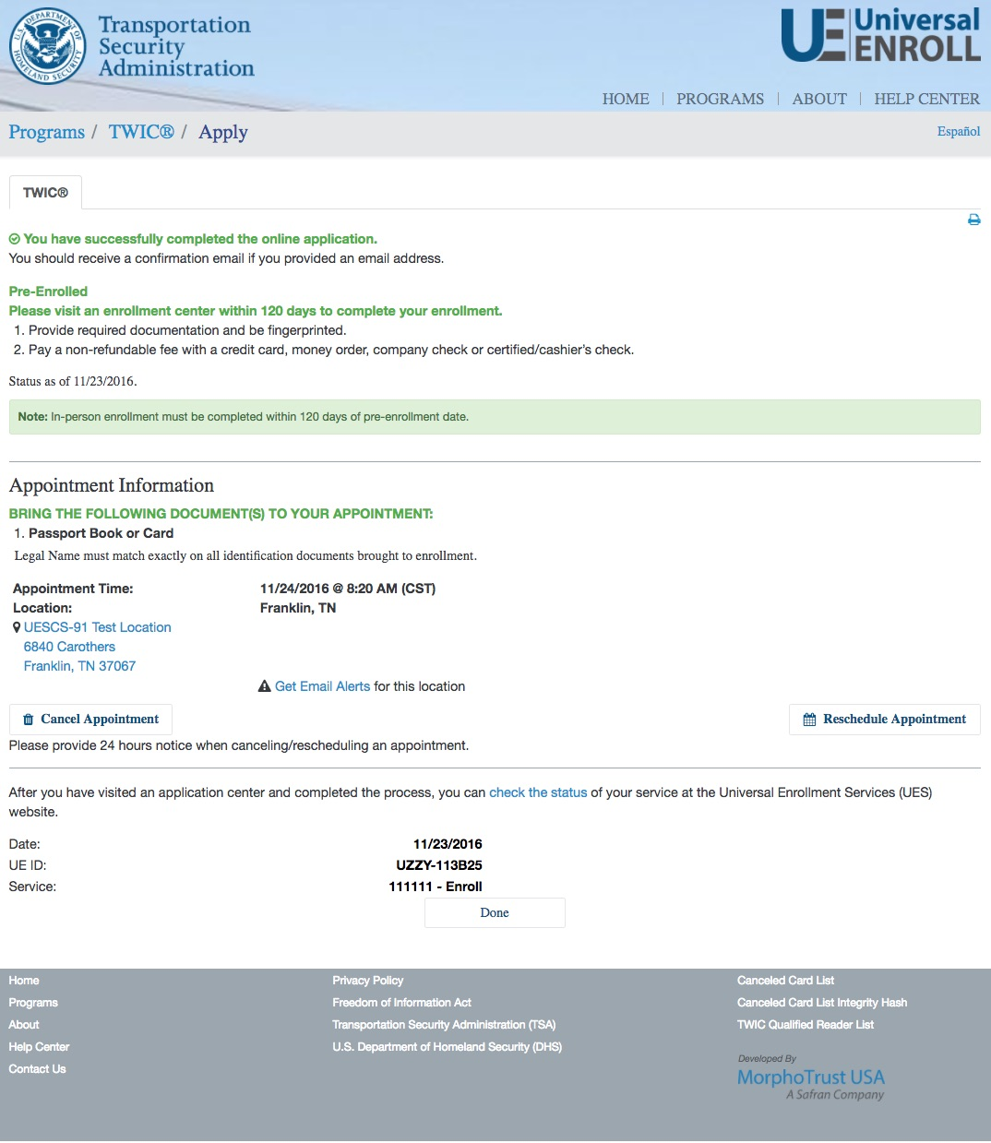
TWIC® Pre-Enrollment
START
Biographic Information
Citizenship
Attributes
Address Information
Employment Information
Acknowledgements
Documents
Appointment
Confirmation
FINISH

Slide 21
Part 2
TWIC® In-Person Standard (New) Enrollment Workflow

Slide 22
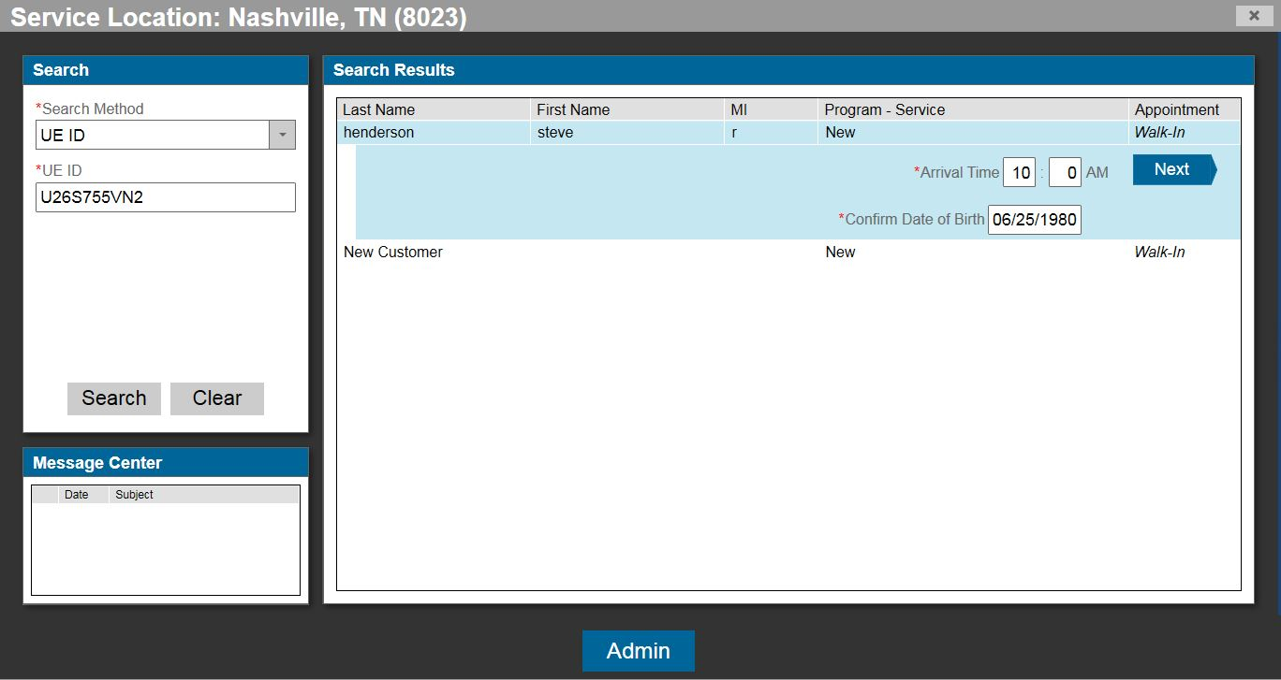
TWIC® Standard Enrollment
START
Biographic Information (Pre-enrollment)
Notices
Citizenship
Documents
Attributes
Employment Information
Biometrics
Acknowledgements
Card Issuance
Fee Payment
Submission/
Confirmation
Survey
FINISH

Slide 23
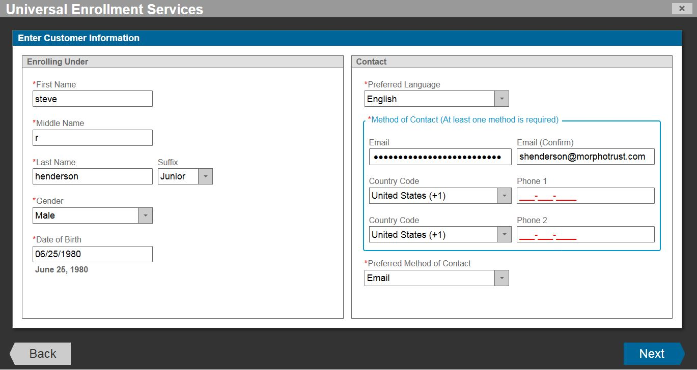
TWIC® Standard Enrollment
START
Biographic Information (No Pre-enrollment)
Notices
Citizenship
Documents
Attributes
Employment Information
Biometrics
Acknowledgements
Card Issuance
Fee Payment
Submission/
Confirmation
Survey
FINISH

Slide 24
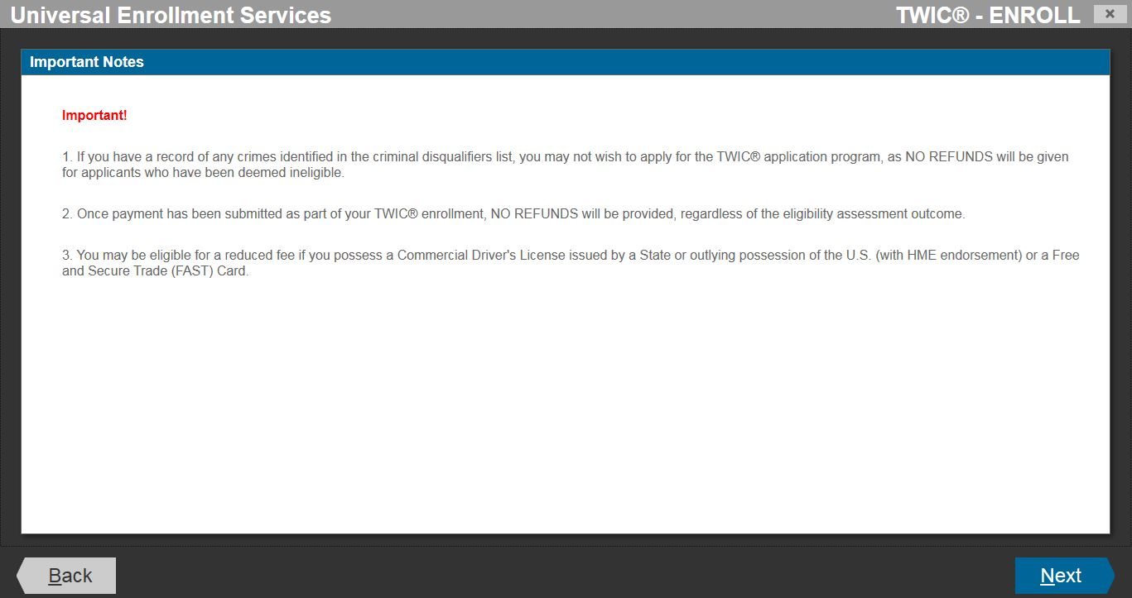
TWIC® Standard Enrollment
START
Biographic Information
Notices
Citizenship
Documents
Attributes
Employment Information
Biometrics
Acknowledgements
Card Issuance
Fee Payment
Submission/
Confirmation
Survey
FINISH

Slide 25
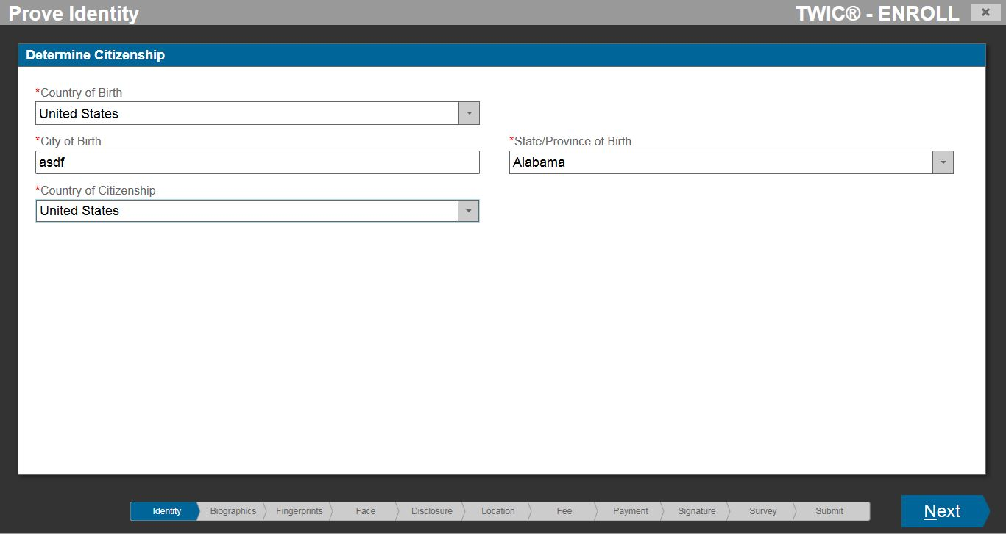
TWIC® Standard Enrollment
START
Biographic Information
Notices
Citizenship
Documents
Attributes
Employment Information
Biometrics
Acknowledgements
Card Issuance
Fee Payment
Submission/
Confirmation
Survey
FINISH

Slide 26
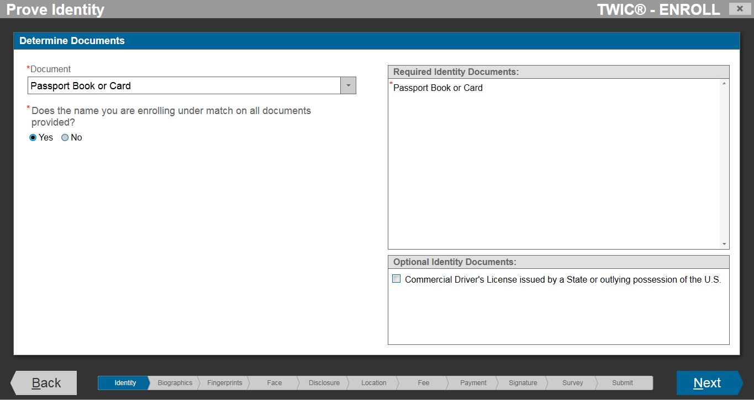
TWIC® Standard Enrollment
START
Biographic Information
Notices
Citizenship
Documents
Attributes
Employment Information
Biometrics
Acknowledgements
Card Issuance
Fee Payment
Submission/
Confirmation
Survey
FINISH

Slide 27
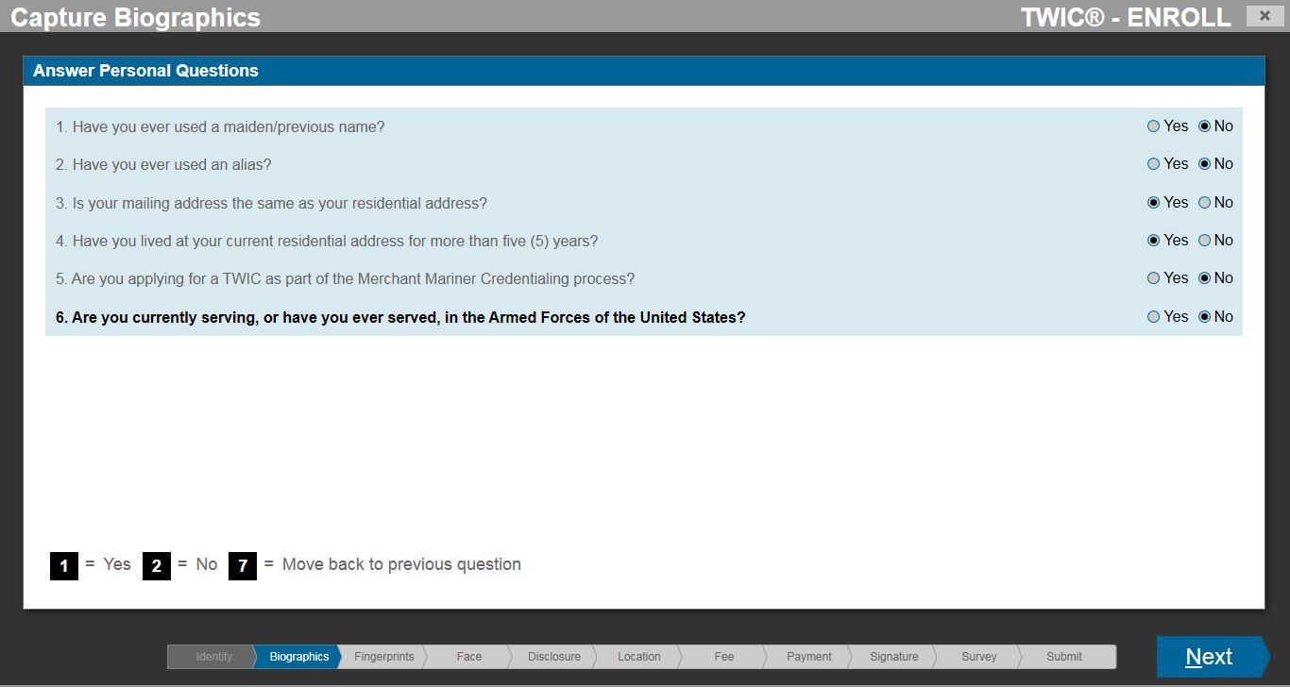
TWIC® Standard Enrollment
START
Biographic Information
Notices
Citizenship
Documents
Attributes
Employment Information
Biometrics
Acknowledgements
Card Issuance
Fee Payment
Submission/
Confirmation
Survey
FINISH

Slide 28
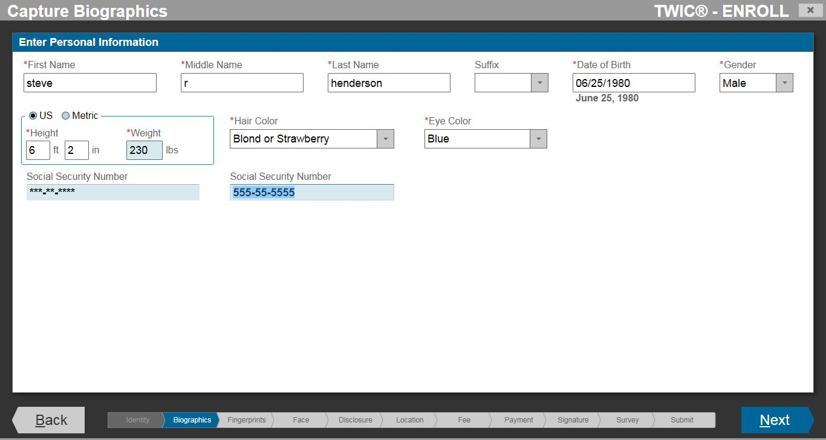
TWIC® Standard Enrollment
START
Biographic Information
Notices
Citizenship
Documents
Attributes
Employment Information
Biometrics
Acknowledgements
Card Issuance
Fee Payment
Submission/
Confirmation
Survey
FINISH

Slide 29
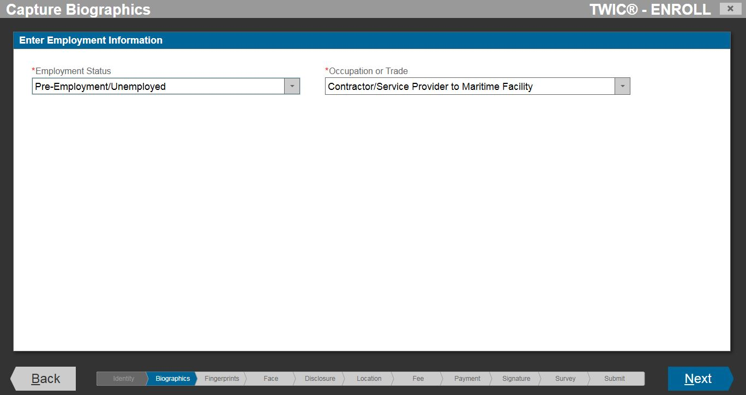
TWIC® Standard Enrollment
START
Biographic Information
Notices
Citizenship
Documents
Attributes
Employment Information
Biometrics
Acknowledgements
Card Issuance
Fee Payment
Submission/
Confirmation
Survey
FINISH

Slide 30
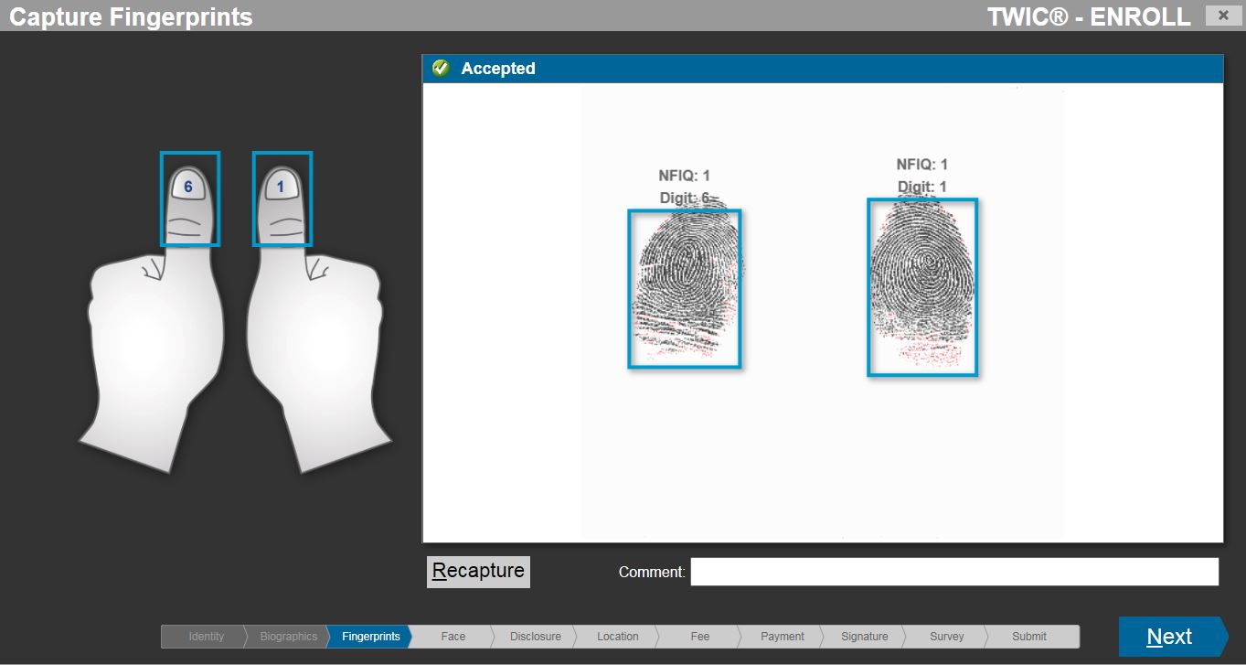
TWIC® Standard Enrollment
START
Biographic Information
Notices
Citizenship
Documents
Attributes
Employment Information
Biometrics (Fingerprints)
Acknowledgements
Card Issuance
Fee Payment
Submission/
Confirmation
Survey
FINISH

Slide 31
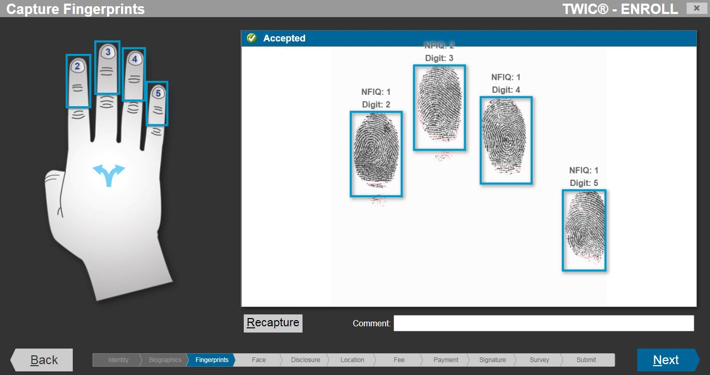
TWIC® Standard Enrollment
START
Biographic Information
Notices
Citizenship
Documents
Attributes
Employment Information
Biometrics (Fingerprints)
Acknowledgements
Card Issuance
Fee Payment
Submission/
Confirmation
Survey
FINISH

Slide 32
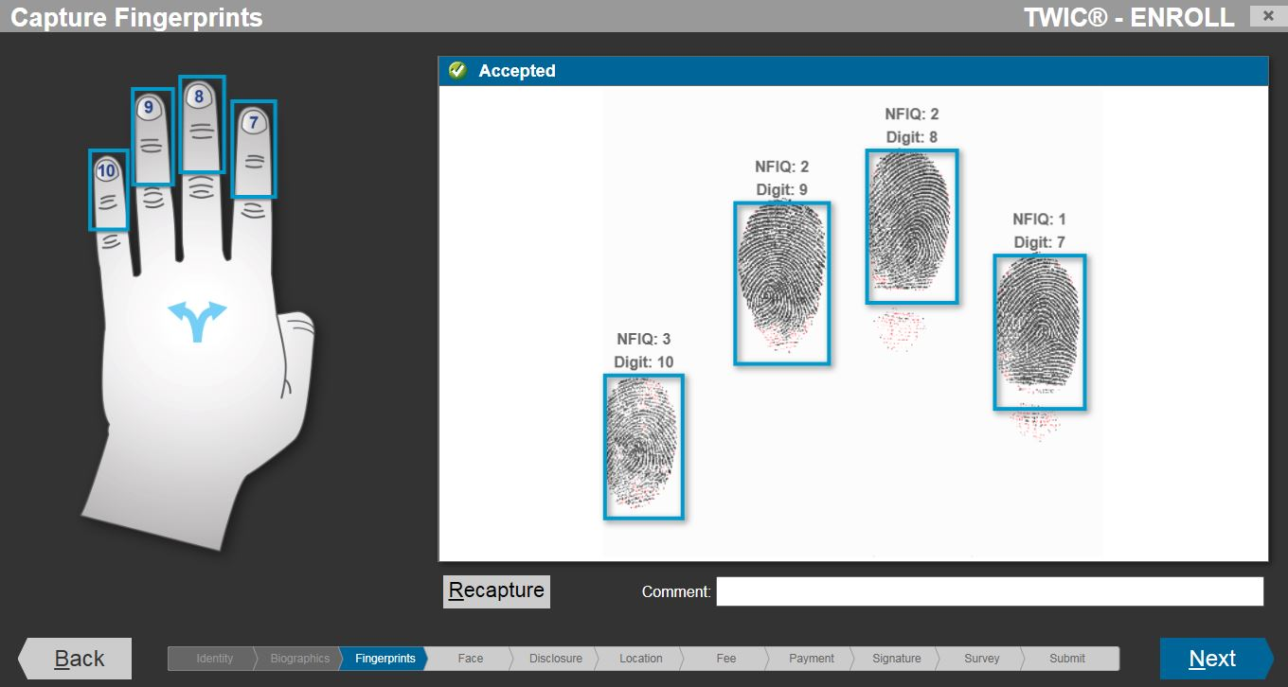
TWIC® Standard Enrollment
START
Biographic Information
Notices
Citizenship
Documents
Attributes
Employment Information
Biometrics (Fingerprints)
Acknowledgements
Card Issuance
Fee Payment
Submission/
Confirmation
Survey
FINISH

Slide 33
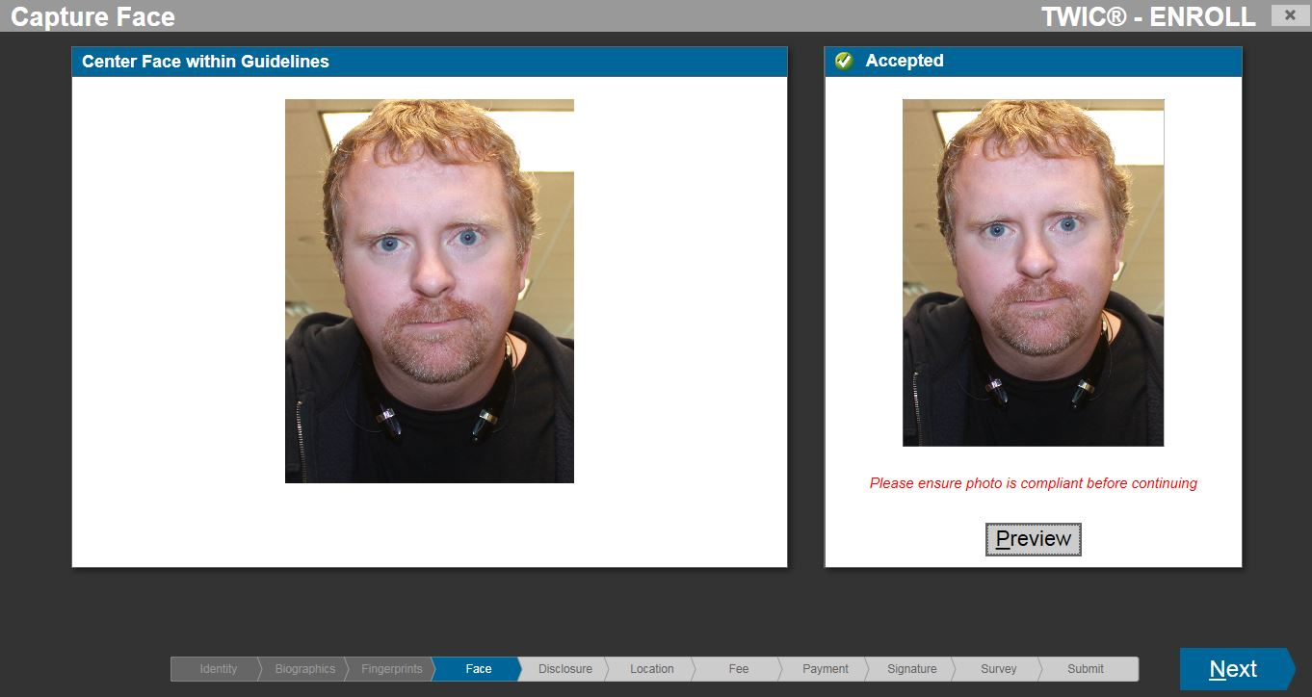
TWIC® Standard Enrollment
START
Biographic Information
Notices
Citizenship
Documents
Attributes
Employment Information
Biometrics (Facial Photograph)
Acknowledgements
Card Issuance
Fee Payment
Submission/
Confirmation
Survey
FINISH

Slide 34
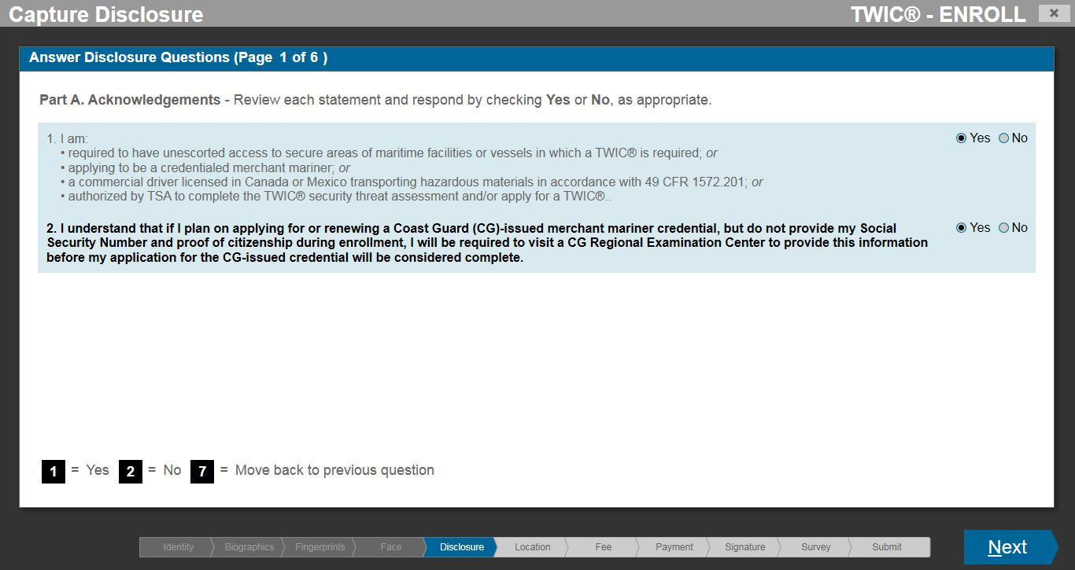
TWIC® Standard Enrollment
START
Biographic Information
Notices
Citizenship
Documents
Attributes
Employment Information
Biometrics
Acknowledgements
Card Issuance
Fee Payment
Submission/
Confirmation
Survey
FINISH

Slide 35
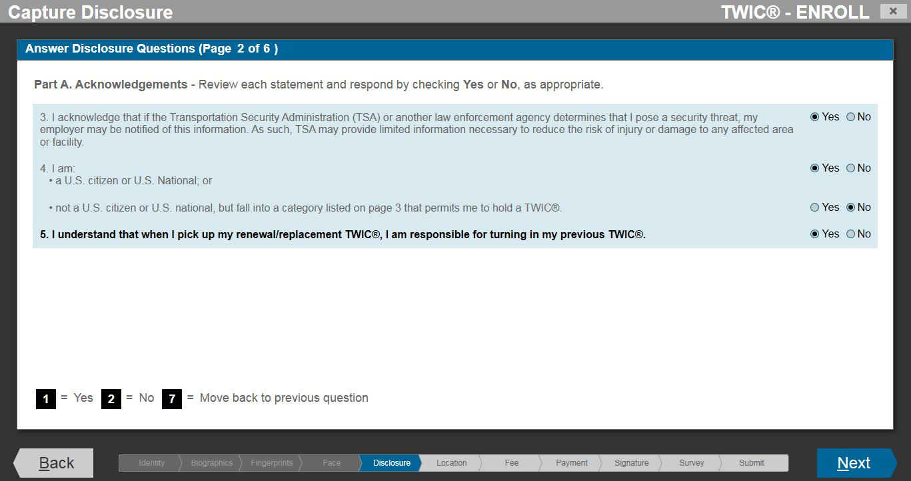
TWIC® Standard Enrollment
START
Biographic Information
Notices
Citizenship
Documents
Attributes
Employment Information
Biometrics
Acknowledgements
Card Issuance
Fee Payment
Submission/
Confirmation
Survey
FINISH

Slide 36
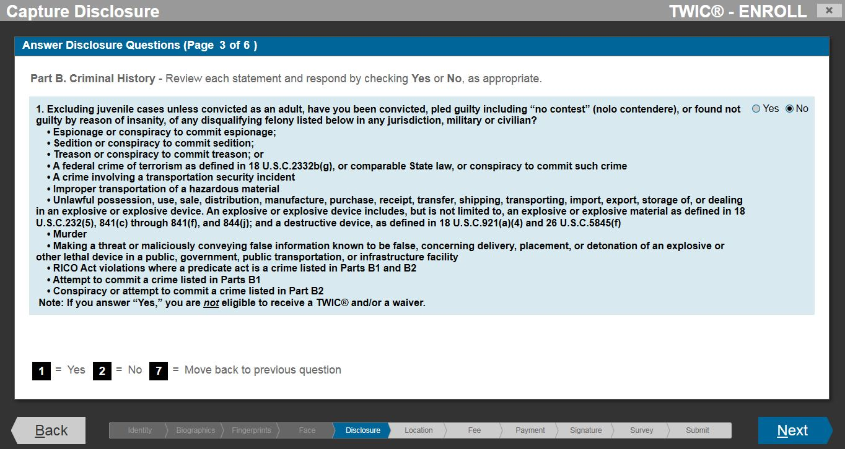
TWIC® Standard Enrollment
START
Biographic Information
Notices
Citizenship
Documents
Attributes
Employment Information
Biometrics
Acknowledgements
Card Issuance
Fee Payment
Submission/
Confirmation
Survey
FINISH

Slide 37
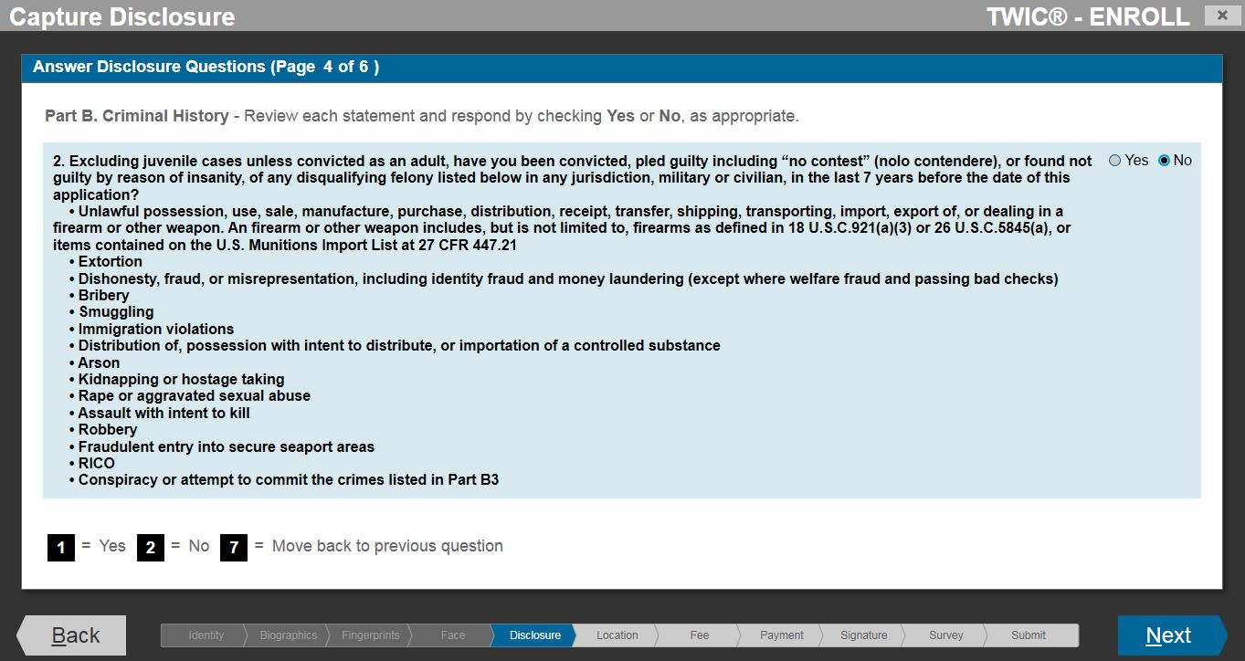
TWIC® Standard Enrollment
START
Biographic Information
Notices
Citizenship
Documents
Attributes
Employment Information
Biometrics
Acknowledgements
Card Issuance
Fee Payment
Submission/
Confirmation
Survey
FINISH

Slide 38
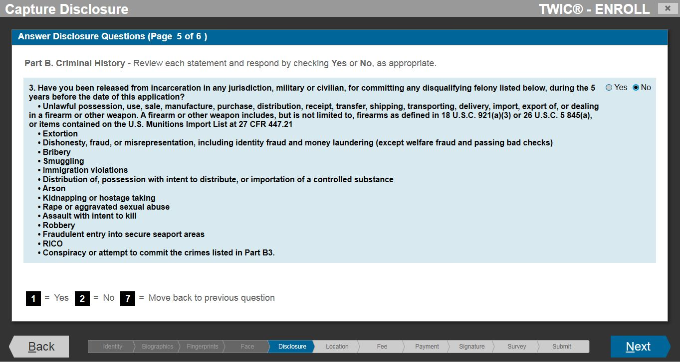
TWIC® Standard Enrollment
START
Biographic Information
Notices
Citizenship
Documents
Attributes
Employment Information
Biometrics
Acknowledgements
Card Issuance
Fee Payment
Submission/
Confirmation
Survey
FINISH

Slide 39
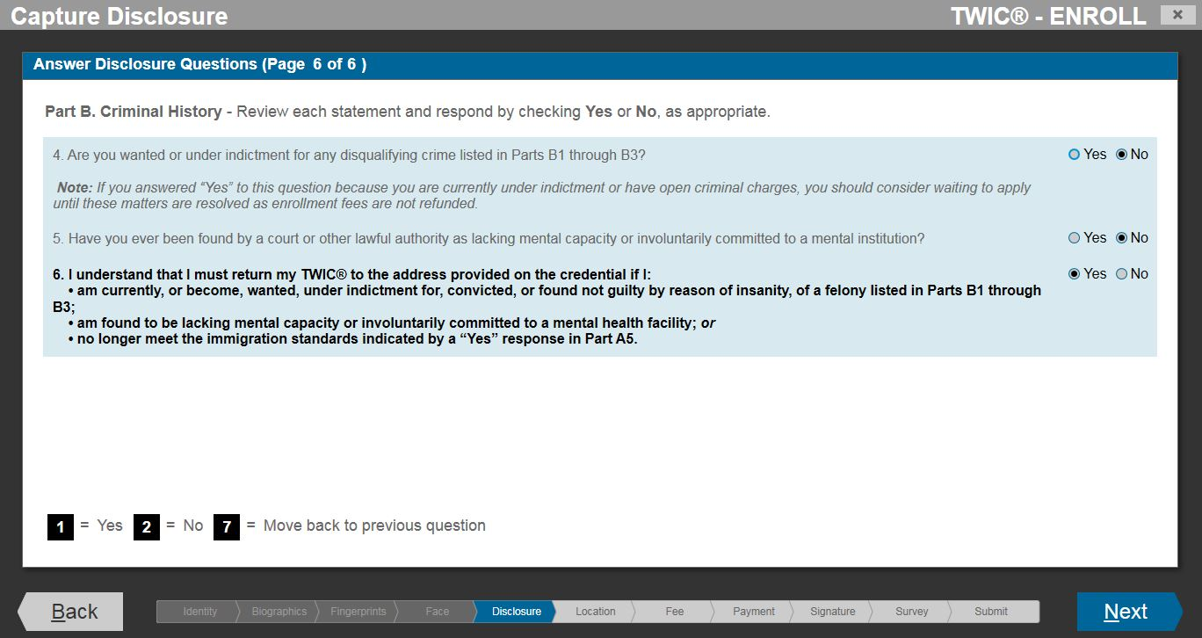
TWIC® Standard Enrollment
START
Biographic Information
Notices
Citizenship
Documents
Attributes
Employment Information
Biometrics
Acknowledgements
Card Issuance
Fee Payment
Submission/
Confirmation
Survey
FINISH

Slide 40
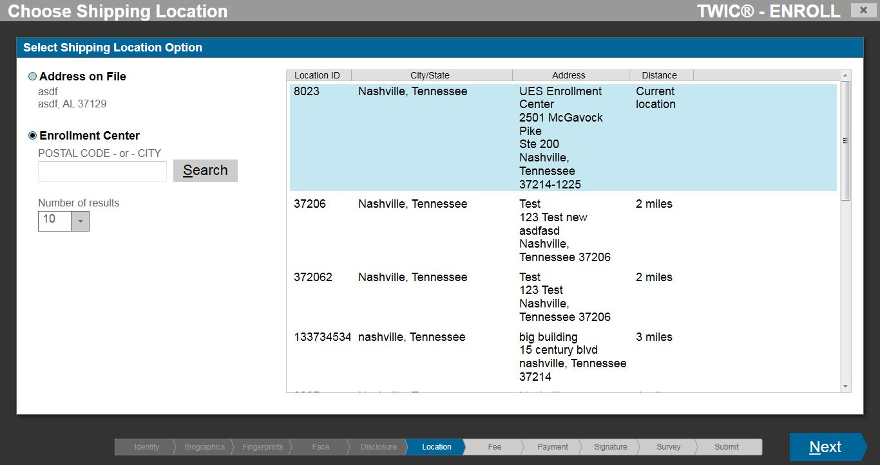
TWIC® Standard Enrollment
START
Biographic Information
Notices
Citizenship
Documents
Attributes
Employment Information
Biometrics
Acknowledgements
Card Issuance (Shipping)
Fee Payment
Submission/
Confirmation
Survey
FINISH

Slide 41
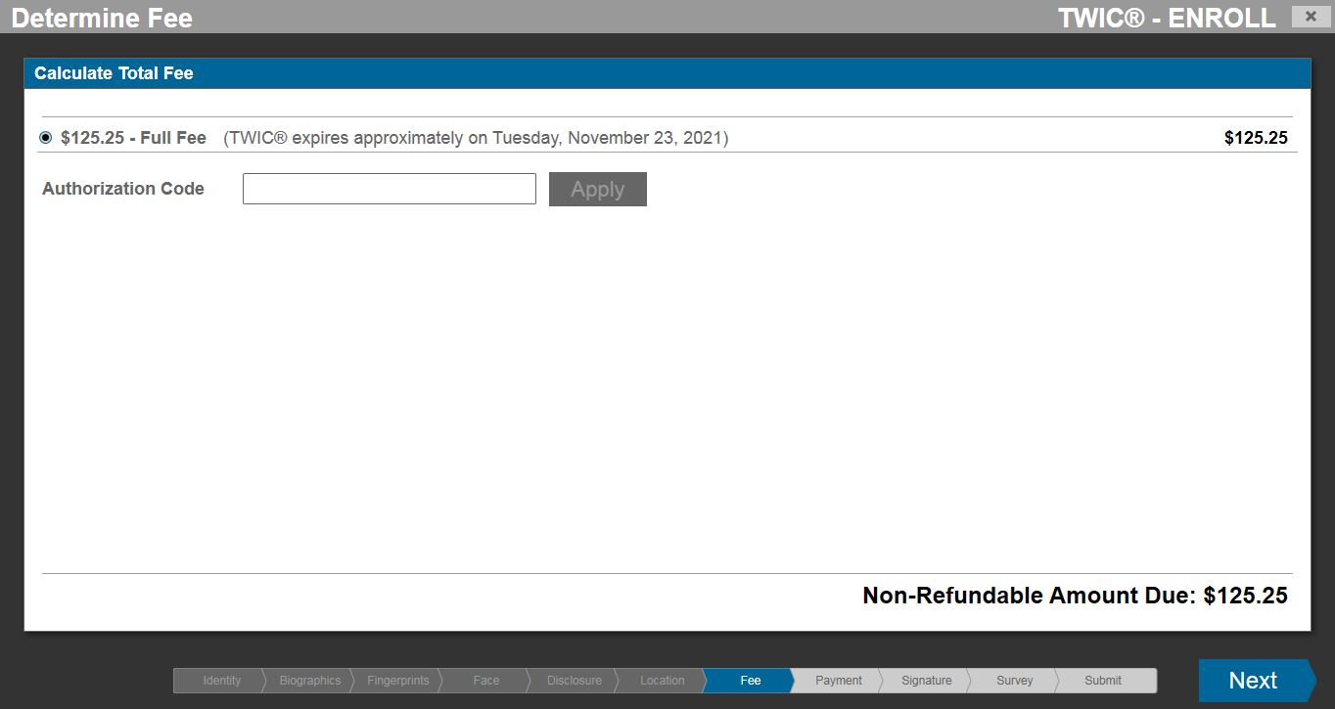
TWIC® Standard Enrollment
START
Biographic Information
Notices
Citizenship
Documents
Attributes
Employment Information
Biometrics
Acknowledgements
Card Issuance
Fee Payment
Submission/
Confirmation
Survey
FINISH

Slide 42
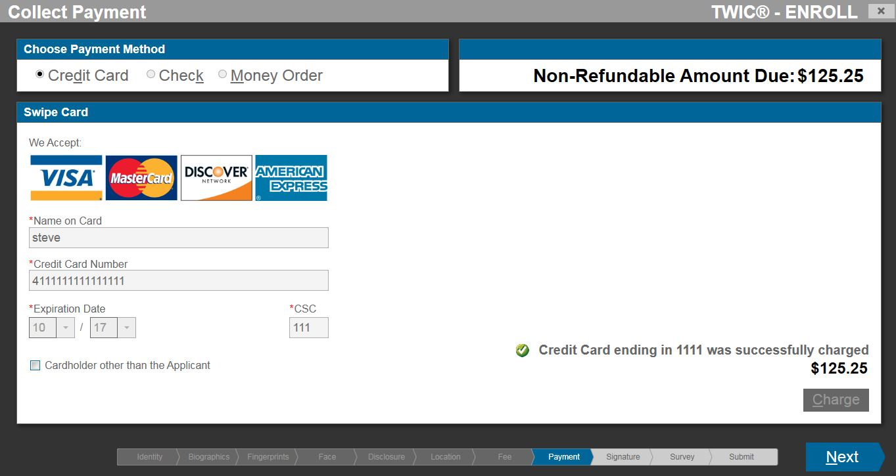
TWIC® Standard Enrollment
START
Biographic Information
Notices
Citizenship
Documents
Attributes
Employment Information
Biometrics
Acknowledgements
Card Issuance
Fee Payment
Submission/
Confirmation
Survey
FINISH

Slide 43
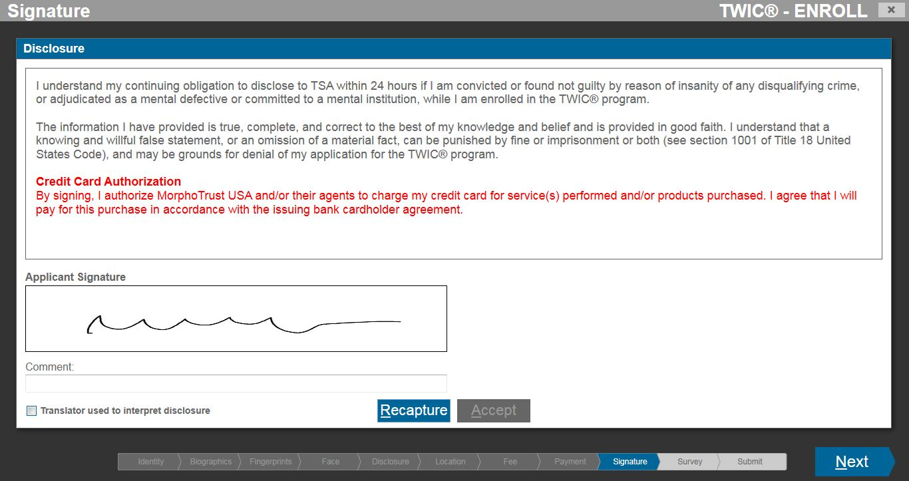
TWIC® Standard Enrollment
START
Biographic Information
Notices
Citizenship
Documents
Attributes
Employment Information
Biometrics
Acknowledgements
Card Issuance
Fee Payment
Submission/
Confirmation
Survey
FINISH

Slide 44
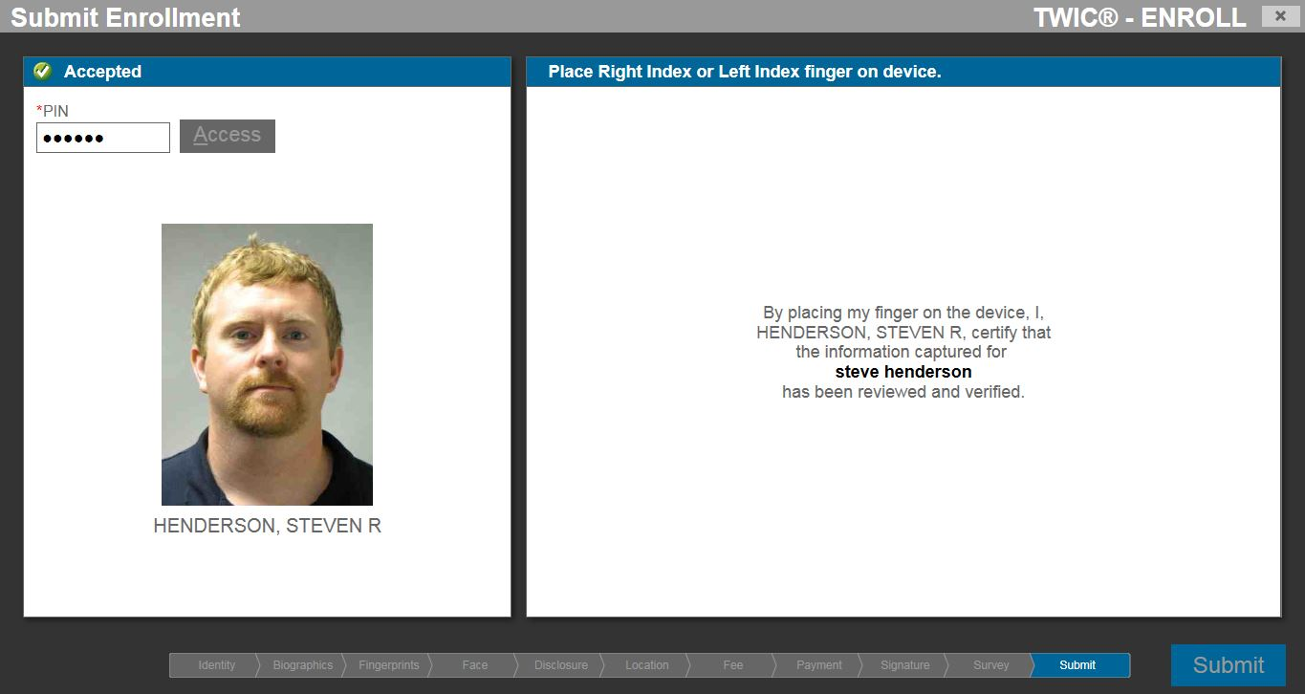
TWIC® Standard Enrollment
START
Biographic Information
Notices
Citizenship
Documents
Attributes
Employment Information
Biometrics
Acknowledgements
Card Issuance
Fee Payment
Submission/
Confirmation
Survey
FINISH

Slide 45
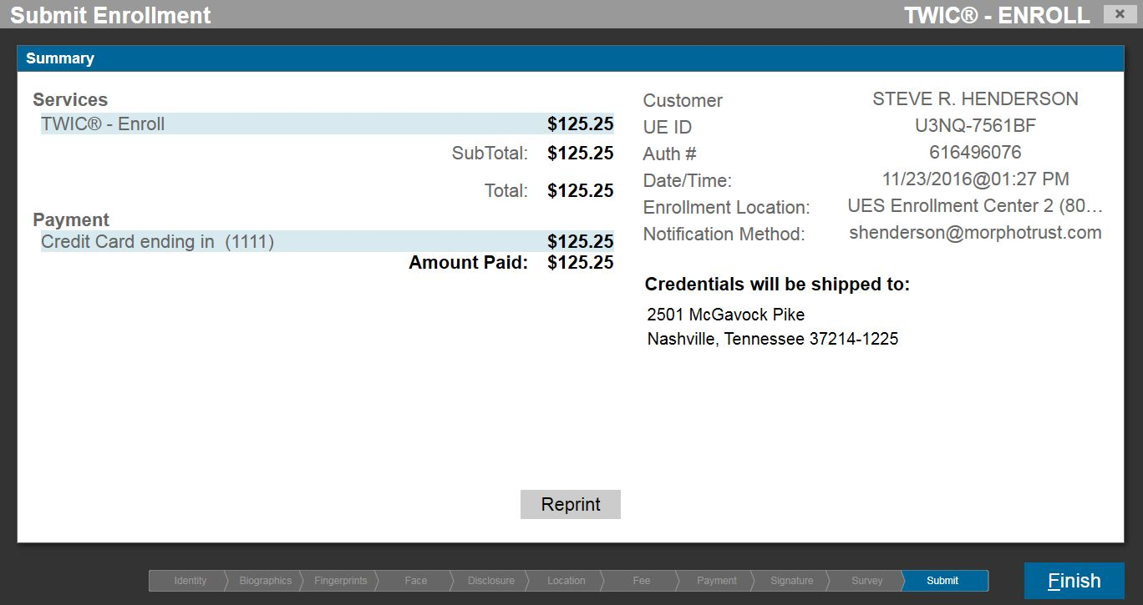
TWIC® Standard Enrollment
START
Biographic Information
Notices
Citizenship
Documents
Attributes
Employment Information
Biometrics
Acknowledgements
Card Issuance
Fee Payment
Submission/
Confirmation
Survey
FINISH

Slide 46
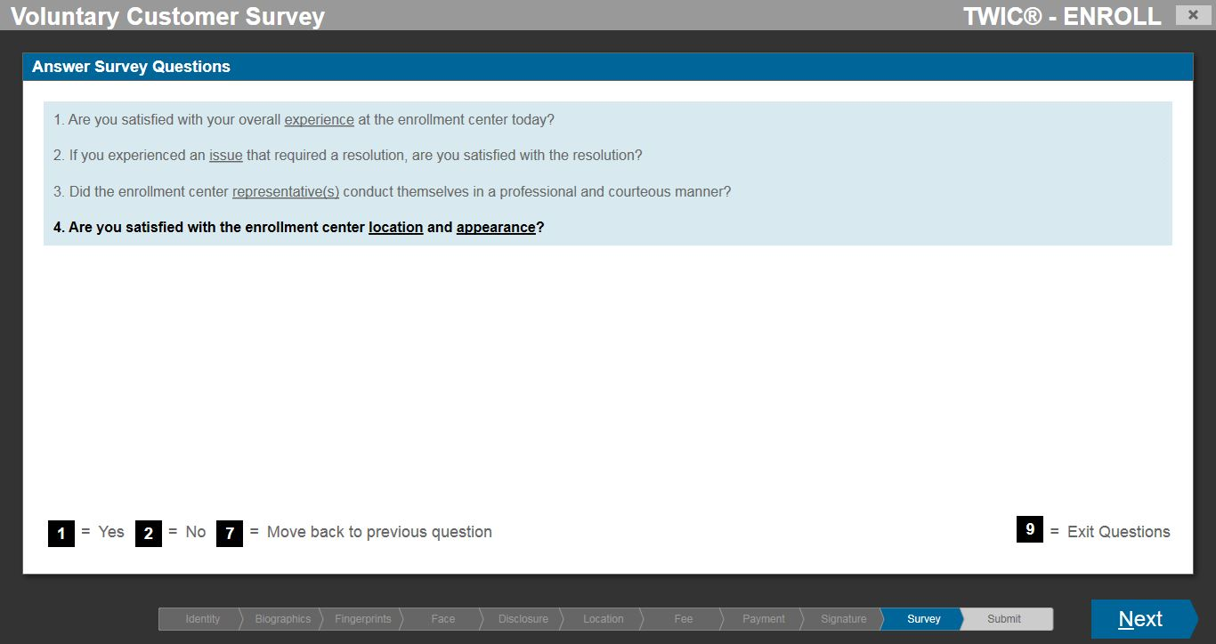
TWIC® Standard Enrollment
START
Biographic Information
Notices
Citizenship
Documents
Attributes
Employment Information
Biometrics
Acknowledgements
Card Issuance
Fee Payment
Submission/
Confirmation
Survey (Optional)
FINISH

Slide 47
Part 3
TWIC® Online Renewal Workflow (Proposed)

Slide 48
TWIC® Online Renewal
*Screenshots are examples only and actual online renewal screens may differ based on development considerations.
START (Applicant Search)
Biographic Information
Notices
Citizenship
Attributes
Applicants may be required to enter their current or expired TWIC® Credential Identification (CIN), printed on the back lower left-hand corner of the physical TWIC® card, to confirm the applicant’s information.
Employment Information
Acknowledgements
Card Issuance
Fee Payment
Submission/
Confirmation
Survey
FINISH

Slide 49
TWIC® Online Renewal
*Screenshots are examples only and actual online renewal screens may differ based on development considerations.
START
Biographic Information
Notices
Citizenship
Attributes
Employment Information
Acknowledgements
Card Issuance
Fee Payment
Submission/
Confirmation
Survey
FINISH

Slide 50
TWIC® Online Renewal
*Screenshots are examples only and actual online renewal screens may differ based on development considerations.
START
Biographic Information
Notices
Citizenship
Attributes
Employment Information
Acknowledgements
Card Issuance
Fee Payment
Submission/
Confirmation
Survey
FINISH

Slide 51
TWIC® Online Renewal
*Screenshots are examples only and actual online renewal screens may differ based on development considerations.
START
Biographic Information
Notices
Citizenship
Attributes
Employment Information
Acknowledgements
Card Issuance
Fee Payment
Submission/
Confirmation
Survey
FINISH

Slide 52
TWIC® Online Renewal
*Screenshots are examples only and actual online renewal screens may differ based on development considerations.
START
Biographic Information
Notices
Citizenship
Attributes
Employment Information
Acknowledgements
Card Issuance
Fee Payment
Submission/
Confirmation
Survey
FINISH

Slide 53
TWIC® Online Renewal
*Screenshots are examples only and actual online renewal screens may differ based on development considerations.
START
Biographic Information
Notices
Citizenship
Attributes
Employment Information
Acknowledgements
Card Issuance
Fee Payment
Submission/
Confirmation
Survey
FINISH

Slide 54
TWIC® Online Renewal
*Screenshots are examples only and actual online renewal screens may differ based on development considerations.
START
Biographic Information
Notices
Citizenship
Attributes
Employment Information
Acknowledgements
Card Issuance
Fee Payment
Submission/
Confirmation
Survey
FINISH

Slide 55
TWIC® Online Renewal
*Screenshots are examples only and actual online renewal screens may differ based on development considerations.
START
Biographic Information
Notices
Citizenship
Attributes
Employment Information
Acknowledgements
Card Issuance
Fee Payment
Submission/
Confirmation
Survey
FINISH

Slide 56
TWIC® Online Renewal
*Screenshots are examples only and actual online renewal screens may differ based on development considerations.
START
Biographic Information
Notices
Citizenship
Attributes
Employment Information
Acknowledgements
Card Issuance
Fee Payment
Submission/
Confirmation
Survey
FINISH

Slide 57
TWIC® Online Renewal
*Screenshots are examples only and actual online renewal screens may differ based on development considerations.
START
Biographic Information
Notices
Citizenship
Attributes
Employment Information
Acknowledgements
Card Issuance (Mailing Address)
Fee Payment
Submission/
Confirmation
Survey
FINISH

Slide 58
TWIC® Online Renewal
*Screenshots are examples only and actual online renewal screens may differ based on development considerations.
START
Biographic Information
Notices
Citizenship
*Note: The TWIC® online renewal fee may be reduced to reflect the enrollment segment costs of online transaction. (The example depicts the TWIC® standard enrollment fee.)
Applicants may enter an Authorization Code for payment if obtained from TSA or another Federal agency.
Attributes
Employment Information
Acknowledgements
Card Issuance
Fee Payment
Submission/
Confirmation
Survey
FINISH

Slide 59
TWIC® Online Renewal
*Screenshots are examples only and actual online renewal screens may differ based on development considerations.
START
Biographic Information
Notices
Citizenship
*Note: The TWIC® online renewal fee may be reduced to reflect the enrollment segment costs of online transaction. (The example depicts the TWIC® standard enrollment fee.)
Attributes
Employment Information
Acknowledgements
Card Issuance
Fee Payment
Submission/
Confirmation
Survey
FINISH

Slide 60
TWIC® Online Renewal
*Screenshots are examples only and actual online renewal screens may differ based on development considerations.
START
Biographic Information
Notices
Citizenship
*Note: The TWIC® online renewal fee may be reduced to reflect the enrollment segment costs of online transaction. (The example depicts the TWIC® standard enrollment fee.)
Attributes
Employment Information
Acknowledgements
Card Issuance
Fee Payment
Submission/
Confirmation (Receipt)
Survey
FINISH

Slide 61
TWIC® Online Renewal
*Screenshots are examples only and actual online renewal screens may differ based on development considerations.
START
Biographic Information
Notices
Citizenship
*Note: Survey questions for online renewal applicants may be updated to eliminate questions on enrollment representatives and locations.
Attributes
Employment Information
Acknowledgements
Card Issuance
Fee Payment
Submission/
Confirmation (Receipt)
Survey (Optional)
FINISH

Slide 62
TWIC® Online Renewal
*Screenshots are examples only and actual online renewal screens may differ based on development considerations.
If during the online renewal process TSA determines that the applicant is required to visit an enrollment center in-person to provide updated biographic or biometric information, the applicant will have the opportunity to schedule an appointment.

Slide 63
Part 4
TWIC® Post-Enrollment Survey

Slide 64
TWIC® Post-Enrollment Survey
Do you want to participate in this optional survey?
YES
NO
All applicants receive the option to complete a post-enrollment survey. Currently, this survey is offered during the in-person standard enrollment workflow at the enrollment workstation.
TSA plans to transition the optional survey to a web-based survey that will be sent to TWIC® applicants via e-mail or hyperlink following submission of their enrollment. Applicants will have the ability to complete the optional survey after departing the enrollment site.

