Slide 1

Basic Annual Report Information from NFIRS:
A National Perspective
December 6, 2007

Slide 2
What is an
Annual Report?
“A document that summarizes the results of operations and financial status of a company for the past year and outlines plans for the future.”
“A report card.”
“An annual performance review, without a raise.”

Slide 3
Annual Reports in the Fire Service
No standard format
Captures the essence of a multi-tasking, complex operation
Varying Audiences
Each report is unique

Slide 4
National vs Local
Perspective
Annual Report (Fire in the United States) at the National level:
  Presents overview of the size and scope of the U.S. fire problem and its components
  Provides detailed information on the components
  Seeks to mitigate the fire problem by understanding it
The overall USFA format may not apply, but the components of the report are useful for other Annual Reports
Commonalities in analysis and presentation

Slide 5
Major Analysis Areas
Fires
Civilian and firefighter deaths
Civilian and firefighter injuries
Dollar loss (property loss + contents loss)
Today’s focus: Fires

Slide 6
In the Beginning….
As you prepare your Annual Report:
Decide focus
Identify audience
Determine data needs
Determine appropriate analysis tools
Determine appropriate data presentation

Slide 7
Data Topics
Not Addressed Today
Non-NFIRS related data:
  Outreach (public education and other)
  Data on inspections
  Arson and arson investigations
NFIRS related data:
  Overall run distributions; fires only
  (which excludes mutual aid)
  Dollar loss (missing values)
  Multiple entry data elements (e.g., human factors contributing to ignition, etc.)
  Complex analytic issues
  (e.g., combining data from multiple elements, etc.)

Slide 8
Analytic Topics
Not Addressed Today continued
Trend analysis – comparison of percentage change indicators
Statistical significance
Computation of Rates

Slide 9
Topics to Consider
NFIRS “unknown” codes (U, UU, UUU) and missing data (blanks or null values)
Data interpretation and presentation – is it more effective to present the data in a graph or table?
Confined fires
Mutual aid
NFIRS version 5.0 vs. 4.1

Slide 10
What is it that we want to know?
For the fire portion of a typical Annual Report:
  Types of fires
  When fires occur
  Where fires occur
  How much loss
  Cause of fire

Slide 11
Data Analysis
With the audience identified and the focus of the report established:
Choose analysis tools
Determine NFIRS data elements to use

Slide 12
Analysis Tools
Software (e.g., Excel, SAS, SQL Server)
NFIRS 5.0 Complete Reference Guide: http://www.nfirs.fema.gov/documentation/reference/
NFIRS Training Courses: http://www.usfa.dhs.gov/fireservice/nfirs/training/index.shtm
Fire Data Analysis Handbook, Second Edition, January 2004: http://www.usfa.dhs.gov/downloads/pdf/publications/
fa-266.pdf

Slide 13
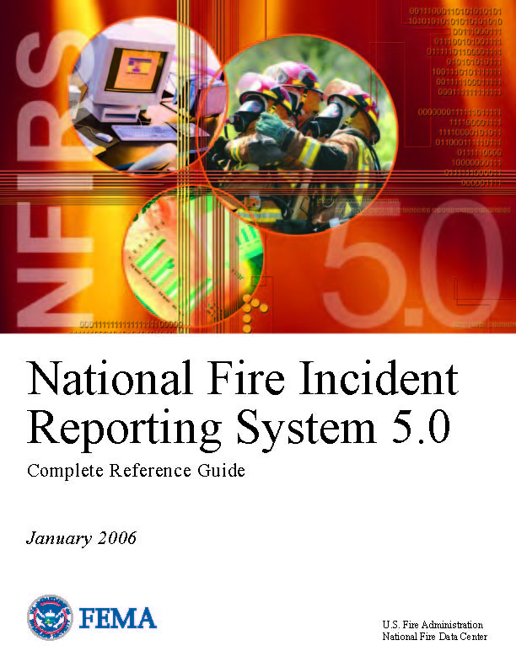
NFIRS 5.0 Complete
Reference Guide:
http://www.nfirs.fema.gov/
documentation/reference/

Slide 14

NFIRS Training Courses:
http://www.usfa.dhs.gov/fireservice/nfirs/training/index.shtm

Slide 15

Fire Data Analysis Handbook, Second Edition, January 2004:
http://www.usfa.dhs.gov/downloads/pdf/publications/
fa-266.pdf

Slide 16
Determine Which NFIRS
Data Elements to Use
Data element(s) appropriate for the information presented
Decide which specific NFIRS codes apply
If NFIRS 4.1 is used, be aware of the differences from NFIRS 5.0
Exclude mutual aid incidents (i.e., where AID ≠ 3
and AID ≠ 4) to avoid double counting fires

Slide 17
Data Interpretation and Presentation
Tables
Graphs
  Appropriate scales
  Bar
  Histogram
  Line
  Pie
Source
Appropriate Titling
Proper Labeling

Slide 18
How to Define
Fire Using NFIRS
From the NFIRS basic module
  Version = 5.0
  Exclude mutual aid incidents
  (i.e., where AID ≠ 3 and AID ≠ 4)
  Incident type (INC_TYPE) 100, 111-173
Note: When analyzing only version 5.0 data,
exclude incident type 110 (4.1 conversion only)

Slide 19
What types of fires occur?
Structure
Vehicle
Outside
Other

Slide 20
How to Define
Types of Fires Using NFIRS
General incident types
  Structures
    Incident type: 111-123
  Vehicles
    Incident type: 130-139
  Outside
    Incident type: 140-162, 164-173 (note, excludes 163)
  Other
    Incident type: 100-109, 163 (outside gas/vapor combustion/explosion)

Slide 21
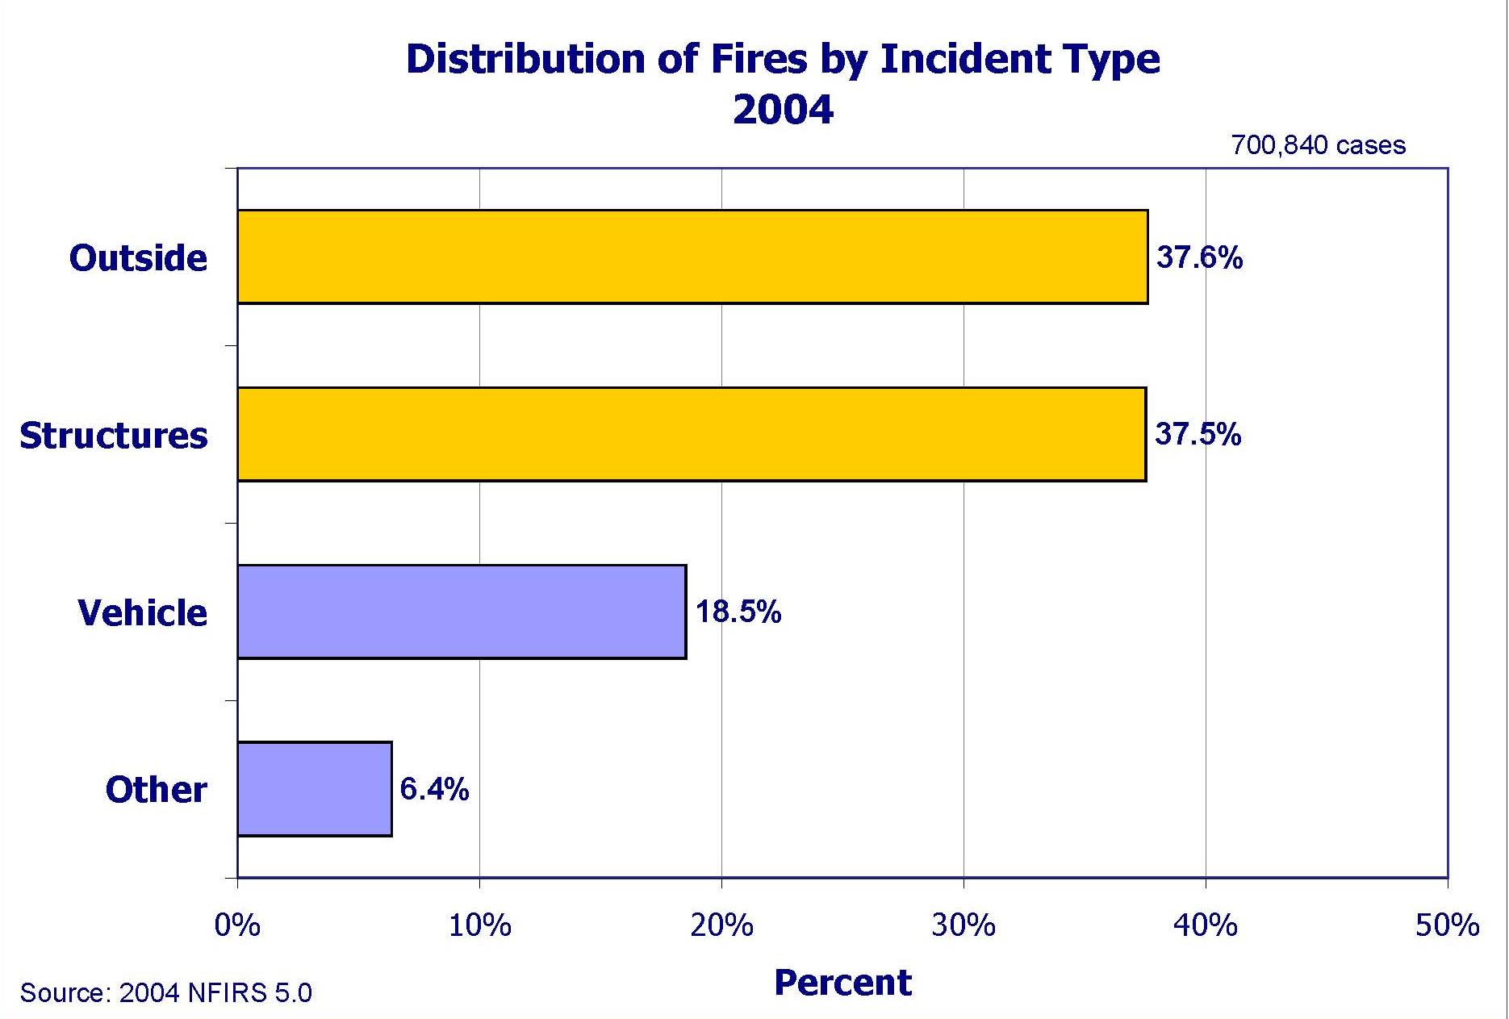
Examples: Distribution of Fires by General Incident Type
Graphically:

Slide 22
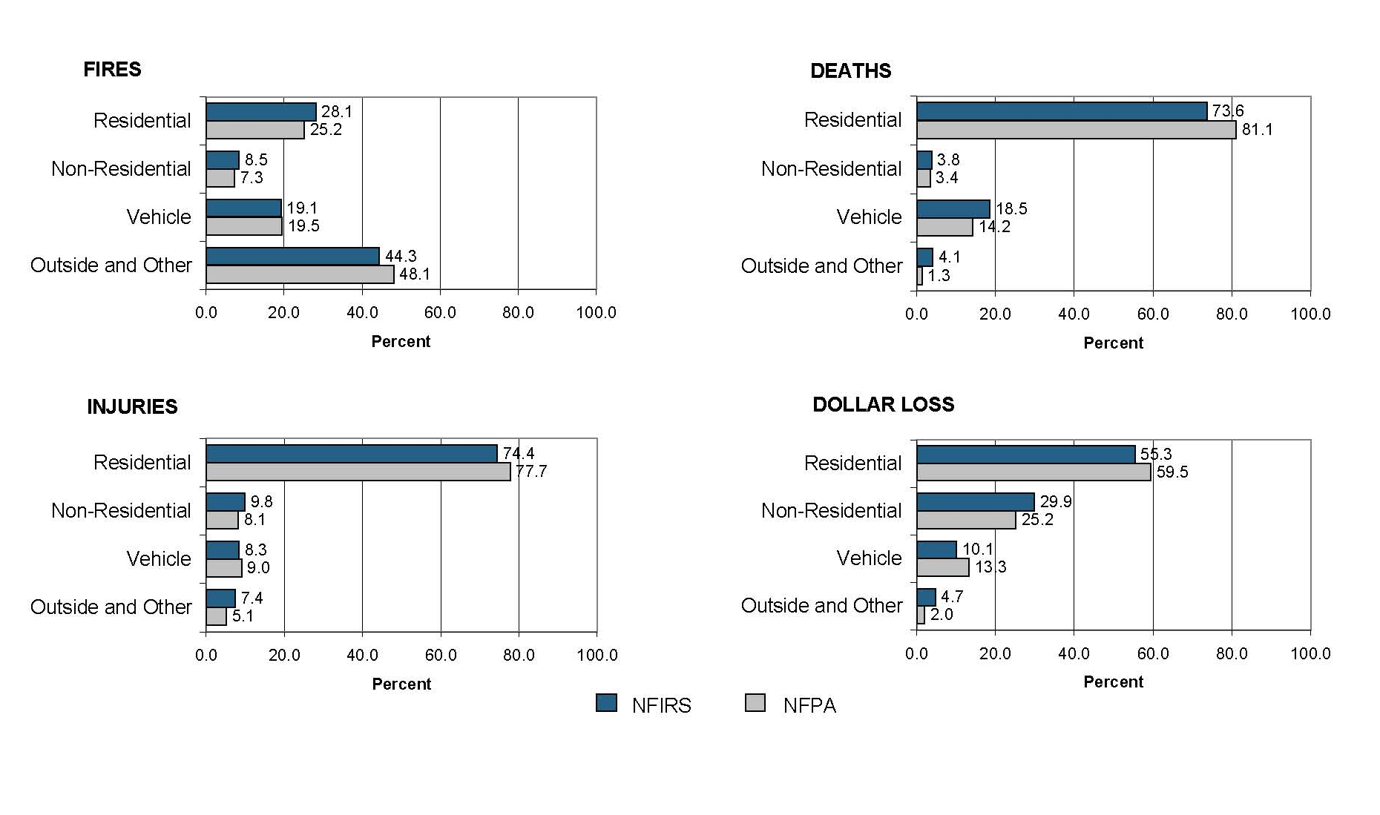
Figure 3: Comparison of NFIRS Data with NFPA
Estimates by General Property Type (3-year average)
Sources: 2002-2004 NFIRS 5.0
2002-2004 NFPA

Slide 23
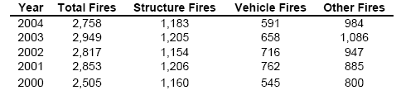
Or, use a table:

Slide 24
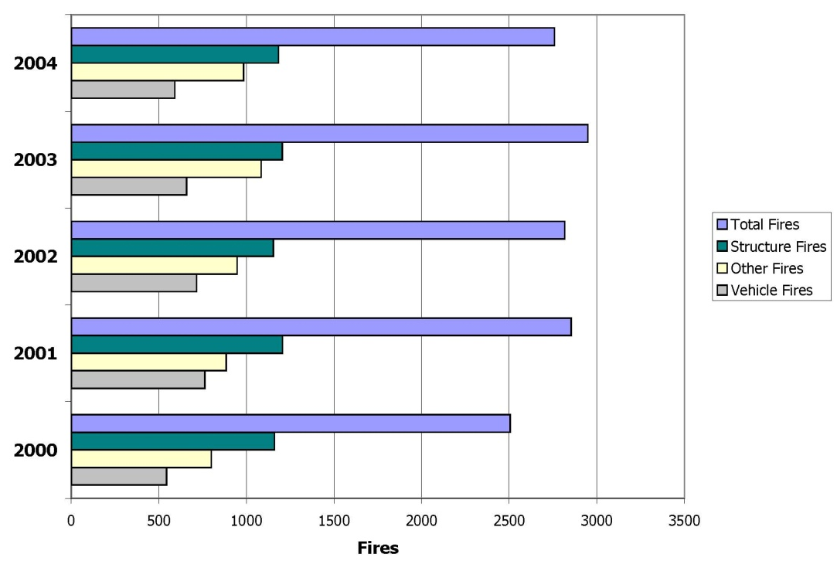
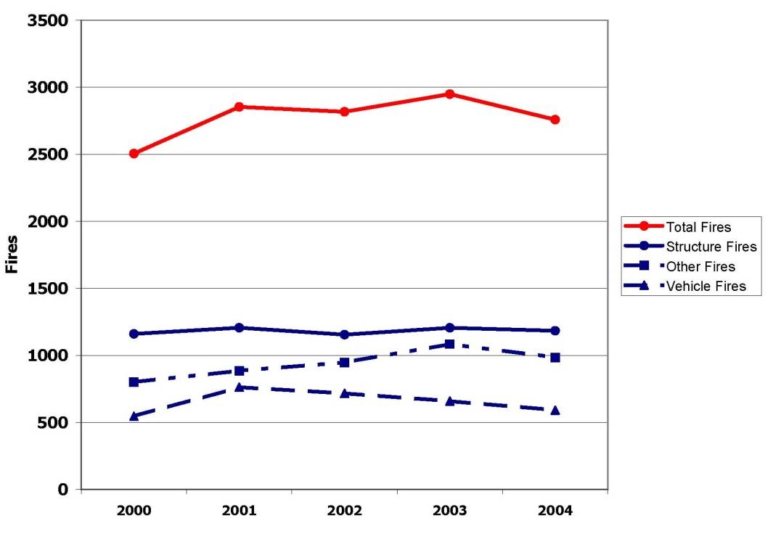
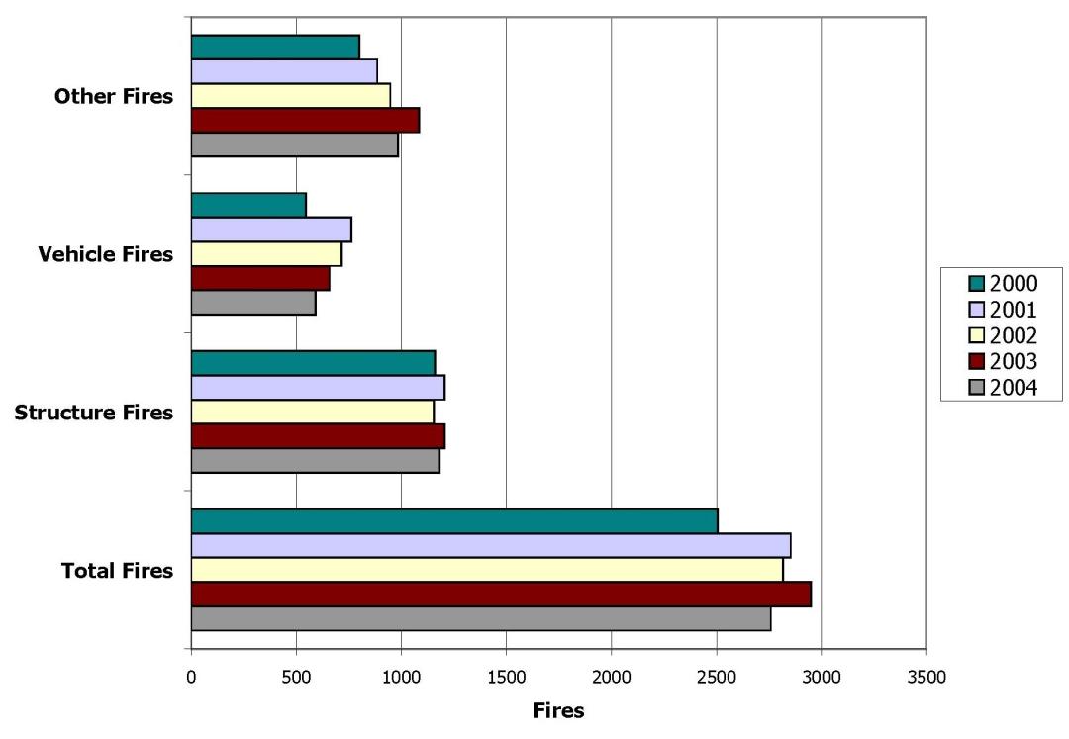
Total Fires and Fires by Major Incident Type 2000-2004
Total Fires and Fires by Major Incident Type 2000-2004
Total Fires and Fires by Major Incident Type 2000-2004

Slide 25
Temporal Analyses:
When Do Fires Occur?
Month/Season
Day of Week
Year
Time of Day

Slide 26
How to Define
When Fires Occur Using NFIRS
From the NFIRS basic module
  Version = 5.0
  Exclude mutual aid incidents
  (i.e., where AID ≠ 3 and AID ≠ 4)
  Define fires (based on INC_TYPE)
  Incident date (INC_DATE)
  Alarm time (ALARM)
Month: Characters 1-2 of the incident date field
Day: Characters 3-4 of the incident date field
Year: Characters 5-8 of the incident date field
Time: Characters 9-12 of the alarm time field

Slide 27
Examples: When Fires Occur

Slide 30
Fire Incident Reporting by Day of the Week
2004
Source: 2004 (etc…)

Slide 31
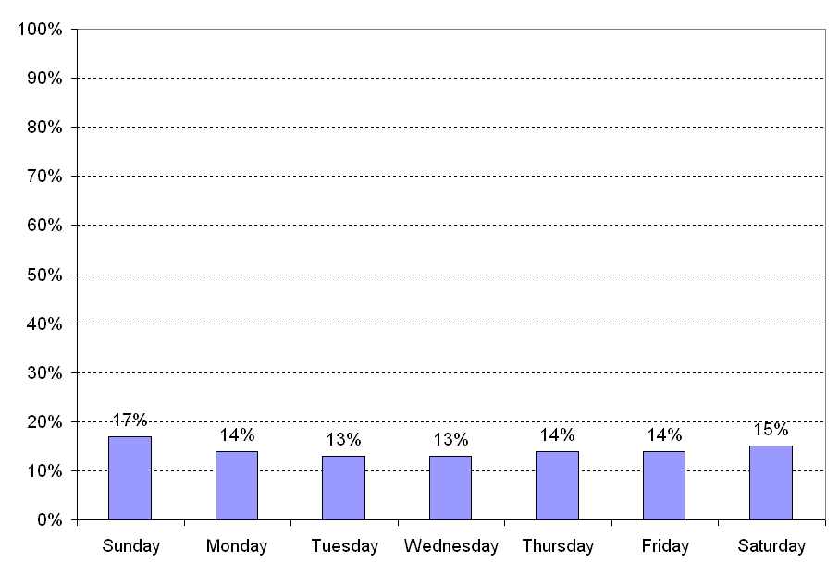
Fire Incident Reporting by Day of the Week
2004
Source: 2004 (etc…)

Slide 34
Where do fires occur?
Property Use
Area of Fire Origin
Geographic Location

Slide 35
How to Define
Where Fires Occur Using NFIRS
From the NFIRS basic module
  Version = 5.0
  Exclude mutual aid incidents
  (i.e., where AID ≠ 3 and AID ≠ 4)
  Define fires (based on INC_TYPE)
  Property use (PROP_USE)
  State (STATE)
From the NFIRS header module
  County (FD_FIP_CTY)
From the NFIRS fire module
  Area of fire origin (AREA_ORIG)

Slide 36
Property Use
Assembly
  PROP_USE: 100-199
Educational
  PROP_USE: 200-299
Health Care, Detention and Correction
  PROP_USE: 300-399
Residential
  PROP_USE: 400-499
Mercantile, Business
  PROP_USE: 500-599
Industry
  PROP_USE: 600-699
Manufacturing
  PROP_USE: 700
Storage
  PROP_USE: 800-899
Outside or Special Property
  PROP_USE: 900-999
Property Use, Other
  PROP_USE: 000
None
  PROP_USE: NNN
Undetermined
  PROP_USE: UUU
Null or Missing Values
  PROP_USE: blank

Slide 37
Examples: Where Fires Occur
Property Types

Slide 39
Area of Fire Origin
Means of Egress
  AREA_ORIG: 01-09
Assembly or Sales Areas
  AREA_ORIG: 10-17
Function Areas
  AREA_ORIG: 20-28
Technical Processing Areas
  AREA_ORIG: 30-38
Storage Areas
  AREA_ORIG: 40-47
Service Areas
  AREA_ORIG: 50-58
Service or Equipment Areas
  AREA_ORIG: 60-68
Structural Areas
  AREA_ORIG: 70-78
Transportation, Vehicle Areas
  AREA_ORIG: 80-86
Outside Areas
  AREA_ORIG: 90-98
Area of Fire Origin, Other
  AREA_ORIG: 00
Undetermined
  AREA_ORIG: UU

Slide 40
Examples: Where Fires Occur
Area of Fire Origin

Slide 42
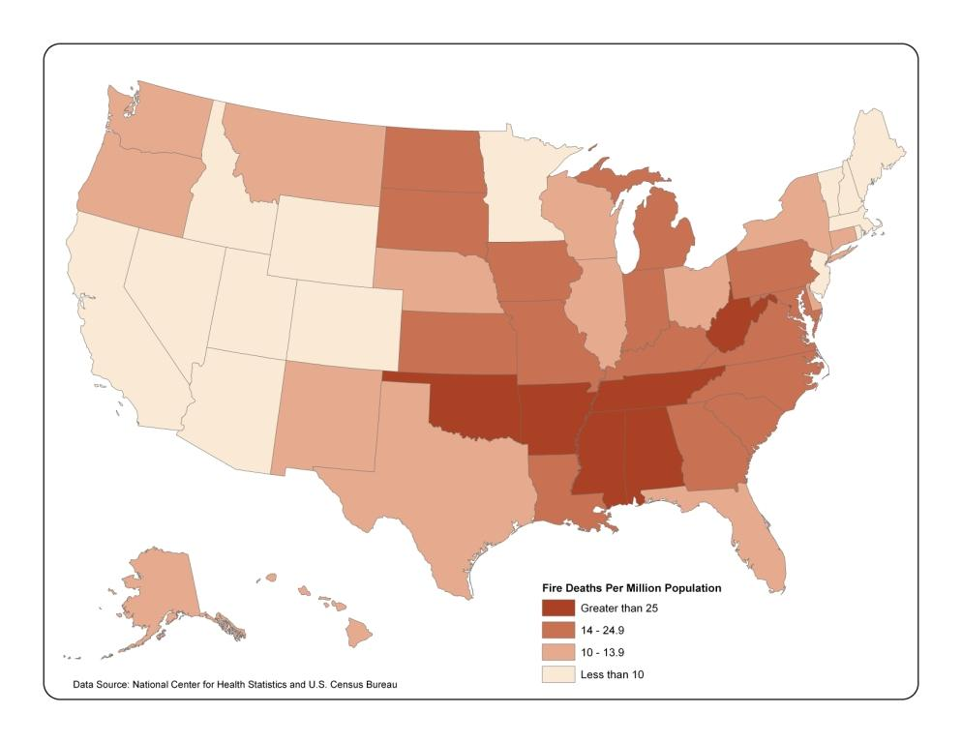
Example: Where Fires Occur
Geographic Location
(Spatial Analyses)

Slide 43
How Much Loss Occurs?
Deaths
Injuries
Contents Loss
Property Loss
Fire Spread

Slide 44
How to Define
Losses Using NFIRS
From the NFIRS basic module
  Version = 5.0
  Exclude mutual aid incidents
  (i.e., where AID ≠ 3 and AID ≠ 4)
  Define fires (based on INC_TYPE)
  Deaths (OTH_DEATH)
  Injuries (OTH_INJ)
  Total dollar loss = Contents loss (CONT_LOSS) + Property loss (PROP_LOSS)
From the NFIRS structure fire module
  Fire Spread (FIRE_SPRD)

Slide 45
Fire Spread and
Confined Fires
Confined fires, by definition, are confined to the object of origin (FIRE_SPRD=1)
  Confined Fires = INC_TYPE 113 to 118
Abbreviated reporting may limit the number of confined fires with fire spread entries
Confined fires with no (or NULL) fire spread entries then need to be counted in with FIRE_SPRD=1

Slide 46
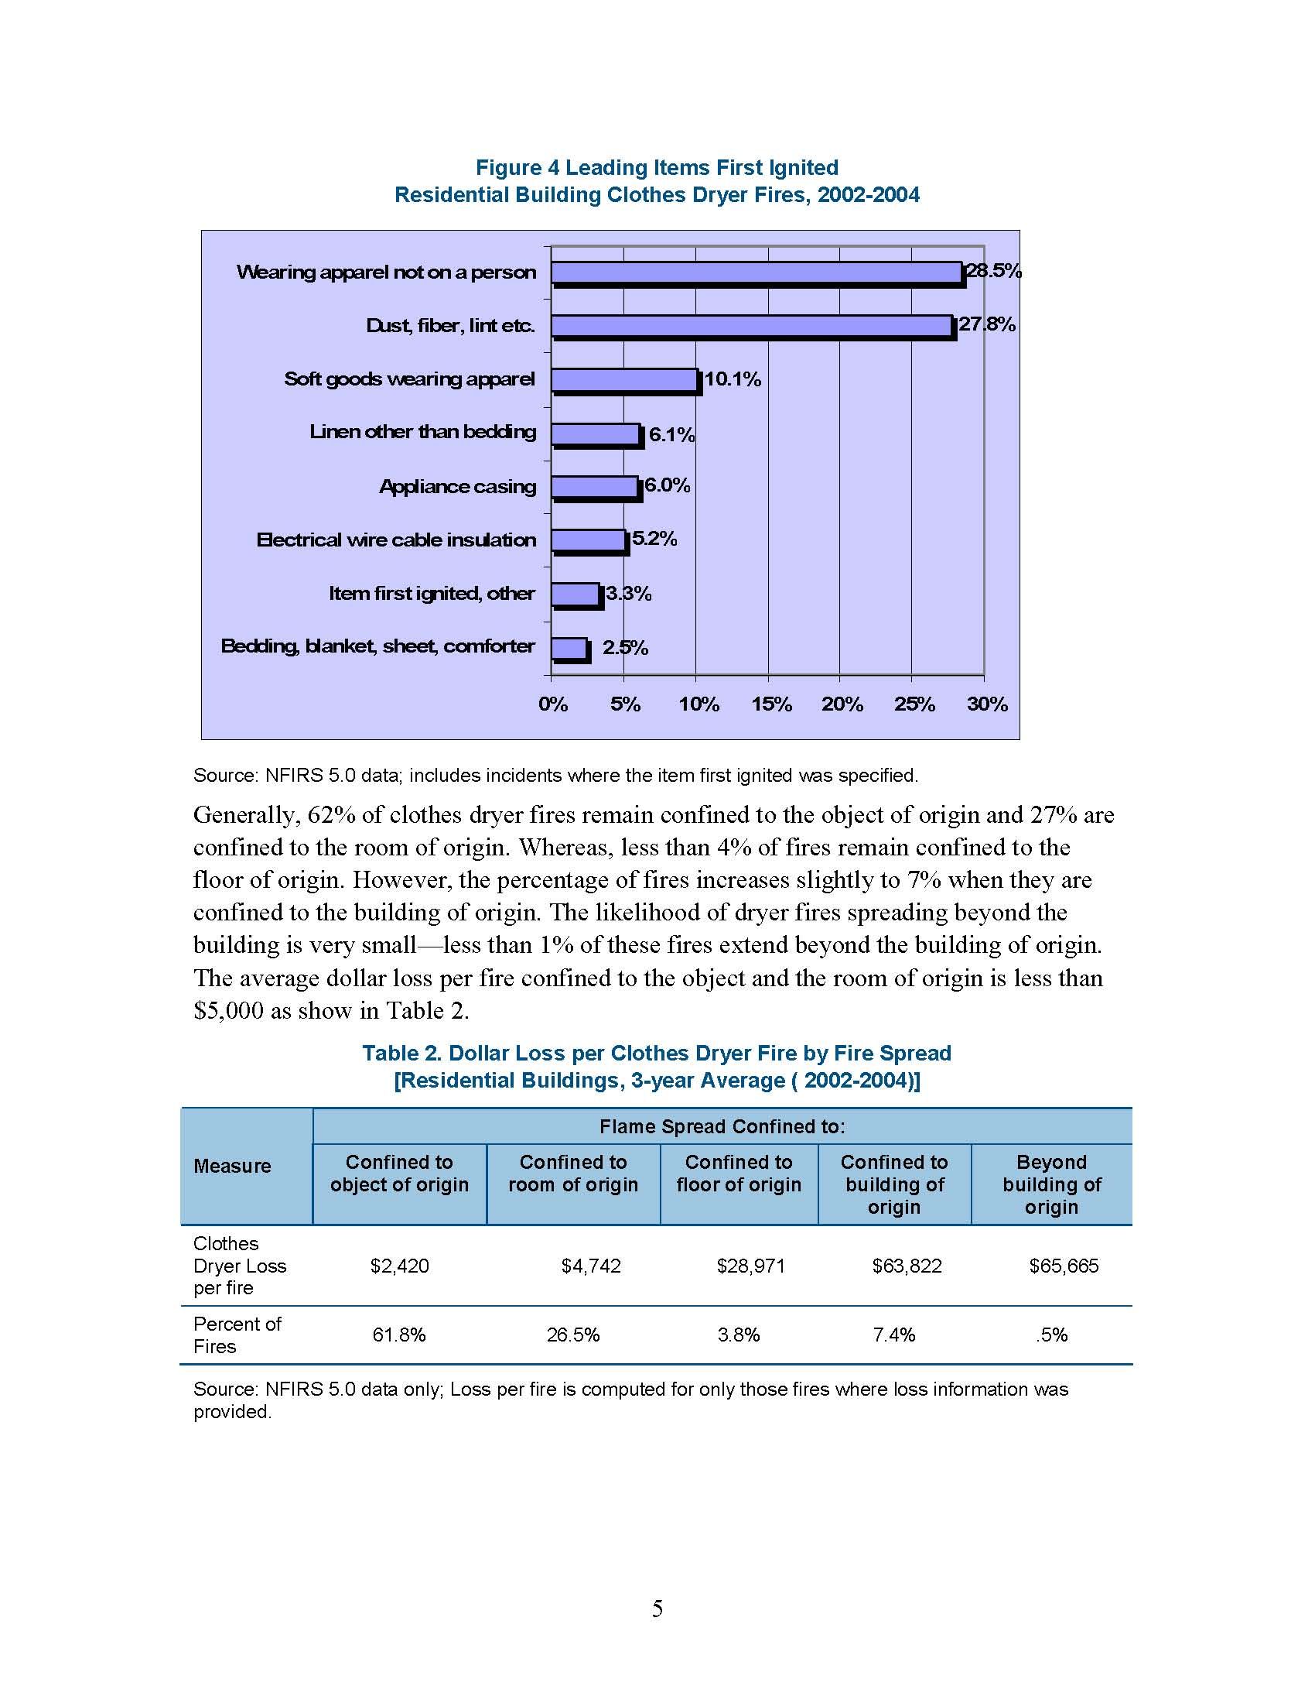
Examples: Fire Spread

Slide 47
What causes the fire?
At USFA, fire cause for structures is determined by information gathered from several data fields from different NFIRS modules.
Cause is mutually exclusive – one and only one cause is assigned to each incident
The cause hierarchy is designed for structure fires, but currently is applied to all fires.
Separate cause hierarchies are under development for vehicles and outside/other fires.
What does this mean for you?

Slide 48
How to Define
Cause Using NFIRS
Option: Implement USFA cause methodology
Option: Cause-related fields from the NFIRS fire module
  Cause of ignition (CAUSE_IGN)
  Equipment involved in ignition (EQUIP_INV)
  Factors contributing to ignition (FACT_IGN_1, FACT_IGN_2)
  Human factors contributing to ignition
  (HUM_FACT1, … , HUM_FACT8)
  Heat source (HEAT_SOURC)
None of these NFIRS variables individually defines fire cause

Slide 49
The NFIRS Cause
Methodology
Cause is a complex chain of events
Hierarchy of definitions
  Assign fire to highest category – if it does not fit in the top category, then consider the second; if not that one, then the third, etc.
Three level process
  Priority cause – Initial hierarchy, 34 categories
  Cause – 34 priority groupings condensed into 16 major groups.
  General Cause – 16 causes condensed into 7 general causes

Slide 50
Cause Hierarchy
Components
Primary Variables Used
  Cause of ignition (CAUSE_IGN)
  Equipment involved in ignition (EQUIP_INV)
  Factors contributing to ignition (FACT_IGN_1, FACT_IGN_2)
  Heat source (HEAT_SOURC)
  Human factors contributing to ignition
  (HUM_FACT1, … , HUM_FACT8)
  Area of Origin (AREA_ORIG)
Secondary Variables
  Age, Equipment power source (EQ_POWER), Mobile property involved (MOB_INVOL)

Slide 51
Hierarchy Matrix
Cause Category Methodology Matrix:
  http://www.nfirs.fema.gov/jsps/nfirsdownload.jsp?url=
  /_download/50causematrix01012004.xls

Slide 52
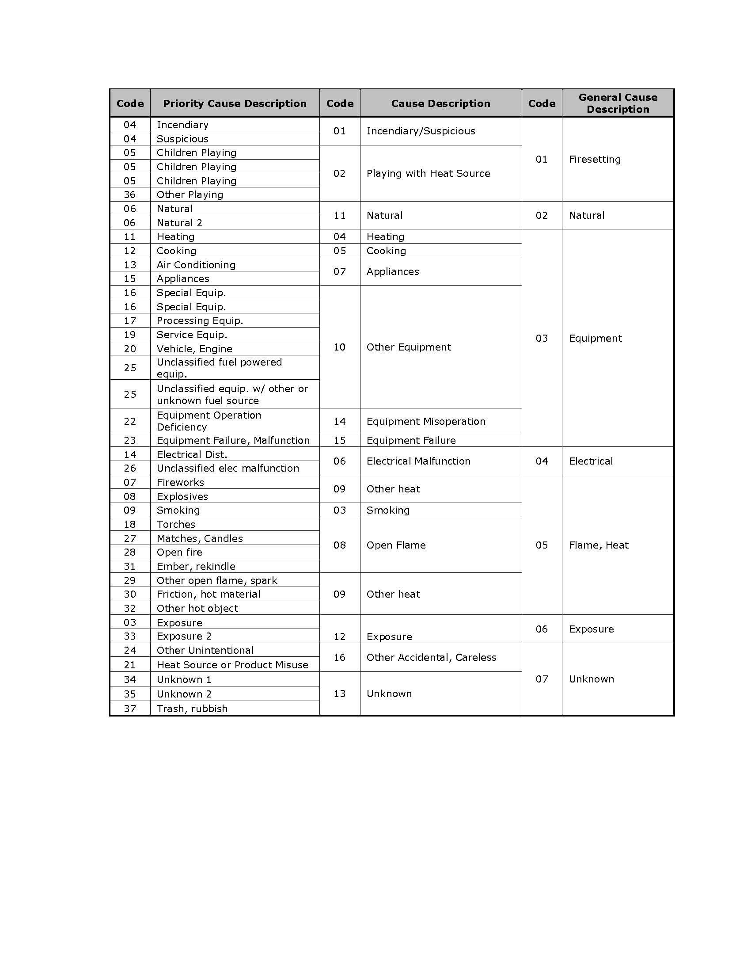

Slide 53
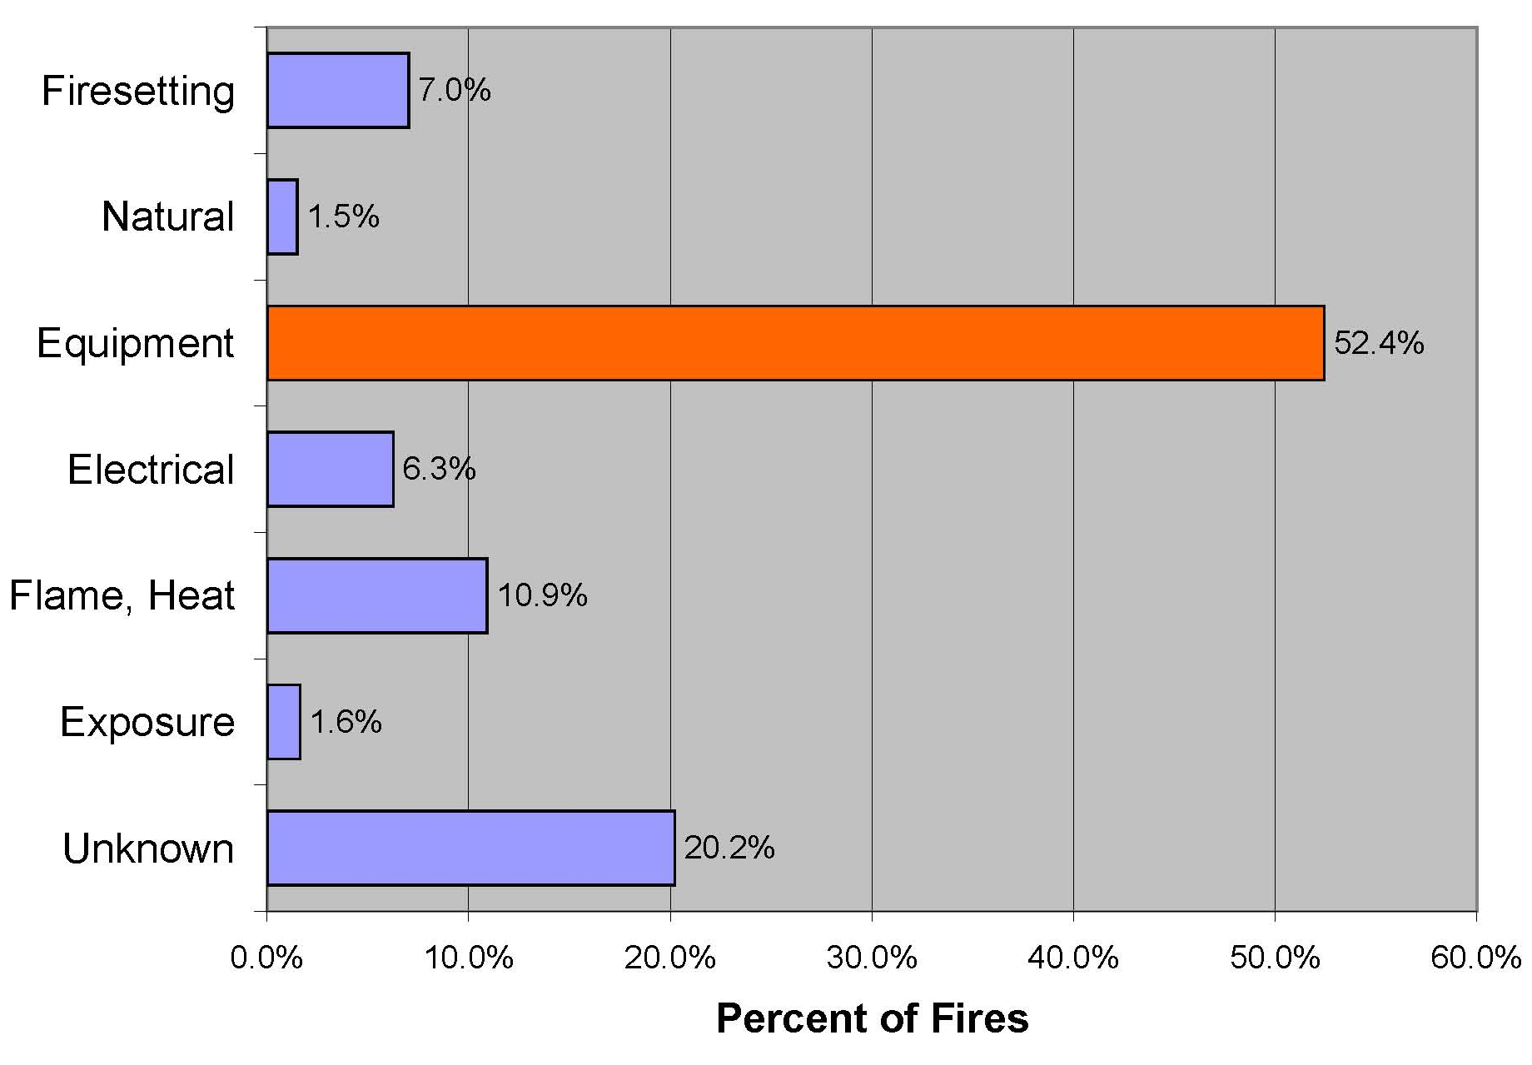
Examples: Fire Cause
General Cause of Residential Structure Fires, 2005
Source: 2005 NFIRS 5.0 Data

Slide 54
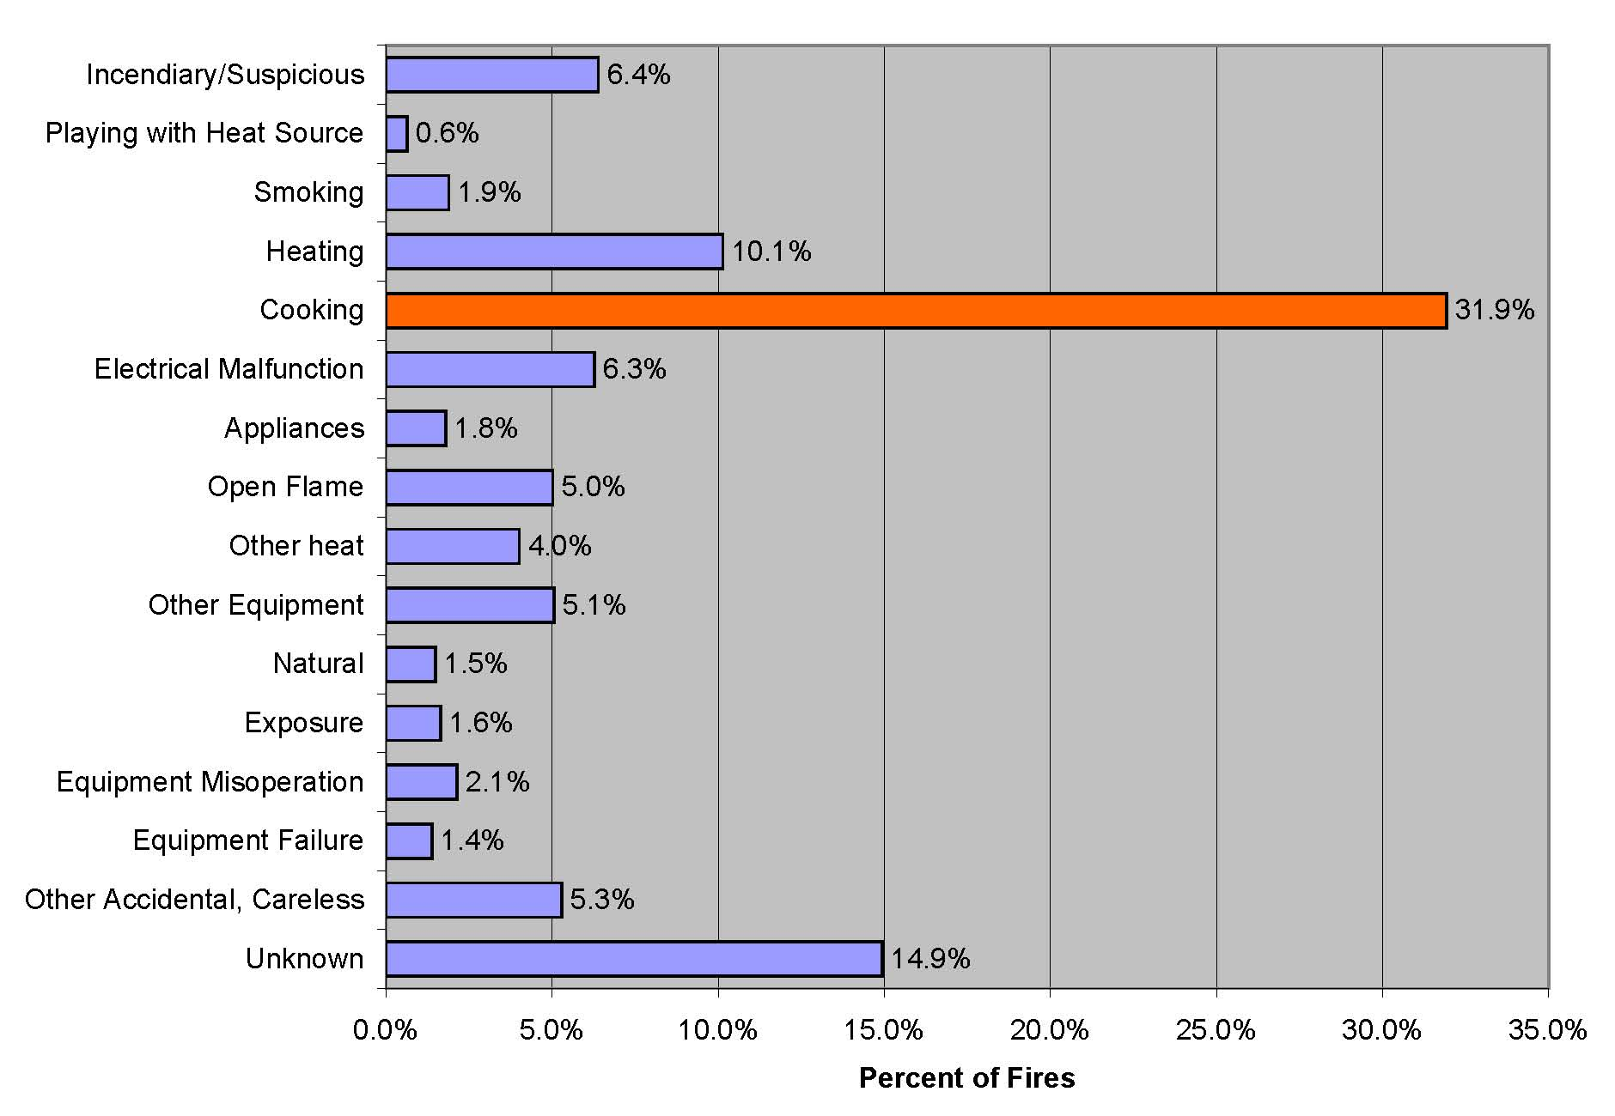
Cause of Residential Structure Fires, 2005
Source: 2005 NFIRS 5.0 Data

Slide 55
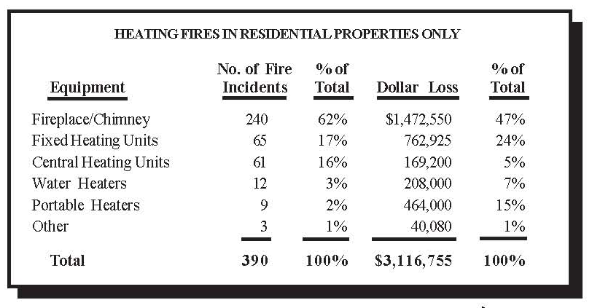
Cause can also be further broken down into components:

Slide 56
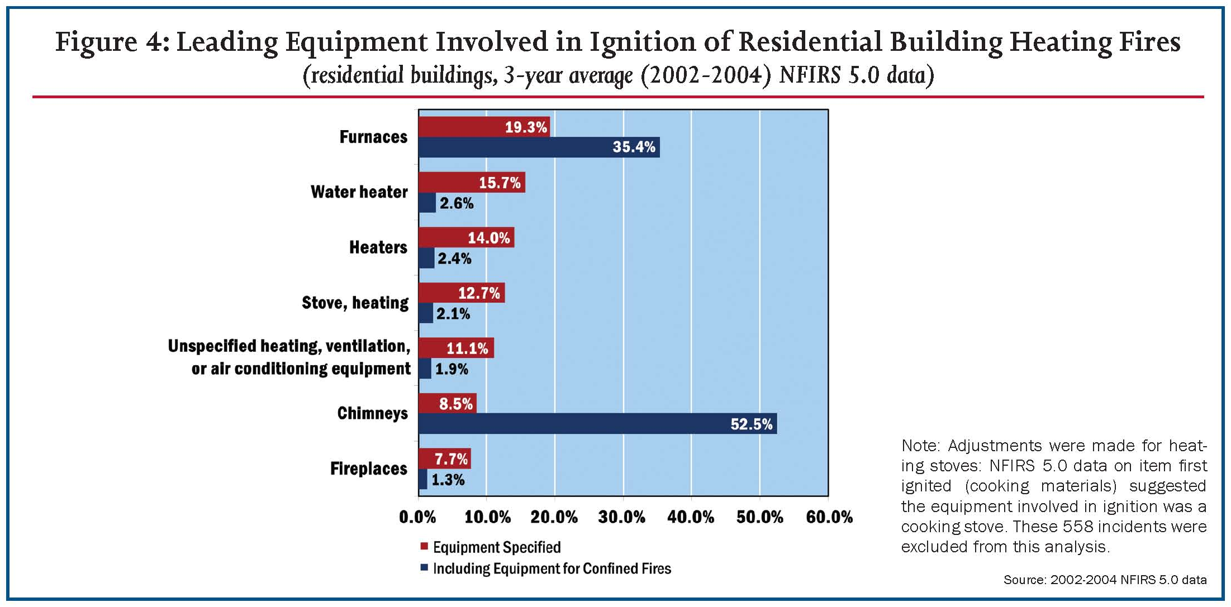

Slide 57
A Last Word:
NFIRS Unknown Values and Missing Data
Unreported data
Data reported as “unknown” or “undetermined”
Adjusting for unknown data – adjusted percentages computed using only those incidents for which data were provided

Slide 58
Summary
Decide focus
Identify audience
Determine data needs
Determine appropriate analysis tools
Determine appropriate data presentation
Write clearly, keep focused

Slide 59
Contact Information
Patricia Frazier, Director
Center for Data Analysis and Special Studies
TriData, a Division of
System Planning Corporation
(703) 351-8300
pfrazier@sysplan.com
www.sysplan.com
Gayle Kelch,
Statistician
National Fire Data Center
U.S. Fire Administration
Federal Emergency Management Agency
Department of Homeland Security
(301) 447-1154
gayle.kelch@dhs.gov
www.usfa.fema.gov

