Slide 1
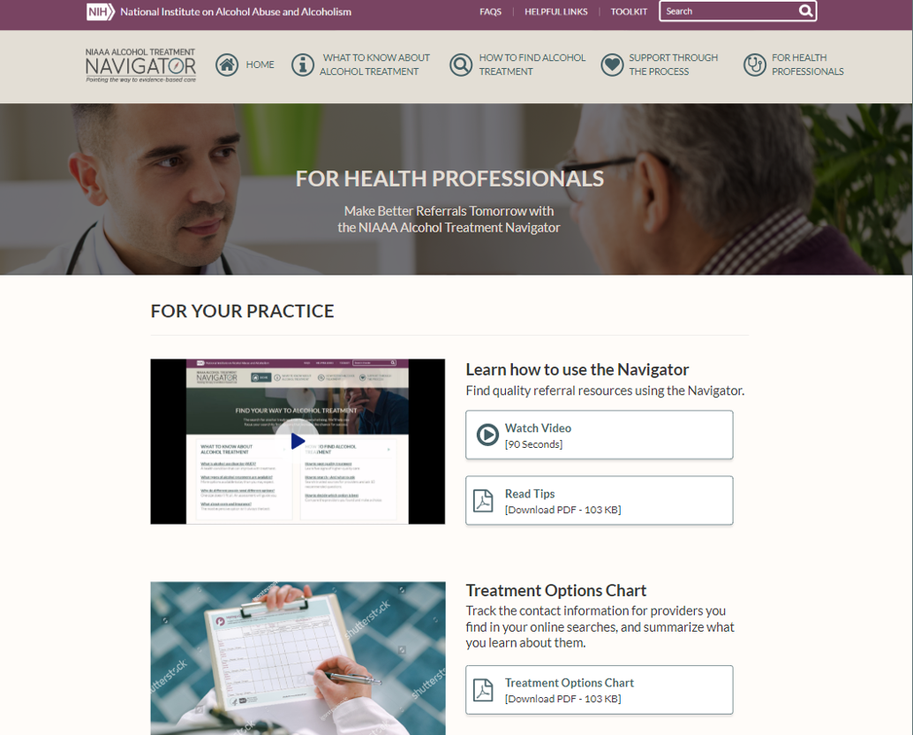
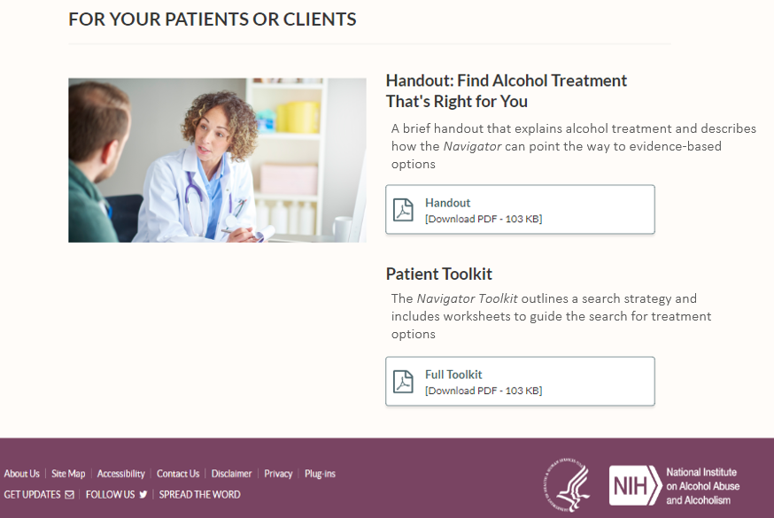
NIAAA Alcohol Treatment Navigator
New Clinician Page
Guidance and fillable forms for you
Handouts for your patients

Slide 2
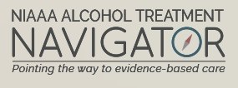
It’s a Search Strategy, Not a Locator
How to create a high-quality, curated referral list of
evidence providers offering evidence-based
alcohol treatment
STEP 1: Search. Use the Navigator search strategies to fill gaps in your referral list. You might add, for example, outpatient and residential programs, as well as board-certified addiction physicians and addiction therapists.
STEP 2: Call. Call the providers and programs to ask questions recommended in the Navigator. See if they offer evidence-based care, meet the needs of your patient population, and are available.
STEP 3: Choose. Select the best options to create your new, expanded referral list.

Slide 3
STEP 1: Search. Use the Navigator search strategies to fill any gaps in your referral list. The Navigator provides trusted directories and strategies to help you find the professional providers highlighted below.

Slide 4
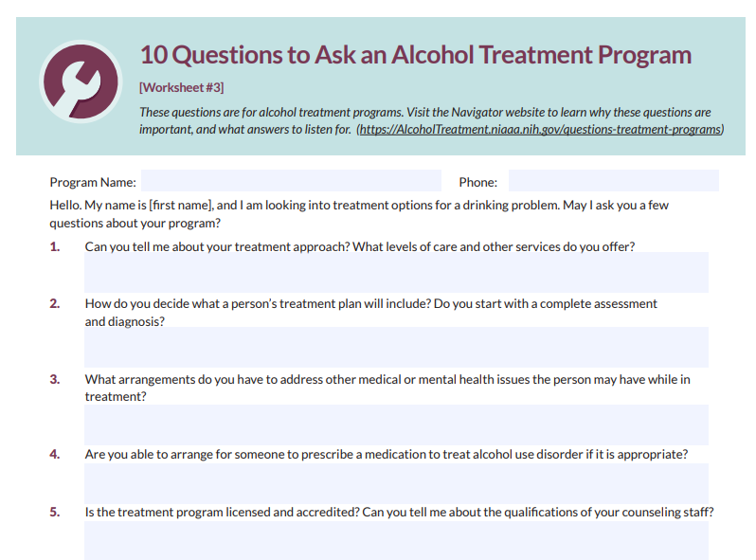
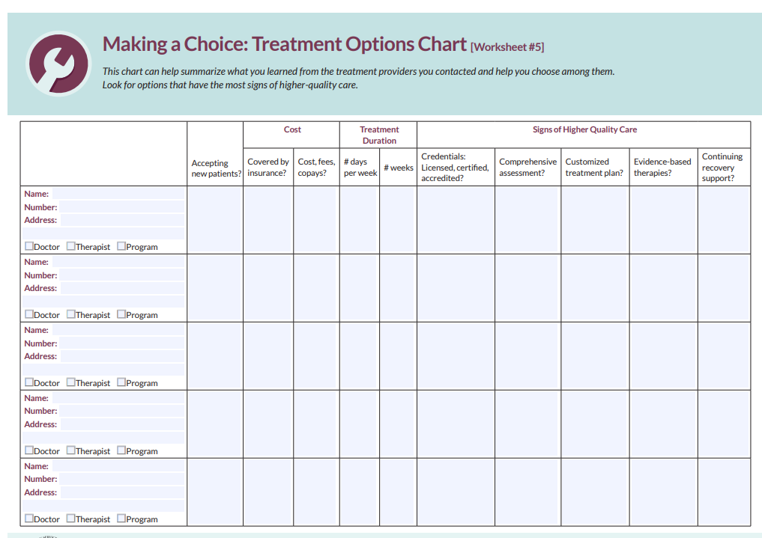
STEP 2: Call. Contact providers and programs to ask specific questions recommended in the Navigator. The Navigator also provides the answers to listen for. See if the providers offer evidence-based care, meet the needs of your patient population, and are available. Capture contact information and details in the Treatment Options Chart, if desired.

Slide 5
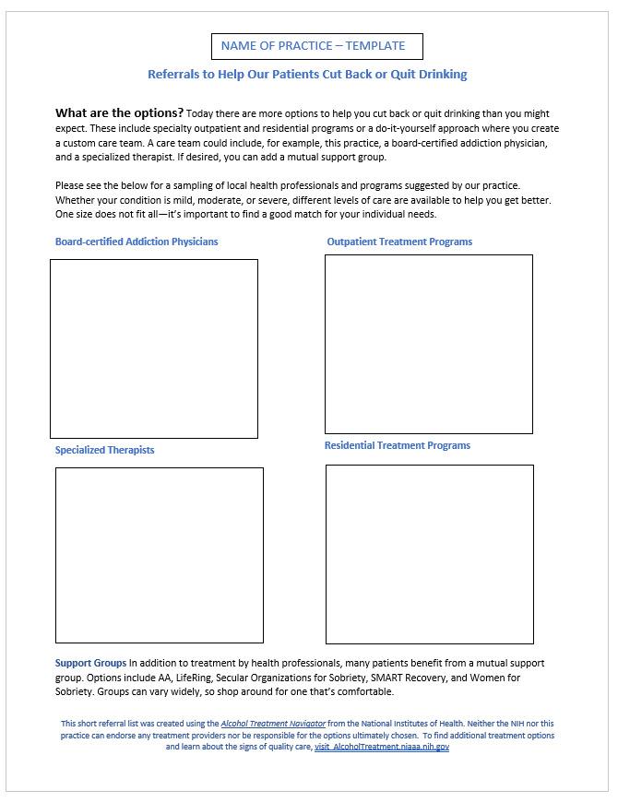
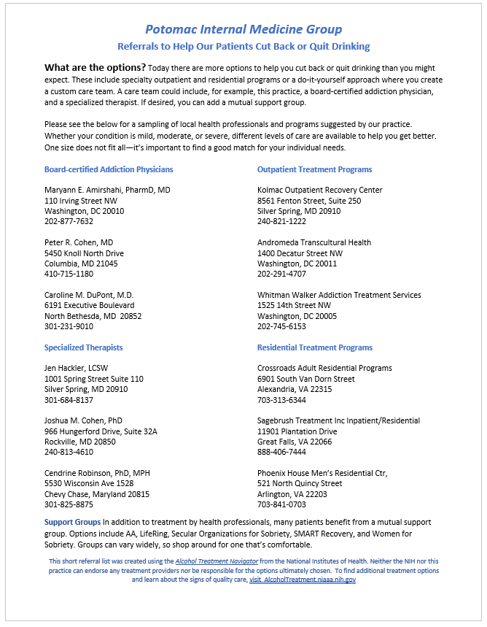
STEP 3: Choose. Select the best options and transfer the contact information create your new, expanded referral list. Enter the providers in the Navigator’s form-fillable Referral List Template if desired.
If desired, use the fillable template to organize the best options you found through your search

Slide 6


NIAAA Clinician’s Core Resource for Alcohol
What Every Clinician Needs to
Know About Alcohol
Clinician’s Core Resource for Alcohol
KNOWLEDGE BANK
What every clinician needs to know about alcohol
Foundational knowledge
Definitions: From moderate & risky drinking patterns to AUD
Risks across the lifespan: From FASD to adolescents to elderly
Neuroscience: AUD as a brain disease
Patient presentation of alcohol-related issues
Common presentations: Medical and mental health issues
Medication interactions: Prevalence and risks
Alcohol withdrawal: Physical and affective features
Clinician strategies for prevention and treatment
Reduce stigma: Increase patient help-seeking behavior
Screen and assess: Use quick, effective methods
Conduct brief intervention: Build motivation to change
Recommend evidence-based treatment: Know the options
Refer to quality providers: Create referral list with new tool
RESOURCE LIBRARY
Primary Care
Hepatology
OB/GYN
Emergency Care
Health Systems

Slide 7
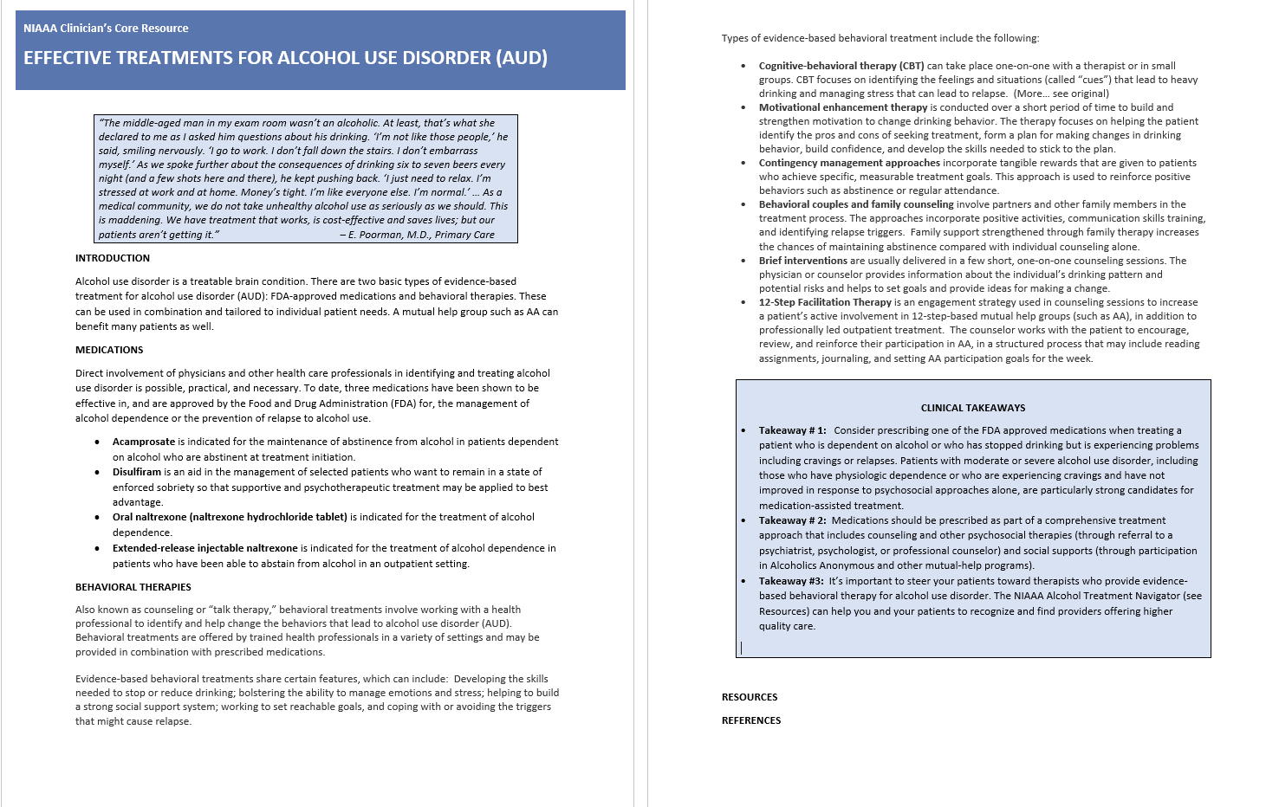
NIAAA Clinician’s Core Resource
Sample Article

Slide 8
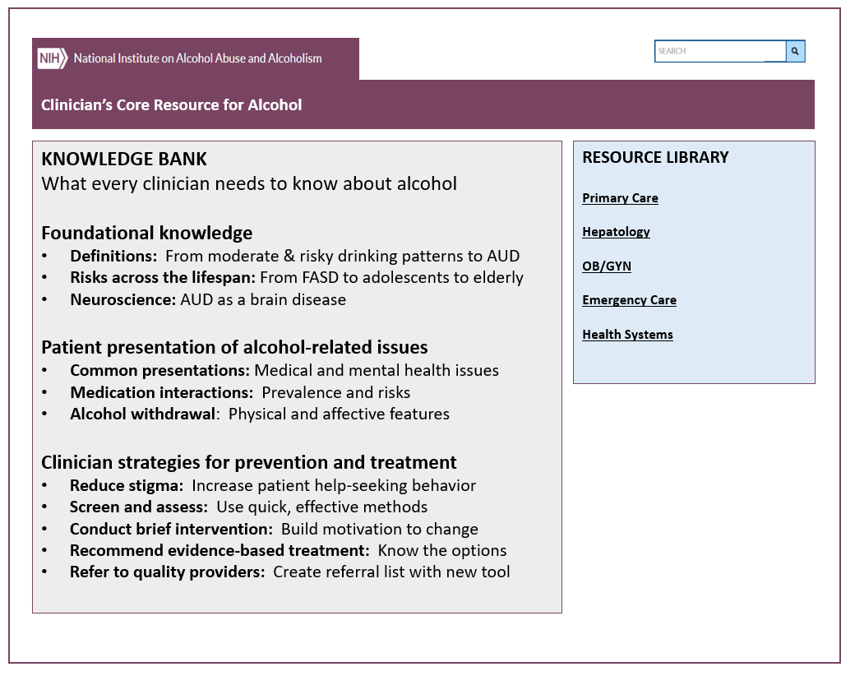
NIAAA Alcohol Treatment Navigator
Make Better Referrals for
Patients With Alcohol Problems
NIAAA Clinician’s Core Resource for Alcohol
What Every Clinician Needs to Know
About Alcohol

