Slide 1

CBP One
TM
Submit Advance Information (Non-MPP)
April 29, 2021

Slide 2
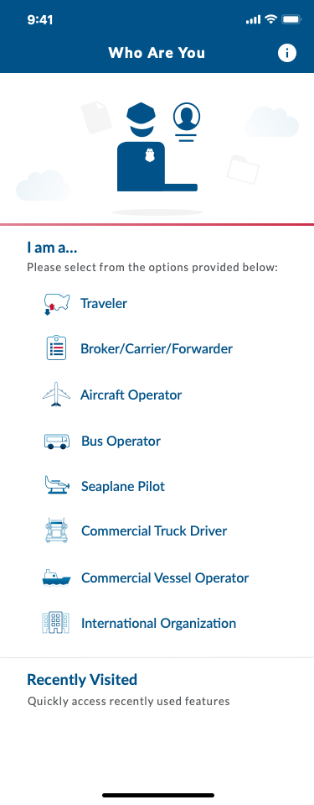
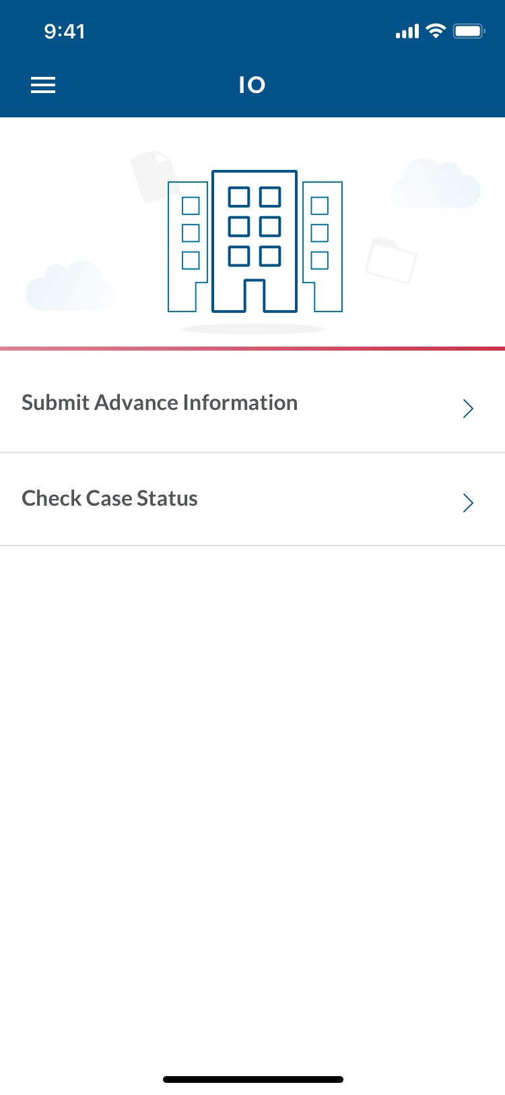
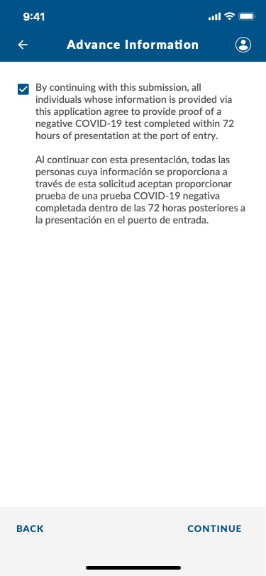
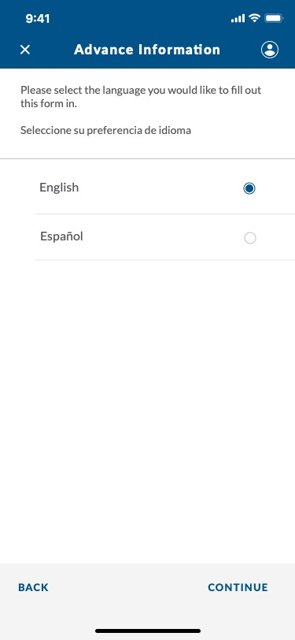
CBP One – IO > Submit Advance Information

Slide 3

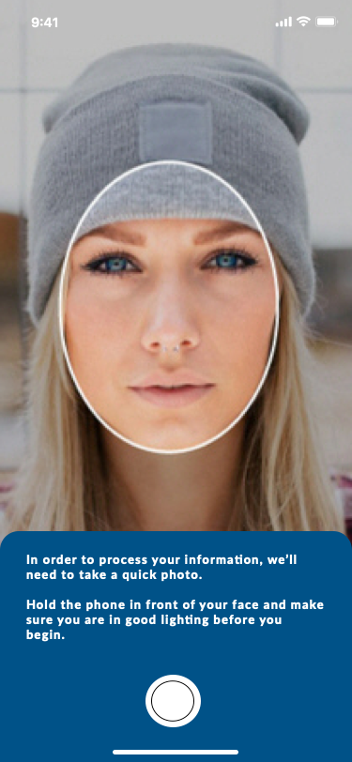
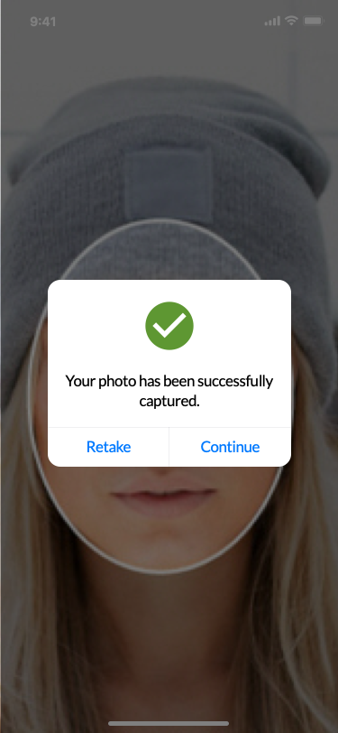
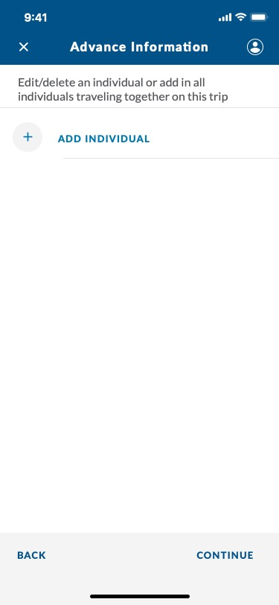
CBP One – Submit Advance Information
NOTE: The photo is optional for now

Slide 4



CBP One – Submit Advance Information Continued

Slide 5

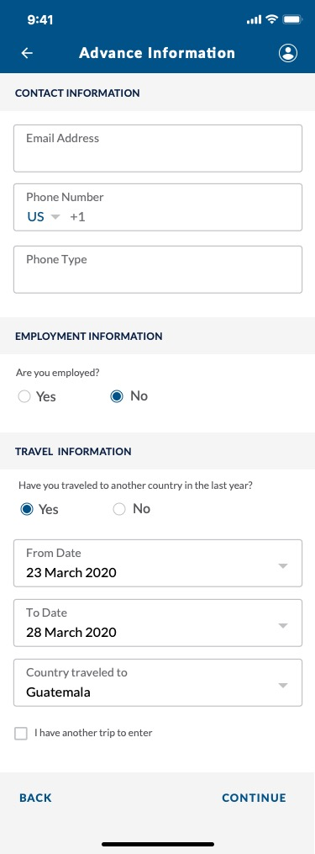

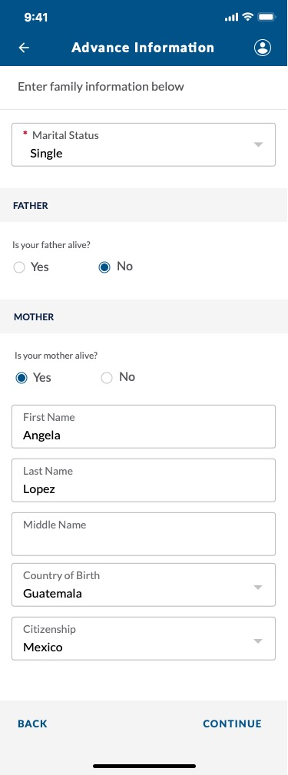
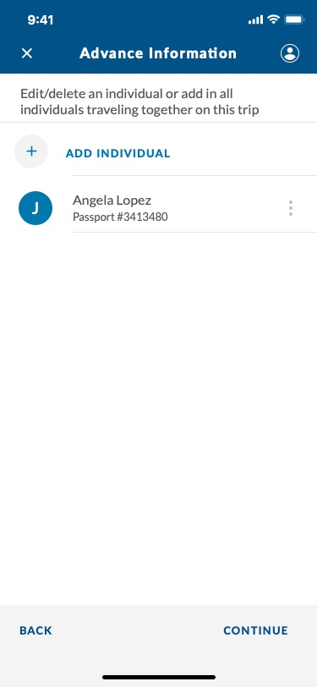
CBP One – Submit Advance Information
Now that we’re done adding in Angela, we are going to add in our second traveler (Santiago).
CBP | OIT

Slide 6

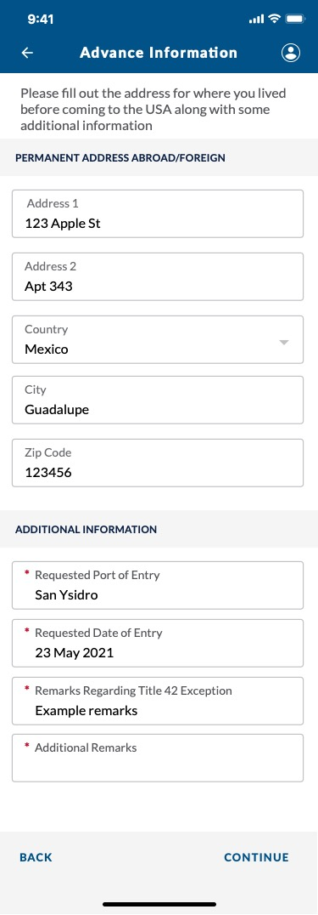
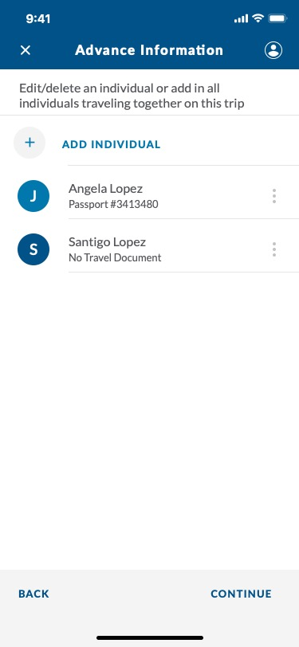
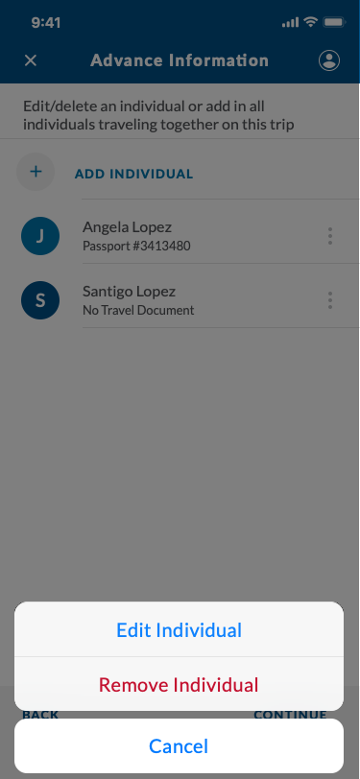
CBP One – Submit Advance Information
CBP | OIT

Slide 7


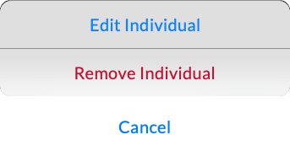
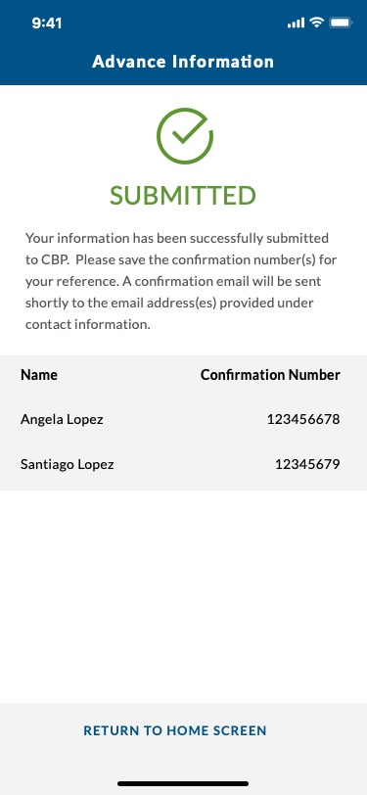
CBP One – Submit Advance Information
CBP | OIT

