Slide 1
CISA Incident Reporting System
Screenshots
https://us-cert.cisa.gov/forms/report
OMB Control No.: 1670-0037; Expiration Date: 12/31/2021

Slide 2
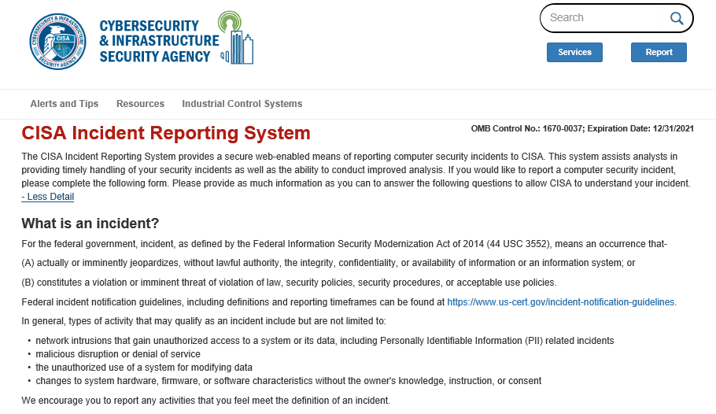
CISA Incident Reporting System Instructions

Slide 3
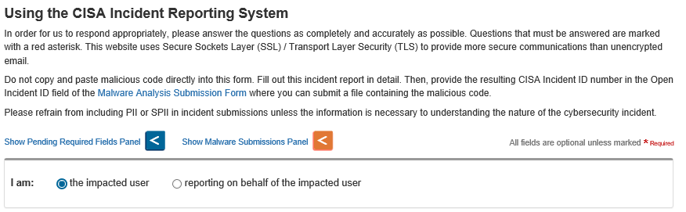
Instructions, continued

Slide 4
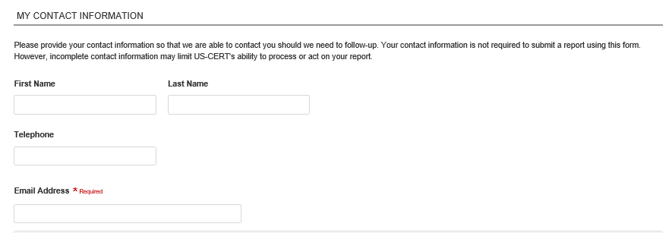
Contact Information

Slide 5
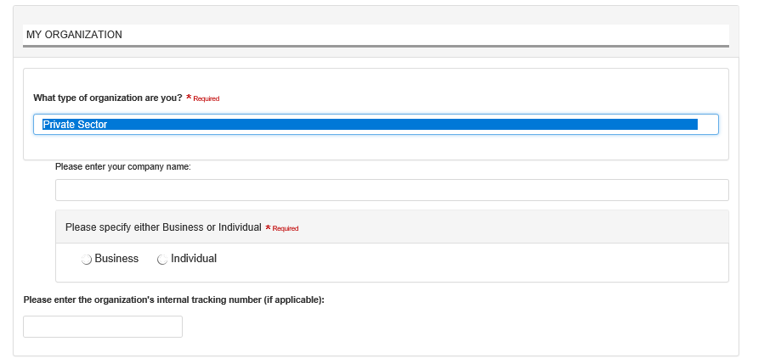
Organization

Slide 6
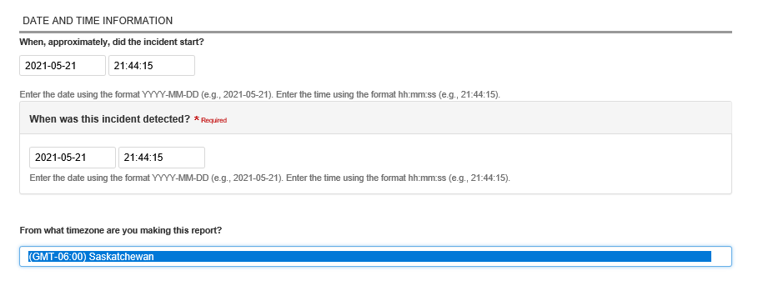
Date/Time of Incident

Slide 7
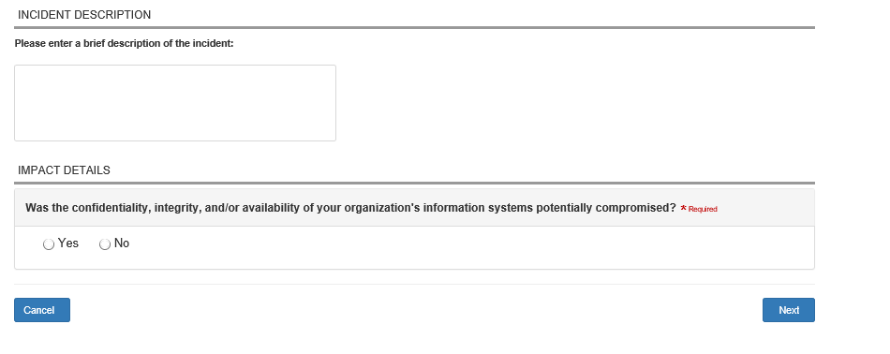
Incident Description

Slide 8
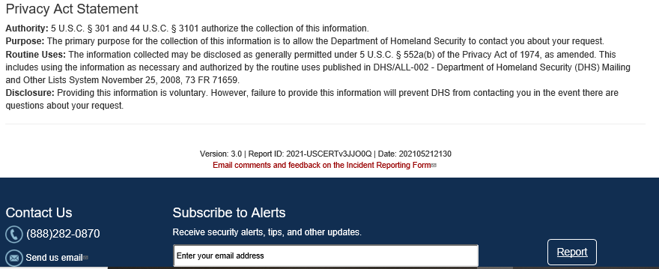
Privacy Act Statement

Slide 9
Paperwork Reduction act Statement
CISA estimates that the total average burden per response associated with this collection is approximately 0.05 hours. An agency may not conduct or sponsor, and a person is not required to respond to, a collection of information unless it displays a valid OMB control number. The control number for this collection is OMB 1670-0037, which expires 12/31/2021. Send comments regarding this burden estimate or collection to: DHS/CISA, Attention: PRA 1670-0037, Mailstop: 0635, 245 Murray Lane SW Bldg 410, Washington, DC 20528.

