Slide 1
Tax Pro Account
Screenshots for Power of Attorney and Tax Information Authorizations

Slide 2
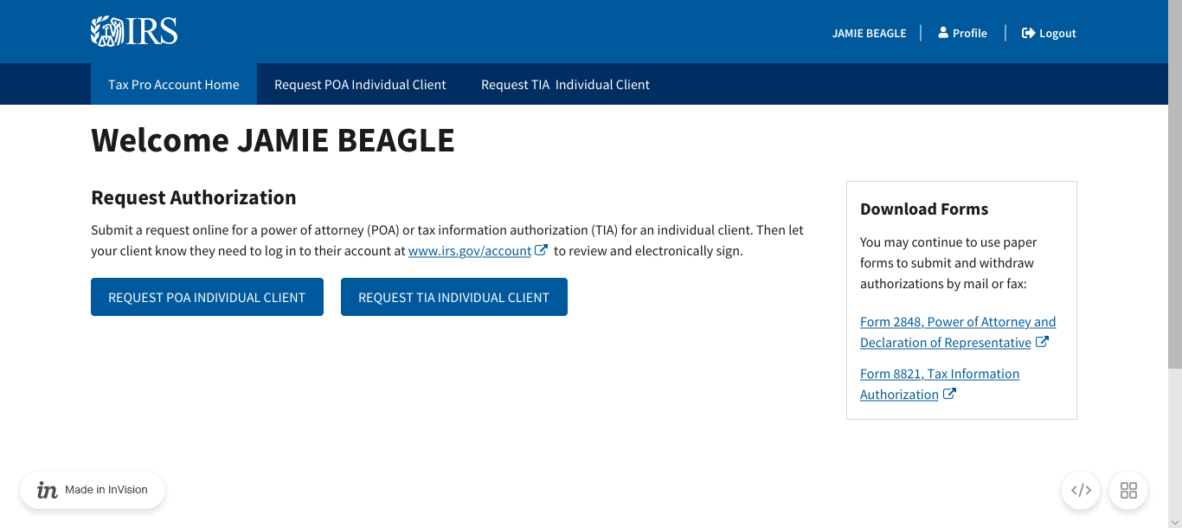
Tax Pro Account Home

Slide 3
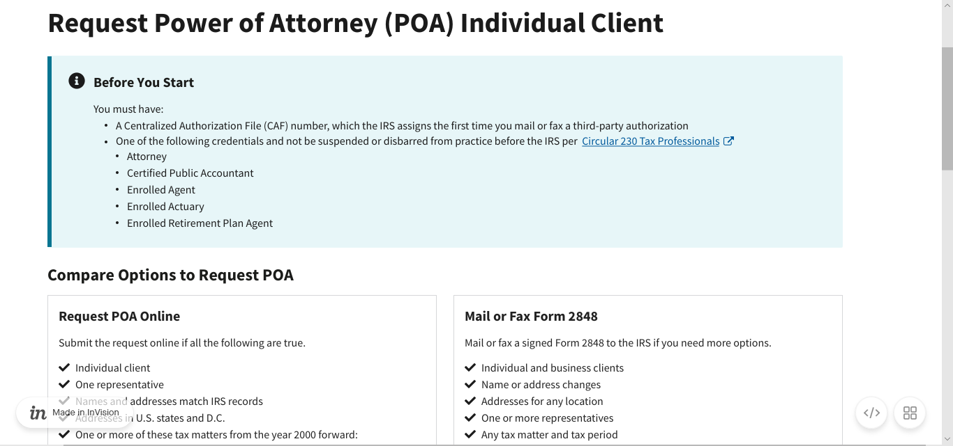
Tax Pro Request POA: Before You Start

Slide 4
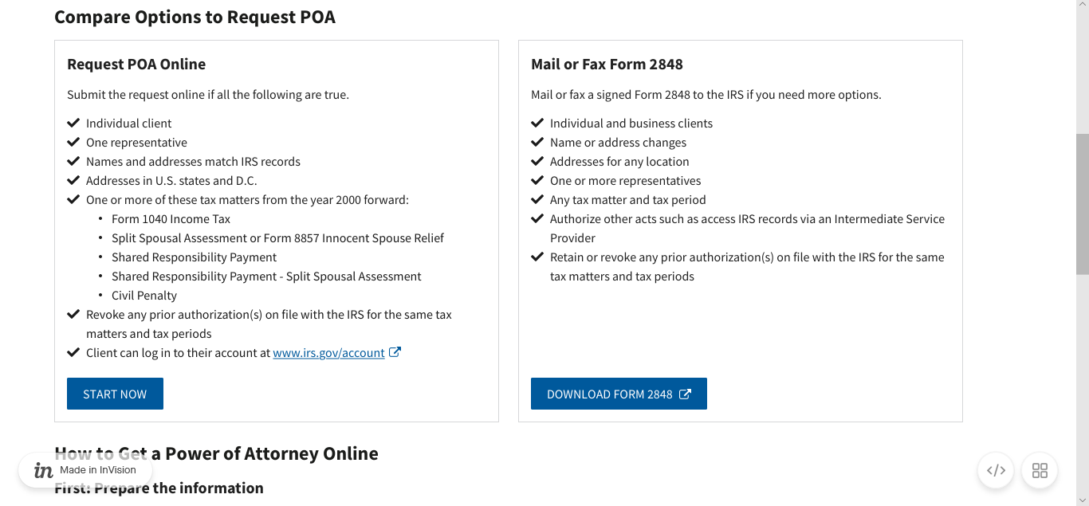
Tax Pro Request POA: Before You Start (continued)

Slide 5
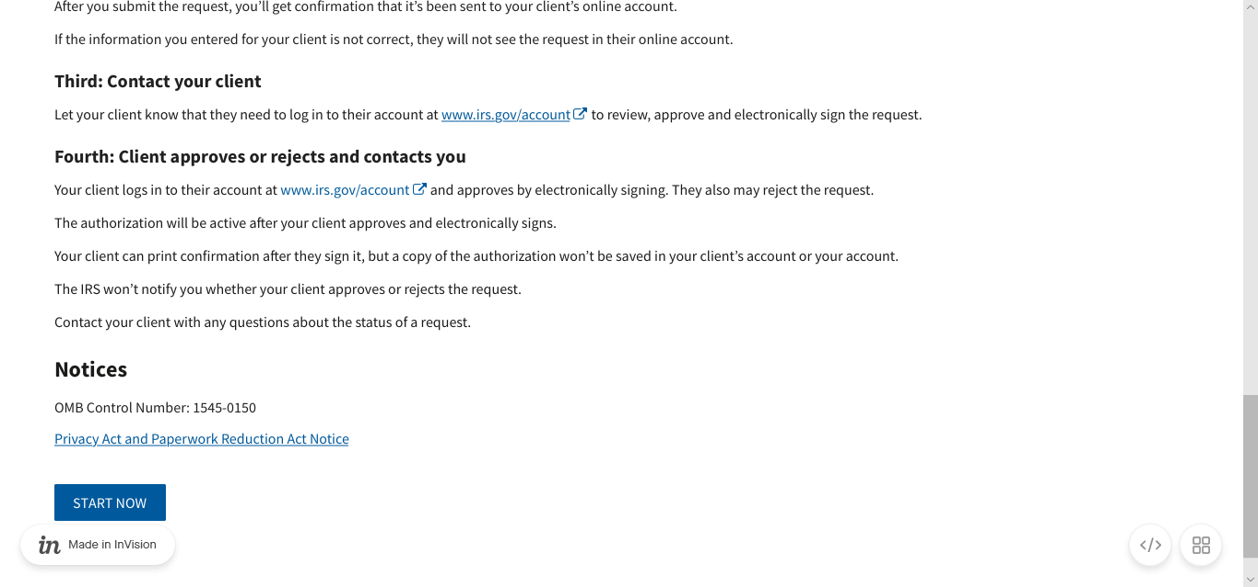
Tax Pro Request POA: Before You Start (continued)

Slide 6
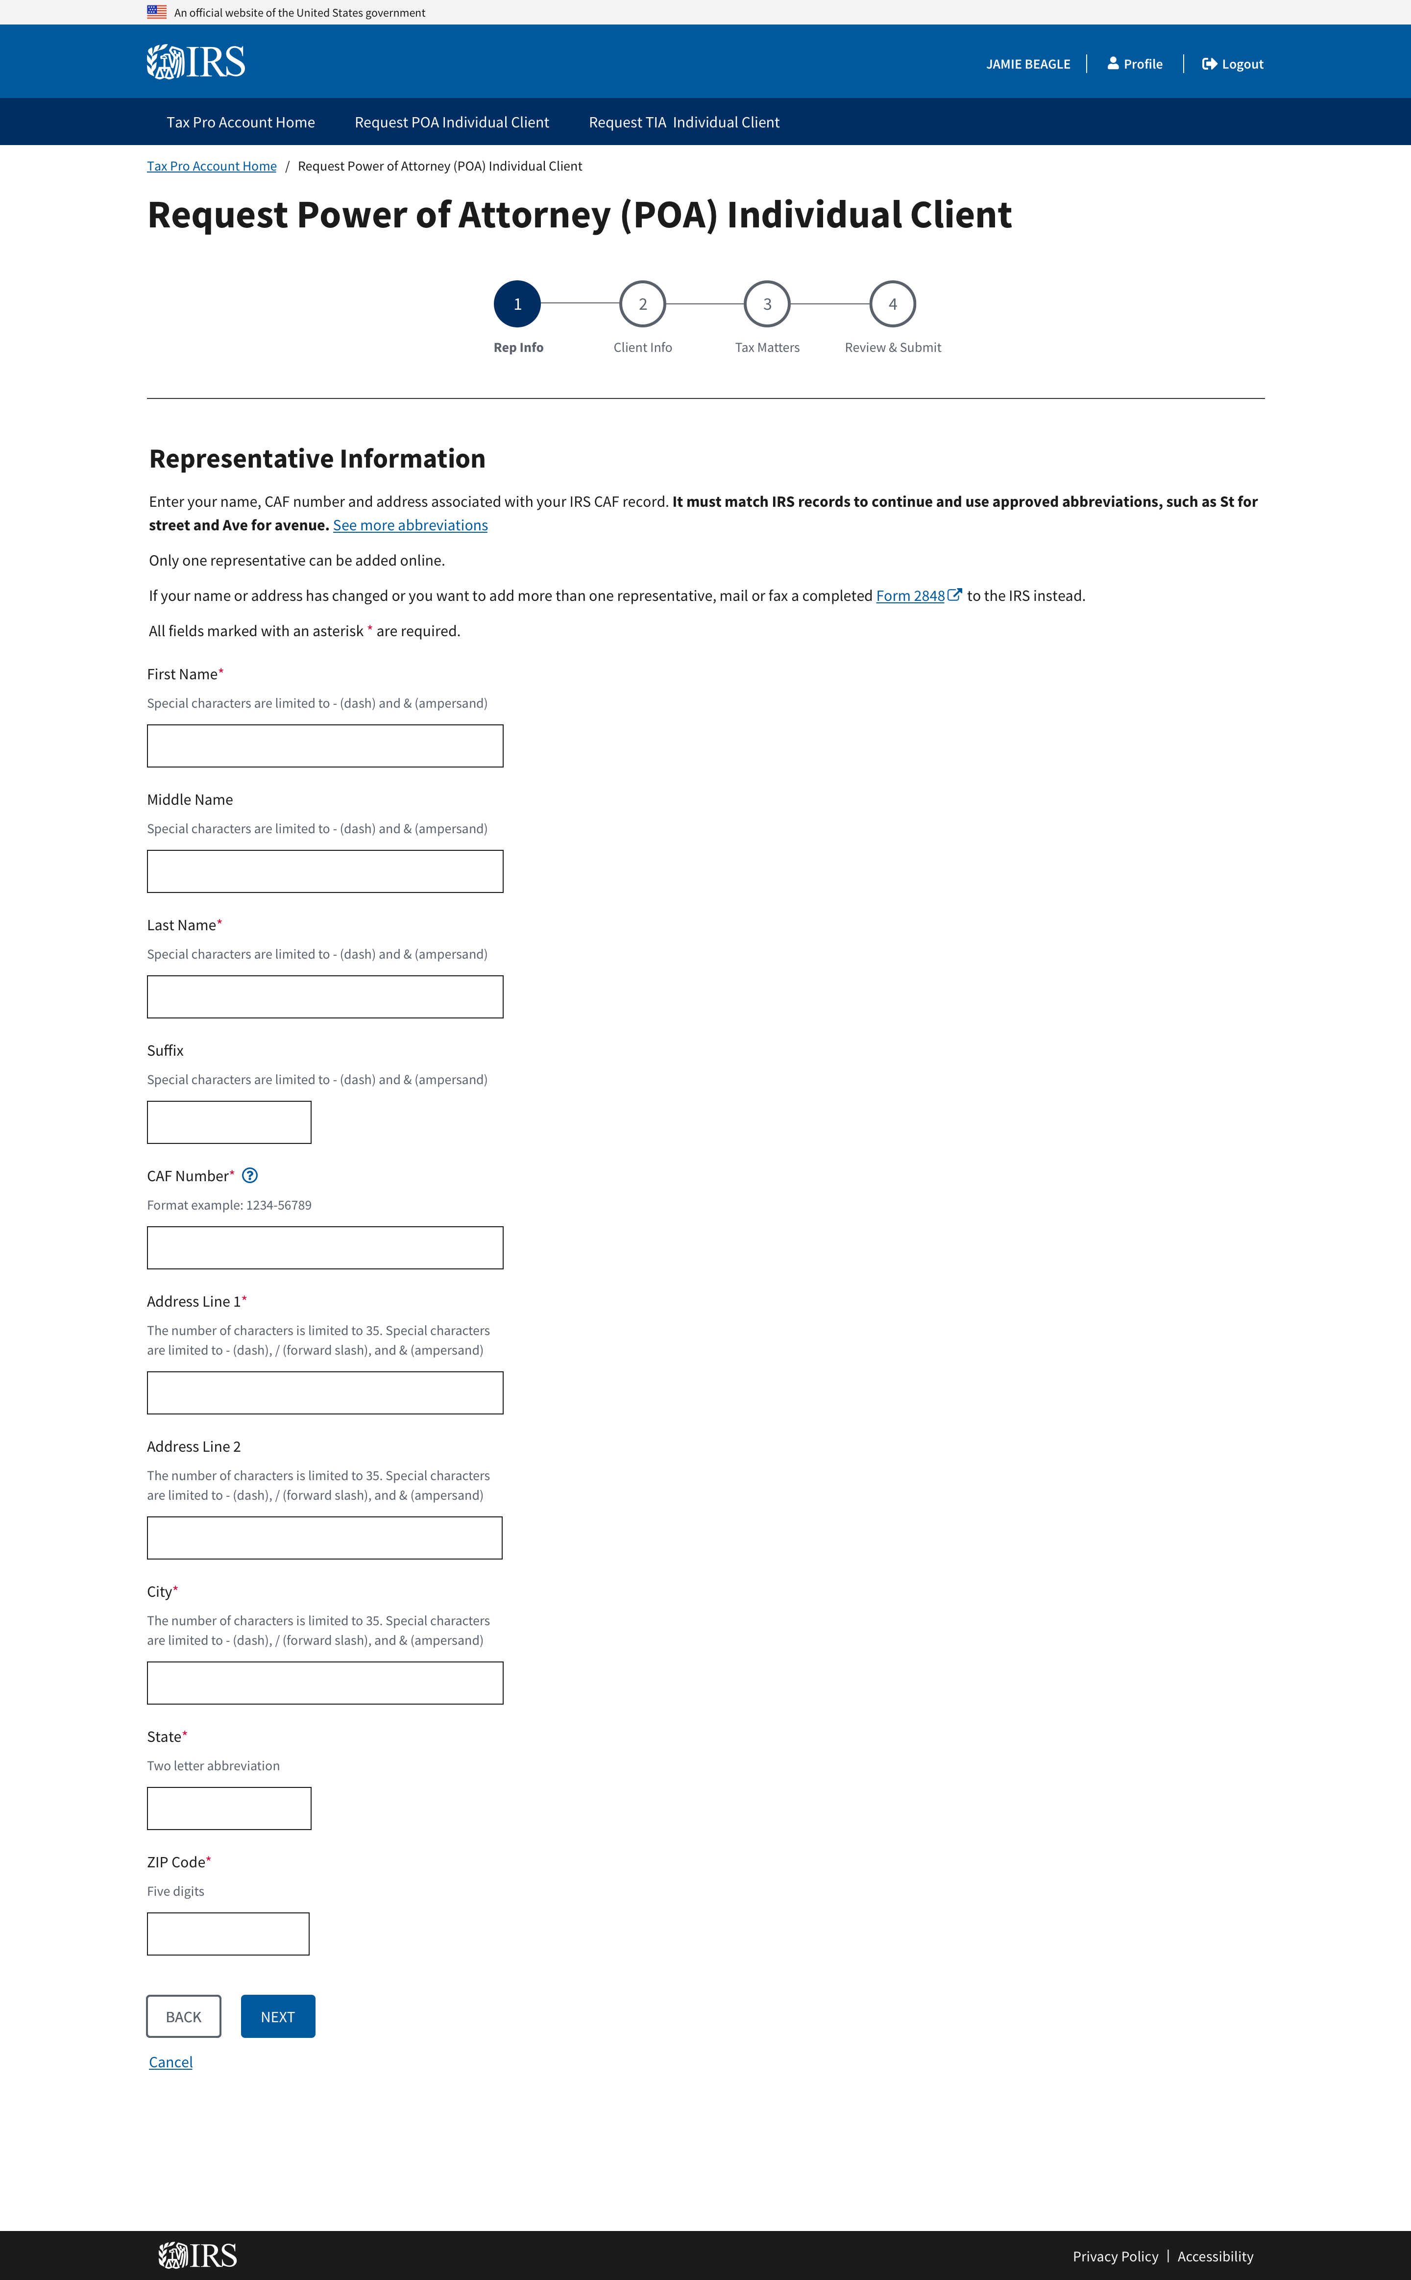
Tax Pro Request POA: Representative Information

Slide 7
Tax Pro Request POA: Representative Information (Continued)

Slide 8
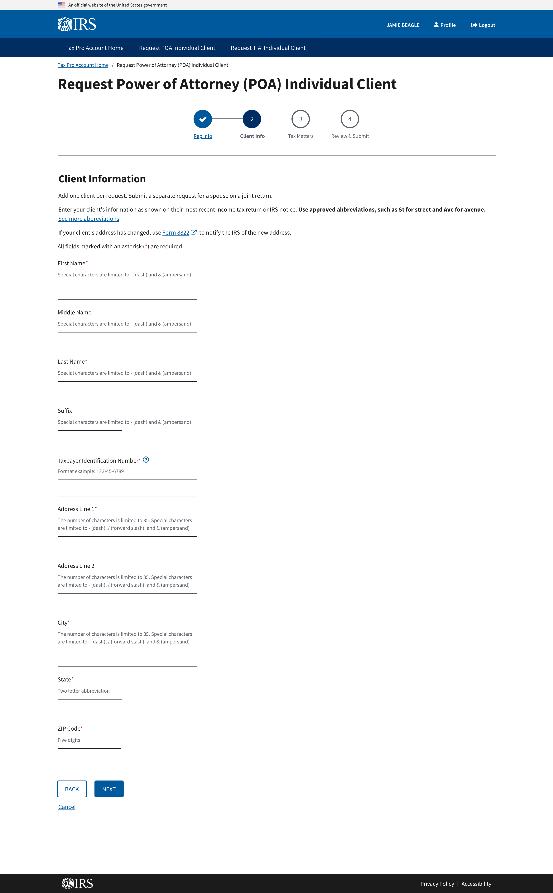
Office of Online Services
Tax Pro Request POA: Client Information

Slide 9
Tax Pro Request POA: Client Information (Cont.)

Slide 10
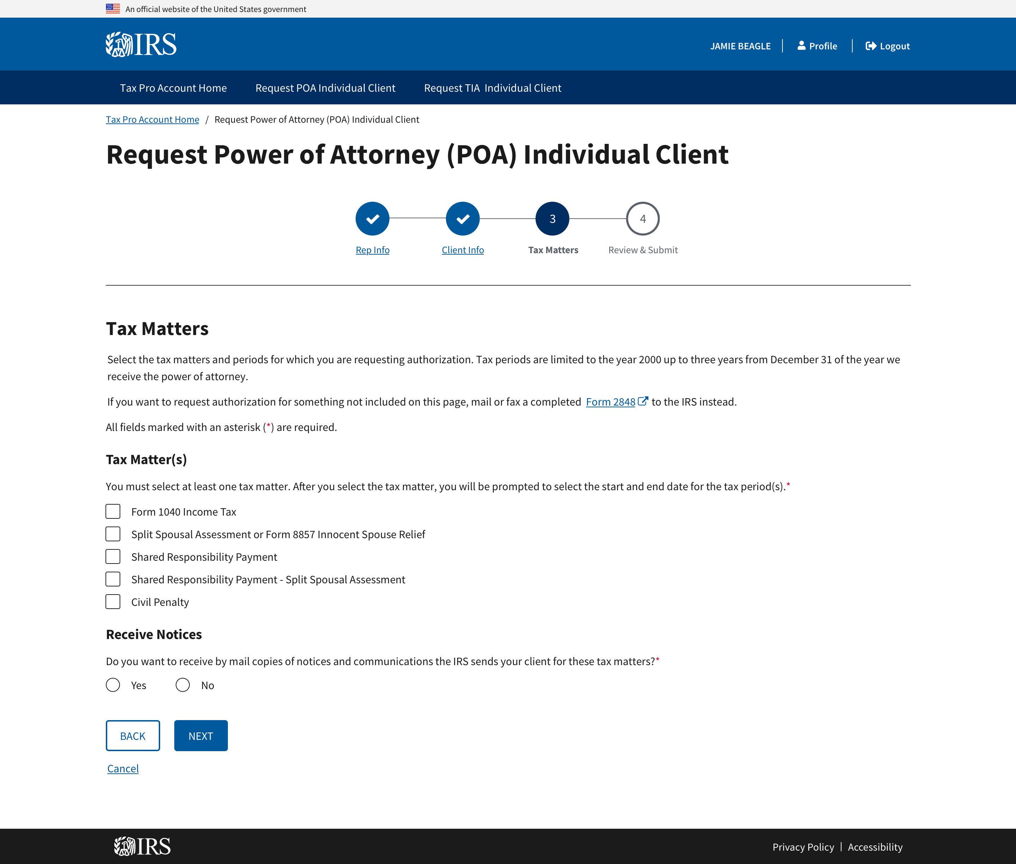
Tax Pro Request POA: Tax Matters

Slide 11
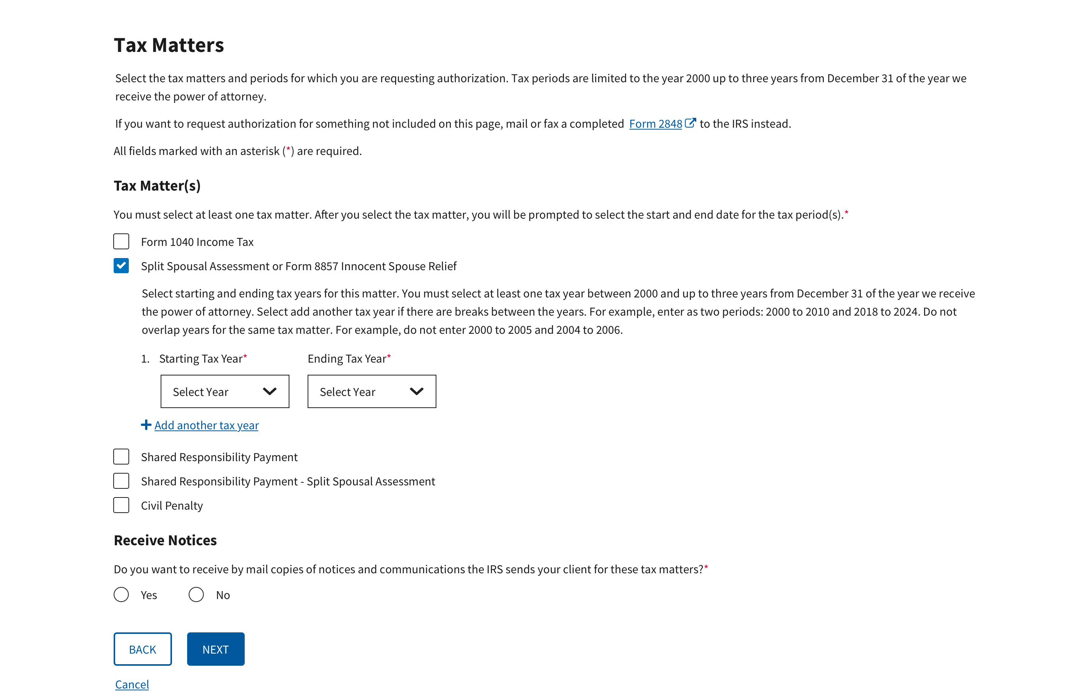
Tax Pro Request POA: Tax Matters (cont.)

Slide 12
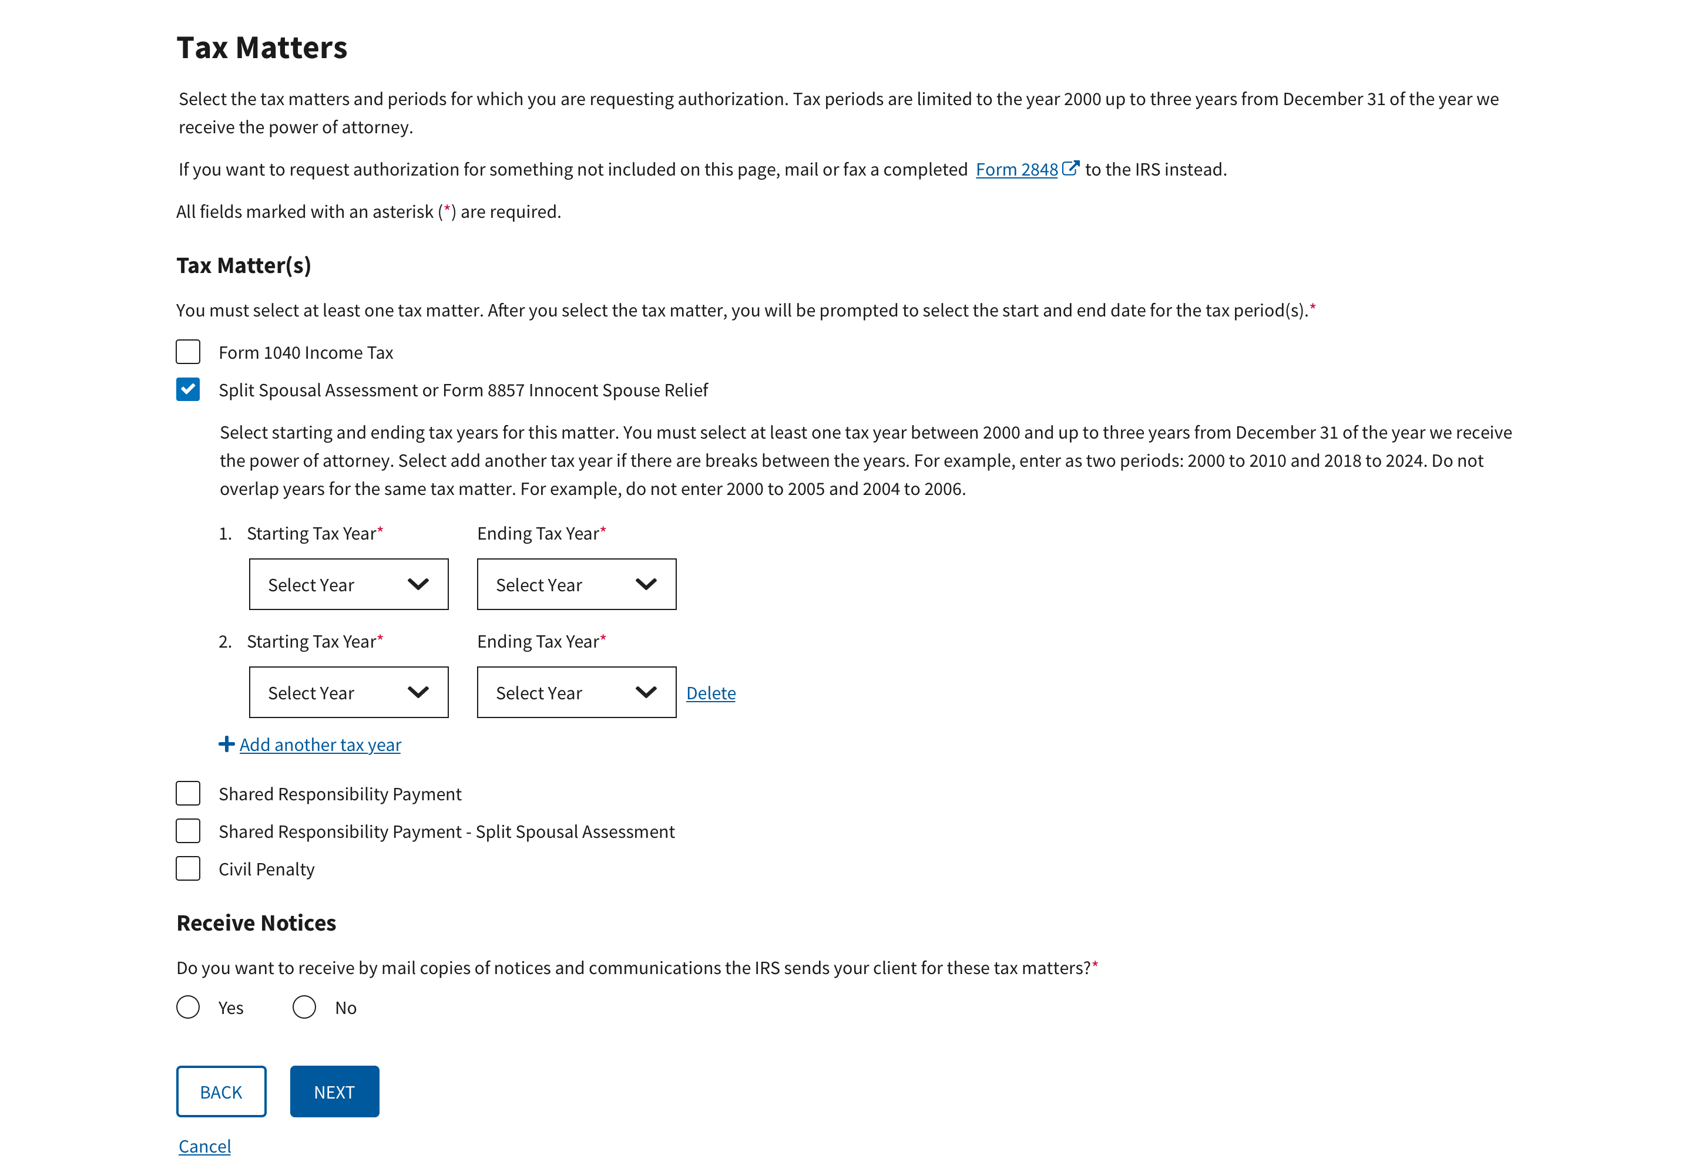
Tax Pro Request POA: Tax Matters (cont.)

Slide 13
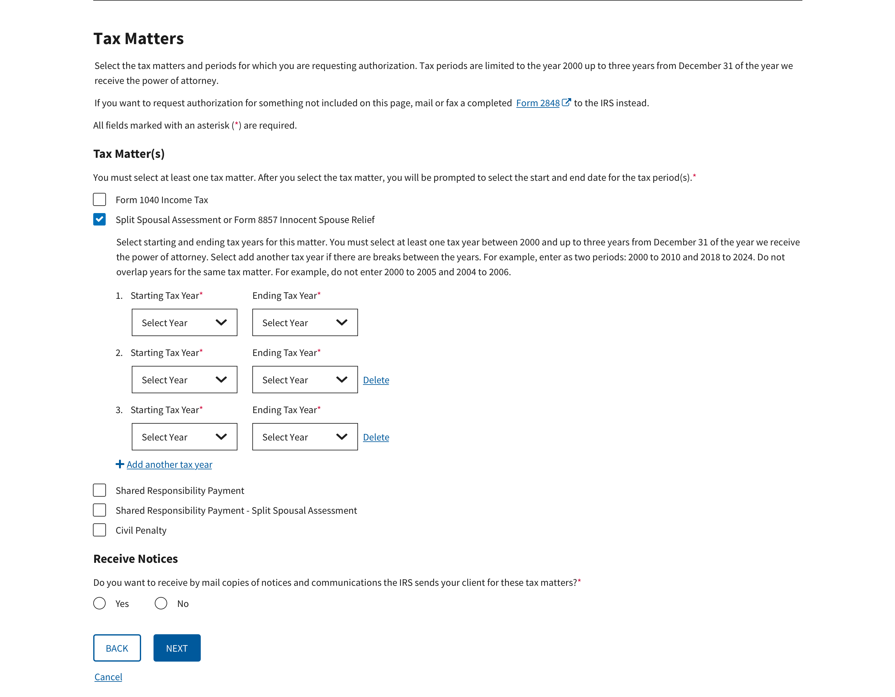
Tax Pro Request POA: Tax Matters (cont.)

Slide 14
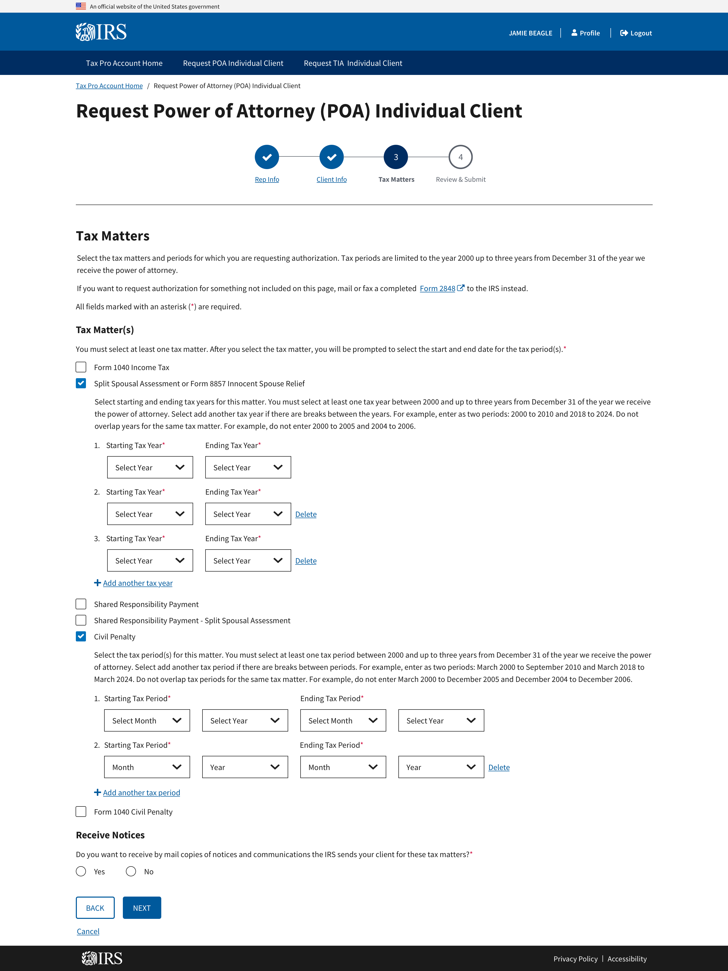
Tax Pro Request POA: Tax Matters (cont.)

Slide 15
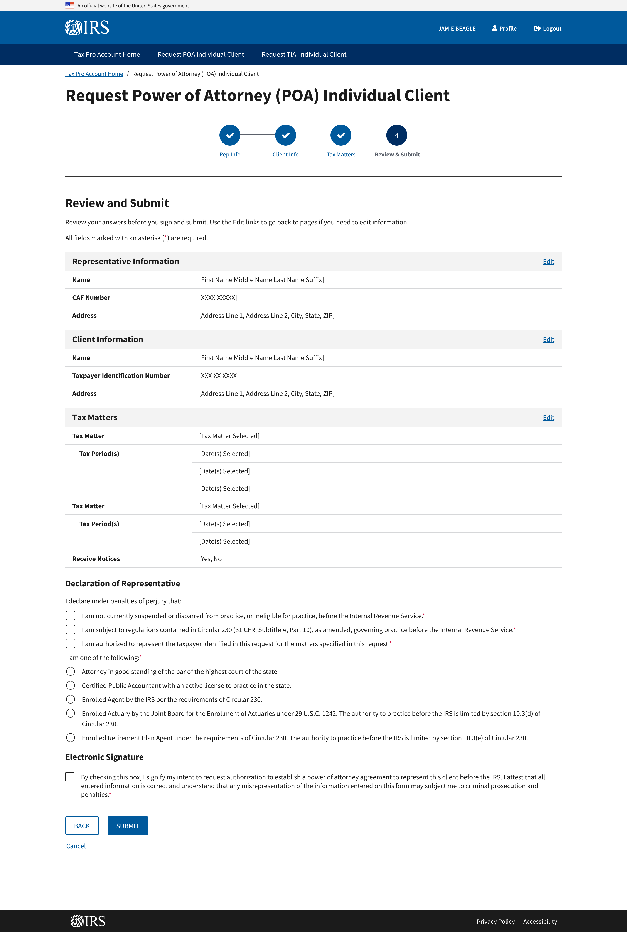
Tax Pro Request POA: Review and Submit

Slide 16
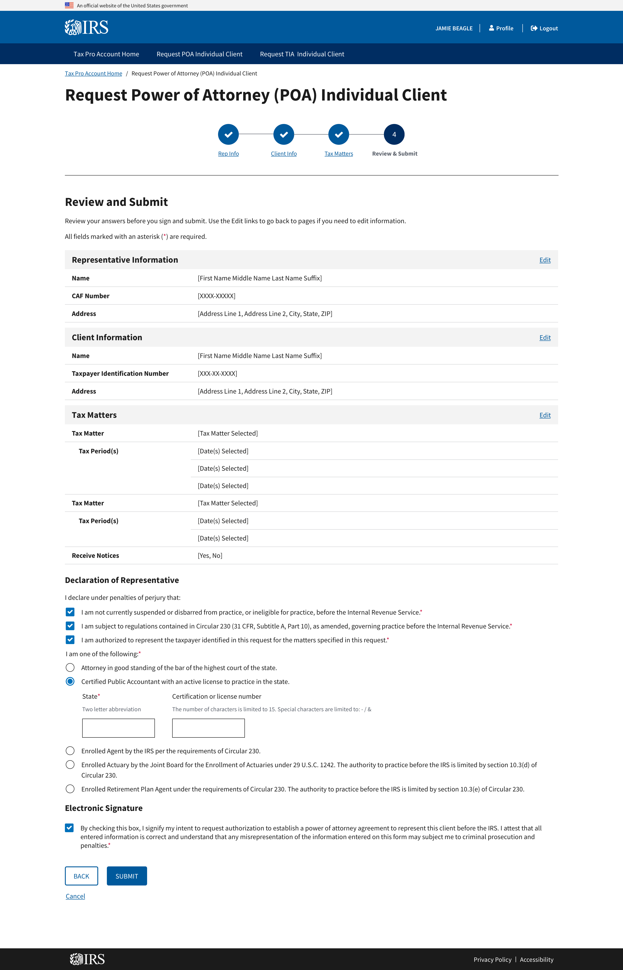
Tax Pro Request POA: Review and Submit (cont.)

Slide 17
Tax Pro Account
For Tax Information Authorization

Slide 18
Tax Pro Request TIA: Before You Start

Slide 19
Tax Pro Request TIA: Before You Start (cont.)

Slide 20
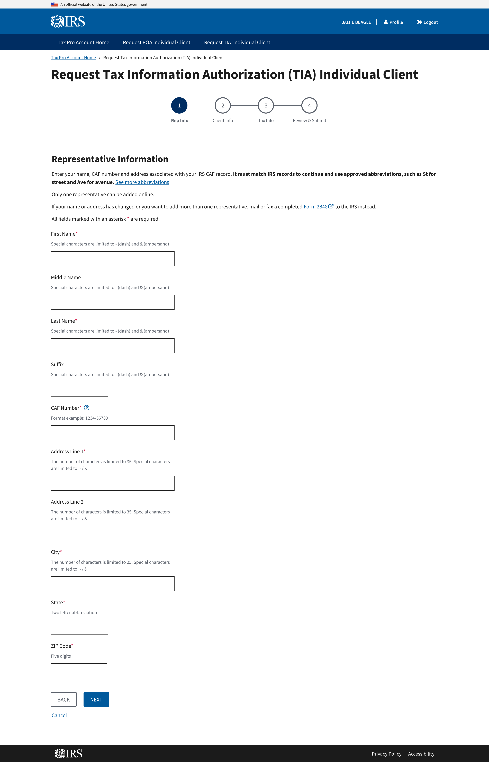
Tax Pro Request TIA: Representative Information

Slide 21
Tax Pro Request TIA: Representative Information (cont.)

Slide 22
Tax Pro Request TIA: Client Information

Slide 23
Tax Pro Request TIA: Client Information (Cont.)

Slide 24
Tax Pro Request TIA: Client Information

Slide 25
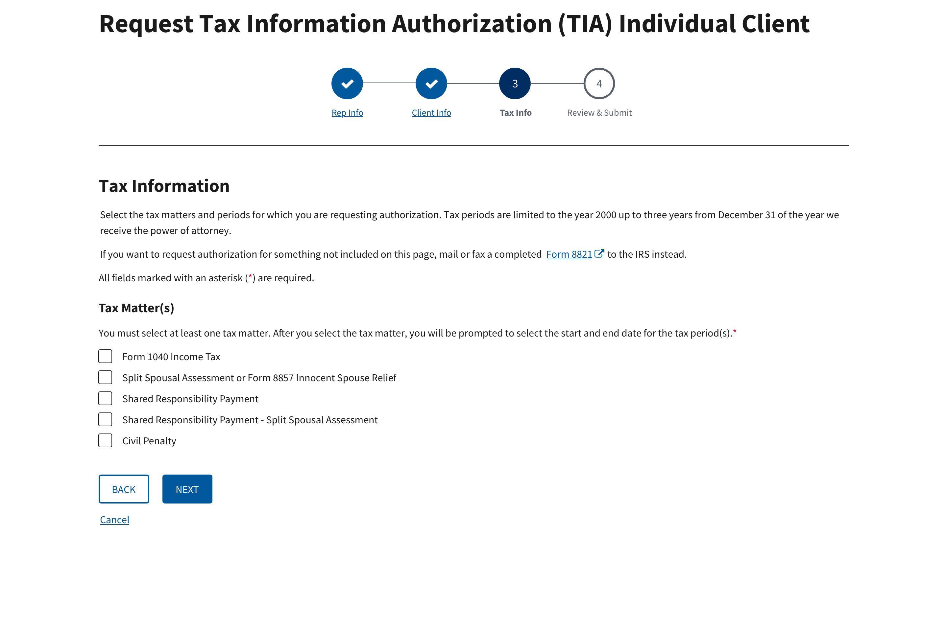
Tax Pro Request TIA: Tax Matters

Slide 26
Tax Pro Request TIA: Client Information

Slide 27
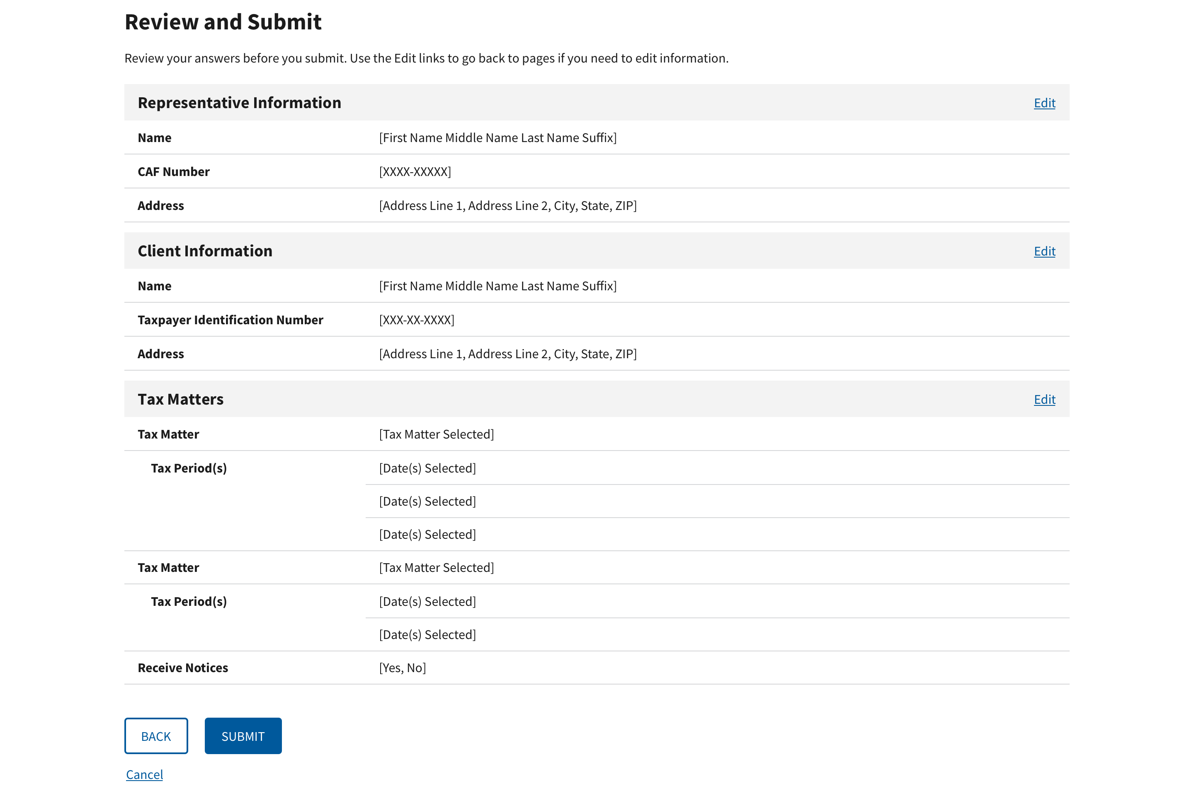
Tax Pro Request TIA: Review and submit page

Slide 28
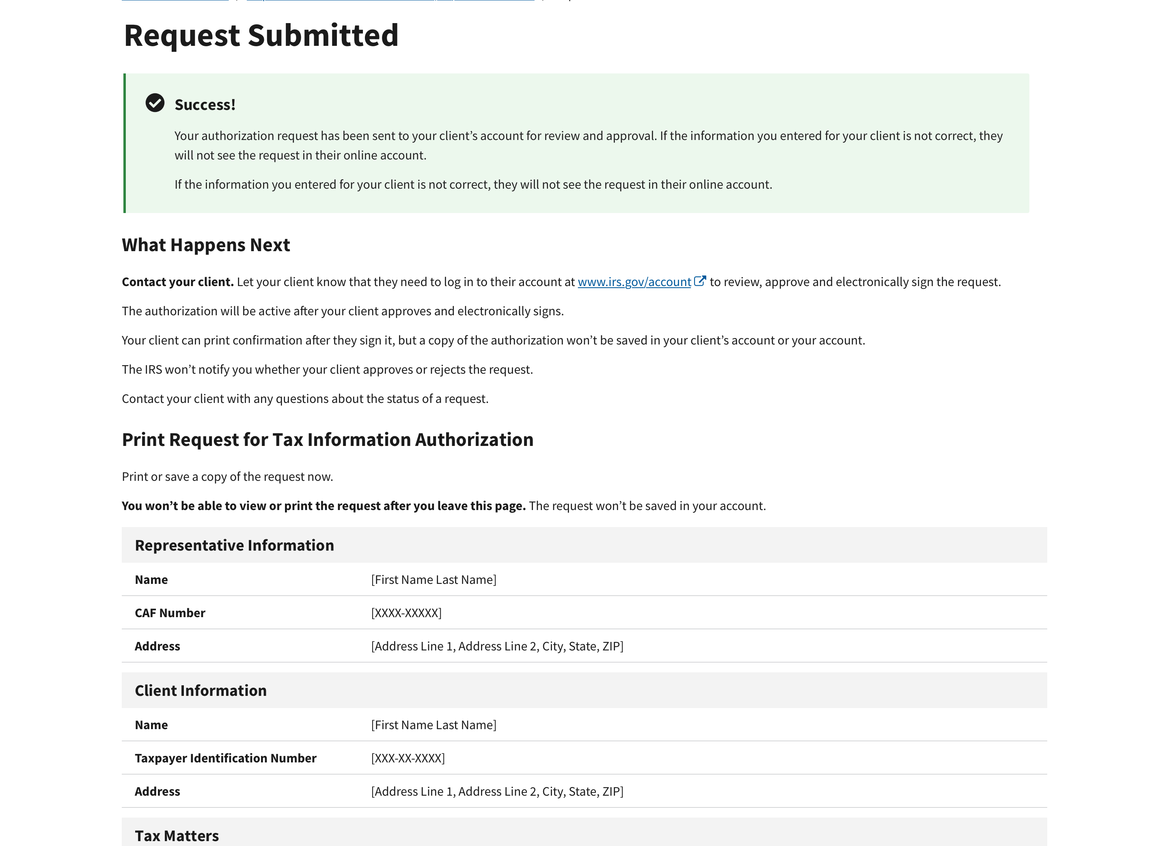
Tax Pro Request TIA: Submitted Request
* Under “Print Request for Tax Information Authorization” page will display all request information

