Slide 1
I-821, Application for Temporary Protected Status
Version: Standalone Form; OMB control number 1615-0043
United States Citizenship and Immigration Services
myUSICS Team
May 2021
Screenshots

Slide 2
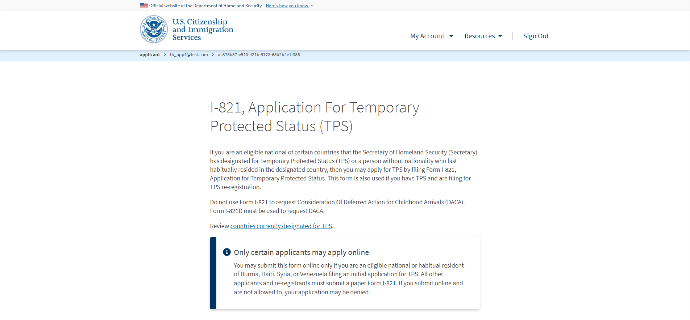
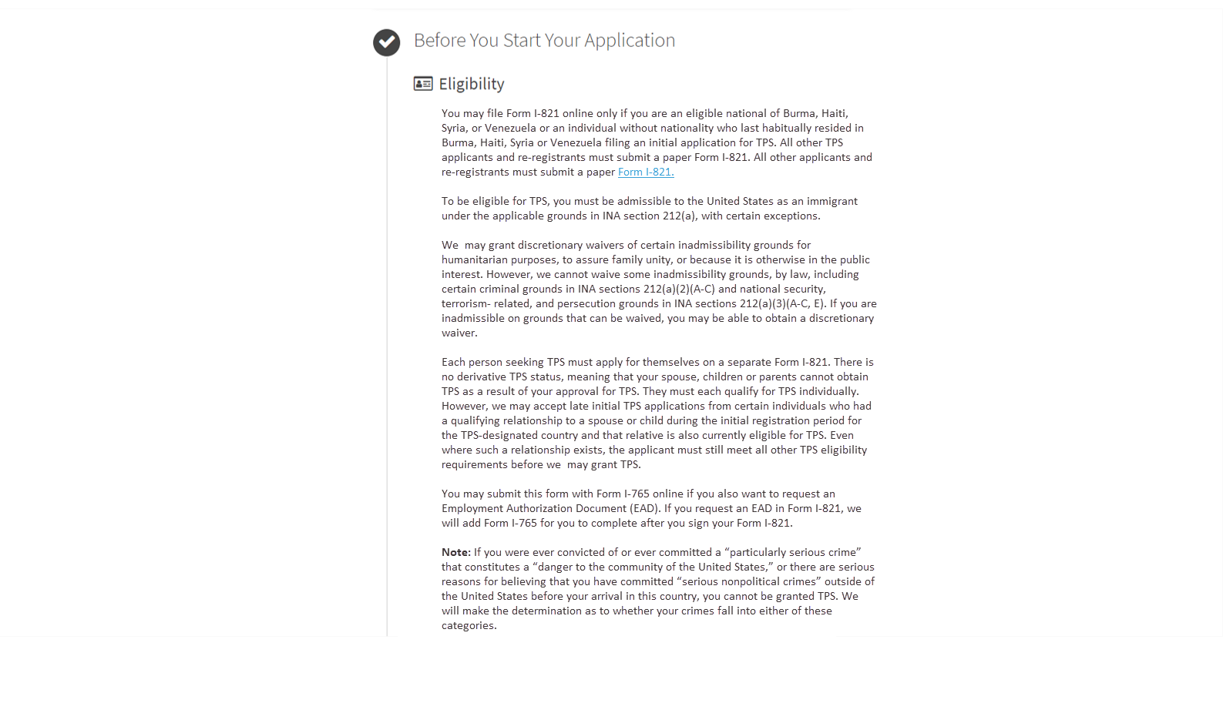
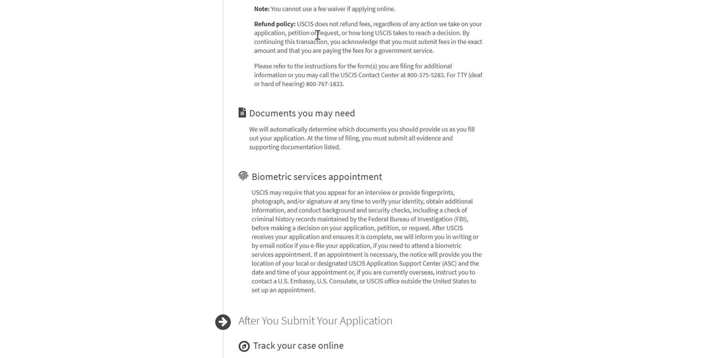
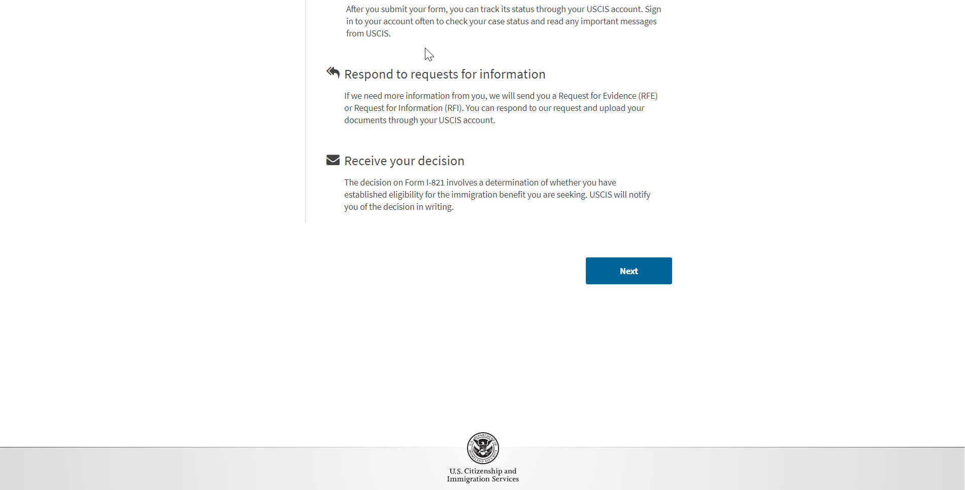
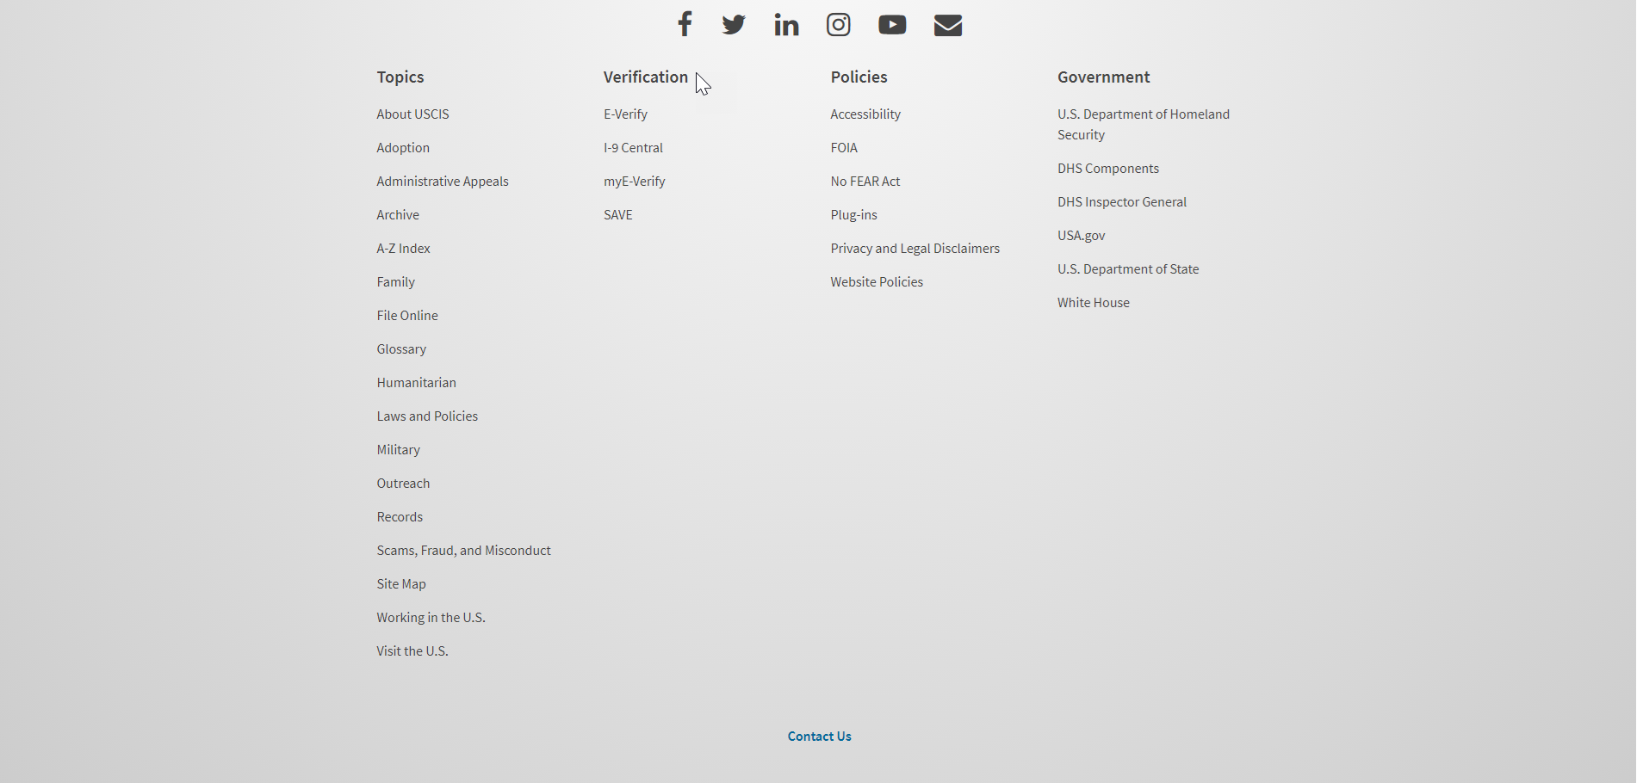
I-821: Application Overview

Slide 3
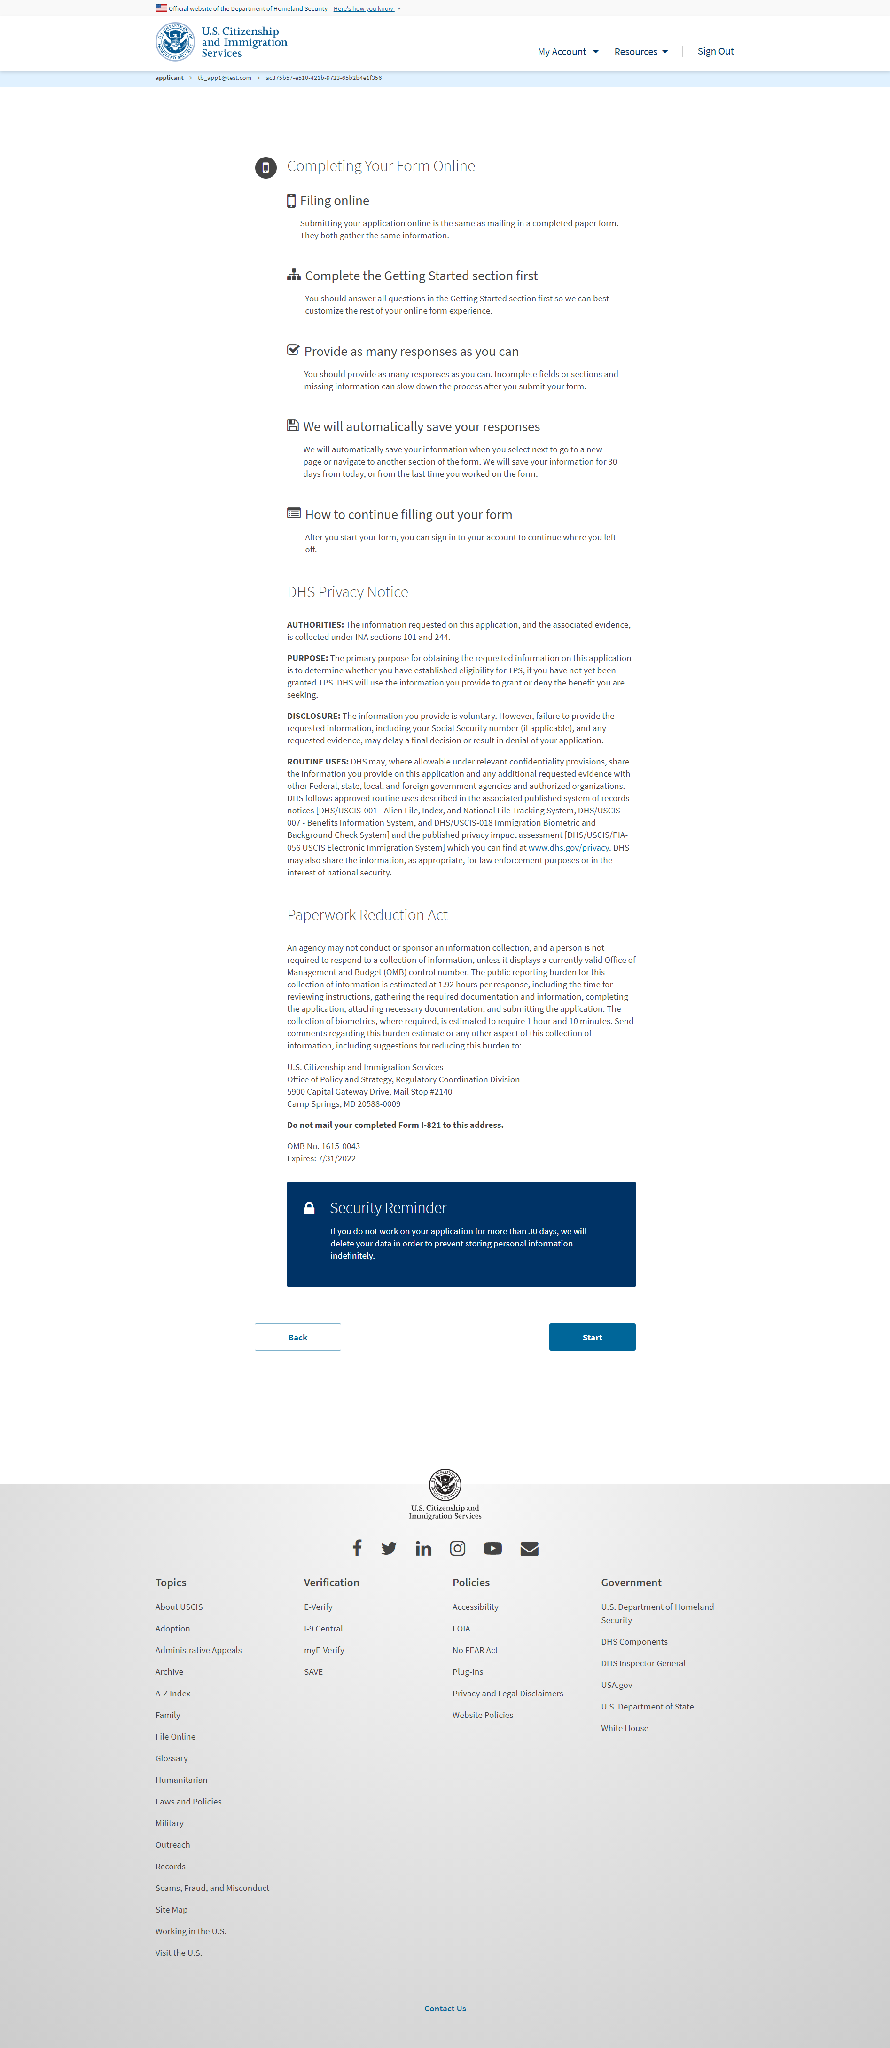
I-821: Start Application

Slide 4
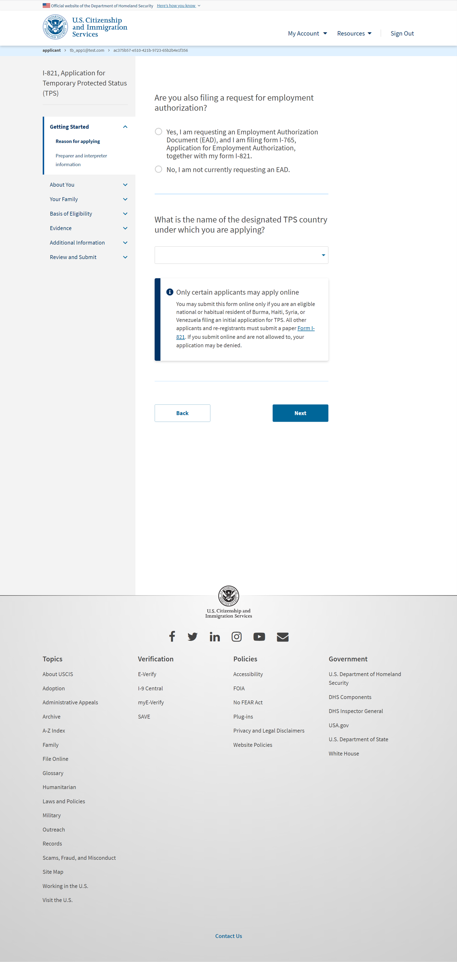
I-821: Getting Started – Reason for applying

Slide 5
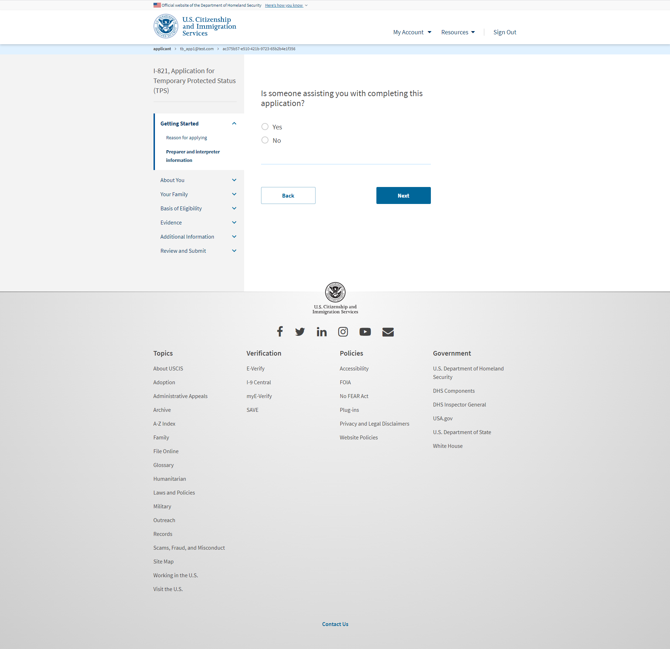
I-821: Getting Started – Preparer and interpreter information

Slide 6
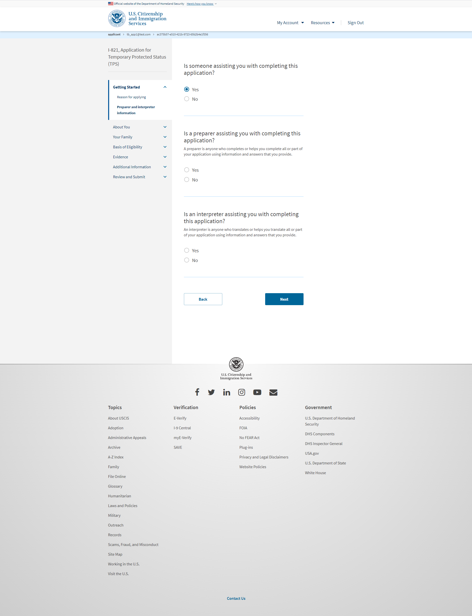
I-821: Getting Started – Preparer and interpreter information (Once selecting ‘Yes’ from previous slide)

Slide 7
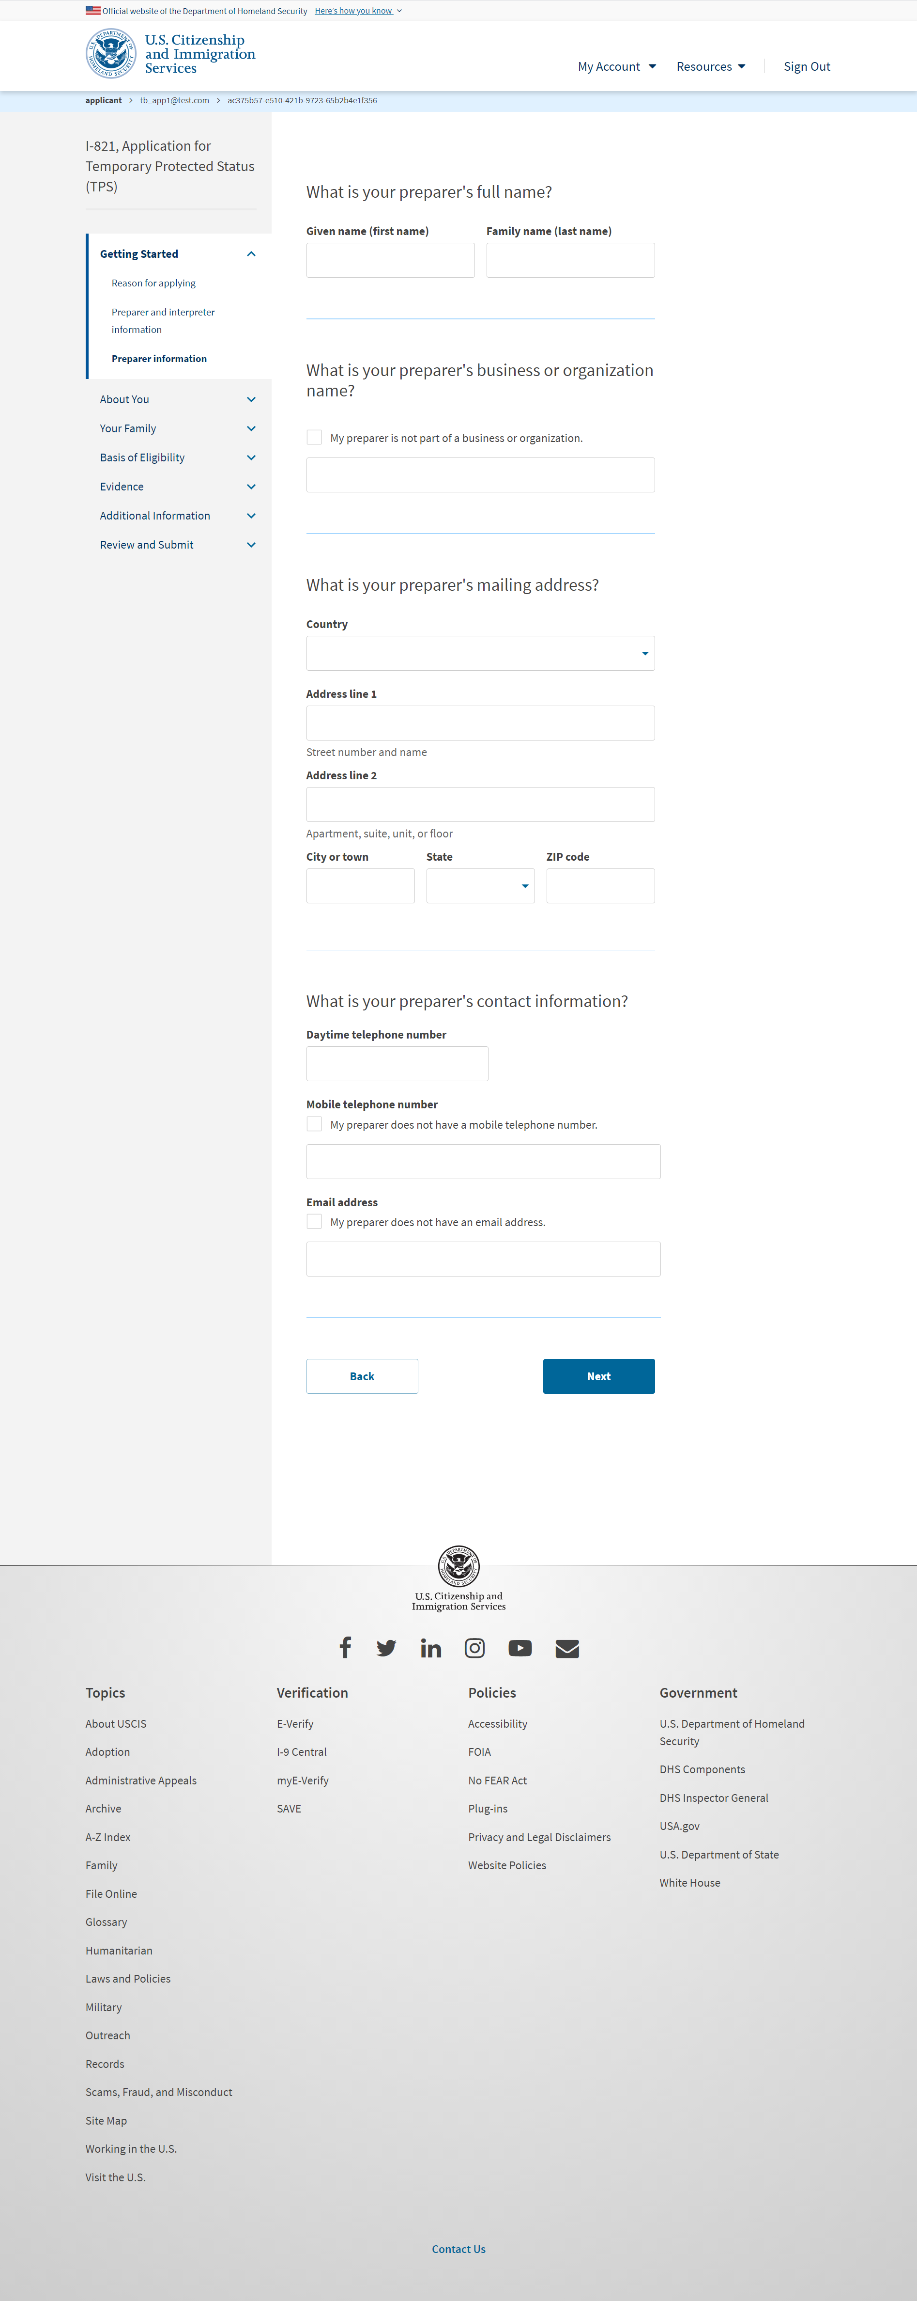
I-821: Getting Started – Preparer information (Once selecting ‘Yes’ to Preparer question)

Slide 8
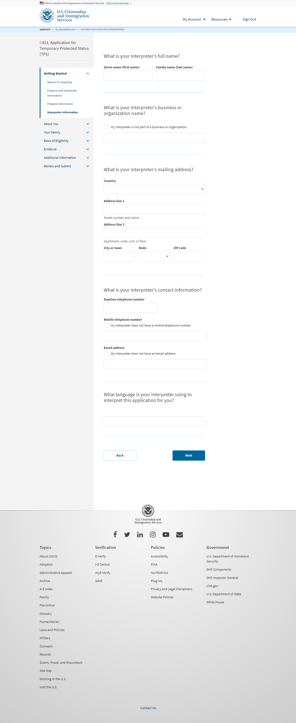
I-821: Getting Started – Interpreter information (Once selecting ‘Yes’ to Interpreter question)

Slide 9
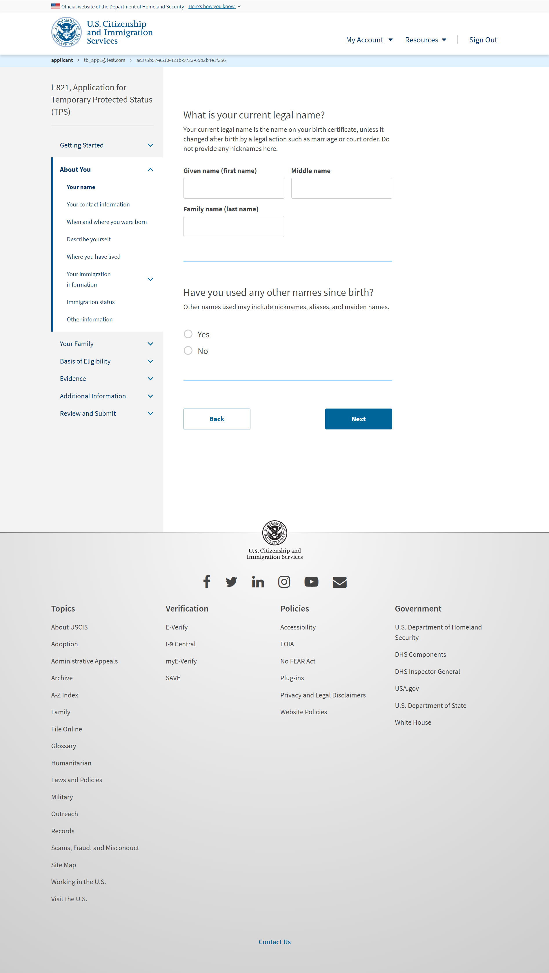
I-821: About You – Your name

Slide 10
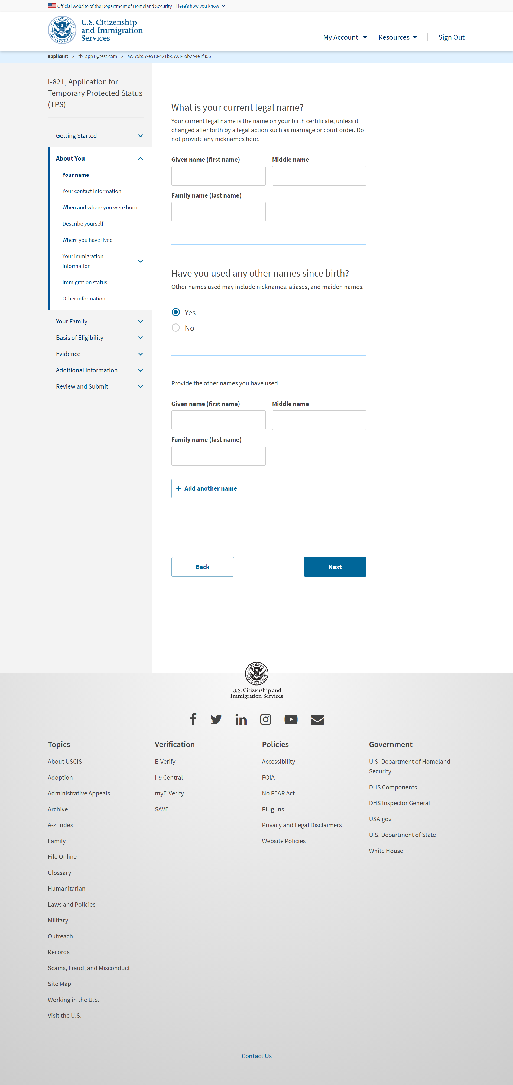
I-821: About You – Your name (if user selects ‘Yes’ for other names)

Slide 11
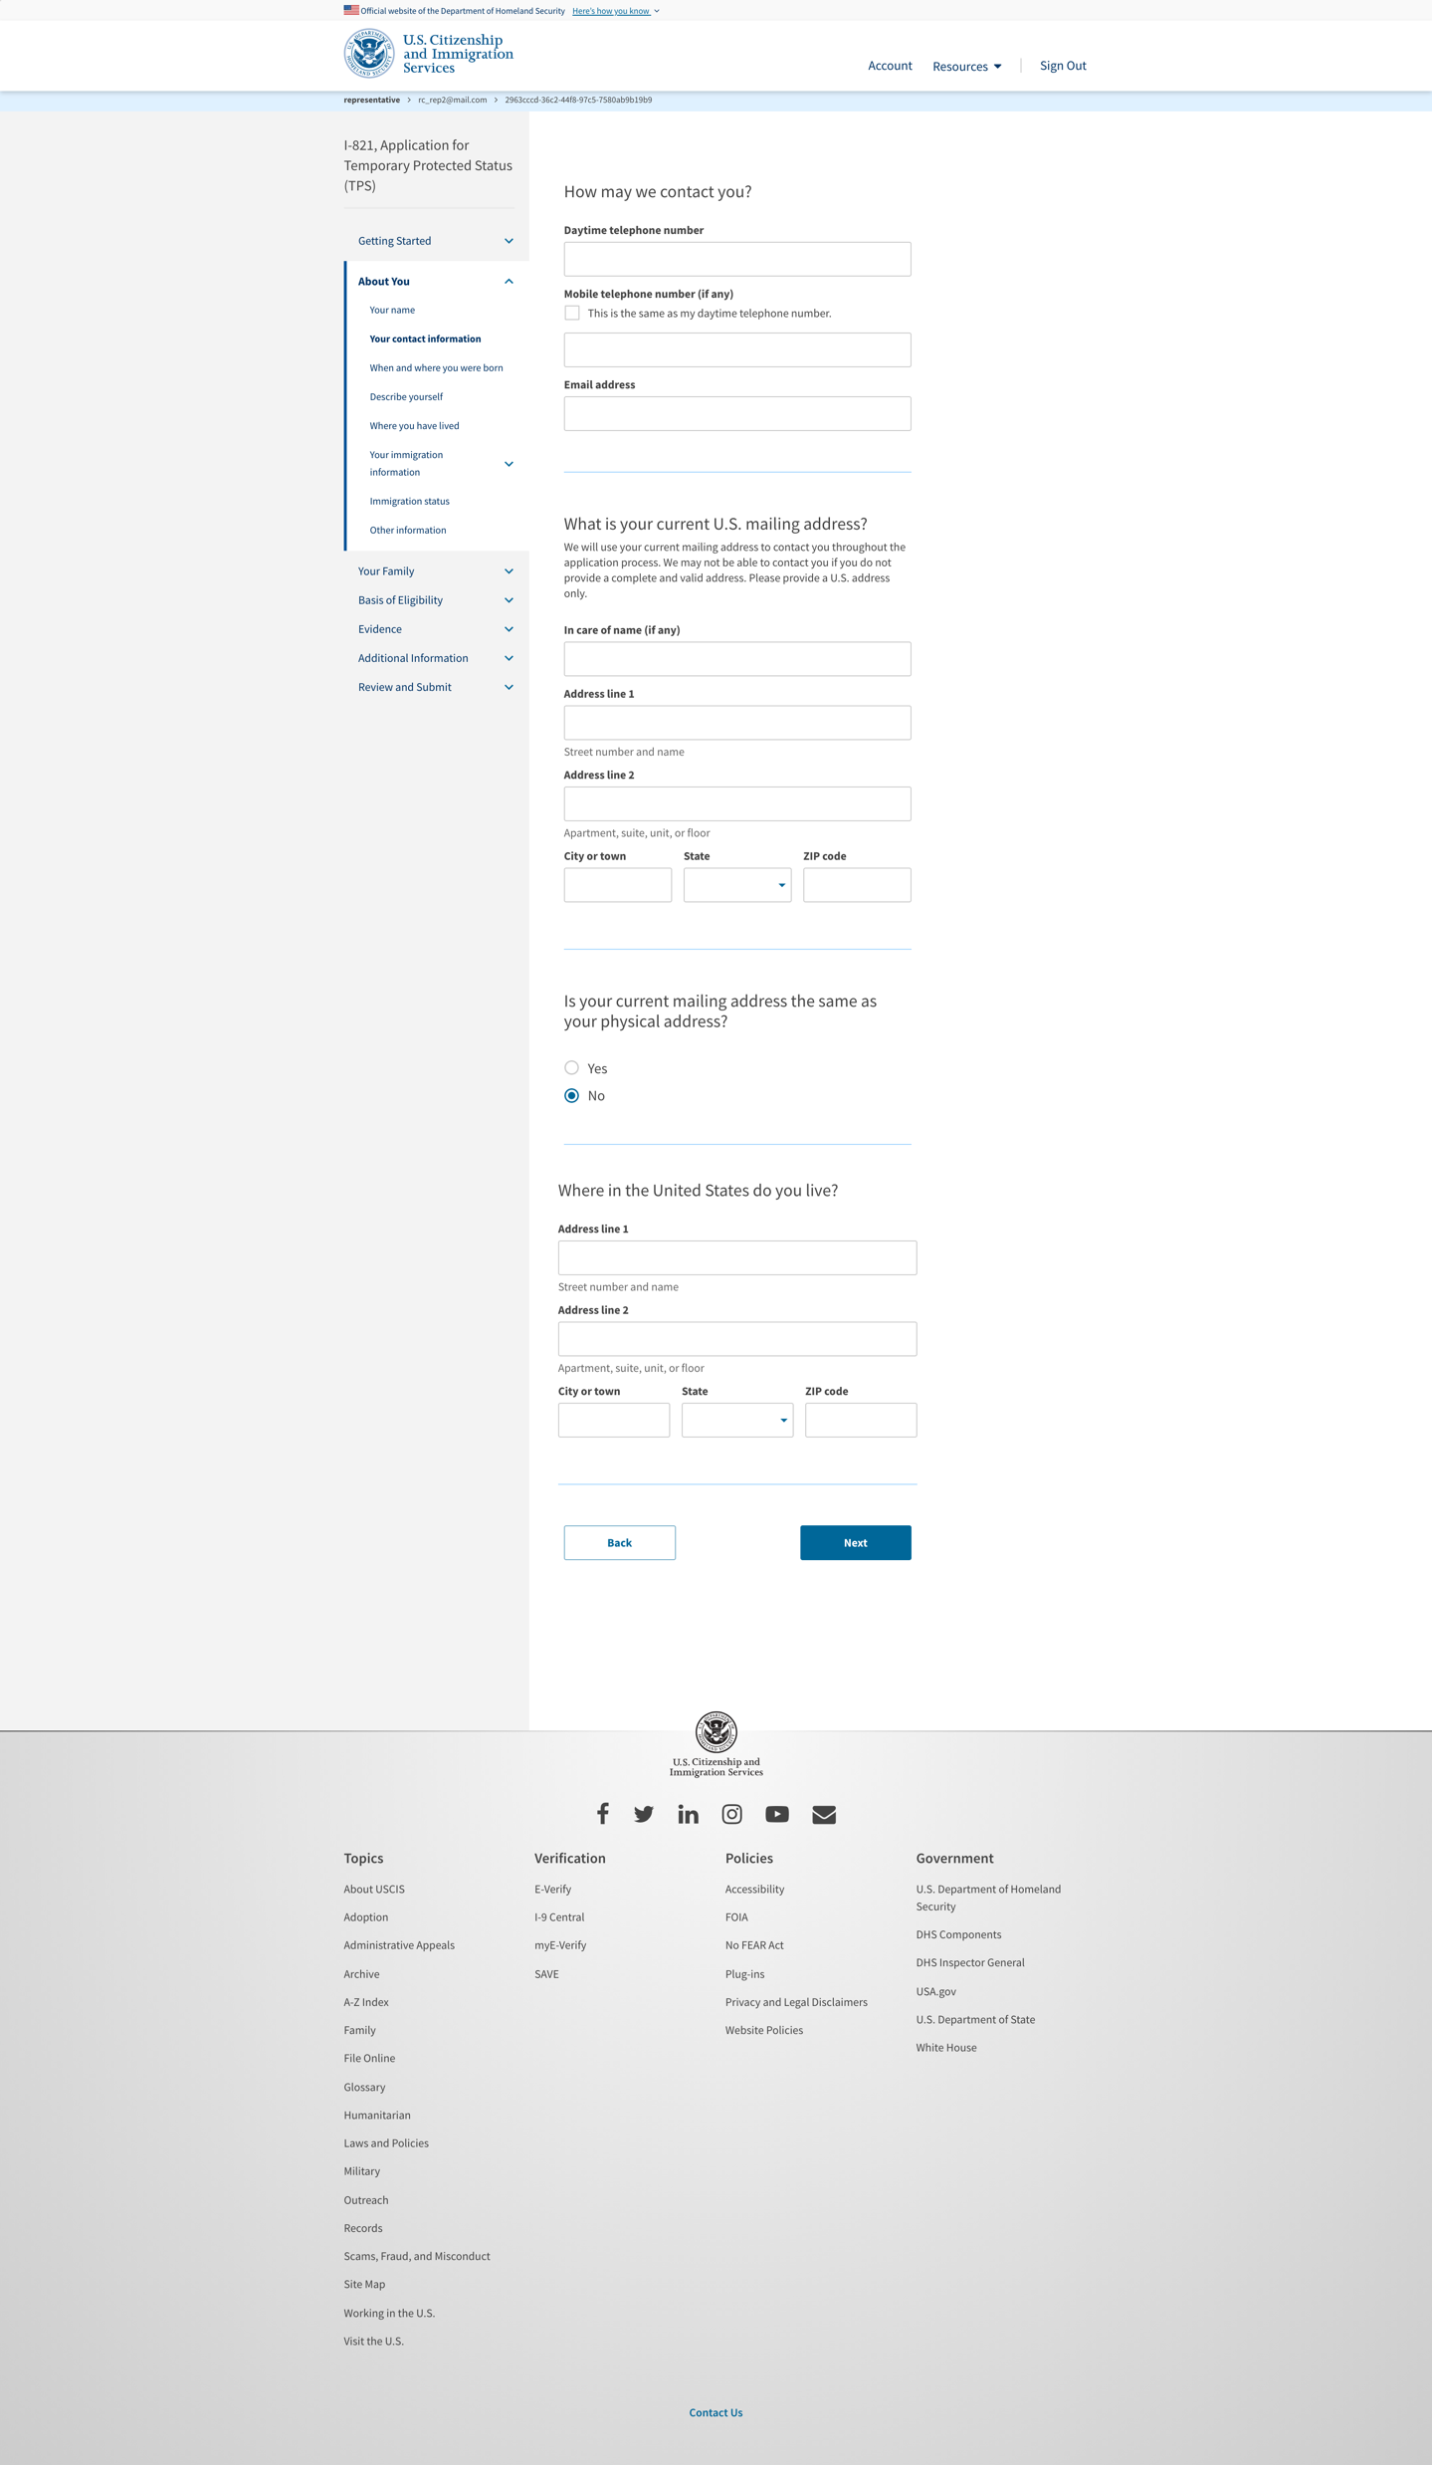
I-821: About You – Your contact information

Slide 12
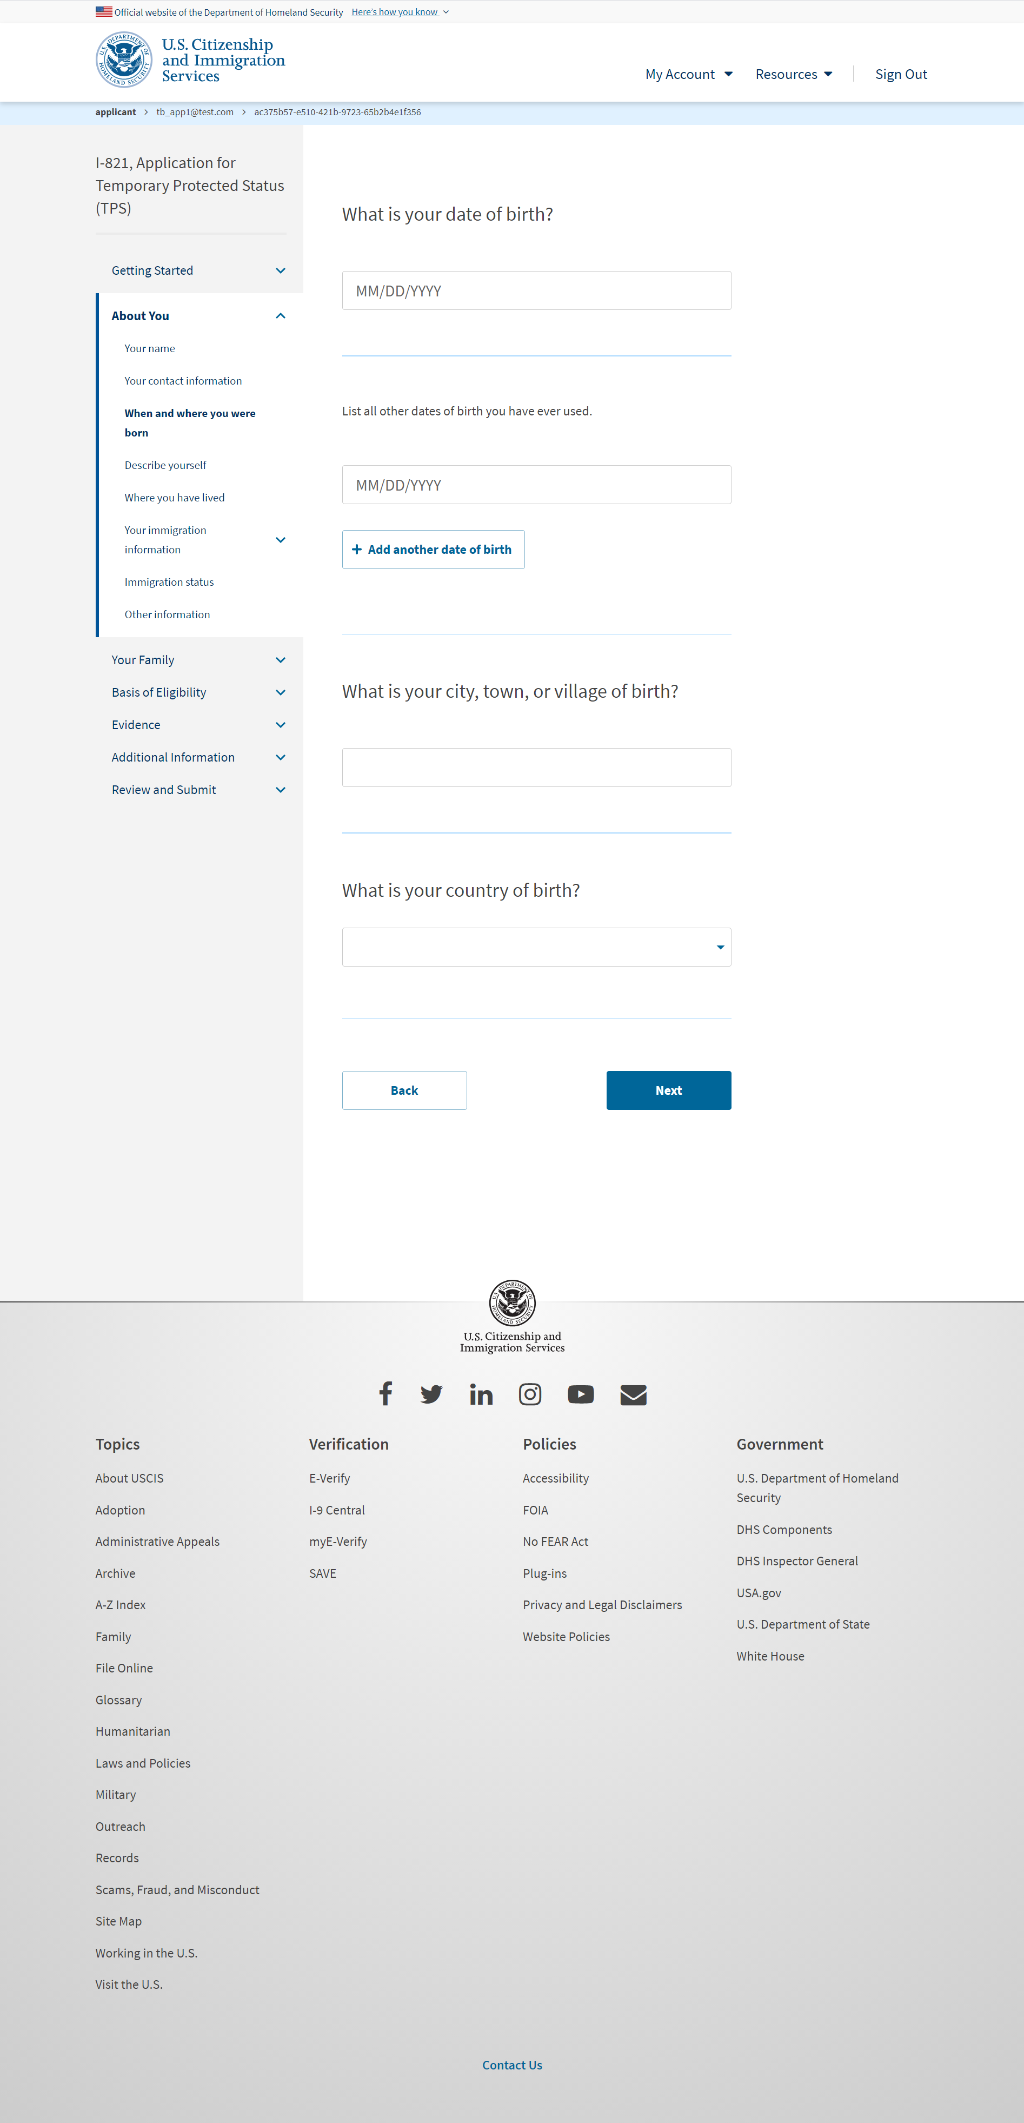
I-821: About You – When and where you were born

Slide 13
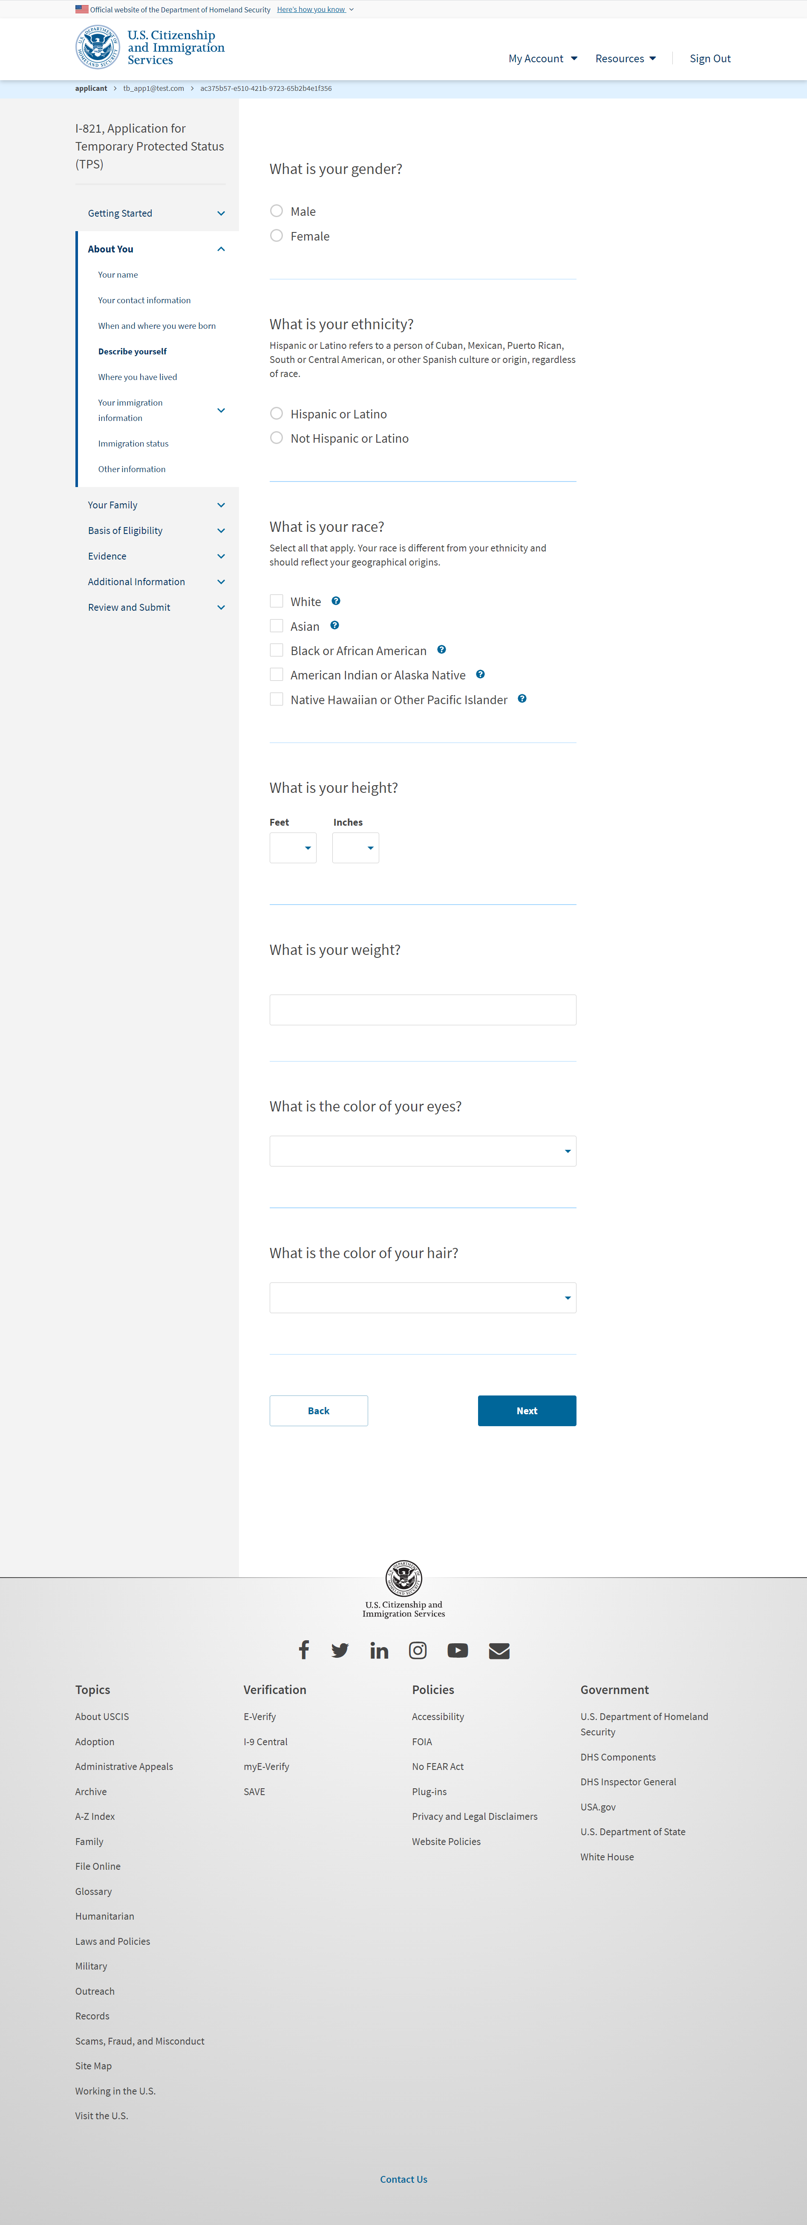
I-821: About You – Describe yourself

Slide 14
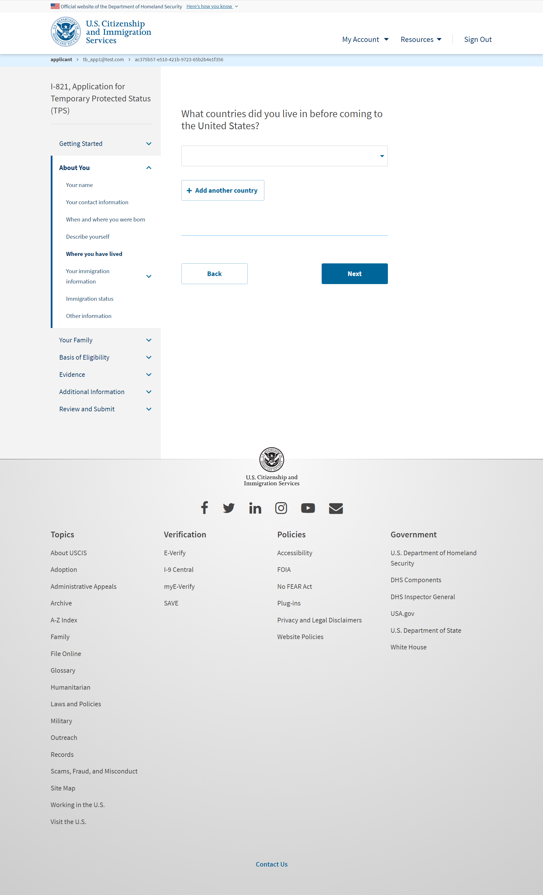
I-821: About You – Where you have lived

Slide 15
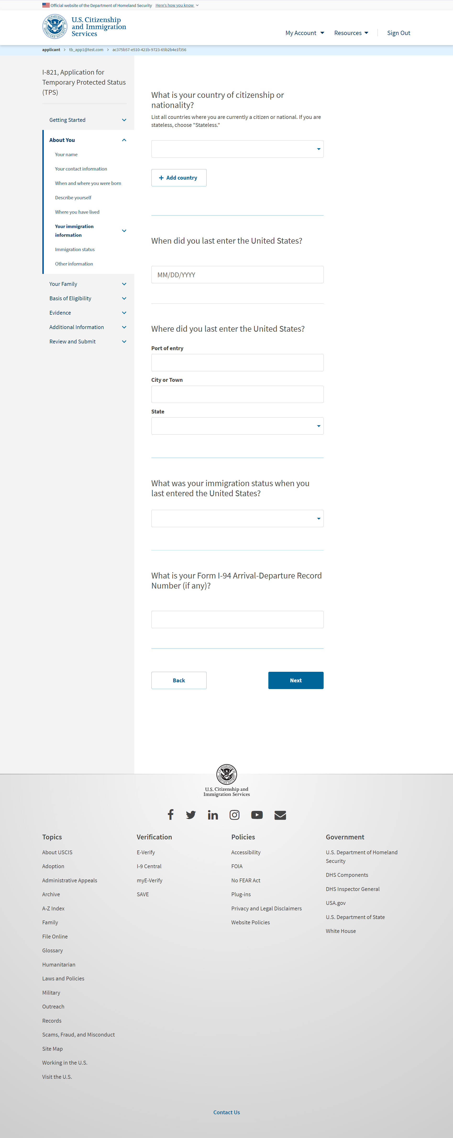
I-821: About You – Your immigration information

Slide 16
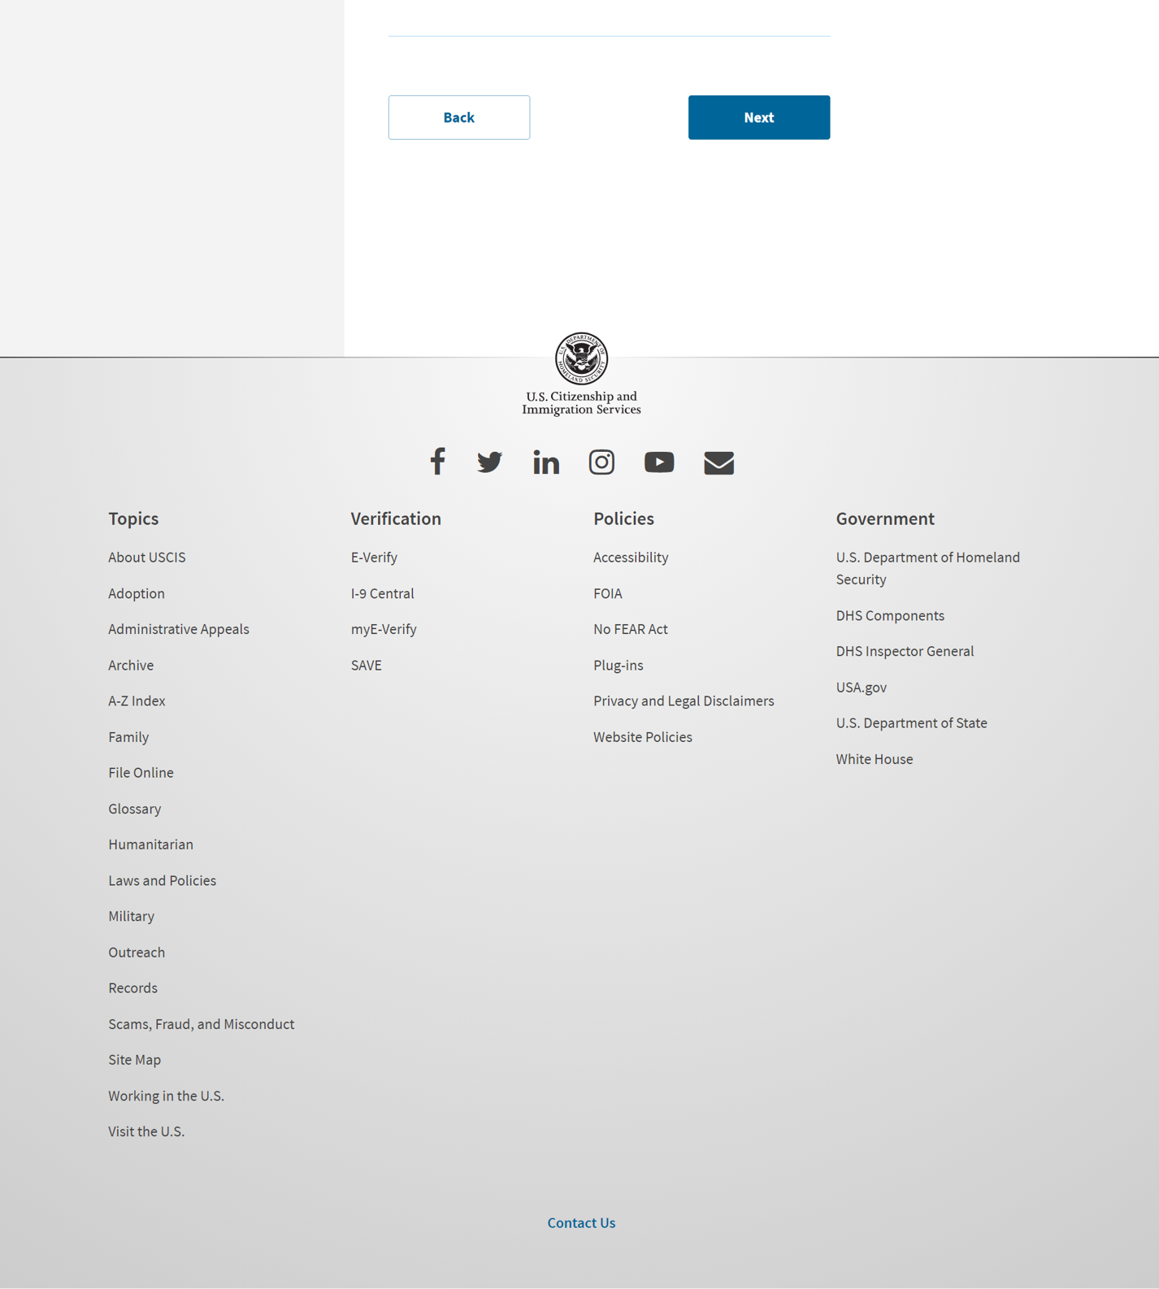
I-821: About You – Your immigration information page 2

Slide 17
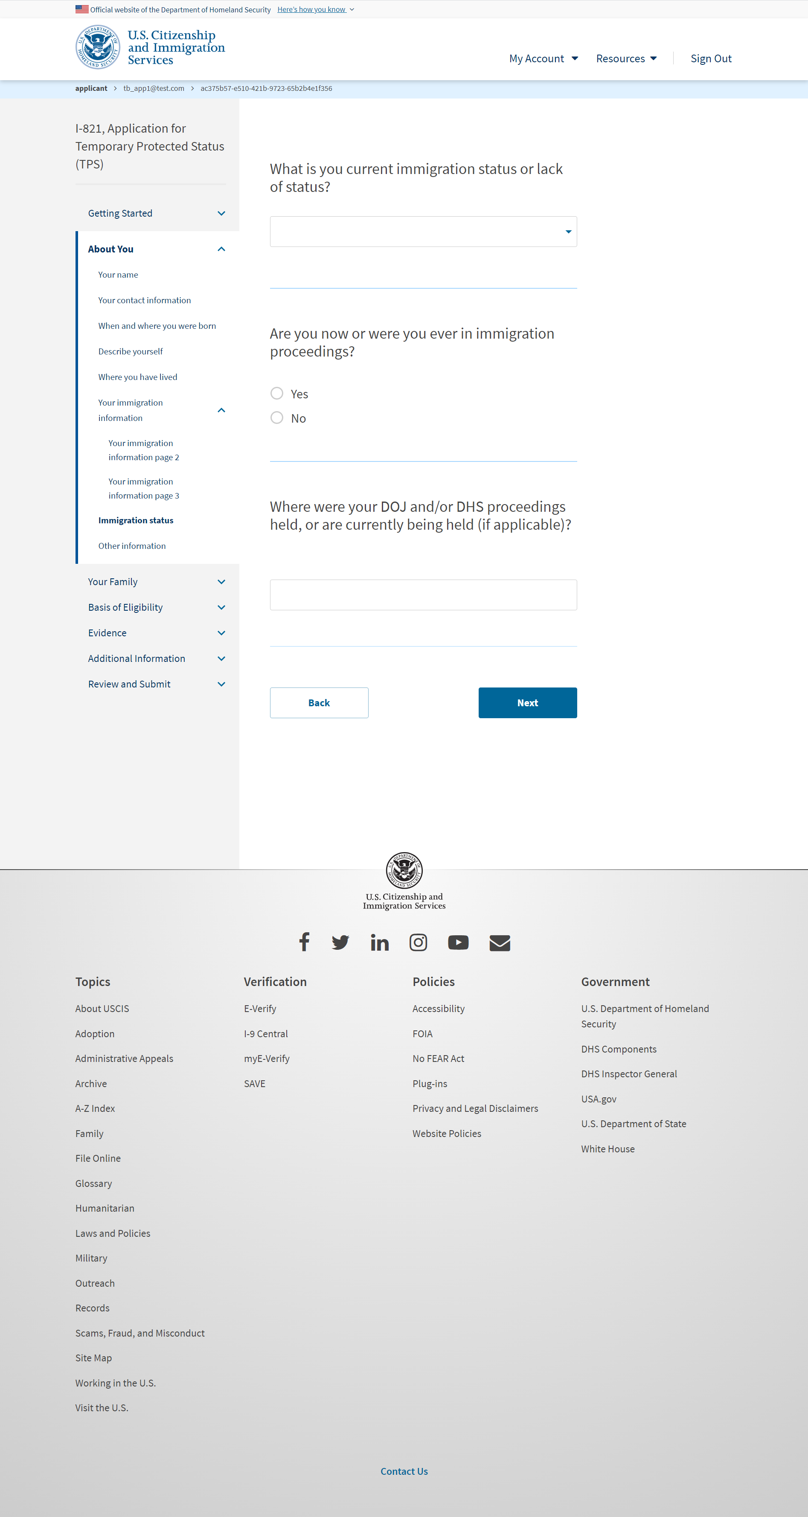
I-821: About You – Immigration status

Slide 18
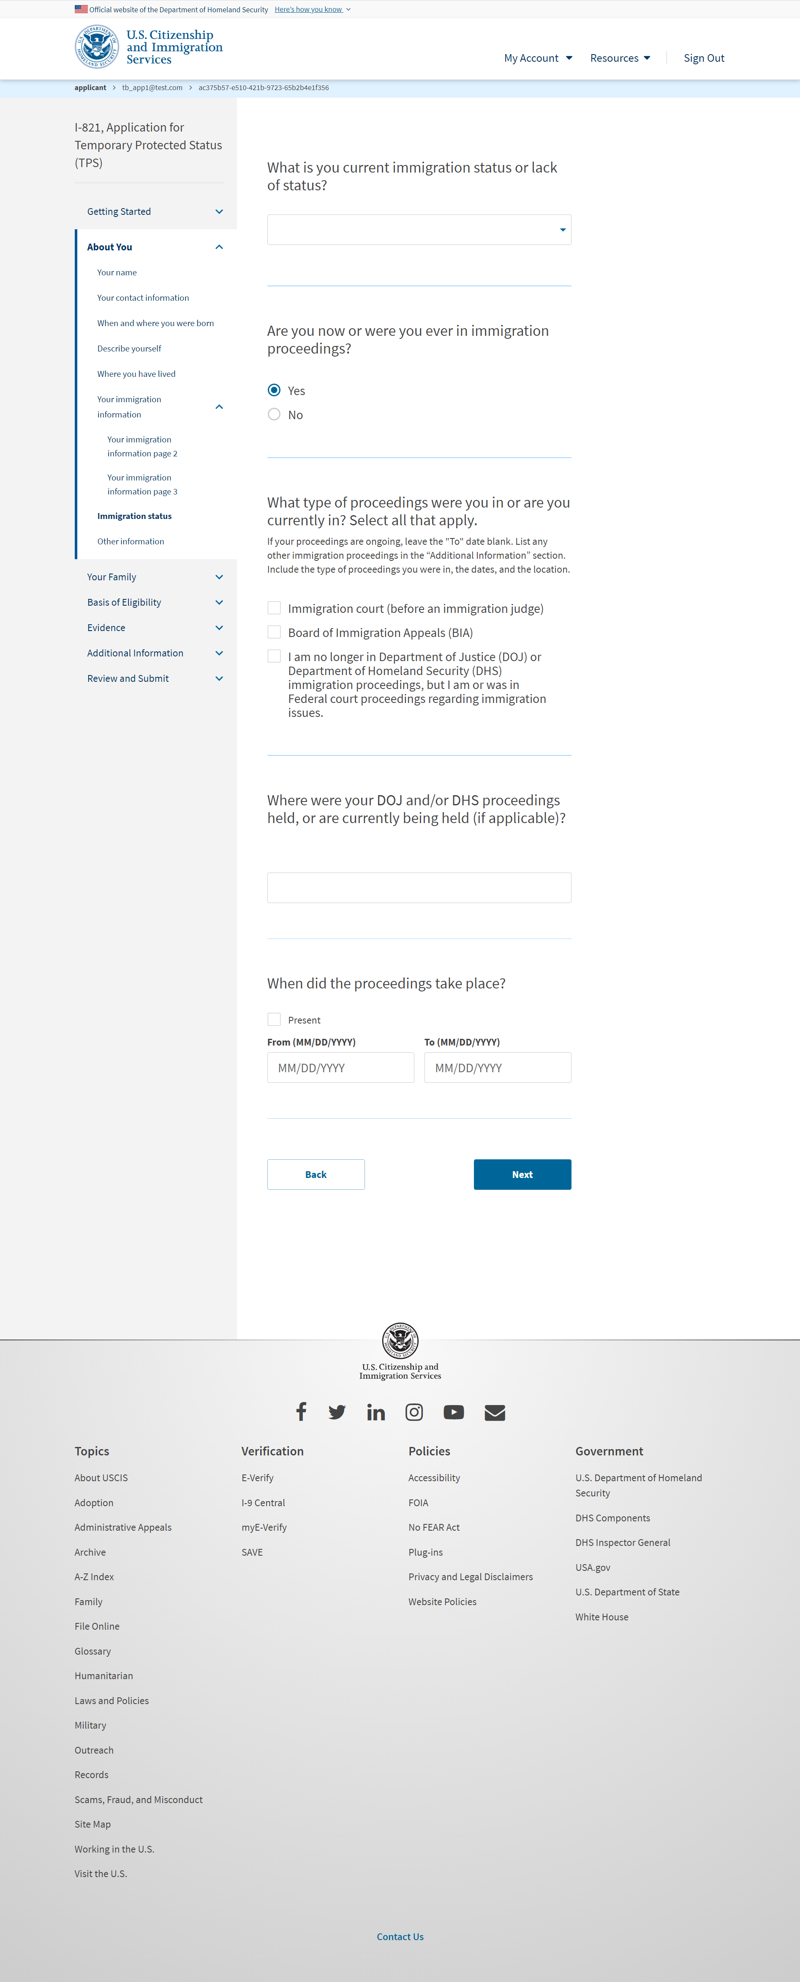
I-821: About You – Immigration status (User selects ‘Yes’ from previous slide)

Slide 19
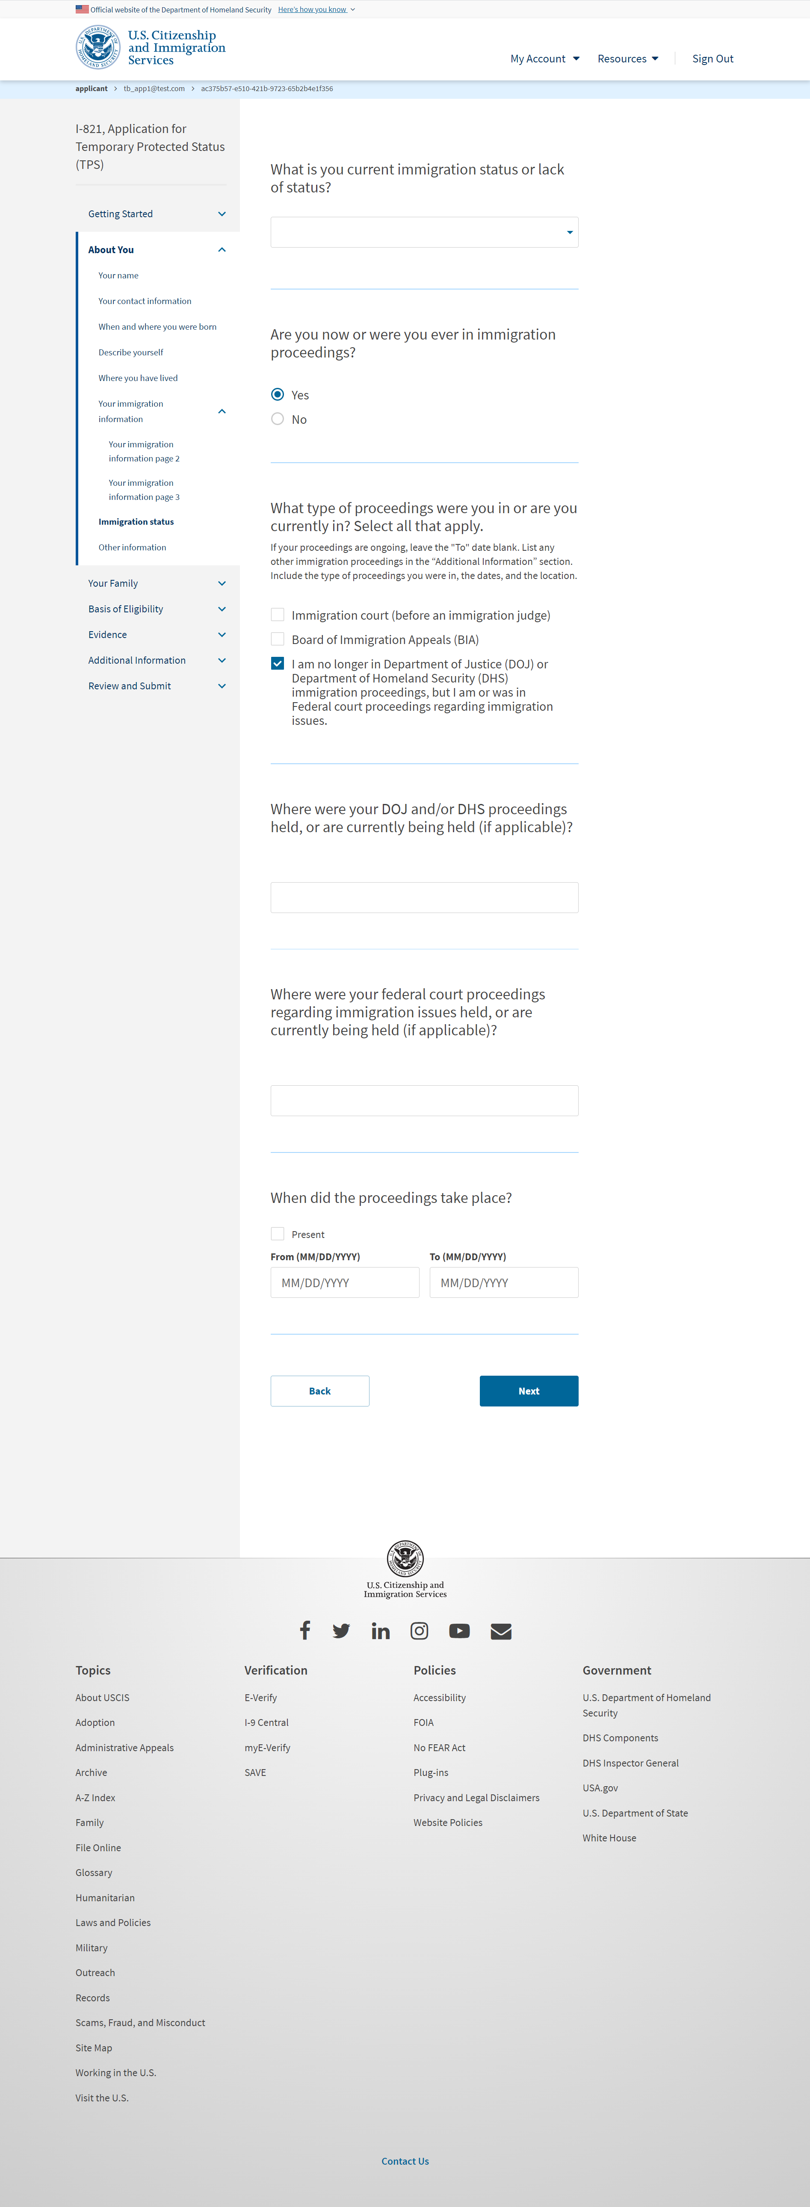
I-821: About You – Immigration status (User selects 3rd checkbox)

Slide 20
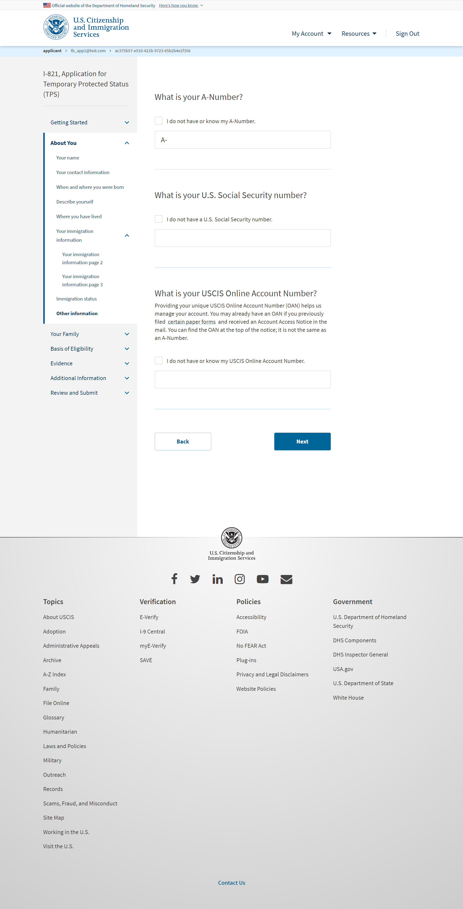
I-821: About You – Other information

Slide 21
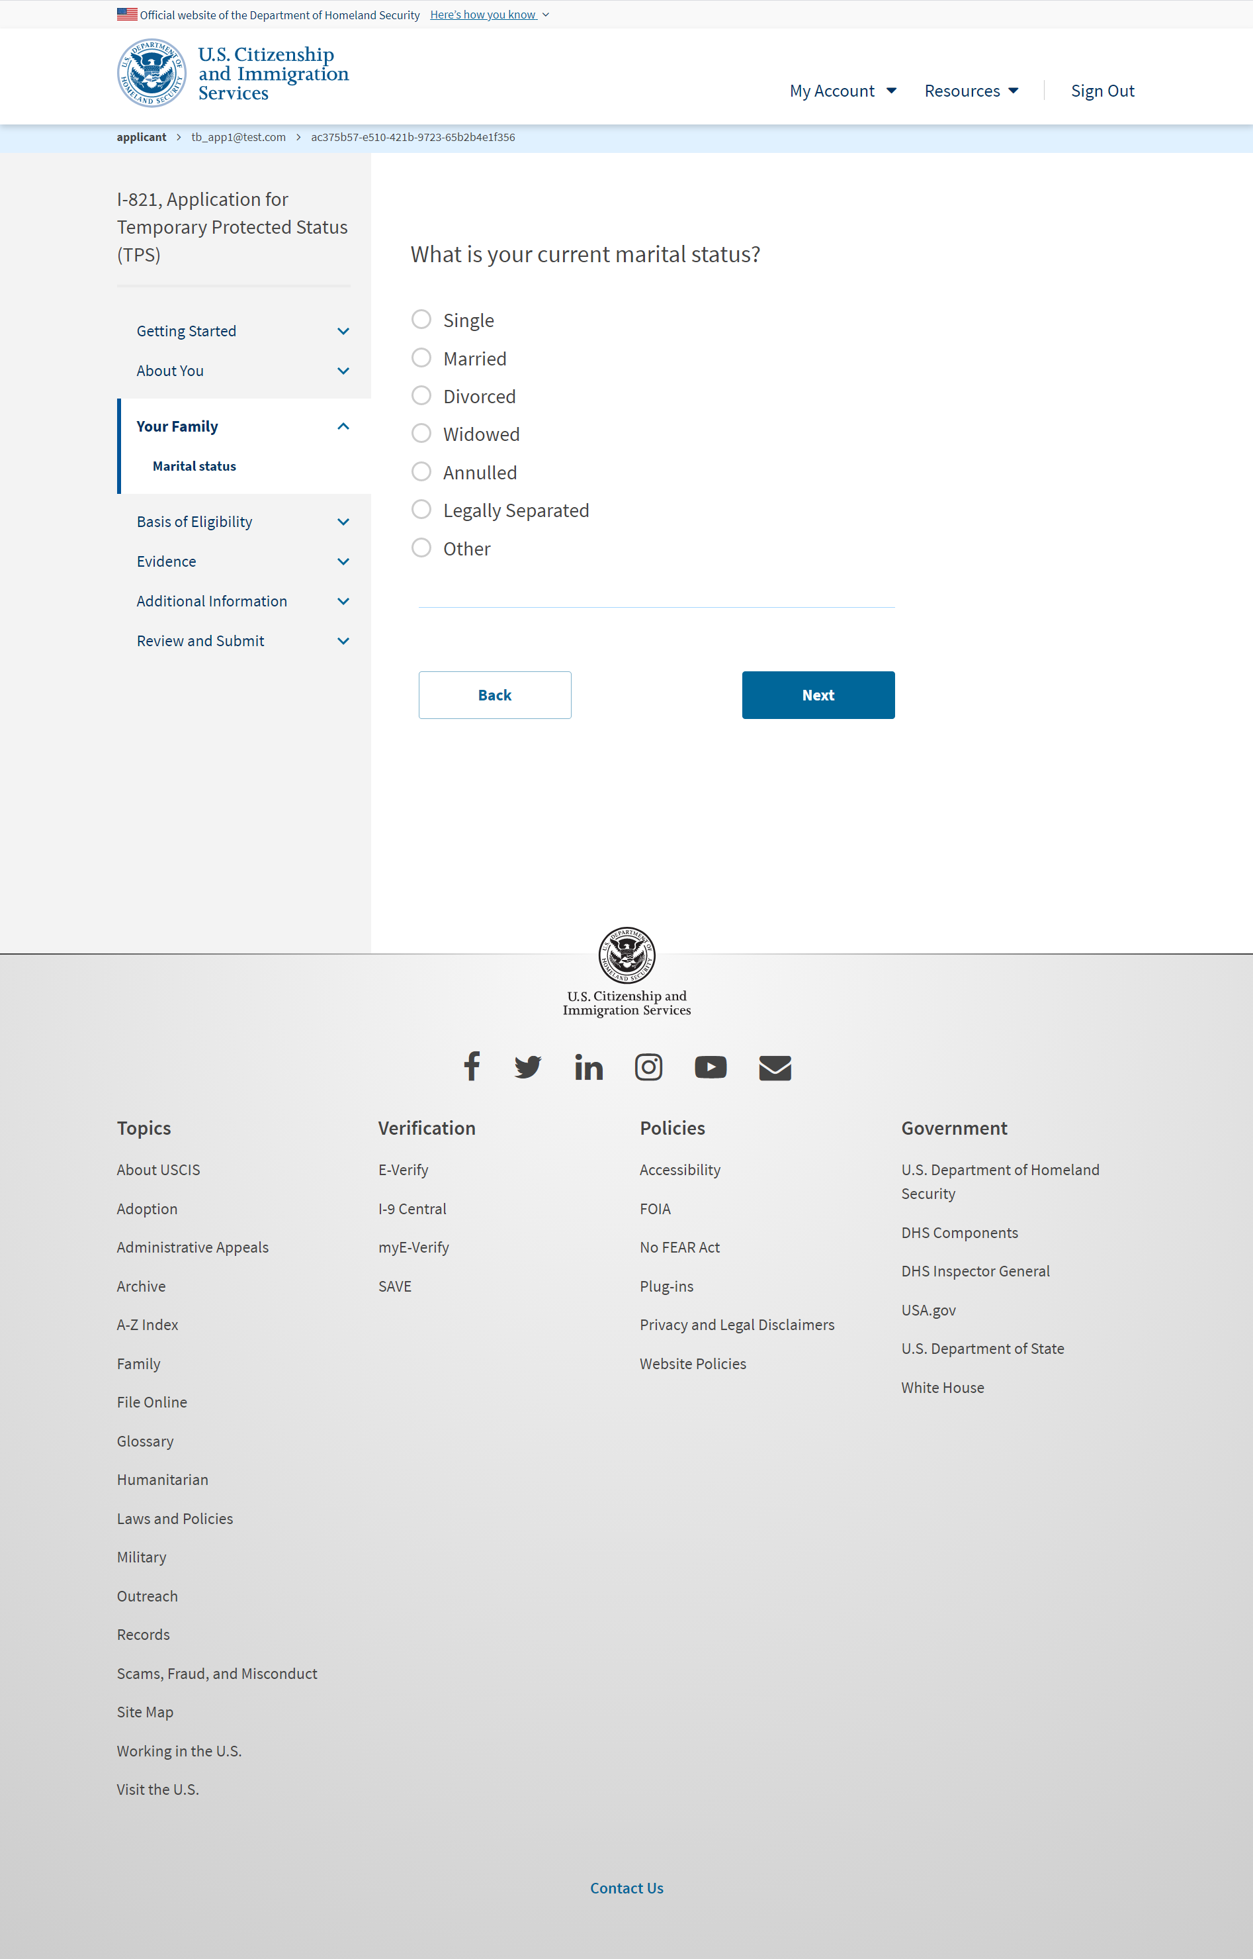
I-821: Your Family – Martial status

Slide 22
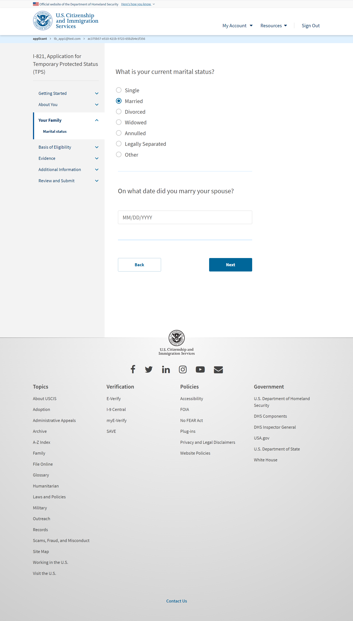
I-821: Your Family – Martial status (if user selects ‘Married’)

Slide 23
I-821: Your Family – Martial status (if user selects ‘Legally Separated’)

Slide 24
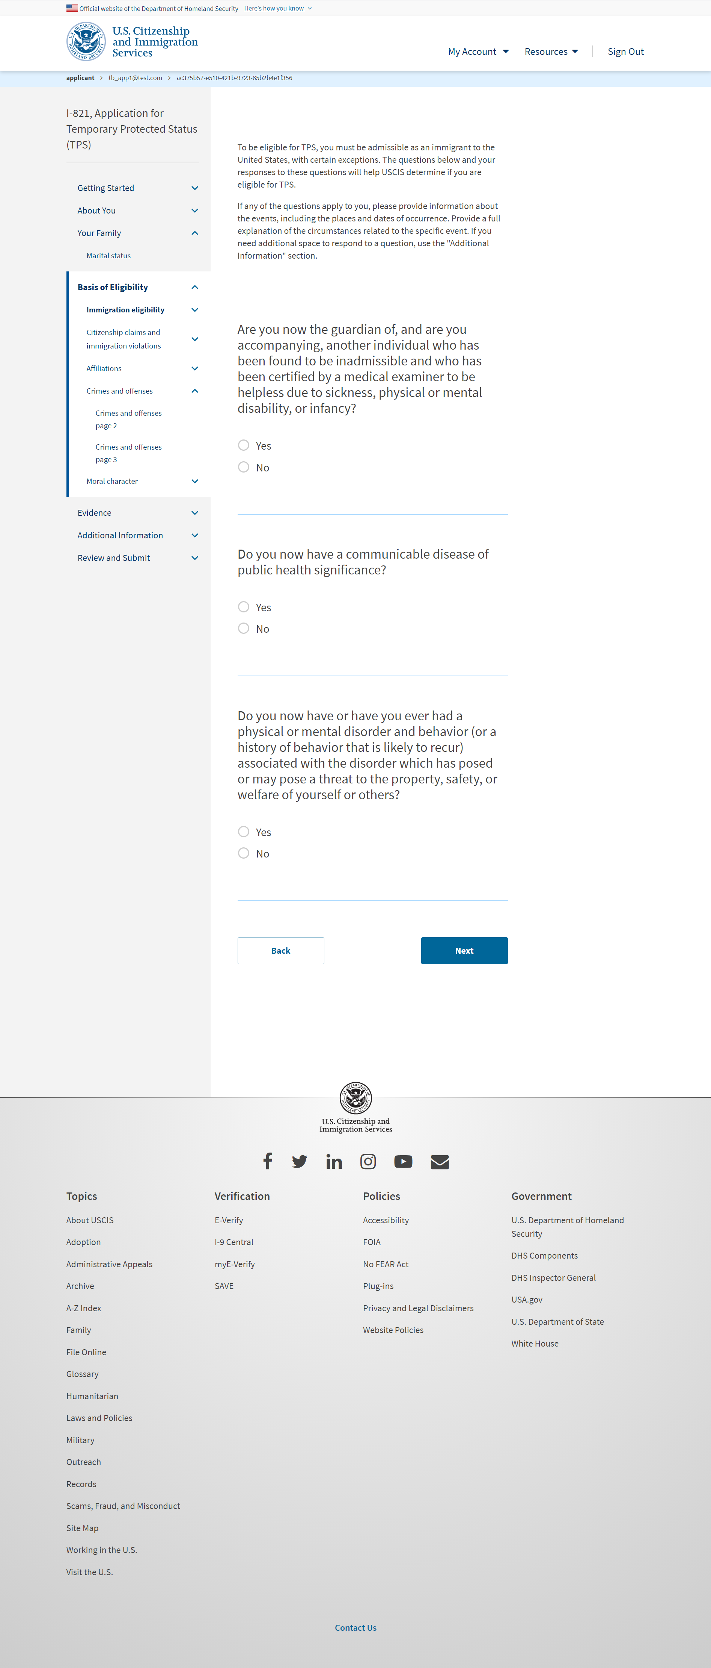
I-821: Basis of Eligibility – Immigration eligibility

Slide 25
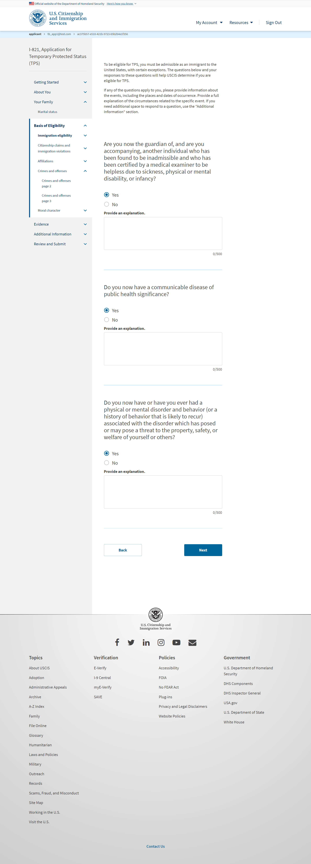
I-821: Basis of Eligibility – Immigration eligibility (if user selects ‘Yes’ from previous slide)

Slide 26
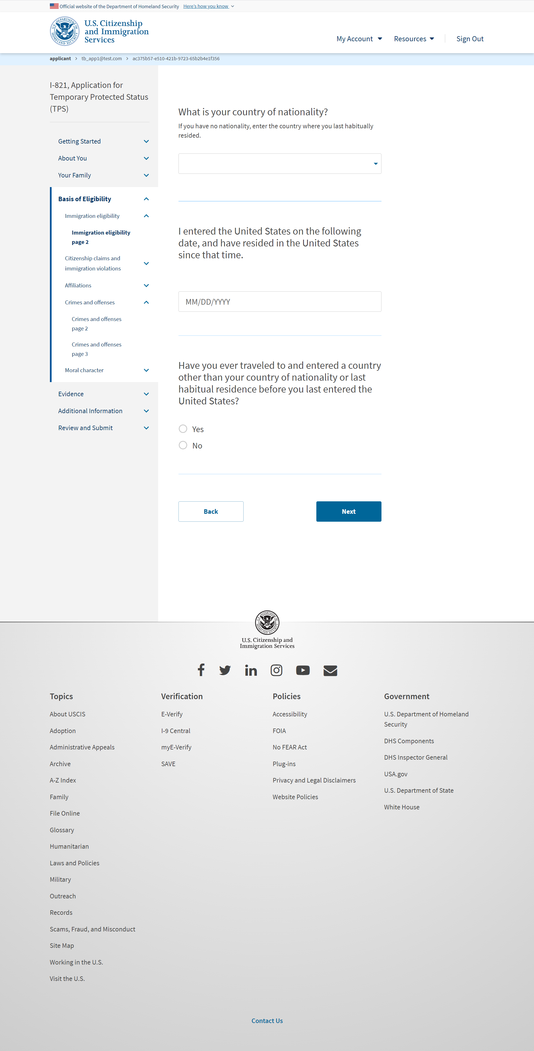
I-821: Basis of Eligibility – Immigration eligibility page 2

Slide 27
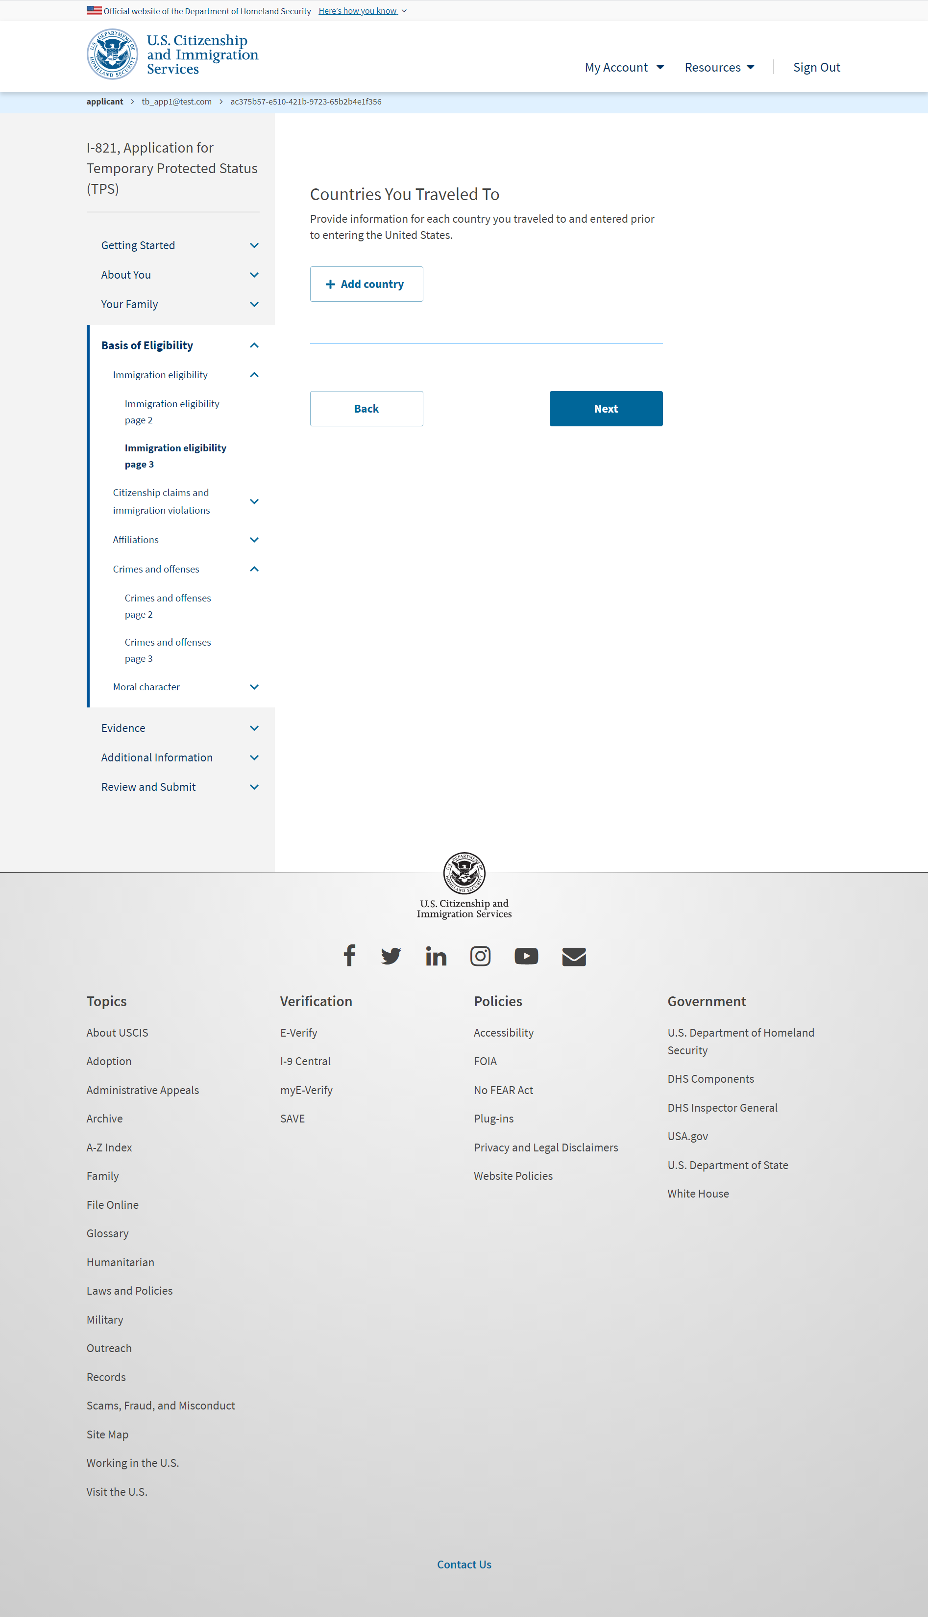
I-821: Basis of Eligibility – Immigration eligibility page 3 (User selects ‘Yes’ from previous slide)

Slide 28
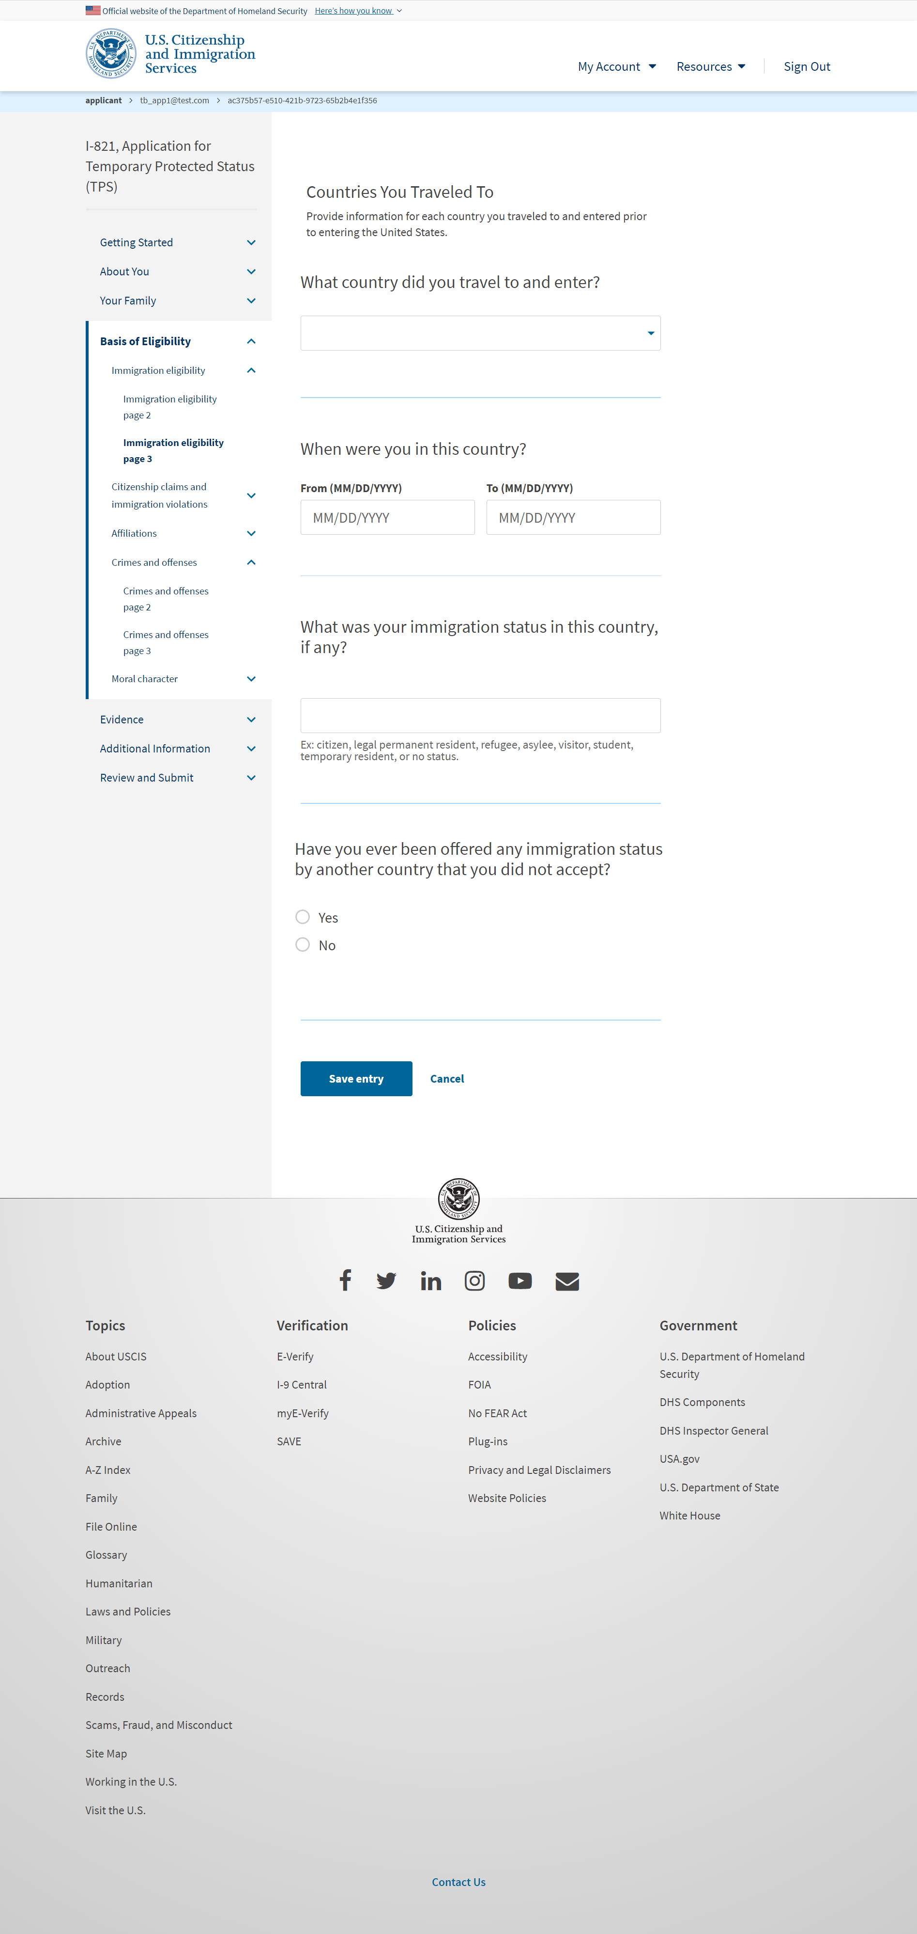
I-821: Basis of Eligibility – Immigration eligibility page 3 (User adds a country)

Slide 29
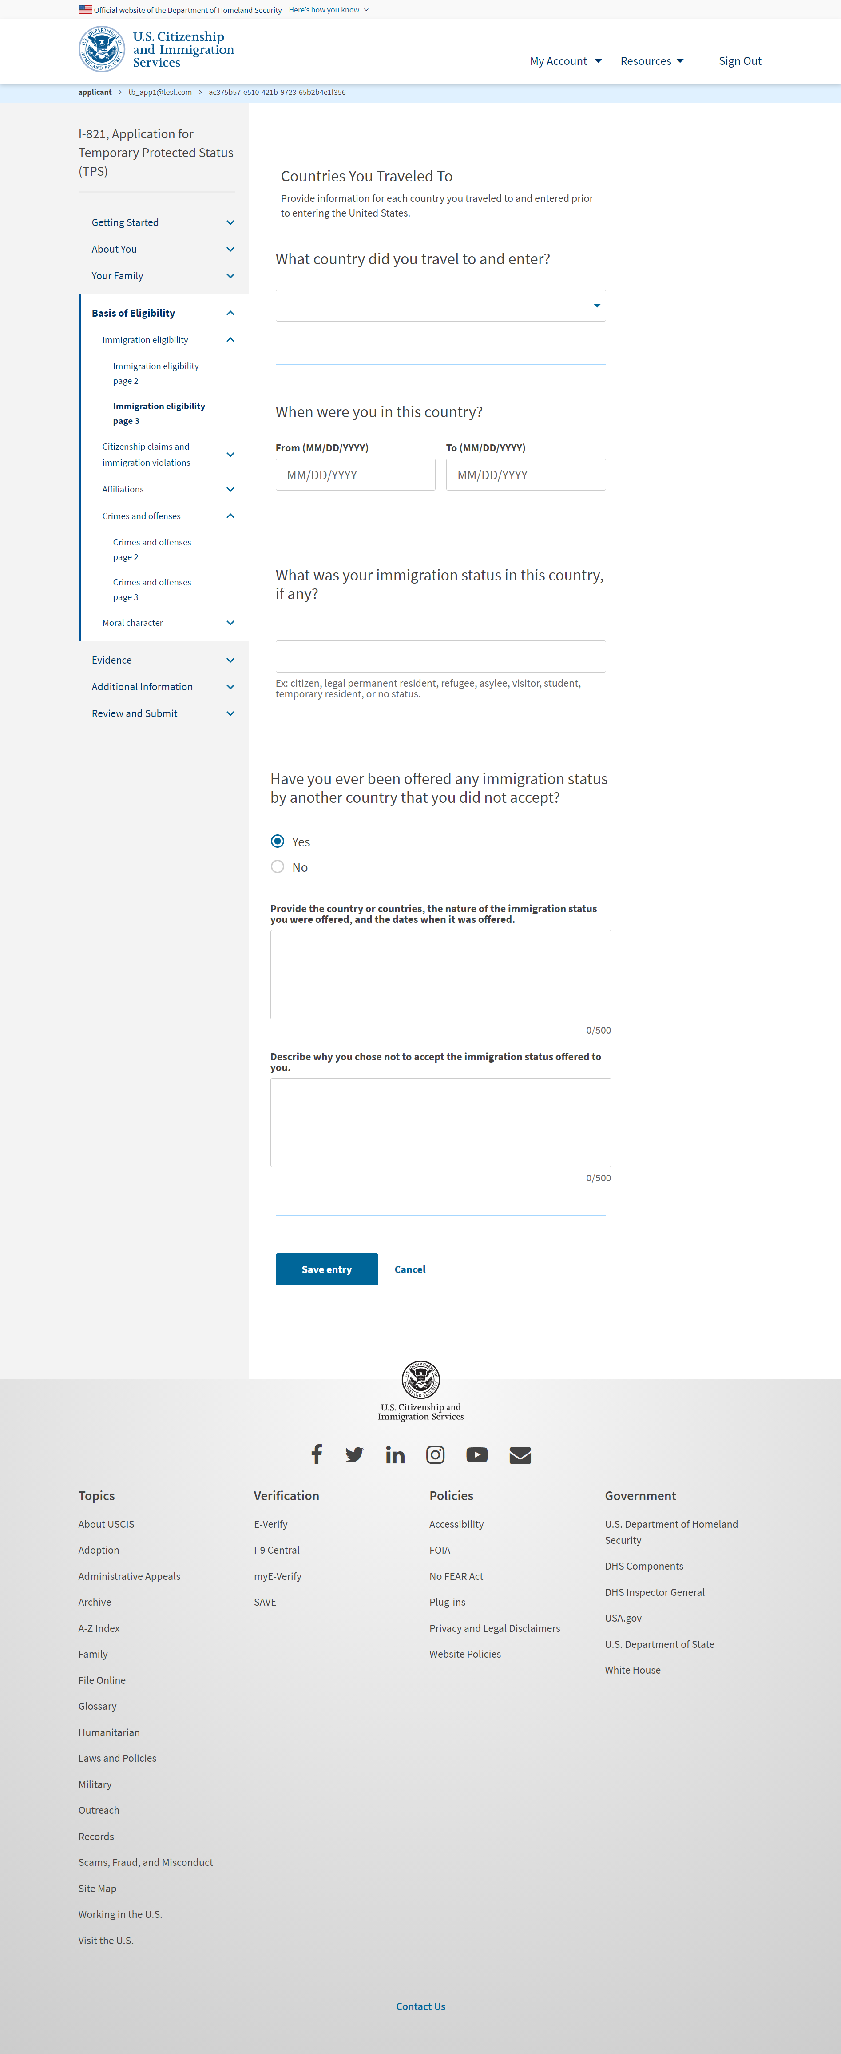
I-821: Basis of Eligibility – Immigration eligibility page 3 (User selects ‘Yes’ on the page)

Slide 30
I-821: Basis of Eligibility – Citizenship claims and immigration violations

Slide 31
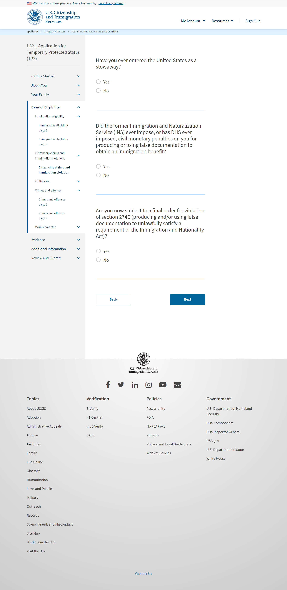
I-821: Basis of Eligibility – Citizenship claims and immigration violations page 2

Slide 32
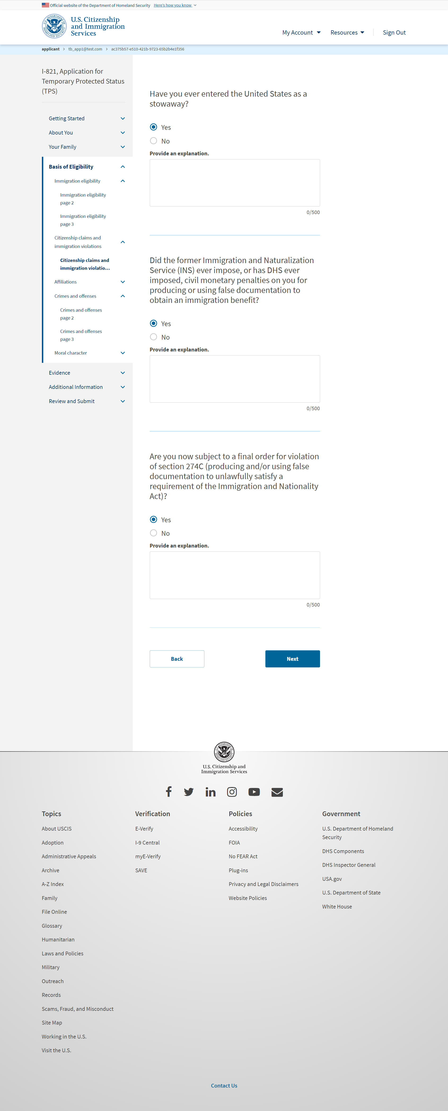
I-821: Basis of Eligibility – Citizenship claims and immigration violations page 2 ( if user selects ‘Yes)

Slide 33
I-821: Basis of Eligibility – Affiliations

Slide 34
I-821: Basis of Eligibility – Affiliations (if user selects ‘Yes’)

Slide 35
I-821: Basis of Eligibility – Affiliations page 2

Slide 36
I-821: Basis of Eligibility – Affiliations page 2 (if user selects ‘Yes’)

Slide 37
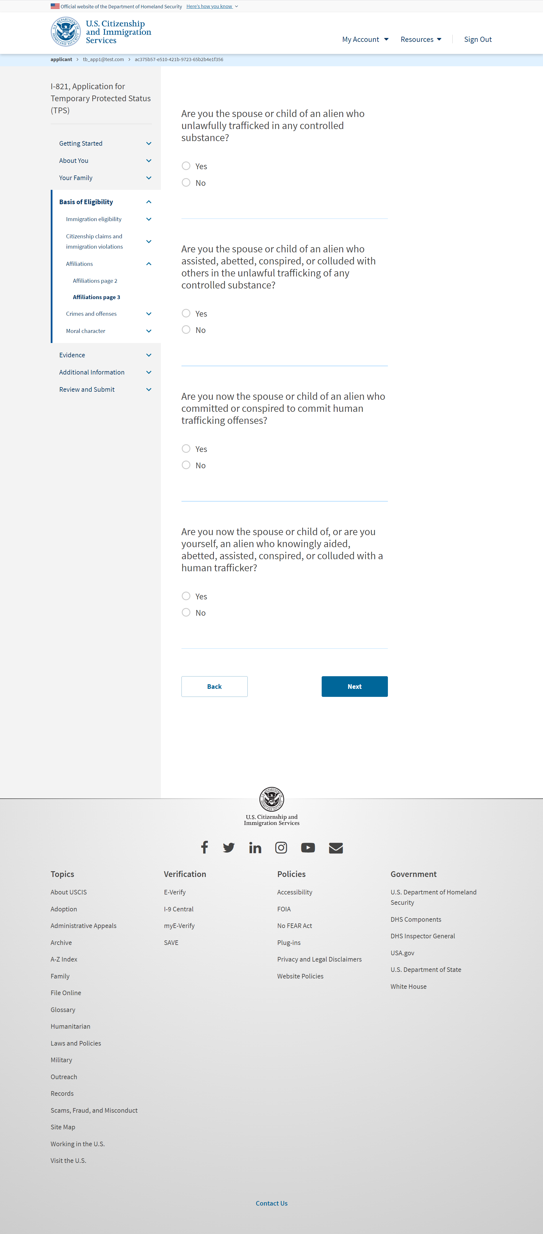
I-821: Basis of Eligibility – Affiliations page 3

Slide 38
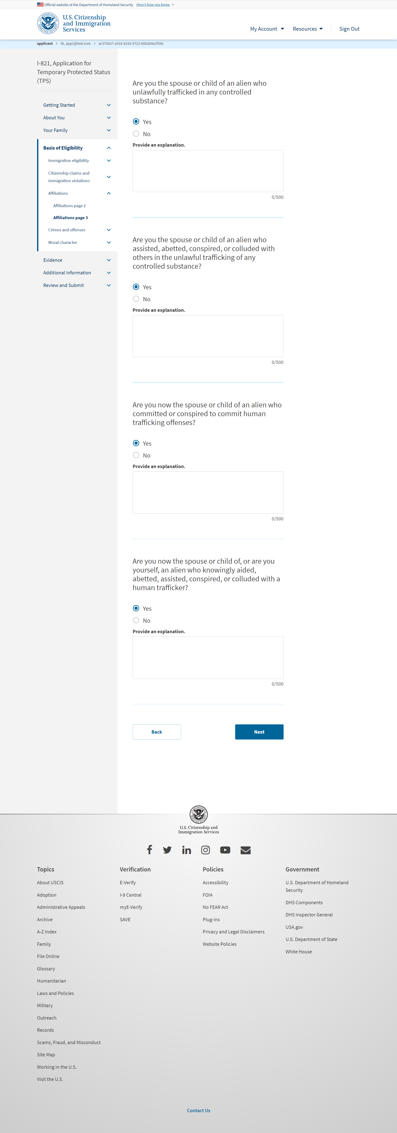
I-821: Basis of Eligibility – Affiliations page 3 (if user selects ‘Yes’)

Slide 39
I-821: Basis of Eligibility – Crimes and offenses

Slide 40
I-821: Basis of Eligibility – Crimes and offenses (if user selects ‘Yes’)

Slide 41
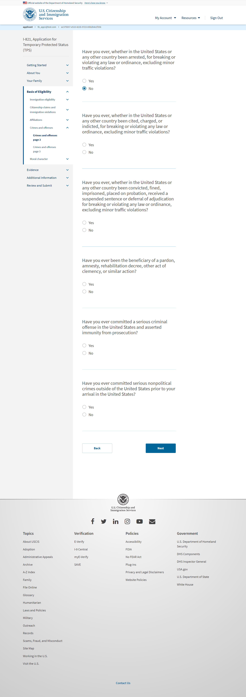
I-821: Basis of Eligibility – Crimes and offenses page 2

Slide 42
I-821: Basis of Eligibility – Crimes and offenses page 2 (if user selects ‘Yes’)

Slide 43
I-821: Basis of Eligibility – Crimes and offenses page 3

Slide 44
I-821: Basis of Eligibility – Crimes and offenses page 3 (if user selects ‘Yes’)

Slide 45
I-821: Basis of Eligibility – Moral character

Slide 46
I-821: Basis of Eligibility – Moral character (if user selects ‘Yes’)

Slide 47
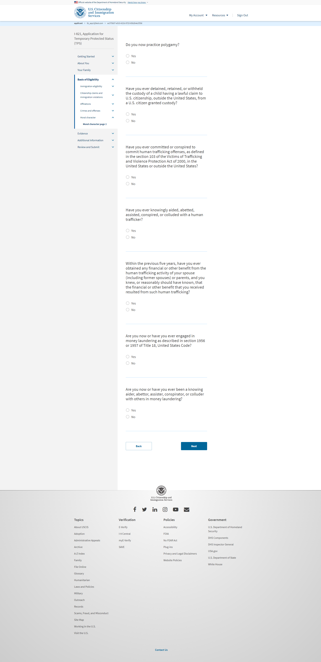
I-821: Basis of Eligibility – Moral character page 2

Slide 48
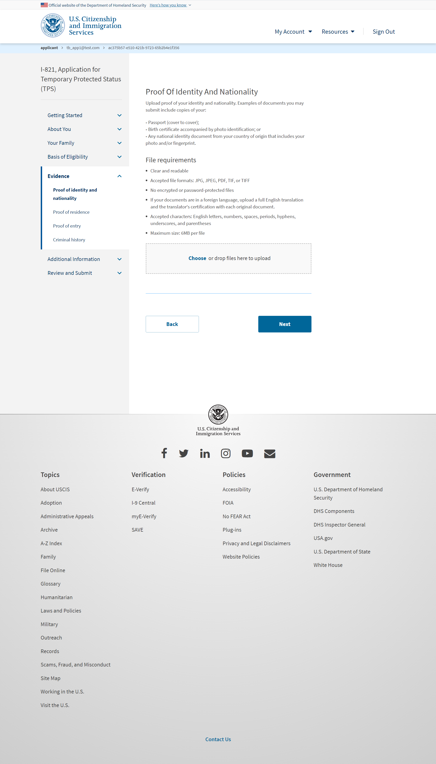
I-821:Evidence – Proof of identity and nationality

Slide 49
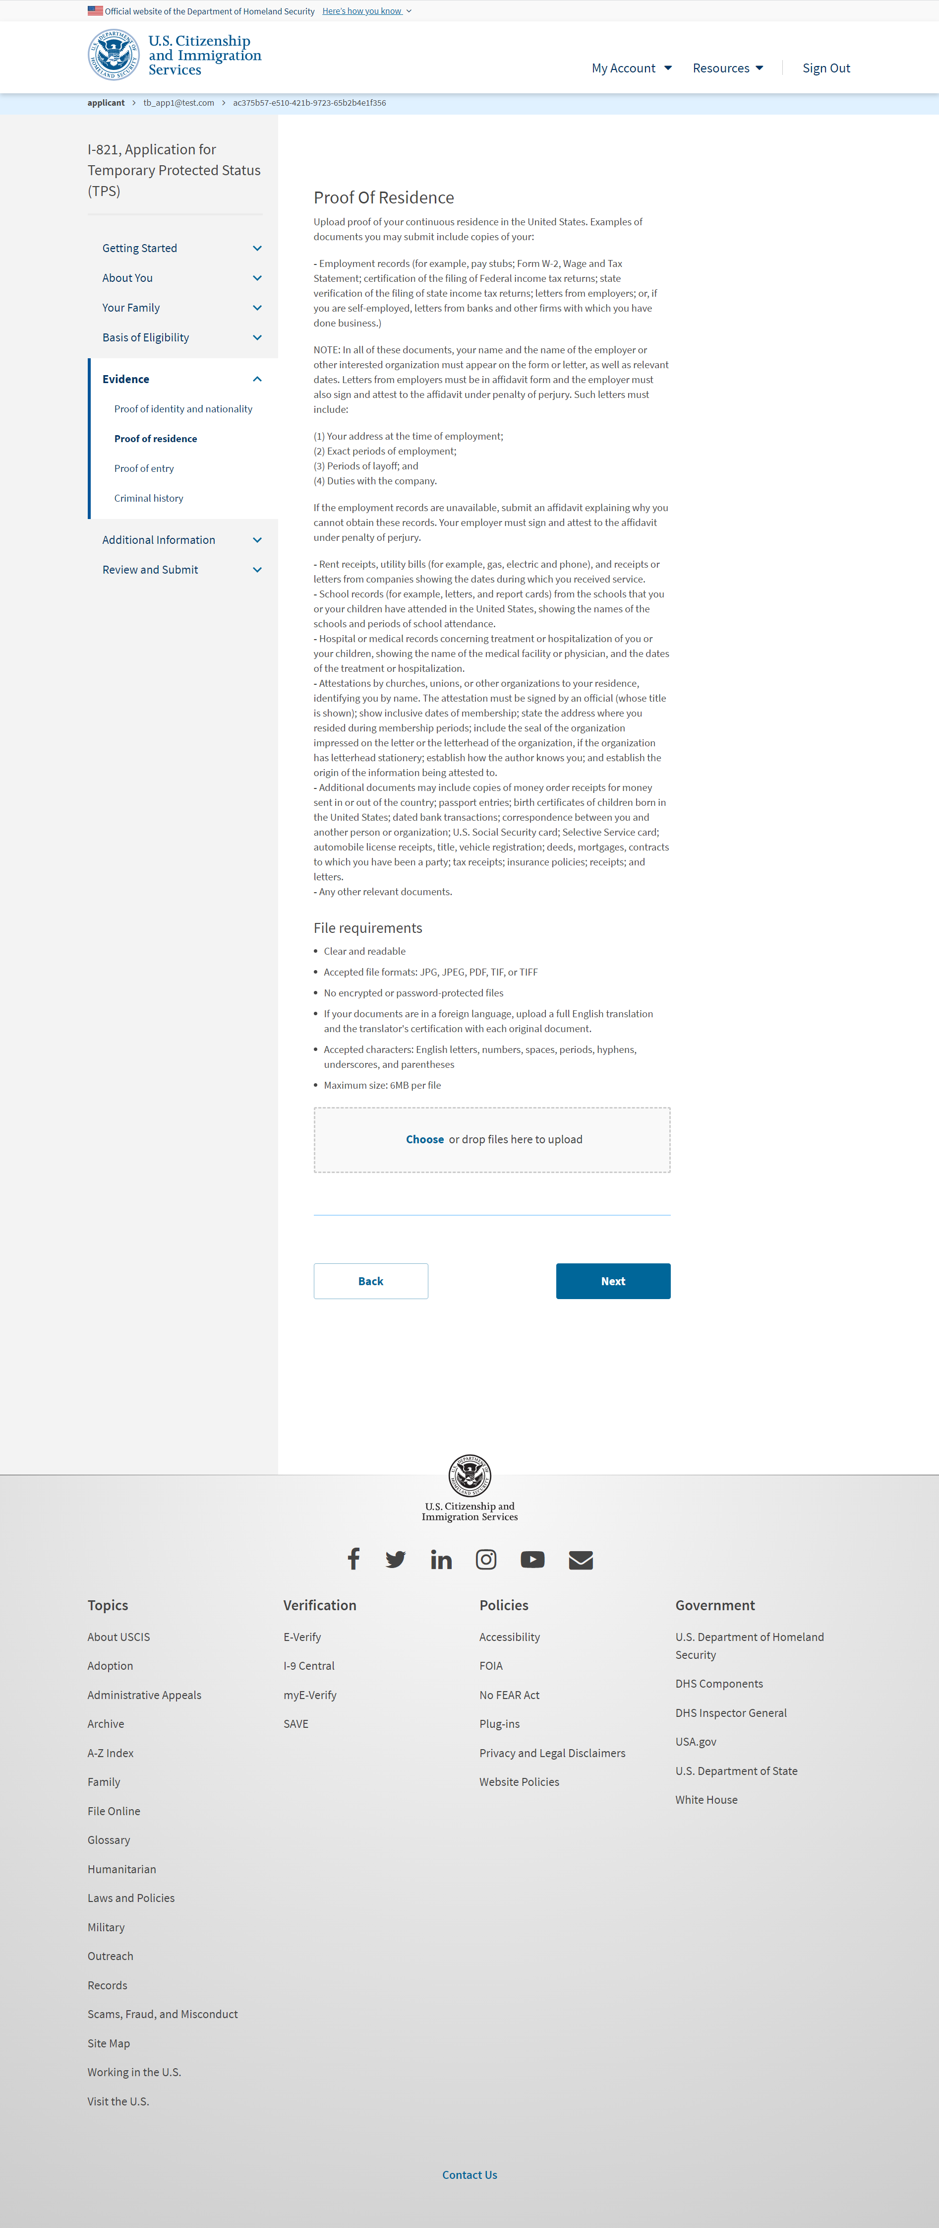
I-821:Evidence – Proof of Residence

Slide 50
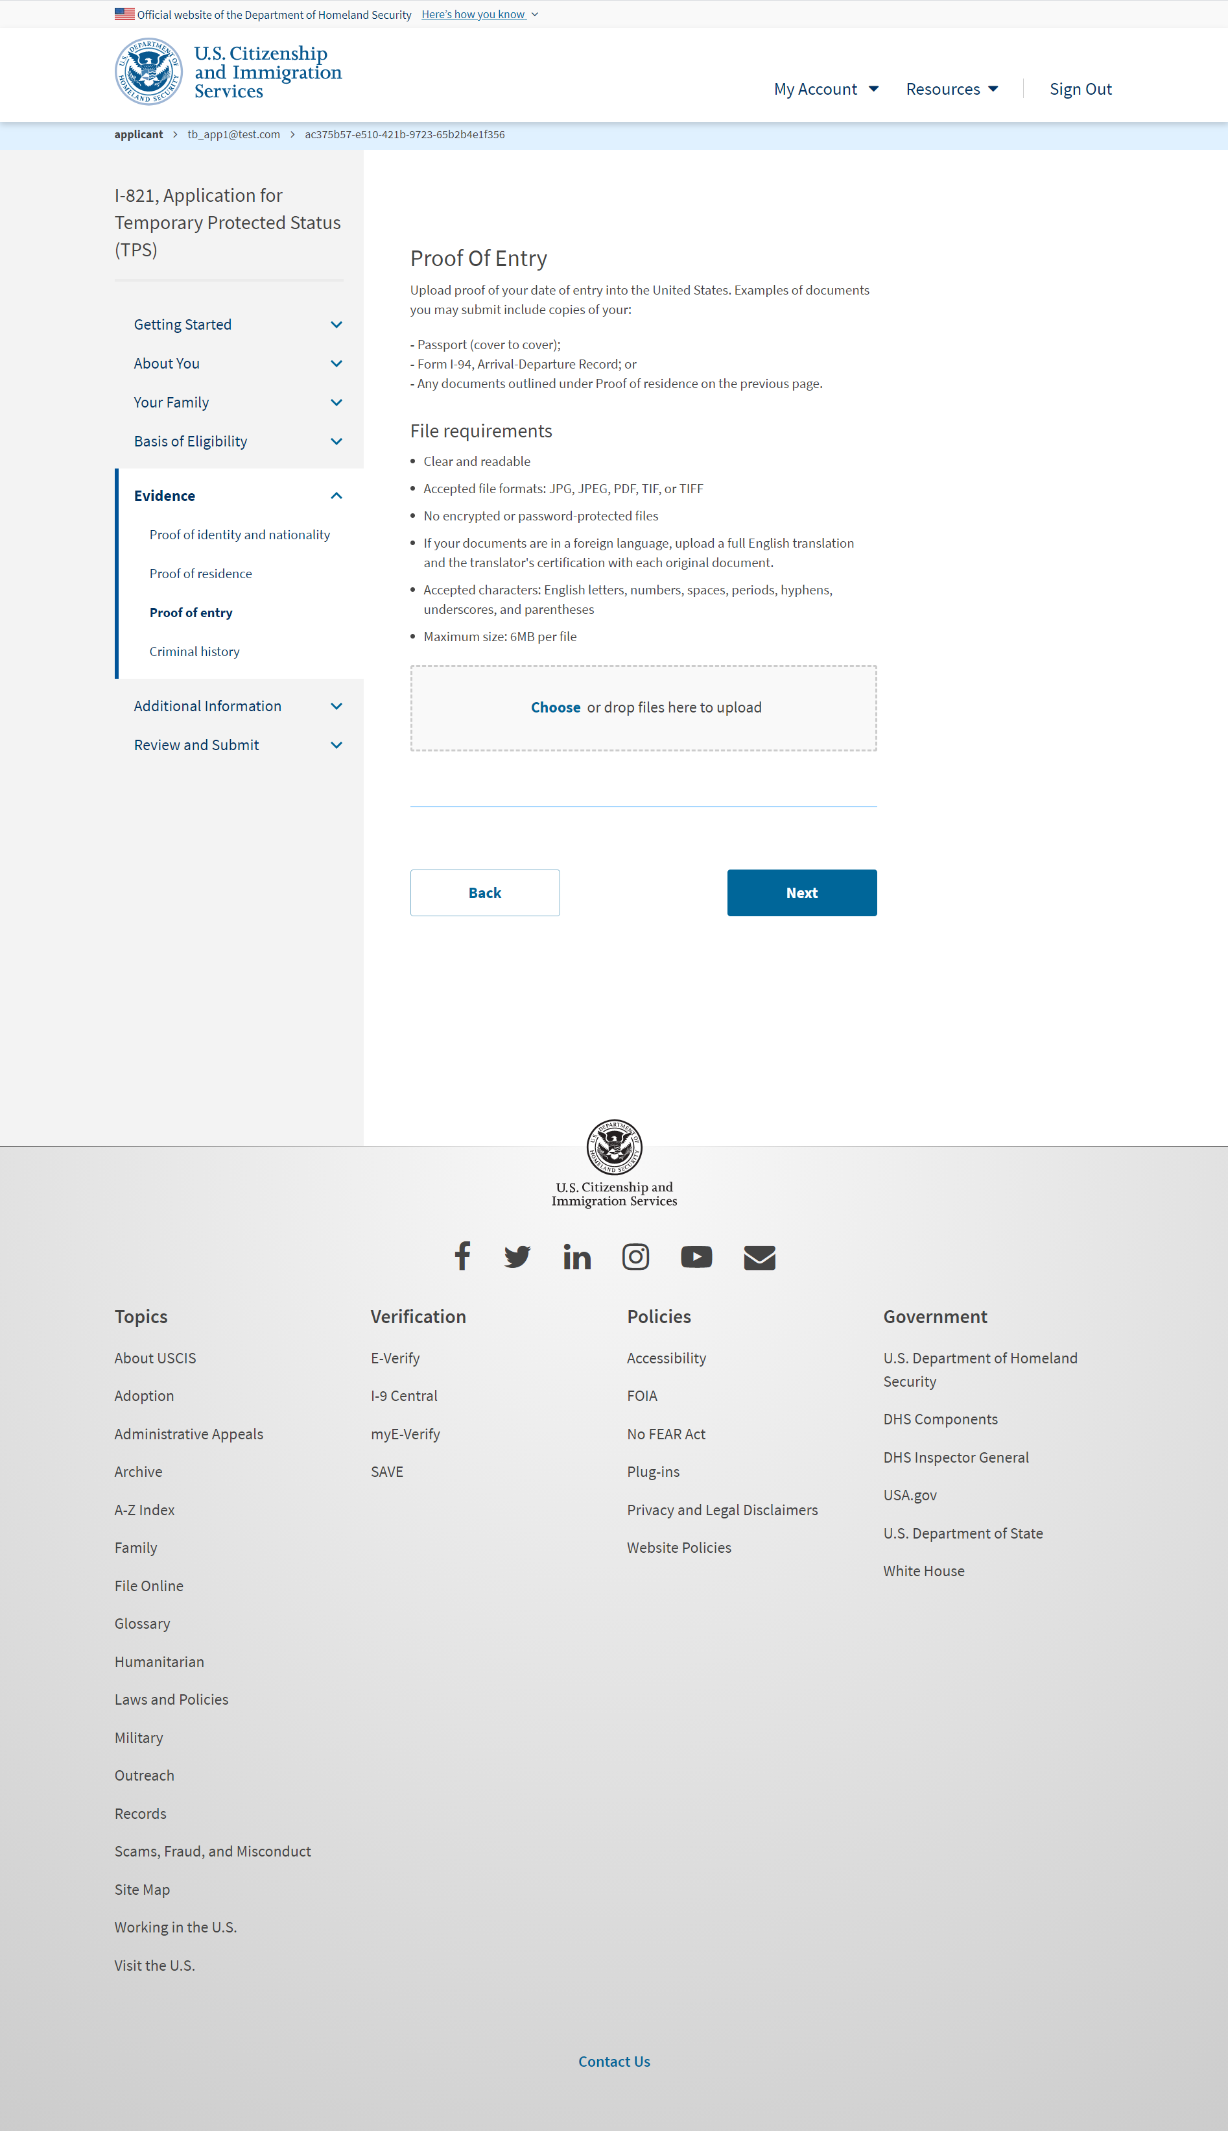
I-821:Evidence – Proof of entry

Slide 51
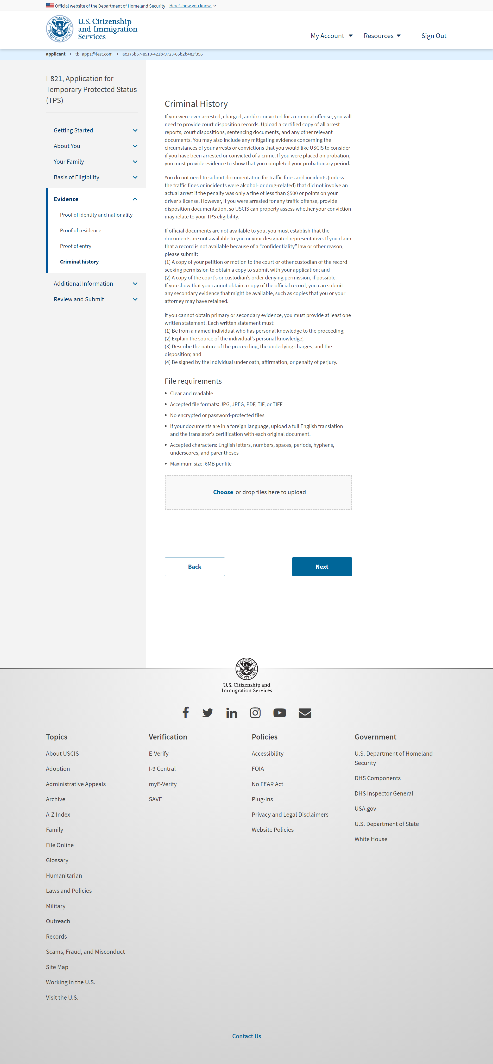
I-821:Evidence – Criminal history

Slide 52
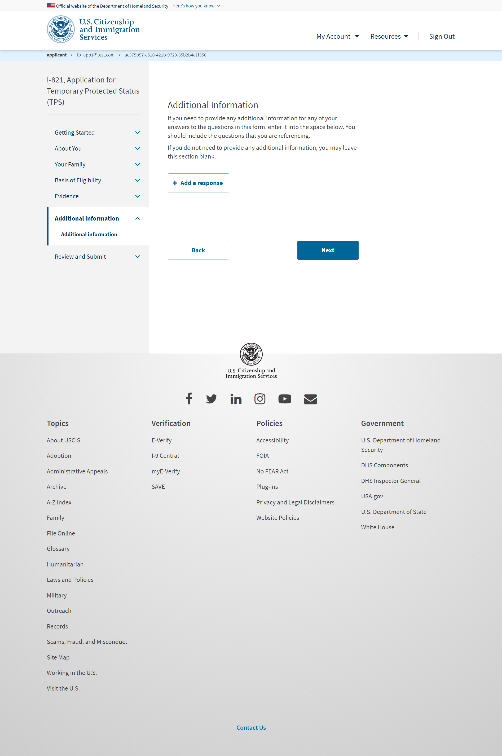
I-821: Additional Information – Additional information

Slide 53
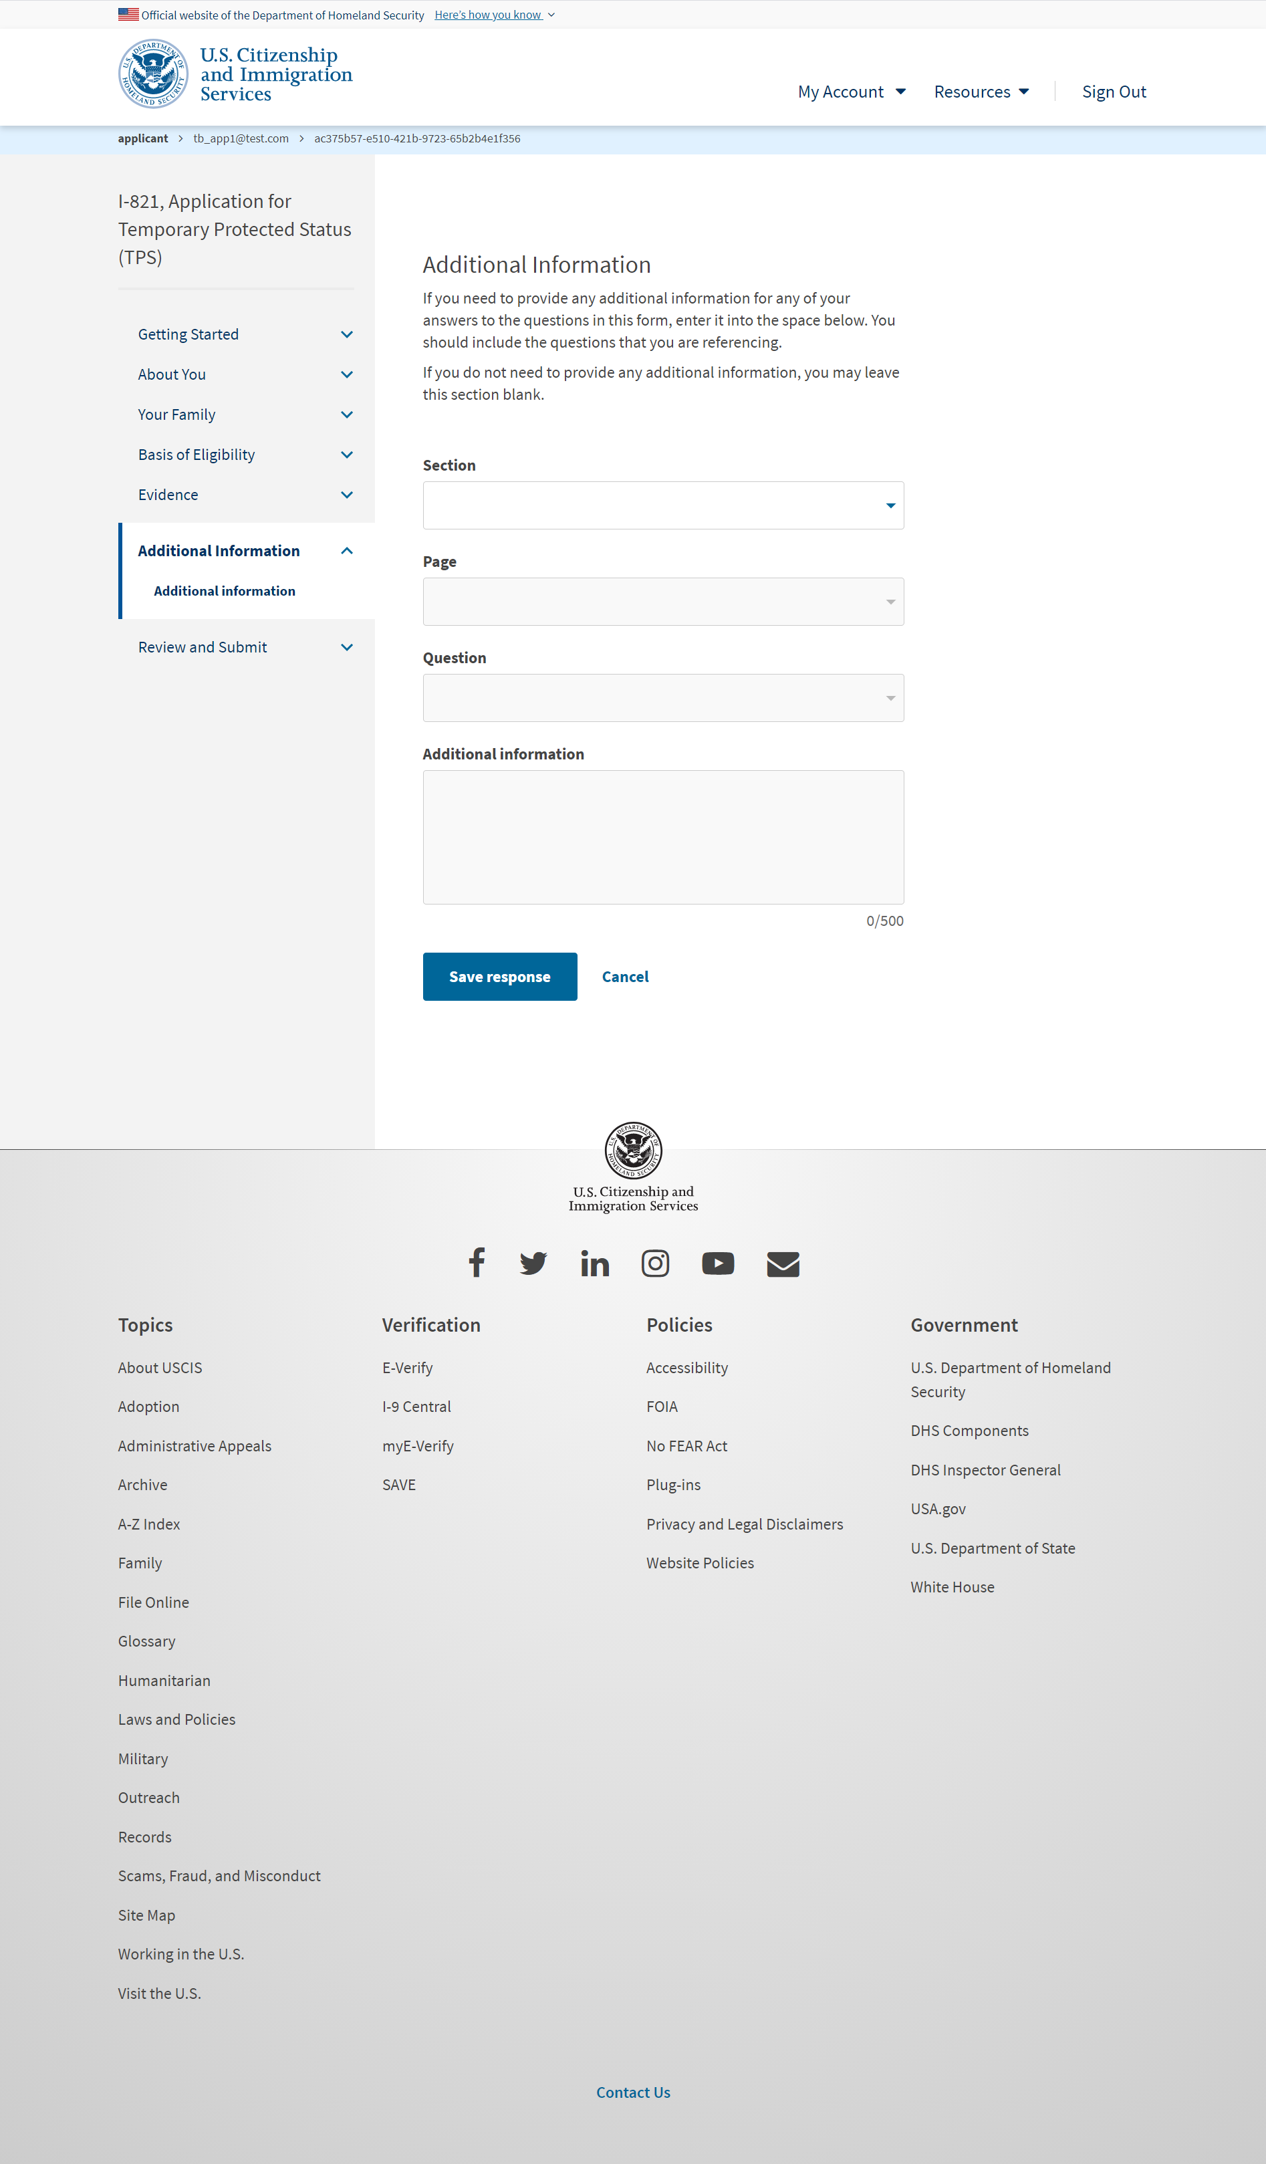
I-821: Additional Information – Additional information (User adds a response)

Slide 54
I-821: Review and Submit – Review your application (with hard stop)

Slide 55
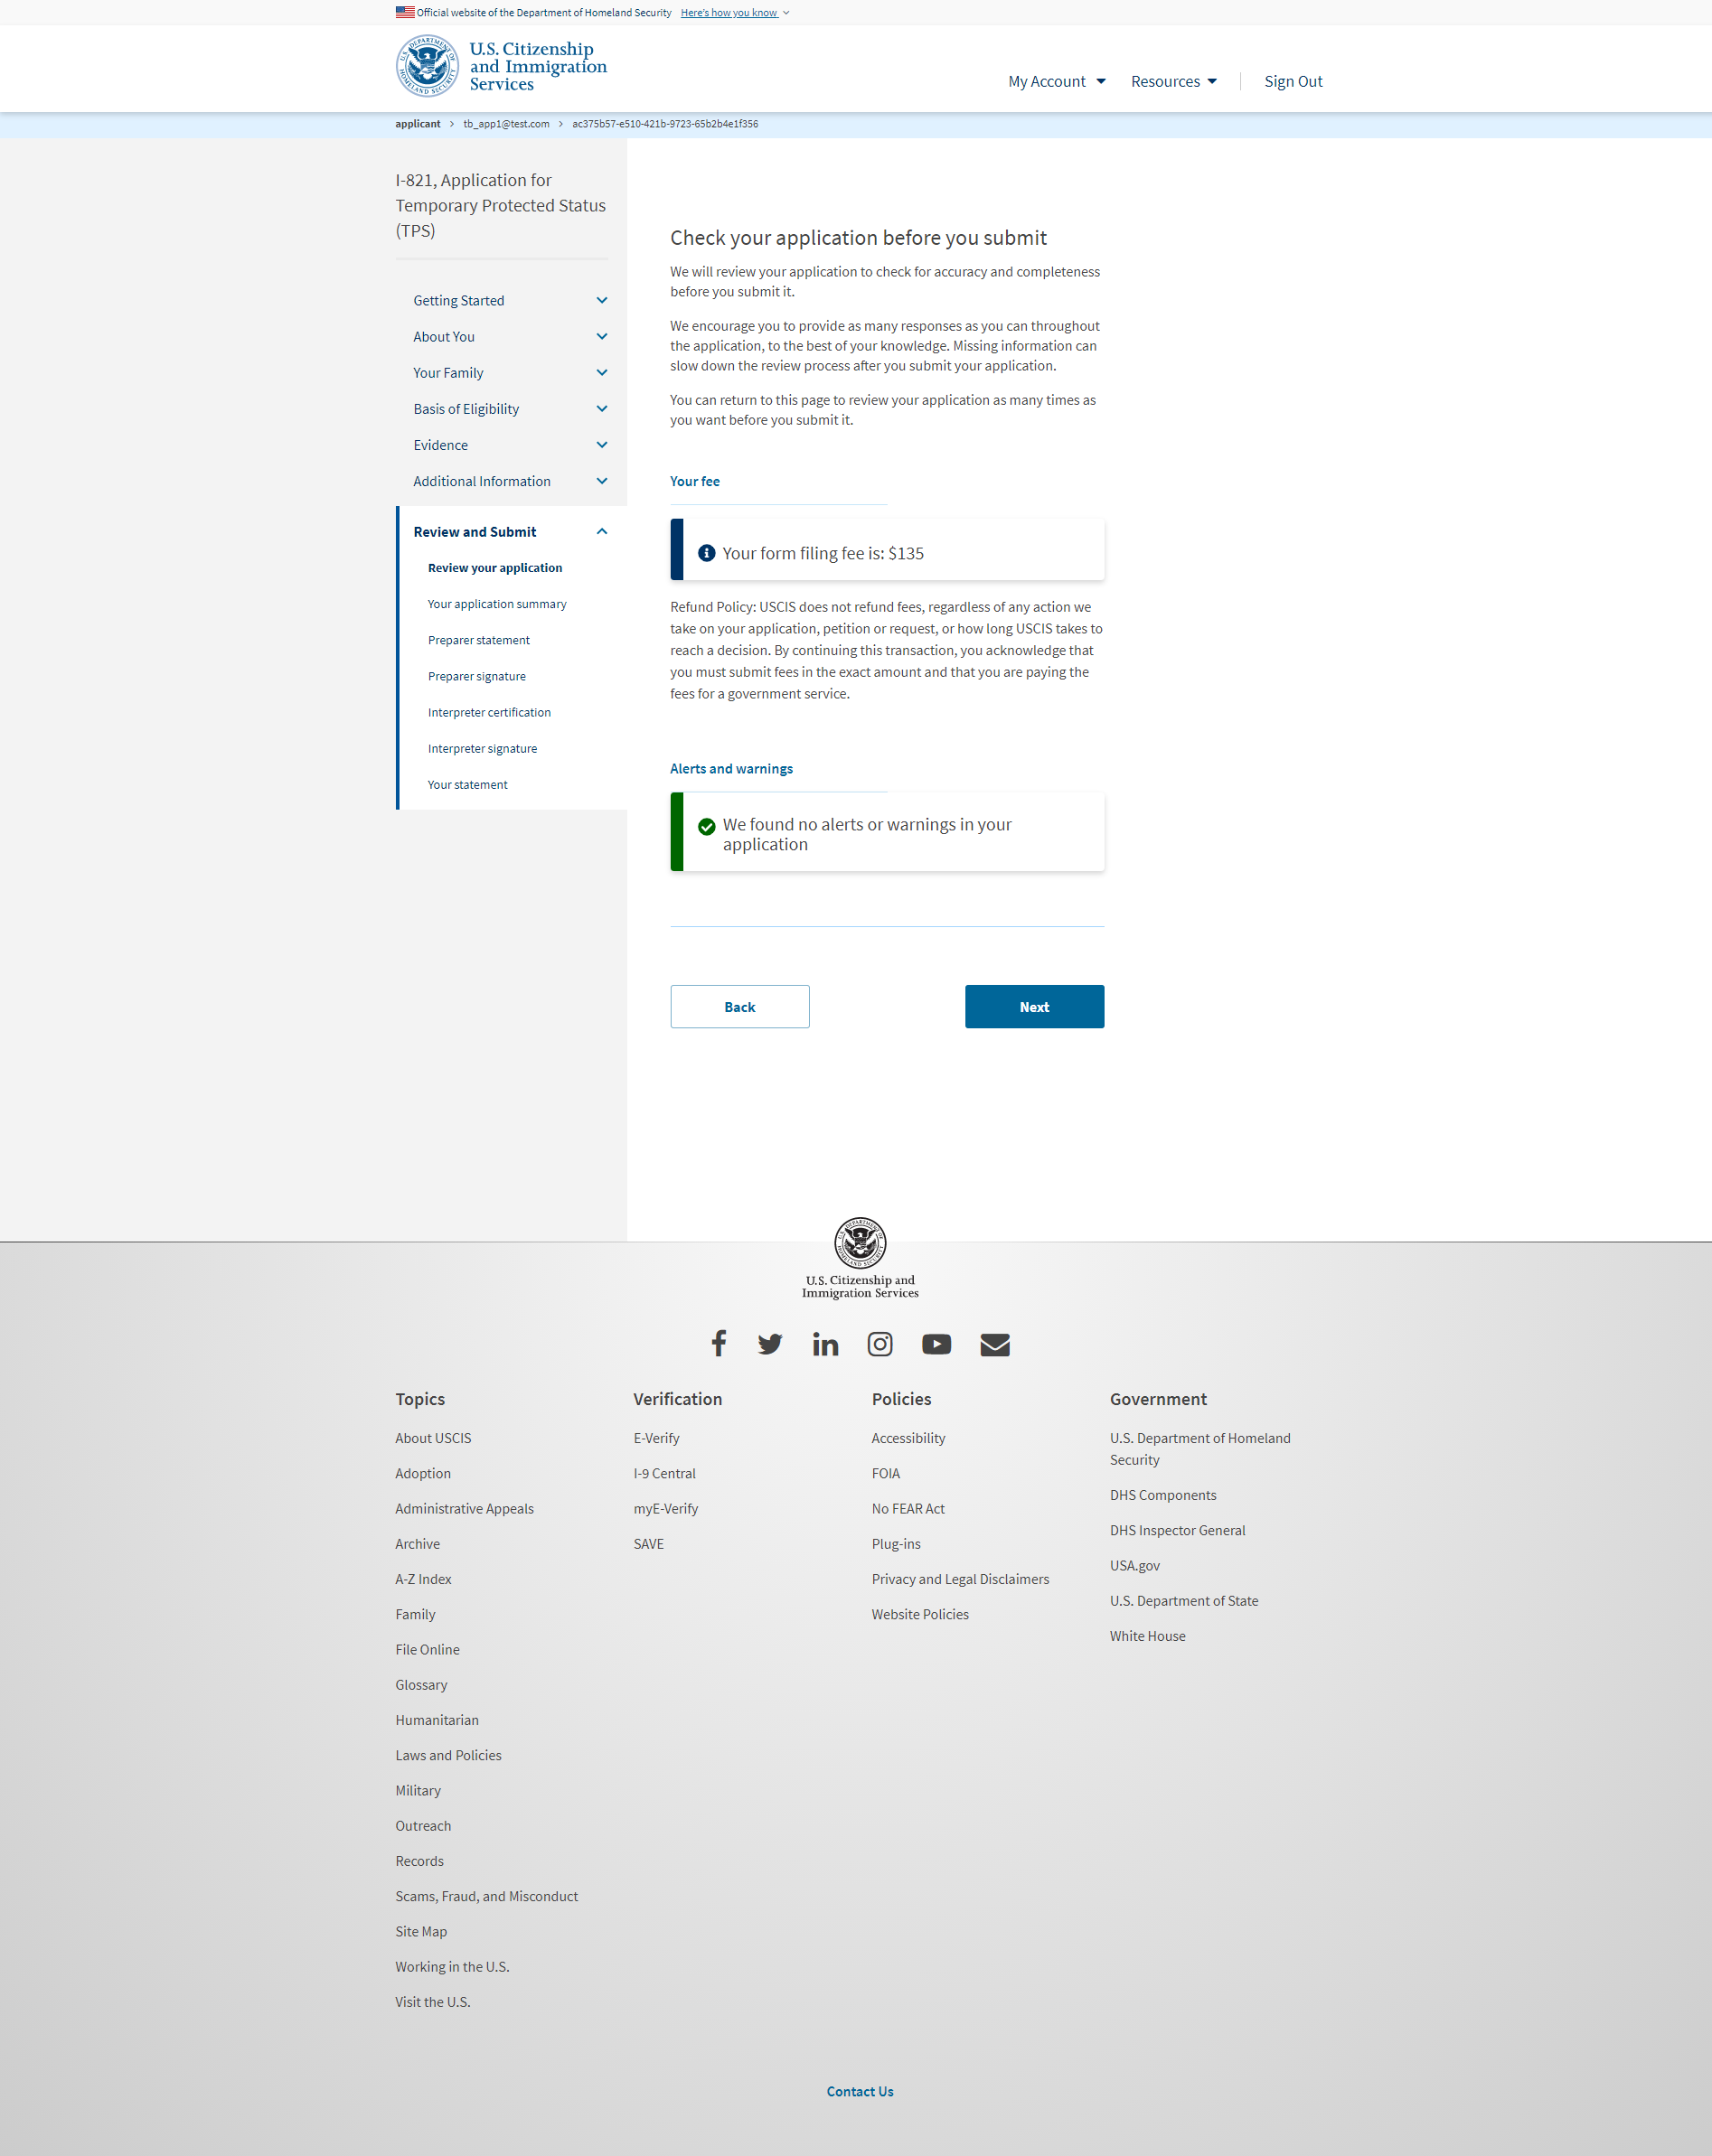
I-821: Review and Submit – Review your application (with no errors)

Slide 56
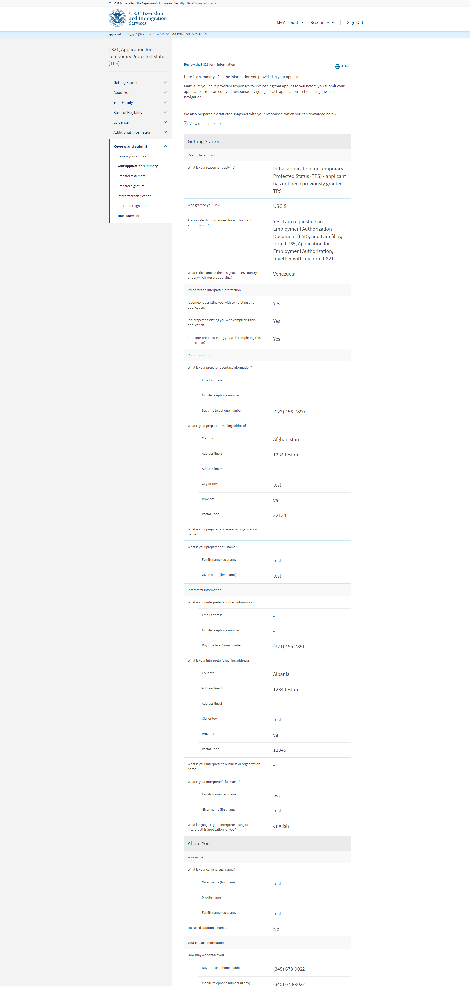
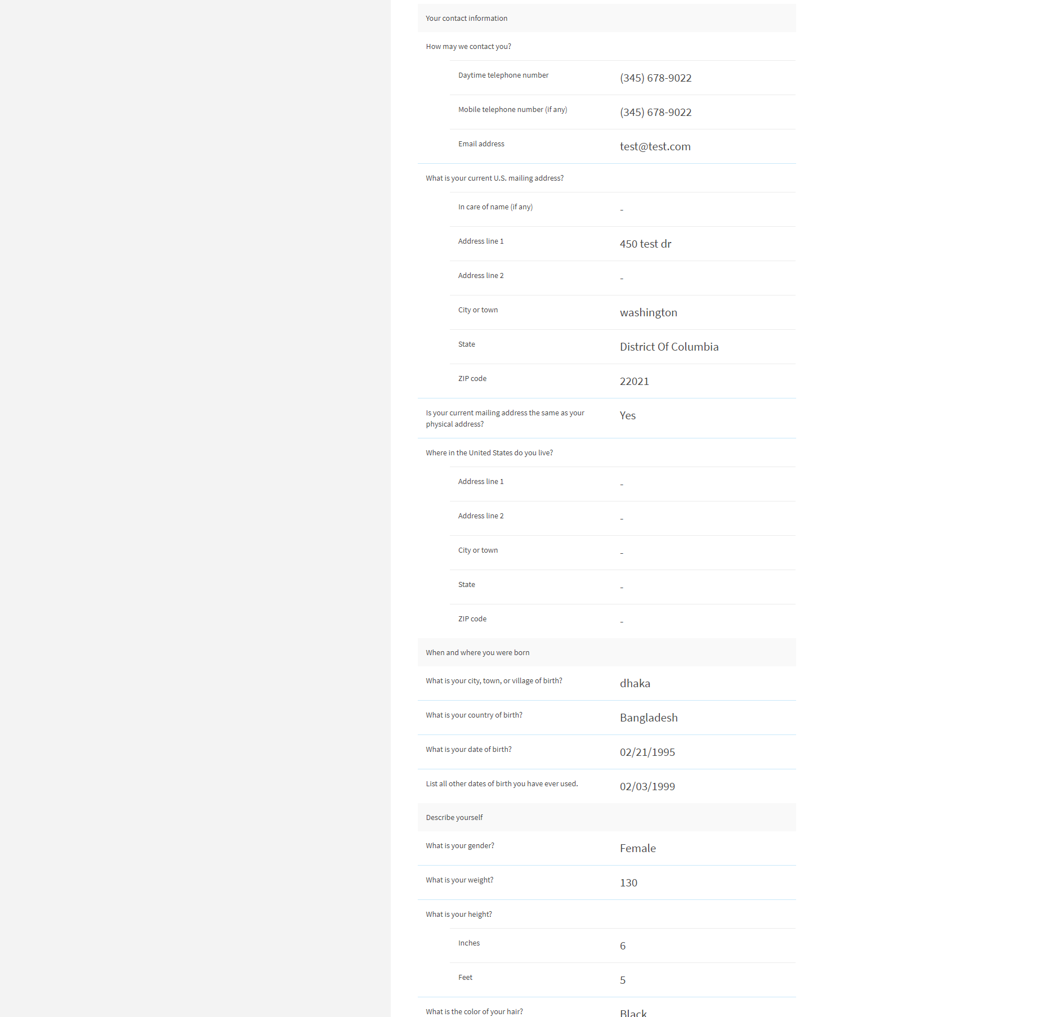
I-821: Review and Submit – Your application summary

Slide 57
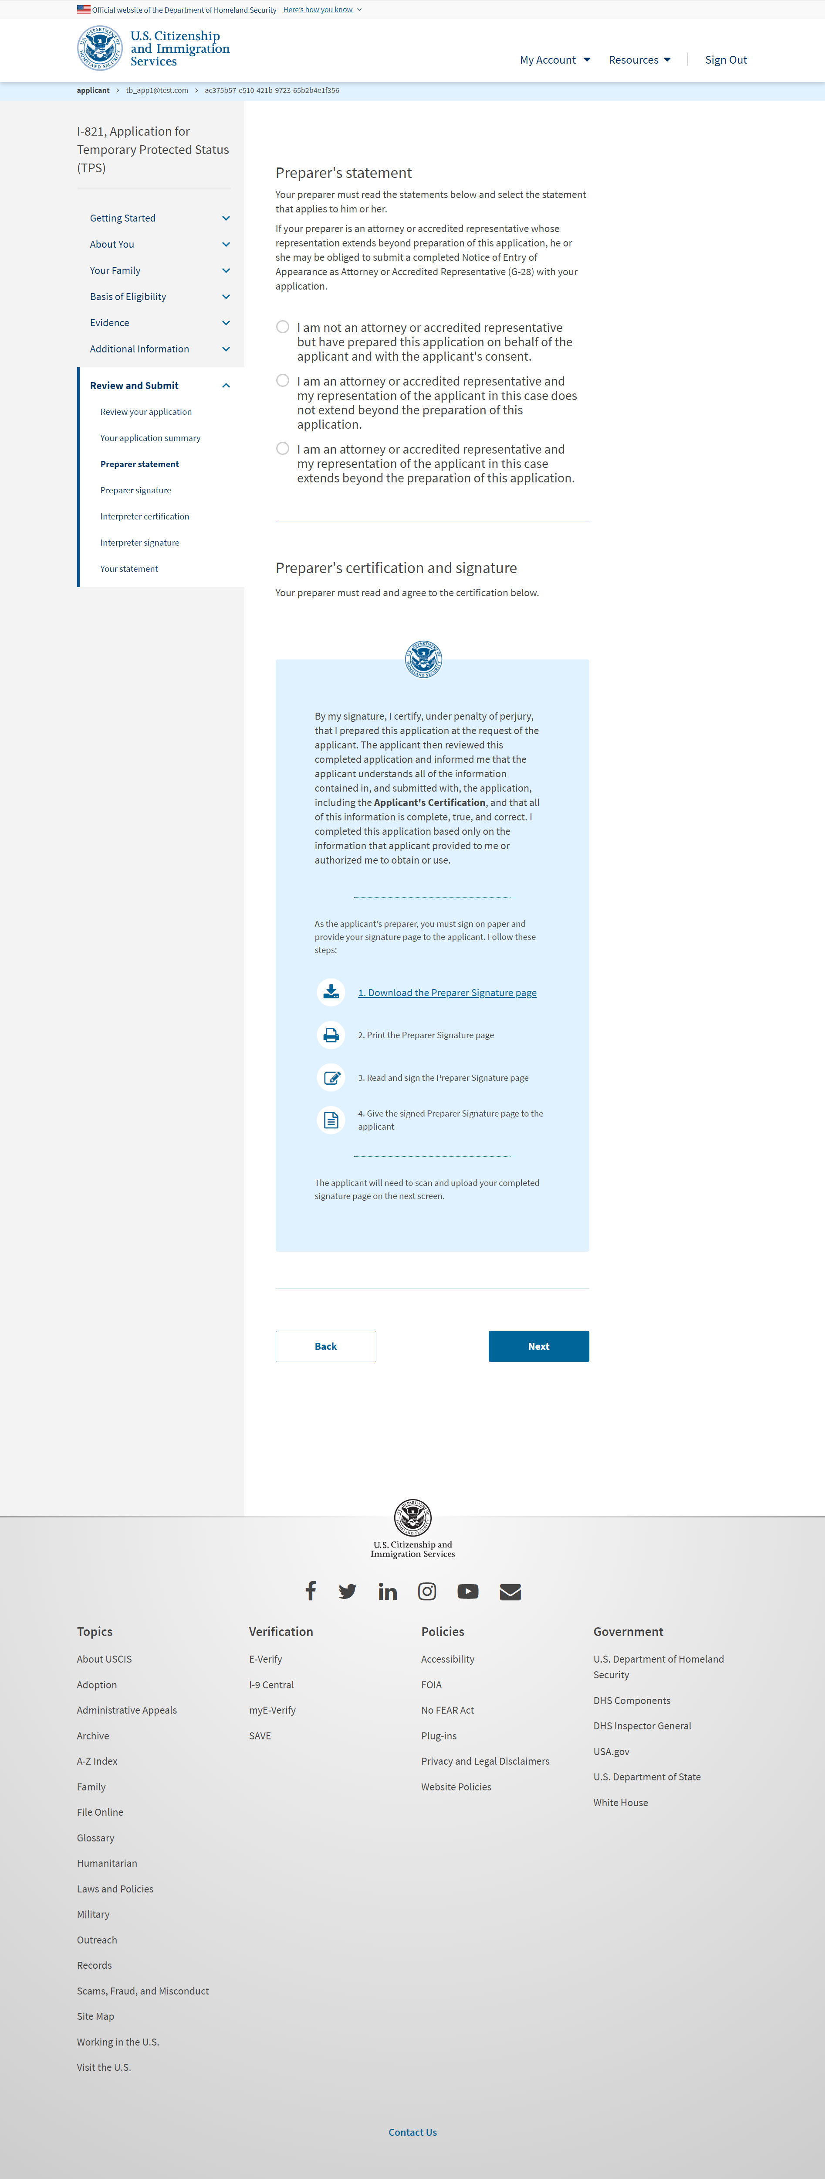
I-821: Review and Submit – Preparer statement

Slide 58
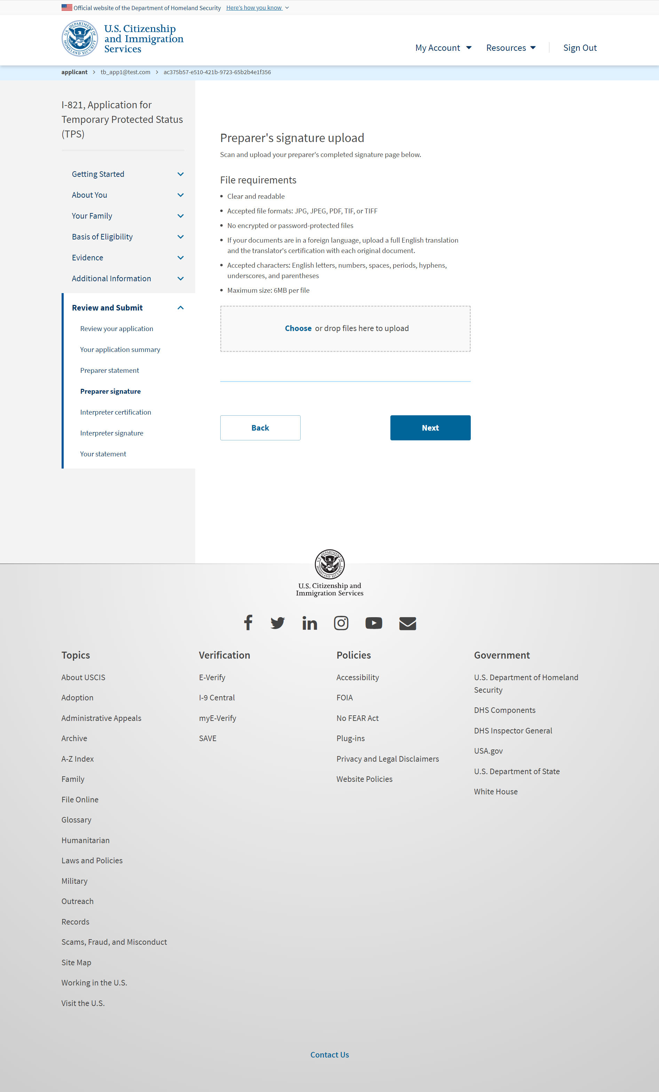
I-821: Review and Submit – Preparer signature

Slide 59
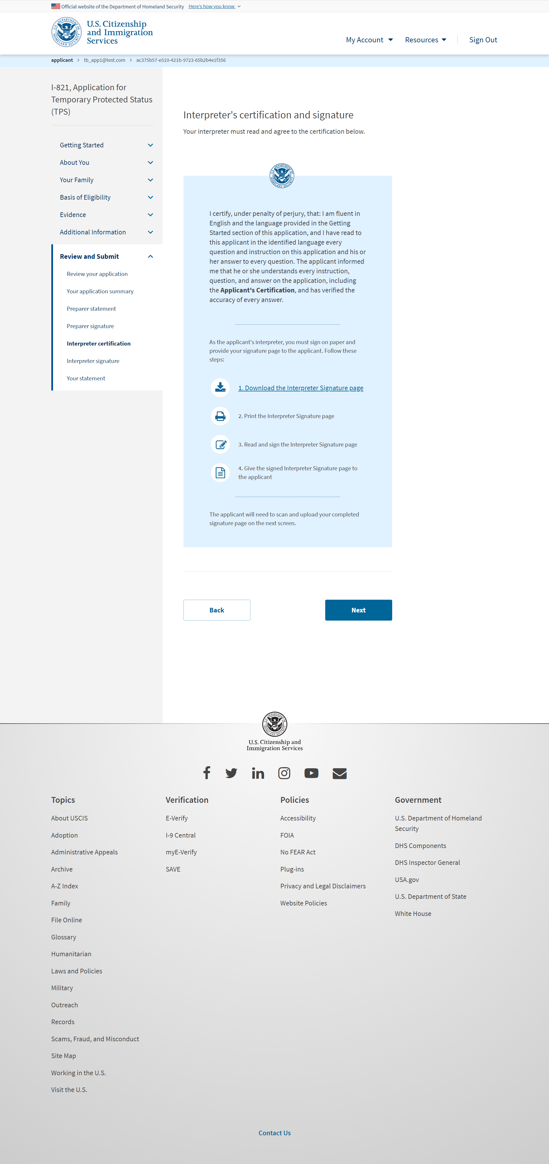
I-821: Review and Submit – Interpreter certification

Slide 60
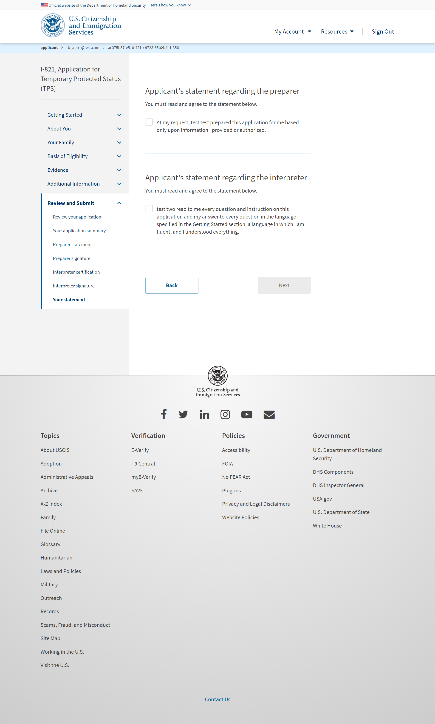
I-821: Review and Submit – Your statement

Slide 61
I-821: Review and Submit – Your signature

Slide 62
I-821: Review and Submit – Your signature (select the checkbox)

Slide 63
I-821: Review and Submit – Pay and submit

Slide 64
Pay.gov flow (outside myUSCIS UI)

Slide 65
I-821: Confirmation – Payment successful

Slide 66
I-821: Confirmation – Payment unsuccessful

