Slide 1
I-821, Application for Temporary Protected Status
Version: Concurrent Filing with I-765
United States Citizenship and Immigration Services
myUSCIS Team
May 2021
Screenshots

Slide 2
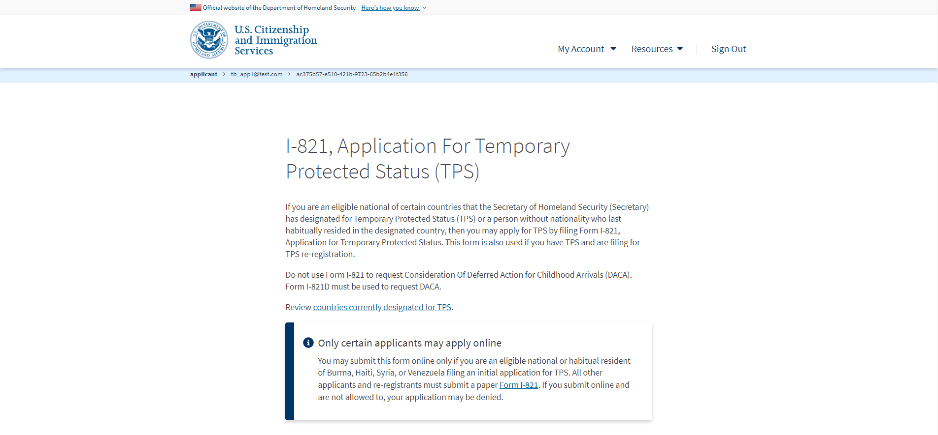
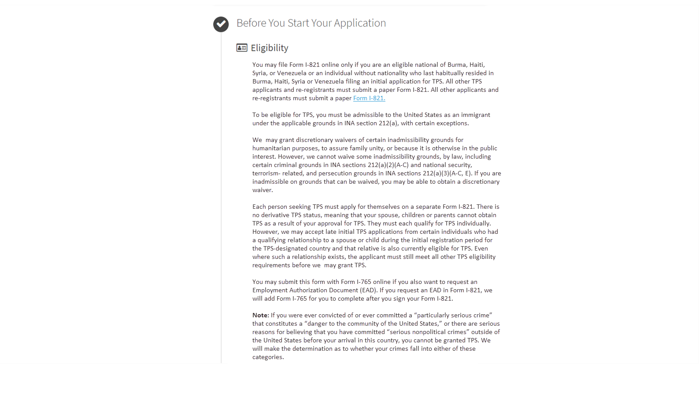
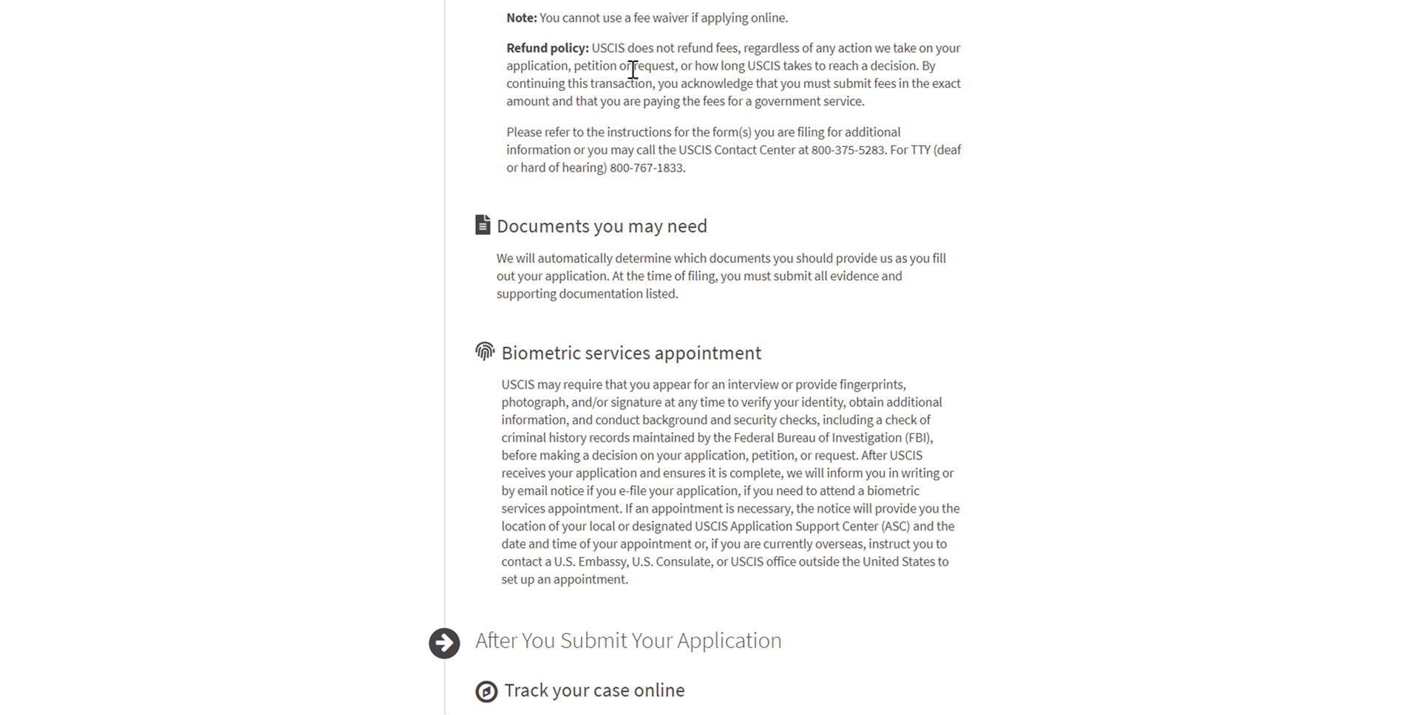
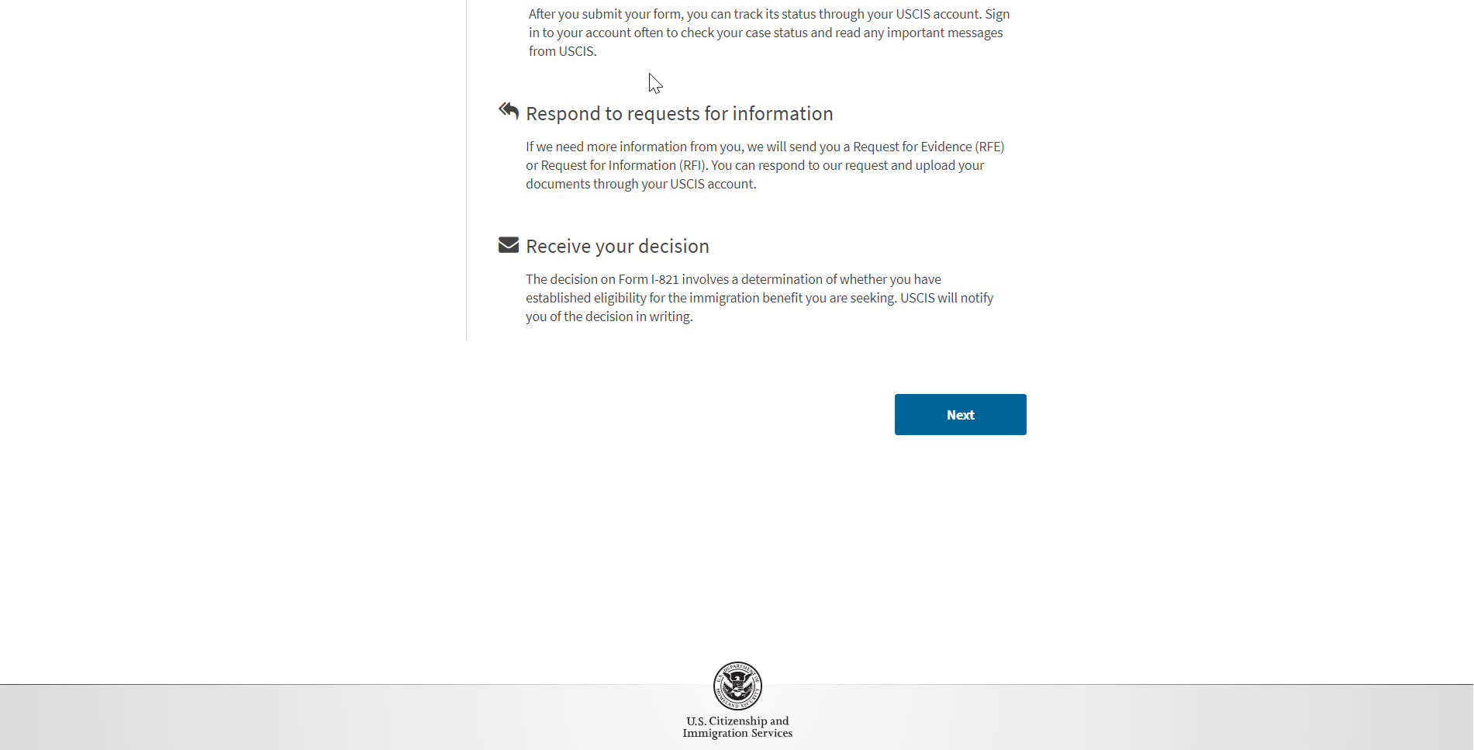
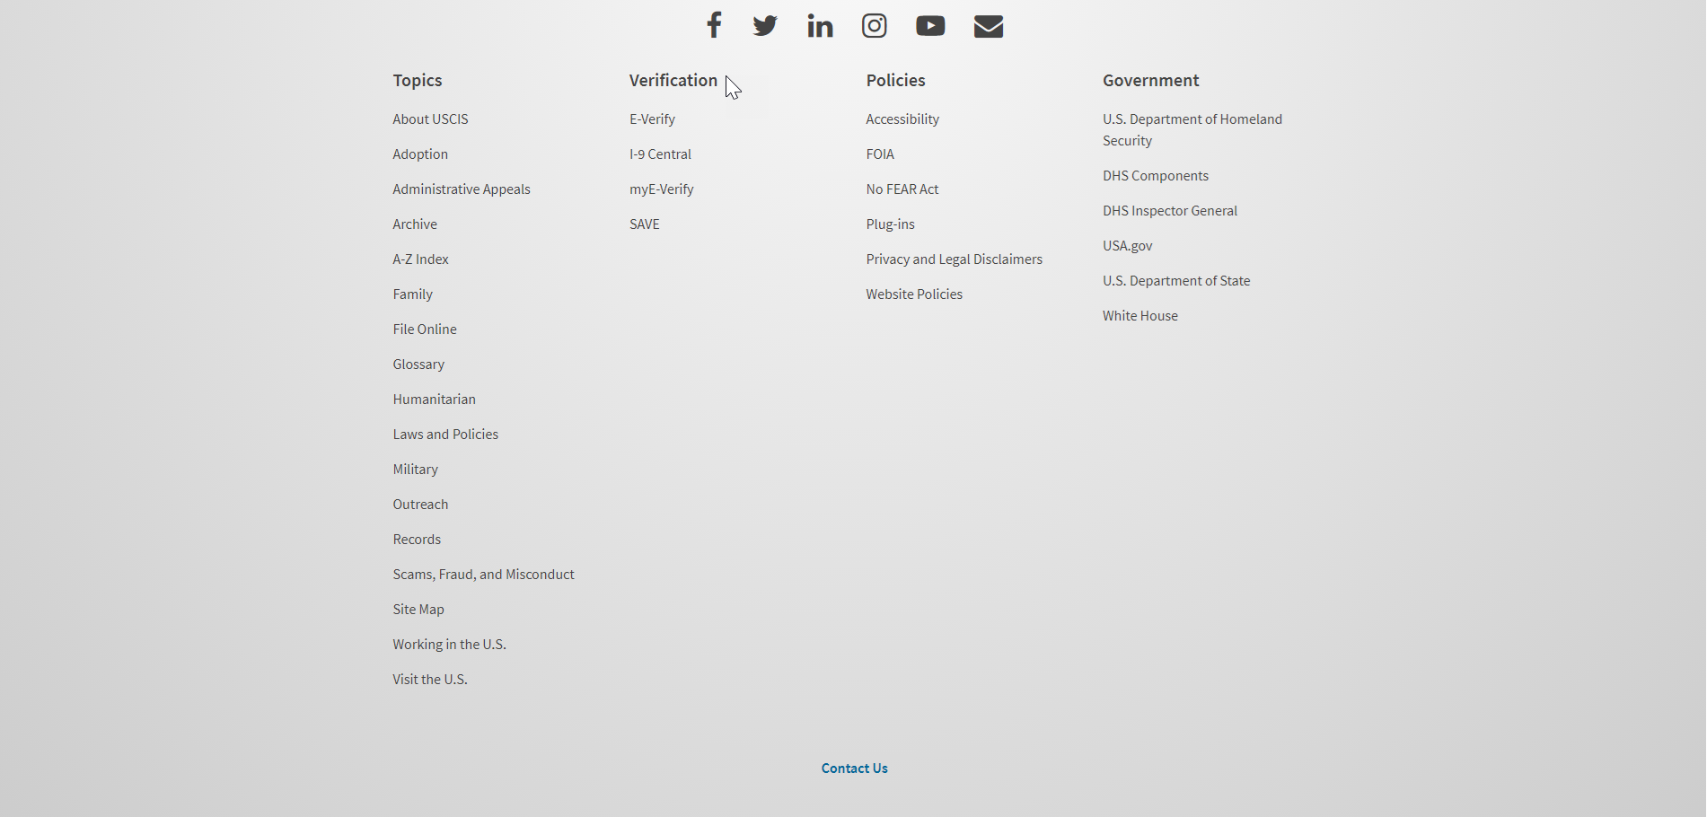
I-821: Application Overview

Slide 3
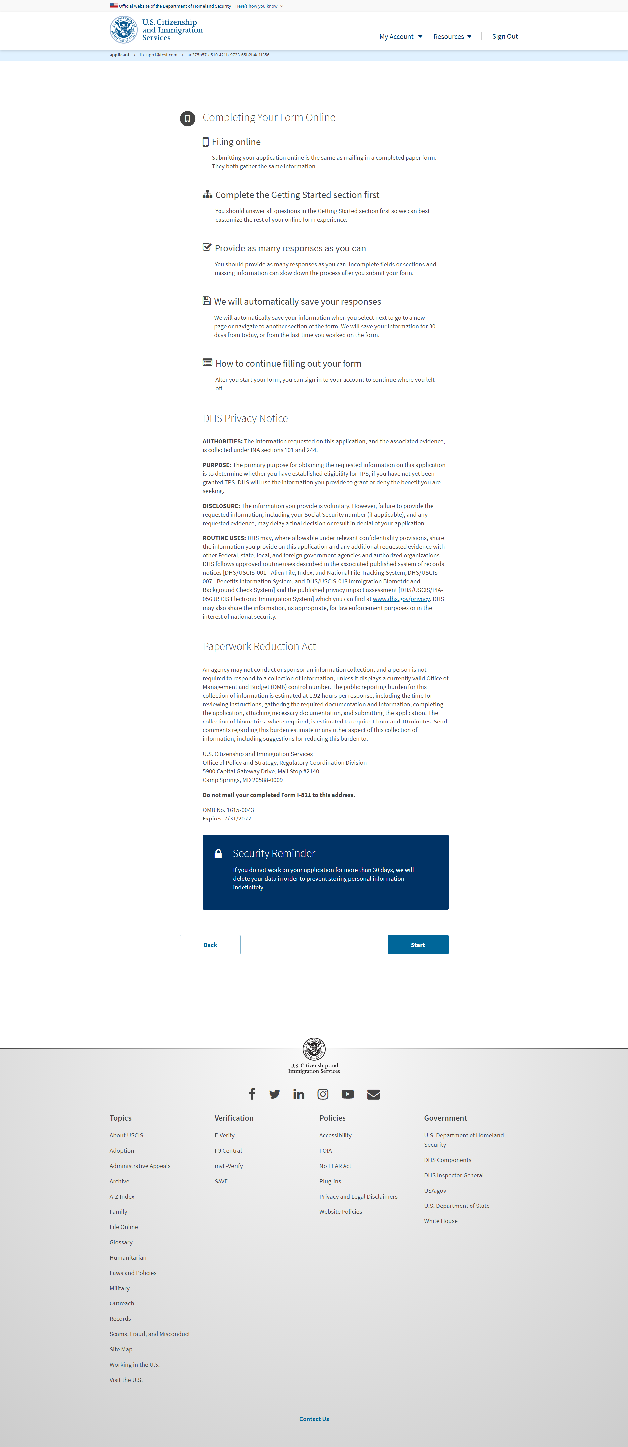
I-821: Start Application

Slide 4
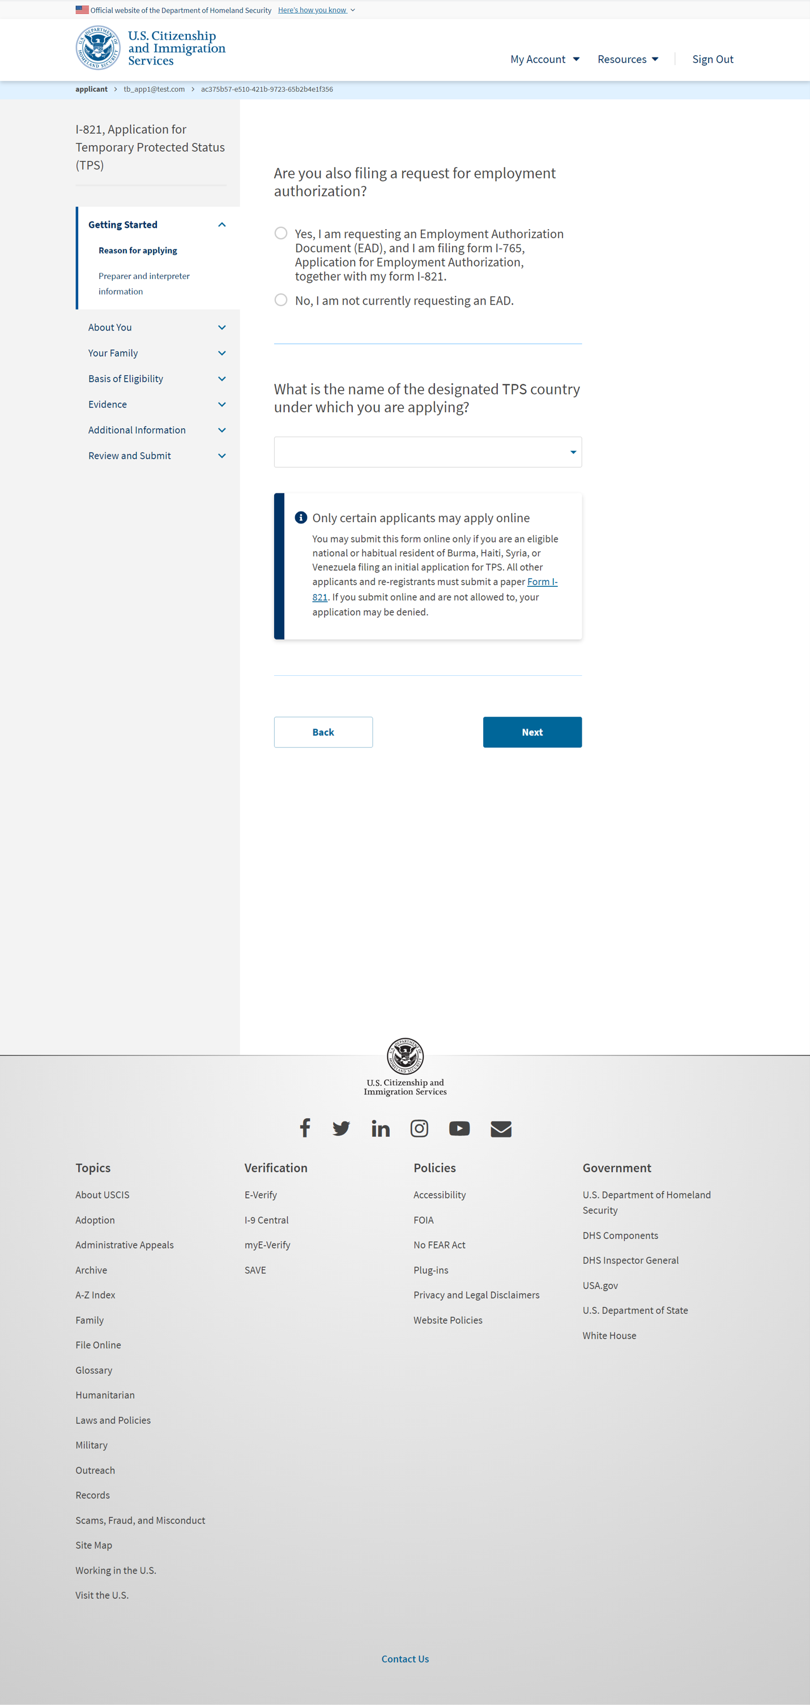
I-821: Getting Started – Reason for applying

Slide 5
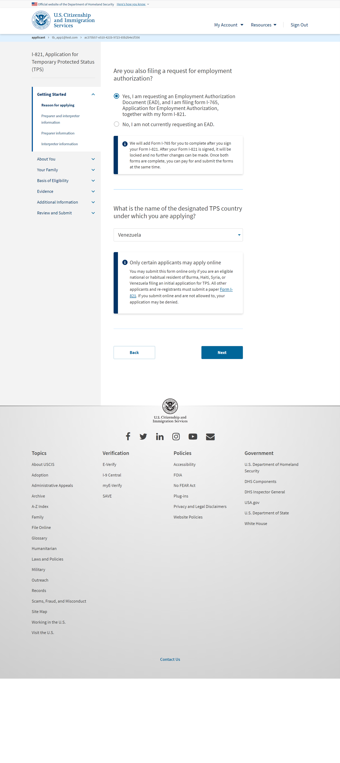
I-821: Getting Started – Reason for applying (also filing I-765)

Slide 6
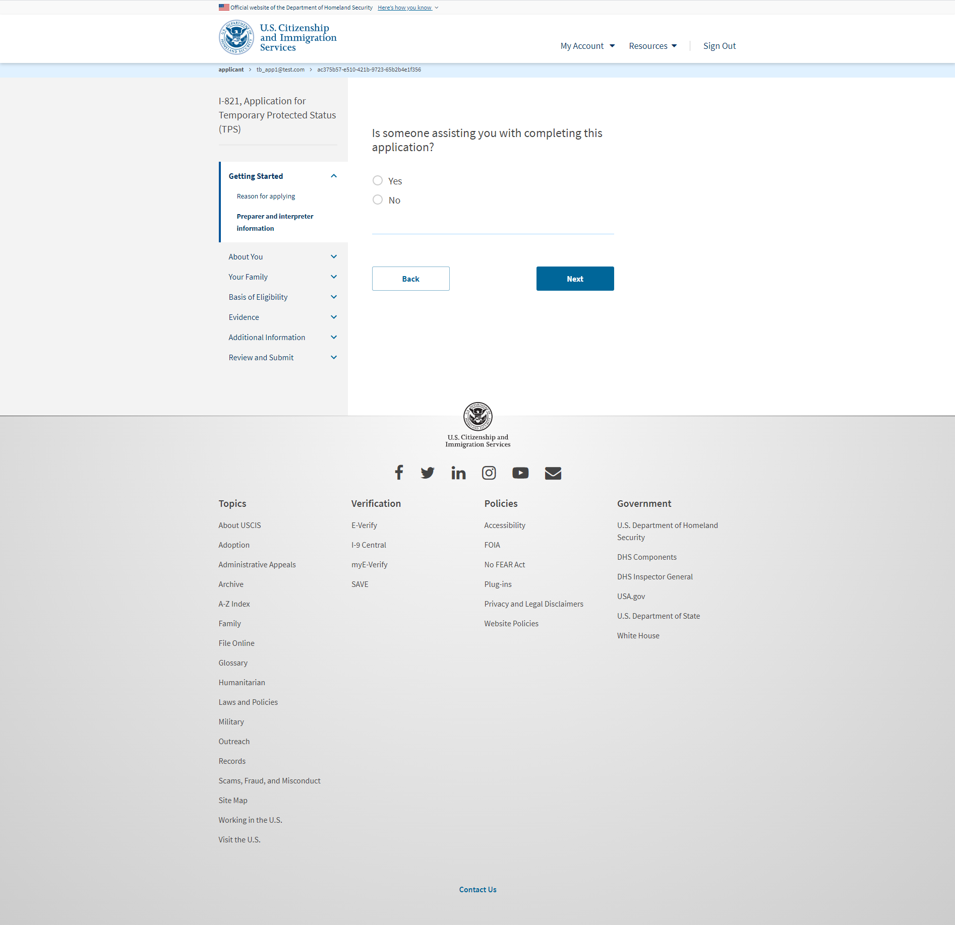
I-821: Getting Started – Preparer and interpreter information

Slide 7
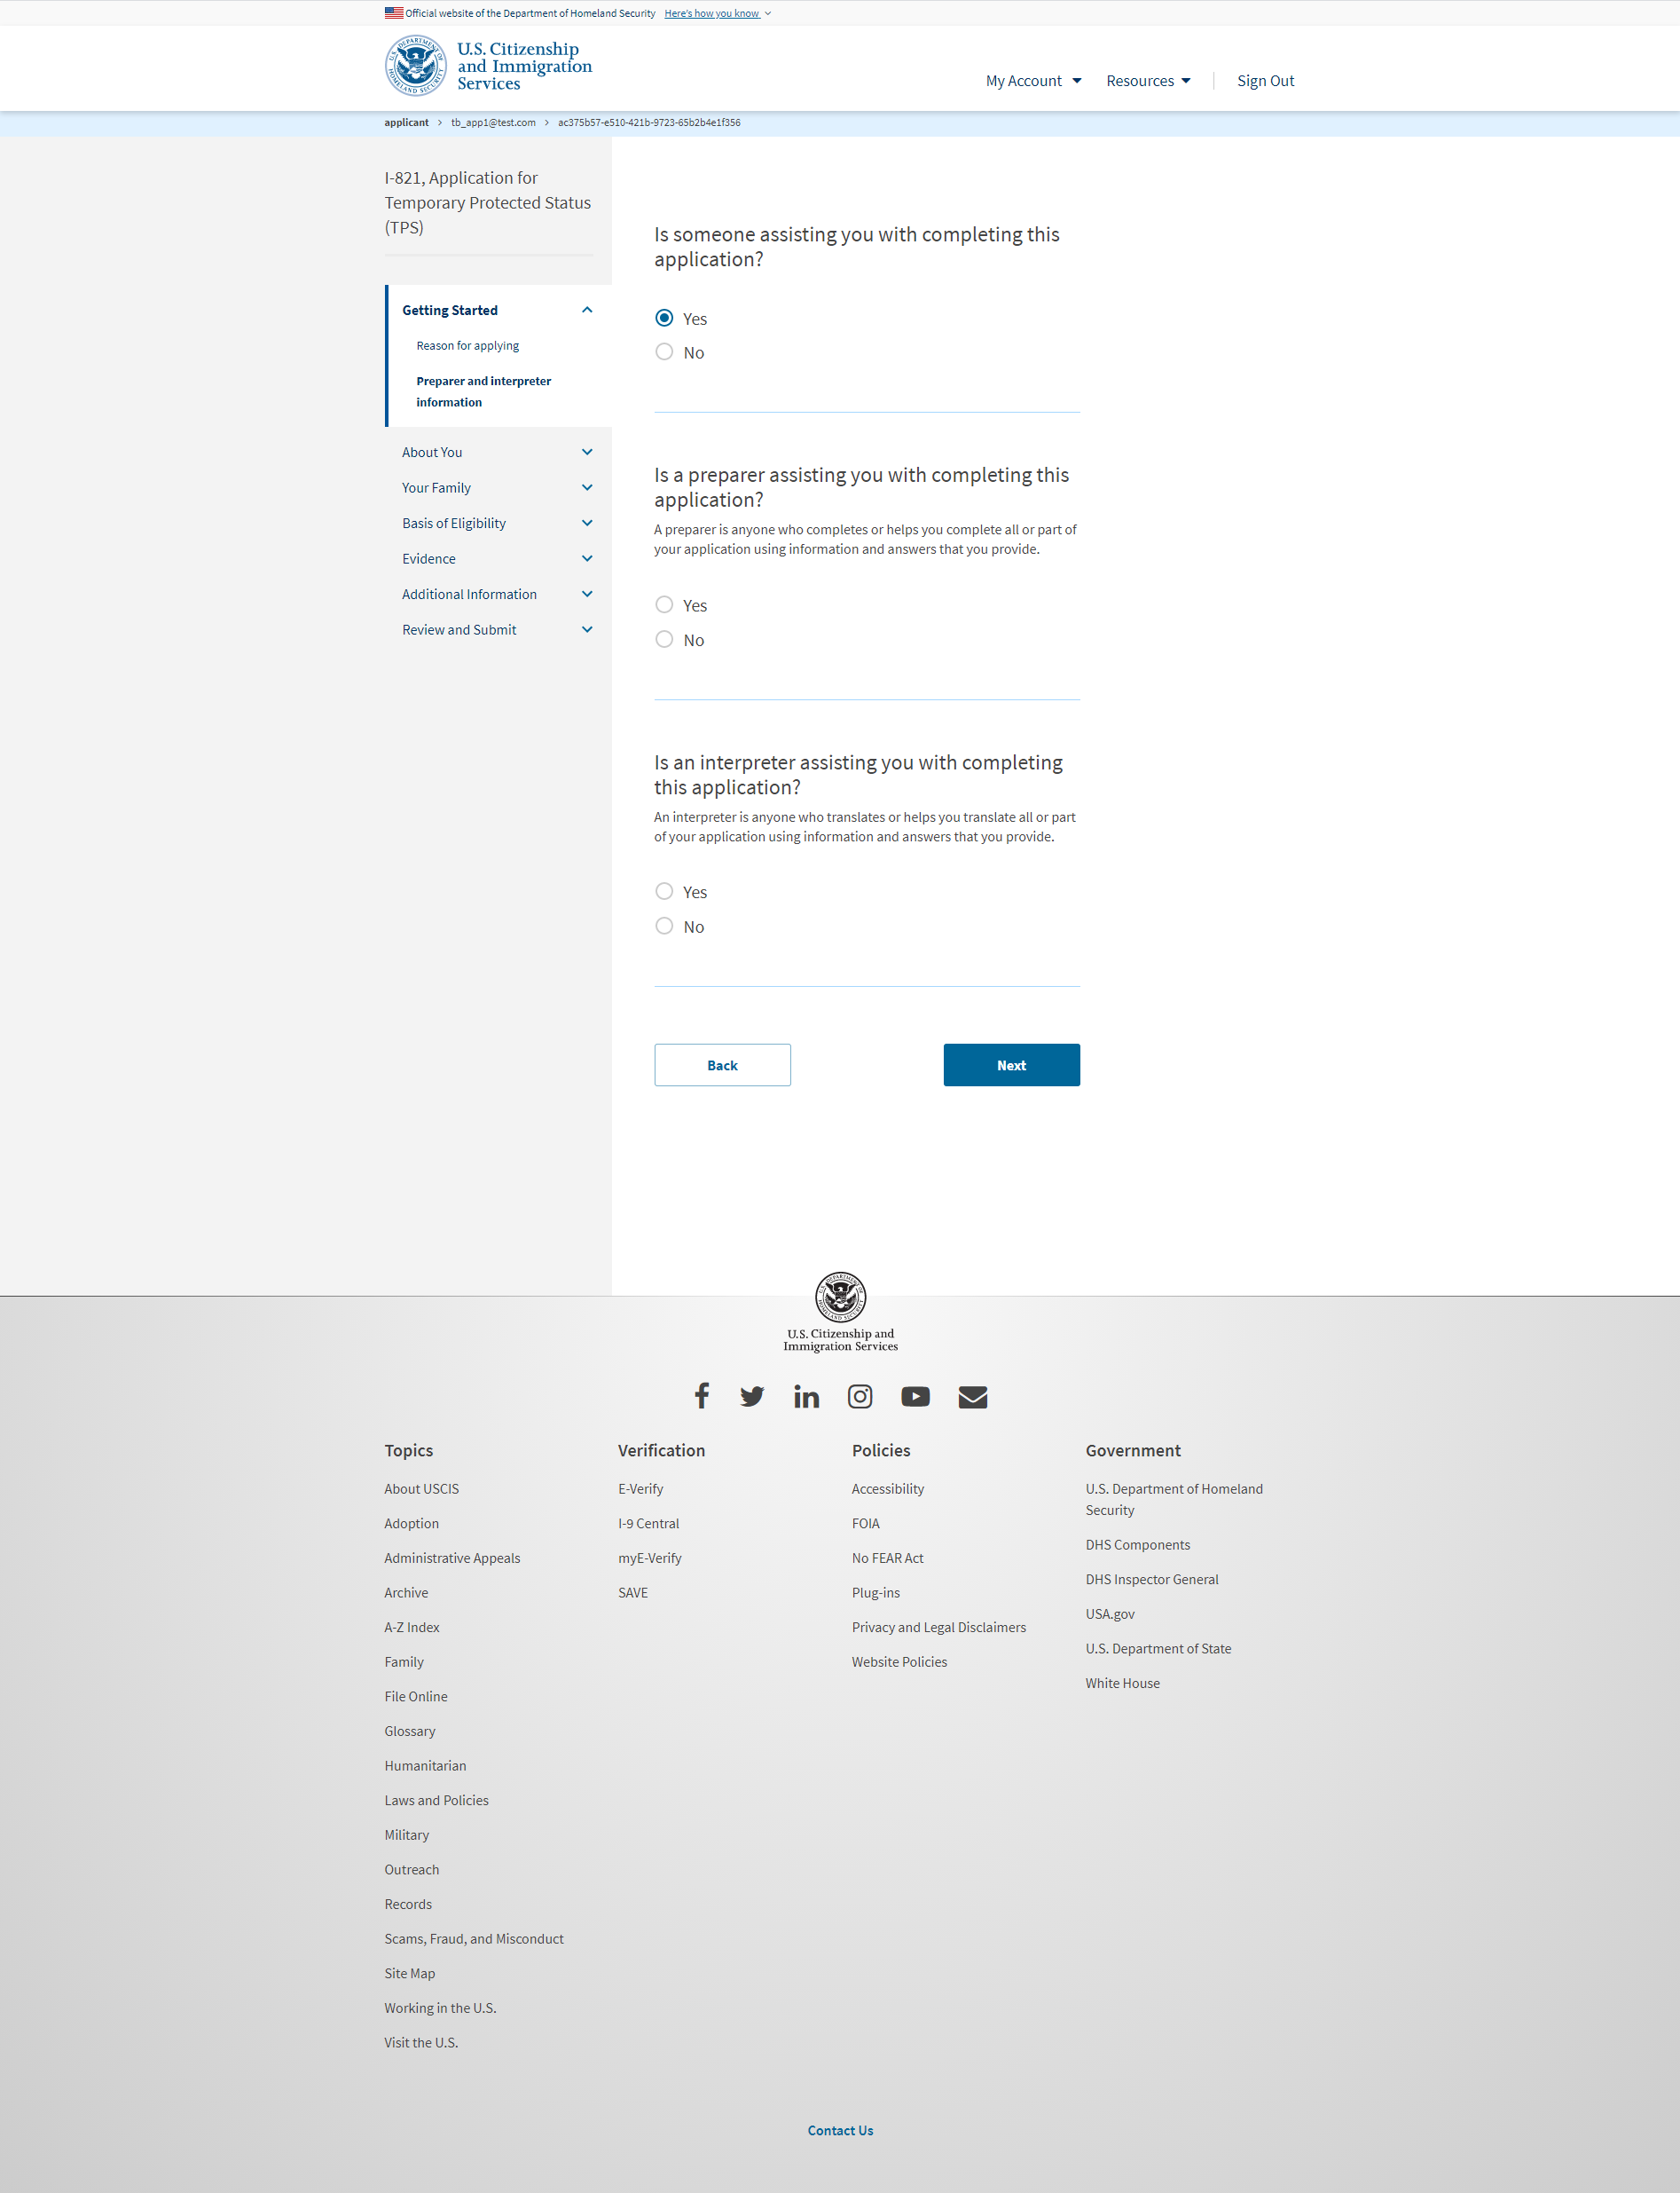
I-821: Getting Started – Preparer and interpreter information (Once selecting ‘Yes’ from previous slide)

Slide 8
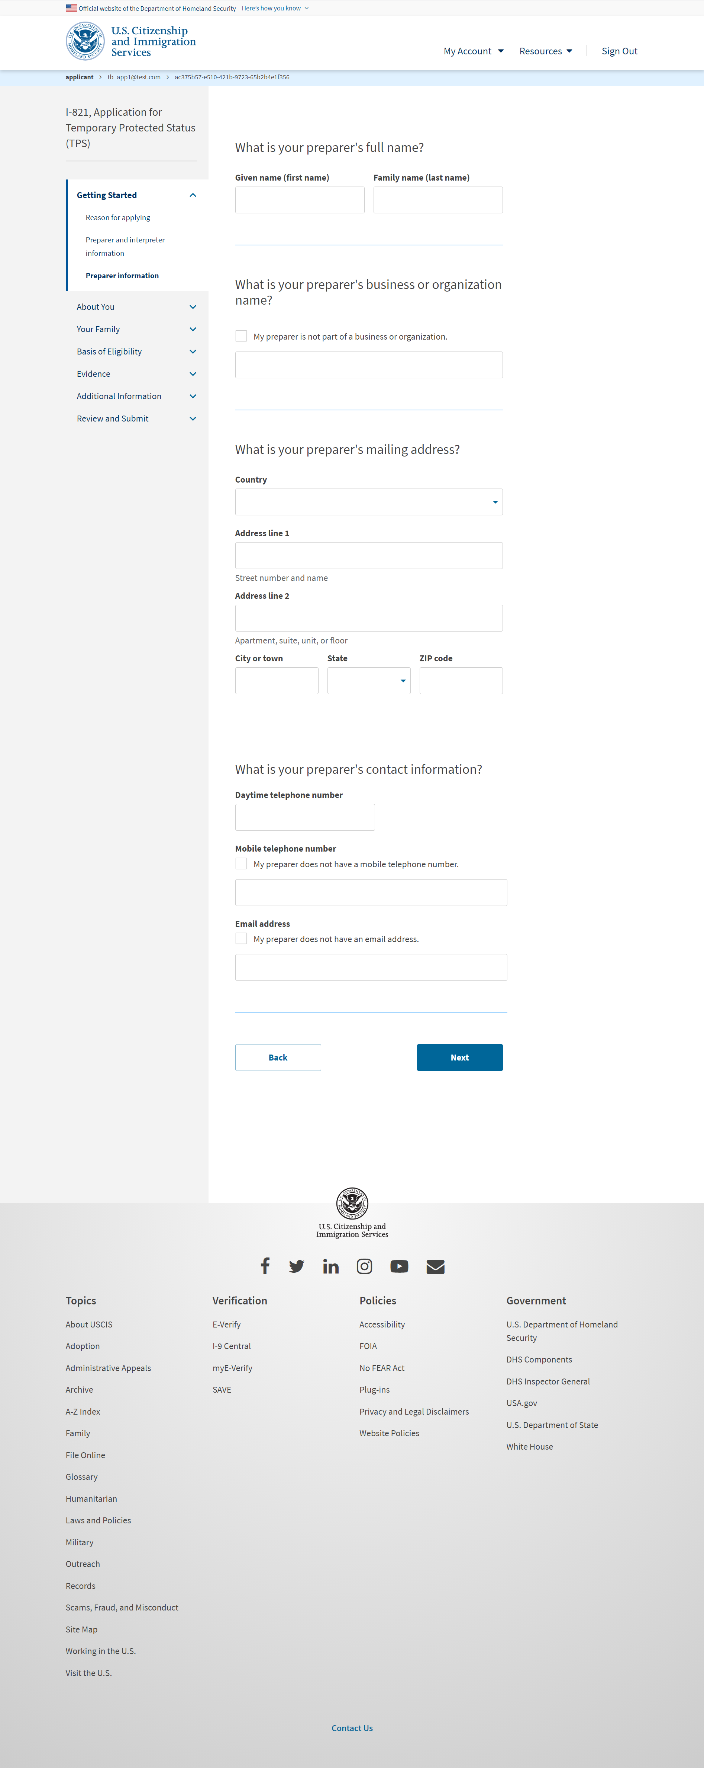
I-821: Getting Started – Preparer information (Once selecting "Yes" to Preparer question)

Slide 9
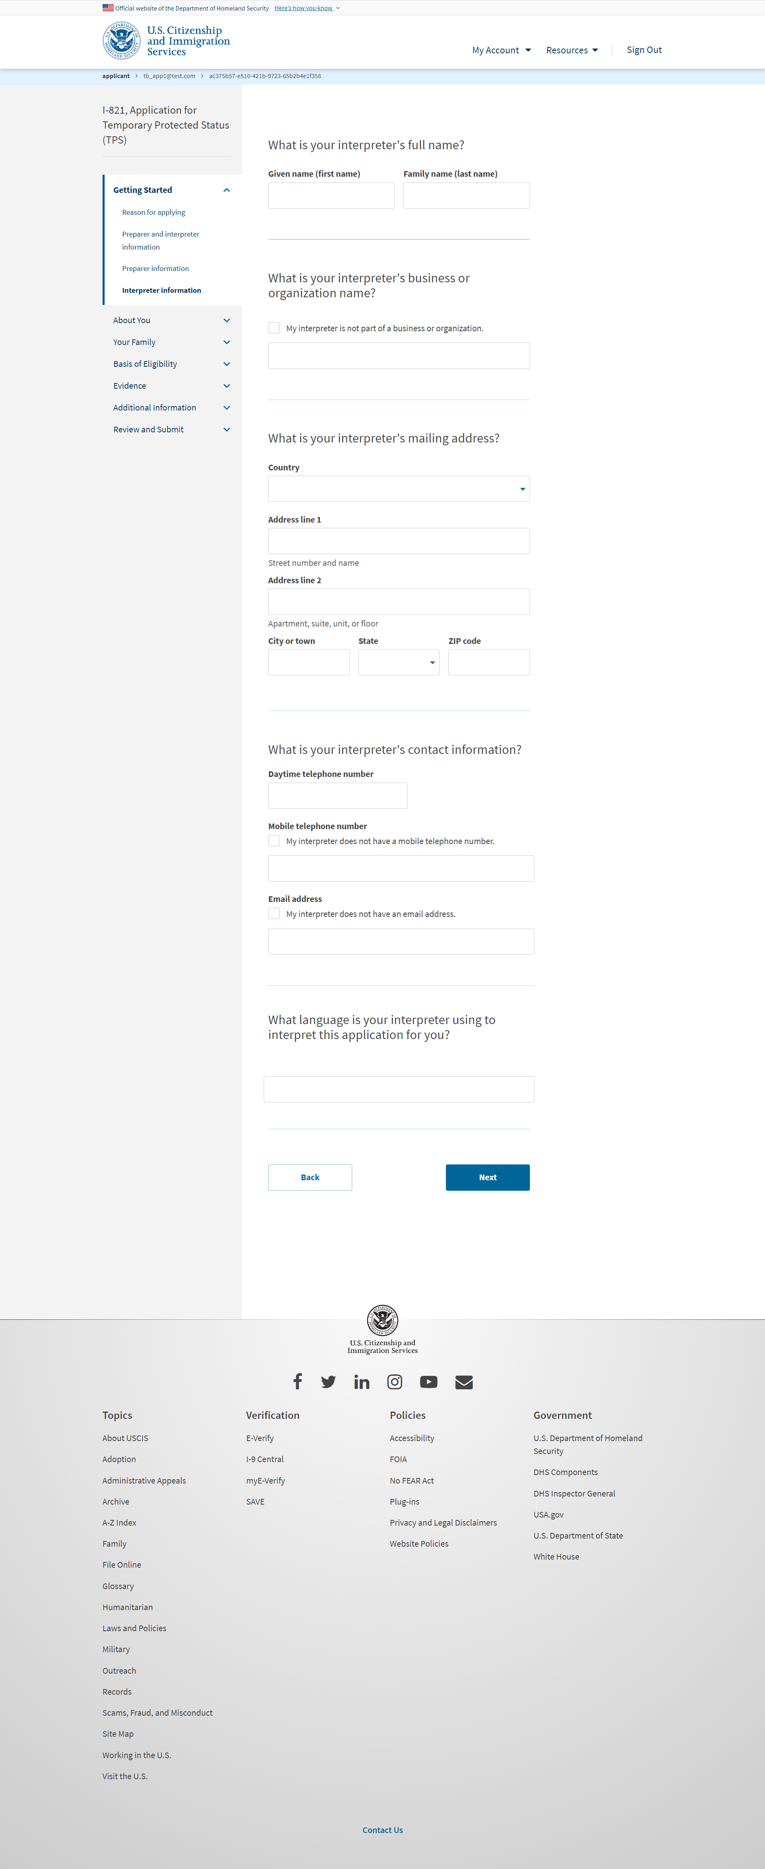
I-821: Getting Started – Interpreter information (Once selecting "Yes" to Interpreter question)

Slide 10
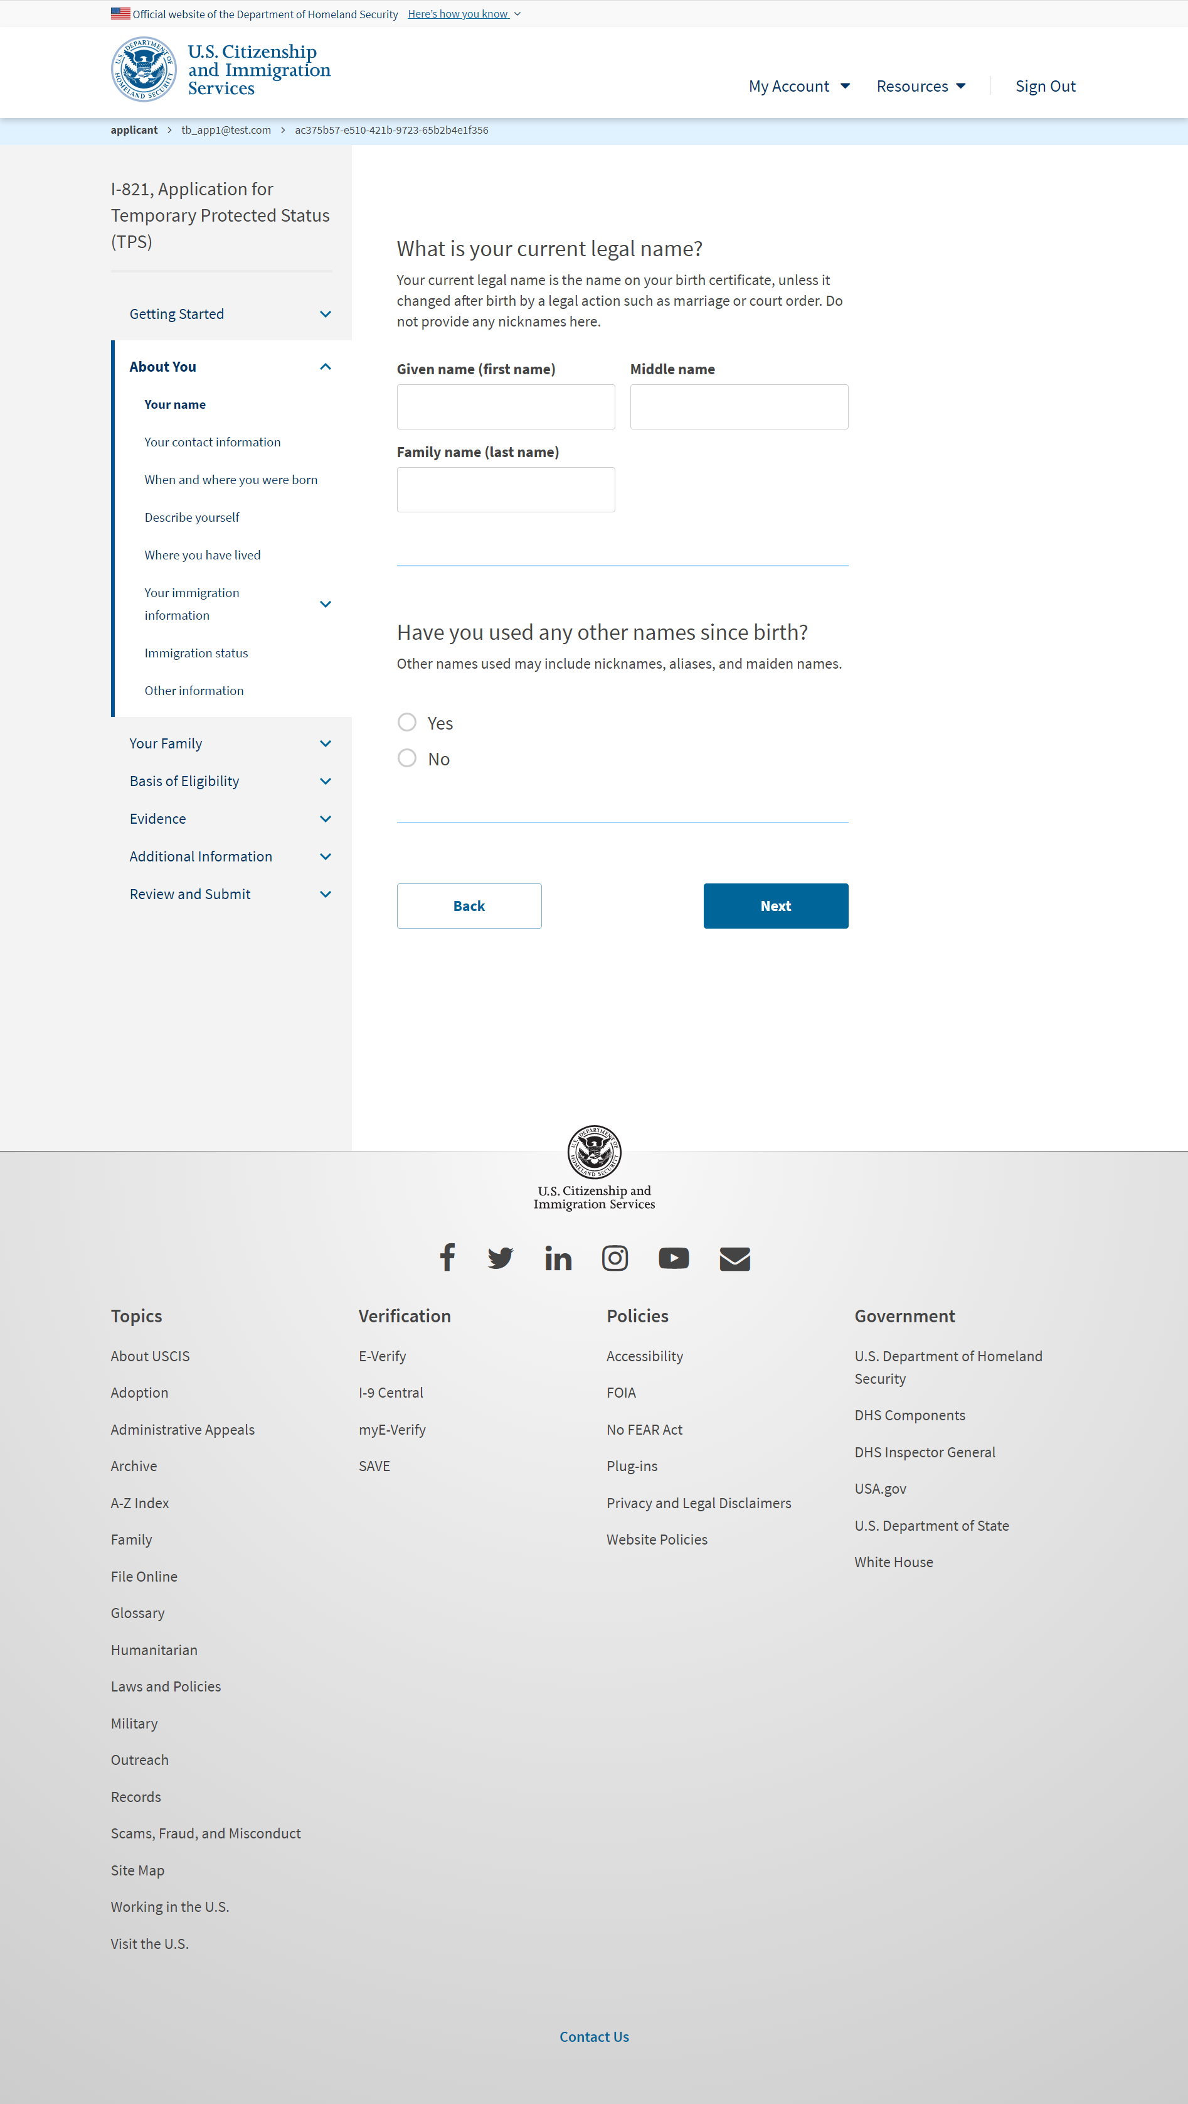
I-821: About You – Your name

Slide 11
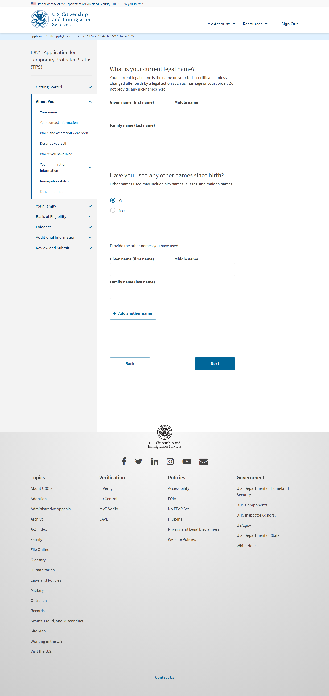
I-821: About You – Your name (if user selects ‘Yes’ for other names)

Slide 12
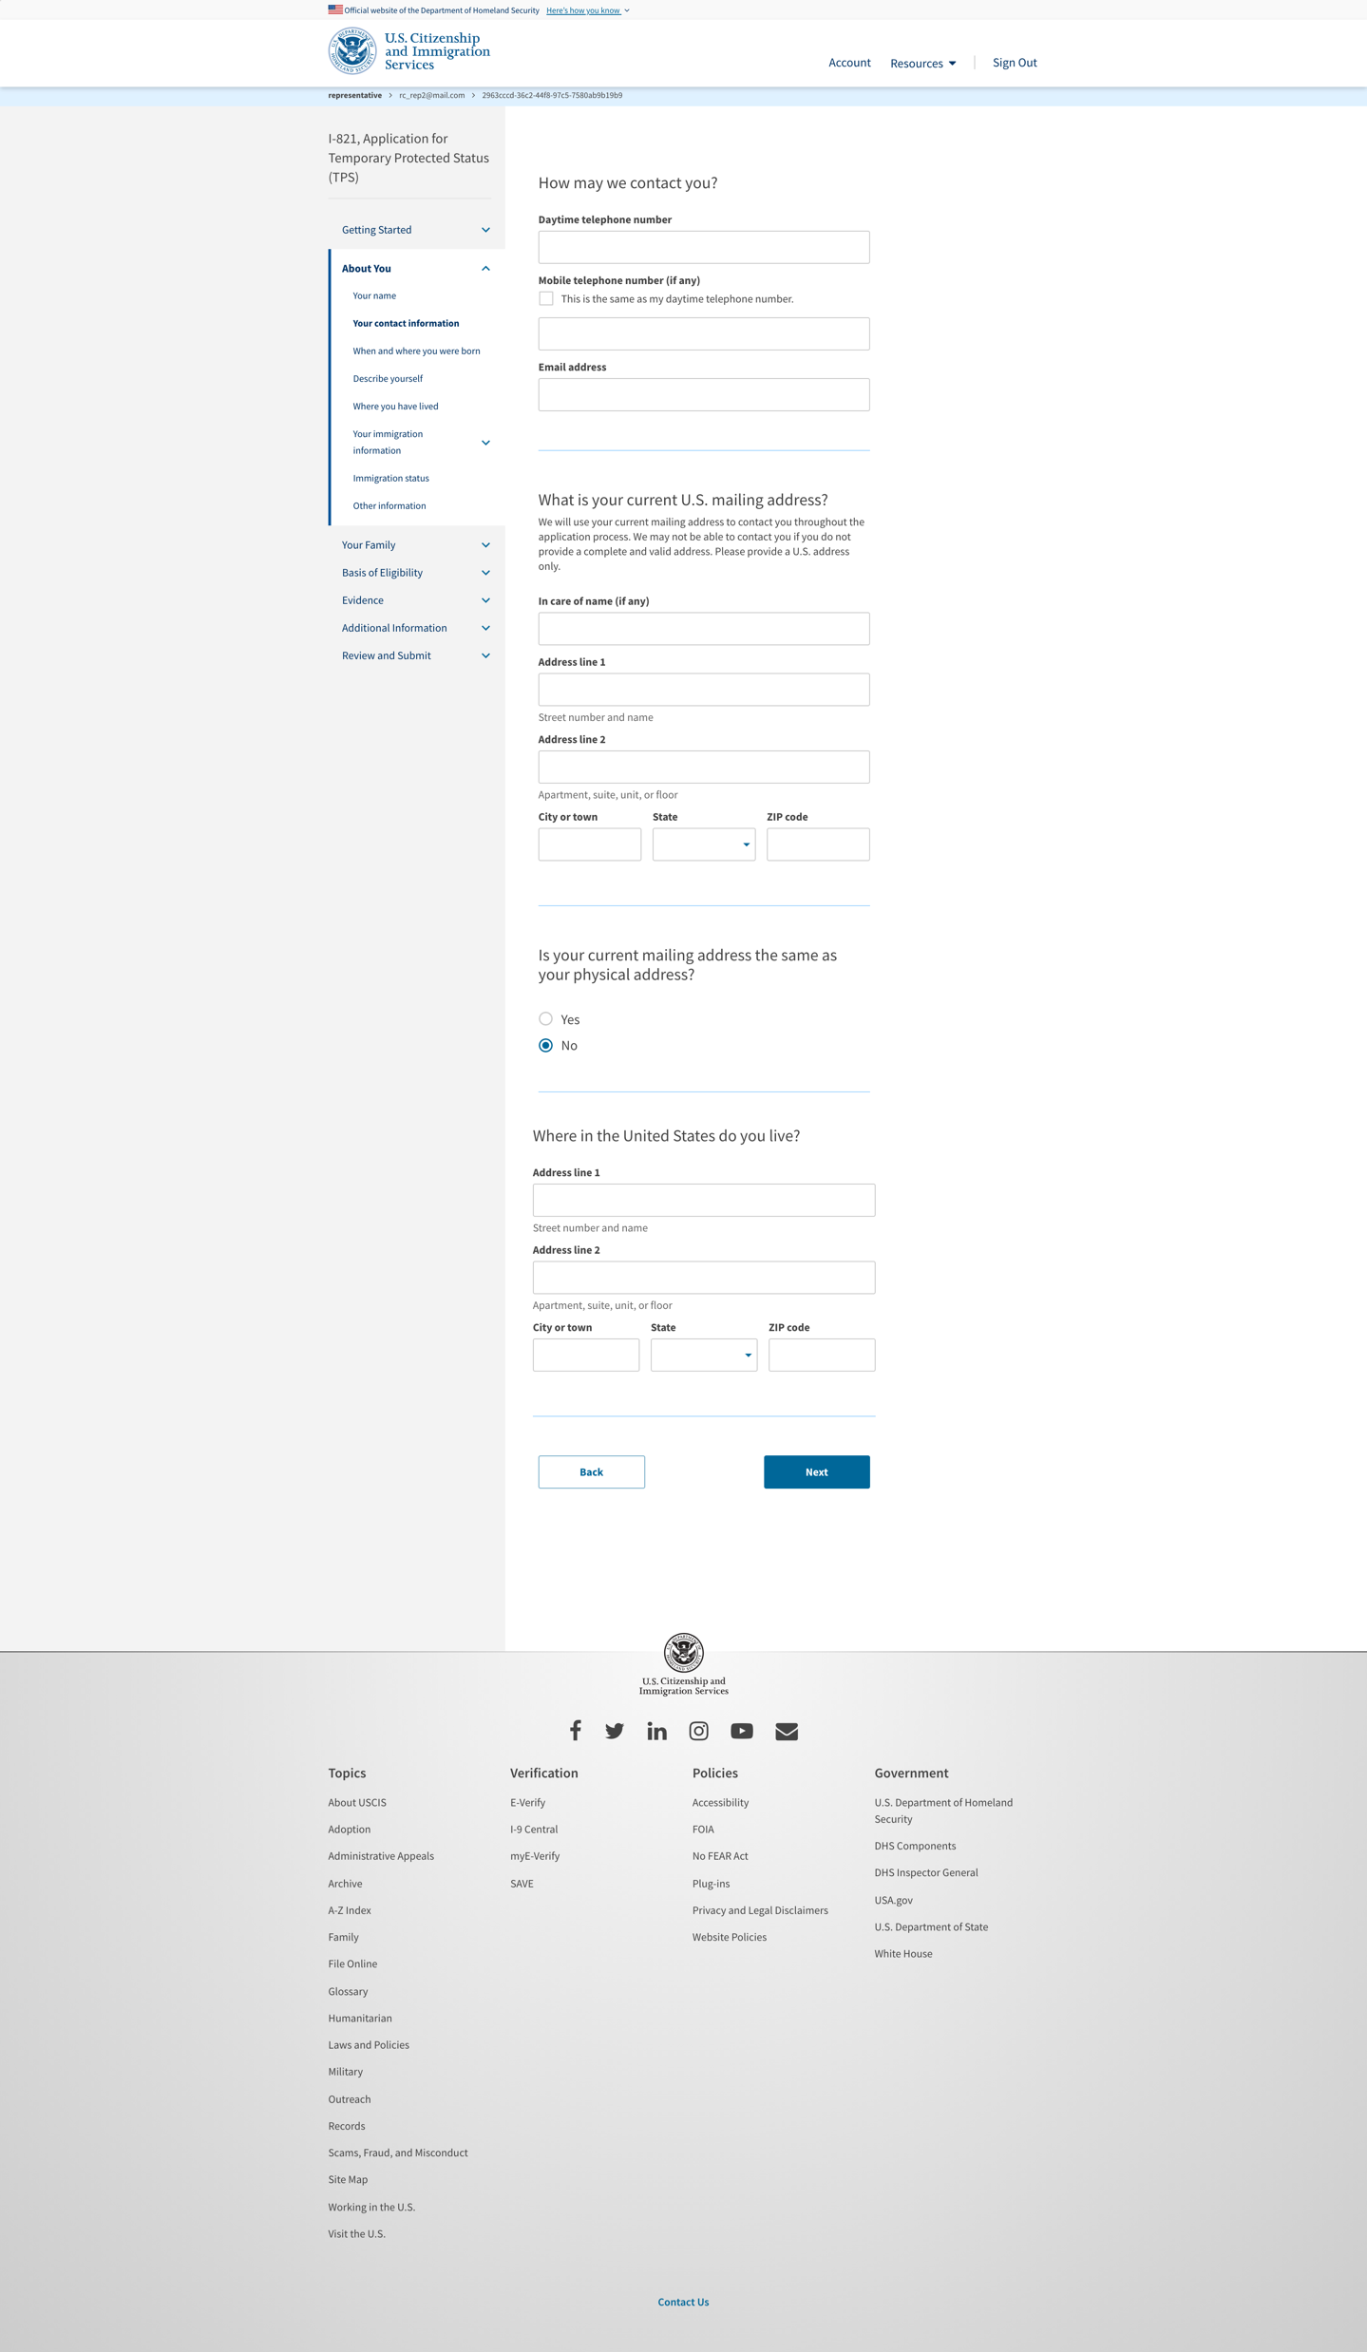
I-821: About You – Your contact information

Slide 13
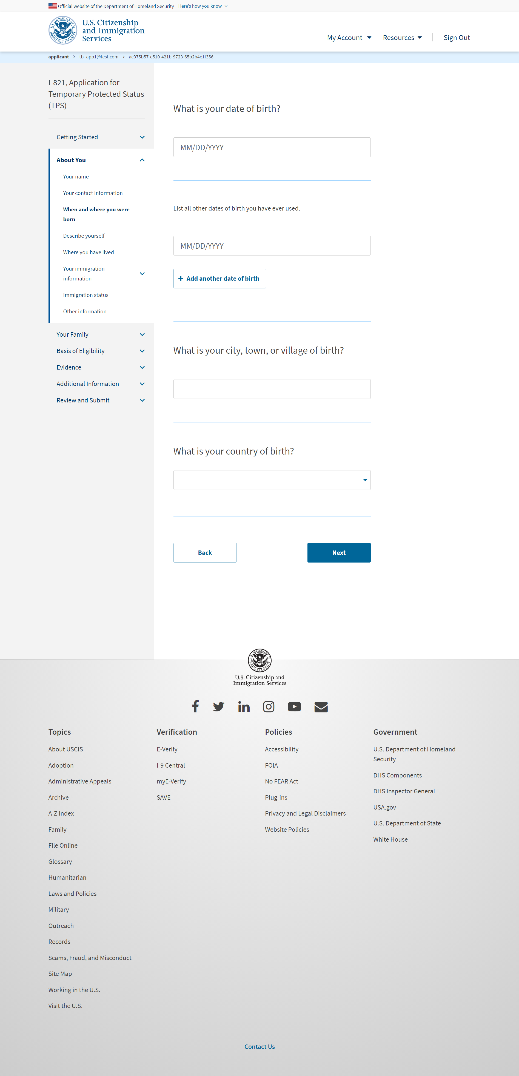
I-821: About You – When and where you were born

Slide 14
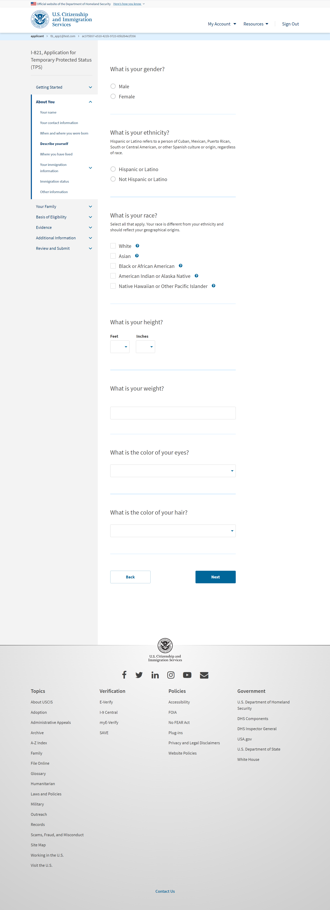
I-821: About You – Describe yourself

Slide 15
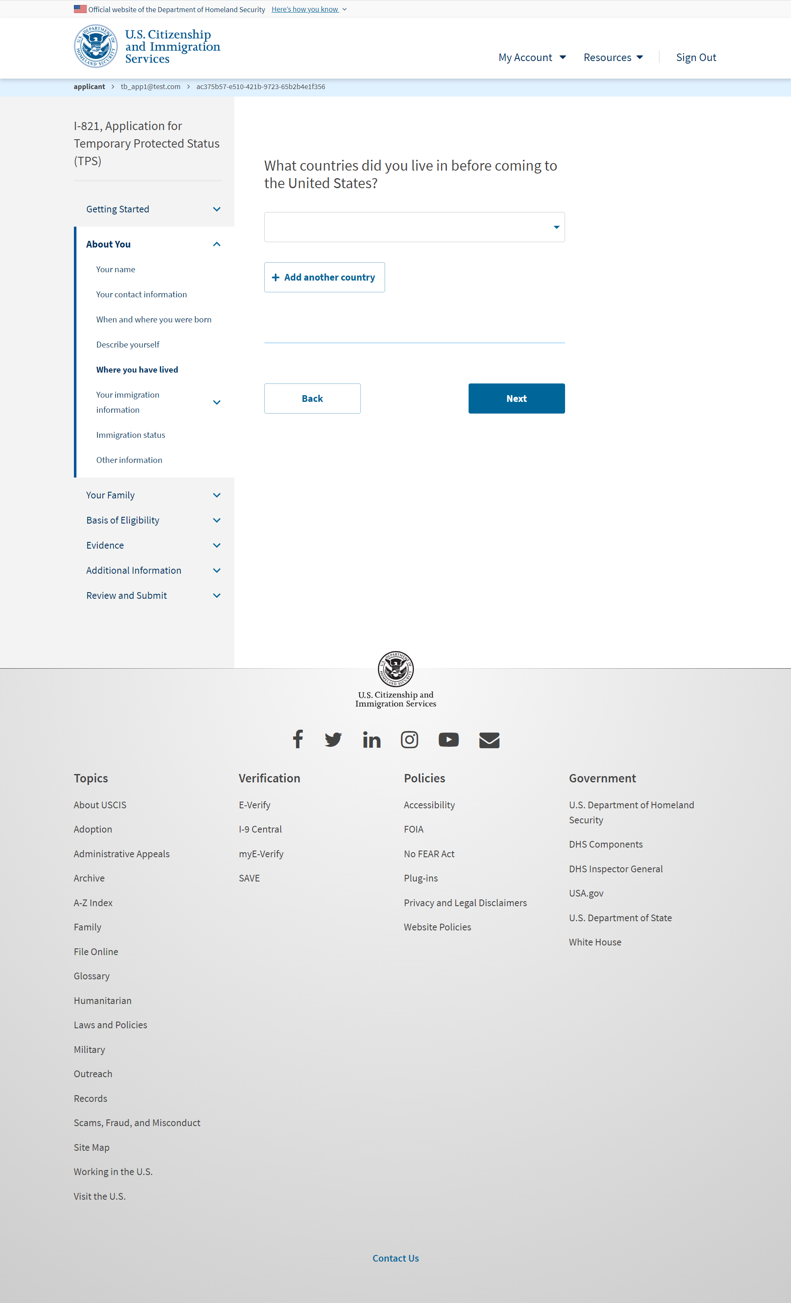
I-821: About You – Where you have lived

Slide 16
I-821: About You – Your immigration information
I-821: About You – Your immigration information page 2

Slide 17
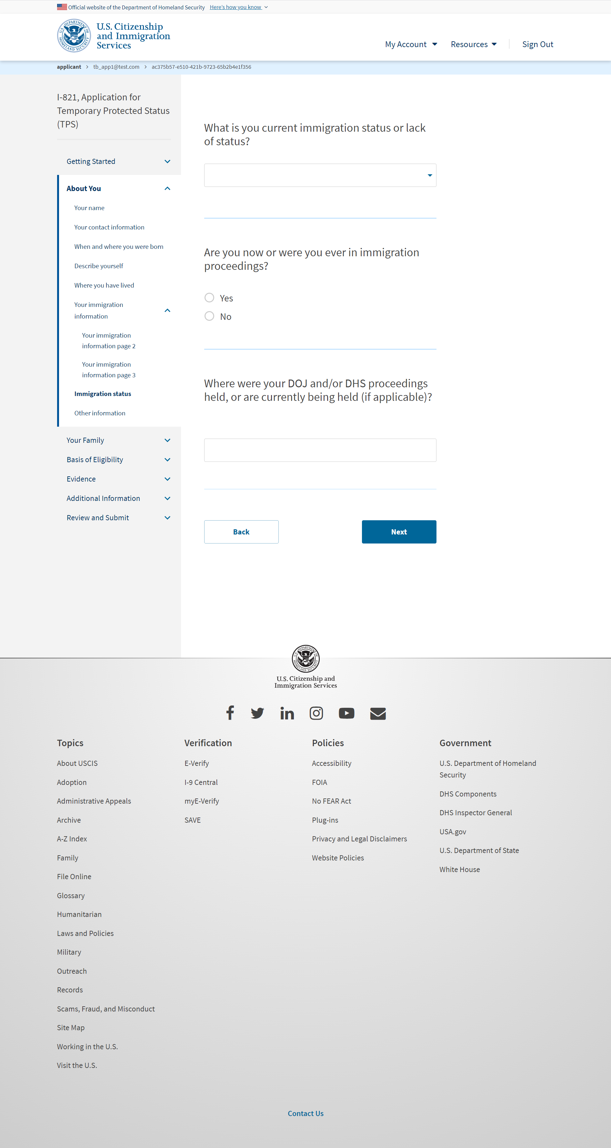
I-821: About You – Immigration status

Slide 18
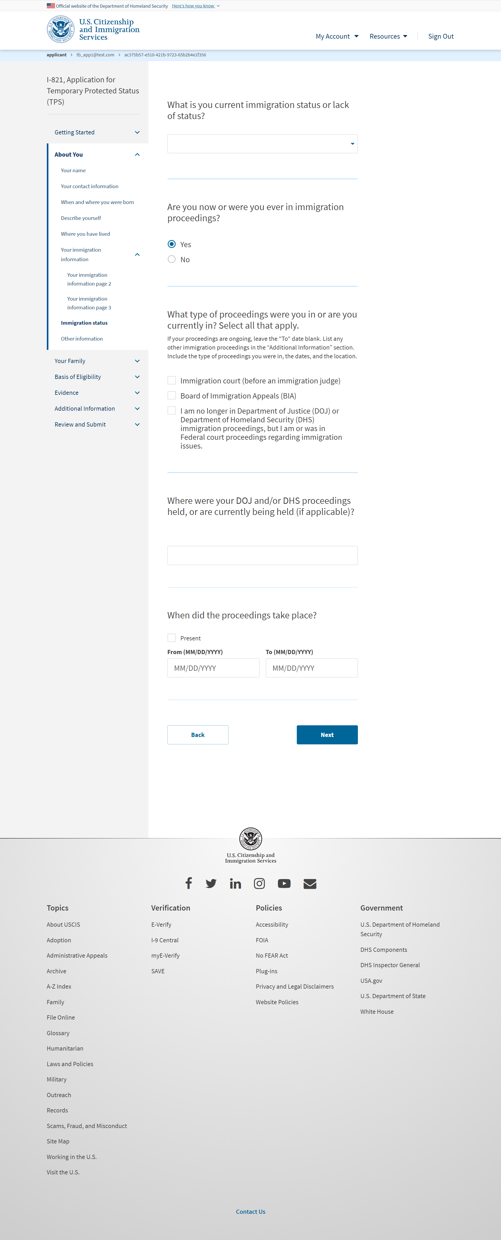
I-821: About You – Immigration status (User selects ‘Yes’ from previous slide)

Slide 19
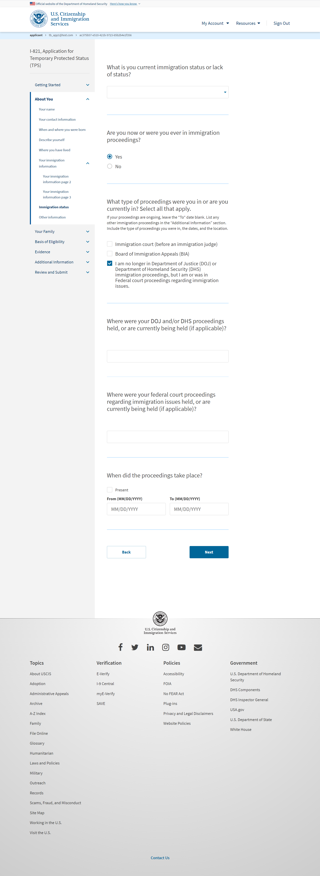
I-821: About You – Immigration status (User selects 3rd checkbox)

Slide 20
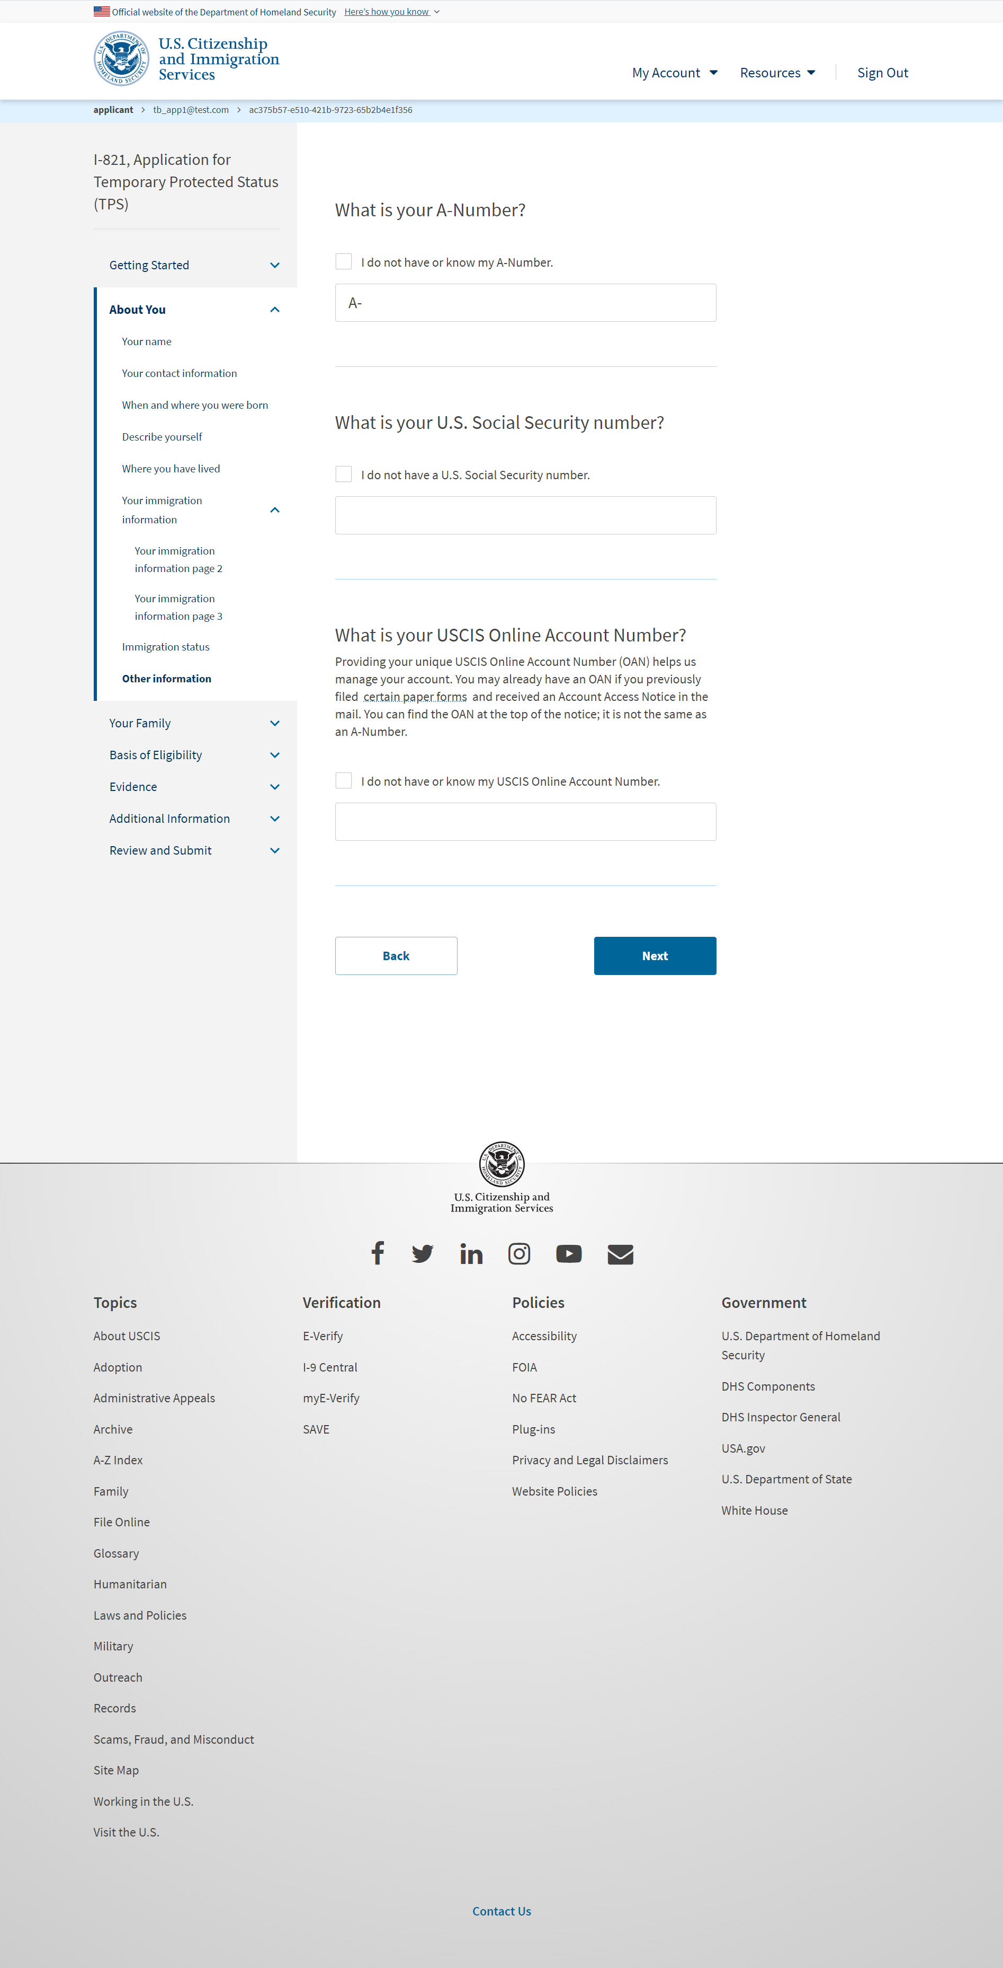
I-821: About You – Other information

Slide 21
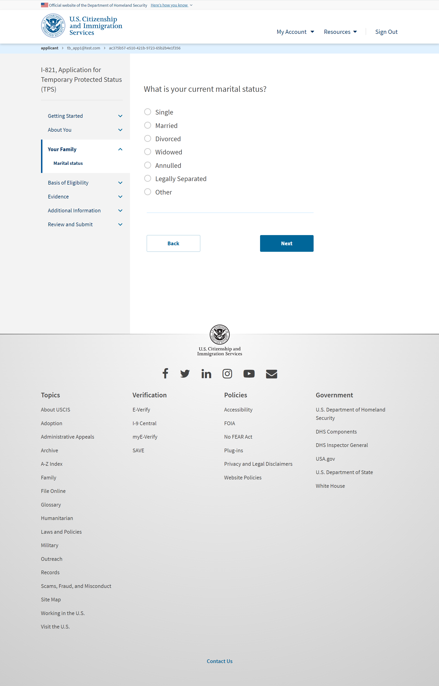
I-821: Your Family – Martial status

Slide 22
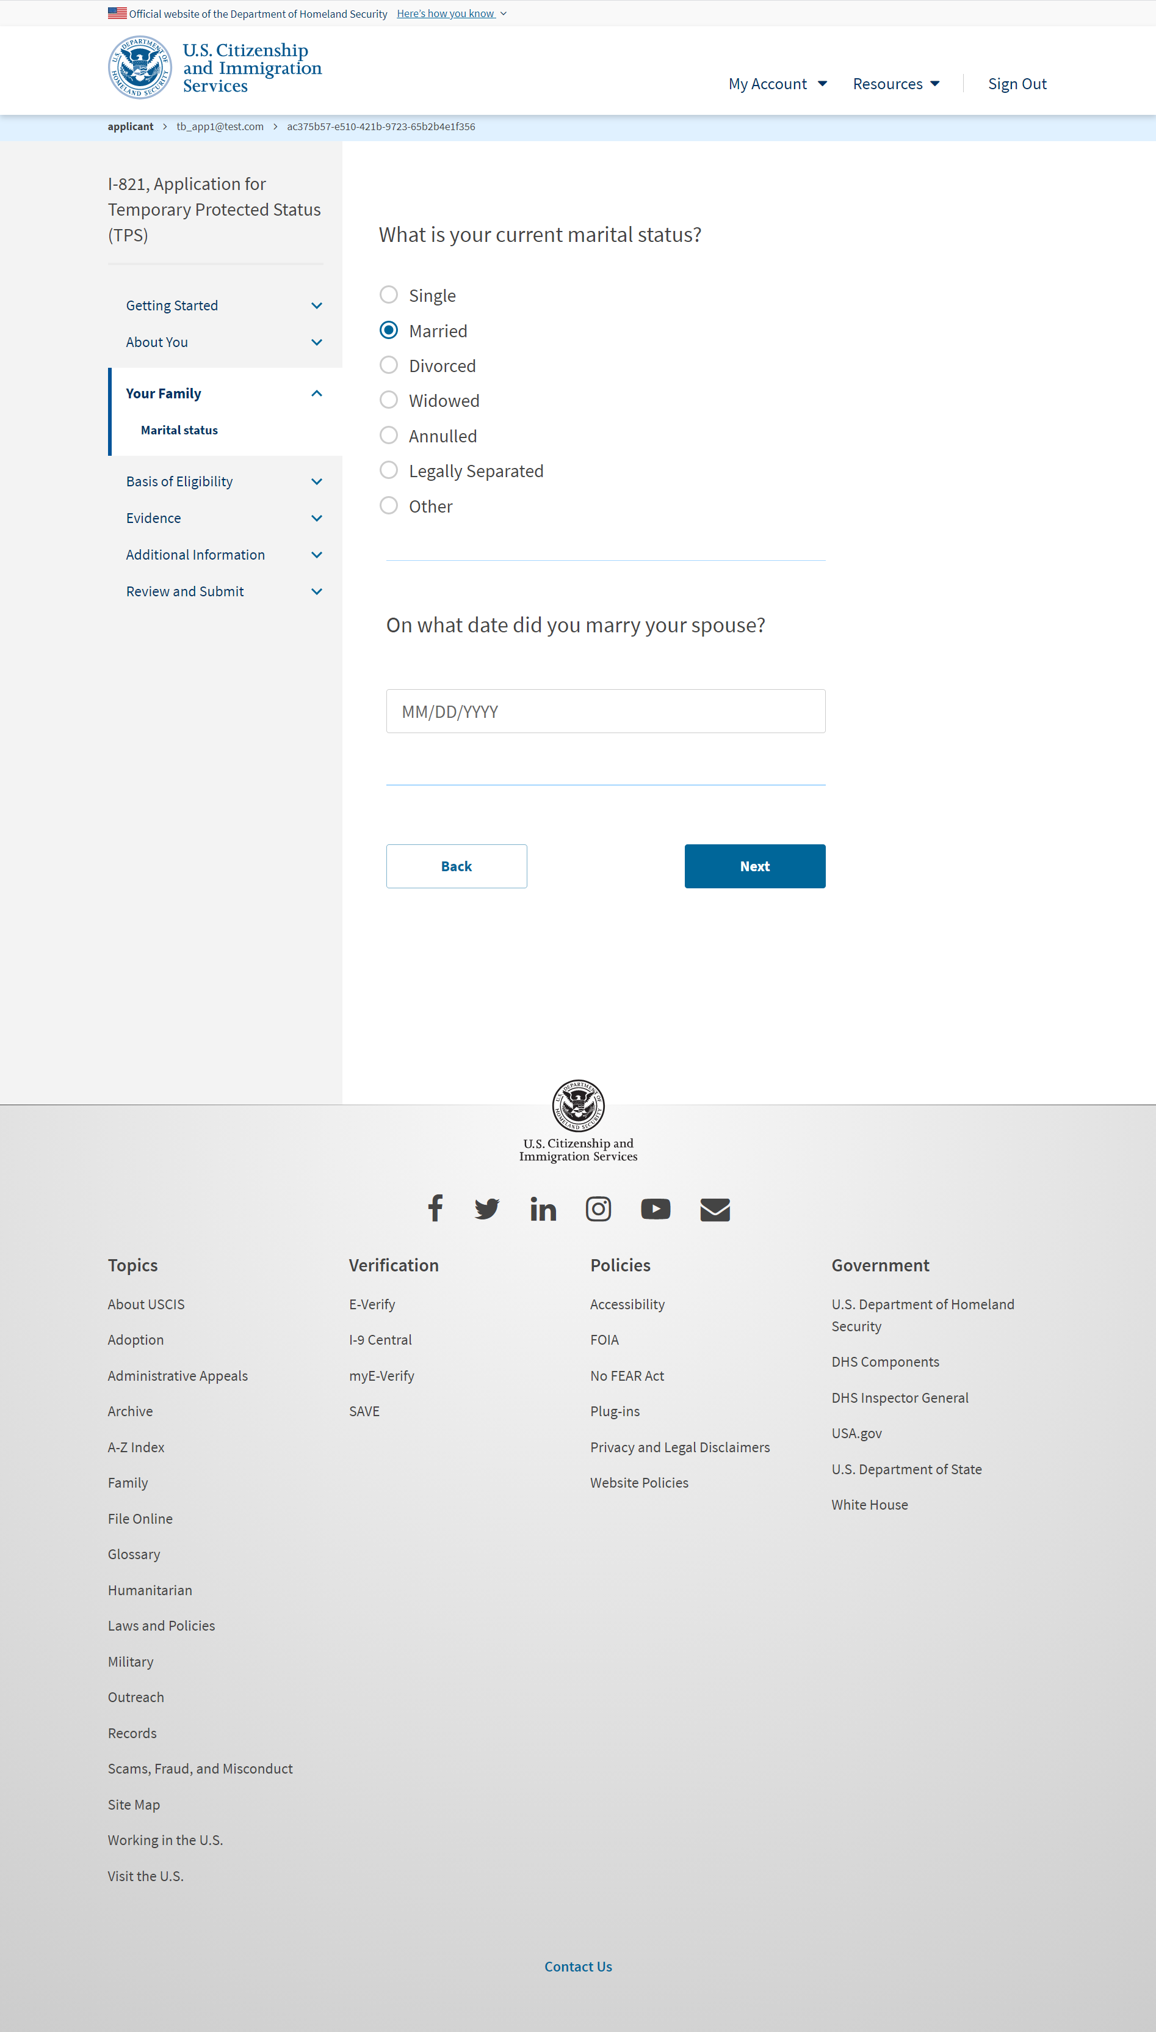
I-821: Your Family – Martial status (if user selects ‘Married’)

Slide 23
I-821: Your Family – Martial status (if user selects ‘Legally Separated’)

Slide 24
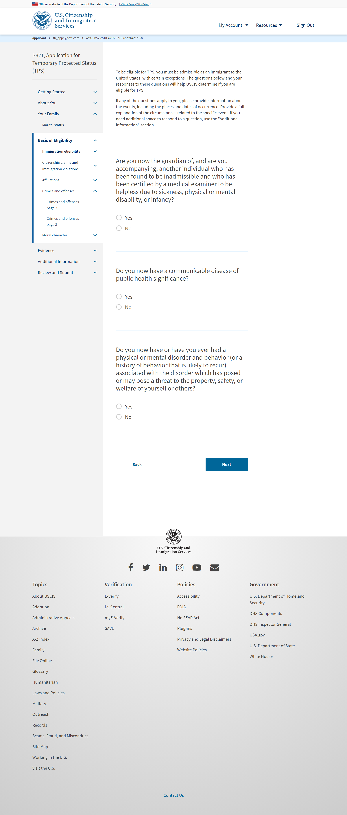
I-821: Basis of Eligibility – Immigration eligibility

Slide 25
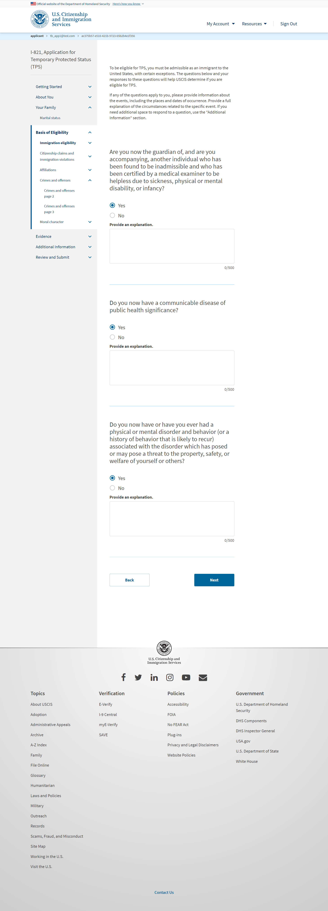
I-821: Basis of Eligibility – Immigration eligibility (if user selects ‘Yes’ from previous slide)

Slide 26
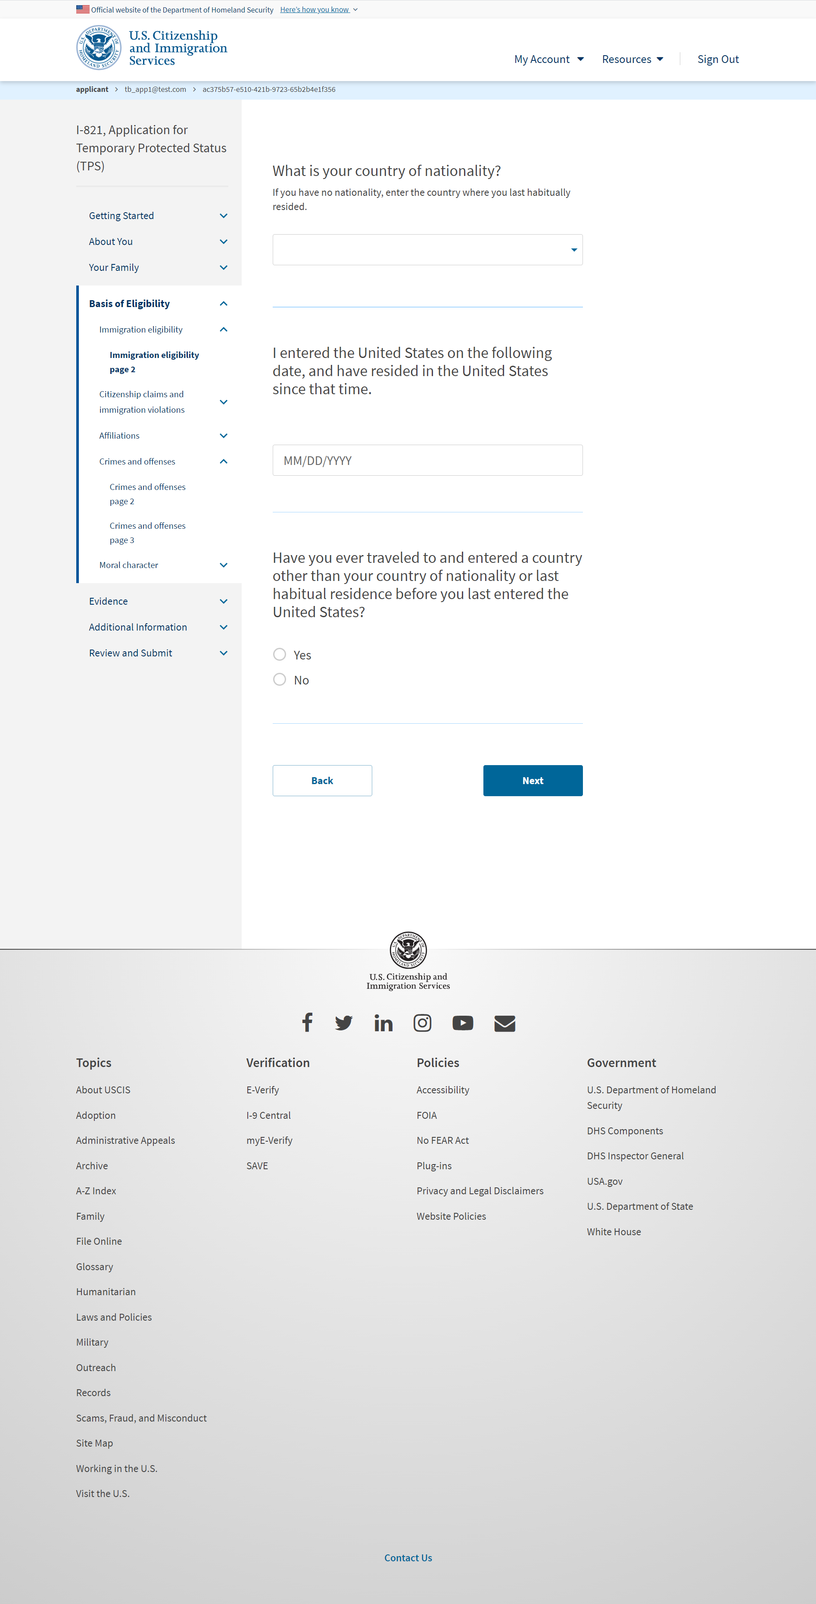
I-821: Basis of Eligibility – Immigration eligibility page 2

Slide 27
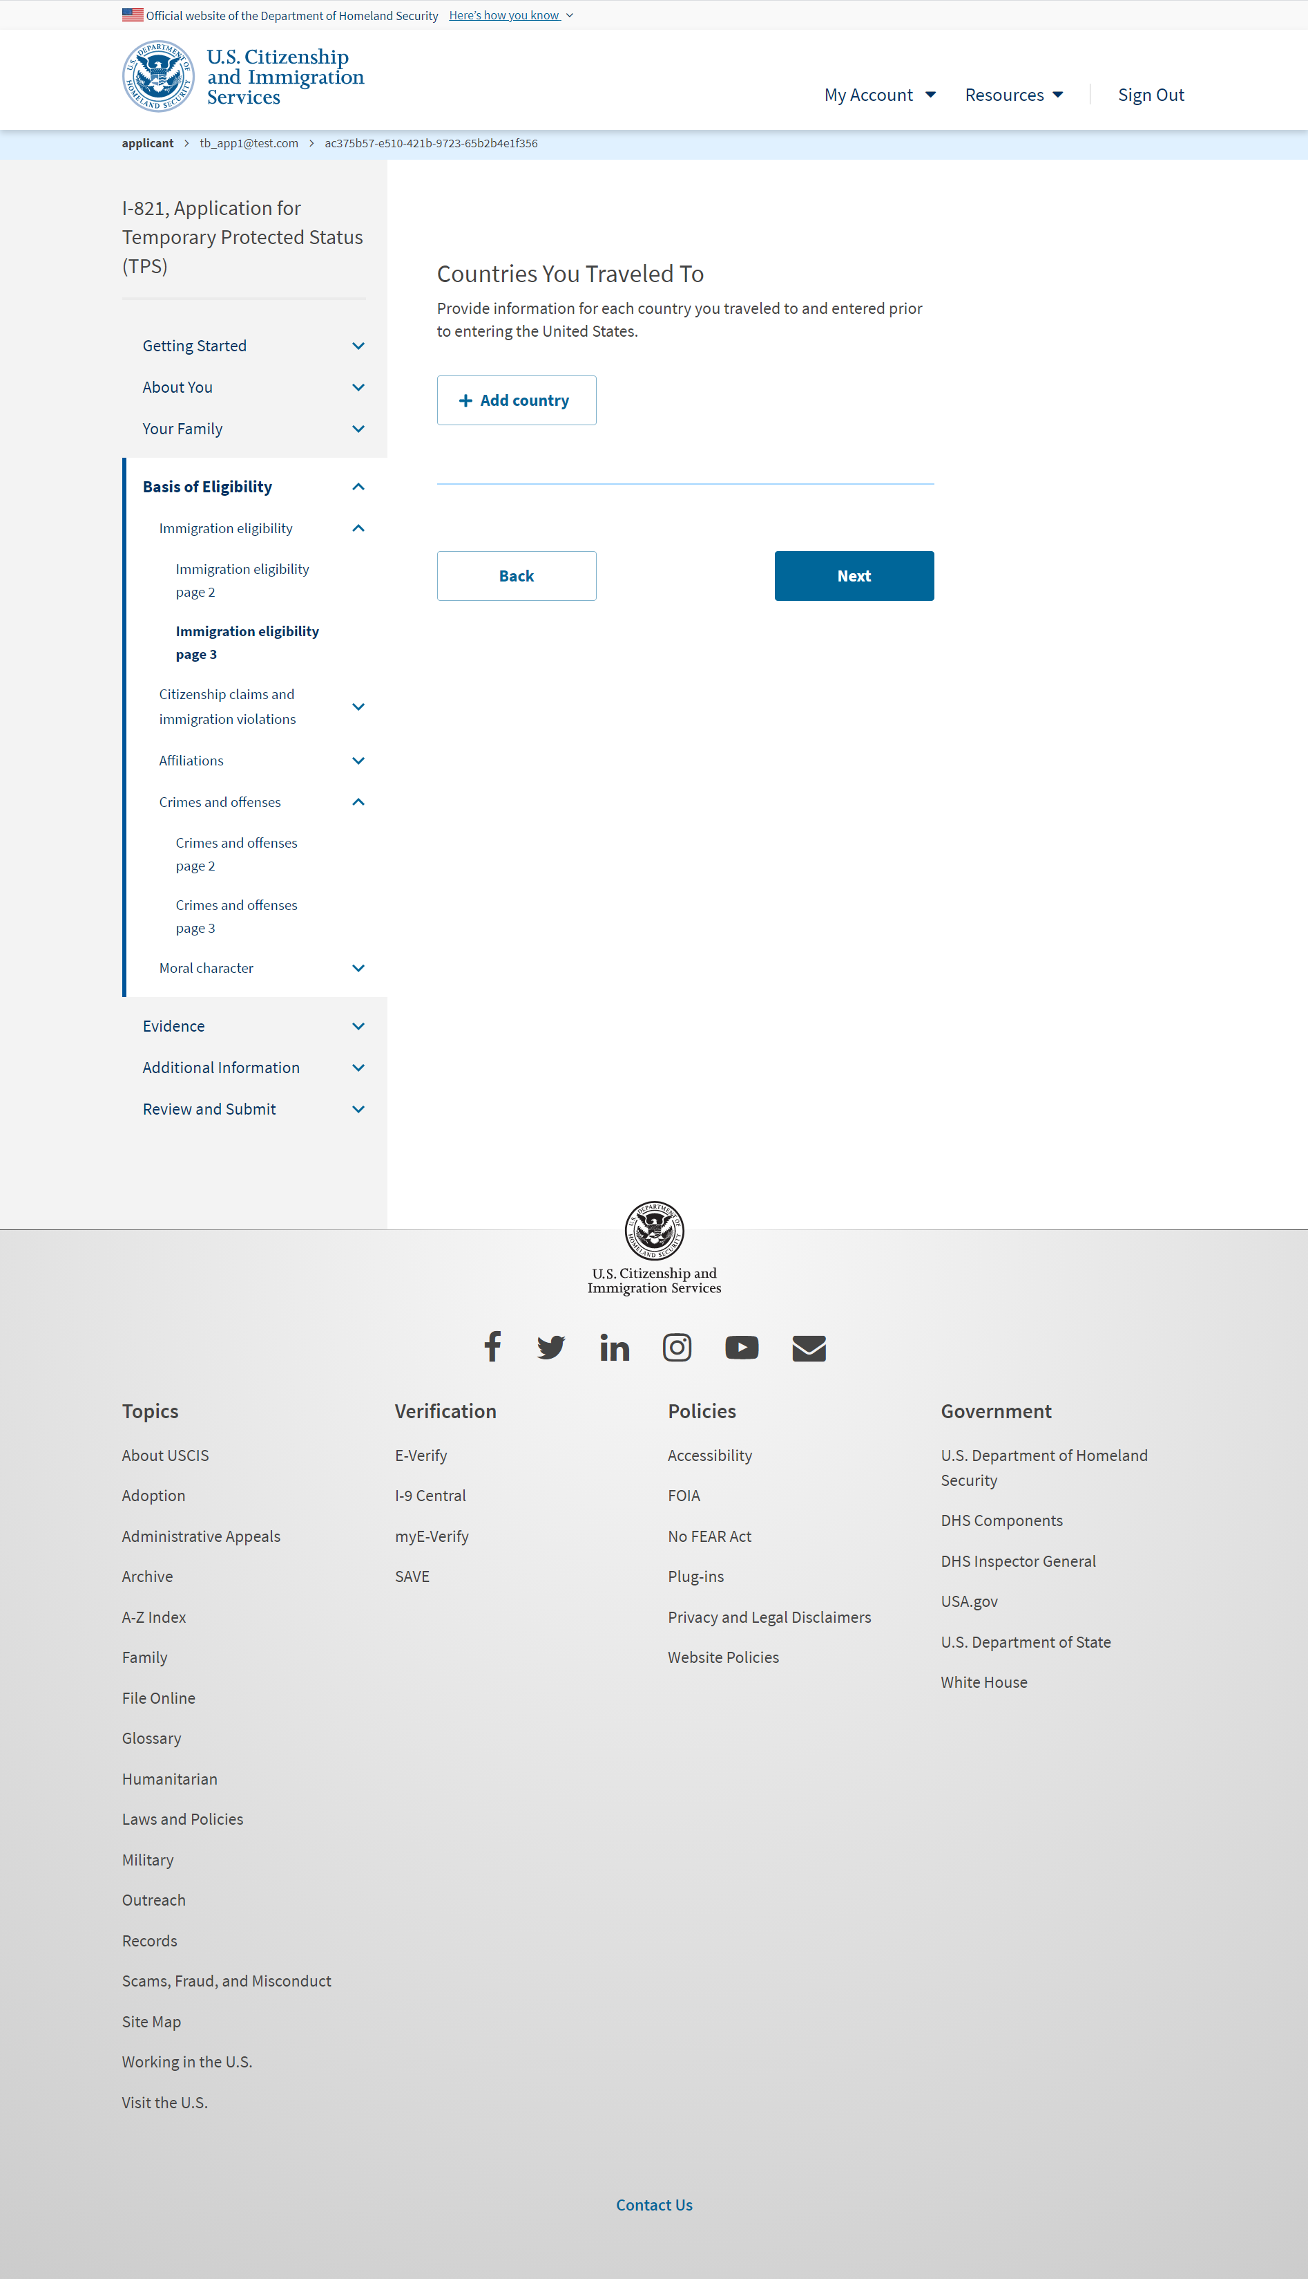
I-821: Basis of Eligibility – Immigration eligibility page 3 (User selects ‘Yes’ from previous slide)

Slide 28
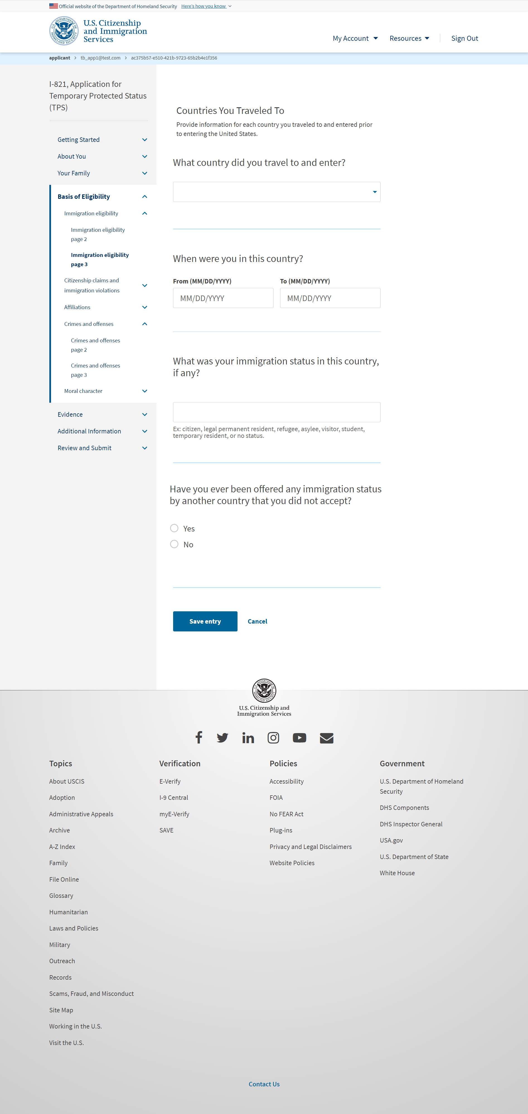
I-821: Basis of Eligibility – Immigration eligibility page 3 (User adds a country)

Slide 29
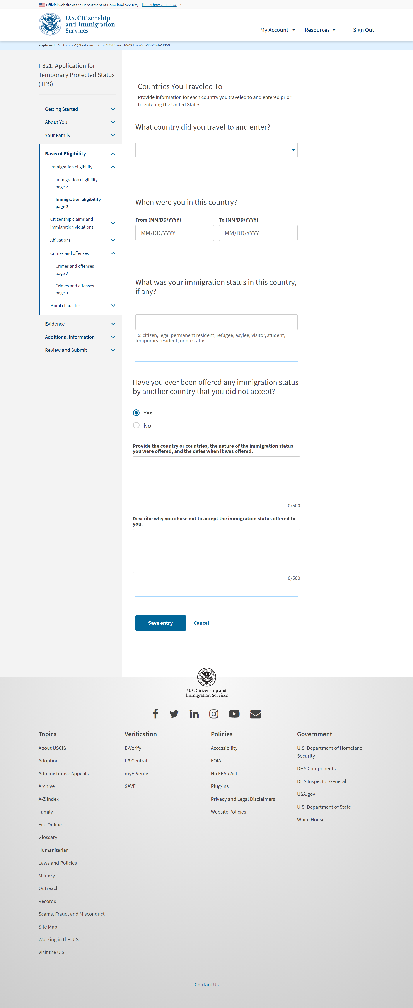
I-821: Basis of Eligibility – Immigration eligibility page 3 (User selects ‘Yes’ on the page)

Slide 30
I-821: Basis of Eligibility – Citizenship claims and immigration violations

Slide 31
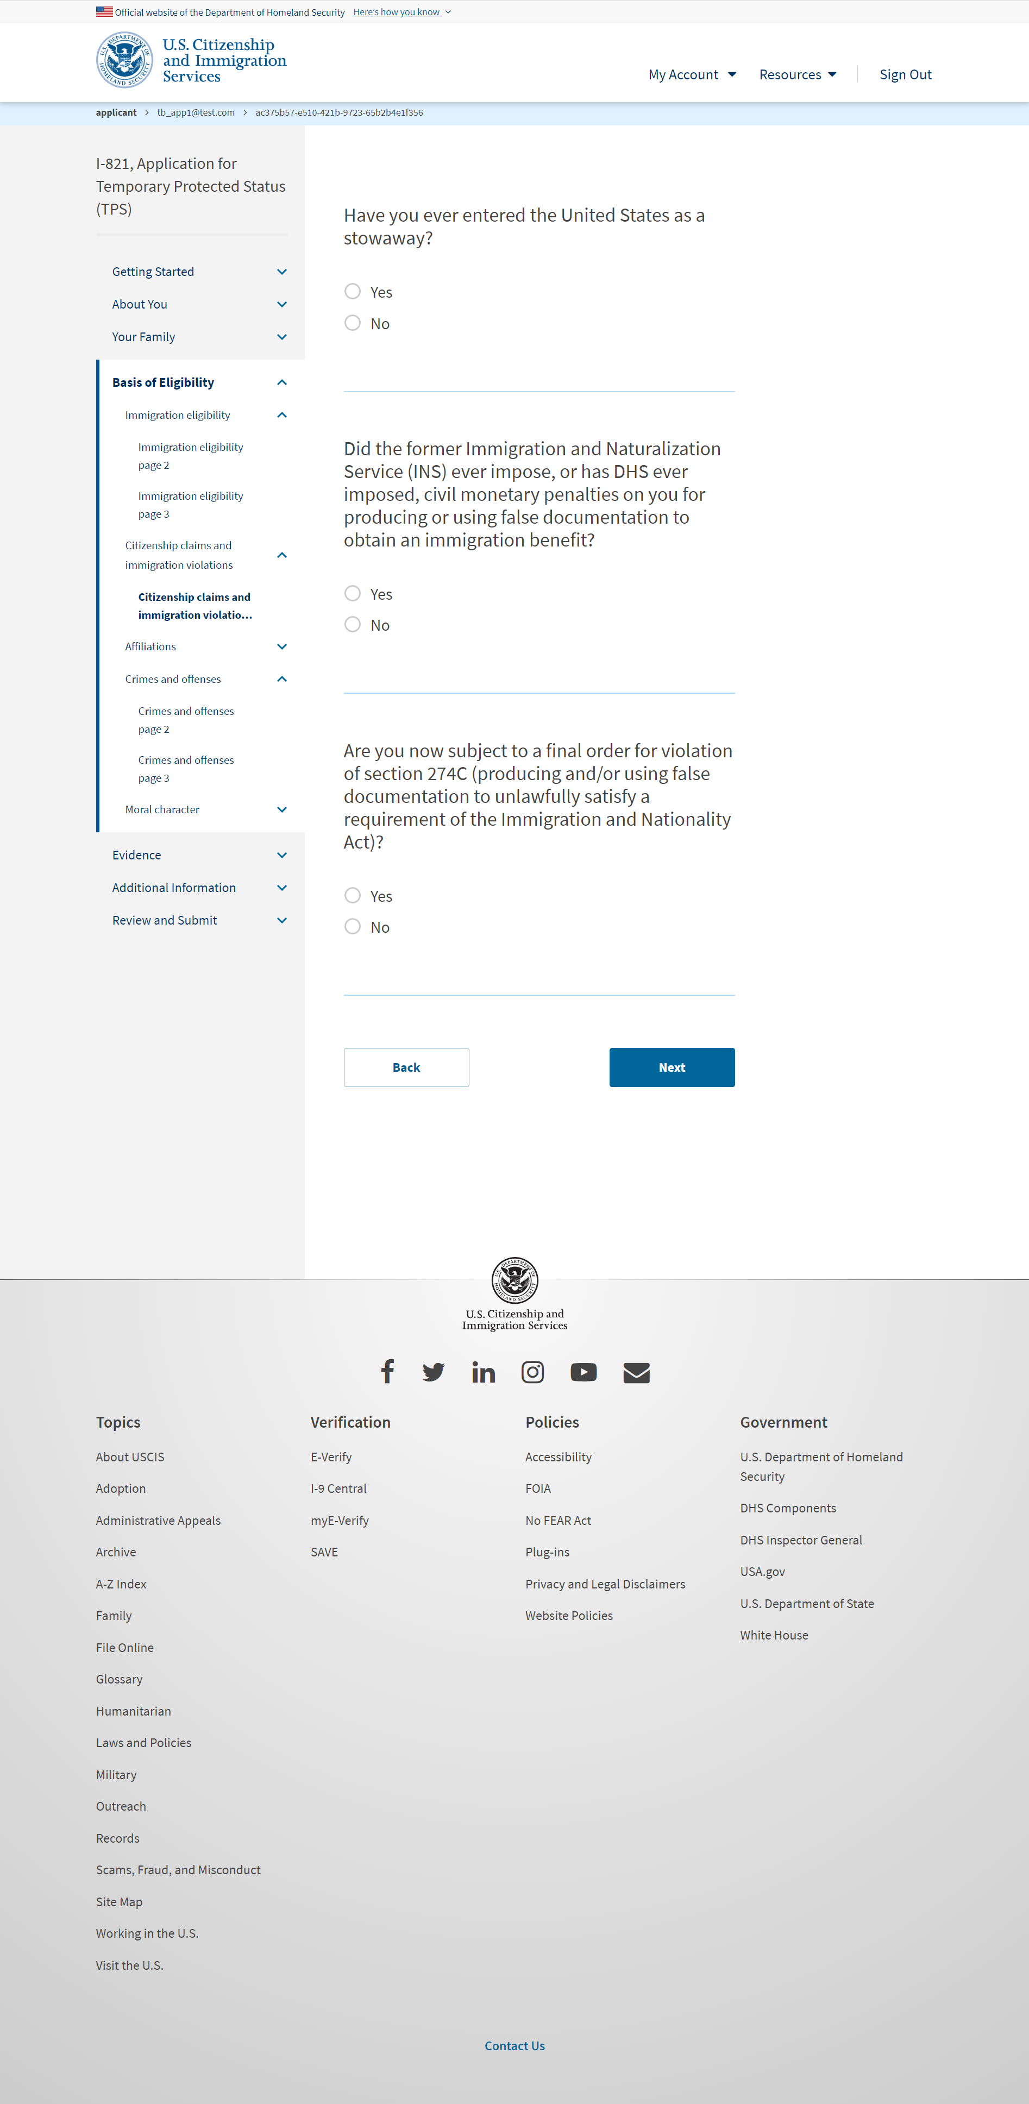
I-821: Basis of Eligibility – Citizenship claims and immigration violations page 2

Slide 32
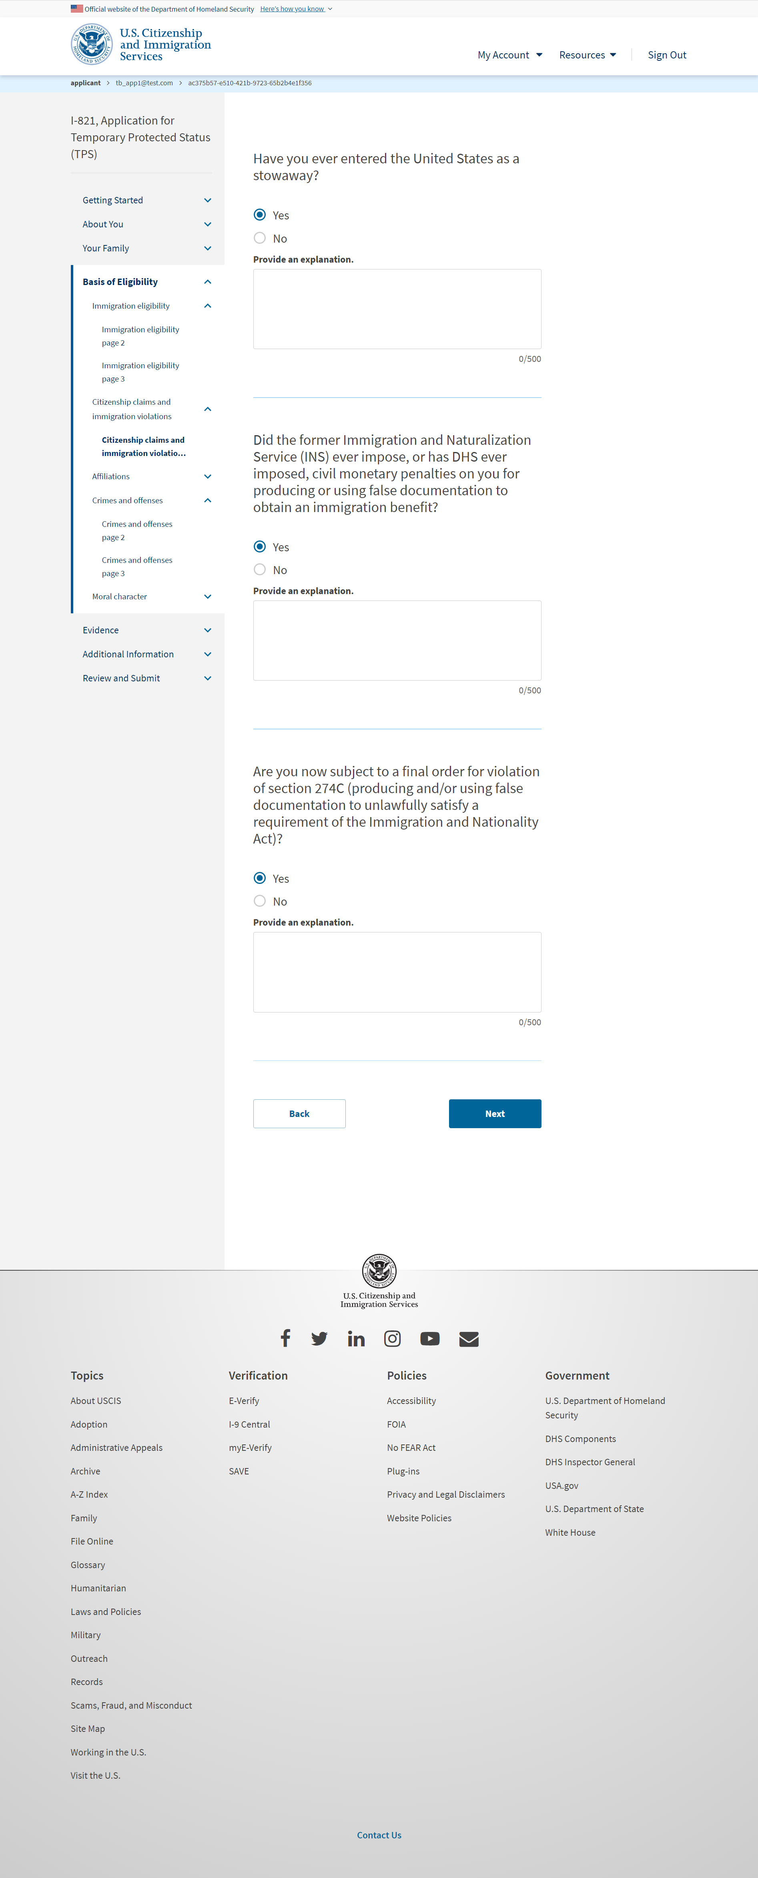
I-821: Basis of Eligibility – Citizenship claims and immigration violations page 2 ( if user selects ‘Yes)

Slide 33
I-821: Basis of Eligibility – Affiliations

Slide 34
I-821: Basis of Eligibility – Affiliations (if user selects ‘Yes’)

Slide 35
I-821: Basis of Eligibility – Affiliations page 2

Slide 36
I-821: Basis of Eligibility – Affiliations page 2 (if user selects ‘Yes’)

Slide 37
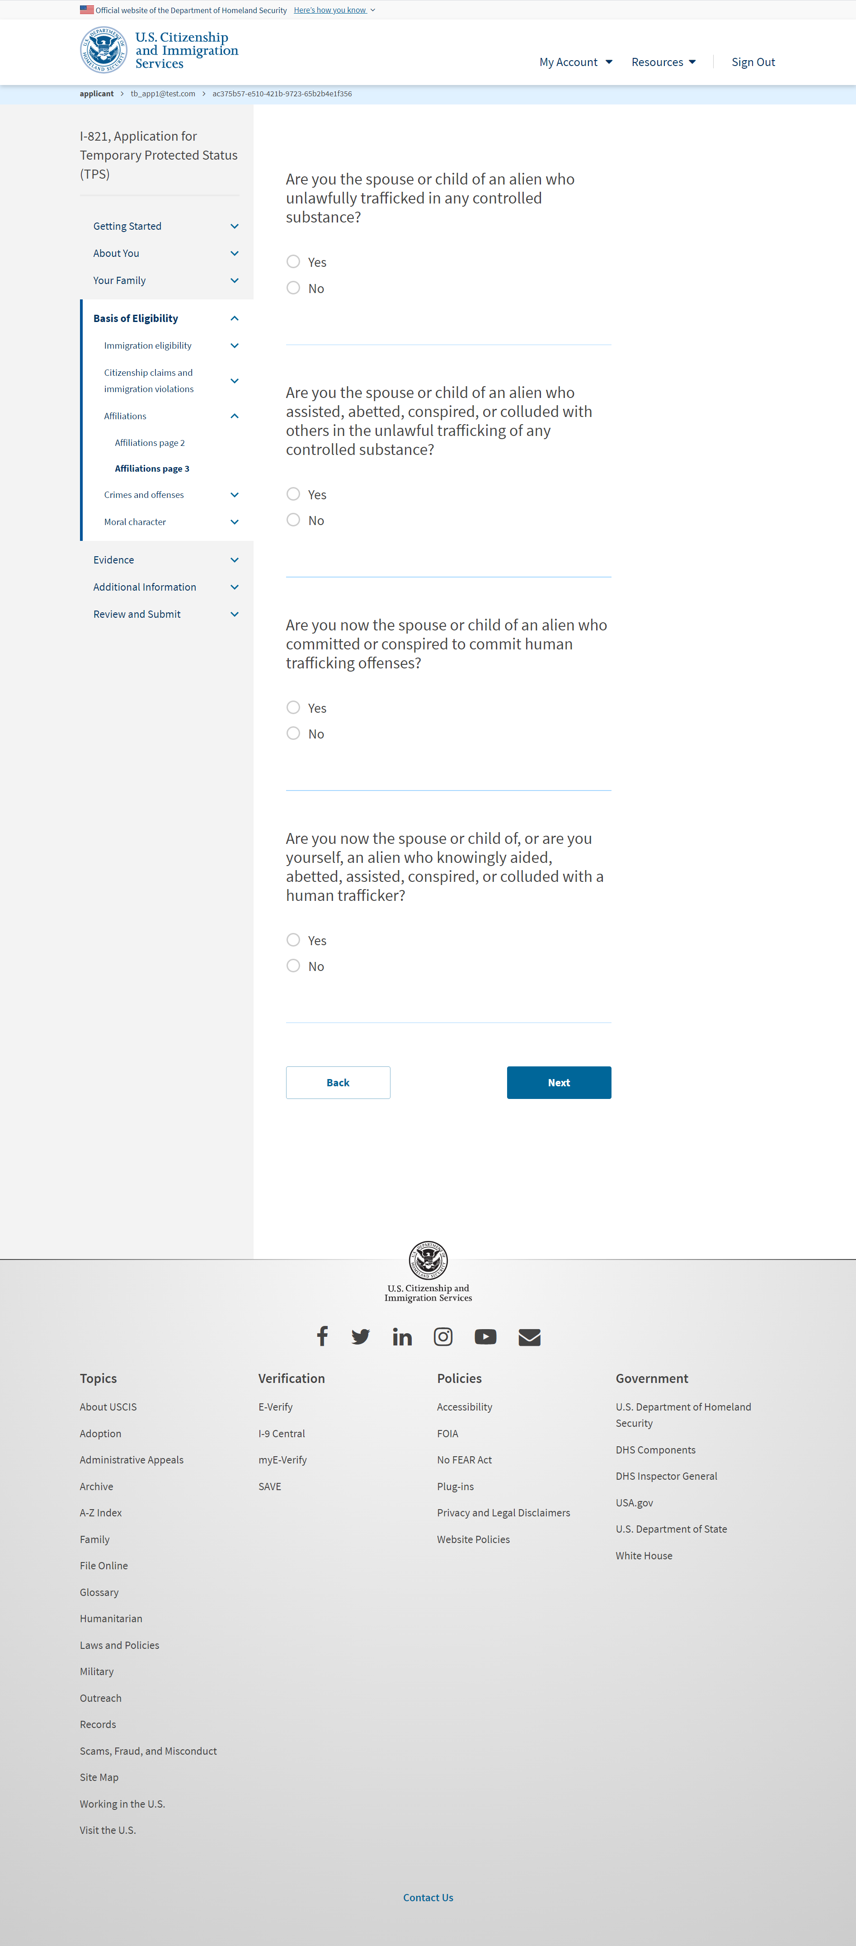
I-821: Basis of Eligibility – Affiliations page 3

Slide 38
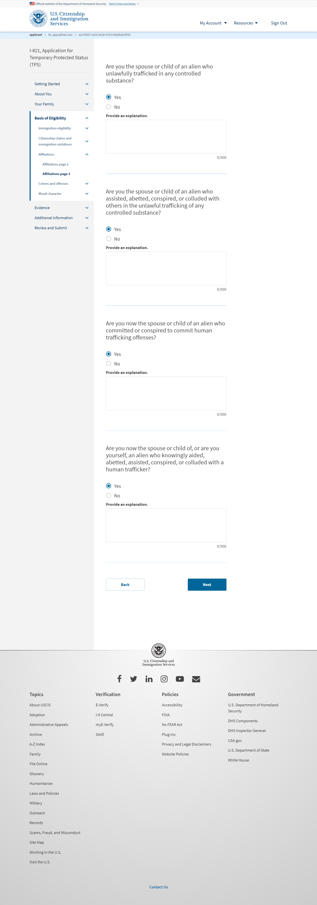
I-821: Basis of Eligibility – Affiliations page 3 (if user selects ‘Yes’)

Slide 39
I-821: Basis of Eligibility – Crimes and offenses

Slide 40
I-821: Basis of Eligibility – Crimes and offenses (if user selects ‘Yes’)

Slide 41
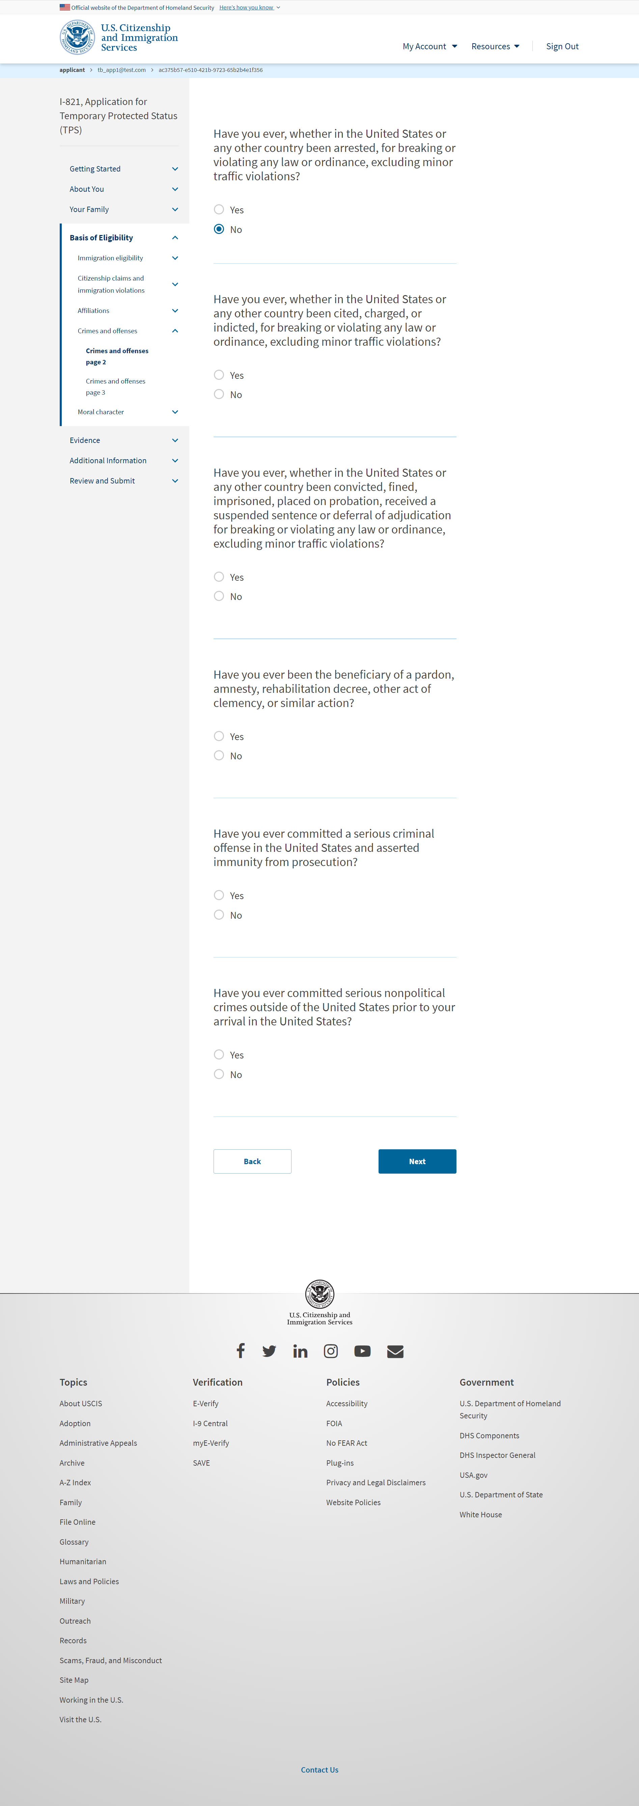
I-821: Basis of Eligibility – Crimes and offenses page 2

Slide 42
I-821: Basis of Eligibility – Crimes and offenses page 2 (if user selects ‘Yes’)

Slide 43
I-821: Basis of Eligibility – Crimes and offenses page 3

Slide 44
I-821: Basis of Eligibility – Crimes and offenses page 3 (if user selects ‘Yes’)

Slide 45
I-821: Basis of Eligibility – Moral character

Slide 46
I-821: Basis of Eligibility – Moral character (if user selects ‘Yes’)

Slide 47
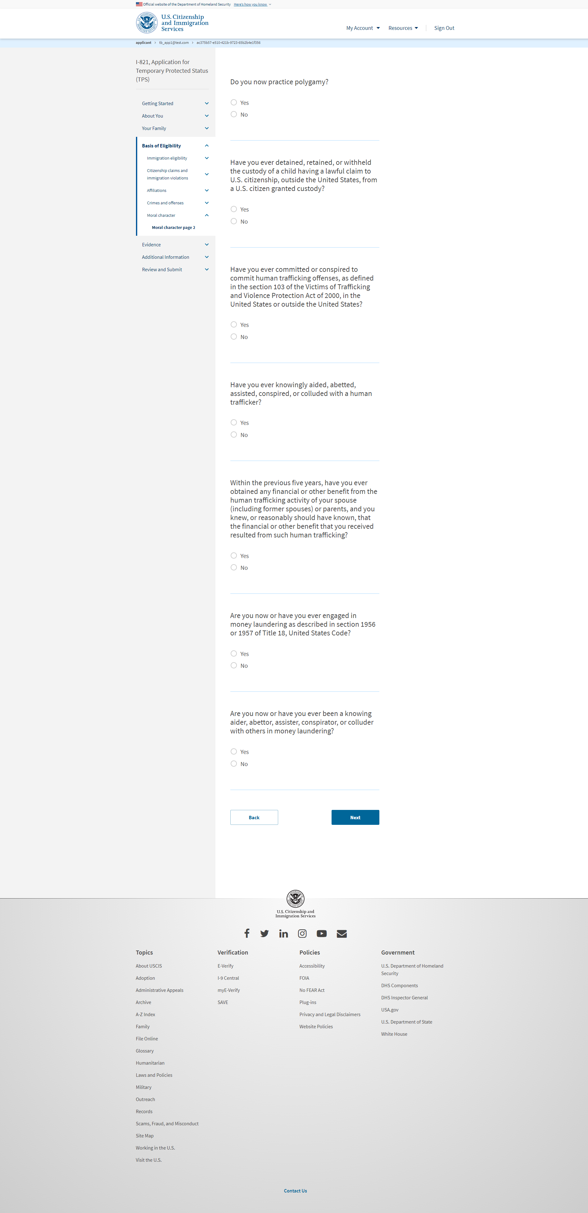
I-821: Basis of Eligibility – Moral character page 2

Slide 48
I-821: Basis of Eligibility – Moral character page 2 (if user selects ‘Yes’)

Slide 49
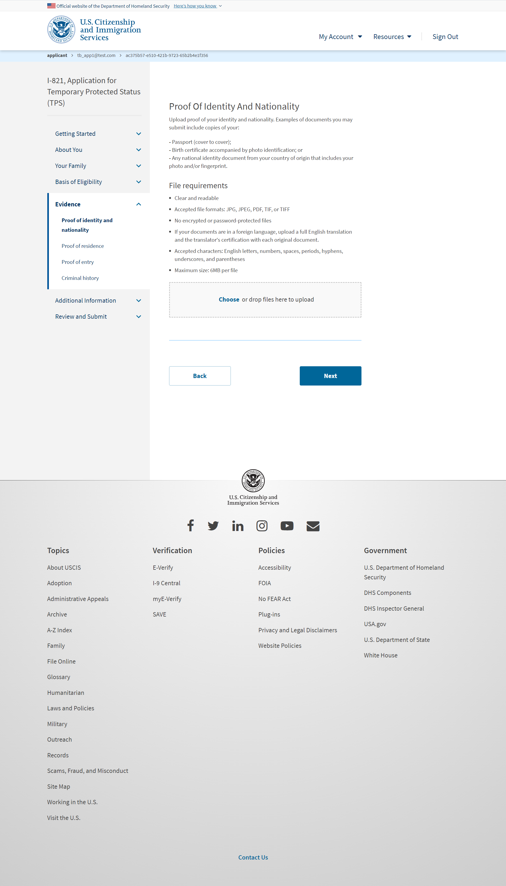
I-821:Evidence – Proof of identity and nationality

Slide 50
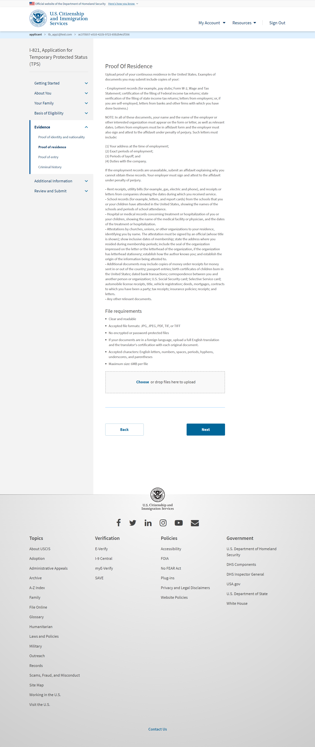
I-821:Evidence – Proof of Residence

Slide 51
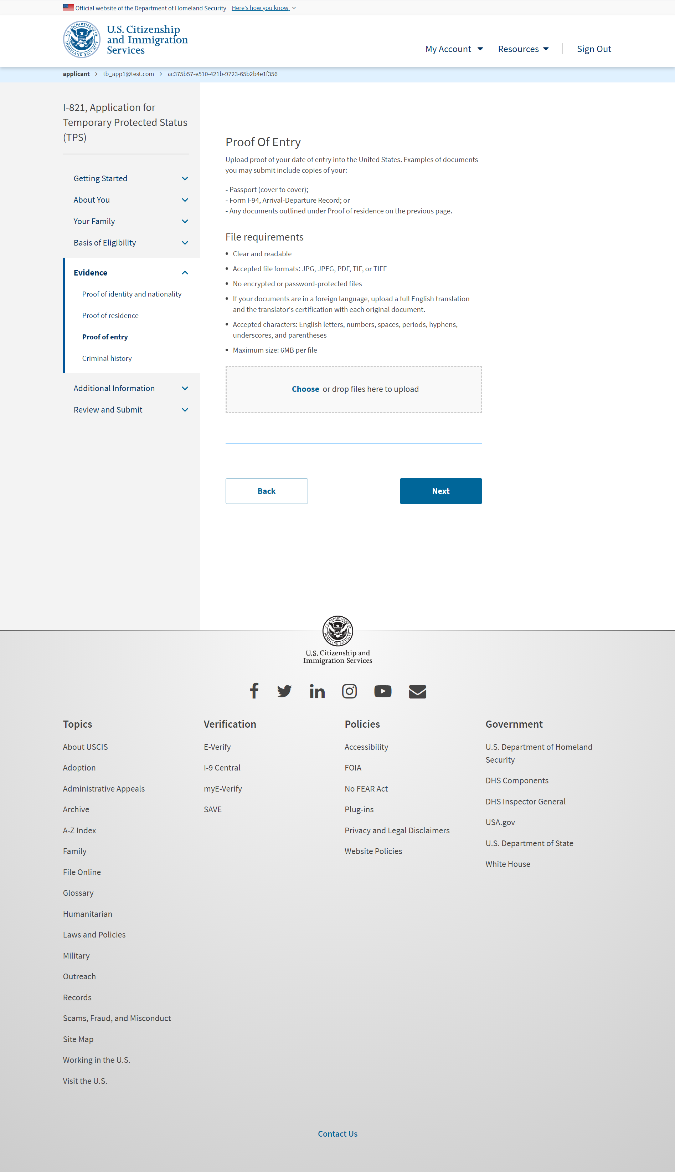
I-821:Evidence – Proof of entry

Slide 52
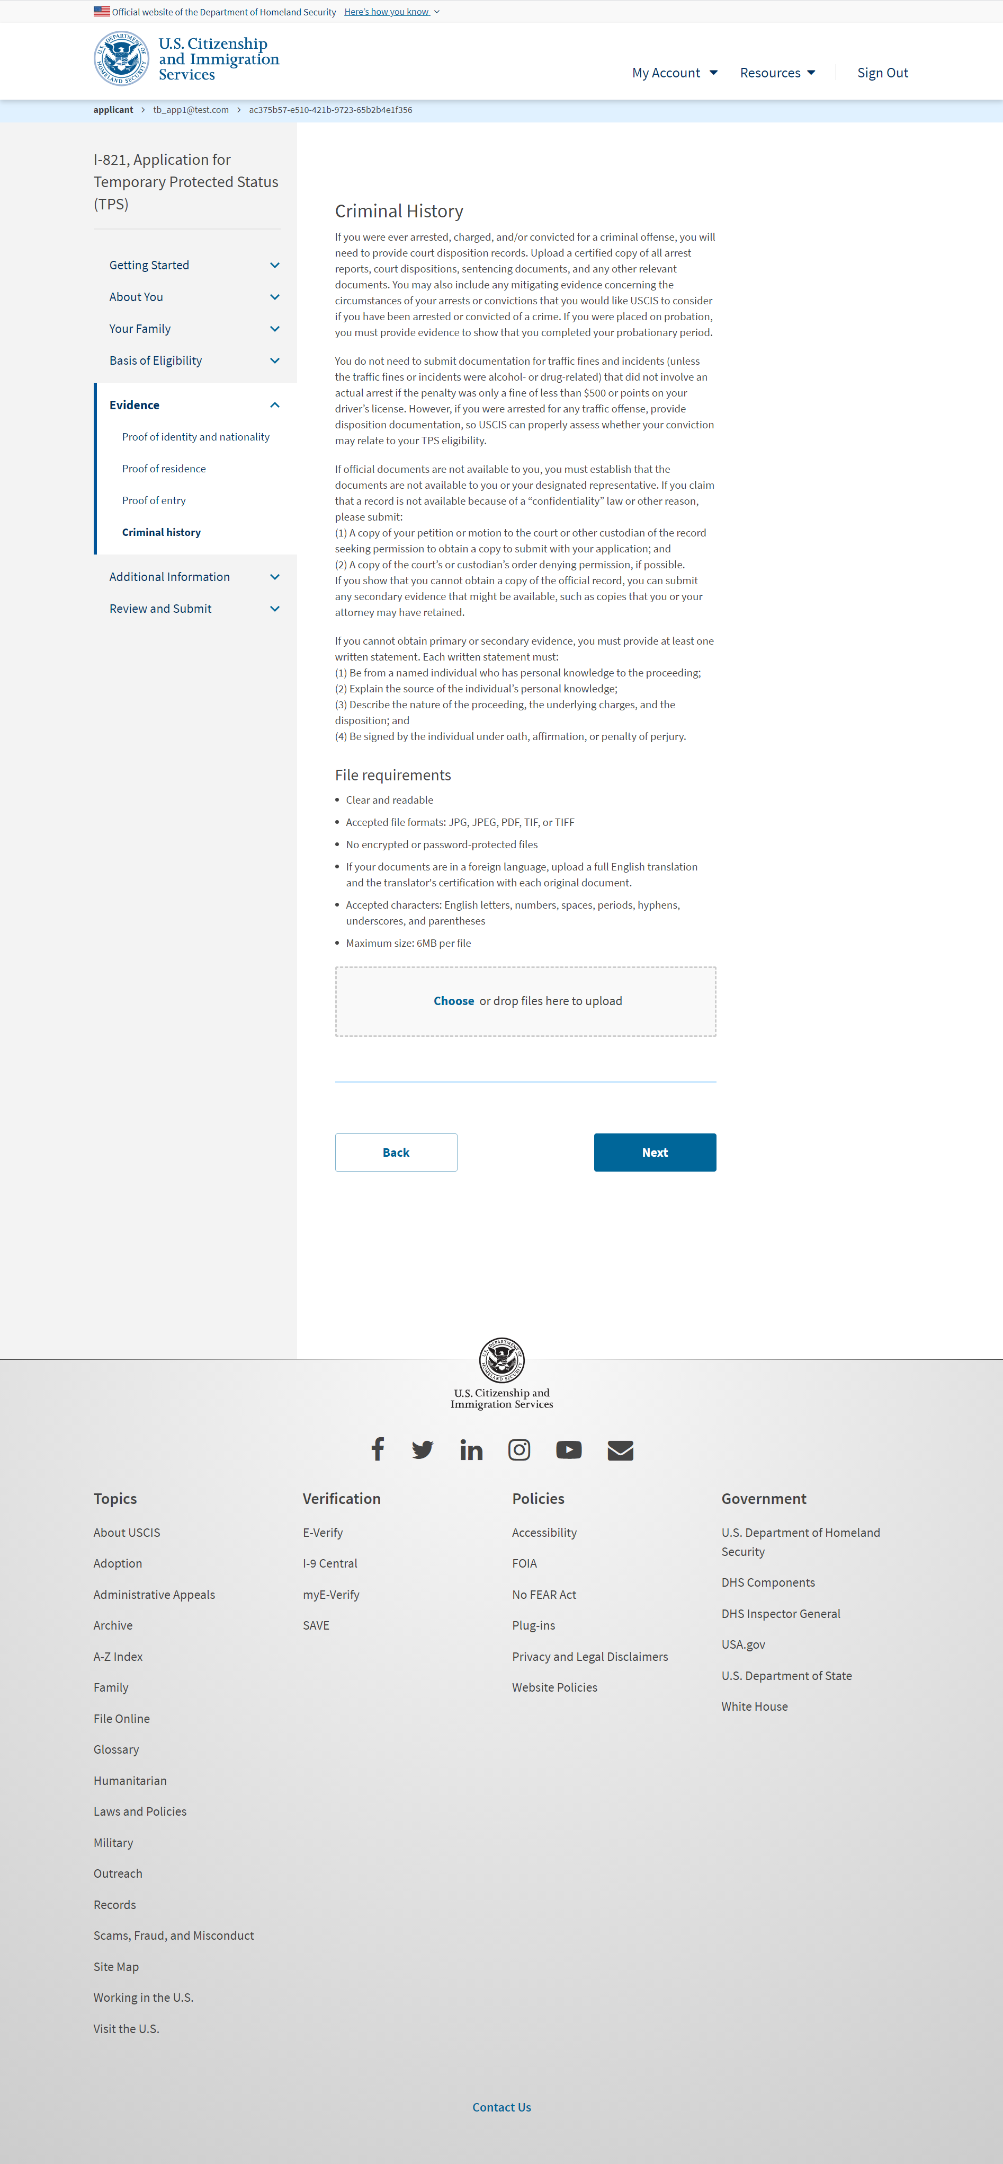
I-821:Evidence – Criminal history

Slide 53
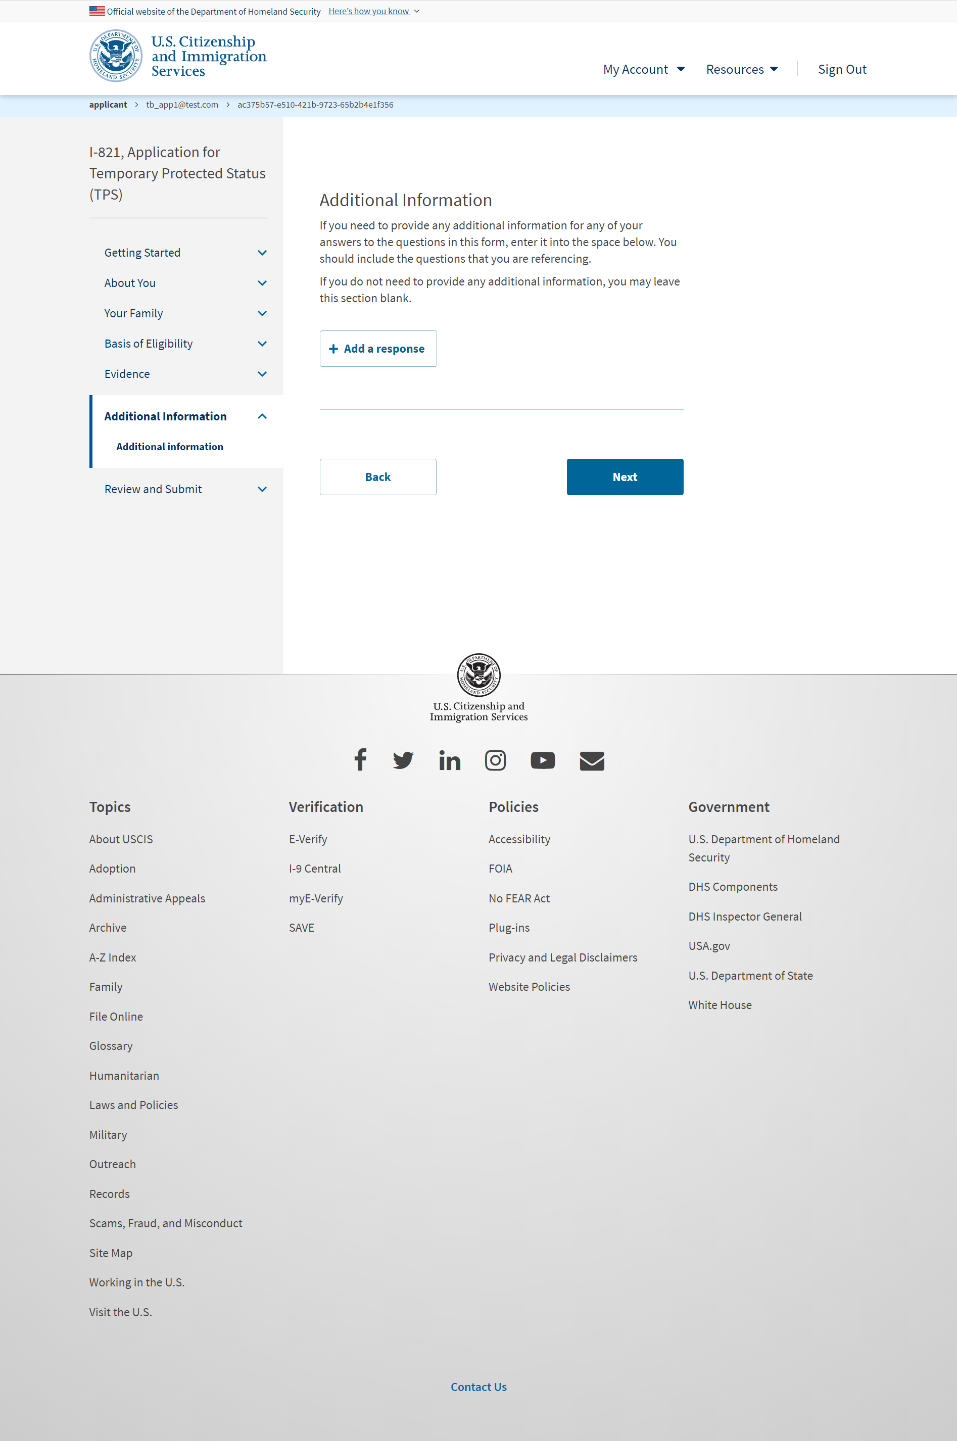
I-821: Additional Information – Additional information

Slide 54
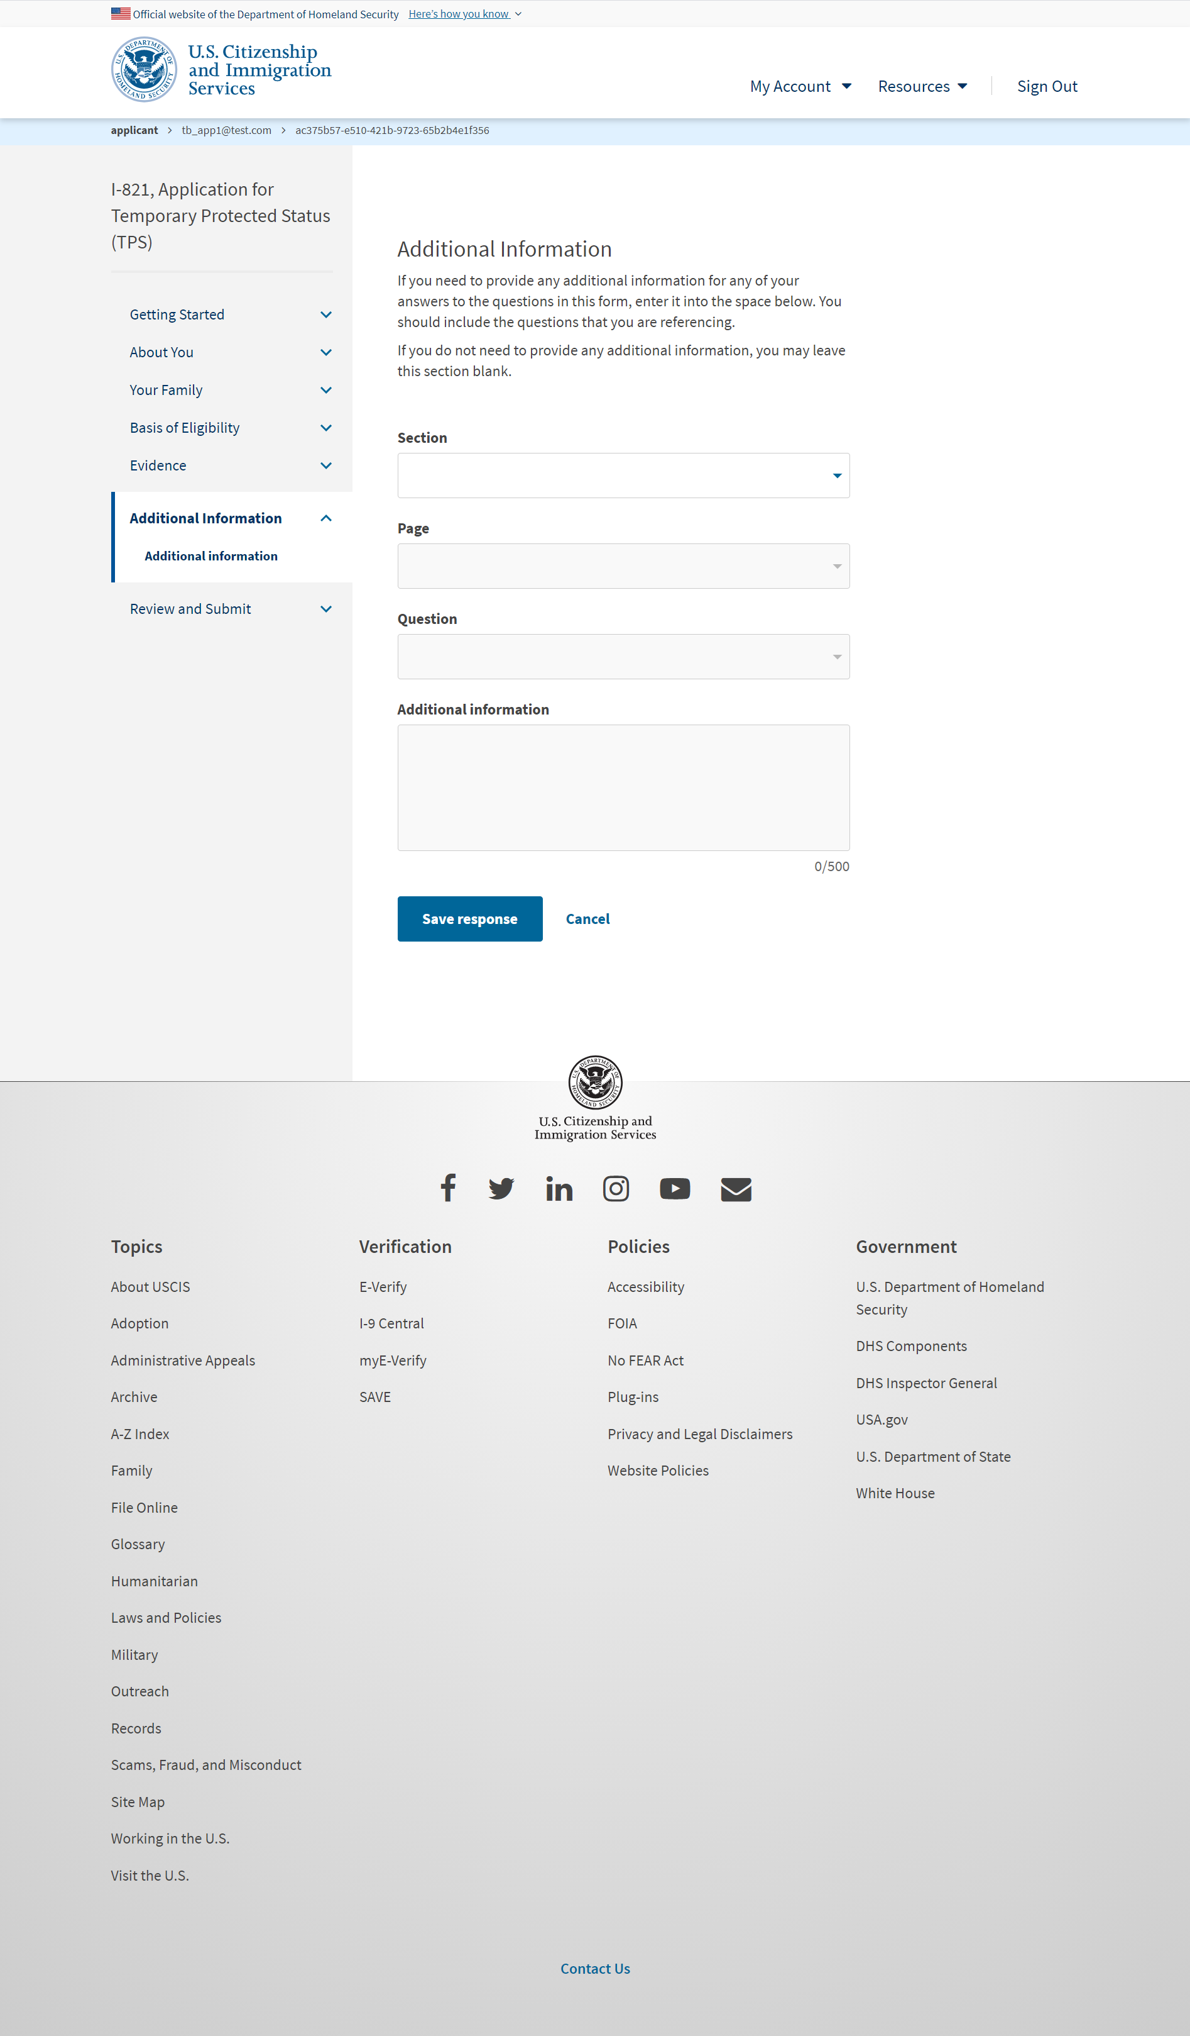
I-821: Additional Information – Additional information (User adds a response)

Slide 55
I-821: Review and Submit – Review your application (with hard stop)

Slide 56
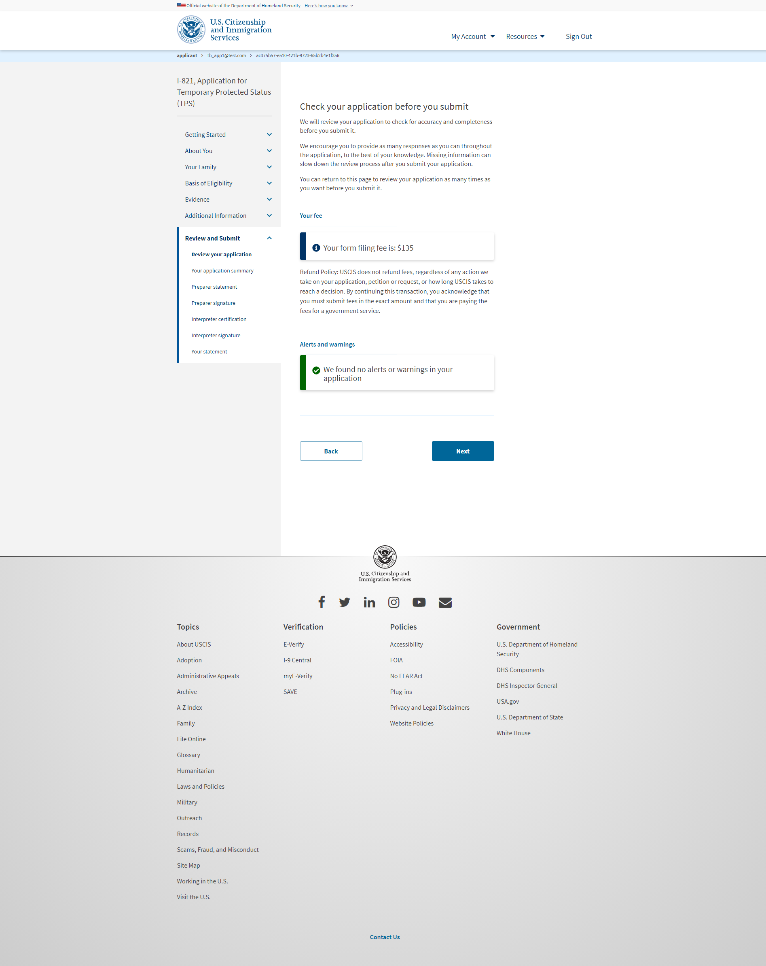
I-821: Review and Submit – Review your application (without errors)

Slide 57
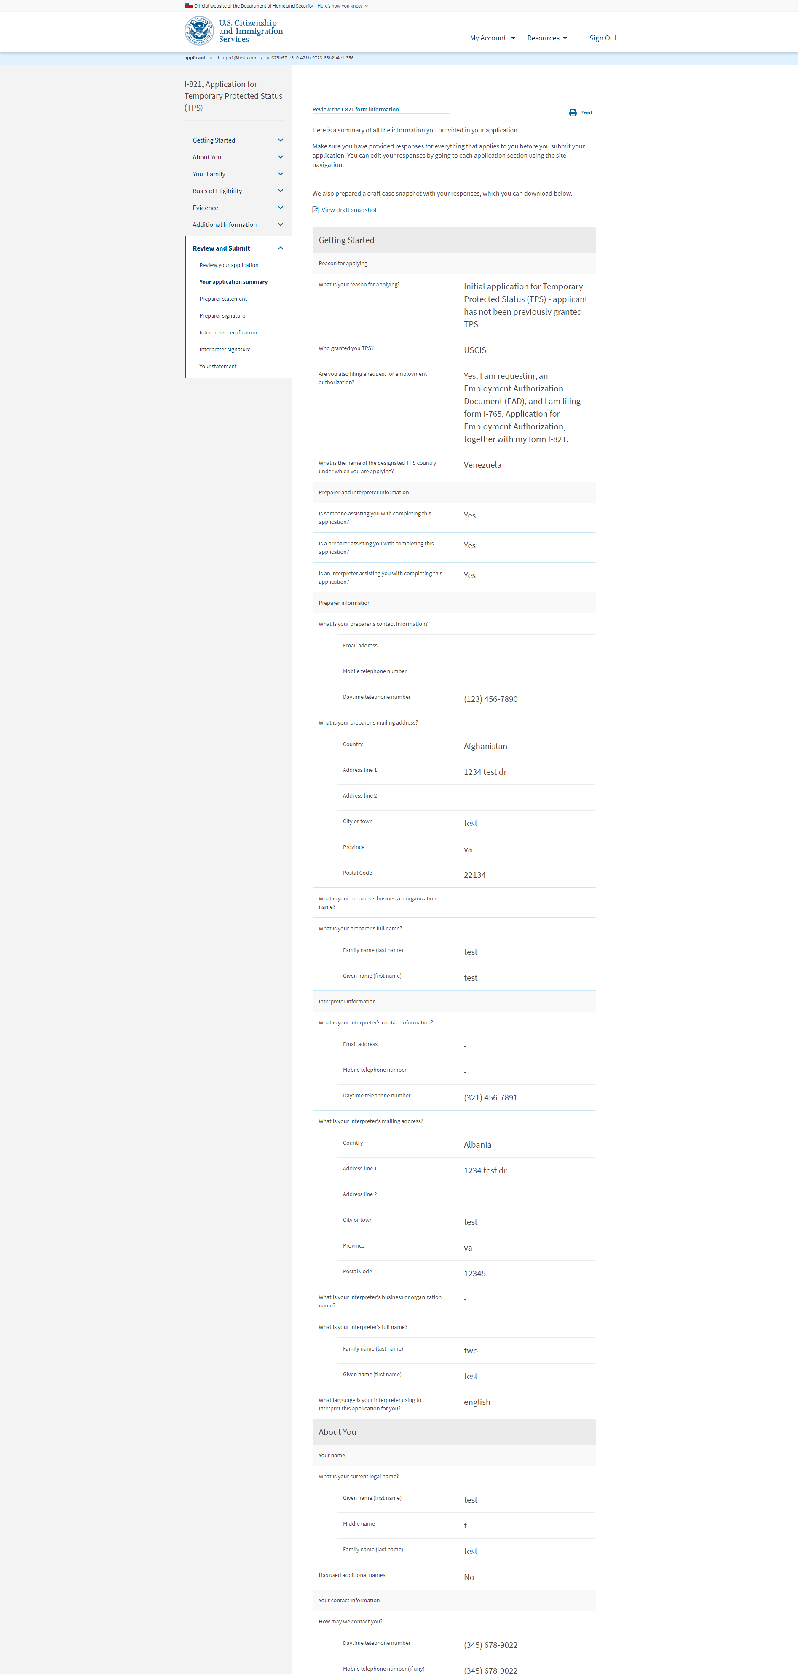
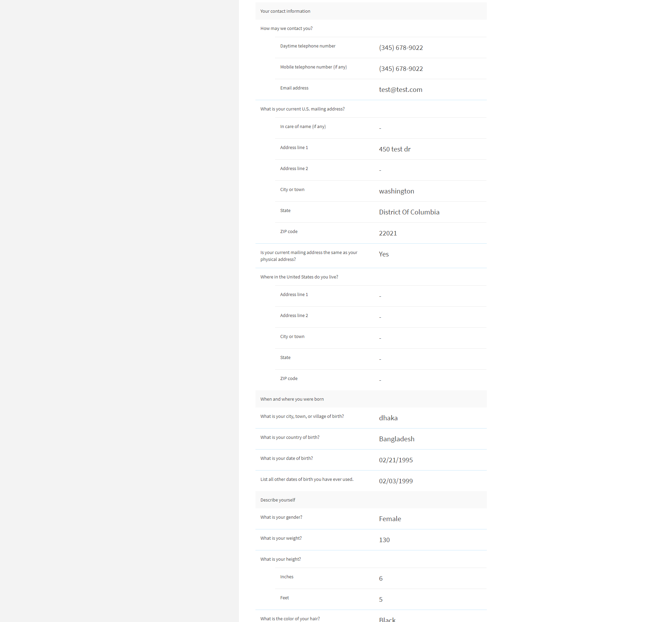
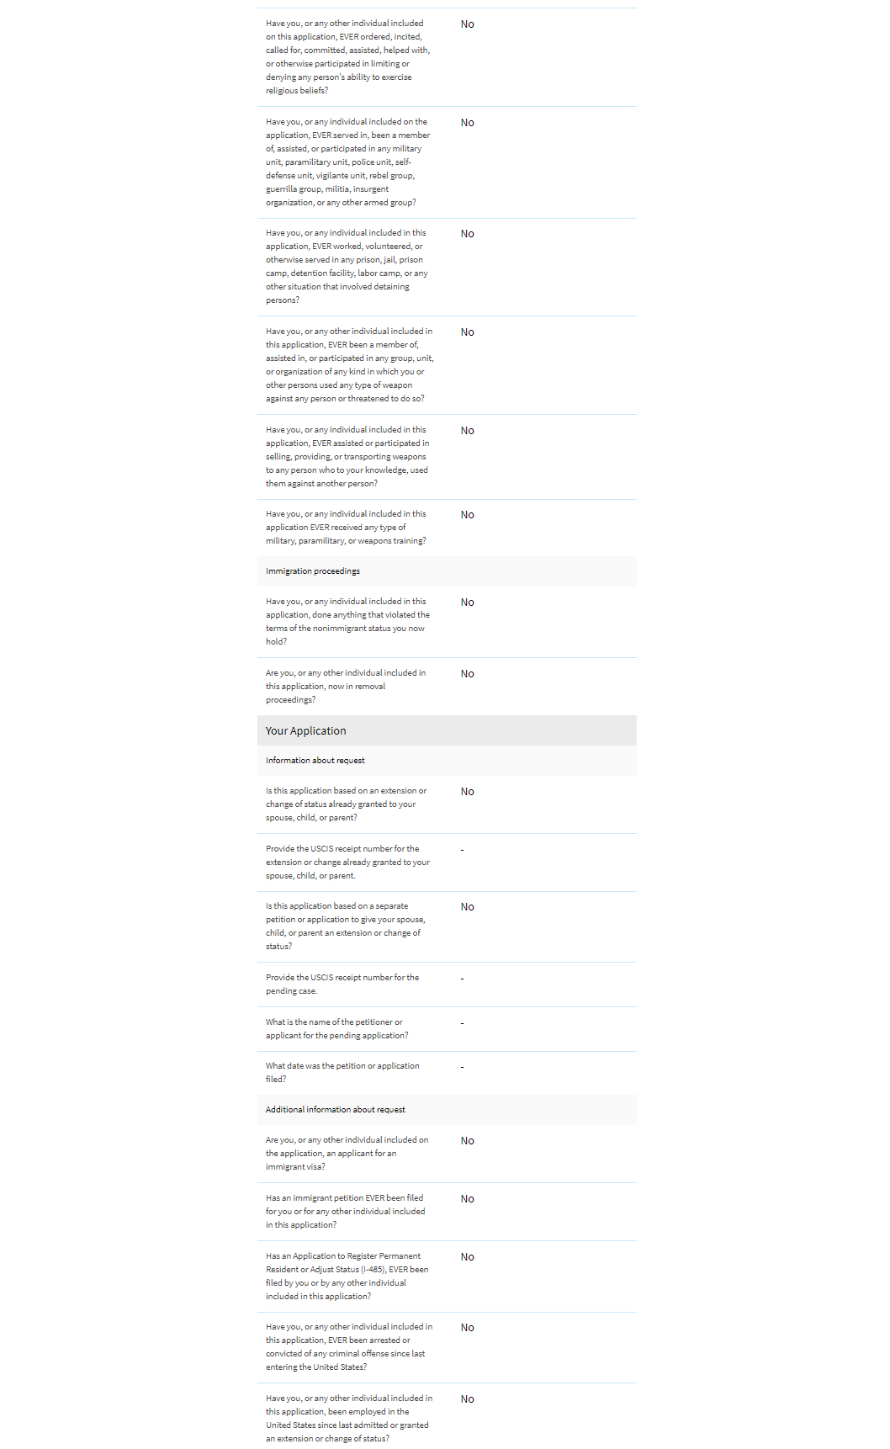
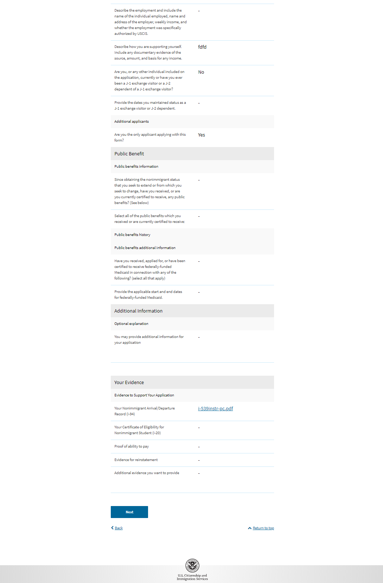
I-821: Review and Submit – Your application summary

Slide 58
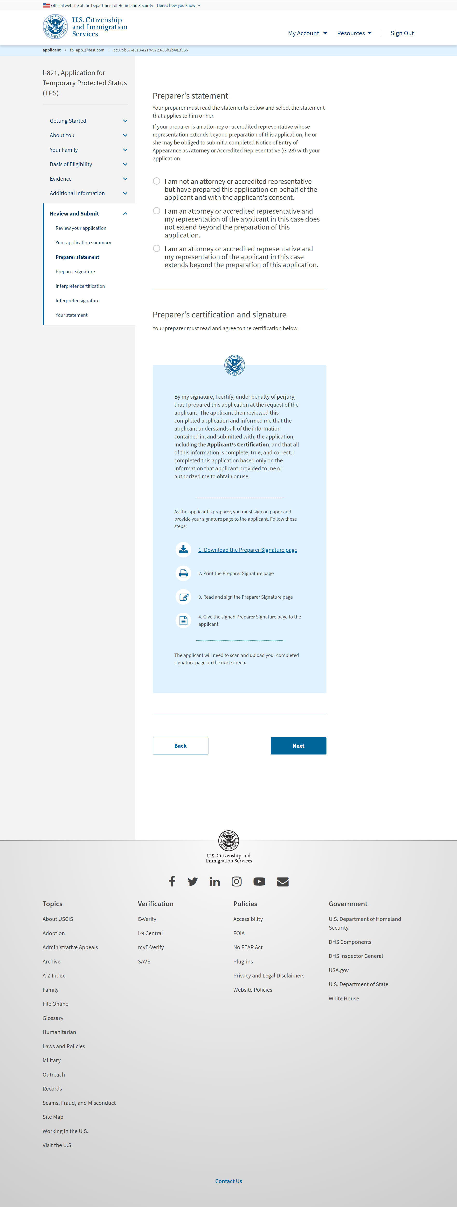
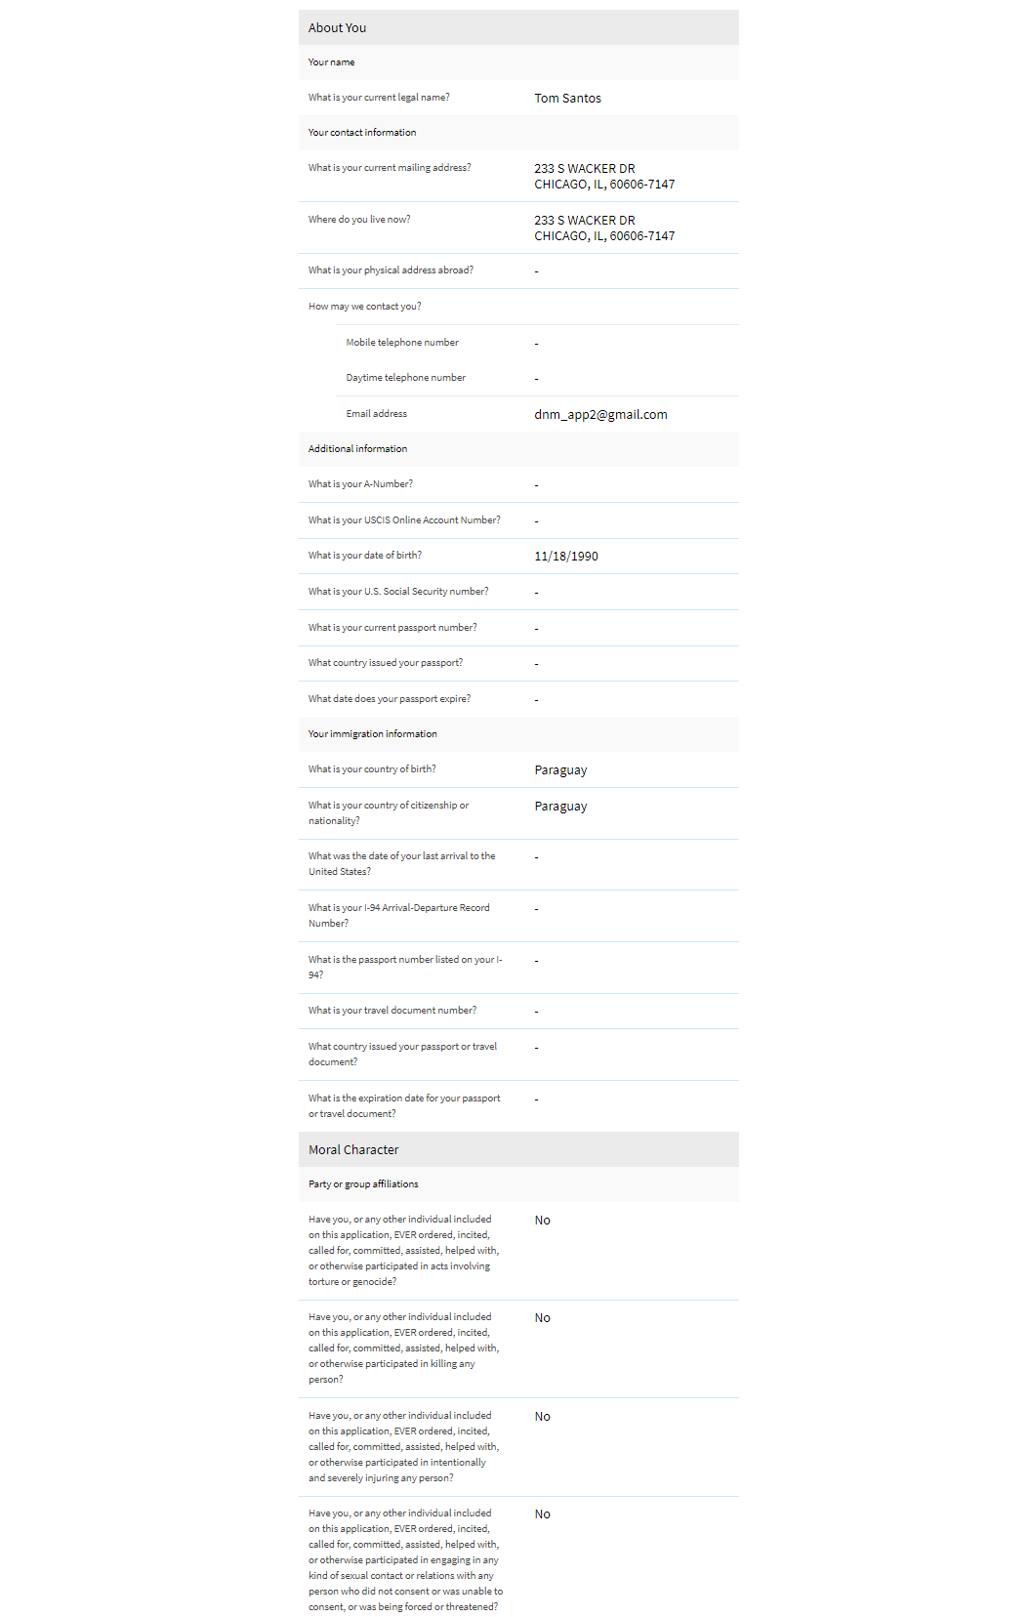
I-821: Review and Submit – Preparer statement

Slide 59
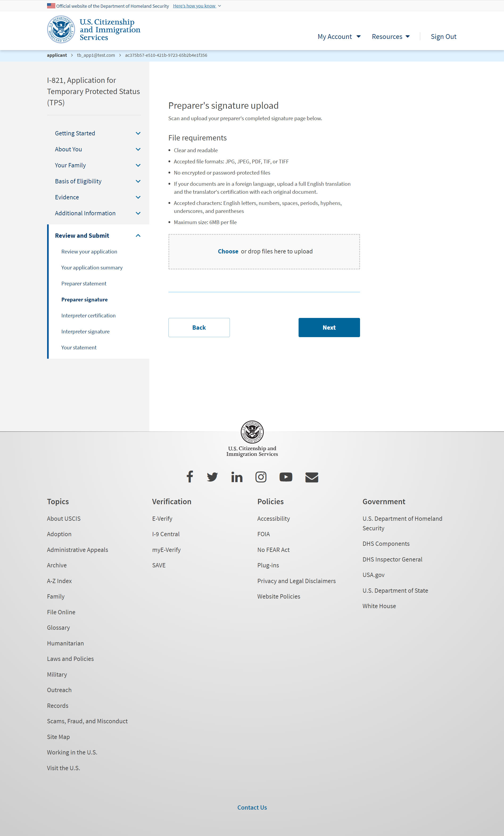
I-821: Review and Submit – Preparer signature

Slide 60
I-821: Review and Submit – Interpreter certification

Slide 61
I-821: Review and Submit – Interpreter signature

Slide 62
I-821: Review and Submit – Your statement

Slide 63
I-821: Review and Submit – Your signature

Slide 64
I-821: Review and Submit – Your signature (User selects the checkbox)

Slide 65
I-821: Review and Submit – Finish the I-821 and continue to the I-765

Slide 66
I-765: Application Overview
(You are submitting an initial Form I-821 or you
Note: You may submit Form I-765 online as an (a) (12) or (c) (19) applicant only if you are:
A national of Burma, Haiti, Syria or Venezuela, or a person without who last habitually resided in one of these four countries;
Filing an initial application for TPS; and
Applying for an initial request to accept employment or renewing permission to accept employment
All other applicants must submit a paper Form I-765.
(c)(3)(A) eligibility category: Submit Form I-765 up to 90 days before being enrolled as an F-1 foreign student for one full academic year at an educational institution approved by U.S. Immigration and Customs Enforcement (ICE) and Student and Exchange Visitor Program (SEVP). Your period of employment will not start before you have completed one full academic year. If you completed the one-year requirement while in another valid nonimmigrant status and you are now in valid F-1 status, you are still eligible to apply for OPT.
(c)(3)(B) eligibility category: Submit Form I-765 up to 90 days before, but no later than 60 days after your program end date. You must submit your application within 30 days of the date that your designated school official (DSO) enters the recommendation for OPT into your Student and Exchange Visitor Information System (SEVIS) record. If you fail to do so, we will deny your OPT request.
(c)(3)(C) eligibility category: Submit Form I-765 application up to 90 days before your current OPT expires, but you must submit within 60 days of the DSO's approval of STEM OPT.
Note: If you are an F-1 student filing for initial or extension of OPT, your OPT and your employment authorization will be automatically terminated if you change educational program levels or transfer to another school. Working in the United States without authorization may result in your removal from the United States or denial of re-entry. Consult your DSO for additional details.
Temporary Protected Status
(a)(12) and (c)(19) eligibility categories: Submit your application with your Form I-821 application or with evidence that we accepted or approved your initial Form I-821. Include evidence of your nationality and identity as required by the Form I-821 Instructions. If an EOIR Immigration Judge (EOIR IJ) or the Board of Immigration Appeals (BIA) granted TPS and you are requesting your first EAD, you must submit a copy of the order that granted TPS with your Form I-765 (such as a copy of your Form I-821 that the EOIR IJ or BIA approved). You must also follow the instructions for filing your application as described in the most recent TPS Federal Register notice regarding a TPS designation, re-designation, or extension for your country.
Note: You may submit this form with Form I-821 online if you are applying under the (a)(12) eligibility category and applying for an initial request to accept employment.
Fee: $410. If you are requesting an EAD as an initial TPS applicant, you must pay the Form I-765 filing fee, unless you are younger than 14 or older than 65.
Note: If you are submitting this form with Form I-821, your total application fee will reflect the fees for Form I-821, Form I-765, and Biometric Services (if required). You will pay for all three at the end of this form.
Refund policy:
USCIS does not refund fees, regardless of any action we take on your application, petition or request, or how long USCIS takes to reach a decision. By continuing this transaction, you acknowledge that you must submit fees in the exact amount and that you are paying the fees for a government service.
Please refer to the instructions for the form(s) you are filing for additional information, or you may call the USCIS Contact Center at 800-375-5283. For TTY (deaf or hard of hearing) 800-767-1833.
USCIS may require that you appear for an interview or provide biometrics (fingerprints, photograph, and/or signature) at any time to verify your identity, obtain additional information, and conduct background and security checks, including a check of criminal history records maintained by the Federal Bureau of Investigation (FBI), before making a decision on your application or petition. After USCIS receives your application and ensures it is complete, we will inform you in writing if you need to attend a biometric services appointment. If an
appointment is necessary, the notice will provide you the location of your local or designated USCIS Application Support Center (ASC) and the date and time of your appointment.
The decision on Form I-765 involves a determination of whether you have established eligibility for the immigration benefit you are seeking. USCIS will notify you of the decision in writing. If your application is approved, we will either mail your EAD to you or we may require you to visit your local USCIS office to pick it up. If USCIS cannot approve your application, you will receive a written notice explaining the basis of your denial.

Slide 67
I-765: Start Application
AUTHORITIES: The information requested on this application, and the associated evidence, is collected under the Immigration and Nationality Act, 8 U.S.C. section 1324a, 8 CFR 274a.12, and 8 CFR 274a.13.

Slide 68
User Completes I-765

Slide 69
I-765: Getting Started – Basis of eligibility

Slide 70
I-765: Getting Started – Reason for applying

Slide 71
I-765 : Getting Started

Slide 72
I-765 : Getting Started

Slide 73
I-765 : Getting Started

Slide 74
I-765 : Getting Started

Slide 75
I-765 : About You

Slide 76
I-765 : About You

Slide 77
I-765 : About You

Slide 78
I-765 : About You

Slide 79
I-765 : About You

Slide 80
I-765 : About You

Slide 81
I-765 : About You

Slide 82
I-765: Evidence – 2 x 2 photo of you

Slide 83
I-765: Evidence – Form I-94

Slide 84
I-765: Evidence – Employment Authorization Document

Slide 85
I-765: Evidence – Proof of identity and nationality

Slide 86
I-765: Review and Submit – Review your application (with hard stop)

Slide 87
I-765: Review and Submit – Review your application (without errors)

Slide 88
I-765: Review and Submit – Your application summary

Slide 89
I-765: Review and Submit – Your statement

Slide 90
I-765: Review and Submit – Your signature

Slide 91
I-765: Review and Submit – Pay and submit

Slide 92
Pay.gov flow (outside myUSCIS UI)

Slide 93
Concurrent Filing: Confirmation – Payment successful

Slide 94
Concurrent Filing: Confirmation – Payment unsuccessful
You did not submit your Application for Temporary Status (I-821) or Application for Employment Authorization (I-765)

