Slide 1
Pesticide Submission Portal (PSP)
Foreign Purchaser Acknowledgement Statements (FPAS) Mock-Ups
June 1, 2021

Slide 2
Interim Changes to Existing PSP Application

Slide 3
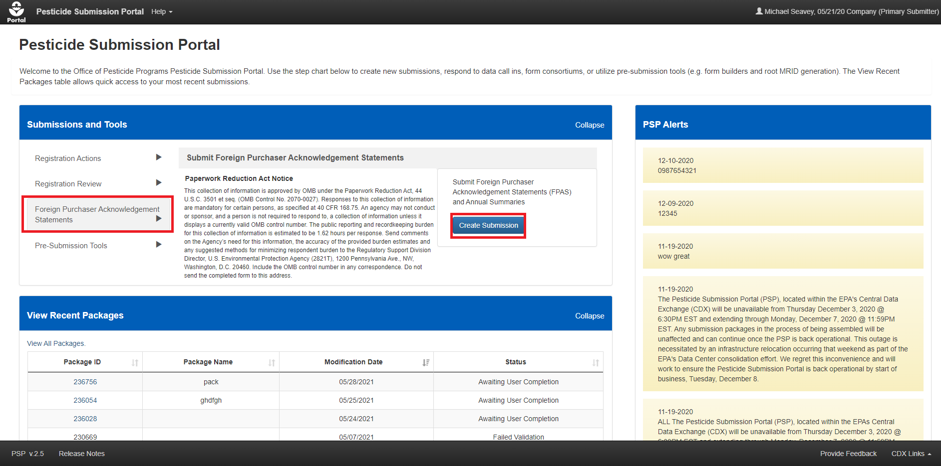
Update PSP Portal ‘Home’ Screen
Notes:
Implement new path to create FPAS submissions.

Slide 4
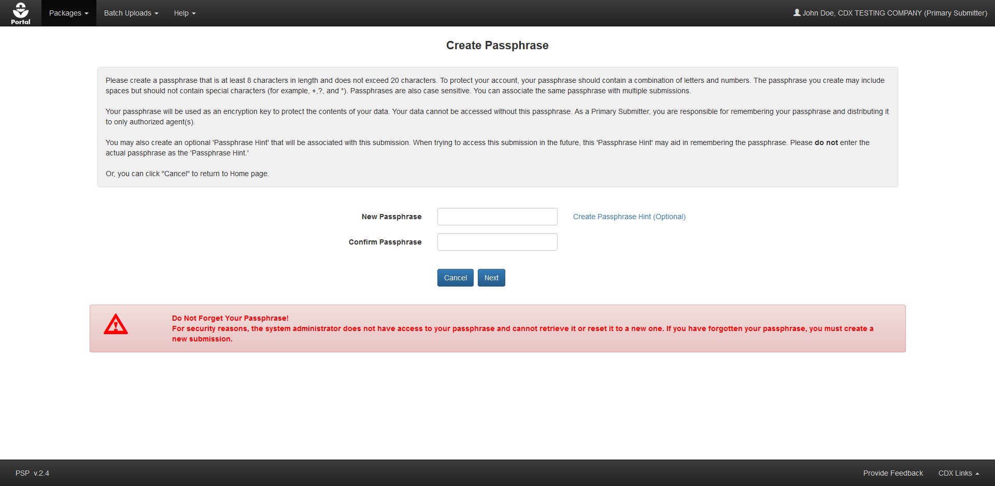
Create Passphrase Screen
Notes:
User creates a submission passphrase which provides access control to the submission and is used as an encryption key for CBI data.

Slide 5
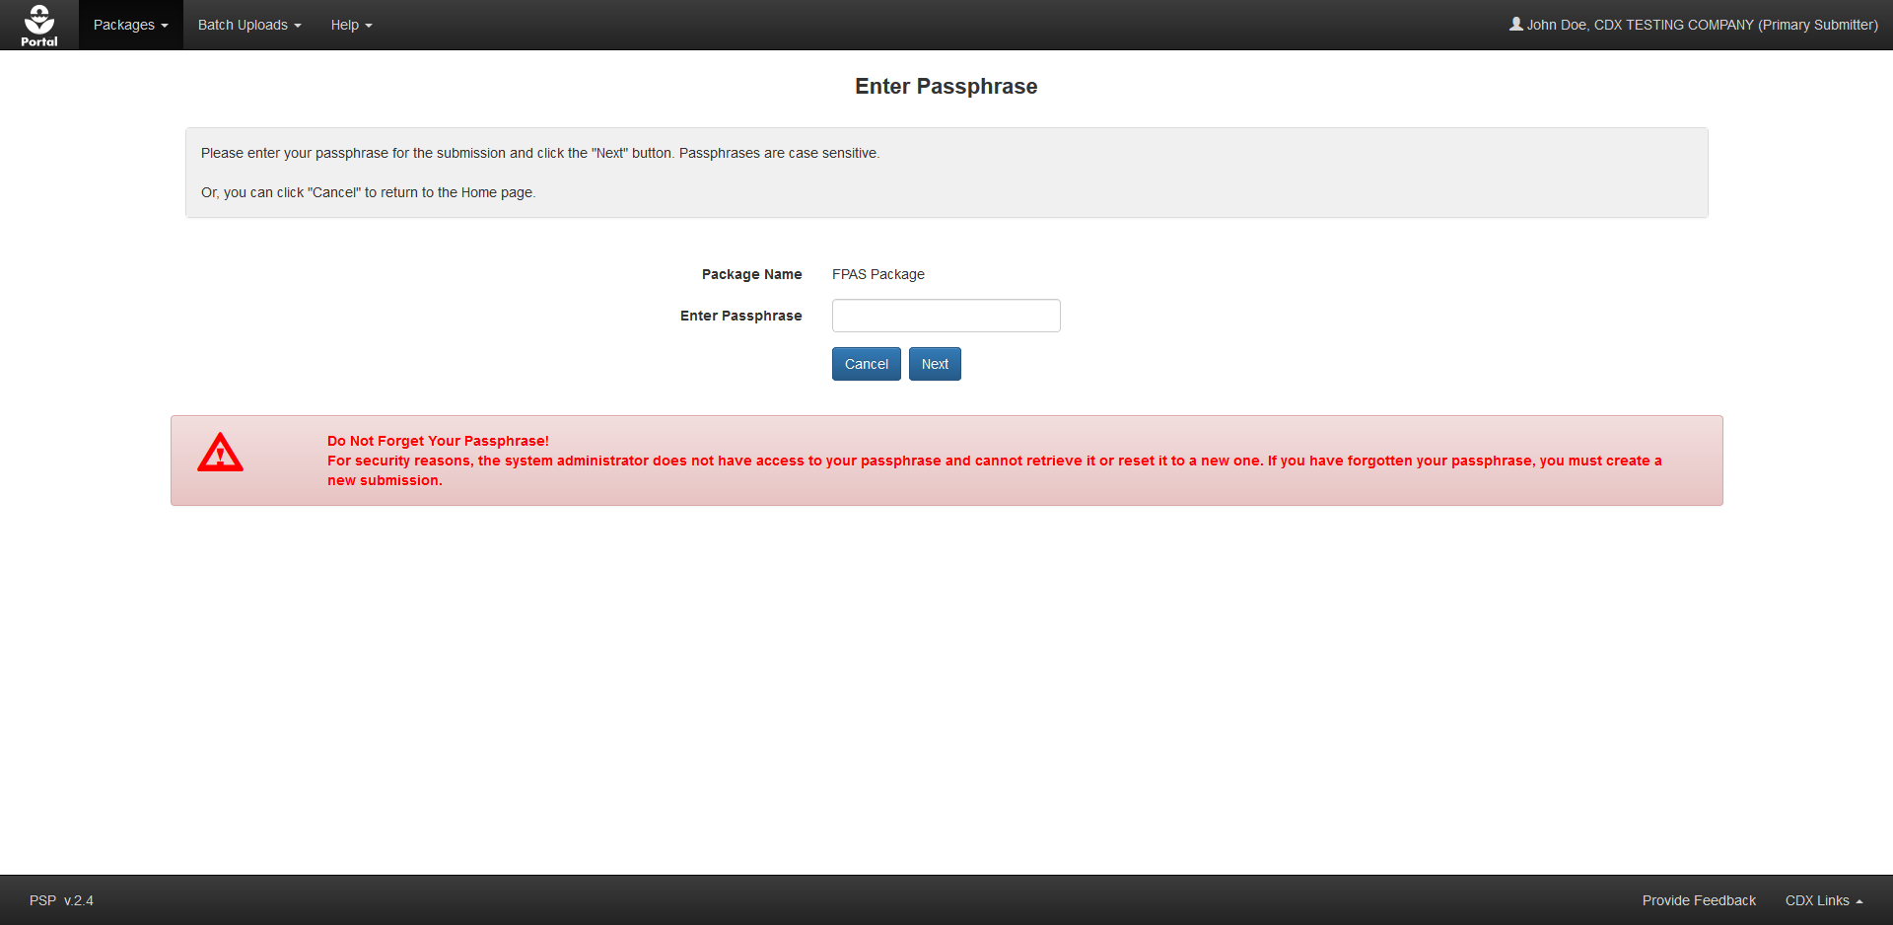
Enter Passphrase Screen
Notes:
When accessing a previously created submission, the user must enter the passphrase that was set during form creation.

Slide 6
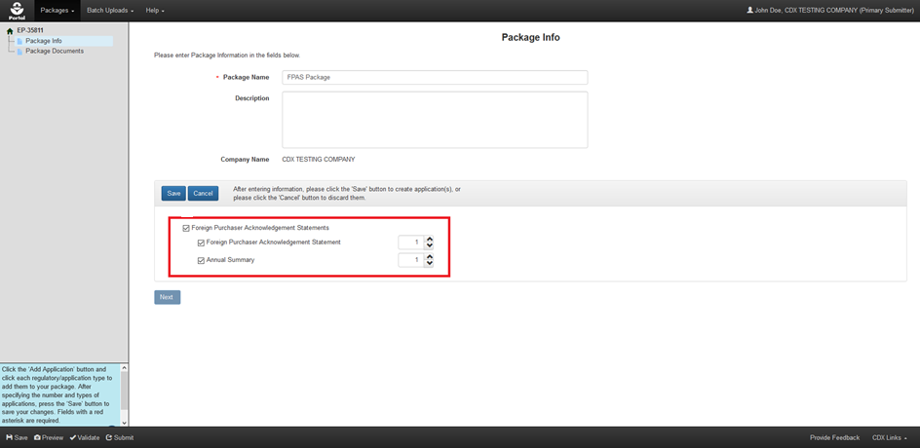
Package Information Screen
Notes:
The ‘Package Information’ screen is the first screen within a package and allows a user to add applications to the package submission. In this case, the screen is updated to allow only ‘Foreign Purchaser Acknowledgement Statement’ and ‘Annual Summary’ applications based on the choice from the Portal.

Slide 7
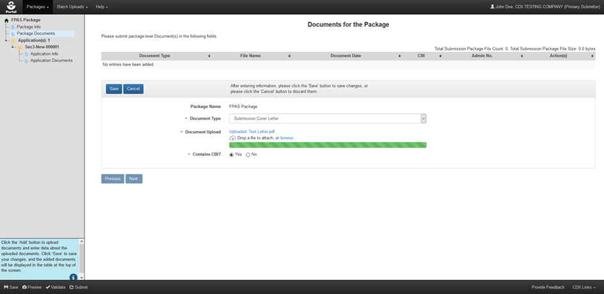
Package Documents Screen
Notes:
The ‘Package Documents’ screen allows a user to upload files that apply to all applications within a package submission. In this case, the screen shows the upload of a ‘Submission Cover Letter’ applicable to the PFAS application in the package.
No package level documents will be required.

Slide 8
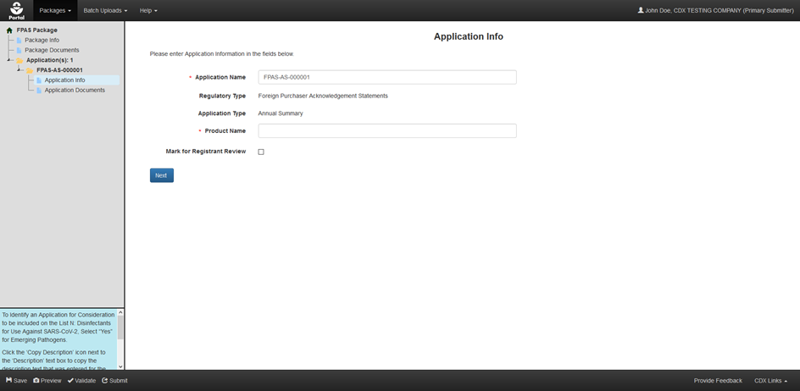
Application Information Screen
Notes:
The ‘Application Information’ screen can be customized to capture necessary data for a per-shipment PFAS and Annual Summary applications.

Slide 9
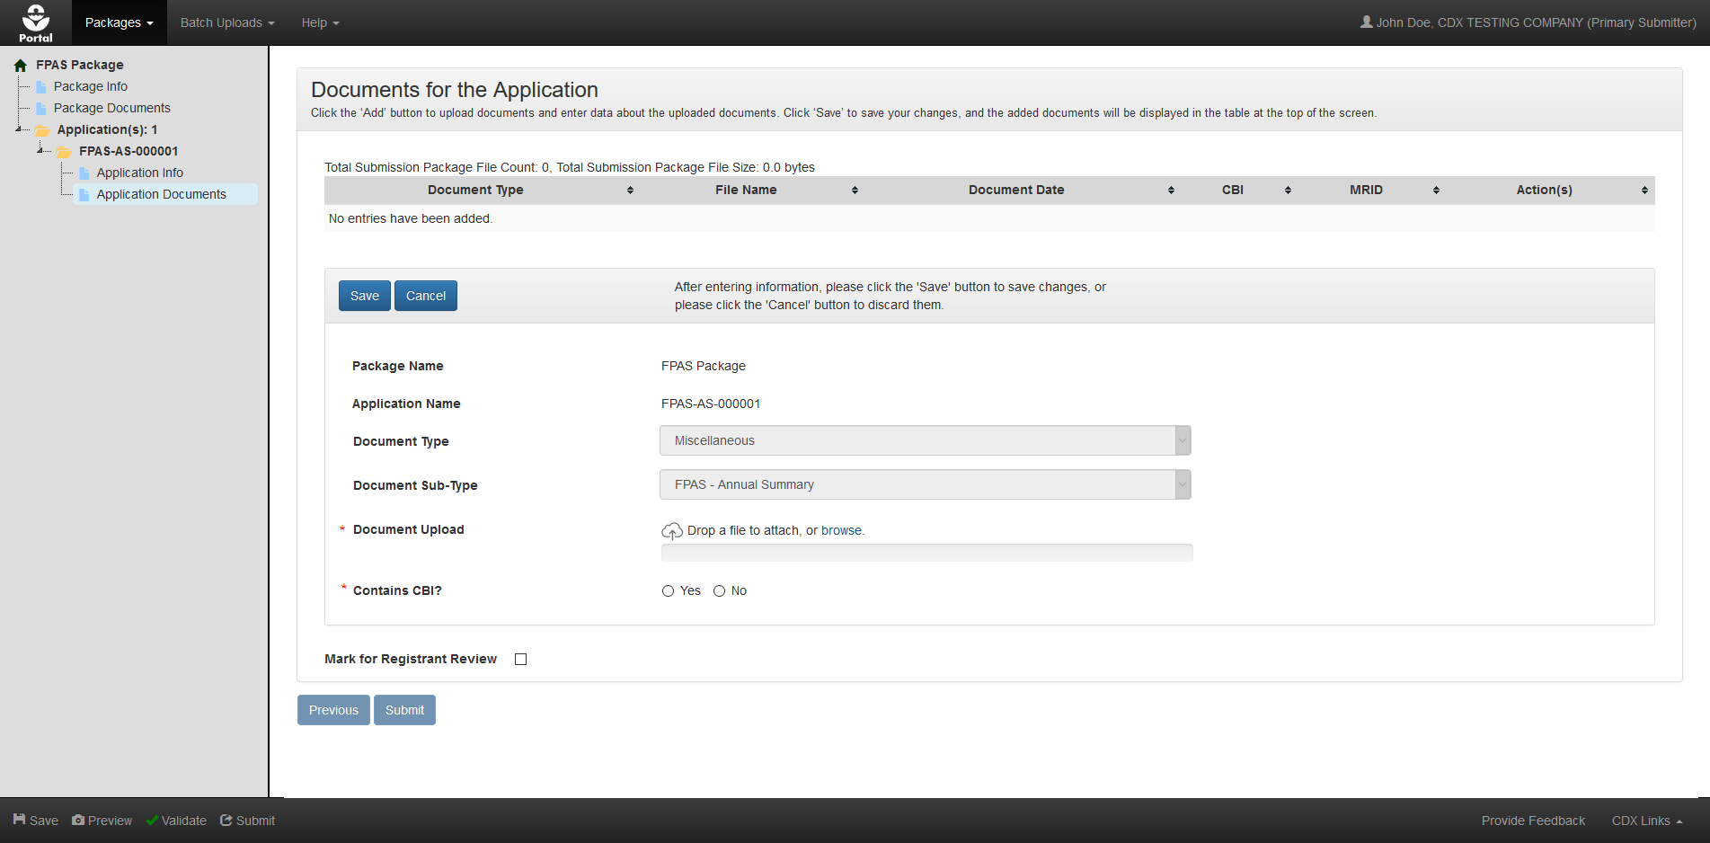
Application Documents Screen
Notes:
The ‘Application Documents’ screen is where the user would upload the per-shipment PFAS or Annual Summary documents based on the application type. The file type values are pre-selected and fixed based on the application type.

Slide 10
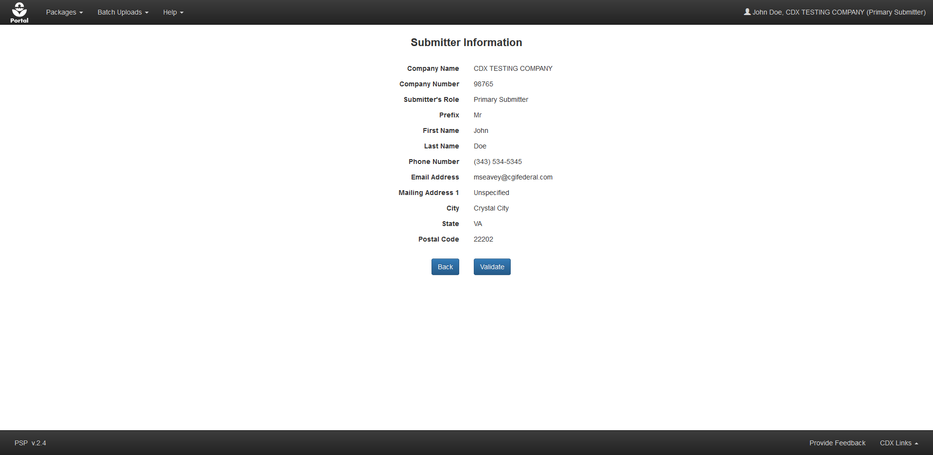
Submitter Information Screen
Notes:
Submitter information displayed for confirmation purposes.

Slide 11
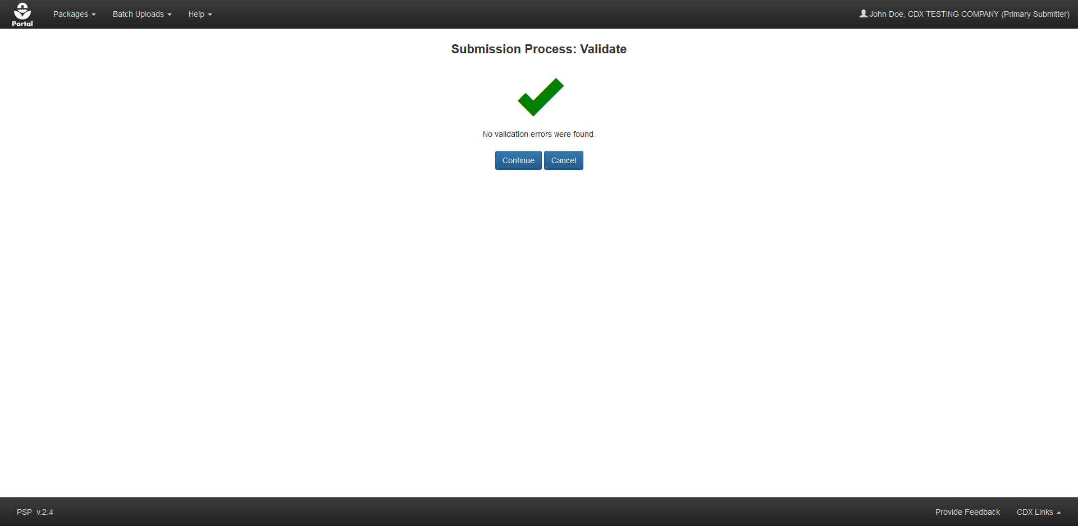
Submission Validation Screen
Notes:
Upon initiating the submission process, global validation of the submission is run to confirm completeness. If validation fails the user is provided a list of errors to rectify. If validation passes, the user may continue to the submission process.

Slide 12
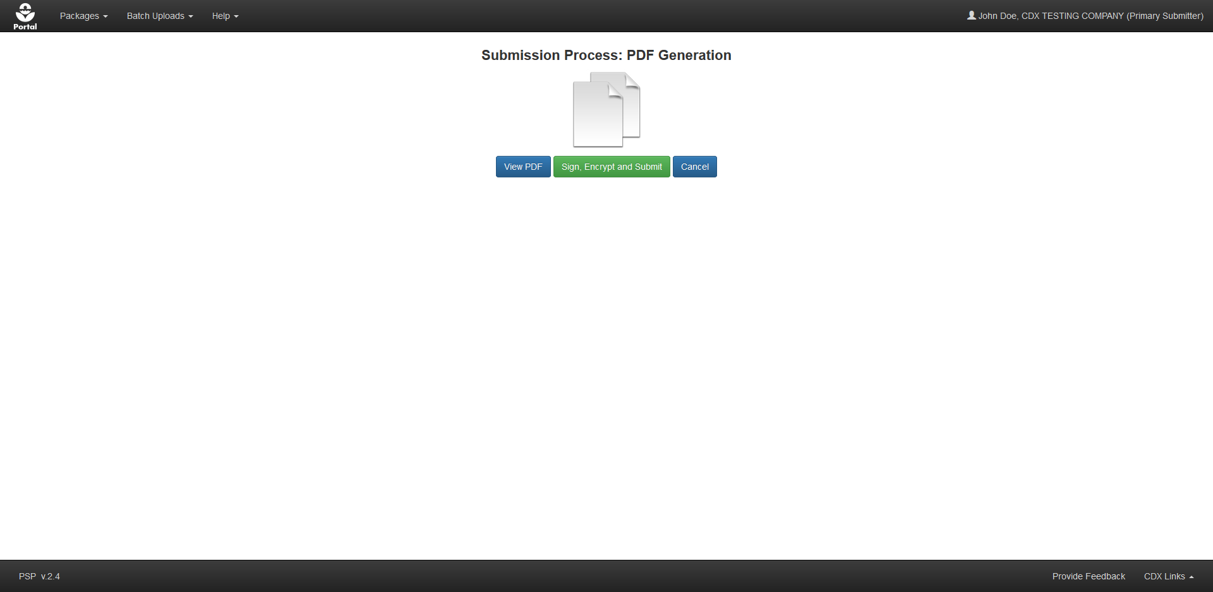
PDF Preview and CROMERR Submission
Notes:
After validation, users are able to view/download a PDF rendering of submission data and initiate the CROMERR signature process.

Slide 13
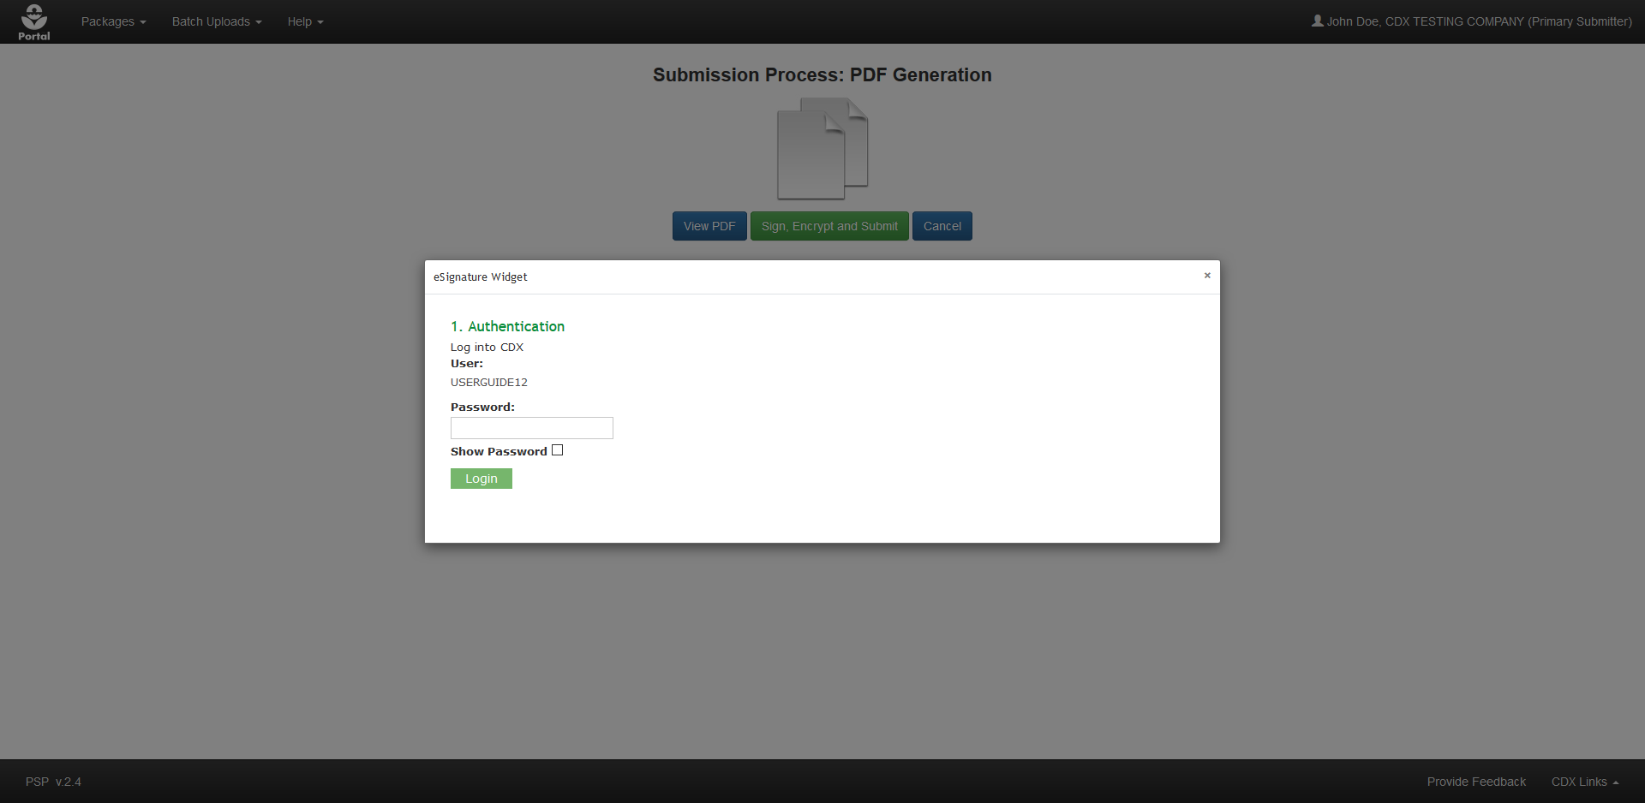
CROMERR eSignature Widget
Notes:
The CROMERR eSignature Widget is used to facilitate electronic signature and transmission of the submission.

Slide 14
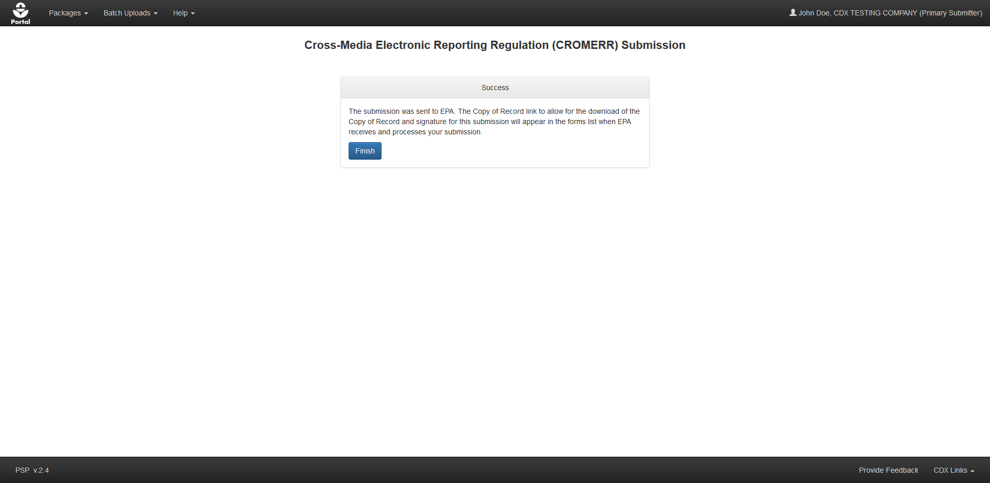
Submission Completed Screen
Notes:
A screen displays confirming that the submission process successfully completed.

