Slide 1
PSB-CY System
Incident Intake -
Updated with drop-down screen information
IMPORTANT: ALL DATA SHOWN IN THIS PRESENTATION IS FOR DEMONSTRATION PURPOSES. NO REAL DATA (PII) FROM ANY PERSON HAS BEEN USED.
17 September 2021

Slide 2
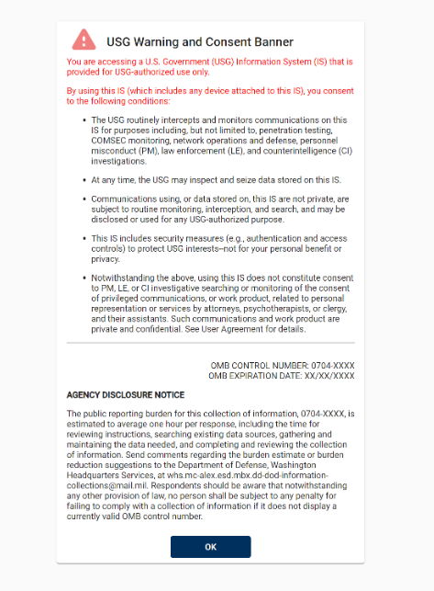
ADN to the Warning page – screenshot

Slide 3
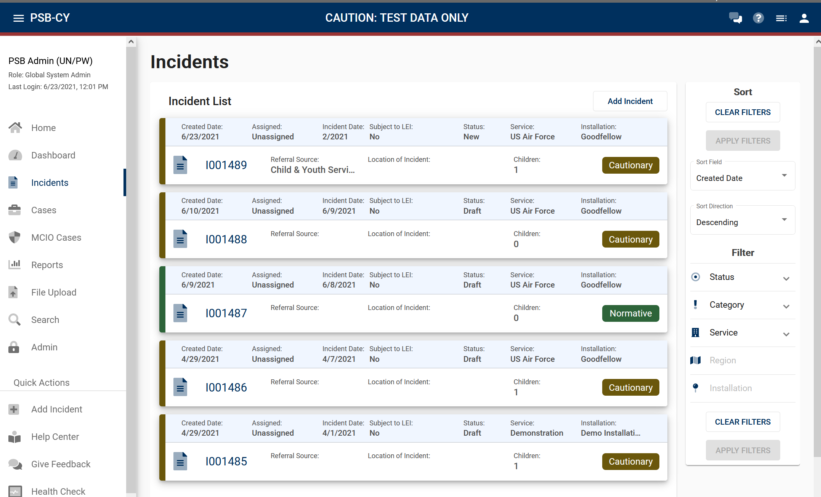
Add Incident
Incident Number
Incident Number
Incident Number
Incident Number
Incident Number

Slide 4
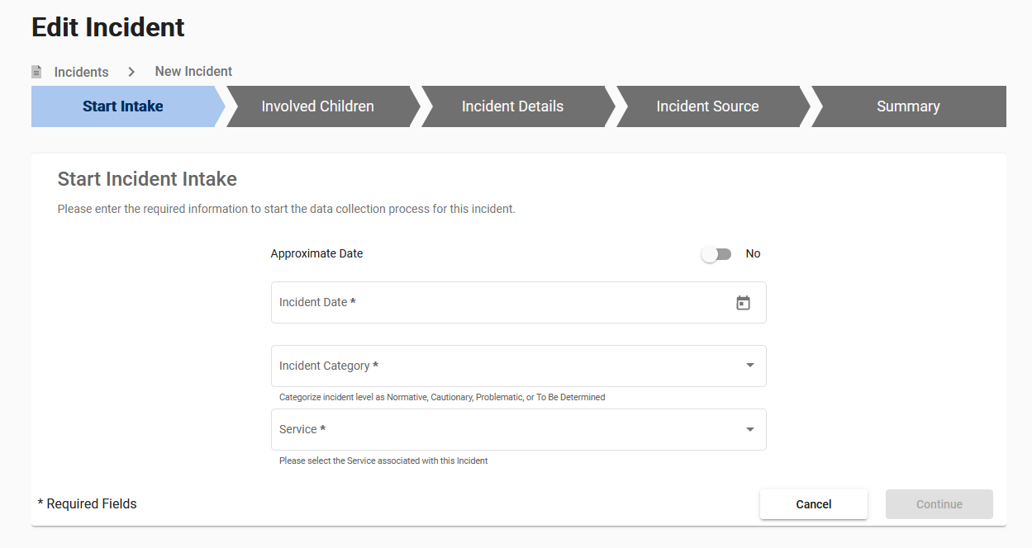
Start Intake

Slide 5
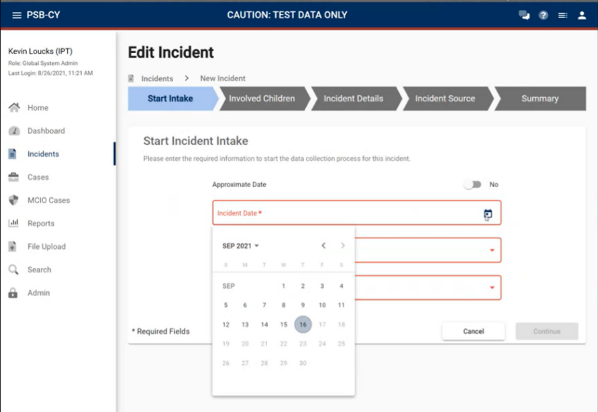
Start Intake
NOTE:
All Date fields throughout the PSB-CY System use the same format.

Slide 6
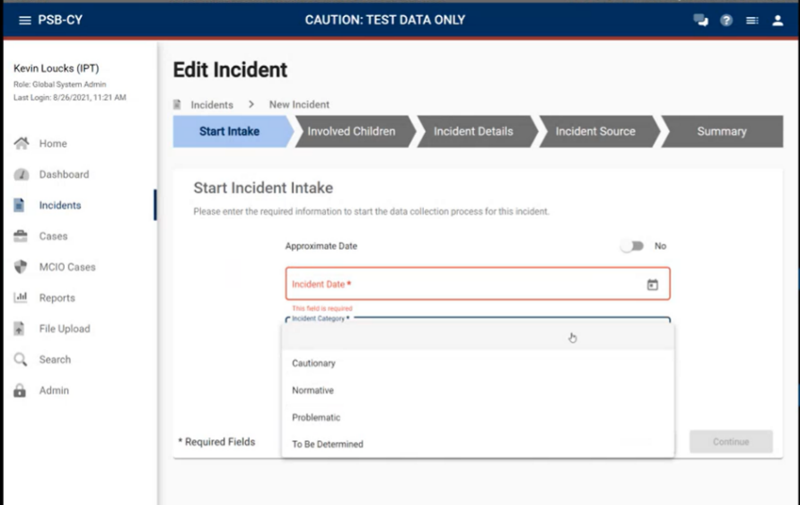
Start Intake

Slide 7
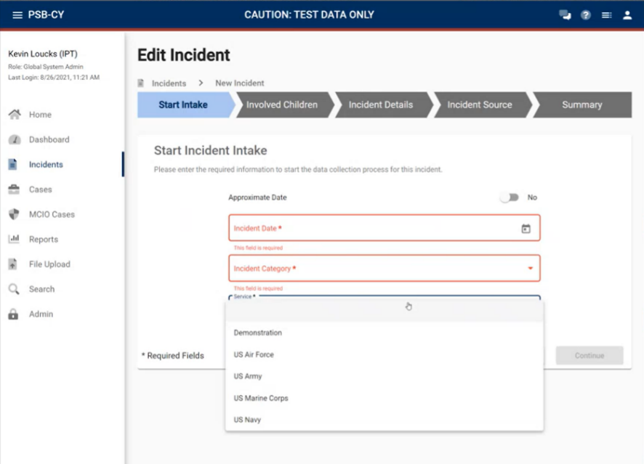
Start Intake

Slide 8
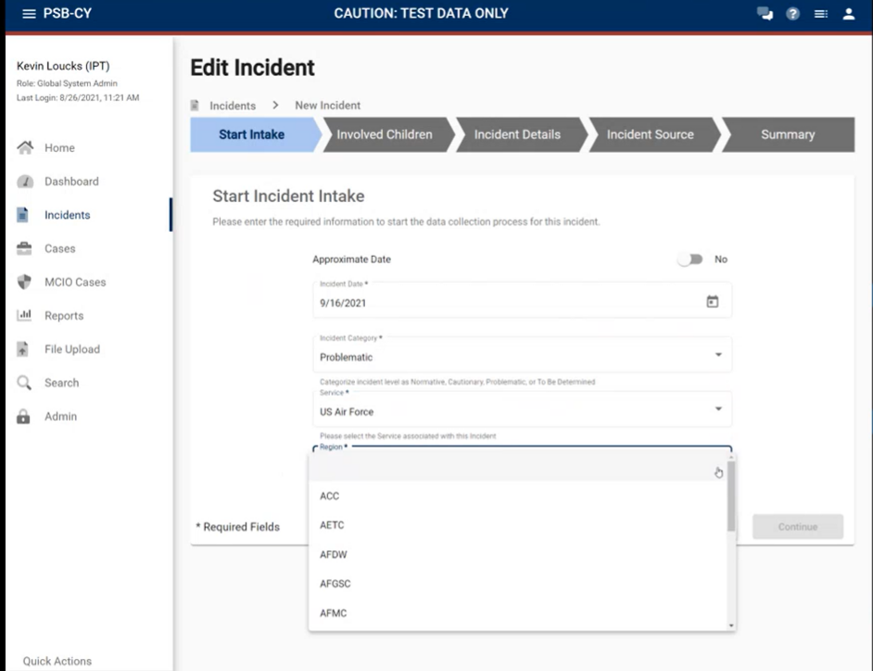
Start Intake

Slide 9
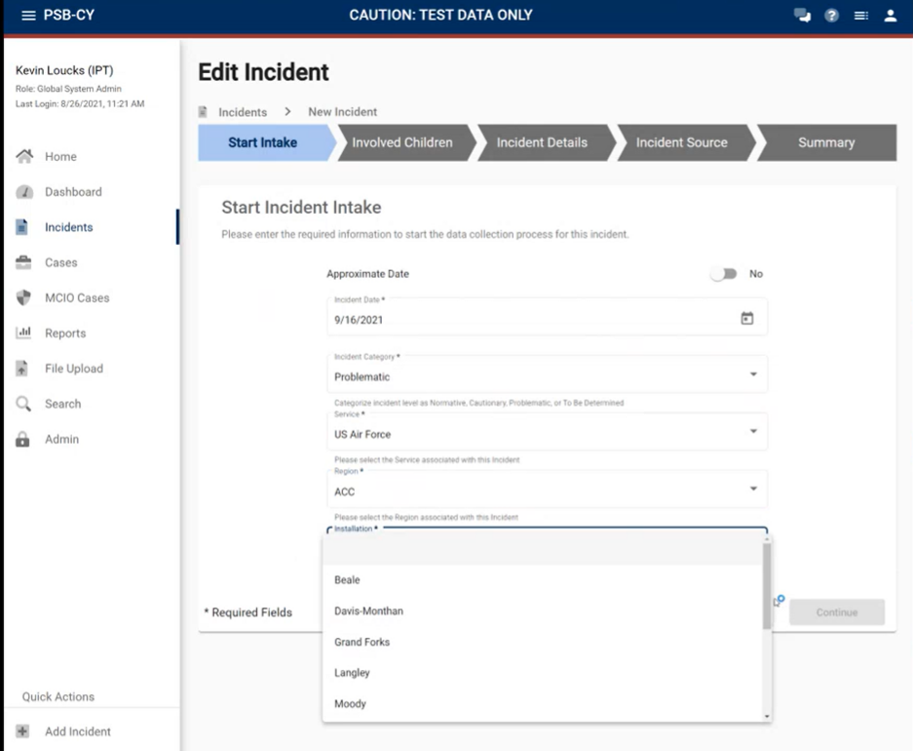
Start Intake

Slide 10
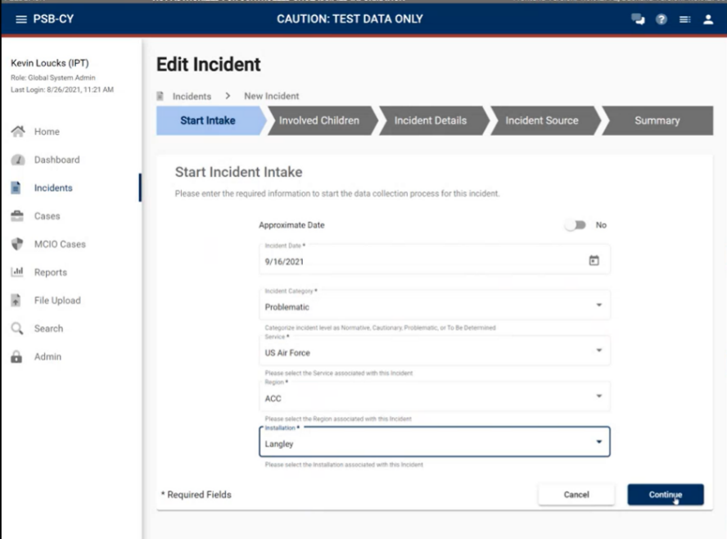
Start Intake

Slide 11
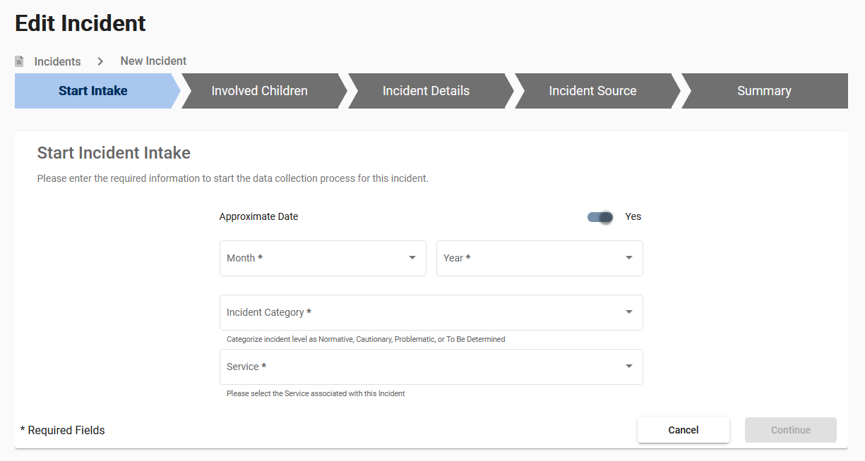
Start Intake

Slide 12
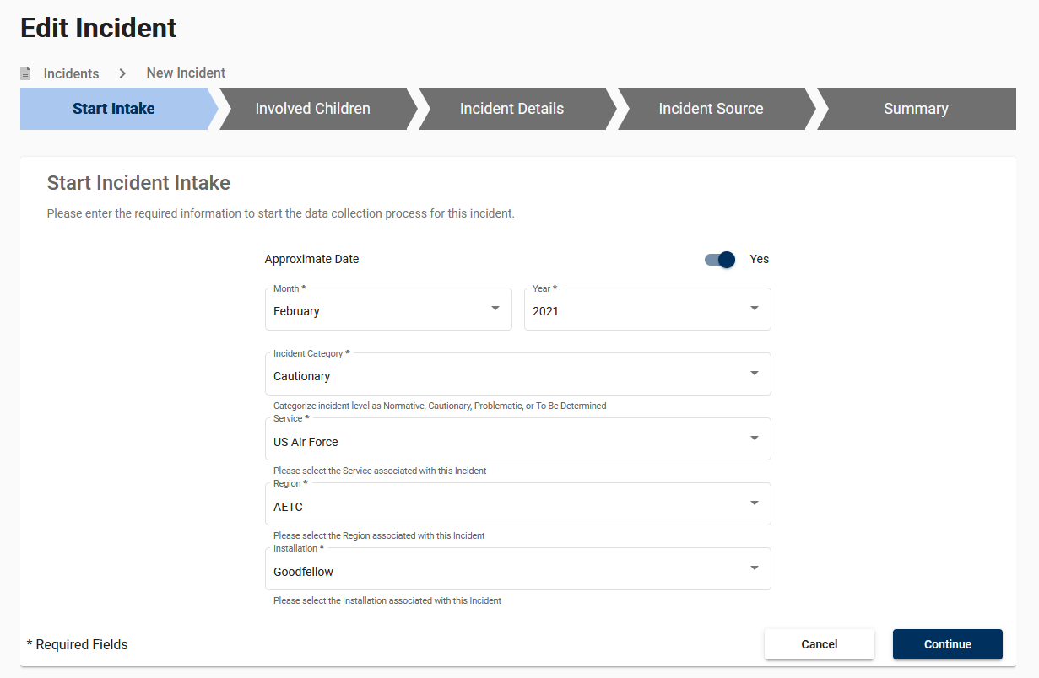
Start Intake
NOTE:
All Date fields throughout the PSB-CY System use the same format. Please see slide 4.

Slide 13
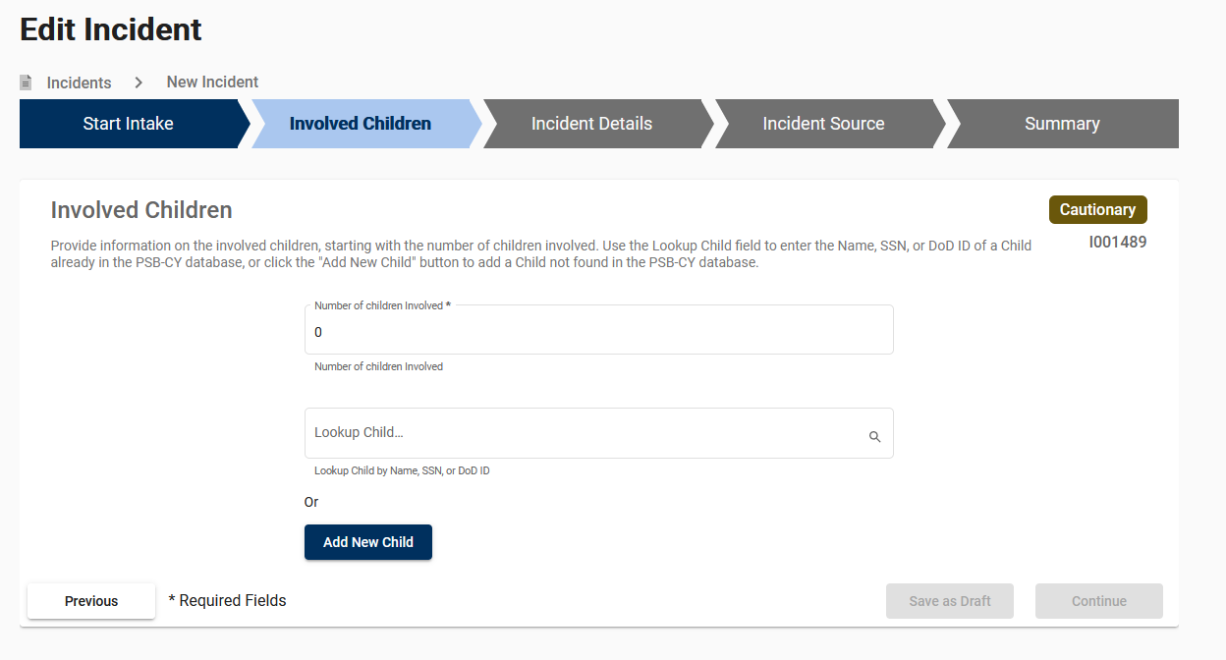
Involved Children

Slide 14
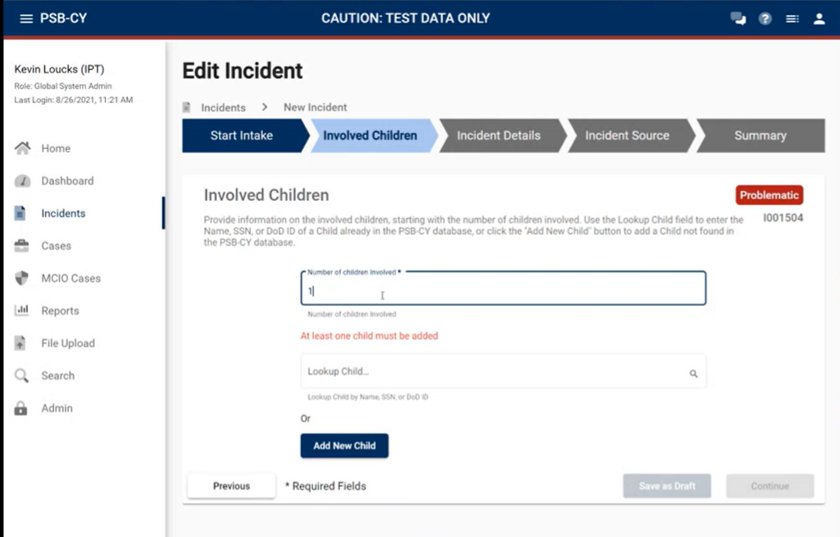
Involved Children

Slide 15
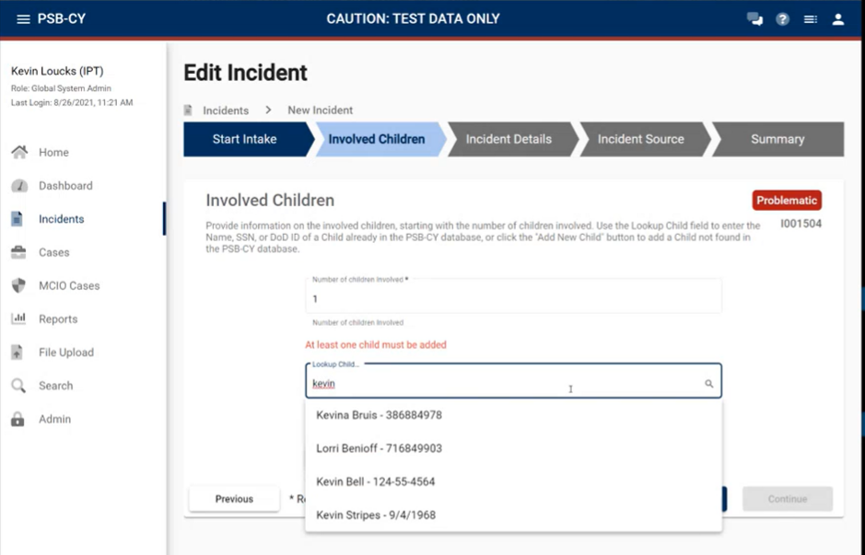
Involved Children

Slide 16
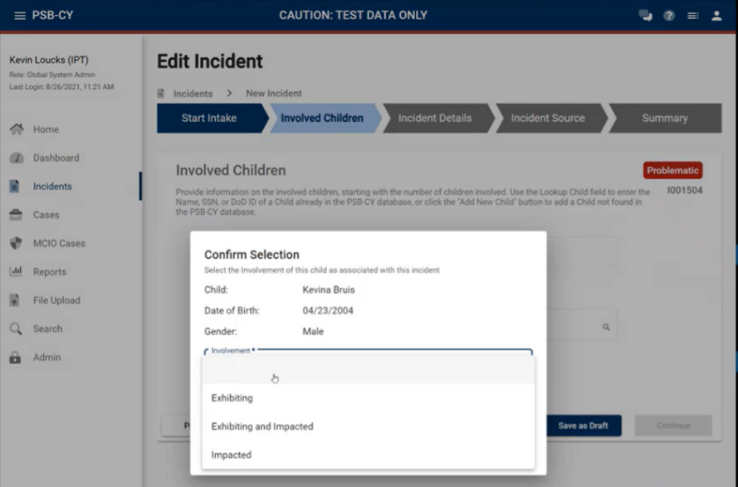
Involved Children

Slide 17
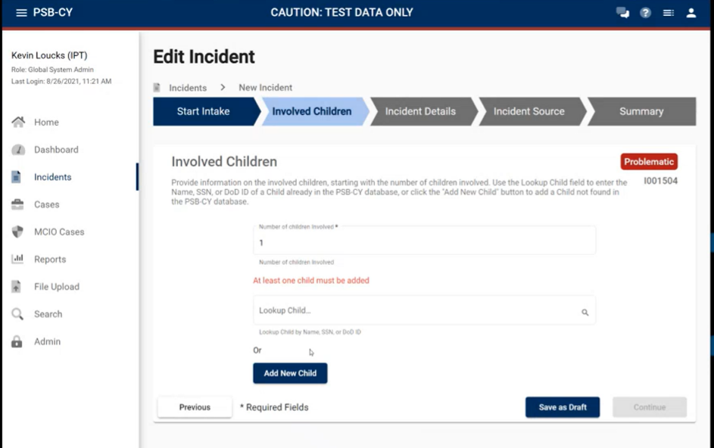
Involved Children

Slide 18
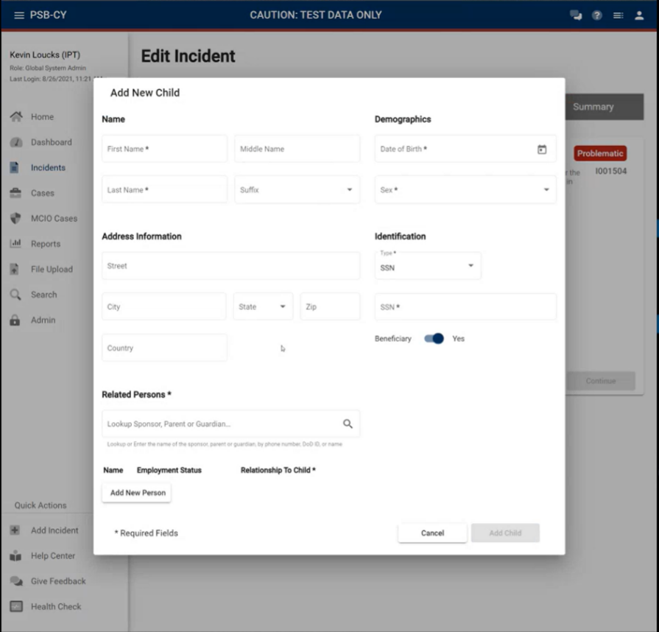
Involved Children

Slide 19
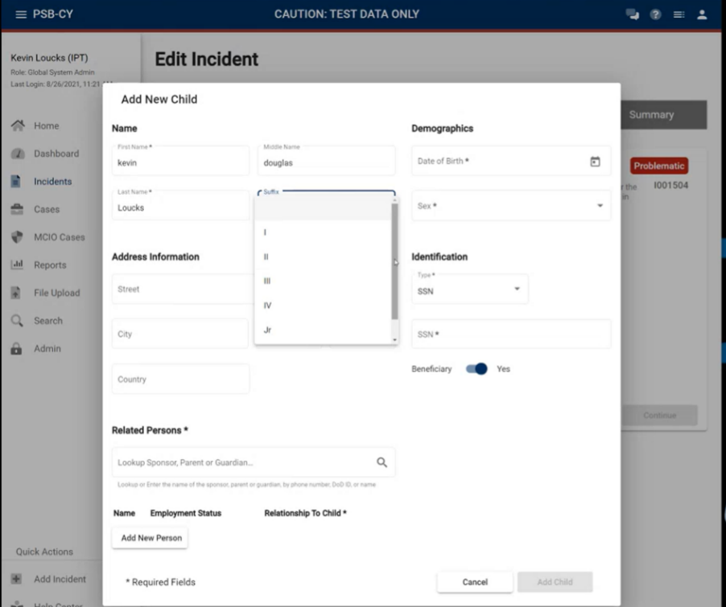
Involved Children

Slide 20
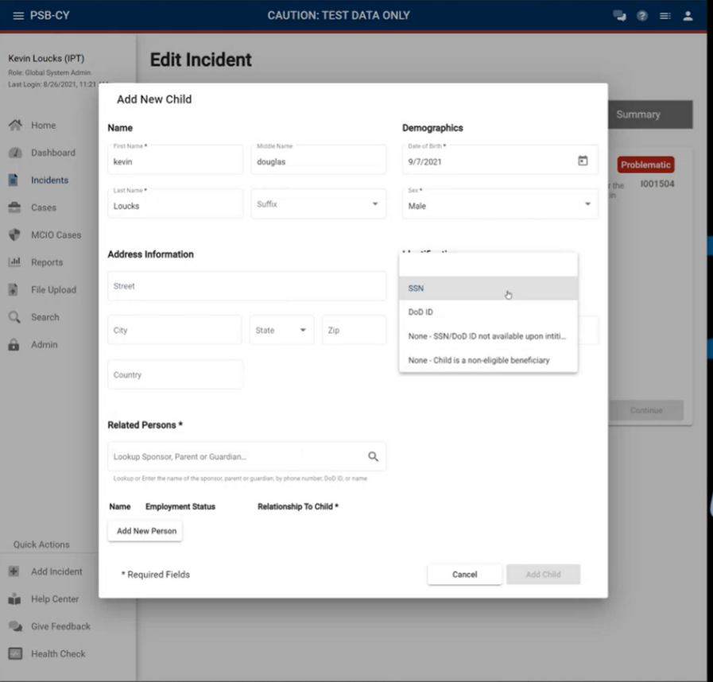
Involved Children

Slide 21
Involved Children

Slide 22
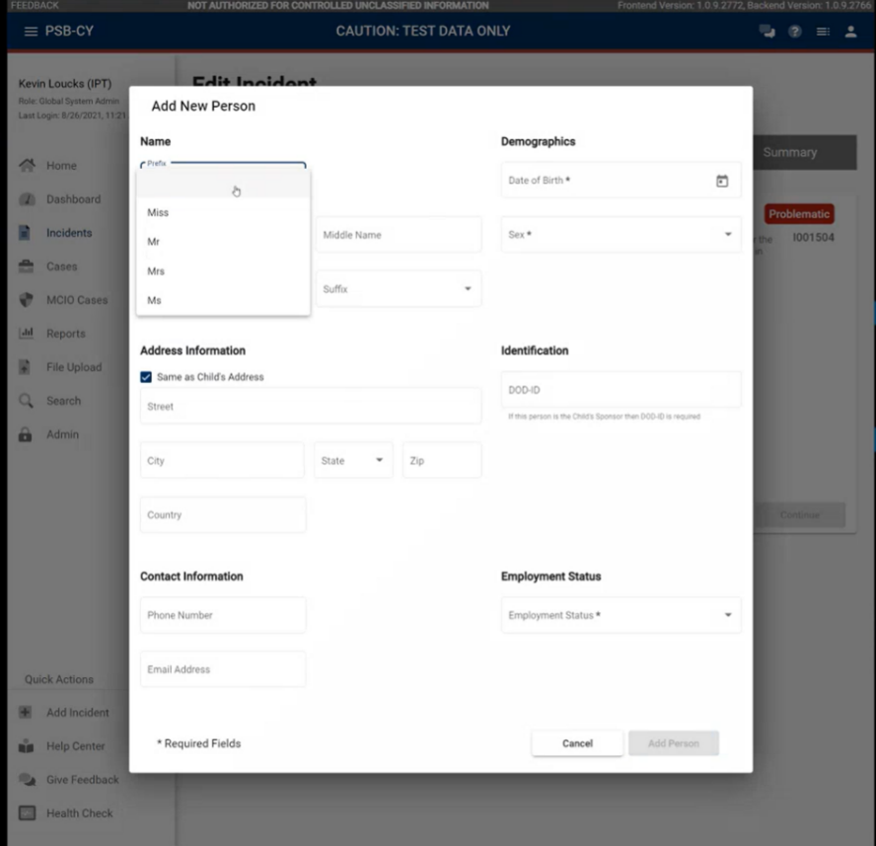
Involved Children

Slide 23
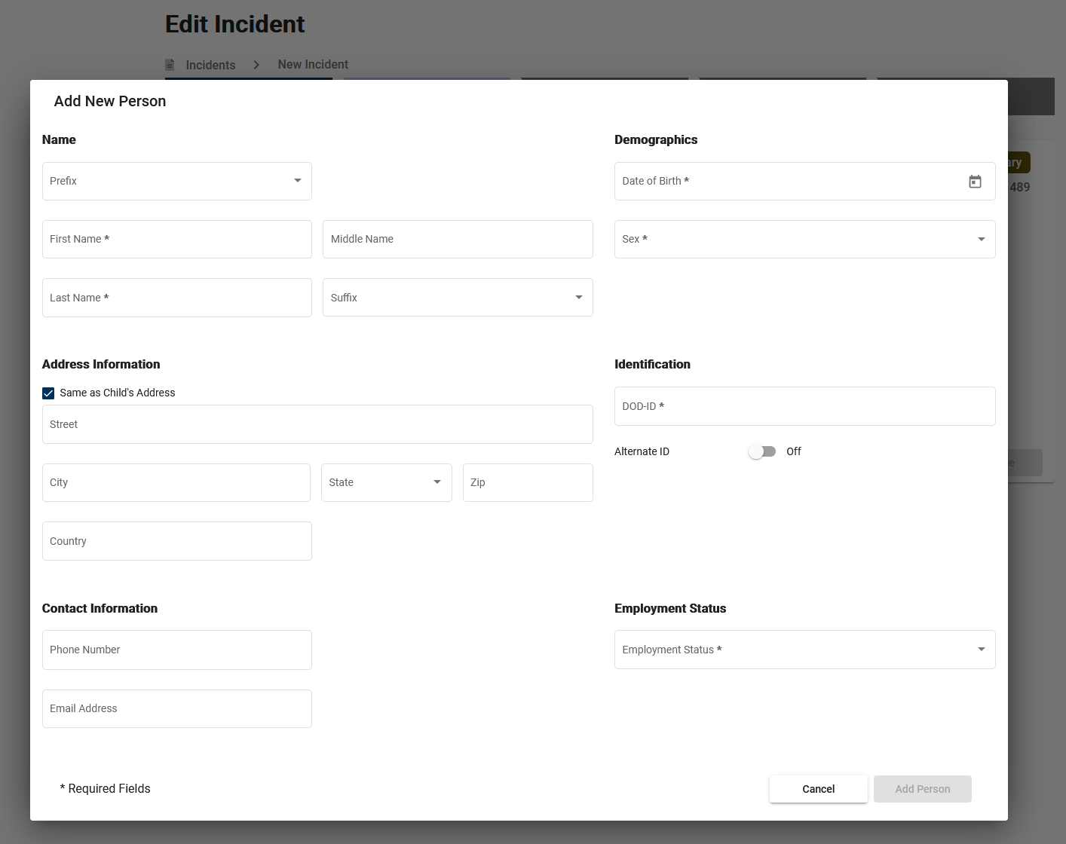
Involved Children

Slide 24
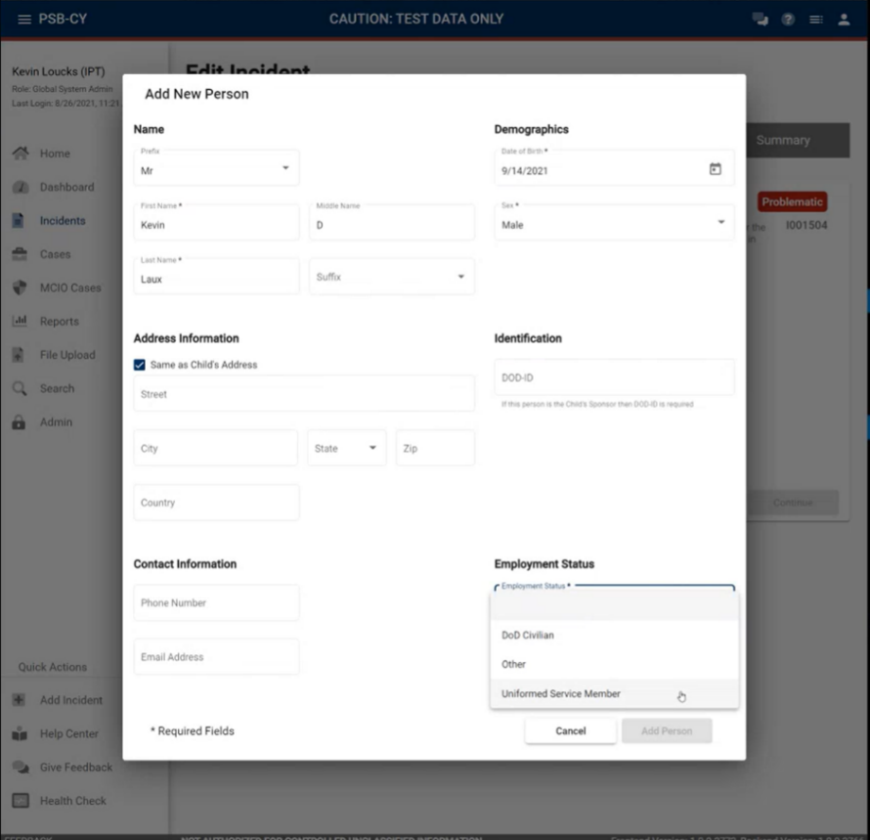
Involved Children

Slide 25
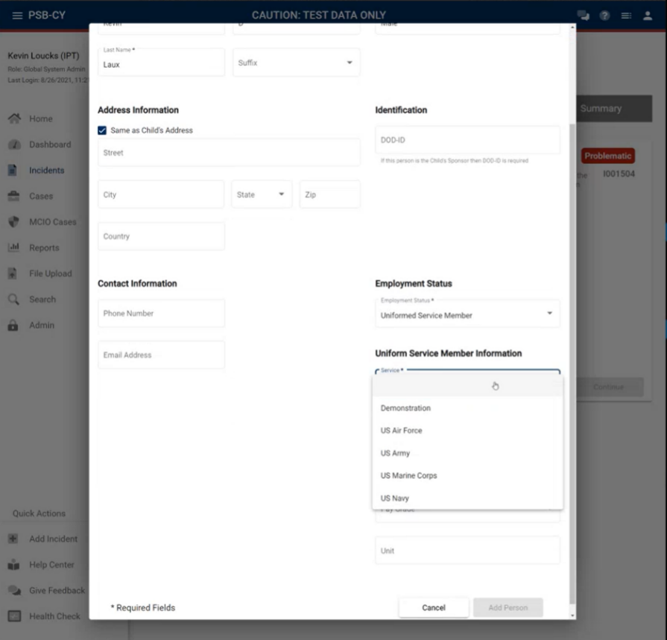
Involved Children

Slide 26
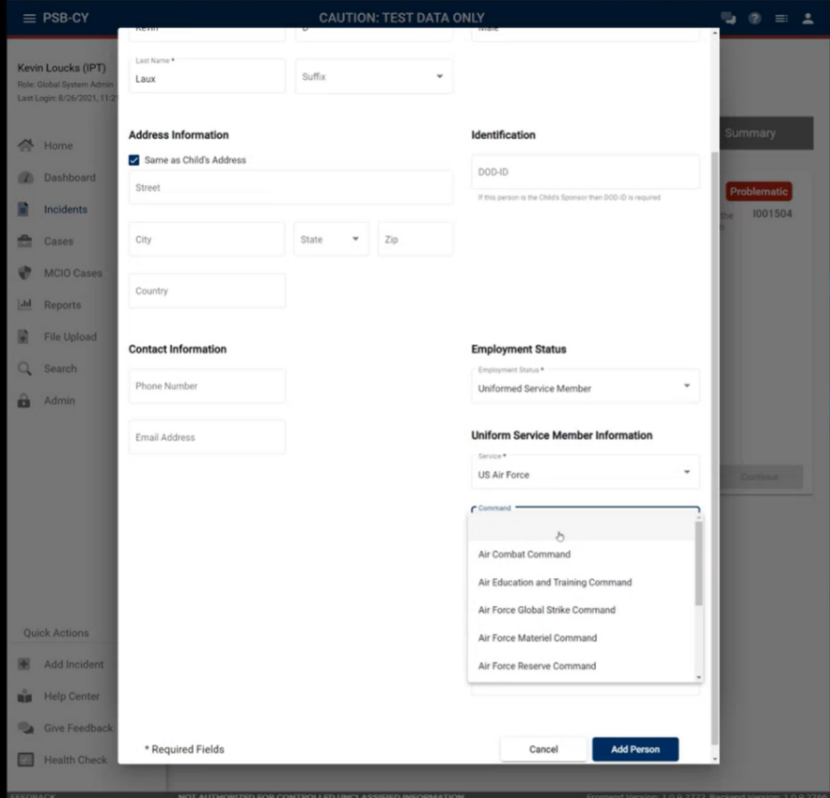
Involved Children

Slide 27
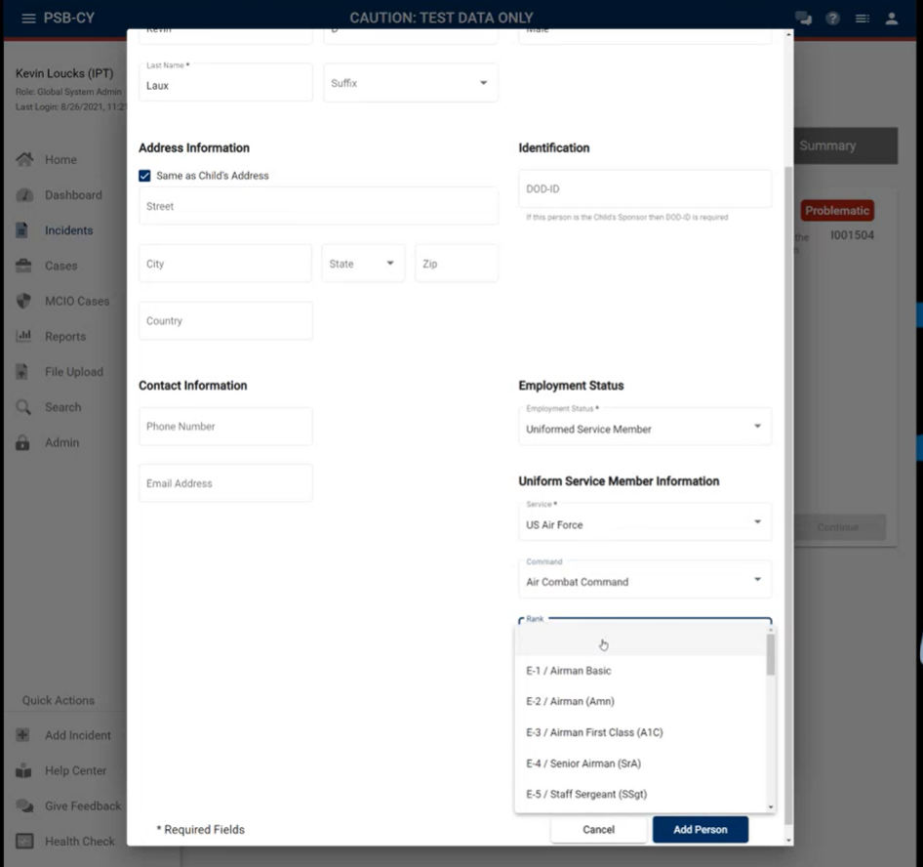
Involved Children

Slide 28
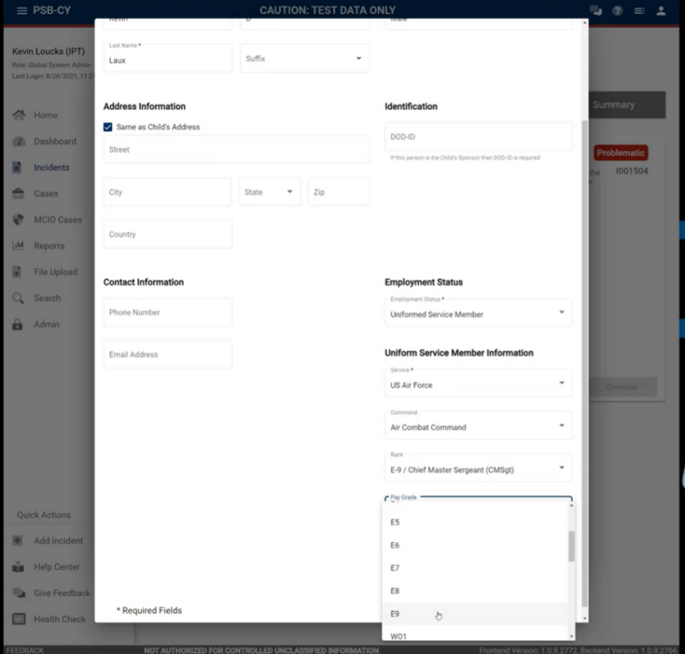
Involved Children

Slide 29
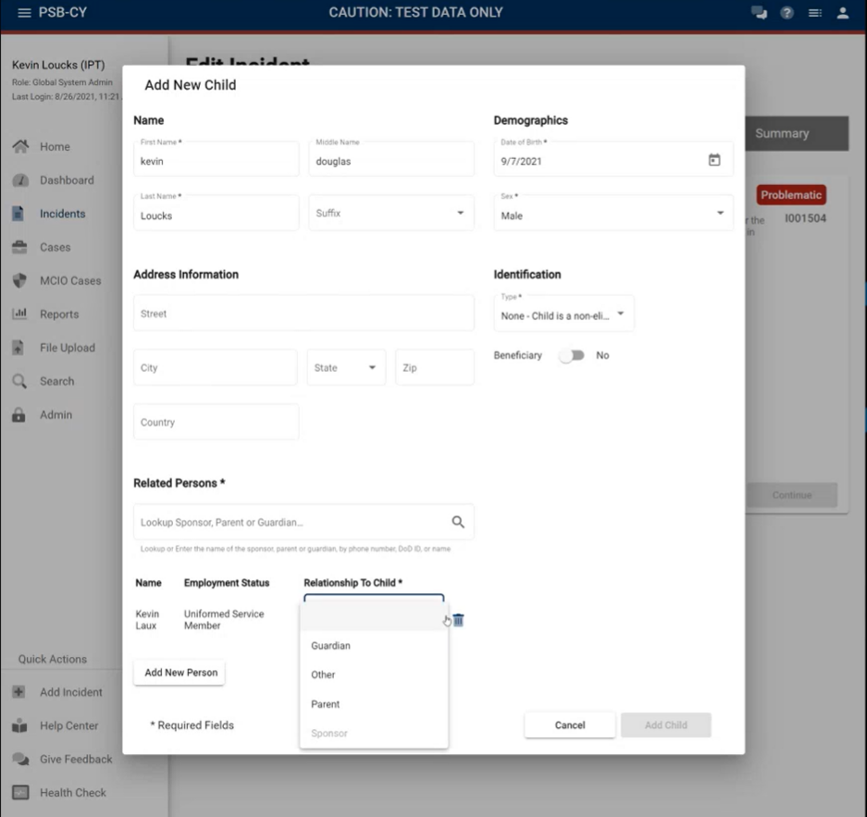
Involved Children

Slide 30
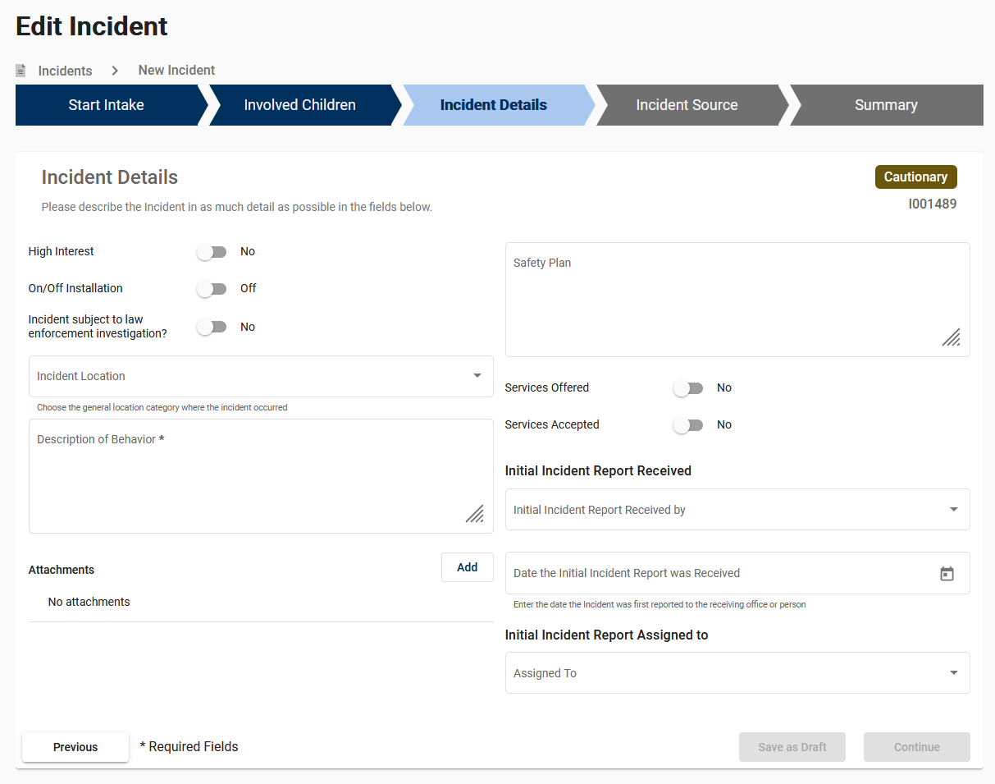
Incident Details

Slide 31
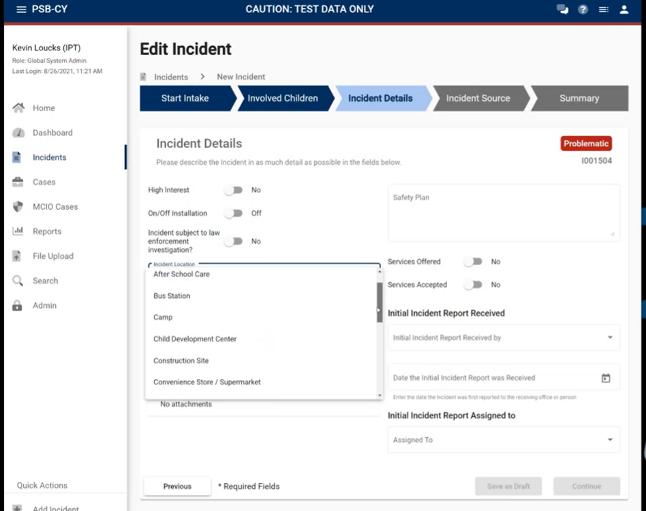
Incident Details

Slide 32
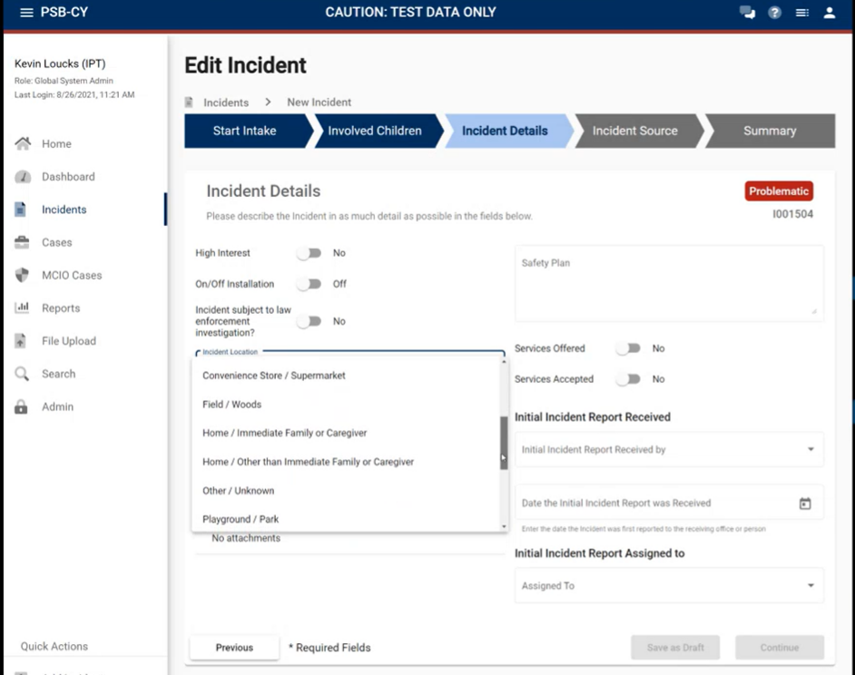
Incident Details

Slide 33
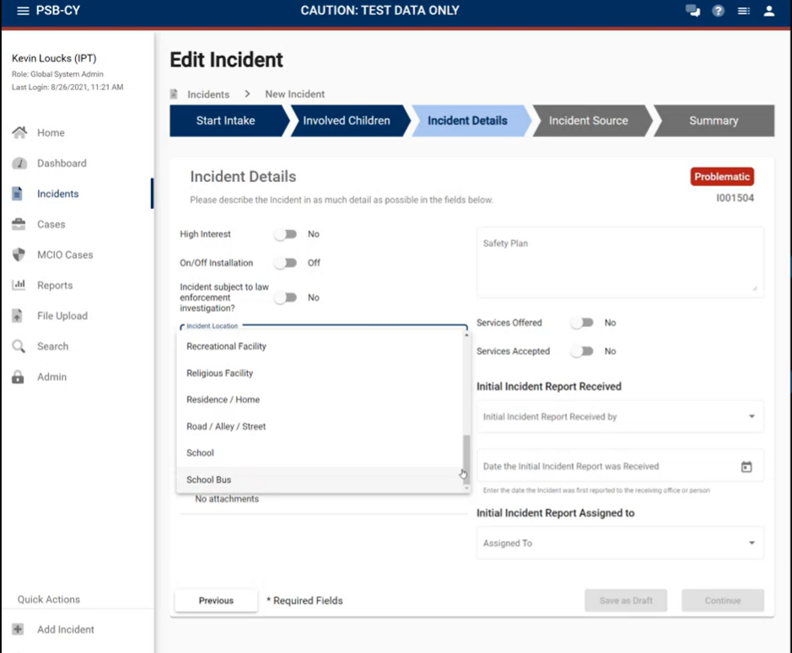
Incident Details

Slide 34
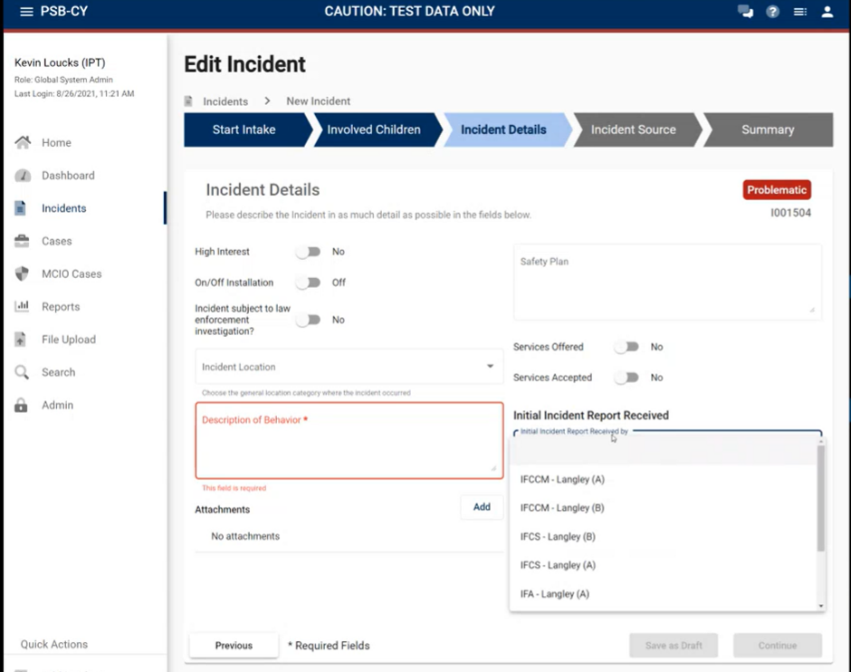
Incident Details

Slide 35
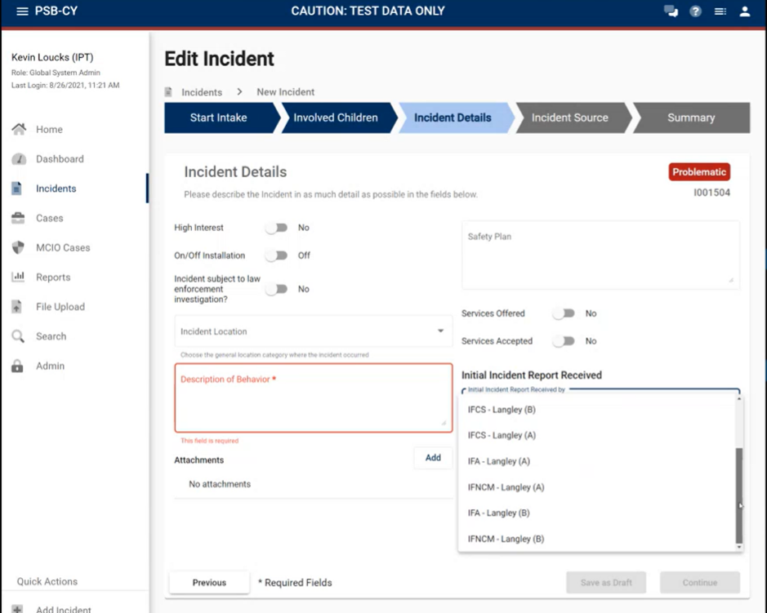
Incident Details

Slide 36
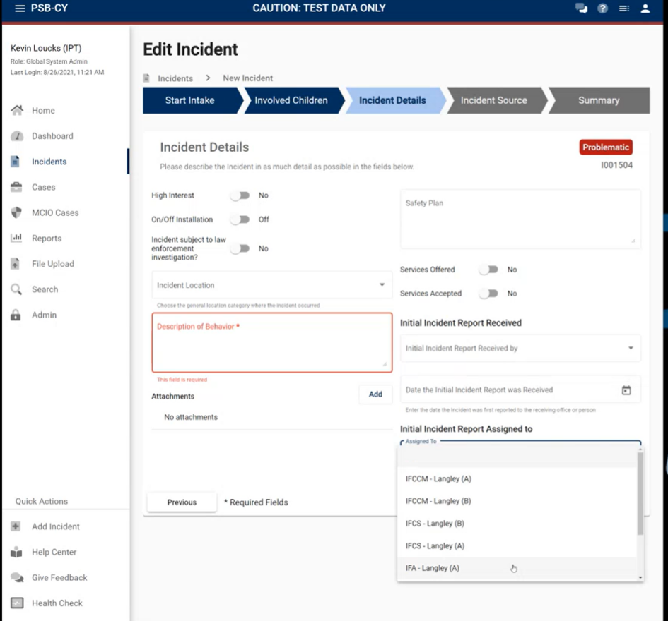
Incident Details

Slide 37
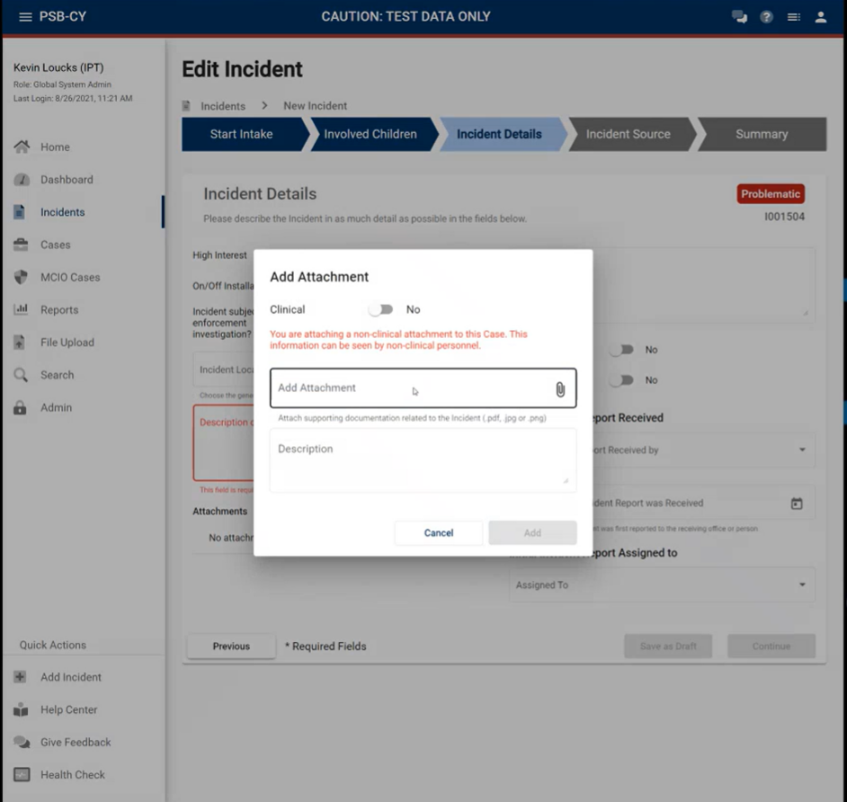

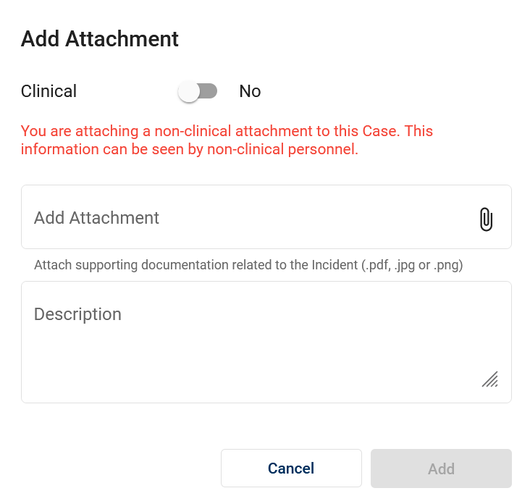
Incident Details

Slide 38
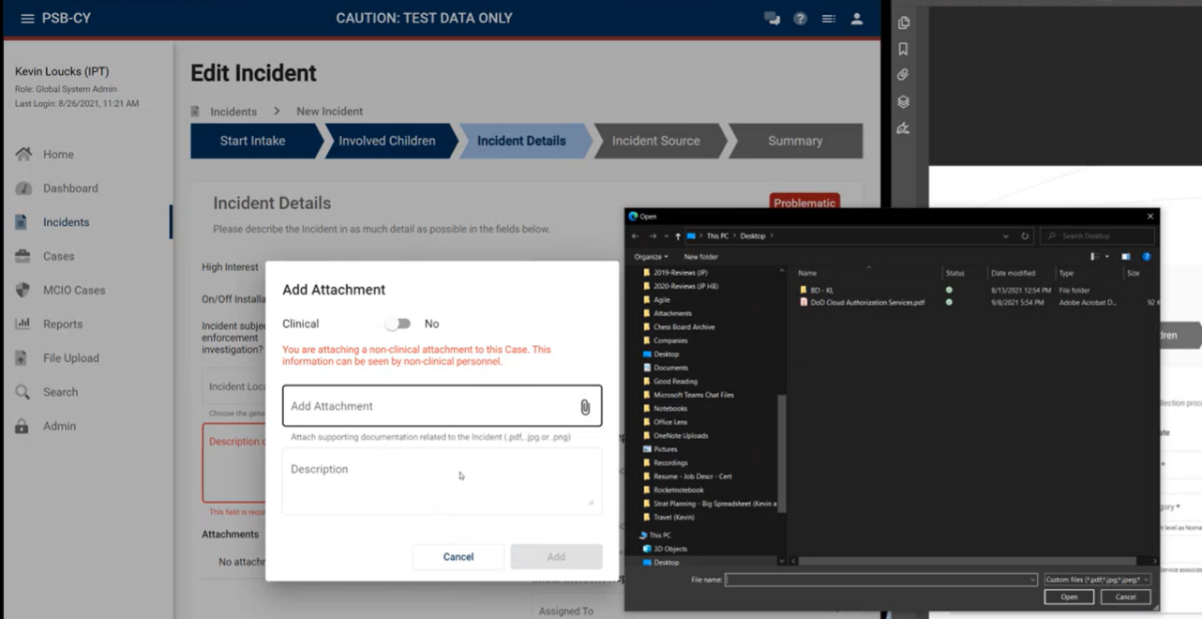
Incident Details

Slide 39
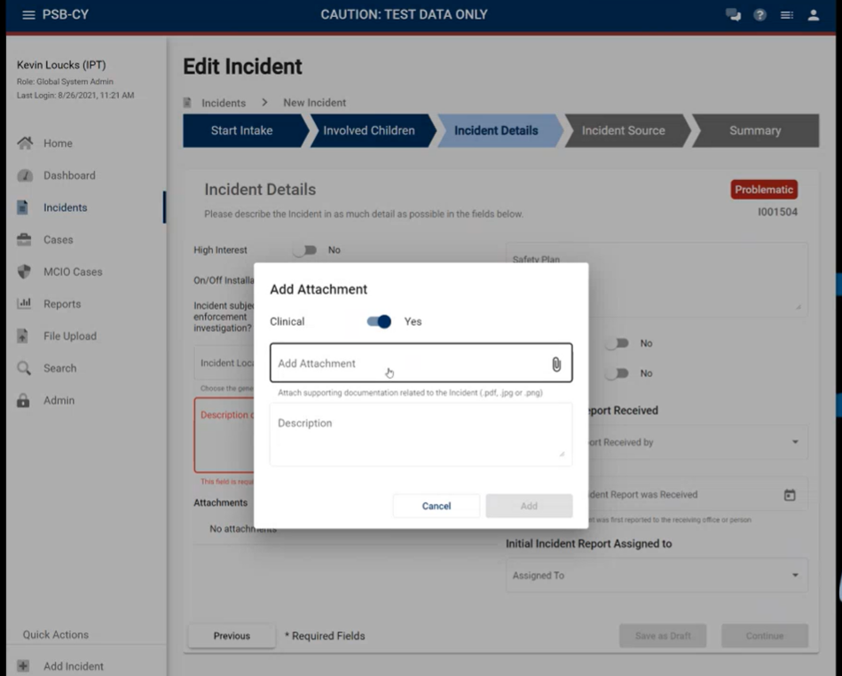
Incident Details

Slide 40
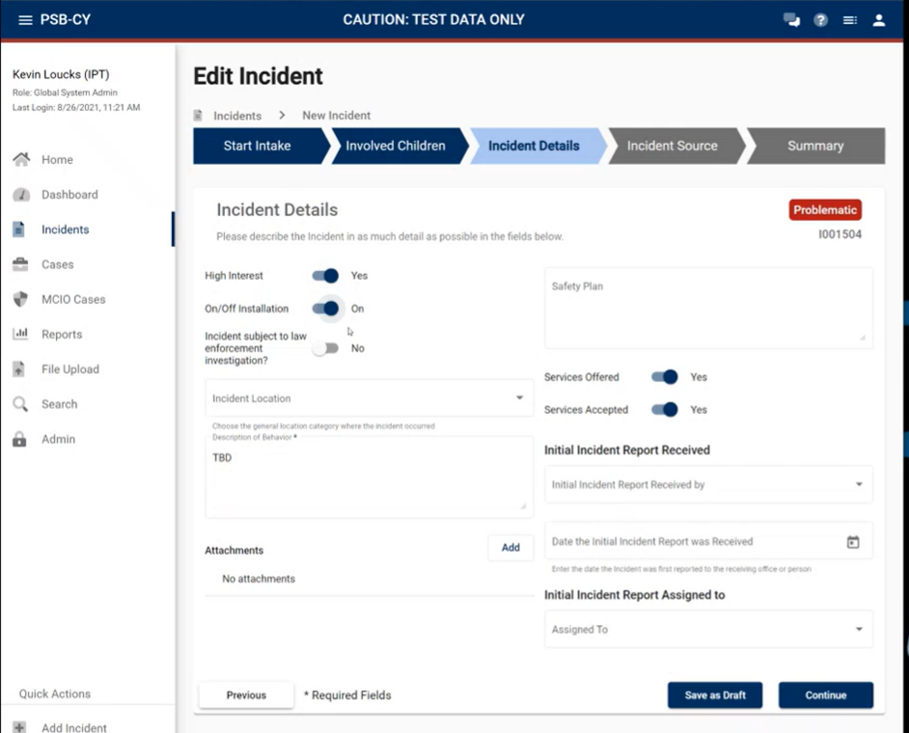
Incident Details

Slide 41
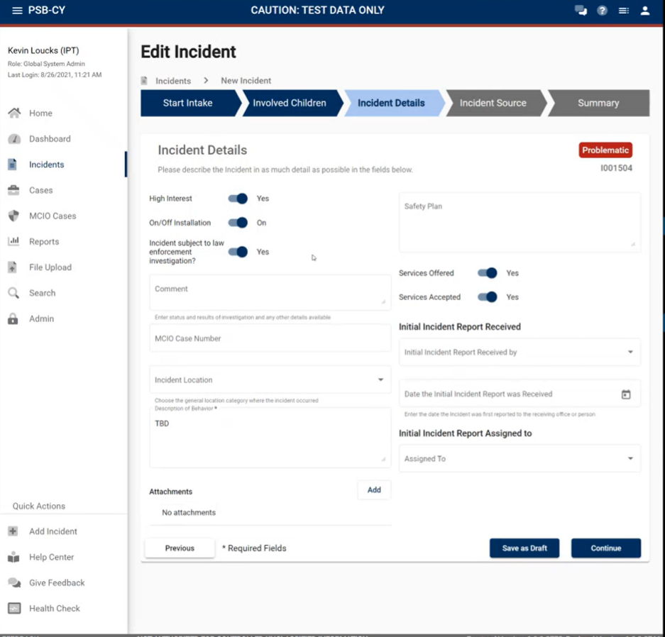
Incident Details

Slide 42
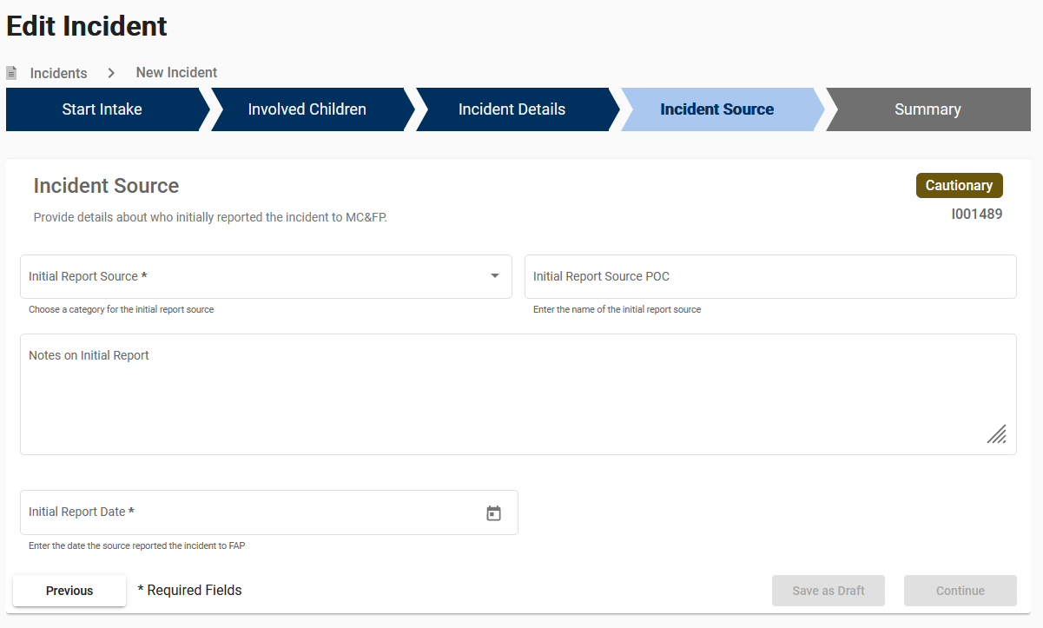
Incident Source

Slide 43
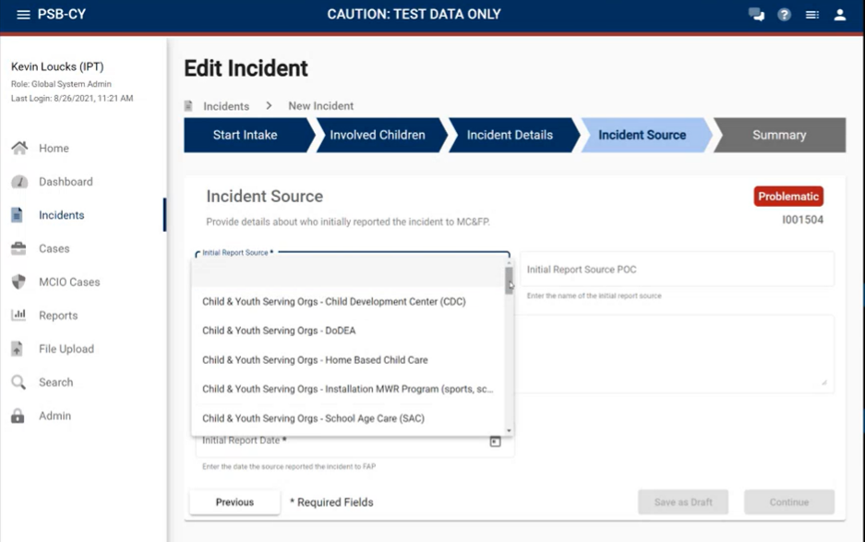
Incident Details

Slide 44
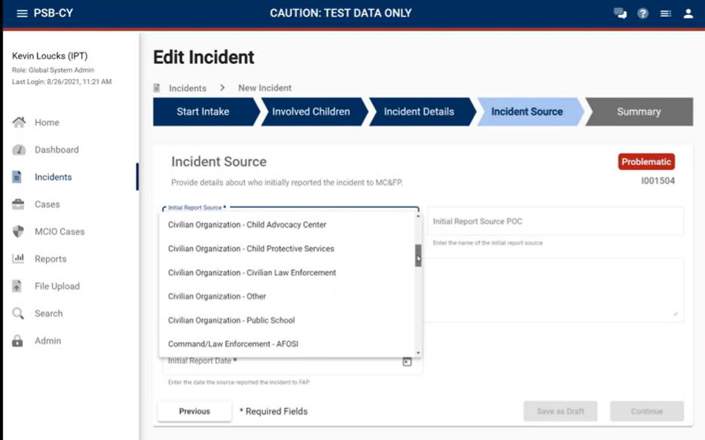
Incident Details

Slide 45
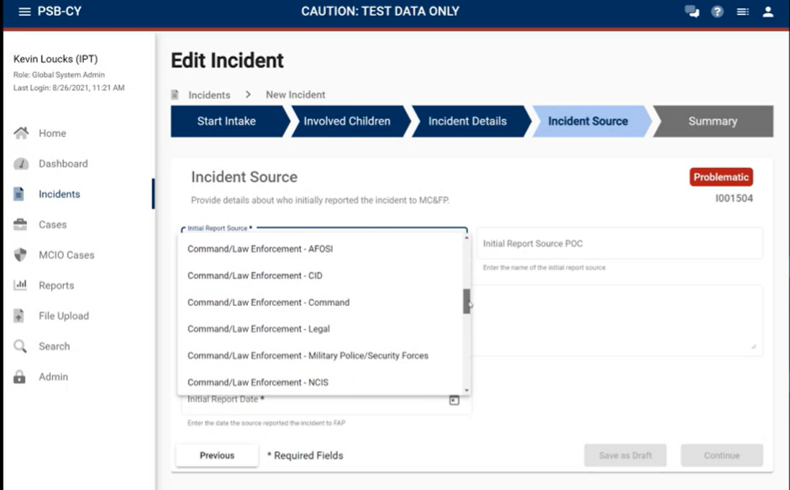
Incident Details

Slide 46
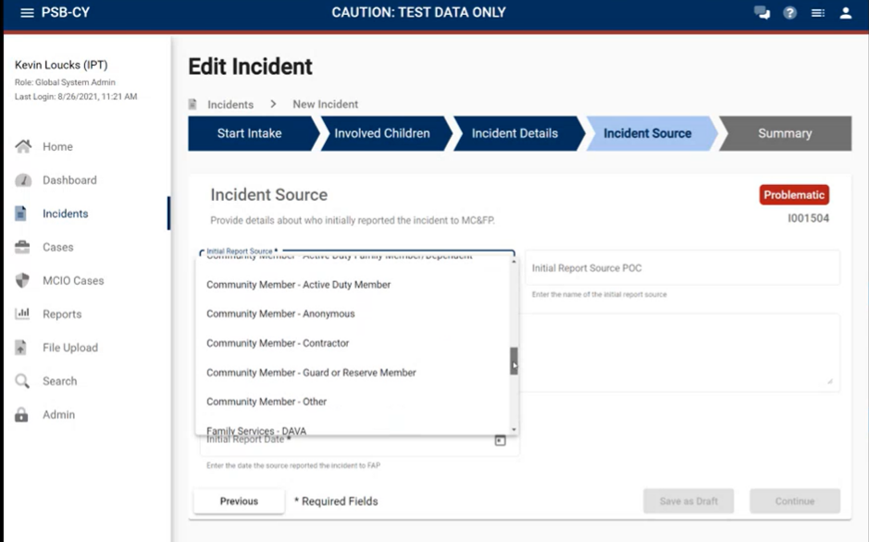
Incident Details

Slide 47

Incident Details

Slide 48
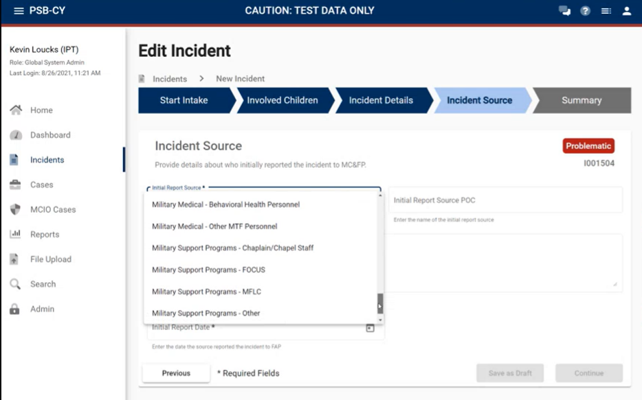
Incident Details

Slide 49
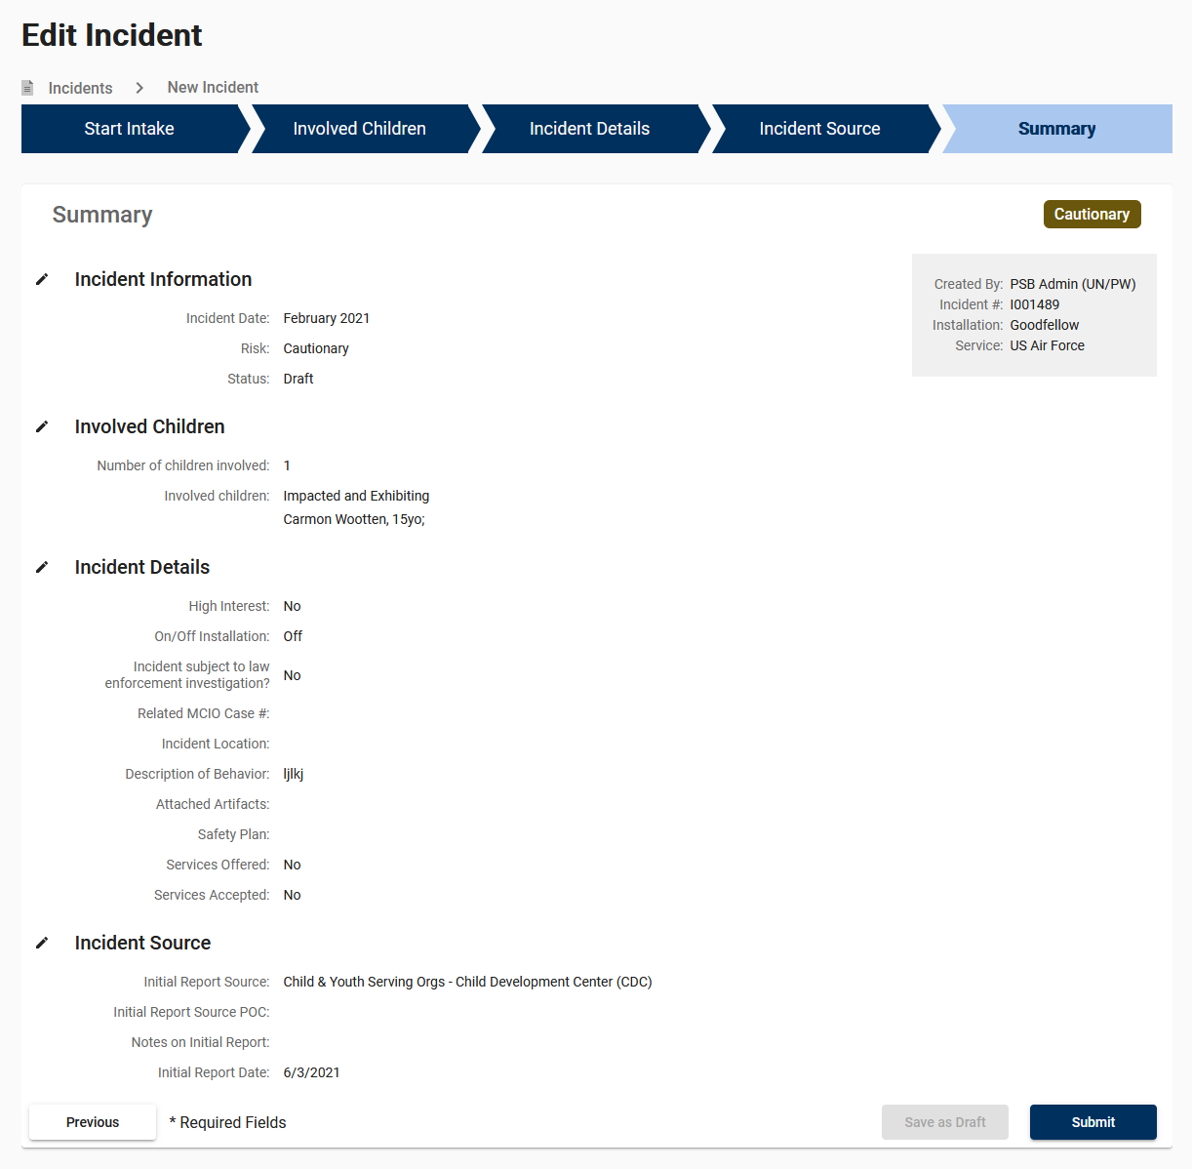
Incident Summary

