Slide 1
PSB-CY System Incident Intake - Updated with drop-down screen information IMPORTANT: ALL DATA SHOWN IN THIS PRESENTATION IS FOR DEMONSTRATION PURPOSES. NO REAL DATA (PII) FROM ANY PERSON HAS BEEN USED.
17 September 2021

Slide 2
ADN to the Warning page – screenshot

Slide 3
Add Incident
Incident Number
Incident Number
Incident Number
Incident Number
Incident Number

Slide 4
Start Intake

Slide 5
Start Intake
NOTE:
All Date fields throughout the PSB-CY System use the same format.

Slide 6
Start Intake

Slide 7
Start Intake

Slide 8
Start Intake

Slide 9
Start Intake

Slide 10
Start Intake

Slide 11
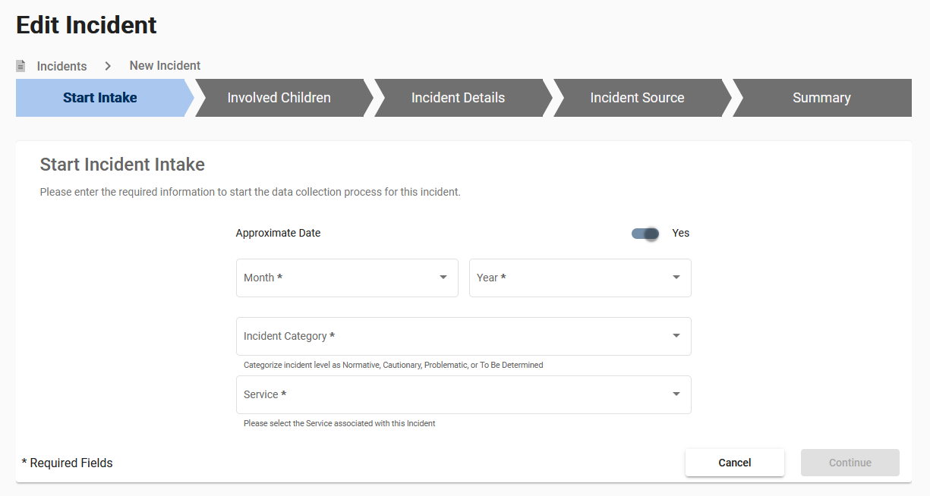
Start Intake

Slide 12
Start Intake
NOTE:
All Date fields throughout the PSB-CY System use the same format. Please see slide 4.

Slide 13
Involved Children

Slide 14
Involved Children

Slide 15
Involved Children

Slide 16
Involved Children

Slide 17
Involved Children

Slide 18
Involved Children

Slide 19
Involved Children

Slide 20
Involved Children

Slide 21
Involved Children

Slide 22
Involved Children

Slide 23
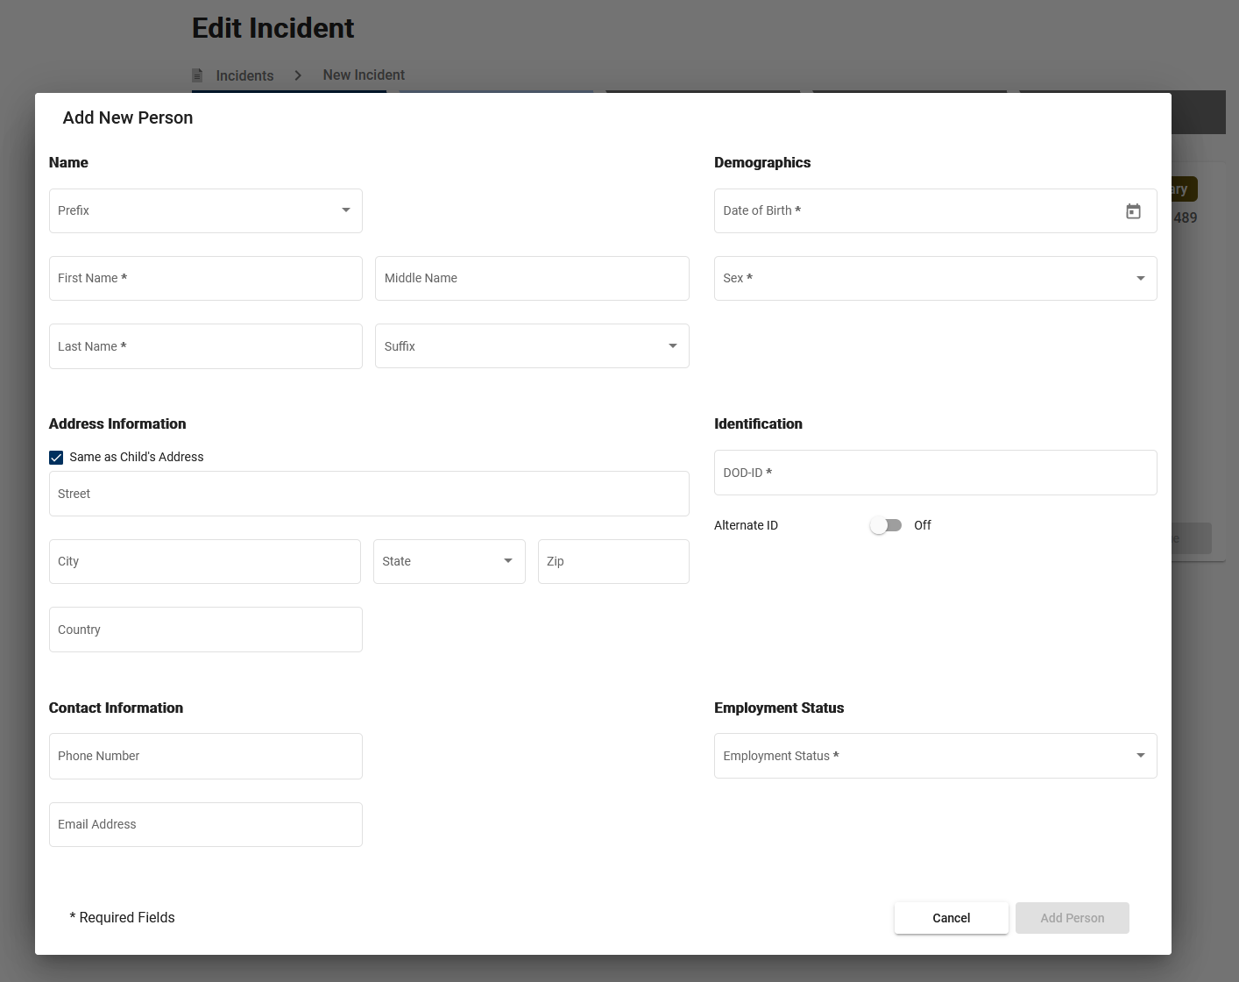
Involved Children

Slide 24
Involved Children

Slide 25
Involved Children

Slide 26
Involved Children

Slide 27
Involved Children

Slide 28
Involved Children

Slide 29
Involved Children

Slide 30
Incident Details

Slide 31
Incident Details

Slide 32
Incident Details

Slide 33
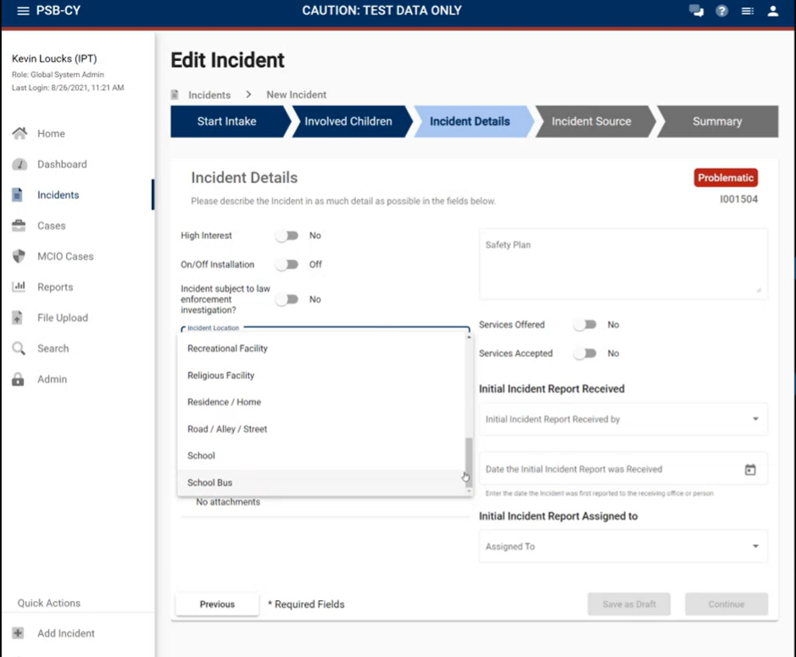
Incident Details

Slide 34
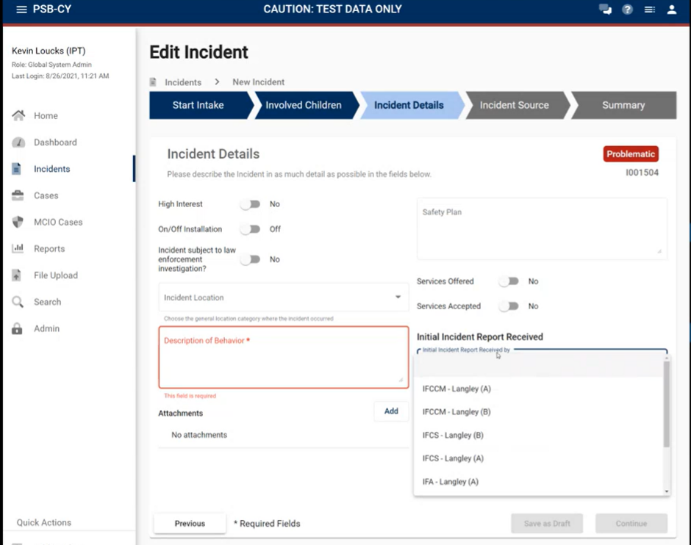
Incident Details

Slide 35
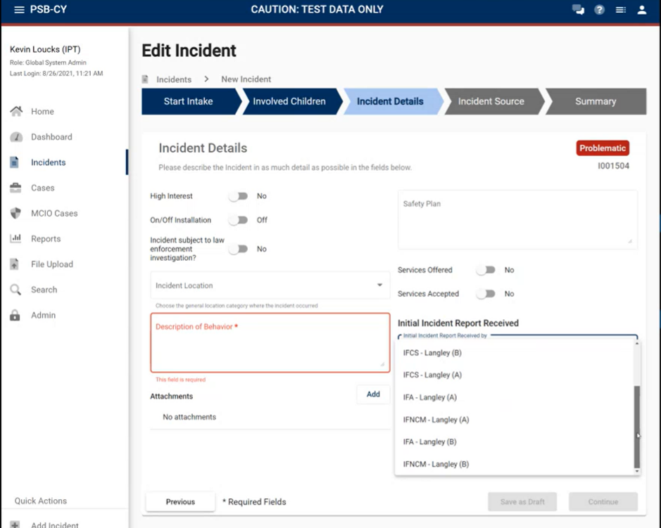
Incident Details

Slide 36
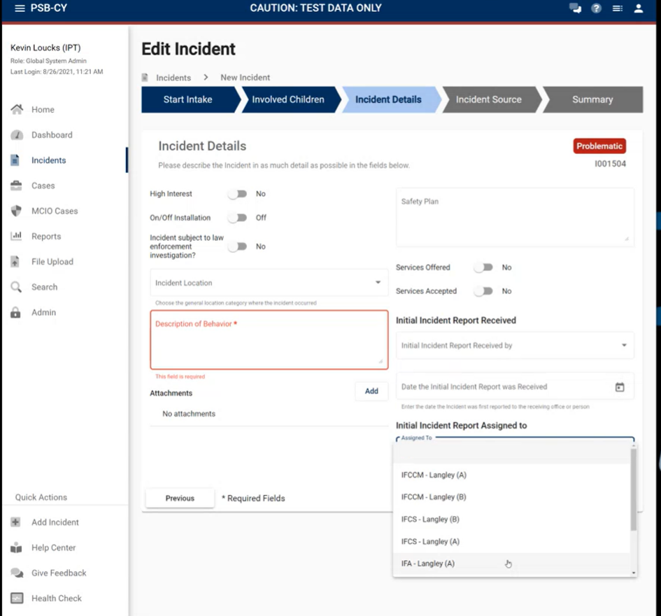
Incident Details

Slide 37
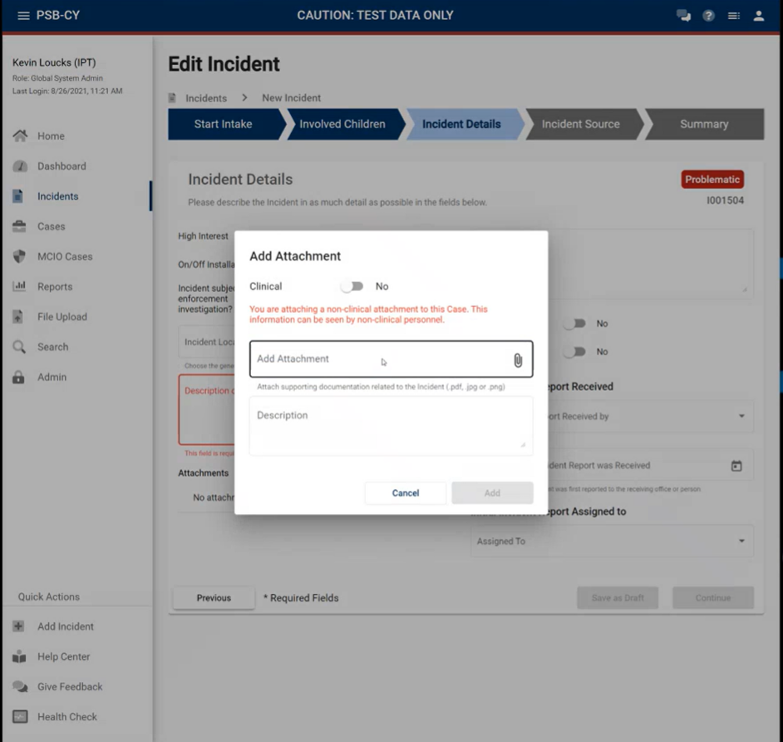
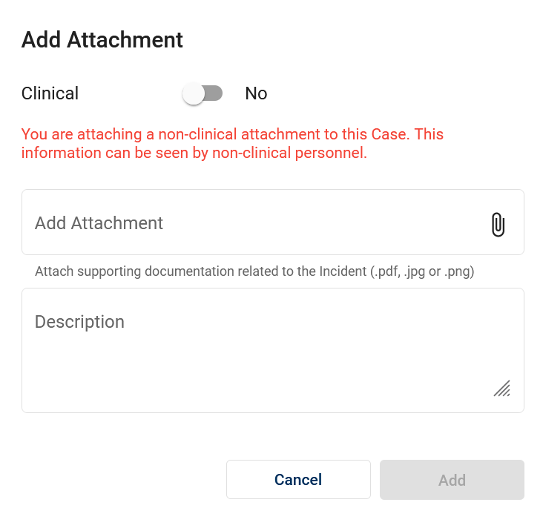
Incident Details

Slide 38
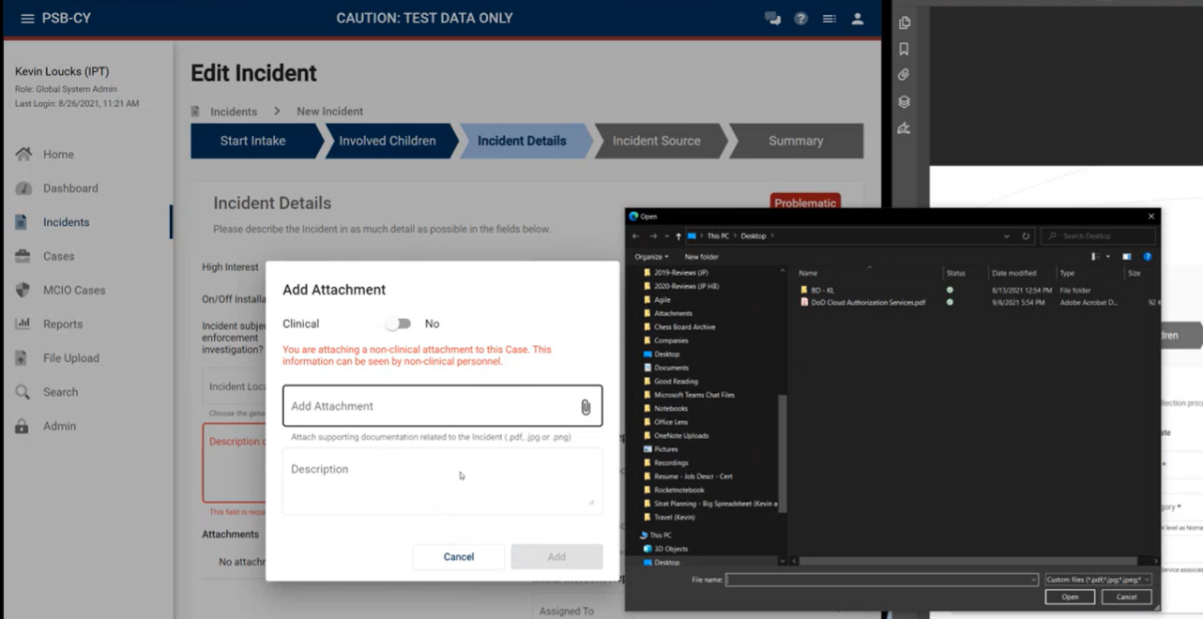
Incident Details

Slide 39
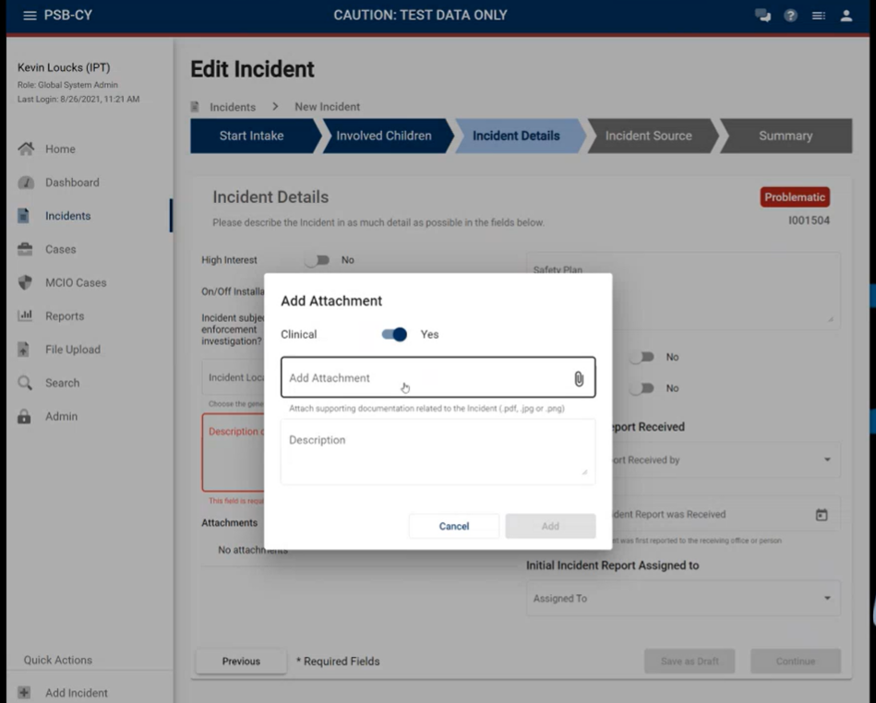
Incident Details

Slide 40
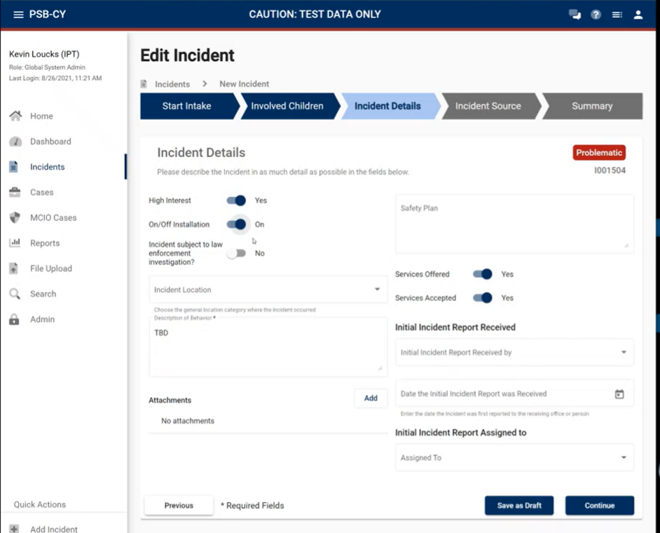
Incident Details

Slide 41
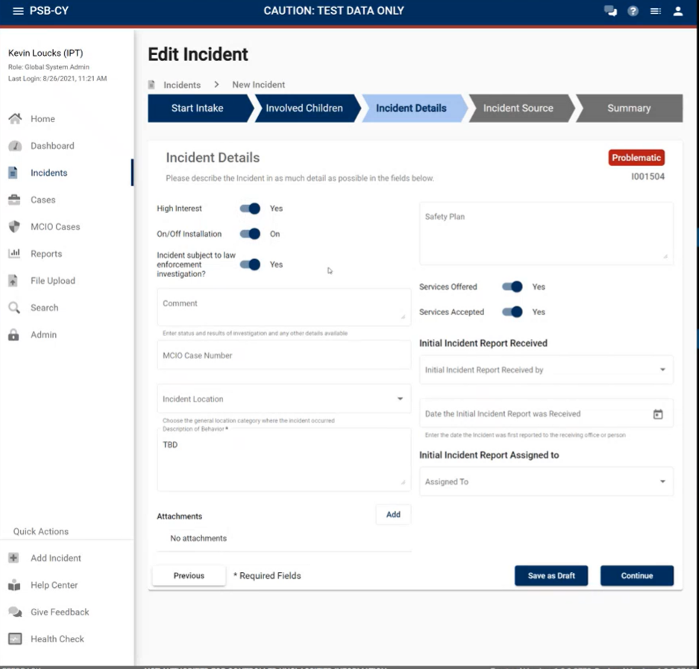
Incident Details

Slide 42
Incident Source

Slide 43
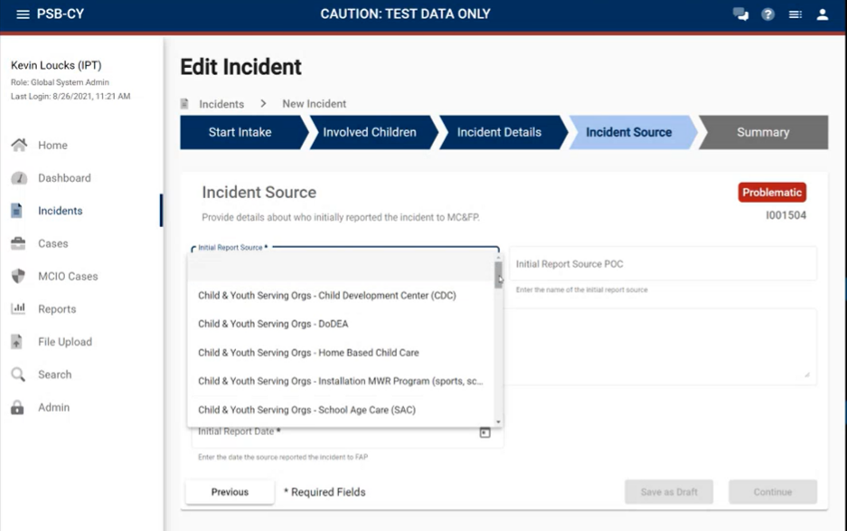
Incident Details

Slide 44
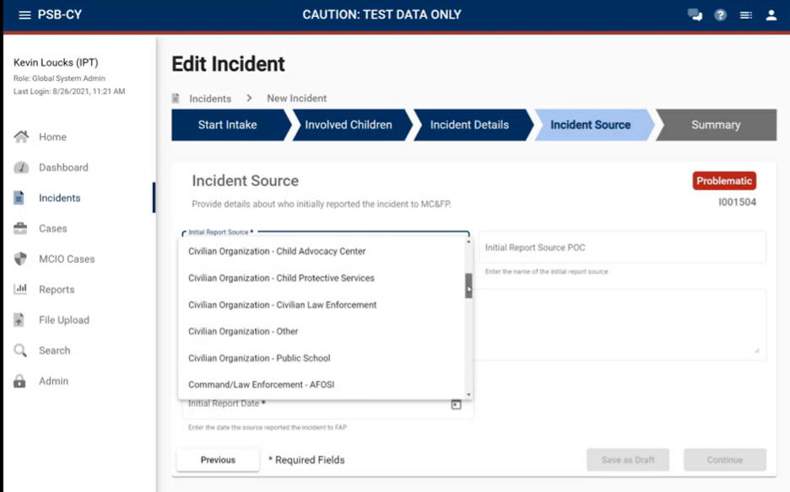
Incident Details

Slide 45
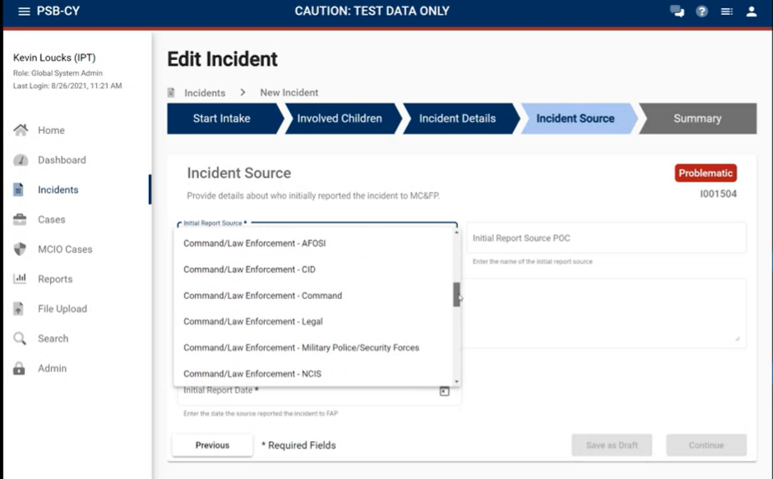
Incident Details

Slide 46
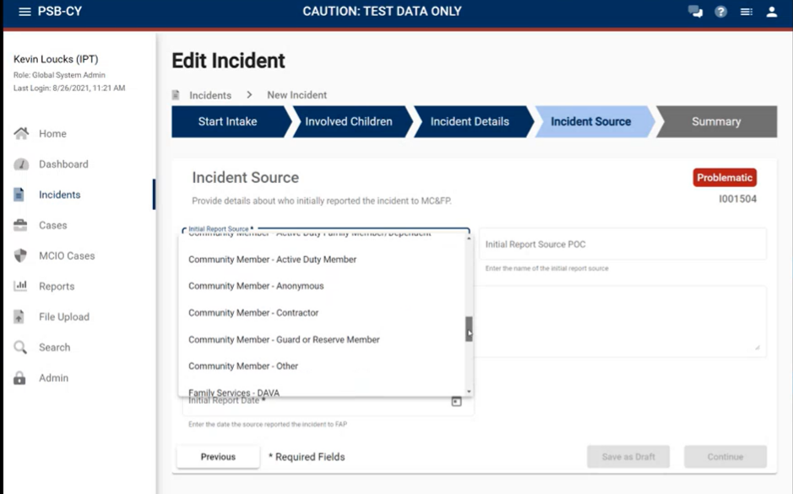
Incident Details

Slide 47
Incident Details

Slide 48
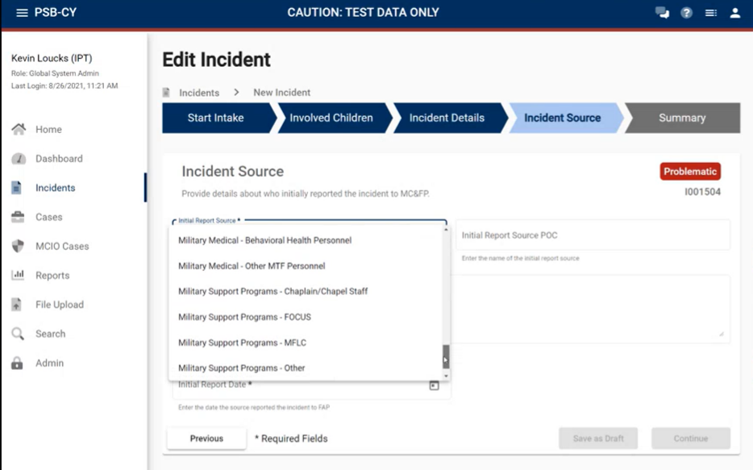
Incident Details

Slide 49
Incident Summary

