Slide 1
MC&FP PSB-CY System
Reports and DASHBOARD Screenshots
ALL DATA REFLECTED IS FICTITIOUS /NOTIONAL FOR SYSTEM DEVELOPMENT, TESTING AND DEMONSTRATION PURPOSES ONLY
Provided by CYAP to DHRA
24 Sep 21

Slide 2
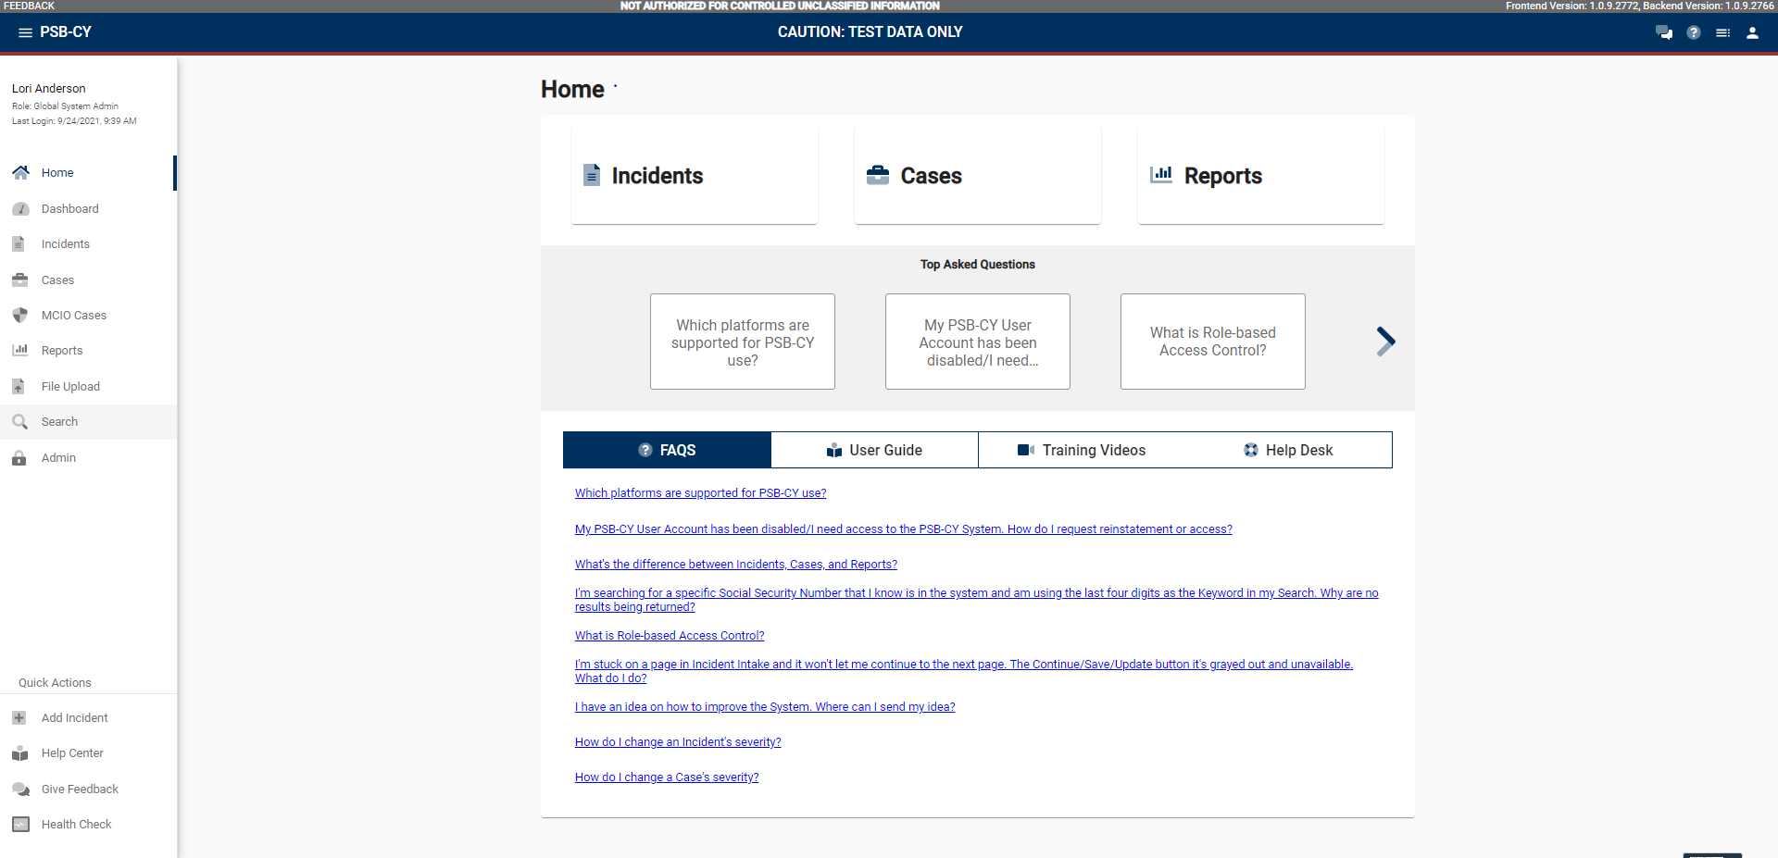
HOME SCREEN

Slide 3
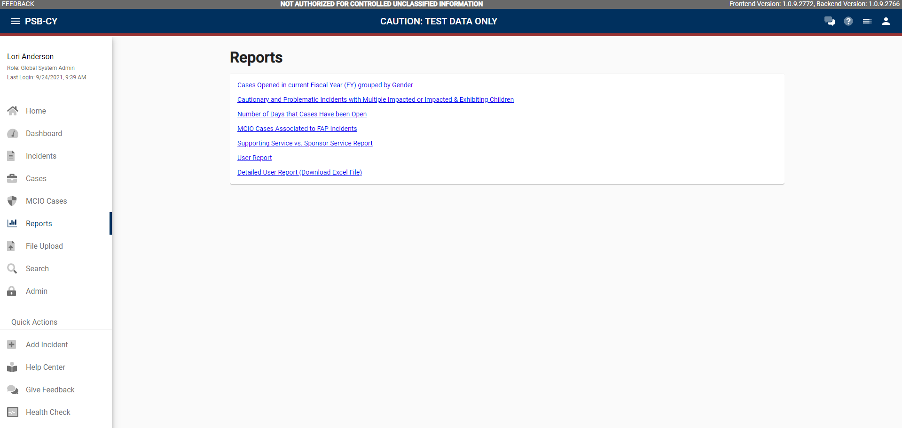
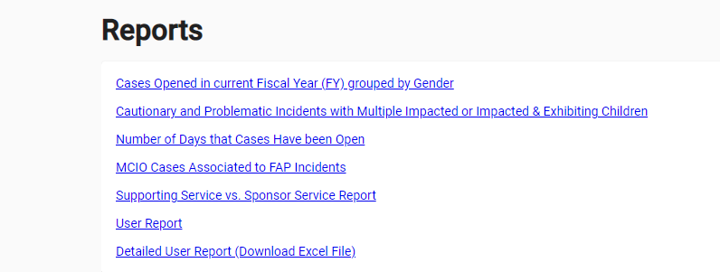
Report Menu

Slide 4
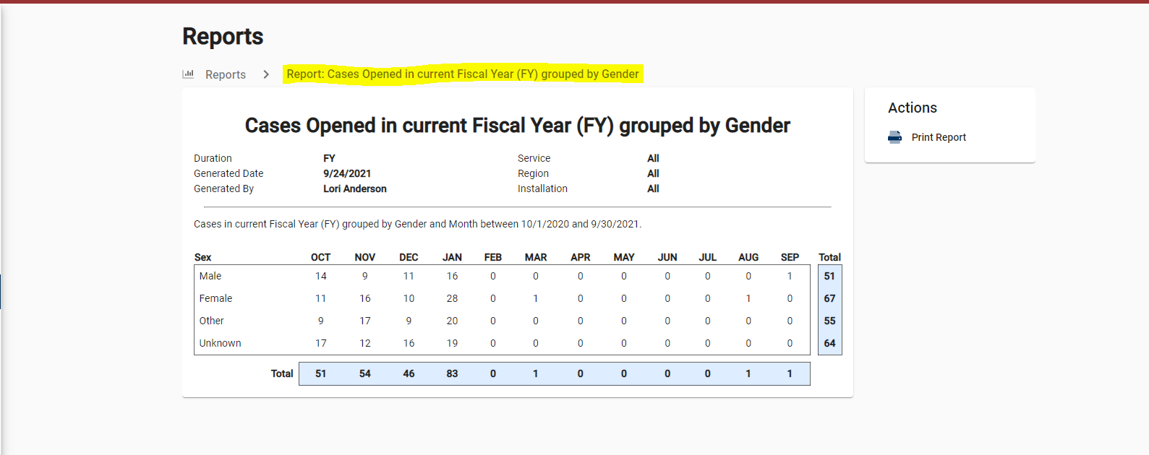
Cases Opened in Current FY by Gender

Slide 5
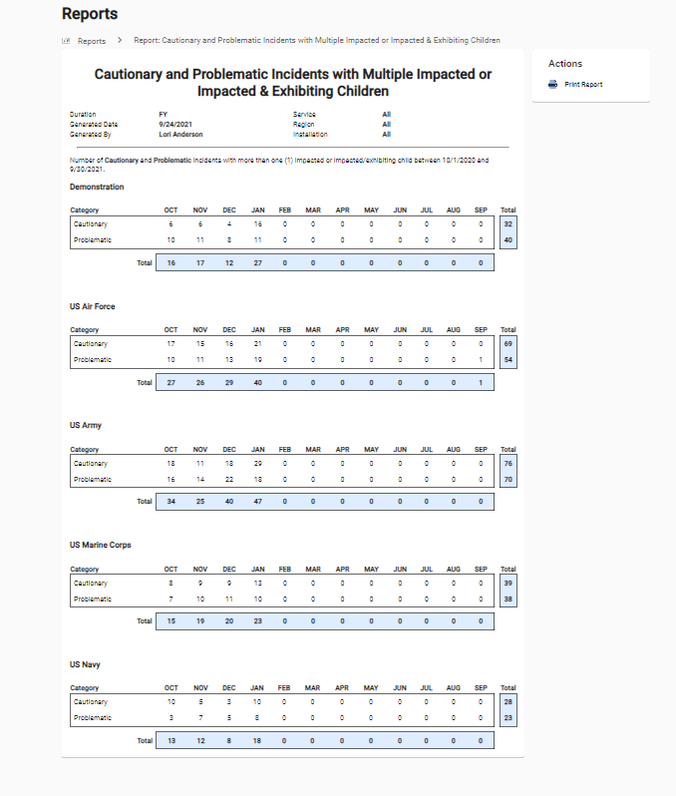
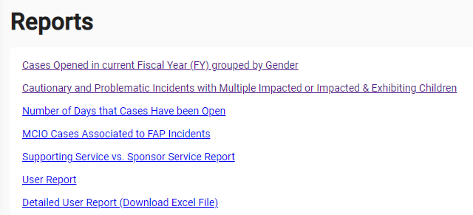
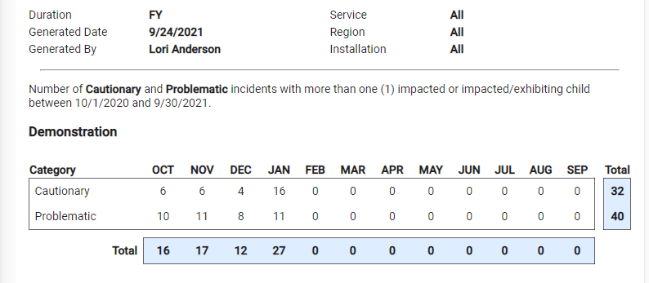
Cautionary and Problematic Incidents with Multiple Impacted or Impacted & Exhibiting Children
Rollup
By Service

Slide 6
Rollup
By Service

Slide 7
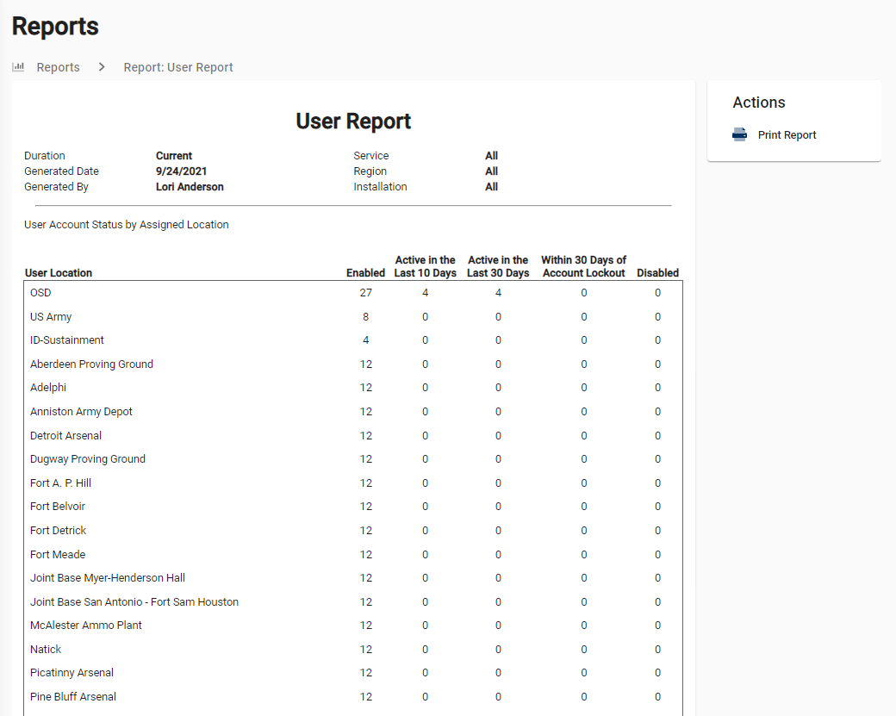

Slide 8
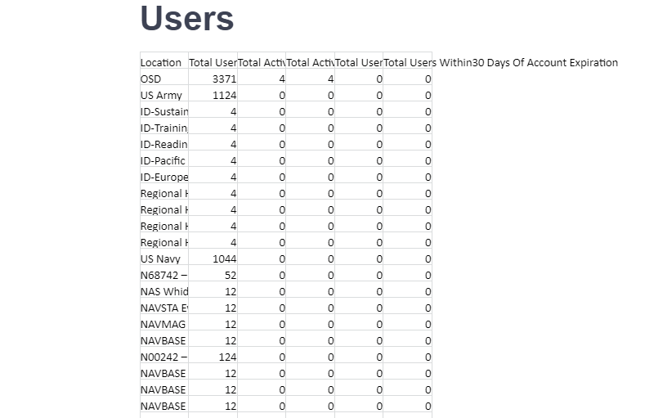
Rollup
By Service

Slide 9
HOME SCREEN

Slide 10
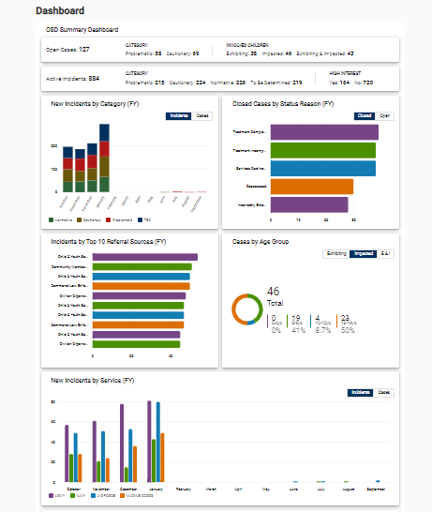

Slide 11
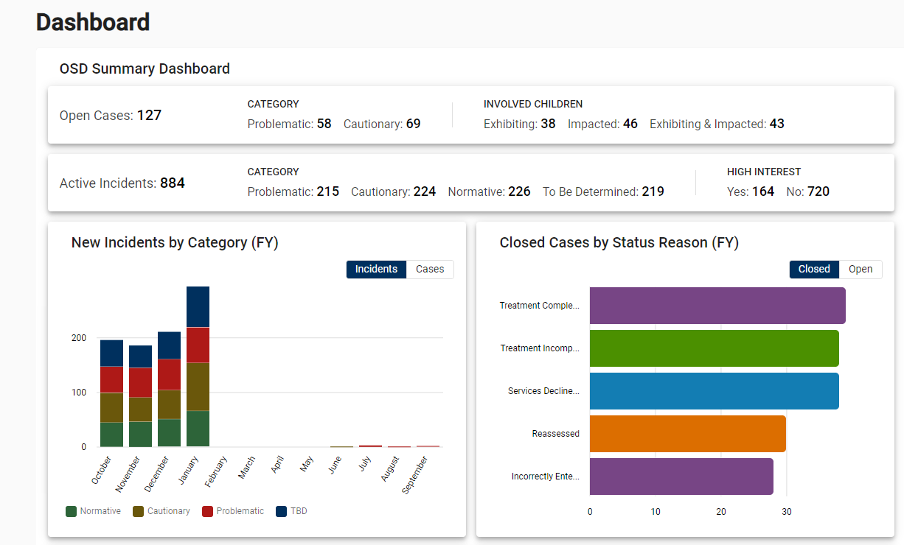

Slide 12
