Slide 1
1652-0030
Electronic Forms

Slide 2
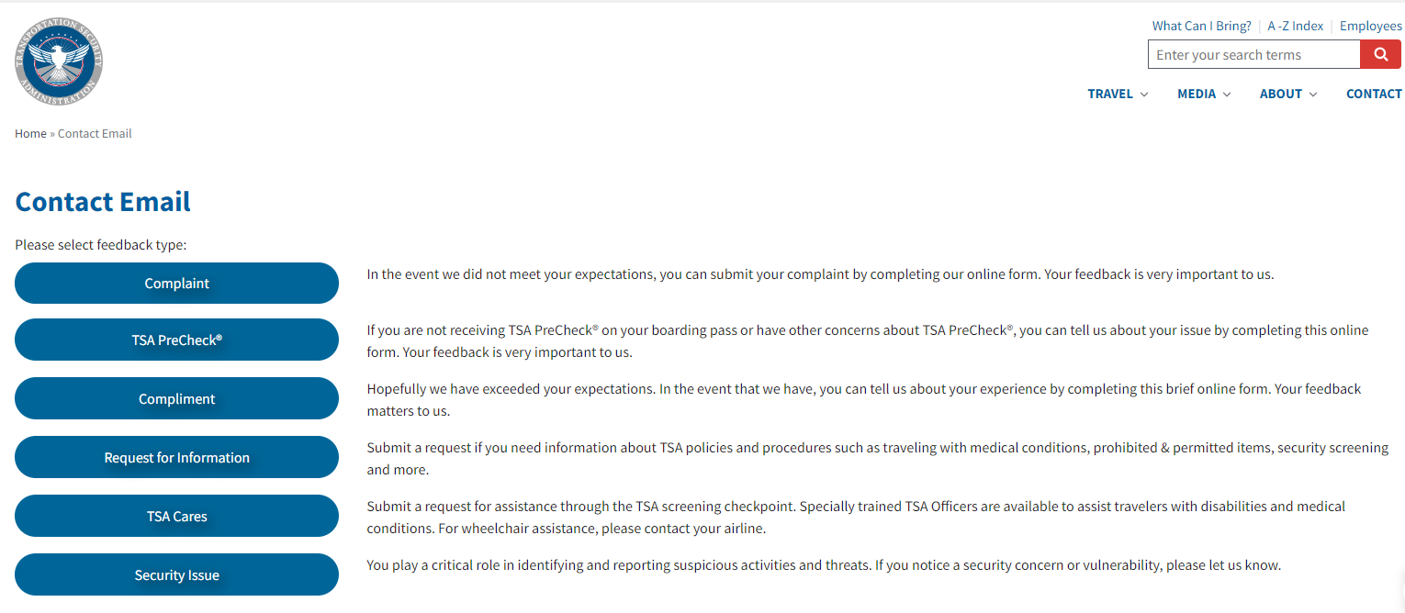
TSA Customer Comment Tools

Slide 3
Complaint

Slide 4
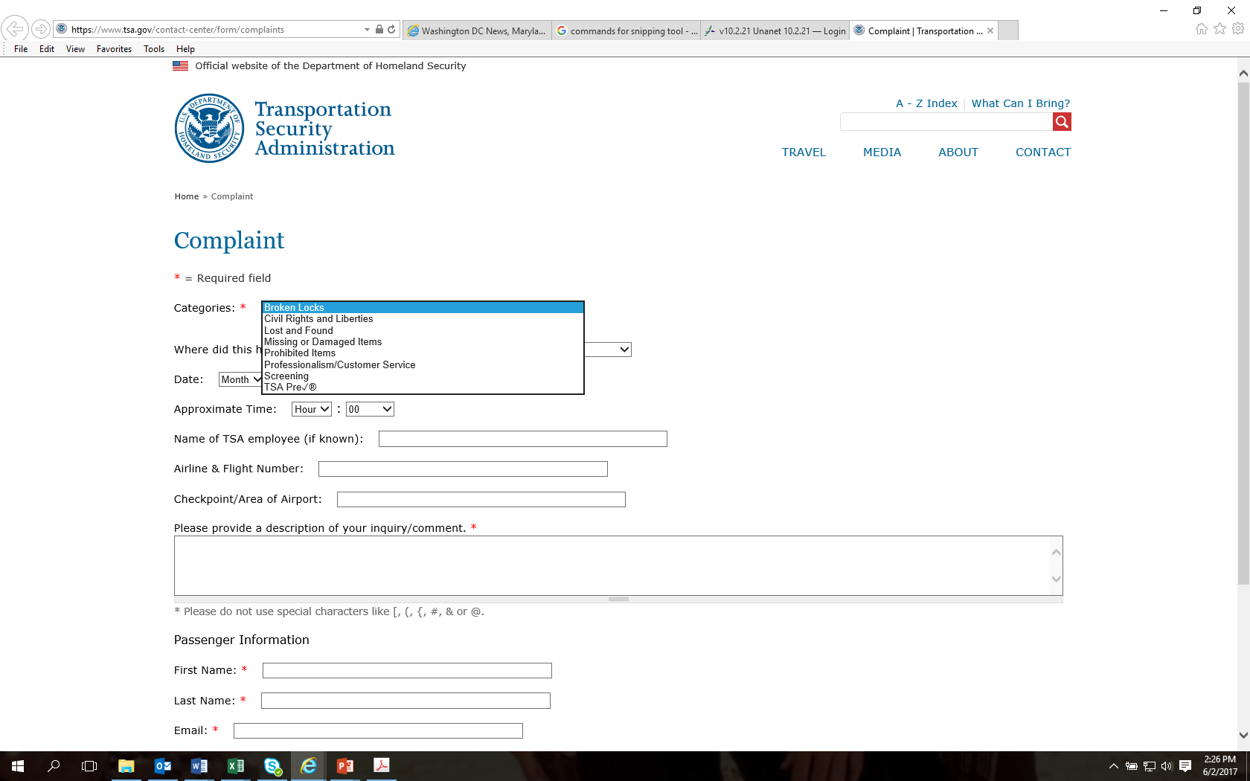

Slide 5
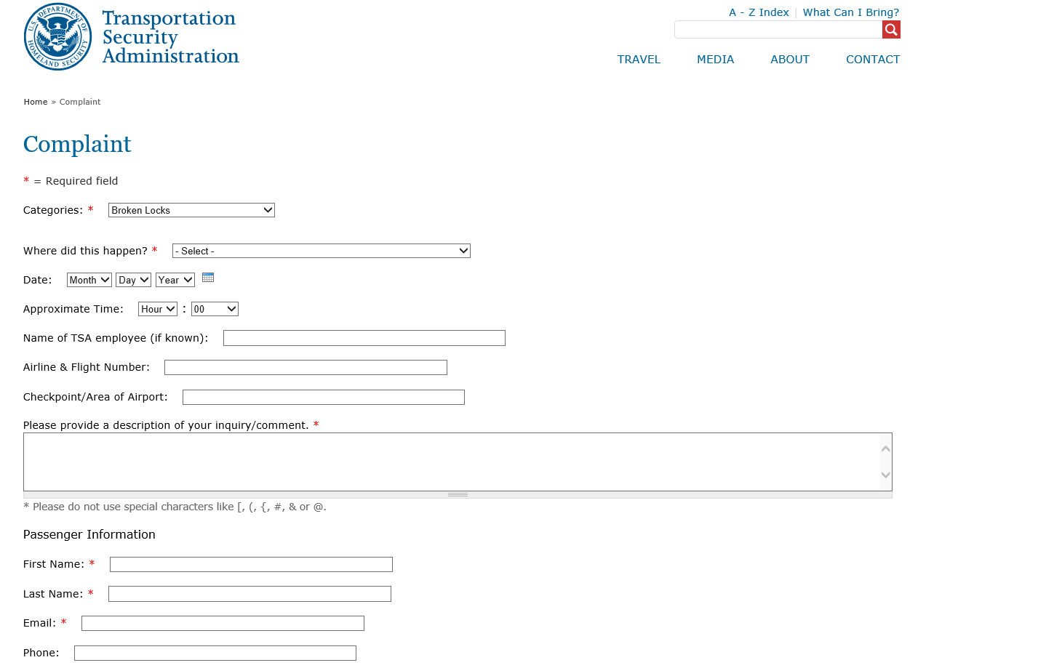

Slide 6
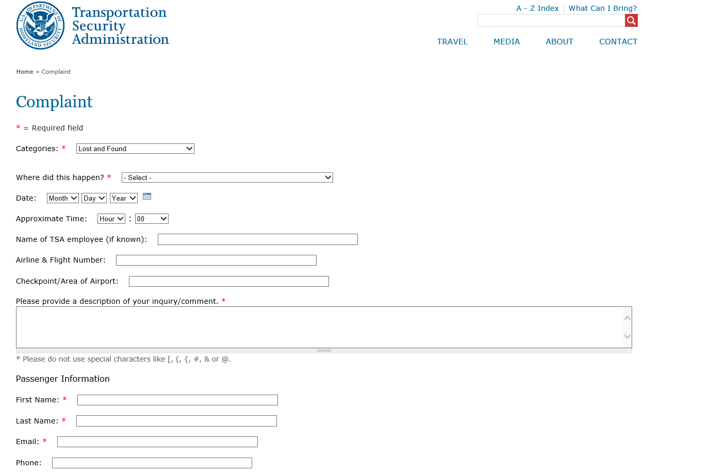

Slide 7
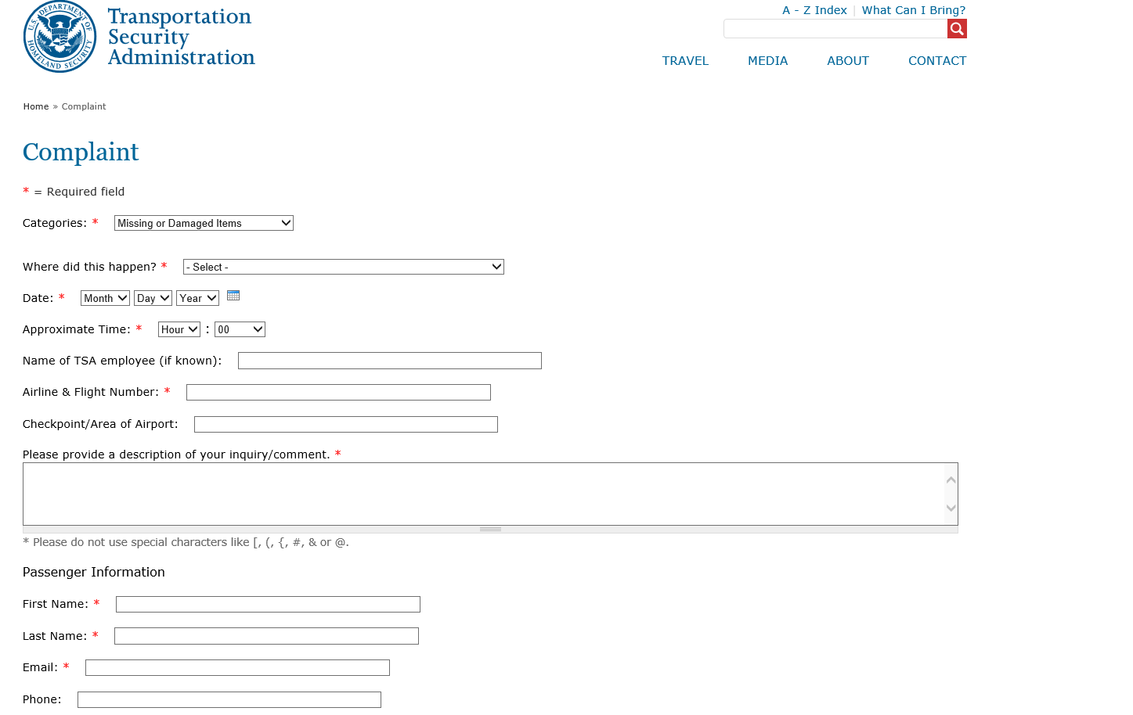

Slide 8
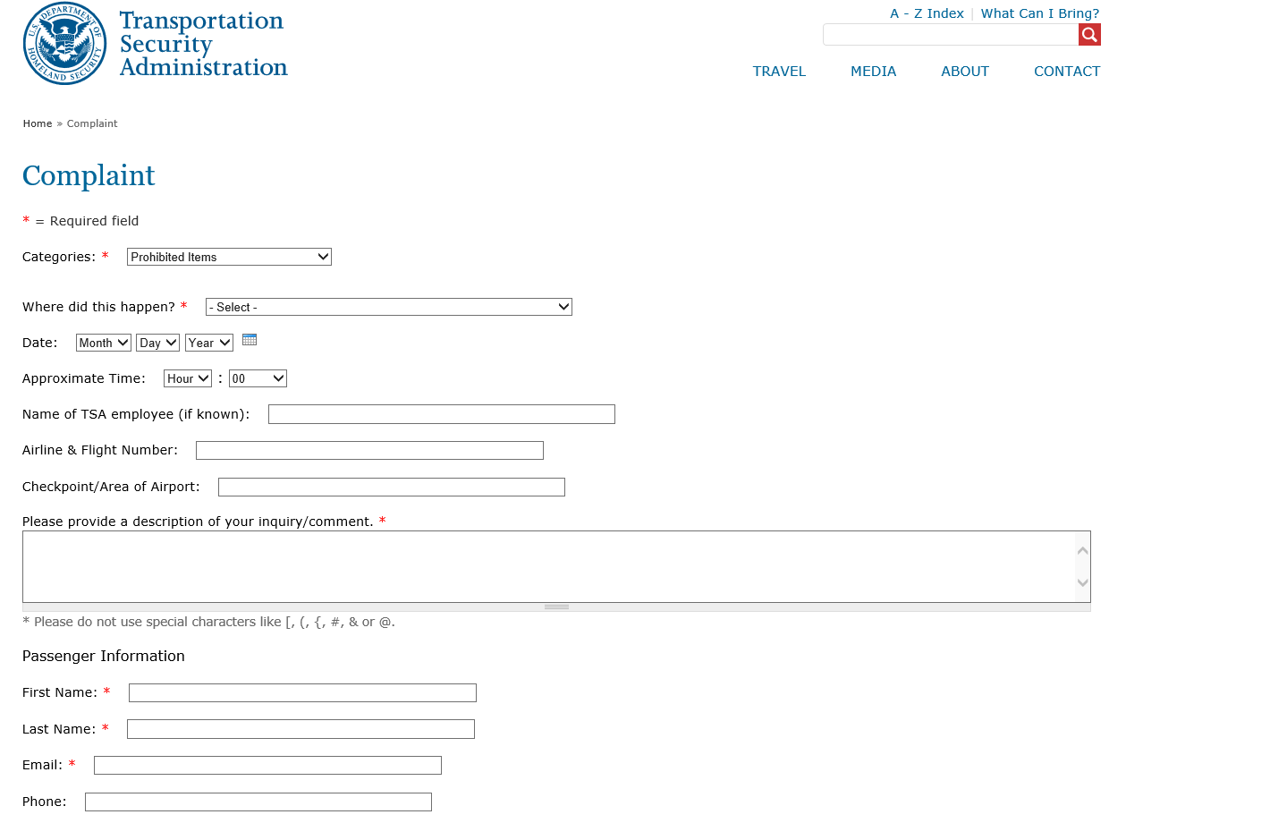

Slide 9
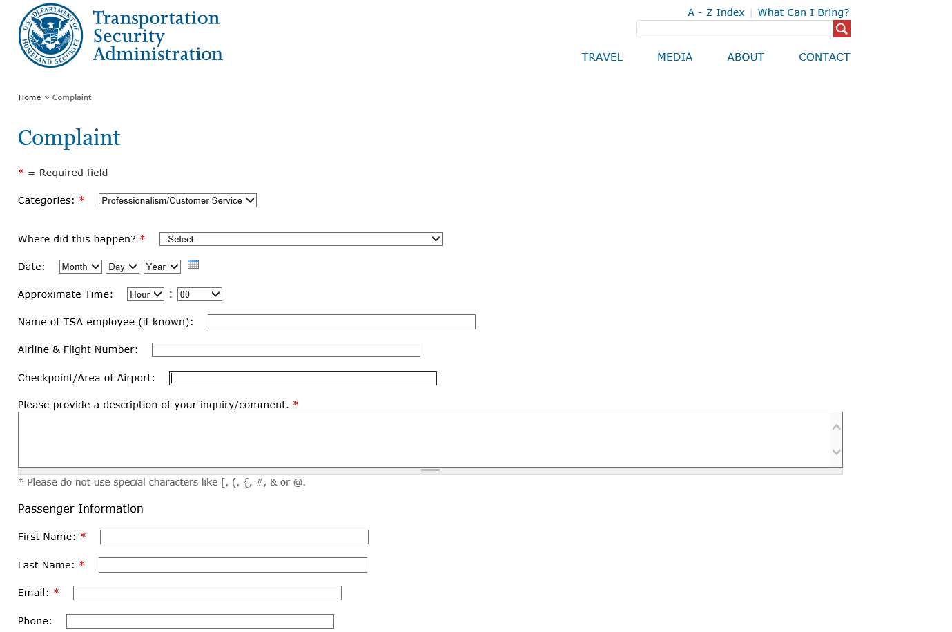

Slide 10
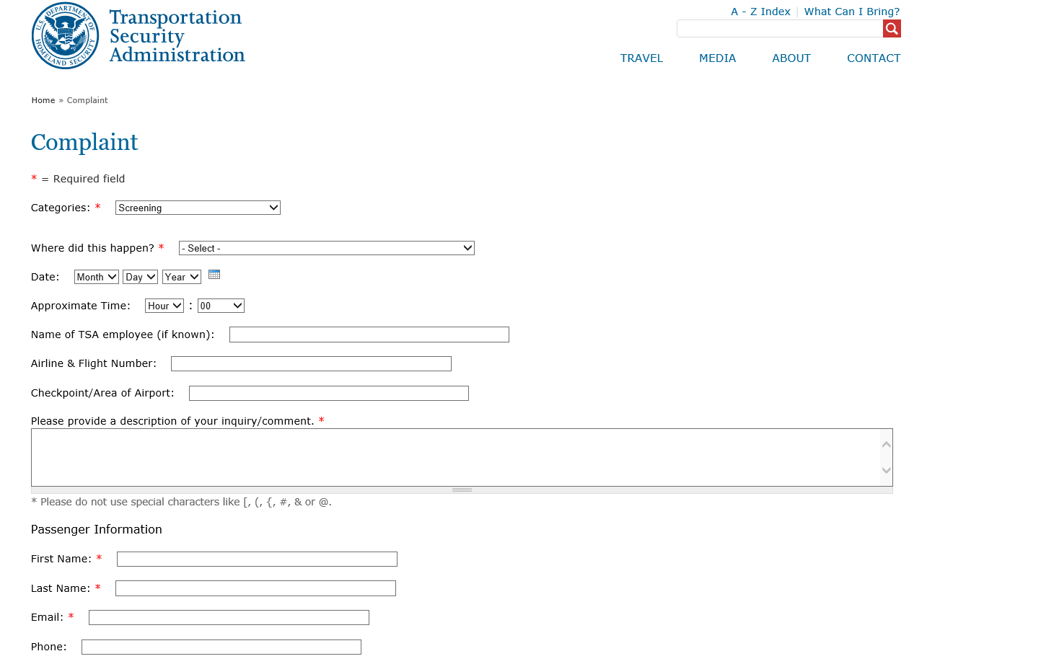

Slide 11
TSA Precheck

Slide 12
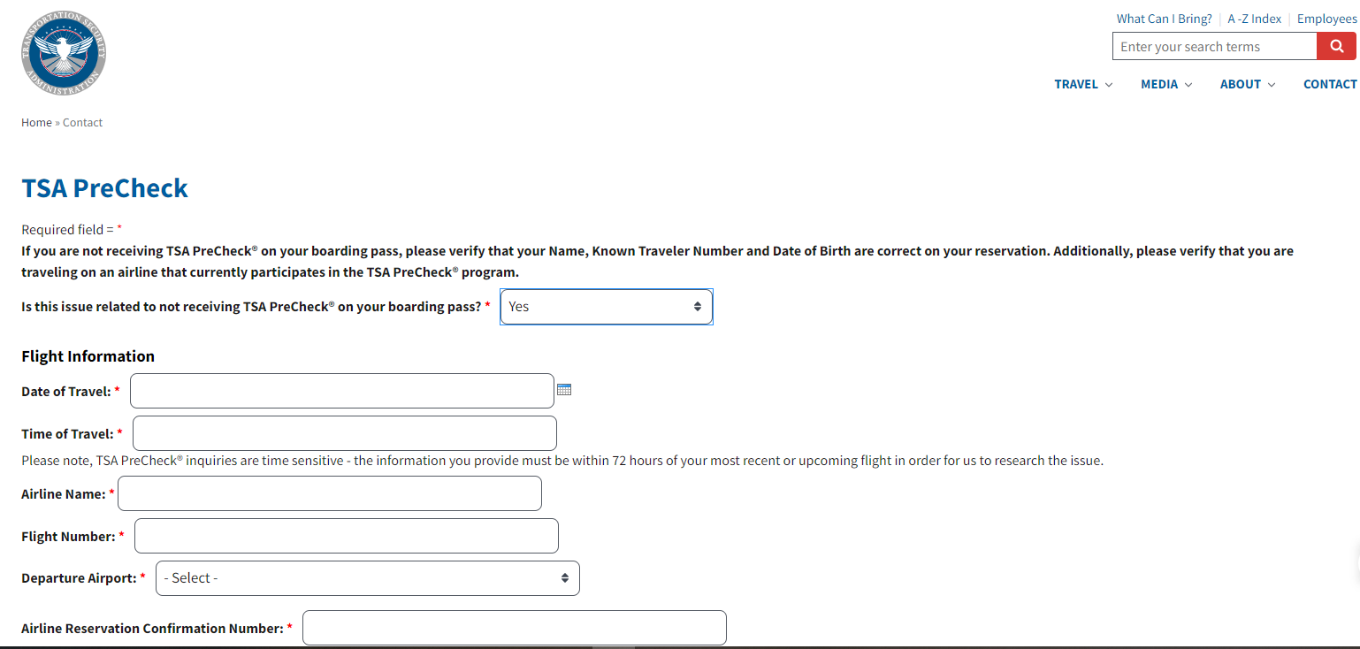

Slide 13
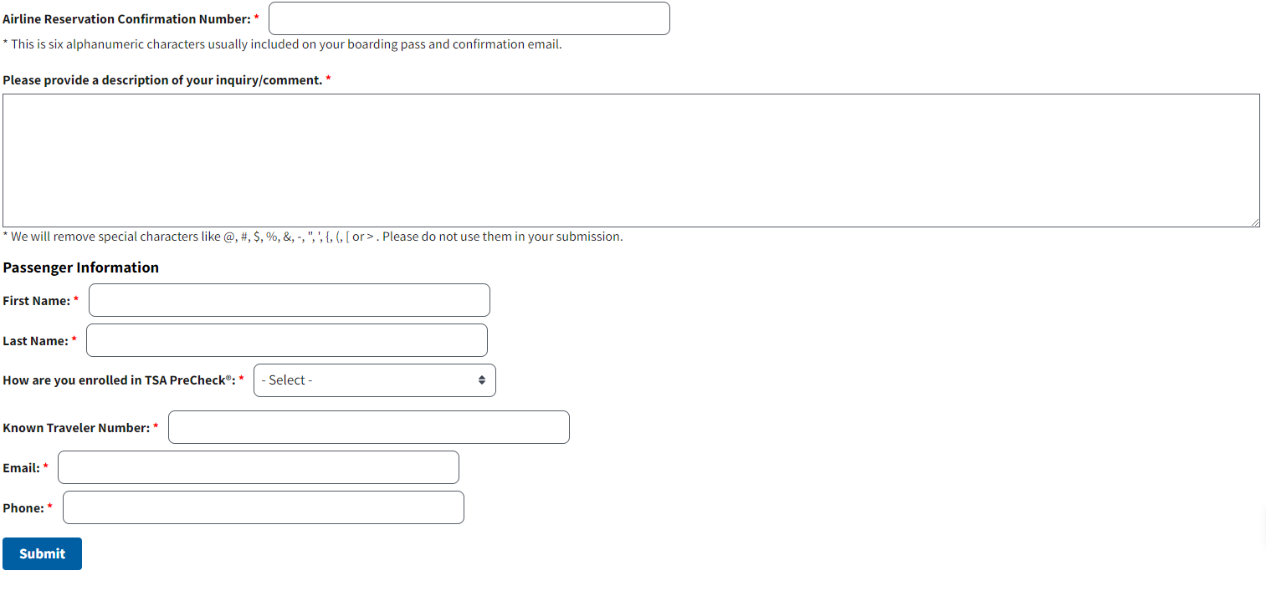

Slide 14
Compliment

Slide 15
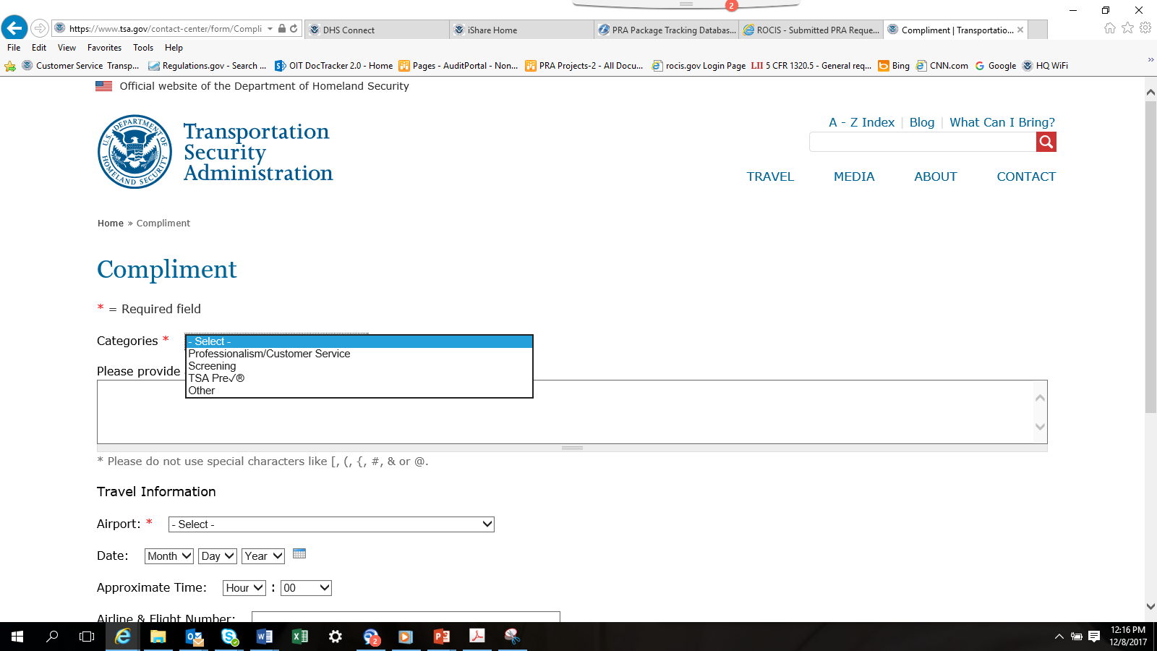

Slide 16
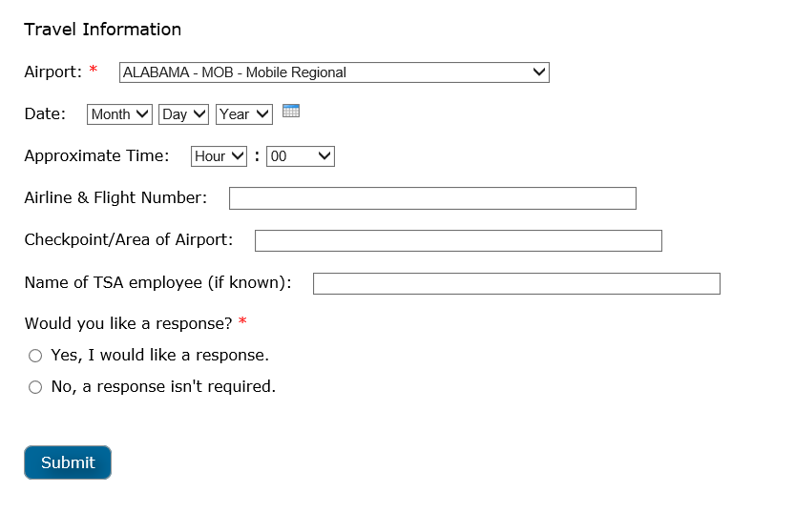

Slide 17
Request for Information

Slide 18
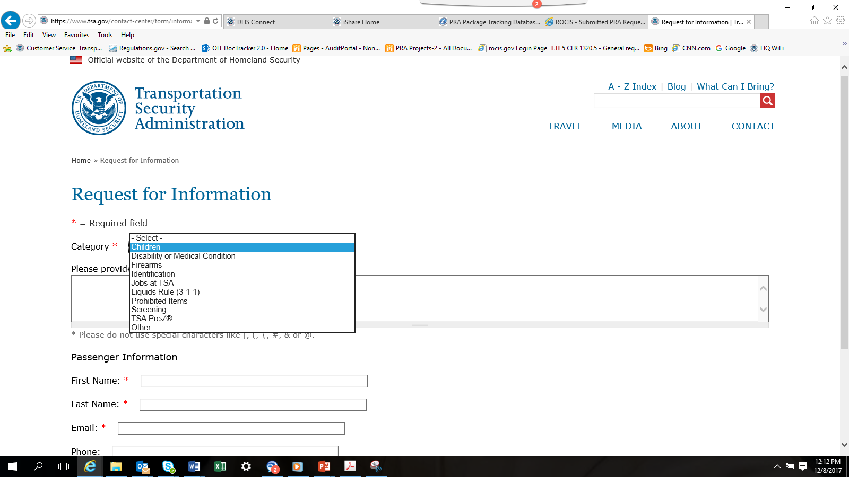

Slide 19
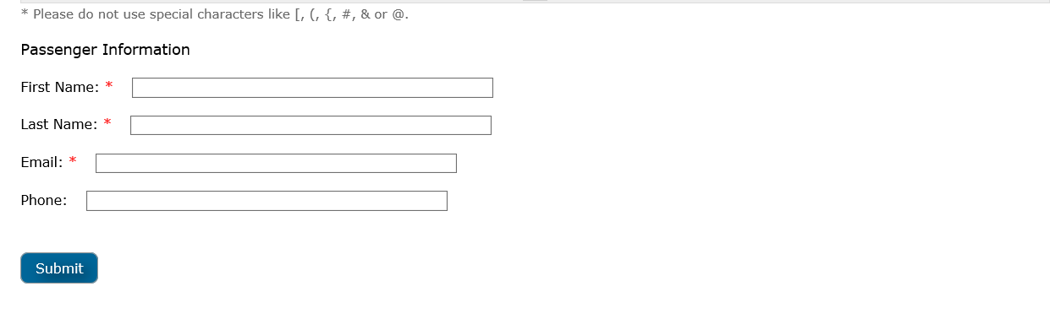

Slide 20
TSA CARES

Slide 21
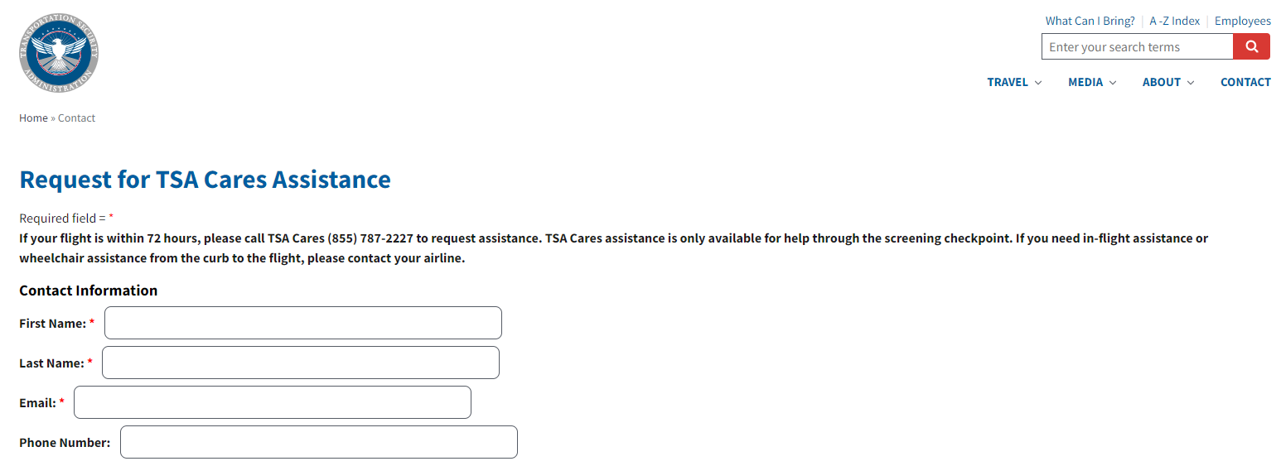

Slide 22
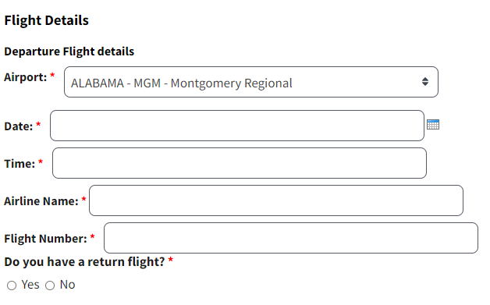

Slide 23
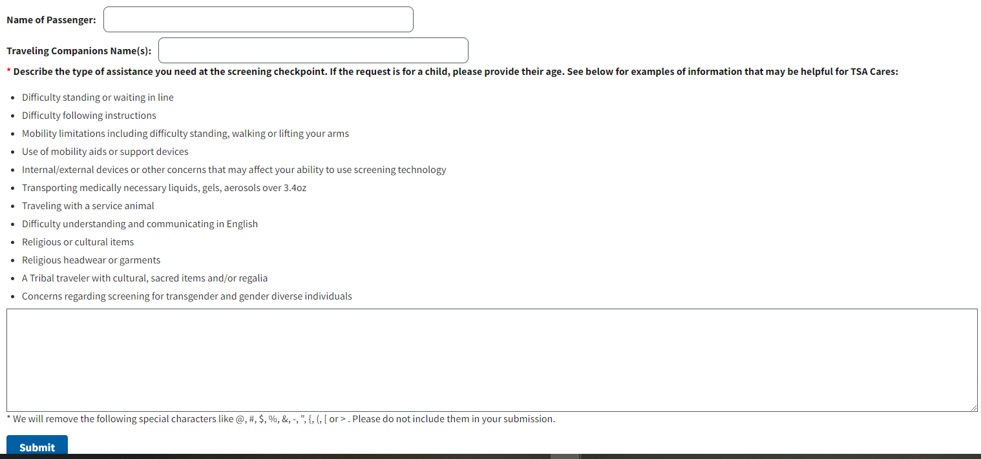

Slide 24
Security Issue

Slide 25
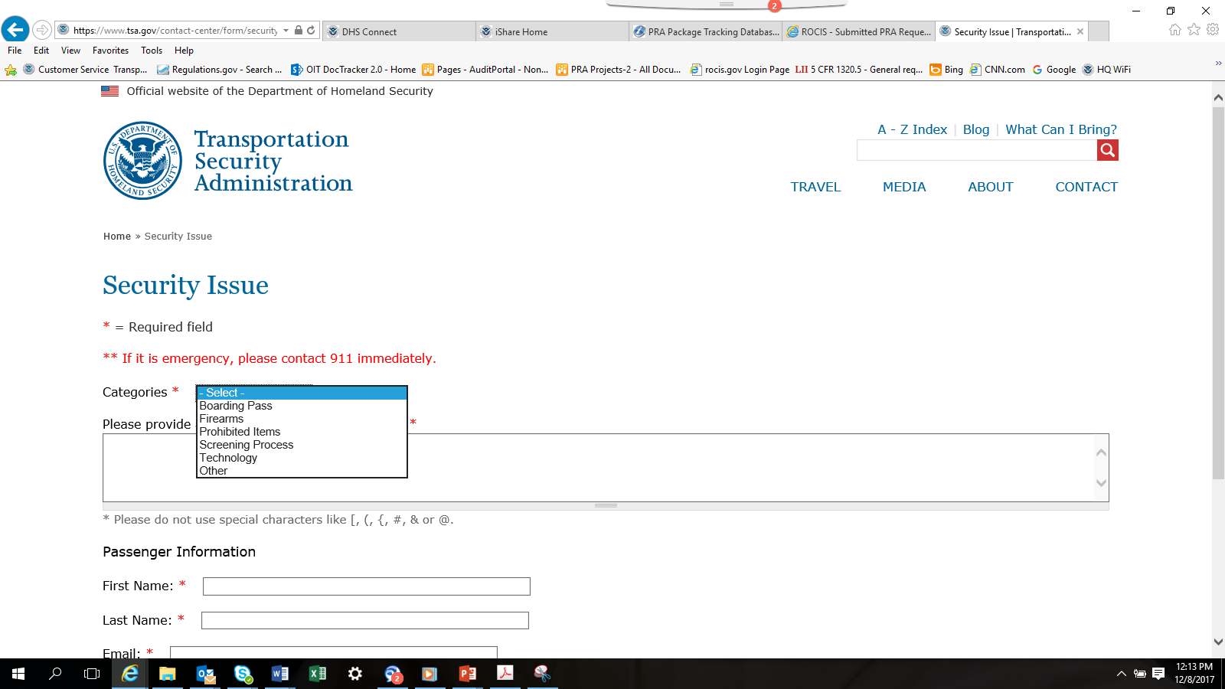

Slide 26
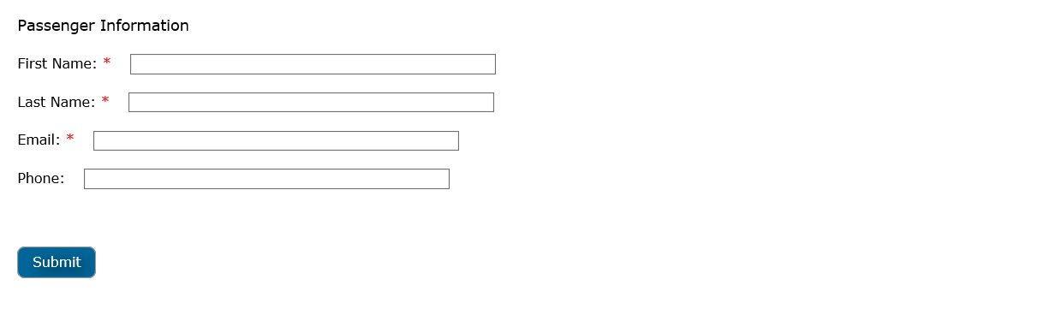

Slide 28
Privacy ACT & Paperwork Reduction Act Statements

Slide 29
Privacy Act & Paperwork Reduction Act Statements
Privacy Act Statement:
AUTHORITY: 49 USC § 114(f)(15). PRINCIPAL PURPOSE(S): This information will be used to manage and respond to traveler inquiries or complaints. ROUTINE USE(S): This information may be shared in accordance with the Privacy Act of 1974, 5 USC § 552(a), for routine uses identified in the TSA system of records, DHS/TSA-006 Correspondence and Matters Tracking Records, or as further described in the Privacy Impact Assessment DHS/TSA/PIA-046 TSA Contact Center, and subsequent updates, available at www.dhs.gov/privacy. DISCLOSURE: Furnishing this information is voluntary; however, failure to provide the requested information may prevent TSA from being able to respond to a traveler’s inquiry or complaint.
Paperwork Reduction Act Statement:
TSA will use the information to improve customer service and may share it with airport operators for this purpose. This is a voluntary collection. It is estimated that the total annual burden per response associated to this collection is approximately 5 minutes. An agency may not conduct or sponsor, and a person is not required to respond to a collection of information, unless it displays a valid OMB control number. The control number assigned to this collection is OMB-1652-0030, which expires 4/30/2022. Send comments regarding this burden estimate or any other aspect of this collection of information including suggestions for reducing this burden to TSA PRA Officer, 6595 Springfield Drive, Springfield, VA 20598-6011. ATTN: PRA 1652-0030.

