Slide 1
Registration Intake Internet
5/25/2018

Slide 2
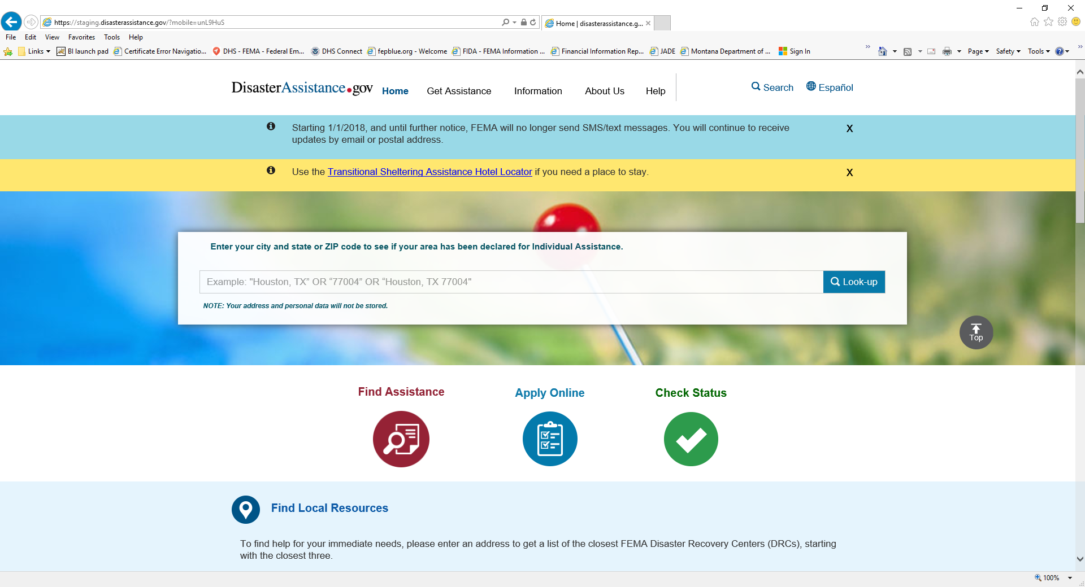
WEB Version of RI

Slide 3
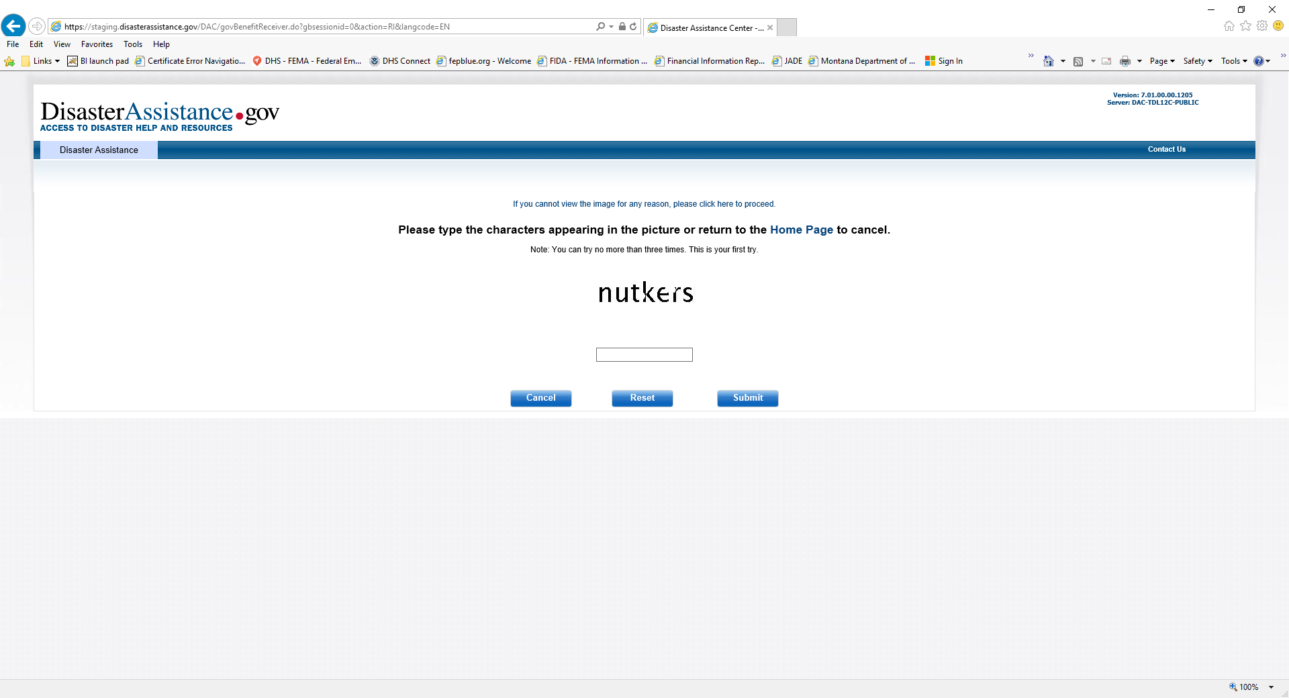

Slide 4
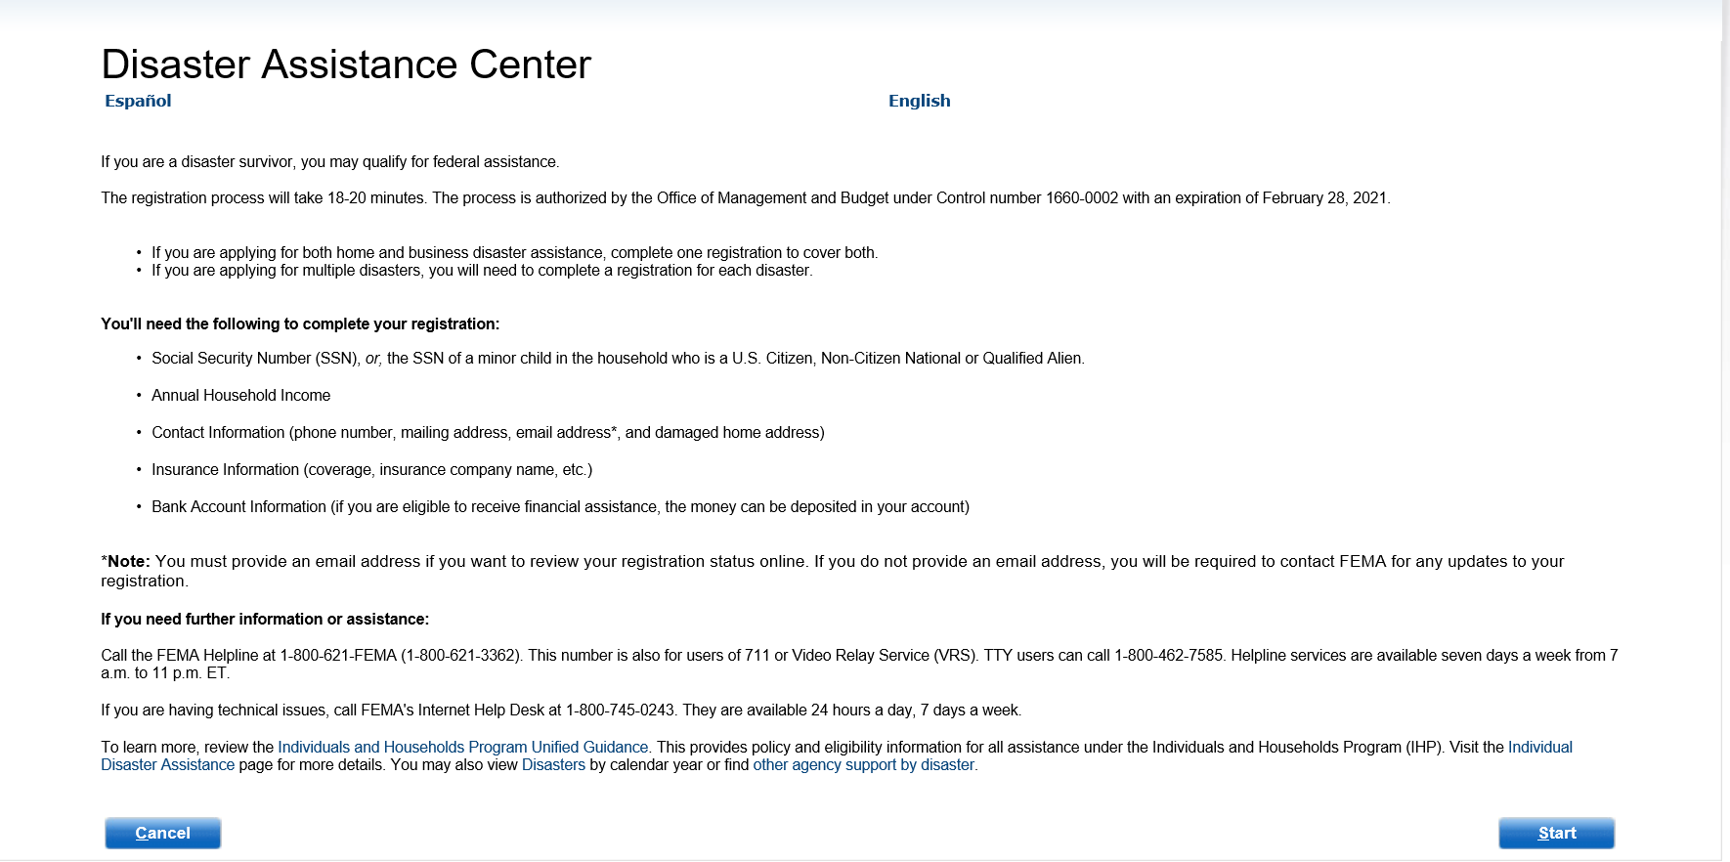
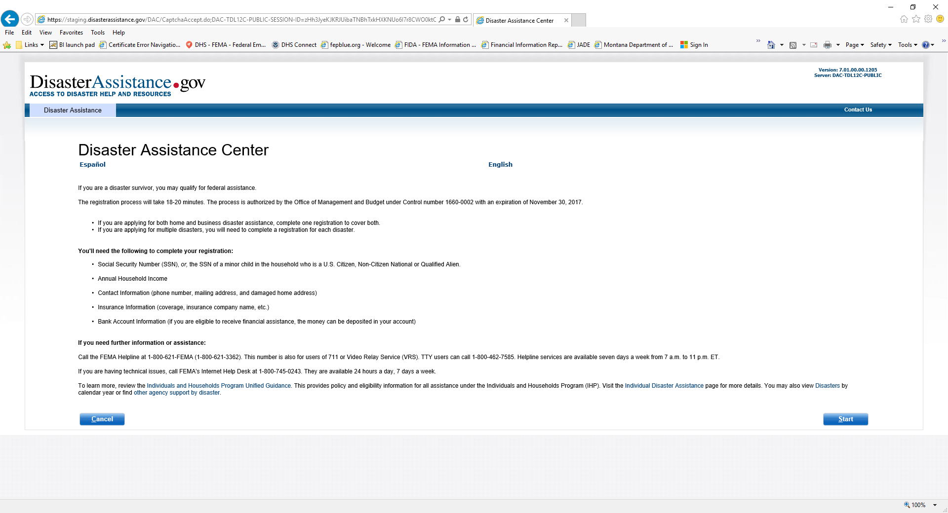
Disaster Assistance Center

Slide 5
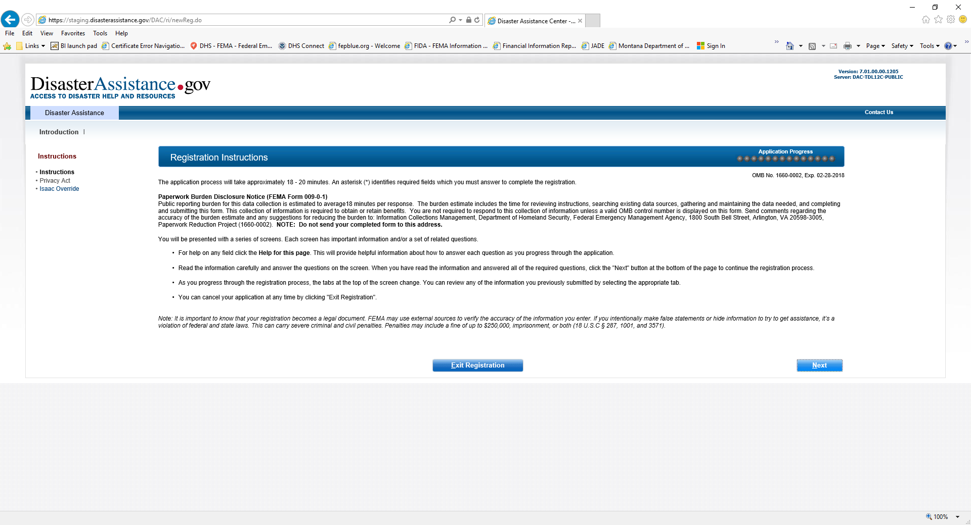
Registration Instructions

Slide 6
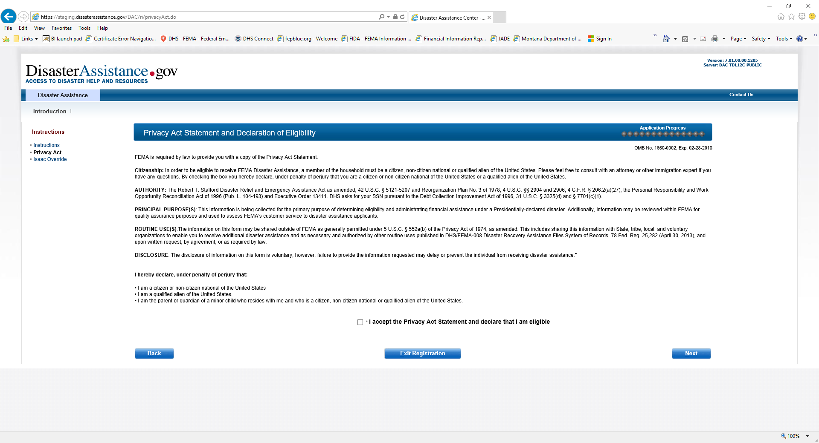
Privacy Act Statement and Declaration of Eligibility

Slide 7
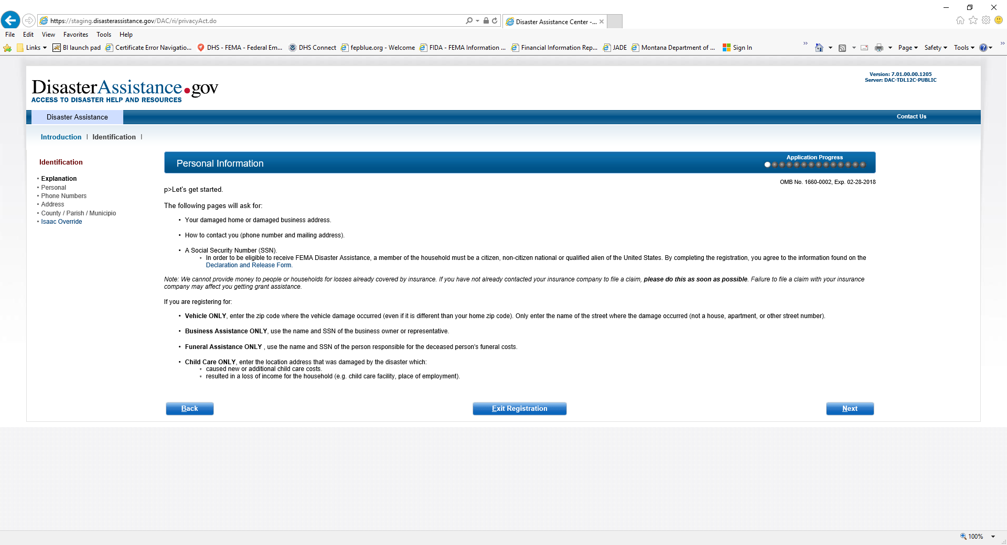
Personal Information

Slide 8
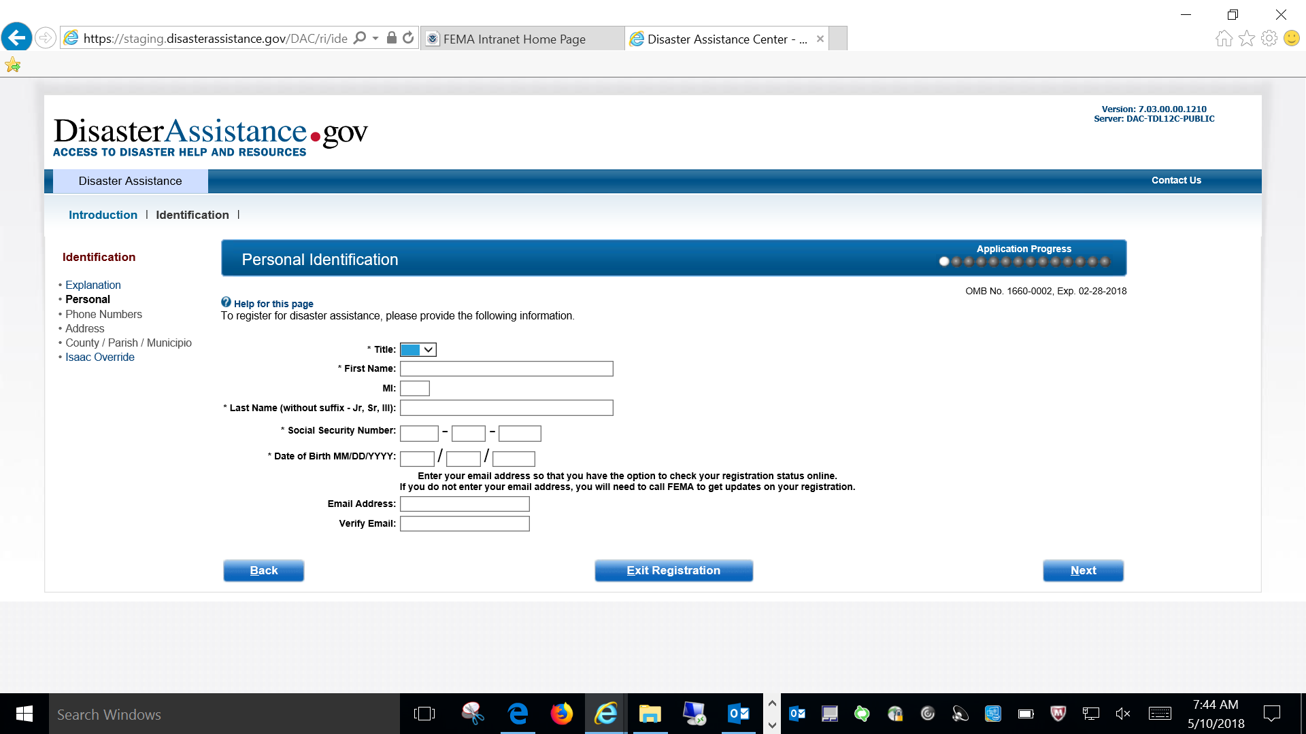
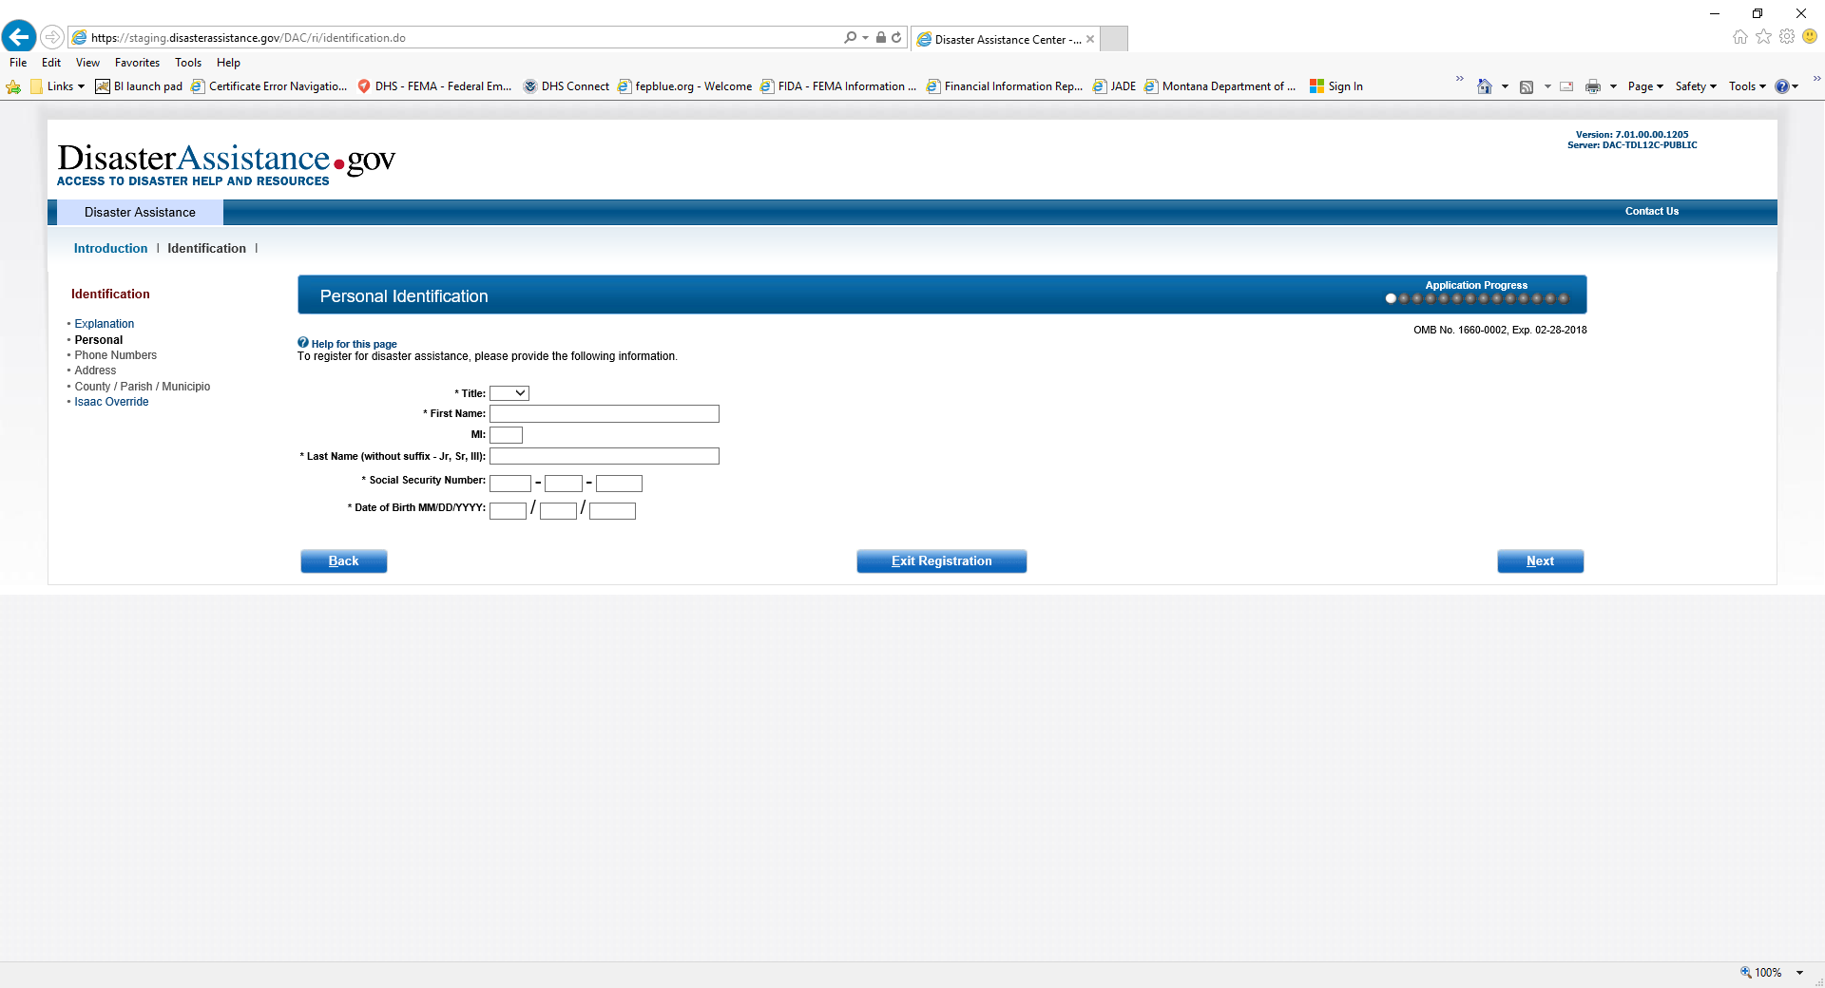
Personal Information

Slide 9
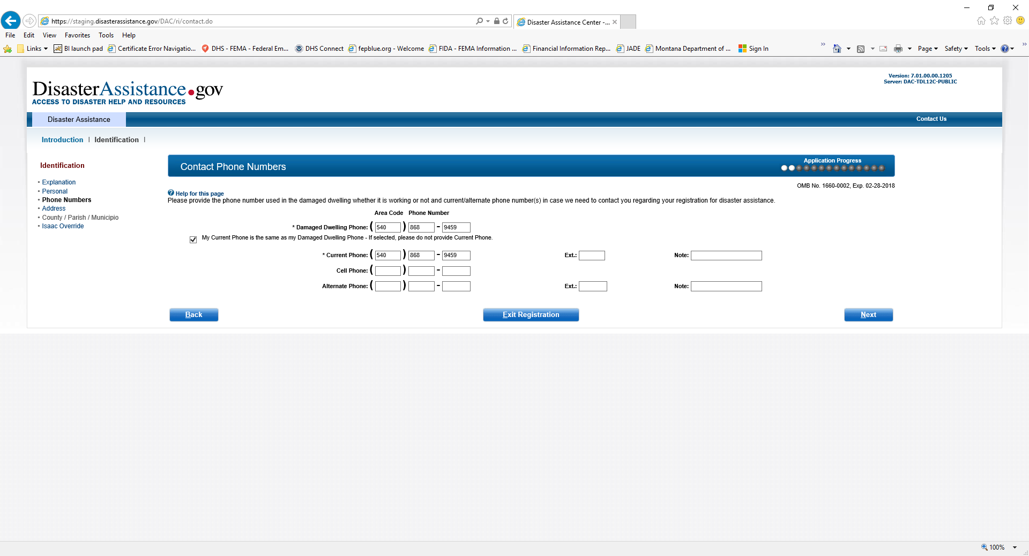
Contact Phone Numbers

Slide 10
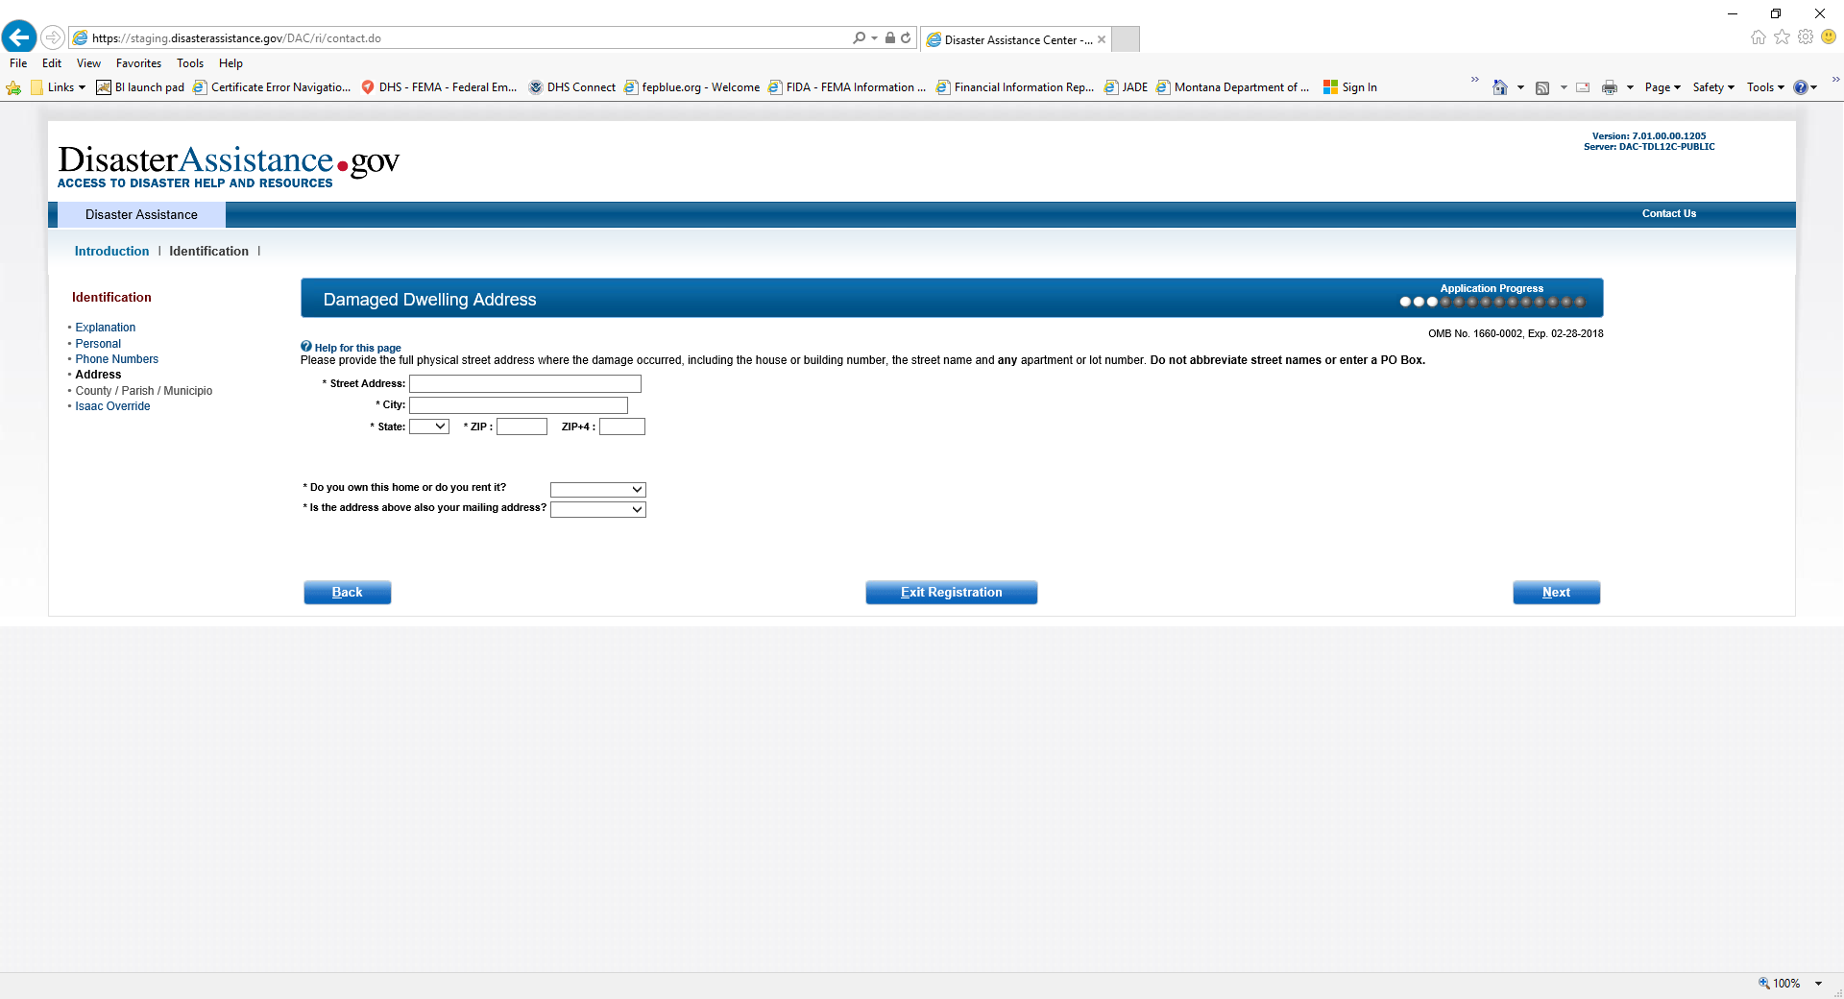
Damage Dwelling Address

Slide 11
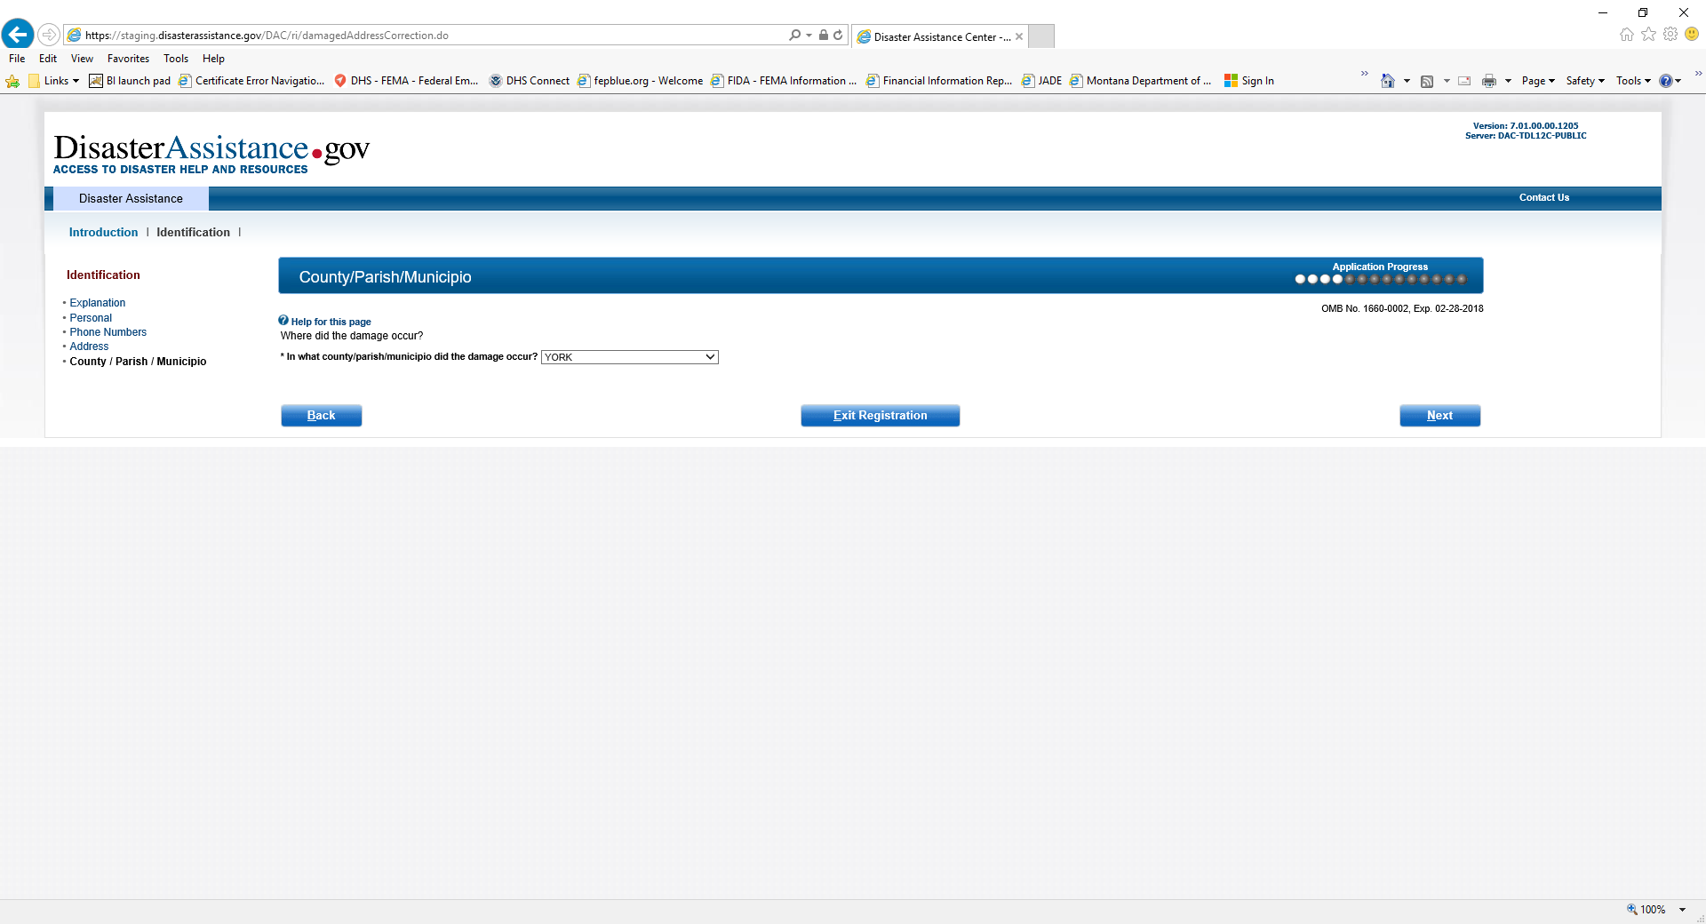
County/Parish/Municipio

Slide 12
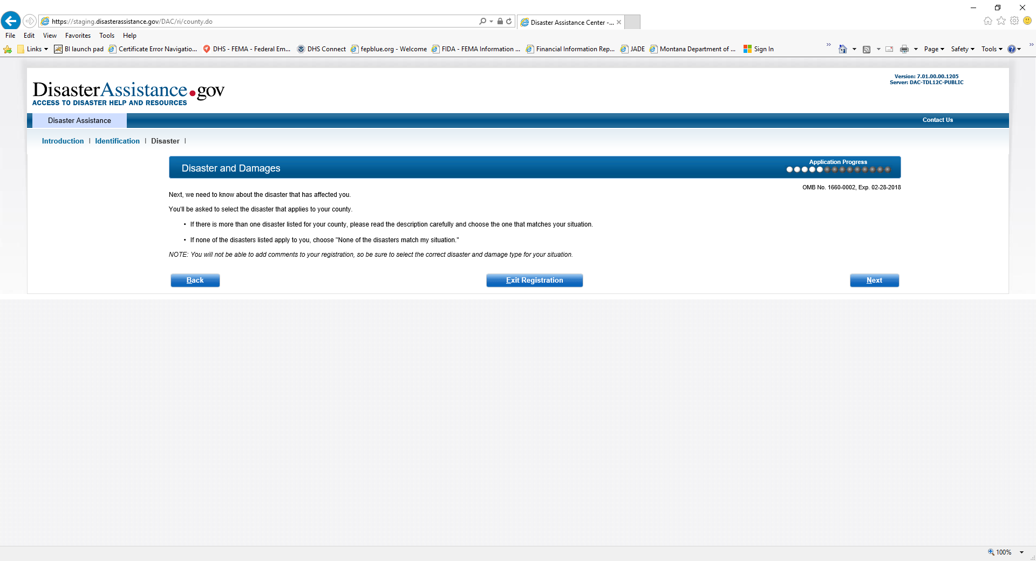
Disaster and Damages

Slide 13
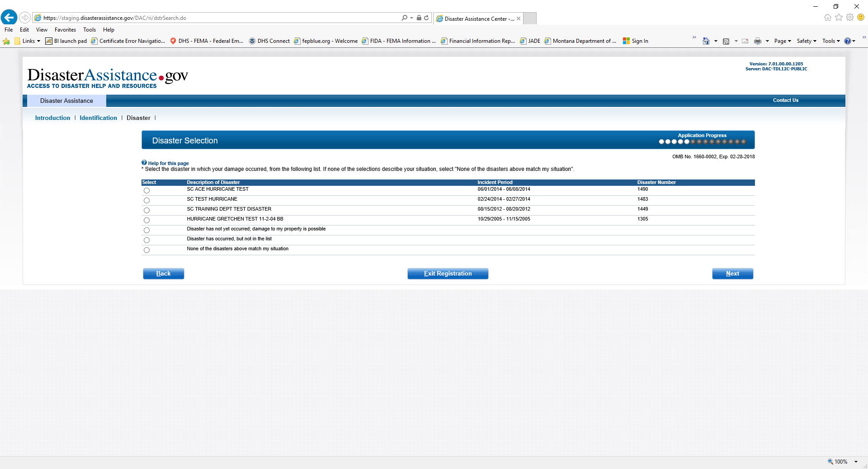
Disaster Selection

Slide 14
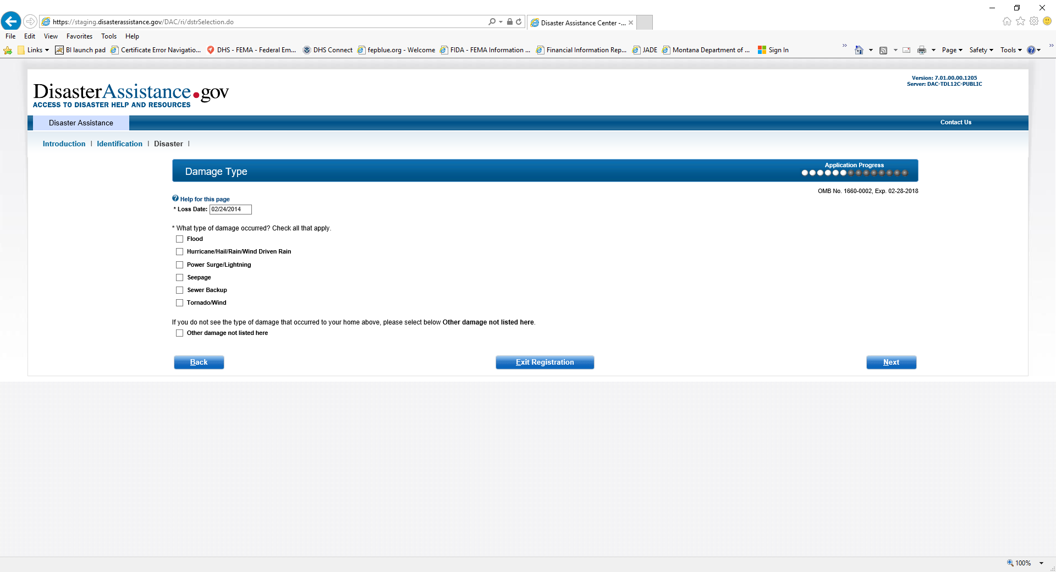
Damage Type

Slide 15
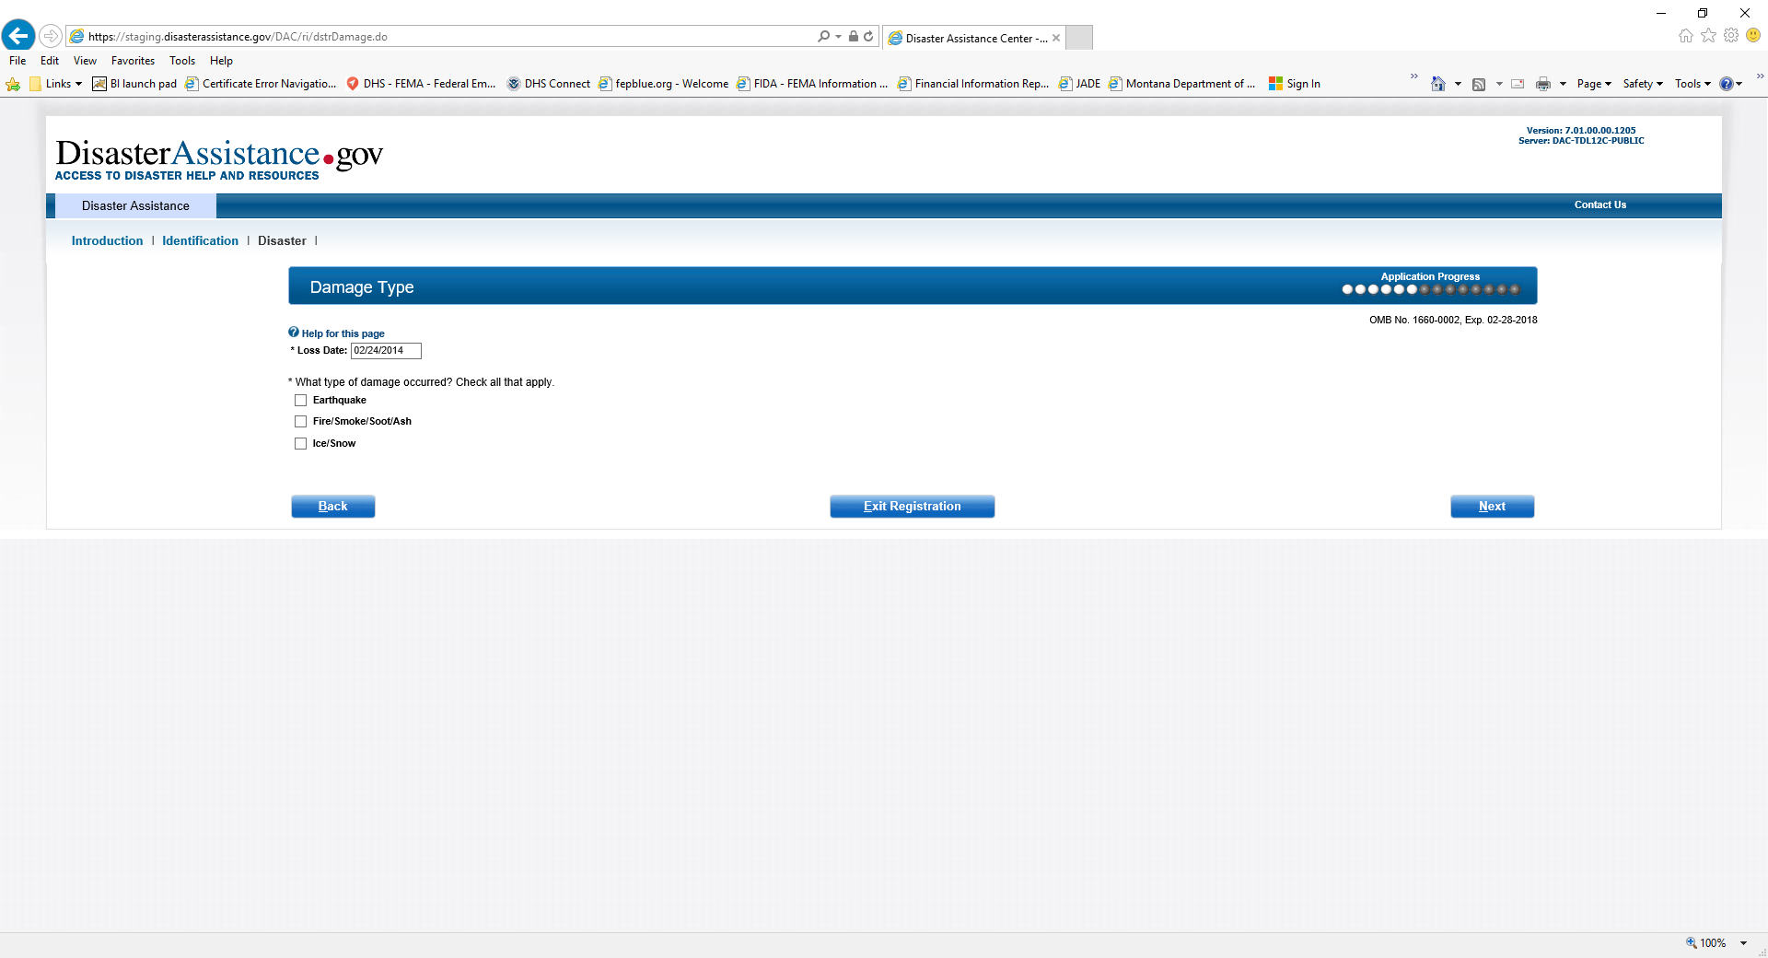
Damage Type “Other”

Slide 16
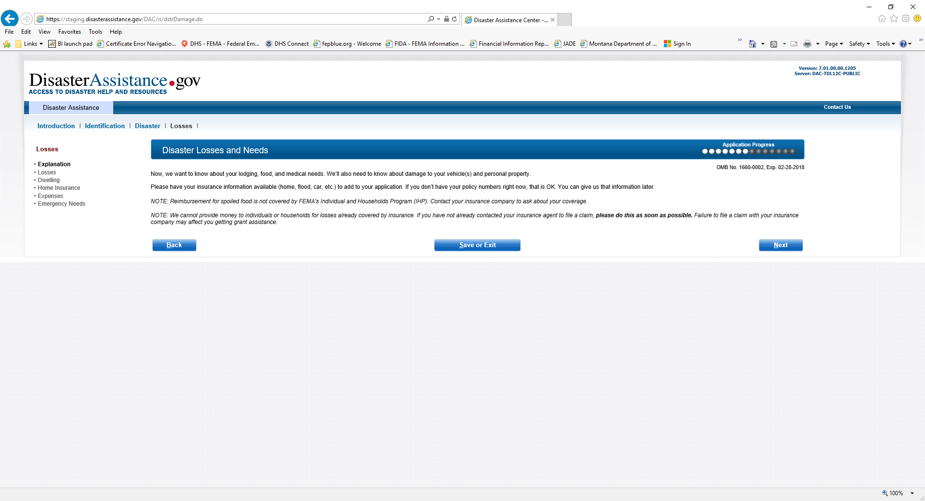
Disaster Losses and Needs

Slide 17
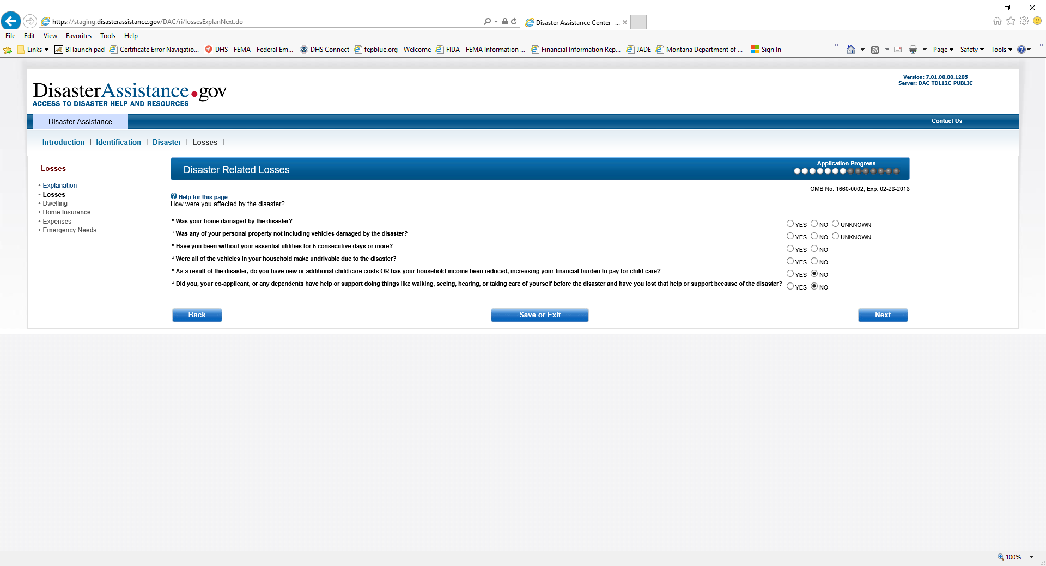
Disaster Related Losses

Slide 18
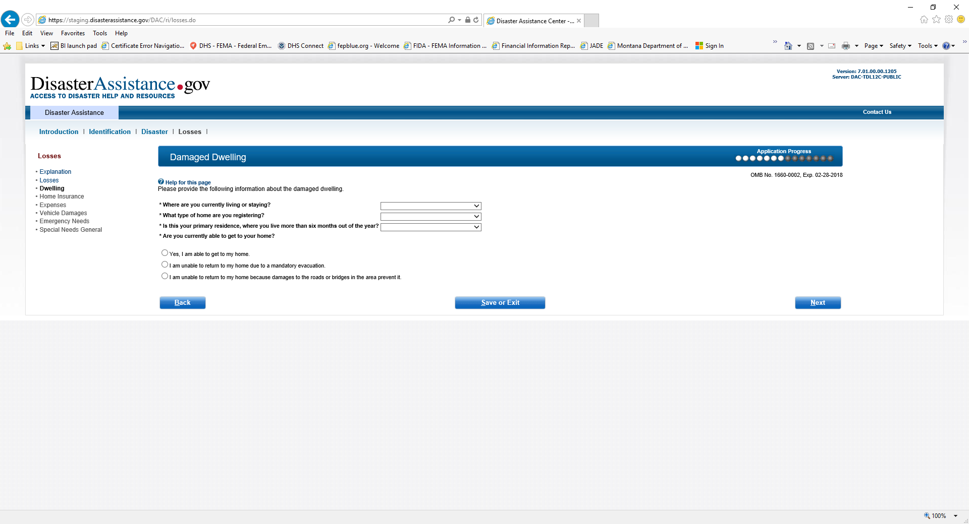
Damaged Dwelling

Slide 19
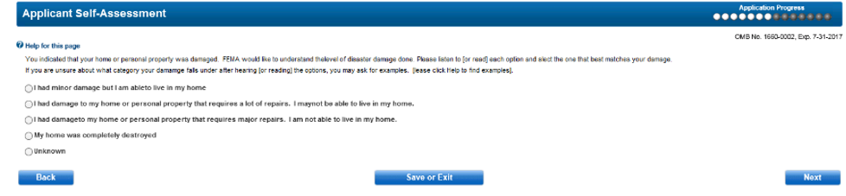
New Screen

Slide 20
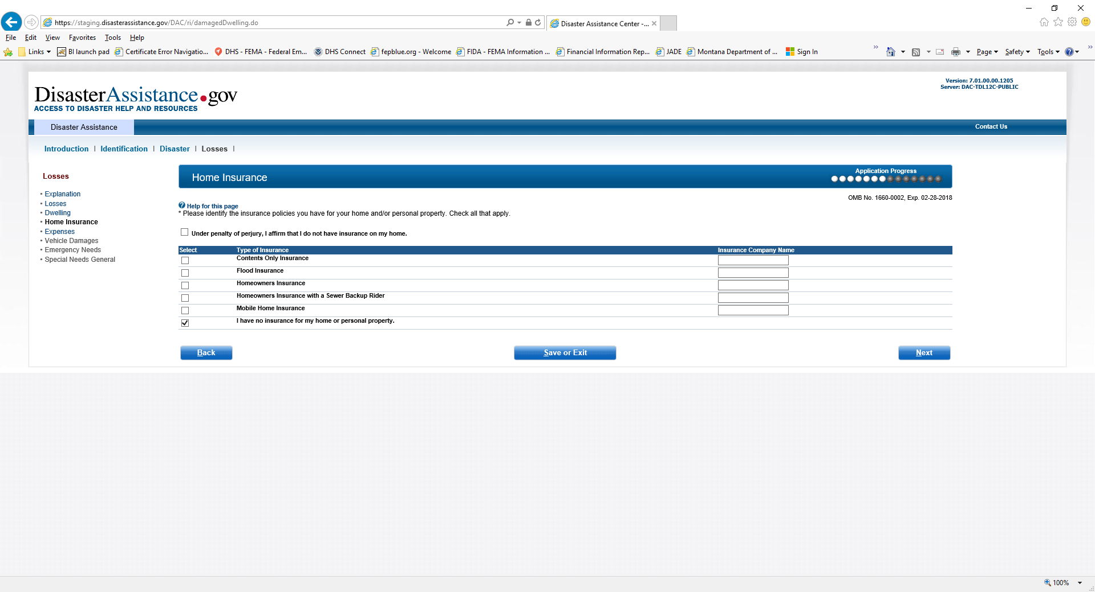
Home Insurance

Slide 21
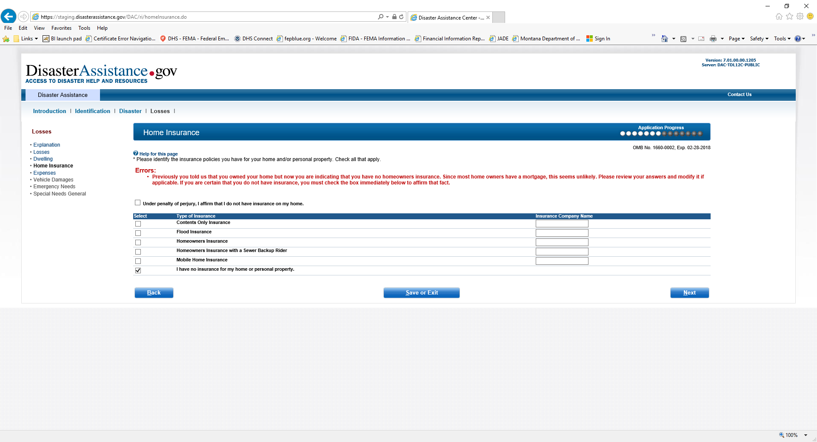
Home Insurance (If did not note insurance for home then must select Under Penalty of perjury prior to moving on)

Slide 22
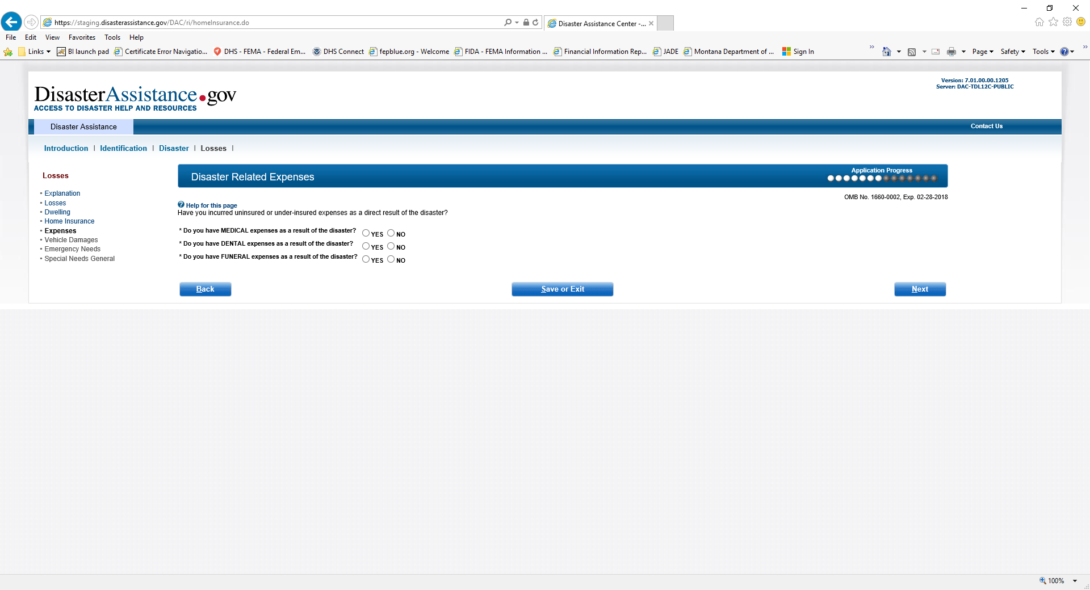
Disaster Related Expenses

Slide 23
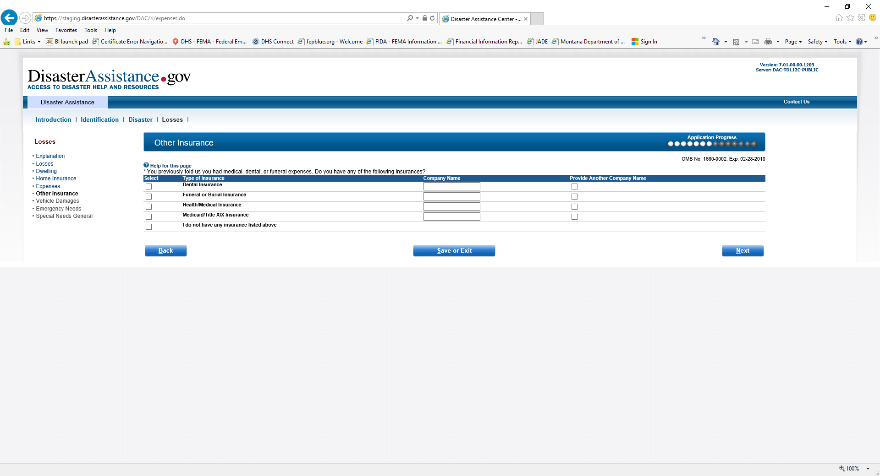
Other Insurance

Slide 24
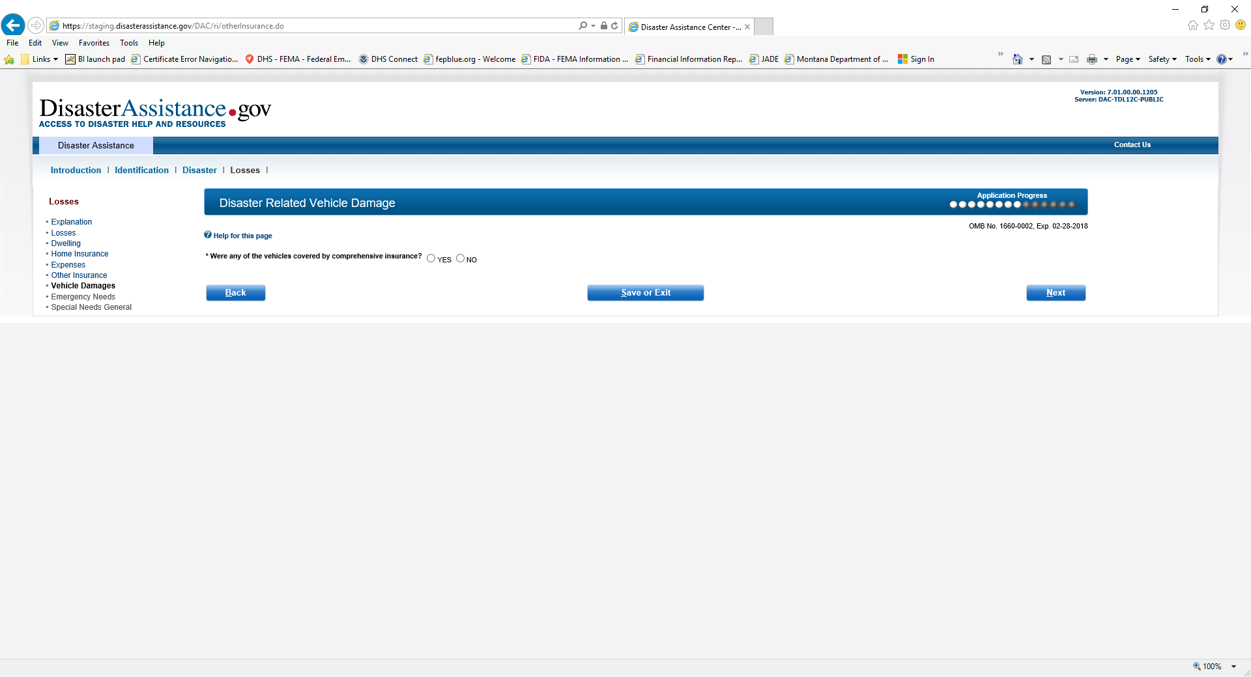
Disaster Related Vehicle Damage

Slide 25
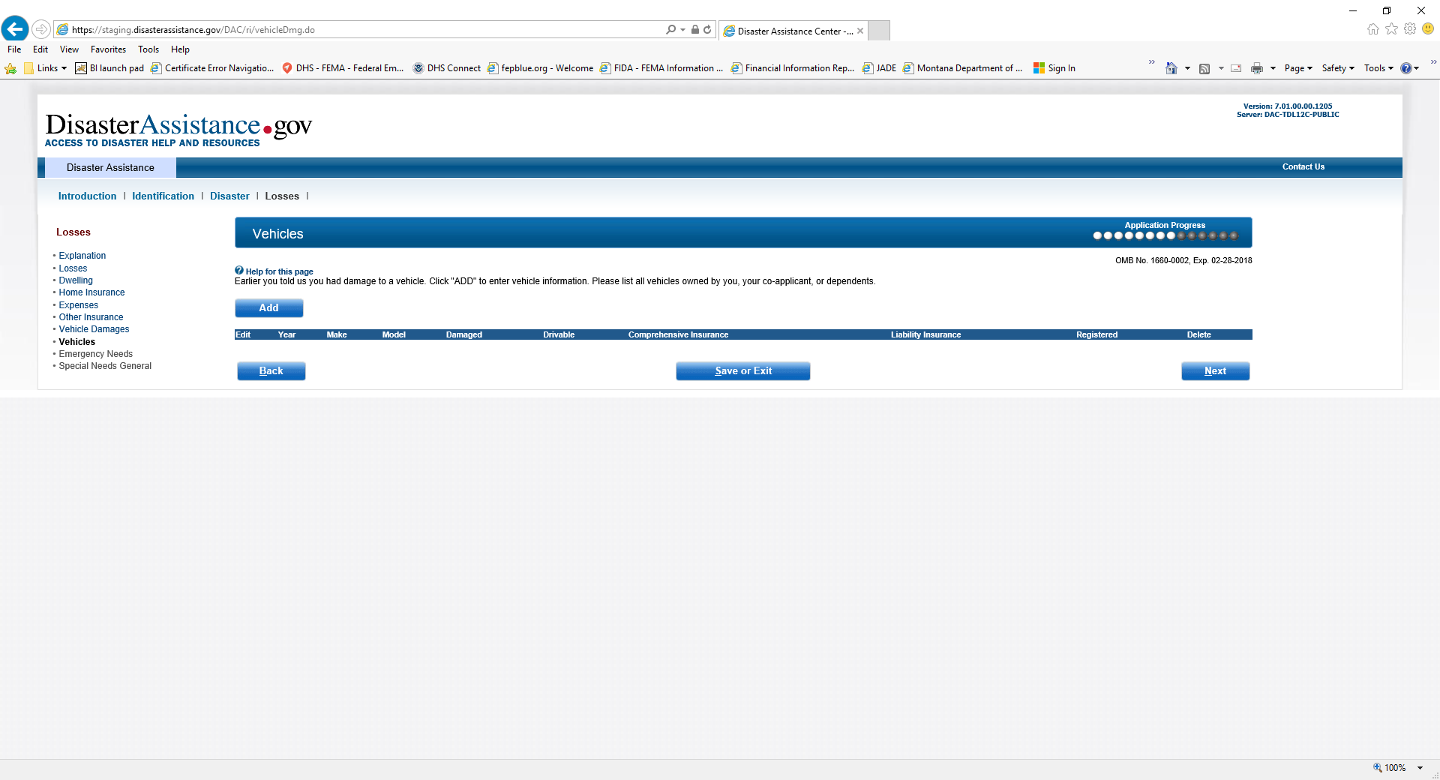
Vehicles

Slide 26
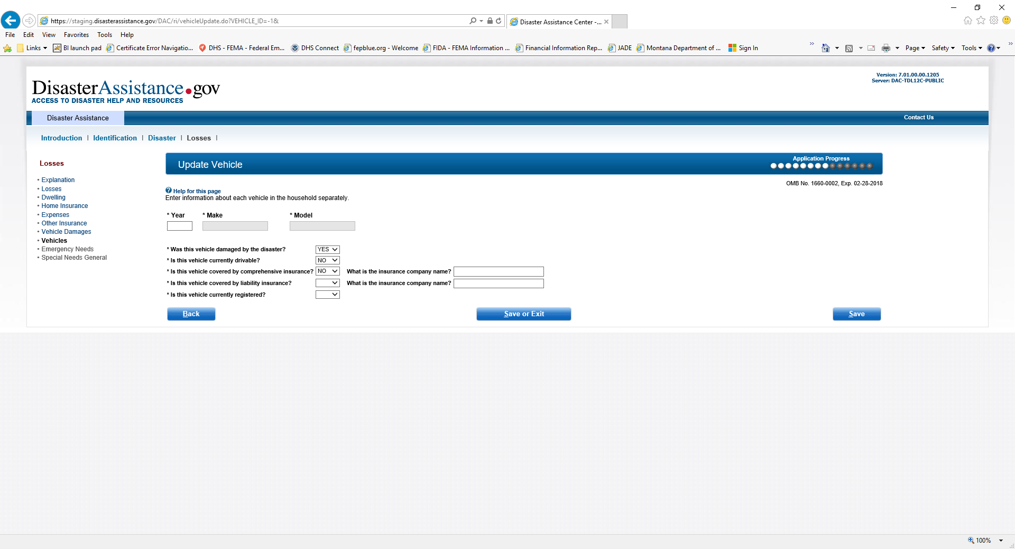
Update Vehicle

Slide 27
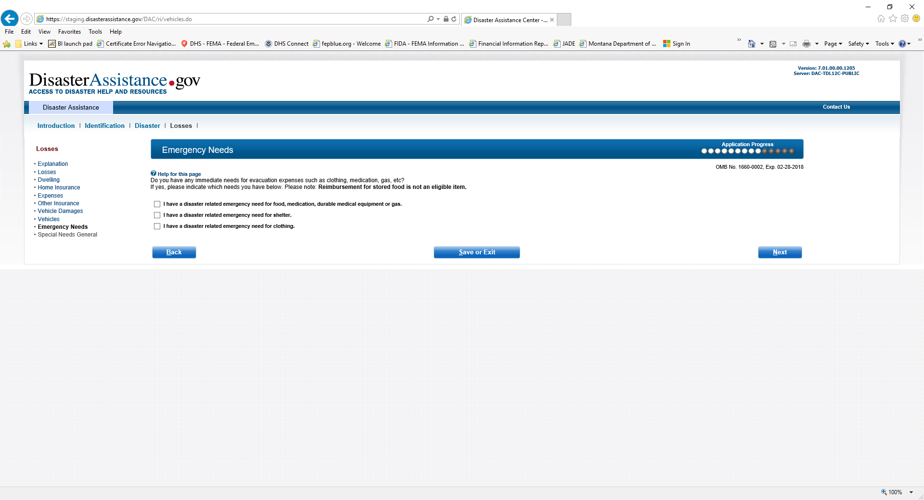
Emergency Needs

Slide 28
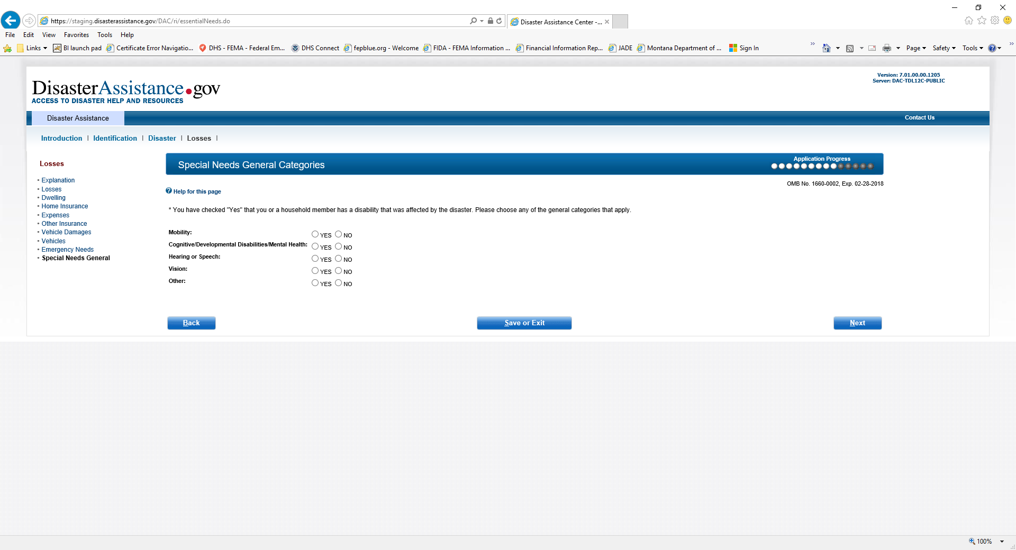
Special Needs General Categories

Slide 29
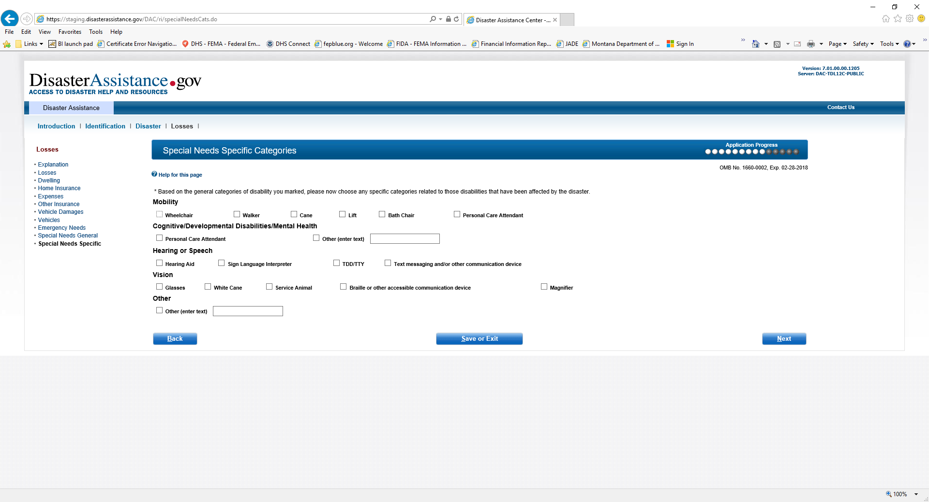
Special Needs Specific Categories

Slide 30
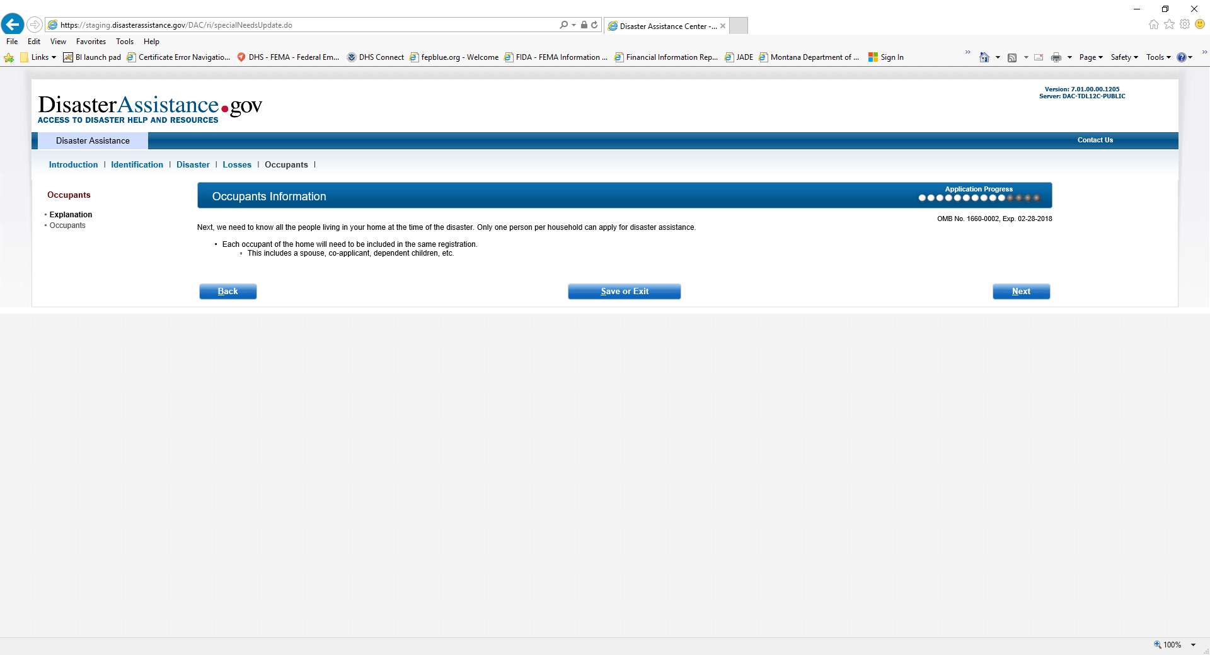
Occupants Information

Slide 31
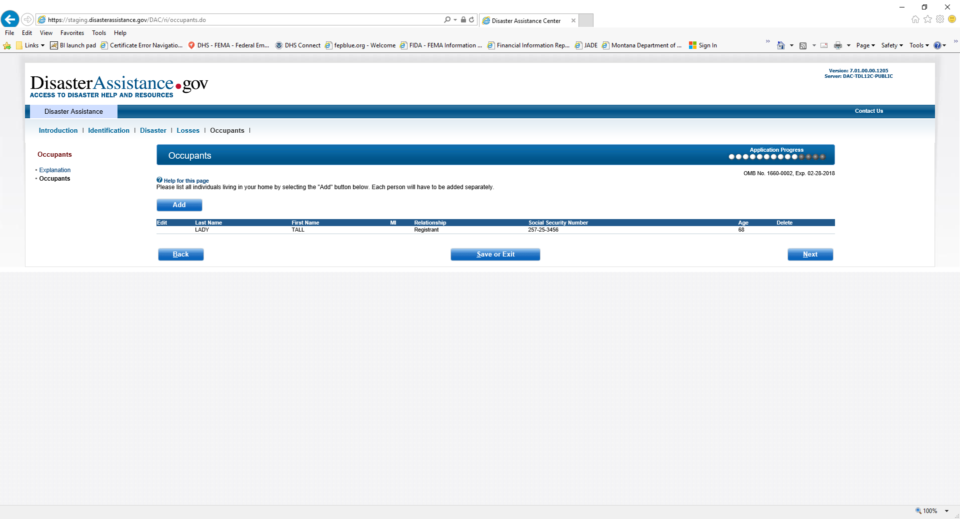
Occupants

Slide 32
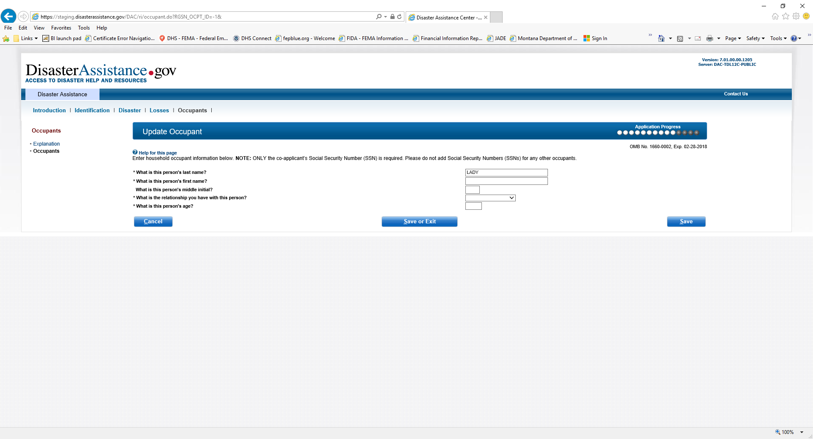
Update Occupant

Slide 33
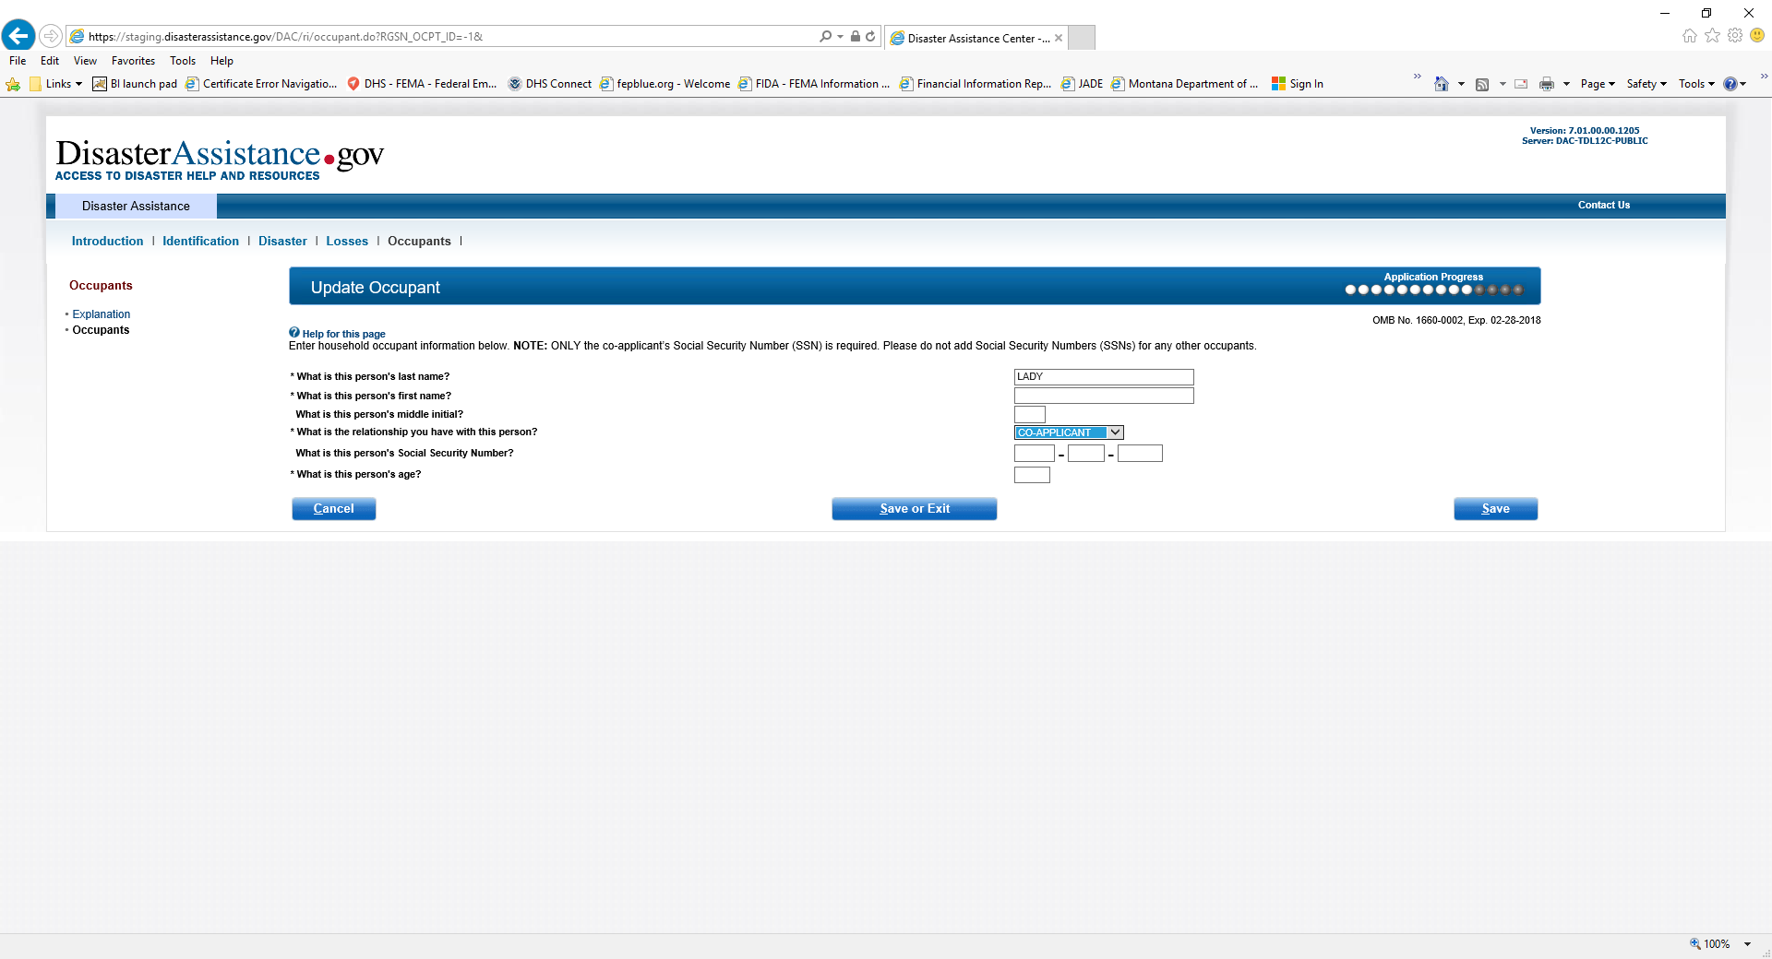
Update Occupant note drop down when selecting co-applicant

Slide 34
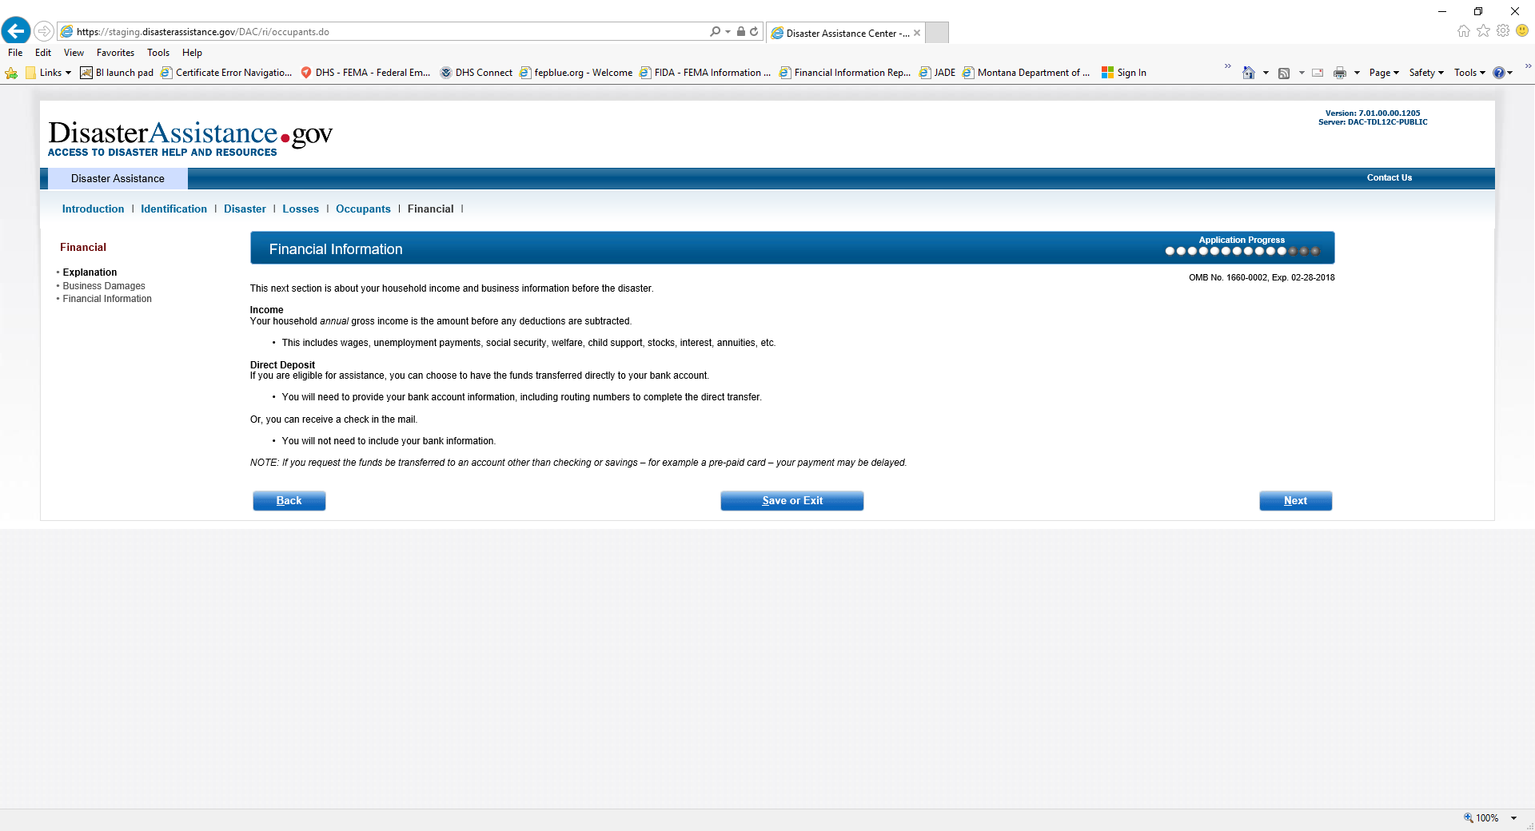
Financial Information

Slide 35
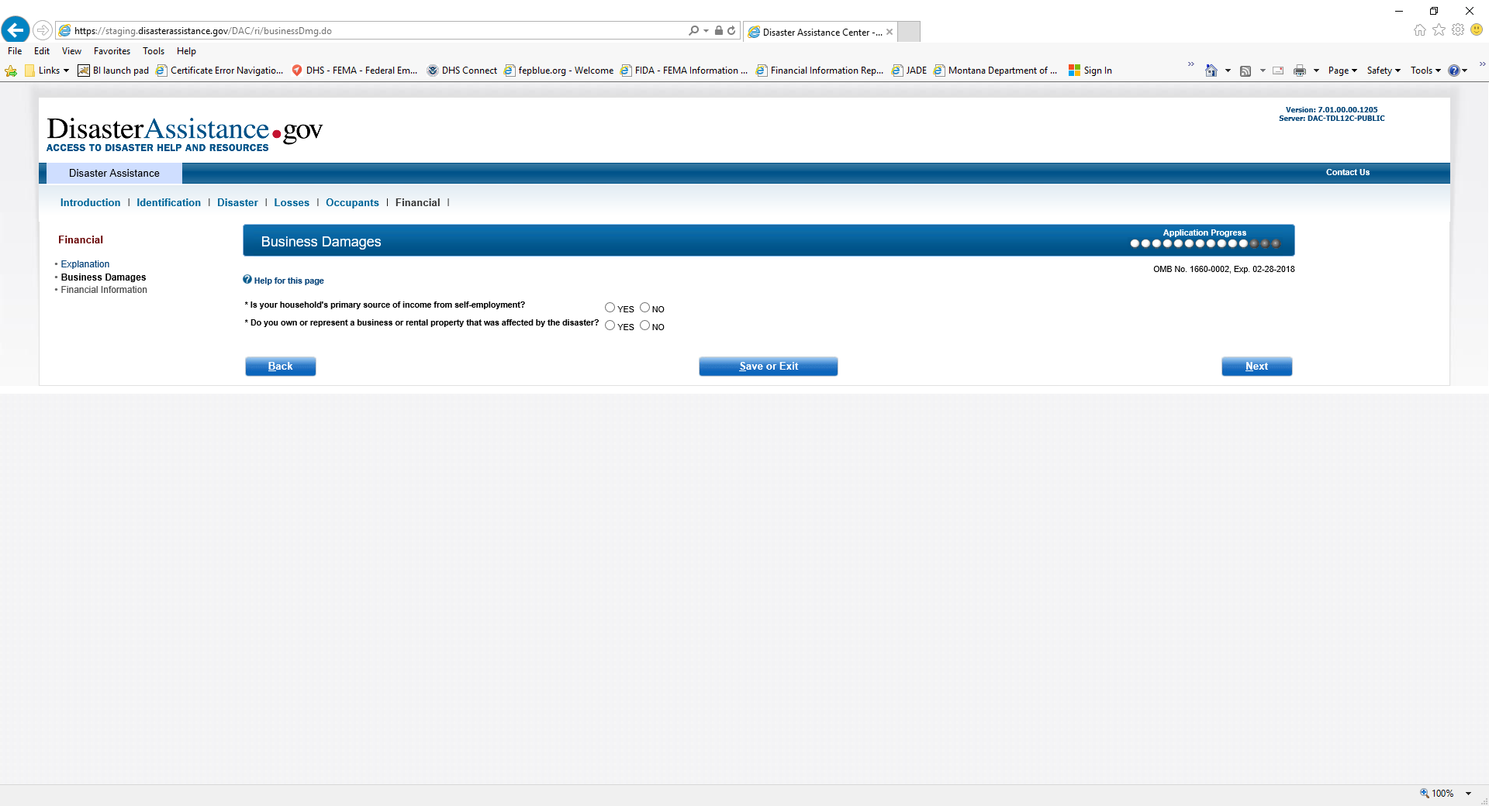
Business Damages

Slide 36
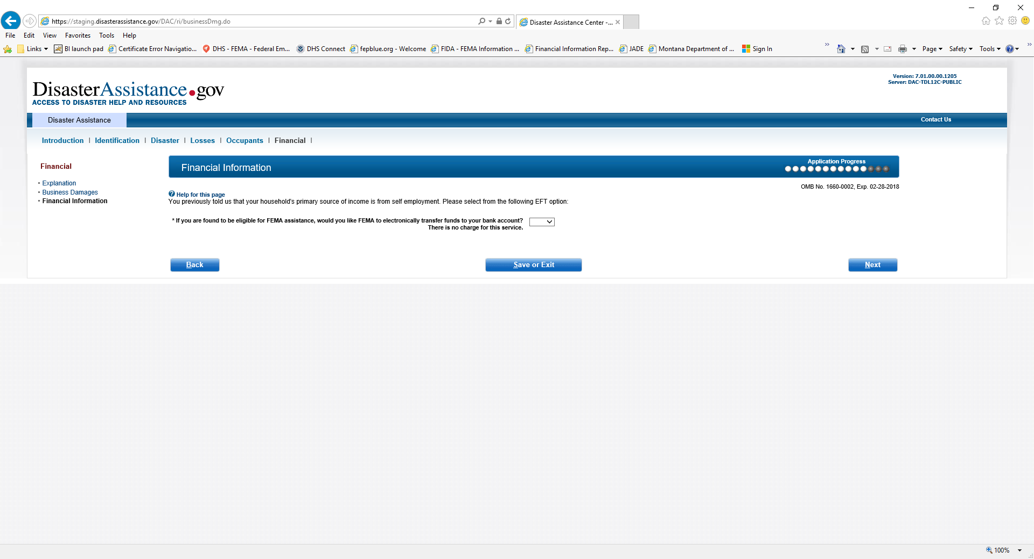
Financial Information when selecting yes to self employed

Slide 37
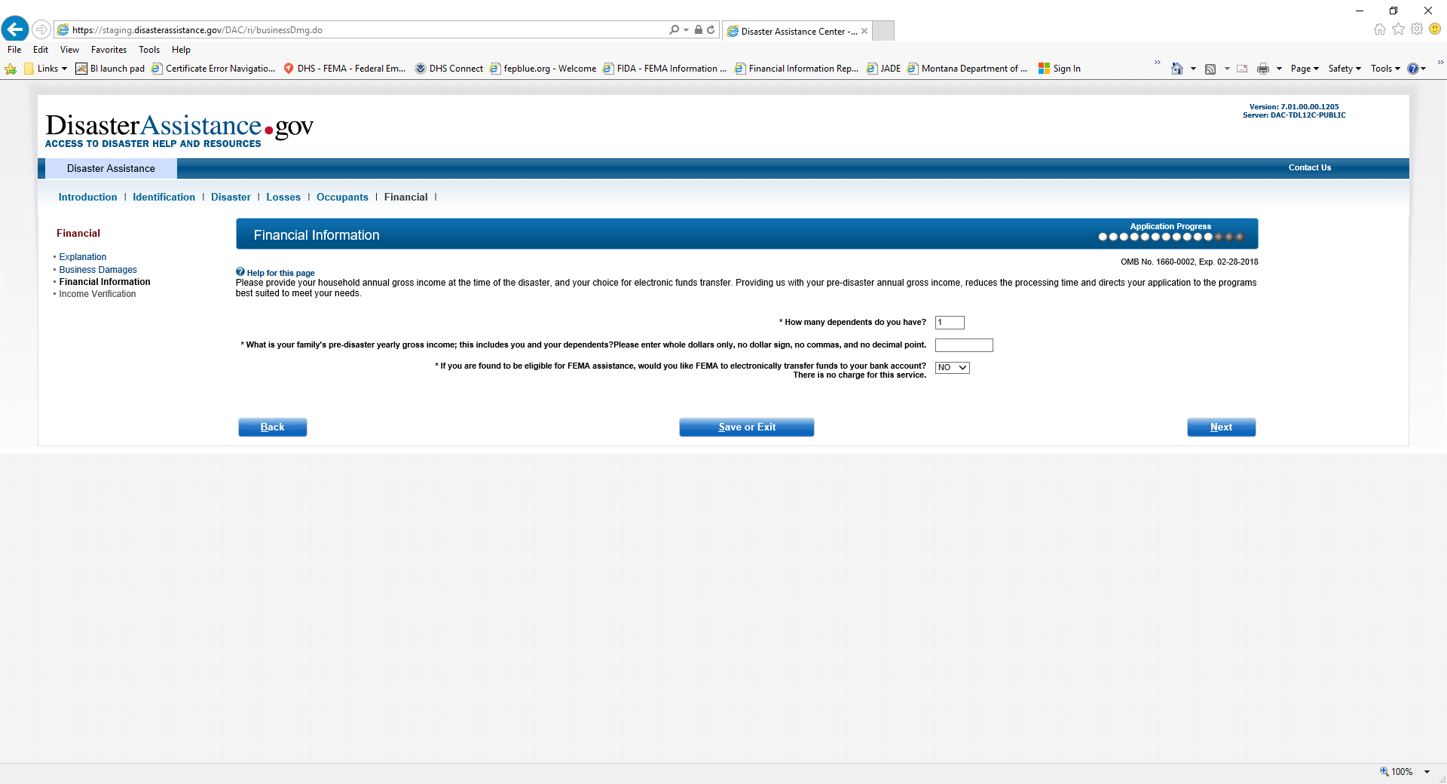
Financial Information when selecting no to self employed

Slide 38
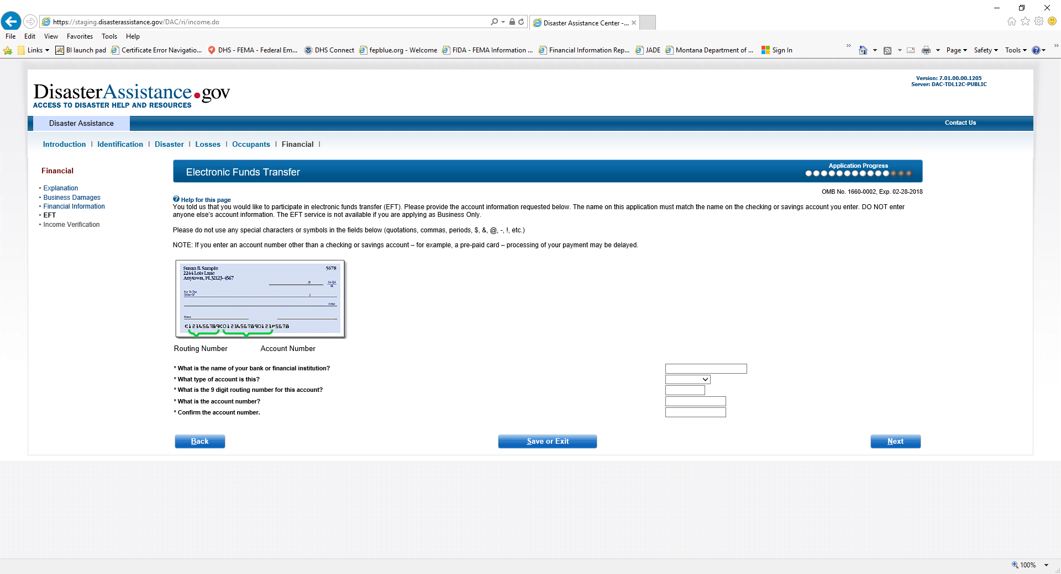
Electronic Funds Transfer

Slide 39
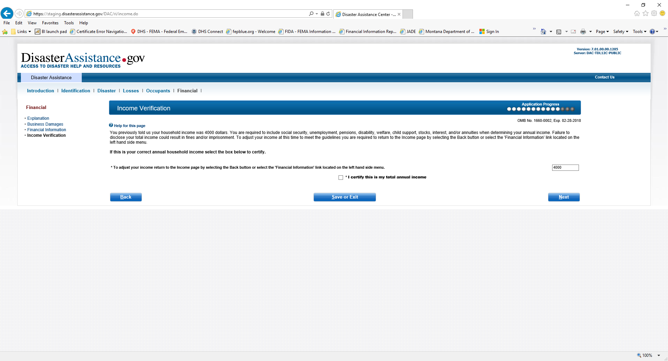
Income Verification

Slide 40
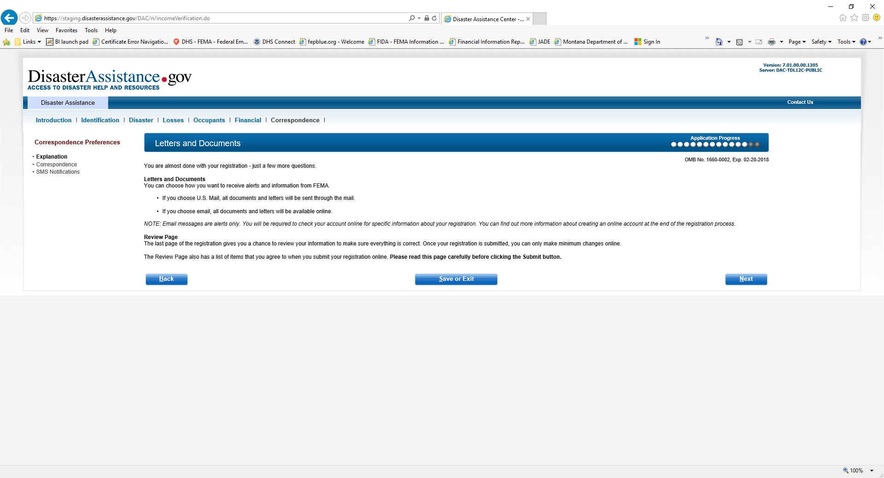
Letter and Documents

Slide 41
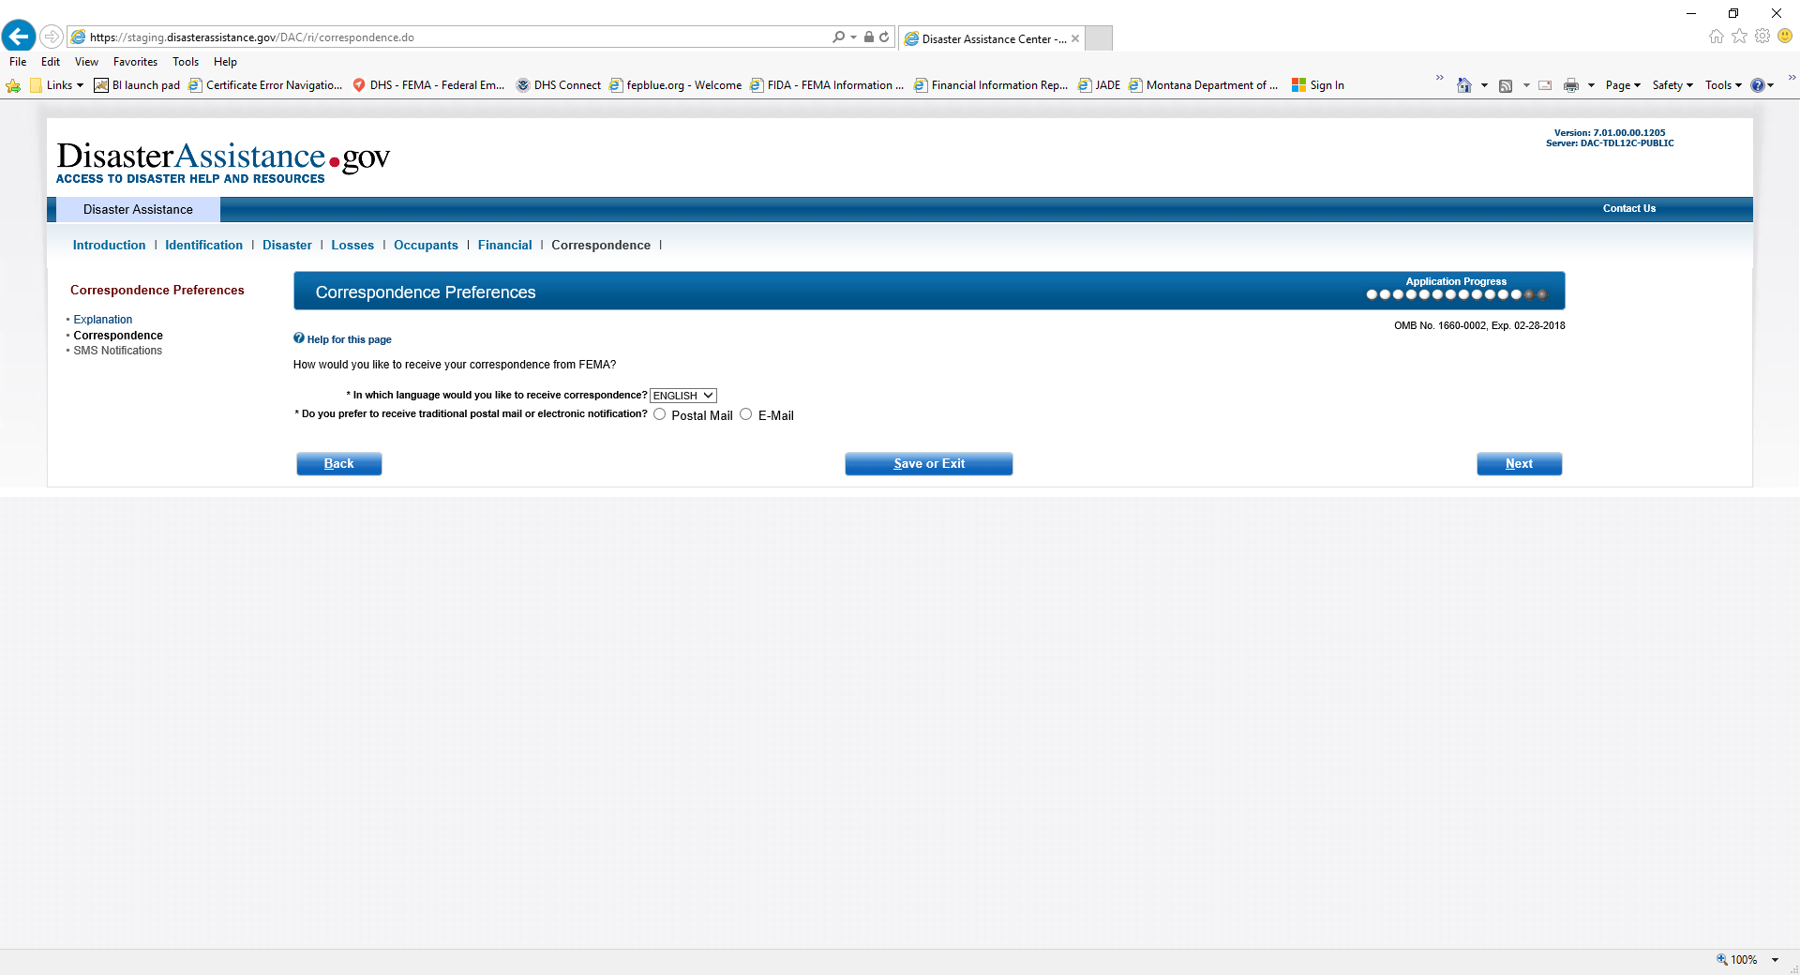
Correspondence Preferences

Slide 42
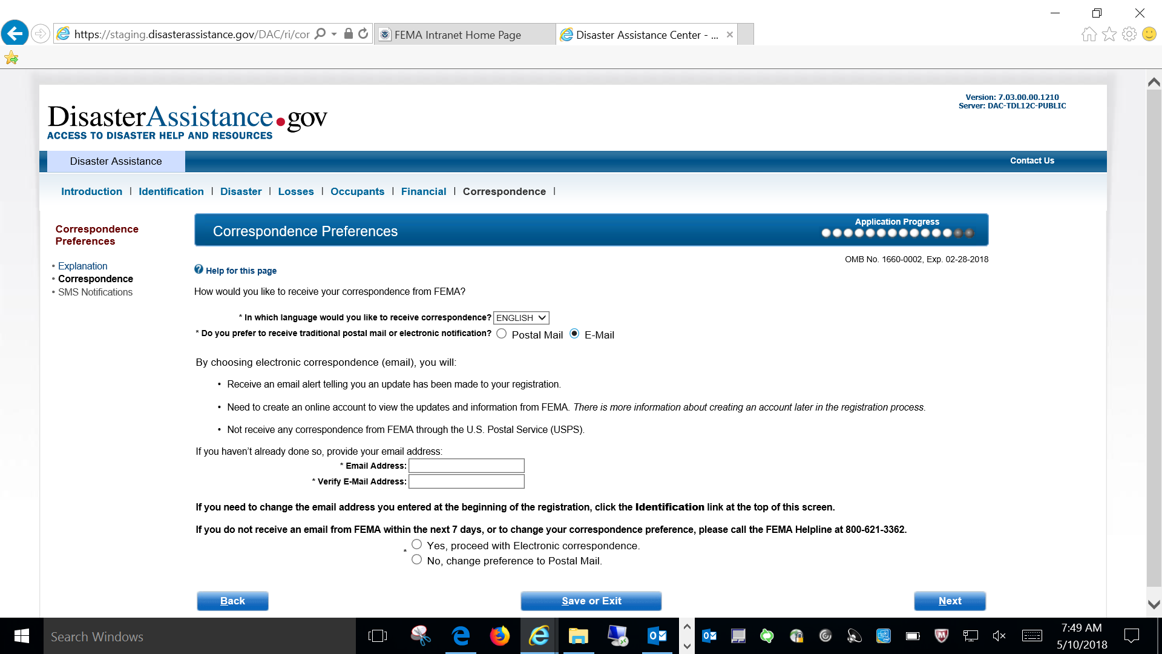
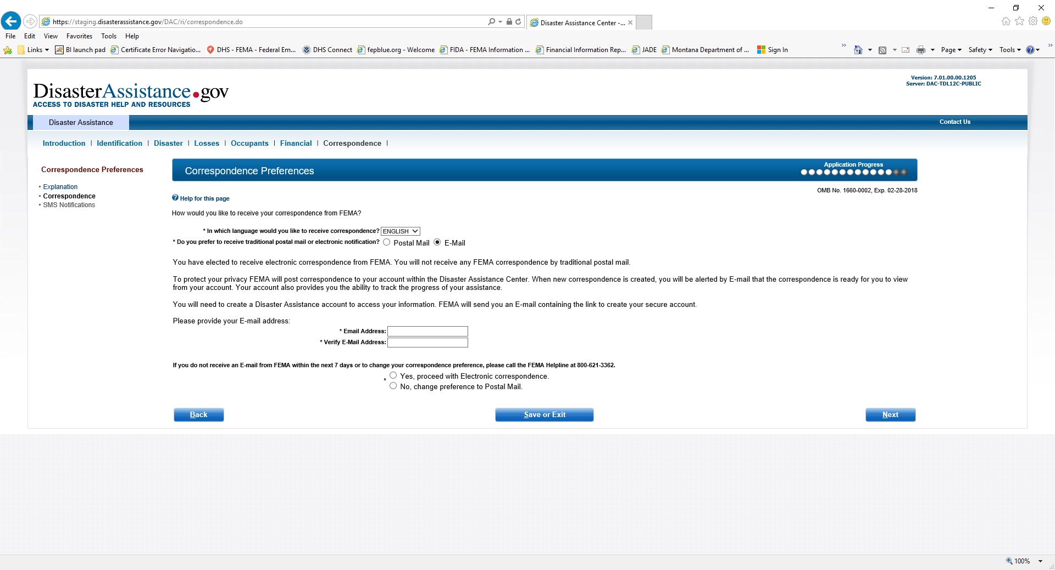
Correspondence Preferences when selecting E-mail has a way of receiving correspondence

Slide 43
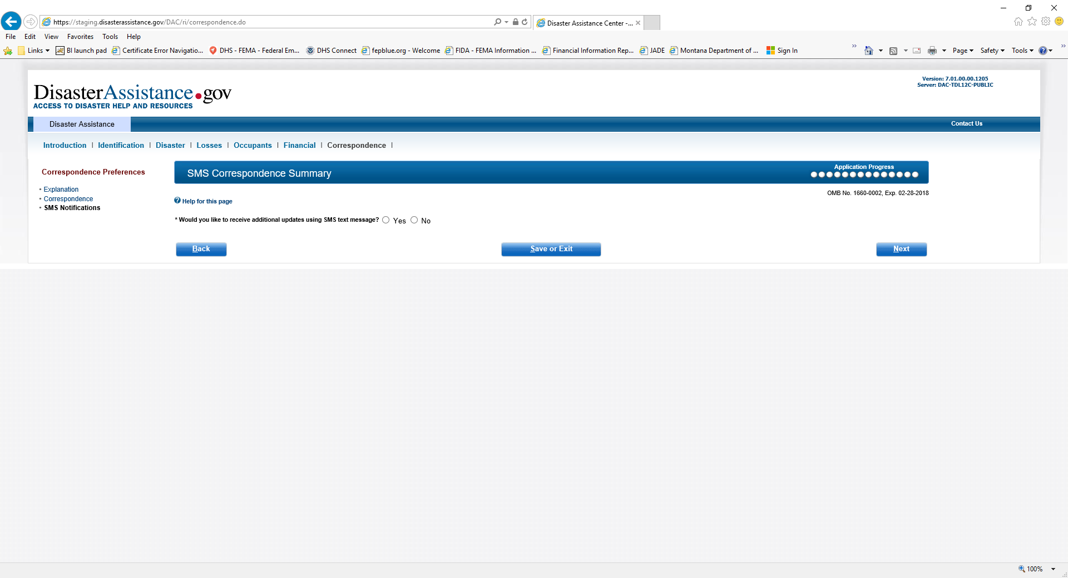
SMS Correspondence Summary

Slide 44
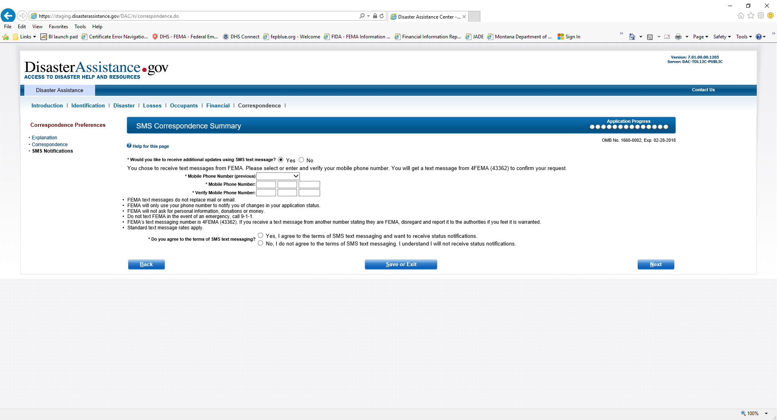
SMS Correspondence Summary when selecting yes to SMS

Slide 45
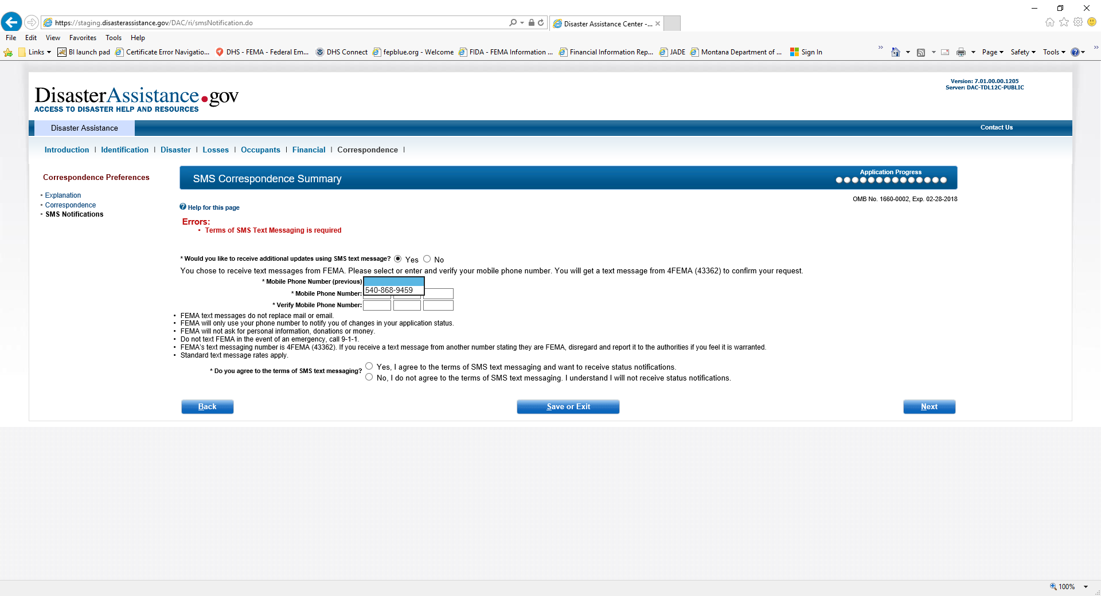
SMS Correspondence Summary when selecting yes the Phone number auto fills

Slide 46
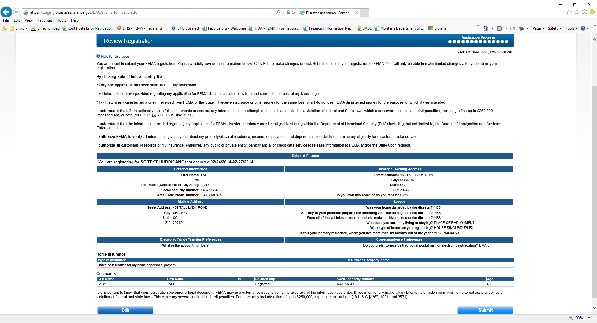
Review Registration

Slide 47
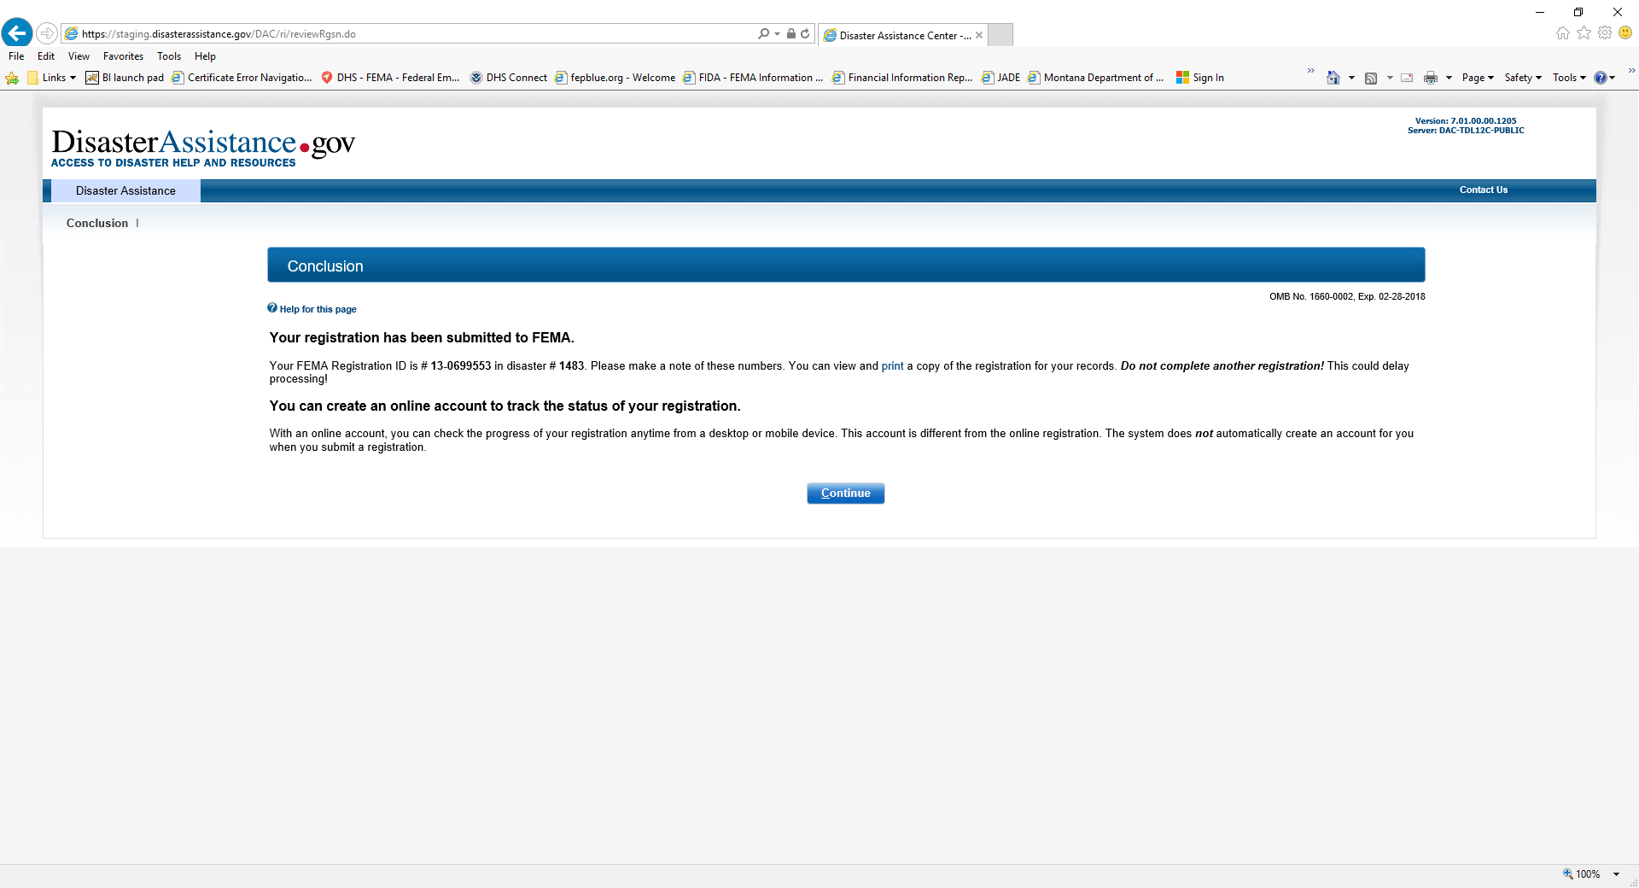
Conclusion

Slide 48
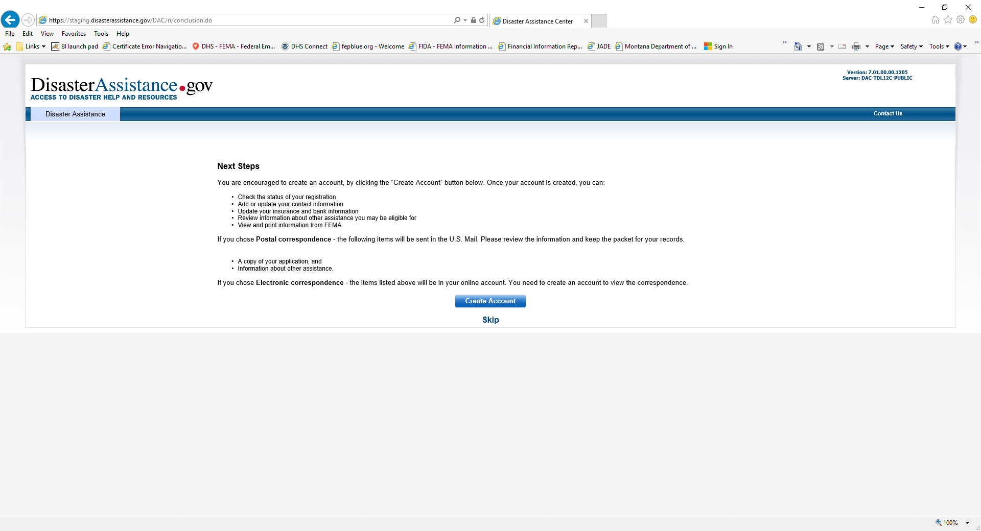
Next Steps

Slide 49

Public Record Questions

Slide 50

User ID and Password

Slide 51

Account Created

Slide 52

What to Expect

Slide 53

Assistance Activities

Slide 54

Referrals

Slide 55

DisasterAssistance.gov Survey Invitation

