Slide 1
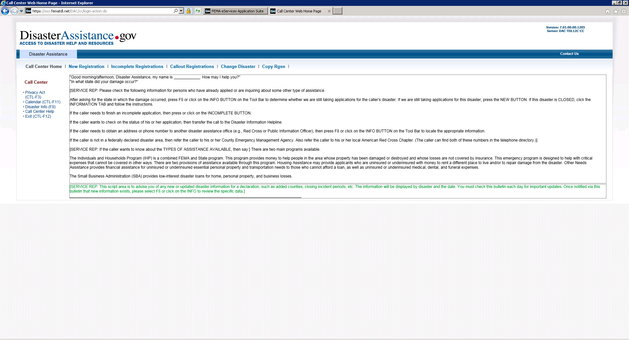
New Registration

Slide 2
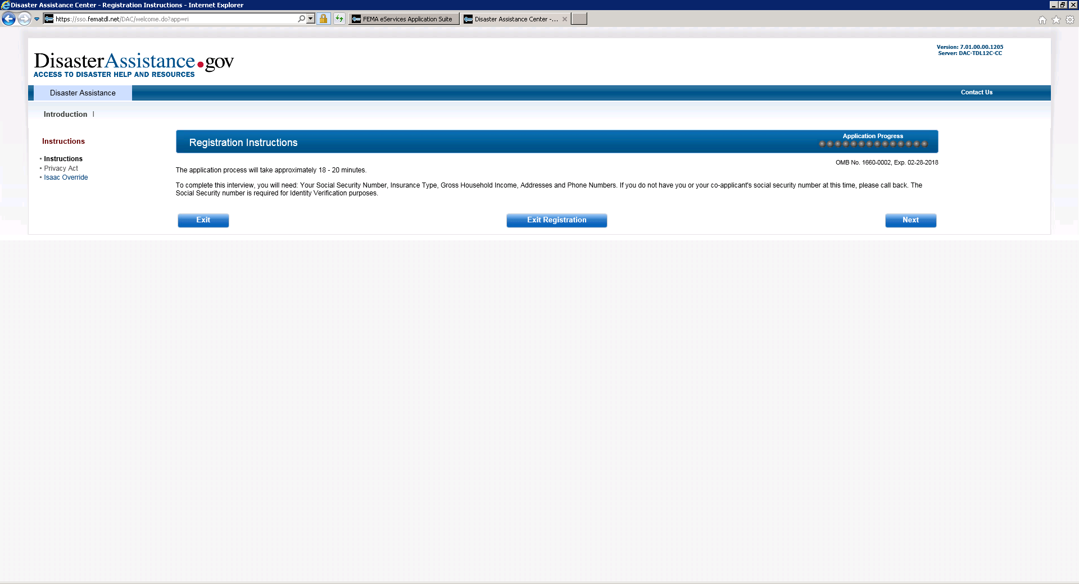
Registrations Instructions

Slide 3
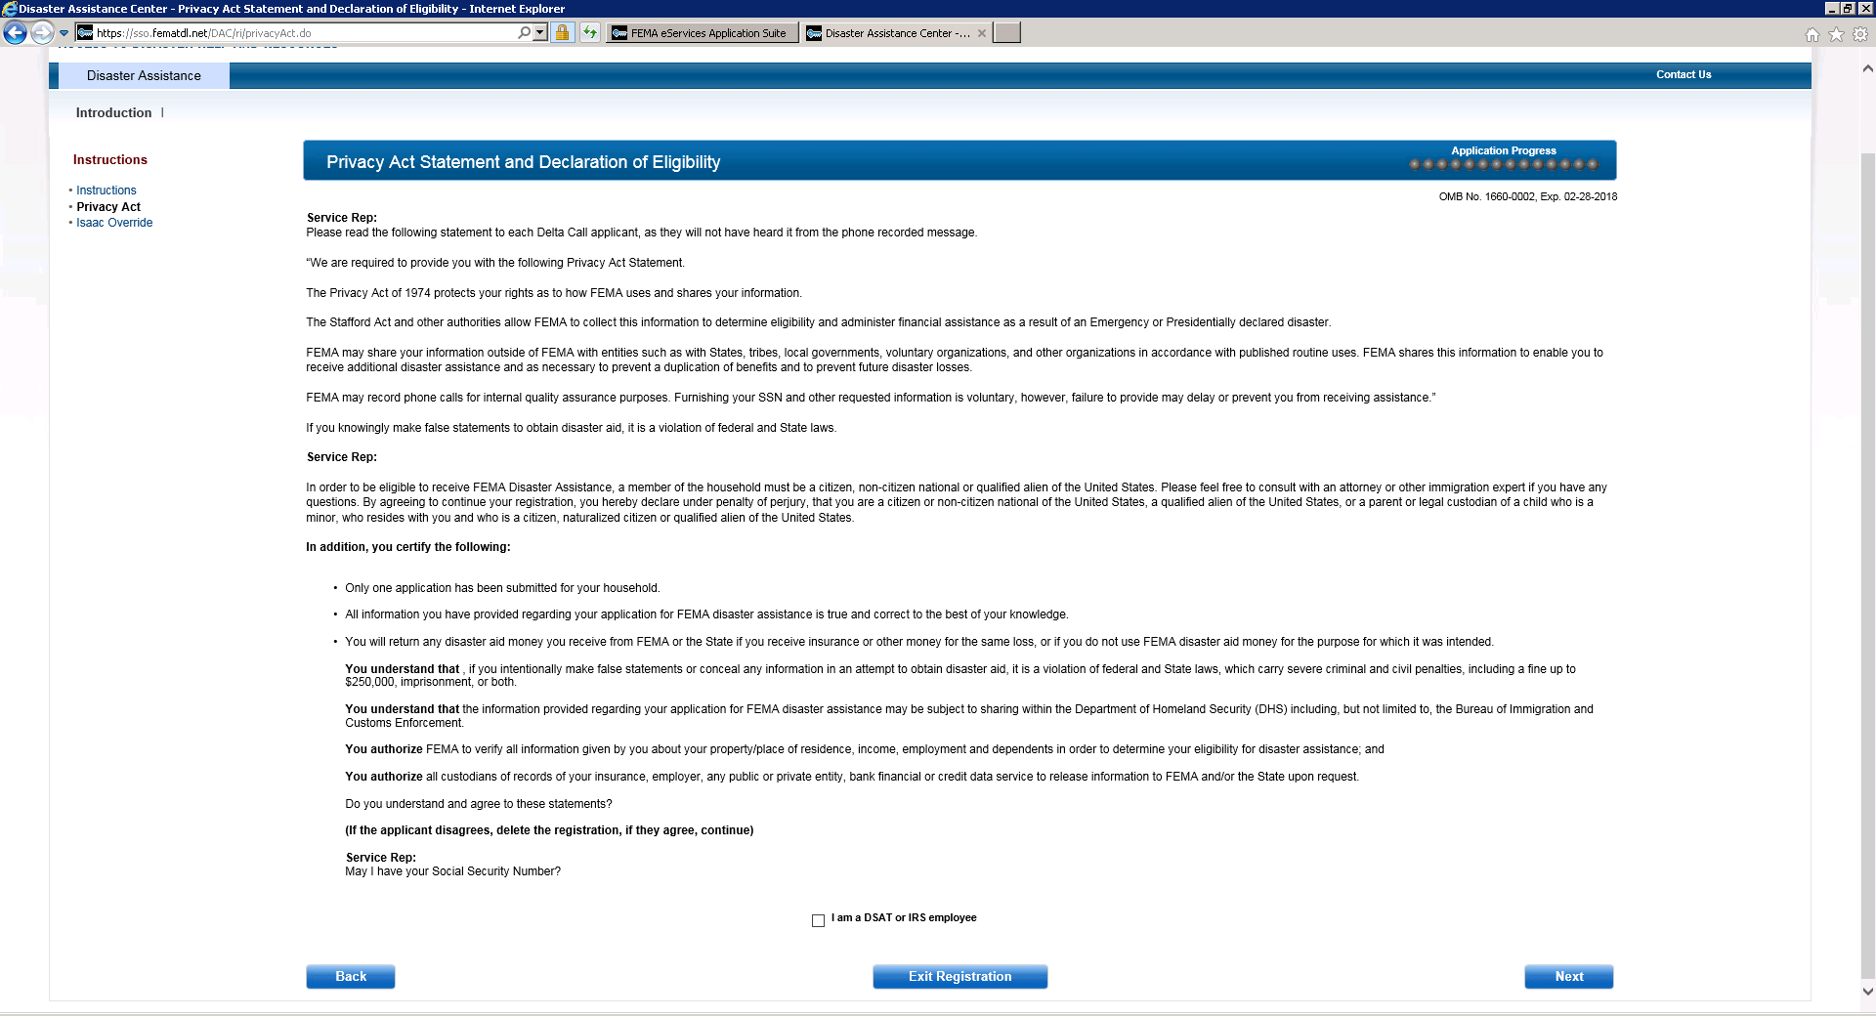
Privacy Act Statement and Declaration of Eligibility

Slide 4
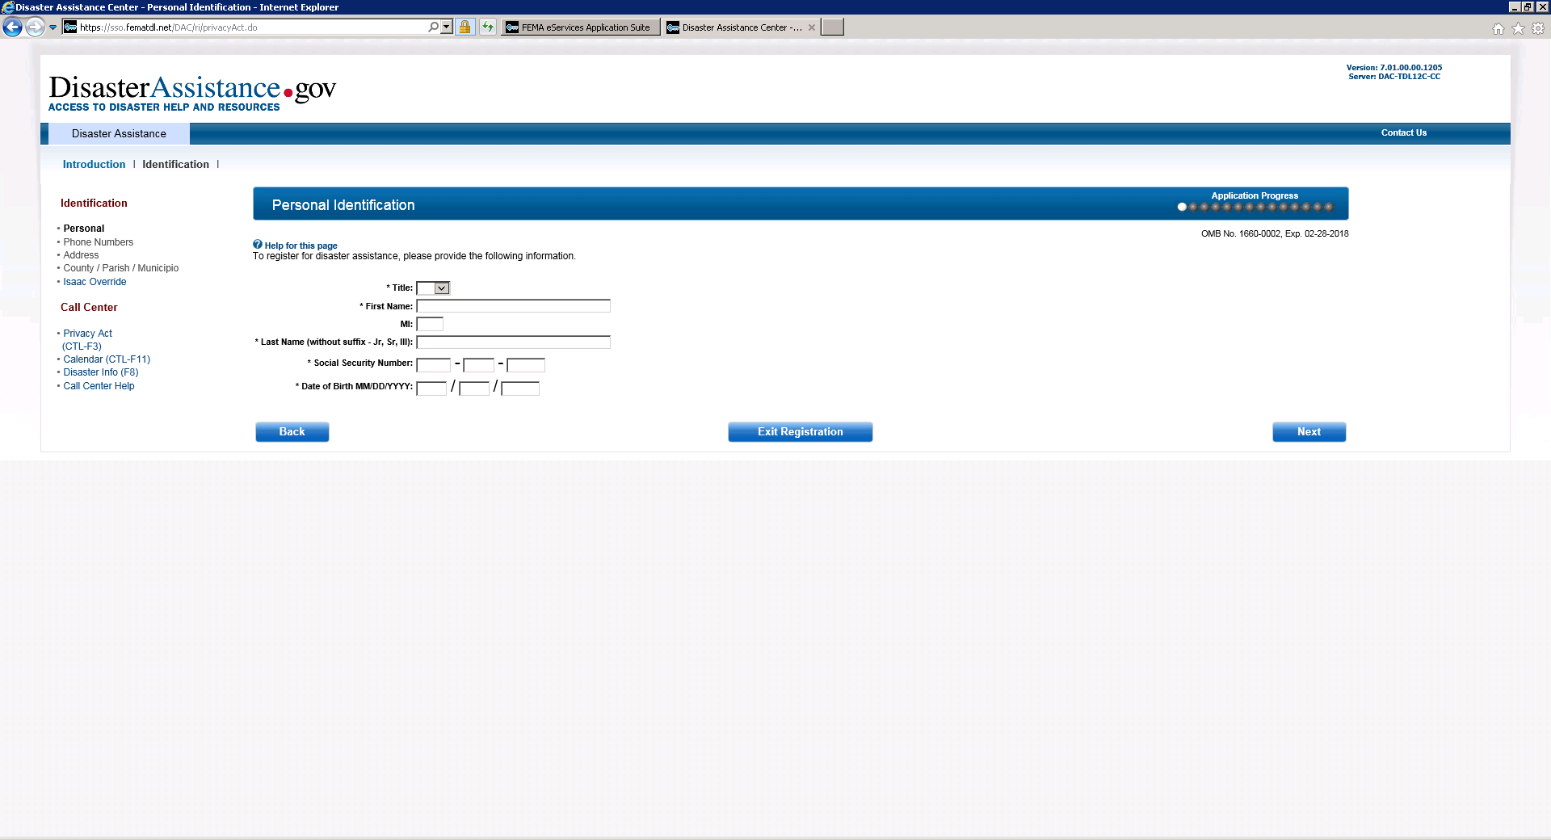
Personal Identification

Slide 5
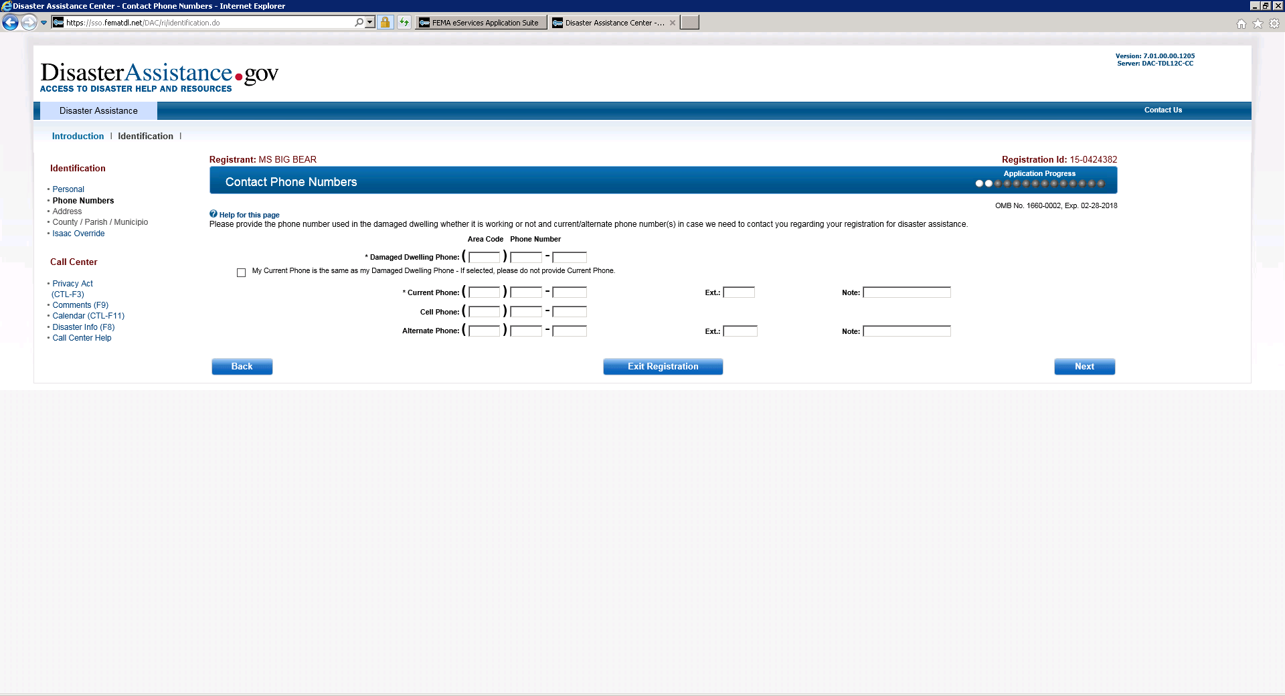
Contact Phone Numbers

Slide 6
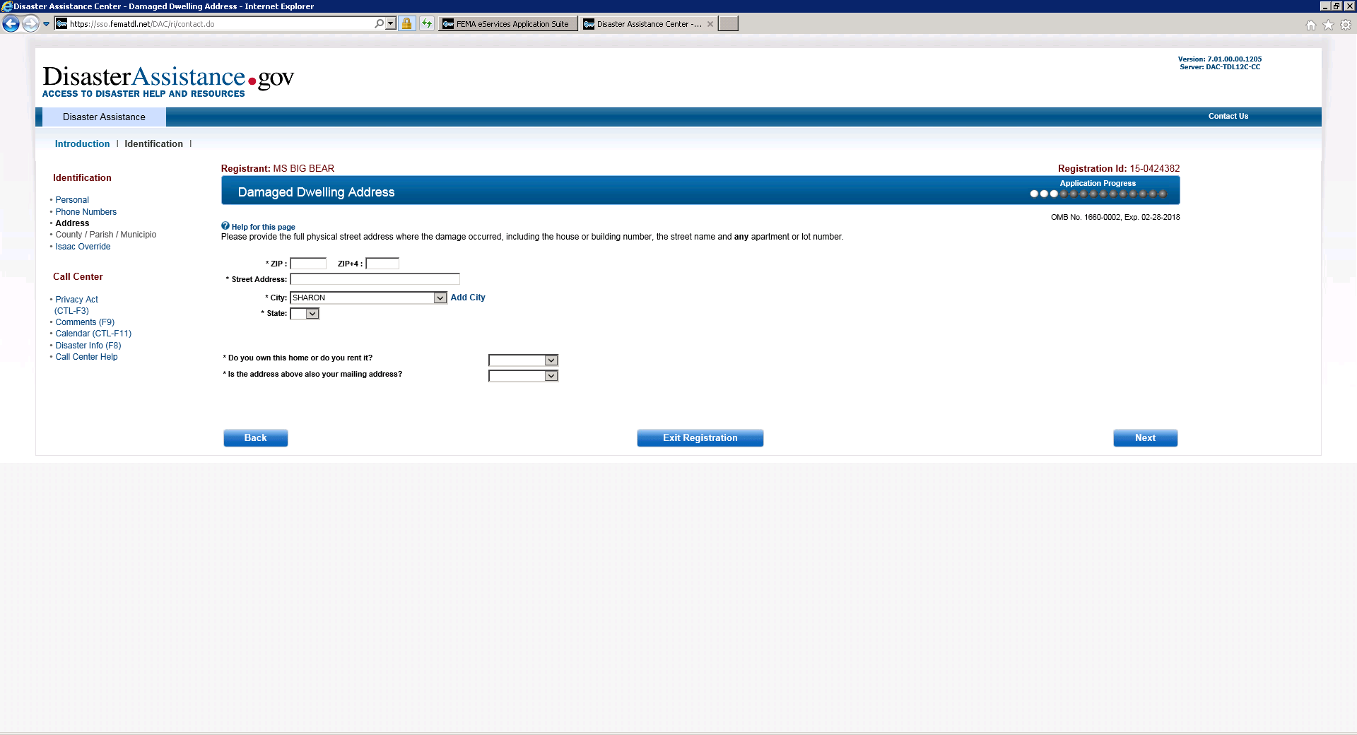
Damaged Dwelling Address

Slide 7
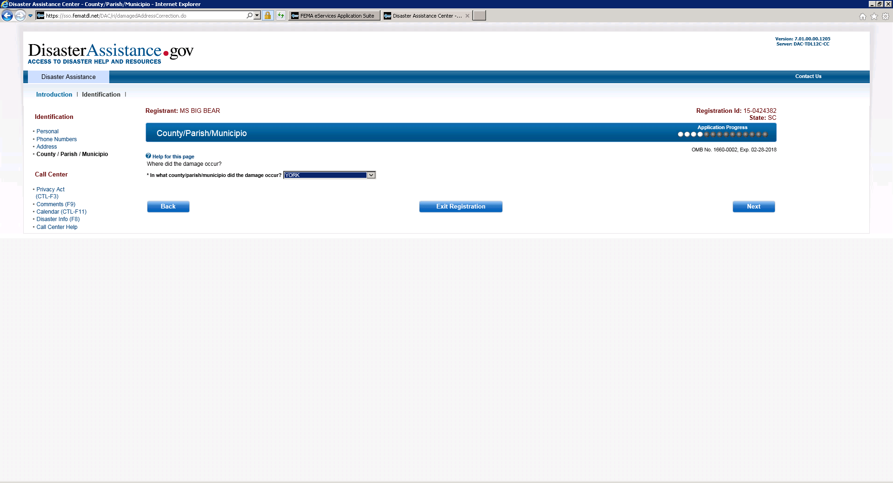
County/Parish/Municipio

Slide 8
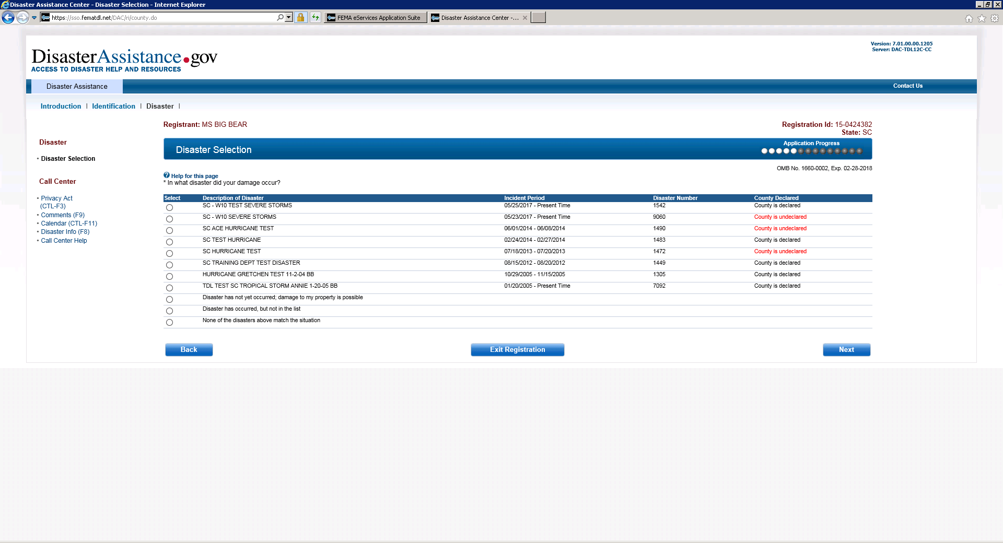
Disaster Selection

Slide 9
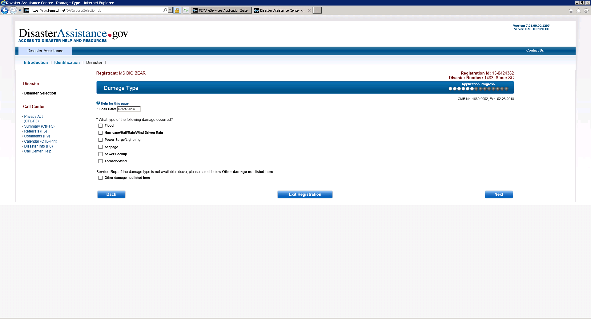
Damage Type

Slide 10
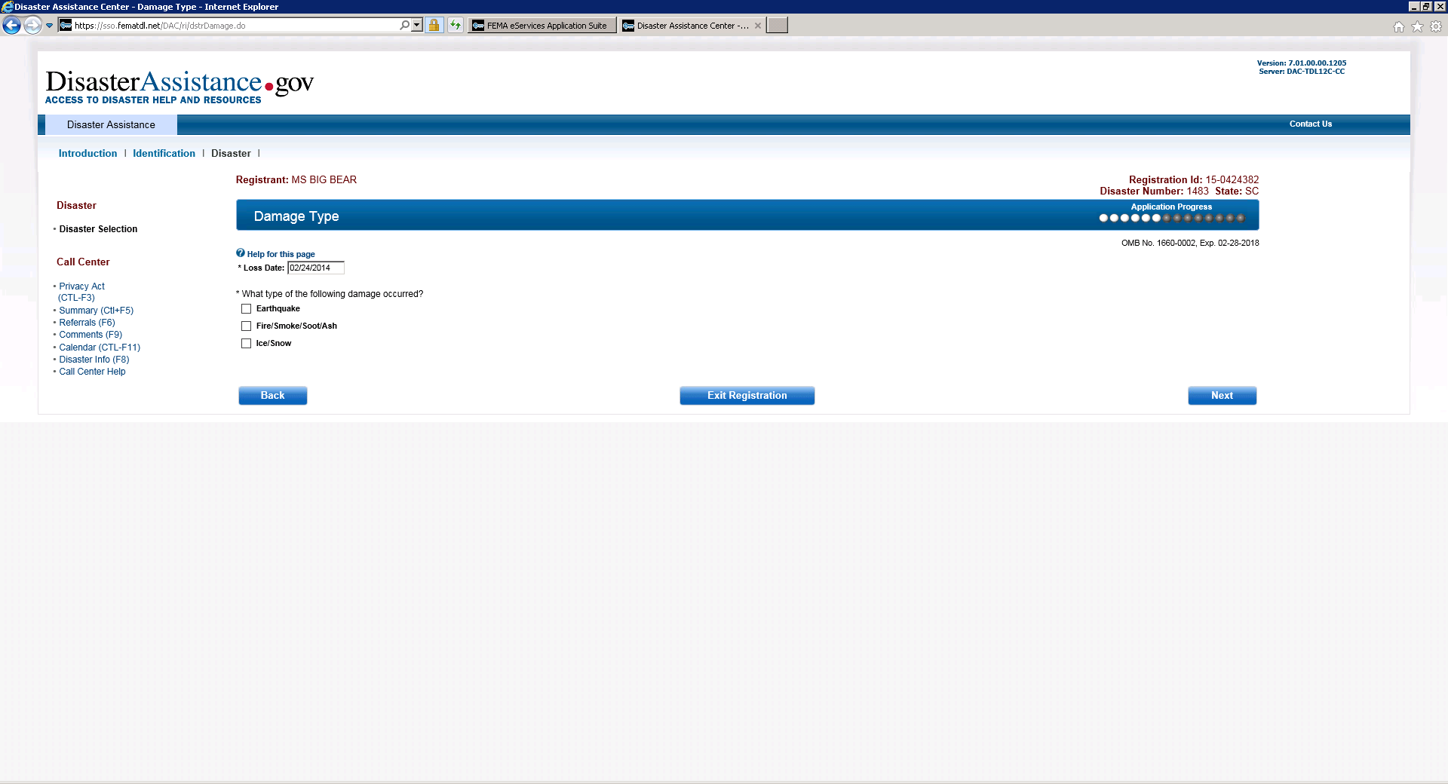
Damage Type “Other”

Slide 11
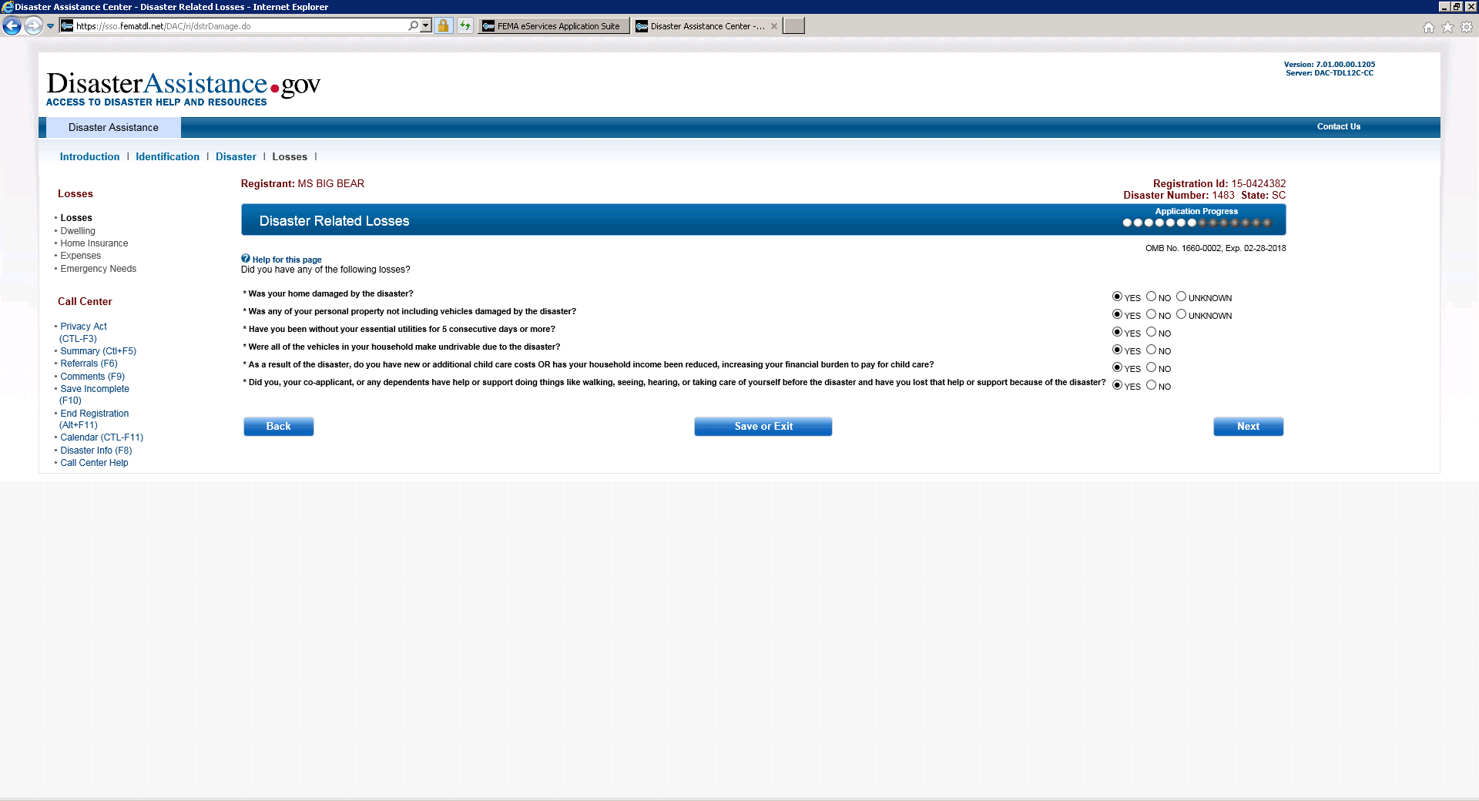
Disaster Related Losses

Slide 12
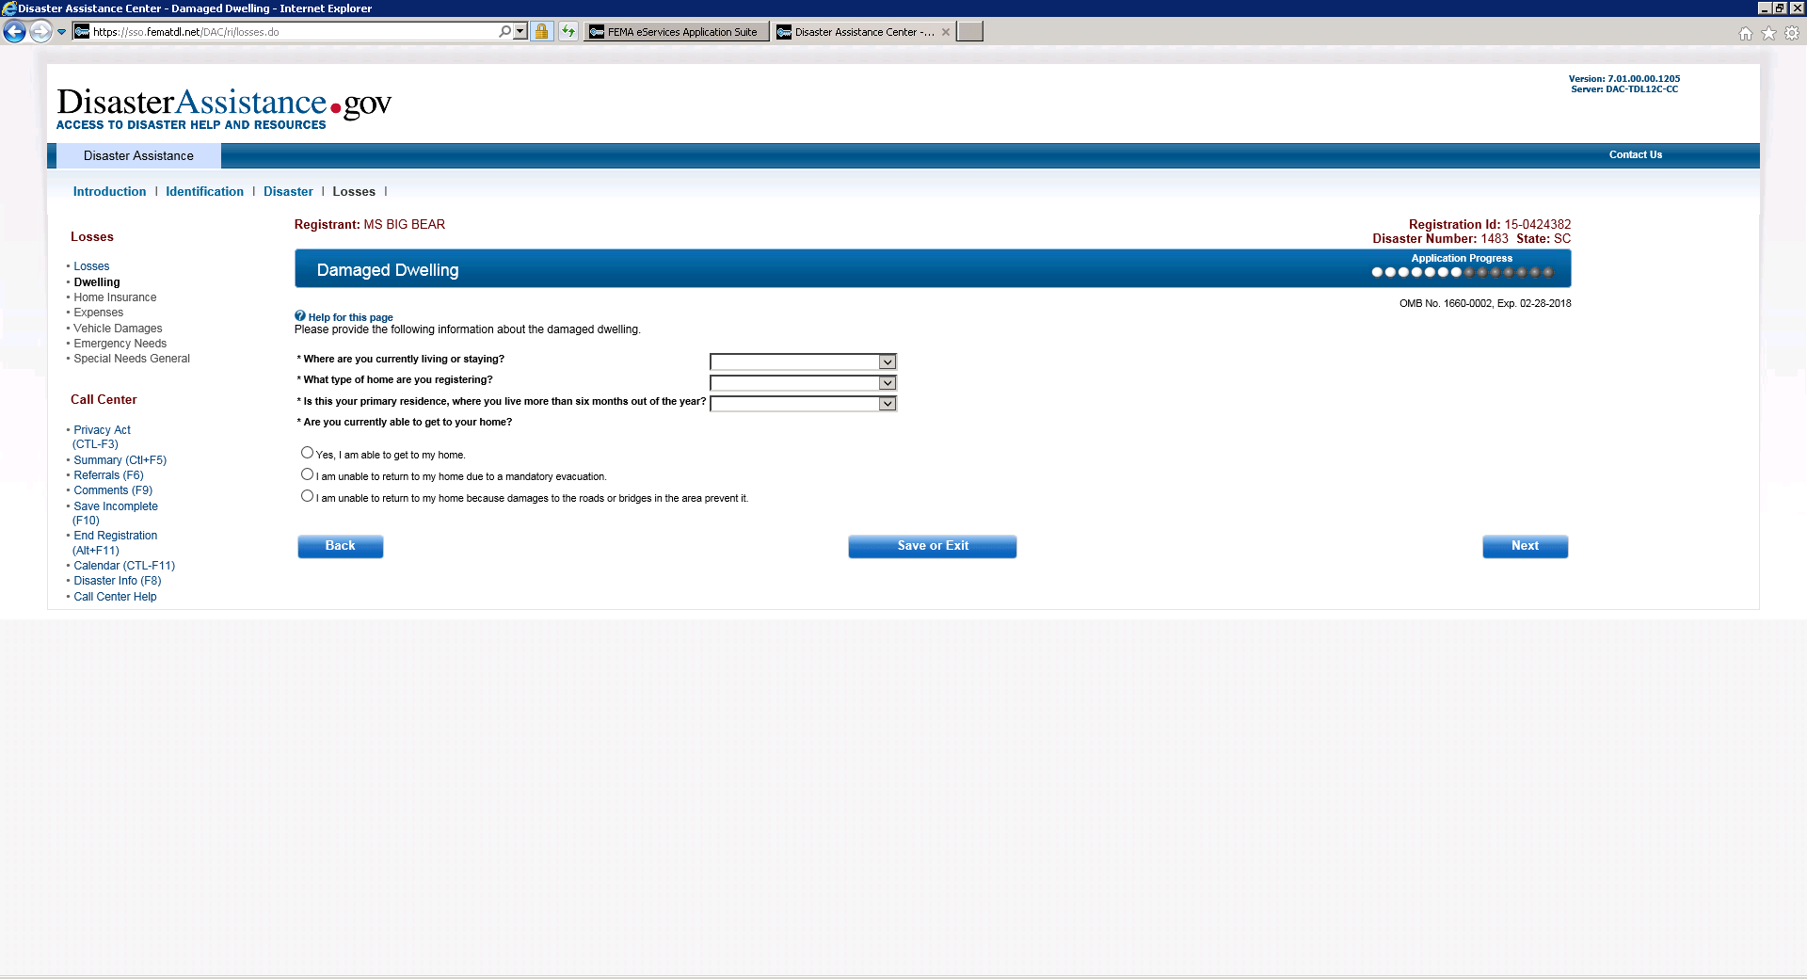
Damaged Dwelling

Slide 13
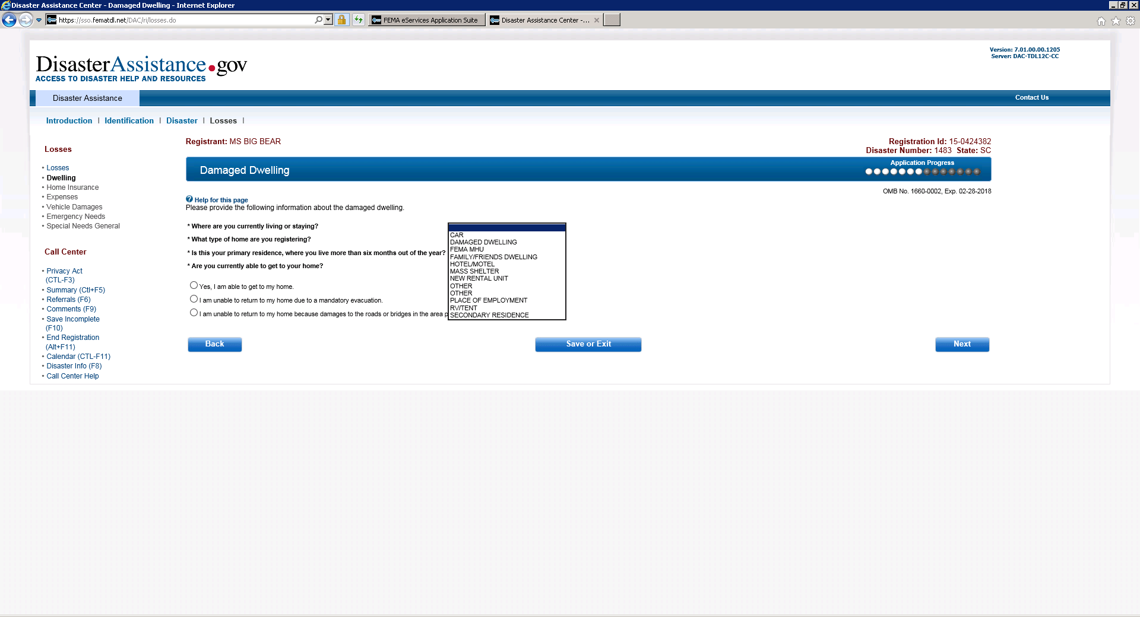
Damage Dwelling (Drop Down for Owner to first question) Where are you currently living or staying?

Slide 14
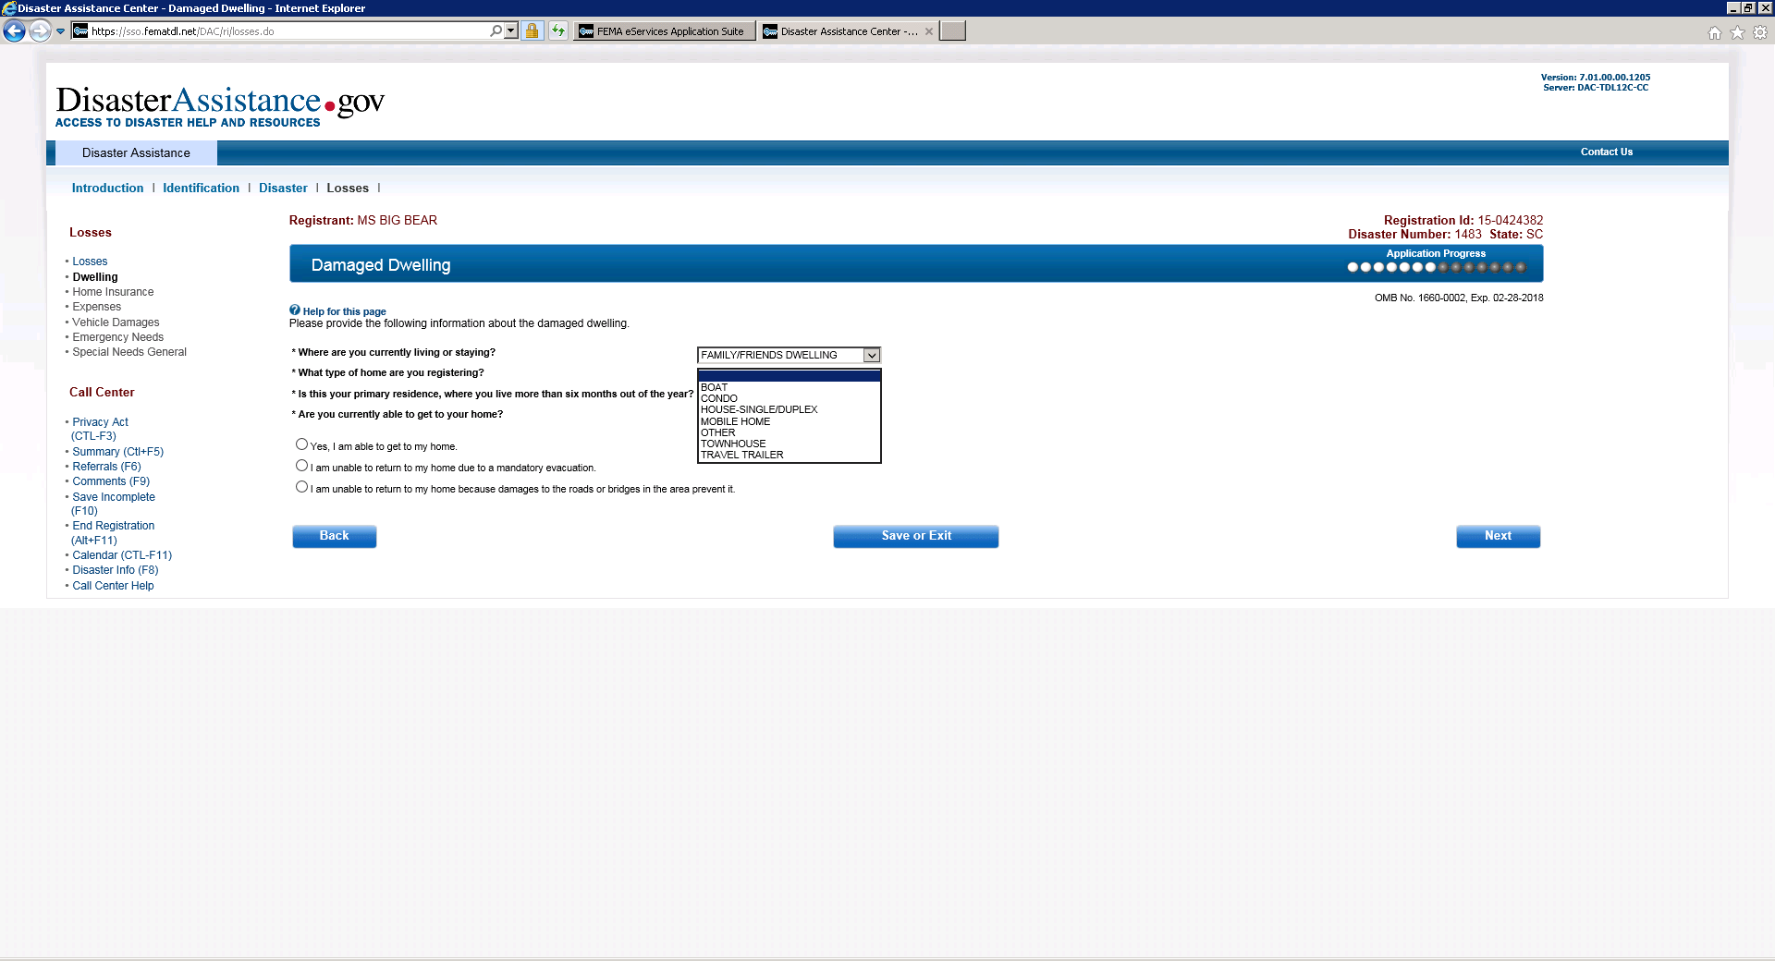
Damaged Dwelling (Drop Down to second question) What type of home are you registering?

Slide 15
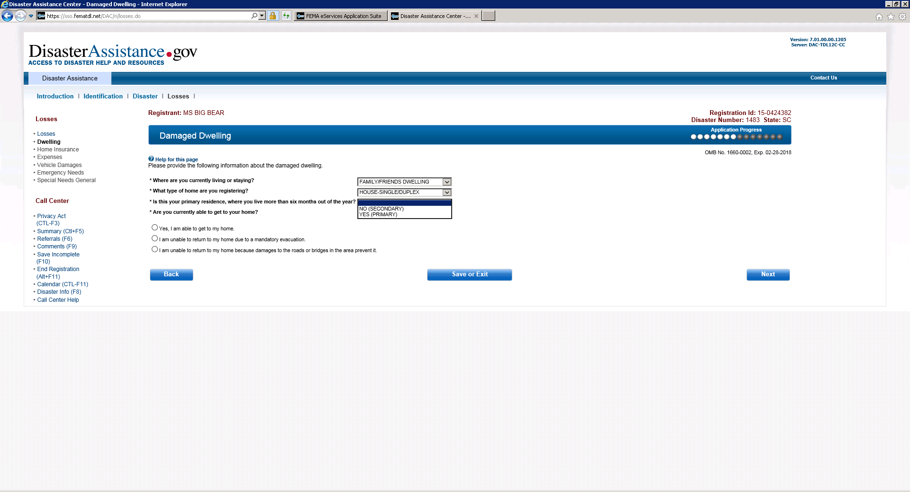
Damaged Dwelling (Drop down to third question) Is this your primary residence…….?

Slide 16
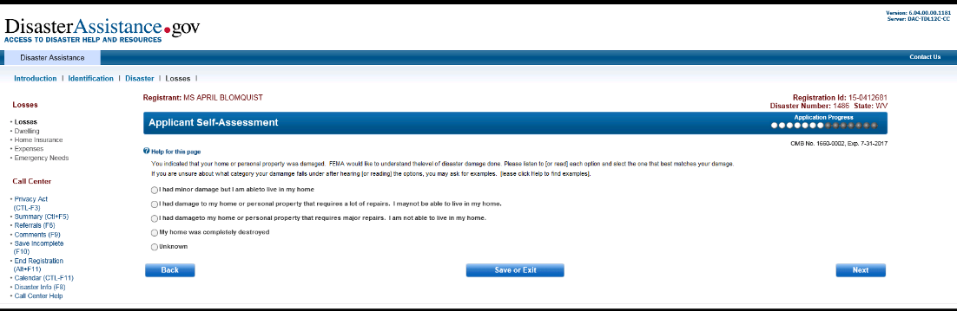

Slide 17
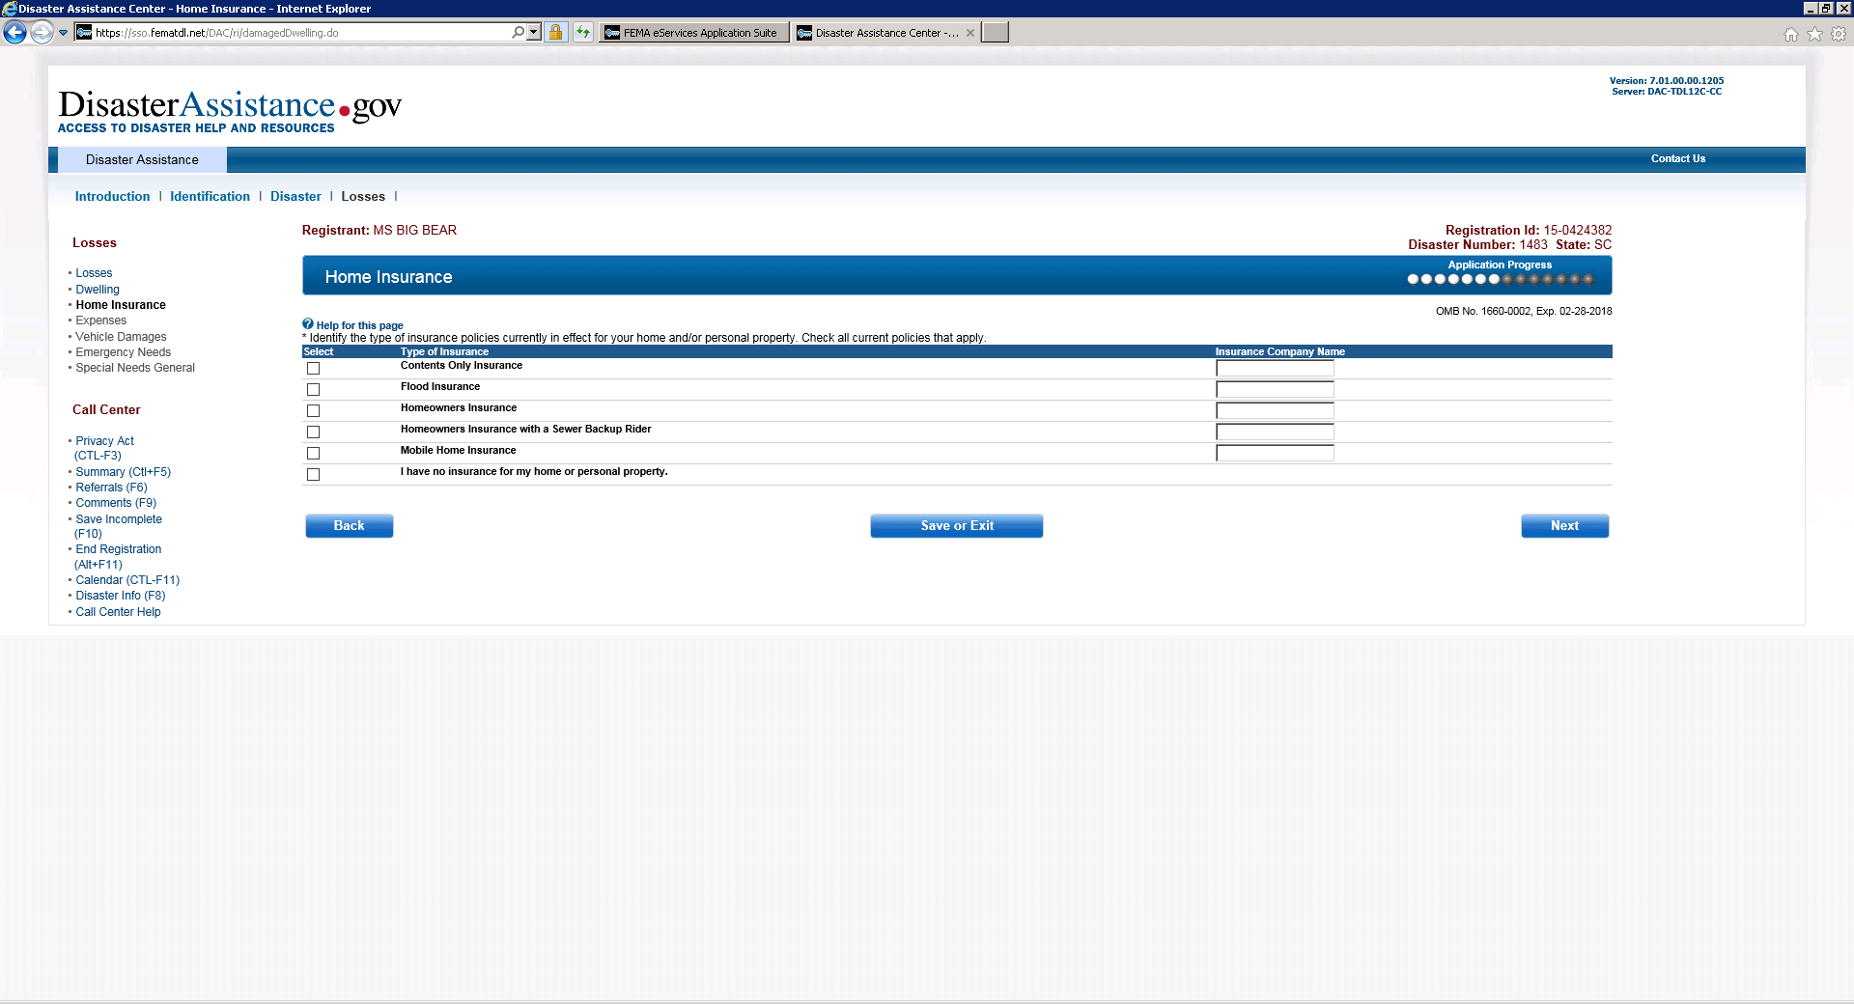
Home Insurance

Slide 18
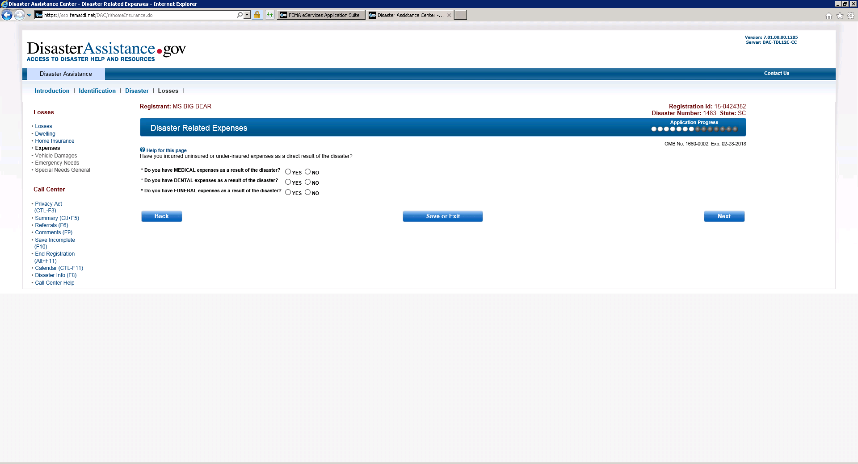
Disaster Related Expenses

Slide 19
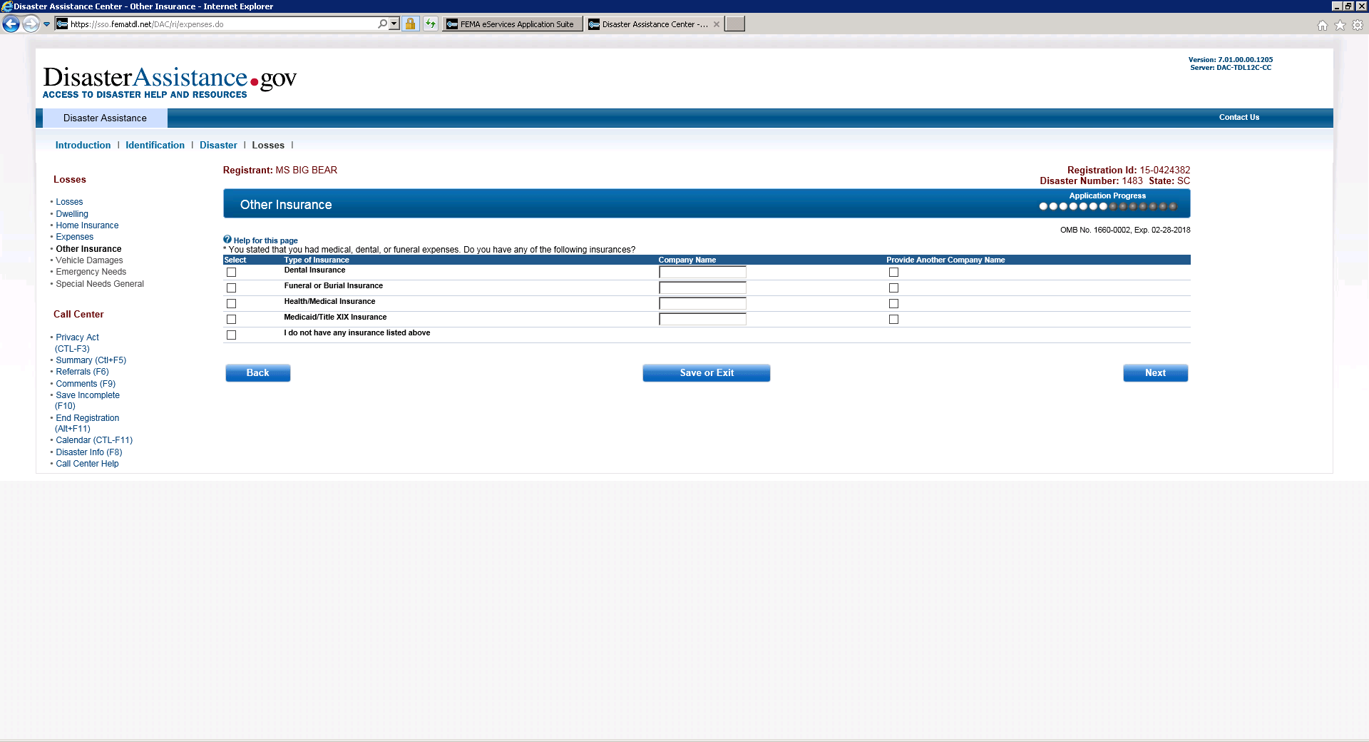
Other Insurance

Slide 20
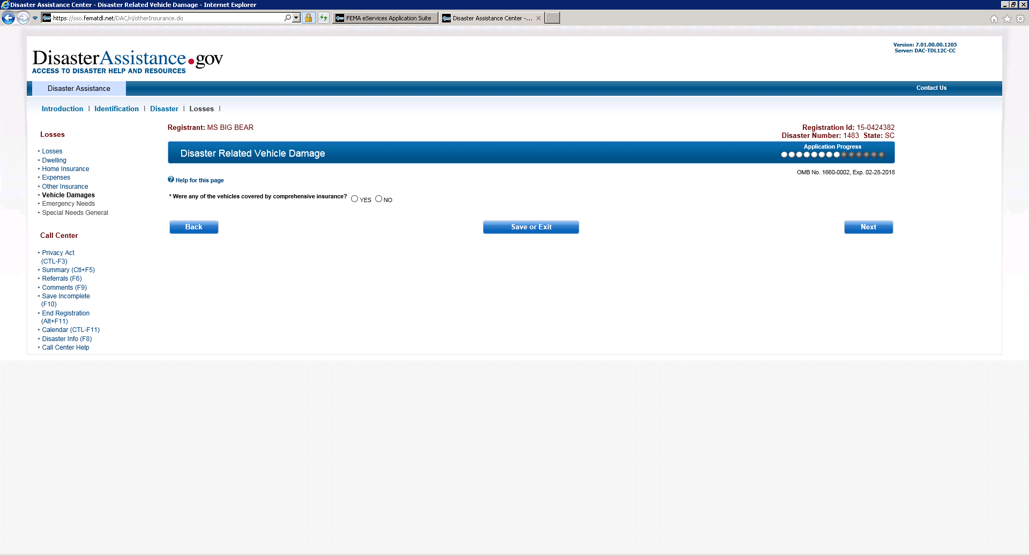
Disaster Related Vehicle Damage

Slide 21
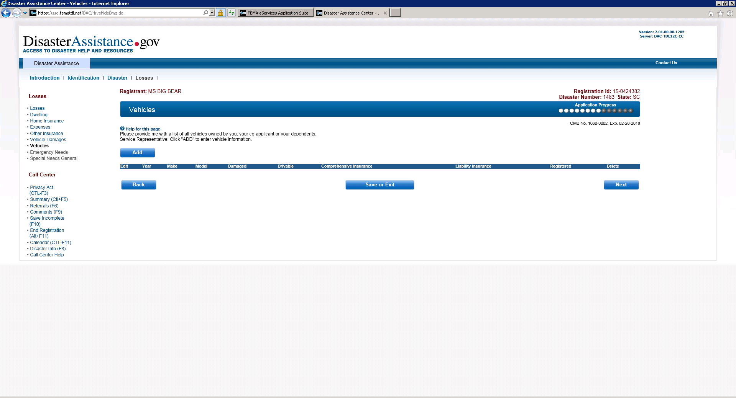
Vehicles

Slide 22
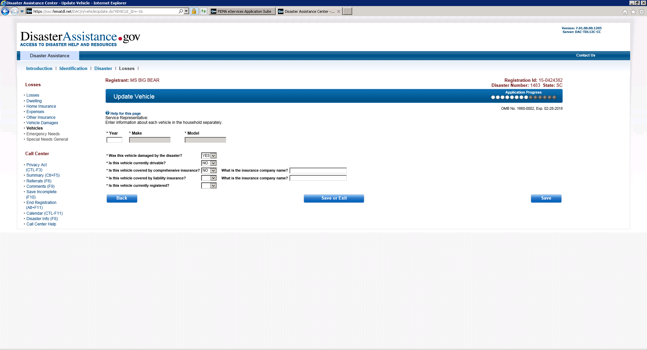
Update Vehicle

Slide 23
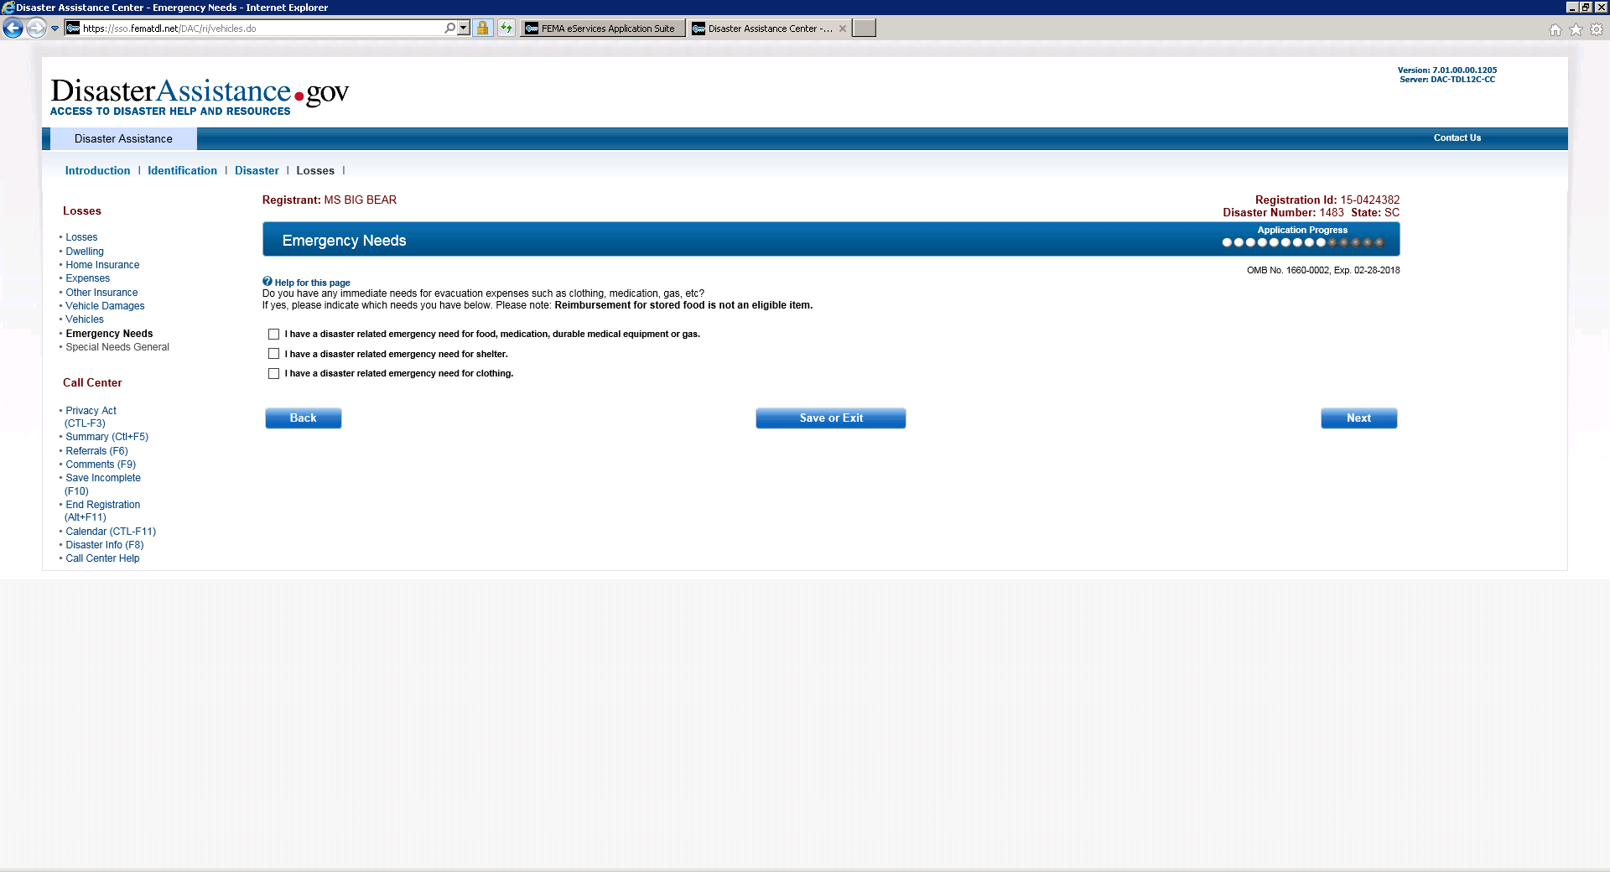
Emergency Needs

Slide 24
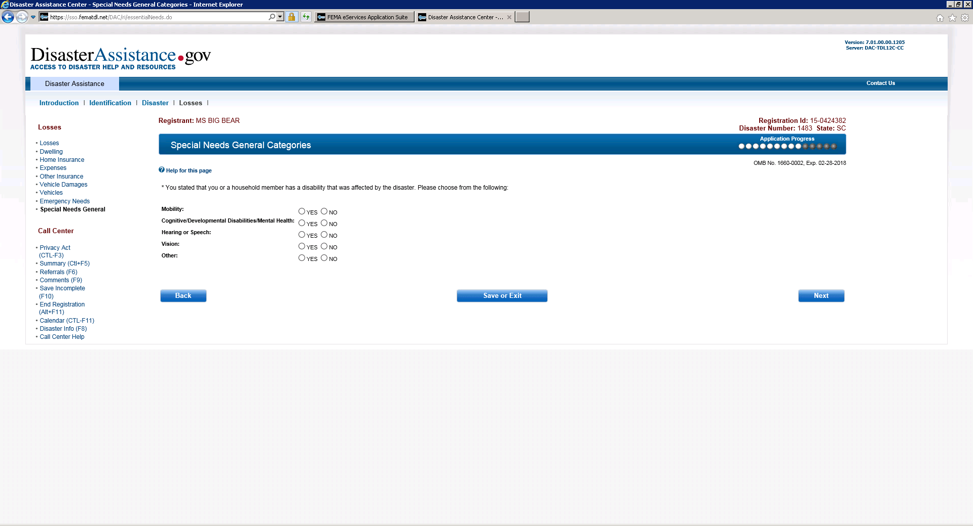
Special Needs General Categories

Slide 25
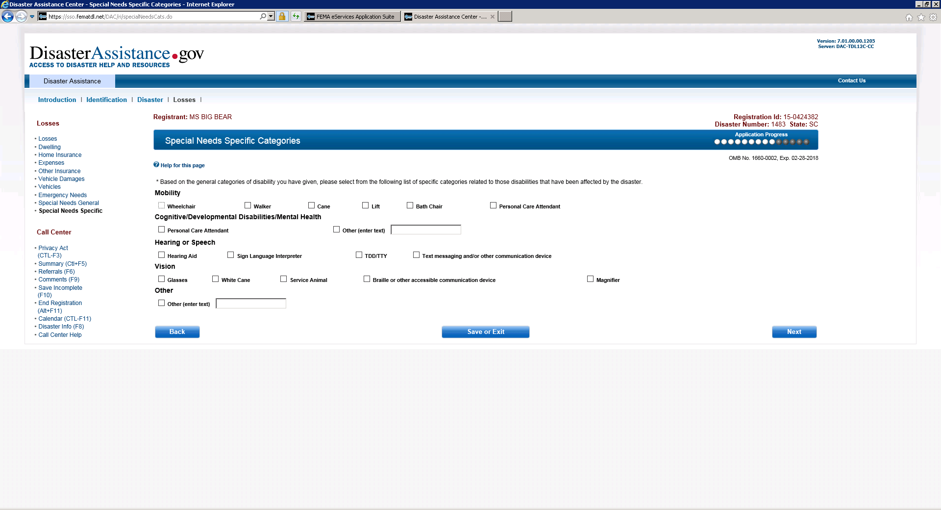
Special Needs Specific Categories

Slide 26
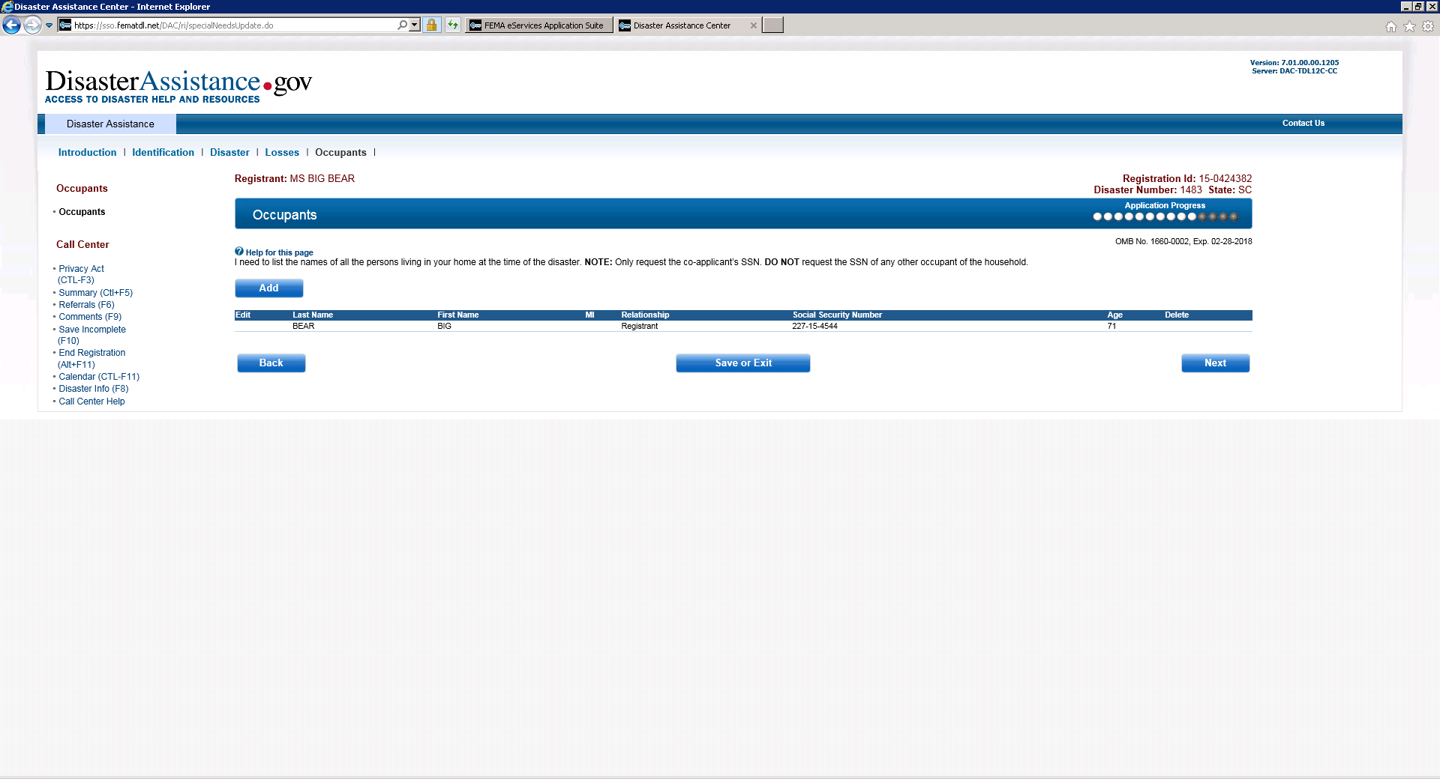
Occupants

Slide 27
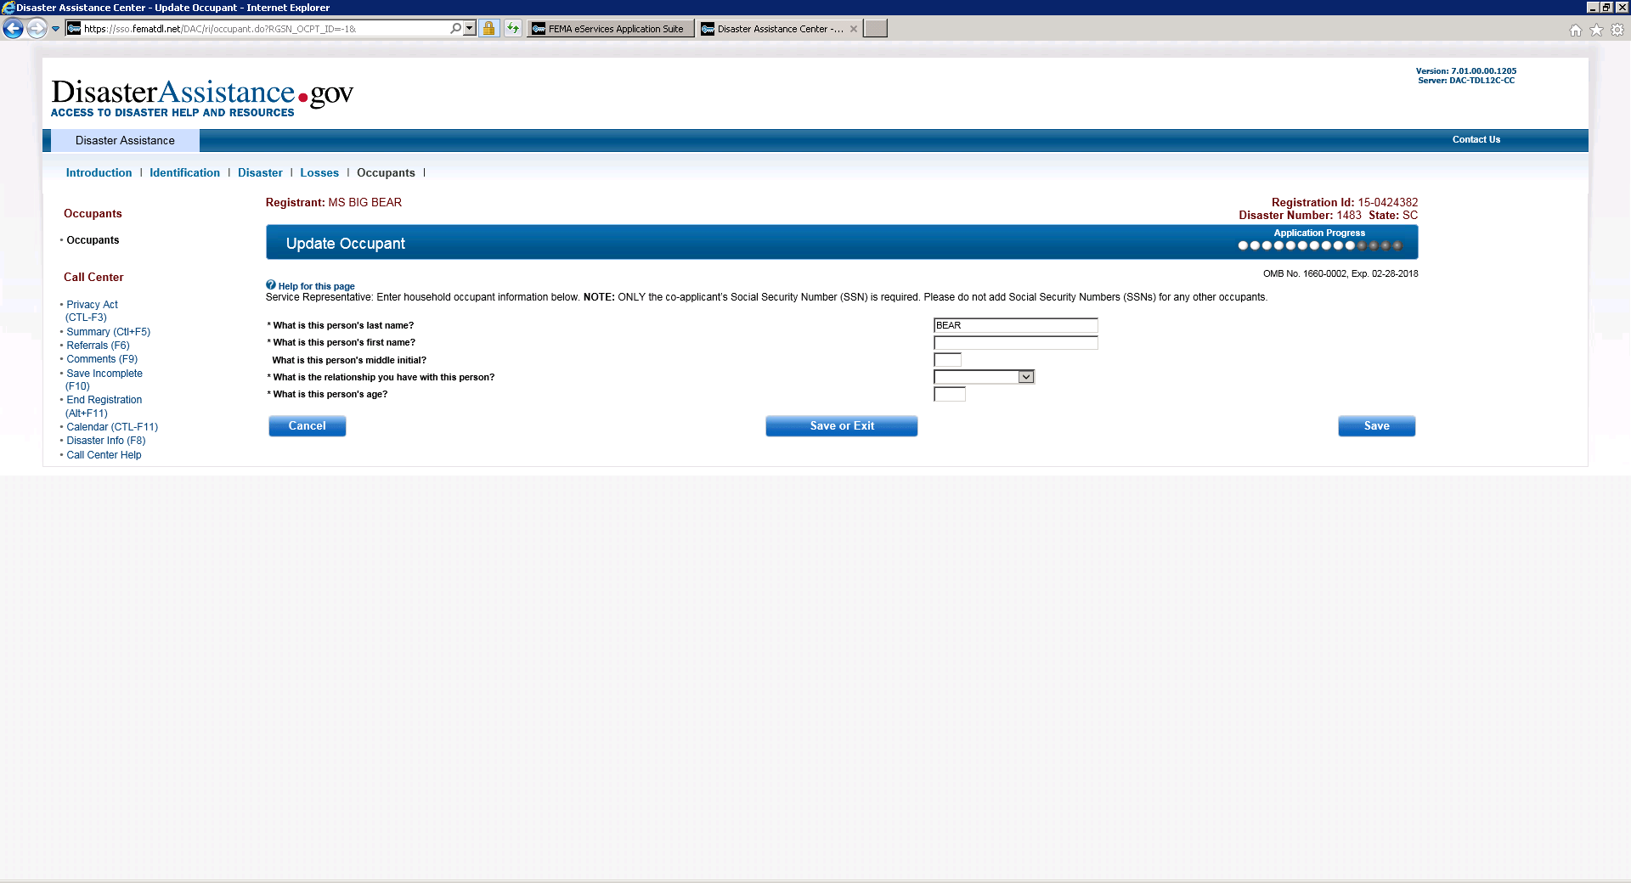
Update Occupant

Slide 28
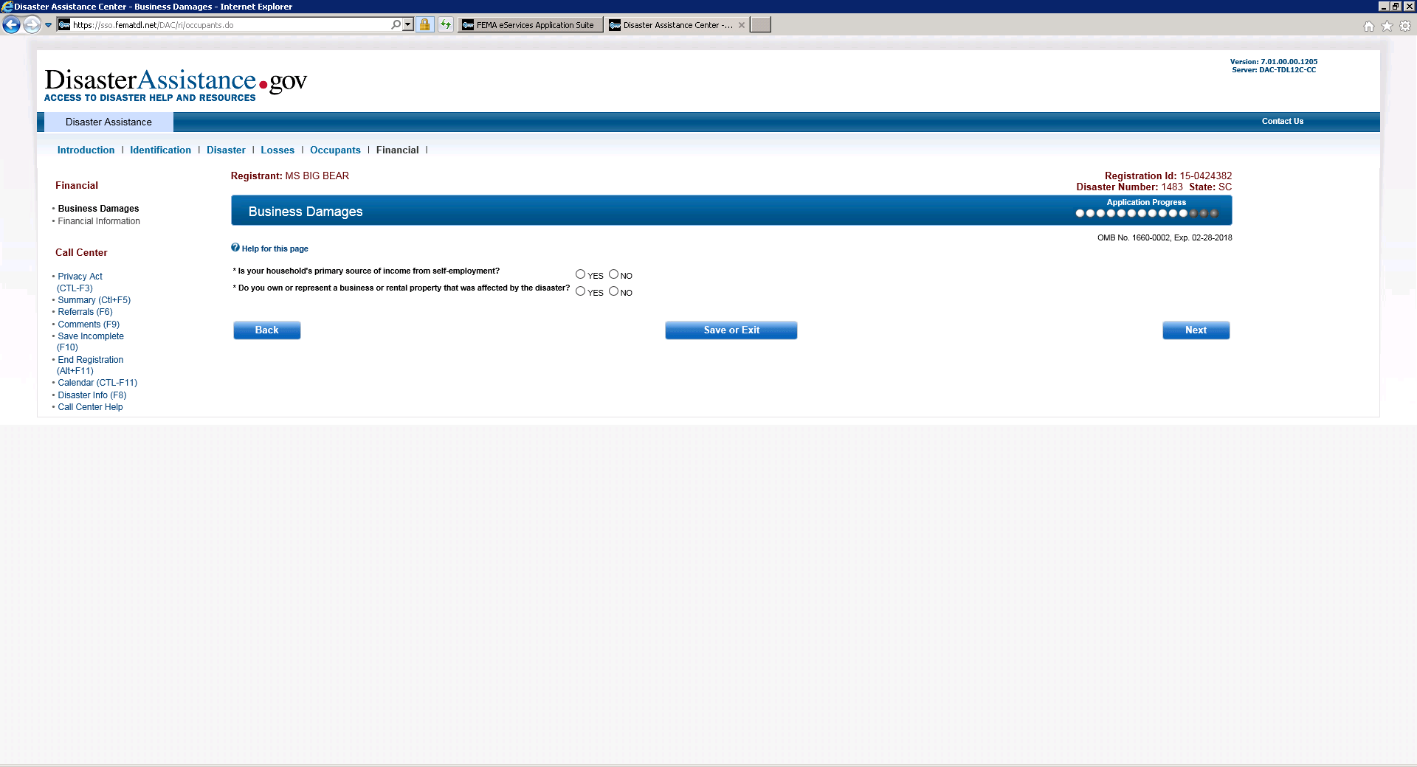
Business Damage

Slide 29
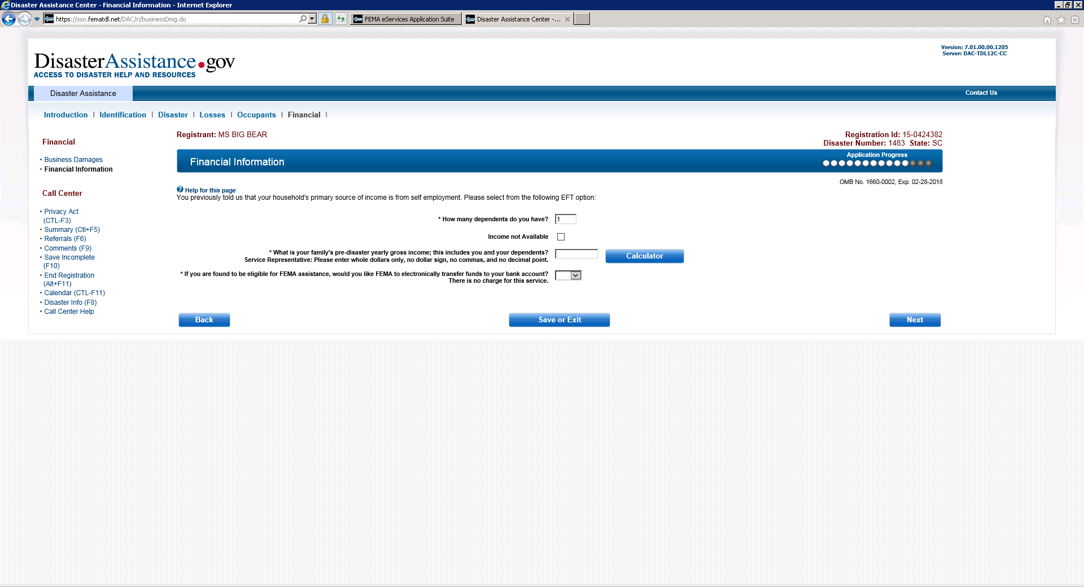
Financial Information (when selecting self employed) from previous screen

Slide 30

Financial Information when selecting No to self employed

Slide 31
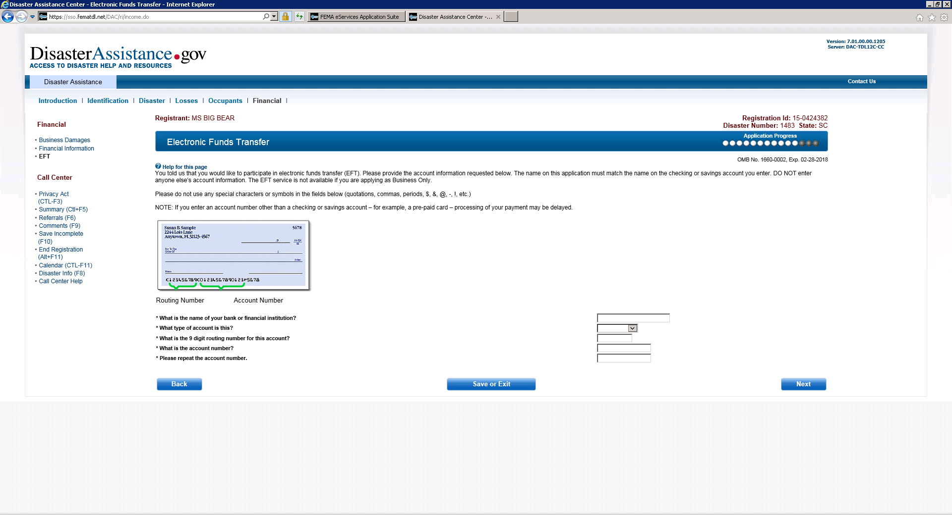
Electronic Funds Transfer

Slide 32
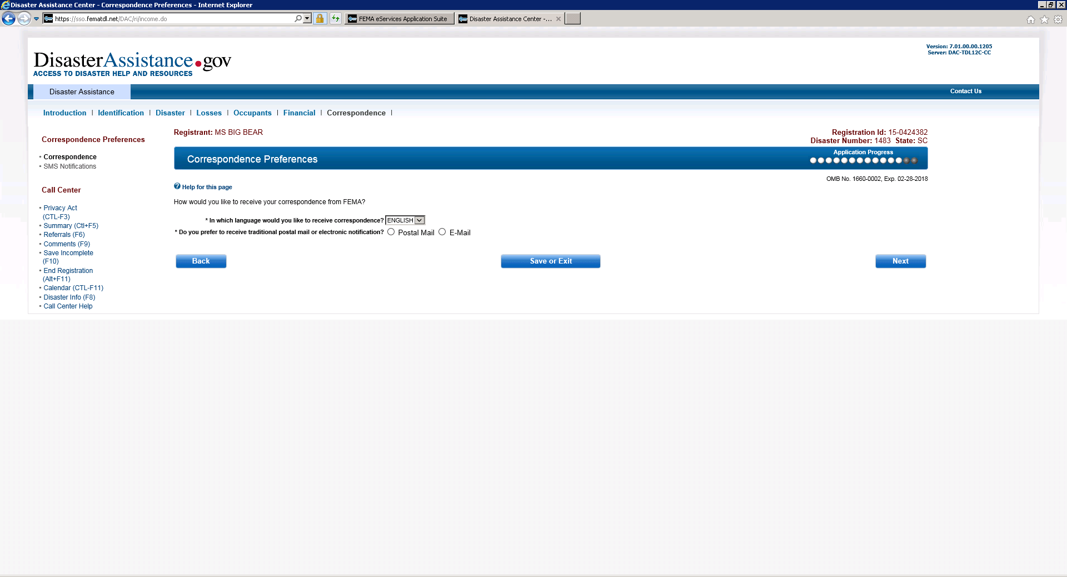
Correspondence Preferences

Slide 33
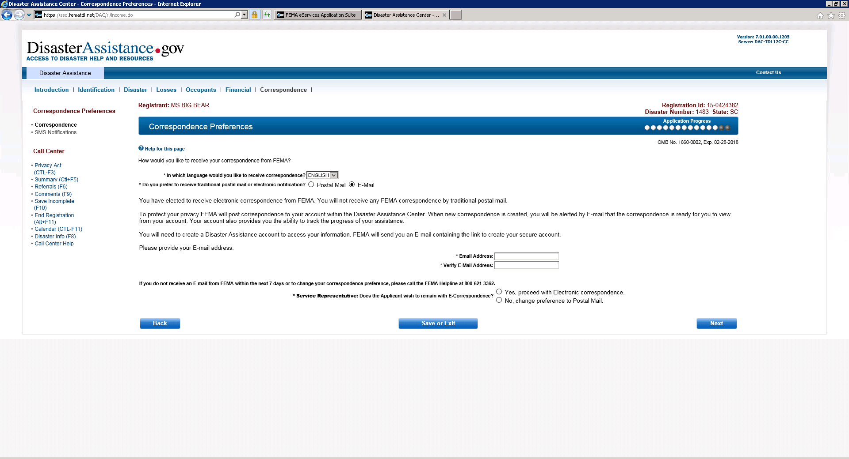
Correspondence Preferences when selecting E-mail

Slide 34
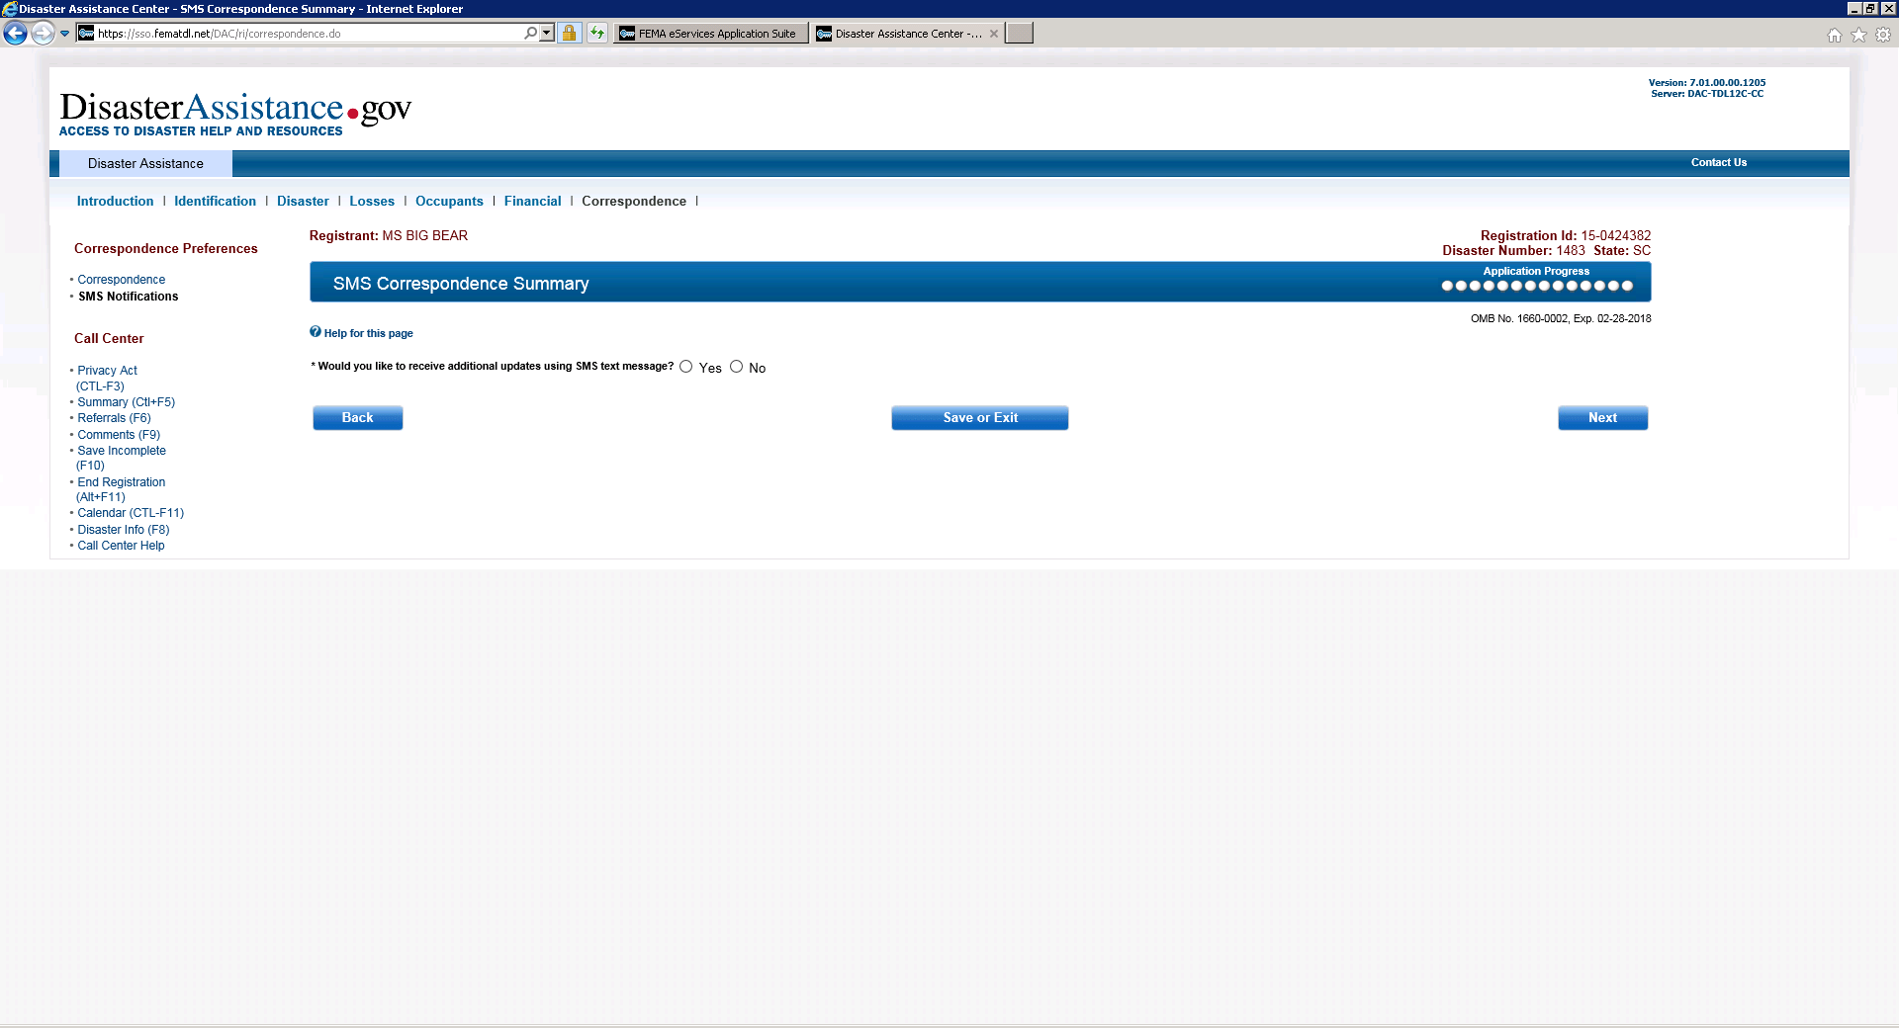
SMS Correspondence Summary

Slide 35
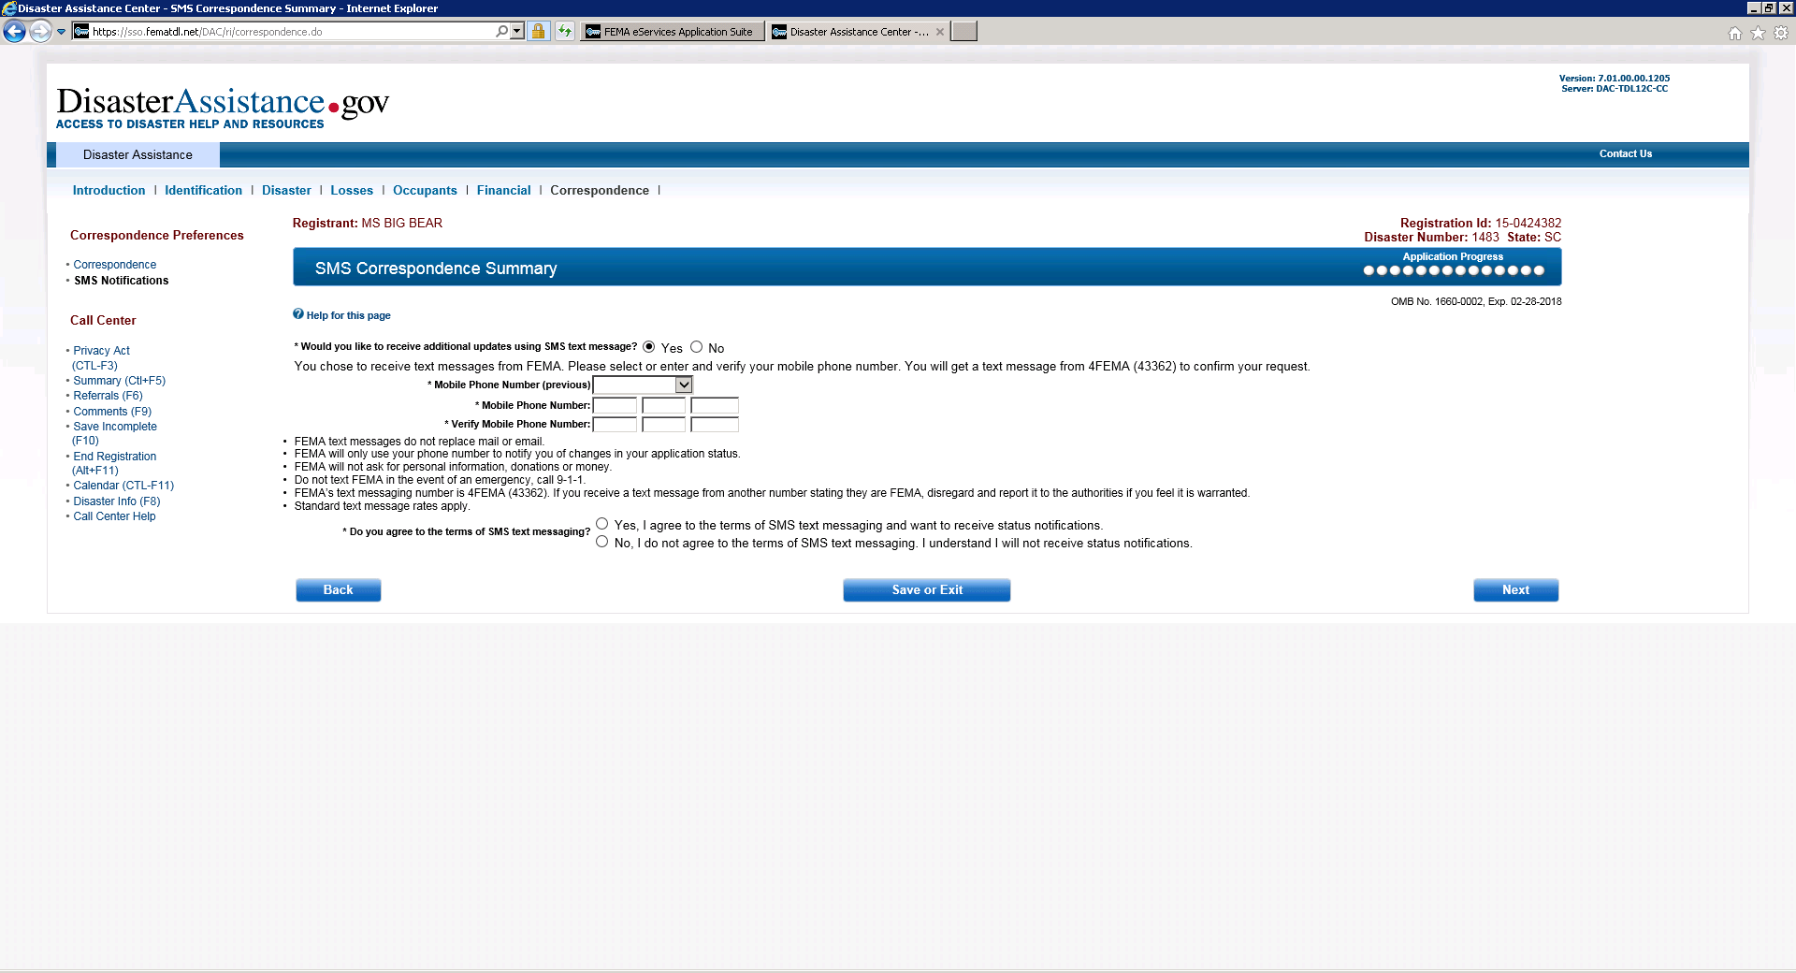
SMS Correspondence Summary when selecting Yes

Slide 36
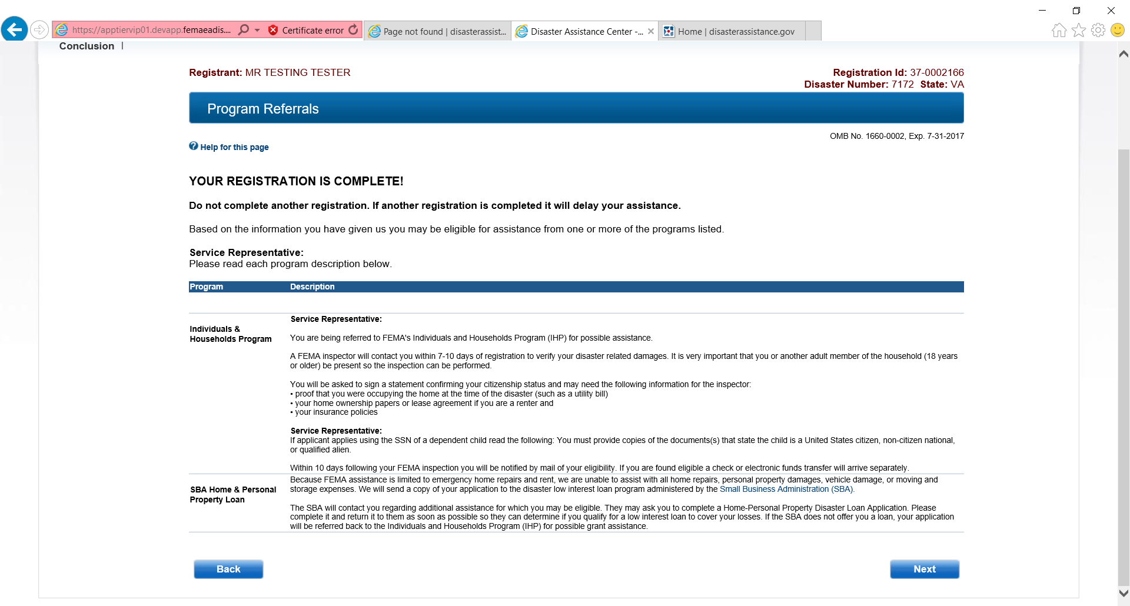
Program Referrals

Slide 37
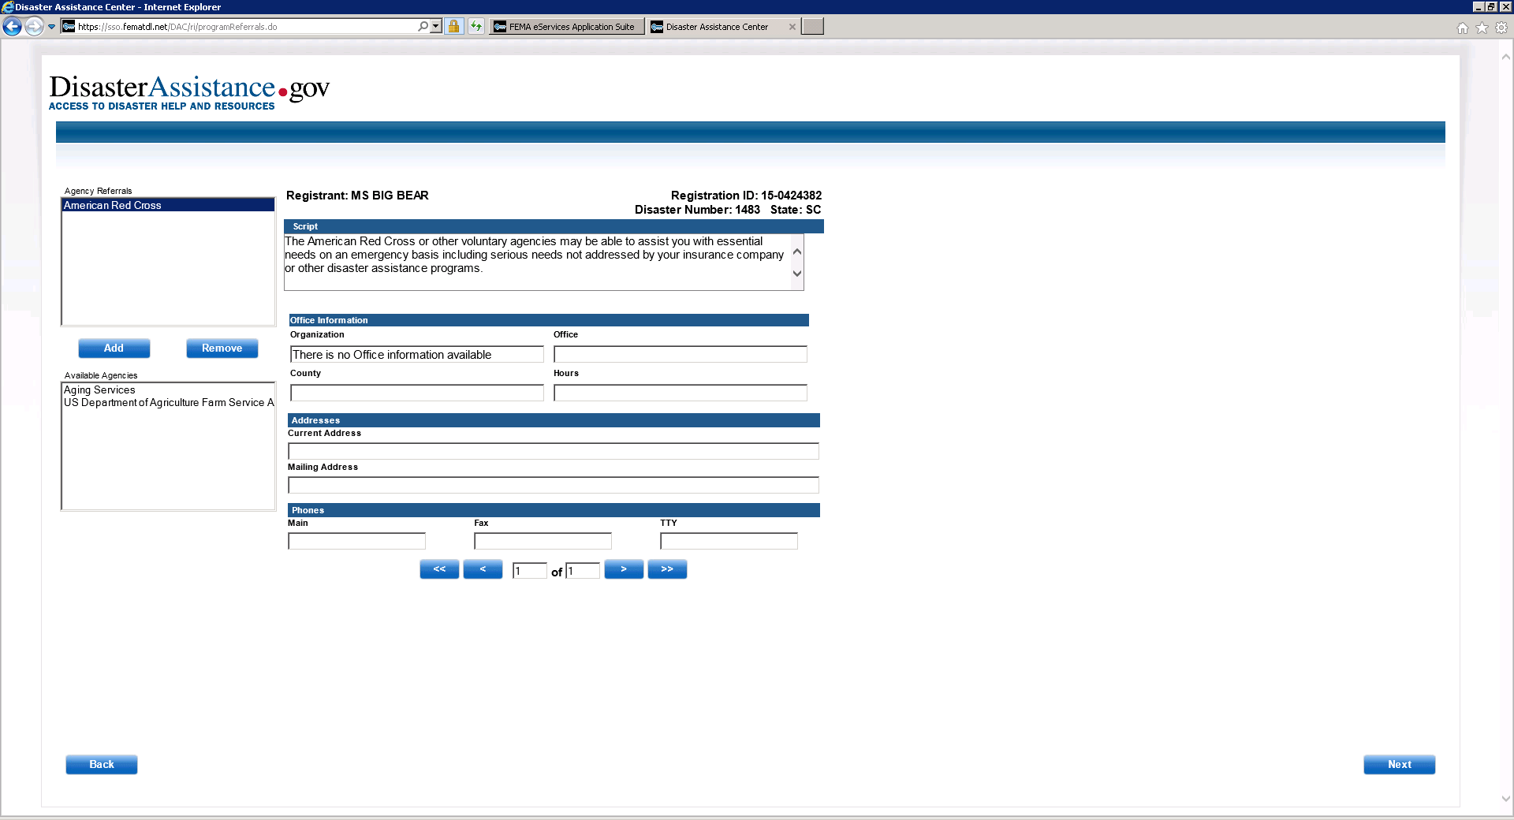
Agency Referrals

Slide 38
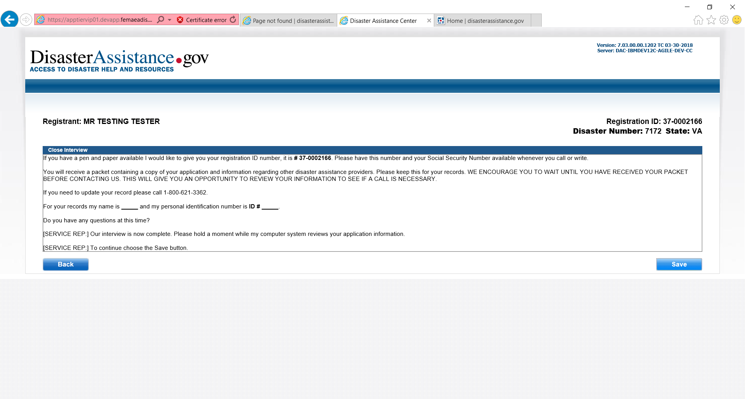
Close Interview
We’re almost done with the registration process.

Slide 39
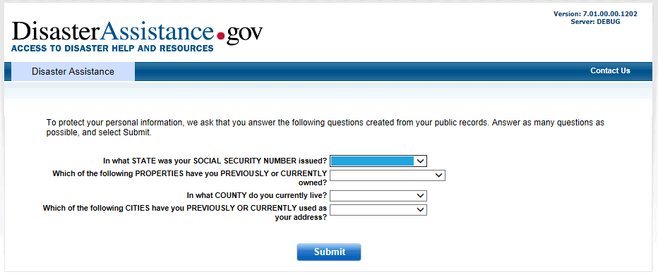

Slide 40
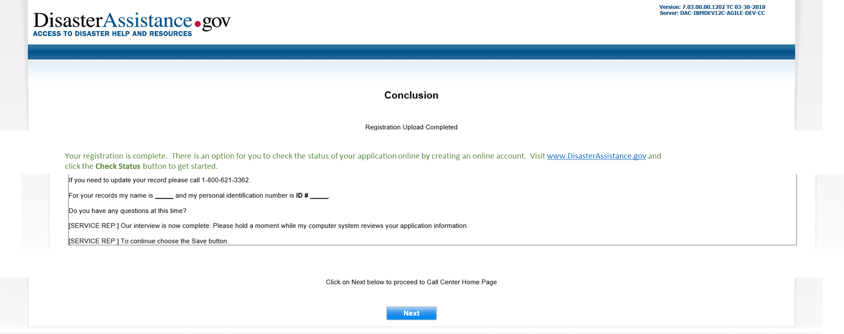
Conclusion

