Slide 1
Pesticide Submission Portal (PSP) Electronic Confidential Statement of Formula (eCSF) Screen Captures
May 7, 2021

Slide 2
Anticipated Benefits
Complete system of electronic generation, submission, review, and storage of structured content
Electronic Confidential Statement of Formula Builder (eCSF)
Benefits:
Industry facing builders perform extensive data validation prior to submission through PSP
Significant time savings to registrants after initial file creation
Reduces burden on EPA staff during 21-day screening and full reviews
Provides targeted and customized suite of tools for reviews
Provides data in an easily storable and searchable format

Slide 3
PSP Portal Screen

Slide 4
eCSF Home Screen

Slide 5
Preliminary Questions Screen

Slide 6
Preliminary Questions – Basic Formulation

Slide 7
Preliminary Questions – Alternate Formulation

Slide 8
Preliminary Questions – 100% Repack

Slide 9
Preliminary Questions – Technical & EUP

Slide 10
Preliminary Questions – MUP

Slide 11
Product Properties Screen

Slide 12
Product Properties – Solid

Slide 13
Product Properties – Solid, Impregnated Material, and Water Soluble Packaging

Slide 14
Product Properties – Solid, Impregnated Material, Collar/Ear Tag

Slide 15
Product Properties – Liquid

Slide 16
Product Properties – Liquid and Water Soluble Packaging

Slide 17
Product Properties – Liquid and Towelette

Slide 18
Product Properties – Gas

Slide 19
Product Properties – Plant Incorporated Protectant w/Other Type

Slide 20
Product Properties – Density Range, pH Range, Flash Point, and Flame Extension

Slide 21
Product Properties – No Density Range, pH Range, Flash Point, or Flame Extension

Slide 22
Product Properties – Density N/A, pH N/A, No Flash Point or Flame Extension

Slide 23
Box 2 – Producers or Box 2 – Product Repackaging Site Screen
Notes:
The screen displays as ‘Box 2 – Producers’ for non-100% repackaged products and as ‘Box 2 – Product Repackaging Site’. Otherwise, the screens are identical.

Slide 24
Box 2 – Producers - Unpopulated

Slide 25
Box 2 – Producers - Populated

Slide 26
Add Producer Modal – Domestic Producer

Slide 27
Add Producer Modal – International Producer

Slide 28
Add Producer Modal – Relabeling Facility

Slide 29
Box 11 – Manufacturing Sites & Component Suppliers Screen

Slide 30
Box 11 – Manufacturing Sites & Component Suppliers - Unpopulated

Slide 31
Box 11 – Manufacturing Sites & Component Suppliers - Populated

Slide 32
Add Site or Supplier Modal

Slide 33
Components Screen

Slide 34
Components - Unpopulated

Slide 35
Components – Populated / Select Primary Site/Supplier

Slide 36
Add Component Modal – Unregistered Active Component – Scroll 1

Slide 37
Add Component Modal – Unregistered Active Component – Scroll 2

Slide 38
Add Component Modal – Unregistered Active Component – Scroll 3

Slide 39
Add Component Modal – Registered Active Component – Scroll 1

Slide 40
Add Component Modal – Registered Active Component – Scroll 2

Slide 41
Add Component Modal – Registered Active Component – Scroll 3

Slide 42
Add Component Modal – Impurity Component

Slide 43
Add Component Modal – Inert Component

Slide 44
Add Component Modal – Dye Component

Slide 45
Add Component Modal – Fragrance Component

Slide 46
Add Component Modal – Fertilizer Component

Slide 47
Add Component Modal – Water Soluble Packaging Material Component

Slide 48
Add Component Modal – Water Soluble Ink Type Component

Slide 49
Add Component Modal – Towelette Component

Slide 50
Certification of Approving Official Screen

Slide 51
Certification of Approving Official

Slide 52
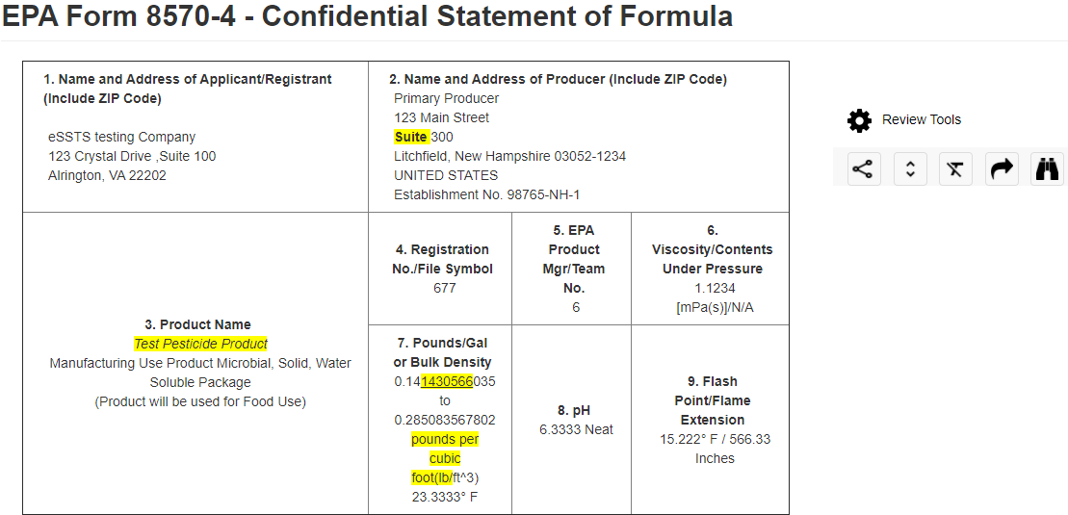
EPA Review
Submitted files received by front end processing
Sent to PM’s and assigned to reviewers
Reviewers will comment and markup forms via review tool (OSCR)
Forms are passed between reviewers and registrants until approved
Official copies generated, stored, and posted as appropriate

